Slide 1

CARPENTRY FOUNDATION / INTAKE 142
Day 01 | Thursday
01
October 29, 2026
Whole numbers and estimation
9:00 AM–10:15 AM • Math • 75 min
Calculator basics and checking
10:30 AM–12:00 PM • Calculation Practice • 90 min
Week 1 • 2 scheduled blocks • 165 teaching minutes
Estimate. Show the method. Label units. Check the result.
Textbook
Exercise Book
Numeracy Hub
Shape Canvas
Day 01 • 2026-10-29 • 01
Notes:
Opening overview | 9:00 AM–9:05 AM | Within the 5-minute Start phase.
Welcome. Today we will work with whole numbers and estimates, then use the calculator to check our thinking. A cut list, a fastener count and an offcut all start with understanding what the numbers represent. Before pressing a key, we will predict the size of the answer. What could an extra zero do to a materials order? It could multiply the order by ten, so our checking habits matter from the first calculation.

Slide 2
DAY 01 / WEEK 1 / CLASS TIMETABLE
Today’s exact schedule
9:00 AM–10:15 AM • 75 min
10:30 AM–12:00 PM • 90 min
Whole numbers and estimation
Calculator basics and checking
9:00 AM–9:05 AM
Start
5
10:30 AM–10:35 AM
Start
5
9:05 AM–9:10 AM
Recall
5
10:35 AM–10:40 AM
Recall
5
9:10 AM–9:25 AM
Teach
15
10:40 AM–10:55 AM
Teach
15
9:25 AM–9:40 AM
Together
15
10:55 AM–11:10 AM
Together
15
9:40 AM–10:00 AM
Practise
20
11:10 AM–11:45 AM
Practise
35
10:00 AM–10:10 AM
Check
10
11:45 AM–11:55 AM
Check
10
10:10 AM–10:15 AM
Wrap up
5
11:55 AM–12:00 PM
Wrap up
5
Math • Math Week 1, Lesson 1
Calculation Practice • Math Week 1, Lesson 2
Break: 10:15 AM–10:30 AM • 15 minutes • excluded from teaching time
Textbook
Exercise Book
Numeracy Hub
Shape Canvas
Day 01 • 2026-10-29 • 02
Notes:
Opening overview | 9:00 AM–9:05 AM | Within the 5-minute Start phase.
Our first block runs from 9:00 to 10:15, followed by a fifteen-minute break. We return at 10:30 for calculator practice and finish at noon. Each block moves from a short recall through an explanation, partner work, practice and an independent check. Which part lets you find out what you can do without a partner? The independent check. Use the practice time to ask about a step that is still unclear.

Slide 3
W01-L01 • START • 9:00 AM–9:05 AM • 5 MIN TOTAL
Whole numbers and estimation
Today’s goal: Read whole-number quantities; estimate and calculate a cut-list total; explain why an answer is reasonable.
Name one use for today’s skill.
Textbook Chapter 1 pp.12–23; Chapter 2 pp.48–51,59
Exercise Book 1A Q1–10 (p.6), Q11–17 (pp.6–7)
Keep your notebook, textbook, exercise book and chosen calculator ready.
Textbook Chapter 1 pp.12–23; Chapter 2 pp.48–51,59
Textbook
Exercise Book
Numeracy Hub
Shape Canvas
Day 01 • 2026-10-29 • 03
Notes:
START | 9:00 AM–9:05 AM | 5 MIN TOTAL — shared phase allocation.
Our goal is to read quantities accurately, estimate a cut-list total and explain whether the exact answer makes sense. A number on its own is incomplete information: we need to know whether it counts pieces or measures millimetres. Think of a carpentry task where you combine several quantities. You might total lengths for a frame or count fixings. Open the exercise book to 1A, and keep your notebook ready to show the thinking as well as the answer.

Slide 4
W01-L01 • RECALL • 9:05 AM–9:10 AM • 5 MIN TOTAL
Recall and reconnect
Use Exercise Book 1A Q3,5,9 without a calculator. Discuss which operation finds an offcut.
Try first without displayed answers.
Resources: Exercise Book 1A Q1–10 (p.6), Q11–17 (pp.6–7)
Textbook Chapter 1 pp.12–23; Chapter 2 pp.48–51,59
Textbook
Exercise Book
Numeracy Hub
Shape Canvas
Day 01 • 2026-10-29 • 04
Notes:
RECALL | 9:05 AM–9:10 AM | 5 MIN TOTAL — shared phase allocation.
Start with exercise book 1A questions 3, 5 and 9 without the calculator. We are checking place value and estimation before adding another tool. When a job asks how much stock remains after a cut, which operation matches that question? Subtraction: start with the available length and remove the amount used. Tell your partner what each number represents before calculating. If you disagree, compare the meaning of the quantities first.

Slide 5
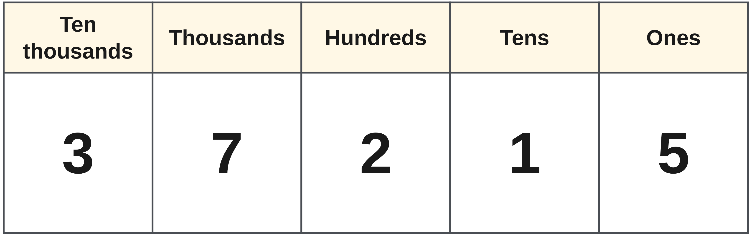
W01-L01 • RECALL • 9:05 AM–9:10 AM • 5 MIN TOTAL
Recall from the Exercise Book | 1A Q3
Write the operation, working and units before checking.
Textbook Chapter 1 pp.12–23; Chapter 2 pp.48–51,59
Textbook
Exercise Book
Numeracy Hub
Shape Canvas
Day 01 • 2026-10-29 • 05
Notes:
RECALL | 9:05 AM–9:10 AM | 5 MIN TOTAL — shared phase allocation.
Question 1A Q3 asks what the 7 is worth in 37,215. Read the number in place-value groups rather than naming the digit by itself. Is this seven ones, seven hundreds or seven thousands? Write your answer before we compare. After the attempt, explain that moving a digit one place to the left multiplies its value by ten; its position is part of the information.
INSTRUCTOR ONLY — AFTER THE ATTEMPT: 7,000
Working to discuss after the attempt: The 7 is in the thousands place: 7 × 1,000 = 7,000.

Slide 6
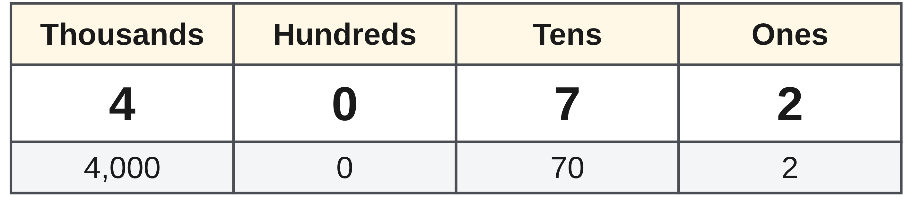
W01-L01 • TEACH • 9:10 AM–9:25 AM • 15 MIN TOTAL
Read the value before calculating
1
A digit’s place tells its value: in 4,072, the 4 means four thousand.
2
Read the quantity and unit together; 1,200 mm is a length.
3
When rounding, name the target place before changing any digits.
4
An estimate uses simpler nearby values; it predicts the size of the answer.
Textbook Chapter 1 pp.12–23; Chapter 2 pp.48–51,59
Textbook
Exercise Book
Numeracy Hub
Shape Canvas
Day 01 • 2026-10-29 • 06
Notes:
TEACH | 9:10 AM–9:25 AM | 15 MIN TOTAL — shared phase allocation.
Look at 4,072. The 4 represents four thousand, the zero holds the hundreds place, the 7 represents seventy and the 2 represents two. That zero keeps the other digits in their proper places. Now read 1,200 mm aloud with its unit: one thousand two hundred millimetres. When rounding, we must first name the target place. Are we rounding to the nearest ten, hundred or thousand? Those are different questions. An estimate keeps the quantity close enough to predict the answer's size; it does not become the final cutting measurement.

Slide 7
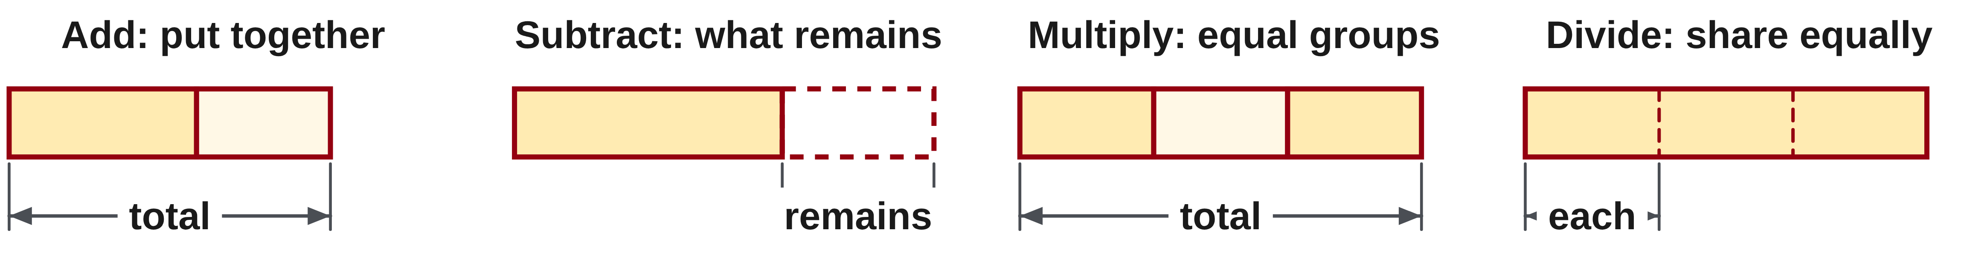
W01-L01 • TEACH • 9:10 AM–9:25 AM • 15 MIN TOTAL
Choose an operation that matches the quantity
1
Add separate quantities to find a total.
2
Subtract the amount used from the starting amount to find what remains.
3
Multiply equal groups; divide to share equally or count groups.
4
Compare the exact result with the estimate and explain any large difference.
Textbook Chapter 1 pp.12–23; Chapter 2 pp.48–51,59
Textbook
Exercise Book
Numeracy Hub
Shape Canvas
Day 01 • 2026-10-29 • 07
Notes:
TEACH | 9:10 AM–9:25 AM | 15 MIN TOTAL — shared phase allocation.
Choose the operation by describing the job in words. If we put different lengths together, we add. If we remove those lengths from stock, we subtract. Equal groups suggest multiplication: packs times fasteners per pack. Division either shares a total equally or tells us how many groups fit. What is the difference between finding a total and finding an offcut? The total combines the pieces; the offcut is what remains after removing them from the starting stock. Keep that meaning attached to your equation, then compare the result with an estimate.

Slide 8
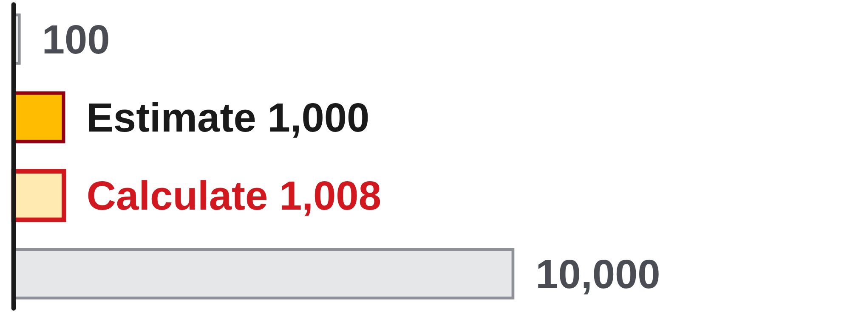
W01-L01 • TEACH • 9:10 AM–9:25 AM • 15 MIN TOTAL
An estimate should agree with the scale
Classroom example: 48 packs contain 21 fasteners each.
Estimate: 50 × 20 = 1,000 fasteners
Calculate: 48 × 21 = 1,008 fasteners
The exact answer is close to 1,000—not 100 or 10,000.
A calculator result still needs a quantity, unit and reason.
Work together
Exercise Book 1A Q11, 13 and 15.
Estimate first; alternate solver and checker. Compare hand and calculator methods.
W1 L1 • Selected calculator: TI-30Xa or Sharp EL-531XT
Textbook
Exercise Book
Numeracy Hub
Shape Canvas
Day 01 • 2026-10-29 • 08
Notes:
TEACH | 9:10 AM–9:25 AM | 15 MIN TOTAL — shared phase allocation.
There are 48 packs with 21 fasteners in each pack. Round to 50 packs and 20 fasteners: 50 times 20 gives about 1,000. For the exact calculation, 48 times 20 is 960, and one more fastener from each of the 48 packs adds 48. That gives 1,008 fasteners. Why is 100 an unlikely answer? It is far below the estimate and would average only about two fasteners per pack. The estimate checks the size; the exact calculation gives the count. Keep both on the page when we move into partner work.

Slide 9
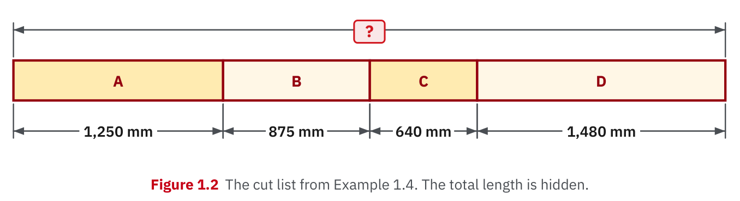
W01-L01 • TEACH • 9:10 AM–9:25 AM • 15 MIN TOTAL
Textbook | page 14
Textbook p.14 · Figure 1.2: read the cut-list dimensions.
Textbook Chapter 1 pp.12–23; Chapter 2 pp.48–51,59
Textbook
Exercise Book
Numeracy Hub
Shape Canvas
Day 01 • 2026-10-29 • 09
Notes:
TEACH | 9:10 AM–9:25 AM | 15 MIN TOTAL — shared phase allocation.
On page 14, trace the four pieces in Figure 1.2: 1,250 mm, 875 mm, 640 mm and 1,480 mm. The question mark represents their combined length. Before calculating, point to every piece that must be included. Which operation combines these four lengths? Addition, because each contributes to the total. Notice that all four dimensions use millimetres; we can add them directly. A drawing helps us check that no piece has been omitted or counted twice. Read the labels rather than measuring the projected picture, whose size changes with the screen.

Slide 10
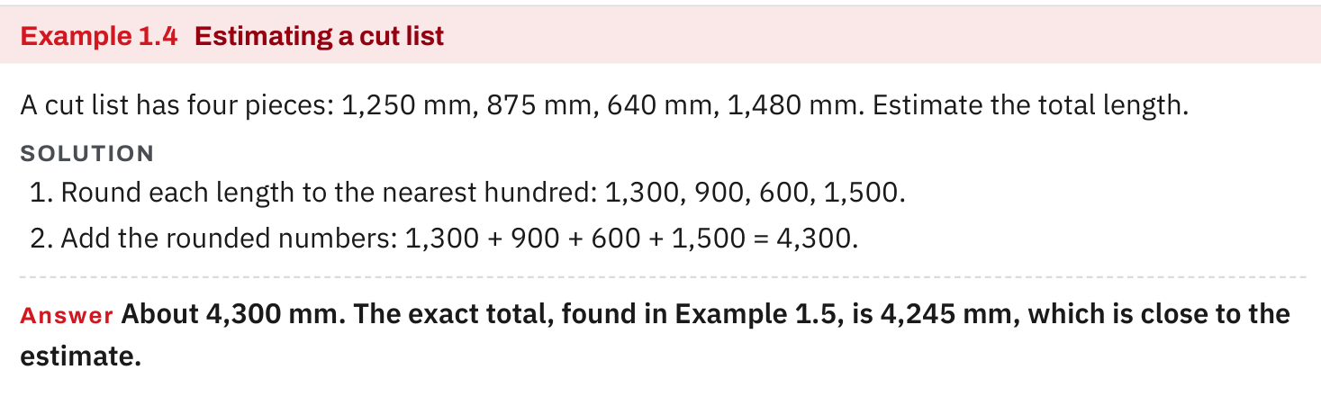
W01-L01 • TEACH • 9:10 AM–9:25 AM • 15 MIN TOTAL
Textbook | page 14
Textbook p.14 · Example 1.4: estimate before calculating.
Textbook Chapter 1 pp.12–23; Chapter 2 pp.48–51,59
Textbook
Exercise Book
Numeracy Hub
Shape Canvas
Day 01 • 2026-10-29 • 10
Notes:
TEACH | 9:10 AM–9:25 AM | 15 MIN TOTAL — shared phase allocation.
Example 1.4 rounds each cut-list length to the nearest hundred. The four approximate lengths are 1,300, 900, 600 and 1,500 mm. Adding gives about 4,300 mm. The exact total is 4,245 mm, only 55 mm below the estimate. Does that difference mean the estimate failed? No: we deliberately replaced each measurement with a nearby, simpler number. The estimate did its job by putting us near the correct total. Use the exact dimensions for the final calculation, and keep the estimate as a reasonableness check beside it.

Slide 11
W01-L01 • TEACH • 9:10 AM–9:25 AM • 15 MIN TOTAL
Spot the mistake. Explain the correction.
A learner estimates 48 × 21 as 1,000, then accepts a calculator result of 100. What check failed?
Discuss the method before checking the answer.
The result is about ten times too small. Re-enter the intended multiplication and compare again.
Textbook Chapter 1 pp.12–23; Chapter 2 pp.48–51,59
Textbook
Exercise Book
Numeracy Hub
Shape Canvas
Day 01 • 2026-10-29 • 11
Notes:
TEACH | 9:10 AM–9:25 AM | 15 MIN TOTAL — shared phase allocation.
The estimate was about 1,000, but the calculator displayed 100. The failed step was accepting the display without comparing it to the estimate. How many times too small is 100 compared with 1,000? About ten times. Recheck the written multiplication, clear the calculator and enter 48 times 21 carefully. The correct 1,008 is consistent with the estimate. We do not change a result just to match our prediction; we investigate the disagreement and find the reason. A calculator records key presses, so a neat display is not proof of a correct setup.

Slide 12
W01-L01 • TOGETHER • 9:25 AM–9:40 AM • 15 MIN TOTAL
Work together
Work Exercise Book 1A Q11,13,15 together. Estimate first, then compare hand and calculator methods.
Work in pairs; alternate solver and checker.
Resources: Exercise Book 1A Q1–10 (p.6), Q11–17 (pp.6–7)
Textbook Chapter 1 pp.12–23; Chapter 2 pp.48–51,59
Textbook
Exercise Book
Numeracy Hub
Shape Canvas
Day 01 • 2026-10-29 • 12
Notes:
TOGETHER | 9:25 AM–9:40 AM | 15 MIN TOTAL — shared phase allocation.
Work on 1A questions 11, 13 and 15 with a partner. The solver first says what operation the question requires and gives an estimate; the checker listens for the meaning and checks each line. Then switch roles. Why estimate before checking the calculator display? A prediction made first is independent of the result we are trying to check. Keep the hand method and calculator result together so any disagreement can be traced to a specific step.

Slide 13
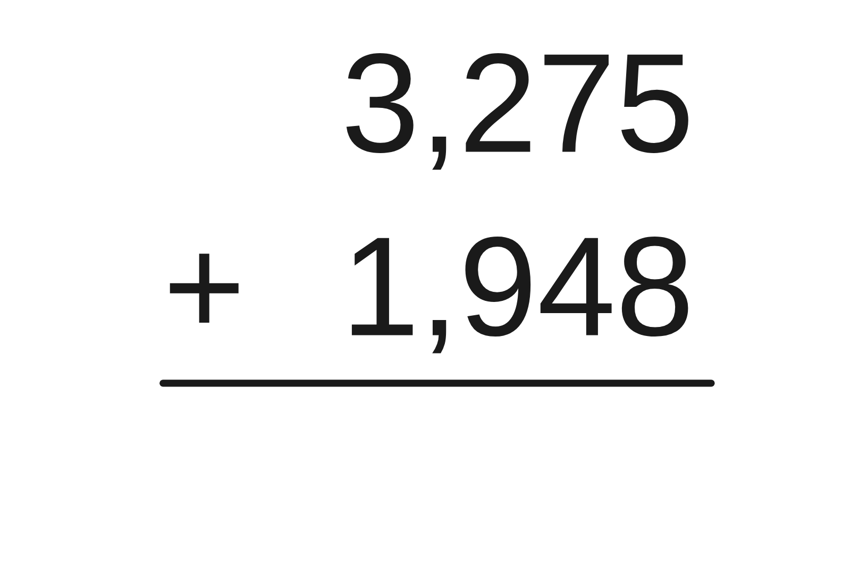
W01-L01 • TOGETHER • 9:25 AM–9:40 AM • 15 MIN TOTAL
Guided practice | 1A Q11
Work with a partner. Take turns explaining the next step.
Textbook Chapter 1 pp.12–23; Chapter 2 pp.48–51,59
Textbook
Exercise Book
Numeracy Hub
Shape Canvas
Day 01 • 2026-10-29 • 13
Notes:
TOGETHER | 9:25 AM–9:40 AM | 15 MIN TOTAL — shared phase allocation.
For 1A Q11, add 3,275 and 1,948. First predict the total using nearby thousands: it should be a little above five thousand. Line up ones under ones and tens under tens before adding. What happens when the ones column totals thirteen? Record three ones and carry one ten. Finish your attempt with your partner, explaining each carried value. Then compare the complete calculation with the worked answer on the next slide.
INSTRUCTOR ONLY — AFTER THE ATTEMPT: 5,223
Working to discuss after the attempt: 3,275 + 1,948 = 5,223. Check: 5,223 − 1,948 = 3,275.

Slide 14
W01-L01 • TOGETHER • 9:25 AM–9:40 AM • 15 MIN TOTAL
Compare your method | 1A Q11
CHECK TOGETHER
5,223
Textbook Chapter 1 pp.12–23; Chapter 2 pp.48–51,59
Textbook
Exercise Book
Numeracy Hub
Shape Canvas
Day 01 • 2026-10-29 • 14
Notes:
TOGETHER | 9:25 AM–9:40 AM | 15 MIN TOTAL — shared phase allocation.
The total is 5,223. In the ones column, 5 plus 8 is 13: write 3 and carry 1. Tens give 7 plus 4 plus 1, or 12. Hundreds give 2 plus 9 plus 1, again 12. Thousands give 3 plus 1 plus the carried 1, or 5. Does the result agree with our estimate near five thousand? Yes. A reverse check is 5,223 minus 1,948; it should restore 3,275.
INSTRUCTOR ONLY — AFTER THE ATTEMPT: 5,223
Working to discuss after the attempt: 3,275 + 1,948 = 5,223. Check: 5,223 − 1,948 = 3,275.

Slide 15
W01-L01 • PRACTISE • 9:40 AM–10:00 AM • 20 MIN TOTAL
Your scheduled practice
Complete Exercise Book 1A Q1–10 and Q12,14,16,17 as time allows. On Shape Canvas, set a rectangle to 1,200 mm by 800 mm and read both sizes only, since area and perimeter come later in the course.
Show working and units; estimate, then check.
Resources: Exercise Book 1A Q1–10 (p.6), Q11–17 (pp.6–7)
Textbook Chapter 1 pp.12–23; Chapter 2 pp.48–51,59
Textbook
Exercise Book
Numeracy Hub
Shape Canvas
Day 01 • 2026-10-29 • 15
Notes:
PRACTISE | 9:40 AM–10:00 AM | 20 MIN TOTAL — shared phase allocation.
Complete 1A questions 1–10 and questions 12, 14, 16 and 17 as time allows. Keep a short estimate beside calculations where it helps, and write the operation before using the calculator. In Shape Canvas, our preview is only to set a rectangle to 1,200 mm by 800 mm and read the labels. What do those two numbers tell us? Two lengths, both in millimetres. We are not being asked to calculate area in this preview.

Slide 16
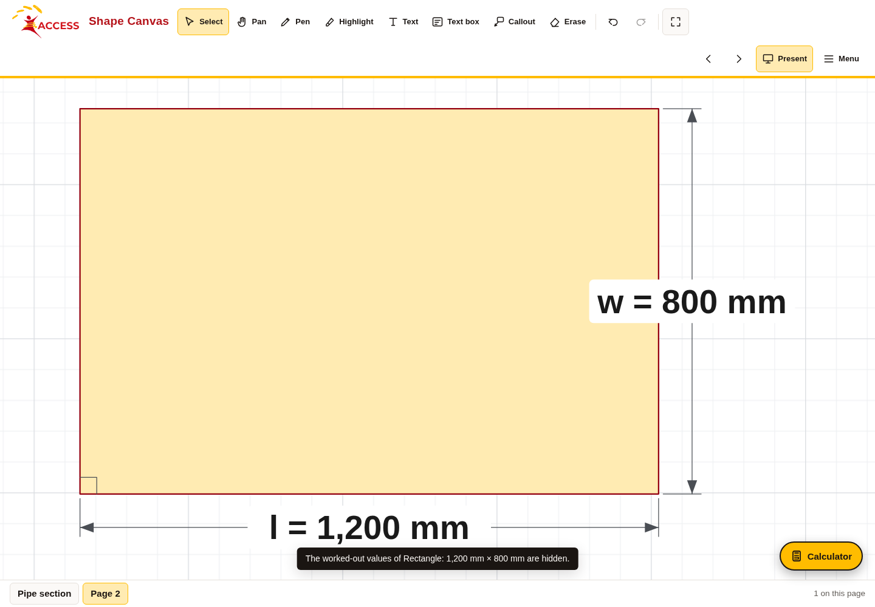
W01-L01 • PRACTISE • 9:40 AM–10:00 AM • 20 MIN TOTAL
Open Shape Canvas
Navigation example. Use the values and units in the assigned task.
Textbook Chapter 1 pp.12–23; Chapter 2 pp.48–51,59
Textbook
Exercise Book
Numeracy Hub
Shape Canvas
Day 01 • 2026-10-29 • 16
Notes:
PRACTISE | 9:40 AM–10:00 AM | 20 MIN TOTAL — shared phase allocation.
Open Shape Canvas and find the rectangle dimensions. Set the unit to millimetres, then enter 1,200 for one side and 800 for the other. Read each label aloud before accepting it. Which side is longer, and by how much? The 1,200 mm side is longer by 400 mm. The screen is a drawing, so its apparent width is not a measuring scale. Use the displayed dimension labels to check your entries.

Slide 17
W01-L01 • PRACTISE • 9:40 AM–10:00 AM • 20 MIN TOTAL
Practise in Numeracy Hub and Shape Canvas
1
Supported: In Numeracy Hub Calculator, select TI-30Xa or Sharp EL-531XT and clear the display.
2
Independent practice: Estimate and write your assigned 1A calculation before checking its result.
3
Supported preview: In Shape Canvas, label a 1,200 mm × 800 mm rectangle; read both lengths only.
Textbook Chapter 1 pp.12–23; Chapter 2 pp.48–51,59
Textbook
Exercise Book
Numeracy Hub
Shape Canvas
Day 01 • 2026-10-29 • 17
Notes:
PRACTISE | 9:40 AM–10:00 AM | 20 MIN TOTAL — shared phase allocation.
In Numeracy Hub, select the calculator model you will use consistently: TI-30Xa or Sharp EL-531XT. Clear the display, write an assigned 1A calculation and estimate its result before entering keys. Then compare your written quantity with the display. For the Shape Canvas preview, read 1,200 mm and 800 mm as separate lengths. If the unit accidentally says inches, would the same numbers describe the same object? No. The unit is part of each measurement and must be checked too.

Slide 18
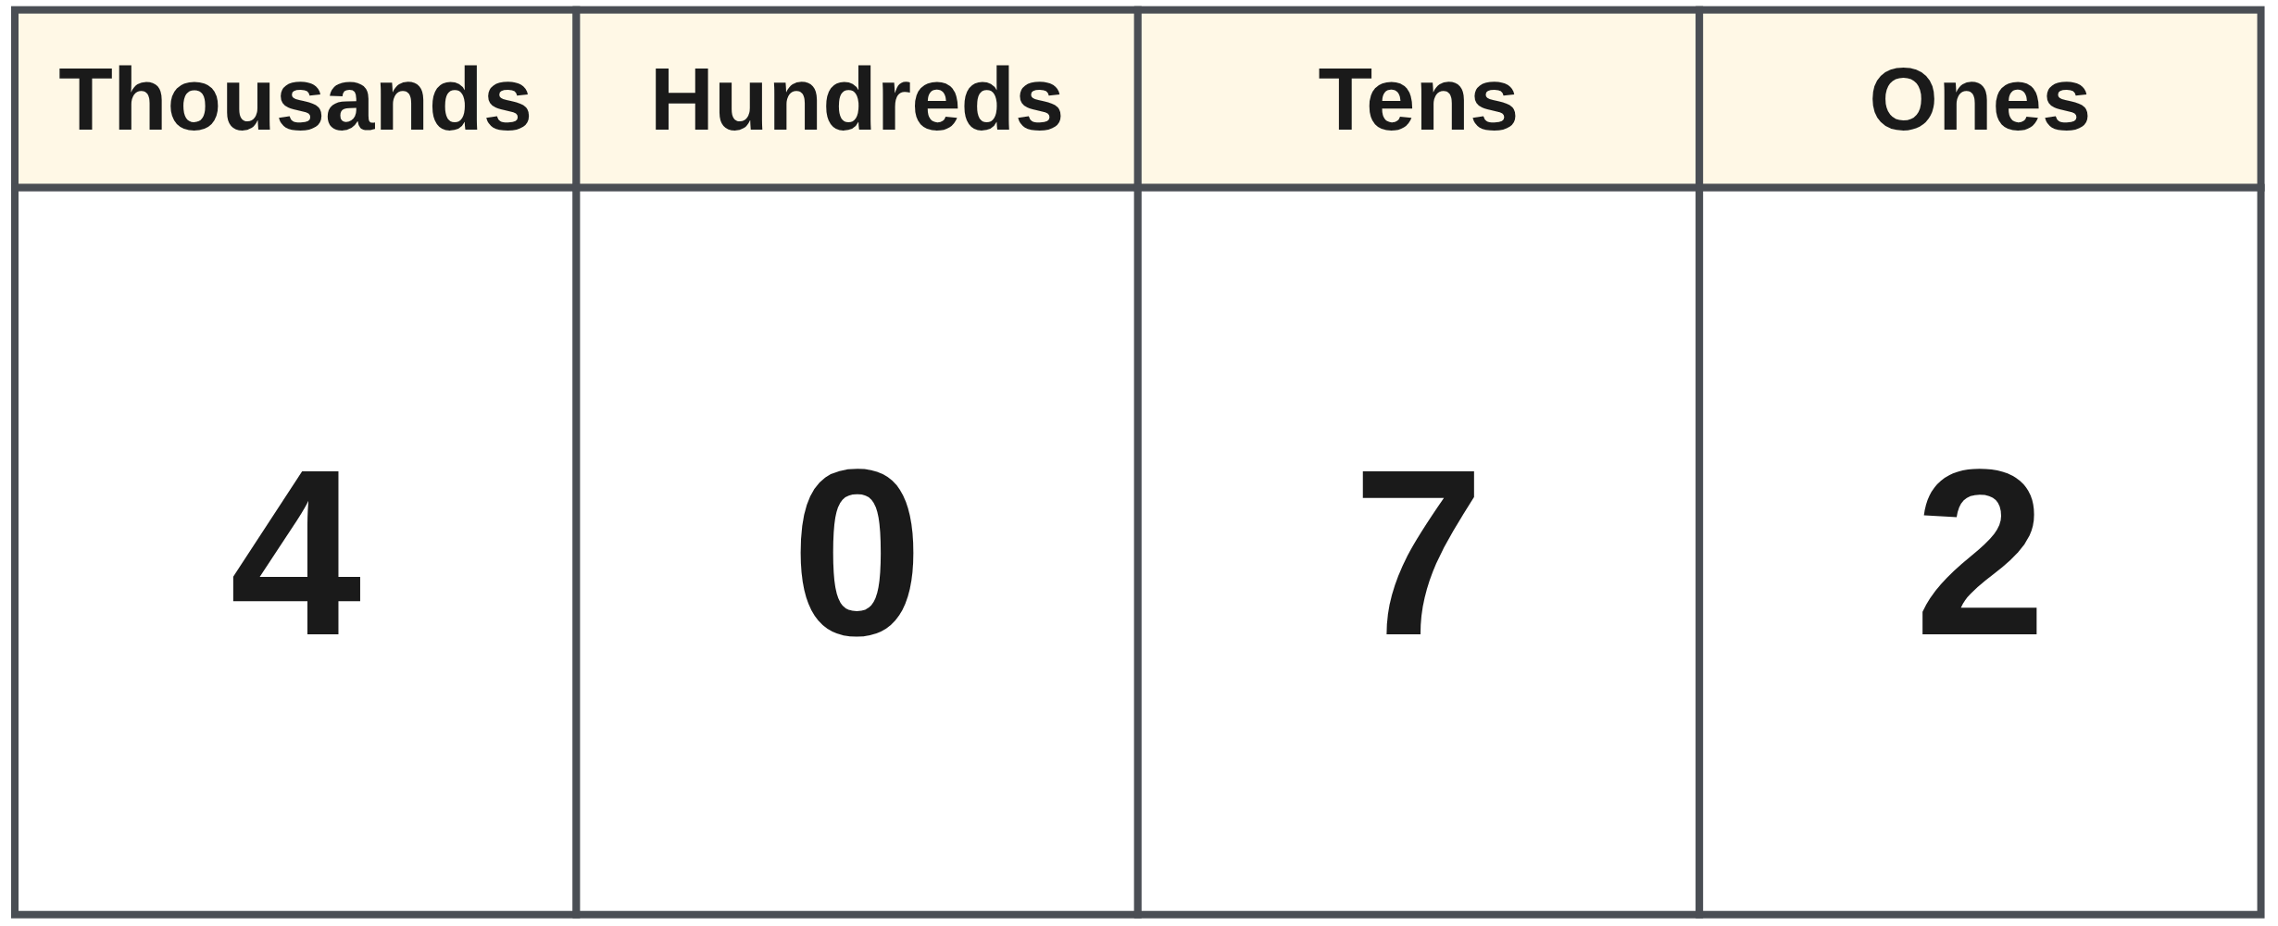
W01-L01 • PRACTISE • 9:40 AM–10:00 AM • 20 MIN TOTAL
Practise from the Exercise Book | 1A Q1
Write the operation, working and units before checking.
Textbook Chapter 1 pp.12–23; Chapter 2 pp.48–51,59
Textbook
Exercise Book
Numeracy Hub
Shape Canvas
Day 01 • 2026-10-29 • 18
Notes:
PRACTISE | 9:40 AM–10:00 AM | 20 MIN TOTAL — shared phase allocation.
For 1A Q1, write 4,072 in words. Read the thousands group, then the final three digits. Which place is held by the zero? The hundreds place. Do not invent a hundreds value just because four digits are present. After you have written your wording, read it back and ask whether someone listening could reconstruct 4,072 rather than 4,702.
INSTRUCTOR ONLY — AFTER THE ATTEMPT: Four thousand seventy-two
Working to discuss after the attempt: 4,072 = 4,000 + 70 + 2. The zero holds the hundreds place.

Slide 19
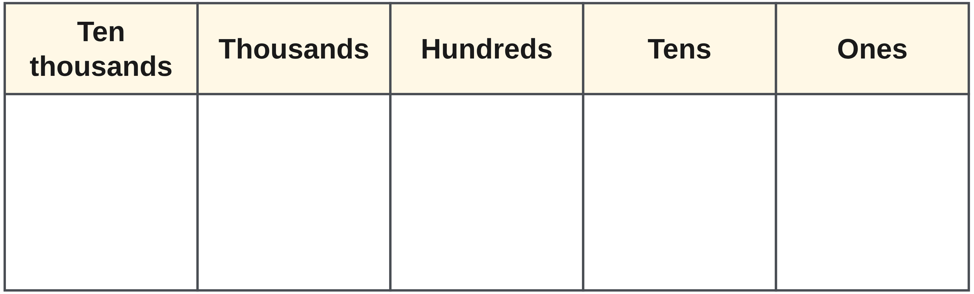
W01-L01 • PRACTISE • 9:40 AM–10:00 AM • 20 MIN TOTAL
Practise from the Exercise Book | 1A Q2
Write the operation, working and units before checking.
Textbook Chapter 1 pp.12–23; Chapter 2 pp.48–51,59
Textbook
Exercise Book
Numeracy Hub
Shape Canvas
Day 01 • 2026-10-29 • 19
Notes:
PRACTISE | 9:40 AM–10:00 AM | 20 MIN TOTAL — shared phase allocation.
For 1A Q2, turn “fifteen thousand three hundred eight” into digits. Separate the thousands from the remaining hundreds, tens and ones. Which place has no value named? The tens place, so it needs a zero. Write the number first, then read it back aloud to a partner after the attempt. That reverse reading is a quick way to catch a missing place holder.
INSTRUCTOR ONLY — AFTER THE ATTEMPT: 15,308
Working to discuss after the attempt: 15,308 = 15,000 + 300 + 8. The tens place is zero.

Slide 20
W01-L01 • CHECK • 10:00 AM–10:10 AM • 10 MIN TOTAL
Check independently
Exercise Book 1A Q5 and Q10; explain one estimate and show the operation used.
Answer independently and show the method.
Resources: Exercise Book 1A Q1–10 (p.6), Q11–17 (pp.6–7)
Textbook Chapter 1 pp.12–23; Chapter 2 pp.48–51,59
Textbook
Exercise Book
Numeracy Hub
Shape Canvas
Day 01 • 2026-10-29 • 20
Notes:
CHECK | 10:00 AM–10:10 AM | 10 MIN TOTAL — shared phase allocation.
Work independently on 1A questions 5 and 10. Show the place you are rounding to and the rounded values used in your estimate. I want to see how you reached the result, not only a number copied from the earlier example. What evidence will let us check the method? The target place and the operation written with the rounded numbers. Keep worked solutions closed until both questions are attempted.

Slide 21
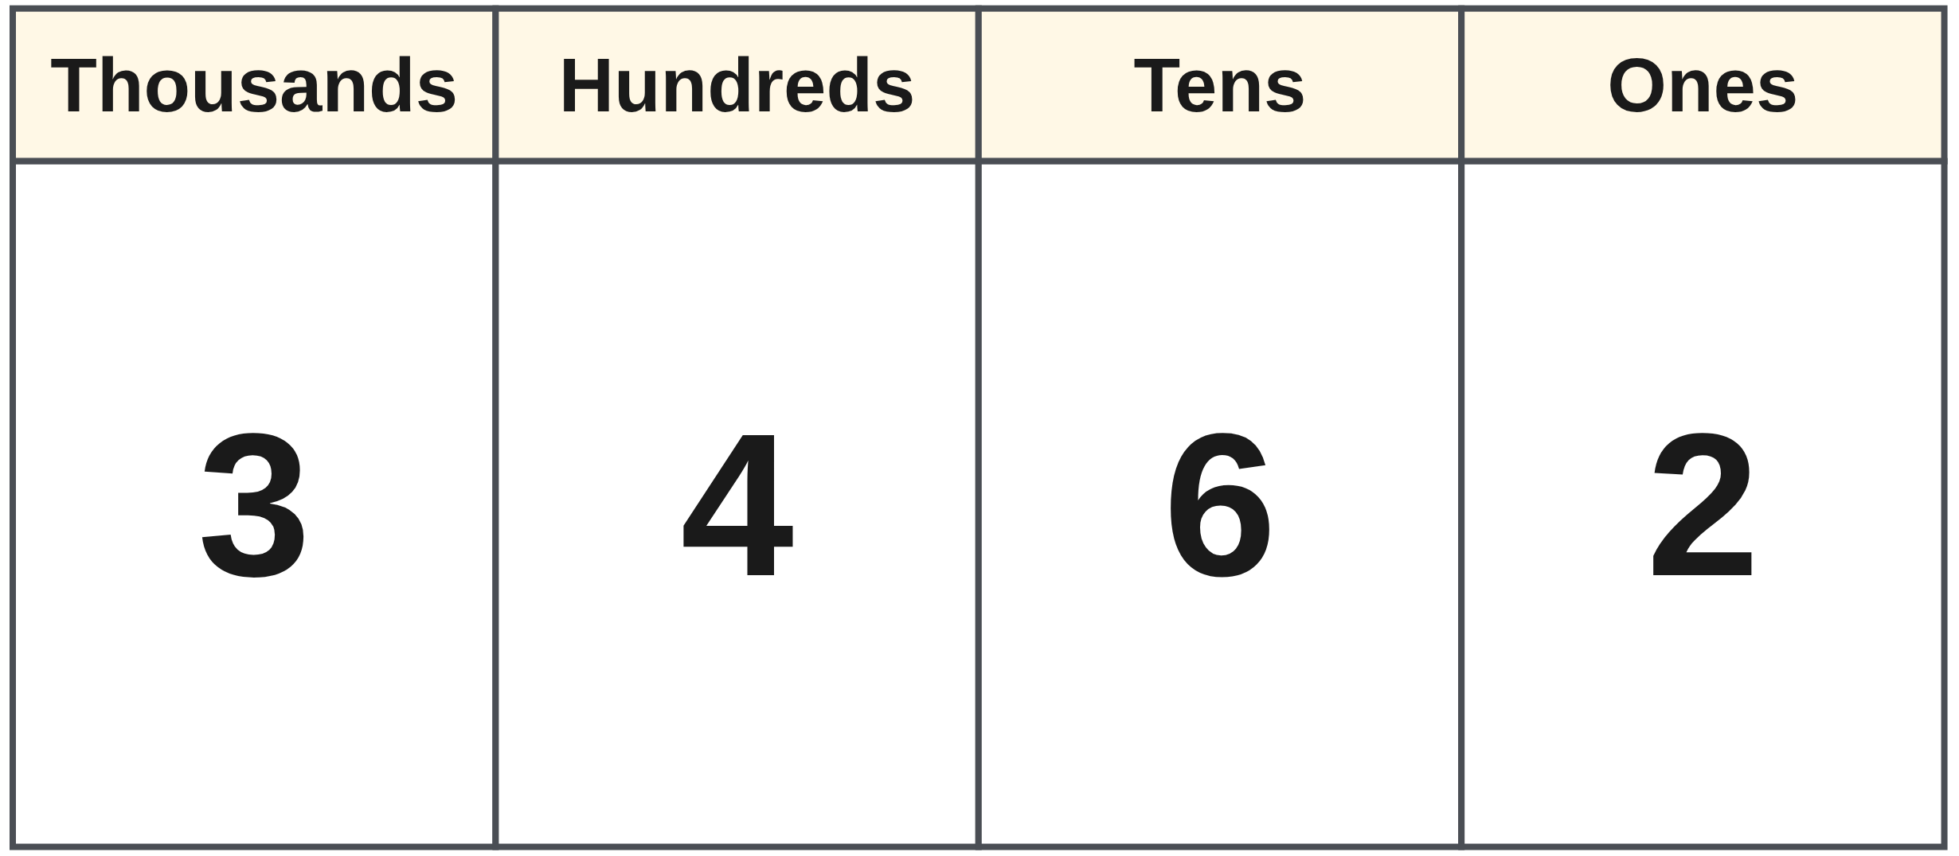
W01-L01 • CHECK • 10:00 AM–10:10 AM • 10 MIN TOTAL
Independent check | 1A Q5
Answer independently. Keep worked solutions closed.
Textbook Chapter 1 pp.12–23; Chapter 2 pp.48–51,59
Textbook
Exercise Book
Numeracy Hub
Shape Canvas
Day 01 • 2026-10-29 • 21
Notes:
CHECK | 10:00 AM–10:10 AM | 10 MIN TOTAL — shared phase allocation.
For 1A Q5, round 3,462 to the nearest ten. Mark the tens place, then inspect the digit immediately to its right. Write the rounded number and one short reason. Do not change the target to hundreds. After the attempt, compare the distances to the two neighbouring multiples of ten; that explains the decision rather than relying only on a memorised slogan.
INSTRUCTOR ONLY — AFTER THE ATTEMPT: 3,460
Working to discuss after the attempt: 3,462 is 2 above 3,460 and 8 below 3,470, so 3,460 is the nearest ten.

Slide 22
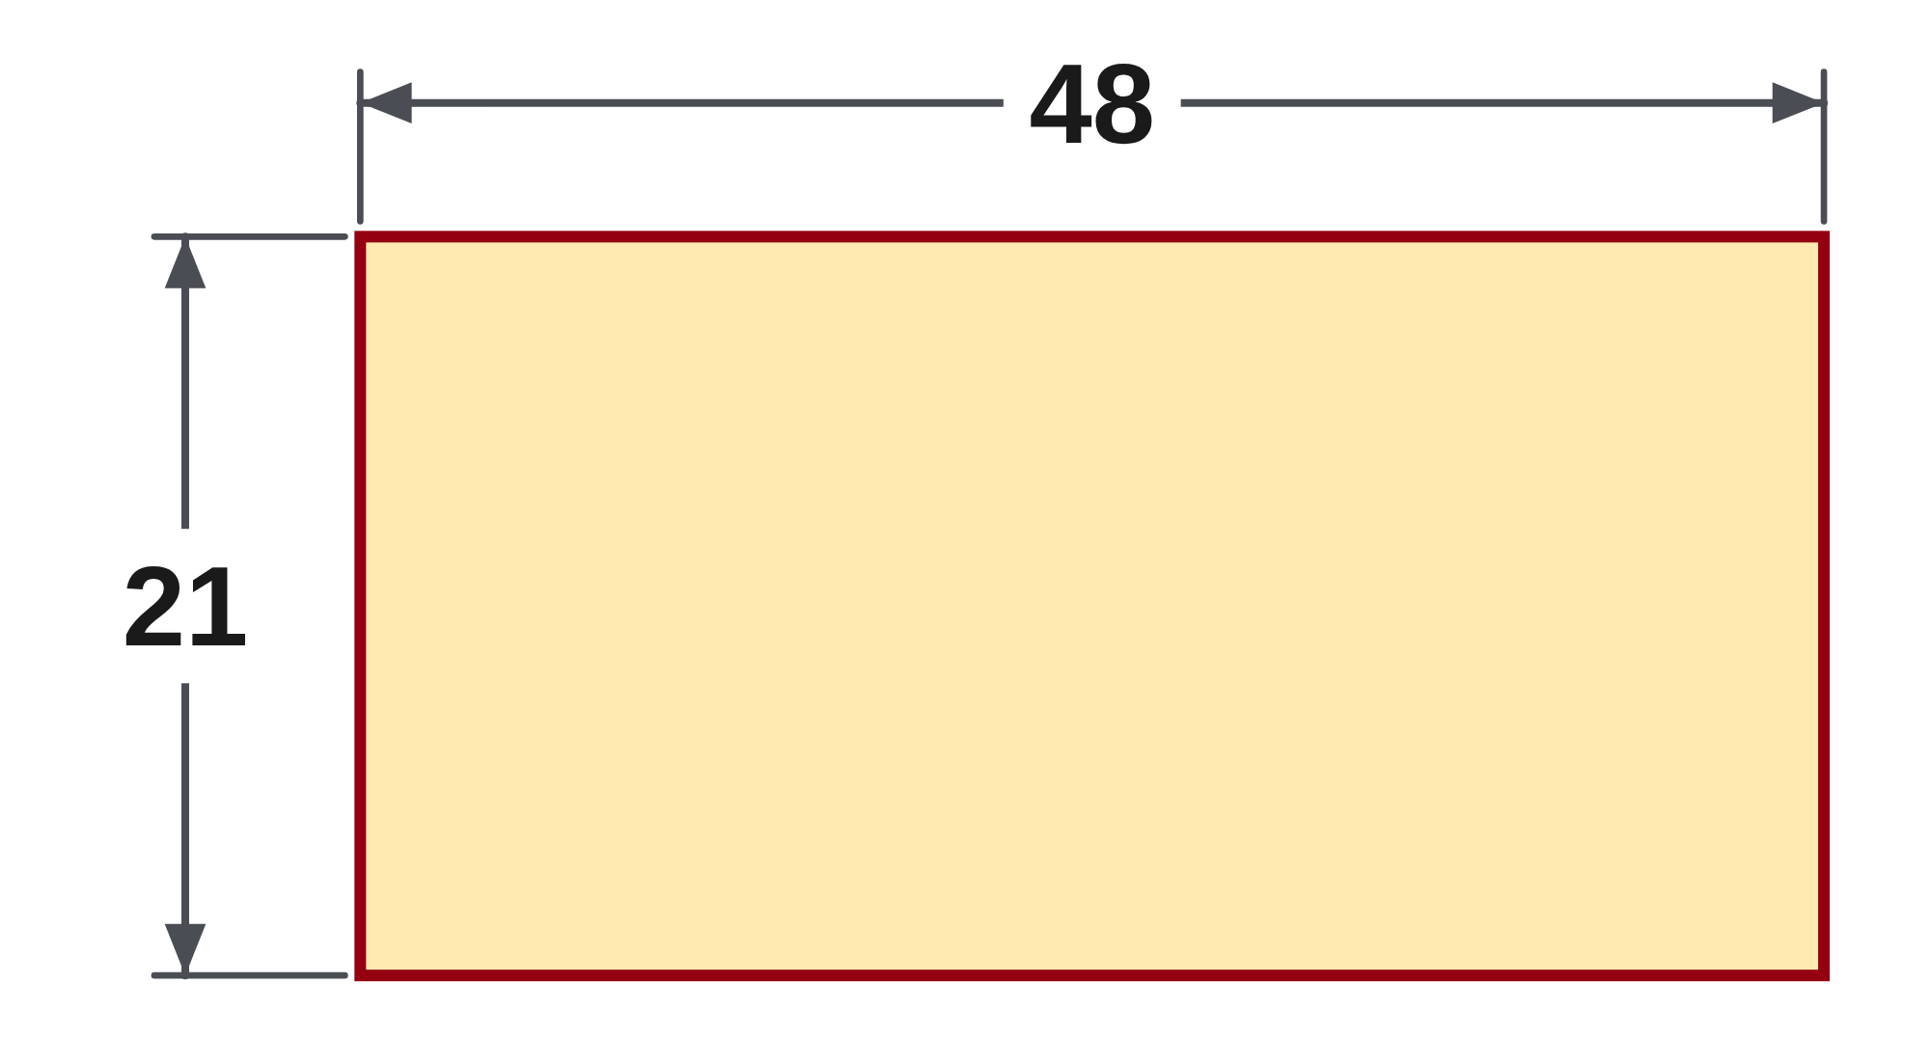
W01-L01 • CHECK • 10:00 AM–10:10 AM • 10 MIN TOTAL
Independent check | 1A Q10
Answer independently. Keep worked solutions closed.
Textbook Chapter 1 pp.12–23; Chapter 2 pp.48–51,59
Textbook
Exercise Book
Numeracy Hub
Shape Canvas
Day 01 • 2026-10-29 • 22
Notes:
CHECK | 10:00 AM–10:10 AM | 10 MIN TOTAL — shared phase allocation.
For 1A Q10, estimate 48 times 21 by rounding both numbers to the nearest ten. Show the two rounded numbers before multiplying. This is asking for an estimate, so label it as approximate. After your attempt, explain why the estimate can be useful even though it is not the exact number of fasteners. It predicts the correct scale and helps us notice a missed digit.
INSTRUCTOR ONLY — AFTER THE ATTEMPT: 1,000 (50 × 20)
Working to discuss after the attempt: 48 rounds to 50 and 21 rounds to 20. The estimated product is 50 × 20 = 1,000; the exact product would be 1,008.

Slide 23
W01-L01 • WRAP UP • 10:10 AM–10:15 AM • 5 MIN TOTAL
Wrap up and choose the next step
Share one learning point and one skill to practise next.
Record a takeaway and next action.
Resources: Exercise Book 1A Q1–10 (p.6), Q11–17 (pp.6–7)
Textbook Chapter 1 pp.12–23; Chapter 2 pp.48–51,59
Textbook
Exercise Book
Numeracy Hub
Shape Canvas
Day 01 • 2026-10-29 • 23
Notes:
WRAP UP | 10:10 AM–10:15 AM | 5 MIN TOTAL — shared phase allocation.
Choose one calculation from this block and finish this sentence: “My answer is reasonable because…” Use an estimate, a reverse calculation or the meaning of the quantities as evidence. Which habit would most help you avoid an incorrect cut-list total? Accept specific answers such as reading every dimension, checking the unit or adding the pieces back. Write one next step for yourself. After the break we will practise calculator entry while keeping these checking habits.

Slide 24
DAY 01 • SCHEDULED BREAK
Break
10:15 AM–10:30 AM
Return ready for: Calculator basics and checking
This break is excluded from teaching minutes.
Textbook
Exercise Book
Numeracy Hub
Shape Canvas
Day 01 • 2026-10-29 • 24
Notes:
Break | 10:15 AM–10:30 AM
We have a break until 10:30. Leave yourself a clear note about any calculation you want to revisit, then take the full break. When we return, have your chosen calculator and exercise book ready for calculator basics and checking. What will stay the same even when we use a calculator? We will still write the intended calculation, label quantities and decide whether the answer makes sense.

Slide 25
W01-L02 • START • 10:30 AM–10:35 AM • 5 MIN TOTAL
Calculator basics and checking
Today’s goal: Use the chosen calculator correctly and check an answer with an estimate or inverse operation.
Name one use for today’s skill.
Textbook Chapter 2 pp.48–53,59; Chapter 1 pp.14–23
Exercise Book 2A Q1–3,6 (p.17); 1A Q11–17,20 (pp.6–7)
Keep your notebook, textbook, exercise book and chosen calculator ready.
Textbook Chapter 2 pp.48–53,59; Chapter 1 pp.14–23
Textbook
Exercise Book
Numeracy Hub
Shape Canvas
Day 01 • 2026-10-29 • 25
Notes:
START | 10:30 AM–10:35 AM | 5 MIN TOTAL — shared phase allocation.
This block is about controlling the calculator rather than trusting every number it shows. We will practise the keys on your chosen model and use an estimate or inverse operation to check a result. Which could detect a wrong answer from a square-root key? Squaring the result should restore the starting number. Keep the textbook's model-specific instructions beside you and record the calculation, the keys and the answer as three connected parts.

Slide 26
W01-L02 • RECALL • 10:35 AM–10:40 AM • 5 MIN TOTAL
Recall and reconnect
Try to clear the display and enter 23 × 23. Check which model they use.
Try first without displayed answers.
Resources: Exercise Book 2A Q1–3,6 (p.17); 1A Q11–17,20 (pp.6–7)
Textbook Chapter 2 pp.48–53,59; Chapter 1 pp.14–23
Textbook
Exercise Book
Numeracy Hub
Shape Canvas
Day 01 • 2026-10-29 • 26
Notes:
RECALL | 10:35 AM–10:40 AM | 5 MIN TOTAL — shared phase allocation.
Clear the display, then enter 23 times 23 on your own calculator. Before comparing, identify the model you are using and read back the calculation. What does multiplying a number by itself mean? It is a square: this calculation is 23 squared. The result should be 529. If your screen differs, inspect the digits and operation before entering the calculation again. The same intended calculation should agree across both supported models.

Slide 27
W01-L02 • TEACH • 10:40 AM–10:55 AM • 15 MIN TOTAL
Know what the key will do
1
Clear the old calculation before beginning a new problem.
2
Use the correction key to repair an entry; reread the intended calculation.
3
The square key multiplies a number by itself; square root reverses this for positive values.
4
Change sign reverses a value’s sign; subtraction finds the difference between two values.
Textbook Chapter 2 pp.48–53,59; Chapter 1 pp.14–23
Textbook
Exercise Book
Numeracy Hub
Shape Canvas
Day 01 • 2026-10-29 • 27
Notes:
TEACH | 10:40 AM–10:55 AM | 15 MIN TOTAL — shared phase allocation.
A fresh problem needs a clear starting point. Clear the old calculation, then enter the new one deliberately. If one digit is wrong, use the model's correction key and reread the entry. The square key means multiply the number by itself; the square-root key asks what positive number squares to the value shown. Change sign and subtraction do different jobs. Which key describes a negative value already being entered? Change sign. Which operation finds the difference between two values? Subtraction. We will keep those meanings separate while following each model's sequence.

Slide 28
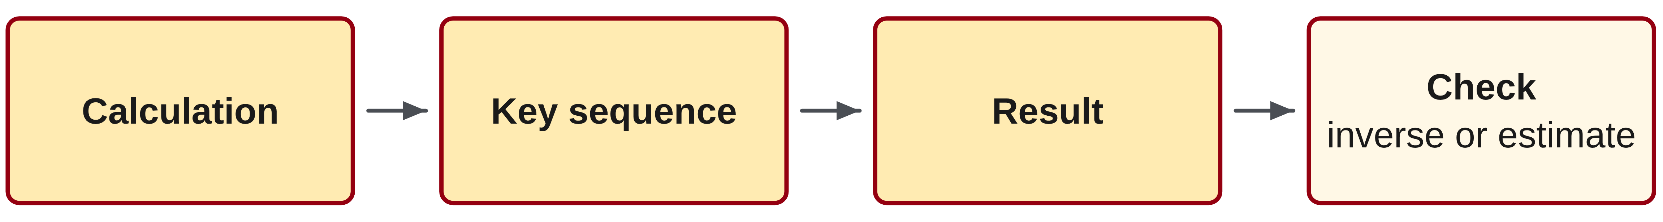
W01-L02 • TEACH • 10:40 AM–10:55 AM • 15 MIN TOTAL
Keep a record that can be checked
1
Write calculation → key sequence → result, using your selected calculator model.
2
For TI-30Xa and Sharp, follow the textbook’s own square-root entry sequence.
3
Use an inverse operation: multiply a quotient back or square a square-root result.
4
Use an estimate as a separate check that the answer has the expected size.
Textbook Chapter 2 pp.48–53,59; Chapter 1 pp.14–23
Textbook
Exercise Book
Numeracy Hub
Shape Canvas
Day 01 • 2026-10-29 • 28
Notes:
TEACH | 10:40 AM–10:55 AM | 15 MIN TOTAL — shared phase allocation.
Record three things: the mathematical calculation, the actual key sequence and the result. Two people using different models can share the same mathematics while pressing keys in a different order. For a square root, follow the textbook's row for your calculator. How can we check a square-root result without repeating the same root key sequence? Square the result and see whether the original value returns. An estimate supplies another check of size. Keeping these checks separate helps us distinguish an incorrect setup from an accidental key press.

Slide 29
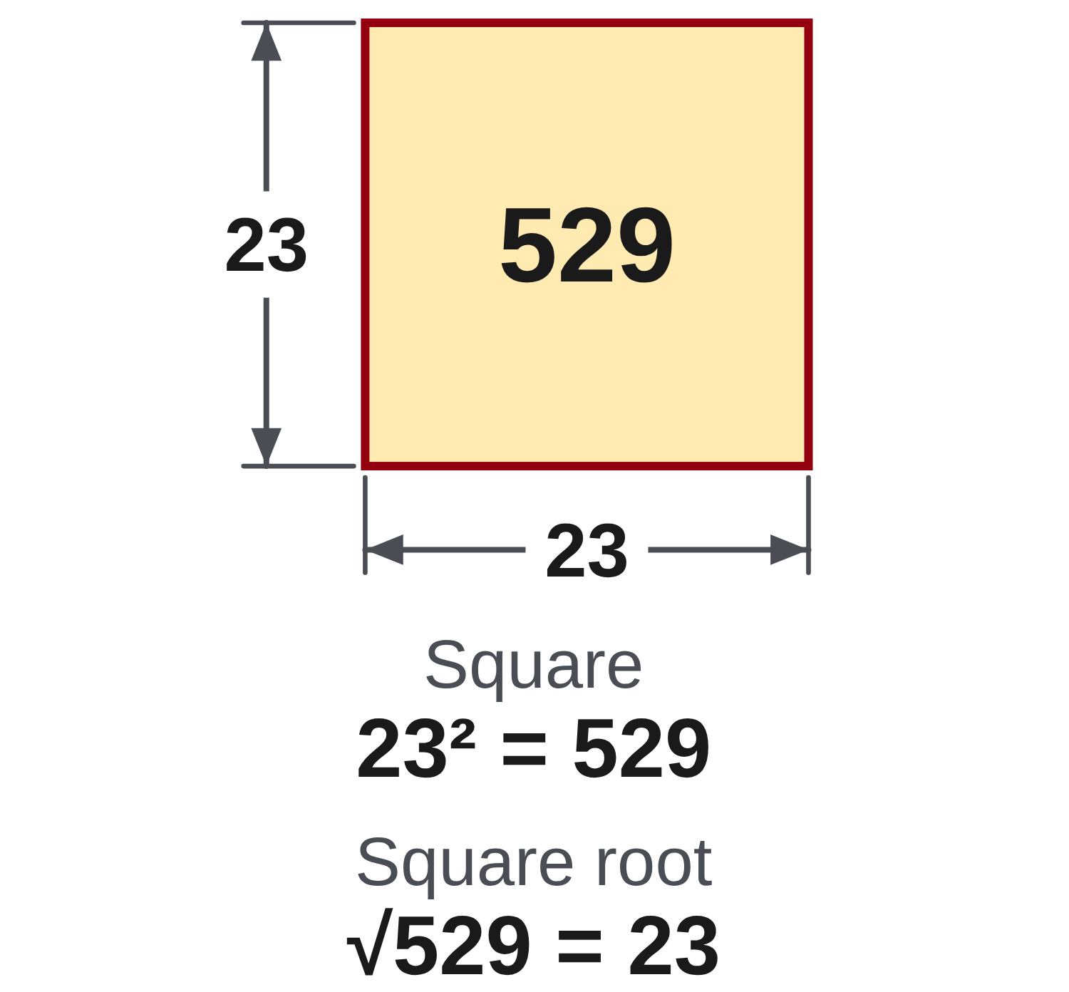
W01-L02 • TEACH • 10:40 AM–10:55 AM • 15 MIN TOTAL
Reverse the operation to check
23² = 23 × 23 = 529
√529 = 23
Squaring and square root undo one another for these positive values.
Write the intended calculation before entering keys.
A second classroom example
2,688 ÷ 12 = 224 pieces
Check: 224 × 12 = 2,688. An estimate near 225 supports the result.
Work together
Exercise Book 2A Q1–3, p.17. Record calculation, keys and answer; compare root entry on the two models.
W1 L2 • Change-sign and subtraction are different operations
Textbook
Exercise Book
Numeracy Hub
Shape Canvas
Day 01 • 2026-10-29 • 29
Notes:
TEACH | 10:40 AM–10:55 AM | 15 MIN TOTAL — shared phase allocation.
Twenty-three squared is 23 times 23, or 529. Reversing that relationship, the positive square root of 529 is 23. Now look at 2,688 divided by 12: the quotient is 224. Multiplying 224 by 12 gives 2,688, so the division relationship checks. Why is a result near 225 plausible? Twelve times 225 is 2,700, close to the starting amount. We now have both an inverse check and a size check. These are stronger evidence than pressing exactly the same division keys twice.

Slide 30
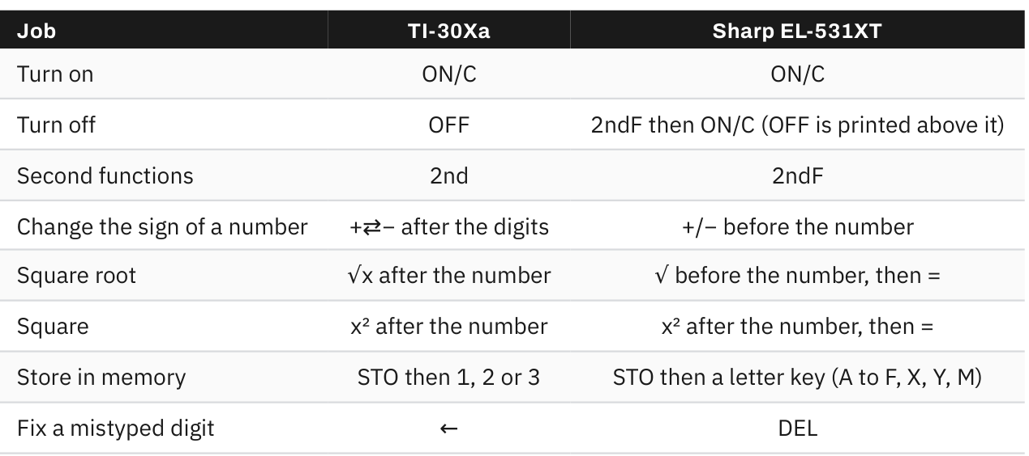
W01-L02 • TEACH • 10:40 AM–10:55 AM • 15 MIN TOTAL
Textbook | page 49
Textbook p.49 · Table 2.1: key differences between the two calculators.
Textbook Chapter 2 pp.48–53,59; Chapter 1 pp.14–23
Textbook
Exercise Book
Numeracy Hub
Shape Canvas
Day 01 • 2026-10-29 • 30
Notes:
TEACH | 10:40 AM–10:55 AM | 15 MIN TOTAL — shared phase allocation.
The textbook's table on page 49 compares the two calculators. On the TI-30Xa, enter the number before the square-root key; on the Sharp, press the root key first, enter the number and finish with equals. For change sign, the TI sequence places the sign key after the digits, while the Sharp sequence places it before. Which row should you follow today? The row for the model you are actually holding. Locate your correction key as well: the TI uses the left-arrow key, and the Sharp uses DEL.

Slide 31
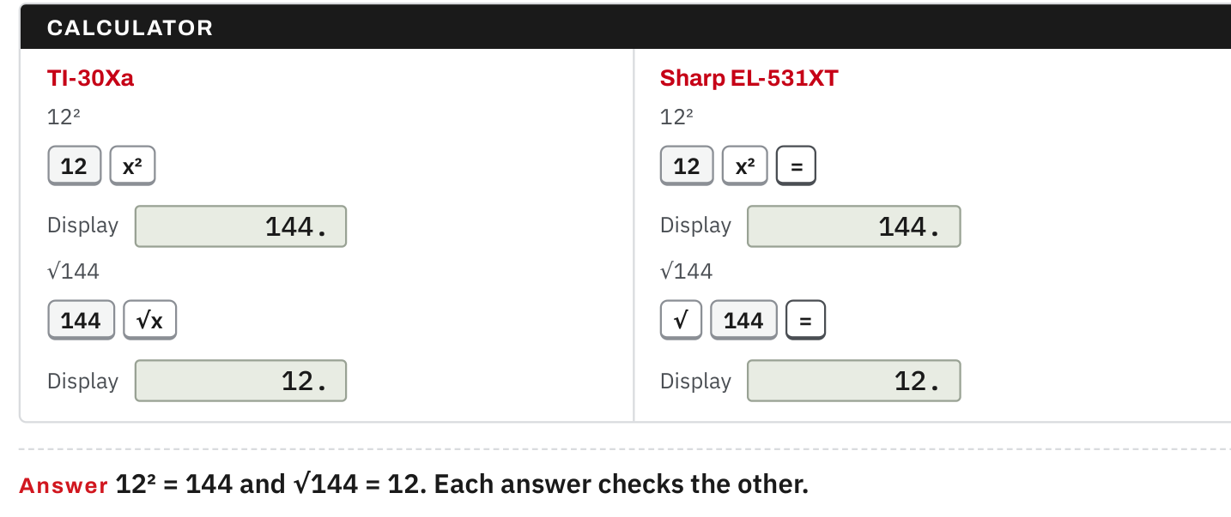
W01-L02 • TEACH • 10:40 AM–10:55 AM • 15 MIN TOTAL
Textbook | page 52
Textbook p.52 · Square and square-root key sequences; each checks the other.
Textbook Chapter 2 pp.48–53,59; Chapter 1 pp.14–23
Textbook
Exercise Book
Numeracy Hub
Shape Canvas
Day 01 • 2026-10-29 • 31
Notes:
TEACH | 10:40 AM–10:55 AM | 15 MIN TOTAL — shared phase allocation.
Page 52 demonstrates 12 squared and the square root of 144. Twelve times twelve makes 144; the root reverses that relationship to give 12. On the TI, 12 then x² gives the square, and 144 then √x gives the root. The Sharp uses 12, x², equals, or √, 144, equals. What stays the same between the two models? The mathematical relationship and the correct result. What changes? The order of the keys needed to express that relationship. Read the intended expression before using either sequence.

Slide 32
W01-L02 • TEACH • 10:40 AM–10:55 AM • 15 MIN TOTAL
Spot the mistake. Explain the correction.
Does pressing the subtraction key necessarily enter a negative number correctly?
Discuss the method before checking the answer.
No. Use the selected model’s change-sign key for a negative value; use subtraction between values.
Textbook Chapter 2 pp.48–53,59; Chapter 1 pp.14–23
Textbook
Exercise Book
Numeracy Hub
Shape Canvas
Day 01 • 2026-10-29 • 32
Notes:
TEACH | 10:40 AM–10:55 AM | 15 MIN TOTAL — shared phase allocation.
The subtraction key does not automatically stand in for the change-sign key. A negative number is a value; subtraction is an operation between values. If the problem contains a negative value, use the textbook's change-sign sequence for your model. Why might using the wrong key produce trouble? The calculator may interpret it as continuing a previous operation or may not form the intended value. Clear the entry, identify whether you are entering a negative number or subtracting a quantity, and then use the matching key sequence.

Slide 33
W01-L02 • TOGETHER • 10:55 AM–11:10 AM • 15 MIN TOTAL
Work together
Solve Exercise Book 2A questions 1–3 together. Compare square-root entry on the two models; estimate before checking.
Work in pairs; alternate solver and checker.
Resources: Exercise Book 2A Q1–3,6 (p.17); 1A Q11–17,20 (pp.6–7)
Textbook Chapter 2 pp.48–53,59; Chapter 1 pp.14–23
Textbook
Exercise Book
Numeracy Hub
Shape Canvas
Day 01 • 2026-10-29 • 33
Notes:
TOGETHER | 10:55 AM–11:10 AM | 15 MIN TOTAL — shared phase allocation.
Solve exercise book 2A questions 1–3 together. One person reads the mathematical expression while the other records the calculator keys; then reverse roles. For a root question, compare the two model sequences without assuming they begin the same way. What would show that both sequences represented the same calculation? The same answer, supported by an inverse check. Keep the estimate and the checking line with the written solution so another person can follow your reasoning.

Slide 34
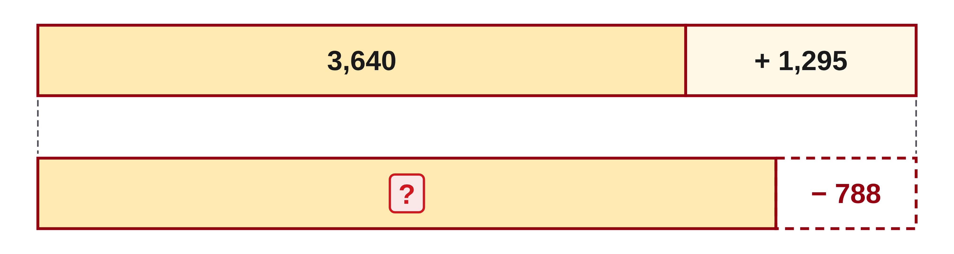
W01-L02 • TOGETHER • 10:55 AM–11:10 AM • 15 MIN TOTAL
Guided practice | 2A Q1
Work with a partner. Take turns explaining the next step.
Textbook Chapter 2 pp.48–53,59; Chapter 1 pp.14–23
Textbook
Exercise Book
Numeracy Hub
Shape Canvas
Day 01 • 2026-10-29 • 34
Notes:
TOGETHER | 10:55 AM–11:10 AM | 15 MIN TOTAL — shared phase allocation.
For 2A Q1, the expression is 3,640 plus 1,295 minus 788. Work through the written operation with your partner, then enter the same sequence carefully. Which intermediate total do you get before subtracting? Establish that together before finishing. Estimate whether the result should be closer to four thousand or five thousand. Record the keys you actually used, and leave your working visible for comparison after the attempt.
INSTRUCTOR ONLY — AFTER THE ATTEMPT: 4,147. TI-30Xa: 3640, +, 1295, −, 788, =. Sharp: 3640, +, 1295, −, 788, =.
Working to discuss after the attempt: 3,640 + 1,295 = 4,935; 4,935 − 788 = 4,147. Reverse the subtraction: 4,147 + 788 = 4,935.

Slide 35
W01-L02 • TOGETHER • 10:55 AM–11:10 AM • 15 MIN TOTAL
Compare your method | 2A Q1
CHECK TOGETHER
4,147. TI-30Xa: 3640, +, 1295, −, 788, =. Sharp: 3640, +, 1295, −, 788, =.
Textbook Chapter 2 pp.48–53,59; Chapter 1 pp.14–23
Textbook
Exercise Book
Numeracy Hub
Shape Canvas
Day 01 • 2026-10-29 • 35
Notes:
TOGETHER | 10:55 AM–11:10 AM | 15 MIN TOTAL — shared phase allocation.
Adding 3,640 and 1,295 gives 4,935. Subtracting 788 leaves 4,147. Both supported calculators use the same ordinary addition-and-subtraction sequence here. How could we reverse the last step? Add 788 back to 4,147; that restores 4,935. Then subtract 1,295 to recover 3,640. If the result differed from your screen, compare one stage at a time instead of erasing all your working. The intermediate total tells us where the disagreement began.
INSTRUCTOR ONLY — AFTER THE ATTEMPT: 4,147. TI-30Xa: 3640, +, 1295, −, 788, =. Sharp: 3640, +, 1295, −, 788, =.
Working to discuss after the attempt: 3,640 + 1,295 = 4,935; 4,935 − 788 = 4,147. Reverse the subtraction: 4,147 + 788 = 4,935.

Slide 36
W01-L02 • PRACTISE • 11:10 AM–11:45 AM • 35 MIN TOTAL
Your scheduled practice
Complete 2A question 6 and selected 1A questions 11–17,20. Record the calculation, keys and answer; use inverse operations to verify two results.
Show working and units; estimate, then check.
Resources: Exercise Book 2A Q1–3,6 (p.17); 1A Q11–17,20 (pp.6–7)
Textbook Chapter 2 pp.48–53,59; Chapter 1 pp.14–23
Textbook
Exercise Book
Numeracy Hub
Shape Canvas
Day 01 • 2026-10-29 • 36
Notes:
PRACTISE | 11:10 AM–11:45 AM | 35 MIN TOTAL — shared phase allocation.
Continue with 2A Q6 and the selected 1A questions 11–17 and 20. For each, keep calculation, key sequence and answer together. Choose two completed calculations and verify them with inverse operations. Which inverse fits addition? Subtraction. Which fits division? Multiplication. A checking line should restore a quantity from the original problem. If it does not, reread the written expression and your model's key order before trying again.

Slide 37
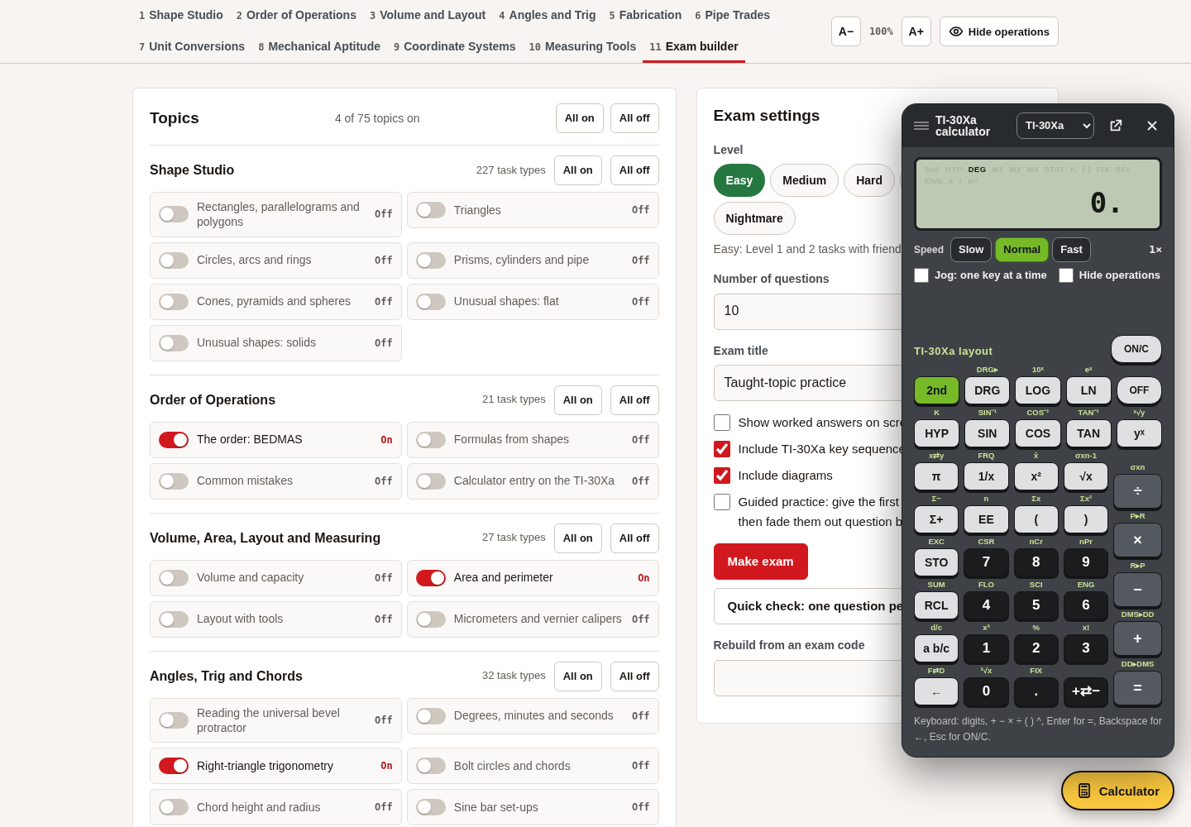
W01-L02 • PRACTISE • 11:10 AM–11:45 AM • 35 MIN TOTAL
Open Numeracy Hub
Navigation example. Use the values and units in the assigned task.
Textbook Chapter 2 pp.48–53,59; Chapter 1 pp.14–23
Textbook
Exercise Book
Numeracy Hub
Shape Canvas
Day 01 • 2026-10-29 • 37
Notes:
PRACTISE | 11:10 AM–11:45 AM | 35 MIN TOTAL — shared phase allocation.
Open the calculator panel in Numeracy Hub and select your usual model. The picture shows where the calculator is opened; your assigned numbers still come from the exercise book. Locate clear, square, root and change sign before starting the next calculation. Which of these keys would help check a square-root answer? The square key. Keep the written expression beside the panel so the visible buttons do not decide the mathematics for you.

Slide 38
W01-L02 • PRACTISE • 11:10 AM–11:45 AM • 35 MIN TOTAL
Practise in Numeracy Hub
1
Supported: Choose one calculator model in Numeracy Hub; locate clear, square, root and sign keys.
2
Supported: Work 2A Q1–3 and record each model-specific key sequence beside the written calculation.
3
Independent practice: Check two completed calculations using inverse operations; retain the working.
Textbook Chapter 2 pp.48–53,59; Chapter 1 pp.14–23
Textbook
Exercise Book
Numeracy Hub
Shape Canvas
Day 01 • 2026-10-29 • 38
Notes:
PRACTISE | 11:10 AM–11:45 AM | 35 MIN TOTAL — shared phase allocation.
First locate clear, square, root and sign on your chosen model in Numeracy Hub. Revisit 2A questions 1–3 and compare each recorded sequence with the textbook. Then choose two results to check backwards. When a root result squares back to the starting value, what has that verified? The numerical square-root relationship. It still matters that we started with the correct expression, so read the original problem as well as the keys. Save the written check with your answer.

Slide 39
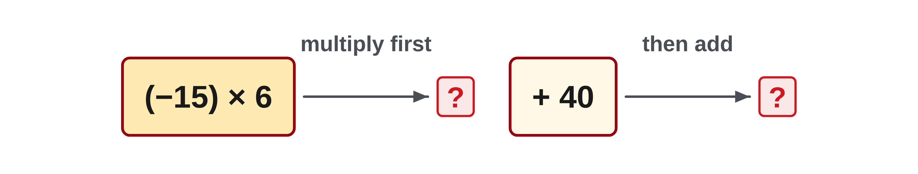
W01-L02 • PRACTISE • 11:10 AM–11:45 AM • 35 MIN TOTAL
Practise from the Exercise Book | 2A Q6
Write the operation, working and units before checking.
Textbook Chapter 2 pp.48–53,59; Chapter 1 pp.14–23
Textbook
Exercise Book
Numeracy Hub
Shape Canvas
Day 01 • 2026-10-29 • 39
Notes:
PRACTISE | 11:10 AM–11:45 AM | 35 MIN TOTAL — shared phase allocation.
For 2A Q6, the negative value is minus fifteen, multiplied by six, followed by adding forty. Write that expression before pressing keys. Which key is needed to enter the negative fifteen? Your model's change-sign key. Try the full calculation, then compare the result with the direction you expect: adding forty moves a negative product back toward zero. The exact model sequences are supplied below for checking after the attempt.
INSTRUCTOR ONLY — AFTER THE ATTEMPT: −50. TI-30Xa: 15, +⇄−, ×, 6, +, 40, =. Sharp: +/−, 15, ×, 6, +, 40, =.
Working to discuss after the attempt: (−15) × 6 = −90, then −90 + 40 = −50. Adding 40 moves the value toward zero but does not pass zero.

Slide 40
W01-L02 • PRACTISE • 11:10 AM–11:45 AM • 35 MIN TOTAL
Practise from the Exercise Book | 1A Q11
Write the operation, working and units before checking.
Textbook Chapter 2 pp.48–53,59; Chapter 1 pp.14–23
Textbook
Exercise Book
Numeracy Hub
Shape Canvas
Day 01 • 2026-10-29 • 40
Notes:
PRACTISE | 11:10 AM–11:45 AM | 35 MIN TOTAL — shared phase allocation.
Return to 1A Q11, 3,275 plus 1,948, this time using the calculator as a check on your written addition. Keep the estimate near five thousand visible. What inverse operation could verify the sum? Subtract either addend from the total and recover the other. After your attempt, use that reverse check rather than accepting agreement between two identical key sequences as the only evidence.
INSTRUCTOR ONLY — AFTER THE ATTEMPT: 5,223
Working to discuss after the attempt: 3,275 + 1,948 = 5,223. Check: 5,223 − 1,948 = 3,275.

Slide 41
W01-L02 • CHECK • 11:45 AM–11:55 AM • 10 MIN TOTAL
Check independently
Redo Exercise Book 2A questions 1 and 3 independently. Explain one checking method.
Answer independently and show the method.
Resources: Exercise Book 2A Q1–3,6 (p.17); 1A Q11–17,20 (pp.6–7)
Textbook Chapter 2 pp.48–53,59; Chapter 1 pp.14–23
Textbook
Exercise Book
Numeracy Hub
Shape Canvas
Day 01 • 2026-10-29 • 41
Notes:
CHECK | 11:45 AM–11:55 AM | 10 MIN TOTAL — shared phase allocation.
Redo 2A questions 1 and 3 independently. Write the expression, use the sequence for your chosen model and explain one checking method. For question 1, choose a reverse operation or a sensible estimate; for question 3, consider the relationship between squaring and square root. What should a checking explanation contain? A specific operation and the quantity it should recover. Leave solutions closed until both attempts are complete.

Slide 42
W01-L02 • CHECK • 11:45 AM–11:55 AM • 10 MIN TOTAL
Independent check | 2A Q1
Answer independently. Keep worked solutions closed.
Textbook Chapter 2 pp.48–53,59; Chapter 1 pp.14–23
Textbook
Exercise Book
Numeracy Hub
Shape Canvas
Day 01 • 2026-10-29 • 42
Notes:
CHECK | 11:45 AM–11:55 AM | 10 MIN TOTAL — shared phase allocation.
For 2A Q1, show your own calculation of 3,640 plus 1,295 minus 788. This time the important evidence is your independent entry and checking line. Read the digits back before evaluating. After the attempt, explain how adding the subtracted amount back can test the final subtraction. If your result is incorrect, identify the first differing line rather than simply replacing the answer.
INSTRUCTOR ONLY — AFTER THE ATTEMPT: 4,147. TI-30Xa: 3640, +, 1295, −, 788, =. Sharp: 3640, +, 1295, −, 788, =.
Working to discuss after the attempt: 3,640 + 1,295 = 4,935; 4,935 − 788 = 4,147. Reverse the subtraction: 4,147 + 788 = 4,935.

Slide 43
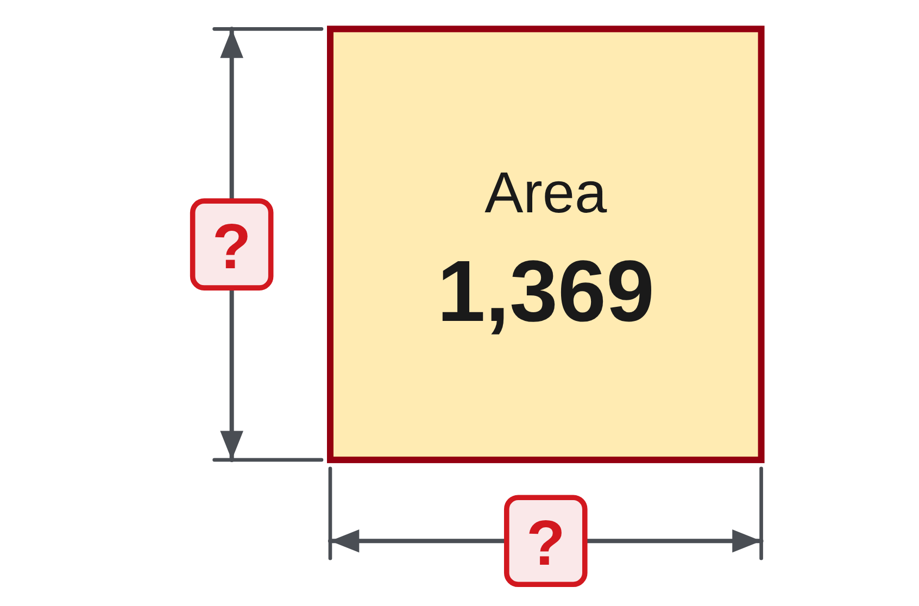
W01-L02 • CHECK • 11:45 AM–11:55 AM • 10 MIN TOTAL
Independent check | 2A Q3
Answer independently. Keep worked solutions closed.
Textbook Chapter 2 pp.48–53,59; Chapter 1 pp.14–23
Textbook
Exercise Book
Numeracy Hub
Shape Canvas
Day 01 • 2026-10-29 • 43
Notes:
CHECK | 11:45 AM–11:55 AM | 10 MIN TOTAL — shared phase allocation.
For 2A Q3, find the square root of 1,369 using the sequence for your model. Record the key order and show an inverse check. Ask yourself which positive number, multiplied by itself, would restore 1,369. Keep the worked answer closed during the attempt. When we compare, the checking line should square the proposed result, not repeat the same square-root entry.
INSTRUCTOR ONLY — AFTER THE ATTEMPT: 37. TI-30Xa: 1369, √x. Sharp: √, 1369, =.
Working to discuss after the attempt: 37 × 37 = 1,369, confirming that the positive square root is 37.

Slide 44
W01-L02 • WRAP UP • 11:55 AM–12:00 PM • 5 MIN TOTAL
Wrap up and choose the next step
Share one learning point and one skill to practise next.
Record a takeaway and next action.
Resources: Exercise Book 2A Q1–3,6 (p.17); 1A Q11–17,20 (pp.6–7)
Textbook Chapter 2 pp.48–53,59; Chapter 1 pp.14–23
Textbook
Exercise Book
Numeracy Hub
Shape Canvas
Day 01 • 2026-10-29 • 44
Notes:
WRAP UP | 11:55 AM–12:00 PM | 5 MIN TOTAL — shared phase allocation.
Pick one calculator feature you can now explain clearly: correction, square, root or change sign. Tell a partner what it does and how you would check its result. Which habit will you carry into tomorrow's quantities and word problems? A useful choice is writing the operation before keying it. Record one specific practice target, such as using your model's root sequence or checking a quotient by multiplication. Your notebook should now show both answers and evidence for trusting them.

