Slide 1

CARPENTRY FOUNDATION / INTAKE 142
Day 02 | Friday
02
October 30, 2026
Quantities, averages and word problems
9:00 AM–10:15 AM • Math • 75 min
Cut-list practice and rounding
10:30 AM–12:00 PM • Calculation Practice • 90 min
Week 1 • 2 scheduled blocks • 165 teaching minutes
Estimate. Show the method. Label units. Check the result.
Textbook
Exercise Book
Numeracy Hub
Shape Canvas
Day 02 • 2026-10-30 • 01
Notes:
Opening overview | 9:00 AM–9:05 AM | Within the 5-minute Start phase.
Today we will turn job descriptions into calculations, then use those calculations to account for stock and offcuts. You will meet three different answers: an exact need, a supplier order and a count of complete pieces. Why might those answers require different rounding decisions? A supplier order must cover the need, while a complete piece must actually fit the available stock. Keep those meanings in view as we move from quantities and averages into cut-list practice.

Slide 2
DAY 02 / WEEK 1 / CLASS TIMETABLE
Today’s exact schedule
9:00 AM–10:15 AM • 75 min
10:30 AM–12:00 PM • 90 min
Quantities, averages and word problems
Cut-list practice and rounding
9:00 AM–9:05 AM
Start
5
10:30 AM–10:35 AM
Start
5
9:05 AM–9:10 AM
Recall
5
10:35 AM–10:40 AM
Recall
5
9:10 AM–9:25 AM
Teach
15
10:40 AM–10:55 AM
Teach
15
9:25 AM–9:40 AM
Together
15
10:55 AM–11:10 AM
Together
15
9:40 AM–10:00 AM
Practise
20
11:10 AM–11:45 AM
Practise
35
10:00 AM–10:10 AM
Check
10
11:45 AM–11:55 AM
Check
10
10:10 AM–10:15 AM
Wrap up
5
11:55 AM–12:00 PM
Wrap up
5
Math • Math Week 1, Lesson 3
Calculation Practice • Math Week 1, Lesson 4
Break: 10:15 AM–10:30 AM • 15 minutes • excluded from teaching time
Textbook
Exercise Book
Numeracy Hub
Shape Canvas
Day 02 • 2026-10-30 • 02
Notes:
Opening overview | 9:00 AM–9:05 AM | Within the 5-minute Start phase.
We begin with quantities, averages and word problems from 9:00 to 10:15. After the break, cut-list practice runs from 10:30 until noon. The first block has twenty minutes of independent practice; the second has thirty-five. What should you do if an operation is unclear during practice? Return to what is given, what is being asked and the answer's unit, then ask about that specific step. We will use independent checks at the end of each block.

Slide 3
W01-L03 • START • 9:00 AM–9:05 AM • 5 MIN TOTAL
Quantities, averages and word problems
Today’s goal: Choose operations from a job problem and explain the difference between full pieces and purchase quantities.
Name one use for today’s skill.
Textbook Chapter 1 pp.17–23
Exercise Book 1A Q15–19 (p.7); 1B Q2–5 (p.8)
Keep your notebook, textbook, exercise book and chosen calculator ready.
Textbook Chapter 1 pp.17–23
Textbook
Exercise Book
Numeracy Hub
Shape Canvas
Day 02 • 2026-10-30 • 03
Notes:
START | 9:00 AM–9:05 AM | 5 MIN TOTAL — shared phase allocation.
Today the important choice happens before the arithmetic: what does the question want us to count or measure? An answer of four boxes and an answer of four pieces describe different things. Think about ordering fixings for a frame. What information would you need? How many fixings the job requires and how many come in a box. We will calculate the need first, then decide what whole supplier units must be purchased, keeping those answers separately labelled.

Slide 4
W01-L03 • RECALL • 9:05 AM–9:10 AM • 5 MIN TOTAL
Recall and reconnect
Identify what information is given, what must be found and which unit the answer needs.
Try first without displayed answers.
Resources: Exercise Book 1A Q15–19 (p.7); 1B Q2–5 (p.8)
Textbook Chapter 1 pp.17–23
Textbook
Exercise Book
Numeracy Hub
Shape Canvas
Day 02 • 2026-10-30 • 04
Notes:
RECALL | 9:05 AM–9:10 AM | 5 MIN TOTAL — shared phase allocation.
Read the job problem and identify three things: the information given, the quantity to find and its unit. If the question mentions pieces per box, which number counts boxes and which counts pieces? Say that distinction before choosing multiplication or division. A rough sketch of the groups can help. The expected discussion is about meaning, not speed: a correct operation follows the relationships in the story, even when several different numbers are present.

Slide 5
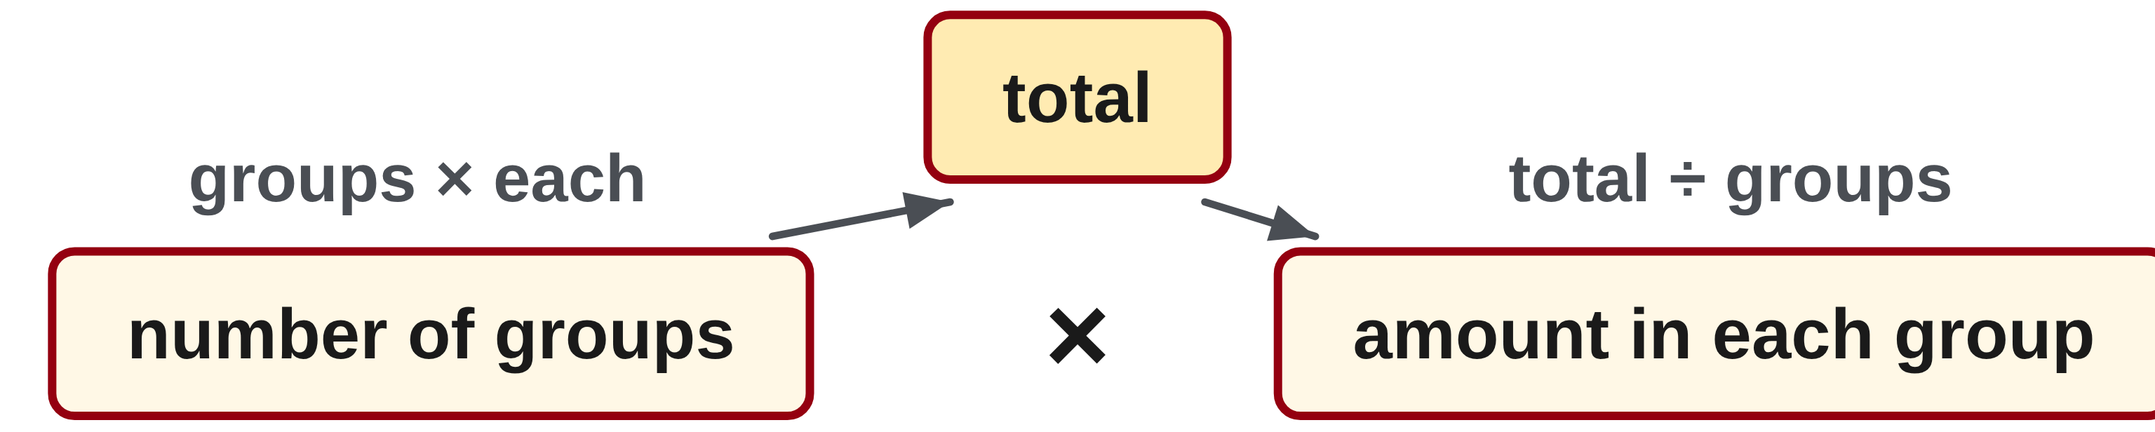
W01-L03 • TEACH • 9:10 AM–9:25 AM • 15 MIN TOTAL
Translate the story into groups
1
Write what is given and what must be found before choosing an operation.
2
Equal groups: number of groups × amount in each group gives the total.
3
Sharing equally: total ÷ number of groups gives the amount in each group.
4
Average: add all the values, then divide by how many values were added.
Textbook Chapter 1 pp.17–23
Textbook
Exercise Book
Numeracy Hub
Shape Canvas
Day 02 • 2026-10-30 • 05
Notes:
TEACH | 9:10 AM–9:25 AM | 15 MIN TOTAL — shared phase allocation.
Translate the story into groups. If we know the number of groups and the amount in each, multiplication gives a total. If we know a total and how many equal groups share it, division gives the amount per group. An average uses two steps: add all the recorded values, then divide by how many values were included. Why must the count match the values actually added? Dividing by a different count changes the meaning of the average. Write labels such as screws, boxes or millimetres so you can explain each stage of the calculation.

Slide 6
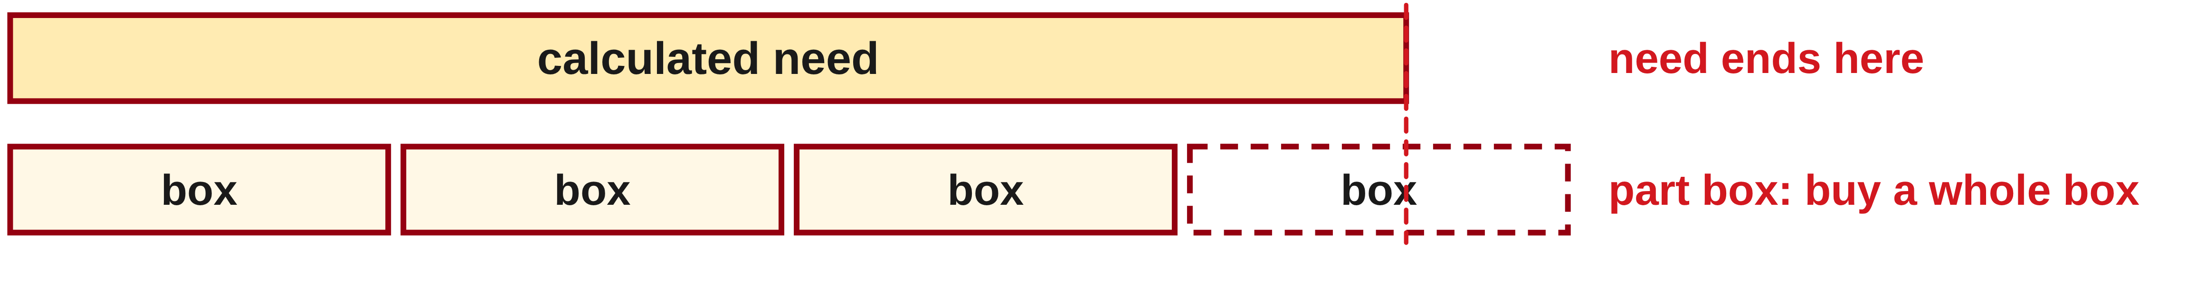
W01-L03 • TEACH • 9:10 AM–9:25 AM • 15 MIN TOTAL
Separate need from purchase quantity
1
First calculate the exact number or length needed for the job.
2
Divide by the supplier’s quantity per box or stock length.
3
A part box still requires a whole box: round the purchase up.
4
Check how much the whole-unit order supplies and whether it covers the need.
Textbook Chapter 1 pp.17–23
Textbook
Exercise Book
Numeracy Hub
Shape Canvas
Day 02 • 2026-10-30 • 06
Notes:
TEACH | 9:10 AM–9:25 AM | 15 MIN TOTAL — shared phase allocation.
Calculate the job's exact need before thinking about the package size. Then divide by the number supplied in each whole box or stock unit. A decimal answer tells us that the need does not fill an exact number of packages; it does not mean the supplier sells that fraction of a package. Which direction must the order move to cover the need? Up to the next whole unit. Check the proposed order by multiplying it back into the quantity supplied. This check reveals whether the order covers the need and how much remains.

Slide 7
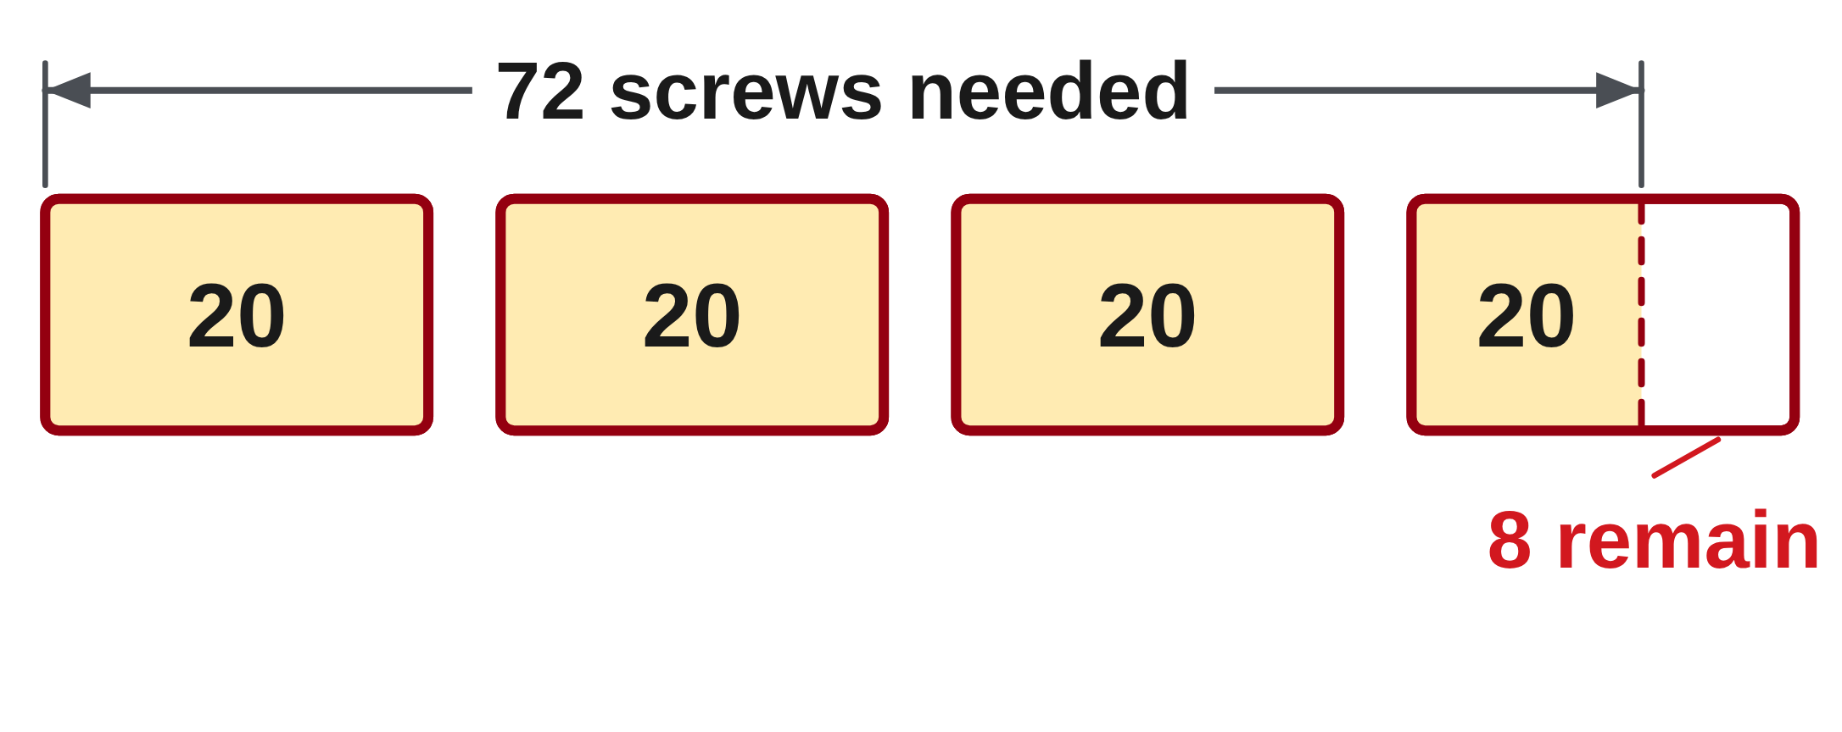
W01-L03 • TEACH • 9:10 AM–9:25 AM • 15 MIN TOTAL
Pieces needed ≠ boxes purchased
Classroom example: 12 brackets need 6 screws each. A box holds 20.
12 × 6 = 72 screws needed
72 ÷ 20 = 3.6 boxes → buy 4 whole boxes
Check: 4 × 20 = 80 screws, so 8 remain
Average example
Lengths 60, 64, 68 and 72 mm:
(60 + 64 + 68 + 72) ÷ 4 = 66 mm
Work together
Exercise Book 1B Q2–3. Separate the calculated need from the supplier order. An aggregate length estimate is not a verified cutting layout.
W1 L3 • Classroom examples use new values; purchase estimate is not a cutting plan
Textbook
Exercise Book
Numeracy Hub
Shape Canvas
Day 02 • 2026-10-30 • 07
Notes:
TEACH | 9:10 AM–9:25 AM | 15 MIN TOTAL — shared phase allocation.
Twelve brackets require six screws each, so the need is 12 times 6, or 72 screws. At twenty screws per box, 72 divided by 20 is 3.6 boxes. Buying four boxes supplies eighty screws and leaves eight; three boxes would supply only sixty. Now compare the average example: 60 plus 64 plus 68 plus 72 is 264 mm, and dividing by four gives 66 mm. What does four mean in each example? Four is the purchase quantity in the first, but the number of measured lengths in the second. Always attach meaning to the divisor or multiplier.

Slide 8
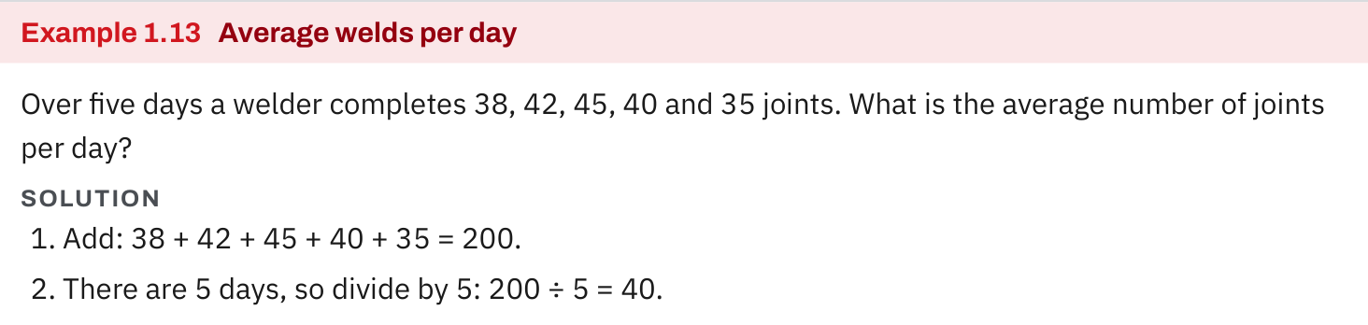
W01-L03 • TEACH • 9:10 AM–9:25 AM • 15 MIN TOTAL
Textbook | page 22
Textbook p.22 · Example 1.13: add the values, then divide by their count.
Textbook Chapter 1 pp.17–23
Textbook
Exercise Book
Numeracy Hub
Shape Canvas
Day 02 • 2026-10-30 • 08
Notes:
TEACH | 9:10 AM–9:25 AM | 15 MIN TOTAL — shared phase allocation.
The textbook's Example 1.13 records five daily totals: 38, 42, 45, 40 and 35 joints. Add them to get 200, then divide by the five days to get an average of forty joints per day. Does an average of forty mean the worker completed exactly forty every day? No: it describes the equal share of the total, while the actual daily values varied. On the calculator, the grouped sum must be completed before division. The same reasoning applies when averaging several measured lengths or production counts in a carpentry task.

Slide 9
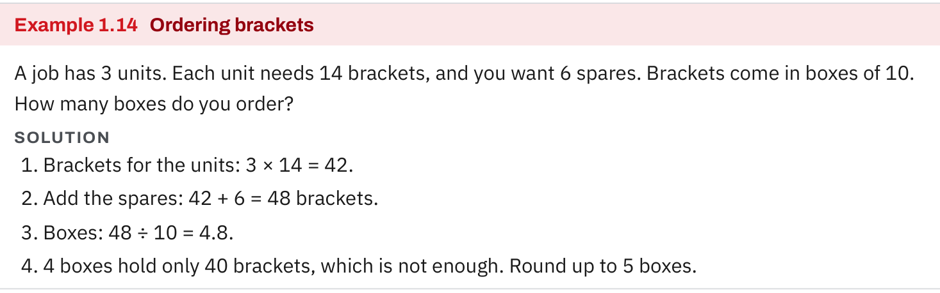
W01-L03 • TEACH • 9:10 AM–9:25 AM • 15 MIN TOTAL
Textbook | page 22
Textbook p.22 · Example 1.14: calculate need, then round the whole-box order up.
Textbook Chapter 1 pp.17–23
Textbook
Exercise Book
Numeracy Hub
Shape Canvas
Day 02 • 2026-10-30 • 09
Notes:
TEACH | 9:10 AM–9:25 AM | 15 MIN TOTAL — shared phase allocation.
In Example 1.14, three units need fourteen brackets each. Multiplication gives forty-two brackets, and six spares increase the need to forty-eight. Each box contains ten, so the quotient is 4.8 boxes. Why is ordering four boxes insufficient? Four boxes supply only forty brackets. Five boxes supply fifty and cover the need. Notice the sequence: calculate the job requirement, add the stated spares, then convert the total to supplier units. The spare allowance is explicit in this example; do not add an unstated allowance to a different question.

Slide 10
W01-L03 • TEACH • 9:10 AM–9:25 AM • 15 MIN TOTAL
Spot the mistake. Explain the correction.
A job needs 3.6 boxes. Why is ordering 3 boxes not enough?
Discuss the method before checking the answer.
Three boxes provide less than the calculated need. Buy 4 whole boxes and check the quantity supplied.
Textbook Chapter 1 pp.17–23
Textbook
Exercise Book
Numeracy Hub
Shape Canvas
Day 02 • 2026-10-30 • 10
Notes:
TEACH | 9:10 AM–9:25 AM | 15 MIN TOTAL — shared phase allocation.
A need of 3.6 boxes cannot be met with three boxes. In our example, three boxes contain sixty screws, but the job needs seventy-two. Four boxes contain eighty, enough to cover that need. What is wrong with simply dropping the decimal part? That would turn a sufficient quantity into a shortage. The question determines the rounding rule. We are ordering enough whole boxes here; later, counting complete pieces from fixed stock will require a different decision. Check every purchase result by calculating the quantity the whole order actually supplies.

Slide 11
W01-L03 • TOGETHER • 9:25 AM–9:40 AM • 15 MIN TOTAL
Work together
Solve 1B questions 2–3. Label the number needed and the number of full supplier units separately.
Work in pairs; alternate solver and checker.
Resources: Exercise Book 1A Q15–19 (p.7); 1B Q2–5 (p.8)
Textbook Chapter 1 pp.17–23
Textbook
Exercise Book
Numeracy Hub
Shape Canvas
Day 02 • 2026-10-30 • 11
Notes:
TOGETHER | 9:25 AM–9:40 AM | 15 MIN TOTAL — shared phase allocation.
Work through exercise book 1B questions 2 and 3 together. Label one line “needed” and another “whole supplier units.” For the pipe question, those units are feet and purchased lengths; for the bolt question, they are bolts and boxes. Why should we keep both answers? The supplier needs an order quantity, while the job calculation needs a material quantity. Explain the rounding decision aloud to your partner and verify the proposed order by multiplication.

Slide 12
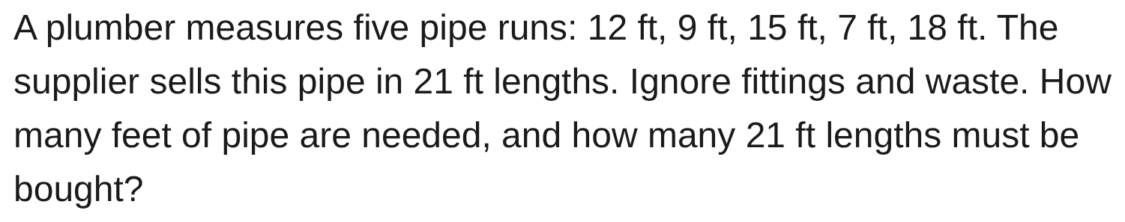
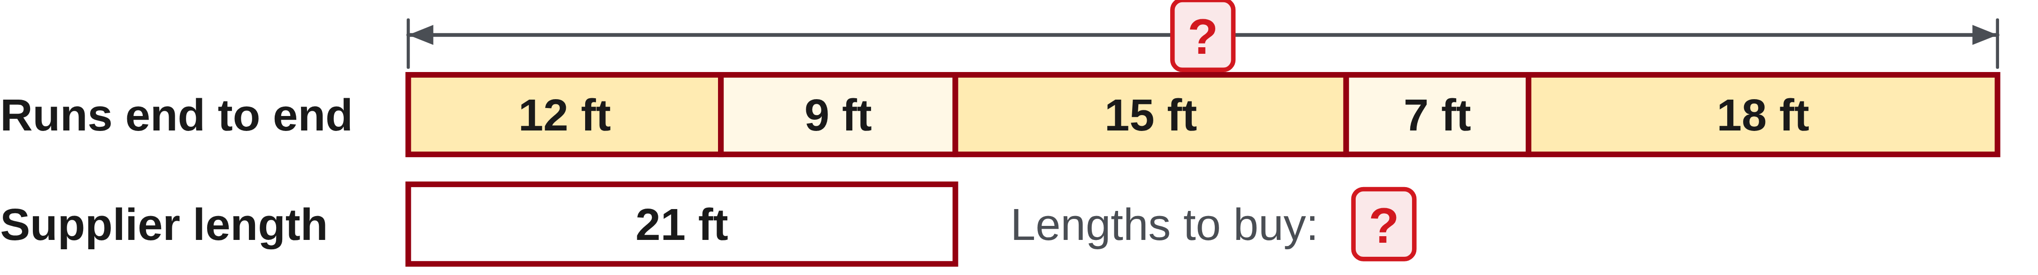
W01-L03 • TOGETHER • 9:25 AM–9:40 AM • 15 MIN TOTAL
Guided practice | 1B Q2
Work with a partner. Take turns explaining the next step.
Textbook Chapter 1 pp.17–23
Textbook
Exercise Book
Numeracy Hub
Shape Canvas
Day 02 • 2026-10-30 • 12
Notes:
TOGETHER | 9:25 AM–9:40 AM | 15 MIN TOTAL — shared phase allocation.
For 1B Q2, add the five runs: 12, 9, 15, 7 and 18 feet. The supplier sells 21-foot lengths. What must you calculate before dividing by twenty-one? The total footage required. Work out the aggregate need and purchase estimate with your partner. This textbook calculation ignores fittings and waste; a real cutting arrangement would still require its own check. Do not claim that a total-length estimate proves every separate run can be cut as shown.
INSTRUCTOR ONLY — AFTER THE ATTEMPT: 61 ft. 61 ÷ 21 = 2.9, so buy 3 lengths. Round up: a part length still has to be bought.
Working to discuss after the attempt: 12 + 9 + 15 + 7 + 18 = 61 ft. 61 ÷ 21 is approximately 2.90. Three lengths supply 63 ft. This is the exercise's aggregate estimate, not proof that its individual runs fit a cutting layout.

Slide 13
W01-L03 • TOGETHER • 9:25 AM–9:40 AM • 15 MIN TOTAL
Compare your method | 1B Q2
CHECK TOGETHER
61 ft. 61 ÷ 21 = 2.9, so buy 3 lengths.
Round up: a part length still has to be bought.
Textbook Chapter 1 pp.17–23
Textbook
Exercise Book
Numeracy Hub
Shape Canvas
Day 02 • 2026-10-30 • 13
Notes:
TOGETHER | 9:25 AM–9:40 AM | 15 MIN TOTAL — shared phase allocation.
The five runs total 61 feet. Dividing by 21 gives about 2.9 supplier lengths, so the stated aggregate estimate rounds up to three lengths. Three lengths provide 63 feet; two provide only 42. What does the spare two feet in the aggregate tell us? Only that total supplied footage exceeds total requested footage. It does not establish a feasible cutting plan for the individual runs. Keep the answer's scope clear while practising the arithmetic the exercise asks for.
INSTRUCTOR ONLY — AFTER THE ATTEMPT: 61 ft. 61 ÷ 21 = 2.9, so buy 3 lengths. Round up: a part length still has to be bought.
Working to discuss after the attempt: 12 + 9 + 15 + 7 + 18 = 61 ft. 61 ÷ 21 is approximately 2.90. Three lengths supply 63 ft. This is the exercise's aggregate estimate, not proof that its individual runs fit a cutting layout.

Slide 14
W01-L03 • PRACTISE • 9:40 AM–10:00 AM • 20 MIN TOTAL
Your scheduled practice
Complete 1A questions 15–18 and 1B questions 4–5. Explain each operation and check the answer using multiplication or addition.
Show working and units; estimate, then check.
Resources: Exercise Book 1A Q15–19 (p.7); 1B Q2–5 (p.8)
Textbook Chapter 1 pp.17–23
Textbook
Exercise Book
Numeracy Hub
Shape Canvas
Day 02 • 2026-10-30 • 14
Notes:
PRACTISE | 9:40 AM–10:00 AM | 20 MIN TOTAL — shared phase allocation.
Complete 1A questions 15–18 and 1B questions 4–5. For every word problem, write what the numbers count before entering an operation. Explain the operation in a short phrase such as “groups times amount per group.” Which reverse check fits a multiplication result? Divide the product by one factor and recover the other. When a question asks for whole pieces and a remainder, retain that form instead of reporting only a decimal quotient.

Slide 15
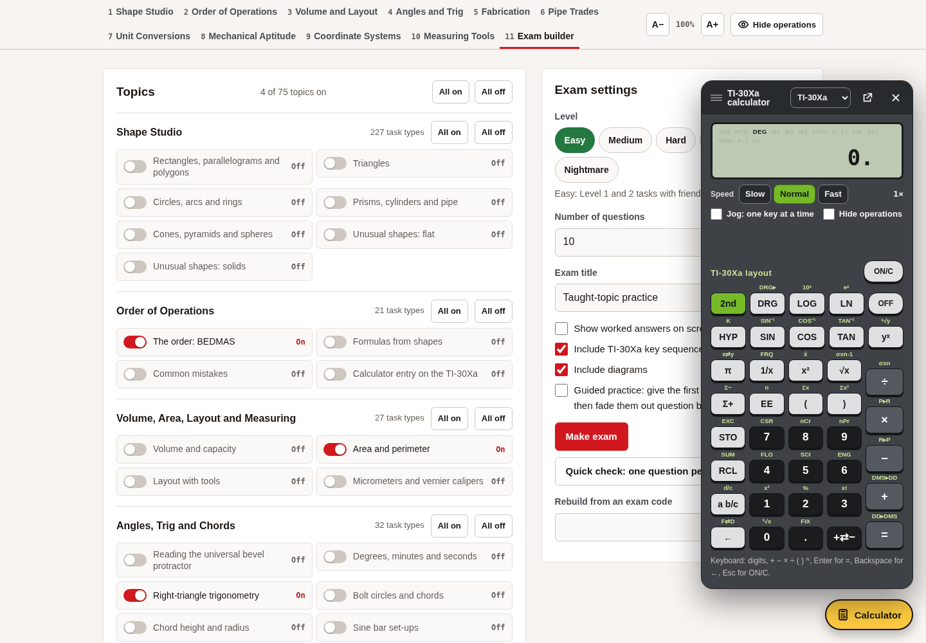
W01-L03 • PRACTISE • 9:40 AM–10:00 AM • 20 MIN TOTAL
Open Numeracy Hub
Navigation example. Use the values and units in the assigned task.
Textbook Chapter 1 pp.17–23
Textbook
Exercise Book
Numeracy Hub
Shape Canvas
Day 02 • 2026-10-30 • 15
Notes:
PRACTISE | 9:40 AM–10:00 AM | 20 MIN TOTAL — shared phase allocation.
Open the calculator in Numeracy Hub and select your usual model. The calculator will handle the arithmetic after you have drawn or described the groups. Can it decide whether a decimal number of boxes should be rounded up? No; that decision comes from the job's requirement and the supplier's whole packages. Enter your written expression, then check that the display agrees with both your estimate and the units you have recorded.

Slide 16
W01-L03 • PRACTISE • 9:40 AM–10:00 AM • 20 MIN TOTAL
Practise in Numeracy Hub
1
Supported: Draw the groups and label what each number counts in 1B Q2–3.
2
Independent practice: Write the operation and units for the assigned 1A/1B questions before keying.
3
Independent checking: Use Numeracy Hub Calculator, then verify with multiplication or addition.
Textbook Chapter 1 pp.17–23
Textbook
Exercise Book
Numeracy Hub
Shape Canvas
Day 02 • 2026-10-30 • 16
Notes:
PRACTISE | 9:40 AM–10:00 AM | 20 MIN TOTAL — shared phase allocation.
For 1B questions 2 and 3, label the groups before keying: feet per supplier length in one problem, bolts per box in the other. Complete the assigned paper calculation, then use Numeracy Hub to check the arithmetic. What would verify a proposed whole-box order? Multiply boxes by bolts per box and compare the supply with the required bolts. Keep this check alongside the original need, rather than replacing the need with the purchased amount.

Slide 17
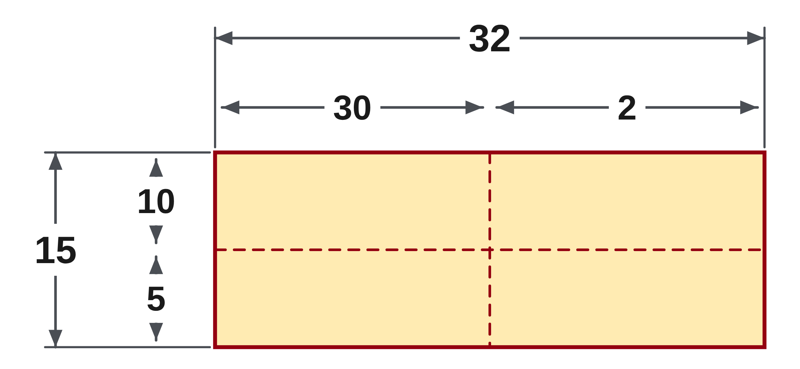
W01-L03 • PRACTISE • 9:40 AM–10:00 AM • 20 MIN TOTAL
Practise from the Exercise Book | 1A Q15
Write the operation, working and units before checking.
Textbook Chapter 1 pp.17–23
Textbook
Exercise Book
Numeracy Hub
Shape Canvas
Day 02 • 2026-10-30 • 17
Notes:
PRACTISE | 9:40 AM–10:00 AM | 20 MIN TOTAL — shared phase allocation.
For 1A Q15, calculate 32 times 15. One useful way to explain the multiplication is to split fifteen into ten and five, while keeping the same total number of groups. Why must both partial products be added? Together they account for all fifteen groups. Try the calculation first, then use your calculator or an inverse operation to check the product after you have recorded your own result.
INSTRUCTOR ONLY — AFTER THE ATTEMPT: 480
Working to discuss after the attempt: 32 × 10 = 320 and 32 × 5 = 160; 320 + 160 = 480.

Slide 18
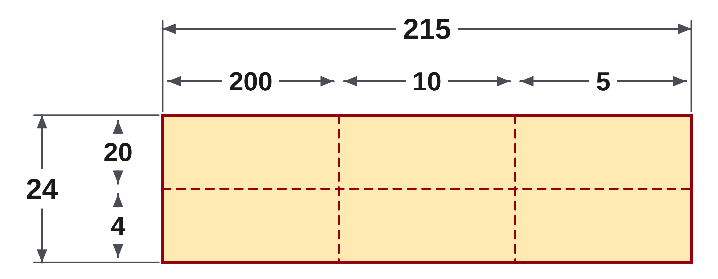
W01-L03 • PRACTISE • 9:40 AM–10:00 AM • 20 MIN TOTAL
Practise from the Exercise Book | 1A Q16
Write the operation, working and units before checking.
Textbook Chapter 1 pp.17–23
Textbook
Exercise Book
Numeracy Hub
Shape Canvas
Day 02 • 2026-10-30 • 18
Notes:
PRACTISE | 9:40 AM–10:00 AM | 20 MIN TOTAL — shared phase allocation.
For 1A Q16, work out 215 times 24. Think about twenty groups and four more groups before using the calculator. What must be carried forward when you split the multiplier? The full value 215 must be multiplied by each part. After the attempt, compare 215 times 20 plus 215 times 4 with your original method. Agreement between these forms explains the product rather than only repeating the same keys.
INSTRUCTOR ONLY — AFTER THE ATTEMPT: 5,160
Working to discuss after the attempt: 215 × 20 = 4,300 and 215 × 4 = 860; 4,300 + 860 = 5,160.

Slide 19
W01-L03 • CHECK • 10:00 AM–10:10 AM • 10 MIN TOTAL
Check independently
Complete 1A question 19 and 1B question 3 independently.
Answer independently and show the method.
Resources: Exercise Book 1A Q15–19 (p.7); 1B Q2–5 (p.8)
Textbook Chapter 1 pp.17–23
Textbook
Exercise Book
Numeracy Hub
Shape Canvas
Day 02 • 2026-10-30 • 19
Notes:
CHECK | 10:00 AM–10:10 AM | 10 MIN TOTAL — shared phase allocation.
Complete 1A Q19 and 1B Q3 independently. The first asks for an average; the second asks for a material need and a whole-box order. What is the key difference between those answers? An average describes an equal share, while an order must supply enough actual items. Show each operation and label the final quantities. Keep previous solutions closed until you have completed both attempts and justified the ordering decision.

Slide 20
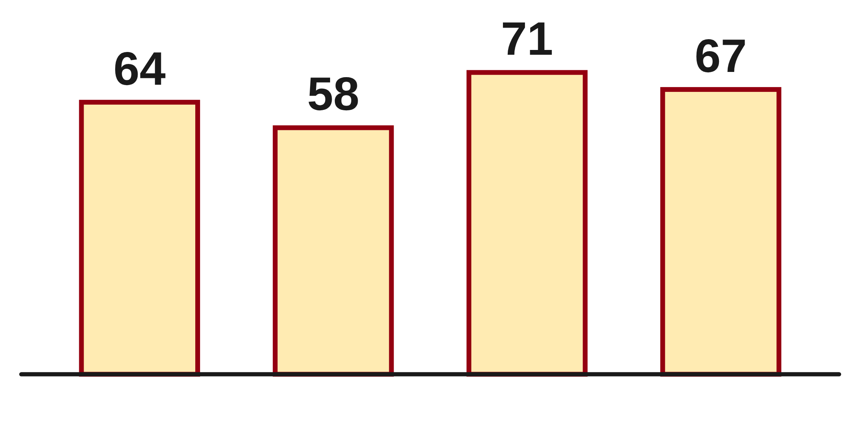
W01-L03 • CHECK • 10:00 AM–10:10 AM • 10 MIN TOTAL
Independent check | 1A Q19
Answer independently. Keep worked solutions closed.
Textbook Chapter 1 pp.17–23
Textbook
Exercise Book
Numeracy Hub
Shape Canvas
Day 02 • 2026-10-30 • 20
Notes:
CHECK | 10:00 AM–10:10 AM | 10 MIN TOTAL — shared phase allocation.
For 1A Q19, find the average of 64, 58, 71 and 67. Show the total and the number of values used. What should the divisor count? The four values being averaged. After the attempt, check that your answer lies between the smallest and largest values; a mean outside that range would signal an error. Use that check as supporting evidence, not as a replacement for the calculation.
INSTRUCTOR ONLY — AFTER THE ATTEMPT: 65
Working to discuss after the attempt: 64 + 58 + 71 + 67 = 260. There are four values, so 260 ÷ 4 = 65.

Slide 21
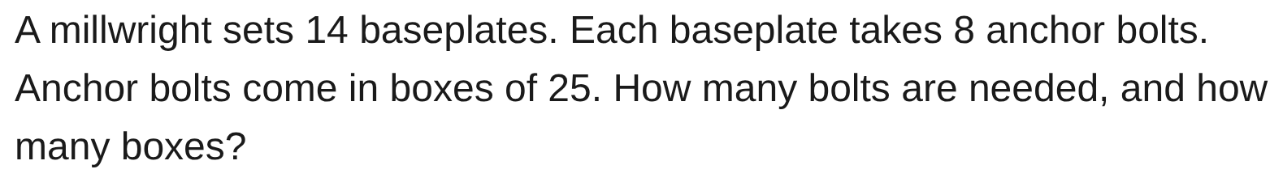
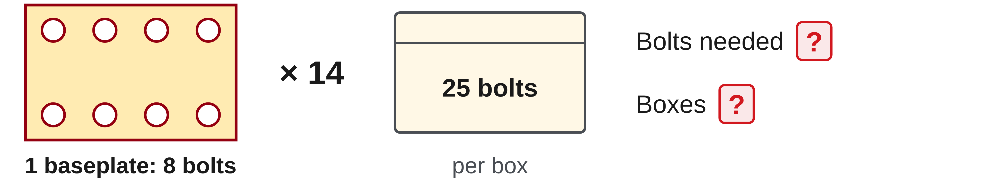
W01-L03 • CHECK • 10:00 AM–10:10 AM • 10 MIN TOTAL
Independent check | 1B Q3
Answer independently. Keep worked solutions closed.
Textbook Chapter 1 pp.17–23
Textbook
Exercise Book
Numeracy Hub
Shape Canvas
Day 02 • 2026-10-30 • 21
Notes:
CHECK | 10:00 AM–10:10 AM | 10 MIN TOTAL — shared phase allocation.
For 1B Q3, fourteen baseplates each require eight anchor bolts, and bolts come in boxes of twenty-five. Write separate answers for bolts needed and boxes purchased. Explain the order quantity rather than merely writing “round.” After the attempt, compare the supply from the proposed number of boxes with the required bolt count. The check should show why one fewer box would not cover the job.
INSTRUCTOR ONLY — AFTER THE ATTEMPT: 112 bolts, 5 boxes 14 × 8 = 112. 112 ÷ 25 = 4.48, round up to 5 boxes.
Working to discuss after the attempt: Four boxes supply 100 bolts, which is short of 112. Five boxes supply 125 bolts, covering the need with 13 left.

Slide 22
W01-L03 • WRAP UP • 10:10 AM–10:15 AM • 5 MIN TOTAL
Wrap up and choose the next step
Share one learning point and one skill to practise next.
Record a takeaway and next action.
Resources: Exercise Book 1A Q15–19 (p.7); 1B Q2–5 (p.8)
Textbook Chapter 1 pp.17–23
Textbook
Exercise Book
Numeracy Hub
Shape Canvas
Day 02 • 2026-10-30 • 22
Notes:
WRAP UP | 10:10 AM–10:15 AM | 5 MIN TOTAL — shared phase allocation.
Choose either an average or an ordering problem and explain why you divided by the number you used. A strong explanation names what that divisor counts. What have we learned about a decimal box quantity? It is a calculation on the way to an order, and a whole-box order must cover the need. Write one checking habit to keep after the break. Next we will account for stock, used lengths and the pieces that can actually be completed.

Slide 23
DAY 02 • SCHEDULED BREAK
Break
10:15 AM–10:30 AM
Return ready for: Cut-list practice and rounding
This break is excluded from teaching minutes.
Textbook
Exercise Book
Numeracy Hub
Shape Canvas
Day 02 • 2026-10-30 • 23
Notes:
Break | 10:15 AM–10:30 AM
Our break ends at 10:30. Before leaving, mark any question where the arithmetic worked but the meaning of the answer was unclear. Bring that question back into the next block. What two quantities will we distinguish next? Complete pieces obtained from fixed stock and whole units purchased to cover a need. We will use cut-list sketches to make that distinction visible.

Slide 24
W01-L04 • START • 10:30 AM–10:35 AM • 5 MIN TOTAL
Cut-list practice and rounding
Today’s goal: Solve multi-step stock problems and distinguish rounding up purchases from rounding down complete pieces.
Name one use for today’s skill.
Textbook sections 1.4–1.8 pp.14–23; sections 2.11 p.59
Exercise Book 1B Q1–5 (p.8); 1C Q1–2 (p.10)
Keep your notebook, textbook, exercise book and chosen calculator ready.
Textbook sections 1.4–1.8 pp.14–23; sections 2.11 p.59
Textbook
Exercise Book
Numeracy Hub
Shape Canvas
Day 02 • 2026-10-30 • 24
Notes:
START | 10:30 AM–10:35 AM | 5 MIN TOTAL — shared phase allocation.
Now we will account for an entire stock length. Every required piece uses some of the stock, and the offcut is what remains under the question's stated assumptions. We will also distinguish buying enough supplier units from counting full pieces that fit. Which would let us round a piece count up? Nothing, if that extra complete piece does not fit. Keep your drawing, equation and rounding explanation together so the answer describes the job correctly.

Slide 25
W01-L04 • RECALL • 10:35 AM–10:40 AM • 5 MIN TOTAL
Recall and reconnect
Explain why buying boxes and cutting full pieces need different rounding decisions. Retrieve 1A Q18 (p.7).
Try first without displayed answers.
Resources: Exercise Book 1B Q1–5 (p.8); 1C Q1–2 (p.10)
Textbook sections 1.4–1.8 pp.14–23; sections 2.11 p.59
Textbook
Exercise Book
Numeracy Hub
Shape Canvas
Day 02 • 2026-10-30 • 25
Notes:
RECALL | 10:35 AM–10:40 AM | 5 MIN TOTAL — shared phase allocation.
Why do purchases and complete-piece counts need different rounding decisions? Purchases must cover a requirement; complete pieces must fit in what is available. Retrieve 1A Q18 and identify the whole-number quotient and remainder. What does the remainder represent in a stock problem? Material left after the complete groups are counted. A partial group cannot become another full piece merely because its decimal part looks large.

Slide 26
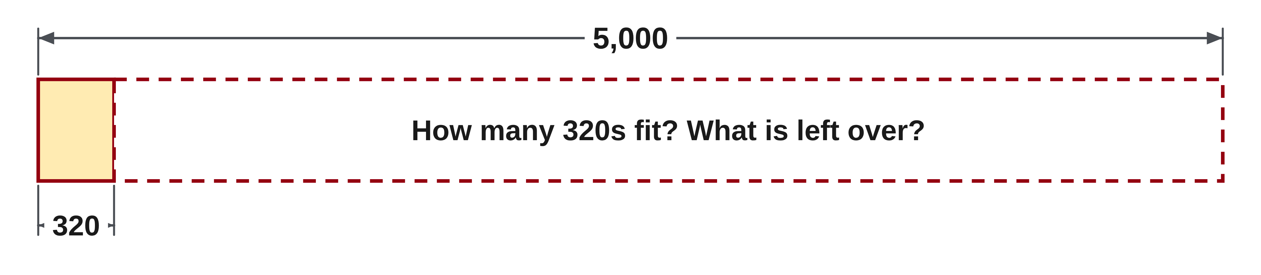
W01-L04 • RECALL • 10:35 AM–10:40 AM • 5 MIN TOTAL
Recall from the Exercise Book | 1A Q18
Write the operation, working and units before checking.
Textbook sections 1.4–1.8 pp.14–23; sections 2.11 p.59
Textbook
Exercise Book
Numeracy Hub
Shape Canvas
Day 02 • 2026-10-30 • 26
Notes:
RECALL | 10:35 AM–10:40 AM | 5 MIN TOTAL — shared phase allocation.
For 1A Q18, divide 5,000 by 320 and report a whole-number quotient with a remainder. Write a multiplication check for the whole groups, then subtract their total from 5,000. What must be true of the remainder? It must be less than one full group of 320. After the attempt, use that condition and the reconstructed total to verify your answer.
INSTRUCTOR ONLY — AFTER THE ATTEMPT: 15 remainder 200
Working to discuss after the attempt: 15 × 320 = 4,800; 5,000 − 4,800 = 200. A sixteenth whole group would need 5,120.

Slide 27
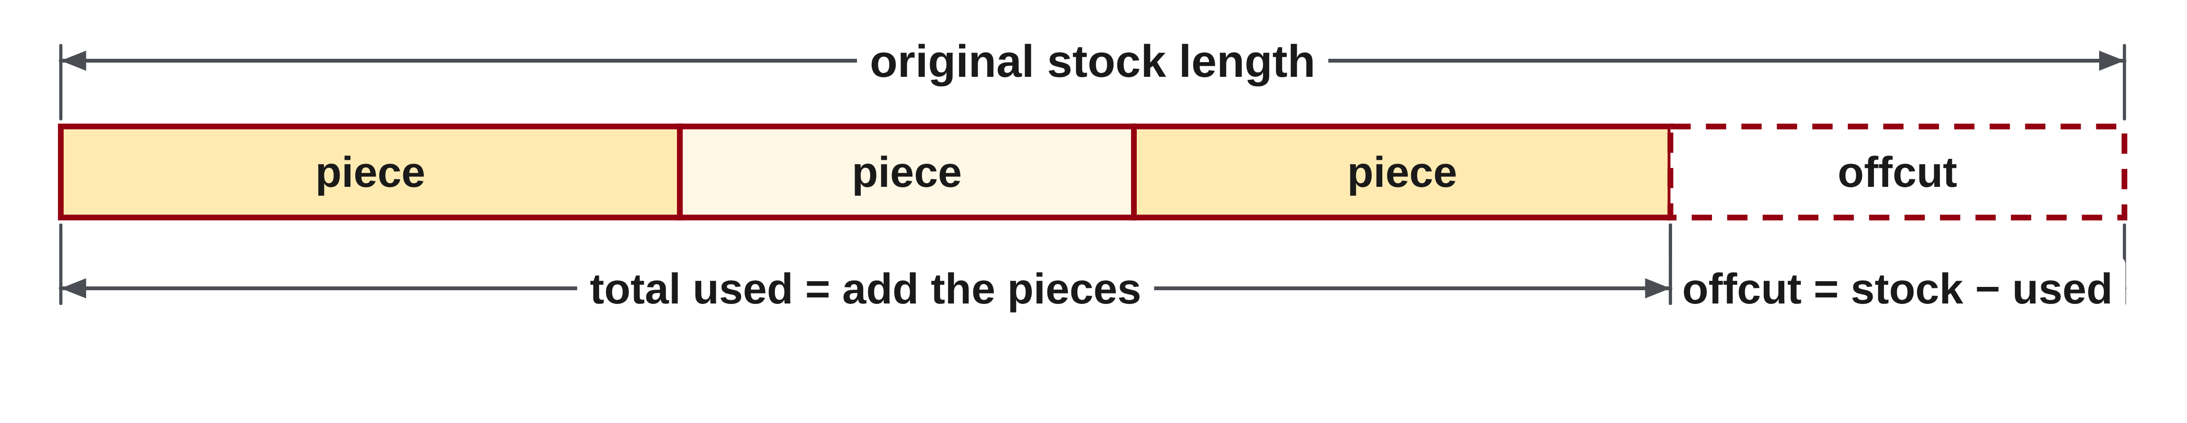
W01-L04 • TEACH • 10:40 AM–10:55 AM • 15 MIN TOTAL
Account for the stock length
1
List the original stock and every specified piece in the same unit.
2
Add the piece lengths to obtain the total used.
3
Offcut = original stock − total used.
4
Check by adding used length and offcut to restore the original stock.
Textbook sections 1.4–1.8 pp.14–23; sections 2.11 p.59
Textbook
Exercise Book
Numeracy Hub
Shape Canvas
Day 02 • 2026-10-30 • 27
Notes:
TEACH | 10:40 AM–10:55 AM | 15 MIN TOTAL — shared phase allocation.
Start by listing the original stock and every specified piece in one common unit. Add the pieces to get the total used, then subtract that total from the stock. Finally, add used length and offcut to reconstruct the starting length. Why is this last line useful? It checks that the whole stock has been accounted for without losing a piece in the calculation. Read the assumptions as well: if the question says to ignore saw cuts, use that simplification. If it states kerf, include the stated cutting loss at the appropriate stage.

Slide 28
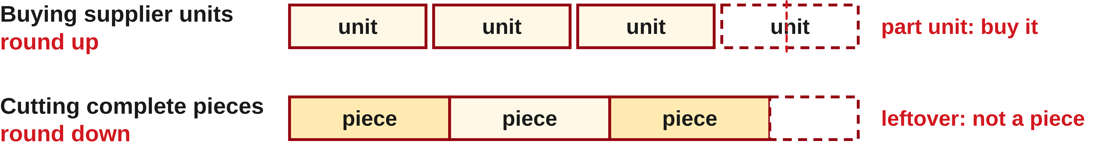
W01-L04 • TEACH • 10:40 AM–10:55 AM • 15 MIN TOTAL
Let the question choose the rounding direction
1
Buying enough whole supplier units requires rounding up.
2
Counting complete pieces from fixed stock requires rounding down.
3
Calculate the offcut from the whole pieces actually obtained.
4
A total-length calculation alone does not prove a cutting arrangement will fit.
Textbook sections 1.4–1.8 pp.14–23; sections 2.11 p.59
Textbook
Exercise Book
Numeracy Hub
Shape Canvas
Day 02 • 2026-10-30 • 28
Notes:
TEACH | 10:40 AM–10:55 AM | 15 MIN TOTAL — shared phase allocation.
The question chooses the rounding direction. When purchasing enough whole boxes or lengths, the order goes up until it covers the need. When cutting complete equal pieces from fixed stock, the count goes down to the number that actually fits. What check can settle an uncertain complete-piece count? Multiply the proposed count by the piece length and compare with the available stock. Then calculate the offcut from the count you will really obtain. A total-length estimate can guide purchasing, but it cannot by itself confirm that a set of different pieces fits a particular cutting arrangement.

Slide 29
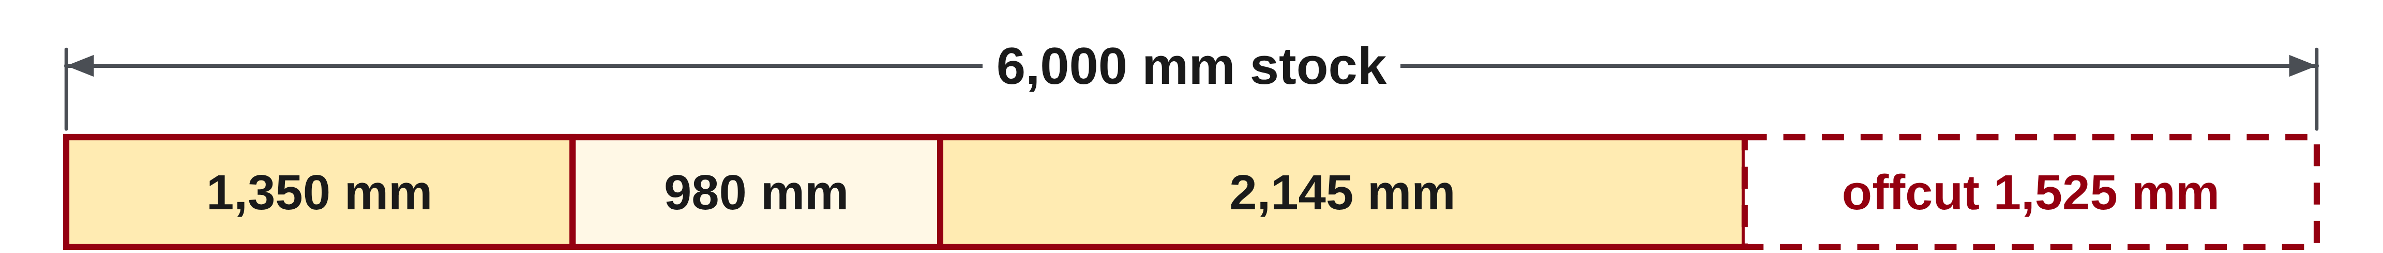
W01-L04 • TEACH • 10:40 AM–10:55 AM • 15 MIN TOTAL
Account for the whole stock length
Exercise Book 1B Q1: stock 6,000 mm; pieces 1,350, 980 and 2,145 mm.
Used = 1,350 + 980 + 2,145 = 4,475 mm
Offcut = 6,000 − 4,475 = 1,525 mm
Check: 4,475 + 1,525 = 6,000 mm
Complete-piece example, ignoring kerf: 100 in ÷ 18 in = 5 full pieces.
Offcut = 100 − 5 × 18 = 10 in. A sixth full piece does not fit.
Together: 1B Q2–3. Identify given quantities, choose operations and justify rounding. Add kerf only when stated; never assume a cutting layout is feasible from a total alone.
Math Week 1 L4 • Shape Canvas: three labelled rectangles and original stock length
Textbook
Exercise Book
Numeracy Hub
Shape Canvas
Day 02 • 2026-10-30 • 29
Notes:
TEACH | 10:40 AM–10:55 AM | 15 MIN TOTAL — shared phase allocation.
For 1B Q1, the three pieces total 1,350 plus 980 plus 2,145, which is 4,475 mm. Subtracting from 6,000 leaves 1,525 mm, and adding those two amounts restores the stock length. In the second example, 100 inches divided by 18 inches gives five complete pieces. Five use ninety inches, leaving ten. Could a sixth fit? Six would require 108 inches, more than the stock. That practical comparison explains why we keep five complete pieces, ignoring kerf as this classroom example states.

Slide 30
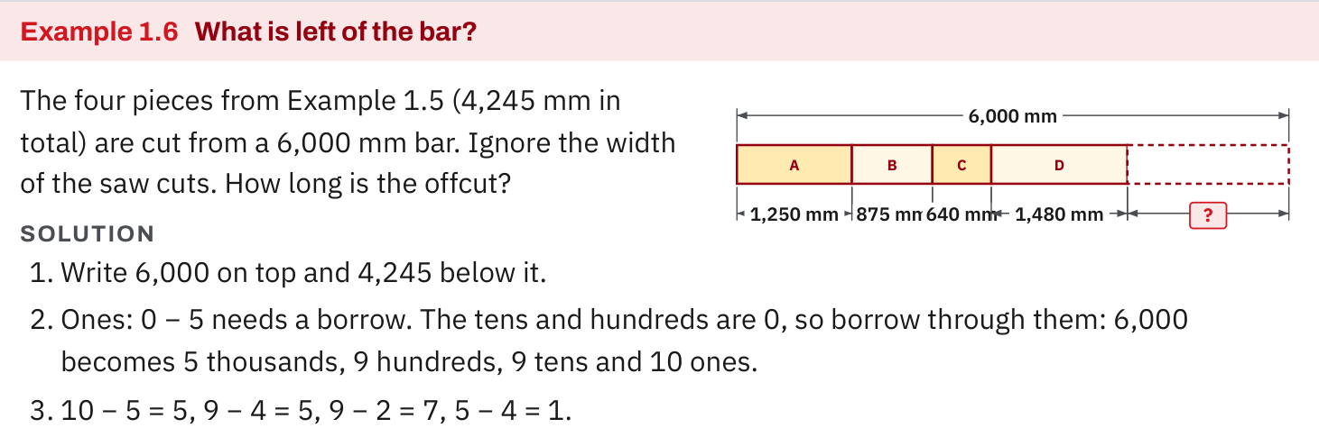
W01-L04 • TEACH • 10:40 AM–10:55 AM • 15 MIN TOTAL
Textbook | page 16
Textbook p.16 · Example 1.6: used length and offcut account for the original stock.
Textbook sections 1.4–1.8 pp.14–23; sections 2.11 p.59
Textbook
Exercise Book
Numeracy Hub
Shape Canvas
Day 02 • 2026-10-30 • 30
Notes:
TEACH | 10:40 AM–10:55 AM | 15 MIN TOTAL — shared phase allocation.
Example 1.6 uses four pieces totalling 4,245 mm from a 6,000 mm bar. Subtraction gives an offcut of 1,755 mm. The textbook shows borrowing across the zeros, but the meaning remains simple: remove the used length from the starting stock. How do we check the answer? Add 4,245 and 1,755 to restore 6,000 mm. Notice that these are the textbook's four pieces, not the three different values from our preceding exercise example. Reading the current diagram prevents us from carrying a remembered total into the wrong problem.

Slide 31
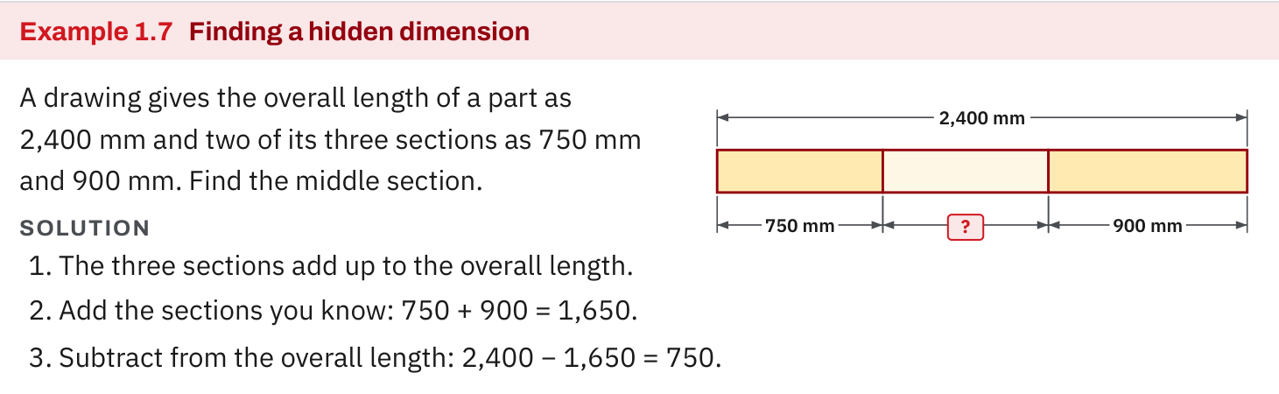
W01-L04 • TEACH • 10:40 AM–10:55 AM • 15 MIN TOTAL
Textbook | page 16
Textbook p.16 · Example 1.7: known parts and a hidden dimension.
Textbook sections 1.4–1.8 pp.14–23; sections 2.11 p.59
Textbook
Exercise Book
Numeracy Hub
Shape Canvas
Day 02 • 2026-10-30 • 31
Notes:
TEACH | 10:40 AM–10:55 AM | 15 MIN TOTAL — shared phase allocation.
Example 1.7 shows an overall length of 2,400 mm, with two known sections of 750 mm and 900 mm. Add the known sections: 750 plus 900 equals 1,650. The hidden middle section is the remaining 2,400 minus 1,650, or 750 mm. Which line verifies the drawing? 750 plus 750 plus 900 equals 2,400 mm. We can also subtract the two known parts in sequence. Both methods account for the same overall length; the sketch tells us which dimensions belong together.

Slide 32
W01-L04 • TEACH • 10:40 AM–10:55 AM • 15 MIN TOTAL
Spot the mistake. Explain the correction.
100 in ÷ 18 in is about 5.56. Can the stock produce 6 complete 18 in pieces?
Discuss the method before checking the answer.
No. Six pieces need 108 in. Five complete pieces use 90 in, leaving 10 in, ignoring kerf.
Textbook sections 1.4–1.8 pp.14–23; sections 2.11 p.59
Textbook
Exercise Book
Numeracy Hub
Shape Canvas
Day 02 • 2026-10-30 • 32
Notes:
TEACH | 10:40 AM–10:55 AM | 15 MIN TOTAL — shared phase allocation.
The decimal quotient 5.56 does not mean six complete 18-inch pieces fit into 100 inches. Six times eighteen is 108 inches, so that claim needs more material than exists. Five pieces use ninety inches and leave ten, with saw cuts ignored in this example. What does the fractional part describe? A fraction of another piece's required length, not another completed piece. Compare the actual proposed length with the stock before deciding. Ordinary rounding to the nearest whole number is not the rule for counting complete pieces.

Slide 33
W01-L04 • TOGETHER • 10:55 AM–11:10 AM • 15 MIN TOTAL
Work together
Work Exercise Book 1B Q2–3 in pairs. Mark given quantities, choose operations, and justify purchase rounding.
Work in pairs; alternate solver and checker.
Resources: Exercise Book 1B Q1–5 (p.8); 1C Q1–2 (p.10)
Textbook sections 1.4–1.8 pp.14–23; sections 2.11 p.59
Textbook
Exercise Book
Numeracy Hub
Shape Canvas
Day 02 • 2026-10-30 • 33
Notes:
TOGETHER | 10:55 AM–11:10 AM | 15 MIN TOTAL — shared phase allocation.
Work through 1B questions 2 and 3 again, focusing this time on explaining the whole-unit purchase. Mark the given quantities and label the calculated need before rounding the order. Why is “I rounded up” incomplete as an explanation? It needs a reason: one fewer whole supplier unit would provide less than the calculated need. Use multiplication to demonstrate that shortage and show that the chosen order covers it under the exercise's stated assumptions.

Slide 34
W01-L04 • TOGETHER • 10:55 AM–11:10 AM • 15 MIN TOTAL
Guided practice | 1B Q2
Work with a partner. Take turns explaining the next step.
Textbook sections 1.4–1.8 pp.14–23; sections 2.11 p.59
Textbook
Exercise Book
Numeracy Hub
Shape Canvas
Day 02 • 2026-10-30 • 34
Notes:
TOGETHER | 10:55 AM–11:10 AM | 15 MIN TOTAL — shared phase allocation.
Revisit 1B Q2 with your partner. Total the five pipe runs, then divide by the 21-foot supplier length. Keep “feet needed” separate from “supplier lengths” in your working. What can the multiplication check prove here? Whether the aggregate supplied length covers the aggregate total. It cannot prove an individual cutting layout. State that limitation while you complete the exercise's purchase estimate, which ignores fittings and waste.
INSTRUCTOR ONLY — AFTER THE ATTEMPT: 61 ft. 61 ÷ 21 = 2.9, so buy 3 lengths. Round up: a part length still has to be bought.
Working to discuss after the attempt: 12 + 9 + 15 + 7 + 18 = 61 ft. 61 ÷ 21 is approximately 2.90. Three lengths supply 63 ft. This is the exercise's aggregate estimate, not proof that its individual runs fit a cutting layout.

Slide 35
W01-L04 • TOGETHER • 10:55 AM–11:10 AM • 15 MIN TOTAL
Compare your method | 1B Q2
CHECK TOGETHER
61 ft. 61 ÷ 21 = 2.9, so buy 3 lengths.
Round up: a part length still has to be bought.
Textbook sections 1.4–1.8 pp.14–23; sections 2.11 p.59
Textbook
Exercise Book
Numeracy Hub
Shape Canvas
Day 02 • 2026-10-30 • 35
Notes:
TOGETHER | 10:55 AM–11:10 AM | 15 MIN TOTAL — shared phase allocation.
The total is 61 feet, and 61 divided by 21 is about 2.9, so the textbook's aggregate purchase estimate is three lengths. Three times twenty-one supplies 63 feet. Why is two insufficient? It supplies only 42 feet. Keep the two-foot aggregate surplus labelled as such; separate pipe runs still need a feasible arrangement. This distinction lets us give the exercise's arithmetic answer without pretending that total footage is a completed cutting plan.
INSTRUCTOR ONLY — AFTER THE ATTEMPT: 61 ft. 61 ÷ 21 = 2.9, so buy 3 lengths. Round up: a part length still has to be bought.
Working to discuss after the attempt: 12 + 9 + 15 + 7 + 18 = 61 ft. 61 ÷ 21 is approximately 2.90. Three lengths supply 63 ft. This is the exercise's aggregate estimate, not proof that its individual runs fit a cutting layout.

Slide 36
W01-L04 • PRACTISE • 11:10 AM–11:45 AM • 35 MIN TOTAL
Your scheduled practice
Solve Exercise Book 1B Q4–5 and 1C Q1–2. Recreate one cut-list sketch on Shape Canvas; write the equation before checking. Use extra time to correct and explain a second method.
Show working and units; estimate, then check.
Resources: Exercise Book 1B Q1–5 (p.8); 1C Q1–2 (p.10)
Textbook sections 1.4–1.8 pp.14–23; sections 2.11 p.59
Textbook
Exercise Book
Numeracy Hub
Shape Canvas
Day 02 • 2026-10-30 • 36
Notes:
PRACTISE | 11:10 AM–11:45 AM | 35 MIN TOTAL — shared phase allocation.
Solve 1B questions 4–5 and 1C questions 1–2. For one cut-list problem, rebuild the sketch in Shape Canvas and write the equation on paper before checking it. What should your drawing make easy to see? The original stock, each stated part and the remaining quantity. Use extra time to correct a mistake and explain a second method. Preserve the original attempt so the improvement in reasoning is visible.

Slide 37
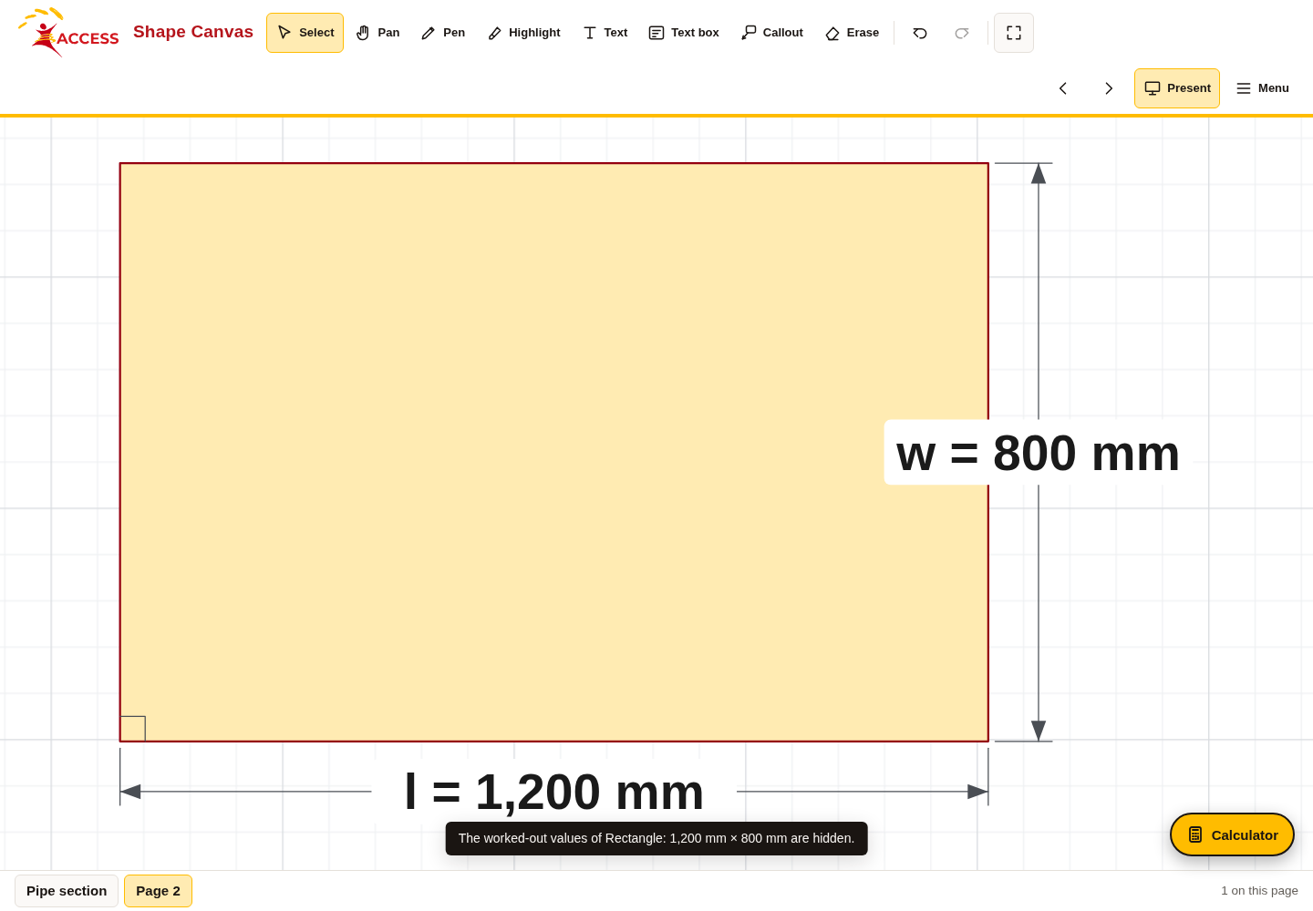
W01-L04 • PRACTISE • 11:10 AM–11:45 AM • 35 MIN TOTAL
Open Shape Canvas
Navigation example. Use the values and units in the assigned task.
Textbook sections 1.4–1.8 pp.14–23; sections 2.11 p.59
Textbook
Exercise Book
Numeracy Hub
Shape Canvas
Day 02 • 2026-10-30 • 37
Notes:
PRACTISE | 11:10 AM–11:45 AM | 35 MIN TOTAL — shared phase allocation.
Open Shape Canvas and use rectangles to represent the cut pieces. The navigation image shows how to work with labelled shapes; enter the values from the assigned question rather than copying unrelated example labels. Add a text label for the stock length. Which information matters more than the drawn width on your screen? The stated dimensions. We are using the diagram to organise quantities and check the cut-list equation.

Slide 38
W01-L04 • PRACTISE • 11:10 AM–11:45 AM • 35 MIN TOTAL
Practise in Numeracy Hub and Shape Canvas
1
Supported: In Shape Canvas, add three rectangles for the cut pieces and label their lengths.
2
Independent practice: Add a Text label for the original stock; write the cut-list equation on paper.
3
Independent checking: Verify the totals in Numeracy Hub Calculator and reconstruct the stock length.
Textbook sections 1.4–1.8 pp.14–23; sections 2.11 p.59
Textbook
Exercise Book
Numeracy Hub
Shape Canvas
Day 02 • 2026-10-30 • 38
Notes:
PRACTISE | 11:10 AM–11:45 AM | 35 MIN TOTAL — shared phase allocation.
Place three labelled rectangles for the pieces, then add the original stock length as a text label. On paper, add the piece lengths and subtract the used total from the stock. Next use Numeracy Hub Calculator to verify the arithmetic. How can you reconstruct the original stock? Add the used amount and the offcut, including any loss only where the problem states it. This final line connects the numerical check back to the drawing.

Slide 39
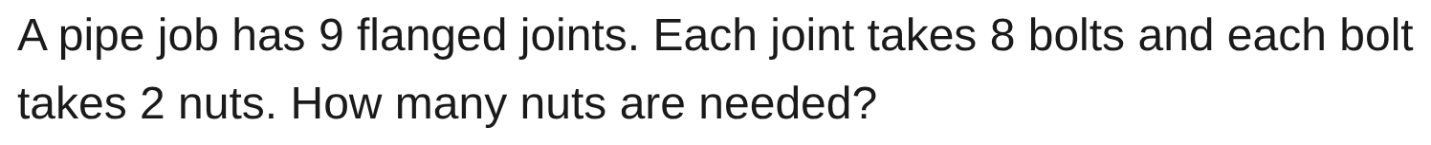
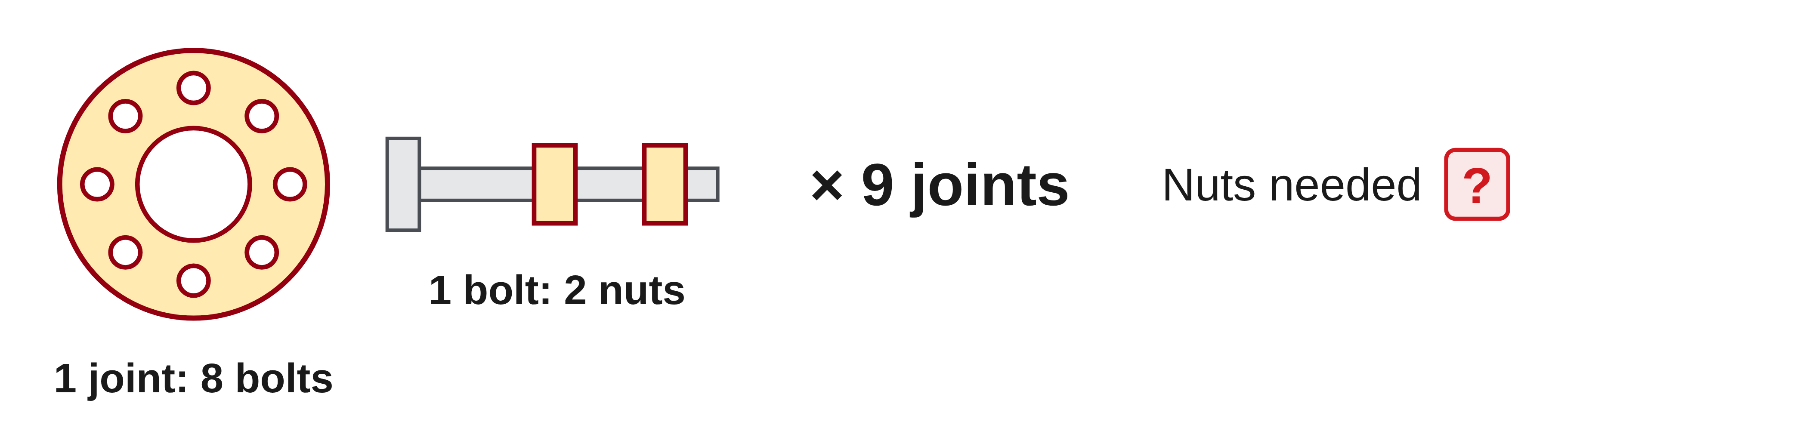
W01-L04 • PRACTISE • 11:10 AM–11:45 AM • 35 MIN TOTAL
Practise from the Exercise Book | 1B Q4
Write the operation, working and units before checking.
Textbook sections 1.4–1.8 pp.14–23; sections 2.11 p.59
Textbook
Exercise Book
Numeracy Hub
Shape Canvas
Day 02 • 2026-10-30 • 39
Notes:
PRACTISE | 11:10 AM–11:45 AM | 35 MIN TOTAL — shared phase allocation.
For 1B Q4, there are nine flanged joints, eight bolts per joint and two nuts per bolt. What does the first multiplication count? Bolts. What does the next multiplication count? Nuts. Keep those labels beside the intermediate quantities so you do not stop after finding the bolts. Attempt the full chain before comparing the answer, then explain why each factor is present.
INSTRUCTOR ONLY — AFTER THE ATTEMPT: 144 nuts
Working to discuss after the attempt: 9 × 8 = 72 bolts. Each takes 2 nuts, so 72 × 2 = 144 nuts.

Slide 40
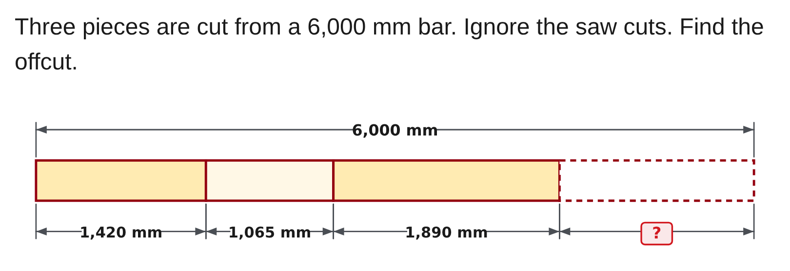
W01-L04 • PRACTISE • 11:10 AM–11:45 AM • 35 MIN TOTAL
Practise from the Exercise Book | 1C Q1
Write the operation, working and units before checking.
Textbook sections 1.4–1.8 pp.14–23; sections 2.11 p.59
Textbook
Exercise Book
Numeracy Hub
Shape Canvas
Day 02 • 2026-10-30 • 40
Notes:
PRACTISE | 11:10 AM–11:45 AM | 35 MIN TOTAL — shared phase allocation.
For 1C Q1, read the diagram's three pieces: 1,420 mm, 1,065 mm and 1,890 mm. The stock is 6,000 mm and saw cuts are ignored. Add the piece lengths before finding the remaining offcut. Which relationship will verify your result? Used length plus offcut must equal 6,000 mm. Try the calculation before checking the answer; make sure you use this diagram's values, not an earlier worked example.
INSTRUCTOR ONLY — AFTER THE ATTEMPT: 1,625 mm
Working to discuss after the attempt: 1,420 + 1,065 + 1,890 = 4,375 mm used. 6,000 − 4,375 = 1,625 mm offcut. Check: 4,375 + 1,625 = 6,000 mm.

Slide 41
W01-L04 • CHECK • 11:45 AM–11:55 AM • 10 MIN TOTAL
Check independently
Rework Exercise Book 1B Q3 and Q5 independently; explain why the two rounding directions differ.
Answer independently and show the method.
Resources: Exercise Book 1B Q1–5 (p.8); 1C Q1–2 (p.10)
Textbook sections 1.4–1.8 pp.14–23; sections 2.11 p.59
Textbook
Exercise Book
Numeracy Hub
Shape Canvas
Day 02 • 2026-10-30 • 41
Notes:
CHECK | 11:45 AM–11:55 AM | 10 MIN TOTAL — shared phase allocation.
Rework 1B questions 3 and 5 independently. One asks for enough boxes of bolts, while the other asks how many complete 18-inch pieces can be cut. Explain why the rounding directions differ. What evidence should appear beside each decision? For the boxes, the supply must cover the need; for the pieces, the total used must not exceed the stock. Show those comparisons and keep solutions closed during the attempt.

Slide 42
W01-L04 • CHECK • 11:45 AM–11:55 AM • 10 MIN TOTAL
Independent check | 1B Q3
Answer independently. Keep worked solutions closed.
Textbook sections 1.4–1.8 pp.14–23; sections 2.11 p.59
Textbook
Exercise Book
Numeracy Hub
Shape Canvas
Day 02 • 2026-10-30 • 42
Notes:
CHECK | 11:45 AM–11:55 AM | 10 MIN TOTAL — shared phase allocation.
For 1B Q3, find the bolts needed for fourteen baseplates, then the whole-box order when each box contains twenty-five. Give both quantities and a sentence explaining the order. After the attempt, show why the next lower box count would be short. The arithmetic alone does not explain the purchase decision; the comparison between supplied bolts and required bolts does.
INSTRUCTOR ONLY — AFTER THE ATTEMPT: 112 bolts, 5 boxes 14 × 8 = 112. 112 ÷ 25 = 4.48, round up to 5 boxes.
Working to discuss after the attempt: Four boxes supply 100 bolts, which is short of 112. Five boxes supply 125 bolts, covering the need with 13 left.

Slide 43
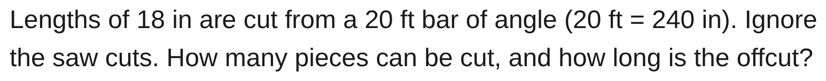
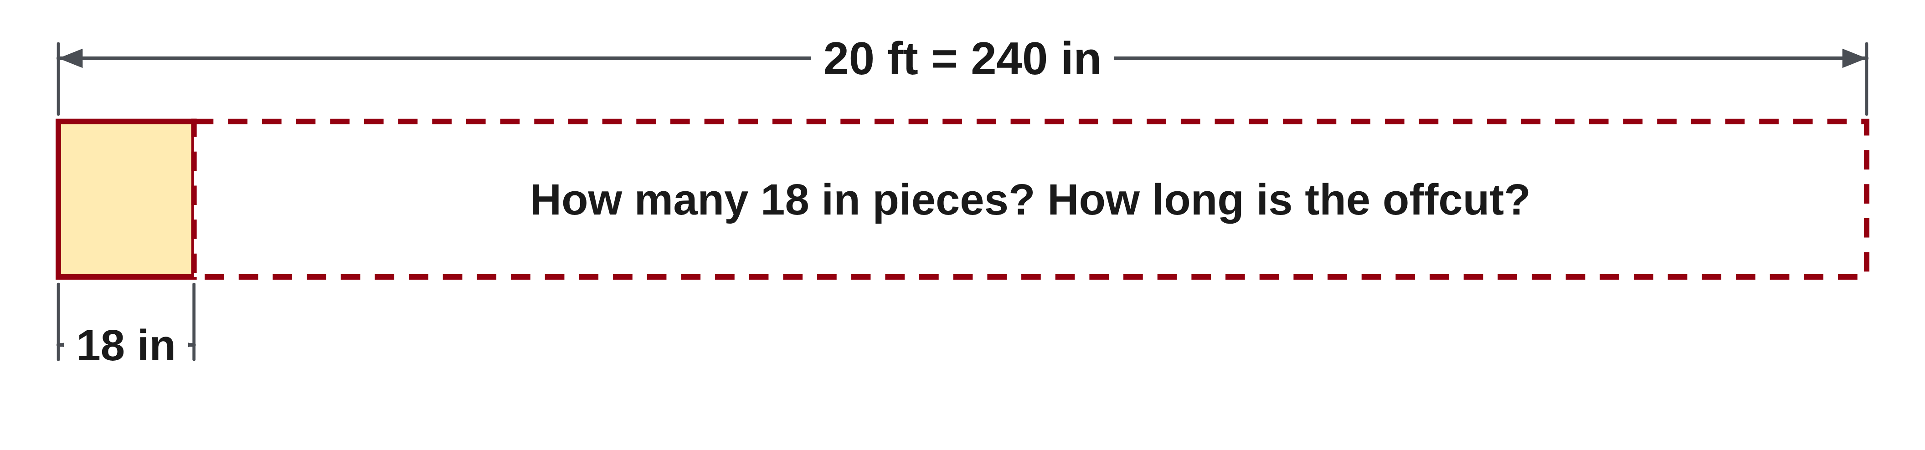
W01-L04 • CHECK • 11:45 AM–11:55 AM • 10 MIN TOTAL
Independent check | 1B Q5
Answer independently. Keep worked solutions closed.
Textbook sections 1.4–1.8 pp.14–23; sections 2.11 p.59
Textbook
Exercise Book
Numeracy Hub
Shape Canvas
Day 02 • 2026-10-30 • 43
Notes:
CHECK | 11:45 AM–11:55 AM | 10 MIN TOTAL — shared phase allocation.
For 1B Q5, use the supplied conversion of twenty feet to 240 inches. Count complete 18-inch pieces, ignoring saw cuts, and calculate the offcut from that whole-piece count. What comparison rules out the next complete piece? Its total required length would exceed 240 inches. Make the decision before checking the worked answer, then reconstruct the original stock from used length and offcut.
INSTRUCTOR ONLY — AFTER THE ATTEMPT: 13 pieces, offcut 6 in 240 ÷ 18 = 13.33. 13 × 18 = 234. 240 − 234 = 6.
Working to discuss after the attempt: A fourteenth complete piece would require 14 × 18 = 252 in, exceeding 240 in. Check the actual result: 234 + 6 = 240 in.

Slide 44
W01-L04 • WRAP UP • 11:55 AM–12:00 PM • 5 MIN TOTAL
Wrap up and choose the next step
Share one learning point and one skill to practise next.
Record a takeaway and next action.
Resources: Exercise Book 1B Q1–5 (p.8); 1C Q1–2 (p.10)
Textbook sections 1.4–1.8 pp.14–23; sections 2.11 p.59
Textbook
Exercise Book
Numeracy Hub
Shape Canvas
Day 02 • 2026-10-30 • 44
Notes:
WRAP UP | 11:55 AM–12:00 PM | 5 MIN TOTAL — shared phase allocation.
Explain the two rounding decisions in your own words: buy enough whole units, but count only complete pieces that fit. Choose a stock problem and point to the check that reconstructs the original amount. Which step will you practise next: translating the problem, adding the pieces, calculating the remainder or justifying the rounding? Write that target beside one corrected solution. Next time we will use brackets to make multi-step calculations communicate their intended order.

