Slide 1

CARPENTRY FOUNDATION / INTAKE 142
Day 05 | Wednesday
05
November 4, 2026
Fractions and inch-tape markings
9:00 AM–10:15 AM • Math • 75 min
Tape and rule reading practice
10:30 AM–12:00 PM • Math • 90 min
Week 2 • 2 scheduled blocks • 165 teaching minutes
Estimate. Show the method. Label units. Check the result.
Textbook
Exercise Book
Numeracy Hub
Shape Canvas
Day 05 • 2026-11-04 • 01
Notes:
Opening overview | 9:00 AM–9:05 AM | Within the 5-minute Start phase.
Today we will connect fractions to the marks on an inch tape or rule. First we will read equal spaces, simplify fractions and compare lengths. After the break, we will practise saying and recording complete readings consistently. What can go wrong if we record only the fraction past a whole-inch mark? We lose the whole inches and describe a different length. Keep an actual rule nearby so the diagrams, fraction names and physical marks can support one another.

Slide 2
DAY 05 / WEEK 2 / CLASS TIMETABLE
Today’s exact schedule
9:00 AM–10:15 AM • 75 min
10:30 AM–12:00 PM • 90 min
Fractions and inch-tape markings
Tape and rule reading practice
9:00 AM–9:05 AM
Start
5
10:30 AM–10:35 AM
Start
5
9:05 AM–9:10 AM
Recall
5
10:35 AM–10:40 AM
Recall
5
9:10 AM–9:25 AM
Teach
15
10:40 AM–10:55 AM
Teach
15
9:25 AM–9:40 AM
Together
15
10:55 AM–11:10 AM
Together
15
9:40 AM–10:00 AM
Practise
20
11:10 AM–11:45 AM
Practise
35
10:00 AM–10:10 AM
Check
10
11:45 AM–11:55 AM
Check
10
10:10 AM–10:15 AM
Wrap up
5
11:55 AM–12:00 PM
Wrap up
5
Math • Math Week 2, Lesson 5
Math • Math Week 2, Lesson 6
Break: 10:15 AM–10:30 AM • 15 minutes • excluded from teaching time
Textbook
Exercise Book
Numeracy Hub
Shape Canvas
Day 05 • 2026-11-04 • 02
Notes:
Opening overview | 9:00 AM–9:05 AM | Within the 5-minute Start phase.
The first block runs from 9:00 to 10:15, followed by a break until 10:30. Tape and rule practice then continues until noon, with a longer independent practice period. What will our partner checking sound like? One person points to a mark, and the other says the whole inches, fractional part and unit. Each block also includes an independent check so you can see whether your own reading method is becoming consistent.

Slide 3
W02-L05 • START • 9:00 AM–9:05 AM • 5 MIN TOTAL
Fractions and inch-tape markings
Today’s goal: Read inch graduations, reduce fractions and compare fractional lengths using a common denominator.
Name one use for today’s skill.
Textbook sections 4.1–4.4 pp.88–94; sections 4.5 pp.95–96
Exercise Book 4A Q1–4 (p.35), Q6–11 (p.36)
Keep your notebook, textbook, exercise book and chosen calculator ready.
Textbook sections 4.1–4.4 pp.88–94; sections 4.5 pp.95–96
Textbook
Exercise Book
Numeracy Hub
Shape Canvas
Day 05 • 2026-11-04 • 03
Notes:
START | 9:00 AM–9:05 AM | 5 MIN TOTAL — shared phase allocation.
Our goal is to read inch graduations, reduce fractions and compare lengths using a common denominator. These are connected skills: a rule shows equal divisions, and a fraction names how many of those divisions we have. Where might a carpenter need two different fraction names for the same length? A drawing may use eighths while a rule is marked in sixteenths. Open exercise book 4A and keep the textbook's inch-rule examples available as a reference.

Slide 4
W02-L05 • RECALL • 9:05 AM–9:10 AM • 5 MIN TOTAL
Recall and reconnect
Try to locate 1/2, 1/4 and 1/8 on an inch rule; use Exercise Book 4A Q1 to check fraction vocabulary.
Try first without displayed answers.
Resources: Exercise Book 4A Q1–4 (p.35), Q6–11 (p.36)
Textbook sections 4.1–4.4 pp.88–94; sections 4.5 pp.95–96
Textbook
Exercise Book
Numeracy Hub
Shape Canvas
Day 05 • 2026-11-04 • 04
Notes:
RECALL | 9:05 AM–9:10 AM | 5 MIN TOTAL — shared phase allocation.
Locate one-half, one-quarter and one-eighth on an actual inch rule. Which is farthest from zero? One-half, because it is the largest of those three lengths. Now identify the numerator and denominator in a fraction. The denominator names the equal divisions in one whole, and the numerator counts how many are selected. Use exercise book 4A Q1 to check that vocabulary against its shaded diagram rather than relying only on the names.

Slide 5
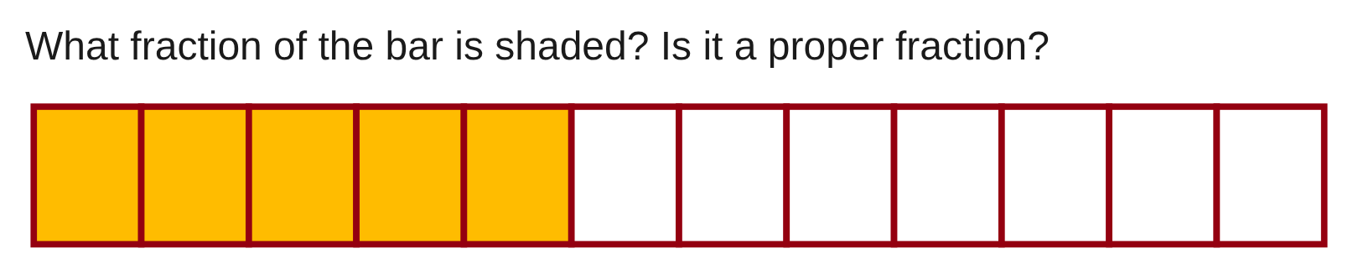
W02-L05 • RECALL • 9:05 AM–9:10 AM • 5 MIN TOTAL
Recall from the Exercise Book | 4A Q1
Write the operation, working and units before checking.
Textbook sections 4.1–4.4 pp.88–94; sections 4.5 pp.95–96
Textbook
Exercise Book
Numeracy Hub
Shape Canvas
Day 05 • 2026-11-04 • 05
Notes:
RECALL | 9:05 AM–9:10 AM | 5 MIN TOTAL — shared phase allocation.
For 4A Q1, count all the equal parts of the bar, then count the shaded parts. Which count belongs in the denominator? All equal parts in the whole bar. Write the fraction and decide whether it is proper. After the attempt, explain that a proper fraction represents less than one whole because its numerator is smaller than its denominator. The shaded length and the written fraction should describe the same part of the bar.
INSTRUCTOR ONLY — AFTER THE ATTEMPT: 5/12. Yes, the numerator is smaller than the denominator.
Working to discuss after the attempt: Five of twelve equal parts are shaded. Since 5 < 12, the shaded amount is less than one whole bar.

Slide 6
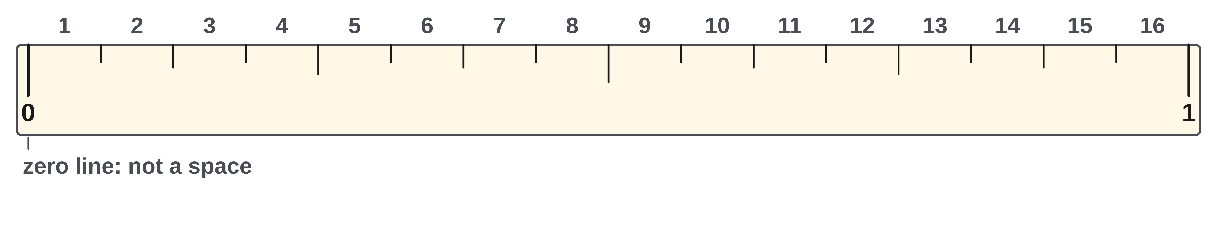
W02-L05 • TEACH • 9:10 AM–9:25 AM • 15 MIN TOTAL
Read an inch as equal spaces
1
Start at zero and find the smallest marked graduation.
2
The denominator tells how many equal spaces make one inch.
3
Count spaces to the mark; the zero line is not the first space.
4
Read whole inches first, then the fractional part.
Textbook sections 4.1–4.4 pp.88–94; sections 4.5 pp.95–96
Textbook
Exercise Book
Numeracy Hub
Shape Canvas
Day 05 • 2026-11-04 • 06
Notes:
TEACH | 9:10 AM–9:25 AM | 15 MIN TOTAL — shared phase allocation.
Begin by locating zero and identifying the smallest marked graduation. If one inch contains sixteen equal spaces, each space represents one-sixteenth inch. Count spaces from the whole-inch mark to the point, not the starting line as a space. Why does counting the zero line as one cause an error? It adds a space that has not been travelled. For a mark beyond one inch, read the whole inches first and then the remaining fraction. The denominator describes the scale's divisions, while the numerator records how many of those spaces you counted.

Slide 7
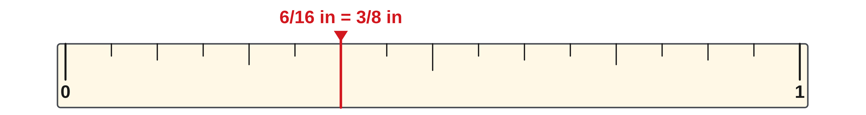
W02-L05 • TEACH • 9:10 AM–9:25 AM • 15 MIN TOTAL
Rename the fraction without moving the mark
1
The numerator counts selected spaces; the denominator names their size.
2
Divide top and bottom by the same factor to reduce a fraction.
3
Equivalent fractions label the same position on the rule.
4
Use a common denominator before comparing two fractional lengths.
Textbook sections 4.1–4.4 pp.88–94; sections 4.5 pp.95–96
Textbook
Exercise Book
Numeracy Hub
Shape Canvas
Day 05 • 2026-11-04 • 07
Notes:
TEACH | 9:10 AM–9:25 AM | 15 MIN TOTAL — shared phase allocation.
A fraction's numerator counts selected equal spaces; its denominator tells the size of those spaces. To reduce a fraction, divide both numbers by the same factor. Six sixteenths becomes three eighths because both six and sixteen divide by two. Did the point on the rule move? No: only its name changed. To compare two lengths, rename them with a common denominator so their spaces have the same size. Comparing numerators is meaningful only after we know they count equal-sized parts of the same whole.

Slide 8
W02-L05 • TEACH • 9:10 AM–9:25 AM • 15 MIN TOTAL
Count spaces, then simplify
Schematic inch rule—not a physical measuring scale.
0
4/16
= 1/4
8/16
= 1/2
12/16
= 3/4
1 in
Six spaces = 6/16 in = 3/8 in
Together: 4A Q3 and Q6–7. Point to each mark and explain equivalent names. Use Numeracy Hub Measuring Tools and an actual rule.
W2 L5 • Read labels, not screen size • Shape Canvas in inch units
Textbook
Exercise Book
Numeracy Hub
Shape Canvas
Day 05 • 2026-11-04 • 08
Notes:
TEACH | 9:10 AM–9:25 AM | 15 MIN TOTAL — shared phase allocation.
This schematic rule divides an inch into sixteen spaces. Four spaces give 4/16, which reduces to 1/4. Eight give 8/16, or 1/2, and twelve give 12/16, or 3/4. Now count six spaces: 6/16 reduces to 3/8. Why do all these names describe positions on the same rule? Each fraction is a different count of the same sixteen equal parts, and reducing preserves its value. The projection may be enlarged, so read the marks and labels rather than treating the screen as a physical inch.

Slide 9
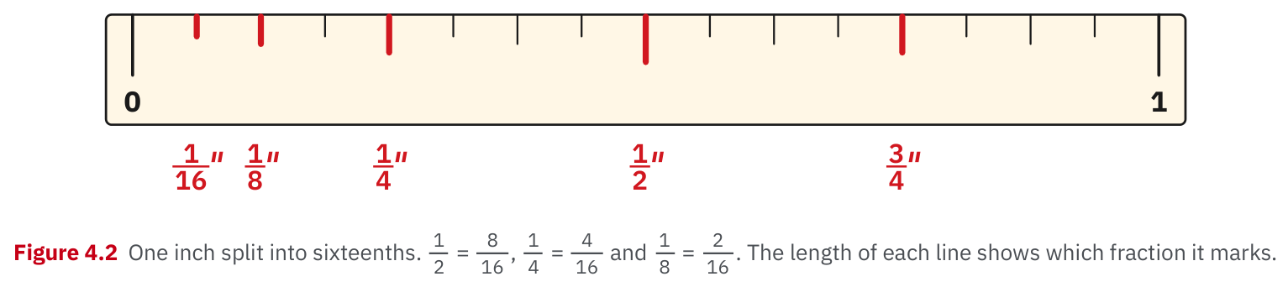
W02-L05 • TEACH • 9:10 AM–9:25 AM • 15 MIN TOTAL
Textbook | page 89
Textbook p.89 · Figure 4.2: one inch divided into sixteenths.
Textbook sections 4.1–4.4 pp.88–94; sections 4.5 pp.95–96
Textbook
Exercise Book
Numeracy Hub
Shape Canvas
Day 05 • 2026-11-04 • 09
Notes:
TEACH | 9:10 AM–9:25 AM | 15 MIN TOTAL — shared phase allocation.
Figure 4.2 on page 89 shows the visual pattern within one inch. Whole-inch lines are longest, the half-inch line is prominent, and shorter lines distinguish quarters, eighths and sixteenths. What does that pattern help you do? Find a familiar landmark before counting smaller spaces. Half an inch is eight sixteenths, a quarter is four sixteenths and an eighth is two sixteenths. Use both the line pattern and the counted spaces as checks, but identify the scale first because another edge of a rule may use different graduations.

Slide 10
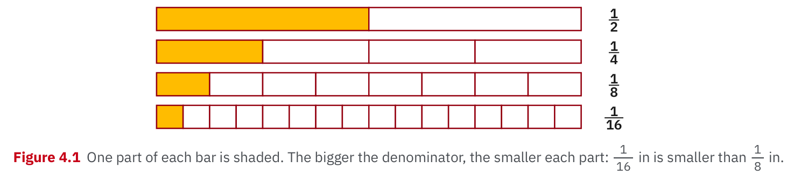
W02-L05 • TEACH • 9:10 AM–9:25 AM • 15 MIN TOTAL
Textbook | page 88
Textbook p.88 · Figure 4.1: larger denominators mean smaller equal parts.
Textbook sections 4.1–4.4 pp.88–94; sections 4.5 pp.95–96
Textbook
Exercise Book
Numeracy Hub
Shape Canvas
Day 05 • 2026-11-04 • 10
Notes:
TEACH | 9:10 AM–9:25 AM | 15 MIN TOTAL — shared phase allocation.
Figure 4.1 compares one-half, one-quarter, one-eighth and one-sixteenth of the same whole length. As the denominator increases, the whole is split into more equal pieces, so each individual piece becomes smaller. Which is longer: one-eighth inch or one-sixteenth inch? One-eighth, because two sixteenths make an eighth. This is why treating fraction denominators like ordinary whole-number size comparisons gives the wrong conclusion. We are comparing the size of one part after the same whole has been divided into different numbers of equal parts.

Slide 11
W02-L05 • TEACH • 9:10 AM–9:25 AM • 15 MIN TOTAL
Spot the mistake. Explain the correction.
A mark six sixteenth-inch spaces from zero is recorded as 6/6 in. Which part was misread?
Discuss the method before checking the answer.
The denominator describes the rule’s 16 spaces per inch. The reading is 6/16 in = 3/8 in.
Textbook sections 4.1–4.4 pp.88–94; sections 4.5 pp.95–96
Textbook
Exercise Book
Numeracy Hub
Shape Canvas
Day 05 • 2026-11-04 • 11
Notes:
TEACH | 9:10 AM–9:25 AM | 15 MIN TOTAL — shared phase allocation.
The mark is six spaces from zero on a rule with sixteen spaces per inch. Recording 6/6 changes the denominator to the count travelled, instead of the number of equal spaces in the whole inch. What length would 6/6 represent? One full inch, which does not match the mark. The correct reading is 6/16 inch, equivalent to 3/8 inch. The numerator counts our six selected spaces; the denominator stays sixteen because that is how the inch is divided. Keep those two jobs separate.

Slide 12
W02-L05 • TOGETHER • 9:25 AM–9:40 AM • 15 MIN TOTAL
Work together
Complete Exercise Book 4A Q3 and Q6–7 with a projected tape/rule. Work with a partner to explain equivalent marks.
Work in pairs; alternate solver and checker.
Resources: Exercise Book 4A Q1–4 (p.35), Q6–11 (p.36)
Textbook sections 4.1–4.4 pp.88–94; sections 4.5 pp.95–96
Textbook
Exercise Book
Numeracy Hub
Shape Canvas
Day 05 • 2026-11-04 • 12
Notes:
TOGETHER | 9:25 AM–9:40 AM | 15 MIN TOTAL — shared phase allocation.
Work on 4A Q3 and questions 6–7 with a partner. For each mark, say the whole-inch part, count the fractional spaces and then simplify the fraction if possible. What should happen on the rule when you simplify? Nothing moves; the new fraction is another name for the same point. Let one person point and the other explain the reading, then reverse roles. Use the actual rule alongside the projected diagram to check the graduation pattern.

Slide 13
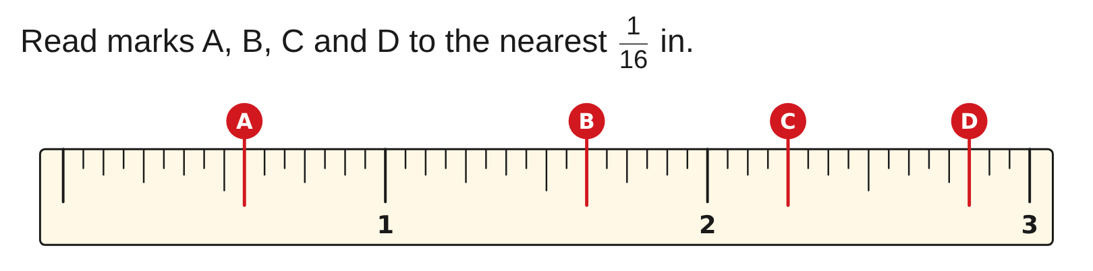
W02-L05 • TOGETHER • 9:25 AM–9:40 AM • 15 MIN TOTAL
Guided practice | 4A Q3
Work with a partner. Take turns explaining the next step.
Textbook sections 4.1–4.4 pp.88–94; sections 4.5 pp.95–96
Textbook
Exercise Book
Numeracy Hub
Shape Canvas
Day 05 • 2026-11-04 • 13
Notes:
TOGETHER | 9:25 AM–9:40 AM | 15 MIN TOTAL — shared phase allocation.
Read marks A, B, C and D in 4A Q3 to the nearest sixteenth inch. For each one, identify the preceding whole-inch line before counting spaces. Which readings will include whole inches? Any marks beyond the first inch. Write the unreduced fraction if it helps you show the count, then simplify while keeping the whole-inch part. Attempt all four with your partner before checking the answers on the next slide.
INSTRUCTOR ONLY — AFTER THE ATTEMPT: A: 9/16 in, B: 1 5/8 in, C: 2 1/4 in, D: 2 13/16 in
Working to discuss after the attempt: A is 9/16 in. B is 1 + 10/16 = 1 5/8 in. C is 2 + 4/16 = 2 1/4 in. D is 2 + 13/16 = 2 13/16 in.

Slide 14
W02-L05 • TOGETHER • 9:25 AM–9:40 AM • 15 MIN TOTAL
Compare your method | 4A Q3
CHECK TOGETHER
A: 9/16 in, B: 1 5/8 in, C: 2 1/4 in, D: 2 13/16 in
Textbook sections 4.1–4.4 pp.88–94; sections 4.5 pp.95–96
Textbook
Exercise Book
Numeracy Hub
Shape Canvas
Day 05 • 2026-11-04 • 14
Notes:
TOGETHER | 9:25 AM–9:40 AM | 15 MIN TOTAL — shared phase allocation.
The readings are A: 9/16 inch, B: 1 5/8 inches, C: 2 1/4 inches and D: 2 13/16 inches. For B, ten sixteenths after one inch reduce to five eighths; for C, four sixteenths after two inches reduce to one quarter. Which readings stay in sixteenths? A and D, because their odd numerators do not share a factor with sixteen. Check the complete reading, including whole inches, rather than comparing only the fractional part.
INSTRUCTOR ONLY — AFTER THE ATTEMPT: A: 9/16 in, B: 1 5/8 in, C: 2 1/4 in, D: 2 13/16 in
Working to discuss after the attempt: A is 9/16 in. B is 1 + 10/16 = 1 5/8 in. C is 2 + 4/16 = 2 1/4 in. D is 2 + 13/16 = 2 13/16 in.

Slide 15
W02-L05 • PRACTISE • 9:40 AM–10:00 AM • 20 MIN TOTAL
Your scheduled practice
Complete Exercise Book 4A Q2,4,8–11. Read real rule/tape marks and compare them with the Numeracy Hub. Complete assigned Q4 (32nds). Use extra time for guided rereading; additional fine-graduation work is extension.
Show working and units; estimate, then check.
Resources: Exercise Book 4A Q1–4 (p.35), Q6–11 (p.36)
Textbook sections 4.1–4.4 pp.88–94; sections 4.5 pp.95–96
Textbook
Exercise Book
Numeracy Hub
Shape Canvas
Day 05 • 2026-11-04 • 15
Notes:
PRACTISE | 9:40 AM–10:00 AM | 20 MIN TOTAL — shared phase allocation.
Complete 4A Q2, Q4 and questions 8–11. Q4 uses 32nds and is part of the assigned work, so read that scale carefully. Additional fine-graduation work is an extension after these questions, not a replacement for Q4. What changes when a rule is divided into thirty-seconds? Each space is half as large as a sixteenth. Compare actual rule marks with Numeracy Hub and write both the counted fraction and its simplified form where useful.

Slide 16

W02-L05 • PRACTISE • 9:40 AM–10:00 AM • 20 MIN TOTAL
Open Numeracy Hub
Navigation example. Use the values and units in the assigned task.
Textbook sections 4.1–4.4 pp.88–94; sections 4.5 pp.95–96
Textbook
Exercise Book
Numeracy Hub
Shape Canvas
Day 05 • 2026-11-04 • 16
Notes:
PRACTISE | 9:40 AM–10:00 AM | 20 MIN TOTAL — shared phase allocation.
Open Numeracy Hub's Measuring Tools section and place your actual inch rule beside it. Locate zero, a whole inch and the smallest displayed graduation in both. What comparison should you make before copying a reading? Confirm whether the two scales use the same divisions. A screen diagram can explain the pattern, but the physical size of the screen image is not the dimension. Use the labels and tick structure to identify the intended reading.

Slide 17
W02-L05 • PRACTISE • 9:40 AM–10:00 AM • 20 MIN TOTAL
Practise in Numeracy Hub and Shape Canvas
1
Supported: Compare a real inch rule with Numeracy Hub Measuring Tools; identify zero and graduation.
2
Supported: Read 4A Q3 and explain Q6–7; in Shape Canvas use inch dimension labels.
3
Independent practice: Complete the assigned marks and fractions, then compare with tape-reading practice.
Textbook sections 4.1–4.4 pp.88–94; sections 4.5 pp.95–96
Textbook
Exercise Book
Numeracy Hub
Shape Canvas
Day 05 • 2026-11-04 • 17
Notes:
PRACTISE | 9:40 AM–10:00 AM | 20 MIN TOTAL — shared phase allocation.
Compare the real rule with Numeracy Hub, then explain marks from 4A Q3 and the equivalent fractions in questions 6–7. In Shape Canvas, use inch dimension labels as another way to describe a stated size. What should you read on the canvas? The numerical label and its unit, not the drawn length on your monitor. Complete the assigned paper fractions before comparing with tape-reading practice, and keep any corrected reading beside the original attempt so the counting error is clear.

Slide 18
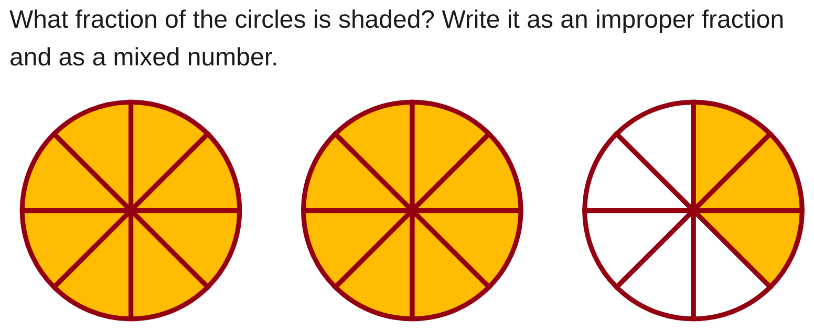
W02-L05 • PRACTISE • 9:40 AM–10:00 AM • 20 MIN TOTAL
Practise from the Exercise Book | 4A Q2
Write the operation, working and units before checking.
Textbook sections 4.1–4.4 pp.88–94; sections 4.5 pp.95–96
Textbook
Exercise Book
Numeracy Hub
Shape Canvas
Day 05 • 2026-11-04 • 18
Notes:
PRACTISE | 9:40 AM–10:00 AM | 20 MIN TOTAL — shared phase allocation.
For 4A Q2, inspect the circles and count shaded eighths across all the wholes. Write an improper fraction and a mixed number for the same shaded amount. What tells you how many eighths belong in one whole? The equal divisions of each circle. Attempt both forms before checking. Afterward, explain how complete groups of eight become whole numbers while the remaining eighths stay as the fractional part.
INSTRUCTOR ONLY — AFTER THE ATTEMPT: 19/8 = 2 3/8
Working to discuss after the attempt: Nineteen eighths contain two complete groups of eight and three eighths remaining: 19 = 2 × 8 + 3.

Slide 19
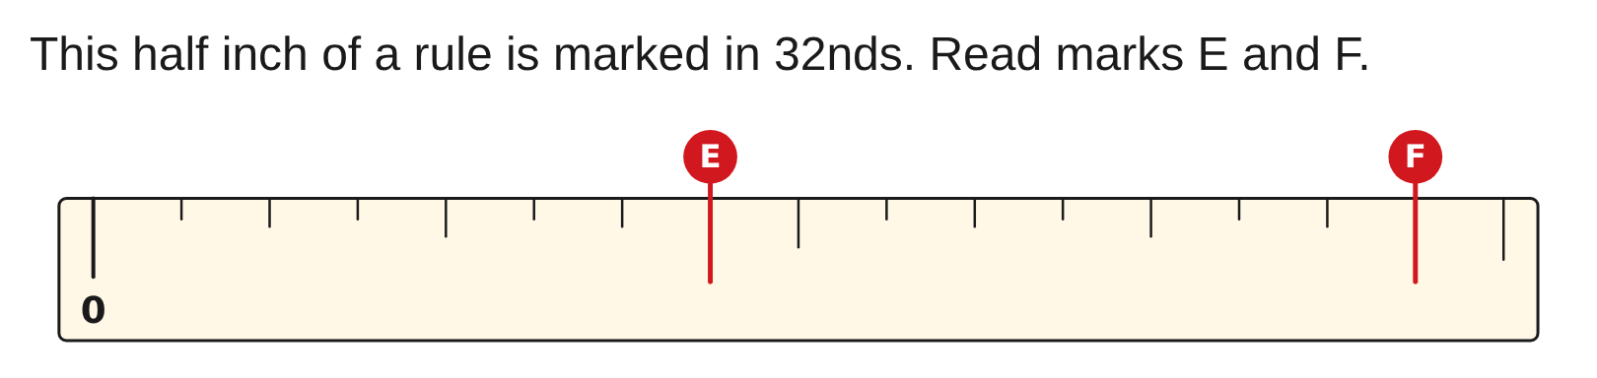
W02-L05 • PRACTISE • 9:40 AM–10:00 AM • 20 MIN TOTAL
Practise from the Exercise Book | 4A Q4
Write the operation, working and units before checking.
Textbook sections 4.1–4.4 pp.88–94; sections 4.5 pp.95–96
Textbook
Exercise Book
Numeracy Hub
Shape Canvas
Day 05 • 2026-11-04 • 19
Notes:
PRACTISE | 9:40 AM–10:00 AM | 20 MIN TOTAL — shared phase allocation.
For 4A Q4, the picture shows only half an inch, but the scale is marked in thirty-seconds of a full inch. What denominator should you use? Thirty-two, not sixteen just because only half the inch is displayed. Count from zero to marks E and F and record the readings with inch units. Attempt both before consulting the answer, then check their positions relative to the half-inch endpoint.
INSTRUCTOR ONLY — AFTER THE ATTEMPT: E: 7/32 in, F: 15/32 in
Working to discuss after the attempt: Each counted space is 1/32 in. E is seven spaces from zero and F is fifteen; both are below the half-inch endpoint at 16/32.

Slide 20
W02-L05 • CHECK • 10:00 AM–10:10 AM • 10 MIN TOTAL
Check independently
Exercise Book 4A Q6 and Q8; explain which fraction is longer and how much longer.
Answer independently and show the method.
Resources: Exercise Book 4A Q1–4 (p.35), Q6–11 (p.36)
Textbook sections 4.1–4.4 pp.88–94; sections 4.5 pp.95–96
Textbook
Exercise Book
Numeracy Hub
Shape Canvas
Day 05 • 2026-11-04 • 20
Notes:
CHECK | 10:00 AM–10:10 AM | 10 MIN TOTAL — shared phase allocation.
Complete 4A Q6 and Q8 independently. One asks you to reduce fractions; the other asks which length is greater and by how much. What must be true before you compare numerators directly? They must refer to equal-sized parts, usually shown by a common denominator. Keep your written conversions visible and solutions closed. Explain how the renamed fraction keeps the same value while making the comparison easier.

Slide 21
W02-L05 • CHECK • 10:00 AM–10:10 AM • 10 MIN TOTAL
Independent check | 4A Q6
Answer independently. Keep worked solutions closed.
Textbook sections 4.1–4.4 pp.88–94; sections 4.5 pp.95–96
Textbook
Exercise Book
Numeracy Hub
Shape Canvas
Day 05 • 2026-11-04 • 21
Notes:
CHECK | 10:00 AM–10:10 AM | 10 MIN TOTAL — shared phase allocation.
For 4A Q6, put 14/32 and 36/64 in lowest terms. Show the common factor used to divide the top and bottom of each fraction. Why must both parts be divided by that same factor? It preserves the fraction's value. Try both reductions independently. After the attempt, check whether any factor still divides both numerator and denominator; if one does, the fraction is not yet in lowest terms.
INSTRUCTOR ONLY — AFTER THE ATTEMPT: 7/16 and 9/16
Working to discuss after the attempt: Divide 14 and 32 by 2 to obtain 7/16. Divide 36 and 64 by 4 to obtain 9/16. Neither result reduces further.

Slide 22
W02-L05 • CHECK • 10:00 AM–10:10 AM • 10 MIN TOTAL
Independent check | 4A Q8
Answer independently. Keep worked solutions closed.
Textbook sections 4.1–4.4 pp.88–94; sections 4.5 pp.95–96
Textbook
Exercise Book
Numeracy Hub
Shape Canvas
Day 05 • 2026-11-04 • 22
Notes:
CHECK | 10:00 AM–10:10 AM | 10 MIN TOTAL — shared phase allocation.
For 4A Q8, compare 9/16 inch with 5/8 inch and find the difference. Choose a common denominator before subtracting. Which original denominator can already express both lengths conveniently? Sixteenths. Complete the comparison and difference before checking the answer. Then explain the result as a number of equal rule spaces, so “how much longer” has a clear measurement meaning.
INSTRUCTOR ONLY — AFTER THE ATTEMPT: 5/8 in, by 1/16 in
Working to discuss after the attempt: 5/8 = 10/16. Ten sixteenths exceeds nine sixteenths by one sixteenth, so 5/8 in is longer by 1/16 in.

Slide 23
W02-L05 • WRAP UP • 10:10 AM–10:15 AM • 5 MIN TOTAL
Wrap up and choose the next step
Share one learning point and one skill to practise next.
Record a takeaway and next action.
Resources: Exercise Book 4A Q1–4 (p.35), Q6–11 (p.36)
Textbook sections 4.1–4.4 pp.88–94; sections 4.5 pp.95–96
Textbook
Exercise Book
Numeracy Hub
Shape Canvas
Day 05 • 2026-11-04 • 23
Notes:
WRAP UP | 10:10 AM–10:15 AM | 5 MIN TOTAL — shared phase allocation.
Choose a fraction you reduced today and point to the same position using both names. What stayed unchanged? The length; only the way we named the equal parts changed. Record one reading habit that prevents mistakes, such as finding the preceding whole inch or counting spaces rather than lines. After the break we will practise complete spoken readings and compare them with actual rule marks until that method becomes more consistent.

Slide 24
DAY 05 • SCHEDULED BREAK
Break
10:15 AM–10:30 AM
Return ready for: Tape and rule reading practice
This break is excluded from teaching minutes.
Textbook
Exercise Book
Numeracy Hub
Shape Canvas
Day 05 • 2026-11-04 • 24
Notes:
Break | 10:15 AM–10:30 AM
Our break runs until 10:30. Keep an actual inch rule and your 4A page ready for the next block. What will we pay particular attention to when we return? Saying the whole number, the fraction and the inch unit together. Use the break fully; then we will practise reading and checking each other's marks without dropping the whole-inch part.

Slide 25
W02-L06 • START • 10:30 AM–10:35 AM • 5 MIN TOTAL
Tape and rule reading practice
Today’s goal: Read inch markings consistently and record each reading in lowest terms.
Name one use for today’s skill.
Textbook Chapter 4 pp.88–92
Exercise Book 4A Q1–4 (p.35); Q6–9 (p.36)
Keep your notebook, textbook, exercise book and chosen calculator ready.
Textbook Chapter 4 pp.88–92
Textbook
Exercise Book
Numeracy Hub
Shape Canvas
Day 05 • 2026-11-04 • 25
Notes:
START | 10:30 AM–10:35 AM | 5 MIN TOTAL — shared phase allocation.
This block is about consistency: read the whole inches, count the fraction and record the complete result in lowest terms. How could an otherwise correct fraction still describe the wrong length? If the whole inches were omitted. We will use the same book questions to practise a repeatable reading method, then create four marks for a partner. Keep the unit beside every written reading and explain corrections by returning to the scale.

Slide 26
W02-L06 • RECALL • 10:35 AM–10:40 AM • 5 MIN TOTAL
Recall and reconnect
Locate zero, one inch, one half and one quarter; ask what the smallest shown graduation represents.
Try first without displayed answers.
Resources: Exercise Book 4A Q1–4 (p.35); Q6–9 (p.36)
Textbook Chapter 4 pp.88–92
Textbook
Exercise Book
Numeracy Hub
Shape Canvas
Day 05 • 2026-11-04 • 26
Notes:
RECALL | 10:35 AM–10:40 AM | 5 MIN TOTAL — shared phase allocation.
Locate zero, one inch, one-half inch and one-quarter inch. Now identify the smallest shown graduation on the rule you are actually using. How do you know its value? Count the equal spaces within a whole inch and compare the landmark marks. Do not assume every edge uses sixteenths. Once the scale is identified, use the whole-inch mark immediately before a point as the start for counting its fractional part.

Slide 27
W02-L06 • TEACH • 10:40 AM–10:55 AM • 15 MIN TOTAL
Say the complete reading
1
Locate the whole-inch mark immediately before the point.
2
Count fractional spaces from that whole-inch mark.
3
Combine the whole inches and fraction, then reduce the fraction.
4
Say the whole reading aloud so a partner can check what was recorded.
Textbook Chapter 4 pp.88–92
Textbook
Exercise Book
Numeracy Hub
Shape Canvas
Day 05 • 2026-11-04 • 27
Notes:
TEACH | 10:40 AM–10:55 AM | 15 MIN TOTAL — shared phase allocation.
Read the complete measurement in two parts. First find the whole-inch line immediately before the point. Then count equal spaces from that line to the point, using the scale's denominator. Combine the whole inches and fraction before simplifying. Why say the reading aloud? Your partner can hear whether the whole number or unit has disappeared. “Two and five eighths inches” identifies a different point from “five eighths inch.” Reducing the fraction changes its name, while the whole-inch part and position remain unchanged.

Slide 28
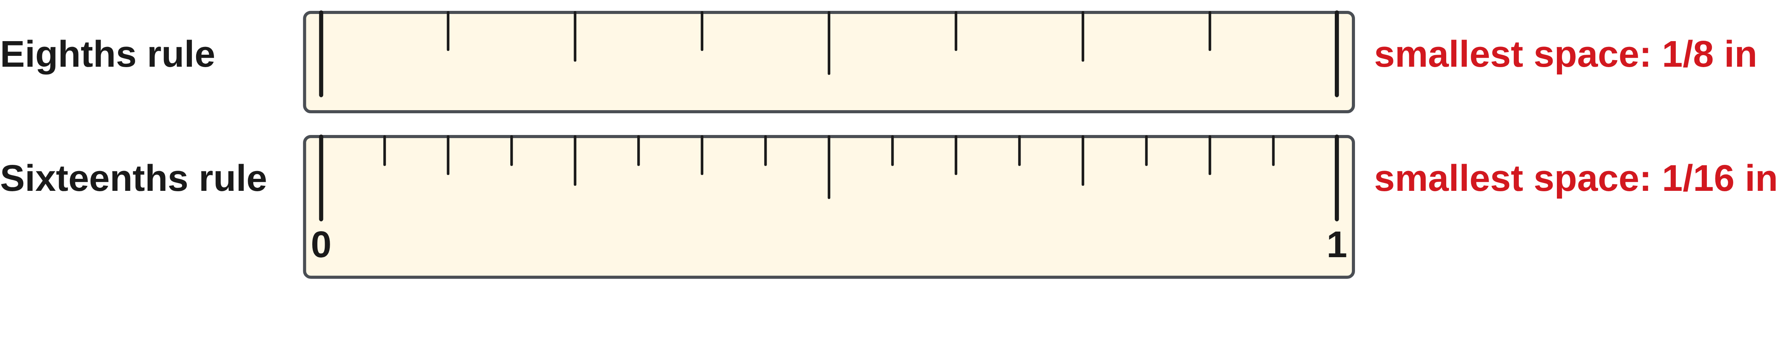
W02-L06 • TEACH • 10:40 AM–10:55 AM • 15 MIN TOTAL
Let the tool set the precision
1
A rule’s smallest graduation sets the precision you can read.
2
Do not invent finer precision than the marked divisions support.
3
Keep the inch unit with every written reading.
4
When readings disagree, return to zero and count spaces again.
Textbook Chapter 4 pp.88–92
Textbook
Exercise Book
Numeracy Hub
Shape Canvas
Day 05 • 2026-11-04 • 28
Notes:
TEACH | 10:40 AM–10:55 AM | 15 MIN TOTAL — shared phase allocation.
The smallest marked graduation tells us what precision the displayed scale supports. If the scale is marked in sixteenths, report the requested reading to those marked divisions; do not invent finer digits because a calculator can display them. Which information decides the denominator: the number of marks you have counted or the scale's divisions per inch? The scale determines it. Keep inches with the result. If partners disagree, return to a clear whole-inch reference and count spaces again, then compare the fraction with the nearby half- or quarter-inch landmark.

Slide 29
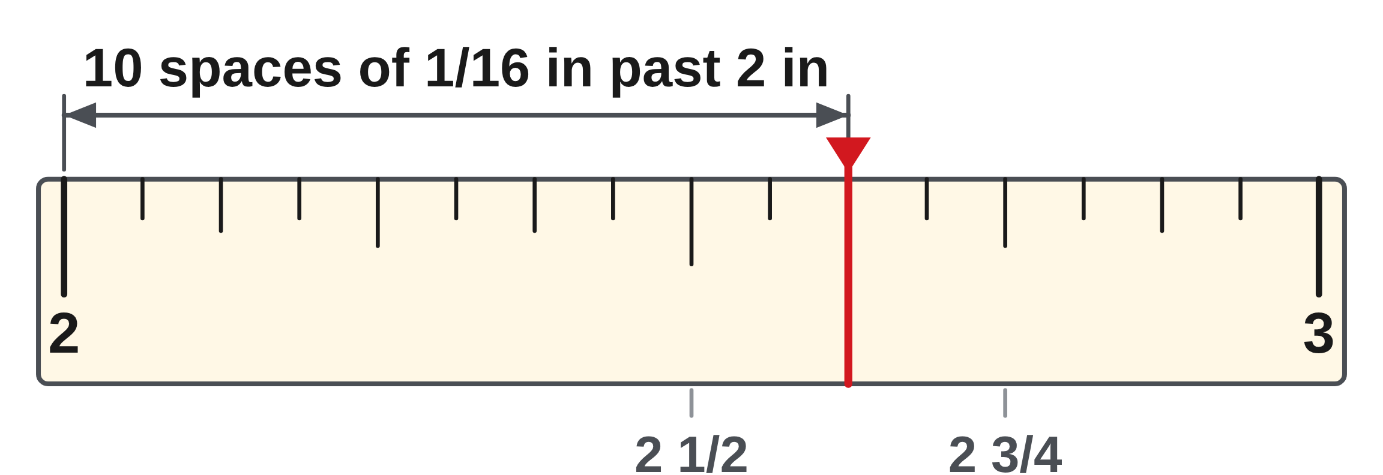
W02-L06 • TEACH • 10:40 AM–10:55 AM • 15 MIN TOTAL
Say the whole reading aloud
Classroom example: a mark is ten sixteenth-inch spaces past 2 in.
2 + 10/16 = 2 + 5/8 = 2 5/8 in
Check the point lies between 2 1/2 in and 2 3/4 in.
“5/8” alone loses the two whole inches.
Together • Read Exercise Book 4A Q3.
One partner points; the other says the whole number and fraction.
Confirm with an actual rule and Numeracy Hub Measuring Tools.
W2 L6 • Lowest terms change the name, not the position of the mark
Textbook
Exercise Book
Numeracy Hub
Shape Canvas
Day 05 • 2026-11-04 • 29
Notes:
TEACH | 10:40 AM–10:55 AM | 15 MIN TOTAL — shared phase allocation.
The point is ten sixteenth-inch spaces past two inches. Write 2 plus 10/16. Reducing the fractional part by two gives 2 5/8 inches. Why is 5/8 inch alone incomplete? It describes only the distance past the two-inch mark, not the full reading from zero. As a location check, the point should lie between 2 1/2 and 2 3/4 inches. Ten sixteenths lies between eight and twelve sixteenths, so that agrees. The count, simplified fraction and landmark check all describe the same position.

Slide 30
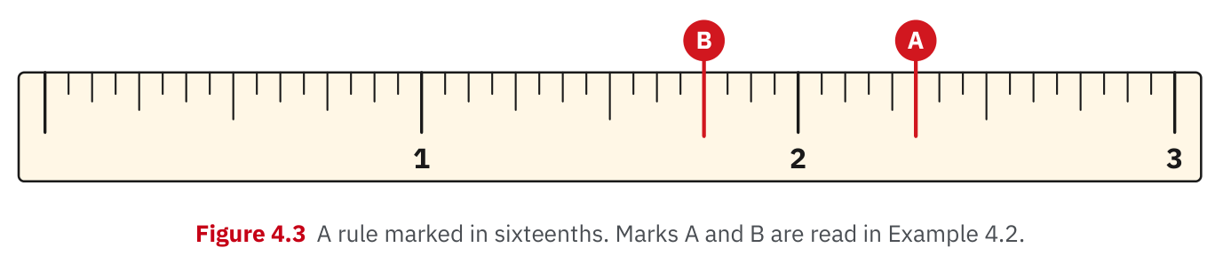
W02-L06 • TEACH • 10:40 AM–10:55 AM • 15 MIN TOTAL
Textbook | page 89
Textbook p.89 · Figure 4.3: read whole inches, then fractional spaces.
Textbook Chapter 4 pp.88–92
Textbook
Exercise Book
Numeracy Hub
Shape Canvas
Day 05 • 2026-11-04 • 30
Notes:
TEACH | 10:40 AM–10:55 AM | 15 MIN TOTAL — shared phase allocation.
Figure 4.3 on page 89 places marks A and B on a rule with whole inches and sixteenths. Before counting, identify the whole-inch line immediately to the left of each point. For A, that reference is two inches; for B, it is one inch. What error would result from counting only the fractional spaces and reporting them alone? We would lose the distance already represented by the whole inches. Trace from each whole-inch reference to its mark, and keep the fractional count attached to the whole-number part for the next example.

Slide 31
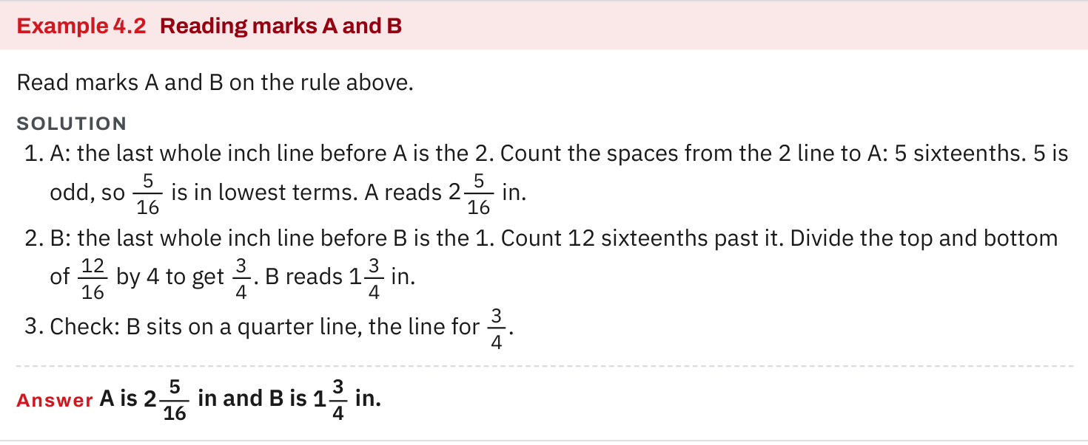
W02-L06 • TEACH • 10:40 AM–10:55 AM • 15 MIN TOTAL
Textbook | page 90
Textbook p.90 · Example 4.2: name and simplify the complete reading.
Textbook Chapter 4 pp.88–92
Textbook
Exercise Book
Numeracy Hub
Shape Canvas
Day 05 • 2026-11-04 • 31
Notes:
TEACH | 10:40 AM–10:55 AM | 15 MIN TOTAL — shared phase allocation.
Example 4.2 reads A as five sixteenths beyond two inches, giving 2 5/16 inches. B is twelve sixteenths beyond one inch; dividing twelve and sixteen by four gives three quarters, so B is 1 3/4 inches. What visual check supports B? It lands on the three-quarter line. Notice that these textbook A and B labels belong to this particular diagram; they are different from the exercise book's marks A–D. Always read the current scale and labels rather than transferring a remembered answer between diagrams.

Slide 32
W02-L06 • TEACH • 10:40 AM–10:55 AM • 15 MIN TOTAL
Spot the mistake. Explain the correction.
A point ten sixteenth-inch spaces beyond 2 in is written as 5/8 in. What is missing?
Discuss the method before checking the answer.
The whole inches were dropped. The complete reading is 2 10/16 in = 2 5/8 in.
Textbook Chapter 4 pp.88–92
Textbook
Exercise Book
Numeracy Hub
Shape Canvas
Day 05 • 2026-11-04 • 32
Notes:
TEACH | 10:40 AM–10:55 AM | 15 MIN TOTAL — shared phase allocation.
Writing 5/8 inch for a point ten sixteenths beyond two inches drops the whole-number part. Ten sixteenths does simplify to five eighths, but the two inches must remain. What complete expression should we keep while reducing? 2 + 10/16 becomes 2 + 5/8, giving 2 5/8 inches. The point is beyond two inches, so any answer less than one inch immediately fails the location check. Simplification changes the fractional name; it cannot erase the whole lengths that came before it.

Slide 33
W02-L06 • TOGETHER • 10:55 AM–11:10 AM • 15 MIN TOTAL
Work together
Read 4A question 3 together. Partners point to each mark and say the whole number and fraction aloud.
Work in pairs; alternate solver and checker.
Resources: Exercise Book 4A Q1–4 (p.35); Q6–9 (p.36)
Textbook Chapter 4 pp.88–92
Textbook
Exercise Book
Numeracy Hub
Shape Canvas
Day 05 • 2026-11-04 • 33
Notes:
TOGETHER | 10:55 AM–11:10 AM | 15 MIN TOTAL — shared phase allocation.
Read 4A Q3 together. One partner points to each mark while the other says the whole number and fraction aloud. Then exchange roles and verify the readings. What should the listener check? The correct whole-inch reference, the counted spaces, the simplified fraction and the inch unit. If two readings differ, return to the scale and locate the first disagreement instead of deciding by confidence or speed.

Slide 34
W02-L06 • TOGETHER • 10:55 AM–11:10 AM • 15 MIN TOTAL
Guided practice | 4A Q3
Work with a partner. Take turns explaining the next step.
Textbook Chapter 4 pp.88–92
Textbook
Exercise Book
Numeracy Hub
Shape Canvas
Day 05 • 2026-11-04 • 34
Notes:
TOGETHER | 10:55 AM–11:10 AM | 15 MIN TOTAL — shared phase allocation.
For 4A Q3, read marks A–D again using the complete-reading method. Start each answer from its preceding whole-inch line. Which mark requires no whole-number part because it lies before one inch? Identify it from the diagram before recording all four. Use sixteenths for the initial count, then reduce where possible. Attempt the set with your partner before comparing the answers, and say each complete measurement aloud.
INSTRUCTOR ONLY — AFTER THE ATTEMPT: A: 9/16 in, B: 1 5/8 in, C: 2 1/4 in, D: 2 13/16 in
Working to discuss after the attempt: A is 9/16 in. B is 1 + 10/16 = 1 5/8 in. C is 2 + 4/16 = 2 1/4 in. D is 2 + 13/16 = 2 13/16 in.

Slide 35
W02-L06 • TOGETHER • 10:55 AM–11:10 AM • 15 MIN TOTAL
Compare your method | 4A Q3
CHECK TOGETHER
A: 9/16 in, B: 1 5/8 in, C: 2 1/4 in, D: 2 13/16 in
Textbook Chapter 4 pp.88–92
Textbook
Exercise Book
Numeracy Hub
Shape Canvas
Day 05 • 2026-11-04 • 35
Notes:
TOGETHER | 10:55 AM–11:10 AM | 15 MIN TOTAL — shared phase allocation.
A is 9/16 inch; B is 1 5/8 inches; C is 2 1/4 inches; D is 2 13/16 inches. Explain B as one inch plus ten sixteenths, and C as two inches plus four sixteenths. Why does D keep a denominator of sixteen? Thirteen and sixteen have no shared factor greater than one. Use the diagram to check that A lies below one inch, B between one and two, and C and D between two and three.
INSTRUCTOR ONLY — AFTER THE ATTEMPT: A: 9/16 in, B: 1 5/8 in, C: 2 1/4 in, D: 2 13/16 in
Working to discuss after the attempt: A is 9/16 in. B is 1 + 10/16 = 1 5/8 in. C is 2 + 4/16 = 2 1/4 in. D is 2 + 13/16 = 2 13/16 in.

Slide 36
W02-L06 • PRACTISE • 11:10 AM–11:45 AM • 35 MIN TOTAL
Your scheduled practice
Complete 4A questions 1–4 and 6–9. Partners create four marks for one another to read; verify with the rule and record corrections.
Show working and units; estimate, then check.
Resources: Exercise Book 4A Q1–4 (p.35); Q6–9 (p.36)
Textbook Chapter 4 pp.88–92
Textbook
Exercise Book
Numeracy Hub
Shape Canvas
Day 05 • 2026-11-04 • 36
Notes:
PRACTISE | 11:10 AM–11:45 AM | 35 MIN TOTAL — shared phase allocation.
Complete 4A questions 1–4 and 6–9. Then create four marks for your partner to read, using the actual rule to verify them. What should you record when a reading is corrected? The original reading, the corrected reading and the reason, such as a missed whole inch or counting the starting line. Keep the work to the assigned scale and questions. The partner exercise is for practising a clear reading method, so the explanation matters as much as agreement.

Slide 37
W02-L06 • PRACTISE • 11:10 AM–11:45 AM • 35 MIN TOTAL
Open Numeracy Hub
Navigation example. Use the values and units in the assigned task.
Textbook Chapter 4 pp.88–92
Textbook
Exercise Book
Numeracy Hub
Shape Canvas
Day 05 • 2026-11-04 • 37
Notes:
PRACTISE | 11:10 AM–11:45 AM | 35 MIN TOTAL — shared phase allocation.
Open Numeracy Hub's Measuring Tools section and compare its rule or tape illustration with your actual inch rule. Find corresponding whole-inch and fractional landmarks. What must you check before transferring a reading from one scale to another? That the graduations represent the same fractions of an inch. Use the displayed example to explain the pattern, while using the actual rule to verify the marks you create for your partner.

Slide 38
W02-L06 • PRACTISE • 11:10 AM–11:45 AM • 35 MIN TOTAL
Practise in Numeracy Hub
1
Supported: Use an actual inch rule alongside Numeracy Hub Measuring Tools; locate matching graduations.
2
Supported: Read marks A–D in 4A Q3 aloud with a partner before independent practice.
3
Independent practice: Create four marks for a partner, verify with the rule and record corrections.
Textbook Chapter 4 pp.88–92
Textbook
Exercise Book
Numeracy Hub
Shape Canvas
Day 05 • 2026-11-04 • 38
Notes:
PRACTISE | 11:10 AM–11:45 AM | 35 MIN TOTAL — shared phase allocation.
Use the actual inch rule beside Numeracy Hub and locate matching graduations. Read 4A Q3 aloud with a partner, then create four marks for one another to read independently. How should you settle a disagreement? Find the preceding whole-inch line, identify the graduation size and recount the spaces. Record the correction and its cause. Avoid treating an enlarged screen diagram as a physical ruler; its labels describe the measurement even when its displayed size changes.

Slide 39
W02-L06 • PRACTISE • 11:10 AM–11:45 AM • 35 MIN TOTAL
Practise from the Exercise Book | 4A Q1
Write the operation, working and units before checking.
Textbook Chapter 4 pp.88–92
Textbook
Exercise Book
Numeracy Hub
Shape Canvas
Day 05 • 2026-11-04 • 39
Notes:
PRACTISE | 11:10 AM–11:45 AM | 35 MIN TOTAL — shared phase allocation.
Revisit 4A Q1 and explain how the shaded bar becomes a fraction. Count the whole's equal parts and the shaded parts separately. Is the shaded amount less than a complete bar? Use the diagram to decide whether the fraction is proper. After the attempt, connect the numerator and denominator to their counts. This same distinction underlies tape reading: one number counts selected spaces, while the other names the whole's division.
INSTRUCTOR ONLY — AFTER THE ATTEMPT: 5/12. Yes, the numerator is smaller than the denominator.
Working to discuss after the attempt: Five of twelve equal parts are shaded. Since 5 < 12, the shaded amount is less than one whole bar.

Slide 40
W02-L06 • PRACTISE • 11:10 AM–11:45 AM • 35 MIN TOTAL
Practise from the Exercise Book | 4A Q2
Write the operation, working and units before checking.
Textbook Chapter 4 pp.88–92
Textbook
Exercise Book
Numeracy Hub
Shape Canvas
Day 05 • 2026-11-04 • 40
Notes:
PRACTISE | 11:10 AM–11:45 AM | 35 MIN TOTAL — shared phase allocation.
For 4A Q2, count the shaded eighths across the circles and express the amount both as an improper fraction and a mixed number. What is one complete circle worth in eighths? Eight eighths. Use that fact to separate whole circles from the remaining fraction. After the attempt, check by converting the mixed number back to eighths and seeing whether it restores the original shaded count.
INSTRUCTOR ONLY — AFTER THE ATTEMPT: 19/8 = 2 3/8
Working to discuss after the attempt: Nineteen eighths contain two complete groups of eight and three eighths remaining: 19 = 2 × 8 + 3.

Slide 41
W02-L06 • CHECK • 11:45 AM–11:55 AM • 10 MIN TOTAL
Check independently
Read marks A–D in 4A question 3 without prompts.
Answer independently and show the method.
Resources: Exercise Book 4A Q1–4 (p.35); Q6–9 (p.36)
Textbook Chapter 4 pp.88–92
Textbook
Exercise Book
Numeracy Hub
Shape Canvas
Day 05 • 2026-11-04 • 41
Notes:
CHECK | 11:45 AM–11:55 AM | 10 MIN TOTAL — shared phase allocation.
Read marks A–D in 4A Q3 independently, without spoken prompts or displayed answers. Record the complete measurement in lowest terms with inch units. Which parts of your method can you check silently? The whole-inch reference, graduation size, counted spaces and whether the fraction reduces. Complete all four before looking back at partner work. We will use the attempts to identify which part of the reading process still needs practice.

Slide 42
W02-L06 • CHECK • 11:45 AM–11:55 AM • 10 MIN TOTAL
Independent check | 4A Q3
Answer independently. Keep worked solutions closed.
Textbook Chapter 4 pp.88–92
Textbook
Exercise Book
Numeracy Hub
Shape Canvas
Day 05 • 2026-11-04 • 42
Notes:
CHECK | 11:45 AM–11:55 AM | 10 MIN TOTAL — shared phase allocation.
For 4A Q3, read each mark to the nearest sixteenth inch and record all four answers independently. Keep the whole-number part where the point lies beyond an inch, and simplify only the fraction. After the attempt, explain one reading by naming the preceding whole inch and the spaces beyond it. That explanation should show why the complete answer refers to the point indicated on the rule.
INSTRUCTOR ONLY — AFTER THE ATTEMPT: A: 9/16 in, B: 1 5/8 in, C: 2 1/4 in, D: 2 13/16 in
Working to discuss after the attempt: A is 9/16 in. B is 1 + 10/16 = 1 5/8 in. C is 2 + 4/16 = 2 1/4 in. D is 2 + 13/16 = 2 13/16 in.

Slide 43
W02-L06 • WRAP UP • 11:55 AM–12:00 PM • 5 MIN TOTAL
Wrap up and choose the next step
Share one learning point and one skill to practise next.
Record a takeaway and next action.
Resources: Exercise Book 4A Q1–4 (p.35); Q6–9 (p.36)
Textbook Chapter 4 pp.88–92
Textbook
Exercise Book
Numeracy Hub
Shape Canvas
Day 05 • 2026-11-04 • 43
Notes:
WRAP UP | 11:55 AM–12:00 PM | 5 MIN TOTAL — shared phase allocation.
Choose one reading you can now explain from the scale to the written answer. Say the whole inches, the fractional spaces and the unit, then show how the fraction reduces. What should remain unchanged when you simplify? The physical position of the mark. Record a specific next practice target, such as reading 32nds, retaining whole inches or comparing equivalent fractions. Keep one corrected example as a reminder of the method you want to repeat.

