Slide 1

CARPENTRY FOUNDATION / INTAKE 142
Day 06 | Thursday
06
November 5, 2026
Equivalent fractions and comparing lengths
9:00 AM–10:15 AM • Math • 75 min
Mixed numbers and fraction calculator entry
10:30 AM–12:00 PM • Math • 90 min
Week 2 • 2 scheduled blocks • 165 teaching minutes
Estimate. Show the method. Label units. Check the result.
Textbook
Exercise Book
Numeracy Hub
Shape Canvas
Day 06 • 2026-11-05 • 01
Notes:
Today we connect the marks on a rule with the numbers we write. Before the break, we will compare fractional lengths and explain exactly how much longer one is. After the break, we will move between mixed numbers, improper fractions, and calculator displays. Which is longer: three quarters or eleven sixteenths? Keep your first answer in mind; today you will be able to prove it with equal-sized parts.

Slide 2
DAY 06 / WEEK 2 / CLASS TIMETABLE
Today’s exact schedule
9:00 AM–10:15 AM • 75 min
10:30 AM–12:00 PM • 90 min
Equivalent fractions and comparing lengths
Mixed numbers and fraction calculator entry
9:00 AM–9:05 AM
Start
5
10:30 AM–10:35 AM
Start
5
9:05 AM–9:10 AM
Recall
5
10:35 AM–10:40 AM
Recall
5
9:10 AM–9:25 AM
Teach
15
10:40 AM–10:55 AM
Teach
15
9:25 AM–9:40 AM
Together
15
10:55 AM–11:10 AM
Together
15
9:40 AM–10:00 AM
Practise
20
11:10 AM–11:45 AM
Practise
35
10:00 AM–10:10 AM
Check
10
11:45 AM–11:55 AM
Check
10
10:10 AM–10:15 AM
Wrap up
5
11:55 AM–12:00 PM
Wrap up
5
Math • Math Week 2, Lesson 7
Math • Math Week 2, Lesson 8
Break: 10:15 AM–10:30 AM • 15 minutes • excluded from teaching time
Textbook
Exercise Book
Numeracy Hub
Shape Canvas
Day 06 • 2026-11-05 • 02
Notes:
Our first block runs from 9:00 to 10:15. We will build the comparison method, work together, practise, and finish with an independent check. Take the full break from 10:15 to 10:30. The second block runs from 10:30 to noon, with a longer practice period from 11:10 to 11:45. Each phase has one shared time allowance. The aim is an explained result: what does the fraction represent, and how can we verify it?

Slide 3
W02-L07 • START • 9:00 AM–9:05 AM • 5 MIN TOTAL
Equivalent fractions and comparing lengths
Today’s goal: Use equivalent fractions to order dimensions and explain the difference between two lengths.
Name one use for today’s skill.
Textbook Chapter 4 pp.91–94
Exercise Book 4A Q6–11 (p.36)
Keep your notebook, textbook, exercise book and chosen calculator ready.
Textbook Chapter 4 pp.91–94
Textbook
Exercise Book
Numeracy Hub
Shape Canvas
Day 06 • 2026-11-05 • 03
Notes:
START • 9:00 AM–9:05 AM • 5 MIN TOTAL — shared across this phase.
Open the textbook to Chapter 4, pages 91–94, and the exercise book to 4A, page 36. A drawing may label one part in quarters and another in sixteenths. We need to compare those dimensions without guessing from the picture. Where might that matter in carpentry? A good answer is checking whether two cut pieces match, or deciding how much must be trimmed. Today our evidence will be equivalent fractions and the marks on a rule.

Slide 4
W02-L07 • RECALL • 9:05 AM–9:10 AM • 5 MIN TOTAL
Recall and reconnect
Show 1/2 and 8/16 on a rule. Explain why they refer to the same point.
Try first without displayed answers.
Resources: Exercise Book 4A Q6–11 (p.36)
Textbook Chapter 4 pp.91–94
Textbook
Exercise Book
Numeracy Hub
Shape Canvas
Day 06 • 2026-11-05 • 04
Notes:
RECALL • 9:05 AM–9:10 AM • 5 MIN TOTAL — shared across this phase.
Point to one half on your rule. Now find eight sixteenths. Did your finger move? It should not: both names identify the same length. Sixteen equal intervals make one whole inch, and eight of them make half an inch. Ask your partner why the denominator changed without the length changing. Listen for this explanation: the parts became smaller, so we needed more parts to reach the same point.

Slide 5
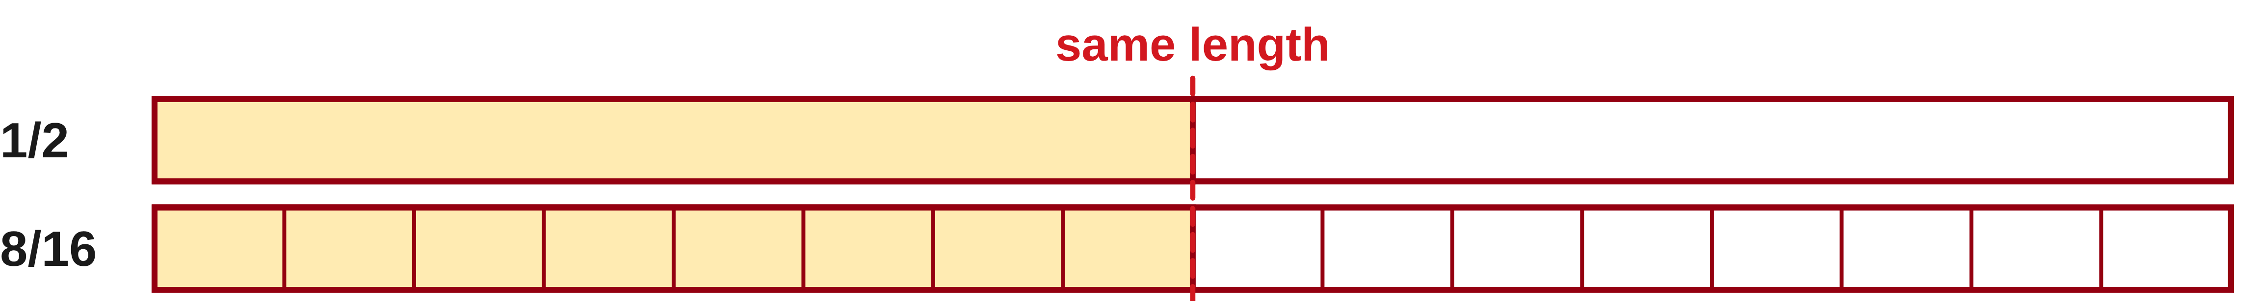
W02-L07 • TEACH • 9:10 AM–9:25 AM • 15 MIN TOTAL
Keep equivalent fractions equal
1
Multiply or divide numerator and denominator by the same nonzero number.
2
Changing the fraction’s name does not change its length.
3
Use a fraction strip or rule to show that equivalent values share one point.
4
Reduce the final answer when the question asks for lowest terms.
Textbook Chapter 4 pp.91–94
Textbook
Exercise Book
Numeracy Hub
Shape Canvas
Day 06 • 2026-11-05 • 05
Notes:
TEACH • 9:10 AM–9:25 AM • 15 MIN TOTAL — shared across this phase.
An equivalent fraction gives the same amount a different name. Starting with one half, multiply both numbers by eight: one times eight is eight, and two times eight is sixteen. We get eight sixteenths. We have subdivided every half into eight equal pieces; we have not stretched the length. What would happen if we changed only the numerator? The amount would change. To simplify, reverse that process by dividing the numerator and denominator by the same common factor. Lowest terms means there is no common whole-number factor greater than one left.

Slide 6
W02-L07 • TEACH • 9:10 AM–9:25 AM • 15 MIN TOTAL
Compare pieces of the same size
1
Find a common denominator before comparing the numerators.
2
With equal denominators, the larger numerator names the longer length.
3
Subtract the equal-sized fractions to find how much longer.
4
Order labelled dimensions by their values, not by the display’s zoom.
Textbook Chapter 4 pp.91–94
Textbook
Exercise Book
Numeracy Hub
Shape Canvas
Day 06 • 2026-11-05 • 06
Notes:
TEACH • 9:10 AM–9:25 AM • 15 MIN TOTAL — shared across this phase.
The numerator tells us how many pieces we have; the denominator tells us the size of those pieces. Comparing eleven sixteenths with three quarters by comparing eleven and three ignores the sizes. Rename the quarters as sixteenths, then compare. Once the denominators match, the larger numerator is the larger fraction. How do we find the gap? Subtract the numerators and keep the common denominator, because the pieces stay the same size. In a drawing or Shape Canvas, read the dimension labels. Zoom can change the picture's appearance but cannot change a stated dimension.

Slide 7
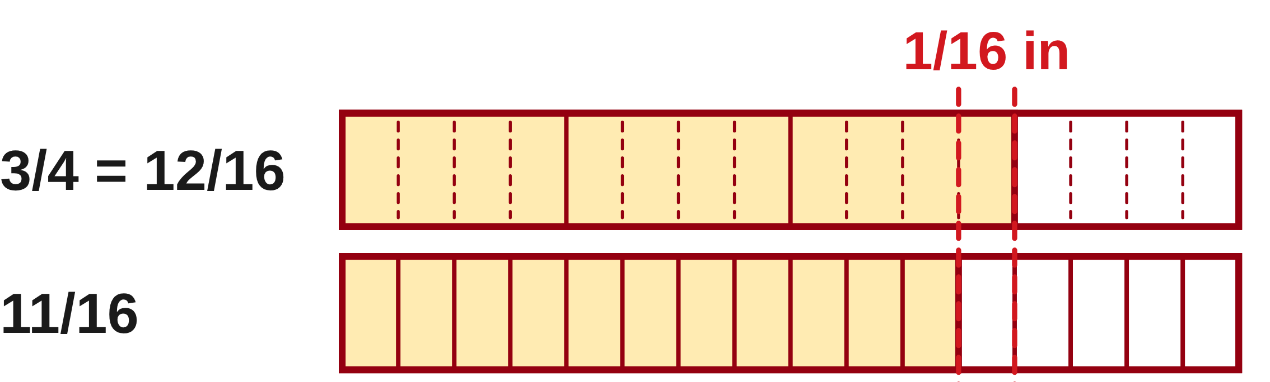
W02-L07 • TEACH • 9:10 AM–9:25 AM • 15 MIN TOTAL
Compare equal-sized fractional units
3/4 = 12/16
12/16 > 11/16
Difference = 12/16 − 11/16 = 1/16 in
The numerators can be compared because the pieces are now the same size. Confirm the two marks on a rule.
Together • Exercise Book 4A Q6–8.
Use fraction strips to explain the longer dimension.
Shape Canvas: compare labelled rectangles in inches, not screen lengths.
W2 L7 • Classroom example uses new values • Common denominator before comparison
Textbook
Exercise Book
Numeracy Hub
Shape Canvas
Day 06 • 2026-11-05 • 07
Notes:
TEACH • 9:10 AM–9:25 AM • 15 MIN TOTAL — shared across this phase.
Let's prove the comparison. Three quarters becomes twelve sixteenths because we multiply both three and four by four. Now compare twelve sixteenths with eleven sixteenths. Twelve equal pieces reach farther than eleven, so three quarters is longer. The difference is twelve minus eleven, all over sixteen: one sixteenth of an inch. Put both marks on the same rule and count the single interval between them. Why do we keep sixteen in the subtraction? Because we are counting sixteenth-inch pieces, not creating a new size of piece.

Slide 8
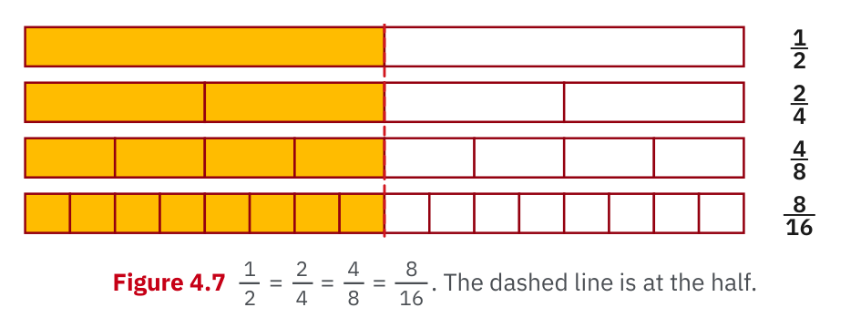
W02-L07 • TEACH • 9:10 AM–9:25 AM • 15 MIN TOTAL
Textbook | page 92
Textbook p.92 · Figure 4.7: equivalent fractions mark the same length.
Textbook Chapter 4 pp.91–94
Textbook
Exercise Book
Numeracy Hub
Shape Canvas
Day 06 • 2026-11-05 • 08
Notes:
TEACH • 9:10 AM–9:25 AM • 15 MIN TOTAL — shared across this phase.
Look across Figure 4.7 on page 92. The halfway position lines up even though each strip is divided differently. Read those names aloud: one half, two quarters, four eighths, eight sixteenths. What stays constant? The endpoint and the total length. What changes? The number and size of the equal pieces. Trace one quarter and then its two eighths; that small comparison explains the whole pattern. This picture is our check against a mechanical rule: multiplying top and bottom together preserves the amount because every original piece is subdivided equally.

Slide 9
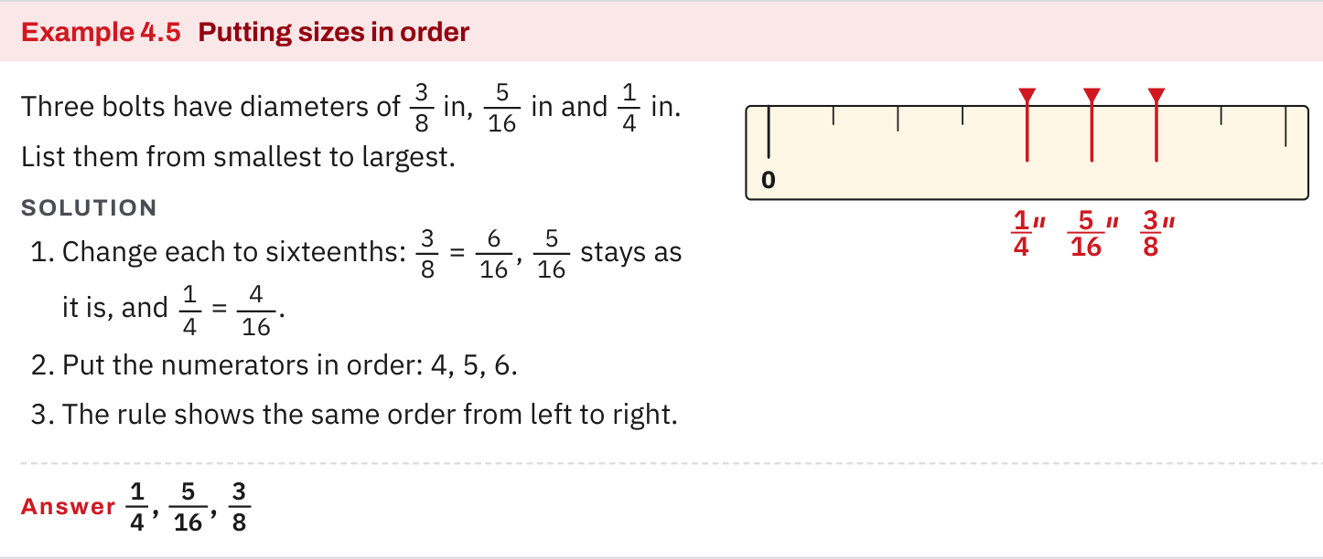
W02-L07 • TEACH • 9:10 AM–9:25 AM • 15 MIN TOTAL
Textbook | page 94
Textbook p.94 · Example 4.5: compare common denominators and confirm on the rule.
Textbook Chapter 4 pp.91–94
Textbook
Exercise Book
Numeracy Hub
Shape Canvas
Day 06 • 2026-11-05 • 09
Notes:
TEACH • 9:10 AM–9:25 AM • 15 MIN TOTAL — shared across this phase.
On page 94, follow Example 4.5 from its fractions to the rule. The useful move is choosing a shared unit before deciding which value is larger. Identify the denominator used in the comparison, then explain why both original fractions can be written with it. If we have quarters and sixteenths, sixteenths work because each quarter contains four of them. Where should the larger fraction appear on the rule? Farther from zero. If the arithmetic says one value is larger but our mark lies to the left, we need to check the conversion or the mark.

Slide 10
W02-L07 • TEACH • 9:10 AM–9:25 AM • 15 MIN TOTAL
Spot the mistake. Explain the correction.
Is 11/16 longer than 3/4 because 11 is greater than 3?
Discuss the method before checking the answer.
Compare equal-sized parts: 3/4 = 12/16, which is longer than 11/16 by 1/16.
Textbook Chapter 4 pp.91–94
Textbook
Exercise Book
Numeracy Hub
Shape Canvas
Day 06 • 2026-11-05 • 10
Notes:
TEACH • 9:10 AM–9:25 AM • 15 MIN TOTAL — shared across this phase.
Someone argues that eleven sixteenths must be longer than three quarters because eleven is greater than three. What information did that argument leave out? It ignored the size of each piece. Eleven small pieces do not automatically outweigh three larger pieces. Rename three quarters as twelve sixteenths. Now the comparison is fair: twelve is greater than eleven, so three quarters is longer by one sixteenth. Explain the correction using the words equal-sized parts. That explanation is more useful than memorizing which of these two fractions happens to be larger.

Slide 11
W02-L07 • TOGETHER • 9:25 AM–9:40 AM • 15 MIN TOTAL
Work together
Work 4A questions 6–8 with fraction strips; confirm the longer length on a rule.
Work in pairs; alternate solver and checker.
Resources: Exercise Book 4A Q6–11 (p.36)
Textbook Chapter 4 pp.91–94
Textbook
Exercise Book
Numeracy Hub
Shape Canvas
Day 06 • 2026-11-05 • 11
Notes:
TOGETHER • 9:25 AM–9:40 AM • 15 MIN TOTAL — shared across this phase.
Work through 4A questions 6–8 together. One partner explains each conversion while the other checks it with fraction strips or a rule, then switch roles. For lowest terms, name the factor you divided by. For a comparison, state the common denominator before choosing the longer length. Ask your partner, 'What did you do to the numerator, and what did you do to the denominator?' Both must change by the same factor for the value to stay equal.

Slide 12
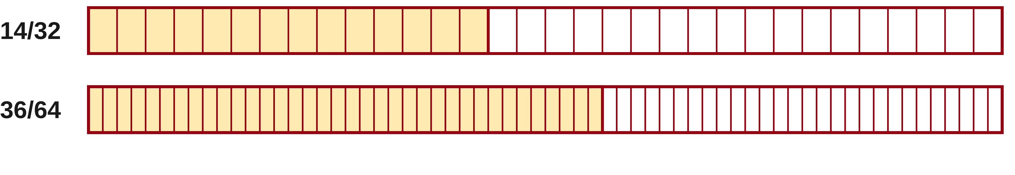
W02-L07 • TOGETHER • 9:25 AM–9:40 AM • 15 MIN TOTAL
Guided practice | 4A Q6
Work with a partner. Take turns explaining the next step.
Textbook Chapter 4 pp.91–94
Textbook
Exercise Book
Numeracy Hub
Shape Canvas
Day 06 • 2026-11-05 • 12
Notes:
TOGETHER • 9:25 AM–9:40 AM • 15 MIN TOTAL — shared across this phase.
Question 6 asks for fourteen thirty-seconds and thirty-six sixty-fourths in lowest terms. First find a factor that divides both numbers in each fraction. Try the reductions on paper before we compare. How will you know you have finished? The two remaining numbers share no factor greater than one.
Instructor only, after the attempt: 14/32 = (14 ÷ 2)/(32 ÷ 2) = 7/16. For 36/64, divide both by four to obtain 9/16. Neither seven nor nine shares a factor with sixteen.

Slide 13
W02-L07 • TOGETHER • 9:25 AM–9:40 AM • 15 MIN TOTAL
Compare your method | 4A Q6
CHECK TOGETHER
7/16 and 9/16
Textbook Chapter 4 pp.91–94
Textbook
Exercise Book
Numeracy Hub
Shape Canvas
Day 06 • 2026-11-05 • 13
Notes:
TOGETHER • 9:25 AM–9:40 AM • 15 MIN TOTAL — shared across this phase.
Our answers are seven sixteenths and nine sixteenths. Notice that both original fractions reduced to sixteenths, but by different factors: two for fourteen thirty-seconds, four for thirty-six sixty-fourths. If you divided thirty-six and sixty-four by two first, eighteen thirty-seconds is correct but not yet in lowest terms; divide by two again. Which final fraction is larger? Nine sixteenths, because both use equal-sized pieces. We can compare their numerators directly now that their denominators match.

Slide 14
W02-L07 • PRACTISE • 9:40 AM–10:00 AM • 20 MIN TOTAL
Your scheduled practice
Complete 4A questions 9–11. Place three labelled dimensions in order and explain the comparison to a partner.
Show working and units; estimate, then check.
Resources: Exercise Book 4A Q6–11 (p.36)
Textbook Chapter 4 pp.91–94
Textbook
Exercise Book
Numeracy Hub
Shape Canvas
Day 06 • 2026-11-05 • 14
Notes:
PRACTISE • 9:40 AM–10:00 AM • 20 MIN TOTAL — shared across this phase.
Complete 4A questions 9–11. In question 9, preserve the three original labels while you rename them with a common denominator. Put the original fractions in the requested order, so the final answer still matches the question. For questions 10 and 11, keep track of whole units as well as fractional pieces. Explain your ordering to a partner using equal-sized units. A convincing explanation says how many of the same-sized pieces each dimension contains, rather than simply saying one looks bigger.

Slide 15

W02-L07 • PRACTISE • 9:40 AM–10:00 AM • 20 MIN TOTAL
Open Numeracy Hub
Navigation example. Use the values and units in the assigned task.
Textbook Chapter 4 pp.91–94
Textbook
Exercise Book
Numeracy Hub
Shape Canvas
Day 06 • 2026-11-05 • 15
Notes:
PRACTISE • 9:40 AM–10:00 AM • 20 MIN TOTAL — shared across this phase.
Open Numeracy Hub and use the navigation shown here to reach the measuring support you need. The values on this screen are an illustration; your written task still uses the fractions in 4A questions 9–11. Before using a display, predict the order on paper. What should a useful check tell us? It should confirm the same relative positions or equivalent values. If the display and your paper disagree, compare the units and the entered fraction before changing your mathematical reasoning.

Slide 16
W02-L07 • PRACTISE • 9:40 AM–10:00 AM • 20 MIN TOTAL
Practise in Shape Canvas
1
Supported: Use fraction strips and a rule to explain the equivalence in 4A Q6–8.
2
Independent practice: In Shape Canvas, select inches and create three labelled dimensions from Q9–11.
3
Independent checking: Order the written values using common denominators and explain them to a partner.
Textbook Chapter 4 pp.91–94
Textbook
Exercise Book
Numeracy Hub
Shape Canvas
Day 06 • 2026-11-05 • 16
Notes:
PRACTISE • 9:40 AM–10:00 AM • 20 MIN TOTAL — shared across this phase.
In Shape Canvas, select inches before creating your labelled dimensions. Use the values in the assigned questions, and keep their written labels visible. Read the labels to compare the dimensions; a zoomed picture is not a ruler. If you need support, return to a fraction strip and show that equivalent labels reach the same endpoint. Ask your partner which common denominator makes the comparison straightforward. They should explain how each original fraction becomes a count of that same unit, then put the dimensions in order.

Slide 17
W02-L07 • PRACTISE • 9:40 AM–10:00 AM • 20 MIN TOTAL
Practise from the Exercise Book | 4A Q9
Write the operation, working and units before checking.
Textbook Chapter 4 pp.91–94
Textbook
Exercise Book
Numeracy Hub
Shape Canvas
Day 06 • 2026-11-05 • 17
Notes:
PRACTISE • 9:40 AM–10:00 AM • 20 MIN TOTAL — shared across this phase.
Put thirteen thirty-seconds, three eighths, and seven sixteenths in order from smallest. Choose thirty-seconds so every value counts the same-sized piece. Write the conversions before ordering the original labels. Which numerator should come first once all three denominators match?
Instructor only, after the attempt: 3/8 = 12/32; 13/32 stays unchanged; 7/16 = 14/32. Therefore the order is 3/8, 13/32, 7/16. Each adjacent value differs by one thirty-second.

Slide 18
W02-L07 • PRACTISE • 9:40 AM–10:00 AM • 20 MIN TOTAL
Practise from the Exercise Book | 4A Q10
Write the operation, working and units before checking.
Textbook Chapter 4 pp.91–94
Textbook
Exercise Book
Numeracy Hub
Shape Canvas
Day 06 • 2026-11-05 • 18
Notes:
PRACTISE • 9:40 AM–10:00 AM • 20 MIN TOTAL — shared across this phase.
Question 10 moves us toward the next block: change thirty-seven eighths and fifty-three sixteenths to mixed numbers. Count how many complete groups fit into each numerator; the leftover pieces remain over the original denominator. Try both before checking.
Instructor only, after the attempt: 37 = 4 × 8 + 5, so 37/8 = 4 5/8. Also 53 = 3 × 16 + 5, so 53/16 = 3 5/16. Both have five leftover pieces, but those pieces are different sizes.

Slide 19
W02-L07 • CHECK • 10:00 AM–10:10 AM • 10 MIN TOTAL
Check independently
Complete 4A questions 6 and 8, showing the common denominator.
Answer independently and show the method.
Resources: Exercise Book 4A Q6–11 (p.36)
Textbook Chapter 4 pp.91–94
Textbook
Exercise Book
Numeracy Hub
Shape Canvas
Day 06 • 2026-11-05 • 19
Notes:
CHECK • 10:00 AM–10:10 AM • 10 MIN TOTAL — shared across this phase.
Now complete 4A questions 6 and 8 independently. For question 6, show the common factor used in each reduction. For question 8, show a common denominator before deciding which length is longer and finding the difference. Your written steps need to make the reasoning visible even without a rule beside them. Ask yourself: did I preserve the fraction's value when I renamed it, and did I label the final difference in inches? Keep solutions closed until the attempt is complete.

Slide 20
W02-L07 • CHECK • 10:00 AM–10:10 AM • 10 MIN TOTAL
Independent check | 4A Q6
Answer independently. Keep worked solutions closed.
Textbook Chapter 4 pp.91–94
Textbook
Exercise Book
Numeracy Hub
Shape Canvas
Day 06 • 2026-11-05 • 20
Notes:
CHECK • 10:00 AM–10:10 AM • 10 MIN TOTAL — shared across this phase.
Reduce fourteen thirty-seconds and thirty-six sixty-fourths without help. Show the division that produces each new numerator and denominator. A fraction that is equivalent but can still be reduced is not yet a finished lowest-terms answer.
Instructor only, after the attempt: 14/32 = 7/16 by dividing numerator and denominator by two. 36/64 = 9/16 by dividing both by four. If a learner writes 18/32, acknowledge the valid first step and ask whether both numbers still share a factor of two.

Slide 21
W02-L07 • CHECK • 10:00 AM–10:10 AM • 10 MIN TOTAL
Independent check | 4A Q8
Answer independently. Keep worked solutions closed.
Textbook Chapter 4 pp.91–94
Textbook
Exercise Book
Numeracy Hub
Shape Canvas
Day 06 • 2026-11-05 • 21
Notes:
CHECK • 10:00 AM–10:10 AM • 10 MIN TOTAL — shared across this phase.
Which is longer, nine sixteenths of an inch or five eighths of an inch, and by how much? Write a comparison using one common denominator, then subtract. Include both the name of the longer length and the size of the difference.
Instructor only, after the attempt: 5/8 = 10/16. Ten sixteenths exceeds nine sixteenths by 1/16, so 5/8 in is longer by 1/16 in. Subtracting nine from five before matching units does not compare like-sized pieces.

Slide 22
W02-L07 • WRAP UP • 10:10 AM–10:15 AM • 5 MIN TOTAL
Wrap up and choose the next step
Share one learning point and one skill to practise next.
Record a takeaway and next action.
Resources: Exercise Book 4A Q6–11 (p.36)
Textbook Chapter 4 pp.91–94
Textbook
Exercise Book
Numeracy Hub
Shape Canvas
Day 06 • 2026-11-05 • 22
Notes:
WRAP UP • 10:10 AM–10:15 AM • 5 MIN TOTAL — shared across this phase.
Finish this sentence: 'Before I compare two fractions, I make sure...' A strong ending is 'they count equal-sized parts.' Name one conversion that helped you today, such as three quarters becoming twelve sixteenths. Then identify whether your next practice should focus on finding equivalent fractions, reducing them, or explaining a difference. After the break, we will keep the same values but change between mixed-number and improper-fraction forms. Whole inches will become groups of fractional pieces.

Slide 23
DAY 06 • SCHEDULED BREAK
Break
10:15 AM–10:30 AM
Return ready for: Mixed numbers and fraction calculator entry
This break is excluded from teaching minutes.
Textbook
Exercise Book
Numeracy Hub
Shape Canvas
Day 06 • 2026-11-05 • 23
Notes:
Take the scheduled break from 10:15 to 10:30. We resume at 10:30 with mixed numbers and fraction calculator entry. Leave your rule and exercise book ready for 4A questions 10–13, and bring your calculator back ready to use.

Slide 24
W02-L08 • START • 10:30 AM–10:35 AM • 5 MIN TOTAL
Mixed numbers and fraction calculator entry
Today’s goal: Convert mixed and improper fractions and match the calculator display to the written value.
Name one use for today’s skill.
Textbook Chapter 4 pp.94–96; Chapter 2 p.54
Exercise Book 4A Q10–13 (p.36); 2A Q9 (p.18)
Keep your notebook, textbook, exercise book and chosen calculator ready.
Textbook Chapter 4 pp.94–96; Chapter 2 p.54
Textbook
Exercise Book
Numeracy Hub
Shape Canvas
Day 06 • 2026-11-05 • 24
Notes:
START • 10:30 AM–10:35 AM • 5 MIN TOTAL — shared across this phase.
We now need to recognize the same length in two forms: a whole-number part plus a fraction, or one count of fractional pieces. Open the textbook to pages 94–96; page 54 supports calculator entry. Where would you expect to see a mixed number? A dimension such as two and three eighths inches is a good example. An improper fraction may appear during calculation. Both forms can describe the same measurement, so we must read and convert them accurately.

Slide 25
W02-L08 • RECALL • 10:35 AM–10:40 AM • 5 MIN TOTAL
Recall and reconnect
Explain how many eighths are in 4 5/8. Check the meaning of numerator and denominator.
Try first without displayed answers.
Resources: Exercise Book 4A Q10–13 (p.36); 2A Q9 (p.18)
Textbook Chapter 4 pp.94–96; Chapter 2 p.54
Textbook
Exercise Book
Numeracy Hub
Shape Canvas
Day 06 • 2026-11-05 • 25
Notes:
RECALL • 10:35 AM–10:40 AM • 5 MIN TOTAL — shared across this phase.
How many eighths are in four and five eighths? Each whole contains eight eighths, so four wholes contain thirty-two eighths. Add the extra five: thirty-seven eighths altogether. Why does the denominator stay eight? We are still counting pieces of size one eighth. Point to the whole part, the numerator, and the denominator in the mixed number. Their jobs differ: four counts complete units, five counts leftover pieces, and eight tells us the size of each piece.

Slide 26
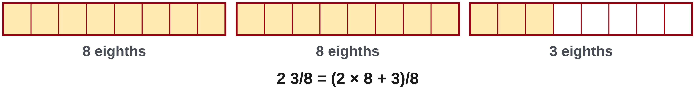
W02-L08 • TEACH • 10:40 AM–10:55 AM • 15 MIN TOTAL
Turn whole units into fractional units
1
A mixed number contains a whole-number part and a fraction.
2
Multiply the whole number by the denominator, then add the numerator.
3
Keep the denominator: the size of each fractional unit has not changed.
4
Write the improper fraction before checking it on the calculator.
Textbook Chapter 4 pp.94–96; Chapter 2 p.54
Textbook
Exercise Book
Numeracy Hub
Shape Canvas
Day 06 • 2026-11-05 • 26
Notes:
TEACH • 10:40 AM–10:55 AM • 15 MIN TOTAL — shared across this phase.
A mixed number combines whole units and a fractional remainder. To turn it into one fraction, first express the wholes in the same fractional unit. For two and three eighths, the two wholes contribute two times eight, or sixteen eighths. Add the three more eighths to get nineteen eighths. That is why the rule is whole times denominator plus numerator, all over the original denominator. What would adding two and three directly mean? It would incorrectly count two whole units as only two eighths. Keep the meaning of each quantity visible as you calculate.

Slide 27
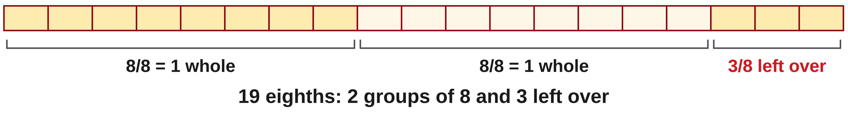
W02-L08 • TEACH • 10:40 AM–10:55 AM • 15 MIN TOTAL
Turn an improper fraction back into a mixed number
1
Divide the numerator by the denominator.
2
The whole-number quotient gives the whole part.
3
The remainder becomes the numerator over the original denominator.
4
Read the calculator display aloud and compare both parts with your written value.
Textbook Chapter 4 pp.94–96; Chapter 2 p.54
Textbook
Exercise Book
Numeracy Hub
Shape Canvas
Day 06 • 2026-11-05 • 27
Notes:
TEACH • 10:40 AM–10:55 AM • 15 MIN TOTAL — shared across this phase.
Now reverse the conversion. An improper fraction tells us how many fractional pieces we have altogether. Divide the numerator by the denominator to find complete wholes. Nineteen eighths contains two full groups of eight and three pieces left over, so it is two and three eighths. Where does the remainder go? It becomes the numerator of the remaining fraction, over the same denominator. Read a calculator display aloud as a whole number and a fraction; do not assume every separator is a decimal point. Compare both parts with your written conversion before accepting the result.

Slide 28
W02-L08 • TEACH • 10:40 AM–10:55 AM • 15 MIN TOTAL
Change the form—not the value
2 3/8 = (2 × 8 + 3)/8 = 19/8
19 ÷ 8 = 2 remainder 3 → 2 3/8
The denominator stays 8 because we are still counting eighths.
Read the calculator fraction display aloud; check that whole and fractional parts match your written value.
Together • Complete 4A Q10–12.
Compare paper conversions with Numeracy Hub Calculator using your selected model and the Textbook fraction-key sequence.
W2 L8 • First explain the fraction; then check the display
Textbook
Exercise Book
Numeracy Hub
Shape Canvas
Day 06 • 2026-11-05 • 28
Notes:
TEACH • 10:40 AM–10:55 AM • 15 MIN TOTAL — shared across this phase.
Watch the round trip on the slide. Two and three eighths becomes (2 × 8 + 3)/8. Two times eight is sixteen; sixteen plus three is nineteen, so the improper form is nineteen eighths. Now divide nineteen by eight: two whole groups use sixteen, leaving three. That brings us back to two and three eighths. What changed during this process? Only the form, not the amount. A good conversion can travel in either direction and return to its starting value. Use that reverse check when the calculator display looks unfamiliar.

Slide 29
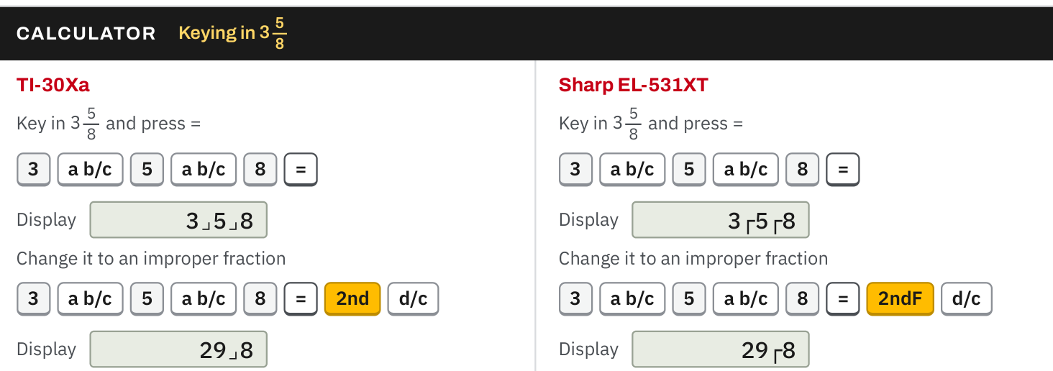
W02-L08 • TEACH • 10:40 AM–10:55 AM • 15 MIN TOTAL
Textbook | page 96
Textbook p.96 · Enter a mixed number and change it to an improper fraction.
Textbook Chapter 4 pp.94–96; Chapter 2 p.54
Textbook
Exercise Book
Numeracy Hub
Shape Canvas
Day 06 • 2026-11-05 • 29
Notes:
TEACH • 10:40 AM–10:55 AM • 15 MIN TOTAL — shared across this phase.
Page 96 shows mixed and improper fraction displays and the conversion sequence for each calculator model. Find the model that matches yours before pressing keys. Enter the whole-number part and both fraction parts in the order shown, then read the displayed value aloud. Ask yourself: does this display show the whole part I intended and the correct numerator and denominator? The d/c conversion changes how the value is presented; it does not alter the value. If your display differs, check entry and model instructions rather than copying a key sequence for a different calculator.

Slide 30
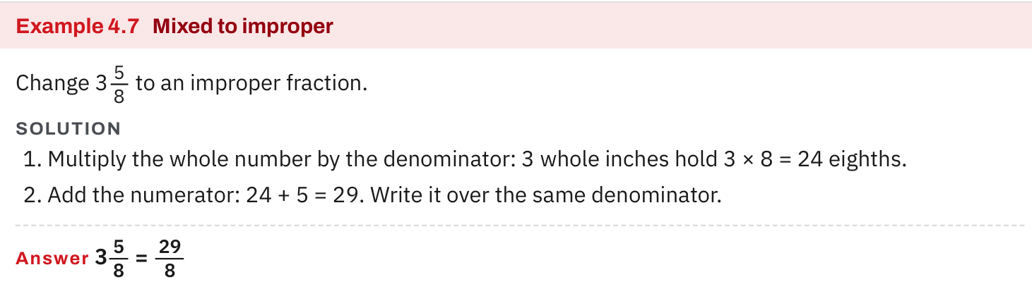
W02-L08 • TEACH • 10:40 AM–10:55 AM • 15 MIN TOTAL
Textbook | page 95
Textbook p.95 · Example 4.7: whole × denominator + numerator.
Textbook Chapter 4 pp.94–96; Chapter 2 p.54
Textbook
Exercise Book
Numeracy Hub
Shape Canvas
Day 06 • 2026-11-05 • 30
Notes:
TEACH • 10:40 AM–10:55 AM • 15 MIN TOTAL — shared across this phase.
In Example 4.7 on page 95, follow the line that multiplies the whole number by the denominator. That multiplication counts all the fractional pieces contained in the wholes. The next addition includes the extra pieces already shown in the mixed number. Why is the whole number multiplied before the numerator is added? Because the two quantities must describe the same kind of piece before we combine them. The denominator stays unchanged throughout. Read the line as a count of pieces, then use the reverse division to confirm that the original whole-number part and remainder return.

Slide 31
W02-L08 • TEACH • 10:40 AM–10:55 AM • 15 MIN TOTAL
Spot the mistake. Explain the correction.
A learner changes 2 3/8 into 5/8 by adding 2 + 3. Why is that wrong?
Discuss the method before checking the answer.
Two whole units contain 16 eighths. Add 3 more eighths: (2 × 8 + 3)/8 = 19/8.
Textbook Chapter 4 pp.94–96; Chapter 2 p.54
Textbook
Exercise Book
Numeracy Hub
Shape Canvas
Day 06 • 2026-11-05 • 31
Notes:
TEACH • 10:40 AM–10:55 AM • 15 MIN TOTAL — shared across this phase.
The suggested answer of five eighths should trouble us before any calculation: two and three eighths is greater than two, while five eighths is less than one. What caused that mismatch? The learner added two wholes to three eighths as though they were the same-sized pieces. Two wholes contain sixteen eighths, so the correct count is sixteen plus three, or nineteen eighths. This size check is powerful: an equivalent form must lie in the same interval between whole numbers. If a conversion crosses from above two to below one, it cannot be equivalent.

Slide 32
W02-L08 • TOGETHER • 10:55 AM–11:10 AM • 15 MIN TOTAL
Work together
Complete 4A questions 10–12. Compare paper conversions with calculator displays.
Work in pairs; alternate solver and checker.
Resources: Exercise Book 4A Q10–13 (p.36); 2A Q9 (p.18)
Textbook Chapter 4 pp.94–96; Chapter 2 p.54
Textbook
Exercise Book
Numeracy Hub
Shape Canvas
Day 06 • 2026-11-05 • 32
Notes:
TOGETHER • 10:55 AM–11:10 AM • 15 MIN TOTAL — shared across this phase.
Complete 4A questions 10–12 with a partner. Write the paper conversion first, then compare it with the calculator display. For an improper fraction, explain the quotient and remainder. For a mixed number, explain how many fractional pieces come from the whole part. Ask your partner to read the display aloud rather than simply showing the screen. If the paper and display disagree, inspect one component at a time: whole part, numerator, denominator. That helps locate an entry error without abandoning a correct method.

Slide 33
W02-L08 • TOGETHER • 10:55 AM–11:10 AM • 15 MIN TOTAL
Guided practice | 4A Q10
Work with a partner. Take turns explaining the next step.
Textbook Chapter 4 pp.94–96; Chapter 2 p.54
Textbook
Exercise Book
Numeracy Hub
Shape Canvas
Day 06 • 2026-11-05 • 33
Notes:
TOGETHER • 10:55 AM–11:10 AM • 15 MIN TOTAL — shared across this phase.
For 4A question 10, divide thirty-seven by eight and fifty-three by sixteen. Do not round the quotient to a decimal; we want whole groups and leftover pieces. What denominator belongs under the remainder? The original one, because the leftover pieces have not changed size.
Instructor only, after the attempt: 37/8 = 4 5/8 because 4 × 8 = 32 and 37 − 32 = 5. 53/16 = 3 5/16 because 3 × 16 = 48 and 53 − 48 = 5.

Slide 34
W02-L08 • TOGETHER • 10:55 AM–11:10 AM • 15 MIN TOTAL
Compare your method | 4A Q10
CHECK TOGETHER
4 5/8 and 3 5/16
Textbook Chapter 4 pp.94–96; Chapter 2 p.54
Textbook
Exercise Book
Numeracy Hub
Shape Canvas
Day 06 • 2026-11-05 • 34
Notes:
TOGETHER • 10:55 AM–11:10 AM • 15 MIN TOTAL — shared across this phase.
Compare your two mixed numbers with four and five eighths, and three and five sixteenths. The remainder is five in both calculations, but that does not make the fractions equal: eighths are larger than sixteenths. Check each conversion backward. Four times eight plus five returns thirty-seven; three times sixteen plus five returns fifty-three. Which original denominator goes with each remainder? Keeping that pairing correct is the key. Now confirm that your calculator displays the same whole and fractional parts.

Slide 35
W02-L08 • PRACTISE • 11:10 AM–11:45 AM • 35 MIN TOTAL
Your scheduled practice
Complete question 13 and practise entering the values in questions 10–12 without changing them. Use 2A question 9 as a supported extension, not an addition-speed test.
Show working and units; estimate, then check.
Resources: Exercise Book 4A Q10–13 (p.36); 2A Q9 (p.18)
Textbook Chapter 4 pp.94–96; Chapter 2 p.54
Textbook
Exercise Book
Numeracy Hub
Shape Canvas
Day 06 • 2026-11-05 • 35
Notes:
PRACTISE • 11:10 AM–11:45 AM • 35 MIN TOTAL — shared across this phase.
Complete question 13, then practise entering the unchanged values from questions 10–12. We are checking faithful entry, not racing. Read every mixed number before you key it in, and compare the result with your written form. Question 2A Q9 is a supported extension for practising the entry sequence; it is not an addition-speed test. If a display surprises you, decide first whether the calculator changed the form or whether you entered a different value. Those are different situations and need different corrections.

Slide 36
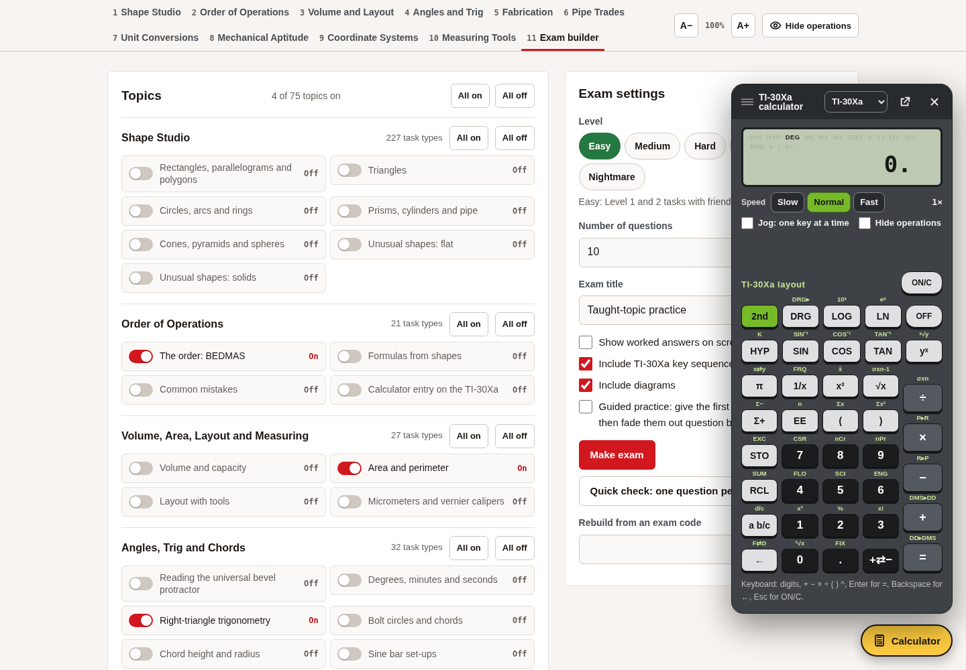
W02-L08 • PRACTISE • 11:10 AM–11:45 AM • 35 MIN TOTAL
Open Numeracy Hub
Navigation example. Use the values and units in the assigned task.
Textbook Chapter 4 pp.94–96; Chapter 2 p.54
Textbook
Exercise Book
Numeracy Hub
Shape Canvas
Day 06 • 2026-11-05 • 36
Notes:
PRACTISE • 11:10 AM–11:45 AM • 35 MIN TOTAL — shared across this phase.
Open the calculator in Numeracy Hub and select the model you are learning to use. Keep page 54 beside you for that model's fraction-key sequence. We will enter a value from 4A questions 10–12 exactly as written. Before pressing the conversion key, predict whether the result should remain between the same two whole numbers. Why is that prediction useful? It catches a missing whole part or a mistaken fraction entry even when the screen's notation is unfamiliar.

Slide 37
W02-L08 • PRACTISE • 11:10 AM–11:45 AM • 35 MIN TOTAL
Practise in Numeracy Hub
1
Supported: Select the learner’s Numeracy Hub calculator model and follow Textbook p.54.
2
Supported: Enter the values from 4A Q10–12 after completing each conversion on paper.
3
Independent checking: Complete Q10–11 without a calculator, then compare the display with your values.
Textbook Chapter 4 pp.94–96; Chapter 2 p.54
Textbook
Exercise Book
Numeracy Hub
Shape Canvas
Day 06 • 2026-11-05 • 37
Notes:
PRACTISE • 11:10 AM–11:45 AM • 35 MIN TOTAL — shared across this phase.
Use the calculator model that matches your learning sequence in the textbook. Complete a conversion from 4A questions 10–12 on paper, then enter it and read the display aloud. Check the whole part, numerator, and denominator separately. After that supported practice, attempt questions 10–11 without the calculator and use it only to verify. What should change when you switch from mixed to improper form? The appearance of the number. The measured amount and its position between whole numbers must stay the same.

Slide 38
W02-L08 • PRACTISE • 11:10 AM–11:45 AM • 35 MIN TOTAL
Practise from the Exercise Book | 4A Q13
Write the operation, working and units before checking.
Textbook Chapter 4 pp.94–96; Chapter 2 p.54
Textbook
Exercise Book
Numeracy Hub
Shape Canvas
Day 06 • 2026-11-05 • 38
Notes:
PRACTISE • 11:10 AM–11:45 AM • 35 MIN TOTAL — shared across this phase.
Question 13 asks for the reciprocal of two and one half. First write the entire mixed number as one improper fraction; only then interchange numerator and denominator. Why can we not simply turn over the one-half part? The reciprocal applies to the whole value.
Instructor only, after the attempt: 2 1/2 = 5/2, so its reciprocal is 2/5. Verify by multiplication: (5/2) × (2/5) = 1. A number greater than one has a positive reciprocal less than one here.

Slide 39
W02-L08 • PRACTISE • 11:10 AM–11:45 AM • 35 MIN TOTAL
Practise from the Exercise Book | 4A Q10
Write the operation, working and units before checking.
Textbook Chapter 4 pp.94–96; Chapter 2 p.54
Textbook
Exercise Book
Numeracy Hub
Shape Canvas
Day 06 • 2026-11-05 • 39
Notes:
PRACTISE • 11:10 AM–11:45 AM • 35 MIN TOTAL — shared across this phase.
Return to question 10 as an entry check. Your paper should show how thirty-seven eighths and fifty-three sixteenths become mixed numbers. Enter each original fraction, convert its display, and compare every part. Does the screen show the same remainder over the same denominator?
Instructor only, after the attempt: The forms are 4 5/8 and 3 5/16. If a learner obtains a decimal, ask whether it represents the same value, then use the model's documented sequence to display the requested mixed-number form.

Slide 40
W02-L08 • CHECK • 11:45 AM–11:55 AM • 10 MIN TOTAL
Check independently
Complete 4A questions 10–11 without the calculator, then check.
Answer independently and show the method.
Resources: Exercise Book 4A Q10–13 (p.36); 2A Q9 (p.18)
Textbook Chapter 4 pp.94–96; Chapter 2 p.54
Textbook
Exercise Book
Numeracy Hub
Shape Canvas
Day 06 • 2026-11-05 • 40
Notes:
CHECK • 11:45 AM–11:55 AM • 10 MIN TOTAL — shared across this phase.
Complete 4A questions 10–11 without the calculator first. Question 10 starts with improper fractions, so show whole groups and remainders. Question 11 starts with mixed numbers, so show whole times denominator plus numerator. After your written attempt is finished, use the calculator to check. Ask yourself whether each converted value remains between the same whole numbers. The check should confirm reasoning you can explain, not replace the conversion steps we are assessing.

Slide 41
W02-L08 • CHECK • 11:45 AM–11:55 AM • 10 MIN TOTAL
Independent check | 4A Q10
Answer independently. Keep worked solutions closed.
Textbook Chapter 4 pp.94–96; Chapter 2 p.54
Textbook
Exercise Book
Numeracy Hub
Shape Canvas
Day 06 • 2026-11-05 • 41
Notes:
CHECK • 11:45 AM–11:55 AM • 10 MIN TOTAL — shared across this phase.
Write the mixed-number forms of thirty-seven eighths and fifty-three sixteenths. Show the multiplication or division that establishes the whole part, then the subtraction that establishes the remainder. Keep this independent until your written attempt is complete.
Instructor only, after the attempt: 37/8 = 4 5/8; 53/16 = 3 5/16. The remainders are both five, but the denominators remain eight and sixteen respectively. A remainder must be smaller than its denominator, otherwise another whole group can still be formed.

Slide 42
W02-L08 • CHECK • 11:45 AM–11:55 AM • 10 MIN TOTAL
Independent check | 4A Q11
Answer independently. Keep worked solutions closed.
Textbook Chapter 4 pp.94–96; Chapter 2 p.54
Textbook
Exercise Book
Numeracy Hub
Shape Canvas
Day 06 • 2026-11-05 • 42
Notes:
CHECK • 11:45 AM–11:55 AM • 10 MIN TOTAL — shared across this phase.
Convert four and seven sixteenths, then six and three quarters, to improper fractions. Write one line showing how the wholes become fractional pieces. What stays unchanged in each answer? The denominator.
Instructor only, after the attempt: (4 × 16 + 7)/16 = 71/16. Also (6 × 4 + 3)/4 = 27/4. Check backward: 71 ÷ 16 gives four remainder seven; 27 ÷ 4 gives six remainder three. Adding the whole number directly to the numerator misses the groups contained in the wholes.

Slide 43
W02-L08 • WRAP UP • 11:55 AM–12:00 PM • 5 MIN TOTAL
Wrap up and choose the next step
Share one learning point and one skill to practise next.
Record a takeaway and next action.
Resources: Exercise Book 4A Q10–13 (p.36); 2A Q9 (p.18)
Textbook Chapter 4 pp.94–96; Chapter 2 p.54
Textbook
Exercise Book
Numeracy Hub
Shape Canvas
Day 06 • 2026-11-05 • 43
Notes:
WRAP UP • 11:55 AM–12:00 PM • 5 MIN TOTAL — shared across this phase.
Tell a partner why two and three eighths and nineteen eighths are the same value. A complete explanation counts sixteen eighths in the two wholes and adds three more. Then explain how the calculator helped you check that value without changing it. Record whether you need more practice with the paper conversion or the key sequence. Our next scheduled work takes fractional dimensions onto a drawing and a rule, where the written form must connect to an actual location on the material.

