Slide 1

CARPENTRY FOUNDATION / INTAKE 142
Day 08 | Monday
08
November 9, 2026
Adding fractional lengths
12:45 PM–2:00 PM • Math • 75 min
Subtracting and regrouping fractions
2:15 PM–3:30 PM • Math • 75 min
Week 3 • 2 scheduled blocks • 150 teaching minutes
Estimate. Show the method. Label units. Check the result.
Textbook
Exercise Book
Numeracy Hub
Shape Canvas
Day 08 • 2026-11-09 • 01
Notes:
Today we use fractional dimensions to find totals and remainders. Before the break, we join lengths and combine layers by addition. After the break, we find what remains or what is missing by subtraction. Both depend on equal-sized fractional parts. What check should a total of two positive lengths pass? It must be longer than either part. For a remainder, we will add it back to the known part and recover the original length.

Slide 2
DAY 08 / WEEK 3 / CLASS TIMETABLE
Today’s exact schedule
12:45 PM–2:00 PM • 75 min
2:15 PM–3:30 PM • 75 min
Adding fractional lengths
Subtracting and regrouping fractions
12:45 PM–12:50 PM
Start
5
2:15 PM–2:20 PM
Start
5
12:50 PM–12:55 PM
Recall
5
2:20 PM–2:25 PM
Recall
5
12:55 PM–1:10 PM
Teach
15
2:25 PM–2:40 PM
Teach
15
1:10 PM–1:25 PM
Together
15
2:40 PM–2:55 PM
Together
15
1:25 PM–1:45 PM
Practise
20
2:55 PM–3:15 PM
Practise
20
1:45 PM–1:55 PM
Check
10
3:15 PM–3:25 PM
Check
10
1:55 PM–2:00 PM
Wrap up
5
3:25 PM–3:30 PM
Wrap up
5
Math • Math Week 3, Lesson 1
Math • Math Week 3, Lesson 2
Break: 2:00 PM–2:15 PM • 15 minutes • excluded from teaching time
Textbook
Exercise Book
Numeracy Hub
Shape Canvas
Day 08 • 2026-11-09 • 02
Notes:
Our first block runs from 12:45 to 2:00, followed by the scheduled break from 2:00 to 2:15. Subtraction begins at 2:15 and finishes at 3:30. Each block includes 15 minutes of teaching, 15 minutes working together, 20 minutes practising, and a 10-minute independent check. Use the working-together time to explain the common denominator and any regrouping aloud. Those explanations will help you carry out the same steps independently during the check.

Slide 3
W03-L01 • START • 12:45 PM–12:50 PM • 5 MIN TOTAL
Adding fractional lengths
Today’s goal: Add fractional and mixed-inch lengths using a common denominator.
Name one use for today’s skill.
Textbook Chapter 4 pp.91–99
Exercise Book 4A Q14 (p.36); 4B Q2–3 (p.37)
Keep your notebook, textbook, exercise book and chosen calculator ready.
Textbook Chapter 4 pp.91–99
Textbook
Exercise Book
Numeracy Hub
Shape Canvas
Day 08 • 2026-11-09 • 03
Notes:
START • 12:45 PM–12:50 PM • 5 MIN TOTAL — shared across this phase.
Open the textbook to Chapter 4, pages 91–99. When two pieces are placed end to end, their lengths add. When plates and a washer form a stack, their thicknesses add too. The arithmetic is the same even though the drawing looks different. Why do we need a common denominator? It lets us count equal-sized parts in one total. We will practise with 4A question 14 and 4B questions 2–3, keeping the written sum and the physical meaning connected.

Slide 4
W03-L01 • RECALL • 12:50 PM–12:55 PM • 5 MIN TOTAL
Recall and reconnect
Retrieve equivalent fractions and ask how many sixteenths make one whole.
Try first without displayed answers.
Resources: Exercise Book 4A Q14 (p.36); 4B Q2–3 (p.37)
Textbook Chapter 4 pp.91–99
Textbook
Exercise Book
Numeracy Hub
Shape Canvas
Day 08 • 2026-11-09 • 04
Notes:
RECALL • 12:50 PM–12:55 PM • 5 MIN TOTAL — shared across this phase.
How many sixteenths make one whole? Sixteen. How many sixteenths make three quarters? Twelve, because each quarter contains four sixteenths. These two facts prepare us for addition: equivalent fractions give us shared units, and a complete set of those units becomes a whole. If a total contains seventeen sixteenths, where does it lie? Just beyond one whole, specifically one and one sixteenth. Keep that picture in mind when a fractional sum is larger than its denominator.

Slide 5
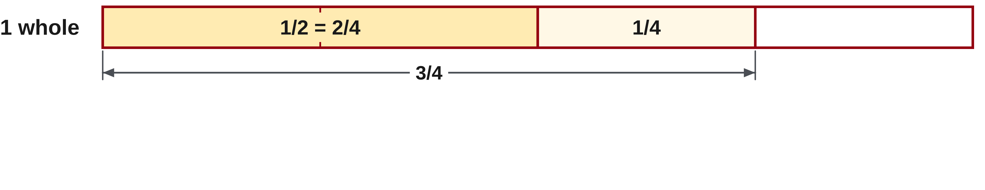
W03-L01 • TEACH • 12:55 PM–1:10 PM • 15 MIN TOTAL
Add equal-sized fractional parts
1
Choose a common denominator before adding fractional lengths.
2
Rename each fraction using that denominator.
3
Add numerators and whole-number parts; do not add denominators.
4
A strip diagram joins the lengths end to end to show the total.
Textbook Chapter 4 pp.91–99
Textbook
Exercise Book
Numeracy Hub
Shape Canvas
Day 08 • 2026-11-09 • 05
Notes:
TEACH • 12:55 PM–1:10 PM • 15 MIN TOTAL — shared across this phase.
Before adding fractions, make their pieces the same size. One half and one quarter cannot be counted simply as two identical pieces; rename the half as two quarters, then add one more quarter. The result is three quarters. Why does the denominator stay four? We are still counting quarter-sized parts. For mixed numbers, combine the whole parts and the equal-sized fractional parts, then inspect the fractional total for complete wholes. A strip diagram places the lengths end to end, so the final endpoint shows the total. It also gives a quick check that adding positive lengths has increased the overall length.

Slide 6
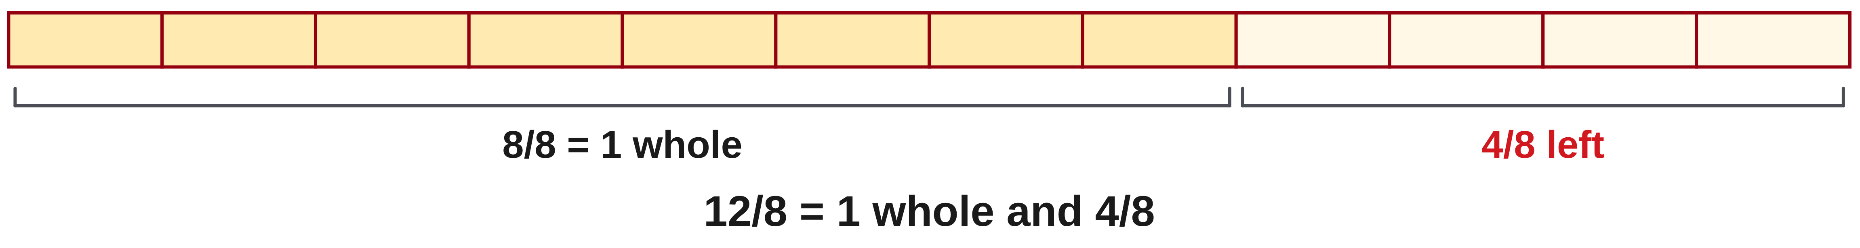
W03-L01 • TEACH • 12:55 PM–1:10 PM • 15 MIN TOTAL
Carry a complete set into the whole number
1
When the numerator reaches the denominator, the fraction contains a whole unit.
2
Move each complete whole into the whole-number part.
3
Keep the remaining fractional part and simplify it.
4
Check that the total is longer than either positive piece being added.
Textbook Chapter 4 pp.91–99
Textbook
Exercise Book
Numeracy Hub
Shape Canvas
Day 08 • 2026-11-09 • 06
Notes:
TEACH • 12:55 PM–1:10 PM • 15 MIN TOTAL — shared across this phase.
A fraction with a numerator as large as its denominator contains at least one whole. For example, twelve eighths includes eight eighths, which is one whole, with four eighths remaining. That extra whole must be added to the whole-number part of a mixed-number sum. What happens if we leave it out? The answer becomes one whole unit too short. Keep the remaining fraction and simplify it only after regrouping. Check the size of the result against the pieces: the sum of two positive lengths must exceed each individual length, and a fractional total beyond one should be visible in the whole part.

Slide 7
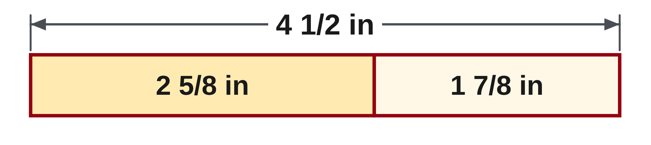
W03-L01 • TEACH • 12:55 PM–1:10 PM • 15 MIN TOTAL
Regroup a full set into one whole
2 5/8 + 1 7/8 = 3 12/8
= 3 + 1 + 4/8 = 4 1/2 in
Twelve eighths contain one whole inch and four eighths.
Check: 2.625 + 1.875 = 4.5 in.
Together • Solve 4A Q14(a), then 4B Q2.
Draw adjoining labelled strips. Explain the carry into the whole number before checking with Numeracy Hub Calculator.
Math Week 3 L1 • Classroom example • Shape Canvas inch labels support the written sum
Textbook
Exercise Book
Numeracy Hub
Shape Canvas
Day 08 • 2026-11-09 • 07
Notes:
TEACH • 12:55 PM–1:10 PM • 15 MIN TOTAL — shared across this phase.
Add two and five eighths to one and seven eighths. The wholes give three; the fractions give twelve eighths. We can temporarily write three and twelve eighths to show the count, but twelve eighths contains one whole and four eighths. Add that whole to three and simplify four eighths to one half: four and one half inches. Why is the answer not three and one half? That would discard the complete set of eight eighths. The decimal check confirms the same amount: 2.625 plus 1.875 equals 4.5 inches. Both forms describe the same total length.

Slide 8
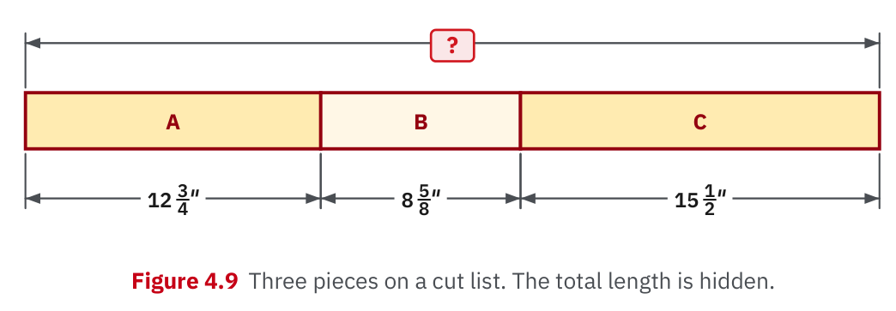
W03-L01 • TEACH • 12:55 PM–1:10 PM • 15 MIN TOTAL
Textbook | page 98
Textbook p.98 · Figure 4.9: adjoining mixed-inch lengths.
Textbook Chapter 4 pp.91–99
Textbook
Exercise Book
Numeracy Hub
Shape Canvas
Day 08 • 2026-11-09 • 08
Notes:
TEACH • 12:55 PM–1:10 PM • 15 MIN TOTAL — shared across this phase.
Figure 4.9 on page 98 places mixed-inch lengths together so we can see why addition is appropriate. Trace each segment and its label before following the overall length. Where does one piece end and the next begin? Their shared endpoint tells us the lengths are adjoining. The fractional labels may use different denominators, so the written calculation must rename them into shared units. Do not measure the projected illustration to obtain the answer; use its dimensions. The picture explains the arrangement, and the labels supply the values for the sum.

Slide 9
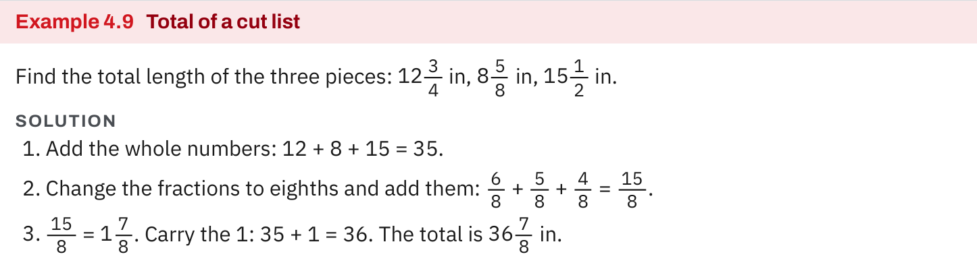
W03-L01 • TEACH • 12:55 PM–1:10 PM • 15 MIN TOTAL
Textbook | page 98
Textbook p.98 · Example 4.9: carry a whole from the fractional total.
Textbook Chapter 4 pp.91–99
Textbook
Exercise Book
Numeracy Hub
Shape Canvas
Day 08 • 2026-11-09 • 09
Notes:
TEACH • 12:55 PM–1:10 PM • 15 MIN TOTAL — shared across this phase.
In Example 4.9 on page 98, watch the fractional total after the numerators have been added. The key step is carrying a complete whole from that fraction into the whole-number total. Point to where the original wholes were combined, then where the extra whole appears. Why are those two contributions separate at first? One comes from the stated whole parts, and the other is formed by the added fractional pieces. Combining them produces the final mixed number. Check that the remaining numerator is smaller than its denominator; otherwise another whole still needs to be regrouped.

Slide 10
W03-L01 • TEACH • 12:55 PM–1:10 PM • 15 MIN TOTAL
Spot the mistake. Explain the correction.
A learner writes 1/2 + 1/4 = 2/6. Why cannot the denominators be added?
Discuss the method before checking the answer.
The parts have different sizes. Rename 1/2 as 2/4; then 2/4 + 1/4 = 3/4.
Textbook Chapter 4 pp.91–99
Textbook
Exercise Book
Numeracy Hub
Shape Canvas
Day 08 • 2026-11-09 • 10
Notes:
TEACH • 12:55 PM–1:10 PM • 15 MIN TOTAL — shared across this phase.
One half plus one quarter cannot equal two sixths. Two sixths is only one third, which is smaller than the half we started with; adding a positive quarter cannot make the total smaller. The denominator is the size label for the pieces, so we do not add denominators. Rename one half as two quarters, then add one quarter to get three quarters. What did the common denominator accomplish? It let us count three pieces of the same size. This explanation works for fractional lengths, layered thicknesses, and any other addition of like units.

Slide 11
W03-L01 • TOGETHER • 1:10 PM–1:25 PM • 15 MIN TOTAL
Work together
Solve 4A question 14(a), then 4B question 2 with a labelled strip diagram.
Work in pairs; alternate solver and checker.
Resources: Exercise Book 4A Q14 (p.36); 4B Q2–3 (p.37)
Textbook Chapter 4 pp.91–99
Textbook
Exercise Book
Numeracy Hub
Shape Canvas
Day 08 • 2026-11-09 • 11
Notes:
TOGETHER • 1:10 PM–1:25 PM • 15 MIN TOTAL — shared across this phase.
Work on 4A question 14(a), then 4B question 2. Draw adjoining strips and label each with its original length. Write a shared denominator beneath the fractional parts before adding. Ask your partner whether the fractions make a complete whole and where that whole appears in the final answer. For the strip drawing, read the overall length back as the sum of its parts. The picture should support the equation, while the equation uses the stated dimensions precisely.

Slide 12
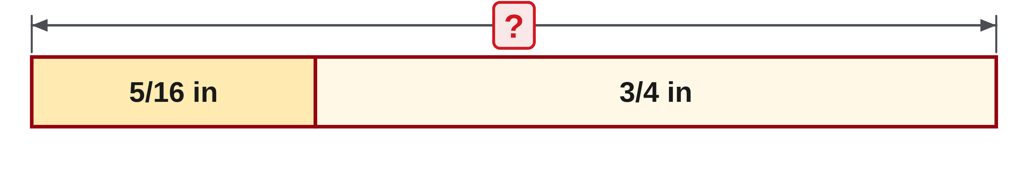
W03-L01 • TOGETHER • 1:10 PM–1:25 PM • 15 MIN TOTAL
Guided practice | 4A Q14a
Work with a partner. Take turns explaining the next step.
Textbook Chapter 4 pp.91–99
Textbook
Exercise Book
Numeracy Hub
Shape Canvas
Day 08 • 2026-11-09 • 12
Notes:
TOGETHER • 1:10 PM–1:25 PM • 15 MIN TOTAL — shared across this phase.
Add five sixteenths and three quarters for 4A question 14(a). Choose sixteenths as the shared unit and rename three quarters before adding. Predict whether the sum will be below or above one whole.
Instructor only, after the attempt: 3/4 = 12/16, so 5/16 + 12/16 = 17/16 = 1 1/16. The prediction should be slightly above one, because five sixteenths is slightly larger than the quarter needed to complete three quarters.

Slide 13
W03-L01 • TOGETHER • 1:10 PM–1:25 PM • 15 MIN TOTAL
Compare your method | 4A Q14a
CHECK TOGETHER
(a) 1 1/16
Textbook Chapter 4 pp.91–99
Textbook
Exercise Book
Numeracy Hub
Shape Canvas
Day 08 • 2026-11-09 • 13
Notes:
TOGETHER • 1:10 PM–1:25 PM • 15 MIN TOTAL — shared across this phase.
The sum is one and one sixteenth. Our shared-unit calculation gives seventeen sixteenths. Sixteen of those pieces make one whole; the final piece remains one sixteenth. Notice that the denominator never changed during the addition itself. Which step created the whole? Regrouping a complete set of sixteen pieces after the numerators were added. If you obtained seventeen twentieths, revisit why denominators name piece sizes rather than quantities to add. The diagram should show a total just beyond one full unit.

Slide 14
W03-L01 • PRACTISE • 1:25 PM–1:45 PM • 20 MIN TOTAL
Your scheduled practice
Complete 4A question 14(b) and 4B question 3. Draw the lengths or layers and show the written addition before calculator checking.
Show working and units; estimate, then check.
Resources: Exercise Book 4A Q14 (p.36); 4B Q2–3 (p.37)
Textbook Chapter 4 pp.91–99
Textbook
Exercise Book
Numeracy Hub
Shape Canvas
Day 08 • 2026-11-09 • 14
Notes:
PRACTISE • 1:25 PM–1:45 PM • 20 MIN TOTAL — shared across this phase.
Complete 4A question 14(b) and 4B question 3. For the mixed-number sum, show the equivalent fractions and the regrouped whole. For the bolt question, draw the plates and washer as three adjoining layers and label their thicknesses. Write the full sum before using the calculator. What does the answer to the bolt question represent? It is the total thickness being clamped, so report inches. Keep the calculation focused on the dimensions supplied rather than adding an allowance the question did not request.

Slide 15

W03-L01 • PRACTISE • 1:25 PM–1:45 PM • 20 MIN TOTAL
Open Shape Canvas
Navigation example. Use the values and units in the assigned task.
Textbook Chapter 4 pp.91–99
Textbook
Exercise Book
Numeracy Hub
Shape Canvas
Day 08 • 2026-11-09 • 15
Notes:
PRACTISE • 1:25 PM–1:45 PM • 20 MIN TOTAL — shared across this phase.
Open Shape Canvas and represent the assigned lengths as adjoining labelled rectangles. Choose inches and use the actual values from the exercise, not the screenshot's example values. A useful drawing lets us see the parts and the total direction clearly. Before entering an answer, say which dimensions you are adding and why. What must remain true even if you resize the view? The labels and the written sum. The visual arrangement helps explain addition; it does not replace the fraction calculation.

Slide 16
W03-L01 • PRACTISE • 1:25 PM–1:45 PM • 20 MIN TOTAL
Practise in Numeracy Hub and Shape Canvas
1
Supported: In Shape Canvas, label adjoining rectangles in inches for 4A Q14(a) or 4B Q2.
2
Independent practice: Draw the lengths or layers for 4A Q14(b) and 4B Q3; write the full sum.
3
Independent checking: Use Numeracy Hub Calculator after the sum; explain any carry into whole inches.
Textbook Chapter 4 pp.91–99
Textbook
Exercise Book
Numeracy Hub
Shape Canvas
Day 08 • 2026-11-09 • 16
Notes:
PRACTISE • 1:25 PM–1:45 PM • 20 MIN TOTAL — shared across this phase.
Use Shape Canvas to label the adjoining lengths from 4A question 14(a) or 4B question 2, then draw the lengths or layers for your independent questions. Write the full addition and show any conversion to a common denominator. Only after that, use Numeracy Hub's calculator to check the result. If the fractional sum contains a whole, explain where that whole moved. The calculator may show an equivalent form, so compare values as well as appearance before deciding that two answers disagree.

Slide 17
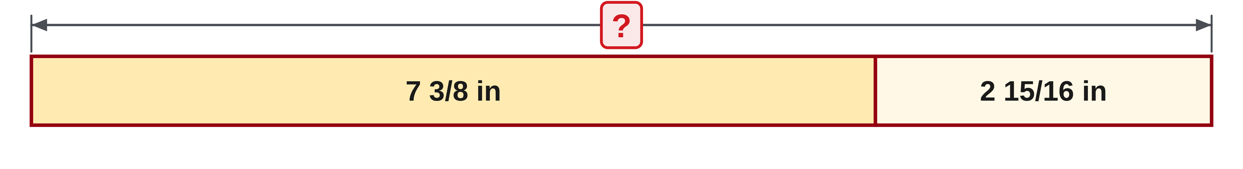
W03-L01 • PRACTISE • 1:25 PM–1:45 PM • 20 MIN TOTAL
Practise from the Exercise Book | 4A Q14b
Write the operation, working and units before checking.
Textbook Chapter 4 pp.91–99
Textbook
Exercise Book
Numeracy Hub
Shape Canvas
Day 08 • 2026-11-09 • 17
Notes:
PRACTISE • 1:25 PM–1:45 PM • 20 MIN TOTAL — shared across this phase.
Add seven and three eighths to two and fifteen sixteenths. Convert the eighths to sixteenths, then combine the whole parts and fractional parts. Pause to inspect whether the fraction contains a complete whole.
Instructor only, after the attempt: 3/8 = 6/16. The sum is 9 + 21/16. Since 21/16 = 1 5/16, the result is 10 5/16. A result of 9 5/16 has lost the whole made by sixteen of the twenty-one sixteenths.

Slide 18
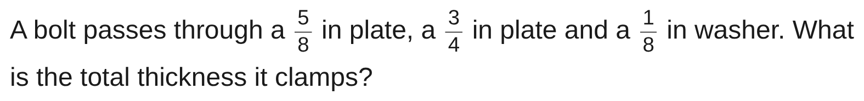
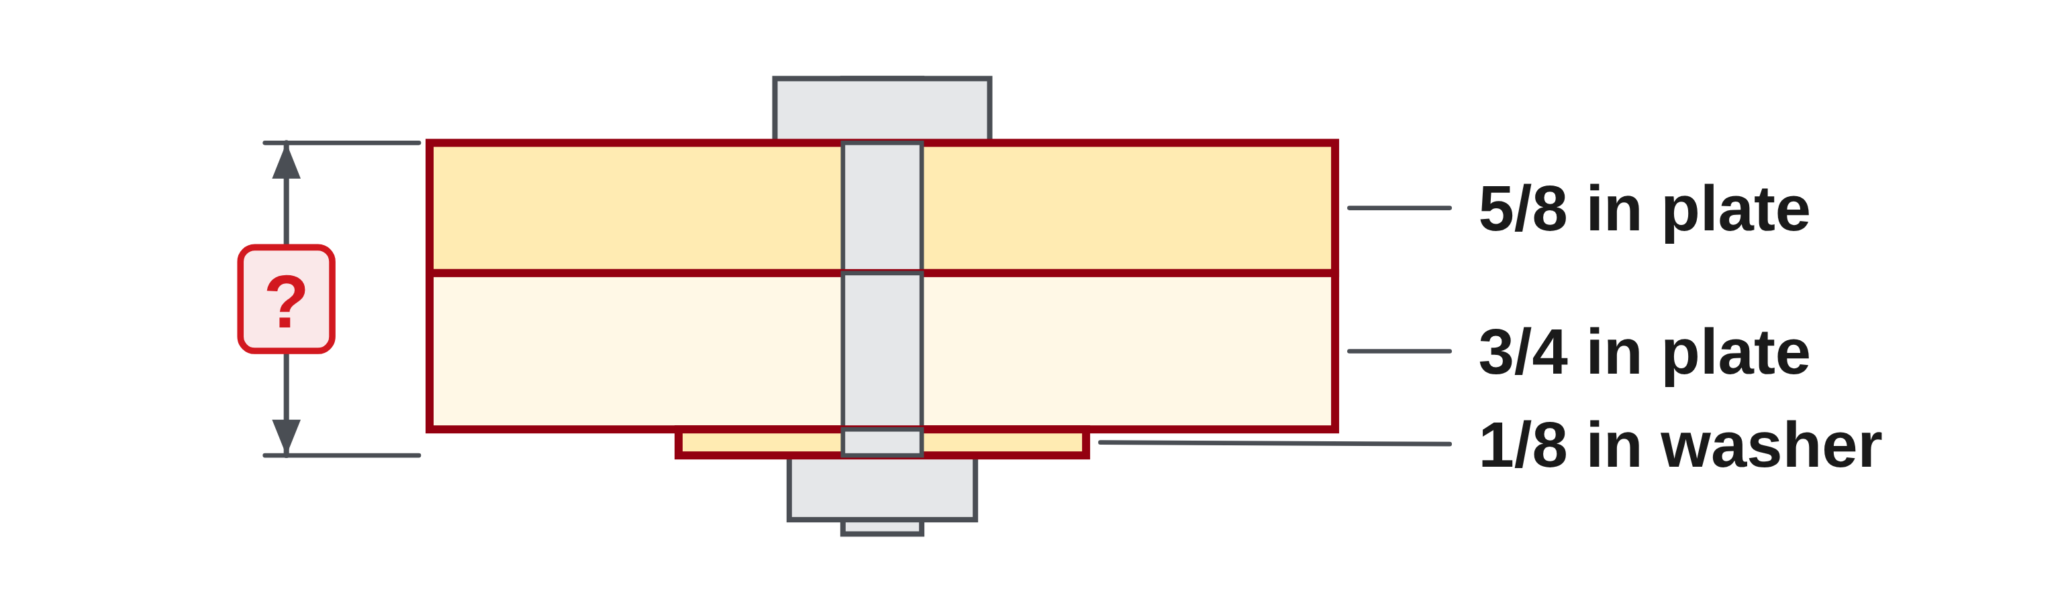
W03-L01 • PRACTISE • 1:25 PM–1:45 PM • 20 MIN TOTAL
Practise from the Exercise Book | 4B Q3
Write the operation, working and units before checking.
Textbook Chapter 4 pp.91–99
Textbook
Exercise Book
Numeracy Hub
Shape Canvas
Day 08 • 2026-11-09 • 18
Notes:
PRACTISE • 1:25 PM–1:45 PM • 20 MIN TOTAL — shared across this phase.
The bolt clamps a five-eighths-inch plate, a three-quarter-inch plate, and a one-eighth-inch washer. Draw all three layers and write their thicknesses as one sum. What common denominator will describe every layer? Eighths works.
Instructor only, after the attempt: 5/8 + 3/4 + 1/8 = 5/8 + 6/8 + 1/8 = 12/8 = 1 1/2 in. The answer is the total clamped thickness. It does not include any unrequested extra length beyond those three layers.

Slide 19
W03-L01 • CHECK • 1:45 PM–1:55 PM • 10 MIN TOTAL
Check independently
Redo 4A question 14(b) and explain the carry into the whole number.
Answer independently and show the method.
Resources: Exercise Book 4A Q14 (p.36); 4B Q2–3 (p.37)
Textbook Chapter 4 pp.91–99
Textbook
Exercise Book
Numeracy Hub
Shape Canvas
Day 08 • 2026-11-09 • 19
Notes:
CHECK • 1:45 PM–1:55 PM • 10 MIN TOTAL — shared across this phase.
Redo 4A question 14(b) independently. Your answer must show more than the final mixed number: include the shared denominator, the fractional sum, and the whole carried from that sum. Explain in a sentence why the whole-number part increases by one beyond the sum of seven and two. Ask yourself whether every sixteenth has been accounted for. Keep the worked solution closed until your independent explanation is complete, then check the arithmetic against the meaning of the parts.

Slide 20
W03-L01 • CHECK • 1:45 PM–1:55 PM • 10 MIN TOTAL
Independent check | 4A Q14b
Answer independently. Keep worked solutions closed.
Textbook Chapter 4 pp.91–99
Textbook
Exercise Book
Numeracy Hub
Shape Canvas
Day 08 • 2026-11-09 • 20
Notes:
CHECK • 1:45 PM–1:55 PM • 10 MIN TOTAL — shared across this phase.
Calculate seven and three eighths plus two and fifteen sixteenths again, showing the carry. Write the temporary fractional total before converting it to a mixed number. Why must the final fractional numerator be smaller than sixteen?
Instructor only, after the attempt: 7 6/16 + 2 15/16 = 9 21/16 = 10 5/16. Sixteen of the twenty-one sixteenths become one additional whole, leaving five sixteenths. A complete explanation accounts for that extra whole rather than merely reporting the answer.

Slide 21
W03-L01 • WRAP UP • 1:55 PM–2:00 PM • 5 MIN TOTAL
Wrap up and choose the next step
Share one learning point and one skill to practise next.
Record a takeaway and next action.
Resources: Exercise Book 4A Q14 (p.36); 4B Q2–3 (p.37)
Textbook Chapter 4 pp.91–99
Textbook
Exercise Book
Numeracy Hub
Shape Canvas
Day 08 • 2026-11-09 • 21
Notes:
WRAP UP • 1:55 PM–2:00 PM • 5 MIN TOTAL — shared across this phase.
Explain why we add numerators but keep the common denominator. A good answer says that the pieces already have equal size, so only their count changes. Then explain how a whole can emerge from the fractional sum. Name whether your next practice should focus on equivalent fractions or on carrying that complete whole. After the break, we will reverse the relationship: instead of finding the total from parts, we will subtract a known part and check the remainder by adding it back.

Slide 22
DAY 08 • SCHEDULED BREAK
Break
2:00 PM–2:15 PM
Return ready for: Subtracting and regrouping fractions
This break is excluded from teaching minutes.
Textbook
Exercise Book
Numeracy Hub
Shape Canvas
Day 08 • 2026-11-09 • 22
Notes:
Take the scheduled break from 2:00 to 2:15. We resume at 2:15 with subtraction and regrouping. Keep your fraction notes available; the next block uses the same shared units but sometimes trades a whole unit into fractional pieces before subtracting.

Slide 23
W03-L02 • START • 2:15 PM–2:20 PM • 5 MIN TOTAL
Subtracting and regrouping fractions
Today’s goal: Find a remaining or missing length by subtracting mixed numbers accurately.
Name one use for today’s skill.
Textbook Chapter 4 pp.97–99
Exercise Book 4A Q15 (p.36); 4C Q1–3 (p.39)
Keep your notebook, textbook, exercise book and chosen calculator ready.
Textbook Chapter 4 pp.97–99
Textbook
Exercise Book
Numeracy Hub
Shape Canvas
Day 08 • 2026-11-09 • 23
Notes:
START • 2:15 PM–2:20 PM • 5 MIN TOTAL — shared across this phase.
Open the textbook to pages 97–99. We will find remaining and missing lengths by subtraction. If a stock length contains a known piece and a remainder, subtracting the known piece finds the remainder. How can we check that result? Add the remainder back to the known piece and recover the overall length. We will use 4A question 15 and the drawings in 4C questions 1–3 to connect that relationship with mixed-number subtraction and regrouping.

Slide 24
W03-L02 • RECALL • 2:20 PM–2:25 PM • 5 MIN TOTAL
Recall and reconnect
Explain how 5 can be written as 4 plus sixteenths. Retrieve one common-denominator example.
Try first without displayed answers.
Resources: Exercise Book 4A Q15 (p.36); 4C Q1–3 (p.39)
Textbook Chapter 4 pp.97–99
Textbook
Exercise Book
Numeracy Hub
Shape Canvas
Day 08 • 2026-11-09 • 24
Notes:
RECALL • 2:20 PM–2:25 PM • 5 MIN TOTAL — shared across this phase.
How can we write five as four plus sixteenths? Five equals four plus sixteen sixteenths, because sixteen sixteenths makes one whole. We have not changed the total; we have renamed one whole in a useful form. Now recall a common-denominator conversion: one quarter equals two eighths. Both ideas are needed when a fractional part is too small to subtract the requested amount. We can exchange one whole for a complete set of fractional pieces, then subtract equal-sized parts.

Slide 25
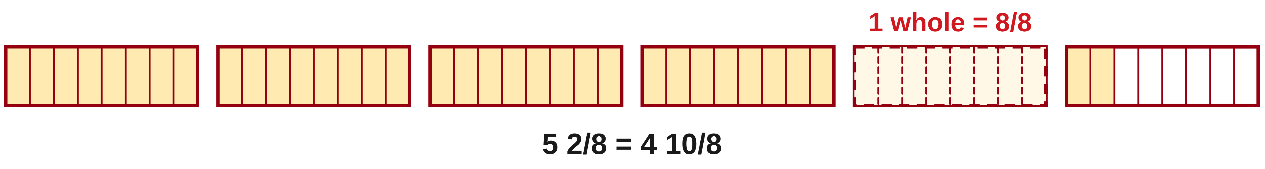
W03-L02 • TEACH • 2:25 PM–2:40 PM • 15 MIN TOTAL
Regroup one whole without changing the length
1
Match the denominators before subtracting.
2
If the top fractional part is too small, rename one whole as fractional units.
3
Reduce the whole-number part by one and add one denominator to the numerator.
4
Subtract the equal-sized parts, then simplify the result.
Textbook Chapter 4 pp.97–99
Textbook
Exercise Book
Numeracy Hub
Shape Canvas
Day 08 • 2026-11-09 • 25
Notes:
TEACH • 2:25 PM–2:40 PM • 15 MIN TOTAL — shared across this phase.
First match the denominators. Then compare the fractional parts in the subtraction. If the starting fraction is smaller than the fraction being removed, regroup one of the starting wholes. Reduce the whole-number part by one and add one complete denominator's worth of pieces to the numerator. Why does that preserve the value? One whole and a full set such as eight eighths are equal. Subtract after the regrouping, keeping the common denominator. Finally simplify the remainder. This is the same idea as exchanging one ten for ten ones in whole-number subtraction, applied to fractional units.

Slide 26
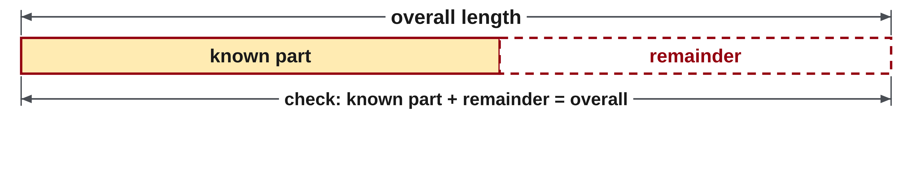
W03-L02 • TEACH • 2:25 PM–2:40 PM • 15 MIN TOTAL
Use the overall dimension to check the remainder
1
Label the overall length and the known part or parts on a drawing.
2
Subtract the known parts from the overall length.
3
Add the found remainder back to the known parts.
4
The reconstructed length must equal the original overall dimension.
Textbook Chapter 4 pp.97–99
Textbook
Exercise Book
Numeracy Hub
Shape Canvas
Day 08 • 2026-11-09 • 26
Notes:
TEACH • 2:25 PM–2:40 PM • 15 MIN TOTAL — shared across this phase.
On a dimensioned drawing, identify the overall length and each known part before calculating. The missing piece is what remains after the known parts are removed from the overall length. Write those labels into the subtraction so the equation follows the drawing. After finding the missing length, add it back to all the known parts. What should that sum equal? Exactly the original overall dimension. This add-back check tests both arithmetic and interpretation: if you forgot a known segment or subtracted a dimension that belongs elsewhere, the reconstructed total will reveal the mismatch.

Slide 27
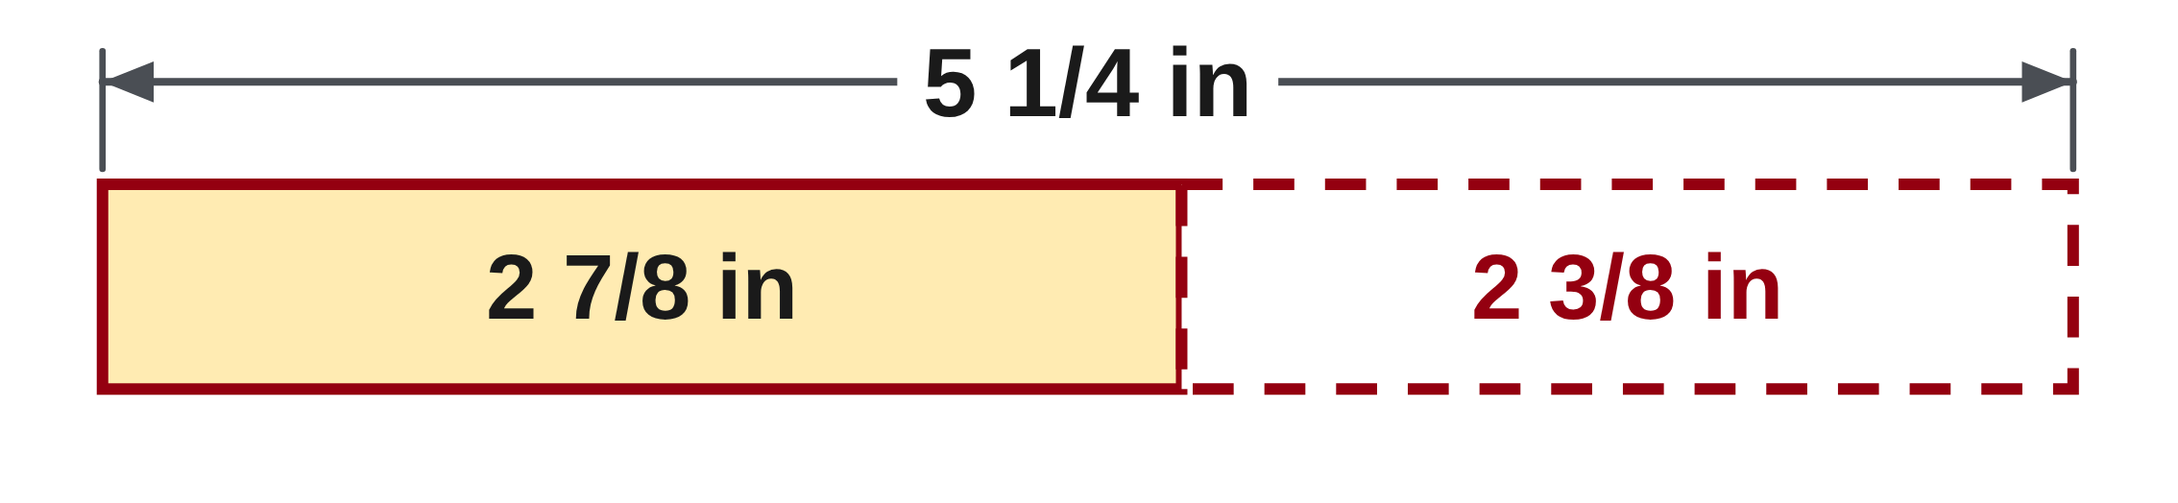
W03-L02 • TEACH • 2:25 PM–2:40 PM • 15 MIN TOTAL
Trade one whole for eight eighths
5 1/4 − 2 7/8 = 5 2/8 − 2 7/8
= 4 10/8 − 2 7/8 = 2 3/8 in
Check: 2 3/8 + 2 7/8 = 5 2/8 = 5 1/4 in.
The found remainder restores the original length.
Together • Solve 4A Q15(a) and 4C Q1 with a drawing.
Shape Canvas: show the overall length and known parts; hide the missing dimension until after the paper attempt.
W3 L2 • Classroom example • Add-back checking is essential
Textbook
Exercise Book
Numeracy Hub
Shape Canvas
Day 08 • 2026-11-09 • 27
Notes:
TEACH • 2:25 PM–2:40 PM • 15 MIN TOTAL — shared across this phase.
We need five and one quarter minus two and seven eighths. Rename one quarter as two eighths. Two eighths is too small for the direct fractional subtraction of seven eighths, so exchange one of the five wholes for eight eighths. Five and two eighths becomes four and ten eighths. Now subtract: four minus two is two, and ten eighths minus seven eighths is three eighths. The result is two and three eighths inches. Check by adding back two and seven eighths: the fractions total ten eighths, giving five and two eighths, or five and one quarter inches.

Slide 28
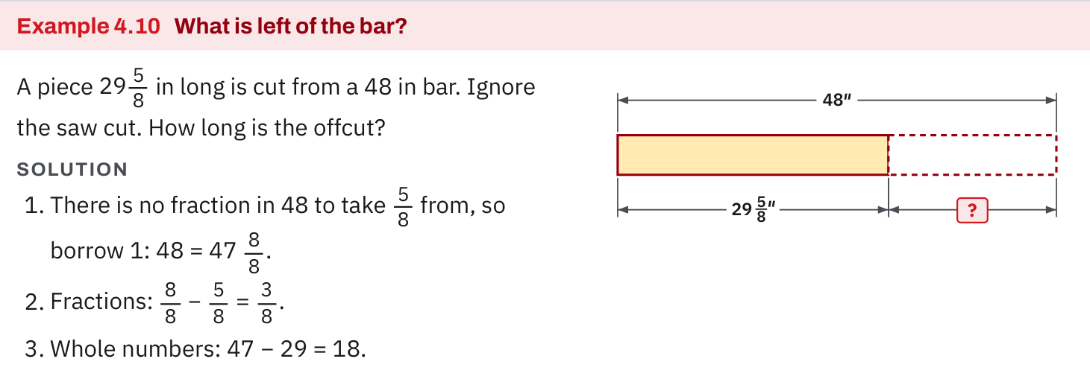
W03-L02 • TEACH • 2:25 PM–2:40 PM • 15 MIN TOTAL
Textbook | page 99
Textbook p.99 · Example 4.10: regroup a whole inch to find an offcut.
Textbook Chapter 4 pp.97–99
Textbook
Exercise Book
Numeracy Hub
Shape Canvas
Day 08 • 2026-11-09 • 28
Notes:
TEACH • 2:25 PM–2:40 PM • 15 MIN TOTAL — shared across this phase.
Example 4.10 on page 99 uses stock and an offcut to give subtraction a physical meaning. Point to the original length, then the known piece, then the remaining portion. Which dimension is the starting amount in the subtraction? The overall stock length. Follow where one whole inch is renamed into fractional pieces in the written working. The length is conserved during that exchange, just expressed differently. If the drawing's leftover portion looked larger after regrouping, we would know the representation was misleading: regrouping changes the notation, not the actual amount of material.

Slide 29
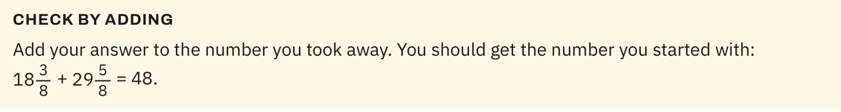
W03-L02 • TEACH • 2:25 PM–2:40 PM • 15 MIN TOTAL
Textbook | page 99
Textbook p.99 · Add the remainder back to verify the original length.
Textbook Chapter 4 pp.97–99
Textbook
Exercise Book
Numeracy Hub
Shape Canvas
Day 08 • 2026-11-09 • 29
Notes:
TEACH • 2:25 PM–2:40 PM • 15 MIN TOTAL — shared across this phase.
Look at the check on page 99. We add the remaining piece back to the piece removed, and the result should reconstruct the original stock length. Why is this stronger than repeating the same subtraction? Addition uses the inverse relationship and can expose a subtraction error we might otherwise repeat. Keep the units with the lengths and align the fractional denominators during the check. If the reconstructed total is short by exactly one inch, inspect whether a regrouped whole was omitted or counted twice in the original subtraction.

Slide 30
W03-L02 • TEACH • 2:25 PM–2:40 PM • 15 MIN TOTAL
Spot the mistake. Explain the correction.
In 5 1/4 − 2 7/8, can you subtract 7 eighths from 2 eighths without regrouping?
Discuss the method before checking the answer.
Regroup first: 5 2/8 becomes 4 10/8. Now subtract the equal-sized parts, then check by adding back.
Textbook Chapter 4 pp.97–99
Textbook
Exercise Book
Numeracy Hub
Shape Canvas
Day 08 • 2026-11-09 • 30
Notes:
TEACH • 2:25 PM–2:40 PM • 15 MIN TOTAL — shared across this phase.
In five and two eighths minus two and seven eighths, do not simply reverse the fractional subtraction to make it look easy. Seven minus two would change which amount is being removed. For our mixed-number method, exchange one starting whole for eight eighths: five and two eighths becomes four and ten eighths. Now ten eighths minus seven eighths leaves three eighths, while four wholes minus two leaves two. What changed during regrouping? The whole-part count decreased by one and the fractional-part count increased by eight, preserving the same total before subtraction.

Slide 31
W03-L02 • TOGETHER • 2:40 PM–2:55 PM • 15 MIN TOTAL
Work together
Solve 4A question 15(a) and 4C question 1 with a drawing.
Work in pairs; alternate solver and checker.
Resources: Exercise Book 4A Q15 (p.36); 4C Q1–3 (p.39)
Textbook Chapter 4 pp.97–99
Textbook
Exercise Book
Numeracy Hub
Shape Canvas
Day 08 • 2026-11-09 • 31
Notes:
TOGETHER • 2:40 PM–2:55 PM • 15 MIN TOTAL — shared across this phase.
Solve 4A question 15(a) and 4C question 1 with a partner. For each, draw or trace the overall length and the known piece. Explain why subtraction finds the missing amount, then show any regrouping before subtracting. Your partner checks by adding the found piece back. Ask each other whether the reconstructed total matches the original label exactly. If it does not, inspect the common denominator and the exchanged whole before changing the final answer by guesswork.

Slide 32
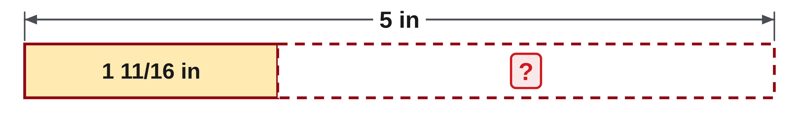
W03-L02 • TOGETHER • 2:40 PM–2:55 PM • 15 MIN TOTAL
Guided practice | 4A Q15a
Work with a partner. Take turns explaining the next step.
Textbook Chapter 4 pp.97–99
Textbook
Exercise Book
Numeracy Hub
Shape Canvas
Day 08 • 2026-11-09 • 32
Notes:
TOGETHER • 2:40 PM–2:55 PM • 15 MIN TOTAL — shared across this phase.
Question 15(a) asks for five minus one and eleven sixteenths. Five has no displayed fraction, so rename one whole before subtracting the eleven sixteenths. How many sixteenths does that whole supply?
Instructor only, after the attempt: 5 = 4 16/16. Then 4 16/16 − 1 11/16 = 3 5/16. Check: 3 5/16 + 1 11/16 = 4 16/16 = 5. The sixteen sixteenths replace a whole; they are not added to five extra wholes.

Slide 33
W03-L02 • TOGETHER • 2:40 PM–2:55 PM • 15 MIN TOTAL
Compare your method | 4A Q15a
CHECK TOGETHER
(a) 3 5/16
Textbook Chapter 4 pp.97–99
Textbook
Exercise Book
Numeracy Hub
Shape Canvas
Day 08 • 2026-11-09 • 33
Notes:
TOGETHER • 2:40 PM–2:55 PM • 15 MIN TOTAL — shared across this phase.
The answer is three and five sixteenths. We began by rewriting five as four and sixteen sixteenths. Subtracting one whole leaves three, and removing eleven of the sixteen sixteenths leaves five. What error would give four and five sixteenths? Keeping all five original wholes after also creating sixteen sixteenths would count a whole twice. The add-back check catches that: our correct remainder plus one and eleven sixteenths returns exactly five, with no extra whole.

Slide 34
W03-L02 • PRACTISE • 2:55 PM–3:15 PM • 20 MIN TOTAL
Your scheduled practice
Complete 4A question 15(b) and 4C questions 2–3. Add the found piece back to the known parts to verify the overall length.
Show working and units; estimate, then check.
Resources: Exercise Book 4A Q15 (p.36); 4C Q1–3 (p.39)
Textbook Chapter 4 pp.97–99
Textbook
Exercise Book
Numeracy Hub
Shape Canvas
Day 08 • 2026-11-09 • 34
Notes:
PRACTISE • 2:55 PM–3:15 PM • 20 MIN TOTAL — shared across this phase.
Complete 4A question 15(b) and 4C questions 2–3. In the drawings, label the overall dimension and known parts before writing the subtraction. For every result, perform the add-back check. If there are several known pieces, their sum plus the missing piece must reproduce the overall length. Ask yourself whether the result is plausible for the space shown, while remembering that the drawing's labels, not its apparent scale, provide the numerical evidence. Keep regrouping visible so a partner can follow where each whole went.

Slide 35
W03-L02 • PRACTISE • 2:55 PM–3:15 PM • 20 MIN TOTAL
Open Shape Canvas
Navigation example. Use the values and units in the assigned task.
Textbook Chapter 4 pp.97–99
Textbook
Exercise Book
Numeracy Hub
Shape Canvas
Day 08 • 2026-11-09 • 35
Notes:
PRACTISE • 2:55 PM–3:15 PM • 20 MIN TOTAL — shared across this phase.
Open Shape Canvas and use the assigned drawing's overall length and known parts. Keep the missing dimension hidden while you work on paper. We are using the drawing to organize the relationship: overall equals known parts plus missing part. Before entering any answer, state which known lengths must be subtracted. What should the hidden value do when it is checked? It should complete the overall length exactly. The picture helps us see that relationship without giving away the independent calculation.

Slide 36
W03-L02 • PRACTISE • 2:55 PM–3:15 PM • 20 MIN TOTAL
Practise in Shape Canvas
1
Supported: In Shape Canvas, show the overall length and known parts for the scheduled drawing.
2
Independent practice: Hide the missing dimension and solve it on paper before revealing a value.
3
Independent checking: Add the found piece to the known parts and verify the overall length.
Textbook Chapter 4 pp.97–99
Textbook
Exercise Book
Numeracy Hub
Shape Canvas
Day 08 • 2026-11-09 • 36
Notes:
PRACTISE • 2:55 PM–3:15 PM • 20 MIN TOTAL — shared across this phase.
Show the overall length and label the known pieces in Shape Canvas. Leave the missing dimension hidden, then solve its value on paper with a common denominator and any needed regrouping. Only after your attempt should you compare or reveal the value. Add your result back to the known pieces. If the sum differs from the overall dimension, use the difference to diagnose the error. A whole-inch mismatch suggests regrouping; a small fractional mismatch suggests a conversion or numerator error.

Slide 37
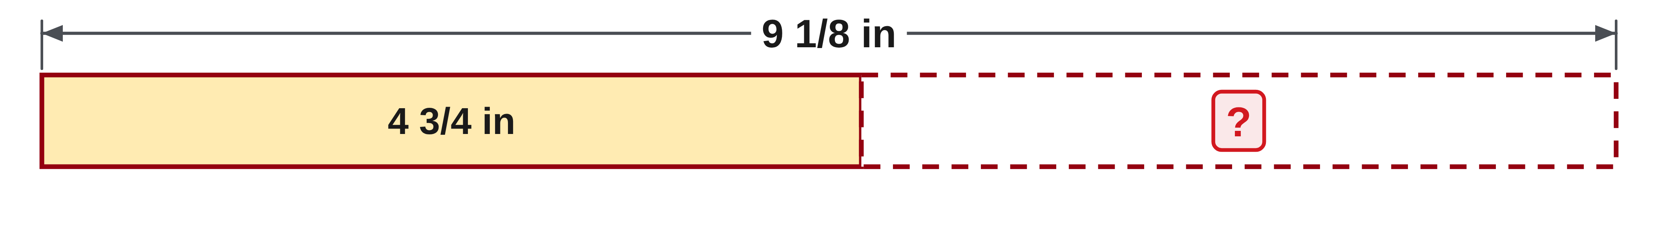
W03-L02 • PRACTISE • 2:55 PM–3:15 PM • 20 MIN TOTAL
Practise from the Exercise Book | 4A Q15b
Write the operation, working and units before checking.
Textbook Chapter 4 pp.97–99
Textbook
Exercise Book
Numeracy Hub
Shape Canvas
Day 08 • 2026-11-09 • 37
Notes:
PRACTISE • 2:55 PM–3:15 PM • 20 MIN TOTAL — shared across this phase.
Subtract four and three quarters from nine and one eighth. Rename the quarters as eighths, then decide whether the starting fractional part is large enough. Show the exchange of one whole before proceeding.
Instructor only, after the attempt: 4 3/4 = 4 6/8; 9 1/8 = 8 9/8. Therefore 8 9/8 − 4 6/8 = 4 3/8. Check: 4 3/8 + 4 6/8 = 8 9/8 = 9 1/8.

Slide 38
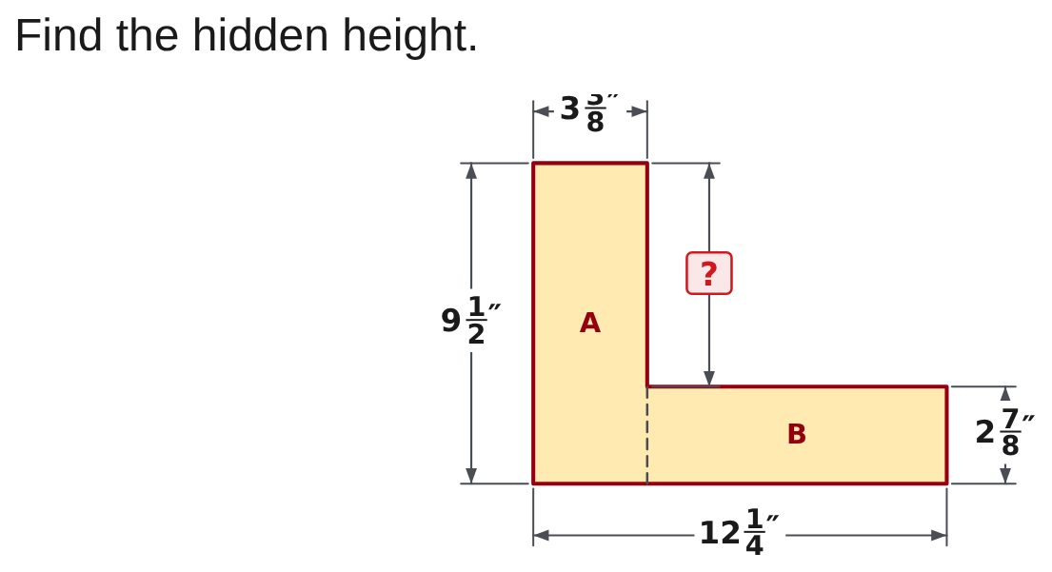
W03-L02 • PRACTISE • 2:55 PM–3:15 PM • 20 MIN TOTAL
Practise from the Exercise Book | 4C Q2
Write the operation, working and units before checking.
Textbook Chapter 4 pp.97–99
Textbook
Exercise Book
Numeracy Hub
Shape Canvas
Day 08 • 2026-11-09 • 38
Notes:
PRACTISE • 2:55 PM–3:15 PM • 20 MIN TOTAL — shared across this phase.
Find the hidden height in 4C question 2. The overall height is nine and one half inches, with two and seven eighths inches known. Write overall minus known, then convert to eighths. Why should the missing height be less than the overall height?
Instructor only, after the attempt: 9 1/2 − 2 7/8 = 9 4/8 − 2 7/8 = 8 12/8 − 2 7/8 = 6 5/8 in. Adding 6 5/8 and 2 7/8 returns 9 1/2 in.

Slide 39
W03-L02 • CHECK • 3:15 PM–3:25 PM • 10 MIN TOTAL
Check independently
Complete 4A question 15(b) and 4C question 3 independently.
Answer independently and show the method.
Resources: Exercise Book 4A Q15 (p.36); 4C Q1–3 (p.39)
Textbook Chapter 4 pp.97–99
Textbook
Exercise Book
Numeracy Hub
Shape Canvas
Day 08 • 2026-11-09 • 39
Notes:
CHECK • 3:15 PM–3:25 PM • 10 MIN TOTAL — shared across this phase.
Complete 4A question 15(b) and 4C question 3 independently. One is a direct mixed-number subtraction; the other requires reading the shaft's overall dimension and all its known steps. Keep the drawing's labels connected to your equation. Show regrouping where needed, then add the result back to verify the overall amount. What should your working let another person see? Which lengths you removed, how you handled fractional units, and why the final missing length fits the original total.

Slide 40
W03-L02 • CHECK • 3:15 PM–3:25 PM • 10 MIN TOTAL
Independent check | 4A Q15b
Answer independently. Keep worked solutions closed.
Textbook Chapter 4 pp.97–99
Textbook
Exercise Book
Numeracy Hub
Shape Canvas
Day 08 • 2026-11-09 • 40
Notes:
CHECK • 3:15 PM–3:25 PM • 10 MIN TOTAL — shared across this phase.
Calculate nine and one eighth minus four and three quarters without referring to the worked solution. Show a common denominator and any regrouping, then use addition to verify your answer.
Instructor only, after the attempt: 9 1/8 − 4 6/8 = 8 9/8 − 4 6/8 = 4 3/8. The check is 4 3/8 + 4 3/4 = 9 1/8. If the answer differs by one whole, inspect whether the whole part decreased during regrouping.

Slide 41
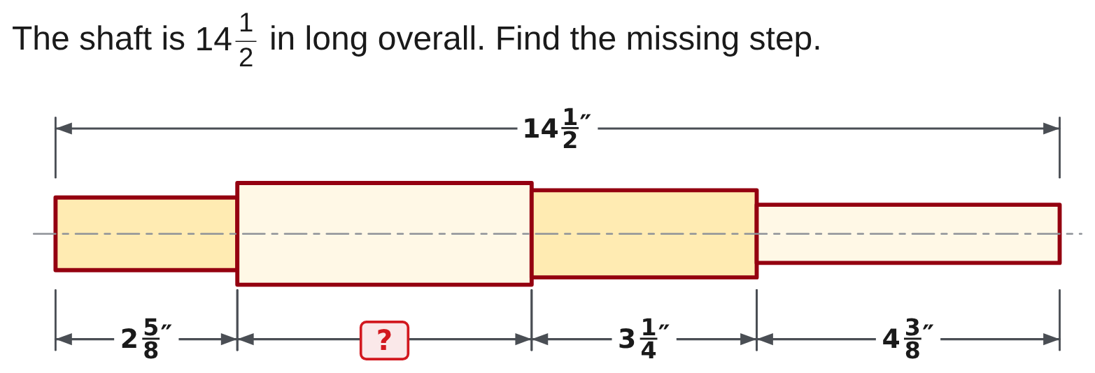
W03-L02 • CHECK • 3:15 PM–3:25 PM • 10 MIN TOTAL
Independent check | 4C Q3
Answer independently. Keep worked solutions closed.
Textbook Chapter 4 pp.97–99
Textbook
Exercise Book
Numeracy Hub
Shape Canvas
Day 08 • 2026-11-09 • 41
Notes:
CHECK • 3:15 PM–3:25 PM • 10 MIN TOTAL — shared across this phase.
The shaft is fourteen and one half inches overall. Find the missing step by subtracting the three known lengths shown. You may add the known parts first or subtract them one at a time, but show every part in your equation.
Instructor only, after the attempt: The known parts are 2 5/8 + 3 1/4 + 4 3/8 = 10 1/4 in. Then 14 1/2 − 10 1/4 = 4 1/4 in. Adding all four steps gives 14 1/2 in.

Slide 42
W03-L02 • WRAP UP • 3:25 PM–3:30 PM • 5 MIN TOTAL
Wrap up and choose the next step
Share one learning point and one skill to practise next.
Record a takeaway and next action.
Resources: Exercise Book 4A Q15 (p.36); 4C Q1–3 (p.39)
Textbook Chapter 4 pp.97–99
Textbook
Exercise Book
Numeracy Hub
Shape Canvas
Day 08 • 2026-11-09 • 42
Notes:
WRAP UP • 3:25 PM–3:30 PM • 5 MIN TOTAL — shared across this phase.
Explain why regrouping one whole does not change a length. The whole becomes an equivalent set of fractional pieces, so the total is preserved. Then describe your add-back check on one of today's questions. Which kind of error did it help you catch or avoid? Record whether you need more practice with shared denominators, the exchanged whole, or interpreting the drawing. Next we move from adding and subtracting individual lengths to repeated pieces, halves, and equal groups.

