Slide 1

CARPENTRY FOUNDATION / INTAKE 142
Day 13 | Thursday
13
November 19, 2026
Ratios, rates and proportions
12:45 PM–2:00 PM • Math • 75 min
Scale drawings and weekly check
2:15 PM–3:30 PM • Math • 75 min
Week 4 • 2 scheduled blocks • 150 teaching minutes
Estimate. Show the method. Label units. Check the result.
Textbook
Exercise Book
Numeracy Hub
Shape Canvas
Day 13 • 2026-11-19 • 01
Notes:
Timing: opening orientation within the scheduled start period.
Today we use ratios to keep quantities in proportion, then apply the same reasoning to scale drawings. The first block runs from 12:45 to 2:00. After the 2:00–2:15 break, we work on drawing lengths, real lengths and our weekly check until 3:30. Our main habit is to name the order of the comparison and match the units. A correct calculation can still describe the wrong thing if the quantities are reversed or one is in metres and the other in millimetres.

Slide 2
DAY 13 / WEEK 4 / CLASS TIMETABLE
Today’s exact schedule
12:45 PM–2:00 PM • 75 min
2:15 PM–3:30 PM • 75 min
Ratios, rates and proportions
Scale drawings and weekly check
12:45 PM–12:50 PM
Start
5
2:15 PM–2:20 PM
Start
5
12:50 PM–12:55 PM
Recall
5
2:20 PM–2:25 PM
Recall
5
12:55 PM–1:10 PM
Teach
15
2:25 PM–2:40 PM
Teach
15
1:10 PM–1:25 PM
Together
15
2:40 PM–2:55 PM
Together
15
1:25 PM–1:45 PM
Practise
20
2:55 PM–3:15 PM
Practise
20
1:45 PM–1:55 PM
Check
10
3:15 PM–3:25 PM
Check
10
1:55 PM–2:00 PM
Wrap up
5
3:25 PM–3:30 PM
Wrap up
5
Math • Math Week 4, Lesson 7
Math • Math Week 4, Lesson 8
Break: 2:00 PM–2:15 PM • 15 minutes • excluded from teaching time
Textbook
Exercise Book
Numeracy Hub
Shape Canvas
Day 13 • 2026-11-19 • 02
Notes:
Timing: opening orientation within the scheduled start period.
We begin each block with five minutes to connect the topic and five to recall earlier skills. Then come fifteen minutes of explanation, fifteen together, twenty for practice, ten for an independent check and five to finish. The scheduled break is 2:00–2:15. In the first block, keep “first quantity to second quantity” clear. In the second, replace those labels with “drawing to real.” That labelled order will tell us which scale factor to apply.

Slide 3
W04-L07 • START • 12:45 PM–12:50 PM • 5 MIN TOTAL
Ratios, rates and proportions
Today’s goal: Simplify ratios in common units and use proportions to scale a material quantity.
Share a prior use of this skill; identify the quantity and unit.
Textbook sections 6.5–6.7 pp.144–148
Exercise Book 6A Q14–18 (p.56); 6B Q4,6 (p.57), Q7 (p.58)
Keep your notebook, textbook, exercise book and chosen calculator ready.
Textbook sections 6.5–6.7 pp.144–148
Textbook
Exercise Book
Numeracy Hub
Shape Canvas
Day 13 • 2026-11-19 • 03
Notes:
Timing: START | 12:45 PM–12:50 PM | 5 MIN TOTAL. Shared phase allocation across these slides.
Open the ratio and proportion work in the textbook and exercise book 6A Q14–18 and 6B Q4, Q6 and Q7. A ratio describes a relationship, not necessarily a total. If two quantities are in the ratio three to two, we know how their sizes compare, but we do not yet know how many units each contains. What extra information would determine their amounts? A total or one known quantity. Today we will use that information while keeping units and order clear.

Slide 4
W04-L07 • RECALL • 12:50 PM–12:55 PM • 5 MIN TOTAL
Recall and reconnect
Use Exercise Book 6A Q14. Explain why millimetres and metres must match before comparing quantities.
Attempt the short retrieval task independently; explain the method before seeing answers.
Resources: Exercise Book 6A Q14–18 (p.56); 6B Q4,6 (p.57), Q7 (p.58)
Textbook sections 6.5–6.7 pp.144–148
Textbook
Exercise Book
Numeracy Hub
Shape Canvas
Day 13 • 2026-11-19 • 04
Notes:
Timing: RECALL | 12:50 PM–12:55 PM | 5 MIN TOTAL. Shared phase allocation across these slides.
Start with 6A Q14 and simplify both ratio terms by the same factor. Then think about a length comparison: why can we not treat two metres to five hundred millimetres as two to five hundred? The units are different-sized pieces of length. We must express both lengths in one unit before comparing their counts. What conversion would make that comparison clear? Two metres becomes two thousand millimetres, so the numbers then refer to equal-sized units.

Slide 5
W04-L07 • RECALL • 12:50 PM–12:55 PM • 5 MIN TOTAL
Recall from the Exercise Book | 6A Q14
Write the operation, working and units before checking.
Textbook sections 6.5–6.7 pp.144–148
Textbook
Exercise Book
Numeracy Hub
Shape Canvas
Day 13 • 2026-11-19 • 05
Notes:
Timing: RECALL | 12:50 PM–12:55 PM | 5 MIN TOTAL. Shared phase allocation across these slides.
For 6A Q14, simplify 36:84. Look for a common factor that divides both quantities exactly. You may reduce in more than one step, provided the same factor is applied to each term every time.
Instructor-only, after the attempt: Divide both by twelve to get 3:7. Check by multiplying both terms back by twelve. Dividing only one side would change the relationship, so it would no longer be an equivalent ratio.

Slide 6
W04-L07 • TEACH • 12:55 PM–1:10 PM • 15 MIN TOTAL
Write ratios with clear units
1
A ratio compares quantities in a stated order.
2
Convert comparable lengths to the same unit before simplifying.
3
Divide both terms by the same factor to keep the ratio equivalent.
4
A rate retains its units, such as dollars per metre.
Textbook sections 6.5–6.7 pp.144–148
Textbook
Exercise Book
Numeracy Hub
Shape Canvas
Day 13 • 2026-11-19 • 06
Notes:
Timing: TEACH | 12:55 PM–1:10 PM | 15 MIN TOTAL. Shared phase allocation across these slides.
A ratio compares quantities in a stated order. Three to two and two to three describe reversed comparisons. When comparing lengths, convert them to a common unit first; only then do their numbers count the same-sized units. Simplifying divides both terms by the same common factor. A rate is also a comparison, but it can retain unlike units, such as dollars per metre or metres per second. What does “per metre” tell us? It gives the cost for one metre. Keep those units because they explain what the number means and how to use it in a calculation.

Slide 7
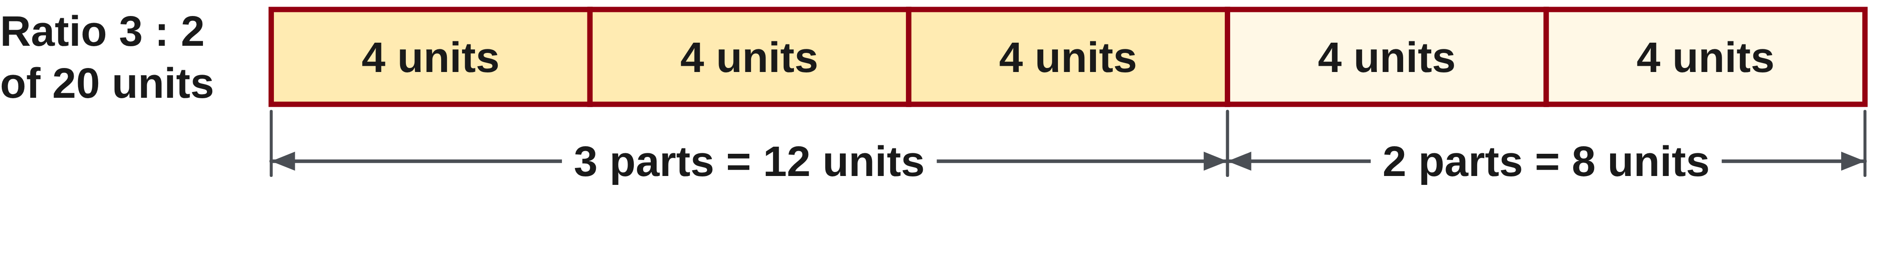
W04-L07 • TEACH • 12:55 PM–1:10 PM • 15 MIN TOTAL
Scale every part by the same factor
1
Add the ratio terms to find the number of equal parts.
2
Find the value of one part, then multiply for each required share.
3
For a proportion, keep corresponding quantities in the same order.
4
Check the scaled quantities against the original ratio.
Textbook sections 6.5–6.7 pp.144–148
Textbook
Exercise Book
Numeracy Hub
Shape Canvas
Day 13 • 2026-11-19 • 07
Notes:
Timing: TEACH | 12:55 PM–1:10 PM | 15 MIN TOTAL. Shared phase allocation across these slides.
To share a total in a ratio, first count all the equal parts. A three-to-two ratio contains five parts altogether. Divide the total by five to find one part, then give three of those parts to the first share and two to the second. For a proportion, corresponding quantities must stay in the same order on both sides. How can we check a shared total? Add the shares to recover the total, then simplify their ratio to recover the stated relationship. Both checks matter: a pair of numbers could total correctly while being shared in the wrong proportions.

Slide 8
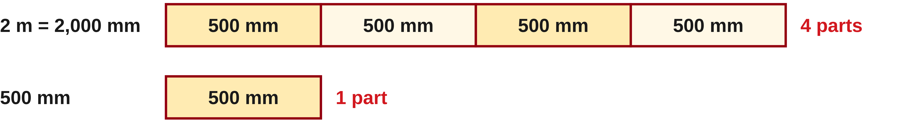
W04-L07 • TEACH • 12:55 PM–1:10 PM • 15 MIN TOTAL
First make the comparison meaningful
2 m : 500 mm = 2,000 : 500 = 4 : 1
Classroom ratio 3:2, total 20 units:
5 total parts → 20 ÷ 5 = 4 units per part → 12 and 8 units.
A 3:2 ratio does not mean the first part is 3/2 of the whole.
Together: 6A Q15,17–18 and 6B Q6. Label rate units.
Use proportional Shape Canvas rectangles; check with the calculator after writing the proportion.
W4 L7 • Book mixing examples are mathematics only, not real product instructions
Textbook
Exercise Book
Numeracy Hub
Shape Canvas
Day 13 • 2026-11-19 • 08
Notes:
Timing: TEACH | 12:55 PM–1:10 PM | 15 MIN TOTAL. Shared phase allocation across these slides.
First compare two metres with five hundred millimetres. Convert two metres to two thousand millimetres, giving 2000:500. Divide both terms by five hundred: 4:1. Now share twenty units in a 3:2 ratio. There are five equal parts, so each part is four units. The shares are twelve and eight; they add to twenty and simplify to 3:2. Is the first share three halves of the whole? No. It is three of the five total parts, or three fifths. The ratio’s second term describes the other share, not the whole.

Slide 9

W04-L07 • TEACH • 12:55 PM–1:10 PM • 15 MIN TOTAL
Textbook | page 145
Textbook p.145 • Figure 6.2 — Equal parts in a 4:1 ratio
Textbook sections 6.5–6.7 pp.144–148
Textbook
Exercise Book
Numeracy Hub
Shape Canvas
Day 13 • 2026-11-19 • 09
Notes:
Timing: TEACH | 12:55 PM–1:10 PM | 15 MIN TOTAL. Shared phase allocation across these slides.
Textbook Figure 6.2 shows a four-to-one ratio using five equal parts. Four belong to the first component and one to the second. The equal size of each part is essential; the number of containers alone is not enough if their volumes differ. What fraction of the whole is the first component? Four fifths, because the whole contains five parts. The second component is one fifth. We are using the book’s mixing diagram to understand the mathematics of sharing a total. The visual makes the difference between part-to-part and part-to-whole comparisons visible.

Slide 10
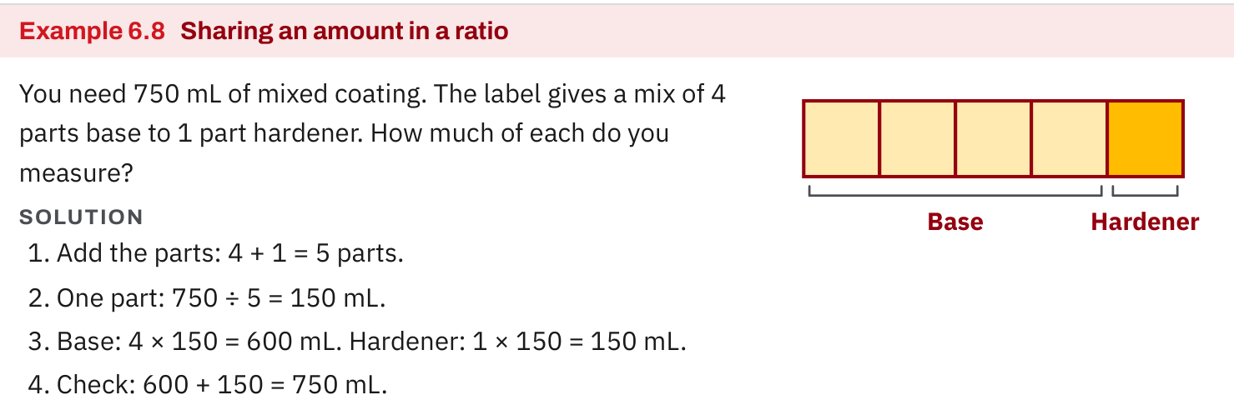
W04-L07 • TEACH • 12:55 PM–1:10 PM • 15 MIN TOTAL
Textbook | page 145
Textbook p.145 • Example 6.8 — Sharing a total in a ratio; classroom math example
Textbook sections 6.5–6.7 pp.144–148
Textbook
Exercise Book
Numeracy Hub
Shape Canvas
Day 13 • 2026-11-19 • 10
Notes:
Timing: TEACH | 12:55 PM–1:10 PM | 15 MIN TOTAL. Shared phase allocation across these slides.
In textbook Example 6.8, the total is 750 millilitres and the classroom ratio is four parts to one part. Add four and one to get five equal parts. One part is 750 divided by five, or 150 millilitres. Four parts give 600 millilitres, leaving 150 millilitres for the second component. Check both conditions: 600 plus 150 is 750, and 600:150 simplifies to 4:1. Why would dividing by four be wrong? Four counts only the first component’s parts; the total includes the additional one part too. We are practising this mathematical relationship with the book’s data.

Slide 11
W04-L07 • TEACH • 12:55 PM–1:10 PM • 15 MIN TOTAL
Spot the mistake. Explain the correction.
Can you simplify 1 m : 50 mm as 1 : 50?
Discuss the method before checking the answer.
No. Convert to common units first: 1,000 mm : 50 mm, then simplify both terms.
Textbook sections 6.5–6.7 pp.144–148
Textbook
Exercise Book
Numeracy Hub
Shape Canvas
Day 13 • 2026-11-19 • 11
Notes:
Timing: TEACH | 12:55 PM–1:10 PM | 15 MIN TOTAL. Shared phase allocation across these slides.
Can we simplify one metre to fifty millimetres as 1:50? Pause and decide what that would claim. It would make the one-metre length look smaller, even though it is much longer. Convert one metre to one thousand millimetres first. Now the ratio is 1000:50, and dividing both terms by fifty gives 20:1. Which check catches the original mistake immediately? The first length should be twenty times the second, not one fiftieth of it. Matching units is part of the calculation, not just a label added at the end.

Slide 12
W04-L07 • TOGETHER • 1:10 PM–1:25 PM • 15 MIN TOTAL
Work together
Work Exercise Book 6A Q15,17–18 and 6B Q6 in pairs. Label numerator and denominator units.
Work in pairs; alternate calculator operator and checker. Show units and an estimated answer.
Resources: Exercise Book 6A Q14–18 (p.56); 6B Q4,6 (p.57), Q7 (p.58)
Textbook sections 6.5–6.7 pp.144–148
Textbook
Exercise Book
Numeracy Hub
Shape Canvas
Day 13 • 2026-11-19 • 12
Notes:
Timing: TOGETHER | 1:10 PM–1:25 PM | 15 MIN TOTAL. Shared phase allocation across these slides.
Work on 6A Q15, Q17–18 and 6B Q6 together. For a length ratio, convert to common units before reducing. For a unit rate, write the numerator and denominator units so “per” has a clear meaning. In a proportion, line up corresponding quantities in the same order. What should the checker ask before approving an equation? “Which quantity does each number represent?” Start with the conversion in Q15 shown next, and explain the order aloud.

Slide 13
W04-L07 • TOGETHER • 1:10 PM–1:25 PM • 15 MIN TOTAL
Guided practice | 6A Q15
Work with a partner. Take turns explaining the next step.
Textbook sections 6.5–6.7 pp.144–148
Textbook
Exercise Book
Numeracy Hub
Shape Canvas
Day 13 • 2026-11-19 • 13
Notes:
Timing: TOGETHER | 1:10 PM–1:25 PM | 15 MIN TOTAL. Shared phase allocation across these slides.
For 6A Q15, compare 250 millimetres to 1.5 metres. Write both in millimetres, preserving the given order, then reduce the ratio. Predict which term should be larger before calculating.
Instructor-only, after the attempt: 1.5 m = 1500 mm, so the ratio is 250:1500. Divide both by 250 to get 1:6. Reversing the terms would describe the longer length compared with the shorter, which is not the requested order.

Slide 14
W04-L07 • TOGETHER • 1:10 PM–1:25 PM • 15 MIN TOTAL
Compare your method | 6A Q15
CHECK TOGETHER
1 : 6
250 : 1,500, divide both by 250
Textbook sections 6.5–6.7 pp.144–148
Textbook
Exercise Book
Numeracy Hub
Shape Canvas
Day 13 • 2026-11-19 • 14
Notes:
Timing: TOGETHER | 1:10 PM–1:25 PM | 15 MIN TOTAL. Shared phase allocation across these slides.
Our ratio is one to six. The first length is 250 millimetres, and six of those lengths make 1500 millimetres. This checks both the arithmetic and the order. Why did the metre symbol disappear during simplification? We first converted both values to the same length unit, so the reduced ratio expresses their relative size. Before conversion, 250 and 1.5 counted different units and could not be compared directly. Ask your partner to reconstruct the original lengths from 1:6 using 250 millimetres per part.

Slide 15
W04-L07 • PRACTISE • 1:25 PM–1:45 PM • 20 MIN TOTAL
Your scheduled practice
Complete Exercise Book 6B Q4 and Q7. Draw proportional parts on Shape Canvas; treat the book’s epoxy mix only as a math example, not a real mixing instruction.
Solve on paper first; use the tool to check; correct one error with a written reason.
Resources: Exercise Book 6A Q14–18 (p.56); 6B Q4,6 (p.57), Q7 (p.58)
Textbook sections 6.5–6.7 pp.144–148
Textbook
Exercise Book
Numeracy Hub
Shape Canvas
Day 13 • 2026-11-19 • 15
Notes:
Timing: PRACTISE | 1:25 PM–1:45 PM | 20 MIN TOTAL. Shared phase allocation across these slides.
Complete 6B Q4 and Q7. In Q4, connect distance, time and a rate in metres per second. In Q7, share the total using the stated number of equal parts. You can draw proportional parts on Shape Canvas after working on paper. What two checks help with a shared total? Add the shares and compare their ratio. Treat the book’s epoxy question as a mathematics example; use its numbers to explain proportional sharing rather than as instructions for an actual product.

Slide 16

W04-L07 • PRACTISE • 1:25 PM–1:45 PM • 20 MIN TOTAL
Open Shape Canvas
Navigation example. Use the values and units in the assigned task.
Textbook sections 6.5–6.7 pp.144–148
Textbook
Exercise Book
Numeracy Hub
Shape Canvas
Day 13 • 2026-11-19 • 16
Notes:
Timing: PRACTISE | 1:25 PM–1:45 PM | 20 MIN TOTAL. Shared phase allocation across these slides.
In Shape Canvas, compare the labelled dimensions of proportional rectangles. Decide the scale factor from the written values before adjusting a shape. If every length doubles, both length and width should receive the same factor when we want a similar rectangle. What would happen if only one dimension changed? The proportions of the rectangle would change. Read the labels to confirm your ratio; a zoomed screen can change how large the picture looks without changing any dimension.

Slide 17
W04-L07 • PRACTISE • 1:25 PM–1:45 PM • 20 MIN TOTAL
Practise in Numeracy Hub and Shape Canvas
1
Write the assigned ratio or proportion with units and solve it on paper.
2
Compare Shape Canvas rectangles whose dimensions use the same scale factor.
3
Check the rate or proportion with Numeracy Hub Calculator and explain the units.
Textbook sections 6.5–6.7 pp.144–148
Textbook
Exercise Book
Numeracy Hub
Shape Canvas
Day 13 • 2026-11-19 • 17
Notes:
Timing: PRACTISE | 1:25 PM–1:45 PM | 20 MIN TOTAL. Shared phase allocation across these slides.
Write the assigned ratio or proportion with its units and solve it first. Use Shape Canvas rectangles to compare corresponding dimensions with the same factor. Then check the rate calculation in Numeracy Hub. What do the units “metres per second” tell us to divide? Distance in metres by time in seconds. When finding a time from a distance and rate, the units should leave seconds. Read the answer as a sentence so the mathematical result stays connected to the question.

Slide 18
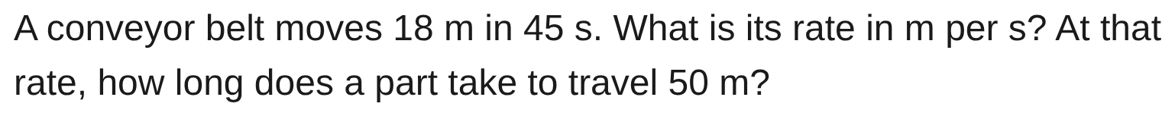
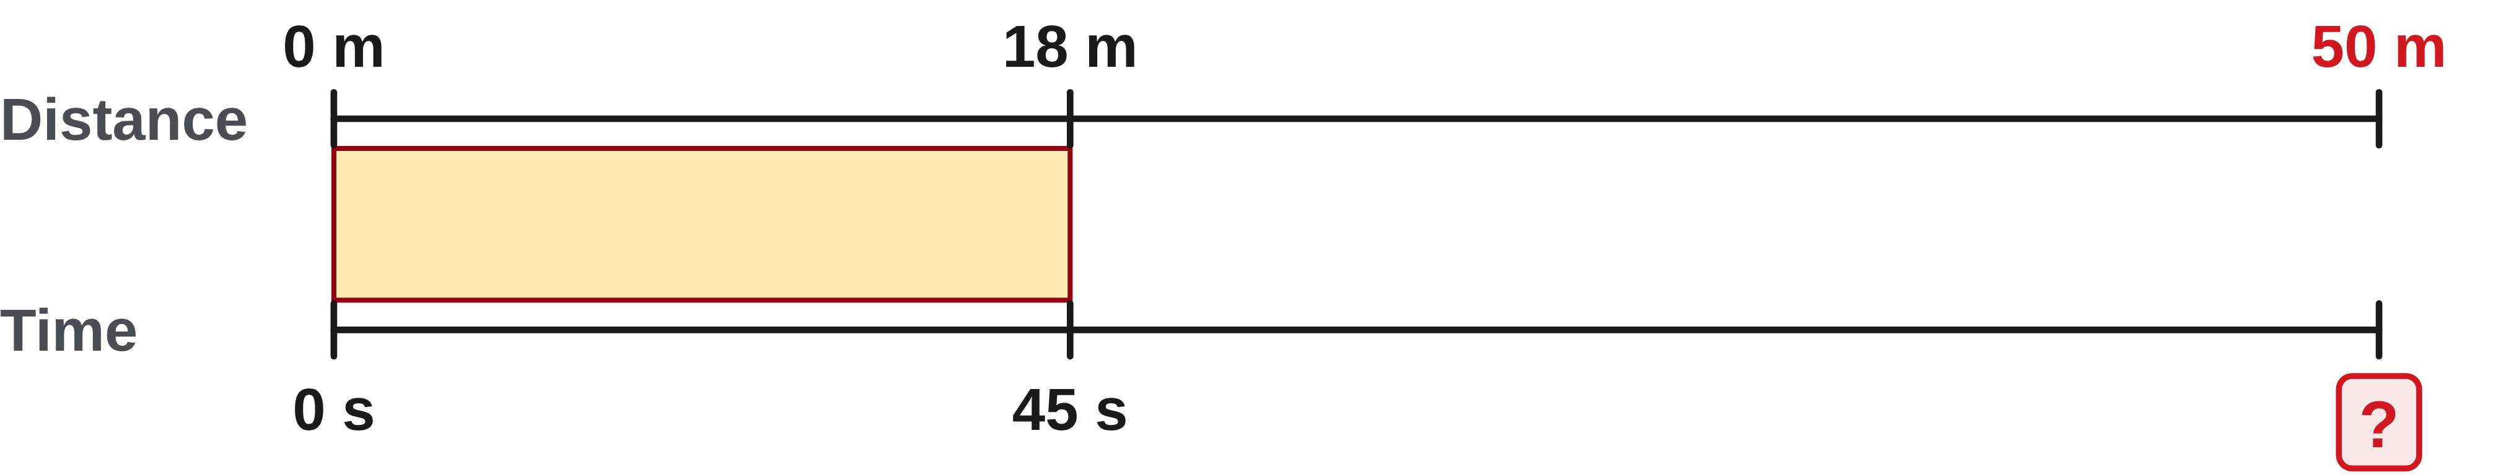
W04-L07 • PRACTISE • 1:25 PM–1:45 PM • 20 MIN TOTAL
Practise from the Exercise Book | 6B Q4
Write the operation, working and units before checking.
Textbook sections 6.5–6.7 pp.144–148
Textbook
Exercise Book
Numeracy Hub
Shape Canvas
Day 13 • 2026-11-19 • 18
Notes:
Timing: PRACTISE | 1:25 PM–1:45 PM | 20 MIN TOTAL. Shared phase allocation across these slides.
For 6B Q4, a conveyor moves eighteen metres in forty-five seconds. Find metres per second, then the time for fifty metres at that rate. Keep the rate’s units in your working so the second operation makes sense.
Instructor-only, after the attempt: 18 ÷ 45 = 0.4 m/s. Time is 50 ÷ 0.4 = 125 s. Check by multiplying 0.4 m/s by 125 s to recover 50 m. A slower-than-one-metre-per-second rate needs more than fifty seconds.

Slide 19
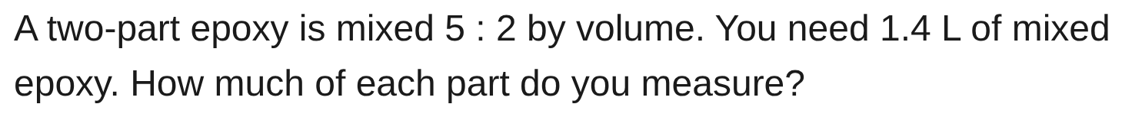
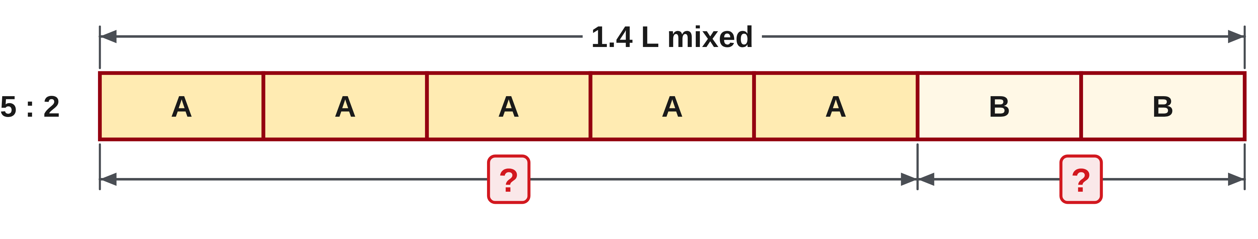
W04-L07 • PRACTISE • 1:25 PM–1:45 PM • 20 MIN TOTAL
Practise from the Exercise Book | 6B Q7
Write the operation, working and units before checking.
Textbook sections 6.5–6.7 pp.144–148
Textbook
Exercise Book
Numeracy Hub
Shape Canvas
Day 13 • 2026-11-19 • 19
Notes:
Timing: PRACTISE | 1:25 PM–1:45 PM | 20 MIN TOTAL. Shared phase allocation across these slides.
In the classroom problem 6B Q7, share 1.4 litres in a 5:2 ratio. Count all equal parts before finding one part. Then find each share and check both their sum and ratio.
Instructor-only, after the attempt: There are seven parts; 1.4 ÷ 7 = 0.2 L per part. The shares are 5 × 0.2 = 1 L and 2 × 0.2 = 0.4 L. They total 1.4 L and retain 5:2.

Slide 20
W04-L07 • CHECK • 1:45 PM–1:55 PM • 10 MIN TOTAL
Check independently
Exercise Book 6A Q18 and Exercise Book 6B Q6; show the proportion or unit-rate calculation.
Solve without displayed answers; include working, units and the requested rounding.
Resources: Exercise Book 6A Q14–18 (p.56); 6B Q4,6 (p.57), Q7 (p.58)
Textbook sections 6.5–6.7 pp.144–148
Textbook
Exercise Book
Numeracy Hub
Shape Canvas
Day 13 • 2026-11-19 • 20
Notes:
Timing: CHECK | 1:45 PM–1:55 PM | 10 MIN TOTAL. Shared phase allocation across these slides.
Complete 6A Q18 and 6B Q6 independently. For the proportion, show how corresponding values stay equivalent. For the bracket quantity, show either the scale factor or the material per bracket. What makes your calculation checkable by another person? Labels that explain what each number counts, plus the intermediate operation. Keep your worked solutions closed until your attempt is recorded, then compare the result with the size you expected.

Slide 21
W04-L07 • CHECK • 1:45 PM–1:55 PM • 10 MIN TOTAL
Independent check | 6A Q18
Answer independently. Keep worked solutions closed.
Textbook sections 6.5–6.7 pp.144–148
Textbook
Exercise Book
Numeracy Hub
Shape Canvas
Day 13 • 2026-11-19 • 21
Notes:
Timing: CHECK | 1:45 PM–1:55 PM | 10 MIN TOTAL. Shared phase allocation across these slides.
For 6A Q18, solve 7/x = 21/36. Keep the numerator and denominator paired. Think about what factor changes seven to twenty-one, and what that implies for the corresponding denominator. Record your reasoning before checking.
Instructor-only, after the attempt: The factor is three, so 3x = 36 and x = 12. Alternatively, 7 × 36 = 21x gives the same result. Both 7/12 and 21/36 are equal fractions.

Slide 22
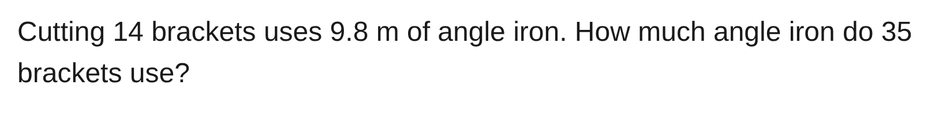
W04-L07 • CHECK • 1:45 PM–1:55 PM • 10 MIN TOTAL
Independent check | 6B Q6
Answer independently. Keep worked solutions closed.
Textbook sections 6.5–6.7 pp.144–148
Textbook
Exercise Book
Numeracy Hub
Shape Canvas
Day 13 • 2026-11-19 • 22
Notes:
Timing: CHECK | 1:45 PM–1:55 PM | 10 MIN TOTAL. Shared phase allocation across these slides.
For 6B Q6, fourteen brackets use 9.8 metres of angle iron. Find the quantity for thirty-five brackets. Decide whether to use the scale factor between bracket counts or find the material for one bracket.
Instructor-only, after the attempt: 35 ÷ 14 = 2.5; 9.8 × 2.5 = 24.5 m. The unit-rate route is 9.8 ÷ 14 = 0.7 m per bracket, then 0.7 × 35 = 24.5 m.

Slide 23
W04-L07 • WRAP UP • 1:55 PM–2:00 PM • 5 MIN TOTAL
Wrap up and choose the next step
Ask: What did you learn? Where will you use it? What will you check next time?
Name the math and one other essential skill used; write the next practice step.
Resources: Exercise Book 6A Q14–18 (p.56); 6B Q4,6 (p.57), Q7 (p.58)
Textbook sections 6.5–6.7 pp.144–148
Textbook
Exercise Book
Numeracy Hub
Shape Canvas
Day 13 • 2026-11-19 • 23
Notes:
Timing: WRAP UP | 1:55 PM–2:00 PM | 5 MIN TOTAL. Shared phase allocation across these slides.
Explain one result using the words “for every.” That phrase helps reveal the ratio’s order. For example, the 1:6 length ratio means one equal part of the first length for every six of the second. What was your most important check today: matching units, preserving order, finding one part or checking the total? Write it beside one example. After the break, the same proportional reasoning will link a dimension on a drawing to the actual size of the part.

Slide 24
DAY 13 • SCHEDULED BREAK
Break
2:00 PM–2:15 PM
Return ready for: Scale drawings and weekly check
This break is excluded from teaching minutes.
Textbook
Exercise Book
Numeracy Hub
Shape Canvas
Day 13 • 2026-11-19 • 24
Notes:
Timing: scheduled break, 2:00–2:15 PM.
Take the scheduled break from 2:00 to 2:15. When we return, we will use ratios to move between drawing dimensions and real dimensions. Keep your notes on matching units and preserving the comparison order nearby.

Slide 25
W04-L08 • START • 2:15 PM–2:20 PM • 5 MIN TOTAL
Scale drawings and weekly check
Today’s goal: Translate drawing lengths to real lengths and explain a multi-step calculation from a dimensioned sketch.
Share a prior use of this skill; identify the quantity and unit.
Textbook sections 6.8 pp.148–150; review Chapter 4–6
Exercise Book 6A Q19–20 (p.56); 6B Q8 (p.58); 6C Q5,7–8 (p.60)
Keep your notebook, textbook, exercise book and chosen calculator ready.
Textbook sections 6.8 pp.148–150; review Chapter 4–6
Textbook
Exercise Book
Numeracy Hub
Shape Canvas
Day 13 • 2026-11-19 • 25
Notes:
Timing: START | 2:15 PM–2:20 PM | 5 MIN TOTAL. Shared phase allocation across these slides.
We now use a ratio to connect a drawing with a real object. A large object may be drawn smaller so it fits on paper; a tiny detail may be enlarged so we can see it. Open 6A Q19–20, 6B Q8 and 6C Q5 and Q7–8. What must we identify before using a scale? Whether our known length is on the drawing or on the real object. That direction determines the operation, along with the scale’s stated order.

Slide 26
W04-L08 • RECALL • 2:20 PM–2:25 PM • 5 MIN TOTAL
Recall and reconnect
Identify what 1:40 means. Compare a drawing length and a real length before calculating.
Attempt the short retrieval task independently; explain the method before seeing answers.
Resources: Exercise Book 6A Q19–20 (p.56); 6B Q8 (p.58); 6C Q5,7–8 (p.60)
Textbook sections 6.8 pp.148–150; review Chapter 4–6
Textbook
Exercise Book
Numeracy Hub
Shape Canvas
Day 13 • 2026-11-19 • 26
Notes:
Timing: RECALL | 2:20 PM–2:25 PM | 5 MIN TOTAL. Shared phase allocation across these slides.
What does a 1:40 scale mean? One drawing unit corresponds to forty real units of the same kind. If the drawing length is one millimetre, the actual length is forty millimetres. Which should be larger on a reduced drawing problem: the real length or the drawn length? The real length. Say “drawing to real” or “real to drawing” before deciding to multiply or divide. This simple spoken check prevents a correct factor being used in the wrong direction.

Slide 27
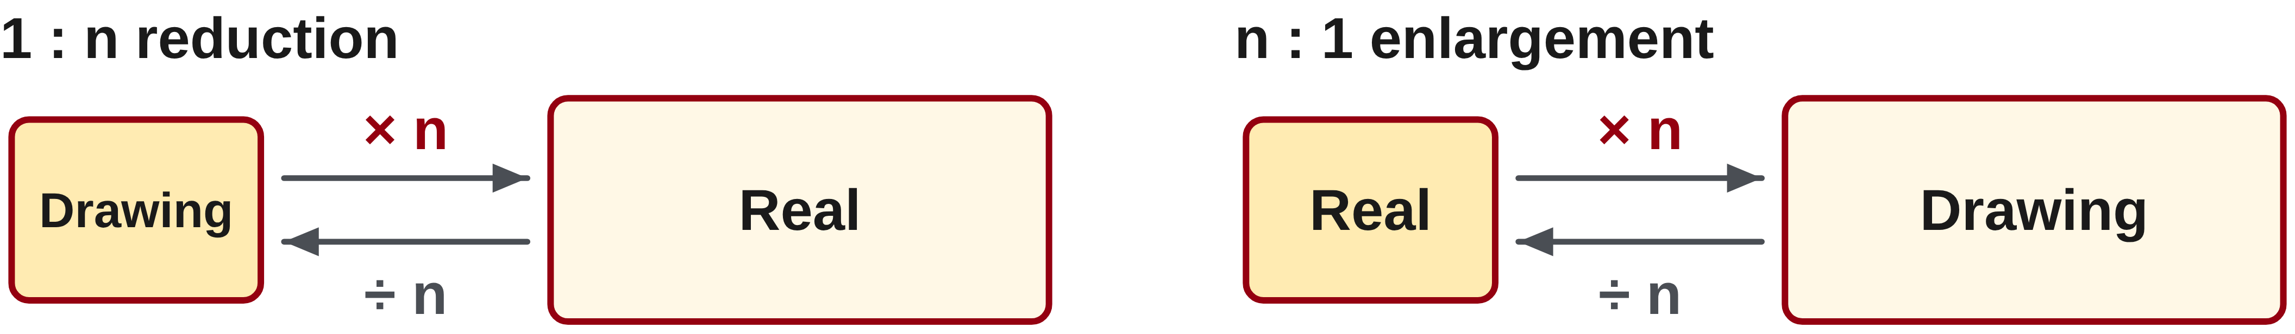
W04-L08 • TEACH • 2:25 PM–2:40 PM • 15 MIN TOTAL
Read the direction of a scale
1
A 1:40 scale means one drawing unit represents 40 matching real units.
2
For 1:n reductions: drawing → real, multiply by n; real → drawing, divide by n.
3
For n:1 enlargements: drawing → real, divide by n; real → drawing, multiply by n.
4
Convert units when needed; keep drawing and real dimensions labelled.
Textbook sections 6.8 pp.148–150; review Chapter 4–6
Textbook
Exercise Book
Numeracy Hub
Shape Canvas
Day 13 • 2026-11-19 • 27
Notes:
Timing: TEACH | 2:25 PM–2:40 PM | 15 MIN TOTAL. Shared phase allocation across these slides.
Read every scale as drawing to real. At 1:40, one on the drawing corresponds to forty in reality, so drawing to real means multiplying by forty; reversing that journey means dividing by forty. At 3:1, the drawing is enlarged: three drawing units correspond to one real unit. Real to drawing then means multiplying by three, while drawing to real means dividing by three. Is “always multiply the drawing measurement” a reliable rule? No. It fails for enlargements. Use the labelled ratio and the direction of travel, with the same units on both sides.

Slide 28
W04-L08 • TEACH • 2:25 PM–2:40 PM • 15 MIN TOTAL
Use dimensions, not screen size
1
Read the written measurement on a drawing.
2
A resized screen image is not a reliable ruler.
3
Write a sketch and an equation showing which length is unknown.
4
Check direction: a 1:40 drawing is smaller; a 3:1 drawing is larger than the real object.
Textbook sections 6.8 pp.148–150; review Chapter 4–6
Textbook
Exercise Book
Numeracy Hub
Shape Canvas
Day 13 • 2026-11-19 • 28
Notes:
Timing: TEACH | 2:25 PM–2:40 PM | 15 MIN TOTAL. Shared phase allocation across these slides.
Written dimensions and the stated scale are our evidence. A projected image or browser zoom may resize the picture, so measuring the screen with a ruler cannot reliably recover the original drawing length. Write which number belongs to the drawing and which to the real object, then connect them with the scale. On a 1:40 reduction, the real object should be larger. On a 3:1 enlargement, the drawing should be larger. What changes when we zoom a labelled drawing? Its appearance on screen, not its stated dimension. Keep these two ideas separate when checking a result.

Slide 29
W04-L08 • TEACH • 2:25 PM–2:40 PM • 15 MIN TOTAL
Multiply to return to full size
6A Q19: 85 mm × 40 = 3,400 mm = 3.4 m
Reverse check: 3,400 mm ÷ 40 = 85 mm.
Classroom example: 2,000 mm at 1:50 is drawn as 40 mm.
Together: 6A Q20 and 6B Q8. Explain where inches, feet and the scale factor enter. Do unit conversions explicitly.
Shape Canvas: label a rectangle, then change its dimensions proportionally. Zooming alone does not change the labelled dimensions.
W4 L8 • Use the labelled scale and dimensions
Textbook
Exercise Book
Numeracy Hub
Shape Canvas
Day 13 • 2026-11-19 • 29
Notes:
Timing: TEACH | 2:25 PM–2:40 PM | 15 MIN TOTAL. Shared phase allocation across these slides.
For 6A Q19, the drawing length is eighty-five millimetres at 1:40. Multiply by forty: 85 × 40 = 3400 millimetres, or 3.4 metres. Reverse the calculation to check: 3400 divided by forty returns eighty-five. In our second example, a real length of two thousand millimetres at 1:50 is drawn as forty millimetres because 2000 divided by fifty is forty. Why did the operation change? The direction changed: first drawing to real, then real to drawing. Label that direction beside your equation instead of memorizing one operation for every problem.

Slide 30
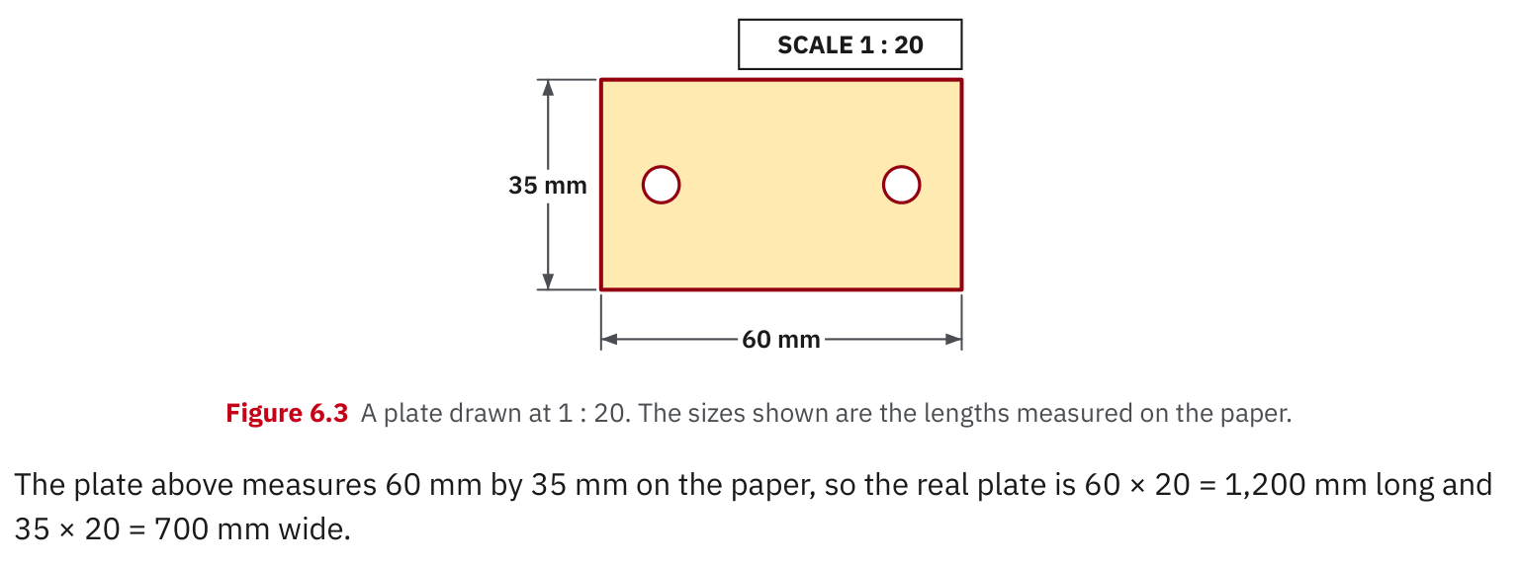
W04-L08 • TEACH • 2:25 PM–2:40 PM • 15 MIN TOTAL
Textbook | page 148
Textbook p.148 • Figure 6.3 — Drawing dimensions and real dimensions
Textbook sections 6.8 pp.148–150; review Chapter 4–6
Textbook
Exercise Book
Numeracy Hub
Shape Canvas
Day 13 • 2026-11-19 • 30
Notes:
Timing: TEACH | 2:25 PM–2:40 PM | 15 MIN TOTAL. Shared phase allocation across these slides.
Textbook Figure 6.3 shows paper dimensions of sixty millimetres by thirty-five millimetres at 1:20. Because these are dimensions measured on the paper, multiply each by twenty to find the real plate: 1200 millimetres by 700 millimetres. Why must both dimensions use the same factor? A scale drawing preserves the shape’s proportions. Compare 60:35 with 1200:700; they simplify to the same ratio. Read the caption carefully: these labels are paper measurements for this example. In other drawings, written dimensions may already state the real sizes, so identify what each label means.

Slide 31
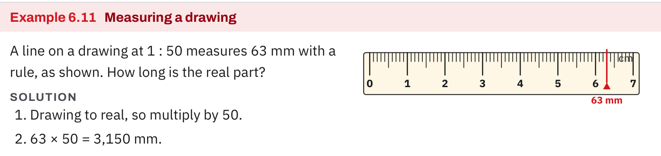
W04-L08 • TEACH • 2:25 PM–2:40 PM • 15 MIN TOTAL
Textbook | page 149
Textbook p.149 • Example 6.11 — Scale factor from drawing to real length
Textbook sections 6.8 pp.148–150; review Chapter 4–6
Textbook
Exercise Book
Numeracy Hub
Shape Canvas
Day 13 • 2026-11-19 • 31
Notes:
Timing: TEACH | 2:25 PM–2:40 PM | 15 MIN TOTAL. Shared phase allocation across these slides.
Textbook Example 6.11 gives a line measured as sixty-three millimetres on a 1:50 drawing. The real length is 63 times 50, which equals 3150 millimetres. Divide by one thousand to express the same length as 3.15 metres. What does a reverse check give? 3150 divided by fifty returns sixty-three millimetres. Keep the scale conversion separate from the millimetre-to-metre conversion: one changes from drawing size to real size, while the other only changes the unit used to describe that same real length. This distinction makes multistep work easier to follow.

Slide 32
W04-L08 • TEACH • 2:25 PM–2:40 PM • 15 MIN TOTAL
Spot the mistake. Explain the correction.
A drawing is reduced to 1:40. Should the real length be divided by 40 again?
Discuss the method before checking the answer.
From drawing to real, multiply by 40. Divide only when going from real to drawing.
Textbook sections 6.8 pp.148–150; review Chapter 4–6
Textbook
Exercise Book
Numeracy Hub
Shape Canvas
Day 13 • 2026-11-19 • 32
Notes:
Timing: TEACH | 2:25 PM–2:40 PM | 15 MIN TOTAL. Shared phase allocation across these slides.
A reduced drawing uses 1:40. A learner takes a drawing measurement and divides by forty again to find the real length. What should warn us? That makes the answer even smaller, though the real object must be larger. The correct drawing-to-real operation is multiplication by forty. Division is appropriate for the reverse journey from real size to the reduced drawing. Point to the known quantity before choosing the operation. Can you explain the correction without saying “because that is the rule”? One drawing unit represents forty actual units, so each drawn unit must expand to forty.

Slide 33
W04-L08 • TOGETHER • 2:40 PM–2:55 PM • 15 MIN TOTAL
Work together
Work Exercise Book 6A Q20 and 6B Q8 with a partner. Explain where inches, feet and the scale factor enter.
Work in pairs; alternate calculator operator and checker. Show units and an estimated answer.
Resources: Exercise Book 6A Q19–20 (p.56); 6B Q8 (p.58); 6C Q5,7–8 (p.60)
Textbook sections 6.8 pp.148–150; review Chapter 4–6
Textbook
Exercise Book
Numeracy Hub
Shape Canvas
Day 13 • 2026-11-19 • 33
Notes:
Timing: TOGETHER | 2:40 PM–2:55 PM | 15 MIN TOTAL. Shared phase allocation across these slides.
Work with a partner on 6A Q20 and 6B Q8. For each, label drawing and real quantities before calculating. When feet and inches appear, convert them explicitly so the scale compares matching units. Why should we not combine a numerical ratio while silently mixing feet and inches? One foot contains twelve inches, so the numerical counts are not directly comparable. Explain the direction and units first, then let your partner check the calculation.

Slide 34
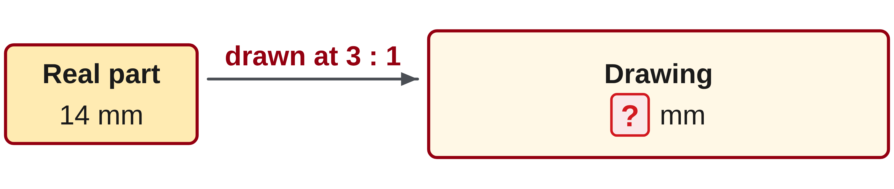
W04-L08 • TOGETHER • 2:40 PM–2:55 PM • 15 MIN TOTAL
Guided practice | 6A Q20
Work with a partner. Take turns explaining the next step.
Textbook sections 6.8 pp.148–150; review Chapter 4–6
Textbook
Exercise Book
Numeracy Hub
Shape Canvas
Day 13 • 2026-11-19 • 34
Notes:
Timing: TOGETHER | 2:40 PM–2:55 PM | 15 MIN TOTAL. Shared phase allocation across these slides.
For 6A Q20, the actual part is fourteen millimetres and the drawing scale is 3:1. Is this a reduction or an enlargement? Predict whether the drawn length should exceed fourteen millimetres, then calculate it.
Instructor-only, after the attempt: It is an enlargement; 14 × 3 = 42 mm on the drawing. The reverse check is 42 ÷ 3 = 14 mm. Dividing fourteen by three would move in the wrong direction.

Slide 35
W04-L08 • TOGETHER • 2:40 PM–2:55 PM • 15 MIN TOTAL
Compare your method | 6A Q20
CHECK TOGETHER
42 mm
Textbook sections 6.8 pp.148–150; review Chapter 4–6
Textbook
Exercise Book
Numeracy Hub
Shape Canvas
Day 13 • 2026-11-19 • 35
Notes:
Timing: TOGETHER | 2:40 PM–2:55 PM | 15 MIN TOTAL. Shared phase allocation across these slides.
The drawing length is forty-two millimetres. Three drawing units represent one real unit, so fourteen real millimetres become forty-two drawn millimetres. Why is this multiplication correct even though we divided when drawing a real length at 1:50? Here the drawing is enlarged rather than reduced. The scale’s order determines the factor. Ask your partner to state both lengths with labels: real, fourteen millimetres; drawing, forty-two millimetres. Those labels make the answer unambiguous.

Slide 36
W04-L08 • PRACTISE • 2:55 PM–3:15 PM • 20 MIN TOTAL
Your scheduled practice
Complete Exercise Book 6C Q5,7–8. Use a four-question paper checkpoint from the week; optional Numeracy Hub review only after core work.
Solve on paper first; use the tool to check; correct one error with a written reason.
Resources: Exercise Book 6A Q19–20 (p.56); 6B Q8 (p.58); 6C Q5,7–8 (p.60)
Textbook sections 6.8 pp.148–150; review Chapter 4–6
Textbook
Exercise Book
Numeracy Hub
Shape Canvas
Day 13 • 2026-11-19 • 36
Notes:
Timing: PRACTISE | 2:55 PM–3:15 PM | 20 MIN TOTAL. Shared phase allocation across these slides.
Complete 6C Q5 and Q7–8, then the scheduled four-question paper checkpoint from the week. For every drawing problem, identify what the labelled sizes represent and record the scale direction. Numeracy Hub review comes after the core paper work. What should you check if a drawing answer looks implausible? Review the scale order, unit conversion and whether you treated a drawn length as a real one. Keep one corrected calculation with a written explanation rather than erasing the reasoning.

Slide 37
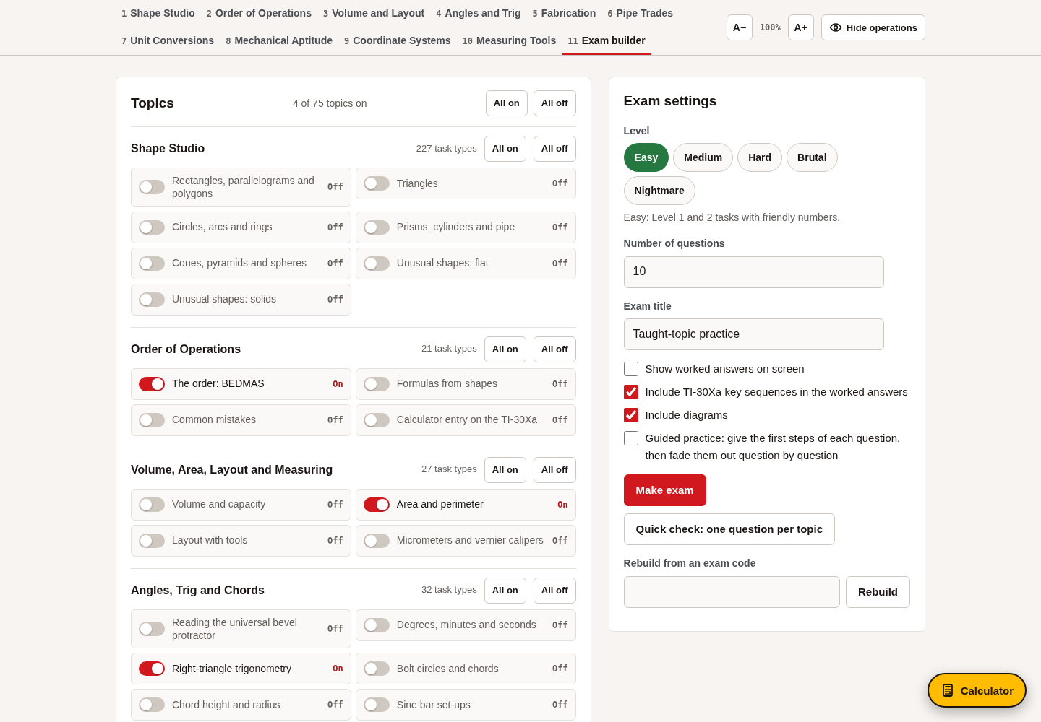
W04-L08 • PRACTISE • 2:55 PM–3:15 PM • 20 MIN TOTAL
Open Numeracy Hub
Navigation example. Use the values and units in the assigned task.
Textbook sections 6.8 pp.148–150; review Chapter 4–6
Textbook
Exercise Book
Numeracy Hub
Shape Canvas
Day 13 • 2026-11-19 • 37
Notes:
Timing: PRACTISE | 2:55 PM–3:15 PM | 20 MIN TOTAL. Shared phase allocation across these slides.
Open Numeracy Hub for review after the core paper tasks. Use the Easy Exam builder only with topics we have already taught this week. The aim is to retrieve the method you used, including decimal placement, percent relationships, ratios and scale direction. What should accompany a calculator result? Your own equation and unit reasoning. Keep the paper checkpoint first so we can see the skills you can use independently before a tool offers additional prompts or feedback.

Slide 38
W04-L08 • PRACTISE • 2:55 PM–3:15 PM • 20 MIN TOTAL
Practise in Numeracy Hub and Shape Canvas
1
Build the assigned dimensioned rectangle in Shape Canvas from written sizes.
2
Change one dimension by the stated factor and predict the resulting labelled dimension.
3
Complete the core paper work first; use optional Easy Exam builder review on taught topics only.
Textbook sections 6.8 pp.148–150; review Chapter 4–6
Textbook
Exercise Book
Numeracy Hub
Shape Canvas
Day 13 • 2026-11-19 • 38
Notes:
Timing: PRACTISE | 2:55 PM–3:15 PM | 20 MIN TOTAL. Shared phase allocation across these slides.
Build the assigned rectangle in Shape Canvas using the written dimensions. Before changing a dimension by the stated factor, predict the new label. Then compare the result with your paper calculation. Does zooming accomplish the same mathematical change? No; zoom changes screen appearance without changing the labelled lengths. Finish the core paper work and checkpoint before optional Numeracy Hub review. Explain one result using the words “drawing” and “real” so the direction of the scale stays visible.

Slide 39
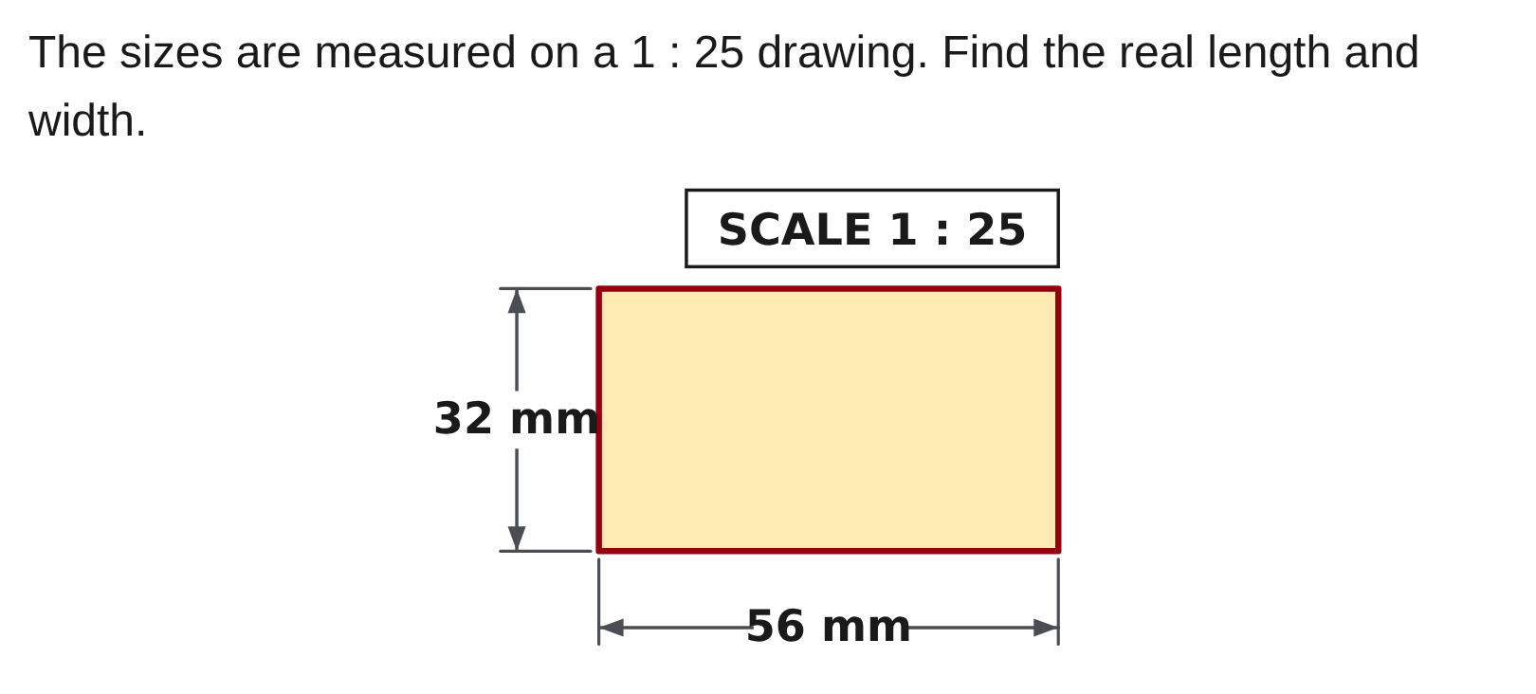
W04-L08 • PRACTISE • 2:55 PM–3:15 PM • 20 MIN TOTAL
Practise from the Exercise Book | 6C Q5
Write the operation, working and units before checking.
Textbook sections 6.8 pp.148–150; review Chapter 4–6
Textbook
Exercise Book
Numeracy Hub
Shape Canvas
Day 13 • 2026-11-19 • 39
Notes:
Timing: PRACTISE | 2:55 PM–3:15 PM | 20 MIN TOTAL. Shared phase allocation across these slides.
For 6C Q5, use the labelled drawing sizes and the 1:25 scale to find the real length and width. Apply the factor to both dimensions, then check that the rectangle retains the same proportions. Record units on both answers.
Instructor-only, after the attempt: The real dimensions are 1400 mm by 800 mm. They correspond to drawing dimensions of 56 mm and 32 mm, each multiplied by twenty-five. Dividing the real answers by twenty-five returns those paper dimensions.

Slide 40
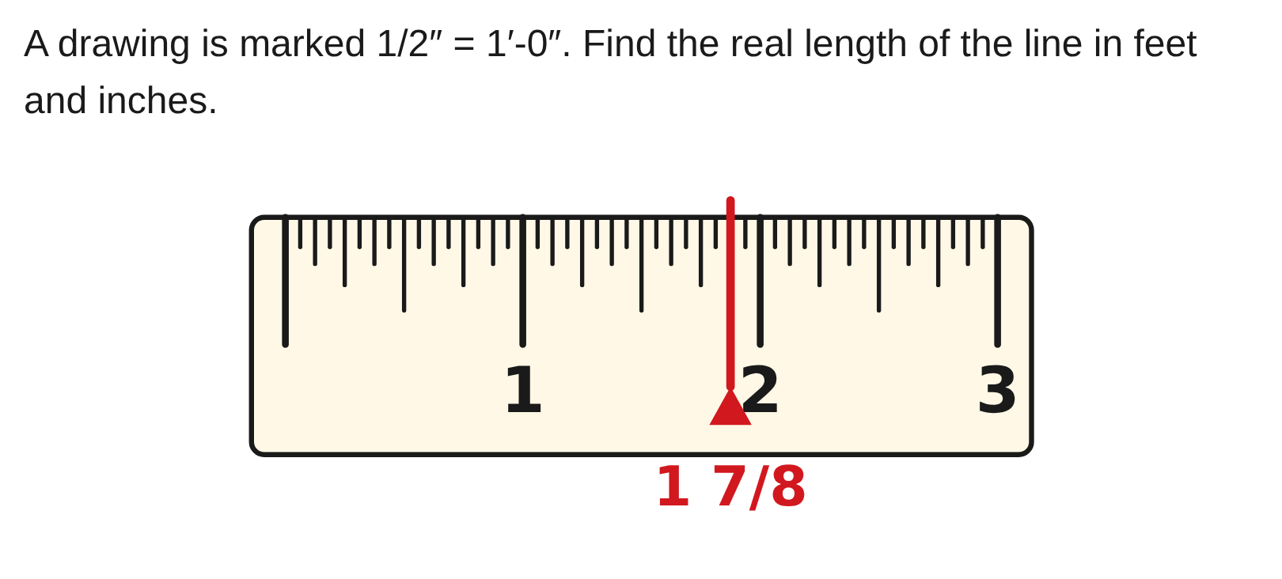
W04-L08 • PRACTISE • 2:55 PM–3:15 PM • 20 MIN TOTAL
Practise from the Exercise Book | 6C Q7
Write the operation, working and units before checking.
Textbook sections 6.8 pp.148–150; review Chapter 4–6
Textbook
Exercise Book
Numeracy Hub
Shape Canvas
Day 13 • 2026-11-19 • 40
Notes:
Timing: PRACTISE | 2:55 PM–3:15 PM | 20 MIN TOTAL. Shared phase allocation across these slides.
For 6C Q7, the scale says one-half inch on the drawing represents one foot in reality. Use the labelled line length to count how many half-inch scale units it contains. Convert any fractional foot to inches before giving feet and inches.
Instructor-only, after the attempt: The real length is 3.75 ft. The fractional 0.75 ft is 0.75 × 12 = 9 in, so the final result is 3′ 9″. It is not 3′ 75″.

Slide 41
W04-L08 • CHECK • 3:15 PM–3:25 PM • 10 MIN TOTAL
Check independently
Exercise Book 6A Q19–20 independently, with units and a sketch showing scale direction.
Solve without displayed answers; include working, units and the requested rounding.
Resources: Exercise Book 6A Q19–20 (p.56); 6B Q8 (p.58); 6C Q5,7–8 (p.60)
Textbook sections 6.8 pp.148–150; review Chapter 4–6
Textbook
Exercise Book
Numeracy Hub
Shape Canvas
Day 13 • 2026-11-19 • 41
Notes:
Timing: CHECK | 3:15 PM–3:25 PM | 10 MIN TOTAL. Shared phase allocation across these slides.
Complete 6A Q19–20 independently. Show the known dimension, the scale and an arrow or sketch identifying the direction from drawing to real or real to drawing. One problem is a reduction and the other an enlargement. What makes a direction check useful? It tells you whether the requested length should be larger or smaller before arithmetic. Include the unit and label your final length as drawn or real, then check your result in reverse.

Slide 42
W04-L08 • CHECK • 3:15 PM–3:25 PM • 10 MIN TOTAL
Independent check | 6A Q19
Answer independently. Keep worked solutions closed.
Textbook sections 6.8 pp.148–150; review Chapter 4–6
Textbook
Exercise Book
Numeracy Hub
Shape Canvas
Day 13 • 2026-11-19 • 42
Notes:
Timing: CHECK | 3:15 PM–3:25 PM | 10 MIN TOTAL. Shared phase allocation across these slides.
For 6A Q19, an eighty-five-millimetre line appears on a 1:40 drawing. Find the real length, with a sketch showing scale direction. Work independently before checking the remembered example.
Instructor-only, after the attempt: 85 × 40 = 3400 mm, equivalent to 3.4 m. The real length is forty times the drawing length. A result of 2.125 mm would come from dividing and would conflict with the reduction relationship.

Slide 43
W04-L08 • CHECK • 3:15 PM–3:25 PM • 10 MIN TOTAL
Independent check | 6A Q20
Answer independently. Keep worked solutions closed.
Textbook sections 6.8 pp.148–150; review Chapter 4–6
Textbook
Exercise Book
Numeracy Hub
Shape Canvas
Day 13 • 2026-11-19 • 43
Notes:
Timing: CHECK | 3:15 PM–3:25 PM | 10 MIN TOTAL. Shared phase allocation across these slides.
For 6A Q20, draw a fourteen-millimetre part at 3:1. State whether the drawing is larger or smaller than the real part, then give the drawn length. Include the reverse check.
Instructor-only, after the attempt: The drawing is enlarged; 14 × 3 = 42 mm. Checking 42 ÷ 3 gives the original 14 mm. The unit stays millimetres because the scale compares matching units; the change is in represented size, not unit type.

Slide 44
W04-L08 • WRAP UP • 3:25 PM–3:30 PM • 5 MIN TOTAL
Wrap up and choose the next step
Ask: What did you learn? Where will you use it? What will you check next time?
Name the math and one other essential skill used; write the next practice step.
Resources: Exercise Book 6A Q19–20 (p.56); 6B Q8 (p.58); 6C Q5,7–8 (p.60)
Textbook sections 6.8 pp.148–150; review Chapter 4–6
Textbook
Exercise Book
Numeracy Hub
Shape Canvas
Day 13 • 2026-11-19 • 44
Notes:
Timing: WRAP UP | 3:25 PM–3:30 PM | 5 MIN TOTAL. Shared phase allocation across these slides.
Finish by explaining one scale answer in a complete sentence: “At this scale, this drawing length represents this real length.” What distinguishes a changed scale dimension from a zoomed picture? Only changing the labelled dimensions changes the mathematical size. Look back across the week and choose one checking habit to retain: estimate decimal magnitude, name the percent whole, match ratio units or label scale direction. Write the habit beside a corrected example so you can apply it to the next dimensioned drawing.

