Slide 1

CARPENTRY FOUNDATION / INTAKE 142
Day 19 | Tuesday
19
December 1, 2026
Volume of boxes and prisms
12:45 PM–2:00 PM • Math • 75 min
Cylinders, capacity and missing heights
2:15 PM–3:30 PM • Math • 75 min
Week 6 • 2 scheduled blocks • 150 teaching minutes
Estimate. Show the method. Label units. Check the result.
Textbook
Exercise Book
Numeracy Hub
Shape Canvas
Day 19 • 2026-12-01 • 01
Notes:
Opening — within the first Start allocation.
Today we move into three dimensions: how much space a container holds, and how we can recover a missing size from its capacity. From 12:45 to 2:00 we work with boxes and prisms. From 2:15 to 3:30 we work with cylinders and hidden heights or lengths. Keep track of what every unit means. Square units measure a surface; cubic units measure space; litres and gallons describe capacity. We will connect those ideas using the same drawings and dimensions.

Slide 2
DAY 19 / WEEK 6 / CLASS TIMETABLE
Today’s exact schedule
12:45 PM–2:00 PM • 75 min
2:15 PM–3:30 PM • 75 min
Volume of boxes and prisms
Cylinders, capacity and missing heights
12:45 PM–12:50 PM
Start
5
2:15 PM–2:20 PM
Start
5
12:50 PM–12:55 PM
Recall
5
2:20 PM–2:25 PM
Recall
5
12:55 PM–1:10 PM
Teach
15
2:25 PM–2:40 PM
Teach
15
1:10 PM–1:25 PM
Together
15
2:40 PM–2:55 PM
Together
15
1:25 PM–1:45 PM
Practise
20
2:55 PM–3:15 PM
Practise
20
1:45 PM–1:55 PM
Check
10
3:15 PM–3:25 PM
Check
10
1:55 PM–2:00 PM
Wrap up
5
3:25 PM–3:30 PM
Wrap up
5
Math • Math Week 6, Lesson 3
Math • Math Week 6, Lesson 4
Break: 2:00 PM–2:15 PM • 15 minutes • excluded from teaching time
Textbook
Exercise Book
Numeracy Hub
Shape Canvas
Day 19 • 2026-12-01 • 02
Notes:
Opening — within the first Start allocation.
The first block includes a 20-minute practice period from 1:25 to 1:45 and an independent check from 1:45 to 1:55. Our break is 2:00 to 2:15. In the second block, practice runs from 2:55 to 3:15, and the check is 3:15 to 3:25. Both blocks end with time to explain and check the reasoning. The main habit today is to make the units consistent before calculating, then show how a volume becomes a capacity or a missing dimension.

Slide 3
W06-L03 • START • 12:45 PM–12:50 PM • 5 MIN TOTAL
Volume of boxes and prisms
Today’s goal: Calculate prism volume using consistent units and convert a capacity to litres.
Describe a prior use of the skill; identify the given and unknown quantities.
Textbook sections 11.1–11.3 pp.268–272; sections 7.4 pp.170–172
Exercise Book 11A Q1–10 (p.103); 11B Q1,5 (p.105)
Keep your notebook, textbook, exercise book and chosen calculator ready.
Textbook sections 11.1–11.3 pp.268–272; sections 7.4 pp.170–172
Textbook
Exercise Book
Numeracy Hub
Shape Canvas
Day 19 • 2026-12-01 • 03
Notes:
START • 12:45 PM–12:50 PM • 5 MIN TOTAL — shared across this phase’s slides.
Imagine a tank with its inside length, width and height labelled. Knowing only its base area does not tell us how much it can hold; we also need the depth or height. What three directions do we measure? Length, width and height. Our goal is to use those measurements consistently and then express capacity in litres when asked. Open chapter 11 in the exercise book. As you work, distinguish inside dimensions, which describe capacity, from outside dimensions, which include the container itself.

Slide 4
W06-L03 • RECALL • 12:50 PM–12:55 PM • 5 MIN TOTAL
Recall and reconnect
Try to distinguish a length, surface area and volume; identify the third dimension on a box.
Attempt the retrieval task independently; explain the method before checking.
Resources: Exercise Book 11A Q1–10 (p.103); 11B Q1,5 (p.105)
Textbook sections 11.1–11.3 pp.268–272; sections 7.4 pp.170–172
Textbook
Exercise Book
Numeracy Hub
Shape Canvas
Day 19 • 2026-12-01 • 04
Notes:
RECALL • 12:50 PM–12:55 PM • 5 MIN TOTAL — shared across this phase’s slides.
Point to one edge of a box: that measures length. Point to one face: that face has area. Now imagine filling the whole interior: that is volume. Which extra dimension turns a base area into a volume? The height or depth. Say the units with each idea: metres for a length, square metres for a face, cubic metres for the space inside. If an answer for a filled box ends in square metres, what has likely been left out? One of the three dimensions.

Slide 5
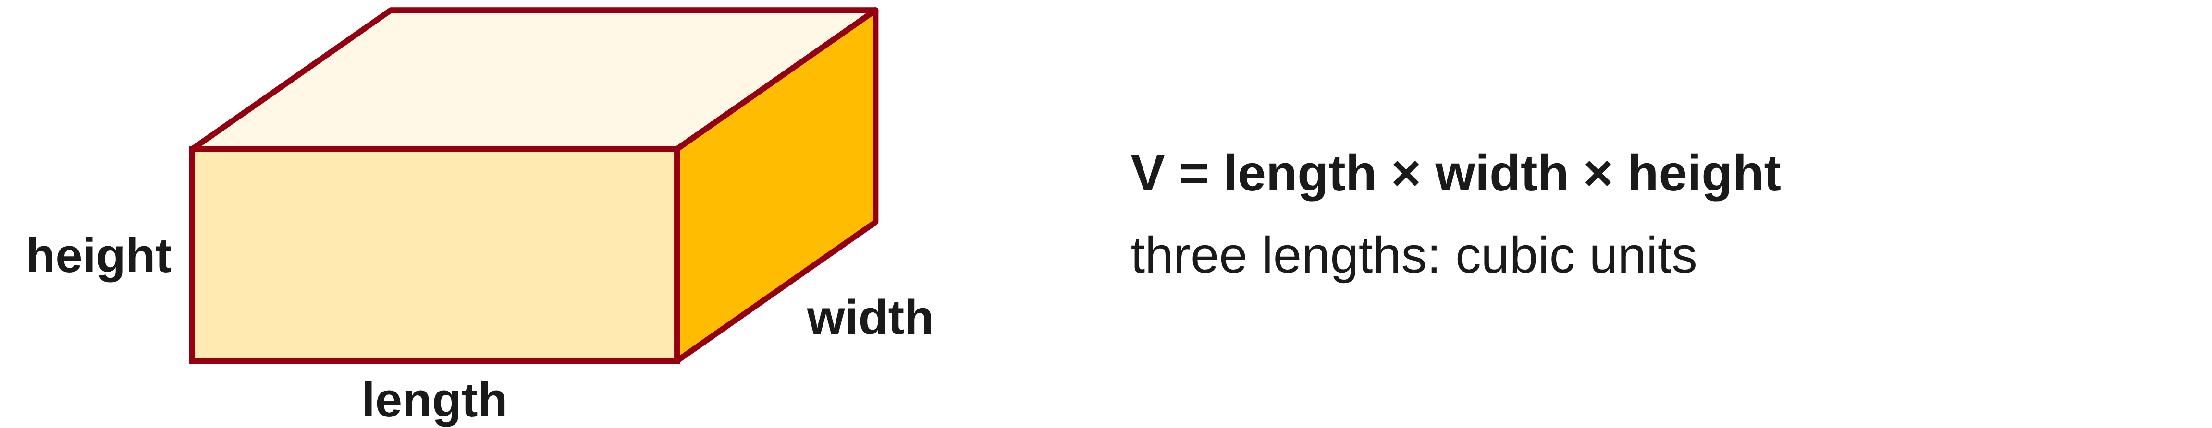
W06-L03 • TEACH • 12:55 PM–1:10 PM • 15 MIN TOTAL
Volume uses three dimensions
1
For a rectangular prism, V = length × width × height.
2
Convert all three lengths to the same unit first.
3
The result uses cubic units because three lengths were multiplied.
4
Doubling only one dimension doubles the volume.
Textbook sections 11.1–11.3 pp.268–272; sections 7.4 pp.170–172
Textbook
Exercise Book
Numeracy Hub
Shape Canvas
Day 19 • 2026-12-01 • 05
Notes:
TEACH • 12:55 PM–1:10 PM • 15 MIN TOTAL — shared across this phase’s slides.
For a rectangular prism, start with the base area, length times width, then multiply by height. That gives V equals l times w times h. Each factor contributes one length direction, which is why the answer uses a cubic unit. Make all three lengths use the same unit before multiplying. What happens if we double only the height while the base stays fixed? We stack twice as many equal layers, so volume doubles. If all three dimensions double, the multiplication has three factors of two, making the volume eight times as large.

Slide 6
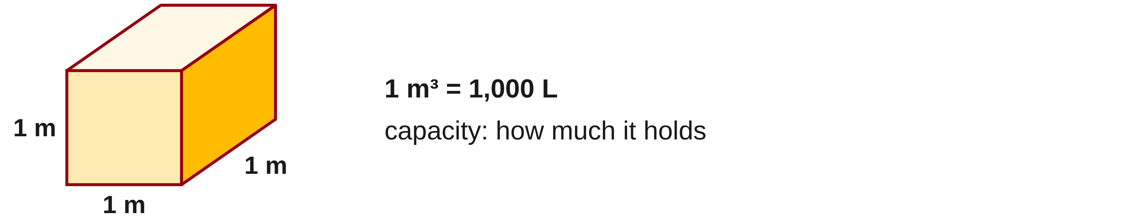
W06-L03 • TEACH • 12:55 PM–1:10 PM • 15 MIN TOTAL
Connect volume and capacity
1
Capacity describes how much a container can hold.
2
1 m³ = 1,000 L; use the book’s matching capacity conversion.
3
A cubic length conversion applies the length factor three times.
4
For pails, divide by one-pail capacity and round as the purchase requires.
Textbook sections 11.1–11.3 pp.268–272; sections 7.4 pp.170–172
Textbook
Exercise Book
Numeracy Hub
Shape Canvas
Day 19 • 2026-12-01 • 06
Notes:
TEACH • 12:55 PM–1:10 PM • 15 MIN TOTAL — shared across this phase’s slides.
Capacity tells us how much a container can hold. We can calculate that interior space in cubic units and then convert it to litres. One cubic metre equals 1,000 litres. A cubic length conversion acts in three directions: the length factor is multiplied by itself three times. Why does that matter for millimetres and metres? One cubic metre contains a billion cubic millimetres, not just a thousand. For pails, divide the required capacity by the capacity of one pail. If a partial pail is needed, the number of whole pails available must still supply the total.

Slide 7
W06-L03 • TEACH • 12:55 PM–1:10 PM • 15 MIN TOTAL
Keep dimensions consistent before multiplying
Reservoir example • 800 mm × 500 mm × 450 mm
Convert to metres: 0.8 m × 0.5 m × 0.45 m.
V = 0.8 × 0.5 × 0.45 = 0.18 m³
Capacity = 0.18 × 1,000 = 180 L
20 L pails needed = 180 ÷ 20 = 9
Check • 9 × 20 L = 180 L. The unit tells us what the number measures.
Doubling one dimension doubles the volume; doubling all three multiplies it by 8.
Together • Work 11A Q2–7,9. Estimate magnitude before calculating.
Shape Canvas: show all three prism dimensions and test a doubled length.
Exercise Book 11B Q1 p.105 • Numeracy Hub → Volume and Layout → Volume and capacity
Textbook
Exercise Book
Numeracy Hub
Shape Canvas
Day 19 • 2026-12-01 • 07
Notes:
TEACH • 12:55 PM–1:10 PM • 15 MIN TOTAL — shared across this phase’s slides.
The reservoir’s inside dimensions are 800 by 500 by 450 millimetres. Convert each to metres: 0.8, 0.5 and 0.45. Multiply: 0.8 times 0.5 times 0.45 equals 0.18 cubic metre. Multiplying by 1,000 gives 180 litres. At 20 litres per pail, 180 divided by 20 gives 9 pails. Check by reversing the last step: 9 times 20 litres is 180 litres. If only the reservoir’s length doubled, what would happen to capacity? It would double to 360 litres because the other two factors stay the same.

Slide 8

W06-L03 • TEACH • 12:55 PM–1:10 PM • 15 MIN TOTAL
Textbook | page 269
Textbook p.269 • Volume of a prism — End area times length
Textbook sections 11.1–11.3 pp.268–272; sections 7.4 pp.170–172
Textbook
Exercise Book
Numeracy Hub
Shape Canvas
Day 19 • 2026-12-01 • 08
Notes:
TEACH • 12:55 PM–1:10 PM • 15 MIN TOTAL — shared across this phase’s slides.
The textbook on page 269 describes a prism as equal end layers extending along a length. First find the area of one end; then multiply by how far that same end shape continues. A box has a rectangular end, so end area times length becomes the product of three dimensions. Why does this method work? The cross-section stays the same along the prism. It also explains the units: square units for the end multiplied by a length unit produce cubic units. Point to the end and the direction of extension in the picture before writing the formula.

Slide 9
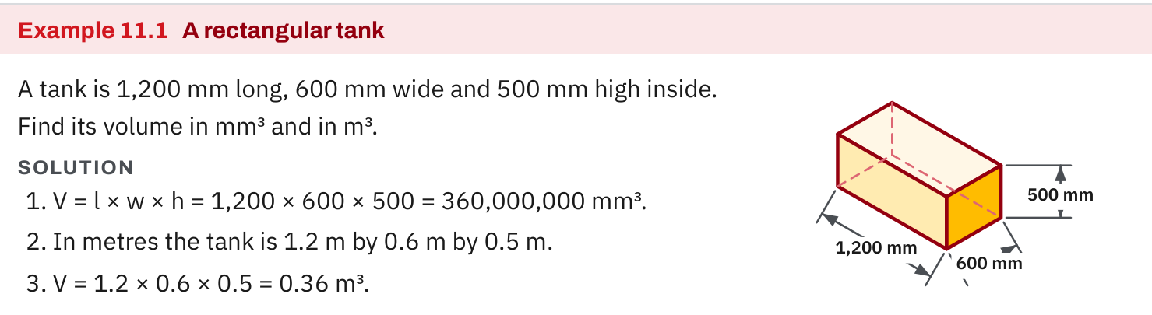
W06-L03 • TEACH • 12:55 PM–1:10 PM • 15 MIN TOTAL
Textbook | page 269
Textbook p.269 • Example 11.1 — Three dimensions of a rectangular tank
Textbook sections 11.1–11.3 pp.268–272; sections 7.4 pp.170–172
Textbook
Exercise Book
Numeracy Hub
Shape Canvas
Day 19 • 2026-12-01 • 09
Notes:
TEACH • 12:55 PM–1:10 PM • 15 MIN TOTAL — shared across this phase’s slides.
Example 11.1 uses inside dimensions of 1,200, 600 and 500 millimetres. Multiplying gives 360,000,000 cubic millimetres. That large number makes sense because a cubic millimetre is tiny. Now convert the dimensions first: 1.2 metres, 0.6 metre and 0.5 metre. Their product is 0.36 cubic metre. Do these answers describe different tanks? No, they describe the same volume in different-sized units. Check the relationship: one cubic metre is one billion cubic millimetres, and 0.36 times one billion is 360 million. The units make the two results comparable.

Slide 10
W06-L03 • TEACH • 12:55 PM–1:10 PM • 15 MIN TOTAL
Spot the mistake. Explain the correction.
A box uses metres for two sides and millimetres for the third. Can the numbers be multiplied as shown?
Discuss the method before checking the answer.
Convert every dimension to one length unit first, then multiply and label the cubic result.
Textbook sections 11.1–11.3 pp.268–272; sections 7.4 pp.170–172
Textbook
Exercise Book
Numeracy Hub
Shape Canvas
Day 19 • 2026-12-01 • 10
Notes:
TEACH • 12:55 PM–1:10 PM • 15 MIN TOTAL — shared across this phase’s slides.
A calculation uses metres for two dimensions and millimetres for the third. Can we multiply the numbers and label the result cubic metres? No: that third factor still represents a different length unit. In our reservoir example, 450 millimetres must become 0.45 metre before joining 0.8 and 0.5. Leaving it as 450 would make the number a thousand times too large if labelled cubic metres. The correction comes before multiplication: convert all three dimensions to the same length unit, then write the cubic unit that follows from those three factors.

Slide 11
W06-L03 • TOGETHER • 1:10 PM–1:25 PM • 15 MIN TOTAL
Work together
Work Exercise Book 11A Q2–7 and Q9. Learners estimate magnitude before calculating.
Work in pairs, alternating solver and checker. Write a diagram, formula, units and estimate.
Resources: Exercise Book 11A Q1–10 (p.103); 11B Q1,5 (p.105)
Textbook sections 11.1–11.3 pp.268–272; sections 7.4 pp.170–172
Textbook
Exercise Book
Numeracy Hub
Shape Canvas
Day 19 • 2026-12-01 • 11
Notes:
TOGETHER • 1:10 PM–1:25 PM • 15 MIN TOTAL — shared across this phase’s slides.
Work through 11A questions 2 to 7 and question 9. Before calculating, decide the size you expect and the unit the answer needs. For a volume conversion, ask whether the conversion factor acts three times. For a box, identify all three dimensions and make them consistent. One partner explains the calculation while the other checks the units. What should you investigate if a small box supposedly holds several cubic metres? Check the conversions first, especially a millimetre dimension accidentally treated as metres.

Slide 12
W06-L03 • TOGETHER • 1:10 PM–1:25 PM • 15 MIN TOTAL
Guided practice | 11A Q2
Work with a partner. Take turns explaining the next step.
Textbook sections 11.1–11.3 pp.268–272; sections 7.4 pp.170–172
Textbook
Exercise Book
Numeracy Hub
Shape Canvas
Day 19 • 2026-12-01 • 12
Notes:
TOGETHER • 1:10 PM–1:25 PM • 15 MIN TOTAL — shared across this phase’s slides.
Question 11A 2 asks you to express 3 cubic centimetres in cubic millimetres. Start with a cube one centimetre on each edge. How many millimetres are along each of its three directions? Use that to establish the conversion before multiplying by three.
Instructor only, after the attempt: 1 cm³ = 10 × 10 × 10 = 1,000 mm³. Therefore 3 cm³ = 3,000 mm³. The factor is 1,000, not the length factor of 10.

Slide 13
W06-L03 • TOGETHER • 1:10 PM–1:25 PM • 15 MIN TOTAL
Compare your method | 11A Q2
CHECK TOGETHER
3,000 mm³
Textbook sections 11.1–11.3 pp.268–272; sections 7.4 pp.170–172
Textbook
Exercise Book
Numeracy Hub
Shape Canvas
Day 19 • 2026-12-01 • 13
Notes:
TOGETHER • 1:10 PM–1:25 PM • 15 MIN TOTAL — shared across this phase’s slides.
Three cubic centimetres equal 3,000 cubic millimetres. The key is that one centimetre becomes ten millimetres along length, width and height. Ten times ten times ten is one thousand. Why does changing to a smaller unit increase the number? More small cubes are needed to describe the same space. This is different from a square conversion, where only two directions are involved. Say the full unit “cubic millimetres” as you check so you remember which conversion factor belongs in the calculation.

Slide 14
W06-L03 • PRACTISE • 1:25 PM–1:45 PM • 20 MIN TOTAL
Your scheduled practice
Complete Exercise Book 11A Q8,10 and 11B Q1,5. Use a Shape Canvas prism to show how doubling one dimension changes volume.
Solve on paper first; check with tools; correct one error and explain the change.
Resources: Exercise Book 11A Q1–10 (p.103); 11B Q1,5 (p.105)
Textbook sections 11.1–11.3 pp.268–272; sections 7.4 pp.170–172
Textbook
Exercise Book
Numeracy Hub
Shape Canvas
Day 19 • 2026-12-01 • 14
Notes:
PRACTISE • 1:25 PM–1:45 PM • 20 MIN TOTAL — shared across this phase’s slides.
Complete 11A questions 8 and 10, then 11B questions 1 and 5. Keep volume and capacity clearly labelled at each step. Use a rectangular prism in Shape Canvas to test what happens when just one dimension doubles. Write your prediction before changing the shape. What should stay unchanged in that test? The other two dimensions. If all three dimensions change, you have tested a different situation. After calculating, use the appropriate conversion to answer in the unit the exercise requests.

Slide 15
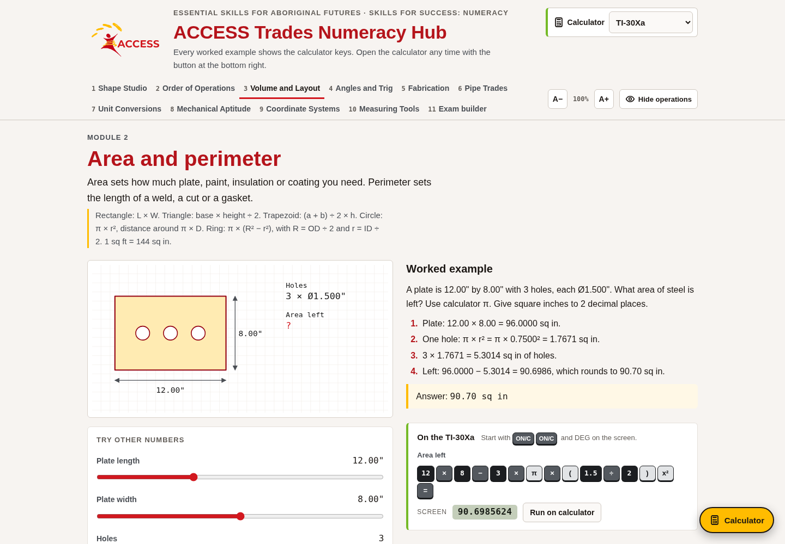
W06-L03 • PRACTISE • 1:25 PM–1:45 PM • 20 MIN TOTAL
Open Numeracy Hub
Navigation example. Use the values and units in the assigned task.
Textbook sections 11.1–11.3 pp.268–272; sections 7.4 pp.170–172
Textbook
Exercise Book
Numeracy Hub
Shape Canvas
Day 19 • 2026-12-01 • 15
Notes:
PRACTISE • 1:25 PM–1:45 PM • 20 MIN TOTAL — shared across this phase’s slides.
Open Numeracy Hub and go to Volume and Layout, then Volume and capacity. Read the box or slab dimensions and convert them to one unit on paper before multiplying. Decide whether the question asks for cubic units or for litres. What must happen between those two answers? A capacity conversion. Use the tool to check your own equation and units after the attempt. If the result disagrees, compare the dimensions first, then the multiplication, and finally the conversion rather than changing the answer without finding the cause.

Slide 16
W06-L03 • PRACTISE • 1:25 PM–1:45 PM • 20 MIN TOTAL
Practise in Numeracy Hub and Shape Canvas
1
Create a rectangular prism in Shape Canvas and display all three dimensions.
2
Predict and calculate the volume change when only one dimension is doubled.
3
Check a box/slab example in Numeracy Hub Volume and Layout → Volume and capacity.
Textbook sections 11.1–11.3 pp.268–272; sections 7.4 pp.170–172
Textbook
Exercise Book
Numeracy Hub
Shape Canvas
Day 19 • 2026-12-01 • 16
Notes:
PRACTISE • 1:25 PM–1:45 PM • 20 MIN TOTAL — shared across this phase’s slides.
Create a rectangular prism in Shape Canvas and show all three dimensions. Write its volume as their product. Now predict the effect of doubling only one dimension: the volume should double. Calculate the new volume before checking the display. Why is it not eight times as large? Only one factor has doubled. Use a box or slab example in Numeracy Hub’s Volume and capacity section to compare the method. Your explanation should identify the one changed factor and the two factors that stayed fixed.

Slide 17
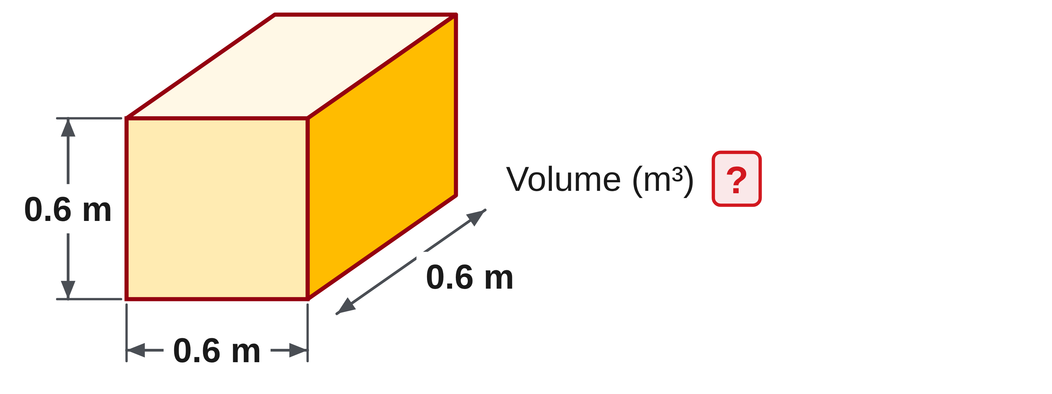
W06-L03 • PRACTISE • 1:25 PM–1:45 PM • 20 MIN TOTAL
Practise from the Exercise Book | 11A Q8
Write the operation, working and units before checking.
Textbook sections 11.1–11.3 pp.268–272; sections 7.4 pp.170–172
Textbook
Exercise Book
Numeracy Hub
Shape Canvas
Day 19 • 2026-12-01 • 17
Notes:
PRACTISE • 1:25 PM–1:45 PM • 20 MIN TOTAL — shared across this phase’s slides.
For 11A question 8, the cube has edges of 0.6 metre. Find its volume in cubic metres. Write all three equal factors so you can see why a cube uses the edge three times.
Instructor only, after the attempt: V = 0.6 × 0.6 × 0.6 = 0.216 m³. The intermediate product 0.36 m² is the area of one face, not the whole volume. Multiplying by the third 0.6 m completes the calculation.

Slide 18
W06-L03 • PRACTISE • 1:25 PM–1:45 PM • 20 MIN TOTAL
Practise from the Exercise Book | 11A Q10
Write the operation, working and units before checking.
Textbook sections 11.1–11.3 pp.268–272; sections 7.4 pp.170–172
Textbook
Exercise Book
Numeracy Hub
Shape Canvas
Day 19 • 2026-12-01 • 18
Notes:
PRACTISE • 1:25 PM–1:45 PM • 20 MIN TOTAL — shared across this phase’s slides.
Convert 1,155 cubic inches to US gallons in 11A question 10. Use the conversion for US gallons and show the unit relationship before dividing. Is the answer likely to be more or fewer than 1,155 gallons?
Instructor only, after the attempt: 1 US gal = 231 in³. Therefore 1,155 ÷ 231 = 5 US gal. Check: 5 × 231 = 1,155 in³. Keep “US” in the answer because an imperial gallon is a different capacity.

Slide 19
W06-L03 • CHECK • 1:45 PM–1:55 PM • 10 MIN TOTAL
Check independently
Exercise Book 11A Q7 and Exercise Book 11B Q1; label volume/capacity and whole pails.
Solve without displayed answers; include working, units and final rounding.
Resources: Exercise Book 11A Q1–10 (p.103); 11B Q1,5 (p.105)
Textbook sections 11.1–11.3 pp.268–272; sections 7.4 pp.170–172
Textbook
Exercise Book
Numeracy Hub
Shape Canvas
Day 19 • 2026-12-01 • 19
Notes:
CHECK • 1:45 PM–1:55 PM • 10 MIN TOTAL — shared across this phase’s slides.
Complete 11A question 7 and 11B question 1 independently. In the box question, the requested result is cubic metres. In the reservoir question, the requested results are litres and whole 20-litre pails. Label each conversion so a reader can follow the change of units. Keep the worked solutions closed until both attempts are complete. What check can you make on the pail answer? Multiply the pail count by 20 litres and compare it with the reservoir’s calculated capacity.

Slide 20
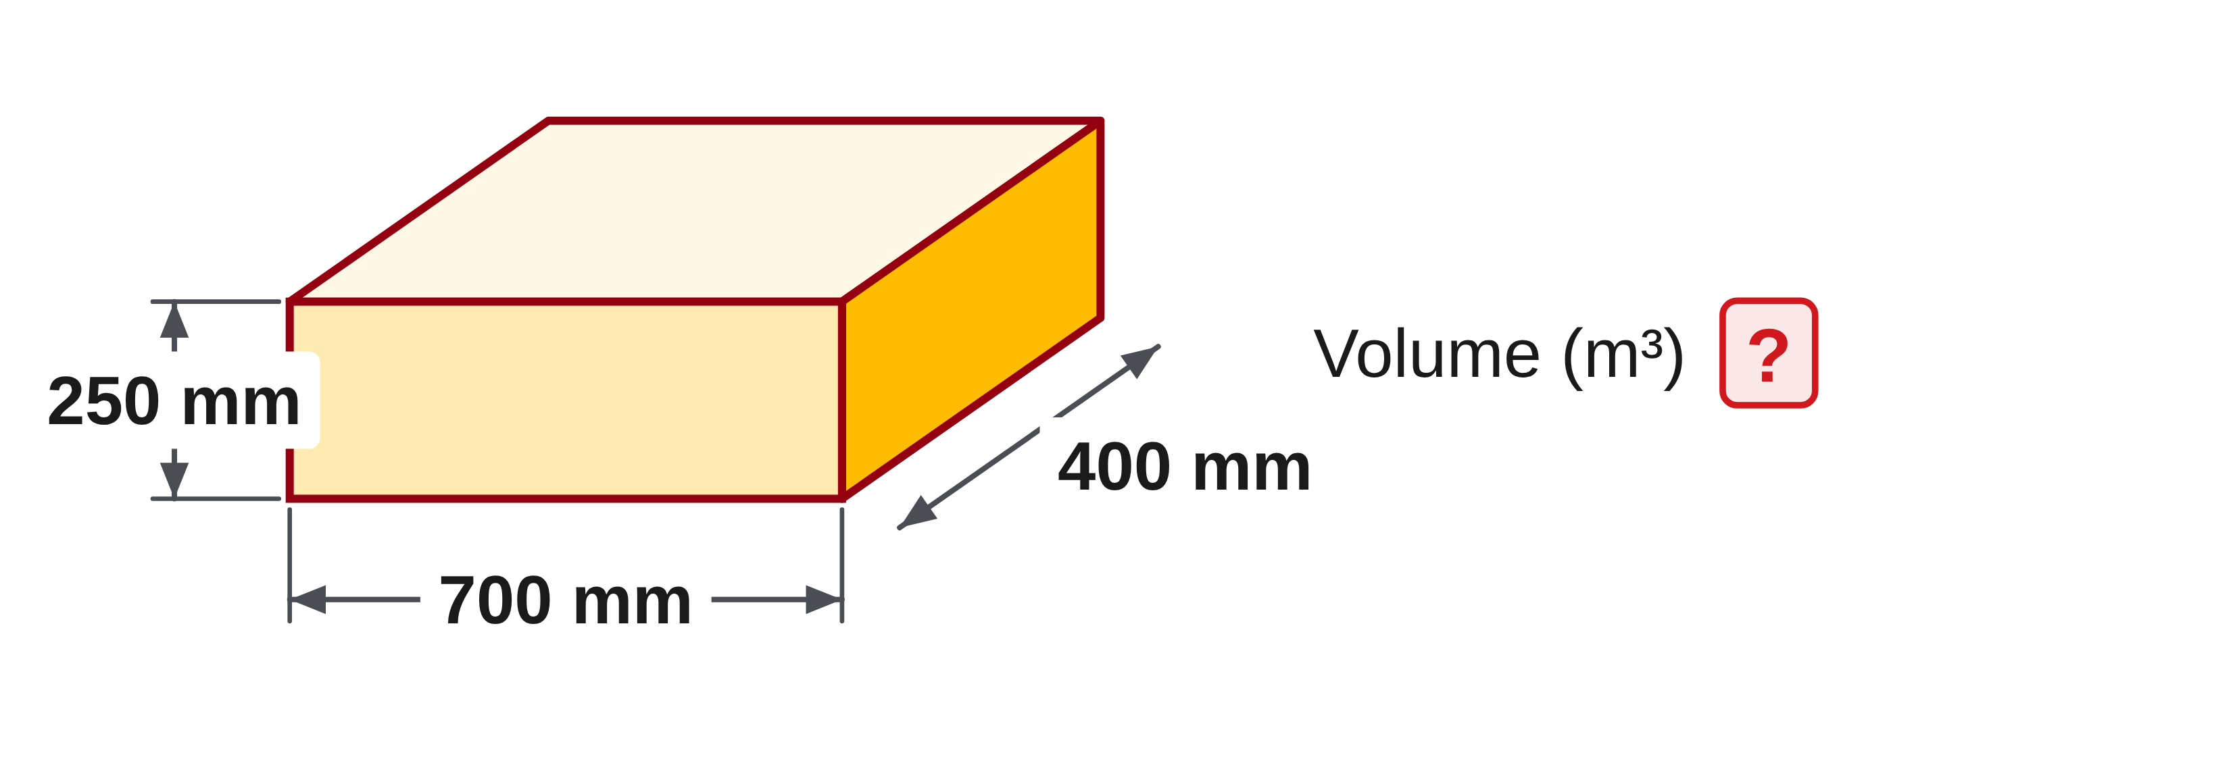
W06-L03 • CHECK • 1:45 PM–1:55 PM • 10 MIN TOTAL
Independent check | 11A Q7
Answer independently. Keep worked solutions closed.
Textbook sections 11.1–11.3 pp.268–272; sections 7.4 pp.170–172
Textbook
Exercise Book
Numeracy Hub
Shape Canvas
Day 19 • 2026-12-01 • 20
Notes:
CHECK • 1:45 PM–1:55 PM • 10 MIN TOTAL — shared across this phase’s slides.
The box measures 700 by 400 by 250 millimetres. Find its volume in cubic metres independently. Show how you make the dimensions or the resulting cubic unit consistent with the requested answer.
Instructor only, after the independent attempt: 0.7 m × 0.4 m × 0.25 m = 0.07 m³. Alternatively, 700 × 400 × 250 = 70,000,000 mm³; dividing by 1,000,000,000 gives 0.07 m³. Both routes should agree.

Slide 21
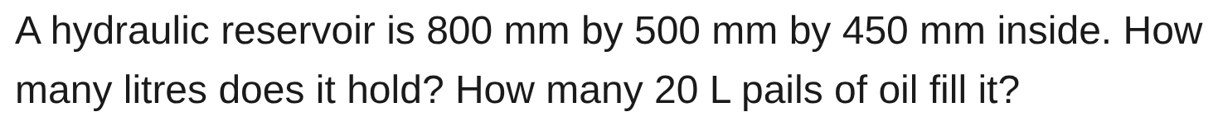
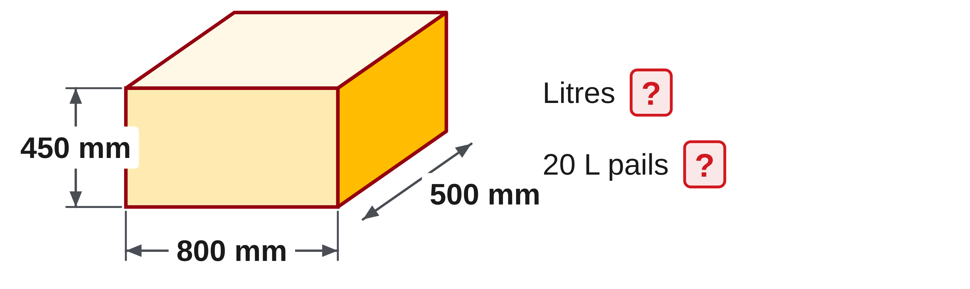
W06-L03 • CHECK • 1:45 PM–1:55 PM • 10 MIN TOTAL
Independent check | 11B Q1
Answer independently. Keep worked solutions closed.
Textbook sections 11.1–11.3 pp.268–272; sections 7.4 pp.170–172
Textbook
Exercise Book
Numeracy Hub
Shape Canvas
Day 19 • 2026-12-01 • 21
Notes:
CHECK • 1:45 PM–1:55 PM • 10 MIN TOTAL — shared across this phase’s slides.
The hydraulic reservoir measures 800 by 500 by 450 millimetres inside. Find its capacity in litres and the number of 20-litre pails that fill it. Keep the inside dimensions and the capacity conversion visible in your working.
Instructor only, after the independent attempt: V = 0.8 × 0.5 × 0.45 = 0.18 m³ = 180 L. Then 180 ÷ 20 = 9 pails. Check: 9 × 20 = 180 L.

Slide 22
W06-L03 • WRAP UP • 1:55 PM–2:00 PM • 5 MIN TOTAL
Wrap up and choose the next step
Ask: What changed in your understanding? Where will you use it? What should you check next time?
Name the math and one other essential skill used; record a next practice step.
Resources: Exercise Book 11A Q1–10 (p.103); 11B Q1,5 (p.105)
Textbook sections 11.1–11.3 pp.268–272; sections 7.4 pp.170–172
Textbook
Exercise Book
Numeracy Hub
Shape Canvas
Day 19 • 2026-12-01 • 22
Notes:
WRAP UP • 1:55 PM–2:00 PM • 5 MIN TOTAL — shared across this phase’s slides.
Explain the difference between the three kinds of quantity we used: a length, an area and a volume. What does the third dimension add to a base area? It extends that area into space. Choose one conversion you checked today and record why its factor was appropriate. After the break, the base will sometimes be a circle instead of a rectangle. The larger idea remains the same: base area times height gives volume, and volume divided by base area can recover a missing dimension.

Slide 23
DAY 19 • SCHEDULED BREAK
Break
2:00 PM–2:15 PM
Return ready for: Cylinders, capacity and missing heights
This break is excluded from teaching minutes.
Textbook
Exercise Book
Numeracy Hub
Shape Canvas
Day 19 • 2026-12-01 • 23
Notes:
Scheduled break — no teaching time.
Our scheduled break is 2:00 to 2:15. Keep your volume work available, especially the conversion between cubic units and litres. When we return, we will replace the rectangular base with a circular base and work backwards from known capacity to missing dimensions. We will resume at 2:15.

Slide 24
W06-L04 • START • 2:15 PM–2:20 PM • 5 MIN TOTAL
Cylinders, capacity and missing heights
Today’s goal: Find a cylinder’s volume and use a known capacity to solve for a missing height or length.
Describe a prior use of the skill; identify the given and unknown quantities.
Textbook sections 11.3–11.4 pp.271–274; sections 8.6 pp.201–203
Exercise Book 11A Q11–13,19,21–22 (p.104); 11B Q2 (p.105); 11C Q1–2 (p.107)
Keep your notebook, textbook, exercise book and chosen calculator ready.
Textbook sections 11.3–11.4 pp.271–274; sections 8.6 pp.201–203
Textbook
Exercise Book
Numeracy Hub
Shape Canvas
Day 19 • 2026-12-01 • 24
Notes:
START • 2:15 PM–2:20 PM • 5 MIN TOTAL — shared across this phase’s slides.
A cylinder can be understood as equal circular layers stacked along its height. We already know how to find a circle’s area, and we just used area times height for a box. Today we bring those ideas together. We will also work backwards: if the capacity and base are known, what height is needed? Keep the radius, diameter and inside dimensions clearly labelled. Which circle measurement belongs in πr²? The radius. That choice is the first check before any cylinder calculation.

Slide 25
W06-L04 • RECALL • 2:20 PM–2:25 PM • 5 MIN TOTAL
Recall and reconnect
Explain why diameter must be halved before using πr²h; distinguish US and imperial gallons.
Attempt the retrieval task independently; explain the method before checking.
Resources: Exercise Book 11A Q11–13,19,21–22 (p.104); 11B Q2 (p.105); 11C Q1–2 (p.107)
Textbook sections 11.3–11.4 pp.271–274; sections 8.6 pp.201–203
Textbook
Exercise Book
Numeracy Hub
Shape Canvas
Day 19 • 2026-12-01 • 25
Notes:
RECALL • 2:20 PM–2:25 PM • 5 MIN TOTAL — shared across this phase’s slides.
If a tank is described as 18 inches across, is that a radius or a diameter? It is the diameter, so the radius is 9 inches. That halving must happen before squaring in πr²h. Now recall the capacity label: US gallons and imperial gallons are different units. Which factor applies to the exercise book’s US gallons? One US gallon equals 231 cubic inches. Say the complete unit when you read it; leaving out “US” can hide a conversion error even when the arithmetic is correct.

Slide 26
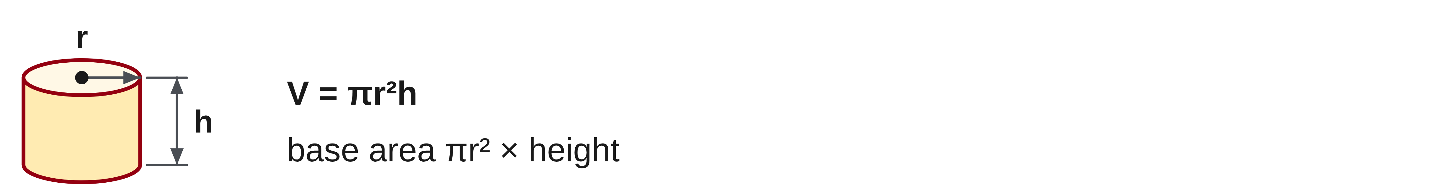
W06-L04 • TEACH • 2:25 PM–2:40 PM • 15 MIN TOTAL
Find the volume of a cylinder
1
A cylinder has circular base area πr².
2
Multiply base area by height: V = πr²h.
3
If the drawing gives diameter, halve it before using the radius formula.
4
Use matching length units, then convert the resulting volume to capacity.
Textbook sections 11.3–11.4 pp.271–274; sections 8.6 pp.201–203
Textbook
Exercise Book
Numeracy Hub
Shape Canvas
Day 19 • 2026-12-01 • 26
Notes:
TEACH • 2:25 PM–2:40 PM • 15 MIN TOTAL — shared across this phase’s slides.
The base of a cylinder is a circle with area πr². Each equal layer has that area, and multiplying by the height gives V equals πr²h. If the drawing gives diameter, divide it by two before squaring. Why would using the diameter as the radius create a large error? Doubling r multiplies r squared by four, so the calculated volume would be four times too large at the same height. Use matching length units for r and h, calculate the cubic volume, then convert to litres or the specified gallon unit only when required.

Slide 27
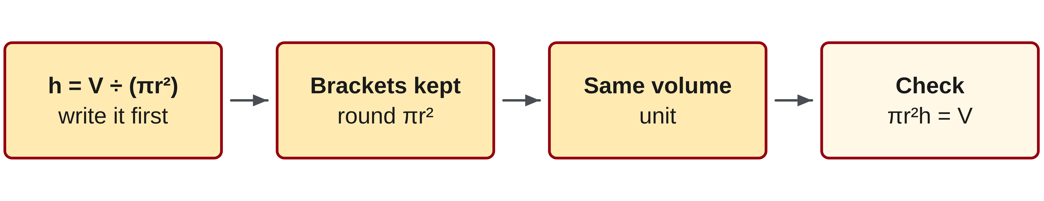
W06-L04 • TEACH • 2:25 PM–2:40 PM • 15 MIN TOTAL
Recover a missing height from volume
1
Write h = V ÷ (πr²) for a cylinder.
2
Keep the full base-area expression inside the denominator brackets.
3
Use a consistent volume unit before dividing by the base area.
4
Substitute the found height into the original volume formula to check.
Textbook sections 11.3–11.4 pp.271–274; sections 8.6 pp.201–203
Textbook
Exercise Book
Numeracy Hub
Shape Canvas
Day 19 • 2026-12-01 • 27
Notes:
TEACH • 2:25 PM–2:40 PM • 15 MIN TOTAL — shared across this phase’s slides.
To find a missing cylinder height, start with V equals πr²h. The factor multiplying h is the entire circular base area, so divide volume by that entire quantity: h equals V divided by the bracketed expression πr². Keep those brackets intact in the calculator. Why must the volume be in a matching cubic unit first? Cubic millimetres divided by square millimetres produce millimetres. Litres divided directly by square millimetres would not give the intended dimension without conversion. Finally, substitute the found height into the original volume formula and compare with the known volume.

Slide 28
W06-L04 • TEACH • 2:25 PM–2:40 PM • 15 MIN TOTAL
Divide volume by base area to find height
Cylinder example • r = 150 mm; h = 600 mm.
V = π × 150² × 600 ≈ 42,411,501 mm³ ≈ 42.41 L.
Check the factor: 1 L = 1,000,000 mm³.
Missing-height example • Rectangular base: 600 mm × 500 mm.
240 L = 240,000,000 mm³.
h = 240,000,000 ÷ (600 × 500) = 800 mm.
Together • Work 11A Q13,19 and 11C Q1.
Check each height by multiplying base area × height.
Shape Canvas: hide a box or cylinder height; solve before revealing it.
Exercise Book pp.104,107 • Numeracy Hub Volume and capacity; Unit Conversions for explicitly labelled L/US gal
Textbook
Exercise Book
Numeracy Hub
Shape Canvas
Day 19 • 2026-12-01 • 28
Notes:
TEACH • 2:25 PM–2:40 PM • 15 MIN TOTAL — shared across this phase’s slides.
For the cylinder, r is 150 millimetres and h is 600 millimetres. Square the radius to get 22,500, then multiply by π and 600. The volume is about 42,411,501 cubic millimetres. Divide by one million cubic millimetres per litre to obtain 42.41 litres. In the rectangular example, convert 240 litres to 240,000,000 cubic millimetres. Divide by the base area, 600 times 500, giving the missing dimension of 800 millimetres. What unites these calculations? Volume is base area times height, so dividing by base area recovers the dimension along that base.

Slide 29
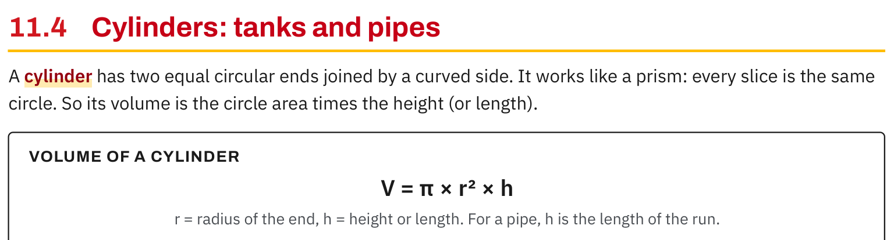
W06-L04 • TEACH • 2:25 PM–2:40 PM • 15 MIN TOTAL
Textbook | page 273
Textbook p.273 • Cylinder volume — Circular base area times height
Textbook sections 11.3–11.4 pp.271–274; sections 8.6 pp.201–203
Textbook
Exercise Book
Numeracy Hub
Shape Canvas
Day 19 • 2026-12-01 • 29
Notes:
TEACH • 2:25 PM–2:40 PM • 15 MIN TOTAL — shared across this phase’s slides.
On page 273, the textbook describes every cylinder slice as the same circle. That is why the formula works like the prism formula: end area times length. The circular end area is πr², so multiplying by the cylinder’s height or length gives πr²h. For a horizontal pipe, does h have to point upward? No; it represents the distance along the cylinder. Which radius should be used for capacity? The inside radius, because the fluid occupies the interior. The outside radius describes a larger cylinder that includes the wall thickness.

Slide 30
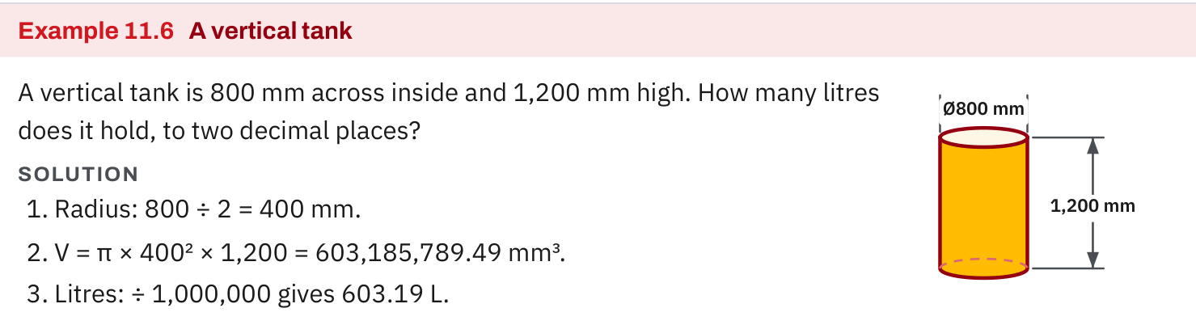
W06-L04 • TEACH • 2:25 PM–2:40 PM • 15 MIN TOTAL
Textbook | page 274
Textbook p.274 • Example 11.6 — Cylinder dimensions and capacity
Textbook sections 11.3–11.4 pp.271–274; sections 8.6 pp.201–203
Textbook
Exercise Book
Numeracy Hub
Shape Canvas
Day 19 • 2026-12-01 • 30
Notes:
TEACH • 2:25 PM–2:40 PM • 15 MIN TOTAL — shared across this phase’s slides.
Example 11.6 on page 274 gives a tank 800 millimetres across inside and 1,200 millimetres high. The radius is 800 divided by two, or 400 millimetres. Calculate π times 400 squared times 1,200: about 603,185,789.49 cubic millimetres. Divide by one million to obtain 603.18578949 litres, then round to 603.19 litres. Why should we keep the full calculator value until the final rounding? It avoids compounding approximations. Why use the inside diameter? Capacity describes the water space, not the space occupied by the tank walls.

Slide 31
W06-L04 • TEACH • 2:25 PM–2:40 PM • 15 MIN TOTAL
Spot the mistake. Explain the correction.
Does a gallon conversion work the same for US and imperial gallons?
Discuss the method before checking the answer.
No. Identify which gallon the question specifies and select its matching conversion factor.
Textbook sections 11.3–11.4 pp.271–274; sections 8.6 pp.201–203
Textbook
Exercise Book
Numeracy Hub
Shape Canvas
Day 19 • 2026-12-01 • 31
Notes:
TEACH • 2:25 PM–2:40 PM • 15 MIN TOTAL — shared across this phase’s slides.
The word “gallon” needs its full label. The textbook gives one US gallon as 231 cubic inches, about 3.785 litres, while an imperial gallon is about 4.546 litres. These are different-sized units. If a question specifies US gallons, which conversion must we select? The US factor. Do not let a calculator setting choose the unit silently for you. Circle the requested capacity unit in the question, write the matching factor, and preserve that label in the answer so someone reading your work knows exactly what quantity you found.

Slide 32
W06-L04 • TOGETHER • 2:40 PM–2:55 PM • 15 MIN TOTAL
Work together
Work Exercise Book 11A Q13,19 and Exercise Book 11C Q1. Partners check by resubstitution.
Work in pairs, alternating solver and checker. Write a diagram, formula, units and estimate.
Resources: Exercise Book 11A Q11–13,19,21–22 (p.104); 11B Q2 (p.105); 11C Q1–2 (p.107)
Textbook sections 11.3–11.4 pp.271–274; sections 8.6 pp.201–203
Textbook
Exercise Book
Numeracy Hub
Shape Canvas
Day 19 • 2026-12-01 • 32
Notes:
TOGETHER • 2:40 PM–2:55 PM • 15 MIN TOTAL — shared across this phase’s slides.
Work through 11A questions 13 and 19 and 11C question 1 with a partner. Identify whether each task calculates a volume or recovers a missing dimension. For a cylinder, label r and h. For a hidden dimension, convert the given capacity to a matching cubic unit before dividing by the base area. How will you check the recovered dimension? Substitute it into the original volume formula. Partners should compare the reconstructed volume with the stated volume, not only compare the final dimension with each other.

Slide 33
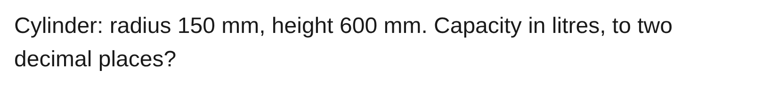
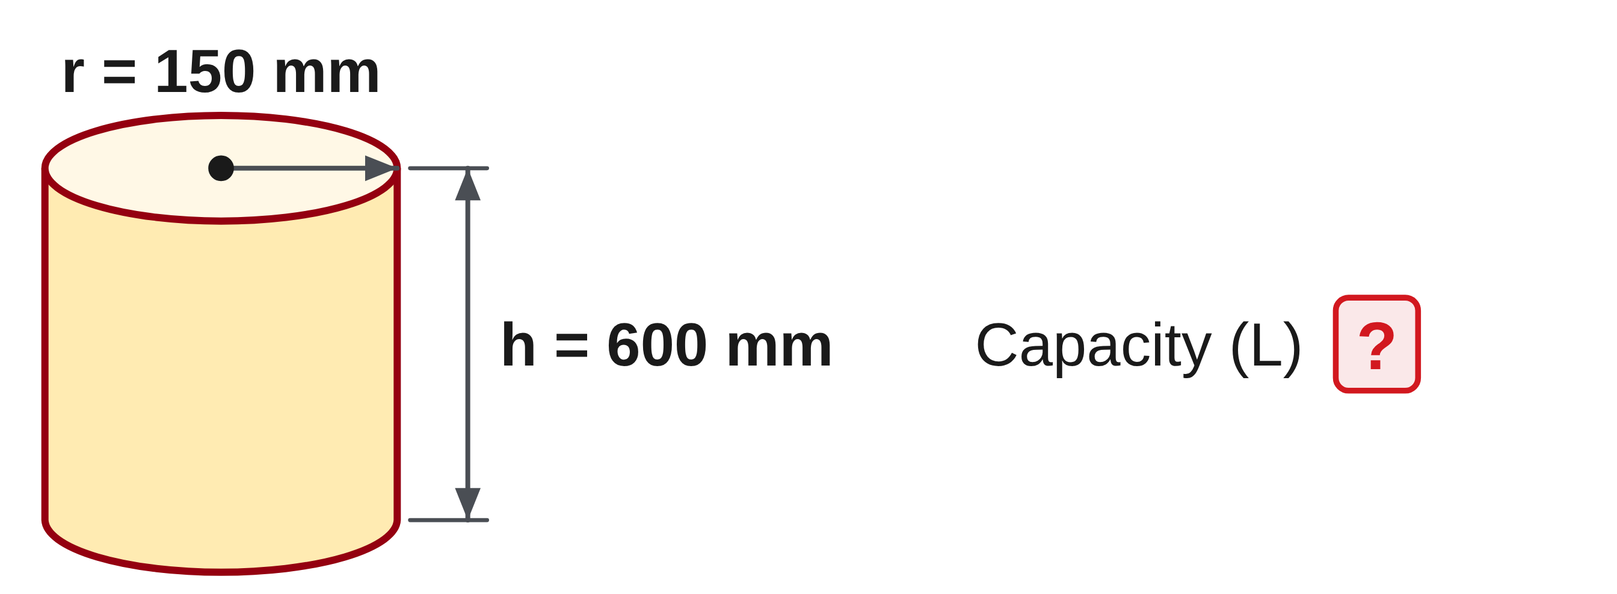
W06-L04 • TOGETHER • 2:40 PM–2:55 PM • 15 MIN TOTAL
Guided practice | 11A Q13
Work with a partner. Take turns explaining the next step.
Textbook sections 11.3–11.4 pp.271–274; sections 8.6 pp.201–203
Textbook
Exercise Book
Numeracy Hub
Shape Canvas
Day 19 • 2026-12-01 • 33
Notes:
TOGETHER • 2:40 PM–2:55 PM • 15 MIN TOTAL — shared across this phase’s slides.
In 11A question 13, the cylinder has radius 150 millimetres and height 600 millimetres. Find its capacity in litres to two decimal places. Notice that the given circle measurement is already a radius, so decide carefully whether any halving is needed.
Instructor only, after the attempt: V = π × 150² × 600 = 42,411,500.823… mm³. Divide by 1,000,000 to get 42.411500823… L, rounded to 42.41 L. The stated radius stays 150 mm.

Slide 34
W06-L04 • TOGETHER • 2:40 PM–2:55 PM • 15 MIN TOTAL
Compare your method | 11A Q13
CHECK TOGETHER
42.41 L
Textbook sections 11.3–11.4 pp.271–274; sections 8.6 pp.201–203
Textbook
Exercise Book
Numeracy Hub
Shape Canvas
Day 19 • 2026-12-01 • 34
Notes:
TOGETHER • 2:40 PM–2:55 PM • 15 MIN TOTAL — shared across this phase’s slides.
The capacity is 42.41 litres. We used 150 as r because the question explicitly called it the radius. Squaring gave 22,500; multiplying by π and 600 gave the cubic volume. The conversion to litres divided that volume by one million. What would happen if we halved the already-given radius? The squared factor would become one quarter of the correct value. Compare your working with the formula and verify that each number has the correct role before accepting the final rounded capacity.

Slide 35
W06-L04 • PRACTISE • 2:55 PM–3:15 PM • 20 MIN TOTAL
Your scheduled practice
Complete Exercise Book 11B Q2 and 11C Q2; compare 11A Q21. Use Shape Canvas to verify a hidden dimension. Cones/spheres are optional book extension, not required this session.
Solve on paper first; check with tools; correct one error and explain the change.
Resources: Exercise Book 11A Q11–13,19,21–22 (p.104); 11B Q2 (p.105); 11C Q1–2 (p.107)
Textbook sections 11.3–11.4 pp.271–274; sections 8.6 pp.201–203
Textbook
Exercise Book
Numeracy Hub
Shape Canvas
Day 19 • 2026-12-01 • 35
Notes:
PRACTISE • 2:55 PM–3:15 PM • 20 MIN TOTAL — shared across this phase’s slides.
Complete 11B question 2 and 11C question 2, then compare with 11A question 21. In the water-heater problem, identify the inside diameter and the required US gallons. In the hidden-height problem, convert litres before dividing by base area. Use Shape Canvas to check a hidden dimension after the paper calculation. Cones and spheres are optional textbook extension work; the required focus is cylinders, capacity and missing dimensions. What check should your final height pass? Base area times that height should reproduce the stated volume within the given rounding.

Slide 36
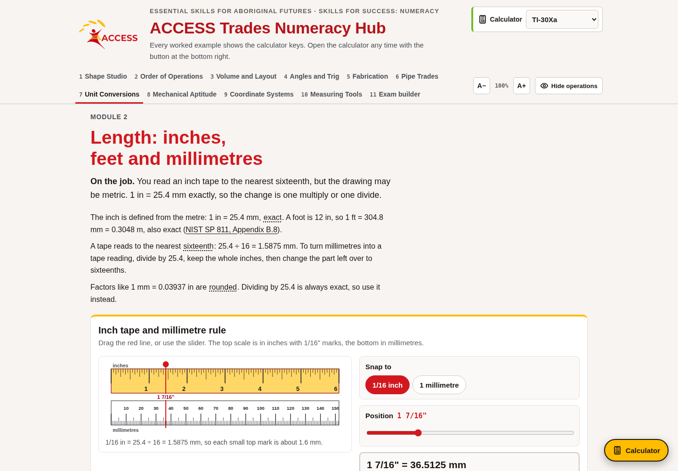
W06-L04 • PRACTISE • 2:55 PM–3:15 PM • 20 MIN TOTAL
Open Numeracy Hub
Navigation example. Use the values and units in the assigned task.
Textbook sections 11.3–11.4 pp.271–274; sections 8.6 pp.201–203
Textbook
Exercise Book
Numeracy Hub
Shape Canvas
Day 19 • 2026-12-01 • 36
Notes:
PRACTISE • 2:55 PM–3:15 PM • 20 MIN TOTAL — shared across this phase’s slides.
Open Numeracy Hub’s Volume and capacity work. Read the dimensions and the capacity unit before choosing a calculation. For a cylinder, confirm whether the circle label is r or D. If the question requires litres or US gallons, use Unit Conversions with that exact unit selected. What is the risk of a generic “gallons” result? It may use a different gallon definition. Make a paper calculation first, then compare both the numerical result and the unit label so the tool checks your reasoning rather than replacing it.

Slide 37
W06-L04 • PRACTISE • 2:55 PM–3:15 PM • 20 MIN TOTAL
Practise in Numeracy Hub and Shape Canvas
1
Set up a cylinder or box in Shape Canvas, then hide its height.
2
Calculate the height on paper from the stated volume or capacity and consistent units.
3
Check in Volume and capacity; use Unit Conversions for the specified L/US gal conversion.
Textbook sections 11.3–11.4 pp.271–274; sections 8.6 pp.201–203
Textbook
Exercise Book
Numeracy Hub
Shape Canvas
Day 19 • 2026-12-01 • 37
Notes:
PRACTISE • 2:55 PM–3:15 PM • 20 MIN TOTAL — shared across this phase’s slides.
Set up a cylinder or box in Shape Canvas and hide the height. Keep the volume or capacity and the base dimensions visible. Convert capacity into a cubic unit that matches the base, then divide by base area. For a cylinder, put the full πr² expression in the denominator. What unit should the quotient have? A length unit, because cubic units divided by square units leave one direction. Reveal the answer after the attempt, and use Numeracy Hub’s Volume and capacity or Unit Conversions to check the relevant conversion.

Slide 38
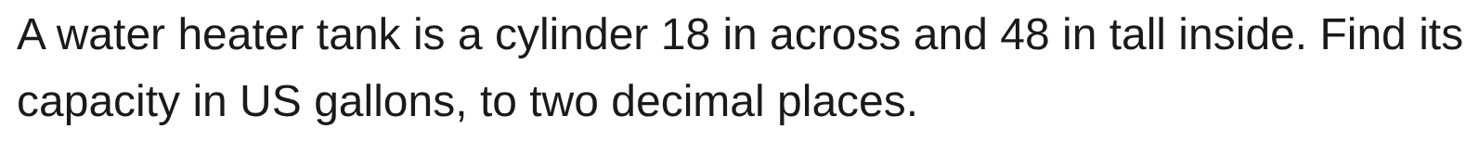
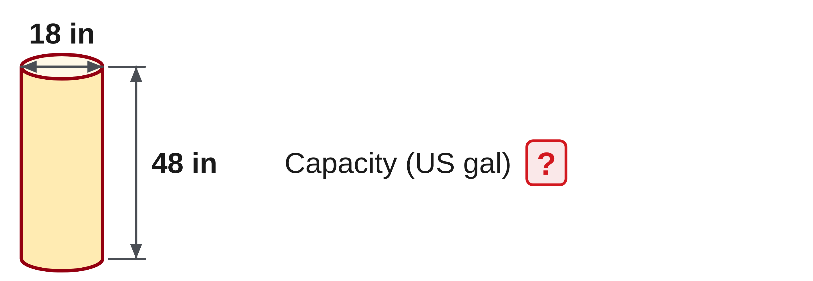
W06-L04 • PRACTISE • 2:55 PM–3:15 PM • 20 MIN TOTAL
Practise from the Exercise Book | 11B Q2
Write the operation, working and units before checking.
Textbook sections 11.3–11.4 pp.271–274; sections 8.6 pp.201–203
Textbook
Exercise Book
Numeracy Hub
Shape Canvas
Day 19 • 2026-12-01 • 38
Notes:
PRACTISE • 2:55 PM–3:15 PM • 20 MIN TOTAL — shared across this phase’s slides.
The water-heater tank is 18 inches across and 48 inches tall inside. Find capacity in US gallons to two decimals. Identify the radius before calculating the circular base, and keep the US-gallon conversion visible.
Instructor only, after the attempt: r = 18 ÷ 2 = 9 in. V = π × 9² × 48 = 12,214.512… in³. Capacity = V ÷ 231 = 52.87667… US gal, rounded to 52.88 US gal. Using 18 as r would quadruple the result.

Slide 39
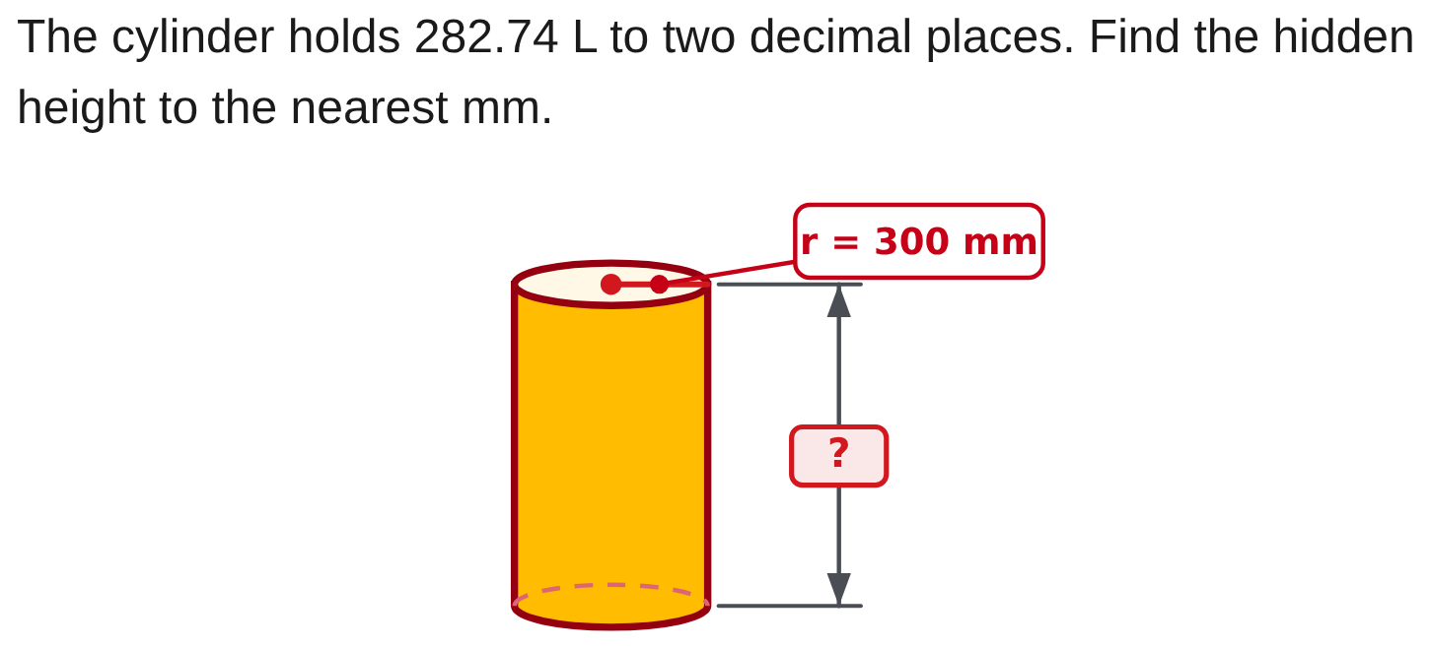
W06-L04 • PRACTISE • 2:55 PM–3:15 PM • 20 MIN TOTAL
Practise from the Exercise Book | 11C Q2
Write the operation, working and units before checking.
Textbook sections 11.3–11.4 pp.271–274; sections 8.6 pp.201–203
Textbook
Exercise Book
Numeracy Hub
Shape Canvas
Day 19 • 2026-12-01 • 39
Notes:
PRACTISE • 2:55 PM–3:15 PM • 20 MIN TOTAL — shared across this phase’s slides.
In 11C question 2, the cylinder holds 282.74 litres and its radius is labelled 300 millimetres. Find the missing height to the nearest millimetre. Convert capacity first, then divide by the whole circular base area.
Instructor only, after the attempt: V = 282,740,000 mm³ and h = 282,740,000 ÷ (π × 300²) ≈ 999.988 mm, so h = 1,000 mm. The slight difference from exactly 1,000 comes from the capacity being given to two decimal places.

Slide 40
W06-L04 • CHECK • 3:15 PM–3:25 PM • 10 MIN TOTAL
Check independently
Exercise Book 11A Q13 and Exercise Book 11C Q1; include capacity units.
Solve without displayed answers; include working, units and final rounding.
Resources: Exercise Book 11A Q11–13,19,21–22 (p.104); 11B Q2 (p.105); 11C Q1–2 (p.107)
Textbook sections 11.3–11.4 pp.271–274; sections 8.6 pp.201–203
Textbook
Exercise Book
Numeracy Hub
Shape Canvas
Day 19 • 2026-12-01 • 40
Notes:
CHECK • 3:15 PM–3:25 PM • 10 MIN TOTAL — shared across this phase’s slides.
Complete 11A question 13 and 11C question 1 independently. One goes from dimensions to litres; the other goes from litres back to a missing length. Show the capacity conversion explicitly in both directions, and keep worked solutions closed. What should your checking equation do in the hidden-length problem? Multiply the found length by the other dimensions and return to the stated volume. Include the unit with each result so it is clear whether you have found capacity or a dimension.

Slide 41
W06-L04 • CHECK • 3:15 PM–3:25 PM • 10 MIN TOTAL
Independent check | 11A Q13
Answer independently. Keep worked solutions closed.
Textbook sections 11.3–11.4 pp.271–274; sections 8.6 pp.201–203
Textbook
Exercise Book
Numeracy Hub
Shape Canvas
Day 19 • 2026-12-01 • 41
Notes:
CHECK • 3:15 PM–3:25 PM • 10 MIN TOTAL — shared across this phase’s slides.
Find the capacity in litres of the cylinder with radius 150 millimetres and height 600 millimetres. Work independently and round the final capacity to two decimal places. Show the cubic volume before converting.
Instructor only, after the independent attempt: V = π × 150² × 600 = 42,411,500.823… mm³. Capacity = V ÷ 1,000,000 = 42.411500823… L, so 42.41 L. The radius is already supplied, and no halving is needed.

Slide 42
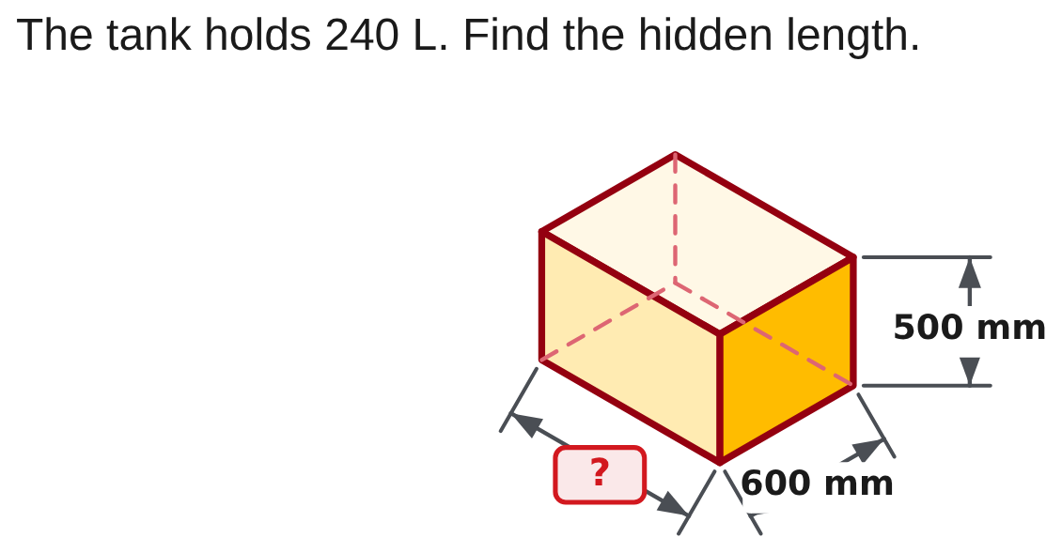
W06-L04 • CHECK • 3:15 PM–3:25 PM • 10 MIN TOTAL
Independent check | 11C Q1
Answer independently. Keep worked solutions closed.
Textbook sections 11.3–11.4 pp.271–274; sections 8.6 pp.201–203
Textbook
Exercise Book
Numeracy Hub
Shape Canvas
Day 19 • 2026-12-01 • 42
Notes:
CHECK • 3:15 PM–3:25 PM • 10 MIN TOTAL — shared across this phase’s slides.
The tank in 11C question 1 holds 240 litres. The two known dimensions are 600 and 500 millimetres. Find the hidden length independently, with a conversion and substitution check.
Instructor only, after the independent attempt: 240 L = 240,000,000 mm³. Missing length = 240,000,000 ÷ (600 × 500) = 800 mm. Check: 800 × 600 × 500 = 240,000,000 mm³ = 240 L. The unknown is a length, so its answer is millimetres.

Slide 43
W06-L04 • WRAP UP • 3:25 PM–3:30 PM • 5 MIN TOTAL
Wrap up and choose the next step
Ask: What changed in your understanding? Where will you use it? What should you check next time?
Name the math and one other essential skill used; record a next practice step.
Resources: Exercise Book 11A Q11–13,19,21–22 (p.104); 11B Q2 (p.105); 11C Q1–2 (p.107)
Textbook sections 11.3–11.4 pp.271–274; sections 8.6 pp.201–203
Textbook
Exercise Book
Numeracy Hub
Shape Canvas
Day 19 • 2026-12-01 • 43
Notes:
WRAP UP • 3:25 PM–3:30 PM • 5 MIN TOTAL — shared across this phase’s slides.
Explain how a box and a cylinder use the same larger idea: base area times the distance along the shape gives volume. What changes between them? The base-area formula. What changes when the height is unknown? We divide the known volume by that base area. Choose one check from today to keep in your notes: radius versus diameter, matching cubic and square units, inside dimensions, or the exact gallon type. Next we move to angles and triangles, where reading the drawing correctly remains the first mathematical step.

