Slide 1

CARPENTRY FOUNDATION / INTAKE 142
Day 20 | Wednesday
20
December 2, 2026
Angles, triangles and drawing interpretation
12:45 PM–2:00 PM • Math • 75 min
Pythagorean theorem and brace lengths
2:15 PM–3:30 PM • Math • 75 min
Week 6 • 2 scheduled blocks • 150 teaching minutes
Estimate. Show the method. Label units. Check the result.
Textbook
Exercise Book
Numeracy Hub
Shape Canvas
Day 20 • 2026-12-02 • 01
Notes:
Opening — within the first Start allocation.
Today we will read the angles and sides of triangular shapes carefully enough to calculate what is missing. From 12:45 to 2:00, we focus on angle totals and drawing interpretation. From 2:15 to 3:30, we use right triangles to find brace and diagonal lengths. In both blocks, the drawing comes first. We will mark what is known, identify the relationship that applies, and then check that the result fits the shape rather than trusting a calculation alone.

Slide 2
DAY 20 / WEEK 6 / CLASS TIMETABLE
Today’s exact schedule
12:45 PM–2:00 PM • 75 min
2:15 PM–3:30 PM • 75 min
Angles, triangles and drawing interpretation
Pythagorean theorem and brace lengths
12:45 PM–12:50 PM
Start
5
2:15 PM–2:20 PM
Start
5
12:50 PM–12:55 PM
Recall
5
2:20 PM–2:25 PM
Recall
5
12:55 PM–1:10 PM
Teach
15
2:25 PM–2:40 PM
Teach
15
1:10 PM–1:25 PM
Together
15
2:40 PM–2:55 PM
Together
15
1:25 PM–1:45 PM
Practise
20
2:55 PM–3:15 PM
Practise
20
1:45 PM–1:55 PM
Check
10
3:15 PM–3:25 PM
Check
10
1:55 PM–2:00 PM
Wrap up
5
3:25 PM–3:30 PM
Wrap up
5
Math • Math Week 6, Lesson 5
Math • Math Week 6, Lesson 6
Break: 2:00 PM–2:15 PM • 15 minutes • excluded from teaching time
Textbook
Exercise Book
Numeracy Hub
Shape Canvas
Day 20 • 2026-12-02 • 02
Notes:
Opening — within the first Start allocation.
We have two 75-minute blocks with a break from 2:00 to 2:15. The first check, 1:45 to 1:55, asks you to use angle relationships independently. The second check, 3:15 to 3:25, asks for missing sides of right triangles. Each block includes 20 minutes of practice before its check. Keep a clear sketch beside your working throughout. Our calculations will be short enough to follow, but choosing the correct relationship from the diagram is the important step.

Slide 3
W06-L05 • START • 12:45 PM–12:50 PM • 5 MIN TOTAL
Angles, triangles and drawing interpretation
Today’s goal: Classify angles and use straight-line and triangle angle totals to find a missing angle.
Describe a prior use of the skill; identify the given and unknown quantities.
Textbook sections 12.1–12.3 pp.298–300
Exercise Book 12A Q1–9 (pp.114–115); 12B Q2 (p.116); 12C Q3–4 (p.118)
Keep your notebook, textbook, exercise book and chosen calculator ready.
Textbook sections 12.1–12.3 pp.298–300
Textbook
Exercise Book
Numeracy Hub
Shape Canvas
Day 20 • 2026-12-02 • 03
Notes:
START • 12:45 PM–12:50 PM • 5 MIN TOTAL — shared across this phase’s slides.
Think about a brace, a gusset or a bend drawn on a plan. The angle label tells us how two directions meet. Today we will classify angles and use known totals to find missing ones. What angle makes a square corner? Ninety degrees. We will also use 180 degrees for a straight line and for the three interior angles of a triangle. Open chapter 12 in the exercise book. Mark the angle we are actually looking for before choosing which total to subtract from.

Slide 4
W06-L05 • RECALL • 12:50 PM–12:55 PM • 5 MIN TOTAL
Recall and reconnect
Try to identify 90°, a straight angle and a full turn; use Exercise Book 12A Q3.
Attempt the retrieval task independently; explain the method before checking.
Resources: Exercise Book 12A Q1–9 (pp.114–115); 12B Q2 (p.116); 12C Q3–4 (p.118)
Textbook sections 12.1–12.3 pp.298–300
Textbook
Exercise Book
Numeracy Hub
Shape Canvas
Day 20 • 2026-12-02 • 04
Notes:
RECALL • 12:50 PM–12:55 PM • 5 MIN TOTAL — shared across this phase’s slides.
Show a quarter turn with your hand: that is 90 degrees, a right angle. A half turn is 180 degrees, a straight angle. A full turn is 360 degrees. Which of those totals describes a complete rotation back to your starting direction? 360 degrees. Now use 12A question 3 to classify the given angles. Compare each with 90 and 180 before giving it a name. Those reference angles help us estimate whether a calculated result looks plausible on a drawing.

Slide 5
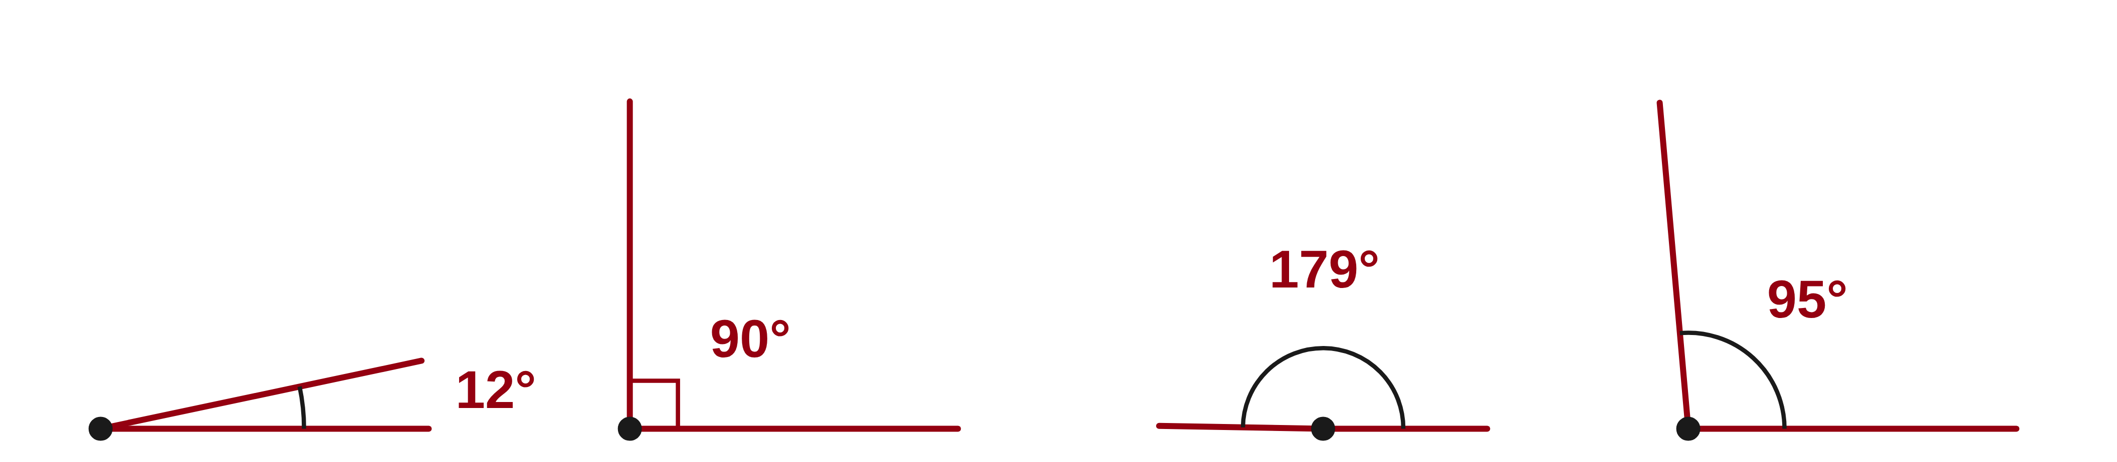
W06-L05 • RECALL • 12:50 PM–12:55 PM • 5 MIN TOTAL
Recall from the Exercise Book | 12A Q3
Write the operation, working and units before checking.
Textbook sections 12.1–12.3 pp.298–300
Textbook
Exercise Book
Numeracy Hub
Shape Canvas
Day 20 • 2026-12-02 • 05
Notes:
RECALL • 12:50 PM–12:55 PM • 5 MIN TOTAL — shared across this phase’s slides.
Name each angle in 12A question 3: 12 degrees, 90 degrees, 179 degrees and 95 degrees. Think about the boundaries of each category rather than the order of the list. An acute angle is below 90; an obtuse angle is above 90 but below 180.
Instructor only, after the attempt: 12° is acute; 90° is right; 179° is obtuse; 95° is obtuse. Being close to 180° does not make 179° a straight angle.

Slide 6
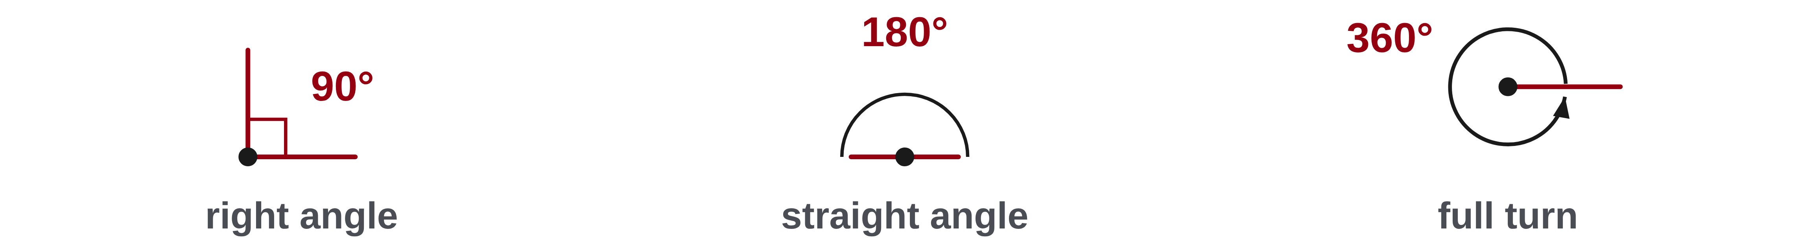
W06-L05 • TEACH • 12:55 PM–1:10 PM • 15 MIN TOTAL
Use the correct angle total
1
A right angle is 90°; a straight angle is 180°; a full turn is 360°.
2
Complementary angles add to 90°.
3
Supplementary angles add to 180°.
4
Mark the relevant total on the drawing before subtracting a known angle.
Textbook sections 12.1–12.3 pp.298–300
Textbook
Exercise Book
Numeracy Hub
Shape Canvas
Day 20 • 2026-12-02 • 06
Notes:
TEACH • 12:55 PM–1:10 PM • 15 MIN TOTAL — shared across this phase’s slides.
Before subtracting, identify the total represented by the relationship. A right angle is 90 degrees; a straight angle is 180; a full turn is 360. Complementary angles add to 90, while supplementary angles add to 180. Which total belongs to two adjacent angles forming a straight line? 180 degrees. Do not choose a total just because one of the labels looks familiar. Mark the complete angle in the drawing and explain why the parts fill it. Then subtract the known part to find what remains, and add the two parts to check the result.

Slide 7
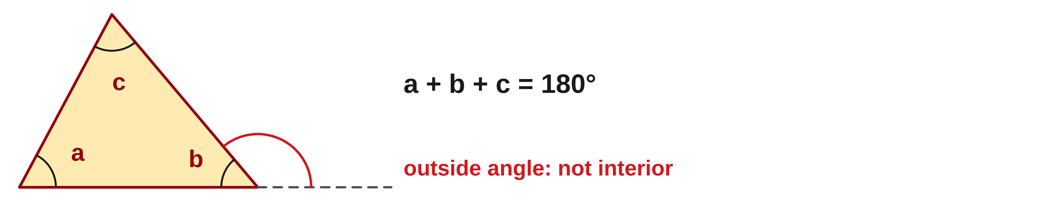
W06-L05 • TEACH • 12:55 PM–1:10 PM • 15 MIN TOTAL
Find a missing angle in a triangle
1
The three interior angles of a triangle add to 180°.
2
Missing angle = 180° − the other two interior angles.
3
An adjacent outside angle is a different angle from the one inside.
4
Check that your three interior angles total 180°.
Textbook sections 12.1–12.3 pp.298–300
Textbook
Exercise Book
Numeracy Hub
Shape Canvas
Day 20 • 2026-12-02 • 07
Notes:
TEACH • 12:55 PM–1:10 PM • 15 MIN TOTAL — shared across this phase’s slides.
Every triangle’s three interior angles add to 180 degrees. If two interior angles are known, subtract both from 180 to find the third. The word “interior” matters: an angle drawn outside beside a side is a different angle. What must we check before using a labelled value in the triangle total? That its arc lies inside the triangle. If the label is outside on a straight extension, first use the straight-line relationship to find the interior angle. After solving, add all three interior angles and verify that the sum is exactly 180 degrees.

Slide 8
W06-L05 • TEACH • 12:55 PM–1:10 PM • 15 MIN TOTAL
Match the missing angle to its total
Complementary angles • Total 90°.
If one is 33°, the other is 90° − 33° = 57°.
Supplementary angles • Total 180°.
If one is 128°, the other is 180° − 128° = 52°.
Triangle example • Known angles 90° and 52°.
Missing angle = 180° − 90° − 52° = 38°; it is acute.
Together • Work 12A Q4–8. Mark known angles and the relevant total.
Shape Canvas: vary one triangle angle and predict the consequence.
Numeracy Hub: inspect diagrams; advanced protractor topics are not required.
Classroom examples demonstrate the three relationships • Textbook pp.298–300 • Sketch and label before calculating
Textbook
Exercise Book
Numeracy Hub
Shape Canvas
Day 20 • 2026-12-02 • 08
Notes:
TEACH • 12:55 PM–1:10 PM • 15 MIN TOTAL — shared across this phase’s slides.
For the complementary pair, the total is 90 degrees. Subtract 33 to get 57, and check 33 plus 57 equals 90. For the supplementary pair, the total is 180. Subtract 128 to get 52, and check 128 plus 52 equals 180. In the triangle, two angles are 90 and 52, so the missing angle is 180 minus 90 minus 52, or 38 degrees. Is 38 acute? Yes, because it is less than 90. The arithmetic is subtraction in all three cases, but the diagram determines the total and which known angles to remove.

Slide 9
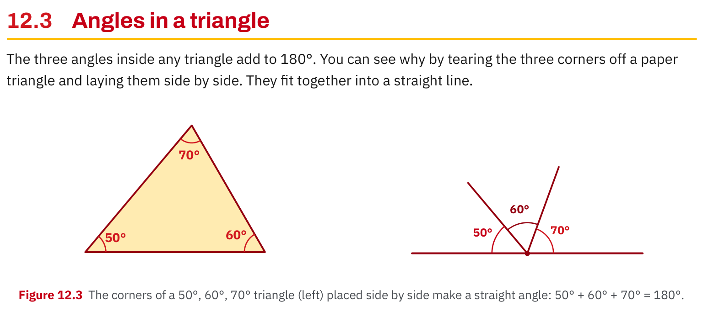
W06-L05 • TEACH • 12:55 PM–1:10 PM • 15 MIN TOTAL
Textbook | page 300
Textbook p.300 • Figure 12.3 — Triangle corners form a straight angle
Textbook sections 12.1–12.3 pp.298–300
Textbook
Exercise Book
Numeracy Hub
Shape Canvas
Day 20 • 2026-12-02 • 09
Notes:
TEACH • 12:55 PM–1:10 PM • 15 MIN TOTAL — shared across this phase’s slides.
Figure 12.3 on page 300 shows the three corners of a triangle arranged together on a straight line. The angles are 50, 60 and 70 degrees. Adding them gives 180, the measure of a straight angle. The corners do not become different angles when moved; their arrangement helps us see the total. Why is this useful for a missing angle? Once two interior angles are known, the third must supply whatever remains of 180. The picture supports the rule for triangles; it is not a rule that any three angles on a drawing automatically add to 180.

Slide 10
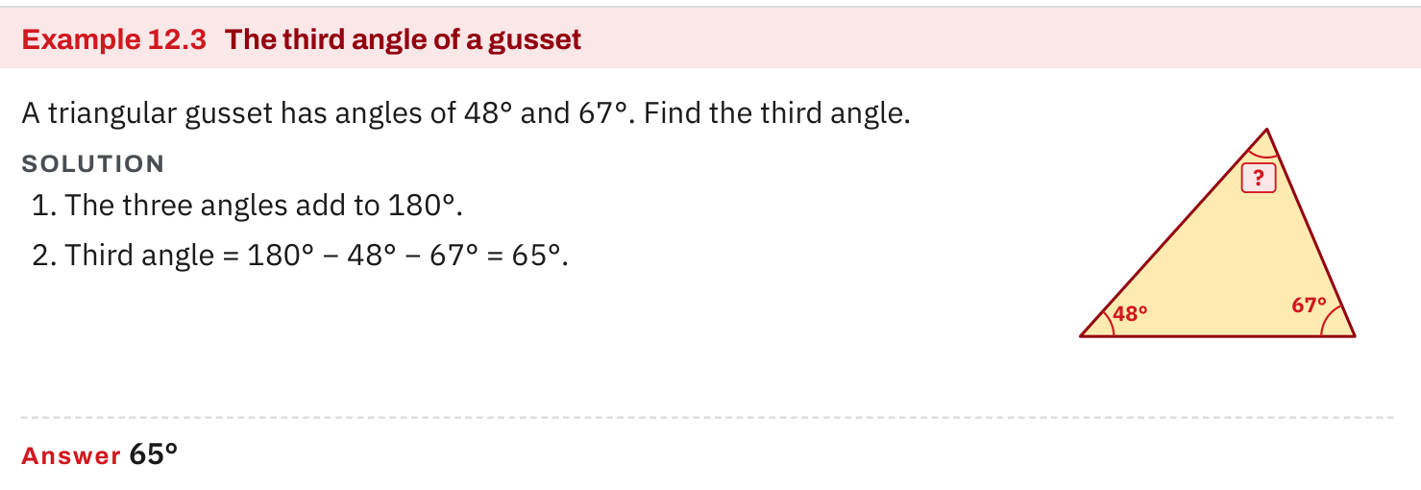
W06-L05 • TEACH • 12:55 PM–1:10 PM • 15 MIN TOTAL
Textbook | page 300
Textbook p.300 • Example 12.3 — Find the missing gusset angle
Textbook sections 12.1–12.3 pp.298–300
Textbook
Exercise Book
Numeracy Hub
Shape Canvas
Day 20 • 2026-12-02 • 10
Notes:
TEACH • 12:55 PM–1:10 PM • 15 MIN TOTAL — shared across this phase’s slides.
The gusset in Example 12.3 has interior angles of 48 and 67 degrees. Add those known angles first: 48 plus 67 is 115. Subtract from 180 to find the remaining angle: 65 degrees. Check all three: 48 plus 67 plus 65 equals 180. What classification does 65 have? It is acute, as are the other two angles in this example. If our result had been negative or larger than 180, the drawing interpretation or subtraction would need checking. Label the missing corner with 65 degrees so the number remains connected to its location.

Slide 11
W06-L05 • TEACH • 12:55 PM–1:10 PM • 15 MIN TOTAL
Spot the mistake. Explain the correction.
A diagram shows an angle beside the triangle. Is it automatically an interior angle?
Discuss the method before checking the answer.
No. Identify the triangle’s interior first; use the straight-line relationship if the label is outside.
Textbook sections 12.1–12.3 pp.298–300
Textbook
Exercise Book
Numeracy Hub
Shape Canvas
Day 20 • 2026-12-02 • 11
Notes:
TEACH • 12:55 PM–1:10 PM • 15 MIN TOTAL — shared across this phase’s slides.
An angle beside a triangle is not automatically one of its interior angles. Point to the three regions inside the triangle at its corners. Now point to the outside angle. If that outside angle and its neighbouring interior angle lie on a straight line, their sum is 180 degrees. We must use that relationship before substituting the interior value into the triangle total. What mistake would come from using the outside label directly? We would combine an exterior angle with interior angles and apply a total that does not match that set.

Slide 12
W06-L05 • TOGETHER • 1:10 PM–1:25 PM • 15 MIN TOTAL
Work together
Solve Exercise Book 12A Q4–8 in pairs. Mark known angles and the relevant total on each sketch.
Work in pairs, alternating solver and checker. Write a diagram, formula, units and estimate.
Resources: Exercise Book 12A Q1–9 (pp.114–115); 12B Q2 (p.116); 12C Q3–4 (p.118)
Textbook sections 12.1–12.3 pp.298–300
Textbook
Exercise Book
Numeracy Hub
Shape Canvas
Day 20 • 2026-12-02 • 12
Notes:
TOGETHER • 1:10 PM–1:25 PM • 15 MIN TOTAL — shared across this phase’s slides.
Work through 12A questions 4 to 8 in pairs. For each sketch, mark the known angles, the angle you need, and the relevant total. Say whether you are using a straight line, a complementary pair or a triangle. One partner explains the relationship; the other checks the subtraction by addition. What should you do if you disagree about the total? Return to the angle marks in the drawing before changing the arithmetic. The geometry decides the equation, and the equation should describe exactly those marked angles.

Slide 13
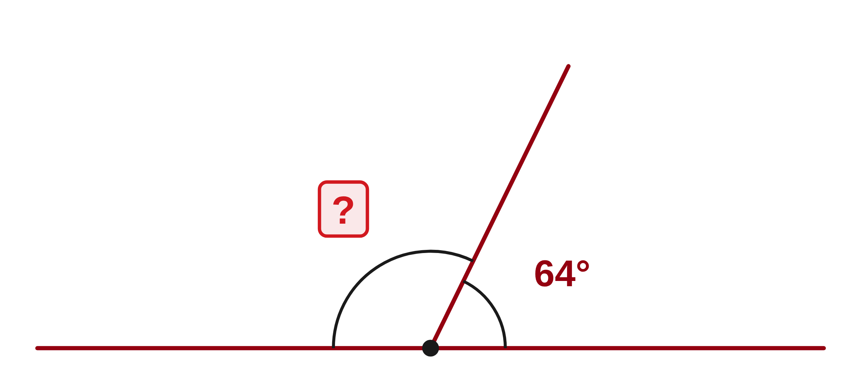
W06-L05 • TOGETHER • 1:10 PM–1:25 PM • 15 MIN TOTAL
Guided practice | 12A Q4
Work with a partner. Take turns explaining the next step.
Textbook sections 12.1–12.3 pp.298–300
Textbook
Exercise Book
Numeracy Hub
Shape Canvas
Day 20 • 2026-12-02 • 13
Notes:
TOGETHER • 1:10 PM–1:25 PM • 15 MIN TOTAL — shared across this phase’s slides.
In 12A question 4, two angles sit on a straight line. One is 64 degrees. Find the other, and explain why the straight line determines the total. Predict whether the missing angle should be acute or obtuse.
Instructor only, after the attempt: 180° − 64° = 116°. Check: 64° + 116° = 180°. It is obtuse because it is greater than 90° and less than 180°.

Slide 14
W06-L05 • TOGETHER • 1:10 PM–1:25 PM • 15 MIN TOTAL
Compare your method | 12A Q4
CHECK TOGETHER
116°
Textbook sections 12.1–12.3 pp.298–300
Textbook
Exercise Book
Numeracy Hub
Shape Canvas
Day 20 • 2026-12-02 • 14
Notes:
TOGETHER • 1:10 PM–1:25 PM • 15 MIN TOTAL — shared across this phase’s slides.
The missing angle is 116 degrees. We chose 180 as the total because the two angles fill a straight line. Subtracting the known 64 leaves 116. Why would 26 degrees answer a different question? That uses 90 minus 64, which would apply to a complementary pair, not this straight-line pair. Add the answer back to the known angle as a check. Your drawing should show the larger angle as obtuse, which agrees with the calculated value rather than simply relying on how the sketch happens to look.

Slide 15
W06-L05 • PRACTISE • 1:25 PM–1:45 PM • 20 MIN TOTAL
Your scheduled practice
Complete Exercise Book 12A Q1–2,9 and 12B Q2; then 12C Q3–4. Use Shape Canvas to vary one angle and explain the consequence.
Solve on paper first; check with tools; correct one error and explain the change.
Resources: Exercise Book 12A Q1–9 (pp.114–115); 12B Q2 (p.116); 12C Q3–4 (p.118)
Textbook sections 12.1–12.3 pp.298–300
Textbook
Exercise Book
Numeracy Hub
Shape Canvas
Day 20 • 2026-12-02 • 15
Notes:
PRACTISE • 1:25 PM–1:45 PM • 20 MIN TOTAL — shared across this phase’s slides.
Complete 12A questions 1, 2 and 9, then 12B question 2 and 12C questions 3 and 4. Label the relevant angle total beside each drawing. In Shape Canvas, vary one triangle angle and explain how the remaining angles must compensate. What remains fixed for a triangle? The sum of the three interior angles is 180 degrees. Keep advanced protractor topics outside this practice; our focus is recognizing and calculating these angle relationships accurately from the given labels.

Slide 16

W06-L05 • PRACTISE • 1:25 PM–1:45 PM • 20 MIN TOTAL
Open Numeracy Hub
Navigation example. Use the values and units in the assigned task.
Textbook sections 12.1–12.3 pp.298–300
Textbook
Exercise Book
Numeracy Hub
Shape Canvas
Day 20 • 2026-12-02 • 16
Notes:
PRACTISE • 1:25 PM–1:45 PM • 20 MIN TOTAL — shared across this phase’s slides.
Open Numeracy Hub’s Angles and Trig section and inspect the diagrams that match our angle work. Before calculating, identify whether the marked angles are inside a triangle, along a straight line, or part of a turn. What total belongs to the chosen relationship? Say it before subtracting. We are using these diagrams to reinforce angle interpretation; advanced protractor topics are not required today. Compare the diagram labels with your paper sketch so the angle you calculate is the one the question actually asks for.

Slide 17
W06-L05 • PRACTISE • 1:25 PM–1:45 PM • 20 MIN TOTAL
Practise in Numeracy Hub and Shape Canvas
1
Use a Shape Canvas triangle and identify its three interior angles.
2
Predict how changing one angle affects the remaining angle total, then compare the labels.
3
Inspect the corresponding diagrams in Numeracy Hub Angles and Trig; omit advanced protractor topics.
Textbook sections 12.1–12.3 pp.298–300
Textbook
Exercise Book
Numeracy Hub
Shape Canvas
Day 20 • 2026-12-02 • 17
Notes:
PRACTISE • 1:25 PM–1:45 PM • 20 MIN TOTAL — shared across this phase’s slides.
Use a triangle in Shape Canvas and identify all three interior angles. Predict what happens when one angle becomes larger. Can the other two keep the same total they had before? No; together they must become smaller by the same increase so that the full sum remains 180 degrees. If one of those other angles stays fixed, the remaining angle takes the entire adjustment. Compare the labels after your prediction, then inspect the corresponding Numeracy Hub diagrams. Explain the preserved total, rather than only describing the picture getting wider or narrower.

Slide 18
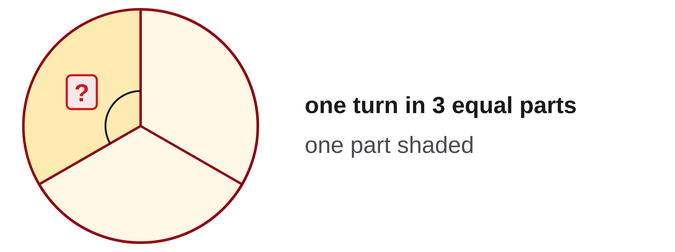
W06-L05 • PRACTISE • 1:25 PM–1:45 PM • 20 MIN TOTAL
Practise from the Exercise Book | 12A Q1
Write the operation, working and units before checking.
Textbook sections 12.1–12.3 pp.298–300
Textbook
Exercise Book
Numeracy Hub
Shape Canvas
Day 20 • 2026-12-02 • 18
Notes:
PRACTISE • 1:25 PM–1:45 PM • 20 MIN TOTAL — shared across this phase’s slides.
Question 12A 1 asks how many degrees are in one third of a turn. Start with the full-turn total and divide it into three equal parts. Predict whether one third of a turn is smaller or larger than a right angle.
Instructor only, after the attempt: 360° ÷ 3 = 120°. It is larger than 90° and smaller than 180°. Check: three turns of 120° add to the full 360° rotation.

Slide 19
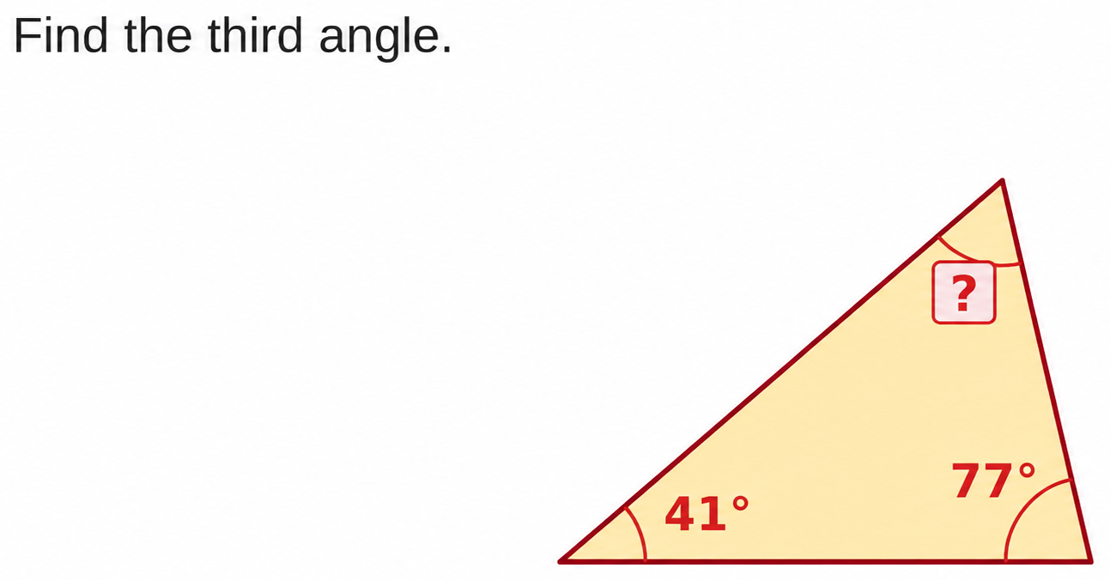
W06-L05 • PRACTISE • 1:25 PM–1:45 PM • 20 MIN TOTAL
Practise from the Exercise Book | 12C Q3
Write the operation, working and units before checking.
Textbook sections 12.1–12.3 pp.298–300
Textbook
Exercise Book
Numeracy Hub
Shape Canvas
Day 20 • 2026-12-02 • 19
Notes:
PRACTISE • 1:25 PM–1:45 PM • 20 MIN TOTAL — shared across this phase’s slides.
Find the third angle in the drawing for 12C question 3. The two labelled interior angles are 41 and 77 degrees. Mark the unknown corner, then write the relationship for all three angles before calculating.
Instructor only, after the attempt: known total = 41° + 77° = 118°. Missing angle = 180° − 118° = 62°. Check: 41° + 77° + 62° = 180°. All three are interior angles, so the triangle total applies directly.

Slide 20
W06-L05 • CHECK • 1:45 PM–1:55 PM • 10 MIN TOTAL
Check independently
Exercise Book 12A Q6–7 and Exercise Book 12B Q2.
Solve without displayed answers; include working, units and final rounding.
Resources: Exercise Book 12A Q1–9 (pp.114–115); 12B Q2 (p.116); 12C Q3–4 (p.118)
Textbook sections 12.1–12.3 pp.298–300
Textbook
Exercise Book
Numeracy Hub
Shape Canvas
Day 20 • 2026-12-02 • 20
Notes:
CHECK • 1:45 PM–1:55 PM • 10 MIN TOTAL — shared across this phase’s slides.
Complete 12A questions 6 and 7 and 12B question 2 independently. Each asks you to identify the correct angle relationship before subtracting. Label the relevant total and include a short addition check. Keep worked solutions closed during the attempts. What should the reader be able to see? Whether you used the 180-degree triangle total, the 90 degrees remaining in a right triangle, or a straight-line pair. The same subtraction operation can appear in different contexts, so the diagram and explanation matter.

Slide 21
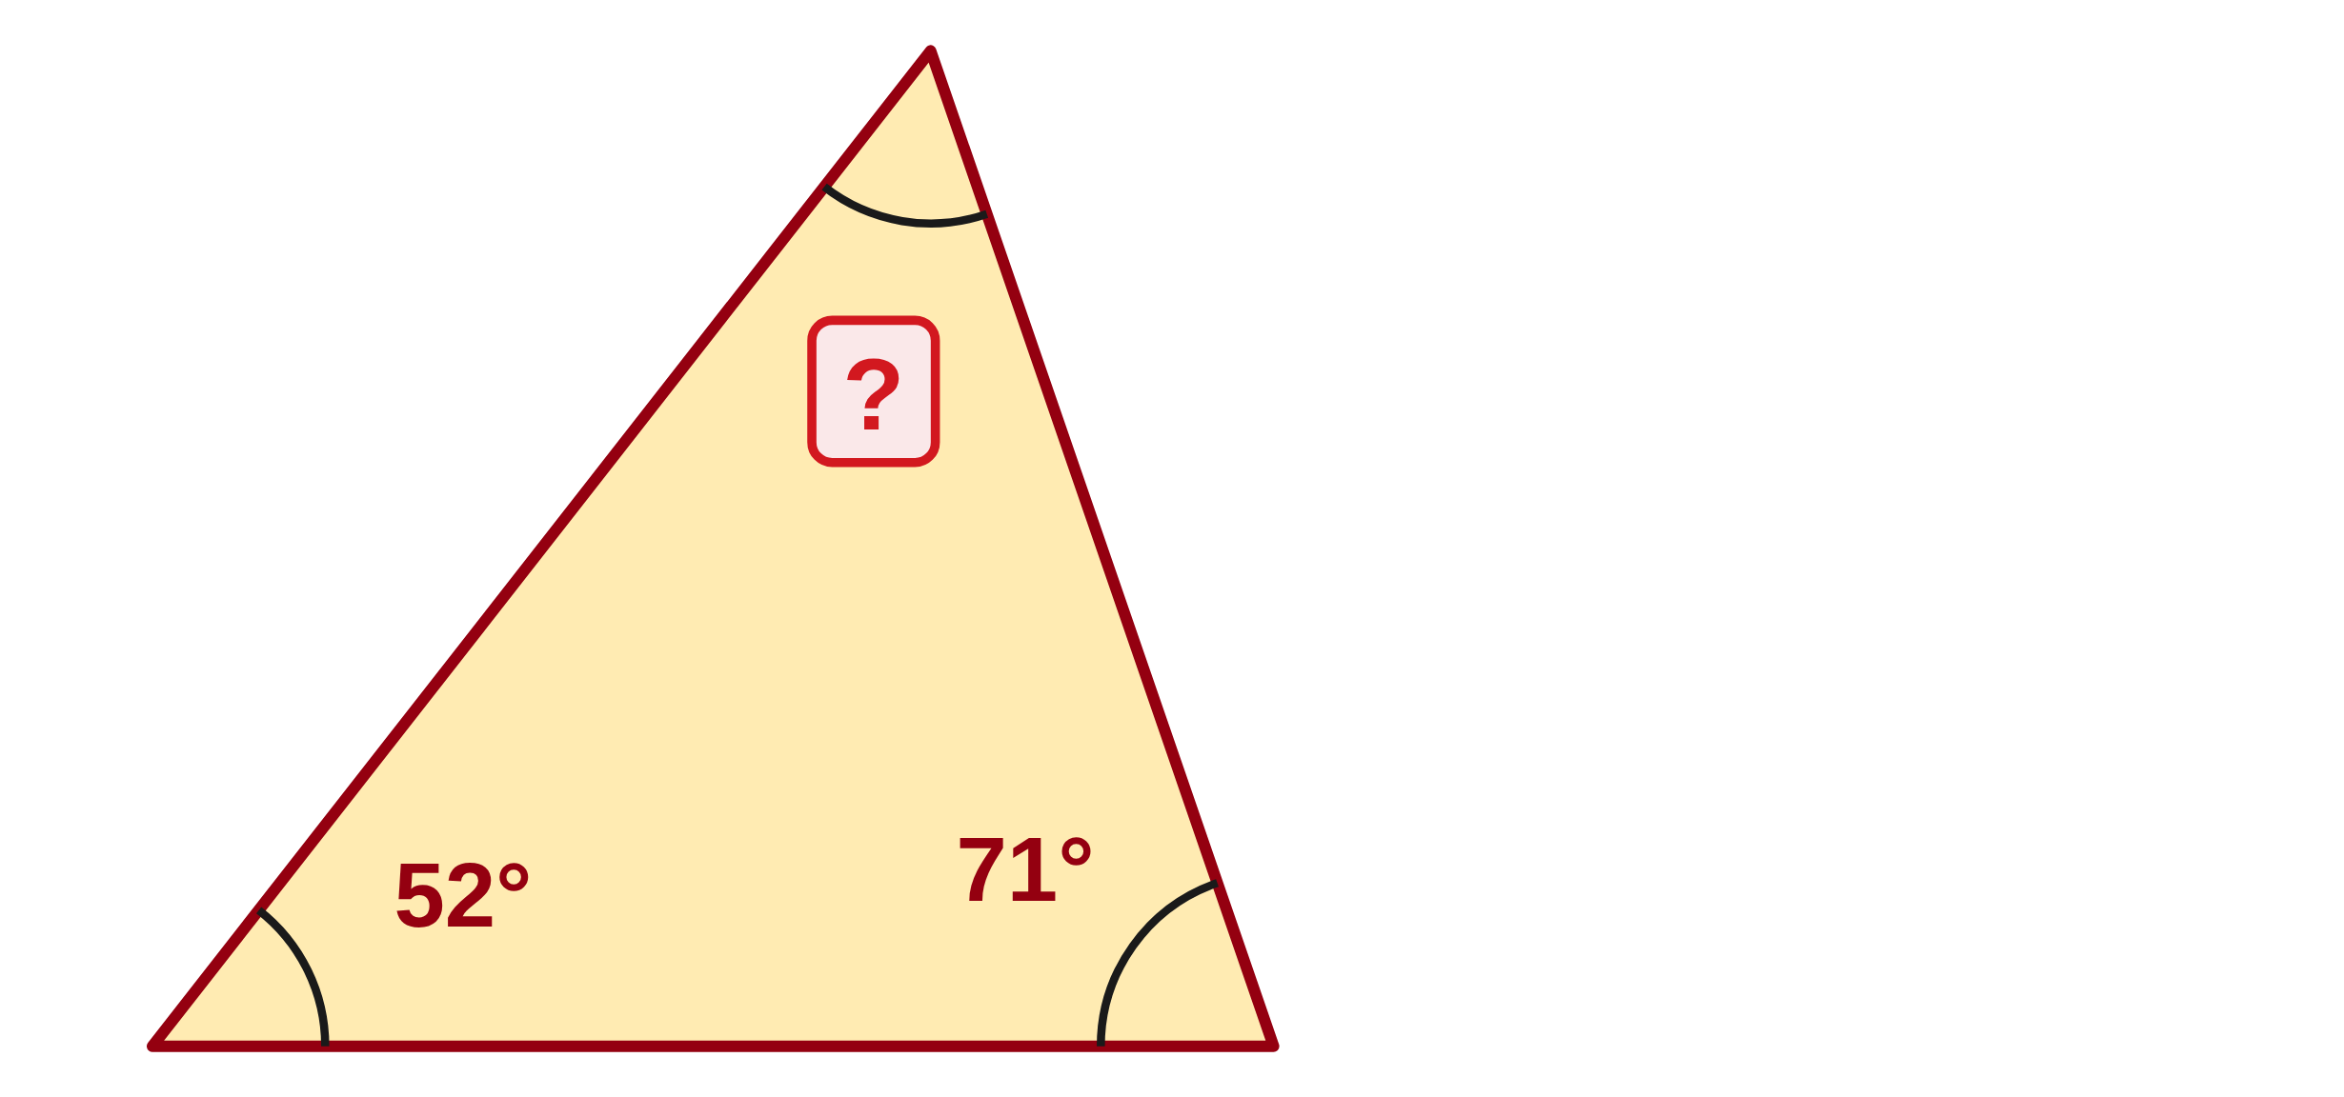
W06-L05 • CHECK • 1:45 PM–1:55 PM • 10 MIN TOTAL
Independent check | 12A Q6
Answer independently. Keep worked solutions closed.
Textbook sections 12.1–12.3 pp.298–300
Textbook
Exercise Book
Numeracy Hub
Shape Canvas
Day 20 • 2026-12-02 • 21
Notes:
CHECK • 1:45 PM–1:55 PM • 10 MIN TOTAL — shared across this phase’s slides.
A triangle has interior angles of 52 and 71 degrees. Find the third angle independently. Show the known total and check that all three angles add correctly after you find the missing one.
Instructor only, after the independent attempt: 52° + 71° = 123°. Third angle = 180° − 123° = 57°. Check: 52° + 71° + 57° = 180°. The answer is acute, which is consistent with 57° being less than 90°.

Slide 22
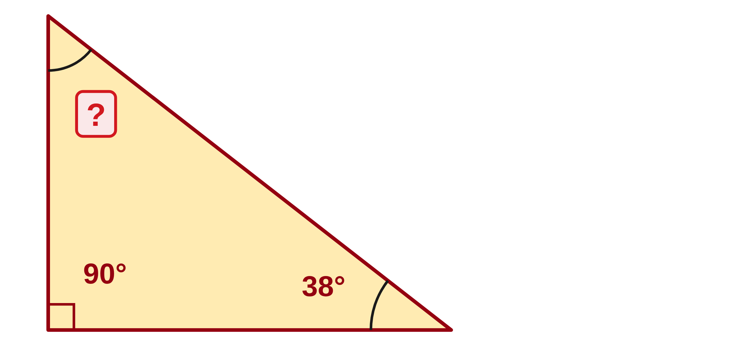
W06-L05 • CHECK • 1:45 PM–1:55 PM • 10 MIN TOTAL
Independent check | 12A Q7
Answer independently. Keep worked solutions closed.
Textbook sections 12.1–12.3 pp.298–300
Textbook
Exercise Book
Numeracy Hub
Shape Canvas
Day 20 • 2026-12-02 • 22
Notes:
CHECK • 1:45 PM–1:55 PM • 10 MIN TOTAL — shared across this phase’s slides.
One acute angle of a right triangle is 38 degrees. Find the other acute angle independently. Remember that the right angle has already used part of the triangle’s 180-degree total.
Instructor only, after the independent attempt: the two acute angles share 180° − 90° = 90°. Therefore the other is 90° − 38° = 52°. Check: 90° + 38° + 52° = 180°. A result of 142° would have omitted the right angle.

Slide 23
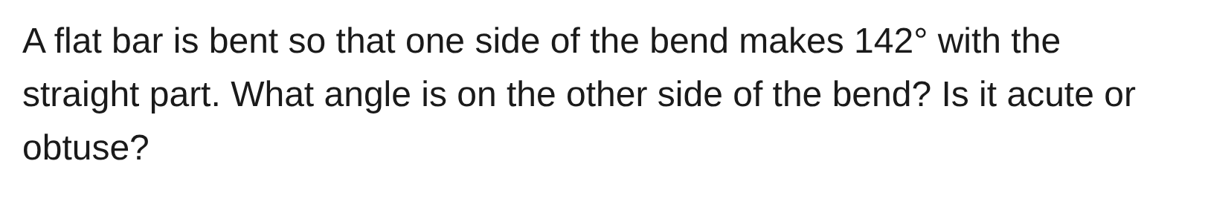
W06-L05 • CHECK • 1:45 PM–1:55 PM • 10 MIN TOTAL
Independent check | 12B Q2
Answer independently. Keep worked solutions closed.
Textbook sections 12.1–12.3 pp.298–300
Textbook
Exercise Book
Numeracy Hub
Shape Canvas
Day 20 • 2026-12-02 • 23
Notes:
CHECK • 1:45 PM–1:55 PM • 10 MIN TOTAL — shared across this phase’s slides.
A flat bar bend has an angle of 142 degrees on one side of the straight part. Find the angle on the other side and classify it as acute or obtuse. Mark the straight-line relationship before calculating.
Instructor only, after the independent attempt: other angle = 180° − 142° = 38°. It is acute because it is less than 90°. Check: 142° + 38° = 180°. The two angles form a straight-line pair.

Slide 24
W06-L05 • WRAP UP • 1:55 PM–2:00 PM • 5 MIN TOTAL
Wrap up and choose the next step
Ask: What changed in your understanding? Where will you use it? What should you check next time?
Name the math and one other essential skill used; record a next practice step.
Resources: Exercise Book 12A Q1–9 (pp.114–115); 12B Q2 (p.116); 12C Q3–4 (p.118)
Textbook sections 12.1–12.3 pp.298–300
Textbook
Exercise Book
Numeracy Hub
Shape Canvas
Day 20 • 2026-12-02 • 24
Notes:
WRAP UP • 1:55 PM–2:00 PM • 5 MIN TOTAL — shared across this phase’s slides.
Choose one missing-angle problem and explain how you knew which total to use. What drawing feature mattered: the straight line, the right-angle mark, or the three interior corners? Record a specific correction if you initially used the wrong total or an outside angle. After the break, we will still use right triangles, but the missing quantity will be a side length. Angle totals tell us about the corners; the squared-side relationship we learn next tells us about the lengths.

Slide 25
DAY 20 • SCHEDULED BREAK
Break
2:00 PM–2:15 PM
Return ready for: Pythagorean theorem and brace lengths
This break is excluded from teaching minutes.
Textbook
Exercise Book
Numeracy Hub
Shape Canvas
Day 20 • 2026-12-02 • 25
Notes:
Scheduled break — no teaching time.
Our scheduled break is 2:00 to 2:15. Keep your right-triangle sketch available. When we return, we will mark the side opposite the right angle and use the Pythagorean theorem to find braces and diagonals. We will restart at 2:15.

Slide 26
W06-L06 • START • 2:15 PM–2:20 PM • 5 MIN TOTAL
Pythagorean theorem and brace lengths
Today’s goal: Find a missing side of a right triangle and verify the result with the squared-side relationship.
Describe a prior use of the skill; identify the given and unknown quantities.
Textbook sections 12.4 pp.301–303; calculator roots pp.51–53
Exercise Book 12A Q10–16 (p.115); 12B Q3 (p.116); 12C Q1–2 (p.118)
Keep your notebook, textbook, exercise book and chosen calculator ready.
Textbook sections 12.4 pp.301–303; calculator roots pp.51–53
Textbook
Exercise Book
Numeracy Hub
Shape Canvas
Day 20 • 2026-12-02 • 26
Notes:
START • 2:15 PM–2:20 PM • 5 MIN TOTAL — shared across this phase’s slides.
A diagonal brace can be longer than either horizontal or vertical distance it spans. How can we calculate it without measuring the drawing on the screen? If the two directions meet at 90 degrees, the right triangle gives us a relationship among the side lengths. Today we will identify the hypotenuse, choose addition or subtraction of squares, and take a square root. The final check is both numerical and visual: the squared relationship must work, and the hypotenuse must remain the longest side.

Slide 27
W06-L06 • RECALL • 2:20 PM–2:25 PM • 5 MIN TOTAL
Recall and reconnect
Label the hypotenuse opposite the right angle. Retrieve a square and a square root.
Attempt the retrieval task independently; explain the method before checking.
Resources: Exercise Book 12A Q10–16 (p.115); 12B Q3 (p.116); 12C Q1–2 (p.118)
Textbook sections 12.4 pp.301–303; calculator roots pp.51–53
Textbook
Exercise Book
Numeracy Hub
Shape Canvas
Day 20 • 2026-12-02 • 27
Notes:
RECALL • 2:20 PM–2:25 PM • 5 MIN TOTAL — shared across this phase’s slides.
Find the right-angle mark on a triangle. The side opposite it, across from that corner, is the hypotenuse. It does not touch the right-angle corner. Now recall our square-root work: squaring a length multiplies it by itself, and a square root reverses that operation. What is 3 squared plus 4 squared? Nine plus sixteen, or twenty-five. Which positive number has square twenty-five? Five. Those operations will let us find a length from the squared-side relationship.

Slide 28
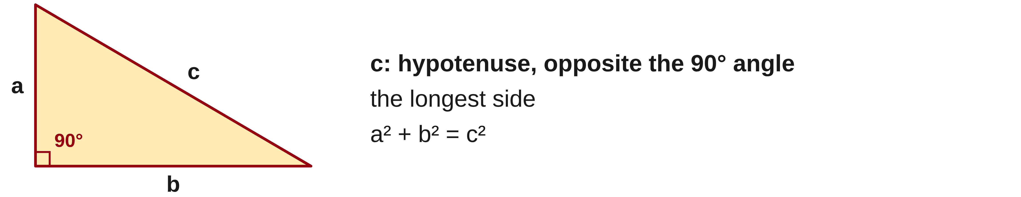
W06-L06 • TEACH • 2:25 PM–2:40 PM • 15 MIN TOTAL
Identify the hypotenuse first
1
Pythagoras applies to a right triangle.
2
The hypotenuse is opposite the 90° angle and is the longest side.
3
Write a² + b² = c² with c as the hypotenuse.
4
Use matching units before squaring side lengths.
Textbook sections 12.4 pp.301–303; calculator roots pp.51–53
Textbook
Exercise Book
Numeracy Hub
Shape Canvas
Day 20 • 2026-12-02 • 28
Notes:
TEACH • 2:25 PM–2:40 PM • 15 MIN TOTAL — shared across this phase’s slides.
Pythagoras applies to right triangles, so first confirm the 90-degree angle. Label the side opposite it c, the hypotenuse; label the two sides meeting at the right angle a and b. The relationship is a squared plus b squared equals c squared. Which side must be longest? c. Before squaring, put all lengths in matching units. Millimetres and metres cannot be mixed as if their numbers describe equal-sized units. The drawing determines which value belongs to c, even if the triangle is rotated or the hypotenuse is not the side that looks most horizontal.

Slide 29
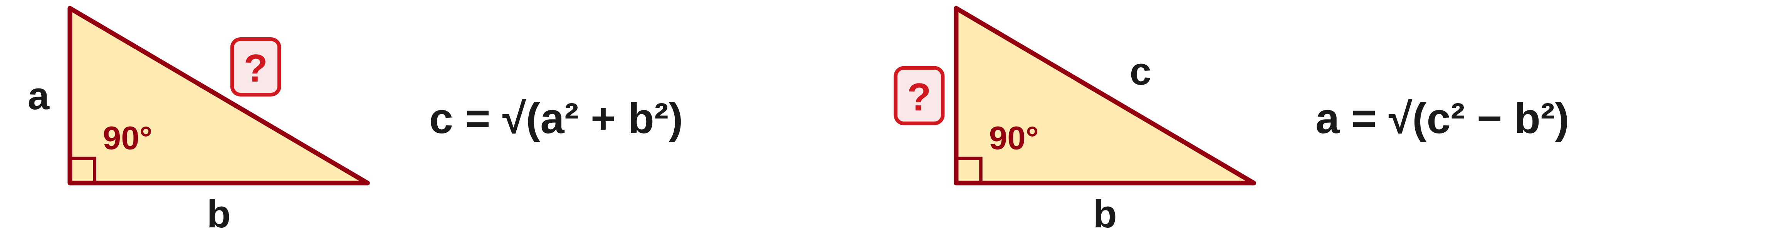
W06-L06 • TEACH • 2:25 PM–2:40 PM • 15 MIN TOTAL
Choose addition or subtraction
1
For the hypotenuse, c = √(a² + b²).
2
For a missing leg, subtract the known leg’s square from c² before taking the root.
3
Bracket the complete sum or difference under the square root.
4
Check the squared relationship and whether the hypotenuse is longest.
Textbook sections 12.4 pp.301–303; calculator roots pp.51–53
Textbook
Exercise Book
Numeracy Hub
Shape Canvas
Day 20 • 2026-12-02 • 29
Notes:
TEACH • 2:25 PM–2:40 PM • 15 MIN TOTAL — shared across this phase’s slides.
For a missing hypotenuse, add the squares of the two legs and then take the square root of the whole sum. For a missing leg, start with the hypotenuse squared and subtract the known leg squared, then take the root of that whole difference. Why does a missing leg use subtraction? The theorem says the two leg squares together equal c squared, so removing one leaves the other. Use brackets to keep the complete sum or difference under the root. Check that the resulting leg is shorter than c and that the original squared equation balances.

Slide 30
W06-L06 • TEACH • 2:25 PM–2:40 PM • 15 MIN TOTAL
Square, combine, then take the root
c = √(1,500² + 2,000²)
= √6,250,000
= 2,500 mm
c = ?
1,500 mm
Check: 2,500² = 6,250,000.
The answer exceeds both legs.
For a missing leg, subtract squares.
2,000 mm
Together • Work 12A Q10–13. Draw and label every triangle first.
Explain the bracketed quantity before entering the square-root key.
Classroom right-triangle example • Diagram is schematic • Use the selected calculator’s root-entry sequence
Textbook
Exercise Book
Numeracy Hub
Shape Canvas
Day 20 • 2026-12-02 • 30
Notes:
TEACH • 2:25 PM–2:40 PM • 15 MIN TOTAL — shared across this phase’s slides.
The right triangle has legs 1,500 and 2,000 millimetres. Square each: 1,500 squared is 2,250,000; 2,000 squared is 4,000,000. Add to obtain 6,250,000. That is c squared, so take the square root to find c: 2,500 millimetres. Check by squaring 2,500; it returns 6,250,000. Does the answer pass the length check? Yes, 2,500 is longer than either leg. Notice that adding 1,500 and 2,000 directly would give a route along two edges, not the diagonal. We add their squares because that is the right-triangle relationship.

Slide 31
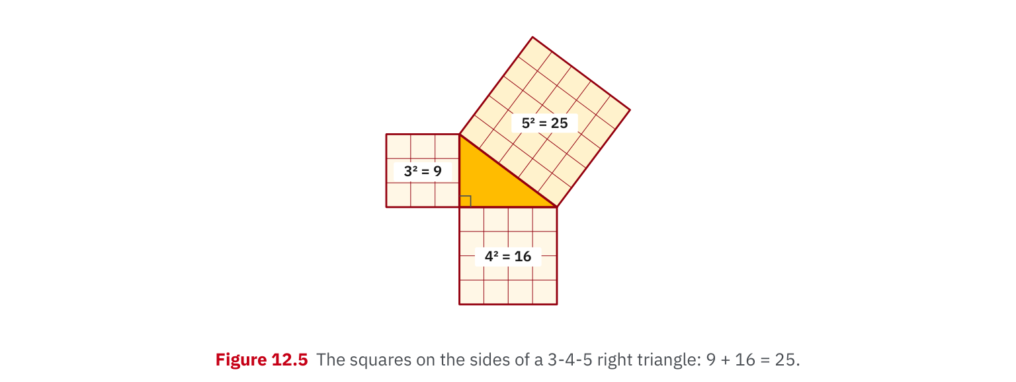
W06-L06 • TEACH • 2:25 PM–2:40 PM • 15 MIN TOTAL
Textbook | page 302
Textbook p.302 • Figure 12.5 — Squares on a 3–4–5 triangle
Textbook sections 12.4 pp.301–303; calculator roots pp.51–53
Textbook
Exercise Book
Numeracy Hub
Shape Canvas
Day 20 • 2026-12-02 • 31
Notes:
TEACH • 2:25 PM–2:40 PM • 15 MIN TOTAL — shared across this phase’s slides.
Figure 12.5 on page 302 draws a square on each side of a 3–4–5 right triangle. The smaller square areas are 3 squared, or 9, and 4 squared, or 16. Together they make 25, the area of the square on side 5. What is being added: the side lengths or the square areas? The square areas. That is why 3 plus 4 does not need to equal 5. When the largest square area is known, taking its square root recovers the side length. The diagram helps us remember both the squares and the final root.

Slide 32
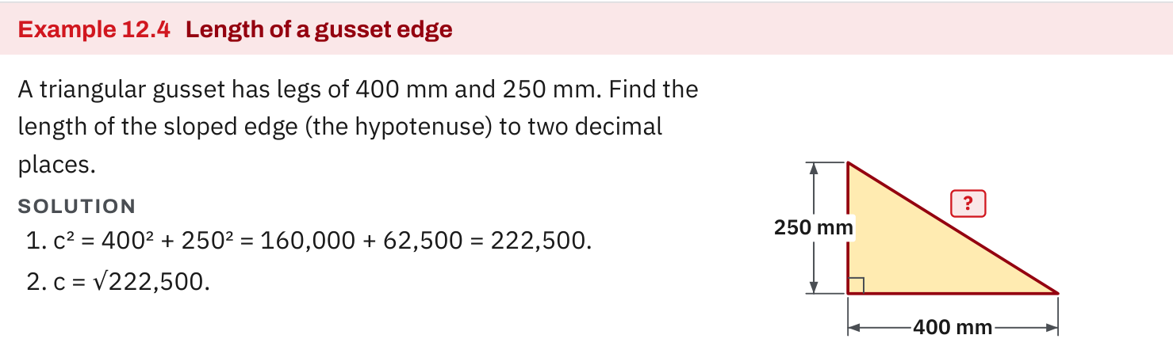
W06-L06 • TEACH • 2:25 PM–2:40 PM • 15 MIN TOTAL
Textbook | page 302
Textbook p.302 • Example 12.4 — Find a gusset hypotenuse
Textbook sections 12.4 pp.301–303; calculator roots pp.51–53
Textbook
Exercise Book
Numeracy Hub
Shape Canvas
Day 20 • 2026-12-02 • 32
Notes:
TEACH • 2:25 PM–2:40 PM • 15 MIN TOTAL — shared across this phase’s slides.
Example 12.4 on page 302 asks for the sloping edge of a gusset whose legs are 400 and 250 millimetres. Identify that edge as the hypotenuse before calculating. Its square is 400 squared plus 250 squared: 160,000 plus 62,500 equals 222,500. Now take the root of the whole result: about 471.70 millimetres to two decimals. Why does 222,500 alone not answer the question? It is the squared length, not the length. Our answer is longer than 400 millimetres, which fits the requirement that the hypotenuse be the longest side.

Slide 33
W06-L06 • TEACH • 2:25 PM–2:40 PM • 15 MIN TOTAL
Spot the mistake. Explain the correction.
A missing leg is calculated by adding the two known squares. What should change?
Discuss the method before checking the answer.
Use the hypotenuse squared minus the known leg squared, then take the square root.
Textbook sections 12.4 pp.301–303; calculator roots pp.51–53
Textbook
Exercise Book
Numeracy Hub
Shape Canvas
Day 20 • 2026-12-02 • 33
Notes:
TEACH • 2:25 PM–2:40 PM • 15 MIN TOTAL — shared across this phase’s slides.
Someone has added the squares of the two known lengths even though the missing side is a leg. Look at which known side is the hypotenuse. The theorem says the hypotenuse square equals the sum of both leg squares. If one leg is missing, we must subtract the known leg square from the hypotenuse square. Adding would produce a result longer than the hypotenuse, which cannot be a leg. Explain the correction by rearranging a squared plus b squared equals c squared, then take the root only after the subtraction is complete.

Slide 34
W06-L06 • TOGETHER • 2:40 PM–2:55 PM • 15 MIN TOTAL
Work together
Solve Exercise Book 12A Q10–13; learners draw and label each triangle before entering keys.
Work in pairs, alternating solver and checker. Write a diagram, formula, units and estimate.
Resources: Exercise Book 12A Q10–16 (p.115); 12B Q3 (p.116); 12C Q1–2 (p.118)
Textbook sections 12.4 pp.301–303; calculator roots pp.51–53
Textbook
Exercise Book
Numeracy Hub
Shape Canvas
Day 20 • 2026-12-02 • 34
Notes:
TOGETHER • 2:40 PM–2:55 PM • 15 MIN TOTAL — shared across this phase’s slides.
Solve 12A questions 10 to 13 together. Draw each triangle and mark the right angle before entering numbers. Label c opposite that angle, then decide whether you are finding c or one of the legs. One partner explains why the calculation uses addition or subtraction; the other checks the equation and the calculator brackets. What should the final operation be? A square root, because the intermediate result is a squared length. Finish by substituting the found side into the original relationship and checking that c is the longest.

Slide 35
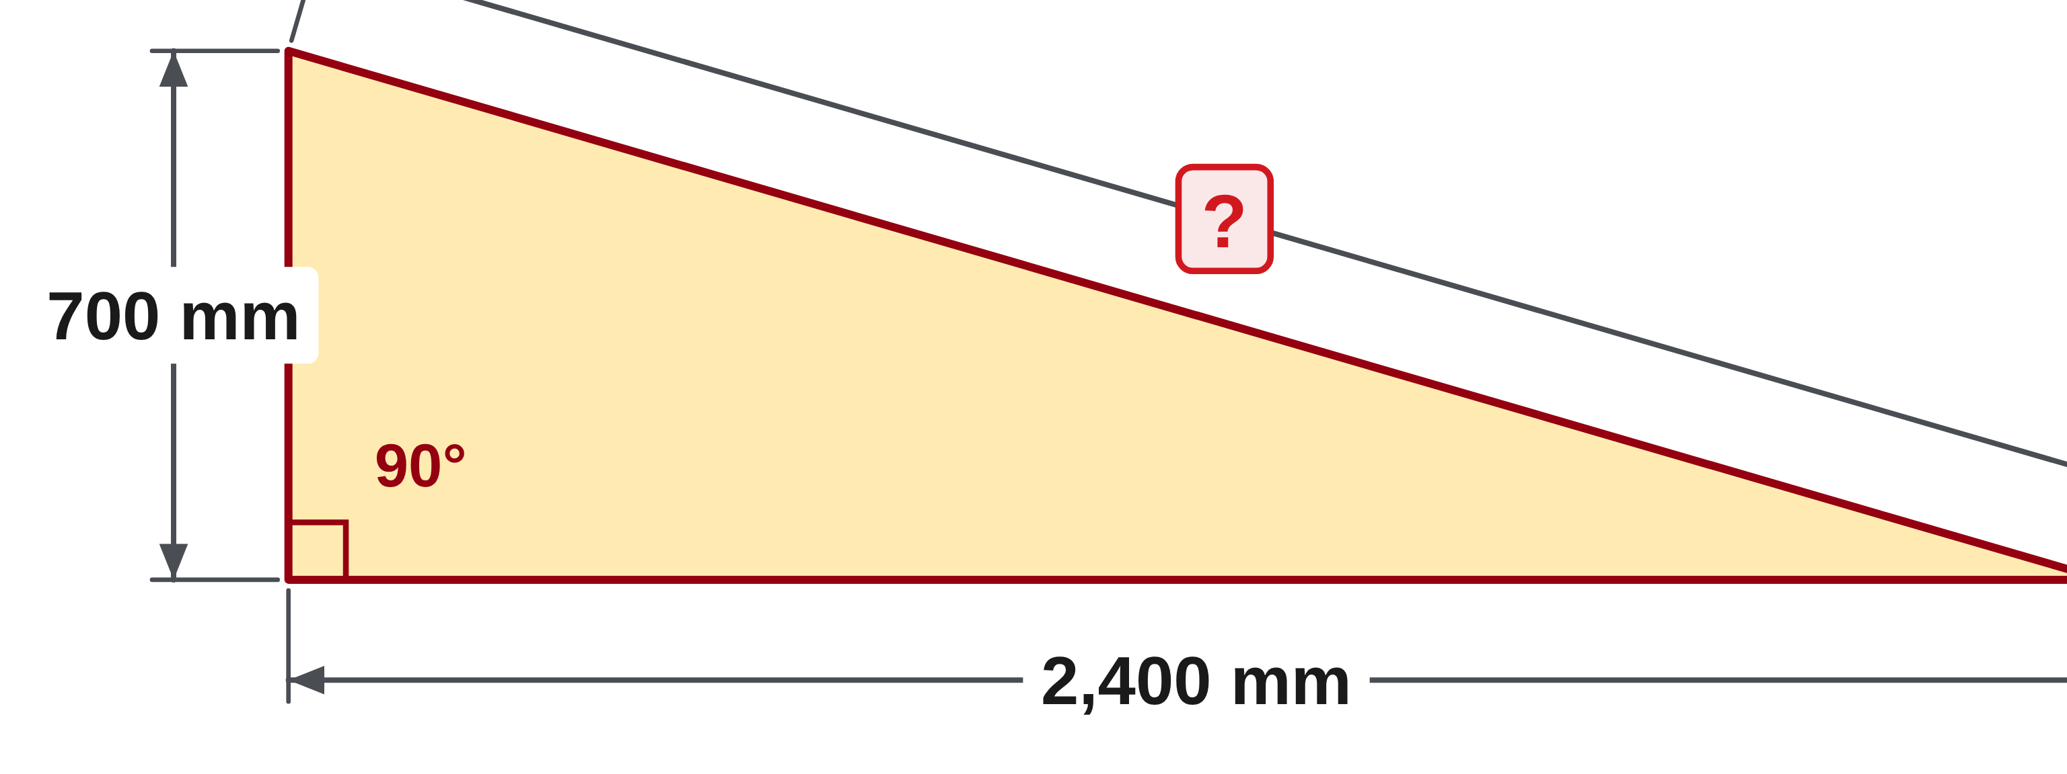
W06-L06 • TOGETHER • 2:40 PM–2:55 PM • 15 MIN TOTAL
Guided practice | 12A Q10
Work with a partner. Take turns explaining the next step.
Textbook sections 12.4 pp.301–303; calculator roots pp.51–53
Textbook
Exercise Book
Numeracy Hub
Shape Canvas
Day 20 • 2026-12-02 • 35
Notes:
TOGETHER • 2:40 PM–2:55 PM • 15 MIN TOTAL — shared across this phase’s slides.
Question 12A 10 gives legs of 700 and 2,400 millimetres. Find the hypotenuse. Mark the right angle, write the squared-side equation, and estimate whether the result should be longer or shorter than 2,400 millimetres.
Instructor only, after the attempt: c = √(700² + 2,400²) = √(490,000 + 5,760,000) = √6,250,000 = 2,500 mm. The result is longer than either leg. Do not stop at the squared value.

Slide 36
W06-L06 • TOGETHER • 2:40 PM–2:55 PM • 15 MIN TOTAL
Compare your method | 12A Q10
CHECK TOGETHER
2,500 mm
Textbook sections 12.4 pp.301–303; calculator roots pp.51–53
Textbook
Exercise Book
Numeracy Hub
Shape Canvas
Day 20 • 2026-12-02 • 36
Notes:
TOGETHER • 2:40 PM–2:55 PM • 15 MIN TOTAL — shared across this phase’s slides.
The hypotenuse is 2,500 millimetres. Squaring the legs gives 490,000 and 5,760,000; adding gives 6,250,000. The square root is 2,500. Now check the original equation: 700 squared plus 2,400 squared equals 2,500 squared. Why is this more convincing than the answer alone? It shows the value satisfies the relationship for the actual triangle. The length check also works: 2,500 exceeds 2,400 and 700. Compare your calculator expression with the written equation, particularly that the entire sum was inside the root.

Slide 37
W06-L06 • PRACTISE • 2:55 PM–3:15 PM • 20 MIN TOTAL
Your scheduled practice
Complete Exercise Book 12A Q15–16, 12B Q3 and 12C Q1–2. Check Shape Canvas answers only after writing the equation.
Solve on paper first; check with tools; correct one error and explain the change.
Resources: Exercise Book 12A Q10–16 (p.115); 12B Q3 (p.116); 12C Q1–2 (p.118)
Textbook sections 12.4 pp.301–303; calculator roots pp.51–53
Textbook
Exercise Book
Numeracy Hub
Shape Canvas
Day 20 • 2026-12-02 • 37
Notes:
PRACTISE • 2:55 PM–3:15 PM • 20 MIN TOTAL — shared across this phase’s slides.
Complete 12A questions 15 and 16, 12B question 3 and 12C questions 1 and 2. Some questions ask whether three lengths make a right triangle; others ask you to find a side. Label the longest side as the candidate hypotenuse when checking a set of lengths. Use Shape Canvas only after writing the equation on paper. What should you do if an answer seems longer than the side labelled c? Recheck which side is missing and whether subtraction, rather than addition, is required.

Slide 38
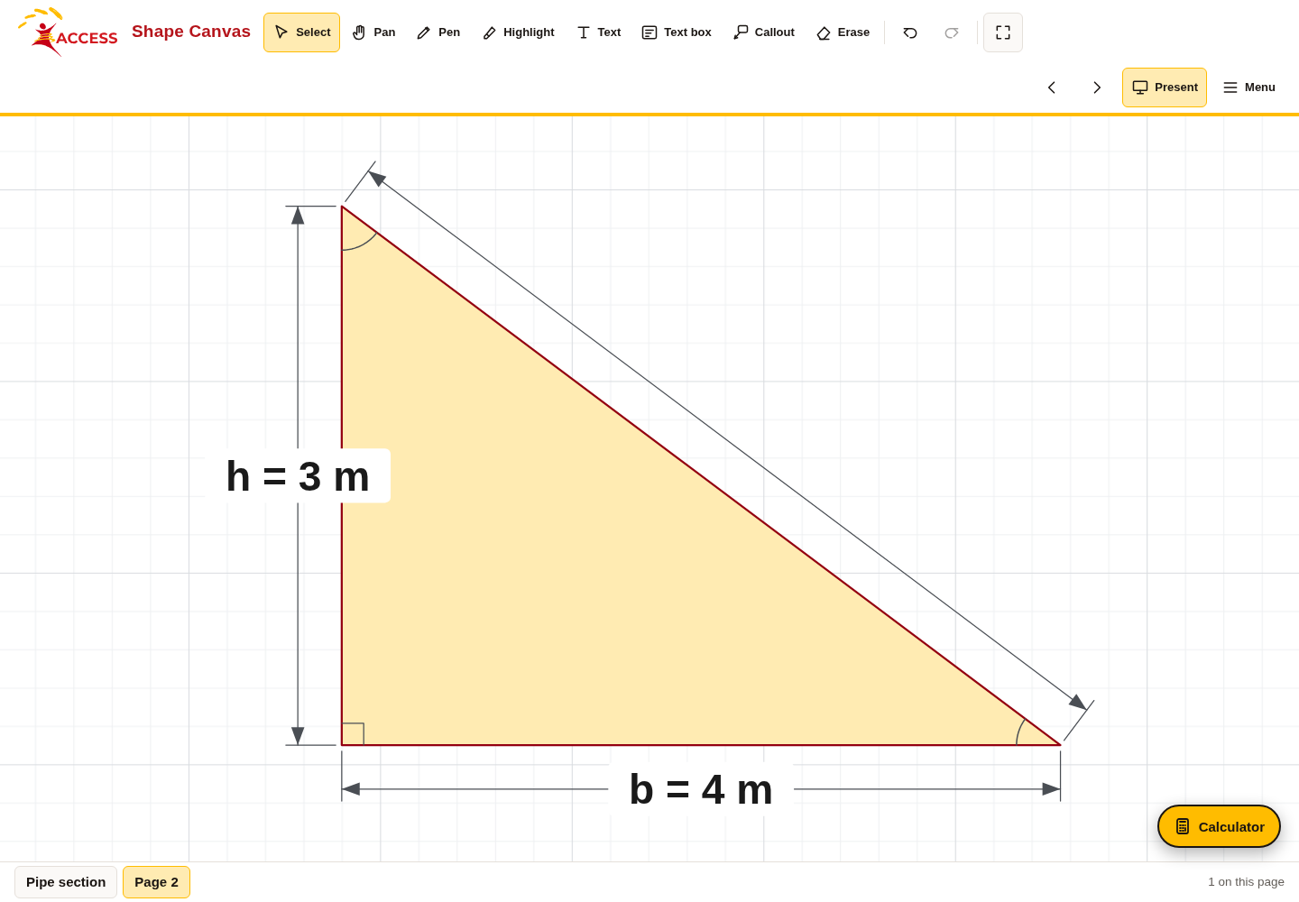
W06-L06 • PRACTISE • 2:55 PM–3:15 PM • 20 MIN TOTAL
Open Shape Canvas
Navigation example. Use the values and units in the assigned task.
Textbook sections 12.4 pp.301–303; calculator roots pp.51–53
Textbook
Exercise Book
Numeracy Hub
Shape Canvas
Day 20 • 2026-12-02 • 38
Notes:
PRACTISE • 2:55 PM–3:15 PM • 20 MIN TOTAL — shared across this phase’s slides.
Open Shape Canvas and choose a right triangle. Find the 90-degree mark and label the opposite side as the hypotenuse. Hide that side or one leg, keeping the other two dimensions visible. Before revealing anything, copy the triangle to paper and decide which equation fits the missing side. What does the right-angle mark authorize us to use? The Pythagorean relationship. A triangle that merely looks close to square on the screen does not establish a right angle; use the labels and shape definition.

Slide 39
W06-L06 • PRACTISE • 2:55 PM–3:15 PM • 20 MIN TOTAL
Practise in Numeracy Hub and Shape Canvas
1
Create a right triangle in Shape Canvas and hide the hypotenuse or one leg.
2
Draw the same triangle and write the correct squared-side equation before calculating.
3
Use Numeracy Hub Calculator for the bracketed sum or difference; reveal the Canvas answer last.
Textbook sections 12.4 pp.301–303; calculator roots pp.51–53
Textbook
Exercise Book
Numeracy Hub
Shape Canvas
Day 20 • 2026-12-02 • 39
Notes:
PRACTISE • 2:55 PM–3:15 PM • 20 MIN TOTAL — shared across this phase’s slides.
Create a right triangle in Shape Canvas and hide either the hypotenuse or a leg. On paper, identify the unknown and write the correct squared equation. If it is c, add the leg squares. If it is a leg, subtract the known leg square from c squared. Use Numeracy Hub Calculator for the bracketed sum or difference and the root, then reveal the Shape Canvas answer last. What are your two checks? Substitute into the squared relationship, and confirm that the hypotenuse is still longer than either leg.

Slide 40
W06-L06 • PRACTISE • 2:55 PM–3:15 PM • 20 MIN TOTAL
Practise from the Exercise Book | 12A Q15
Write the operation, working and units before checking.
Textbook sections 12.4 pp.301–303; calculator roots pp.51–53
Textbook
Exercise Book
Numeracy Hub
Shape Canvas
Day 20 • 2026-12-02 • 40
Notes:
PRACTISE • 2:55 PM–3:15 PM • 20 MIN TOTAL — shared across this phase’s slides.
Question 12A 15 asks whether lengths 8, 15 and 17 make a right triangle. Start with the largest length as the possible hypotenuse. Compare its square with the sum of the squares of the other two lengths. Do not decide only because the numbers look familiar.
Instructor only, after the attempt: 8² + 15² = 64 + 225 = 289, and 17² = 289. The equality holds, so the lengths make a right triangle.

Slide 41
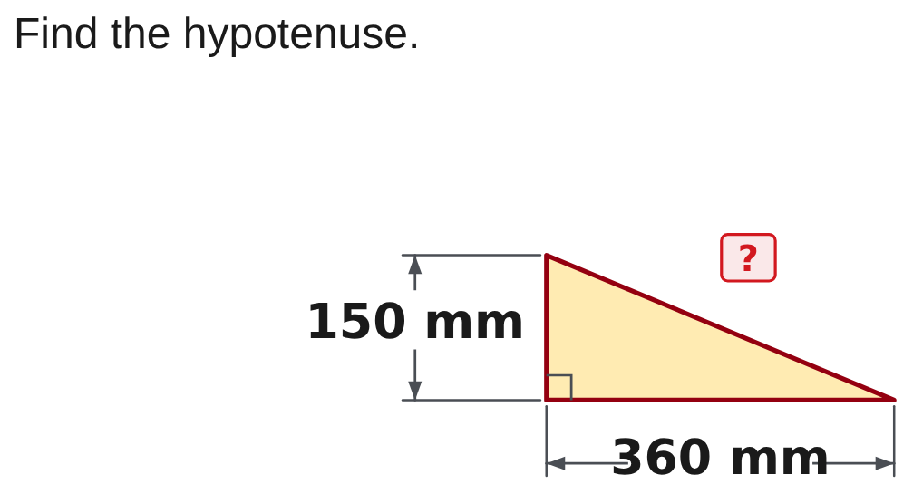
W06-L06 • PRACTISE • 2:55 PM–3:15 PM • 20 MIN TOTAL
Practise from the Exercise Book | 12C Q1
Write the operation, working and units before checking.
Textbook sections 12.4 pp.301–303; calculator roots pp.51–53
Textbook
Exercise Book
Numeracy Hub
Shape Canvas
Day 20 • 2026-12-02 • 41
Notes:
PRACTISE • 2:55 PM–3:15 PM • 20 MIN TOTAL — shared across this phase’s slides.
In 12C question 1, the right triangle has legs labelled 360 and 150 millimetres. Find the sloping hypotenuse. Mark c on the drawing and put the full sum of squares under the square root.
Instructor only, after the attempt: c = √(360² + 150²) = √(129,600 + 22,500) = √152,100 = 390 mm. Check: 390² = 152,100, and 390 is longer than both 360 and 150.

Slide 42
W06-L06 • CHECK • 3:15 PM–3:25 PM • 10 MIN TOTAL
Check independently
Exercise Book 12A Q10 and Q12 with the right-angle diagram and units.
Solve without displayed answers; include working, units and final rounding.
Resources: Exercise Book 12A Q10–16 (p.115); 12B Q3 (p.116); 12C Q1–2 (p.118)
Textbook sections 12.4 pp.301–303; calculator roots pp.51–53
Textbook
Exercise Book
Numeracy Hub
Shape Canvas
Day 20 • 2026-12-02 • 42
Notes:
CHECK • 3:15 PM–3:25 PM • 10 MIN TOTAL — shared across this phase’s slides.
Complete 12A questions 10 and 12 independently. Draw and label the right-angle triangle for each. One asks for a hypotenuse and the other for a leg, so choose the operation from the labelled equation. Keep worked answers closed until you have attempted both. What should your working make clear? Which side is c, why you added or subtracted squares, and why the final answer uses a length unit. Include either a substitution check or the full squared equality with your result.

Slide 43
W06-L06 • CHECK • 3:15 PM–3:25 PM • 10 MIN TOTAL
Independent check | 12A Q10
Answer independently. Keep worked solutions closed.
Textbook sections 12.4 pp.301–303; calculator roots pp.51–53
Textbook
Exercise Book
Numeracy Hub
Shape Canvas
Day 20 • 2026-12-02 • 43
Notes:
CHECK • 3:15 PM–3:25 PM • 10 MIN TOTAL — shared across this phase’s slides.
Find the hypotenuse for a right triangle with legs 700 and 2,400 millimetres. Work independently, showing the square-root expression and the final unit. Check that your result is longer than both legs.
Instructor only, after the independent attempt: c = √(700² + 2,400²) = √(490,000 + 5,760,000) = √6,250,000 = 2,500 mm. Substituting gives 490,000 + 5,760,000 = 6,250,000, so the squared relationship holds.

Slide 44
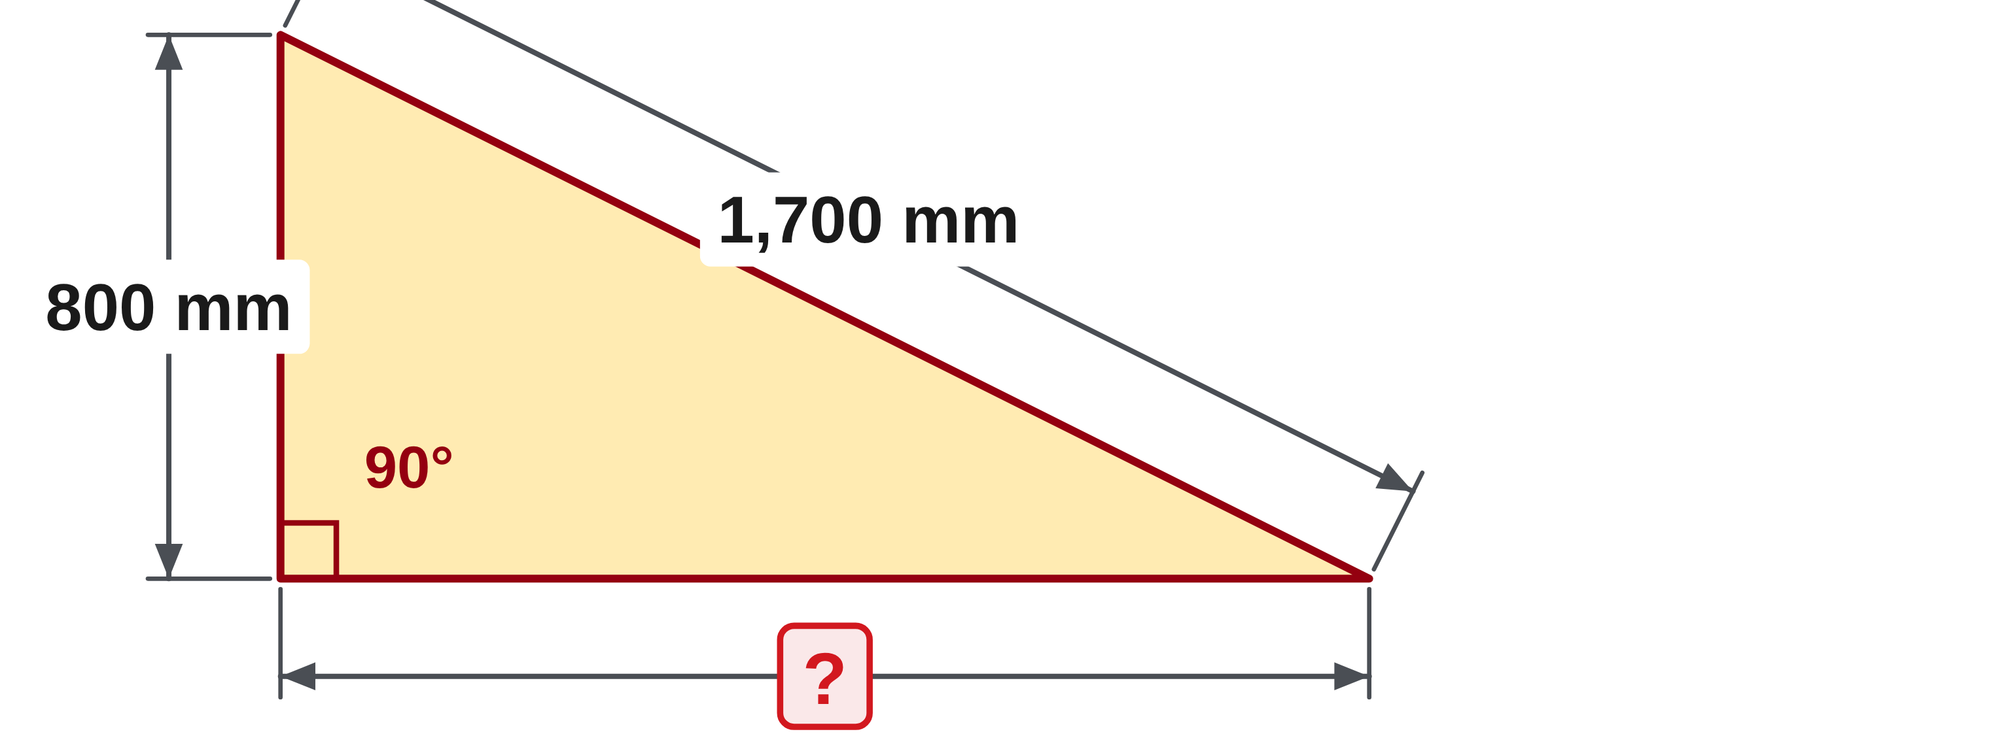
W06-L06 • CHECK • 3:15 PM–3:25 PM • 10 MIN TOTAL
Independent check | 12A Q12
Answer independently. Keep worked solutions closed.
Textbook sections 12.4 pp.301–303; calculator roots pp.51–53
Textbook
Exercise Book
Numeracy Hub
Shape Canvas
Day 20 • 2026-12-02 • 44
Notes:
CHECK • 3:15 PM–3:25 PM • 10 MIN TOTAL — shared across this phase’s slides.
The hypotenuse is 1,700 millimetres and one leg is 800 millimetres. Find the other leg independently. Make sure your equation treats 1,700 as c and that the whole difference stays under the root.
Instructor only, after the independent attempt: missing leg = √(1,700² − 800²) = √(2,890,000 − 640,000) = √2,250,000 = 1,500 mm. Check: 1,500² + 800² = 2,890,000 = 1,700². The missing leg is shorter than the hypotenuse.

Slide 45
W06-L06 • WRAP UP • 3:25 PM–3:30 PM • 5 MIN TOTAL
Wrap up and choose the next step
Ask: What changed in your understanding? Where will you use it? What should you check next time?
Name the math and one other essential skill used; record a next practice step.
Resources: Exercise Book 12A Q10–16 (p.115); 12B Q3 (p.116); 12C Q1–2 (p.118)
Textbook sections 12.4 pp.301–303; calculator roots pp.51–53
Textbook
Exercise Book
Numeracy Hub
Shape Canvas
Day 20 • 2026-12-02 • 45
Notes:
WRAP UP • 3:25 PM–3:30 PM • 5 MIN TOTAL — shared across this phase’s slides.
Choose one triangle from this block and explain why your calculation used addition or subtraction. The decision should come from which side is unknown, not from memorizing an answer. What two checks support the result? The squares satisfy the original equation, and the hypotenuse is longest. Record one specific habit you will keep: mark the right angle, label c, keep matching units, or include the final root. Those habits make a brace-length calculation readable and checkable by someone else on the job.

