Slide 1

CARPENTRY FOUNDATION / INTAKE 142
Day 23 | Monday
23
December 7, 2026
Carpentry drawing: floor layout and cut list
12:45 PM–2:00 PM • Math • 75 min
Materials practice: sheeting and allowance
2:15 PM–3:30 PM • Calculation Practice • 75 min
Week 7 • 2 scheduled blocks • 150 teaching minutes
Estimate. Show the method. Label units. Check the result.
Textbook
Exercise Book
Numeracy Hub
Shape Canvas
Day 23 • 2026-12-07 • 01
Notes:
Opening — within the first scheduled Start period; no additional teaching time.
Today we combine our earlier methods into a floor-layout and material-quantity task. First we draw and measure a 7.2 by 3.6-metre floor, then keep a separate stock-cutting calculation organized. After the break we check a nine-sheet layout and calculate the stated ten-percent allowance. The distinction matters: a drawing, an area estimate and an order quantity each answer a different question. We will keep the assumptions visible so another person can follow our decisions.

Slide 2
DAY 23 / WEEK 7 / CLASS TIMETABLE
Today’s exact schedule
12:45 PM–2:00 PM • 75 min
2:15 PM–3:30 PM • 75 min
Carpentry drawing: floor layout and cut list
Materials practice: sheeting and allowance
12:45 PM–12:50 PM
Start
5
2:15 PM–2:20 PM
Start
5
12:50 PM–12:55 PM
Recall
5
2:20 PM–2:25 PM
Recall
5
12:55 PM–1:10 PM
Teach
15
2:25 PM–2:40 PM
Teach
15
1:10 PM–1:25 PM
Together
15
2:40 PM–2:55 PM
Together
15
1:25 PM–1:45 PM
Practise
20
2:55 PM–3:15 PM
Practise
20
1:45 PM–1:55 PM
Check
10
3:15 PM–3:25 PM
Check
10
1:55 PM–2:00 PM
Wrap up
5
3:25 PM–3:30 PM
Wrap up
5
Math • Math Week 7, Lesson 1
Calculation Practice • Math Week 7, Lesson 2
Break: 2:00 PM–2:15 PM • 15 minutes • excluded from teaching time
Textbook
Exercise Book
Numeracy Hub
Shape Canvas
Day 23 • 2026-12-07 • 02
Notes:
Opening — within the first scheduled Start period; no additional teaching time.
The floor-layout block runs from 12:45 to 2:00, with its independent check at 1:45. We take the scheduled break and return at 2:15 for materials calculation practice until 3:30. Both blocks include fifteen minutes together and twenty minutes of practice. Keep the floor sketch from the first block; we will use it again after the break. The separate stock example remains separate even when its cut-list note sits beside the floor drawing.

Slide 3
W07-L01 • START • 12:45 PM–12:50 PM • 5 MIN TOTAL
Carpentry drawing: floor layout and cut list
Today’s goal: Extract dimensions from a drawing, calculate a perimeter and offcut, and explain assumptions in a cut list.
Identify one target skill and the checking habit to use today.
Textbook Chapter 3 pp.68–75; Chapter 9 pp.220–221; Chapter 10 pp.242–245
Exercise Book 10B Q1 (p.95); 3C Q3 (p.29); 12B Q5 (p.117)
Keep your notebook, textbook, exercise book and chosen calculator ready.
Textbook Chapter 3 pp.68–75; Chapter 9 pp.220–221; Chapter 10 pp.242–245
Textbook
Exercise Book
Numeracy Hub
Shape Canvas
Day 23 • 2026-12-07 • 03
Notes:
START • 12:45 PM–12:50 PM • 5 MIN TOTAL — shared across this phase’s slides.
Our floor is a rectangle, 7.2 metres by 3.6 metres. We will calculate its boundary, surface area and diagonal, then work with a separate 6,000-millimetre stock piece. Before calculating, ask what each number describes and which sketch it belongs to. What unit would you expect for a boundary? Metres. What unit describes coverage? Square metres. Those labels help prevent a correct arithmetic operation from being applied to the wrong quantity.

Slide 4
W07-L01 • RECALL • 12:50 PM–12:55 PM • 5 MIN TOTAL
Recall and reconnect
Discuss which dimensions are needed for perimeter, area and diagonal; retrieve one kerf calculation.
Review previous feedback and attempt the retrieval prompt without displayed solutions.
Resources: Exercise Book 10B Q1 (p.95); 3C Q3 (p.29); 12B Q5 (p.117)
Textbook Chapter 3 pp.68–75; Chapter 9 pp.220–221; Chapter 10 pp.242–245
Textbook
Exercise Book
Numeracy Hub
Shape Canvas
Day 23 • 2026-12-07 • 04
Notes:
RECALL • 12:50 PM–12:55 PM • 5 MIN TOTAL — shared across this phase’s slides.
For a rectangular floor, which dimensions do we need for perimeter and area? Length and width. The diagonal uses those same two dimensions in a different relationship. Recall also what happens when stock is cut: the blade removes material at each cut. What is that removed width called? Kerf. In the separate stock problem, the four cuts each remove 3 millimetres. Keep that loss in your equation rather than assuming the required pieces are the only material leaving the original stock.

Slide 5
W07-L01 • TEACH • 12:55 PM–1:10 PM • 15 MIN TOTAL
Match each floor measurement to its purpose
1
The floor is a 7.2 m × 3.6 m rectangle: label both dimensions before choosing a calculation.
2
Perimeter measures the boundary: 2(7.2 + 3.6) = 21.6 m. Area measures coverage: 7.2 × 3.6 = 25.92 m².
3
The diagonal crosses the rectangle: √(7.2² + 3.6²) ≈ 8.05 m. It is a length, not an area.
4
Keep the rectangular layout and no-waste assumptions visible. This is the instructor’s plywood adaptation of 10B Q1.
Textbook Chapter 3 pp.68–75; Chapter 9 pp.220–221; Chapter 10 pp.242–245
Textbook
Exercise Book
Numeracy Hub
Shape Canvas
Day 23 • 2026-12-07 • 05
Notes:
TEACH • 12:55 PM–1:10 PM • 15 MIN TOTAL — shared across this phase’s slides.
Trace the boundary of the 7.2 by 3.6-metre floor. Two long edges and two short edges give 2 times the sum of 7.2 and 3.6, or 21.6 metres. Coverage is different: 7.2 times 3.6 gives 25.92 square metres. The diagonal crosses the floor, so Pythagoras gives the square root of 7.2 squared plus 3.6 squared, about 8.05 metres. Which answer belongs to a sheeting calculation? Area. Which could help check square? The diagonal. These quantities share dimensions but serve different purposes, so keep their labels attached.

Slide 6
W07-L01 • TEACH • 12:55 PM–1:10 PM • 15 MIN TOTAL
Keep the floor and stock calculations separate
1
Exercise Book 3C Q3 is a separate 6,000 mm stock problem; its dimensions do not come from the floor drawing.
2
Keep all four stated cuts and the 3 mm kerf in the stock equation: stock − total pieces − total kerf = offcut.
3
Check backwards: total pieces + total kerf + offcut must equal the original stock length.
4
Use metres for the floor and millimetres for the stock. Attach each unit and assumption to the correct sketch.
Textbook Chapter 3 pp.68–75; Chapter 9 pp.220–221; Chapter 10 pp.242–245
Textbook
Exercise Book
Numeracy Hub
Shape Canvas
Day 23 • 2026-12-07 • 06
Notes:
TEACH • 12:55 PM–1:10 PM • 15 MIN TOTAL — shared across this phase’s slides.
Now separate the stock sketch from the floor. Exercise 3C Q3 gives a 6,000-millimetre bar, four pieces of 1,200 millimetres and four cuts with a 3-millimetre kerf. The floor dimensions do not enter that equation. Required pieces use 4,800 millimetres; cutting removes another 12 millimetres. Subtract both from the original stock. Why do we include four kerfs? The question explicitly states four cuts. Do not replace that information with a different imagined layout. A good cut list makes the pieces, cutting loss and remaining offcut add back to the original length.

Slide 7
W07-L01 • TEACH • 12:55 PM–1:10 PM • 15 MIN TOTAL
One floor, three different measurements
7.2 m
Boundary: P = 2(7.2 + 3.6)
= 21.6 m
Coverage: A = 7.2 × 3.6
= 25.92 m²
3.6 m
Diagonal: √(7.2² + 3.6²) ≈ 8.05 m.
Keep rectangular-layout and no-waste assumptions explicit.
Together • Annotate this floor and a separate 6,000 mm stock sketch.
Identify which information belongs in each calculation before using tools.
Instructor carpentry adaptation of 10B Q1; plywood replaces checker plate • Shape Canvas units: m • Schematic
Textbook
Exercise Book
Numeracy Hub
Shape Canvas
Day 23 • 2026-12-07 • 07
Notes:
TEACH • 12:55 PM–1:10 PM • 15 MIN TOTAL — shared across this phase’s slides.
This drawing lets us see three measurements without confusing them. Walk around the boundary to understand 21.6 metres. Cover the inside with unit squares to understand 25.92 square metres. Trace corner to corner to understand the 8.05-metre diagonal. Which is the longest single straight segment in this rectangle? The diagonal, so a result shorter than 7.2 metres would need checking. We are using a plywood classroom adaptation of the exercise's rectangle. That changes the context, not the geometry, and it does not justify adding unstated cuts, prices or waste assumptions.

Slide 8
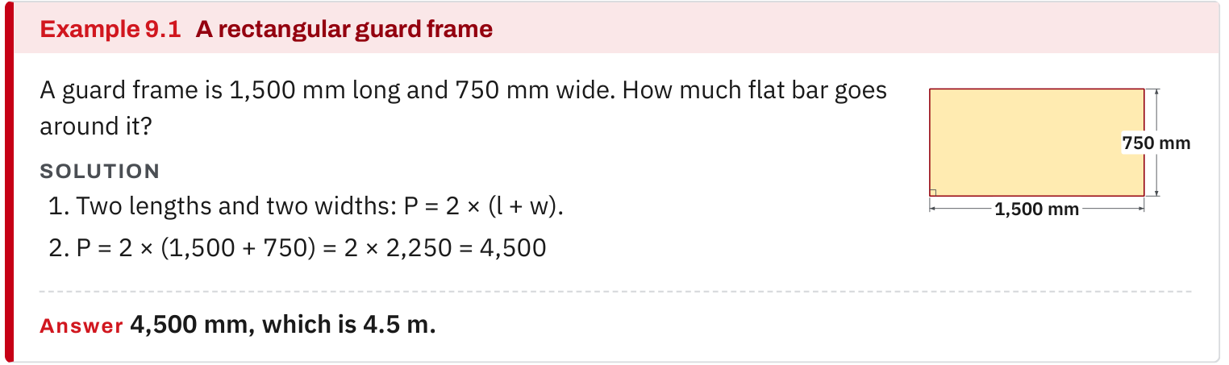
W07-L01 • TEACH • 12:55 PM–1:10 PM • 15 MIN TOTAL
Textbook | page 220
Example 9.1: label the boundary before calculating a perimeter.
Textbook Chapter 3 pp.68–75; Chapter 9 pp.220–221; Chapter 10 pp.242–245
Textbook
Exercise Book
Numeracy Hub
Shape Canvas
Day 23 • 2026-12-07 • 08
Notes:
TEACH • 12:55 PM–1:10 PM • 15 MIN TOTAL — shared across this phase’s slides.
In Example 9.1 on page 220, the perimeter follows the outside boundary. Point to each edge as you read the expression. This prevents the common mistake of counting only one length and one width. For our floor, adding 7.2 and 3.6 reaches only halfway around; doubling completes the route. What unit belongs to that sum? Metres, because we are adding lengths. We do not square the unit unless we are multiplying dimensions to measure area. Use that boundary-versus-coverage distinction whenever you select a formula from a drawing.

Slide 9
W07-L01 • TEACH • 12:55 PM–1:10 PM • 15 MIN TOTAL
Spot the mistake. Explain the correction.
A cut-list equation subtracts the required pieces from 6,000 mm but has no kerf term. What quantity is missing?
Discuss the method before checking the answer.
Include the material lost to all four stated cuts at 3 mm per cut. Keep this stock calculation separate from the floor, then check that pieces, kerf and offcut total 6,000 mm.
Textbook Chapter 3 pp.68–75; Chapter 9 pp.220–221; Chapter 10 pp.242–245
Textbook
Exercise Book
Numeracy Hub
Shape Canvas
Day 23 • 2026-12-07 • 09
Notes:
TEACH • 12:55 PM–1:10 PM • 15 MIN TOTAL — shared across this phase’s slides.
The proposed cut-list equation subtracts the four pieces but forgets the kerf. What is missing physically? Material removed by the four cuts. Four times 3 millimetres is 12 millimetres, so the offcut must be 12 millimetres smaller than a calculation that ignores cutting loss. Keep the original 6,000-millimetre stock length visible and check backwards: pieces plus kerf plus offcut must total 6,000. Why not borrow the floor's metre dimensions here? They describe a different object and cannot explain this stock's remaining length.

Slide 10
W07-L01 • TOGETHER • 1:10 PM–1:25 PM • 15 MIN TOTAL
Work together
Partners annotate the floor rectangle and a separate 6,000 mm stock sketch from Exercise Book 3C Q3. Decide which information belongs to each calculation.
Explain the method and check directions; work with a partner only where permitted.
Resources: Exercise Book 10B Q1 (p.95); 3C Q3 (p.29); 12B Q5 (p.117)
Textbook Chapter 3 pp.68–75; Chapter 9 pp.220–221; Chapter 10 pp.242–245
Textbook
Exercise Book
Numeracy Hub
Shape Canvas
Day 23 • 2026-12-07 • 10
Notes:
TOGETHER • 1:10 PM–1:25 PM • 15 MIN TOTAL — shared across this phase’s slides.
Work with a partner on two labelled drawings. One is the floor rectangle in metres; the other is the 6,000-millimetre stock sketch from 3C Q3. Point to every number and explain which calculation needs it. The checker should ask, “Is this boundary, coverage, diagonal or remaining stock?” Then swap roles. Your drawings do not need artistic detail. They need dimensions, units and enough labels to prevent the two contexts from being mixed.

Slide 11
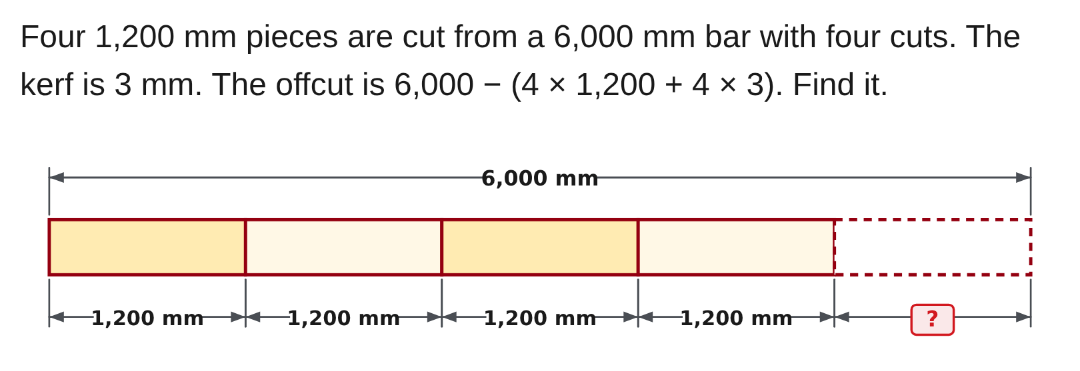
W07-L01 • TOGETHER • 1:10 PM–1:25 PM • 15 MIN TOTAL
Guided practice | 3C Q3
Work with a partner. Take turns explaining the next step.
Textbook Chapter 3 pp.68–75; Chapter 9 pp.220–221; Chapter 10 pp.242–245
Textbook
Exercise Book
Numeracy Hub
Shape Canvas
Day 23 • 2026-12-07 • 11
Notes:
TOGETHER • 1:10 PM–1:25 PM • 15 MIN TOTAL — shared across this phase’s slides.
Attempt 3C Q3 with your partner. Read the brackets as the total stock consumed: four required pieces plus four kerf losses. Work that total before subtracting it from 6,000 millimetres. What must your final answer represent? The offcut still available after all four cuts. Once you have a result, add it back to the pieces and cutting loss. That backward check tells us whether the complete stock length has been accounted for.
INSTRUCTOR ONLY — AFTER THE ATTEMPT: 1,188 mm

Slide 12
W07-L01 • TOGETHER • 1:10 PM–1:25 PM • 15 MIN TOTAL
Compare your method | 3C Q3
CHECK TOGETHER
1,188 mm
Textbook Chapter 3 pp.68–75; Chapter 9 pp.220–221; Chapter 10 pp.242–245
Textbook
Exercise Book
Numeracy Hub
Shape Canvas
Day 23 • 2026-12-07 • 12
Notes:
TOGETHER • 1:10 PM–1:25 PM • 15 MIN TOTAL — shared across this phase’s slides.
Four pieces of 1,200 millimetres use 4,800 millimetres. Four cuts at 3 millimetres use another 12. Together those consume 4,812 millimetres, leaving 6,000 minus 4,812, or 1,188 millimetres. Check by adding 4,800, 12 and 1,188: we recover 6,000. What would an answer of 1,200 millimetres reveal? The kerf was omitted. The final number is useful because the equation also tells us exactly what assumptions produced it.
INSTRUCTOR ONLY — AFTER THE ATTEMPT: 1,188 mm

Slide 13
W07-L01 • PRACTISE • 1:25 PM–1:45 PM • 20 MIN TOTAL
Your scheduled practice
Draw and label the floor in Shape Canvas. Calculate perimeter, floor area and diagonal; solve Exercise Book 3C Q3 without changing its four cuts or 3 mm kerf. Record units and assumptions; do not mix the two problem contexts.
Keep numbered written solutions and units. Use tools only under the conditions stated for this block.
Resources: Exercise Book 10B Q1 (p.95); 3C Q3 (p.29); 12B Q5 (p.117)
Textbook Chapter 3 pp.68–75; Chapter 9 pp.220–221; Chapter 10 pp.242–245
Textbook
Exercise Book
Numeracy Hub
Shape Canvas
Day 23 • 2026-12-07 • 13
Notes:
PRACTISE • 1:25 PM–1:45 PM • 20 MIN TOTAL — shared across this phase’s slides.
Draw and label the floor in Shape Canvas, then calculate perimeter, area and diagonal on paper. Complete the separate 3C Q3 stock calculation with all four cuts and the 3-millimetre kerf unchanged. Keep the metre and millimetre contexts clearly separated. The frame reasoning in 12B Q5 helps you explain why a diagonal target is useful, but its rack dimensions do not replace this floor's dimensions. Record the rectangular layout and no-waste assumptions beside the floor sketch for the materials block.

Slide 14

W07-L01 • PRACTISE • 1:25 PM–1:45 PM • 20 MIN TOTAL
Open Shape Canvas
Navigation example. Use the values and units in the assigned task.
Textbook Chapter 3 pp.68–75; Chapter 9 pp.220–221; Chapter 10 pp.242–245
Textbook
Exercise Book
Numeracy Hub
Shape Canvas
Day 23 • 2026-12-07 • 14
Notes:
PRACTISE • 1:25 PM–1:45 PM • 20 MIN TOTAL — shared across this phase’s slides.
Open Shape Canvas and set the unit to metres before entering 7.2 and 3.6. Label the rectangle so another person can read the dimensions without opening a settings panel. Add a diagonal if you are checking its length. What would a 7.2-millimetre rectangle represent? A different size, even though the entered number looks the same. Unit selection is therefore part of the model, not a cosmetic setting. Keep your paper equations beside the drawing.

Slide 15
W07-L01 • PRACTISE • 1:25 PM–1:45 PM • 20 MIN TOTAL
Practise in Numeracy Hub and Shape Canvas
1
In Shape Canvas, set units to m and draw the 7.2 m × 3.6 m floor rectangle; label the dimensions.
2
Add a Text cut-list note that keeps the separate 6,000 mm stock problem, four cuts and 3 mm kerf explicit; retain the written equations and assumptions.
3
After the paper calculations, use Numeracy Hub Calculator for numerical checks. Save the labelled floor sketch and assumptions for the next material-order block.
Textbook Chapter 3 pp.68–75; Chapter 9 pp.220–221; Chapter 10 pp.242–245
Textbook
Exercise Book
Numeracy Hub
Shape Canvas
Day 23 • 2026-12-07 • 15
Notes:
PRACTISE • 1:25 PM–1:45 PM • 20 MIN TOTAL — shared across this phase’s slides.
Use a Text note in Shape Canvas to preserve the separate stock calculation. Write that it concerns 6,000 millimetres of stock, four 1,200-millimetre pieces and four 3-millimetre kerfs. The note can sit beside the floor, but its heading must prevent anyone from treating it as a floor dimension. After your written arithmetic, use Numeracy Hub Calculator to check the numerical results. Save the labelled floor sketch and its assumptions because we will build the sheet layout from it after the break.

Slide 16
W07-L01 • PRACTISE • 1:25 PM–1:45 PM • 20 MIN TOTAL
Practise from the Exercise Book | 3C Q3
Write the operation, working and units before checking.
Textbook Chapter 3 pp.68–75; Chapter 9 pp.220–221; Chapter 10 pp.242–245
Textbook
Exercise Book
Numeracy Hub
Shape Canvas
Day 23 • 2026-12-07 • 16
Notes:
PRACTISE • 1:25 PM–1:45 PM • 20 MIN TOTAL — shared across this phase’s slides.
Reattempt the stock equation in 3C Q3 without changing the given cuts. Keep the entire consumed amount inside brackets. After your attempt, compare the pieces total, 4,800 millimetres, and kerf total, 12 millimetres, before comparing the offcut. If one total differs, repair that line rather than replacing only the final answer. A complete solution ends at 1,188 millimetres and shows that adding the offcut back returns the full 6,000-millimetre stock length.
INSTRUCTOR ONLY — AFTER THE ATTEMPT: 1,188 mm

Slide 17
W07-L01 • CHECK • 1:45 PM–1:55 PM • 10 MIN TOTAL
Check independently
Submit the labelled floor plan, perimeter calculation and stock offcut equation.
Submit work and demonstrate the checking strategy; identify a remaining difficulty.
Resources: Exercise Book 10B Q1 (p.95); 3C Q3 (p.29); 12B Q5 (p.117)
Textbook Chapter 3 pp.68–75; Chapter 9 pp.220–221; Chapter 10 pp.242–245
Textbook
Exercise Book
Numeracy Hub
Shape Canvas
Day 23 • 2026-12-07 • 17
Notes:
CHECK • 1:45 PM–1:55 PM • 10 MIN TOTAL — shared across this phase’s slides.
Submit your labelled floor plan, perimeter calculation and stock offcut equation. Keep the two contexts identifiable and include the units with each result. Show your checking strategy in the working, not just a tick beside the answer. Finish your own response before comparing with anyone else.
INSTRUCTOR ONLY — AFTER THE ATTEMPT: Floor perimeter = 21.6 m; floor area = 25.92 m²; diagonal ≈ 8.05 m. Stock offcut = 6,000 − (4 × 1,200 + 4 × 3) = 1,188 mm. Check the requested submitted items and separation of contexts.

Slide 18
W07-L01 • WRAP UP • 1:55 PM–2:00 PM • 5 MIN TOTAL
Wrap up and choose the next step
Identify what improved, what needs another attempt and which resource will support the next step.
Name the math and another essential skill used; record a concrete follow-up action.
Resources: Exercise Book 10B Q1 (p.95); 3C Q3 (p.29); 12B Q5 (p.117)
Textbook Chapter 3 pp.68–75; Chapter 9 pp.220–221; Chapter 10 pp.242–245
Textbook
Exercise Book
Numeracy Hub
Shape Canvas
Day 23 • 2026-12-07 • 18
Notes:
WRAP UP • 1:55 PM–2:00 PM • 5 MIN TOTAL — shared across this phase’s slides.
Look at your two drawings and name one detail that made them easier to read. It might be units, an explicit kerf line or a label distinguishing area from perimeter. What quantity will we carry into the sheet-count calculation? The floor area, 25.92 square metres, together with the actual rectangle dimensions. Keep both. Area tells us how much surface needs covering, while the dimensions will let us check whether the proposed sheet arrangement fits.

Slide 19
DAY 23 • SCHEDULED BREAK
Break
2:00 PM–2:15 PM
Return ready for: Materials practice: sheeting and allowance
This break is excluded from teaching minutes.
Textbook
Exercise Book
Numeracy Hub
Shape Canvas
Day 23 • 2026-12-07 • 19
Notes:
Scheduled break — resume at the time shown.
We take our break now and restart at 2:15 with sheeting and allowance. Keep your 7.2 by 3.6-metre floor sketch available. After the break, we will compare a no-waste layout with a separate whole-sheet order that includes the stated allowance. You will need the drawing as well as the area calculation.

Slide 20
W07-L02 • START • 2:15 PM–2:20 PM • 5 MIN TOTAL
Materials practice: sheeting and allowance
Today’s goal: Use area and a stated classroom allowance to build a material quantity and distinguish an estimate from a cutting layout.
Identify one target skill and the checking habit to use today.
Textbook sections 6.4 pp.142–143; Chapter 10 pp.242–254
Exercise Book 10B Q1–2 (p.95); 6B Q2 (p.57)
Keep your notebook, textbook, exercise book and chosen calculator ready.
Textbook sections 6.4 pp.142–143; Chapter 10 pp.242–254
Textbook
Exercise Book
Numeracy Hub
Shape Canvas
Day 23 • 2026-12-07 • 20
Notes:
START • 2:15 PM–2:20 PM • 5 MIN TOTAL — shared across this phase’s slides.
Our next task is a material quantity note for the floor. We will first determine the no-waste sheet count and verify an arrangement that fits the rectangle. Then we add the ten-percent allowance specified for this classroom exercise. What distinction must stay visible? The base layout and the purchase quantity. An allowance changes what we order; it does not change the floor's dimensions or pretend that the base layout contains an extra sheet.

Slide 21
W07-L02 • RECALL • 2:20 PM–2:25 PM • 5 MIN TOTAL
Recall and reconnect
Retrieve the floor area and one-sheet area from the previous block. Explain why a fractional purchase quantity rounds up.
Review previous feedback and attempt the retrieval prompt without displayed solutions.
Resources: Exercise Book 10B Q1–2 (p.95); 6B Q2 (p.57)
Textbook sections 6.4 pp.142–143; Chapter 10 pp.242–254
Textbook
Exercise Book
Numeracy Hub
Shape Canvas
Day 23 • 2026-12-07 • 21
Notes:
RECALL • 2:20 PM–2:25 PM • 5 MIN TOTAL — shared across this phase’s slides.
Recall the floor area: 7.2 times 3.6 is 25.92 square metres. One sheet is 1.2 by 2.4 metres, so it covers 2.88 square metres. What operation compares total coverage with coverage per sheet? Division. Before calculating the order, explain why a result such as 9.9 sheets cannot become an order for nine. Nine is below the required quantity. Whole-sheet purchasing means rounding up after the allowance calculation, while keeping the exact base count visible.

Slide 22
W07-L02 • TEACH • 2:25 PM–2:40 PM • 15 MIN TOTAL
An area count needs a matching layout
1
The floor area is 25.92 m². One 1.2 m × 2.4 m sheet covers 2.88 m².
2
The no-waste area calculation gives 25.92 ÷ 2.88 = 9 sheets.
3
Three 2.4 m lengths make 7.2 m; three 1.2 m widths make 3.6 m. This 3 × 3 arrangement verifies the nine-sheet rectangular layout.
4
An area estimate alone does not prove that every cutting layout will fit. Here, both dimensions are checked against the arrangement.
Textbook sections 6.4 pp.142–143; Chapter 10 pp.242–254
Textbook
Exercise Book
Numeracy Hub
Shape Canvas
Day 23 • 2026-12-07 • 22
Notes:
TEACH • 2:25 PM–2:40 PM • 15 MIN TOTAL — shared across this phase’s slides.
Divide 25.92 square metres by 2.88 square metres per sheet. The no-waste result is nine sheets. Now test the actual arrangement: three lengths of 2.4 metres span 7.2 metres, and three widths of 1.2 metres span 3.6 metres. That gives a three-by-three arrangement with nine rectangles. Why do we check both dimensions after dividing areas? Equal total area alone does not guarantee that arbitrary pieces can cover an arbitrary shape. Here the matching dimensions verify this simple rectangular layout, so the area calculation and drawing support each other.

Slide 23
W07-L02 • TEACH • 2:25 PM–2:40 PM • 15 MIN TOTAL
Separate the base quantity from the allowance
1
Keep the nine-sheet no-waste base visible before adding any allowance.
2
For this classroom exercise only, the stated 10% allowance gives 9 × 1.10 = 9.9 sheets.
3
An order needs whole sheets, so round 9.9 up to 10. The additional sheet belongs to the allowance calculation.
4
The 10% is instructor-provided problem data, not a universal site allowance. Do not add prices or other unstated job assumptions.
Textbook sections 6.4 pp.142–143; Chapter 10 pp.242–254
Textbook
Exercise Book
Numeracy Hub
Shape Canvas
Day 23 • 2026-12-07 • 23
Notes:
TEACH • 2:25 PM–2:40 PM • 15 MIN TOTAL — shared across this phase’s slides.
Keep the base of nine sheets on its own line. Ten percent of nine is 0.9, so the total with allowance is 9.9 sheets. Multiplying nine by 1.10 expresses the same calculation: one whole original quantity plus ten percent extra. We buy whole sheets, so the order becomes ten. Which sheet belongs to the allowance rather than the verified floor grid? The tenth. Ten percent is the stated data for this classroom task; it is not a rule for every job. Different real specifications require their own stated allowance and layout decisions.

Slide 24
W07-L02 • TEACH • 2:25 PM–2:40 PM • 15 MIN TOTAL
Verify the base layout before adding allowance
3 × 2.4 m = 7.2 m
Base: 25.92 ÷ 2.88 = 9
With 10%: 9 × 1.10 = 9.9
Whole-sheet order: 10
The nine-sheet arrangement verifies
this simple rectangular base layout.
The tenth sheet is the stated
classroom planning allowance.
3 × 1.2 m = 3.6 m • 9 sheets
Together • Recreate the 3 × 3 layout in Shape Canvas. Compare the exact
no-waste layout with the separate allowance quantity; explain final rounding.
Instructor adaptation • Sheet size 1.2 m × 2.4 m • 10% is classroom data, not a universal job allowance
Textbook
Exercise Book
Numeracy Hub
Shape Canvas
Day 23 • 2026-12-07 • 24
Notes:
TEACH • 2:25 PM–2:40 PM • 15 MIN TOTAL — shared across this phase’s slides.
Trace the three sheets along the long dimension: 2.4 plus 2.4 plus 2.4 equals 7.2 metres. Trace three across the short dimension: 1.2 times three equals 3.6 metres. That verifies the nine-sheet base in the drawing. Beside it, the allowance calculation gives 9 times 1.10 equals 9.9, so the order is ten whole sheets. Where would you draw the tenth sheet? Separately as allowance stock, not as another piece needed to cover this exact grid. Keeping those representations separate makes the quantity note honest and clear.

Slide 25
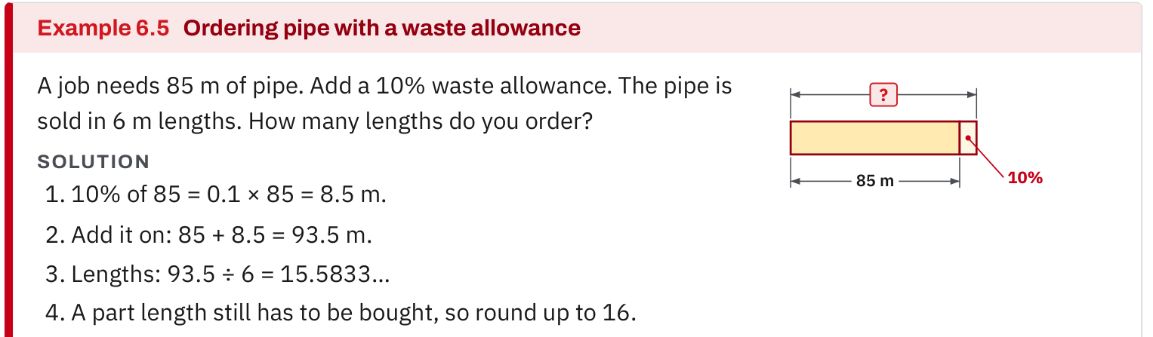
W07-L02 • TEACH • 2:25 PM–2:40 PM • 15 MIN TOTAL
Textbook | page 142
Example 6.5: a stated allowance is added to the original quantity.
Textbook sections 6.4 pp.142–143; Chapter 10 pp.242–254
Textbook
Exercise Book
Numeracy Hub
Shape Canvas
Day 23 • 2026-12-07 • 25
Notes:
TEACH • 2:25 PM–2:40 PM • 15 MIN TOTAL — shared across this phase’s slides.
Example 6.5 on page 142 shows an allowance added to an original quantity. Identify the base first, then the percentage of that base, then the total. In our task, the base is nine sheets and the added amount is ten percent of nine. What does the one in 1.10 represent? The entire original quantity. What does 0.10 represent? The additional ten percent. That explanation matters because multiplying by 0.10 alone finds only the extra amount, not the total quantity required for the order.

Slide 26
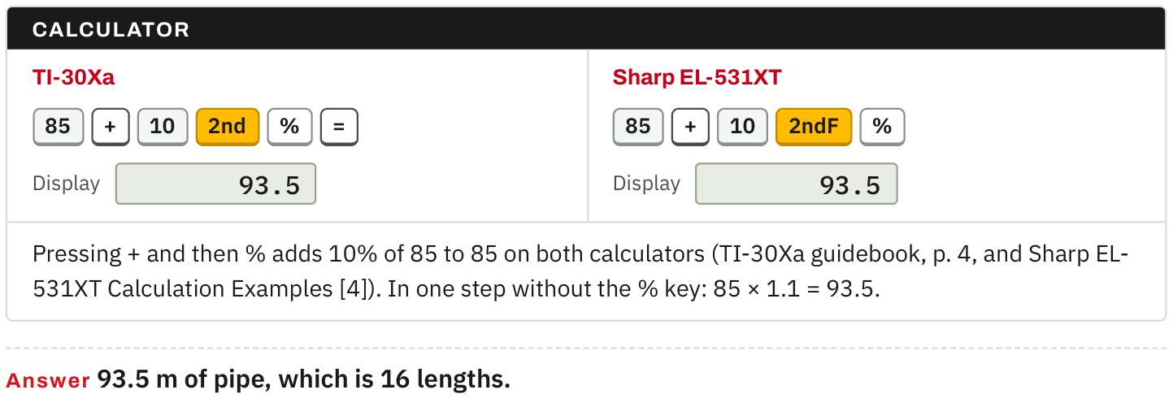
W07-L02 • TEACH • 2:25 PM–2:40 PM • 15 MIN TOTAL
Textbook | page 142
Example 6.5: compare calculator entries and the whole-length order.
Textbook sections 6.4 pp.142–143; Chapter 10 pp.242–254
Textbook
Exercise Book
Numeracy Hub
Shape Canvas
Day 23 • 2026-12-07 • 26
Notes:
TEACH • 2:25 PM–2:40 PM • 15 MIN TOTAL — shared across this phase’s slides.
Compare the two calculator routes in the textbook example. One finds the percentage amount and adds it to the base; the other uses a total multiplier. For our sheet count, 9 plus 9 times 0.10 and 9 times 1.10 both give 9.9. We retain that unrounded quantity in the working, then round up to a whole-sheet purchase. Why not round the allowance first? Early rounding can change the order unnecessarily. The final purchasing unit determines the last rounding decision, while the exact arithmetic remains visible for checking.

Slide 27
W07-L02 • TEACH • 2:25 PM–2:40 PM • 15 MIN TOTAL
Spot the mistake. Explain the correction.
A quantity note shows 9.9 sheets and orders 9 because the base layout used nine. Why is the order short?
Discuss the method before checking the answer.
The verified base and the allowance order answer different questions. Keep the base at nine, retain the stated 10% calculation, and round the final purchase quantity up to ten whole sheets.
Textbook sections 6.4 pp.142–143; Chapter 10 pp.242–254
Textbook
Exercise Book
Numeracy Hub
Shape Canvas
Day 23 • 2026-12-07 • 27
Notes:
TEACH • 2:25 PM–2:40 PM • 15 MIN TOTAL — shared across this phase’s slides.
The note says 9.9 sheets but orders nine because the grid used nine. The error is mixing the base-layout question with the allowance-order question. Nine correctly covers the no-waste rectangle. The stated allowance requires 9.9 before whole-sheet rounding, so ordering nine fails to include it. What should the corrected note show? Nine-sheet base, ten-percent allowance, 9.9 calculated total and ten-sheet order. A reader can then see exactly why the layout and order numbers differ without assuming one calculation must be wrong.

Slide 28
W07-L02 • TOGETHER • 2:40 PM–2:55 PM • 15 MIN TOTAL
Work together
Pairs lay out nine sheets as three 2.4 m lengths by three 1.2 m widths. Compare the verified no-waste layout with the separate allowance quantity.
Explain the method and check directions; work with a partner only where permitted.
Resources: Exercise Book 10B Q1–2 (p.95); 6B Q2 (p.57)
Textbook sections 6.4 pp.142–143; Chapter 10 pp.242–254
Textbook
Exercise Book
Numeracy Hub
Shape Canvas
Day 23 • 2026-12-07 • 28
Notes:
TOGETHER • 2:40 PM–2:55 PM • 15 MIN TOTAL — shared across this phase’s slides.
Recreate the nine-sheet arrangement with your partner. Use three 2.4-metre lengths along the 7.2-metre direction and three 1.2-metre widths across the 3.6-metre direction. One person checks the dimension totals while the other checks the sheet count, then swap. Write the allowance calculation beside the verified base. Explain aloud why a ten-sheet order does not mean the floor grid suddenly contains ten equal sheet positions. The extra quantity belongs to the stated allowance.

Slide 29
W07-L02 • PRACTISE • 2:55 PM–3:15 PM • 20 MIN TOTAL
Your scheduled practice
Prepare a quantity note: floor area, sheet area, nine-sheet base and stated 10% allowance. Then solve Exercise Book 10B Q2 for coating tins. Check units, final rounding and assumptions; no prices are assumed.
Keep numbered written solutions and units. Use tools only under the conditions stated for this block.
Resources: Exercise Book 10B Q1–2 (p.95); 6B Q2 (p.57)
Textbook sections 6.4 pp.142–143; Chapter 10 pp.242–254
Textbook
Exercise Book
Numeracy Hub
Shape Canvas
Day 23 • 2026-12-07 • 29
Notes:
PRACTISE • 2:55 PM–3:15 PM • 20 MIN TOTAL — shared across this phase’s slides.
Prepare the quantity note with floor area, one-sheet area, nine-sheet base, ten-percent allowance and final whole-sheet order. Then complete 10B Q2 about coating tins. The same purchasing principle applies, but the quantities differ: surface area leads to litres, then litres lead to whole tins. Keep its two-sided coating instruction visible. Use 6B Q2 as the scheduled allowance reference. Do not add prices or other assumptions that are absent from the task.

Slide 30
W07-L02 • PRACTISE • 2:55 PM–3:15 PM • 20 MIN TOTAL
Open Shape Canvas
Navigation example. Use the values and units in the assigned task.
Textbook sections 6.4 pp.142–143; Chapter 10 pp.242–254
Textbook
Exercise Book
Numeracy Hub
Shape Canvas
Day 23 • 2026-12-07 • 30
Notes:
PRACTISE • 2:55 PM–3:15 PM • 20 MIN TOTAL — shared across this phase’s slides.
Open the saved floor sketch in Shape Canvas. Keep the floor at 7.2 by 3.6 metres and create sheet rectangles of 2.4 by 1.2 metres in the verified orientation. Use the edges to check for gaps or overlaps rather than relying only on a count of objects. What should three sheet lengths equal? 7.2 metres. What should three widths equal? 3.6 metres. Label the separate allowance in the quantity note rather than distorting the grid to include it.

Slide 31
W07-L02 • PRACTISE • 2:55 PM–3:15 PM • 20 MIN TOTAL
Practise in Numeracy Hub and Shape Canvas
1
Open the floor sketch in Shape Canvas and use 1.2 m × 2.4 m sheet rectangles to recreate the scheduled 3 × 3 arrangement.
2
Check the arrangement against the 7.2 m and 3.6 m floor dimensions; record the floor area, sheet area and nine-sheet base in the written quantity note.
3
Use Numeracy Hub Calculator after paper working to compare the no-waste count with 9 × 1.10. Record the stated allowance and final whole-sheet rounding separately.
Textbook sections 6.4 pp.142–143; Chapter 10 pp.242–254
Textbook
Exercise Book
Numeracy Hub
Shape Canvas
Day 23 • 2026-12-07 • 31
Notes:
PRACTISE • 2:55 PM–3:15 PM • 20 MIN TOTAL — shared across this phase’s slides.
After drawing the grid, check its two dimension totals and record the area division on paper. Then use Numeracy Hub Calculator to compare nine with nine times 1.10. Keep the two results on separate labelled lines. What question does nine answer? The no-waste base count. What question does ten answer? The whole-sheet order including the stated allowance. The drawing verifies fit; the arithmetic explains the allowance; the note communicates both decisions.

Slide 32
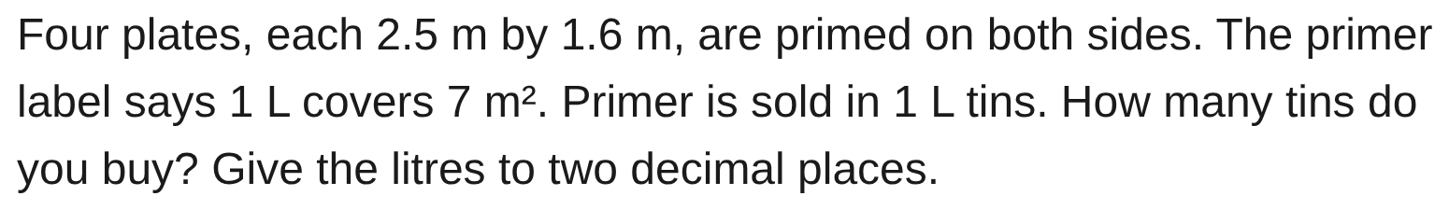
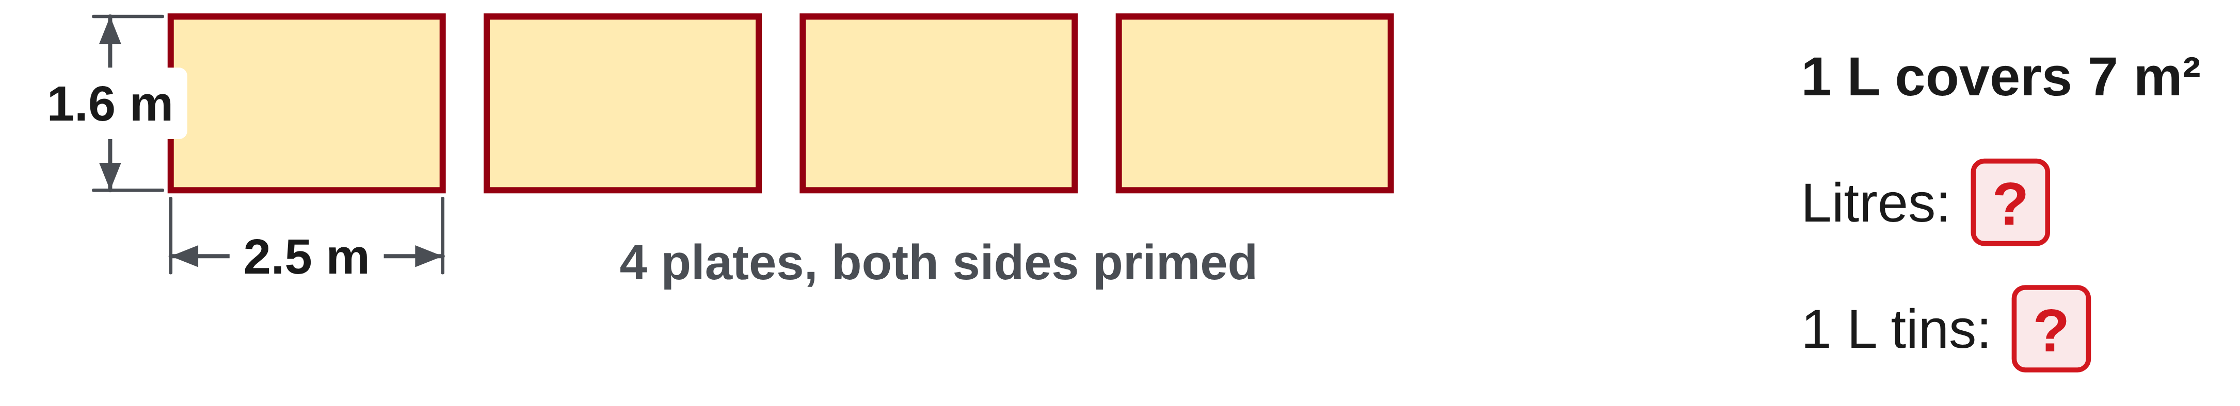
W07-L02 • PRACTISE • 2:55 PM–3:15 PM • 20 MIN TOTAL
Practise from the Exercise Book | 10B Q2
Write the operation, working and units before checking.
Textbook sections 6.4 pp.142–143; Chapter 10 pp.242–254
Textbook
Exercise Book
Numeracy Hub
Shape Canvas
Day 23 • 2026-12-07 • 32
Notes:
PRACTISE • 2:55 PM–3:15 PM • 20 MIN TOTAL — shared across this phase’s slides.
For 10B Q2, first calculate the area of one face: 2.5 times 1.6 is 4 square metres. Four plates have two faces each, so after your attempt compare the coated area with 4 times 2 times 4, or 32 square metres. Divide by 7 square metres per litre to get about 4.57 litres. Why buy five one-litre tins? Four tins are below the required amount. The litre estimate and whole-tin purchase answer different parts of the question.
INSTRUCTOR ONLY — AFTER THE ATTEMPT: 4.57 L, so 5 tins Working: Area 2 × 4 × 4 = 32 m², 32 ÷ 7

Slide 33
W07-L02 • CHECK • 3:15 PM–3:25 PM • 10 MIN TOTAL
Check independently
Explain the nine-sheet base, allowance order, and why an area estimate alone does not prove every cutting layout.
Submit work and demonstrate the checking strategy; identify a remaining difficulty.
Resources: Exercise Book 10B Q1–2 (p.95); 6B Q2 (p.57)
Textbook sections 6.4 pp.142–143; Chapter 10 pp.242–254
Textbook
Exercise Book
Numeracy Hub
Shape Canvas
Day 23 • 2026-12-07 • 33
Notes:
CHECK • 3:15 PM–3:25 PM • 10 MIN TOTAL — shared across this phase’s slides.
Independently explain the nine-sheet base, the allowance calculation and the final order. Include a short reason why area division alone does not prove every possible cutting layout. Point to the two dimension checks that verify this specific arrangement. Submit your own quantity note before comparing answers.
INSTRUCTOR ONLY — AFTER THE ATTEMPT: Base = 25.92/2.88 = 9. The 3 × 3 layout spans 7.2 m by 3.6 m. Allowance total = 9 × 1.10 = 9.9, so order 10 whole sheets. Keep the tenth sheet separate from the base grid.

Slide 34
W07-L02 • WRAP UP • 3:25 PM–3:30 PM • 5 MIN TOTAL
Wrap up and choose the next step
Identify what improved, what needs another attempt and which resource will support the next step.
Name the math and another essential skill used; record a concrete follow-up action.
Resources: Exercise Book 10B Q1–2 (p.95); 6B Q2 (p.57)
Textbook sections 6.4 pp.142–143; Chapter 10 pp.242–254
Textbook
Exercise Book
Numeracy Hub
Shape Canvas
Day 23 • 2026-12-07 • 34
Notes:
WRAP UP • 3:25 PM–3:30 PM • 5 MIN TOTAL — shared across this phase’s slides.
Look at the finished quantity note and identify its three stages: geometry, allowance and purchasing. Which stage proved the nine-sheet arrangement fits? Checking both floor dimensions against the three-by-three grid. Which stage produced ten? Applying the stated allowance and rounding the final quantity up to whole sheets. Record one checking habit you want to keep, such as naming the base before using a percentage. That habit transfers to materials, coatings and other quantity decisions.

