Slide 1

CARPENTRY FOUNDATION / INTAKE 142
Day 04 | Tuesday
04
November 3, 2026
Brackets, squares and square roots
12:45 PM–2:00 PM • Math • 75 min
Calculation checking workshop
2:15 PM–3:30 PM • Math • 75 min
Week 2 • 2 scheduled blocks • 150 teaching minutes
Estimate. Show the method. Label units. Check the result.
Textbook
Exercise Book
Numeracy Hub
Shape Canvas
Day 04 • 2026-11-03 • 01
Notes:
Opening overview | 12:45 PM–12:50 PM | Within the 5-minute Start phase.
Today we will look closely at what squares and square roots act on, then practise checking calculations by a different method. A small bracket can change the quantity being squared, and that can change the answer dramatically. What could help us catch such an error before using the result? Marking the group, showing intermediate steps and comparing with an independent check. We will build those habits into both the paper work and calculator work this afternoon.

Slide 2
DAY 04 / WEEK 2 / CLASS TIMETABLE
Today’s exact schedule
12:45 PM–2:00 PM • 75 min
2:15 PM–3:30 PM • 75 min
Brackets, squares and square roots
Calculation checking workshop
12:45 PM–12:50 PM
Start
5
2:15 PM–2:20 PM
Start
5
12:50 PM–12:55 PM
Recall
5
2:20 PM–2:25 PM
Recall
5
12:55 PM–1:10 PM
Teach
15
2:25 PM–2:40 PM
Teach
15
1:10 PM–1:25 PM
Together
15
2:40 PM–2:55 PM
Together
15
1:25 PM–1:45 PM
Practise
20
2:55 PM–3:15 PM
Practise
20
1:45 PM–1:55 PM
Check
10
3:15 PM–3:25 PM
Check
10
1:55 PM–2:00 PM
Wrap up
5
3:25 PM–3:30 PM
Wrap up
5
Math • Math Week 2, Lesson 3
Math • Math Week 2, Lesson 4
Break: 2:00 PM–2:15 PM • 15 minutes • excluded from teaching time
Textbook
Exercise Book
Numeracy Hub
Shape Canvas
Day 04 • 2026-11-03 • 02
Notes:
Opening overview | 12:45 PM–12:50 PM | Within the 5-minute Start phase.
Our first block, from 12:45 to 2:00, focuses on brackets, squares and square roots. After the break, the checking workshop runs from 2:15 to 3:30. Each block has time to explain, work together, practise and check independently. What will you keep on the page while checking? The original expression and your intermediate lines. They allow us to inspect the calculation instead of guessing from a final number.

Slide 3
W02-L03 • START • 12:45 PM–12:50 PM • 5 MIN TOTAL
Brackets, squares and square roots
Today’s goal: Explain what an exponent or root acts on and avoid applying it to the wrong part of an expression.
Name one use for today’s skill.
Textbook Chapter 3 pp.69–75; Chapter 2 pp.51–53
Exercise Book 3A Q4–10 (p.25); 2A Q2–3 (p.17)
Keep your notebook, textbook, exercise book and chosen calculator ready.
Textbook Chapter 3 pp.69–75; Chapter 2 pp.51–53
Textbook
Exercise Book
Numeracy Hub
Shape Canvas
Day 04 • 2026-11-03 • 03
Notes:
START | 12:45 PM–12:50 PM | 5 MIN TOTAL — shared phase allocation.
Our goal is to identify precisely what an exponent or root acts on. In a formula, a square might belong to one number or to an entire bracketed group. How can we show which one is intended? By marking the base or grouping before evaluating. Think of this as reading the calculation as carefully as a dimensioned drawing: the symbols tell us what belongs together. Keep the exercise book ready at 3A and the calculator instructions available for model-specific root entry.

Slide 4
W02-L03 • RECALL • 12:50 PM–12:55 PM • 5 MIN TOTAL
Recall and reconnect
Discuss whether (6 − 4)² means the same as 6² − 4². Explain before calculating.
Try first without displayed answers.
Resources: Exercise Book 3A Q4–10 (p.25); 2A Q2–3 (p.17)
Textbook Chapter 3 pp.69–75; Chapter 2 pp.51–53
Textbook
Exercise Book
Numeracy Hub
Shape Canvas
Day 04 • 2026-11-03 • 04
Notes:
RECALL | 12:50 PM–12:55 PM | 5 MIN TOTAL — shared phase allocation.
Compare (6 − 4)² with 6² − 4² before calculating. In the first, what is squared? The result of the bracketed subtraction. In the second, what is squared? Six and four separately. Now test your explanation: the first gives 2², or 4, while the second gives 36 minus 16, or 20. The unequal answers show that moving a square across a subtraction changes the calculation.

Slide 5

W02-L03 • TEACH • 12:55 PM–1:10 PM • 15 MIN TOTAL
Identify the base of an exponent
1
In 4², only the 4 is squared.
2
In (6 − 4)², the complete bracket result is squared.
3
Calculate inside brackets before applying the exponent.
4
A changed bracket can change the value even when the same numbers appear.
Textbook Chapter 3 pp.69–75; Chapter 2 pp.51–53
Textbook
Exercise Book
Numeracy Hub
Shape Canvas
Day 04 • 2026-11-03 • 05
Notes:
TEACH | 12:55 PM–1:10 PM | 15 MIN TOTAL — shared phase allocation.
The base is the complete quantity an exponent belongs to. In 4², the base is four, so the square means four times four. In (6 − 4)², the base is the entire bracketed difference; calculate the difference first, then square that result. Which part would you circle to show the base? Circle four in the first expression and the complete bracket in the second. The exponent is not an instruction to square every number you happen to see nearby. Read its attachment before doing arithmetic, then preserve that structure in the calculator entry.

Slide 6

W02-L03 • TEACH • 12:55 PM–1:10 PM • 15 MIN TOTAL
Identify the whole quantity under the root
1
The root sign acts on the quantity written under it.
2
For √(9 + 16), add inside the grouping before finding the square root.
3
A square root of a sum is not generally the sum of the separate roots.
4
Write the grouping before using your calculator’s model-specific root sequence.
Textbook Chapter 3 pp.69–75; Chapter 2 pp.51–53
Textbook
Exercise Book
Numeracy Hub
Shape Canvas
Day 04 • 2026-11-03 • 06
Notes:
TEACH | 12:55 PM–1:10 PM | 15 MIN TOTAL — shared phase allocation.
A square-root sign acts on everything grouped beneath it. For √(9 + 16), the sum is the quantity whose square root we need, so first calculate twenty-five, then find its root, five. What happens if we take two separate roots instead? √9 is three and √16 is four, giving seven when added. Five and seven differ because the expressions mean different things. The root bar and brackets communicate the grouping. Write that grouping explicitly before following the root-key sequence for your calculator model.

Slide 7
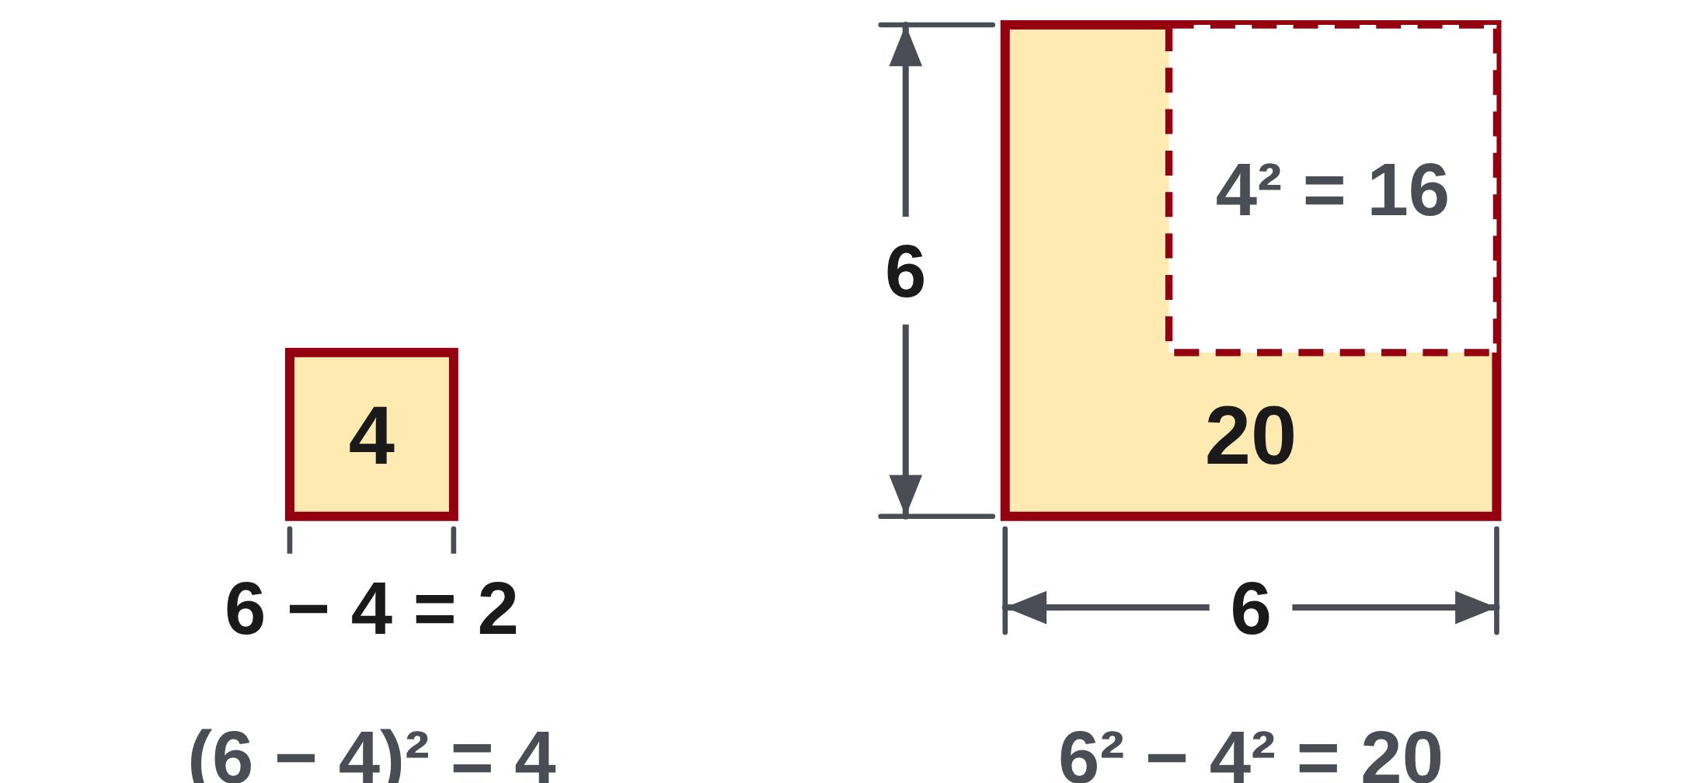
W02-L03 • TEACH • 12:55 PM–1:10 PM • 15 MIN TOTAL
Mark the base before squaring
(6 − 4)² = 2² = 4
6² − 4² = 36 − 16 = 20
3 × 4² = 3 × 16 = 48
Square root check: √(9 + 16) = √25 = 5.
It is not √9 + √16, which equals 7.
Together • Exercise Book 3A Q4–7.
Say the next operation aloud; compare paper and calculator results.
Use Numeracy Hub Common mistakes only for taught examples.
W2 L3 • Match the written grouping to the selected calculator’s key sequence
Textbook
Exercise Book
Numeracy Hub
Shape Canvas
Day 04 • 2026-11-03 • 07
Notes:
TEACH | 12:55 PM–1:10 PM | 15 MIN TOTAL — shared phase allocation.
Read the first expression as “square the difference”: six minus four is two, and two squared is four. Read the second as “subtract the squares”: thirty-six minus sixteen is twenty. For 3 × 4², only four is squared, giving three times sixteen, or forty-eight. Finally, √(9 + 16) gives five because the root acts on the complete sum of twenty-five. Which question should come before using a square or root key? “What complete quantity does this symbol act on?” That question keeps the written meaning and the calculator sequence aligned.

Slide 8
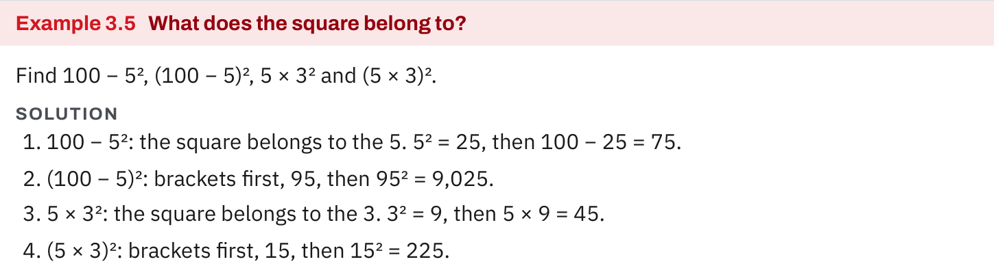
W02-L03 • TEACH • 12:55 PM–1:10 PM • 15 MIN TOTAL
Textbook | page 71
Textbook p.71 · Example 3.5: identify what the square belongs to.
Textbook Chapter 3 pp.69–75; Chapter 2 pp.51–53
Textbook
Exercise Book
Numeracy Hub
Shape Canvas
Day 04 • 2026-11-03 • 08
Notes:
TEACH | 12:55 PM–1:10 PM | 15 MIN TOTAL — shared phase allocation.
Example 3.5 makes the effect of the base very clear. In 100 − 5², only five is squared, so the result is 100 minus 25, or 75. In (100 − 5)², the bracket gives 95, and 95² is 9,025. Why is the second result so much larger? We squared ninety-five rather than five. The example also compares 5 × 3², giving 45, with (5 × 3)², giving 225. These are different instructions, even though their digits look similar. Point to the base before calculating each expression.

Slide 9
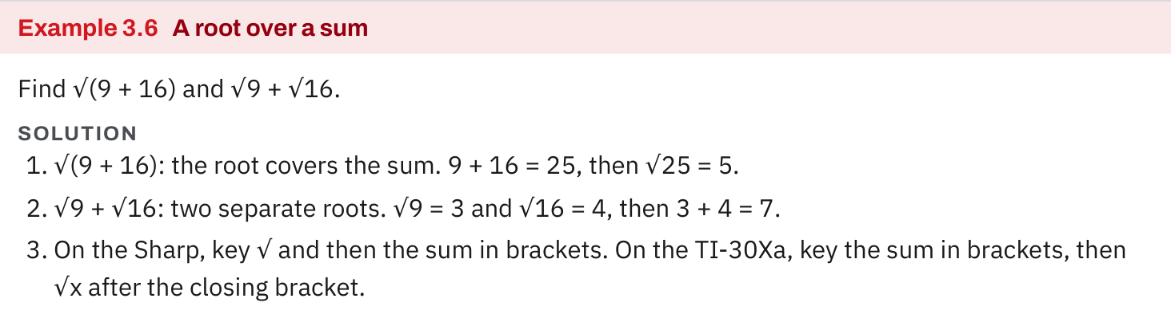
W02-L03 • TEACH • 12:55 PM–1:10 PM • 15 MIN TOTAL
Textbook | page 72
Textbook p.72 · Example 3.6: one root over a sum versus two separate roots.
Textbook Chapter 3 pp.69–75; Chapter 2 pp.51–53
Textbook
Exercise Book
Numeracy Hub
Shape Canvas
Day 04 • 2026-11-03 • 09
Notes:
TEACH | 12:55 PM–1:10 PM | 15 MIN TOTAL — shared phase allocation.
Example 3.6 compares one root over a sum with two separate roots. The grouped sum 9 plus 16 is 25, so √(9 + 16) is five. Separately, √9 plus √16 is three plus four, or seven. On the TI-30Xa, enter the bracketed sum and then √x; on the Sharp, begin with √, enter the bracketed sum and finish with equals. What does the calculator sequence need to preserve? That the root acts on the whole sum. The keys differ, but the mathematical group must stay the same.

Slide 10
W02-L03 • TEACH • 12:55 PM–1:10 PM • 15 MIN TOTAL
Spot the mistake. Explain the correction.
A learner says (6 − 4)² and 6² − 4² must have the same value. What changes?
Discuss the method before checking the answer.
The first squares the difference and gives 4. The second subtracts two squares and gives 20.
Textbook Chapter 3 pp.69–75; Chapter 2 pp.51–53
Textbook
Exercise Book
Numeracy Hub
Shape Canvas
Day 04 • 2026-11-03 • 10
Notes:
TEACH | 12:55 PM–1:10 PM | 15 MIN TOTAL — shared phase allocation.
The claim that (6 − 4)² and 6² − 4² are equal overlooks what is being squared. The first squares a difference: two times two gives four. The second finds the difference between two squares: thirty-six minus sixteen gives twenty. What exact correction would you write beside the error? Identify the complete bracket as the first expression's base and keep the two individual bases in the second. Do not change the symbols to force equal answers; explain why the original expressions represent different operations.

Slide 11
W02-L03 • TOGETHER • 1:10 PM–1:25 PM • 15 MIN TOTAL
Work together
Work 3A questions 4–7. Identify the next operation aloud and compare paper and calculator results.
Work in pairs; alternate solver and checker.
Resources: Exercise Book 3A Q4–10 (p.25); 2A Q2–3 (p.17)
Textbook Chapter 3 pp.69–75; Chapter 2 pp.51–53
Textbook
Exercise Book
Numeracy Hub
Shape Canvas
Day 04 • 2026-11-03 • 11
Notes:
TOGETHER | 1:10 PM–1:25 PM | 15 MIN TOTAL — shared phase allocation.
Work through 3A questions 4–7 with a partner. Say the next operation aloud before calculating and point to the symbols that justify it. Where there is a bracket, complete that group first; where there is an exponent, identify its base. What should your partner check besides the final answer? Whether unchanged terms survived each rewritten line. Compare with the calculator only after the paper sequence represents the expression correctly.

Slide 12
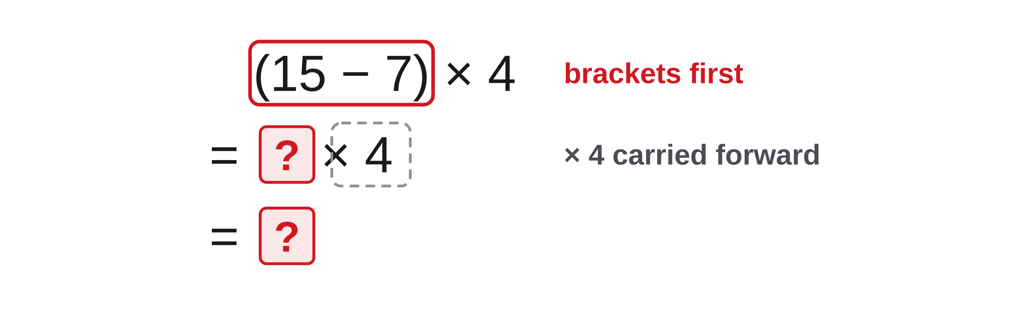
W02-L03 • TOGETHER • 1:10 PM–1:25 PM • 15 MIN TOTAL
Guided practice | 3A Q4
Work with a partner. Take turns explaining the next step.
Textbook Chapter 3 pp.69–75; Chapter 2 pp.51–53
Textbook
Exercise Book
Numeracy Hub
Shape Canvas
Day 04 • 2026-11-03 • 12
Notes:
TOGETHER | 1:10 PM–1:25 PM | 15 MIN TOTAL — shared phase allocation.
For 3A Q4, the expression is (15 − 7) × 4. Which part is grouped, and what instruction follows that group? First find the difference, then multiply the result by four. Try the expression with your partner before checking the next slide. Ask whether an intermediate line still shows the multiplication, since dropping it would leave only a partial answer.
INSTRUCTOR ONLY — AFTER THE ATTEMPT: 32
Working to discuss after the attempt: 15 − 7 = 8 inside the bracket; 8 × 4 = 32.

Slide 13
W02-L03 • TOGETHER • 1:10 PM–1:25 PM • 15 MIN TOTAL
Compare your method | 3A Q4
CHECK TOGETHER
32
Textbook Chapter 3 pp.69–75; Chapter 2 pp.51–53
Textbook
Exercise Book
Numeracy Hub
Shape Canvas
Day 04 • 2026-11-03 • 13
Notes:
TOGETHER | 1:10 PM–1:25 PM | 15 MIN TOTAL — shared phase allocation.
The bracketed difference is fifteen minus seven, which is eight. The remaining expression is eight times four, giving thirty-two. What would happen if we multiplied seven by four before subtracting? We would ignore the bracket and evaluate a different expression. The intermediate line 8 × 4 shows both that the group has been completed and that the outside operation is still waiting. Use that format in the remaining partner questions.
INSTRUCTOR ONLY — AFTER THE ATTEMPT: 32
Working to discuss after the attempt: 15 − 7 = 8 inside the bracket; 8 × 4 = 32.

Slide 14
W02-L03 • PRACTISE • 1:25 PM–1:45 PM • 20 MIN TOTAL
Your scheduled practice
Solve 3A questions 8–10 and 2A questions 2–3. Make a deliberate bracket error, explain it, then correct it.
Show working and units; estimate, then check.
Resources: Exercise Book 3A Q4–10 (p.25); 2A Q2–3 (p.17)
Textbook Chapter 3 pp.69–75; Chapter 2 pp.51–53
Textbook
Exercise Book
Numeracy Hub
Shape Canvas
Day 04 • 2026-11-03 • 14
Notes:
PRACTISE | 1:25 PM–1:45 PM | 20 MIN TOTAL — shared phase allocation.
Complete 3A questions 8–10 and 2A questions 2–3. For one taught example, deliberately write an incorrect grouping beside the correct version and explain what the error changes. Why keep both versions visible? The comparison shows which quantity an operation acts on. Label the incorrect version clearly, then use paper reasoning and the model-specific calculator sequence to verify the corrected version. The point is to diagnose a bracket error, not simply obtain a different display.

Slide 15
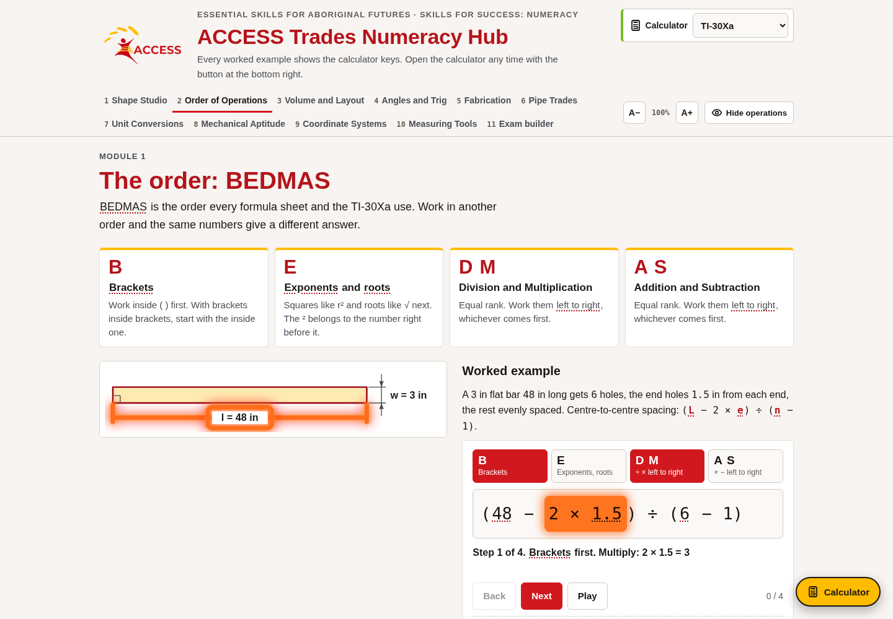
W02-L03 • PRACTISE • 1:25 PM–1:45 PM • 20 MIN TOTAL
Open Numeracy Hub
Navigation example. Use the values and units in the assigned task.
Textbook Chapter 3 pp.69–75; Chapter 2 pp.51–53
Textbook
Exercise Book
Numeracy Hub
Shape Canvas
Day 04 • 2026-11-03 • 15
Notes:
PRACTISE | 1:25 PM–1:45 PM | 20 MIN TOTAL — shared phase allocation.
Open Numeracy Hub's Order of Operations section and choose Common mistakes. Use the examples that match the brackets, squares and roots we have already taught. Before revealing a correction, identify the base or complete quantity under the root. Which feature should you compare between the incorrect and correct lines? The grouping. The tool should help explain that difference; it should not replace the written expression or introduce a new topic during this practice block.

Slide 16
W02-L03 • PRACTISE • 1:25 PM–1:45 PM • 20 MIN TOTAL
Practise in Numeracy Hub
1
Supported: Open Numeracy Hub → Order of Operations → Common mistakes; use taught examples only.
2
Independent practice: Write a deliberate bracket error beside a corrected version; explain the scope.
3
Independent checking: Number the operations and compare the correct working with the tool.
Textbook Chapter 3 pp.69–75; Chapter 2 pp.51–53
Textbook
Exercise Book
Numeracy Hub
Shape Canvas
Day 04 • 2026-11-03 • 16
Notes:
PRACTISE | 1:25 PM–1:45 PM | 20 MIN TOTAL — shared phase allocation.
Choose a taught bracket error in Numeracy Hub and write the incorrect and corrected expressions side by side. Point to exactly what changed: perhaps the complete group is squared, or the root covers the sum. Then number the operations in the corrected version. What explanation is stronger than “the brackets were wrong”? Name the quantity the operation should act on and show how the incorrect version acted on a different quantity. Keep that explanation with your paper work.

Slide 17
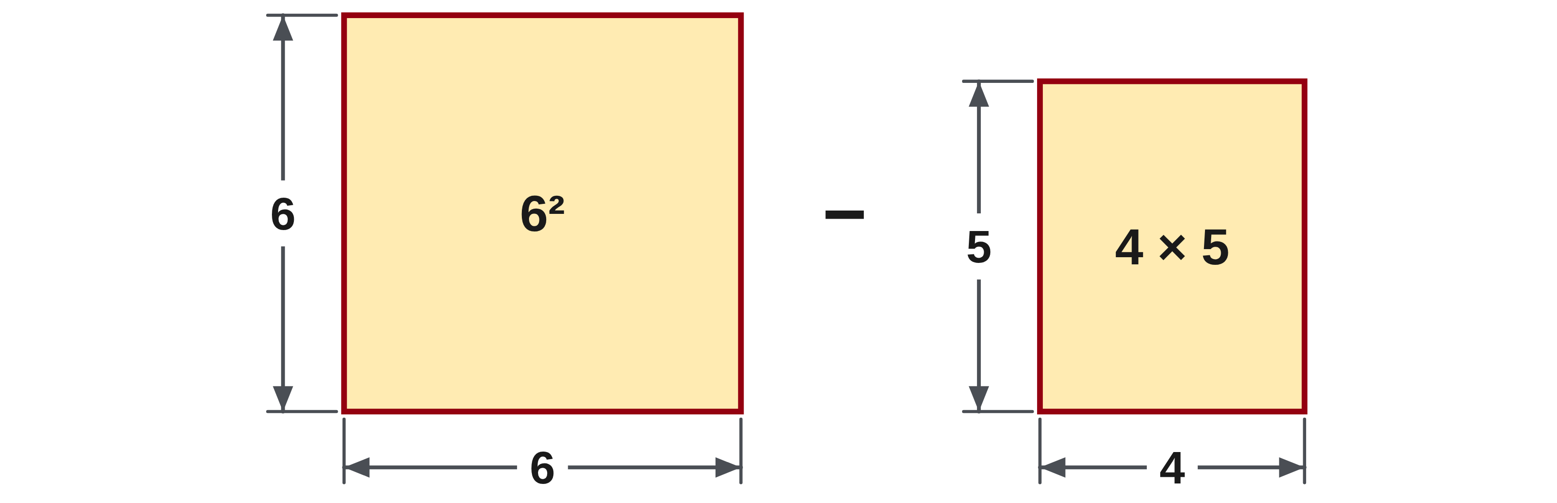
W02-L03 • PRACTISE • 1:25 PM–1:45 PM • 20 MIN TOTAL
Practise from the Exercise Book | 3A Q8
Write the operation, working and units before checking.
Textbook Chapter 3 pp.69–75; Chapter 2 pp.51–53
Textbook
Exercise Book
Numeracy Hub
Shape Canvas
Day 04 • 2026-11-03 • 17
Notes:
PRACTISE | 1:25 PM–1:45 PM | 20 MIN TOTAL — shared phase allocation.
For 3A Q8, evaluate 6² − 4 × 5. Mark the base of the square before performing any subtraction. Which two higher-ranked results must be ready first? The square of six and the product of four and five. Try your sequence, then compare with the answer after the attempt. If your first line squared six minus four, you have introduced a bracket that was never given.
INSTRUCTOR ONLY — AFTER THE ATTEMPT: 16
Working to discuss after the attempt: 6² = 36 and 4 × 5 = 20; the final subtraction is 36 − 20 = 16.

Slide 18
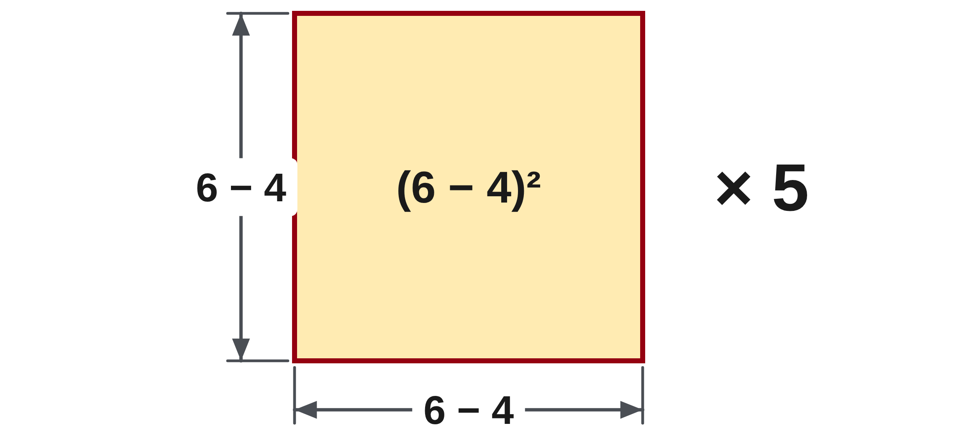
W02-L03 • PRACTISE • 1:25 PM–1:45 PM • 20 MIN TOTAL
Practise from the Exercise Book | 3A Q9
Write the operation, working and units before checking.
Textbook Chapter 3 pp.69–75; Chapter 2 pp.51–53
Textbook
Exercise Book
Numeracy Hub
Shape Canvas
Day 04 • 2026-11-03 • 18
Notes:
PRACTISE | 1:25 PM–1:45 PM | 20 MIN TOTAL — shared phase allocation.
For 3A Q9, the expression is (6 − 4)² × 5. The bracket changes the base, so record its value before squaring. What operation remains after the square is evaluated? Multiplication by five. Complete your attempt before consulting the answer. In your explanation, distinguish squaring the difference from subtracting individual squares; those are different instructions and do not generally produce the same value.
INSTRUCTOR ONLY — AFTER THE ATTEMPT: 20
Working to discuss after the attempt: 6 − 4 = 2; 2² = 4; 4 × 5 = 20. The bracketed difference is the base of the square.

Slide 19
W02-L03 • CHECK • 1:45 PM–1:55 PM • 10 MIN TOTAL
Check independently
Complete 3A questions 8–9 with each operation numbered.
Answer independently and show the method.
Resources: Exercise Book 3A Q4–10 (p.25); 2A Q2–3 (p.17)
Textbook Chapter 3 pp.69–75; Chapter 2 pp.51–53
Textbook
Exercise Book
Numeracy Hub
Shape Canvas
Day 04 • 2026-11-03 • 19
Notes:
CHECK | 1:45 PM–1:55 PM | 10 MIN TOTAL — shared phase allocation.
Complete 3A questions 8 and 9 independently with every operation numbered. Your working should make clear what the exponent belongs to in each expression. Why are both questions useful together? They reveal whether a changed bracket changes your sequence appropriately. Keep previous solutions closed while you write the steps. We will compare the operation order after you have made both attempts.

Slide 20
W02-L03 • CHECK • 1:45 PM–1:55 PM • 10 MIN TOTAL
Independent check | 3A Q8
Answer independently. Keep worked solutions closed.
Textbook Chapter 3 pp.69–75; Chapter 2 pp.51–53
Textbook
Exercise Book
Numeracy Hub
Shape Canvas
Day 04 • 2026-11-03 • 20
Notes:
CHECK | 1:45 PM–1:55 PM | 10 MIN TOTAL — shared phase allocation.
For 3A Q8, read the expression exactly as written and decide what the square applies to. Show the intermediate values without skipping straight to a calculator result. After the attempt, explain why the final subtraction waits for the exponent and product. The order numbers you wrote should let another person reconstruct the full reasoning, even if they do not have your calculator.
INSTRUCTOR ONLY — AFTER THE ATTEMPT: 16
Working to discuss after the attempt: 6² = 36 and 4 × 5 = 20; the final subtraction is 36 − 20 = 16.

Slide 21
W02-L03 • CHECK • 1:45 PM–1:55 PM • 10 MIN TOTAL
Independent check | 3A Q9
Answer independently. Keep worked solutions closed.
Textbook Chapter 3 pp.69–75; Chapter 2 pp.51–53
Textbook
Exercise Book
Numeracy Hub
Shape Canvas
Day 04 • 2026-11-03 • 21
Notes:
CHECK | 1:45 PM–1:55 PM | 10 MIN TOTAL — shared phase allocation.
For 3A Q9, begin with the complete bracketed quantity as the base of the square. Number the operations and preserve the final multiplication by five in your working. What would reveal that the bracket had been ignored? A first step that squared six or four separately. After the attempt, use the correct grouping to explain the result rather than changing the written expression to match a remembered answer.
INSTRUCTOR ONLY — AFTER THE ATTEMPT: 20
Working to discuss after the attempt: 6 − 4 = 2; 2² = 4; 4 × 5 = 20. The bracketed difference is the base of the square.

Slide 22
W02-L03 • WRAP UP • 1:55 PM–2:00 PM • 5 MIN TOTAL
Wrap up and choose the next step
Share one learning point and one skill to practise next.
Record a takeaway and next action.
Resources: Exercise Book 3A Q4–10 (p.25); 2A Q2–3 (p.17)
Textbook Chapter 3 pp.69–75; Chapter 2 pp.51–53
Textbook
Exercise Book
Numeracy Hub
Shape Canvas
Play quiz
Quiz PDF
Day 04 • 2026-11-03 • 22
Notes:
WRAP UP | 1:55 PM–2:00 PM | 5 MIN TOTAL — shared phase allocation.
Finish this sentence using an actual expression from your page: “The square belongs to…” Then explain how you showed that in your working. What is the corresponding question for a square root? Identify the complete quantity under the root. Write one correction you can now explain confidently. After the break, we will select checks that can expose these errors even when a calculator produces a clean-looking result.

Slide 23
DAY 04 • SCHEDULED BREAK
Break
2:00 PM–2:15 PM
Return ready for: Calculation checking workshop
This break is excluded from teaching minutes.
Textbook
Exercise Book
Numeracy Hub
Shape Canvas
Day 04 • 2026-11-03 • 23
Notes:
Break | 2:00 PM–2:15 PM
We break until 2:15. Keep one bracket or root example available for the checking workshop when we return. What kind of check might expose a repeated entry mistake? A different setup, an inverse operation or an estimate can reveal something that repeating the same keys may miss. Use the break fully, then return ready to explain how a check supports an answer.

Slide 24
W02-L04 • START • 2:15 PM–2:20 PM • 5 MIN TOTAL
Calculation checking workshop
Today’s goal: Use estimation, inverse operations and a second method to check calculations.
Name one use for today’s skill.
Textbook Chapter 2 p.59; Chapter 3 pp.68–75
Exercise Book 1A Q20 (p.7); 3B Q2–3 (p.27); 3C Q2–3 (p.29)
Keep your notebook, textbook, exercise book and chosen calculator ready.
Textbook Chapter 2 p.59; Chapter 3 pp.68–75
Textbook
Exercise Book
Numeracy Hub
Shape Canvas
Day 04 • 2026-11-03 • 24
Notes:
START | 2:15 PM–2:20 PM | 5 MIN TOTAL — shared phase allocation.
The next block is a checking workshop. We will use estimation, inverse operations and different methods to test calculations. What does a calculator's repeated result prove if we repeat the same mistaken entry? It proves only that we repeated the same calculation. We need checks that examine the size, relationship or setup from another direction. Keep space beside each solution for an estimate and a separate checking line, with units attached.

Slide 25
W02-L04 • RECALL • 2:20 PM–2:25 PM • 5 MIN TOTAL
Recall and reconnect
Take a moment to name one common keying error and one way to detect it.
Try first without displayed answers.
Resources: Exercise Book 1A Q20 (p.7); 3B Q2–3 (p.27); 3C Q2–3 (p.29)
Textbook Chapter 2 p.59; Chapter 3 pp.68–75
Textbook
Exercise Book
Numeracy Hub
Shape Canvas
Day 04 • 2026-11-03 • 25
Notes:
RECALL | 2:20 PM–2:25 PM | 5 MIN TOTAL — shared phase allocation.
Name one keying mistake you have seen: an extra zero, a missed bracket, a wrong sign or a repeated digit. Now choose a check that could detect it. An estimate is useful for an extra zero; inspecting the grouping helps with a bracket; reversing an operation can test the numerical relationship. Why not use exactly the same check for every mistake? Different checks reveal different kinds of problems. Match the check to what you suspect.

Slide 26
W02-L04 • TEACH • 2:25 PM–2:40 PM • 15 MIN TOTAL
Choose a check for the error you suspect
1
An estimate checks whether the answer is a sensible size.
2
An inverse operation checks the numerical relationship.
3
A second method checks whether the original setup counted the right quantities.
4
Repeating the same key sequence can repeat the same error.
Textbook Chapter 2 p.59; Chapter 3 pp.68–75
Textbook
Exercise Book
Numeracy Hub
Shape Canvas
Day 04 • 2026-11-03 • 26
Notes:
TEACH | 2:25 PM–2:40 PM | 15 MIN TOTAL — shared phase allocation.
An estimate checks scale: is the answer roughly the size we expected? An inverse operation checks a relationship: can we work backwards to an original quantity? A second setup checks the counting: did we include all four frame sides or all the stock pieces? Which would best reveal a missing frame side? Adding each side explicitly offers a different setup from a grouped formula. Repeating the same keys can help detect an accidental press, but it can also repeat a mistaken expression perfectly. Choose evidence that tests the part of the calculation you are uncertain about.

Slide 27

W02-L04 • TEACH • 2:25 PM–2:40 PM • 15 MIN TOTAL
Put a missing dimension back into the total
1
Write the original perimeter relationship before solving for a missing side.
2
Substitute the found dimension into that original relationship.
3
Check that all four sides recreate the stated perimeter.
4
Keep an estimate and a separate check line beside the solution.
Textbook Chapter 2 p.59; Chapter 3 pp.68–75
Textbook
Exercise Book
Numeracy Hub
Shape Canvas
Day 04 • 2026-11-03 • 27
Notes:
TEACH | 2:25 PM–2:40 PM | 15 MIN TOTAL — shared phase allocation.
When finding a missing side, begin with the original perimeter relationship. After solving, put the proposed side back into that relationship and count all four sides. Why test the original relationship rather than repeating the rearranged expression? It asks whether the found dimension actually satisfies the stated frame. Keep an estimate beside the exact solution and write the substitution as a separate check. That check connects the answer back to the physical boundary, so a mistake in rearranging or entering the calculation has another chance to become visible.

Slide 28

W02-L04 • TEACH • 2:25 PM–2:40 PM • 15 MIN TOTAL
Use a genuinely different method
Exercise Book 3B Q2: rectangle sides 1,350 mm and 875 mm.
1,350 + 875 + 1,350 + 875 = 4,450 mm
2 × (1,350 + 875) = 4,450 mm
Both count the same four sides. An estimate of 2 × (1,400 + 900) = 4,600 mm supports the scale.
Together • Recheck 3B Q2 both ways.
Then substitute a missing dimension back into the original perimeter. Ask whether the total is restored.
W2 L4 • Repeating an incorrect key sequence is not an independent check
Textbook
Exercise Book
Numeracy Hub
Shape Canvas
Day 04 • 2026-11-03 • 28
Notes:
TEACH | 2:25 PM–2:40 PM | 15 MIN TOTAL — shared phase allocation.
For 3B Q2, the rectangle measures 1,350 mm by 875 mm. Adding four sides gives 1,350 plus 875 plus 1,350 plus 875, or 4,450 mm. Grouping one length and one width gives 2 × 2,225, also 4,450 mm. Why are these useful checks on one another? They represent the same four sides in different ways. Rounding to 1,400 and 900 gives an estimated 4,600 mm, which supports the scale. Agreement among the sketch, the two setups and the estimate gives more confidence than repeating one key sequence.

Slide 29
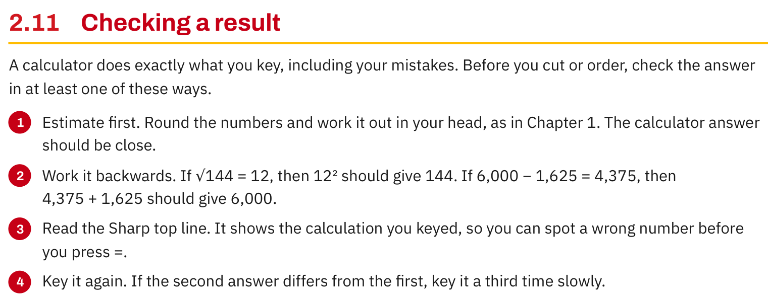
W02-L04 • TEACH • 2:25 PM–2:40 PM • 15 MIN TOTAL
Textbook | page 59
Textbook p.59 · Checking a result: estimate, reverse and inspect the entry.
Textbook Chapter 2 p.59; Chapter 3 pp.68–75
Textbook
Exercise Book
Numeracy Hub
Shape Canvas
Day 04 • 2026-11-03 • 29
Notes:
TEACH | 2:25 PM–2:40 PM | 15 MIN TOTAL — shared phase allocation.
Page 59 lists ways to check a calculator result. Estimate first; work the operation backwards; inspect the entered expression; and, when needed, key it again carefully. What does a reverse subtraction check look like? Add the difference back to the subtracted amount and see whether the starting total is restored. For example, 4,375 plus 1,625 restores 6,000. Each check supplies a different kind of evidence. Re-entry may catch a mistyped digit, while an inverse or different setup can expose an error that repeated keys would preserve.

Slide 30
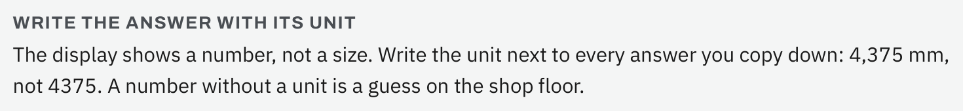
W02-L04 • TEACH • 2:25 PM–2:40 PM • 15 MIN TOTAL
Textbook | page 59
Textbook p.59 · Record the unit with the checked answer.
Textbook Chapter 2 p.59; Chapter 3 pp.68–75
Textbook
Exercise Book
Numeracy Hub
Shape Canvas
Day 04 • 2026-11-03 • 30
Notes:
TEACH | 2:25 PM–2:40 PM | 15 MIN TOTAL — shared phase allocation.
The reminder on page 59 is to write the unit with the answer. A calculator shows a number, but it does not tell someone whether the number is millimetres, inches or a count of parts. Why is “4,375” incomplete on a shop drawing or cut list? The reader cannot know the intended size without the unit and context. Write 4,375 mm when that is the quantity being measured. Checking units also helps distinguish a perimeter, which is a length, from a different kind of measurement. Meaning belongs beside the numerical result.

Slide 31
W02-L04 • TEACH • 2:25 PM–2:40 PM • 15 MIN TOTAL
Spot the mistake. Explain the correction.
Two attempts with identical calculator keys give the same number. Is that a different checking method?
Discuss the method before checking the answer.
No. Check with an inverse operation or a different setup, such as adding sides instead of grouping pairs.
Textbook Chapter 2 p.59; Chapter 3 pp.68–75
Textbook
Exercise Book
Numeracy Hub
Shape Canvas
Day 04 • 2026-11-03 • 31
Notes:
TEACH | 2:25 PM–2:40 PM | 15 MIN TOTAL — shared phase allocation.
Two identical key sequences can give the same answer while repeating the same error. What has agreement actually checked? It may show consistent entry, but it does not independently verify the intended setup. For the rectangle, switch from the grouped formula to adding all four sides. For a subtraction, reverse it by addition. For a square root, square the result. These changes test the relationship from another direction. Select a check that could expose the error you are worried about, rather than simply pressing equals until the answer feels familiar.

Slide 32
W02-L04 • TOGETHER • 2:40 PM–2:55 PM • 15 MIN TOTAL
Work together
Recheck 3B question 2 in two ways: add the four sides and use the grouped formula.
Work in pairs; alternate solver and checker.
Resources: Exercise Book 1A Q20 (p.7); 3B Q2–3 (p.27); 3C Q2–3 (p.29)
Textbook Chapter 2 p.59; Chapter 3 pp.68–75
Textbook
Exercise Book
Numeracy Hub
Shape Canvas
Day 04 • 2026-11-03 • 32
Notes:
TOGETHER | 2:40 PM–2:55 PM | 15 MIN TOTAL — shared phase allocation.
Recheck 3B Q2 with your partner. One person adds the four sides explicitly, while the other uses the grouped perimeter expression. Compare the meaning of the terms before comparing the totals. What should both methods count? Two lengths and two widths, with every side included once. Then exchange methods so each person can explain why the two expressions represent the same boundary. Keep both lines in your notebook as evidence of the check.

Slide 33
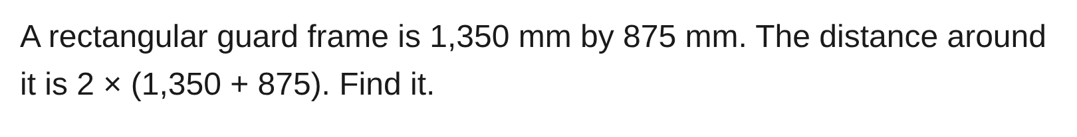
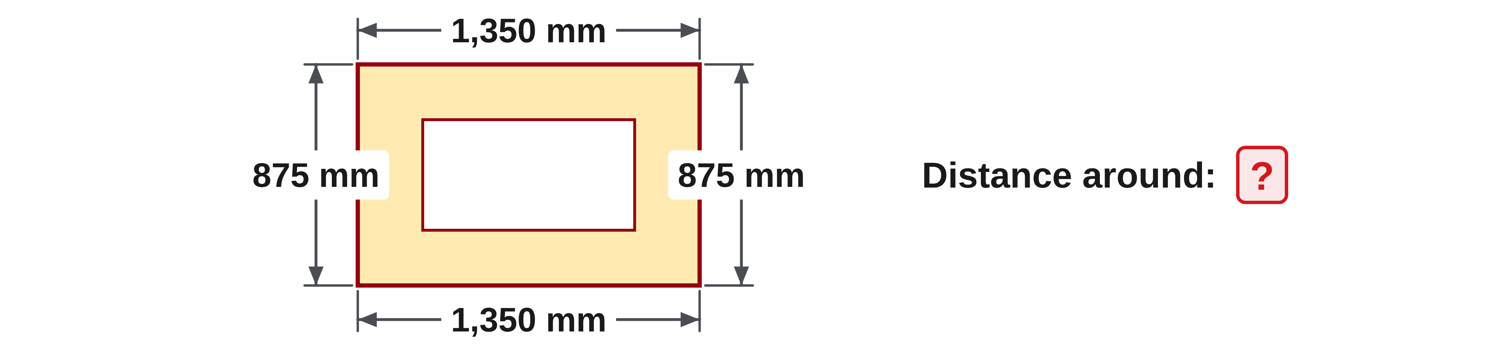
W02-L04 • TOGETHER • 2:40 PM–2:55 PM • 15 MIN TOTAL
Guided practice | 3B Q2
Work with a partner. Take turns explaining the next step.
Textbook Chapter 2 p.59; Chapter 3 pp.68–75
Textbook
Exercise Book
Numeracy Hub
Shape Canvas
Day 04 • 2026-11-03 • 33
Notes:
TOGETHER | 2:40 PM–2:55 PM | 15 MIN TOTAL — shared phase allocation.
For 3B Q2, the rectangular guard frame is 1,350 mm by 875 mm. Calculate the distance around it using 2 × (1,350 + 875), then check by listing the four sides. Which operation comes first in the grouped form? The sum inside the brackets. Try both methods before comparing with the next slide, and retain millimetres as the unit of the boundary length.
INSTRUCTOR ONLY — AFTER THE ATTEMPT: 4,450 mm Brackets first: 2,225. Then 2 × 2,225.
Working to discuss after the attempt: Four-side check: 1,350 + 875 + 1,350 + 875 = 4,450 mm. Grouped check: 2 × 2,225 = 4,450 mm.

Slide 34
W02-L04 • TOGETHER • 2:40 PM–2:55 PM • 15 MIN TOTAL
Compare your method | 3B Q2
CHECK TOGETHER
4,450 mm
Brackets first: 2,225. Then 2 × 2,225.
Textbook Chapter 2 p.59; Chapter 3 pp.68–75
Textbook
Exercise Book
Numeracy Hub
Shape Canvas
Day 04 • 2026-11-03 • 34
Notes:
TOGETHER | 2:40 PM–2:55 PM | 15 MIN TOTAL — shared phase allocation.
The bracketed sum is 2,225 mm. Doubling gives 4,450 mm. Adding the four sides separately also gives 4,450 mm, confirming that the grouped expression counts the same boundary. What error might the four-side method reveal? Omitting one width or doubling only the length in an incorrectly bracketed formula. Our estimate near 4,600 mm is consistent with the exact total. Each piece of evidence checks a different aspect of the solution.
INSTRUCTOR ONLY — AFTER THE ATTEMPT: 4,450 mm Brackets first: 2,225. Then 2 × 2,225.
Working to discuss after the attempt: Four-side check: 1,350 + 875 + 1,350 + 875 = 4,450 mm. Grouped check: 2 × 2,225 = 4,450 mm.

Slide 35
W02-L04 • PRACTISE • 2:55 PM–3:15 PM • 20 MIN TOTAL
Your scheduled practice
Complete 3B question 3 and 3C questions 2–3. Add an estimate and a check line to every solution. Finish with two new Numeracy Hub questions.
Show working and units; estimate, then check.
Resources: Exercise Book 1A Q20 (p.7); 3B Q2–3 (p.27); 3C Q2–3 (p.29)
Textbook Chapter 2 p.59; Chapter 3 pp.68–75
Textbook
Exercise Book
Numeracy Hub
Shape Canvas
Day 04 • 2026-11-03 • 35
Notes:
PRACTISE | 2:55 PM–3:15 PM | 20 MIN TOTAL — shared phase allocation.
Complete 3B Q3 and 3C questions 2–3, adding an estimate and a check line to every solution. Then attempt two new Level 1 Numeracy Hub questions from the topics already taught. Which check fits an offcut? Add the used material and the offcut, including any stated kerf, to restore the stock. Which fits a hidden frame dimension? Substitute it into the complete perimeter. Choose the check because it matches the quantity, not because it is the quickest extra line.

Slide 36
W02-L04 • PRACTISE • 2:55 PM–3:15 PM • 20 MIN TOTAL
Open Numeracy Hub
Navigation example. Use the values and units in the assigned task.
Textbook Chapter 2 p.59; Chapter 3 pp.68–75
Textbook
Exercise Book
Numeracy Hub
Shape Canvas
Day 04 • 2026-11-03 • 36
Notes:
PRACTISE | 2:55 PM–3:15 PM | 20 MIN TOTAL — shared phase allocation.
Open Numeracy Hub's Order of Operations section and select Level 1 questions within the taught topics. Keep the expression before solving it. Why save the question as well as the answer? Without the original expression, you cannot later tell whether a correct-looking result belongs to the task you attempted. Complete the paper calculation and a checking line before using the displayed solution to review your method.

Slide 37
W02-L04 • PRACTISE • 2:55 PM–3:15 PM • 20 MIN TOTAL
Practise in Numeracy Hub
1
Supported: For 3B Q2, compare adding four sides with the grouped perimeter formula.
2
Independent practice: Solve two Level 1 Numeracy Hub BEDMAS questions from taught topics on paper.
3
Independent checking: Keep each question and add an estimate or second-method check before review.
Textbook Chapter 2 p.59; Chapter 3 pp.68–75
Textbook
Exercise Book
Numeracy Hub
Shape Canvas
Day 04 • 2026-11-03 • 37
Notes:
PRACTISE | 2:55 PM–3:15 PM | 20 MIN TOTAL — shared phase allocation.
Start by comparing the two forms of 3B Q2: four sides added individually and one length-plus-width pair doubled. Then solve two Level 1 BEDMAS questions on paper. For each, select an estimate or different-method check before reviewing the tool's result. What makes a check useful? It must test a relationship or part of the setup that could be wrong. Retain the original question, your sequence and the checking line so the comparison remains understandable after you close Numeracy Hub.

Slide 38
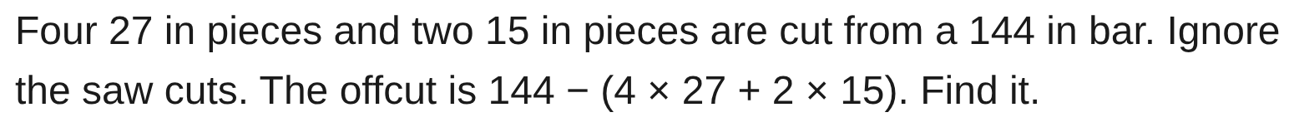
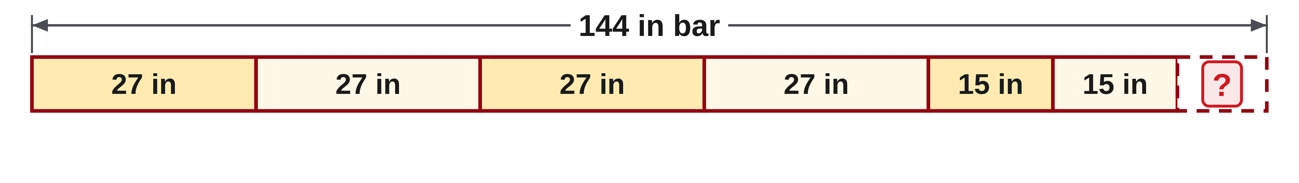
W02-L04 • PRACTISE • 2:55 PM–3:15 PM • 20 MIN TOTAL
Practise from the Exercise Book | 3B Q3
Write the operation, working and units before checking.
Textbook Chapter 2 p.59; Chapter 3 pp.68–75
Textbook
Exercise Book
Numeracy Hub
Shape Canvas
Day 04 • 2026-11-03 • 38
Notes:
PRACTISE | 2:55 PM–3:15 PM | 20 MIN TOTAL — shared phase allocation.
For 3B Q3, find the offcut after four 27-inch pieces and two 15-inch pieces are removed from 144 inches. The problem ignores saw cuts. What should your checking line reconstruct? The original 144-inch stock. Try the grouped calculation, then independently add the six piece lengths and the proposed offcut. That comparison checks both the arithmetic and whether every piece has been counted.
INSTRUCTOR ONLY — AFTER THE ATTEMPT: 6 in 4 × 27 = 108, 2 × 15 = 30, 108 + 30 = 138, 144 − 138 = 6.
Working to discuss after the attempt: Check: 108 + 30 + 6 = 144 in, restoring the stock with saw cuts ignored.

Slide 39
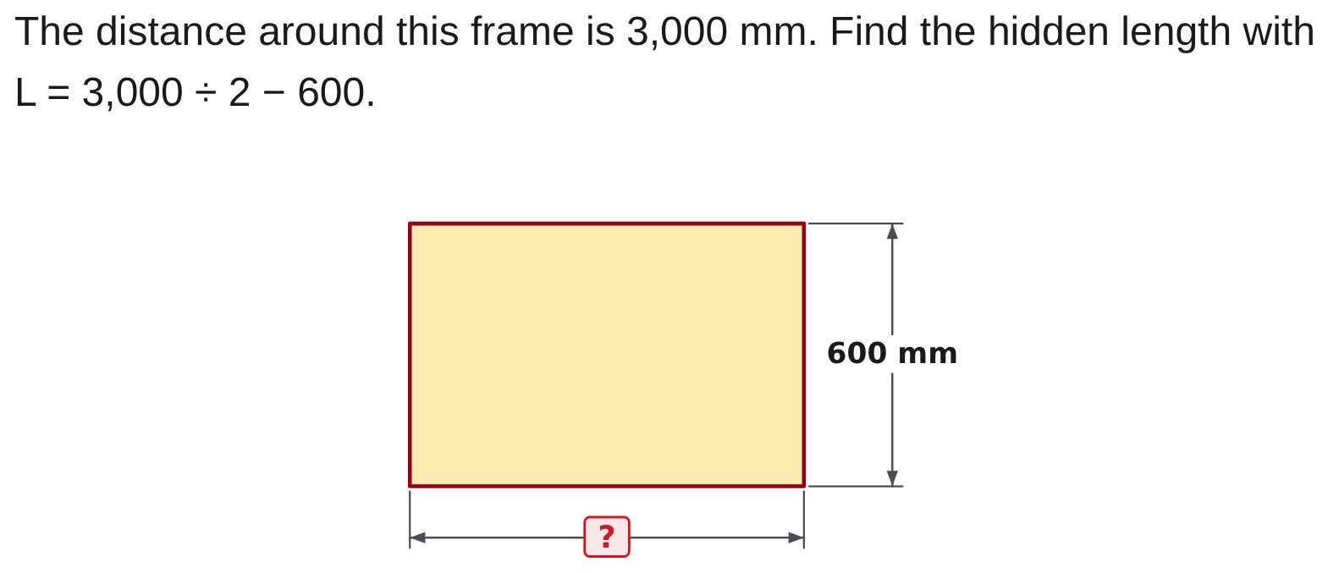
W02-L04 • PRACTISE • 2:55 PM–3:15 PM • 20 MIN TOTAL
Practise from the Exercise Book | 3C Q2
Write the operation, working and units before checking.
Textbook Chapter 2 p.59; Chapter 3 pp.68–75
Textbook
Exercise Book
Numeracy Hub
Shape Canvas
Day 04 • 2026-11-03 • 39
Notes:
PRACTISE | 2:55 PM–3:15 PM | 20 MIN TOTAL — shared phase allocation.
For 3C Q2, calculate L = 3,000 ÷ 2 − 600, then test the proposed length in the complete perimeter. Why is that stronger than repeating the same division and subtraction? The perimeter check returns to the original boundary relationship. After your attempt, show that twice the sum of the length and the known 600 mm width equals the stated 3,000 mm.
INSTRUCTOR ONLY — AFTER THE ATTEMPT: L = 1,500 − 600 = 900 mm
Working to discuss after the attempt: Half the perimeter is 1,500 mm, which is one length plus the 600 mm width. Subtracting gives 900 mm. Check: 2 × (900 + 600) = 3,000 mm.

Slide 40
W02-L04 • CHECK • 3:15 PM–3:25 PM • 10 MIN TOTAL
Check independently
Explain why 3C question 2 is 900 mm and show that it gives the stated 3,000 mm perimeter.
Answer independently and show the method.
Resources: Exercise Book 1A Q20 (p.7); 3B Q2–3 (p.27); 3C Q2–3 (p.29)
Textbook Chapter 2 p.59; Chapter 3 pp.68–75
Textbook
Exercise Book
Numeracy Hub
Shape Canvas
Day 04 • 2026-11-03 • 40
Notes:
CHECK | 3:15 PM–3:25 PM | 10 MIN TOTAL — shared phase allocation.
Explain independently why the missing length in 3C Q2 is 900 mm and show how that value restores a 3,000 mm perimeter. The value is given in this prompt; the evidence we need is your reasoning and substitution. What does dividing the perimeter by two represent? One length plus one width. Write that relationship, then demonstrate the full boundary rather than relying on the given answer alone.

Slide 41
W02-L04 • CHECK • 3:15 PM–3:25 PM • 10 MIN TOTAL
Independent check | 3C Q2
Answer independently. Keep worked solutions closed.
Textbook Chapter 2 p.59; Chapter 3 pp.68–75
Textbook
Exercise Book
Numeracy Hub
Shape Canvas
Day 04 • 2026-11-03 • 41
Notes:
CHECK | 3:15 PM–3:25 PM | 10 MIN TOTAL — shared phase allocation.
For 3C Q2, show the missing-length calculation and a separate perimeter check. Explain what 3,000 divided by two represents before subtracting the known width. After the attempt, compare the two directions: solving from the perimeter to the length, then rebuilding the perimeter from the length. The independent check should show the original 3,000 mm boundary, with all four sides accounted for.
INSTRUCTOR ONLY — AFTER THE ATTEMPT: L = 1,500 − 600 = 900 mm
Working to discuss after the attempt: Half the perimeter is 1,500 mm, which is one length plus the 600 mm width. Subtracting gives 900 mm. Check: 2 × (900 + 600) = 3,000 mm.

Slide 42
W02-L04 • WRAP UP • 3:25 PM–3:30 PM • 5 MIN TOTAL
Wrap up and choose the next step
Share one learning point and one skill to practise next.
Record a takeaway and next action.
Resources: Exercise Book 1A Q20 (p.7); 3B Q2–3 (p.27); 3C Q2–3 (p.29)
Textbook Chapter 2 p.59; Chapter 3 pp.68–75
Textbook
Exercise Book
Numeracy Hub
Shape Canvas
Play quiz
Quiz PDF
Day 04 • 2026-11-03 • 42
Notes:
WRAP UP | 3:25 PM–3:30 PM | 5 MIN TOTAL — shared phase allocation.
Choose one result from the workshop and name what your check tested: size, inverse relationship or counting setup. Which check would be least likely to help if the same wrong bracket were entered twice? Repeating the identical keys alone. Record a check you can explain clearly and one error it would catch. Next we move to fractions and inch markings, where reading the scale and preserving the unit will be just as important as performing the calculation.

