Slide 1

CARPENTRY FOUNDATION / INTAKE 142
Day 07 | Friday
07
November 6, 2026
Marking fractional dimensions
9:00 AM–10:15 AM • Math • 75 min
Fraction foundations checkpoint
10:30 AM–12:00 PM • Math • 90 min
Week 2 • 2 scheduled blocks • 165 teaching minutes
Estimate. Show the method. Label units. Check the result.
Textbook
Exercise Book
Numeracy Hub
Shape Canvas
Day 07 • 2026-11-06 • 01
Notes:
Today our fraction work becomes a physical marking task. We will read dimensions, transfer them to paper strips, and check the marks independently. After the break, a foundations checkpoint will show how confidently you can read, simplify, compare, and convert fractions. What makes a mark trustworthy? It must come from the stated dimension, a clear starting point, and a check from zero. A larger picture on a screen does not make the dimension larger.

Slide 2
DAY 07 / WEEK 2 / CLASS TIMETABLE
Today’s exact schedule
9:00 AM–10:15 AM • 75 min
10:30 AM–12:00 PM • 90 min
Marking fractional dimensions
Fraction foundations checkpoint
9:00 AM–9:05 AM
Start
5
10:30 AM–10:35 AM
Start
5
9:05 AM–9:10 AM
Recall
5
10:35 AM–10:40 AM
Recall
5
9:10 AM–9:25 AM
Teach
15
10:40 AM–10:55 AM
Teach
15
9:25 AM–9:40 AM
Together
15
10:55 AM–11:10 AM
Together
15
9:40 AM–10:00 AM
Practise
20
11:10 AM–11:45 AM
Practise
35
10:00 AM–10:10 AM
Check
10
11:45 AM–11:55 AM
Check
10
10:10 AM–10:15 AM
Wrap up
5
11:55 AM–12:00 PM
Wrap up
5
Math • Math Week 2, Lesson 9
Math • Math Week 2, Lesson 10
Break: 10:15 AM–10:30 AM • 15 minutes • excluded from teaching time
Textbook
Exercise Book
Numeracy Hub
Shape Canvas
Day 07 • 2026-11-06 • 02
Notes:
We begin at 9:00 with marking fractional dimensions and finish that block at 10:15. The break is 10:15–10:30. From 10:30 to noon, we review the fraction foundations and complete the checkpoint. The independent practice period lasts 35 minutes, from 11:10 to 11:45; the final check follows at 11:45. You will have time to identify an error, explain it, and retry its type. That explanation will tell us more than a corrected answer alone.

Slide 3
W02-L09 • START • 9:00 AM–9:05 AM • 5 MIN TOTAL
Marking fractional dimensions
Today’s goal: Transfer a labelled inch dimension to a paper strip and check it with a partner.
Name one use for today’s skill.
Textbook Chapter 4 pp.88–96
Exercise Book 4A Q3 (p.35), Q8–11 (p.36)
Keep your notebook, textbook, exercise book and chosen calculator ready.
Textbook Chapter 4 pp.88–96
Textbook
Exercise Book
Numeracy Hub
Shape Canvas
Day 07 • 2026-11-06 • 03
Notes:
START • 9:00 AM–9:05 AM • 5 MIN TOTAL — shared across this phase.
Open the textbook to Chapter 4, pages 88–96. Today we will take a dimension written in inches and place it accurately on a paper strip. This is the same connection we need between a drawing and a piece of material. What could go wrong even if we read the fraction correctly? Starting the rule at the wrong point would shift the mark. We will deliberately check the start point, the whole inches, and the fractional spaces as separate parts of the job.

Slide 4
W02-L09 • RECALL • 9:05 AM–9:10 AM • 5 MIN TOTAL
Recall and reconnect
Identify what stays the same when a drawing is zoomed. Distinguish dimensions from screen size.
Try first without displayed answers.
Resources: Exercise Book 4A Q3 (p.35), Q8–11 (p.36)
Textbook Chapter 4 pp.88–96
Textbook
Exercise Book
Numeracy Hub
Shape Canvas
Day 07 • 2026-11-06 • 04
Notes:
RECALL • 9:05 AM–9:10 AM • 5 MIN TOTAL — shared across this phase.
Imagine zooming in on a rectangle in Shape Canvas. The picture becomes larger, but its dimension label remains unchanged. Which tells us how long to mark our paper strip? The label does. A screen can enlarge or shrink a drawing to make it easier to see. Unless a task supplies a scale and asks for a scaled measurement, the physical size on the screen is not our measurement. Tell a partner what stays the same after zooming: the stated dimensions and the represented object.

Slide 5
W02-L09 • TEACH • 9:10 AM–9:25 AM • 15 MIN TOTAL
Transfer a written dimension to a strip
1
Choose one start point and align the rule’s zero with it.
2
Locate the whole inches before counting fractional spaces.
3
Mark the position clearly and write the full dimension with its unit.
4
Use the drawing’s stated dimension, even when its screen size changes.
Textbook Chapter 4 pp.88–96
Textbook
Exercise Book
Numeracy Hub
Shape Canvas
Day 07 • 2026-11-06 • 05
Notes:
TEACH • 9:10 AM–9:25 AM • 15 MIN TOTAL — shared across this phase.
Choose one clear starting point on the paper strip and put the rule's zero exactly there. Do not assume the end of the rule is zero; inspect its markings. Locate the whole inches first, then count the fractional spaces beyond the last whole-inch mark. Make one precise mark and label it with the complete dimension and inches. Why count spaces rather than tick marks? A distance is the interval between positions; counting the starting line as the first piece shifts the result. Read the written dimension again before lifting the rule, so the mark and its label agree.

Slide 6
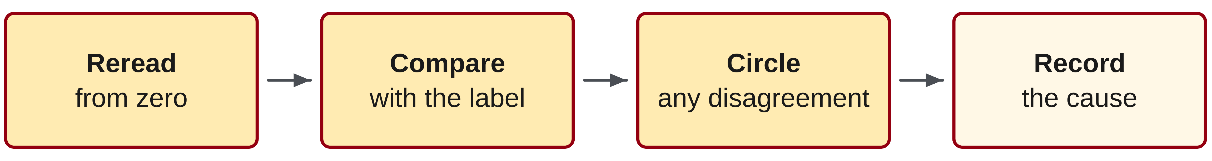
W02-L09 • TEACH • 9:10 AM–9:25 AM • 15 MIN TOTAL
Verify the mark from the beginning
1
Ask a partner to reread the mark from zero without copying your answer.
2
Compare the new reading with the original dimension label.
3
Circle a disagreement before adjusting the mark.
4
Record whether the error came from the start point, whole inches or fractional spaces.
Textbook Chapter 4 pp.88–96
Textbook
Exercise Book
Numeracy Hub
Shape Canvas
Day 07 • 2026-11-06 • 06
Notes:
TEACH • 9:10 AM–9:25 AM • 15 MIN TOTAL — shared across this phase.
A partner check works best when it is a new reading, not agreement with an answer already supplied. Exchange strips and reread each mark from the original zero. First say the whole inches, then the fraction and unit. Compare that reading with the intended dimension. If they disagree, circle the disagreement before moving anything. Was zero aligned incorrectly, was a whole inch missed, or were the small spaces miscounted? Naming the cause helps prevent the same error. What would happen if the checker simply copied the label? We would have two copies of one answer, not two independent readings.

Slide 7
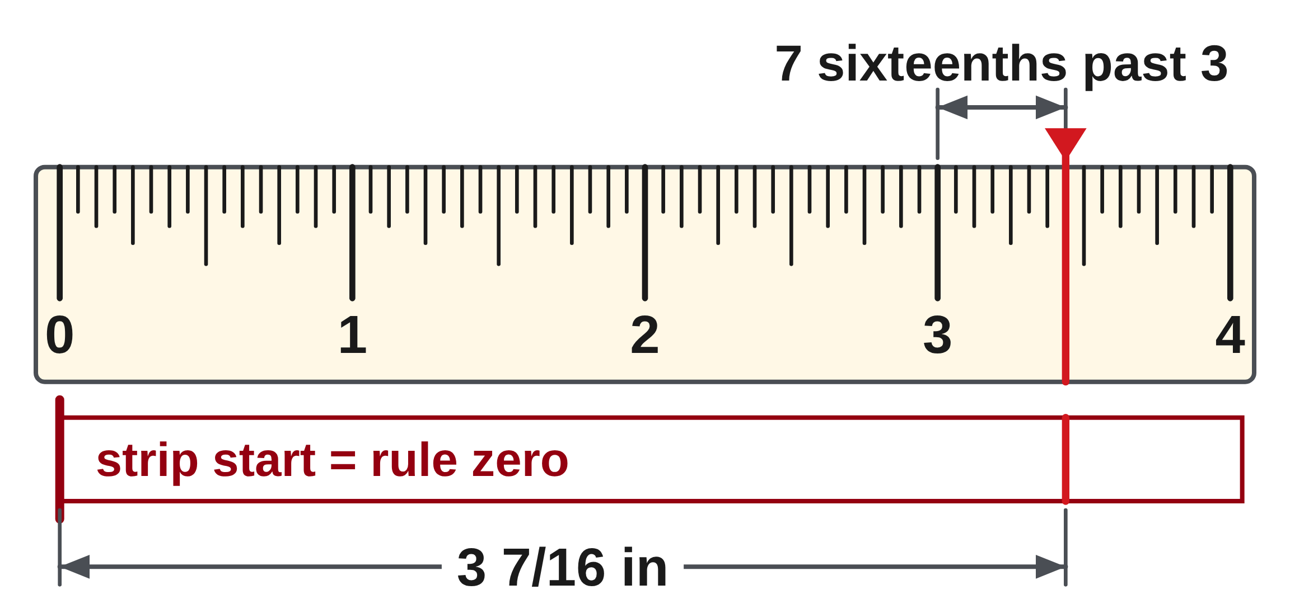
W02-L09 • TEACH • 9:10 AM–9:25 AM • 15 MIN TOTAL
Mark once; reread independently
Classroom dimension: 3 7/16 in
1. Align the rule’s zero with the chosen start point.
2. Find 3 whole inches.
3. Count seven sixteenth-inch spaces.
4. Mark and label; a partner rereads from zero.
Together • Use all four values in 4A Q3 to mark a strip.
Partners verify each mark. In Shape Canvas, use the written dimension labels—not the physical size on the screen.
W2 L9 • A zoom change must not change the dimension you mark
Textbook
Exercise Book
Numeracy Hub
Shape Canvas
Day 07 • 2026-11-06 • 07
Notes:
TEACH • 9:10 AM–9:25 AM • 15 MIN TOTAL — shared across this phase.
Our example is three and seven sixteenths inches. Start at zero, locate three whole inches, then count seven sixteenth-inch spaces beyond three. The mark should fall just short of three and one half, because eight sixteenths is one half. That nearby benchmark gives us a quick reasonableness check. Label the mark 3 7/16 in and ask a partner to reread it from zero. Where should they begin counting the seven spaces? At the three-inch mark, not at the start of the rule. A zoom change on the displayed example must not alter the paper-strip measurement.

Slide 8
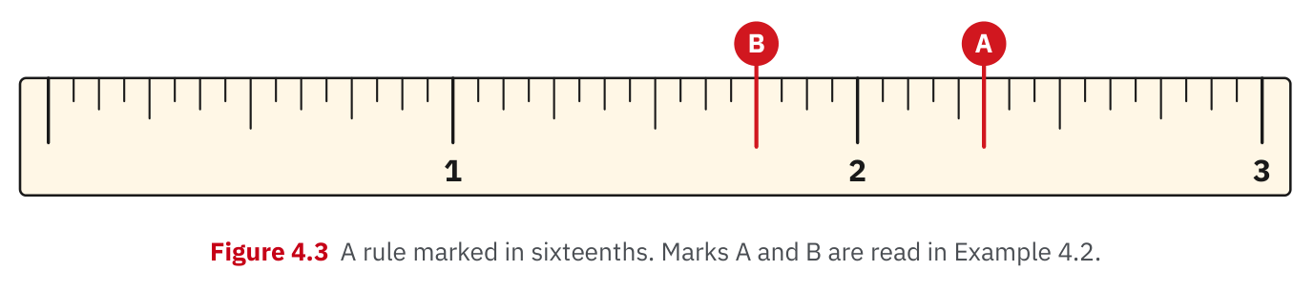
W02-L09 • TEACH • 9:10 AM–9:25 AM • 15 MIN TOTAL
Textbook | page 89
Textbook p.89 · Figure 4.3: transfer the written measurement, not the screen size.
Textbook Chapter 4 pp.88–96
Textbook
Exercise Book
Numeracy Hub
Shape Canvas
Day 07 • 2026-11-06 • 08
Notes:
TEACH • 9:10 AM–9:25 AM • 15 MIN TOTAL — shared across this phase.
Figure 4.3 on page 89 shows how a dimension reading relates to the ruler's subdivisions. Look first for the preceding whole-inch mark, then identify the size of the small intervals. That establishes the denominator before we count the numerator. How would you transfer a reading from this illustration to your paper? Write the full reading, place your own rule at zero, and reconstruct that measurement using your rule. We are transferring information, not tracing the picture's physical width. That distinction matters whenever drawings are printed, projected, or resized on a screen.

Slide 9
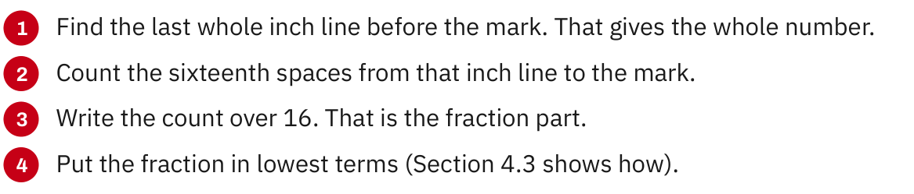
W02-L09 • TEACH • 9:10 AM–9:25 AM • 15 MIN TOTAL
Textbook | page 89
Textbook p.89 · Four steps for rereading a mark from the last whole inch.
Textbook Chapter 4 pp.88–96
Textbook
Exercise Book
Numeracy Hub
Shape Canvas
Day 07 • 2026-11-06 • 09
Notes:
TEACH • 9:10 AM–9:25 AM • 15 MIN TOTAL — shared across this phase.
Use the steps on page 89 to reread a mark systematically. Locate the last whole inch before the mark. Determine how many equal spaces divide the next inch. Count from the whole-inch position to the mark, then simplify the fraction if possible. Why not start by naming a familiar-looking tick? Tick lengths vary among rules, and a rushed guess can hide a whole-inch error. The sequence gives us a reproducible reading. Ask your partner to say both the unsimplified fraction and its simplest form when the count can be reduced; the endpoint must remain identical.

Slide 10
W02-L09 • TEACH • 9:10 AM–9:25 AM • 15 MIN TOTAL
Spot the mistake. Explain the correction.
A Shape Canvas rectangle looks longer after zooming. Should its paper-strip dimension increase?
Discuss the method before checking the answer.
No. Zoom changes the display size. Use the unchanged written dimension label to mark the strip.
Textbook Chapter 4 pp.88–96
Textbook
Exercise Book
Numeracy Hub
Shape Canvas
Day 07 • 2026-11-06 • 10
Notes:
TEACH • 9:10 AM–9:25 AM • 15 MIN TOTAL — shared across this phase.
The rectangle grows on screen when we zoom in. Should the paper-strip dimension increase too? No: zoom changes the display, not the object described by the dimension label. If the label still says three and seven sixteenths inches, that is the length we mark. What would need to change for us to make a different mark? The specified dimension itself. Point to the label before measuring. This habit keeps a visual impression from overriding the actual information on a drawing, especially when a projected image is much larger than the physical part.

Slide 11
W02-L09 • TOGETHER • 9:25 AM–9:40 AM • 15 MIN TOTAL
Work together
Use the four values in 4A question 3 to mark and label a paper strip; partners verify each mark.
Work in pairs; alternate solver and checker.
Resources: Exercise Book 4A Q3 (p.35), Q8–11 (p.36)
Textbook Chapter 4 pp.88–96
Textbook
Exercise Book
Numeracy Hub
Shape Canvas
Day 07 • 2026-11-06 • 11
Notes:
TOGETHER • 9:25 AM–9:40 AM • 15 MIN TOTAL — shared across this phase.
Use all four values in 4A question 3 to mark and label a paper strip. Start by reading A, B, C, and D from the exercise diagram. Then transfer each value from the same zero point on your strip. Your partner should reread the marks without borrowing your answer. If you disagree, compare whole inches first and fractional intervals second. Which part of the process could explain a constant shift in every mark? A misplaced starting point would shift them all.

Slide 12
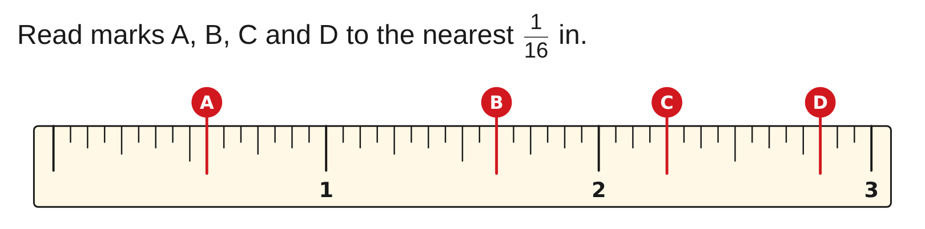
W02-L09 • TOGETHER • 9:25 AM–9:40 AM • 15 MIN TOTAL
Guided practice | 4A Q3
Work with a partner. Take turns explaining the next step.
Textbook Chapter 4 pp.88–96
Textbook
Exercise Book
Numeracy Hub
Shape Canvas
Day 07 • 2026-11-06 • 12
Notes:
TOGETHER • 9:25 AM–9:40 AM • 15 MIN TOTAL — shared across this phase.
Read A, B, C, and D to the nearest sixteenth of an inch before marking your strip. For each, identify the whole-inch part and count the remaining sixteenths. Simplify only after the reading is secure.
Instructor only, after the attempt: A = 9/16 in; B = 1 5/8 in, from 1 10/16; C = 2 1/4 in, from 2 4/16; D = 2 13/16 in. Preserve the whole inches when simplifying the fractional part.

Slide 13
W02-L09 • TOGETHER • 9:25 AM–9:40 AM • 15 MIN TOTAL
Compare your method | 4A Q3
CHECK TOGETHER
A: 9/16 in, B: 1 5/8 in, C: 2 1/4 in, D: 2 13/16 in
Textbook Chapter 4 pp.88–96
Textbook
Exercise Book
Numeracy Hub
Shape Canvas
Day 07 • 2026-11-06 • 13
Notes:
TOGETHER • 9:25 AM–9:40 AM • 15 MIN TOTAL — shared across this phase.
Check A at nine sixteenths, B at one and five eighths, C at two and one quarter, and D at two and thirteen sixteenths inches. B can first be read as one and ten sixteenths, and C as two and four sixteenths. Those unsimplified readings help us count the ruler spaces; the simplified labels name the same positions. Which marks lie beyond two inches? C and D. If either was placed before two, revisit the whole-inch step before changing the fraction.

Slide 14
W02-L09 • PRACTISE • 9:40 AM–10:00 AM • 20 MIN TOTAL
Your scheduled practice
Create four dimension labels from questions 8–11, then mark them on paper. Compare readings, circle disagreements and correct them with a written reason.
Show working and units; estimate, then check.
Resources: Exercise Book 4A Q3 (p.35), Q8–11 (p.36)
Textbook Chapter 4 pp.88–96
Textbook
Exercise Book
Numeracy Hub
Shape Canvas
Day 07 • 2026-11-06 • 14
Notes:
PRACTISE • 9:40 AM–10:00 AM • 20 MIN TOTAL — shared across this phase.
Create four dimension labels using questions 8–11, then transfer those dimensions to paper. Compare your marks with a partner's readings. Keep any disagreement visible long enough to explain its cause, then correct it with a written reason. If you select a value involving thirty-seconds, use a rule that can represent thirty-seconds; do not silently replace it with a nearby sixteenth. What makes a useful correction? 'I counted the starting line as one interval' identifies a cause; 'I got it wrong' does not.

Slide 15

W02-L09 • PRACTISE • 9:40 AM–10:00 AM • 20 MIN TOTAL
Open Numeracy Hub
Navigation example. Use the values and units in the assigned task.
Textbook Chapter 4 pp.88–96
Textbook
Exercise Book
Numeracy Hub
Shape Canvas
Day 07 • 2026-11-06 • 15
Notes:
PRACTISE • 9:40 AM–10:00 AM • 20 MIN TOTAL — shared across this phase.
Numeracy Hub can support a careful reading of the measuring intervals shown here. Use it to revisit the size of the fractional divisions, then return to the actual dimension labels in your assignment. The screen is a reference for reading; your paper mark still comes from your physical rule and its zero point. Ask yourself what denominator the displayed subdivision represents. If your actual rule uses a different subdivision, rename the fraction equivalently before counting its spaces.

Slide 16
W02-L09 • PRACTISE • 9:40 AM–10:00 AM • 20 MIN TOTAL
Practise in Shape Canvas
1
Supported: In Shape Canvas, create rectangles labelled with the four values from 4A Q3.
2
Independent practice: Use the labels and an actual rule to mark a paper strip from one start point.
3
Independent checking: Exchange strips, reread from zero and explain any corrected disagreement.
Textbook Chapter 4 pp.88–96
Textbook
Exercise Book
Numeracy Hub
Shape Canvas
Day 07 • 2026-11-06 • 16
Notes:
PRACTISE • 9:40 AM–10:00 AM • 20 MIN TOTAL — shared across this phase.
Create rectangles in Shape Canvas labelled with the four values from 4A question 3. Keep the units in inches. Use those labels and an actual rule to mark a strip from one common start point. Exchange strips and read each mark independently before comparing labels. What is the value of the digital drawing here? It gives us clearly labelled dimensions to transfer and discuss. The screen's size is not a measuring instrument. Explain any correction by naming the start-point, whole-inch, or fractional-space error that caused it.

Slide 17
W02-L09 • PRACTISE • 9:40 AM–10:00 AM • 20 MIN TOTAL
Practise from the Exercise Book | 4A Q8
Write the operation, working and units before checking.
Textbook Chapter 4 pp.88–96
Textbook
Exercise Book
Numeracy Hub
Shape Canvas
Day 07 • 2026-11-06 • 17
Notes:
PRACTISE • 9:40 AM–10:00 AM • 20 MIN TOTAL — shared across this phase.
For question 8, mark nine sixteenths and five eighths from the same zero. Decide which is longer, then explain the gap using a common denominator. Try the arithmetic before looking at the difference on the rule.
Instructor only, after the attempt: 5/8 = 10/16, so 5/8 in is longer than 9/16 in by 1/16 in. The marks should be adjacent sixteenth-inch positions. If the physical gap is larger, recheck how each label was transferred.

Slide 18
W02-L09 • PRACTISE • 9:40 AM–10:00 AM • 20 MIN TOTAL
Practise from the Exercise Book | 4A Q9
Write the operation, working and units before checking.
Textbook Chapter 4 pp.88–96
Textbook
Exercise Book
Numeracy Hub
Shape Canvas
Day 07 • 2026-11-06 • 18
Notes:
PRACTISE • 9:40 AM–10:00 AM • 20 MIN TOTAL — shared across this phase.
Question 9 compares thirteen thirty-seconds, three eighths, and seven sixteenths. Rewrite all three in thirty-seconds before ordering. A rule with thirty-second divisions can confirm the positions; a sixteenth-only rule cannot show the middle value exactly.
Instructor only, after the attempt: 3/8 = 12/32 and 7/16 = 14/32. The ascending order is 3/8, 13/32, 7/16. Thirteen thirty-seconds sits halfway between twelve thirty-seconds and fourteen thirty-seconds, so do not round it to either neighbour.

Slide 19
W02-L09 • CHECK • 10:00 AM–10:10 AM • 10 MIN TOTAL
Check independently
Read two partner-created marks and simplify 14/32 and 36/64.
Answer independently and show the method.
Resources: Exercise Book 4A Q3 (p.35), Q8–11 (p.36)
Textbook Chapter 4 pp.88–96
Textbook
Exercise Book
Numeracy Hub
Shape Canvas
Day 07 • 2026-11-06 • 19
Notes:
CHECK • 10:00 AM–10:10 AM • 10 MIN TOTAL — shared across this phase.
Independently read two marks your partner created. Record the full dimensions and units before comparing with their intended labels. Then simplify fourteen thirty-seconds and thirty-six sixty-fourths, showing the common factors. Your partner's marks have answers determined by their actual positions, so verify them from zero.
Instructor only, after the attempt: 14/32 = 7/16 by dividing both numbers by two; 36/64 = 9/16 by dividing both by four. For physical marks, assess the reading against the actual mark, not an assumed answer.

Slide 20
W02-L09 • WRAP UP • 10:10 AM–10:15 AM • 5 MIN TOTAL
Wrap up and choose the next step
Share one learning point and one skill to practise next.
Record a takeaway and next action.
Resources: Exercise Book 4A Q3 (p.35), Q8–11 (p.36)
Textbook Chapter 4 pp.88–96
Textbook
Exercise Book
Numeracy Hub
Shape Canvas
Play quiz
Quiz PDF
Day 07 • 2026-11-06 • 20
Notes:
WRAP UP • 10:10 AM–10:15 AM • 5 MIN TOTAL — shared across this phase.
Name one habit that made your marks more reliable today. Aligning zero, finding whole inches first, counting spaces, and independent rereading are all useful answers. Choose one correction you made and explain why it was needed. What stayed unchanged when the drawing was zoomed? Its labelled dimensions. After the break we will bring reading, simplifying, comparing, and converting together in a foundations checkpoint, then use the results to choose a precise practice priority.

Slide 21
DAY 07 • SCHEDULED BREAK
Break
10:15 AM–10:30 AM
Return ready for: Fraction foundations checkpoint
This break is excluded from teaching minutes.
Textbook
Exercise Book
Numeracy Hub
Shape Canvas
Day 07 • 2026-11-06 • 21
Notes:
Take the scheduled break from 10:15 to 10:30. Return at 10:30 for the fraction foundations checkpoint. Keep your rule, paper, and exercise book available so you can show both measurement readings and fraction calculations.

Slide 22
W02-L10 • START • 10:30 AM–10:35 AM • 5 MIN TOTAL
Fraction foundations checkpoint
Today’s goal: Independently read, simplify, compare and convert fractions before progressing to operations.
Name one use for today’s skill.
Textbook Chapter 4 pp.88–96
Exercise Book 4A Q3,6,8,10–11 (pp.35–36)
Keep your notebook, textbook, exercise book and chosen calculator ready.
Textbook Chapter 4 pp.88–96
Textbook
Exercise Book
Numeracy Hub
Shape Canvas
Day 07 • 2026-11-06 • 22
Notes:
START • 10:30 AM–10:35 AM • 5 MIN TOTAL — shared across this phase.
This block checks the foundations we need before fraction operations. You will read ruler marks, simplify fractions, compare lengths, and convert number forms. The goal is to see which steps you can carry out independently and which need more practice. Why keep working even when the answer seems obvious? It lets us distinguish a reading error from a conversion error. Use the textbook on pages 88–96 during the review; the independent attempt comes before checking the answers.

Slide 23
W02-L10 • RECALL • 10:35 AM–10:40 AM • 5 MIN TOTAL
Recall and reconnect
Take a moment to name the fraction skill they find hardest; review the meaning of simplest form.
Try first without displayed answers.
Resources: Exercise Book 4A Q3,6,8,10–11 (pp.35–36)
Textbook Chapter 4 pp.88–96
Textbook
Exercise Book
Numeracy Hub
Shape Canvas
Day 07 • 2026-11-06 • 23
Notes:
RECALL • 10:35 AM–10:40 AM • 5 MIN TOTAL — shared across this phase.
Which fraction skill feels least secure right now: reading, simplifying, comparing, or converting? Name the actual step that gives you trouble. Recall what simplest form means: the numerator and denominator have no common whole-number factor greater than one. Does simplest form mean the smallest-looking numerator alone? No; we must preserve the value by dividing both parts by the same factor. An honest practice priority helps us use the checkpoint well, because it directs attention to the step that needs repair.

Slide 24
W02-L10 • TEACH • 10:40 AM–10:55 AM • 15 MIN TOTAL
Show the reading and the number form
1
For a tape mark, record the whole inches, fractional spaces and unit.
2
For simplification, divide numerator and denominator by the same factor.
3
For a mixed number, account for all whole units before writing an improper fraction.
4
Keep enough working to distinguish a reading error from a conversion error.
Textbook Chapter 4 pp.88–96
Textbook
Exercise Book
Numeracy Hub
Shape Canvas
Day 07 • 2026-11-06 • 24
Notes:
TEACH • 10:40 AM–10:55 AM • 15 MIN TOTAL — shared across this phase.
Each question type needs its own visible evidence. For a ruler reading, record the whole inches, the counted fractional spaces, and the unit. To simplify, show the common factor dividing both numbers. To compare, rename the values with a common denominator. To convert a mixed number, count all the fractional pieces in its whole part before adding the remainder. Why show these intermediate steps? If an answer is wrong, they reveal where the reasoning changed. A correctly read mark followed by an incorrect reduction needs different practice from a mark read from the wrong whole inch.

Slide 25
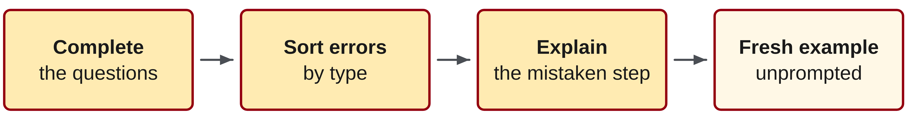
W02-L10 • TEACH • 10:40 AM–10:55 AM • 15 MIN TOTAL
Use a checkpoint to locate the next practice need
1
Complete the assigned questions before displaying answers.
2
Sort errors into reading, simplifying, comparing or converting.
3
Explain the mistaken step before attempting a fresh example of that type.
4
A fresh unprompted solution shows whether the correction is understood.
Textbook Chapter 4 pp.88–96
Textbook
Exercise Book
Numeracy Hub
Shape Canvas
Day 07 • 2026-11-06 • 25
Notes:
TEACH • 10:40 AM–10:55 AM • 15 MIN TOTAL — shared across this phase.
A checkpoint is useful when we can learn from its pattern. Finish your own attempt before checking. Then identify whether each difficulty involved reading, simplifying, comparing, or converting. For example, a correct unsimplified reading followed by an incorrect reduced fraction points to simplification, not measurement. Explain the mistaken step in words, then try a fresh partner-created example of that same type without prompts. What tells us the correction has become yours? You can solve the new example and explain its check without copying the earlier answer. That is the evidence we will look for in the final check.

Slide 26
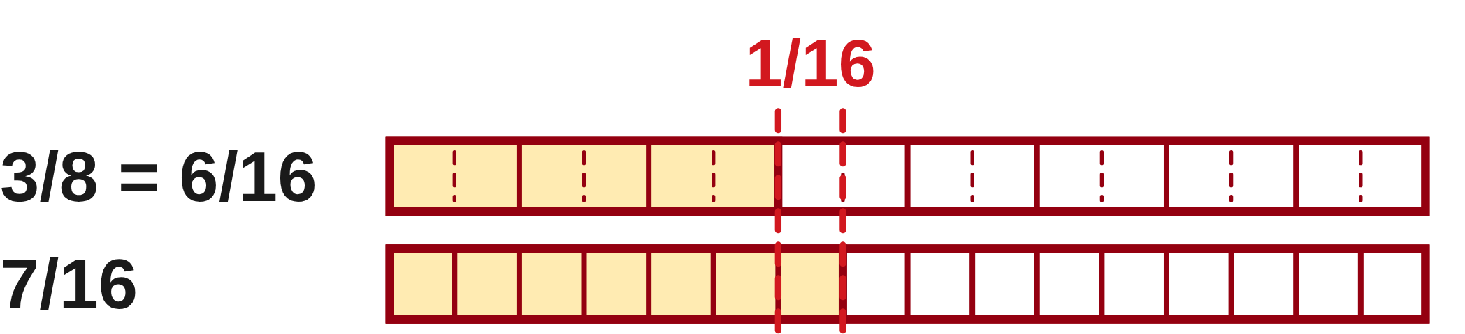
W02-L10 • TEACH • 10:40 AM–10:55 AM • 15 MIN TOTAL
Show the method on different examples
Simplify: 12/16 = 3/4
Compare: 3/8 = 6/16, so 7/16 is longer by 1/16
Convert: 2 1/4 = 9/4
For a tape reading: identify whole inches, count spaces and simplify. Use a fresh mark on an actual rule.
Together
Use fraction strips to explain equivalence. Clarify directions and units without giving the checkpoint answers.
W2 L10 • These are preparation examples, not the scored book items
Textbook
Exercise Book
Numeracy Hub
Shape Canvas
Day 07 • 2026-11-06 • 26
Notes:
TEACH • 10:40 AM–10:55 AM • 15 MIN TOTAL — shared across this phase.
Here are preparation examples with different values. Twelve sixteenths simplifies to three quarters because both twelve and sixteen divide by four. To compare three eighths and seven sixteenths, rename three eighths as six sixteenths; seven sixteenths is larger by one sixteenth. Finally, two and one quarter contains eight quarters in the two wholes plus one more, so it is nine quarters. Which step do all these examples have in common? We preserve the size of the value while choosing a useful form. For ruler reading, use the same discipline: whole inches first, then equal spaces and simplification.

Slide 27
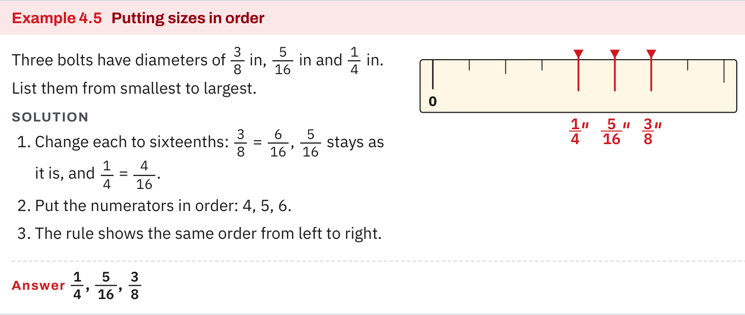
W02-L10 • TEACH • 10:40 AM–10:55 AM • 15 MIN TOTAL
Textbook | page 94
Textbook p.94 · Different-number preparation: compare and order sizes.
Textbook Chapter 4 pp.88–96
Textbook
Exercise Book
Numeracy Hub
Shape Canvas
Day 07 • 2026-11-06 • 27
Notes:
TEACH • 10:40 AM–10:55 AM • 15 MIN TOTAL — shared across this phase.
On page 94, follow the preparation example for comparing and ordering dimensions. Identify where the fractions are renamed so their parts have the same size. Then read the ordering from the shared-unit values, not from the original numerators alone. If two labels have different denominators, what must we know before comparing their numerators? We need a common denominator. Keep this example separate from your checkpoint answers: its purpose is to remind you of the method. On your own questions, you will choose the appropriate denominator and show the conversions yourself.

Slide 28
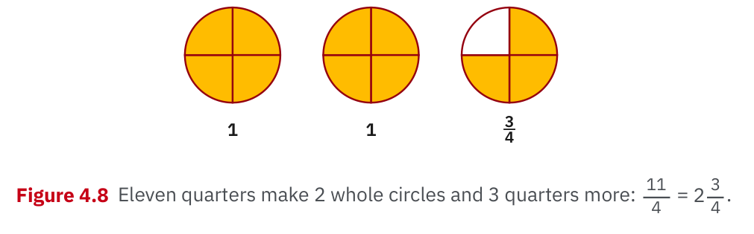
W02-L10 • TEACH • 10:40 AM–10:55 AM • 15 MIN TOTAL
Textbook | page 94
Textbook p.94 · Figure 4.8: eleven quarters are two wholes and three quarters.
Textbook Chapter 4 pp.88–96
Textbook
Exercise Book
Numeracy Hub
Shape Canvas
Day 07 • 2026-11-06 • 28
Notes:
TEACH • 10:40 AM–10:55 AM • 15 MIN TOTAL — shared across this phase.
Figure 4.8 represents eleven quarters. Group the pieces into complete wholes: four quarters make the first whole, and four more make the second. How many quarters remain? Three. Therefore eleven quarters is two and three quarters. This picture explains the quotient-and-remainder method: eleven divided by four gives two whole groups and a remainder of three. Why is the remaining denominator still four? The leftover pieces are quarters. Reverse the explanation by counting two times four plus three, and you return to eleven quarter-sized pieces without changing the total amount.

Slide 29
W02-L10 • TEACH • 10:40 AM–10:55 AM • 15 MIN TOTAL
Spot the mistake. Explain the correction.
A learner simplifies 12/16 to 3/16 by dividing only the numerator. Has the value stayed the same?
Discuss the method before checking the answer.
No. Divide both numerator and denominator by 4: 12/16 = 3/4.
Textbook Chapter 4 pp.88–96
Textbook
Exercise Book
Numeracy Hub
Shape Canvas
Day 07 • 2026-11-06 • 29
Notes:
TEACH • 10:40 AM–10:55 AM • 15 MIN TOTAL — shared across this phase.
A learner changes twelve sixteenths into three sixteenths by dividing only the numerator by four. Has the value stayed the same? No: three sixteenths is only one quarter of twelve sixteenths. To simplify without changing the amount, divide both twelve and sixteen by four. The result is three quarters. Ask yourself where the two proposed answers lie on a rule: three quarters is past halfway, while three sixteenths is well before halfway. That visual check exposes the mistake immediately and reinforces why both parts must change together.

Slide 30
W02-L10 • TOGETHER • 10:55 AM–11:10 AM • 15 MIN TOTAL
Work together
Use fraction strips to explain equivalence; clarify question directions and required units.
Work in pairs; alternate solver and checker.
Resources: Exercise Book 4A Q3,6,8,10–11 (pp.35–36)
Textbook Chapter 4 pp.88–96
Textbook
Exercise Book
Numeracy Hub
Shape Canvas
Day 07 • 2026-11-06 • 30
Notes:
TOGETHER • 10:55 AM–11:10 AM • 15 MIN TOTAL — shared across this phase.
Use fraction strips with a partner to explain equivalence before beginning the checkpoint. Show how subdividing each piece changes the count but preserves the endpoint. Clarify what each direction asks: 'simplify' means lowest terms, 'compare' means decide relative size, and 'convert' means change number form. Which answers require inches? Measurements and differences of lengths do. We are clarifying methods and units here, so keep the actual checkpoint answers closed until everyone has made an independent attempt.

Slide 31
W02-L10 • PRACTISE • 11:10 AM–11:45 AM • 35 MIN TOTAL
Your scheduled practice
Complete 4A questions 3,6,8,10–11 independently. Check, sort errors by reading or number form, and redo missed types with partner-created examples.
Show working and units; estimate, then check.
Resources: Exercise Book 4A Q3,6,8,10–11 (pp.35–36)
Textbook Chapter 4 pp.88–96
Textbook
Exercise Book
Numeracy Hub
Shape Canvas
Day 07 • 2026-11-06 • 31
Notes:
PRACTISE • 11:10 AM–11:45 AM • 35 MIN TOTAL — shared across this phase.
Complete 4A questions 3, 6, 8, 10, and 11 independently first. After that, check the work and sort any errors by skill. Do not erase the evidence before understanding it. If the error was in a ruler reading, identify the whole-inch or interval step. If it was a number-form error, identify the factor, common denominator, or whole-group calculation. Then ask a partner for a fresh example of the missed type and try it without prompts. The retry should show the corrected reasoning.

Slide 32
W02-L10 • PRACTISE • 11:10 AM–11:45 AM • 35 MIN TOTAL
Open Numeracy Hub
Navigation example. Use the values and units in the assigned task.
Textbook Chapter 4 pp.88–96
Textbook
Exercise Book
Numeracy Hub
Shape Canvas
Day 07 • 2026-11-06 • 32
Notes:
PRACTISE • 11:10 AM–11:45 AM • 35 MIN TOTAL — shared across this phase.
Numeracy Hub is available for checking after your first attempt. Use its measuring support or chosen calculator to investigate one specific result that did not match. Before checking, say what you expect the tool to confirm: a ruler position, an equivalent fraction, or a mixed-number form. If the display differs, compare the entered value and units with your written question. The useful outcome is an explanation of the discrepancy, because the final retry will ask you to use that understanding independently.

Slide 33
W02-L10 • PRACTISE • 11:10 AM–11:45 AM • 35 MIN TOTAL
Practise in Shape Canvas
1
Independent first attempt: Use paper and a rule for 4A Q3,6,8,10–11 without displayed answers.
2
Checking after completion: Use the chosen calculator or rule to locate and explain one error.
3
Independent retry: Rebuild one corrected dimension in Shape Canvas, then solve a fresh missed type.
Textbook Chapter 4 pp.88–96
Textbook
Exercise Book
Numeracy Hub
Shape Canvas
Day 07 • 2026-11-06 • 33
Notes:
PRACTISE • 11:10 AM–11:45 AM • 35 MIN TOTAL — shared across this phase.
Start with paper and a rule for 4A questions 3, 6, 8, 10, and 11. After checking, choose one corrected dimension and rebuild its labelled drawing in Shape Canvas. Explain what the corrected label means and where it belongs on a real rule. Then solve a fresh partner-created example of the same missed type. What does this sequence test? It shows whether you can connect the corrected number to a dimension and apply the repaired method beyond the original question.

Slide 34
W02-L10 • PRACTISE • 11:10 AM–11:45 AM • 35 MIN TOTAL
Practise from the Exercise Book | 4A Q3
Write the operation, working and units before checking.
Textbook Chapter 4 pp.88–96
Textbook
Exercise Book
Numeracy Hub
Shape Canvas
Day 07 • 2026-11-06 • 34
Notes:
PRACTISE • 11:10 AM–11:45 AM • 35 MIN TOTAL — shared across this phase.
Read the four marks in 4A question 3 independently. Write whole inches and fractional spaces before simplifying, so your reasoning remains visible. Do not use the earlier displayed answers until the attempt is finished.
Instructor only, after the attempt: A = 9/16 in; B = 1 5/8 in; C = 2 1/4 in; D = 2 13/16 in. B's ten sixteenths reduces to five eighths; C's four sixteenths reduces to one quarter. Use the unsimplified readings to locate any measurement-versus-reduction error.

Slide 35
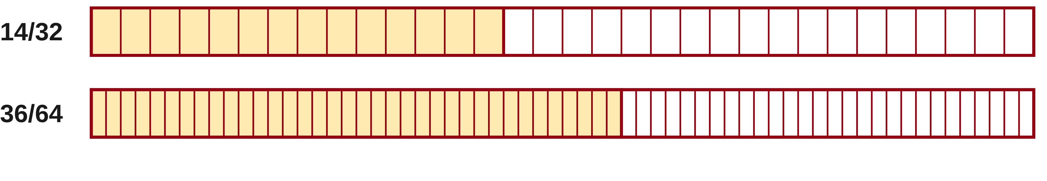
W02-L10 • PRACTISE • 11:10 AM–11:45 AM • 35 MIN TOTAL
Practise from the Exercise Book | 4A Q6
Write the operation, working and units before checking.
Textbook Chapter 4 pp.88–96
Textbook
Exercise Book
Numeracy Hub
Shape Canvas
Day 07 • 2026-11-06 • 35
Notes:
PRACTISE • 11:10 AM–11:45 AM • 35 MIN TOTAL — shared across this phase.
For question 6, reduce fourteen thirty-seconds and thirty-six sixty-fourths to lowest terms. Show which common factor you use, and check whether another reduction remains possible. Can a result be equivalent but unfinished? Yes, if its numerator and denominator still share a factor.
Instructor only, after the attempt: 14/32 = 7/16 and 36/64 = 9/16. Eighteen thirty-seconds is an equivalent intermediate form for the second value, but dividing both parts by two again is needed for lowest terms.

Slide 36
W02-L10 • CHECK • 11:45 AM–11:55 AM • 10 MIN TOTAL
Check independently
Redo one missed type without prompts and explain how the check shows it is correct.
Answer independently and show the method.
Resources: Exercise Book 4A Q3,6,8,10–11 (pp.35–36)
Textbook Chapter 4 pp.88–96
Textbook
Exercise Book
Numeracy Hub
Shape Canvas
Day 07 • 2026-11-06 • 36
Notes:
CHECK • 11:45 AM–11:55 AM • 10 MIN TOTAL — shared across this phase.
Choose one type you missed and solve a fresh example of that type without prompts. After finishing, explain how you checked it. For a reading, reread from zero; for simplification, multiply back by the common factor; for comparison, verify equal-sized parts; for conversion, reverse the whole-group calculation. What makes your explanation convincing? It must connect your actual values to a valid check. Answers will vary with the partner-created example, so judge the result against that example and its shown reasoning.

Slide 37
W02-L10 • WRAP UP • 11:55 AM–12:00 PM • 5 MIN TOTAL
Wrap up and choose the next step
Share one learning point and one skill to practise next.
Record a takeaway and next action.
Resources: Exercise Book 4A Q3,6,8,10–11 (pp.35–36)
Textbook Chapter 4 pp.88–96
Textbook
Exercise Book
Numeracy Hub
Shape Canvas
Play quiz
Quiz PDF
Day 07 • 2026-11-06 • 37
Notes:
WRAP UP • 11:55 AM–12:00 PM • 5 MIN TOTAL — shared across this phase.
Name the foundation you can now do reliably and the specific step you will keep practising. 'Fractions' is too broad; 'finding the common denominator before comparison' is a useful target. Tell a partner how one corrected answer was verified. Next week we will use these foundations in fraction operations before applying them to job situations in Week 4. Equal-sized parts, complete whole groups, and clear units will remain our checks as the calculations become longer.

