Slide 1

CARPENTRY FOUNDATION / INTAKE 142
Day 09 | Tuesday
09
November 10, 2026
Repeated pieces and equal groups
12:45 PM–2:00 PM • Math • 75 min
Fraction operations: check and retry
2:15 PM–3:30 PM • Math • 75 min
Week 3 • 2 scheduled blocks • 150 teaching minutes
Estimate. Show the method. Label units. Check the result.
Textbook
Exercise Book
Numeracy Hub
Shape Canvas
Day 09 • 2026-11-10 • 01
Notes:
Today we find totals made from repeated pieces, divide lengths into equal parts, and locate centre lines. Then we bring all four fraction operations together and use checking to repair specific errors. Before calculating, ask what the answer represents. Is it a length, or a count of pieces? That distinction will guide both the operation and the final label. A calculator can confirm arithmetic, but we must decide what the arithmetic means.

Slide 2
DAY 09 / WEEK 3 / CLASS TIMETABLE
Today’s exact schedule
12:45 PM–2:00 PM • 75 min
2:15 PM–3:30 PM • 75 min
Repeated pieces and equal groups
Fraction operations: check and retry
12:45 PM–12:50 PM
Start
5
2:15 PM–2:20 PM
Start
5
12:50 PM–12:55 PM
Recall
5
2:20 PM–2:25 PM
Recall
5
12:55 PM–1:10 PM
Teach
15
2:25 PM–2:40 PM
Teach
15
1:10 PM–1:25 PM
Together
15
2:40 PM–2:55 PM
Together
15
1:25 PM–1:45 PM
Practise
20
2:55 PM–3:15 PM
Practise
20
1:45 PM–1:55 PM
Check
10
3:15 PM–3:25 PM
Check
10
1:55 PM–2:00 PM
Wrap up
5
3:25 PM–3:30 PM
Wrap up
5
Math • Math Week 3, Lesson 3
Math • Math Week 3, Lesson 4
Break: 2:00 PM–2:15 PM • 15 minutes • excluded from teaching time
Textbook
Exercise Book
Numeracy Hub
Shape Canvas
Day 09 • 2026-11-10 • 02
Notes:
We work from 12:45 to 2:00 on repeated pieces and equal groups. The scheduled break is 2:00–2:15. From 2:15 to 3:30, we check and retry fraction operations. In each block, the teaching and shared work prepare you for an independent attempt. The final check in the second block includes one item for each operation. Keep your original working visible during corrections so you can explain which step changed and why the new method works.

Slide 3
W03-L03 • START • 12:45 PM–12:50 PM • 5 MIN TOTAL
Repeated pieces and equal groups
Today’s goal: Use multiplication and division to find repeated fractional lengths and centre lines.
Name one use for today’s skill.
Textbook Chapter 4 pp.100–107
Exercise Book 4A Q16–17 (p.36); 4B Q4–5 (p.37); 4C Q5 (p.40)
Keep your notebook, textbook, exercise book and chosen calculator ready.
Textbook Chapter 4 pp.100–107
Textbook
Exercise Book
Numeracy Hub
Shape Canvas
Day 09 • 2026-11-10 • 03
Notes:
START • 12:45 PM–12:50 PM • 5 MIN TOTAL — shared across this phase.
Open the textbook to pages 100–107. Repeated pieces suggest multiplication: we want several copies of the same length. Equal sharing suggests division: we want the length of one share. Dividing a total length by a specified piece length asks a different question: how many such pieces fit? Which situation describes a centre line? Equal sharing into two halves. We will connect these meanings to 4A questions 16–17, 4B questions 4–5, and 4C question 5.

Slide 4
W03-L03 • RECALL • 12:50 PM–12:55 PM • 5 MIN TOTAL
Recall and reconnect
Explain how repeated addition connects to multiplication and how dividing by two finds a centre.
Try first without displayed answers.
Resources: Exercise Book 4A Q16–17 (p.36); 4B Q4–5 (p.37); 4C Q5 (p.40)
Textbook Chapter 4 pp.100–107
Textbook
Exercise Book
Numeracy Hub
Shape Canvas
Day 09 • 2026-11-10 • 04
Notes:
RECALL • 12:50 PM–12:55 PM • 5 MIN TOTAL — shared across this phase.
How does repeated addition connect to multiplication? Adding the same length three times gives three times that length. If a plate has a centre line, how much width lies on each side? Half the full width, so divide the width by two. The result remains a length. Now imagine dividing a total length by the length of one piece. What does that result tell us? The number of pieces. Same operation, different meaning; read what is being divided by what.

Slide 5
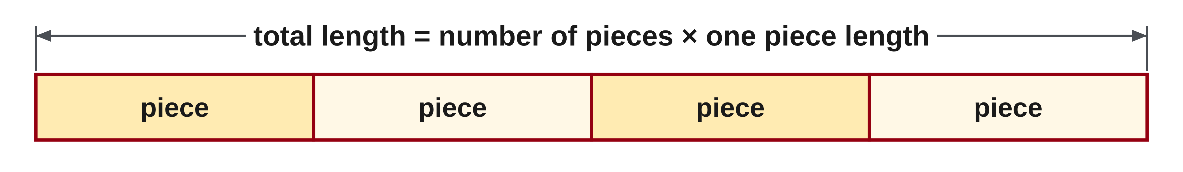
W03-L03 • TEACH • 12:55 PM–1:10 PM • 15 MIN TOTAL
Multiply to find repeated fractional lengths
1
Convert a mixed number to an improper fraction when useful.
2
Multiply the numerators and multiply the denominators.
3
Simplify and convert back to a mixed number when needed.
4
A repeated-strip drawing checks whether the total fits the number of pieces.
Textbook Chapter 4 pp.100–107
Textbook
Exercise Book
Numeracy Hub
Shape Canvas
Day 09 • 2026-11-10 • 05
Notes:
TEACH • 12:55 PM–1:10 PM • 15 MIN TOTAL — shared across this phase.
To multiply mixed numbers, convert each complete value to an improper fraction first. That keeps the whole and fractional parts together as one count. Multiply numerators to count the selected parts and multiply denominators to describe their resulting subdivision; then simplify and convert back if needed. A whole-number repeat count can be written over one. For repeated lengths, the result should match a drawing of equal labelled strips placed end to end. What must stay equal in that drawing? Every repeated piece length. If one rectangle has a different labelled length, it no longer represents a simple repeated-piece multiplication.

Slide 6
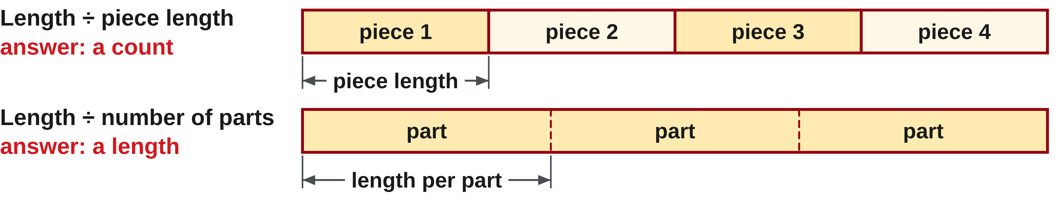
W03-L03 • TEACH • 12:55 PM–1:10 PM • 15 MIN TOTAL
Explain what division counts or measures
1
Dividing a length by a piece length gives a count of pieces.
2
Dividing a length by a number of equal parts gives a length per part.
3
To divide by a fraction, multiply by the reciprocal of the divisor.
4
Check a centre line by doubling its distance from the starting edge.
Textbook Chapter 4 pp.100–107
Textbook
Exercise Book
Numeracy Hub
Shape Canvas
Day 09 • 2026-11-10 • 06
Notes:
TEACH • 12:55 PM–1:10 PM • 15 MIN TOTAL — shared across this phase.
Division can find a piece count or a length per part. A length divided by a piece length counts how many equal pieces fit, so the final answer is a count. A length divided by a number of equal shares gives the length of each share. For a fraction divisor, multiply by its reciprocal; convert a mixed divisor to an improper fraction before taking that reciprocal. How can we check a centre-line distance? Double it and recover the full width. That check keeps the calculation tied to the physical meaning: the centre has two equal distances to opposite edges.

Slide 7
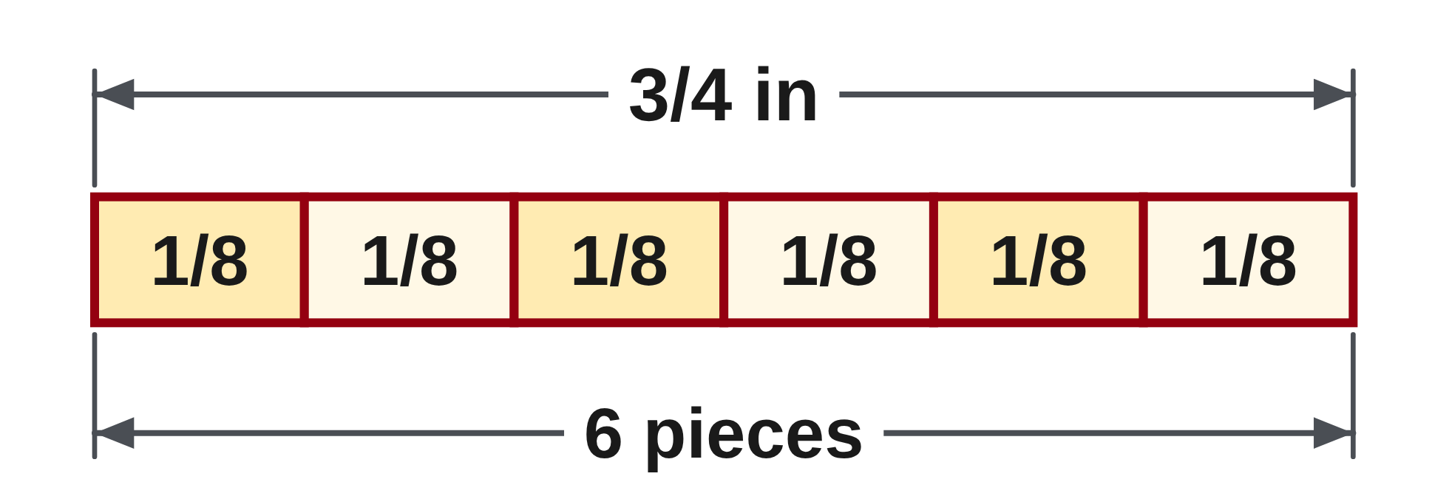
W03-L03 • TEACH • 12:55 PM–1:10 PM • 15 MIN TOTAL
Ask what the result measures or counts
3 × 2 3/8 in = 3 × 19/8 = 57/8 = 7 1/8 in
3/4 in ÷ 1/8 in = 3/4 × 8/1 = 6 pieces
The reciprocal changes division to multiplication.
Check the second result: six eighth-inch pieces total 3/4 in.
These classroom examples ignore kerf.
Together: 4A Q16(a), Q17(a), then 4B Q5 with a centre-line sketch. Repeat a labelled Shape Canvas rectangle and compare totals.
W3 L3 • Explain the meaning before using Numeracy Hub Calculator to check
Textbook
Exercise Book
Numeracy Hub
Shape Canvas
Day 09 • 2026-11-10 • 07
Notes:
TEACH • 12:55 PM–1:10 PM • 15 MIN TOTAL — shared across this phase.
Three pieces of two and three eighths inches give three times nineteen eighths: fifty-seven eighths. Seven complete groups of eight use fifty-six eighths, leaving one, so the total is seven and one eighth inches. Now the second example asks how many one-eighth-inch pieces fit into three quarters of an inch. Three quarters is six eighths, so the answer is six pieces. The reciprocal calculation, 3/4 × 8/1, confirms six. Why are the final labels different? The first operation combines lengths; the second counts pieces. These examples ignore kerf, so no cutting allowance is included.

Slide 8
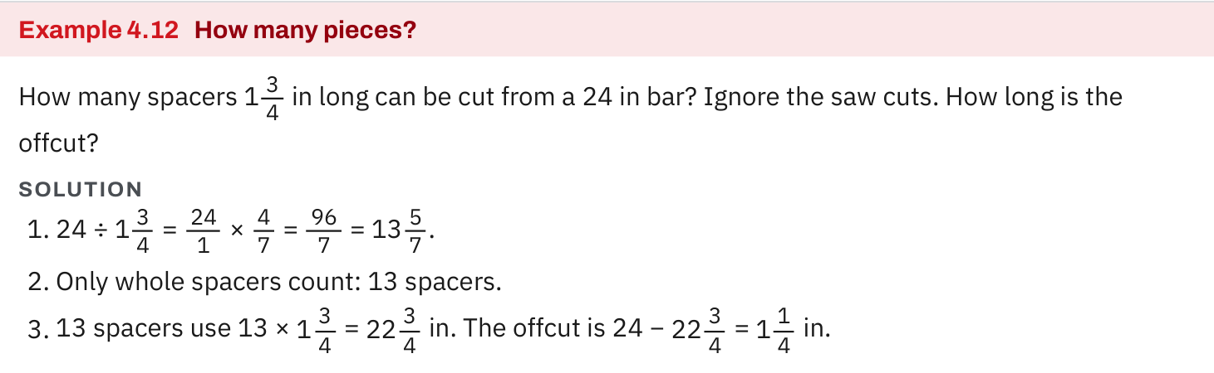
W03-L03 • TEACH • 12:55 PM–1:10 PM • 15 MIN TOTAL
Textbook | page 101
Textbook p.101 · Example 4.12: divide fractional lengths and count complete pieces.
Textbook Chapter 4 pp.100–107
Textbook
Exercise Book
Numeracy Hub
Shape Canvas
Day 09 • 2026-11-10 • 08
Notes:
TEACH • 12:55 PM–1:10 PM • 15 MIN TOTAL — shared across this phase.
Example 4.12 on page 101 divides a stock length by a piece length. Follow which value is the total and which is the size of one piece. The quotient tells us how many piece lengths fit. If it is not a whole number, what can we actually make? Only the complete pieces allowed by the whole-number part; a partial quotient is not another complete piece. To find the offcut, multiply the number of complete pieces by the piece length, then subtract from the stock length. This keeps the piece count distinct from the remaining length.

Slide 9
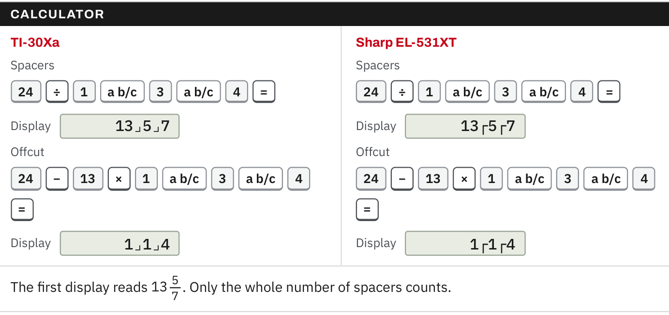
W03-L03 • TEACH • 12:55 PM–1:10 PM • 15 MIN TOTAL
Textbook | page 101
Textbook p.101 · Exact fraction calculator entry for the pieces and offcut.
Textbook Chapter 4 pp.100–107
Textbook
Exercise Book
Numeracy Hub
Shape Canvas
Day 09 • 2026-11-10 • 09
Notes:
TEACH • 12:55 PM–1:10 PM • 15 MIN TOTAL — shared across this phase.
Page 101 shows how exact fraction entry supports the piece-count and offcut calculation. Enter the stock and piece dimensions as written, using the documented fraction sequence for your calculator. Avoid rounding them to short decimals before division, because that could shift a result near a whole-piece boundary. What value goes into the offcut calculation? The number of complete pieces multiplied by the exact piece length. Then subtract that used length from the stock. Read the final display as a length and compare it with one full piece: an offcut smaller than a piece cannot supply another complete piece.

Slide 10
W03-L03 • TEACH • 12:55 PM–1:10 PM • 15 MIN TOTAL
Spot the mistake. Explain the correction.
For 3/4 in ÷ 1/8 in, should the answer be labelled inches?
Discuss the method before checking the answer.
The quotient counts eighth-inch pieces: 6 pieces. Check that 6 × 1/8 in restores 3/4 in.
Textbook Chapter 4 pp.100–107
Textbook
Exercise Book
Numeracy Hub
Shape Canvas
Day 09 • 2026-11-10 • 10
Notes:
TEACH • 12:55 PM–1:10 PM • 15 MIN TOTAL — shared across this phase.
Three quarters of an inch divided by one eighth of an inch gives six, but six what? Six pieces of the specified size. Calling it six inches would describe a length much larger than the stock and would contradict the question. Check the meaning by multiplying: six pieces times one eighth of an inch per piece equals six eighths of an inch, or three quarters. The length units in the division cancel because we are counting how many equal lengths fit. Always attach the label that matches the question being answered.

Slide 11
W03-L03 • TOGETHER • 1:10 PM–1:25 PM • 15 MIN TOTAL
Work together
Work 4A questions 16(a) and 17(a), then 4B question 5 with a centre-line sketch.
Work in pairs; alternate solver and checker.
Resources: Exercise Book 4A Q16–17 (p.36); 4B Q4–5 (p.37); 4C Q5 (p.40)
Textbook Chapter 4 pp.100–107
Textbook
Exercise Book
Numeracy Hub
Shape Canvas
Day 09 • 2026-11-10 • 11
Notes:
TOGETHER • 1:10 PM–1:25 PM • 15 MIN TOTAL — shared across this phase.
Work through 4A questions 16(a) and 17(a), then 4B question 5. Explain the operation before calculating. For multiplication, state what repeats or what fraction of a quantity is taken. For division, say whether the answer is a count or a length. Sketch the plate in question 5 with a centre line splitting it into two equal widths. What must the two distances add to? The full plate width. Use that relationship as your check after the calculation.

Slide 12
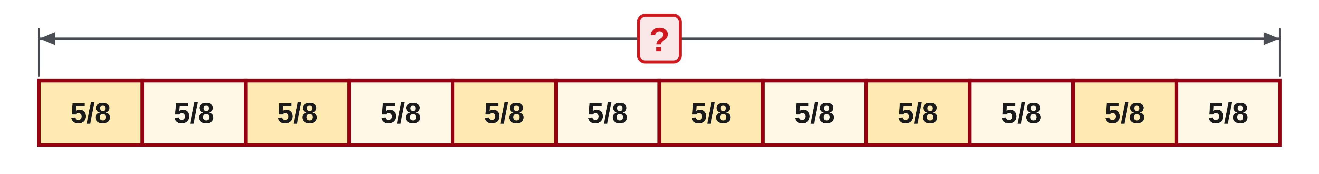
W03-L03 • TOGETHER • 1:10 PM–1:25 PM • 15 MIN TOTAL
Guided practice | 4A Q16a
Work with a partner. Take turns explaining the next step.
Textbook Chapter 4 pp.100–107
Textbook
Exercise Book
Numeracy Hub
Shape Canvas
Day 09 • 2026-11-10 • 12
Notes:
TOGETHER • 1:10 PM–1:25 PM • 15 MIN TOTAL — shared across this phase.
Multiply five eighths by twelve. Think of twelve equal groups, each containing five eighth-sized parts. Write twelve as twelve over one if that helps organize the multiplication. Predict whether the result lies between seven and eight.
Instructor only, after the attempt: (5/8) × (12/1) = 60/8 = 7 4/8 = 7 1/2. Alternatively, simplify 12/8 to 3/2 first, then obtain 15/2. Both routes count the same total and must reach the same value.

Slide 13
W03-L03 • TOGETHER • 1:10 PM–1:25 PM • 15 MIN TOTAL
Compare your method | 4A Q16a
CHECK TOGETHER
(a) 7 1/2
Textbook Chapter 4 pp.100–107
Textbook
Exercise Book
Numeracy Hub
Shape Canvas
Day 09 • 2026-11-10 • 13
Notes:
TOGETHER • 1:10 PM–1:25 PM • 15 MIN TOTAL — shared across this phase.
The result is seven and one half. Twelve groups of five eighths contain sixty eighths altogether. Fifty-six eighths make seven wholes, leaving four eighths, which simplifies to one half. Why did the denominator remain eight in this whole-number multiplication? Multiplying by twelve repeated the number of eighth-sized parts; the whole-number multiplier has denominator one. If you simplified before multiplying, explain which common factor you cancelled and why it preserved the fraction's value. Compare the reasoning, not just the final display.

Slide 14
W03-L03 • PRACTISE • 1:25 PM–1:45 PM • 20 MIN TOTAL
Your scheduled practice
Complete remaining parts of 4A questions 16–17, 4B question 4 and 4C question 5. Explain what the division result counts or measures.
Show working and units; estimate, then check.
Resources: Exercise Book 4A Q16–17 (p.36); 4B Q4–5 (p.37); 4C Q5 (p.40)
Textbook Chapter 4 pp.100–107
Textbook
Exercise Book
Numeracy Hub
Shape Canvas
Day 09 • 2026-11-10 • 14
Notes:
PRACTISE • 1:25 PM–1:45 PM • 20 MIN TOTAL — shared across this phase.
Complete the remaining parts of 4A questions 16–17, then 4B question 4 and 4C question 5. Convert mixed numbers before multiplication or fraction division, and keep the exact fractions through the calculation. For each word problem, finish by explaining what the answer counts or measures. If it is a centre-line or equal-share problem, multiplying your answer by the number of shares should recover the original length. For repeated pieces, dividing the total by the repeat count should recover one piece.

Slide 15

W03-L03 • PRACTISE • 1:25 PM–1:45 PM • 20 MIN TOTAL
Open Shape Canvas
Navigation example. Use the values and units in the assigned task.
Textbook Chapter 4 pp.100–107
Textbook
Exercise Book
Numeracy Hub
Shape Canvas
Day 09 • 2026-11-10 • 15
Notes:
PRACTISE • 1:25 PM–1:45 PM • 20 MIN TOTAL — shared across this phase.
Open Shape Canvas and repeat a labelled rectangle to represent equal pieces. Use the assigned value for one piece and make sure every repeated label matches it. Before finding the total, state how many copies you have. What equation matches the drawing? Number of pieces times length per piece equals total length. We are using the visual arrangement to explain multiplication; the written labels provide the exact fractional values. Keep any calculated total hidden until the paper attempt is complete.

Slide 16
W03-L03 • PRACTISE • 1:25 PM–1:45 PM • 20 MIN TOTAL
Practise in Numeracy Hub and Shape Canvas
1
Supported: Repeat a labelled Shape Canvas rectangle to show multiplication as equal pieces.
2
Independent practice: Write exact fraction calculations for the assigned 4A, 4B and 4C items.
3
Independent checking: Use Numeracy Hub Calculator; label each answer as a length or a piece count.
Textbook Chapter 4 pp.100–107
Textbook
Exercise Book
Numeracy Hub
Shape Canvas
Day 09 • 2026-11-10 • 16
Notes:
PRACTISE • 1:25 PM–1:45 PM • 20 MIN TOTAL — shared across this phase.
Use a repeated Shape Canvas rectangle to show why multiplication fits the assigned repeated-piece question. Then write the exact fraction calculation on paper. For the division questions, say aloud whether you are finding how many pieces fit or how long each equal part will be. Use Numeracy Hub's calculator after that reasoning to check arithmetic. What final label belongs on a centre-line answer? Inches, because it measures a distance. A complete-piece answer should instead say how many pieces.

Slide 17
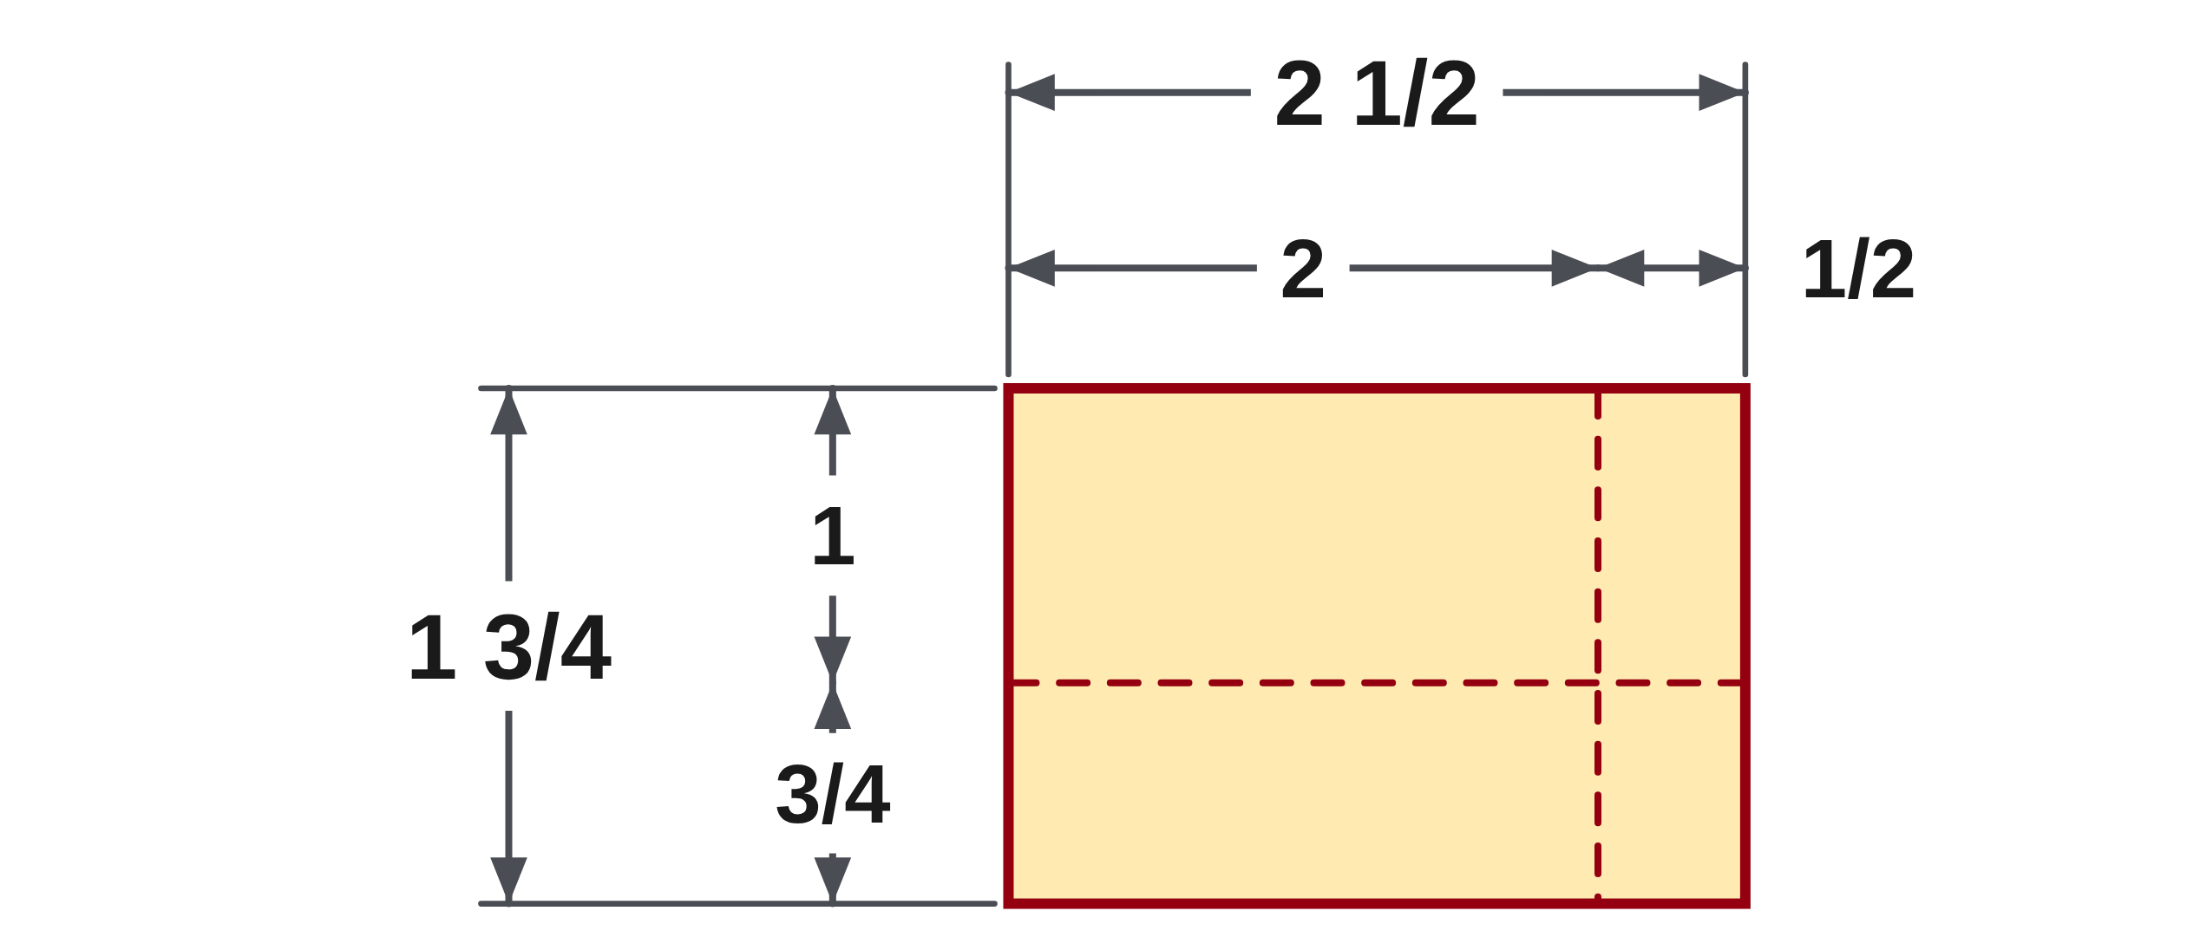
W03-L03 • PRACTISE • 1:25 PM–1:45 PM • 20 MIN TOTAL
Practise from the Exercise Book | 4A Q16b
Write the operation, working and units before checking.
Textbook Chapter 4 pp.100–107
Textbook
Exercise Book
Numeracy Hub
Shape Canvas
Day 09 • 2026-11-10 • 17
Notes:
PRACTISE • 1:25 PM–1:45 PM • 20 MIN TOTAL — shared across this phase.
Multiply two and one half by one and three quarters. Convert both complete mixed numbers to improper fractions first; do not multiply the whole parts and fractional parts separately. Then multiply and simplify.
Instructor only, after the attempt: 2 1/2 = 5/2 and 1 3/4 = 7/4. Their product is 35/8 = 4 3/8. The result exceeds 2 1/2 because the multiplier 1 3/4 is greater than one. This pure-number exercise does not supply length units.

Slide 18
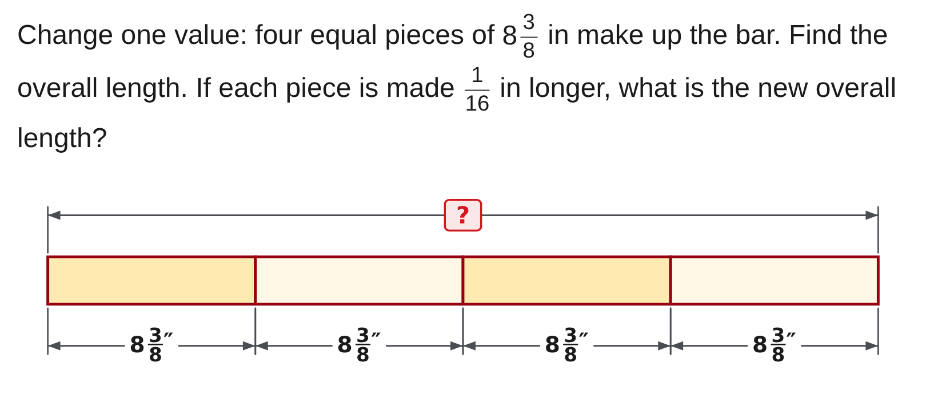
W03-L03 • PRACTISE • 1:25 PM–1:45 PM • 20 MIN TOTAL
Practise from the Exercise Book | 4C Q5
Write the operation, working and units before checking.
Textbook Chapter 4 pp.100–107
Textbook
Exercise Book
Numeracy Hub
Shape Canvas
Day 09 • 2026-11-10 • 18
Notes:
PRACTISE • 1:25 PM–1:45 PM • 20 MIN TOTAL — shared across this phase.
Four equal pieces are each eight and three eighths inches long. Find their total, then consider increasing every piece by one sixteenth of an inch. How many increases must the new total include?
Instructor only, after the attempt: 4 × 8 3/8 = 4 × 67/8 = 268/8 = 33 1/2 in. Four increases of 1/16 in total 4/16 = 1/4 in, so the new overall length is 33 3/4 in. Adding only one sixteenth would overlook three changed pieces.

Slide 19
W03-L03 • CHECK • 1:45 PM–1:55 PM • 10 MIN TOTAL
Check independently
Complete 4A question 17(b) and 4B question 5.
Answer independently and show the method.
Resources: Exercise Book 4A Q16–17 (p.36); 4B Q4–5 (p.37); 4C Q5 (p.40)
Textbook Chapter 4 pp.100–107
Textbook
Exercise Book
Numeracy Hub
Shape Canvas
Day 09 • 2026-11-10 • 19
Notes:
CHECK • 1:45 PM–1:55 PM • 10 MIN TOTAL — shared across this phase.
Complete 4A question 17(b) and 4B question 5 independently. Show the division and keep fraction forms exact. In the plate question, label the answer as a distance from one edge to the centre line. How can you check the two answers? Multiply each equal share by the number of shares to recover the original quantity. The arithmetic should support the physical interpretation, and the centre-line sketch should show two equal halves rather than two unequal remainder pieces.

Slide 20
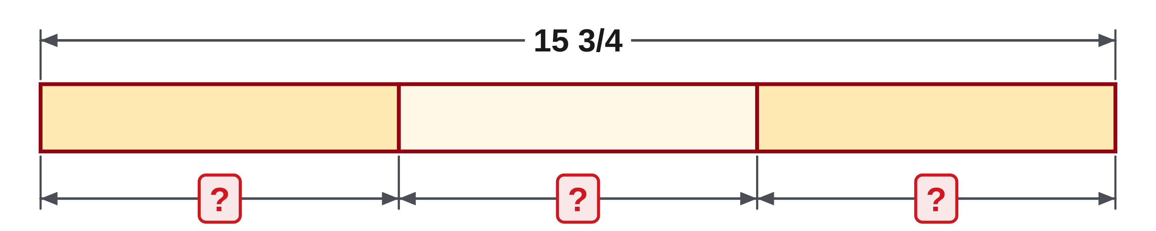
W03-L03 • CHECK • 1:45 PM–1:55 PM • 10 MIN TOTAL
Independent check | 4A Q17b
Answer independently. Keep worked solutions closed.
Textbook Chapter 4 pp.100–107
Textbook
Exercise Book
Numeracy Hub
Shape Canvas
Day 09 • 2026-11-10 • 20
Notes:
CHECK • 1:45 PM–1:55 PM • 10 MIN TOTAL — shared across this phase.
Divide fifteen and three quarters by three. Convert the mixed number to one fraction, then multiply by the reciprocal of three. Show the simplified result and use multiplication to check it.
Instructor only, after the attempt: 15 3/4 = 63/4. Then (63/4) ÷ 3 = (63/4) × (1/3) = 63/12 = 21/4 = 5 1/4. Check: 3 × 5 1/4 = 15 3/4. This question supplies no physical unit, so do not invent one.

Slide 21
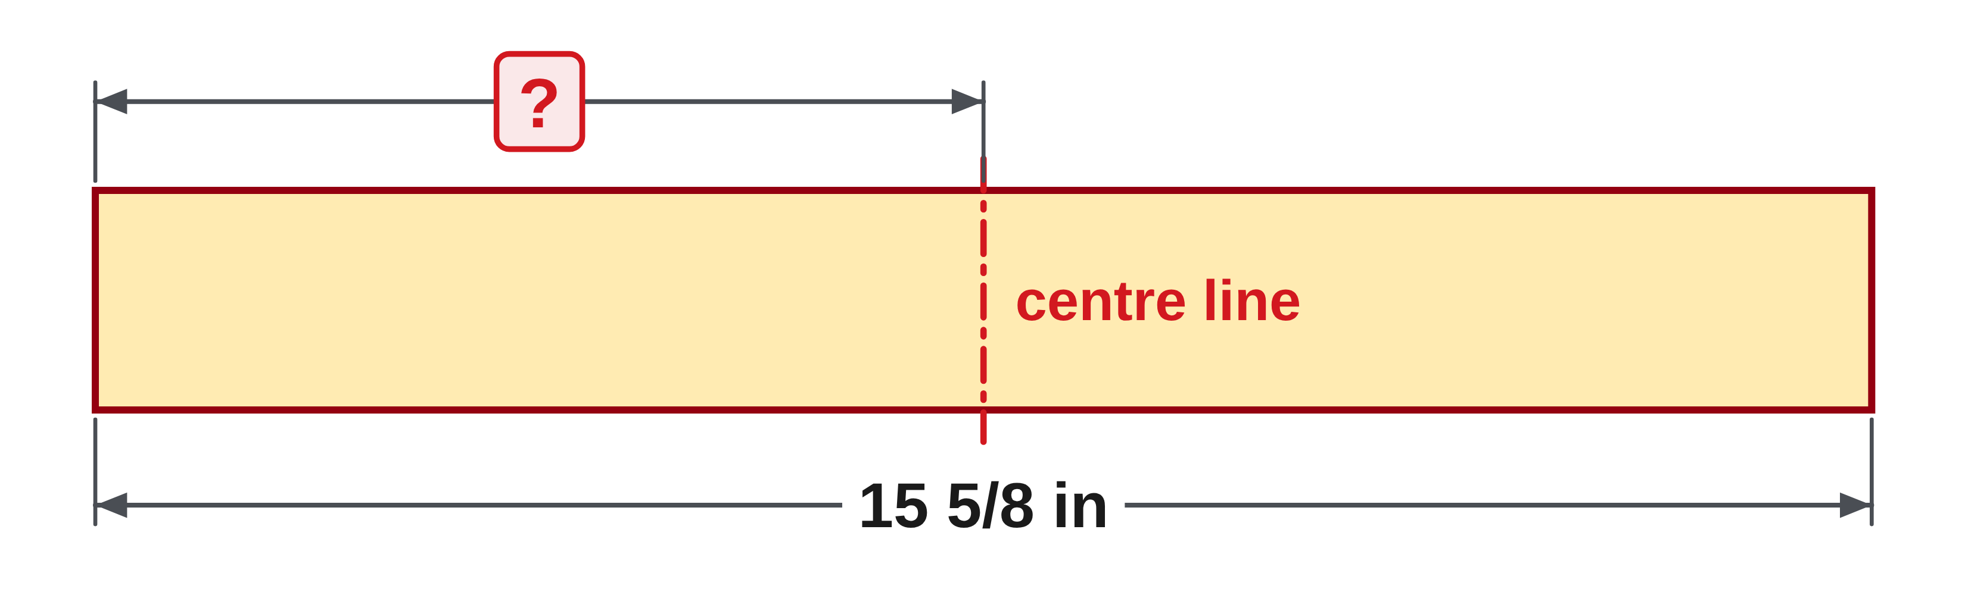
W03-L03 • CHECK • 1:45 PM–1:55 PM • 10 MIN TOTAL
Independent check | 4B Q5
Answer independently. Keep worked solutions closed.
Textbook Chapter 4 pp.100–107
Textbook
Exercise Book
Numeracy Hub
Shape Canvas
Day 09 • 2026-11-10 • 21
Notes:
CHECK • 1:45 PM–1:55 PM • 10 MIN TOTAL — shared across this phase.
A plate is fifteen and five eighths inches wide. Find the centre-line distance from one edge. The centre splits the full width into two equal lengths, so write the division by two and check by doubling your answer.
Instructor only, after the attempt: 15 5/8 = 125/8; (125/8) × (1/2) = 125/16 = 7 13/16 in. Doubling 7 13/16 gives 15 10/16 = 15 5/8 in. The denominator changes to sixteenths because halving an eighth creates sixteenths.

Slide 22
W03-L03 • WRAP UP • 1:55 PM–2:00 PM • 5 MIN TOTAL
Wrap up and choose the next step
Share one learning point and one skill to practise next.
Record a takeaway and next action.
Resources: Exercise Book 4A Q16–17 (p.36); 4B Q4–5 (p.37); 4C Q5 (p.40)
Textbook Chapter 4 pp.100–107
Textbook
Exercise Book
Numeracy Hub
Shape Canvas
Play quiz
Quiz PDF
Day 09 • 2026-11-10 • 22
Notes:
WRAP UP • 1:55 PM–2:00 PM • 5 MIN TOTAL — shared across this phase.
Give one example of a division answer that is a length and one that is a count. A centre-line distance is a length; the number of equal pieces fitting into stock is a count. Explain why doubling a centre-line distance checks it. Then identify whether your next practice should focus on converting mixed numbers, using the reciprocal, or interpreting the answer's unit. After the break, we will check all four fraction operations and use corrected reasoning on a fresh example.

Slide 23
DAY 09 • SCHEDULED BREAK
Break
2:00 PM–2:15 PM
Return ready for: Fraction operations: check and retry
This break is excluded from teaching minutes.
Textbook
Exercise Book
Numeracy Hub
Shape Canvas
Day 09 • 2026-11-10 • 23
Notes:
Take the scheduled break from 2:00 to 2:15. We return at 2:15 to check and retry fraction operations. Keep today's written calculations available so a correction can point to the exact step that needs attention.

Slide 24
W03-L04 • START • 2:15 PM–2:20 PM • 5 MIN TOTAL
Fraction operations: check and retry
Today’s goal: Choose the correct fraction operation, show the working and correct a documented error.
Name one use for today’s skill.
Textbook Chapter 4 pp.97–107
Exercise Book 4A Q14–17 (p.36); 4C Q1–3 (p.39)
Keep your notebook, textbook, exercise book and chosen calculator ready.
Textbook Chapter 4 pp.97–107
Textbook
Exercise Book
Numeracy Hub
Shape Canvas
Day 09 • 2026-11-10 • 24
Notes:
START • 2:15 PM–2:20 PM • 5 MIN TOTAL — shared across this phase.
This block brings addition, subtraction, multiplication, and division together. The first decision is choosing the operation that fits the situation; the second is using the correct fraction procedure. What makes a correction useful? It identifies the original error and explains why the revised method works. We will use the textbook on pages 97–107, questions 14–17 in 4A, and the missing-dimension drawings in 4C questions 1–3. Your final answers should be in simplest form, with working that another person can follow.

Slide 25
W03-L04 • RECALL • 2:20 PM–2:25 PM • 5 MIN TOTAL
Recall and reconnect
Present four short situations: total, remainder, repeated pieces and equal sharing. Name the operation.
Try first without displayed answers.
Resources: Exercise Book 4A Q14–17 (p.36); 4C Q1–3 (p.39)
Textbook Chapter 4 pp.97–107
Textbook
Exercise Book
Numeracy Hub
Shape Canvas
Day 09 • 2026-11-10 • 25
Notes:
RECALL • 2:20 PM–2:25 PM • 5 MIN TOTAL — shared across this phase.
Name the operation for each situation. Combining two adjoining lengths asks for addition. Finding an offcut after removing a known piece asks for subtraction. Finding the total of several equal pieces asks for multiplication. Sharing a length equally asks for division. What should come before choosing a fraction rule? Understanding which of those relationships the question describes. A correctly executed procedure for the wrong operation still answers a different question, so read the situation before touching the calculator.

Slide 26
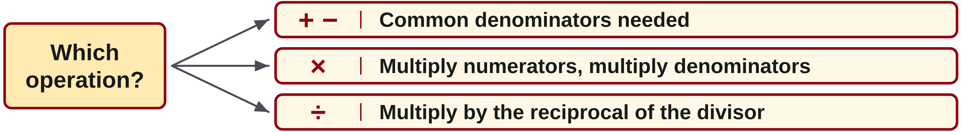
W03-L04 • TEACH • 2:25 PM–2:40 PM • 15 MIN TOTAL
Choose the method from the operation
1
Addition and subtraction need common denominators.
2
Multiplication multiplies numerators and denominators.
3
Division multiplies by the reciprocal of the divisor.
4
Choose the operation from the situation before applying a procedure.
Textbook Chapter 4 pp.97–107
Textbook
Exercise Book
Numeracy Hub
Shape Canvas
Day 09 • 2026-11-10 • 26
Notes:
TEACH • 2:25 PM–2:40 PM • 15 MIN TOTAL — shared across this phase.
Addition and subtraction require equal-sized parts, so use common denominators. Multiplication combines fractions by multiplying numerators and denominators; common denominators are not a prerequisite. Division uses multiplication by the reciprocal of the divisor. Convert mixed numbers before applying those multiplication or division rules. How do we decide which procedure applies? First identify the operation from the situation. Combining a half-inch layer and a quarter-inch layer is addition, while taking half of a quarter-inch amount is multiplication. The same two fractions can therefore lead to different answers because they describe different relationships.

Slide 27
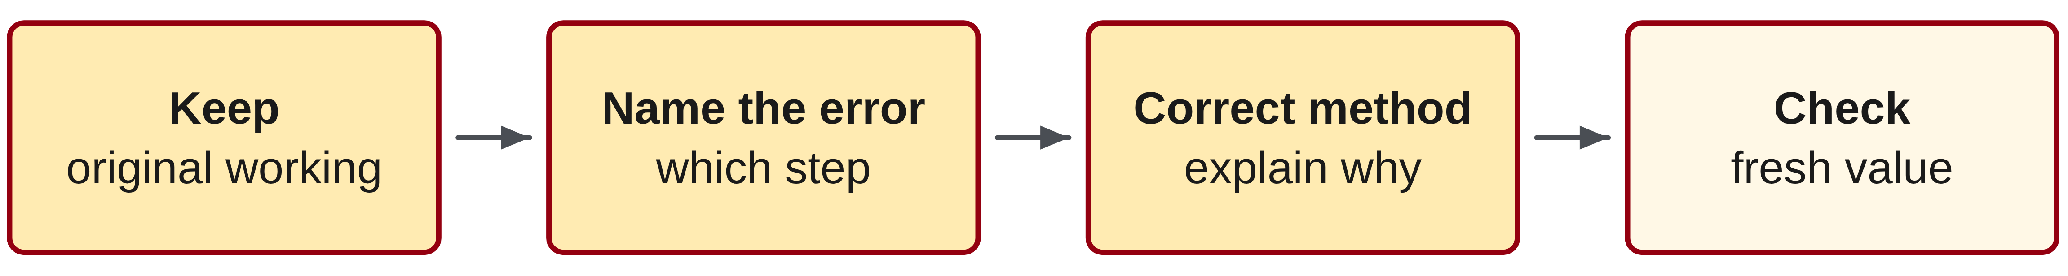
W03-L04 • TEACH • 2:25 PM–2:40 PM • 15 MIN TOTAL
Make the correction explain the error
1
Keep the original working so the incorrect step can be identified.
2
State whether the error is in the operation, denominator, regrouping or reciprocal.
3
Write a corrected method and explain why it preserves the quantities.
4
Use a fresh partner-created value to check the same skill without copying.
Textbook Chapter 4 pp.97–107
Textbook
Exercise Book
Numeracy Hub
Shape Canvas
Day 09 • 2026-11-10 • 27
Notes:
TEACH • 2:25 PM–2:40 PM • 15 MIN TOTAL — shared across this phase.
Keep the original working when you correct an error. Point to the first step where the reasoning went wrong: was it the chosen operation, an equivalent fraction, a regrouped whole, or the reciprocal? Write a corrected line and explain why it follows from the quantities. For example, 'I changed only the numerator' identifies why a simplification changed the value. Why try a fresh partner-created value next? It shows whether you understand the method beyond remembering one answer. The final evidence is a new solution with a valid check, not a neatly copied correction.

Slide 28
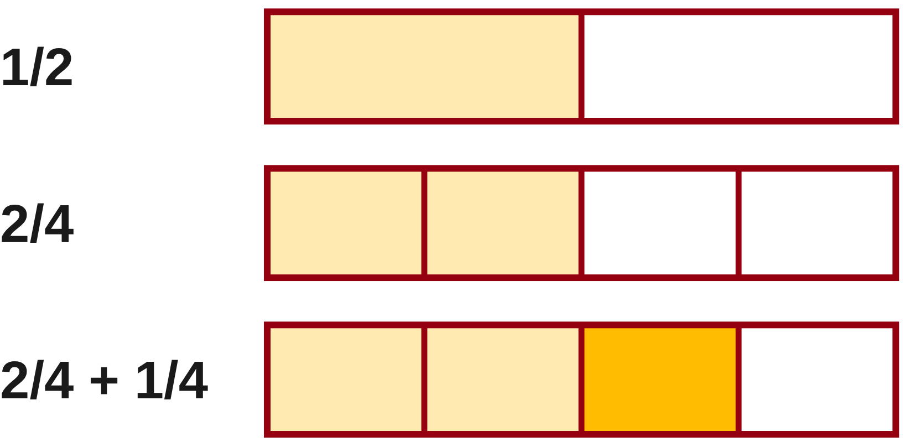
W03-L04 • TEACH • 2:25 PM–2:40 PM • 15 MIN TOTAL
Explain why the first method failed
Incorrect: 1/2 + 1/4 = 2/6.
The denominators were added even though the pieces differ in size.
Correct: 2/4 + 1/4 = 3/4
Contrast multiplication: 1/2 × 1/4 = 1/8.
Here the question asks for half of a quarter, not a combined length.
Together: explain one method from 4A Q14–17 without copying a partner. Instructor models the most common error from Monday’s work.
W3 L4 • Use paper first; rebuild one missing-length sketch in Shape Canvas
Textbook
Exercise Book
Numeracy Hub
Shape Canvas
Day 09 • 2026-11-10 • 28
Notes:
TEACH • 2:25 PM–2:40 PM • 15 MIN TOTAL — shared across this phase.
Compare the two operations on this slide. One half plus one quarter means a combined amount. Rename the half as two quarters, then add one quarter to obtain three quarters. Adding the denominators would incorrectly change the piece size. One half times one quarter means half of a quarter. Splitting a quarter into two equal pieces gives one eighth, so multiplication produces a smaller amount here. What decides which answer is appropriate? The operation and the situation, not simply the presence of fractions. Explain that difference before applying either rule to today's exercises.

Slide 29
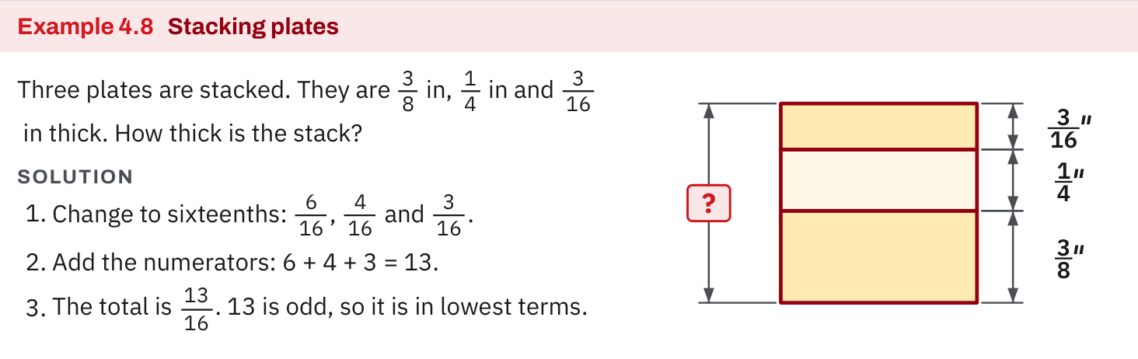
W03-L04 • TEACH • 2:25 PM–2:40 PM • 15 MIN TOTAL
Textbook | page 97
Textbook p.97 · Example 4.8: use equal-sized fractions to add a stack.
Textbook Chapter 4 pp.97–107
Textbook
Exercise Book
Numeracy Hub
Shape Canvas
Day 09 • 2026-11-10 • 29
Notes:
TEACH • 2:25 PM–2:40 PM • 15 MIN TOTAL — shared across this phase.
Example 4.8 on page 97 shows a stack of labelled plates. Each layer contributes its thickness to the total, so addition is the appropriate operation. Read the labels, then follow the common-denominator calculation. Why are equal-sized fractional units needed? We must count the thicknesses together in one consistent unit. The drawing helps diagnose an operation error: multiplying the layer thicknesses would not represent adding layers to a stack. Before evaluating any numbers, describe in words how the physical arrangement creates the total being asked for.

Slide 30
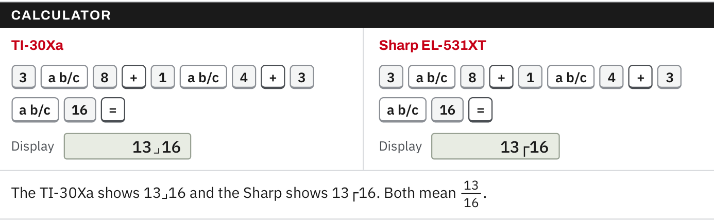
W03-L04 • TEACH • 2:25 PM–2:40 PM • 15 MIN TOTAL
Textbook | page 97
Textbook p.97 · Check the written fraction method on the chosen calculator.
Textbook Chapter 4 pp.97–107
Textbook
Exercise Book
Numeracy Hub
Shape Canvas
Day 09 • 2026-11-10 • 30
Notes:
TEACH • 2:25 PM–2:40 PM • 15 MIN TOTAL — shared across this phase.
Use the calculator sequence on page 97 to check a written fraction method after the paper attempt. Enter the same values and operation that appear in your equation. If the calculator result differs, do not immediately replace your work. Compare the chosen operation, the fraction entry, and any mixed-number display conversion. What can a calculator verify reliably? The arithmetic of what you entered. It cannot decide whether a stack requires addition or whether you copied the correct dimension from a drawing; those decisions still come from your interpretation.

Slide 31
W03-L04 • TEACH • 2:25 PM–2:40 PM • 15 MIN TOTAL
Spot the mistake. Explain the correction.
Must you find a common denominator before every fraction multiplication?
Discuss the method before checking the answer.
No. Common denominators support addition and subtraction. Multiply numerators and denominators directly.
Textbook Chapter 4 pp.97–107
Textbook
Exercise Book
Numeracy Hub
Shape Canvas
Day 09 • 2026-11-10 • 31
Notes:
TEACH • 2:25 PM–2:40 PM • 15 MIN TOTAL — shared across this phase.
Must every fraction multiplication begin with common denominators? No. That preparation is essential for addition and subtraction because we are combining or removing equal-sized pieces. In multiplication, multiply numerators and denominators directly, after converting mixed numbers if present. For example, one half times one quarter becomes one eighth. Why is the denominator eight? The quarter is divided into two equal parts. Using a common denominator first is possible but unnecessary and does not turn the multiplication into an addition rule. Read the operation symbol carefully before choosing the procedure.

Slide 32
W03-L04 • TOGETHER • 2:40 PM–2:55 PM • 15 MIN TOTAL
Work together
Pairs explain a method from 4A questions 14–17 without copying the partner’s calculation.
Work in pairs; alternate solver and checker.
Resources: Exercise Book 4A Q14–17 (p.36); 4C Q1–3 (p.39)
Textbook Chapter 4 pp.97–107
Textbook
Exercise Book
Numeracy Hub
Shape Canvas
Day 09 • 2026-11-10 • 32
Notes:
TOGETHER • 2:40 PM–2:55 PM • 15 MIN TOTAL — shared across this phase.
Choose a method from 4A questions 14–17 and explain it to your partner without copying their calculation. One person talks through why each step is valid while the other listens for the key rule. For addition or subtraction, ask about equal-sized parts and regrouping. For multiplication or division, ask about improper fractions and the divisor's reciprocal. Then switch roles. Which explanation is stronger: naming a rule or connecting it to the actual values? Connecting it to the values shows you understand the calculation in front of you.

Slide 33
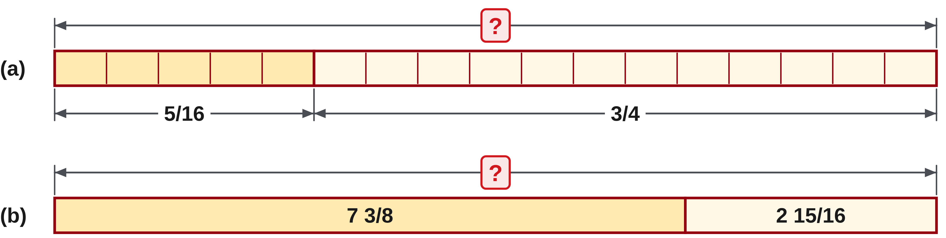
W03-L04 • TOGETHER • 2:40 PM–2:55 PM • 15 MIN TOTAL
Guided practice | 4A Q14
Work with a partner. Take turns explaining the next step.
Textbook Chapter 4 pp.97–107
Textbook
Exercise Book
Numeracy Hub
Shape Canvas
Day 09 • 2026-11-10 • 33
Notes:
TOGETHER • 2:40 PM–2:55 PM • 15 MIN TOTAL — shared across this phase.
Work through both parts of 4A question 14. Explain the common denominator and identify any complete whole formed by the fractional sum. Let each partner finish a written attempt before comparing.
Instructor only, after the attempt: (a) 5/16 + 3/4 = 5/16 + 12/16 = 17/16 = 1 1/16. (b) 7 3/8 + 2 15/16 = 9 21/16 = 10 5/16. Both additions produce a whole from their fractional totals.

Slide 34
W03-L04 • TOGETHER • 2:40 PM–2:55 PM • 15 MIN TOTAL
Compare your method | 4A Q14
CHECK TOGETHER
(a) 1 1/16 (b) 10 5/16
Textbook Chapter 4 pp.97–107
Textbook
Exercise Book
Numeracy Hub
Shape Canvas
Day 09 • 2026-11-10 • 34
Notes:
TOGETHER • 2:40 PM–2:55 PM • 15 MIN TOTAL — shared across this phase.
Both answers require carrying a whole. In part (a), seventeen sixteenths becomes one whole and one sixteenth. In part (b), the original wholes total nine, and the fractions total twenty-one sixteenths. Sixteen of those pieces form an extra whole, so the result is ten and five sixteenths. What shared error could make both answers one whole too small? Reducing the leftover numerator without carrying the complete set into the whole part. State where that extra whole came from in each calculation.

Slide 35
W03-L04 • PRACTISE • 2:55 PM–3:15 PM • 20 MIN TOTAL
Your scheduled practice
Complete one part of each question 14–17 independently, then 4C questions 1–3. Mark, explain and retry one error with a fresh partner-created value.
Show working and units; estimate, then check.
Resources: Exercise Book 4A Q14–17 (p.36); 4C Q1–3 (p.39)
Textbook Chapter 4 pp.97–107
Textbook
Exercise Book
Numeracy Hub
Shape Canvas
Day 09 • 2026-11-10 • 35
Notes:
PRACTISE • 2:55 PM–3:15 PM • 20 MIN TOTAL — shared across this phase.
Complete one part of each question 14–17 independently, then work through 4C questions 1–3. After checking, select one error to explain and retry with a fresh partner-created value. Classify the error precisely: operation, denominator, regrouping, or reciprocal. For the hidden dimensions, write overall minus known parts and use addition to reconstruct the overall length. What should remain in your notes after correction? The original mistaken step, a corrected method, and a check showing why the new result fits.

Slide 36
W03-L04 • PRACTISE • 2:55 PM–3:15 PM • 20 MIN TOTAL
Open Shape Canvas
Navigation example. Use the values and units in the assigned task.
Textbook Chapter 4 pp.97–107
Textbook
Exercise Book
Numeracy Hub
Shape Canvas
Day 09 • 2026-11-10 • 36
Notes:
PRACTISE • 2:55 PM–3:15 PM • 20 MIN TOTAL — shared across this phase.
Open Shape Canvas to rebuild one missing-length sketch from the assigned 4C work. Label the overall dimension and the known part or parts, leaving the missing value hidden while you calculate. Say the relationship aloud: known lengths plus missing length equal the overall length. Which operation isolates the missing length? Subtraction of the known parts from the overall dimension. The diagram should make that relationship clear while your paper records the exact fraction method and the add-back check.

Slide 37
W03-L04 • PRACTISE • 2:55 PM–3:15 PM • 20 MIN TOTAL
Practise in Shape Canvas
1
Independent first attempt: Complete one part of 4A Q14–17 and the assigned 4C drawings on paper.
2
Checking after completion: Use the chosen calculator and explain one difference from your result.
3
Independent retry: Rebuild one missing-length sketch in Shape Canvas and solve a fresh missed type.
Textbook Chapter 4 pp.97–107
Textbook
Exercise Book
Numeracy Hub
Shape Canvas
Day 09 • 2026-11-10 • 37
Notes:
PRACTISE • 2:55 PM–3:15 PM • 20 MIN TOTAL — shared across this phase.
Make the first attempt on paper for one part of 4A questions 14–17 and the assigned 4C drawings. Use the chosen calculator only after completing the calculation. If it differs, explain whether the problem lies in your method or the entered expression. Rebuild one missing-length sketch in Shape Canvas, then solve a fresh example of your missed type independently. What should transfer to the new numbers? The correct operation, the fraction procedure, and a check suited to the situation.

Slide 38
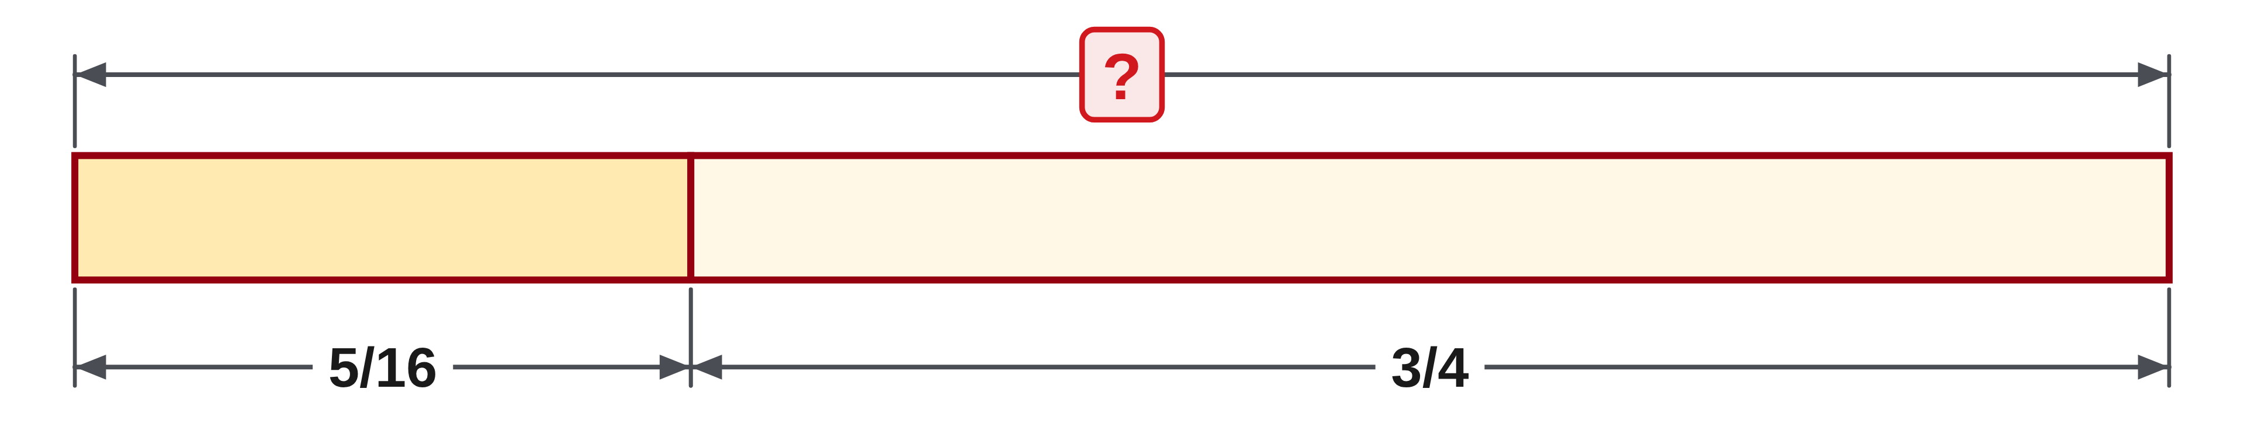
W03-L04 • PRACTISE • 2:55 PM–3:15 PM • 20 MIN TOTAL
Practise from the Exercise Book | 4A Q14a
Write the operation, working and units before checking.
Textbook Chapter 4 pp.97–107
Textbook
Exercise Book
Numeracy Hub
Shape Canvas
Day 09 • 2026-11-10 • 38
Notes:
PRACTISE • 2:55 PM–3:15 PM • 20 MIN TOTAL — shared across this phase.
For 4A question 14(a), add five sixteenths and three quarters. Write the equivalent fraction that makes the denominators match, then handle any whole contained in the sum. Explain why the denominator is not added.
Instructor only, after the attempt: Three quarters is twelve sixteenths. Five plus twelve gives seventeen sixteenths, which is 1 1/16. The denominator stays sixteen because we are counting sixteenth-sized pieces throughout the addition; regrouping sixteen pieces creates one whole.

Slide 39
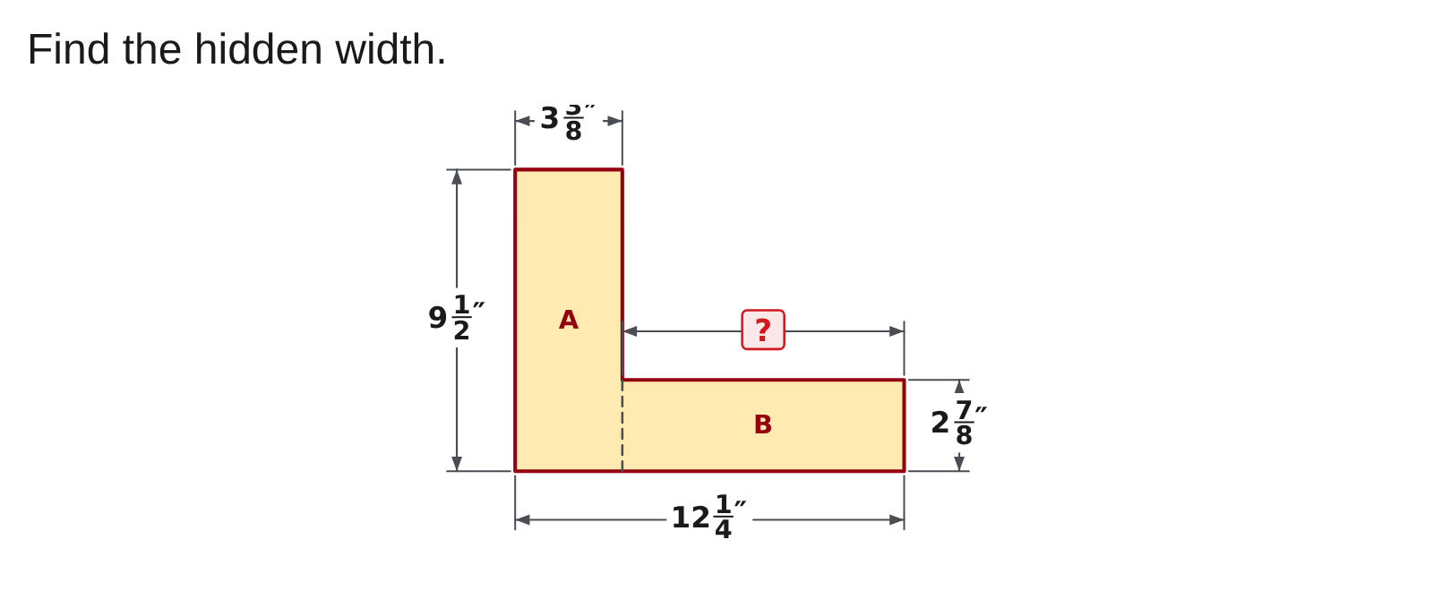
W03-L04 • PRACTISE • 2:55 PM–3:15 PM • 20 MIN TOTAL
Practise from the Exercise Book | 4C Q1
Write the operation, working and units before checking.
Textbook Chapter 4 pp.97–107
Textbook
Exercise Book
Numeracy Hub
Shape Canvas
Day 09 • 2026-11-10 • 39
Notes:
PRACTISE • 2:55 PM–3:15 PM • 20 MIN TOTAL — shared across this phase.
Find the hidden width in 4C question 1. Read twelve and one quarter inches as the overall width and three and three eighths inches as the known part. Write the subtraction and check by addition.
Instructor only, after the attempt: 12 1/4 − 3 3/8 = 12 2/8 − 3 3/8 = 11 10/8 − 3 3/8 = 8 7/8 in. Add 3 3/8 back: 8 7/8 + 3 3/8 = 12 1/4 in.

Slide 40
W03-L04 • CHECK • 3:15 PM–3:25 PM • 10 MIN TOTAL
Check independently
Redo 4A questions 14(a),15(a),16(b),17(b). Give simplest forms.
Answer independently and show the method.
Resources: Exercise Book 4A Q14–17 (p.36); 4C Q1–3 (p.39)
Textbook Chapter 4 pp.97–107
Textbook
Exercise Book
Numeracy Hub
Shape Canvas
Day 09 • 2026-11-10 • 40
Notes:
CHECK • 3:15 PM–3:25 PM • 10 MIN TOTAL — shared across this phase.
Independently redo 4A questions 14(a), 15(a), 16(b), and 17(b). These cover addition, subtraction, multiplication, and division. Before each calculation, identify its operation and the rule that belongs to it. Give simplest forms and leave enough working to show the method. Which two operations need a common denominator? Addition and subtraction. For division, identify the divisor before taking its reciprocal. Keep the solutions closed until you have completed all four attempts so the check reflects your own reasoning.

Slide 41
W03-L04 • CHECK • 3:15 PM–3:25 PM • 10 MIN TOTAL
Independent check | 4A Q14a
Answer independently. Keep worked solutions closed.
Textbook Chapter 4 pp.97–107
Textbook
Exercise Book
Numeracy Hub
Shape Canvas
Day 09 • 2026-11-10 • 41
Notes:
CHECK • 3:15 PM–3:25 PM • 10 MIN TOTAL — shared across this phase.
Add five sixteenths and three quarters independently. Show the common denominator and convert any improper fractional total to simplest mixed form. Explain why the result should exceed one whole.
Instructor only, after the attempt: 3/4 = 12/16, so the total is 17/16 = 1 1/16. The quarter needed to complete three quarters is four sixteenths, and the added five sixteenths exceeds it by one sixteenth. That confirms the size of the result.

Slide 42
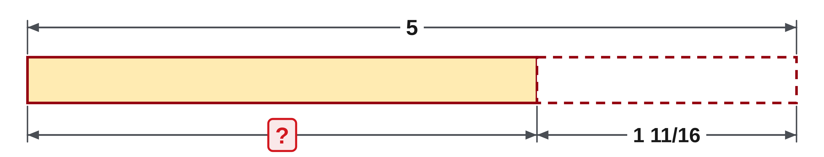
W03-L04 • CHECK • 3:15 PM–3:25 PM • 10 MIN TOTAL
Independent check | 4A Q15a
Answer independently. Keep worked solutions closed.
Textbook Chapter 4 pp.97–107
Textbook
Exercise Book
Numeracy Hub
Shape Canvas
Day 09 • 2026-11-10 • 42
Notes:
CHECK • 3:15 PM–3:25 PM • 10 MIN TOTAL — shared across this phase.
Subtract one and eleven sixteenths from five. Show how you rename a whole before subtracting the fractional part, then add your result back to check it.
Instructor only, after the attempt: 5 = 4 16/16. Subtracting 1 11/16 gives 3 5/16. The check is 3 5/16 + 1 11/16 = 4 16/16 = 5. The starting whole-number part must decrease from five to four when that whole is converted into sixteen sixteenths.

Slide 43
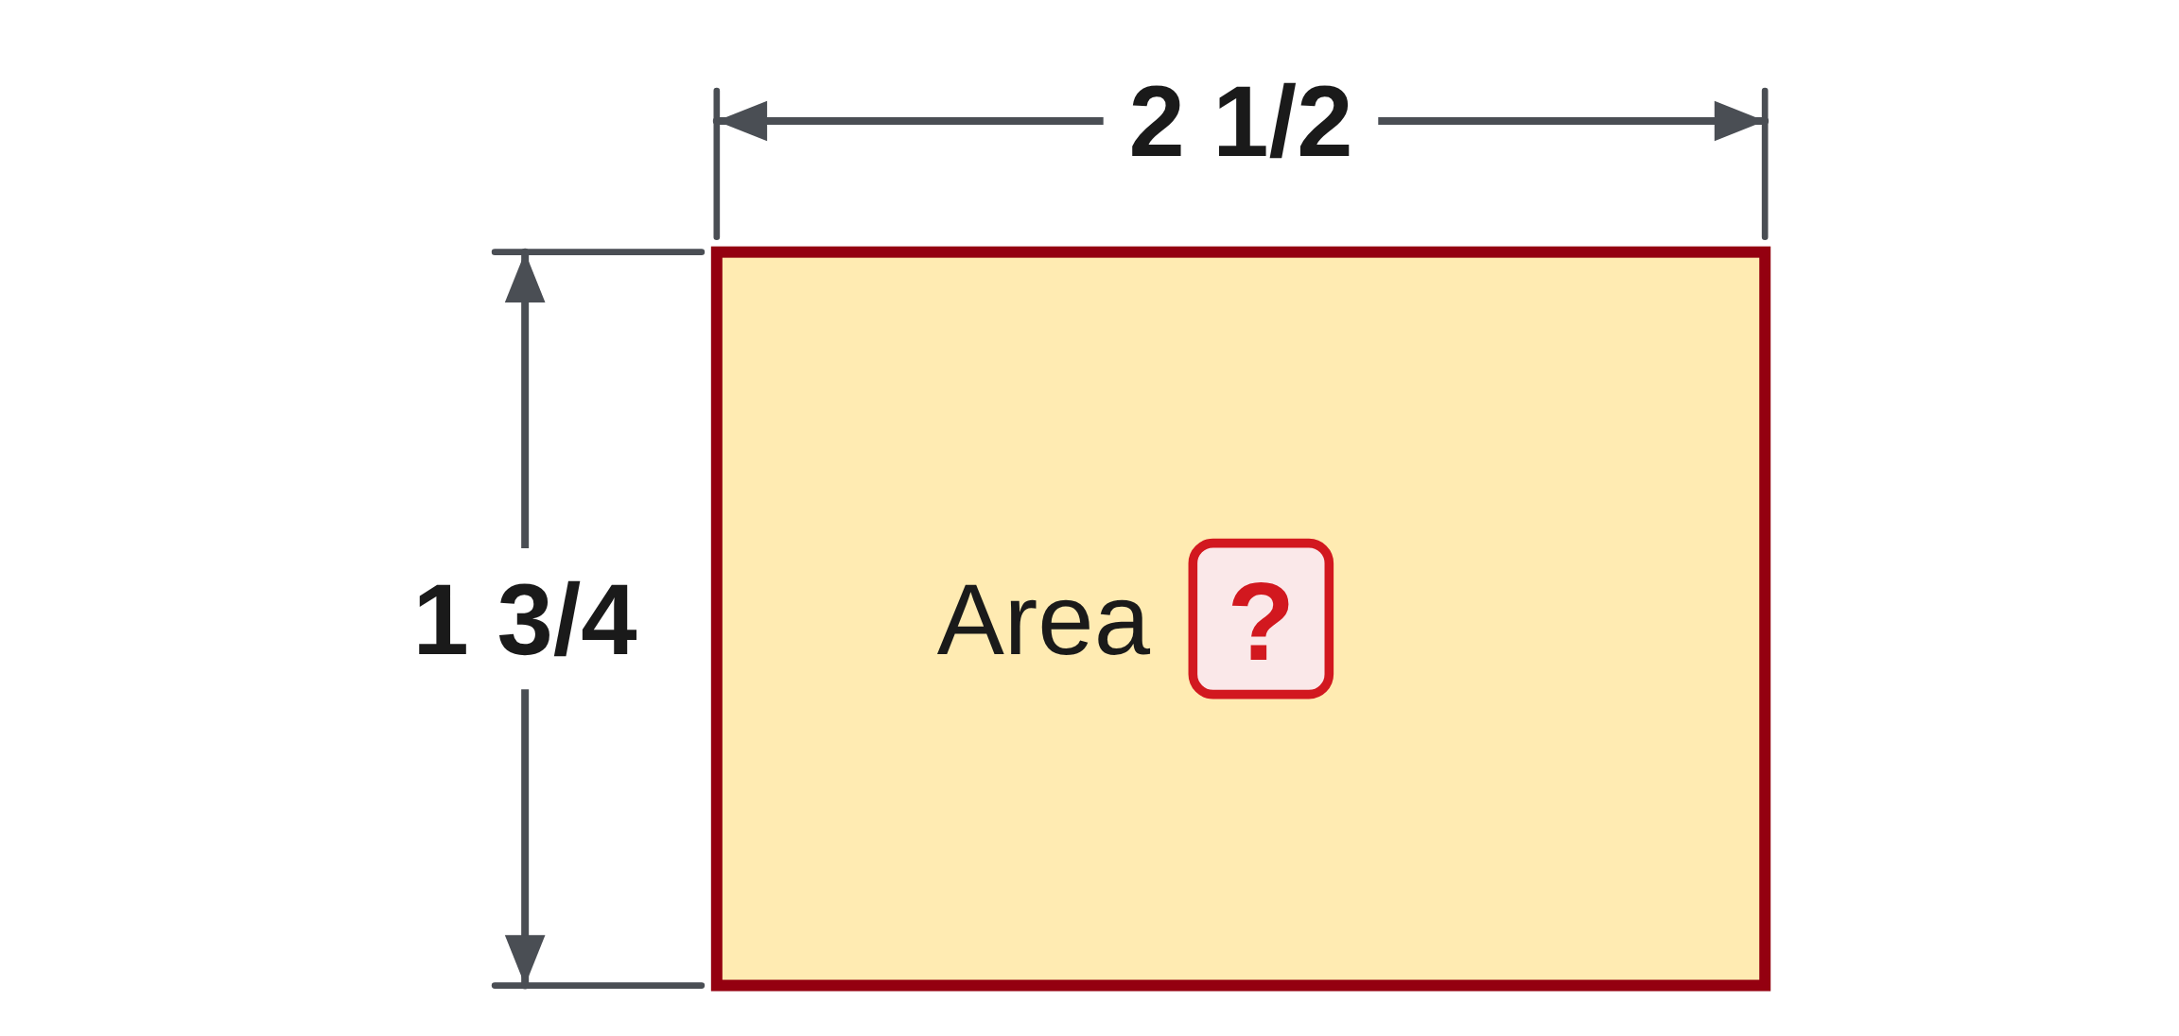
W03-L04 • CHECK • 3:15 PM–3:25 PM • 10 MIN TOTAL
Independent check | 4A Q16b
Answer independently. Keep worked solutions closed.
Textbook Chapter 4 pp.97–107
Textbook
Exercise Book
Numeracy Hub
Shape Canvas
Day 09 • 2026-11-10 • 43
Notes:
CHECK • 3:15 PM–3:25 PM • 10 MIN TOTAL — shared across this phase.
Multiply two and one half by one and three quarters. Convert both mixed numbers fully, multiply the fractions, and give the result in simplest form. Keep your paper attempt independent.
Instructor only, after the attempt: (5/2) × (7/4) = 35/8 = 4 3/8. Multiplying the whole parts separately from the fractions would omit the interactions between them; converting each complete mixed number avoids that error. No measurement unit is supplied in this numerical question.

Slide 44
W03-L04 • CHECK • 3:15 PM–3:25 PM • 10 MIN TOTAL
Independent check | 4A Q17b
Answer independently. Keep worked solutions closed.
Textbook Chapter 4 pp.97–107
Textbook
Exercise Book
Numeracy Hub
Shape Canvas
Day 09 • 2026-11-10 • 44
Notes:
CHECK • 3:15 PM–3:25 PM • 10 MIN TOTAL — shared across this phase.
Divide fifteen and three quarters by three. Identify the divisor, convert the mixed number, and show the reciprocal multiplication. What multiplication should restore the original value after you finish?
Instructor only, after the attempt: (63/4) × (1/3) = 63/12 = 21/4 = 5 1/4. Multiplying 5 1/4 by three returns 15 3/4. Only the divisor, three, is replaced by its reciprocal when division becomes multiplication; the starting fraction remains 63/4.

Slide 45
W03-L04 • WRAP UP • 3:25 PM–3:30 PM • 5 MIN TOTAL
Wrap up and choose the next step
Share one learning point and one skill to practise next.
Record a takeaway and next action.
Resources: Exercise Book 4A Q14–17 (p.36); 4C Q1–3 (p.39)
Textbook Chapter 4 pp.97–107
Textbook
Exercise Book
Numeracy Hub
Shape Canvas
Play quiz
Quiz PDF
Day 09 • 2026-11-10 • 45
Notes:
WRAP UP • 3:25 PM–3:30 PM • 5 MIN TOTAL — shared across this phase.
Name the operation that felt most secure and the exact step that still needs attention. Explain one correction using the original error and the reason your revised method works. What is your best independent check for subtraction? Add the remainder back to the known part. For equal sharing, multiply the share by the number of shares. Week 4 applies these skills to cut lists and centre lines before moving into decimals, percent, ratio, and scale, so keep these checks available as the contexts change.

