Slide 1

CARPENTRY FOUNDATION / INTAKE 142
Day 10 | Monday
10
November 16, 2026
Fraction addition and subtraction: job practice
12:45 PM–2:00 PM • Math • 75 min
Fraction cut lists, centre lines and kerf
2:15 PM–3:30 PM • Math • 75 min
Week 4 • 2 scheduled blocks • 150 teaching minutes
Estimate. Show the method. Label units. Check the result.
Textbook
Exercise Book
Numeracy Hub
Shape Canvas
Day 10 • 2026-11-16 • 01
Notes:
Today we apply fraction methods to job situations: combined lengths, missing lengths, cut lists, centre lines, and cutting loss. Before the break, we strengthen addition and subtraction with clear regrouping and checks. After the break, we account for repeated pieces and the stated kerf. What must a complete cut-list check include? Finished pieces, material lost in the specified cuts, and the offcut. Together those quantities must reconstruct the original stock length.

Slide 2
DAY 10 / WEEK 4 / CLASS TIMETABLE
Today’s exact schedule
12:45 PM–2:00 PM • 75 min
2:15 PM–3:30 PM • 75 min
Fraction addition and subtraction: job practice
Fraction cut lists, centre lines and kerf
12:45 PM–12:50 PM
Start
5
2:15 PM–2:20 PM
Start
5
12:50 PM–12:55 PM
Recall
5
2:20 PM–2:25 PM
Recall
5
12:55 PM–1:10 PM
Teach
15
2:25 PM–2:40 PM
Teach
15
1:10 PM–1:25 PM
Together
15
2:40 PM–2:55 PM
Together
15
1:25 PM–1:45 PM
Practise
20
2:55 PM–3:15 PM
Practise
20
1:45 PM–1:55 PM
Check
10
3:15 PM–3:25 PM
Check
10
1:55 PM–2:00 PM
Wrap up
5
3:25 PM–3:30 PM
Wrap up
5
Math • Math Week 4, Lesson 1
Math • Math Week 4, Lesson 2
Break: 2:00 PM–2:15 PM • 15 minutes • excluded from teaching time
Textbook
Exercise Book
Numeracy Hub
Shape Canvas
Day 10 • 2026-11-16 • 02
Notes:
The first block runs from 12:45 to 2:00, with the independent addition-and-subtraction check from 1:45 to 1:55. Take the full break from 2:00 to 2:15. Cut lists, centre lines, and kerf run from 2:15 to 3:30, with the final check from 3:15 to 3:25. Each set of slides shares its phase's time allocation. Keep the calculations visible so we can use an identified regrouping issue from the first block to improve the cut-list work in the second.

Slide 3
W04-L01 • START • 12:45 PM–12:50 PM • 5 MIN TOTAL
Fraction addition and subtraction: job practice
Today’s goal: Add or subtract mixed-inch sizes using common denominators and record the result in lowest terms.
Share a prior use of this skill; identify the quantity and unit.
Textbook sections 4.3–4.6 pp.92–99
Exercise Book 4A Q10–15 (p.36); 4B Q2–3 (p.37)
Keep your notebook, textbook, exercise book and chosen calculator ready.
Textbook sections 4.3–4.6 pp.92–99
Textbook
Exercise Book
Numeracy Hub
Shape Canvas
Day 10 • 2026-11-16 • 03
Notes:
START • 12:45 PM–12:50 PM • 5 MIN TOTAL — shared across this phase.
Open the textbook to sections 4.3–4.6, pages 92–99. We are applying mixed-inch addition and subtraction to dimensions that could appear in a cut list or an assembly. Name a time you needed a total or a remaining length, and identify its unit. Why do units matter before calculating? Every combined length must use the same unit. We will work in inches, use common denominators for the fractional parts, and report the result in lowest terms with a check that fits the situation.

Slide 4
W04-L01 • RECALL • 12:50 PM–12:55 PM • 5 MIN TOTAL
Recall and reconnect
Use the Week 3 checks to review common denominators and regrouping. Start with Exercise Book 4A questions 6 and 10.
Attempt the short retrieval task independently; explain the method before seeing answers.
Resources: Exercise Book 4A Q10–15 (p.36); 4B Q2–3 (p.37)
Textbook sections 4.3–4.6 pp.92–99
Textbook
Exercise Book
Numeracy Hub
Shape Canvas
Day 10 • 2026-11-16 • 04
Notes:
RECALL • 12:50 PM–12:55 PM • 5 MIN TOTAL — shared across this phase.
Use your Week 3 work to recall two ideas: equivalent fractions preserve a value, and regrouping exchanges a whole for fractional pieces without changing the total. Start with 4A questions 6 and 10. For question 6, name the common factor that reduces each fraction. For question 10, divide to find whole groups and a remainder. How do these skills support today's operations? They let us choose shared units and move whole amounts into or out of the fractional part accurately.

Slide 5
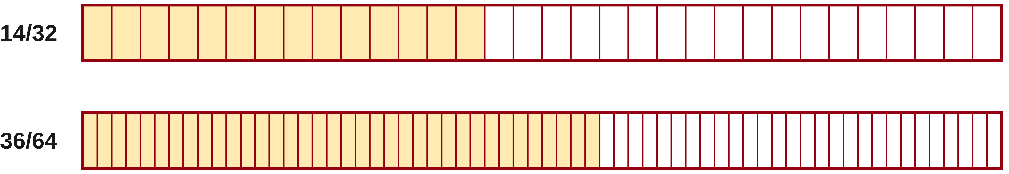
W04-L01 • RECALL • 12:50 PM–12:55 PM • 5 MIN TOTAL
Recall from the Exercise Book | 4A Q6
Write the operation, working and units before checking.
Textbook sections 4.3–4.6 pp.92–99
Textbook
Exercise Book
Numeracy Hub
Shape Canvas
Day 10 • 2026-11-16 • 05
Notes:
RECALL • 12:50 PM–12:55 PM • 5 MIN TOTAL — shared across this phase.
Reduce fourteen thirty-seconds and thirty-six sixty-fourths to lowest terms. Show the factor applied to both numerator and denominator. How can you check the reduction? Multiply both parts of the reduced fraction back by that same factor.
Instructor only, after the attempt: 14/32 = 7/16 by dividing both by two. 36/64 = 9/16 by dividing both by four. If the second answer is 18/32, the value is equivalent but another common factor of two remains.

Slide 6
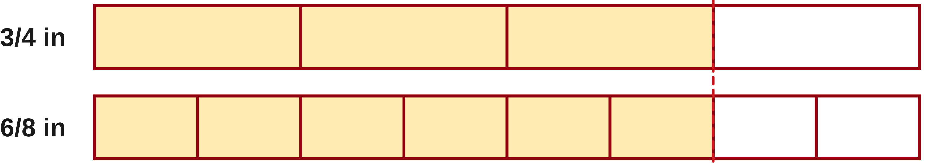
W04-L01 • TEACH • 12:55 PM–1:10 PM • 15 MIN TOTAL
Add lengths with matching parts
1
Use one unit: write every length in inches before combining it.
2
Choose a common denominator so both fractions name equal-sized parts.
3
Rewrite equivalent fractions; add numerators and keep the common denominator.
4
Combine whole inches, carry any whole from the fraction, then reduce.
Textbook sections 4.3–4.6 pp.92–99
Textbook
Exercise Book
Numeracy Hub
Shape Canvas
Day 10 • 2026-11-16 • 06
Notes:
TEACH • 12:55 PM–1:10 PM • 15 MIN TOTAL — shared across this phase.
Start with one physical unit: inches. Within that unit, choose a common fractional denominator so the parts can be counted together. Rename each fraction without changing its value, add the numerators, and keep the common denominator. Combine the whole inches separately, then inspect the fractional sum for complete wholes. Why is the carry necessary? A full set of fractional pieces represents another whole inch, so it belongs in the whole-number total. Reduce the leftover fraction at the end. The finished answer should be larger than each positive length added, which provides a useful first check before calculator entry.

Slide 7
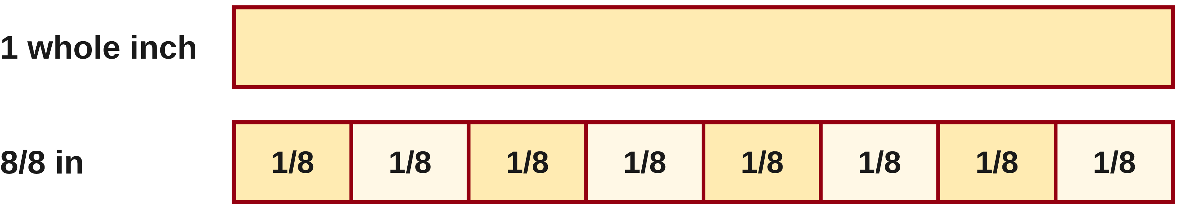
W04-L01 • TEACH • 12:55 PM–1:10 PM • 15 MIN TOTAL
Subtract across a whole inch
1
Compare the fractional parts before you subtract.
2
If needed, trade one whole inch for a full denominator of fractional parts.
3
Subtract whole and fractional parts; simplify the result.
4
Check by adding the result to the length you took away.
Textbook sections 4.3–4.6 pp.92–99
Textbook
Exercise Book
Numeracy Hub
Shape Canvas
Day 10 • 2026-11-16 • 07
Notes:
TEACH • 12:55 PM–1:10 PM • 15 MIN TOTAL — shared across this phase.
Subtraction begins with common denominators too. Compare the starting fractional part with the amount to remove. If it is too small, exchange one whole inch for a complete denominator's worth of pieces. For eighths, reduce the whole part by one and add eight to the numerator. What protects the value during this exchange? The lost whole and the eight new eighths are equal. Subtract the whole and fractional parts, simplify, then add the result back to the length removed. Recovering the original overall dimension confirms that the remainder and the removed part still account for the whole.

Slide 8
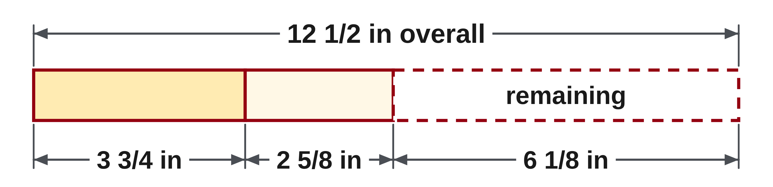
W04-L01 • TEACH • 12:55 PM–1:10 PM • 15 MIN TOTAL
Use the overall dimension as a check
Classroom sketch: total 12 1/2 in; known parts 3 3/4 in and 2 5/8 in.
Known = 3 6/8 + 2 5/8 = 6 3/8 in
Remaining = 12 4/8 − 6 3/8 = 6 1/8 in
Check: 6 3/8 + 6 1/8 = 12 1/2 in.
Mark the fractional part on a rule.
Together: 4A Q14(a), Q15(a), then 4B Q2. Explain regrouping to a partner; check fraction entry on the selected calculator.
W4 L1 • Shape Canvas: fractional dimensions in inches • New classroom example
Textbook
Exercise Book
Numeracy Hub
Shape Canvas
Day 10 • 2026-11-16 • 08
Notes:
TEACH • 12:55 PM–1:10 PM • 15 MIN TOTAL — shared across this phase.
The overall length is twelve and one half inches. The known parts are three and three quarters plus two and five eighths. Convert three quarters to six eighths: the known parts total five and eleven eighths, which is six and three eighths. Rename the overall half as four eighths. Subtract six and three eighths from twelve and four eighths to obtain six and one eighth inches remaining. Where did the extra whole in the known total come from? Eight of the eleven eighths formed it. Check: six and three eighths plus six and one eighth equals twelve and one half inches.

Slide 9
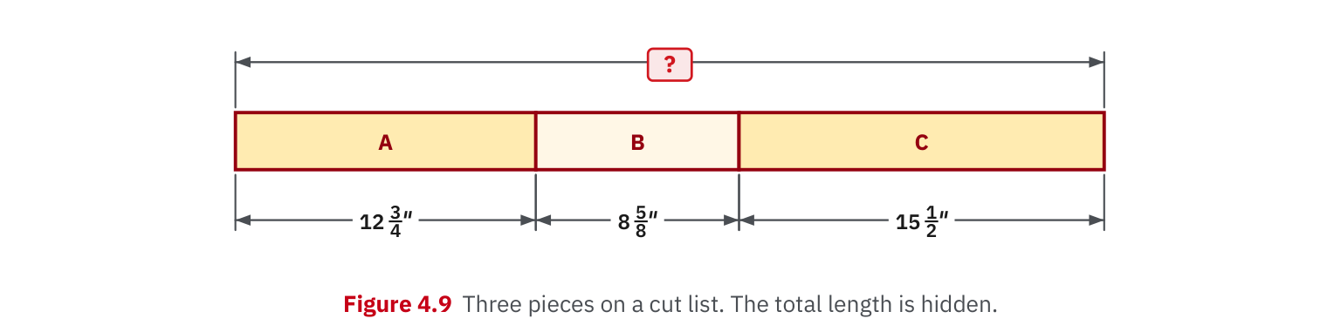
W04-L01 • TEACH • 12:55 PM–1:10 PM • 15 MIN TOTAL
Textbook | page 98
Textbook p.98 • Figure 4.9 — Fractional cut-list dimensions
Textbook sections 4.3–4.6 pp.92–99
Textbook
Exercise Book
Numeracy Hub
Shape Canvas
Day 10 • 2026-11-16 • 09
Notes:
TEACH • 12:55 PM–1:10 PM • 15 MIN TOTAL — shared across this phase.
Figure 4.9 on page 98 provides fractional cut-list dimensions. Trace each labelled piece and identify the overall total being sought. We combine the stated lengths, not their apparent widths in the picture. Before adding, choose a denominator that can represent each fraction exactly. What should you watch after adding the fractional parts? Whether their count has reached a full whole inch. A diagram can show why the total grows, while the written arithmetic shows precisely how the smaller fractional pieces combine and carry into the whole-inch count.

Slide 10
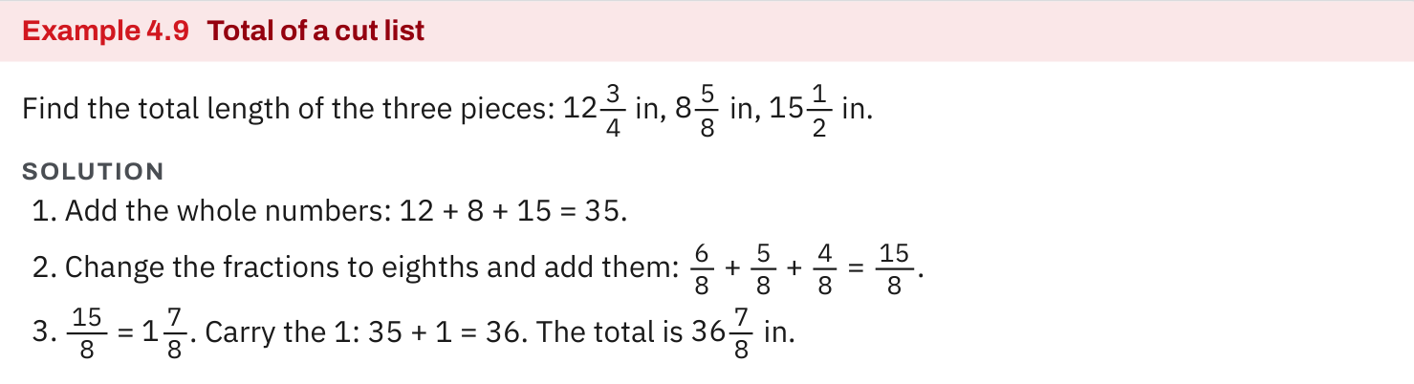
W04-L01 • TEACH • 12:55 PM–1:10 PM • 15 MIN TOTAL
Textbook | page 98
Textbook p.98 • Example 4.9 — Common denominator and carrying a whole inch
Textbook sections 4.3–4.6 pp.92–99
Textbook
Exercise Book
Numeracy Hub
Shape Canvas
Day 10 • 2026-11-16 • 10
Notes:
TEACH • 12:55 PM–1:10 PM • 15 MIN TOTAL — shared across this phase.
Follow Example 4.9 on page 98 and point to the common-denominator line. Each renamed fraction describes the original piece length, so no material is added by the conversion. Next locate the fractional total and the carried whole. Why should we keep that intermediate line? It makes the source of the extra whole visible and helps us catch an answer that is one inch too short. Finally, examine the remaining fraction: its numerator should be smaller than the denominator and in lowest terms. Read the final length aloud as whole inches plus the fractional remainder.

Slide 11
W04-L01 • TEACH • 12:55 PM–1:10 PM • 15 MIN TOTAL
Spot the mistake. Explain the correction.
A learner adds the denominators when adding two fractional lengths. What must stay the same?
Discuss the method before checking the answer.
The denominator names the size of each part. Rename with a common denominator; add only numerators.
Textbook sections 4.3–4.6 pp.92–99
Textbook
Exercise Book
Numeracy Hub
Shape Canvas
Day 10 • 2026-11-16 • 11
Notes:
TEACH • 12:55 PM–1:10 PM • 15 MIN TOTAL — shared across this phase.
A learner adds the denominators while adding lengths. What must stay the same during the actual addition? The size of the fractional unit. Once both fractions are written in sixteenths, for example, adding more sixteenth-sized pieces does not turn them into thirty-seconds. We add their counts, the numerators, and keep the shared denominator. Ask yourself whether the proposed answer is larger than either positive part. A result smaller than one starting length is a clear sign that the method has changed the quantity incorrectly rather than combined the lengths.

Slide 12
W04-L01 • TOGETHER • 1:10 PM–1:25 PM • 15 MIN TOTAL
Work together
Work Exercise Book 4A Q14(a) and Q15(a), then Exercise Book 4B Q2. Explain the regrouping to a partner.
Work in pairs; alternate calculator operator and checker. Show units and an estimated answer.
Resources: Exercise Book 4A Q10–15 (p.36); 4B Q2–3 (p.37)
Textbook sections 4.3–4.6 pp.92–99
Textbook
Exercise Book
Numeracy Hub
Shape Canvas
Day 10 • 2026-11-16 • 12
Notes:
TOGETHER • 1:10 PM–1:25 PM • 15 MIN TOTAL — shared across this phase.
Work through 4A questions 14(a) and 15(a), then 4B question 2. Explain the difference between carrying a whole in addition and exchanging a whole in subtraction. In both cases the total value of the regrouped quantity stays the same. Alternate calculator operator and checker after the written calculation. What should the checker inspect before accepting the display? The entered fractions, the operation, the expected size, and the unit. A matching number is useful only when it answers the intended dimensional question.

Slide 13
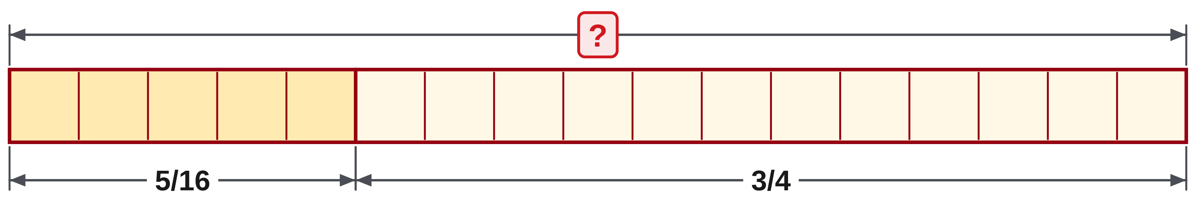
W04-L01 • TOGETHER • 1:10 PM–1:25 PM • 15 MIN TOTAL
Guided practice | 4A Q14a
Work with a partner. Take turns explaining the next step.
Textbook sections 4.3–4.6 pp.92–99
Textbook
Exercise Book
Numeracy Hub
Shape Canvas
Day 10 • 2026-11-16 • 13
Notes:
TOGETHER • 1:10 PM–1:25 PM • 15 MIN TOTAL — shared across this phase.
Add five sixteenths and three quarters. First choose a denominator that describes both exactly. Then decide whether the fractional total contains a full whole before writing the final answer.
Instructor only, after the attempt: 3/4 = 12/16, so 5/16 + 12/16 = 17/16 = 1 1/16. The total is slightly greater than one because five sixteenths is one sixteenth greater than the quarter needed to complete three quarters.

Slide 14
W04-L01 • TOGETHER • 1:10 PM–1:25 PM • 15 MIN TOTAL
Compare your method | 4A Q14a
CHECK TOGETHER
(a) 1 1/16
Textbook sections 4.3–4.6 pp.92–99
Textbook
Exercise Book
Numeracy Hub
Shape Canvas
Day 10 • 2026-11-16 • 14
Notes:
TOGETHER • 1:10 PM–1:25 PM • 15 MIN TOTAL — shared across this phase.
The result is one and one sixteenth. The key intermediate result is seventeen sixteenths: sixteen make the whole and one remains. Why not reduce seventeen and sixteen by a common factor? They have none greater than one, so the improper fraction is already reduced; changing it to a mixed number simply makes the whole part visible. On the paper rule, this result lies one sixteenth beyond one whole unit. The numerical form and the marked location should tell the same story.

Slide 15
W04-L01 • PRACTISE • 1:25 PM–1:45 PM • 20 MIN TOTAL
Your scheduled practice
Complete remaining Exercise Book 4A Q14–15 and 4B Q3. Mark each result on a paper rule; use calculator checking only after the written solution.
Solve on paper first; use the tool to check; correct one error with a written reason.
Resources: Exercise Book 4A Q10–15 (p.36); 4B Q2–3 (p.37)
Textbook sections 4.3–4.6 pp.92–99
Textbook
Exercise Book
Numeracy Hub
Shape Canvas
Day 10 • 2026-11-16 • 15
Notes:
PRACTISE • 1:25 PM–1:45 PM • 20 MIN TOTAL — shared across this phase.
Complete the remaining parts of 4A questions 14–15 and 4B question 3. For each, write the shared denominator and show the carry or exchange of a whole when needed. Then mark the result on a paper rule as directed, using the classroom inch interpretation for these values. Only after the written solution should you check with the calculator. If you correct a result, explain the cause: a mismatched denominator, a lost whole, or an entry error. Keep the original step visible enough to understand the repair.

Slide 16

W04-L01 • PRACTISE • 1:25 PM–1:45 PM • 20 MIN TOTAL
Open Shape Canvas
Navigation example. Use the values and units in the assigned task.
Textbook sections 4.3–4.6 pp.92–99
Textbook
Exercise Book
Numeracy Hub
Shape Canvas
Day 10 • 2026-11-16 • 16
Notes:
PRACTISE • 1:25 PM–1:45 PM • 20 MIN TOTAL — shared across this phase.
Open Shape Canvas and set the units to inches. Enter the fractional rectangle dimensions from today's work, keeping the labels visible. We will use those labels to support an addition or subtraction, then mark the written result on a paper rule. What tells us which operation to choose? Whether the task asks us to combine known parts or find a missing part from an overall length. The geometry organizes the relationship, while the exact fraction calculation determines the value.

Slide 17
W04-L01 • PRACTISE • 1:25 PM–1:45 PM • 20 MIN TOTAL
Practise in Numeracy Hub and Shape Canvas
1
Set Shape Canvas to in and enter the fractional rectangle dimensions from today’s work.
2
Calculate the assigned addition or subtraction on paper; mark the result on a paper rule.
3
Use the selected Numeracy Hub calculator to check the fraction entry and compare results.
Textbook sections 4.3–4.6 pp.92–99
Textbook
Exercise Book
Numeracy Hub
Shape Canvas
Day 10 • 2026-11-16 • 17
Notes:
PRACTISE • 1:25 PM–1:45 PM • 20 MIN TOTAL — shared across this phase.
Set Shape Canvas to inches and use the assigned fractional dimensions. Calculate on paper first, then mark the result on the paper rule. Check the same expression with the selected Numeracy Hub calculator model. If the display shows an improper fraction instead of a mixed number, compare the values before deciding they differ. What does the physical mark help verify? It confirms the whole-inch position and fractional remainder, catching a result that lost or gained a whole during regrouping.

Slide 18
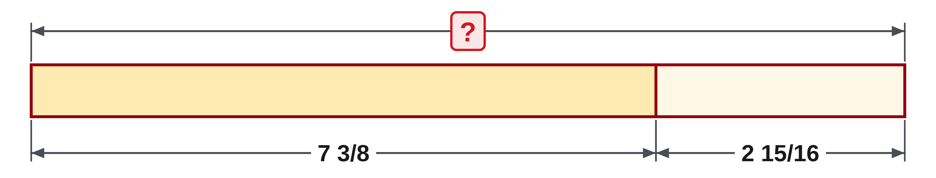
W04-L01 • PRACTISE • 1:25 PM–1:45 PM • 20 MIN TOTAL
Practise from the Exercise Book | 4A Q14b
Write the operation, working and units before checking.
Textbook sections 4.3–4.6 pp.92–99
Textbook
Exercise Book
Numeracy Hub
Shape Canvas
Day 10 • 2026-11-16 • 18
Notes:
PRACTISE • 1:25 PM–1:45 PM • 20 MIN TOTAL — shared across this phase.
Add seven and three eighths to two and fifteen sixteenths. Use sixteenths, combine the wholes, and account for the full whole contained in the fractional sum. Try before checking.
Instructor only, after the attempt: 3/8 = 6/16; 7 + 2 = 9; 6/16 + 15/16 = 21/16 = 1 5/16. Therefore the total is 10 5/16. When the result is interpreted in inches for the marking task, place it five sixteenths beyond ten inches.

Slide 19
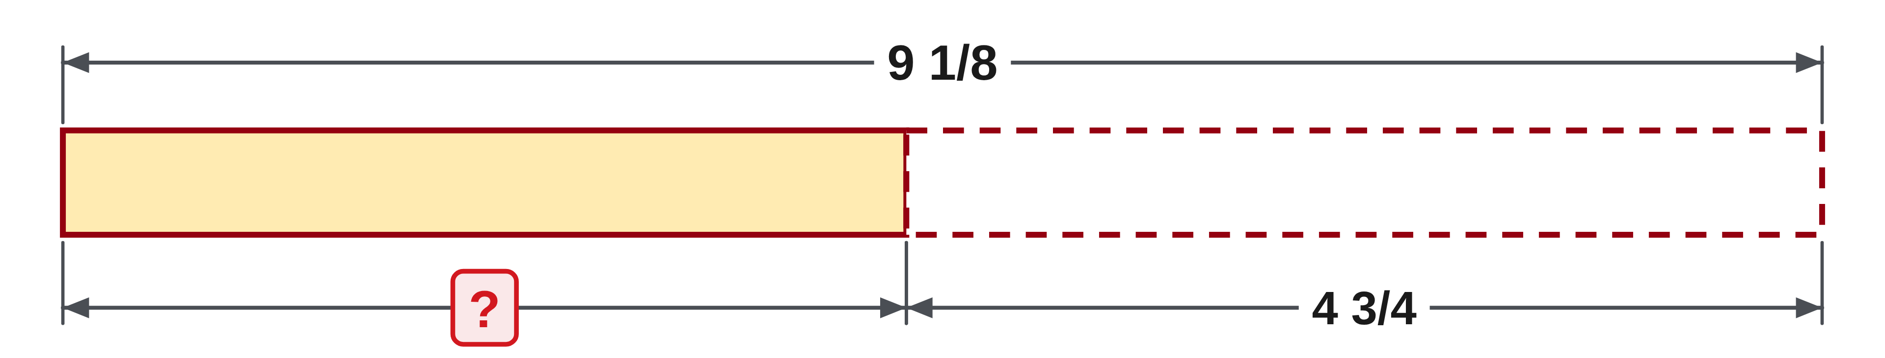
W04-L01 • PRACTISE • 1:25 PM–1:45 PM • 20 MIN TOTAL
Practise from the Exercise Book | 4A Q15b
Write the operation, working and units before checking.
Textbook sections 4.3–4.6 pp.92–99
Textbook
Exercise Book
Numeracy Hub
Shape Canvas
Day 10 • 2026-11-16 • 19
Notes:
PRACTISE • 1:25 PM–1:45 PM • 20 MIN TOTAL — shared across this phase.
Subtract four and three quarters from nine and one eighth. Convert the quarters to eighths and show whether a whole must be exchanged. Check the result by adding it back.
Instructor only, after the attempt: 9 1/8 − 4 6/8 = 8 9/8 − 4 6/8 = 4 3/8. The check is 4 3/8 + 4 3/4 = 9 1/8. Exchanging a whole lowers nine to eight while raising the fractional count from one eighth to nine eighths.

Slide 20
W04-L01 • CHECK • 1:45 PM–1:55 PM • 10 MIN TOTAL
Check independently
Exercise Book 4A Q14(b) and Q15(b). Show common denominators and simplified answers.
Solve without displayed answers; include working, units and the requested rounding.
Resources: Exercise Book 4A Q10–15 (p.36); 4B Q2–3 (p.37)
Textbook sections 4.3–4.6 pp.92–99
Textbook
Exercise Book
Numeracy Hub
Shape Canvas
Day 10 • 2026-11-16 • 20
Notes:
CHECK • 1:45 PM–1:55 PM • 10 MIN TOTAL — shared across this phase.
Complete 4A questions 14(b) and 15(b) independently, showing common denominators and simplified answers. These items ask for exact fractions; no decimal rounding is needed. For the addition, account for any whole created by the fractional total. For the subtraction, account for the whole exchanged before removing the larger fractional part. What should your checks show? Addition must produce a plausible total, and the subtraction remainder added back must recover the starting number. Keep worked solutions closed until the attempt is complete.

Slide 21
W04-L01 • CHECK • 1:45 PM–1:55 PM • 10 MIN TOTAL
Independent check | 4A Q14b
Answer independently. Keep worked solutions closed.
Textbook sections 4.3–4.6 pp.92–99
Textbook
Exercise Book
Numeracy Hub
Shape Canvas
Day 10 • 2026-11-16 • 21
Notes:
CHECK • 1:45 PM–1:55 PM • 10 MIN TOTAL — shared across this phase.
Independently add seven and three eighths to two and fifteen sixteenths. Include the temporary improper fractional total so the carry is visible. Explain where the extra whole comes from.
Instructor only, after the attempt: 7 6/16 + 2 15/16 = 9 21/16 = 10 5/16. Twenty-one sixteenths contains sixteen sixteenths, or one whole, plus five sixteenths. A final whole part of nine indicates that the complete set of sixteen was not carried into the total.

Slide 22
W04-L01 • CHECK • 1:45 PM–1:55 PM • 10 MIN TOTAL
Independent check | 4A Q15b
Answer independently. Keep worked solutions closed.
Textbook sections 4.3–4.6 pp.92–99
Textbook
Exercise Book
Numeracy Hub
Shape Canvas
Day 10 • 2026-11-16 • 22
Notes:
CHECK • 1:45 PM–1:55 PM • 10 MIN TOTAL — shared across this phase.
Independently subtract four and three quarters from nine and one eighth. Show the equivalent fraction and the regrouped starting quantity before subtracting. Use addition to check the result.
Instructor only, after the attempt: 9 1/8 becomes 8 9/8, while 4 3/4 becomes 4 6/8. The difference is 4 3/8. Adding 4 3/8 to 4 6/8 gives 8 9/8, equivalent to the original 9 1/8. Exact fractions are required; no rounding is involved.

Slide 23
W04-L01 • WRAP UP • 1:55 PM–2:00 PM • 5 MIN TOTAL
Wrap up and choose the next step
Ask: What did you learn? Where will you use it? What will you check next time?
Name the math and one other essential skill used; write the next practice step.
Resources: Exercise Book 4A Q10–15 (p.36); 4B Q2–3 (p.37)
Textbook sections 4.3–4.6 pp.92–99
Textbook
Exercise Book
Numeracy Hub
Shape Canvas
Play quiz
Quiz PDF
Day 10 • 2026-11-16 • 23
Notes:
WRAP UP • 1:55 PM–2:00 PM • 5 MIN TOTAL — shared across this phase.
Explain one situation where today's addition or subtraction would be useful: a total cut length, a stack thickness, or a remaining dimension are good examples. Name one check you will use next time. Then identify another skill you used, such as reading a drawing or explaining a calculation to a partner. If a regrouping step caused trouble, mark it for the next block. Cut lists will use the same arithmetic, with an additional quantity to account for: material lost in the stated saw cuts.

Slide 24
DAY 10 • SCHEDULED BREAK
Break
2:00 PM–2:15 PM
Return ready for: Fraction cut lists, centre lines and kerf
This break is excluded from teaching minutes.
Textbook
Exercise Book
Numeracy Hub
Shape Canvas
Day 10 • 2026-11-16 • 24
Notes:
Take the scheduled break from 2:00 to 2:15. We resume at 2:15 with fraction cut lists, centre lines, and kerf. Keep the addition and subtraction checks available; they will help us account for pieces, cutting loss, and the remaining stock.

Slide 25
W04-L02 • START • 2:15 PM–2:20 PM • 5 MIN TOTAL
Fraction cut lists, centre lines and kerf
Today’s goal: Use multiplication and division of fractions to find repeated cuts, centres and offcuts including stated kerf.
Share a prior use of this skill; identify the quantity and unit.
Textbook sections 4.7 pp.100–107; fraction worksheets pp.108–110
Exercise Book 4A Q16–17 (p.36); 4B Q1,4–7 (pp.37–38); 4C Q5 (p.40)
Keep your notebook, textbook, exercise book and chosen calculator ready.
Textbook sections 4.7 pp.100–107; fraction worksheets pp.108–110
Textbook
Exercise Book
Numeracy Hub
Shape Canvas
Day 10 • 2026-11-16 • 25
Notes:
START • 2:15 PM–2:20 PM • 5 MIN TOTAL — shared across this phase.
Open the textbook to section 4.7, pages 100–107; the fraction worksheets are on pages 108–110. We will use multiplication and division for repeated cuts and centre lines, then include the kerf stated in each problem. Kerf is the width of material removed by a saw cut. Why must it be counted separately from finished pieces? It uses stock without becoming part of a finished piece. Our final check will account for the pieces, every specified cutting loss, and the offcut.

Slide 26
W04-L02 • RECALL • 2:20 PM–2:25 PM • 5 MIN TOTAL
Recall and reconnect
Explain how many equal gaps lie between nine marked points. Review the difference between a piece and a saw cut.
Attempt the short retrieval task independently; explain the method before seeing answers.
Resources: Exercise Book 4A Q16–17 (p.36); 4B Q1,4–7 (pp.37–38); 4C Q5 (p.40)
Textbook sections 4.7 pp.100–107; fraction worksheets pp.108–110
Textbook
Exercise Book
Numeracy Hub
Shape Canvas
Day 10 • 2026-11-16 • 26
Notes:
RECALL • 2:20 PM–2:25 PM • 5 MIN TOTAL — shared across this phase.
Imagine nine marked points in a straight row. How many spaces lie between the first and last point? Eight. Trace from one point to the next to count intervals rather than marks. Now distinguish a finished piece from a saw cut. A piece is retained material; a cut removes a stated width of material. Can the number of pieces alone always tell us the number of cuts? No. The arrangement and the problem's instructions determine the cuts we must count.

Slide 27
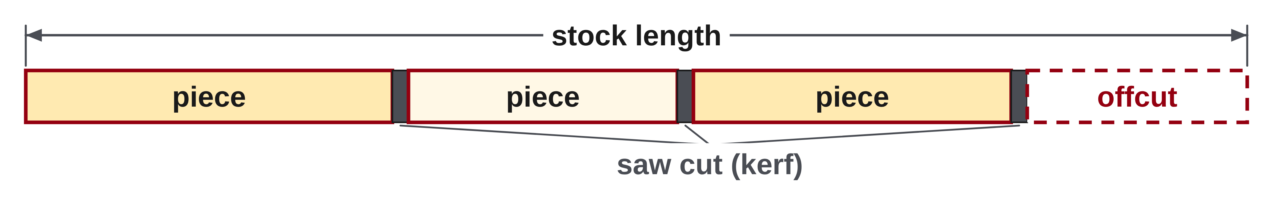
W04-L02 • TEACH • 2:25 PM–2:40 PM • 15 MIN TOTAL
Count pieces, spaces and cuts
1
Draw the stock and label every required piece before calculating.
2
Total repeated pieces = number of pieces × length of one piece.
3
Count the saw cuts shown in the problem; include each stated kerf.
4
Offcut = stock length − piece lengths − total stated kerf.
Textbook sections 4.7 pp.100–107; fraction worksheets pp.108–110
Textbook
Exercise Book
Numeracy Hub
Shape Canvas
Day 10 • 2026-11-16 • 27
Notes:
TEACH • 2:25 PM–2:40 PM • 15 MIN TOTAL — shared across this phase.
Draw the stock and label every required piece before calculating. Equal pieces can be totalled by multiplying the repeat count by one piece length; unequal pieces must be summed individually. Then count the saw cuts specified or shown in the problem and multiply by its stated kerf. Subtract both finished-piece length and cutting loss from the stock to find the offcut. What should the conservation check say? Pieces plus kerf plus offcut equal stock. Keep those categories separate in the working so you can see whether a missing allowance, an incorrect cut count, or fraction arithmetic caused any mismatch.

Slide 28
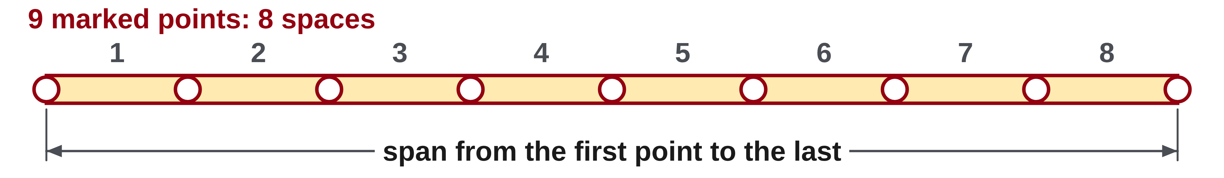
W04-L02 • TEACH • 2:25 PM–2:40 PM • 15 MIN TOTAL
Divide lengths into equal parts
1
Nine marked points have eight spaces between the first and last point.
2
For equal spacing, divide the span by the number of spaces.
3
Divide by a fraction by multiplying by its reciprocal.
4
Round down for complete pieces; keep the remainder as an offcut.
Textbook sections 4.7 pp.100–107; fraction worksheets pp.108–110
Textbook
Exercise Book
Numeracy Hub
Shape Canvas
Day 10 • 2026-11-16 • 28
Notes:
TEACH • 2:25 PM–2:40 PM • 15 MIN TOTAL — shared across this phase.
Equal spacing depends on intervals, not just on marked points. Nine points spanning from the first to the last create eight spaces, so divide that span by eight. For a centre line, divide the full width by two equal halves. A piece-count question instead divides available length by the amount required for one complete piece, including stated cutting loss when applicable. Why do complete-piece counts round down? A fractional part of another piece is not a full usable piece of the requested size. Keep the unused length as an offcut and verify it from exact values rather than rounding the dimensions early.

Slide 29
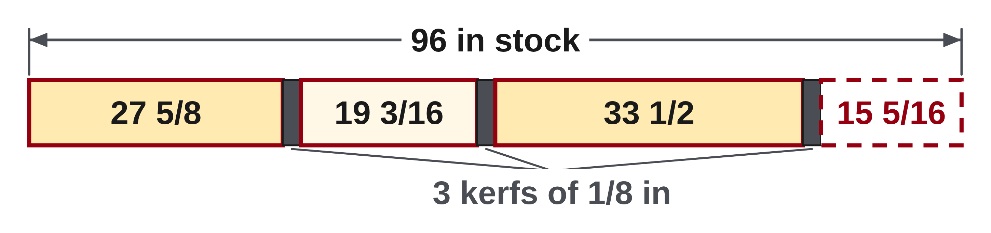
W04-L02 • TEACH • 2:25 PM–2:40 PM • 15 MIN TOTAL
Keep cutting loss inside the used total
Exercise Book 4B Q1: 96 in stock; three stated 1/8 in kerfs.
Pieces = 27 5/8 + 19 3/16 + 33 1/2 = 80 5/16 in
Kerf = 3 × 1/8 = 3/8 = 6/16 in
Offcut = 96 − 80 11/16 = 15 5/16 in
Check: pieces + kerf + offcut = 96 in.
Together: 4B Q4–5. Draw equal spaces for Q6 before writing an equation. Shape Canvas: repeated rectangles plus stock and kerf labels.
W4 L2 • Given kerf is problem data, not a universal allowance
Textbook
Exercise Book
Numeracy Hub
Shape Canvas
Day 10 • 2026-11-16 • 29
Notes:
TEACH • 2:25 PM–2:40 PM • 15 MIN TOTAL — shared across this phase.
For 4B question 1, the three finished pieces total eighty and five sixteenths inches: 27 5/8 + 19 3/16 + 33 1/2. The problem states three kerfs of one eighth inch, so cutting loss is three eighths, or six sixteenths. Add that to the piece total: eighty and eleven sixteenths inches used. Subtract from ninety-six inches to obtain fifteen and five sixteenths inches of offcut. What confirms the accounting? 80 5/16 + 6/16 + 15 5/16 equals 96. The one-eighth-inch kerf is this problem's data, not a value to assume for every saw or cut.

Slide 30
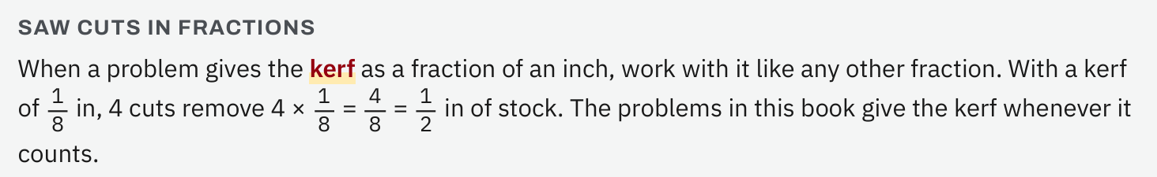
W04-L02 • TEACH • 2:25 PM–2:40 PM • 15 MIN TOTAL
Textbook | page 100
Textbook p.100 • Saw cuts in fractions — Count the stated kerfs
Textbook sections 4.7 pp.100–107; fraction worksheets pp.108–110
Textbook
Exercise Book
Numeracy Hub
Shape Canvas
Day 10 • 2026-11-16 • 30
Notes:
TEACH • 2:25 PM–2:40 PM • 15 MIN TOTAL — shared across this phase.
On page 100, trace where the saw cuts lie relative to the finished pieces. A kerf is a narrow interval of removed material, so it occupies length along the stock even though it is absent from the finished cut list. Count the cuts described by the example, then associate one stated kerf width with each. What would happen if we ignored those intervals? We would overestimate the offcut or believe more finished material fits than the stock can supply. Keep the cut count and the piece count visible as separate information before writing the arithmetic.

Slide 31
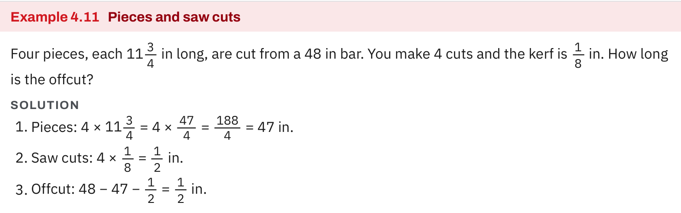
W04-L02 • TEACH • 2:25 PM–2:40 PM • 15 MIN TOTAL
Textbook | page 100
Textbook p.100 • Example 4.11 — Pieces, kerf and offcut
Textbook sections 4.7 pp.100–107; fraction worksheets pp.108–110
Textbook
Exercise Book
Numeracy Hub
Shape Canvas
Day 10 • 2026-11-16 • 31
Notes:
TEACH • 2:25 PM–2:40 PM • 15 MIN TOTAL — shared across this phase.
Example 4.11 on page 100 separates finished pieces, kerf, and offcut. Follow each term into the used-length total, then into the subtraction from stock. Why is the offcut calculated last? We must first account for everything already consumed. After finding it, reverse the process by adding all retained pieces, all stated kerfs, and the offcut. The sum should reproduce the original stock length exactly. This check is especially useful with fractions because a missing eighth-inch kerf can be mistaken for a small arithmetic error unless the terms are labelled clearly.

Slide 32
W04-L02 • TEACH • 2:25 PM–2:40 PM • 15 MIN TOTAL
Spot the mistake. Explain the correction.
A cut list has three pieces. Can you assume there are always three cuts?
Discuss the method before checking the answer.
No. Draw and count the cuts required by that question. Use only its stated kerf.
Textbook sections 4.7 pp.100–107; fraction worksheets pp.108–110
Textbook
Exercise Book
Numeracy Hub
Shape Canvas
Day 10 • 2026-11-16 • 32
Notes:
TEACH • 2:25 PM–2:40 PM • 15 MIN TOTAL — shared across this phase.
A list contains three pieces. Can we always assume three cuts? No. The number depends on how the pieces are arranged in the stock and what the question says about the cuts. Read the stated conditions and draw the boundaries before assigning cutting loss. In the worked question, three kerfs were explicitly given, so three is justified there. What if another question says one cut per spacer? Then each spacer consumes its finished length plus one kerf. The arithmetic follows the described cutting arrangement; we do not substitute an automatic rule based only on the number of pieces.

Slide 33
W04-L02 • TOGETHER • 2:40 PM–2:55 PM • 15 MIN TOTAL
Work together
Solve Exercise Book 4B Q4–5 together. Draw the equal spaces for Q6 before forming the equation.
Work in pairs; alternate calculator operator and checker. Show units and an estimated answer.
Resources: Exercise Book 4A Q16–17 (p.36); 4B Q1,4–7 (pp.37–38); 4C Q5 (p.40)
Textbook sections 4.7 pp.100–107; fraction worksheets pp.108–110
Textbook
Exercise Book
Numeracy Hub
Shape Canvas
Day 10 • 2026-11-16 • 33
Notes:
TOGETHER • 2:40 PM–2:55 PM • 15 MIN TOTAL — shared across this phase.
Solve 4B questions 4 and 5 together. One asks how many thin shims fill a gap; the other asks for the centre-line distance across a plate. Explain why the first answer is a count and the second is a length. Then draw the equal spaces for question 6 before writing its equation. Ask your partner to count intervals with a finger from the first marked point to the last. The drawing should establish the correct divisor before any fraction calculation begins.

Slide 34
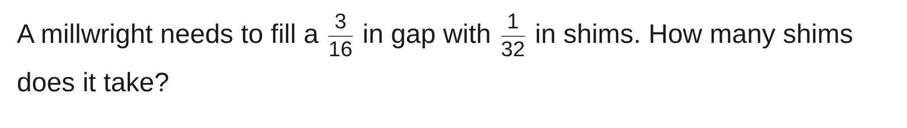
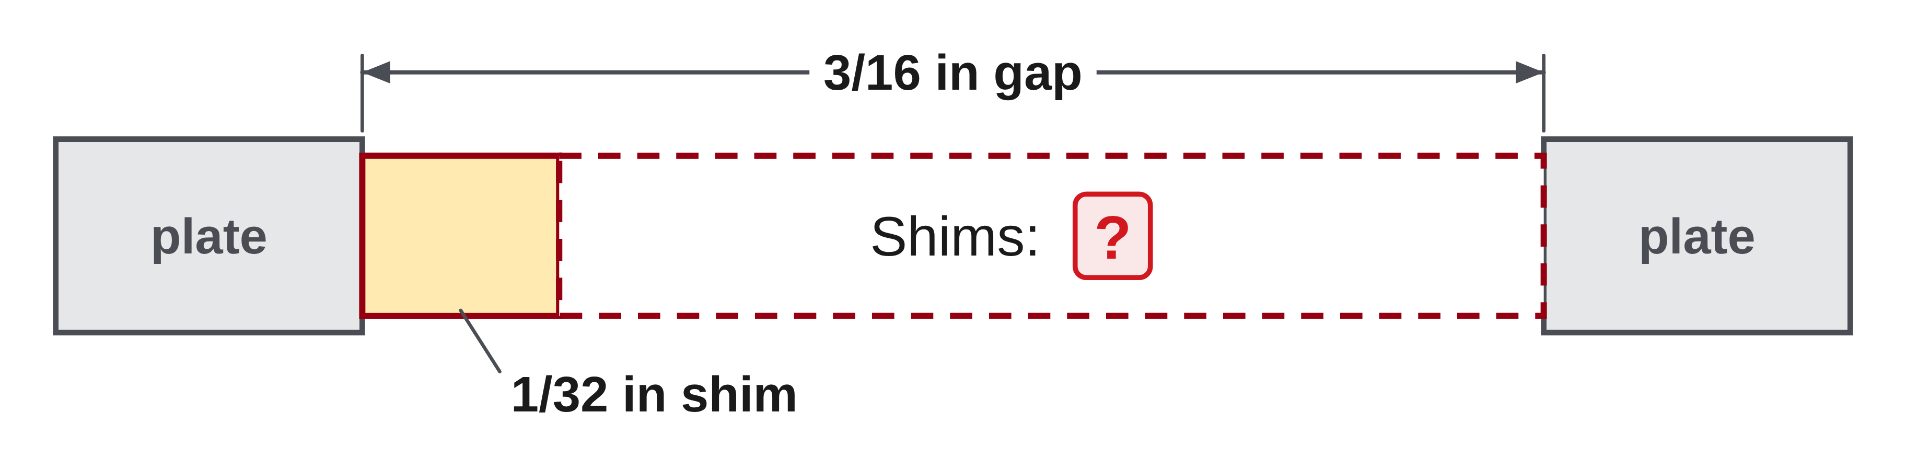
W04-L02 • TOGETHER • 2:40 PM–2:55 PM • 15 MIN TOTAL
Guided practice | 4B Q4
Work with a partner. Take turns explaining the next step.
Textbook sections 4.7 pp.100–107; fraction worksheets pp.108–110
Textbook
Exercise Book
Numeracy Hub
Shape Canvas
Day 10 • 2026-11-16 • 34
Notes:
TOGETHER • 2:40 PM–2:55 PM • 15 MIN TOTAL — shared across this phase.
A three-sixteenths-inch gap must be filled with one-thirty-second-inch shims. How many equal shim thicknesses fit into that gap? Write total gap divided by thickness per shim, then check by multiplication.
Instructor only, after the attempt: (3/16) ÷ (1/32) = (3/16) × 32 = 6 shims. Equivalently, 3/16 = 6/32, so six layers of 1/32 in exactly fill the gap. The answer counts shims; it is not a length of six inches.

Slide 35
W04-L02 • TOGETHER • 2:40 PM–2:55 PM • 15 MIN TOTAL
Compare your method | 4B Q4
CHECK TOGETHER
6 shims
3/16 ÷ 1/32 = 3/16 × 32/1 = 6
Textbook sections 4.7 pp.100–107; fraction worksheets pp.108–110
Textbook
Exercise Book
Numeracy Hub
Shape Canvas
Day 10 • 2026-11-16 • 35
Notes:
TOGETHER • 2:40 PM–2:55 PM • 15 MIN TOTAL — shared across this phase.
Six shims is correct. The gap measures six thirty-seconds of an inch, and each shim contributes one thirty-second, so six equal layers fill it. The reciprocal calculation gives the same result: three sixteenths times thirty-two equals six. Why does dividing by a small fractional thickness produce a larger count? Many small layers fit into the total gap. Check the answer by multiplying six by one thirty-second; the resulting six thirty-seconds reduces to the original three-sixteenths-inch gap.

Slide 36
W04-L02 • PRACTISE • 2:55 PM–3:15 PM • 20 MIN TOTAL
Your scheduled practice
Solve Exercise Book 4A Q16–17, 4B Q6–7 and 4C Q5 as time permits. Explain why complete pieces round down; use only the kerf given in the question.
Solve on paper first; use the tool to check; correct one error with a written reason.
Resources: Exercise Book 4A Q16–17 (p.36); 4B Q1,4–7 (pp.37–38); 4C Q5 (p.40)
Textbook sections 4.7 pp.100–107; fraction worksheets pp.108–110
Textbook
Exercise Book
Numeracy Hub
Shape Canvas
Day 10 • 2026-11-16 • 36
Notes:
PRACTISE • 2:55 PM–3:15 PM • 20 MIN TOTAL — shared across this phase.
Work through 4A questions 16–17, then 4B questions 6–7 and 4C question 5 as time permits. Keep the fractions exact until the final interpretation. In the spacing question, count intervals before dividing. In the spacer question, include only the kerf stated and follow its cut-count condition. Explain why a fractional piece count must be reduced to the number of complete pieces available. What check should follow? Multiply that complete count by the stock used per piece, then subtract to obtain the offcut.

Slide 37
W04-L02 • PRACTISE • 2:55 PM–3:15 PM • 20 MIN TOTAL
Open Shape Canvas
Navigation example. Use the values and units in the assigned task.
Textbook sections 4.7 pp.100–107; fraction worksheets pp.108–110
Textbook
Exercise Book
Numeracy Hub
Shape Canvas
Day 10 • 2026-11-16 • 37
Notes:
PRACTISE • 2:55 PM–3:15 PM • 20 MIN TOTAL — shared across this phase.
Open Shape Canvas and use inches to model the assigned cut-list pieces. Repeat rectangles only when their labelled lengths are equal; use each actual label when the list contains different lengths. Add text for the stock and the question's stated kerf so both remain visible. What must a complete representation account for? Finished pieces, cutting loss, and remaining stock. The drawing organizes those quantities, while your paper calculation determines exact totals and tests whether the required pieces fit.

Slide 38
W04-L02 • PRACTISE • 2:55 PM–3:15 PM • 20 MIN TOTAL
Practise in Numeracy Hub and Shape Canvas
1
In Shape Canvas, use in units and repeat rectangles for the assigned cut-list pieces.
2
Add text labels for stock length and the problem’s stated kerf; solve on paper.
3
Check the total and offcut with Numeracy Hub Calculator after the written solution.
Textbook sections 4.7 pp.100–107; fraction worksheets pp.108–110
Textbook
Exercise Book
Numeracy Hub
Shape Canvas
Day 10 • 2026-11-16 • 38
Notes:
PRACTISE • 2:55 PM–3:15 PM • 20 MIN TOTAL — shared across this phase.
Build the assigned pieces in Shape Canvas with inch labels, and add text for stock length and the stated kerf. Count the cuts according to the problem before writing a kerf total. Solve on paper, then check the expression using Numeracy Hub's calculator. Ask whether pieces plus kerf plus offcut reproduce the stock exactly. If the total is short by one kerf width, inspect the cut count. If it is short by a whole inch, inspect mixed-number regrouping. Use the mismatch to locate the cause.

Slide 39
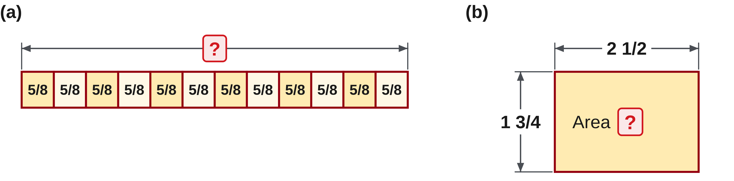
W04-L02 • PRACTISE • 2:55 PM–3:15 PM • 20 MIN TOTAL
Practise from the Exercise Book | 4A Q16
Write the operation, working and units before checking.
Textbook sections 4.7 pp.100–107; fraction worksheets pp.108–110
Textbook
Exercise Book
Numeracy Hub
Shape Canvas
Day 10 • 2026-11-16 • 39
Notes:
PRACTISE • 2:55 PM–3:15 PM • 20 MIN TOTAL — shared across this phase.
Complete both multiplications in 4A question 16. In part (a), twelve repeats five eighths. In part (b), convert both mixed numbers to improper fractions before multiplying. Keep the two methods clear in your working.
Instructor only, after the attempt: (a) (5/8) × 12 = 60/8 = 7 1/2. (b) (5/2) × (7/4) = 35/8 = 4 3/8. These are numerical exercises, so no physical units are supplied. Simplify the fractional remainder in each final mixed number.

Slide 40
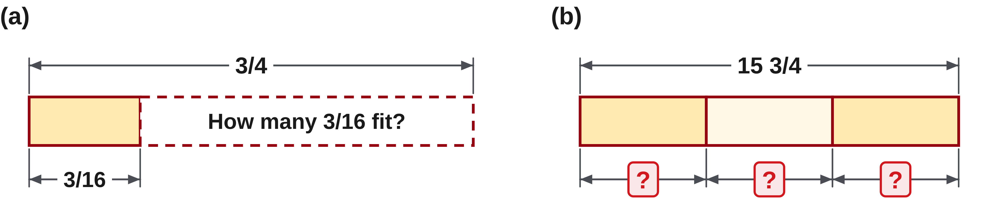
W04-L02 • PRACTISE • 2:55 PM–3:15 PM • 20 MIN TOTAL
Practise from the Exercise Book | 4A Q17
Write the operation, working and units before checking.
Textbook sections 4.7 pp.100–107; fraction worksheets pp.108–110
Textbook
Exercise Book
Numeracy Hub
Shape Canvas
Day 10 • 2026-11-16 • 40
Notes:
PRACTISE • 2:55 PM–3:15 PM • 20 MIN TOTAL — shared across this phase.
Complete both divisions in 4A question 17. Identify the divisor in each expression, then replace division by multiplication using that divisor's reciprocal. In part (b), convert the mixed number first.
Instructor only, after the attempt: (a) (3/4) × (16/3) = 4. (b) (63/4) × (1/3) = 63/12 = 21/4 = 5 1/4. Check by multiplying each quotient by its original divisor. Only the divisor is inverted; the starting value stays unchanged.

Slide 41
W04-L02 • CHECK • 3:15 PM–3:25 PM • 10 MIN TOTAL
Check independently
Exercise Book 4B Q5 and Q7; show centre line, complete pieces and offcut.
Solve without displayed answers; include working, units and the requested rounding.
Resources: Exercise Book 4A Q16–17 (p.36); 4B Q1,4–7 (pp.37–38); 4C Q5 (p.40)
Textbook sections 4.7 pp.100–107; fraction worksheets pp.108–110
Textbook
Exercise Book
Numeracy Hub
Shape Canvas
Day 10 • 2026-11-16 • 41
Notes:
CHECK • 3:15 PM–3:25 PM • 10 MIN TOTAL — shared across this phase.
Complete 4B questions 5 and 7 independently. For question 5, show the centre-line distance and verify that two equal halves restore the full width. For question 7, show the length used per complete spacer, the number of complete spacers, and the offcut. Why must the kerf be inside the per-spacer amount in that question? It states one cut for each spacer. Use that condition exactly and retain the fractional values throughout; rounding applies to the count of complete pieces, not to the dimensions themselves.

Slide 42
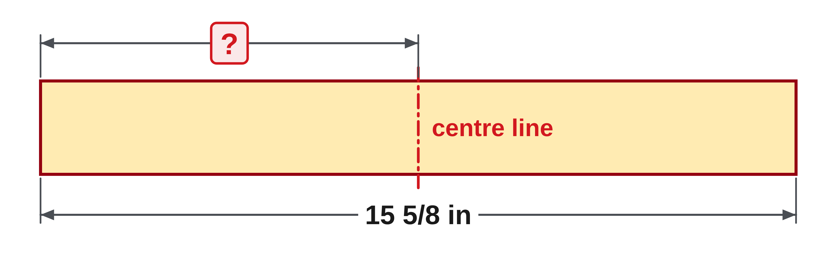
W04-L02 • CHECK • 3:15 PM–3:25 PM • 10 MIN TOTAL
Independent check | 4B Q5
Answer independently. Keep worked solutions closed.
Textbook sections 4.7 pp.100–107; fraction worksheets pp.108–110
Textbook
Exercise Book
Numeracy Hub
Shape Canvas
Day 10 • 2026-11-16 • 42
Notes:
CHECK • 3:15 PM–3:25 PM • 10 MIN TOTAL — shared across this phase.
Find the centre line of a plate fifteen and five eighths inches wide. Divide the full width into two equal parts, then double your result as a check. Keep the answer as an exact inch measurement.
Instructor only, after the attempt: (125/8) ÷ 2 = 125/16 = 7 13/16 in from the edge. Twice 7 13/16 equals 15 10/16 = 15 5/8 in. Halving the complete width requires halving both its whole and fractional contributions together.

Slide 43
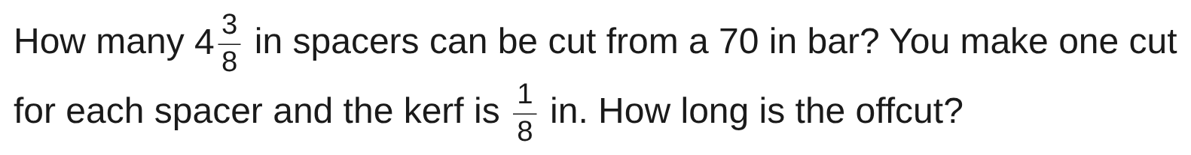
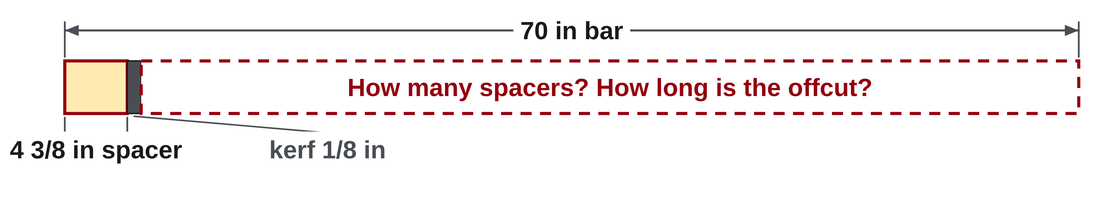
W04-L02 • CHECK • 3:15 PM–3:25 PM • 10 MIN TOTAL
Independent check | 4B Q7
Answer independently. Keep worked solutions closed.
Textbook sections 4.7 pp.100–107; fraction worksheets pp.108–110
Textbook
Exercise Book
Numeracy Hub
Shape Canvas
Day 10 • 2026-11-16 • 43
Notes:
CHECK • 3:15 PM–3:25 PM • 10 MIN TOTAL — shared across this phase.
Find the number of 4 3/8 in spacers from 70 in stock, with one 1/8 in kerf per spacer. Include cutting loss before dividing, then find the offcut from the complete-piece count.
Instructor only, after the attempt: Each spacer uses 4 3/8 + 1/8 = 4 1/2 in. 70 ÷ 4 1/2 = 15 5/9, so 15 complete spacers fit. They use 67 1/2 in, leaving 2 1/2 in. Sixteen would require 72 in and cannot fit.

Slide 44
W04-L02 • WRAP UP • 3:25 PM–3:30 PM • 5 MIN TOTAL
Wrap up and choose the next step
Ask: What did you learn? Where will you use it? What will you check next time?
Name the math and one other essential skill used; write the next practice step.
Resources: Exercise Book 4A Q16–17 (p.36); 4B Q1,4–7 (pp.37–38); 4C Q5 (p.40)
Textbook sections 4.7 pp.100–107; fraction worksheets pp.108–110
Textbook
Exercise Book
Numeracy Hub
Shape Canvas
Play quiz
Quiz PDF
Day 10 • 2026-11-16 • 44
Notes:
WRAP UP • 3:25 PM–3:30 PM • 5 MIN TOTAL — shared across this phase.
Explain the difference between counting points, spaces, pieces, and cuts. Which one supplies the divisor or multiplier depends on the question. Describe one check you used today: double a centre-line distance, rebuild a total from repeated pieces, or add pieces, kerf, and offcut back to stock. Name another skill that helped, such as interpreting the drawing or explaining a cut arrangement. Next we bridge fractional inches to decimals, keeping exact fractions until the task actually requires a rounding step.

