Slide 1

CARPENTRY FOUNDATION / INTAKE 142
Day 12 | Wednesday
12
November 18, 2026
Percent: part of a whole
12:45 PM–2:00 PM • Math • 75 min
Waste allowance and purchase quantities
2:15 PM–3:30 PM • Math • 75 min
Week 4 • 2 scheduled blocks • 150 teaching minutes
Estimate. Show the method. Label units. Check the result.
Textbook
Exercise Book
Numeracy Hub
Shape Canvas
Day 12 • 2026-11-18 • 01
Notes:
Timing: opening orientation within the scheduled start period.
Today we use percent to describe a part of a quantity and to plan a purchase. From 12:45 to 2:00, we connect percent, decimals and fractions. After our 2:00–2:15 break, we apply allowances and discounts, then decide how many whole units to order. We finish at 3:30. Our central question is “Percent of what?” Once we identify the whole, the arithmetic has a clear meaning. Keep your calculator, textbook and exercise book ready.

Slide 2
DAY 12 / WEEK 4 / CLASS TIMETABLE
Today’s exact schedule
12:45 PM–2:00 PM • 75 min
2:15 PM–3:30 PM • 75 min
Percent: part of a whole
Waste allowance and purchase quantities
12:45 PM–12:50 PM
Start
5
2:15 PM–2:20 PM
Start
5
12:50 PM–12:55 PM
Recall
5
2:20 PM–2:25 PM
Recall
5
12:55 PM–1:10 PM
Teach
15
2:25 PM–2:40 PM
Teach
15
1:10 PM–1:25 PM
Together
15
2:40 PM–2:55 PM
Together
15
1:25 PM–1:45 PM
Practise
20
2:55 PM–3:15 PM
Practise
20
1:45 PM–1:55 PM
Check
10
3:15 PM–3:25 PM
Check
10
1:55 PM–2:00 PM
Wrap up
5
3:25 PM–3:30 PM
Wrap up
5
Math • Math Week 4, Lesson 5
Math • Math Week 4, Lesson 6
Break: 2:00 PM–2:15 PM • 15 minutes • excluded from teaching time
Textbook
Exercise Book
Numeracy Hub
Shape Canvas
Day 12 • 2026-11-18 • 02
Notes:
Timing: opening orientation within the scheduled start period.
Both blocks follow the timetable shown here. We have five minutes to begin, five for recall, fifteen to learn the method, fifteen together, twenty for practice, ten to check independently and five to finish. Our break is 2:00–2:15. The first block asks how much a percentage represents. The second asks what happens when we add or subtract that amount. Watch for the difference between an allowance by itself and the total order including that allowance.

Slide 3
W04-L05 • START • 12:45 PM–12:50 PM • 5 MIN TOTAL
Percent: part of a whole
Today’s goal: Convert percentages, decimals and fractions; find a percentage of a quantity.
Share a prior use of this skill; identify the quantity and unit.
Textbook sections 6.1–6.3 pp.138–142; calculator percent p.55
Exercise Book 6A Q1–10 (p.55); 6C Q1–2 (p.59)
Keep your notebook, textbook, exercise book and chosen calculator ready.
Textbook sections 6.1–6.3 pp.138–142; calculator percent p.55
Textbook
Exercise Book
Numeracy Hub
Shape Canvas
Day 12 • 2026-11-18 • 03
Notes:
Timing: START | 12:45 PM–12:50 PM | 5 MIN TOTAL. Shared phase allocation across these slides.
A percent tells us how many parts out of one hundred equal parts. We can use it for a share of stock, a price adjustment or a waste allowance, but we must identify the quantity being compared. Open the assigned chapter and exercise book 6A Q1–10 and 6C Q1–2. What does fifty percent mean in familiar fraction language? One half. Today we will use that connection to calculate unfamiliar rates and check whether the result is reasonable.

Slide 4
W04-L05 • RECALL • 12:50 PM–12:55 PM • 5 MIN TOTAL
Recall and reconnect
Retrieve 0.5 = 1/2 and ask for the matching percent. Use Exercise Book 6A Q1 and Q3.
Attempt the short retrieval task independently; explain the method before seeing answers.
Resources: Exercise Book 6A Q1–10 (p.55); 6C Q1–2 (p.59)
Textbook sections 6.1–6.3 pp.138–142; calculator percent p.55
Textbook
Exercise Book
Numeracy Hub
Shape Canvas
Day 12 • 2026-11-18 • 04
Notes:
Timing: RECALL | 12:50 PM–12:55 PM | 5 MIN TOTAL. Shared phase allocation across these slides.
Recall that 0.5 equals one half. If a whole is divided into one hundred equal parts, half of them is fifty, so one half equals fifty percent. Use 6A Q1 and Q3 to connect the forms. What operation changes a percent to a decimal? Dividing by one hundred, because percent means “per hundred.” Explain the meaning before using a shortcut about moving the point; meaning helps you spot a point moved in the wrong direction.

Slide 5
W04-L05 • RECALL • 12:50 PM–12:55 PM • 5 MIN TOTAL
Recall from the Exercise Book | 6A Q1
Write the operation, working and units before checking.
Textbook sections 6.1–6.3 pp.138–142; calculator percent p.55
Textbook
Exercise Book
Numeracy Hub
Shape Canvas
Day 12 • 2026-11-18 • 05
Notes:
Timing: RECALL | 12:50 PM–12:55 PM | 5 MIN TOTAL. Shared phase allocation across these slides.
For 6A Q1, write 64% as a decimal. Read the symbol aloud as “sixty-four per hundred,” then express that as division. Record the decimal before checking it.
Instructor-only, after the attempt: 64 ÷ 100 = 0.64. Because 64% is below 100%, its decimal should be below one. An answer of 64 or 6.4 would represent a much larger share than the stated percentage.

Slide 6
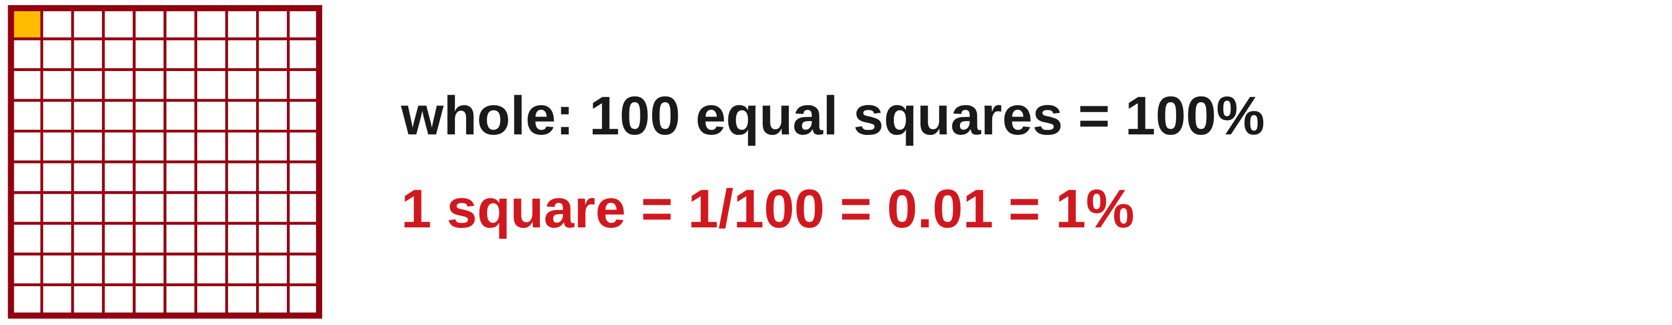
W04-L05 • TEACH • 12:55 PM–1:10 PM • 15 MIN TOTAL
Percent means parts per hundred
1
A percent compares a part with a whole using 100 equal parts.
2
Convert percent to decimal by dividing by 100.
3
Convert decimal to percent by multiplying by 100.
4
Name the whole before you calculate the part.
Textbook sections 6.1–6.3 pp.138–142; calculator percent p.55
Textbook
Exercise Book
Numeracy Hub
Shape Canvas
Day 12 • 2026-11-18 • 06
Notes:
Timing: TEACH | 12:55 PM–1:10 PM | 15 MIN TOTAL. Shared phase allocation across these slides.
Percent standardizes a comparison by treating the whole as one hundred equal parts. Twenty-five percent means twenty-five of those parts, which is twenty-five hundredths or 0.25. To move from percent to decimal, divide by one hundred. To move from decimal to percent, multiply by one hundred and include the percent symbol. Does 0.25 mean a quarter of one metre or a quarter of one hundred metres? We cannot tell until the whole is named. The percentage describes the relationship; the whole supplies the actual quantity and unit. Say both before calculating.

Slide 7
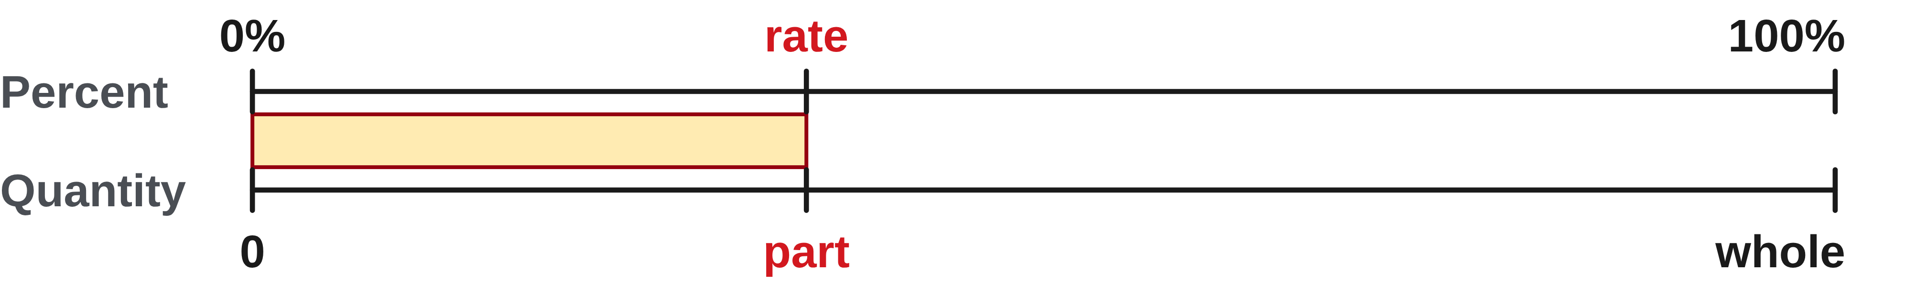
W04-L05 • TEACH • 12:55 PM–1:10 PM • 15 MIN TOTAL
Find a percentage of a quantity
1
Write the rate as a decimal.
2
Part = decimal rate × whole quantity.
3
The part keeps the same measurement unit as the whole.
4
If the rate is below 100%, the part should be smaller than the whole.
Textbook sections 6.1–6.3 pp.138–142; calculator percent p.55
Textbook
Exercise Book
Numeracy Hub
Shape Canvas
Day 12 • 2026-11-18 • 07
Notes:
Timing: TEACH | 12:55 PM–1:10 PM | 15 MIN TOTAL. Shared phase allocation across these slides.
To find a percentage of a quantity, change the rate to a decimal and multiply by the whole. The decimal is a multiplier; it does not replace the measurement unit. Twelve percent of a millimetre quantity produces a millimetre quantity. If a positive rate is below one hundred percent, the resulting part should be smaller than the whole. What would a rate of one hundred percent give? The whole itself, because the decimal multiplier is one. That simple boundary check can expose a percent accidentally entered as a whole-number multiplier.

Slide 8
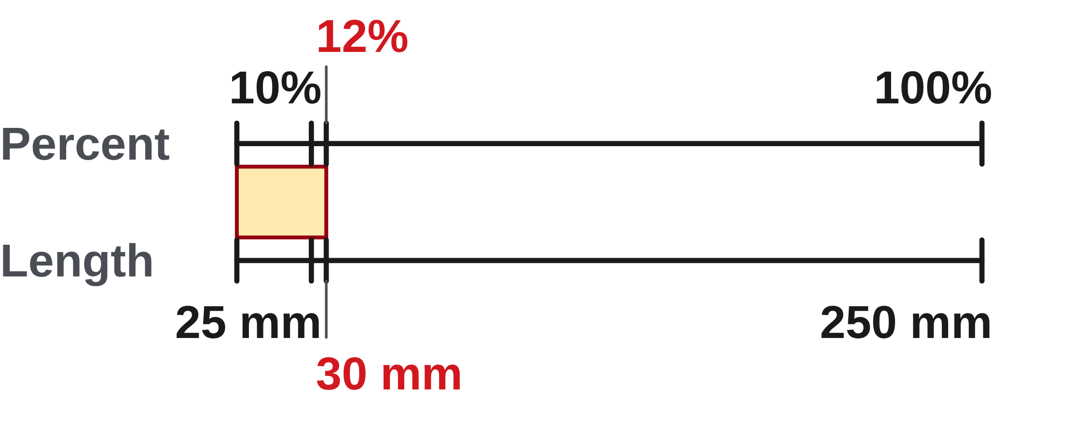
W04-L05 • TEACH • 12:55 PM–1:10 PM • 15 MIN TOTAL
Write the whole and rate before multiplying
12% of 250 mm = 0.12 × 250 = 30 mm
24 out of 300 = 24 ÷ 300 × 100 = 8%
Check the first result: 10% is 25 mm, so 12% should be slightly larger.
Do not multiply by 12 when you mean 12%.
Together: 6A Q5–8 and 6C Q2. Label part, whole and rate.
Compare decimal multiplication with the model-specific percent key. Calculate the 6C Q2 rectangle width before drawing it.
W4 L5 • Numeracy Hub Calculator and Shape Canvas • Classroom examples
Textbook
Exercise Book
Numeracy Hub
Shape Canvas
Day 12 • 2026-11-18 • 08
Notes:
Timing: TEACH | 12:55 PM–1:10 PM | 15 MIN TOTAL. Shared phase allocation across these slides.
In our first example, the whole is 250 millimetres and the rate is twelve percent. Convert twelve percent to 0.12, then multiply: 0.12 times 250 gives 30 millimetres. Ten percent would be 25 millimetres, so 30 is sensible. The second example asks for the rate: twenty-four out of three hundred. Divide the part by the whole, 24 ÷ 300 = 0.08, then multiply by one hundred to get eight percent. Which quantity goes first in that division? The part. Reversing part and whole describes a different relationship.

Slide 9
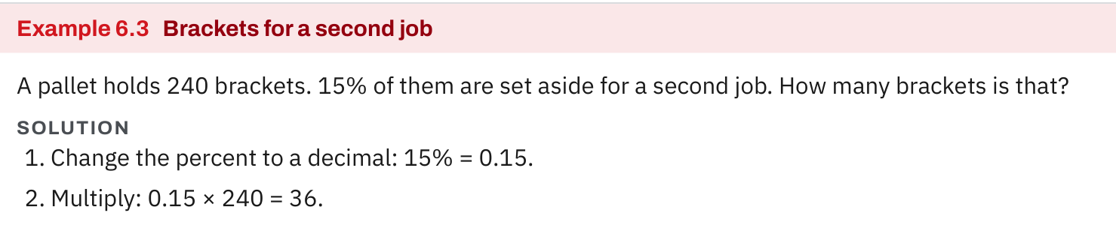
W04-L05 • TEACH • 12:55 PM–1:10 PM • 15 MIN TOTAL
Textbook | page 140
Textbook p.140 • Example 6.3 — Find a percent of a quantity
Textbook sections 6.1–6.3 pp.138–142; calculator percent p.55
Textbook
Exercise Book
Numeracy Hub
Shape Canvas
Day 12 • 2026-11-18 • 09
Notes:
Timing: TEACH | 12:55 PM–1:10 PM | 15 MIN TOTAL. Shared phase allocation across these slides.
Textbook page 140 gives 240 brackets, with fifteen percent set aside for another job. The whole is all 240 brackets. Fifteen percent becomes 0.15, so 240 times 0.15 equals 36 brackets. Check mentally: ten percent is 24, five percent is half of that, twelve, and 24 plus twelve is 36. What does 36 represent? The brackets set aside, not the number remaining. Read the requested quantity carefully before deciding whether another addition or subtraction is needed. Here the example asks only for the part.

Slide 10
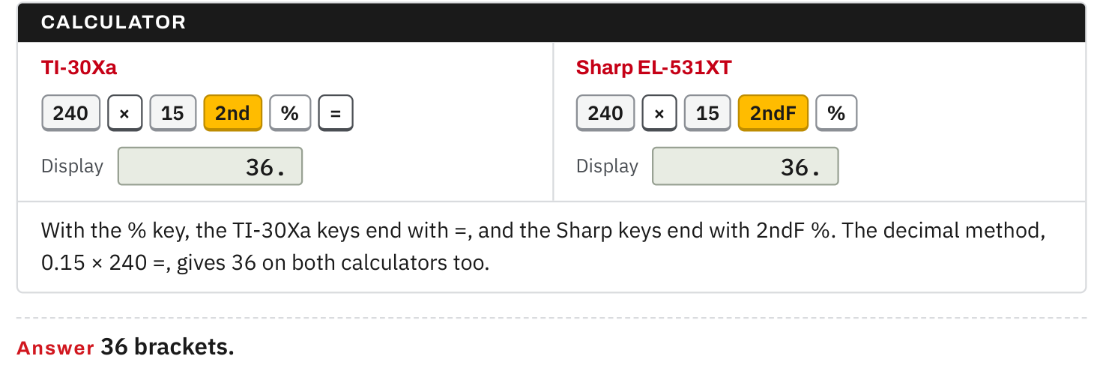
W04-L05 • TEACH • 12:55 PM–1:10 PM • 15 MIN TOTAL
Textbook | page 140
Textbook p.140 • Example 6.3 — Compare the two calculator models
Textbook sections 6.1–6.3 pp.138–142; calculator percent p.55
Textbook
Exercise Book
Numeracy Hub
Shape Canvas
Day 12 • 2026-11-18 • 10
Notes:
Timing: TEACH | 12:55 PM–1:10 PM | 15 MIN TOTAL. Shared phase allocation across these slides.
The textbook shows two calculator models calculating the same fifteen percent of 240. On the TI-30Xa, the displayed percent sequence finishes with equals. On the Sharp EL-531XT, the answer appears after 2ndF percent; do not add equals to that sequence. Both give 36. The decimal method, 0.15 times 240 equals, works on either model. What must remain the same even when the key sequence differs? The mathematical relationship: rate times whole. Use your model’s sequence and a mental size check so a key habit from another calculator does not mislead you.

Slide 11
W04-L05 • TEACH • 12:55 PM–1:10 PM • 15 MIN TOTAL
Spot the mistake. Explain the correction.
A learner enters 25 × the whole to find 25% of it. What is missing?
Discuss the method before checking the answer.
The percent must become a decimal: 25 ÷ 100. Multiply the whole by 0.25.
Textbook sections 6.1–6.3 pp.138–142; calculator percent p.55
Textbook
Exercise Book
Numeracy Hub
Shape Canvas
Day 12 • 2026-11-18 • 11
Notes:
Timing: TEACH | 12:55 PM–1:10 PM | 15 MIN TOTAL. Shared phase allocation across these slides.
Someone enters twenty-five times the whole to find twenty-five percent of it. What is missing? Give everyone a moment to connect percent with “per hundred.” Twenty-five percent is 25 divided by 100, or 0.25. Multiplying by twenty-five produces twenty-five wholes, while multiplying by 0.25 produces one quarter of a whole. Should twenty-five percent of a positive quantity be larger or smaller than that quantity? Smaller. That size question catches this error before we even calculate an exact result. Write the decimal rate first when the percent key feels uncertain.

Slide 12
W04-L05 • TOGETHER • 1:10 PM–1:25 PM • 15 MIN TOTAL
Work together
Work Exercise Book 6A Q5–8 and 6C Q2. Label the part, whole and rate.
Work in pairs; alternate calculator operator and checker. Show units and an estimated answer.
Resources: Exercise Book 6A Q1–10 (p.55); 6C Q1–2 (p.59)
Textbook sections 6.1–6.3 pp.138–142; calculator percent p.55
Textbook
Exercise Book
Numeracy Hub
Shape Canvas
Day 12 • 2026-11-18 • 12
Notes:
Timing: TOGETHER | 1:10 PM–1:25 PM | 15 MIN TOTAL. Shared phase allocation across these slides.
Work together on 6A Q5–8 and 6C Q2. Name the form requested: fraction, decimal, percent or measured quantity. In a percent calculation, label the part, the whole and the rate before choosing an operation. One partner explains the relationship while the other checks the calculation. If the question asks for a missing width, what unit should the answer carry? The same length unit used in the given rectangle, once the calculation is complete.

Slide 13
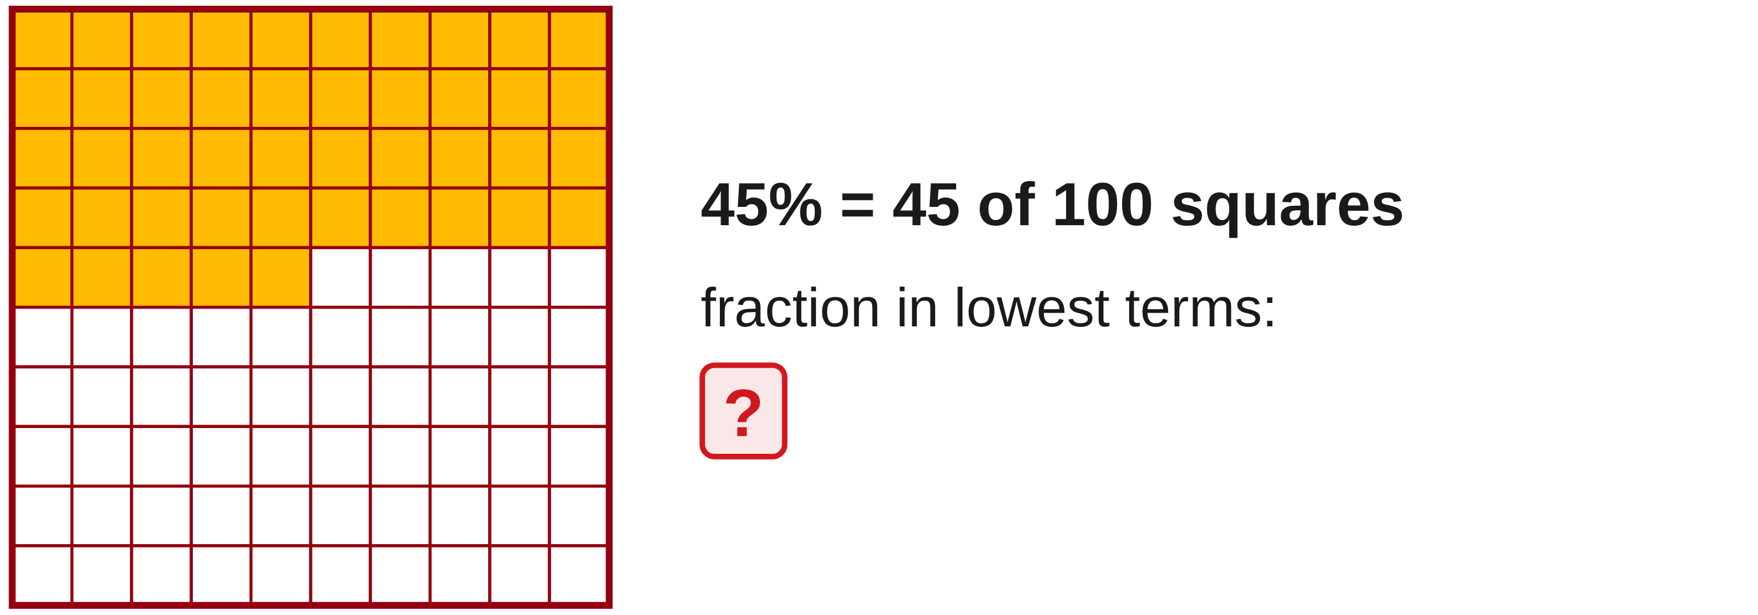
W04-L05 • TOGETHER • 1:10 PM–1:25 PM • 15 MIN TOTAL
Guided practice | 6A Q5
Work with a partner. Take turns explaining the next step.
Textbook sections 6.1–6.3 pp.138–142; calculator percent p.55
Textbook
Exercise Book
Numeracy Hub
Shape Canvas
Day 12 • 2026-11-18 • 13
Notes:
Timing: TOGETHER | 1:10 PM–1:25 PM | 15 MIN TOTAL. Shared phase allocation across these slides.
For 6A Q5, write 45% as a fraction in lowest terms. Begin with the meaning of percent and then find a factor that divides both numerator and denominator. Explain to your partner why reducing the fraction preserves its value.
Instructor-only, after the attempt: 45/100 reduces by five to 9/20. Both parts of the fraction must be divided by the same number. Dividing only the numerator would change the represented share.

Slide 14
W04-L05 • TOGETHER • 1:10 PM–1:25 PM • 15 MIN TOTAL
Compare your method | 6A Q5
CHECK TOGETHER
9/20
Textbook sections 6.1–6.3 pp.138–142; calculator percent p.55
Textbook
Exercise Book
Numeracy Hub
Shape Canvas
Day 12 • 2026-11-18 • 14
Notes:
Timing: TOGETHER | 1:10 PM–1:25 PM | 15 MIN TOTAL. Shared phase allocation across these slides.
Our fraction is nine twentieths. Forty-five percent first becomes 45/100. Dividing the top and bottom by five gives 9/20, and there is no larger common factor left. Check by dividing nine by twenty: 0.45, which converts back to forty-five percent. Why does the denominator change from one hundred to twenty? We regrouped the same share into larger equal parts. The amount did not change; only its representation became simpler.

Slide 15
W04-L05 • PRACTISE • 1:25 PM–1:45 PM • 20 MIN TOTAL
Your scheduled practice
Complete Exercise Book 6A Q2,4,9–10 and 6C Q1. Create the 6C Q2 rectangle in Shape Canvas after calculating its missing width.
Solve on paper first; use the tool to check; correct one error with a written reason.
Resources: Exercise Book 6A Q1–10 (p.55); 6C Q1–2 (p.59)
Textbook sections 6.1–6.3 pp.138–142; calculator percent p.55
Textbook
Exercise Book
Numeracy Hub
Shape Canvas
Day 12 • 2026-11-18 • 15
Notes:
Timing: PRACTISE | 1:25 PM–1:45 PM | 20 MIN TOTAL. Shared phase allocation across these slides.
Complete 6A Q2, Q4 and Q9–10, plus 6C Q1. After calculating the missing width for 6C Q2, build that rectangle in Shape Canvas. Keep the labels “part,” “whole” and “rate” beside your work so you can explain the direction of each calculation. What do you do if your percentage is below one hundred but the part exceeds the whole? Check whether you divided by one hundred or accidentally used the percent number as the multiplier.

Slide 16

W04-L05 • PRACTISE • 1:25 PM–1:45 PM • 20 MIN TOTAL
Open Shape Canvas
Navigation example. Use the values and units in the assigned task.
Textbook sections 6.1–6.3 pp.138–142; calculator percent p.55
Textbook
Exercise Book
Numeracy Hub
Shape Canvas
Day 12 • 2026-11-18 • 16
Notes:
Timing: PRACTISE | 1:25 PM–1:45 PM | 20 MIN TOTAL. Shared phase allocation across these slides.
Open Shape Canvas for the rectangle from 6C Q2. Read the given dimension and the percentage relationship from the exercise before entering anything. We are using the canvas to check a width we have already calculated. Which dimension is the whole in the stated comparison? Use the exercise wording to identify it, then attach the correct unit to the missing width. Compare the resulting labels with your written calculation; the screen’s apparent proportions do not replace the labelled dimensions.

Slide 17
W04-L05 • PRACTISE • 1:25 PM–1:45 PM • 20 MIN TOTAL
Practise in Numeracy Hub and Shape Canvas
1
Label the part, whole and rate in the assigned book question before using a tool.
2
Calculate the missing width for 6C Q2, then create its rectangle in Shape Canvas.
3
Check with the matching Numeracy Hub calculator model and compare the methods.
Textbook sections 6.1–6.3 pp.138–142; calculator percent p.55
Textbook
Exercise Book
Numeracy Hub
Shape Canvas
Day 12 • 2026-11-18 • 17
Notes:
Timing: PRACTISE | 1:25 PM–1:45 PM | 20 MIN TOTAL. Shared phase allocation across these slides.
First write the part, whole and rate for the assigned question. Calculate the missing width in 6C Q2 on paper, then create the rectangle with those dimensions in Shape Canvas. Use the matching calculator model in Numeracy Hub to check the arithmetic. What should agree between paper and screen? The numeric width and its unit. If a percent-key result differs from decimal multiplication, check the model’s sequence before changing a method you can justify from the percent relationship.

Slide 18
W04-L05 • PRACTISE • 1:25 PM–1:45 PM • 20 MIN TOTAL
Practise from the Exercise Book | 6A Q2
Write the operation, working and units before checking.
Textbook sections 6.1–6.3 pp.138–142; calculator percent p.55
Textbook
Exercise Book
Numeracy Hub
Shape Canvas
Day 12 • 2026-11-18 • 18
Notes:
Timing: PRACTISE | 1:25 PM–1:45 PM | 20 MIN TOTAL. Shared phase allocation across these slides.
For 6A Q2, write 3.5% as a decimal. This is only three and a half parts per hundred, so expect a small decimal. Write the division explicitly rather than guessing where the point belongs.
Instructor-only, after the attempt: 3.5 ÷ 100 = 0.035. Check backwards: 0.035 × 100 = 3.5%. The value 0.35 would mean thirty-five percent, ten times the requested rate.

Slide 19
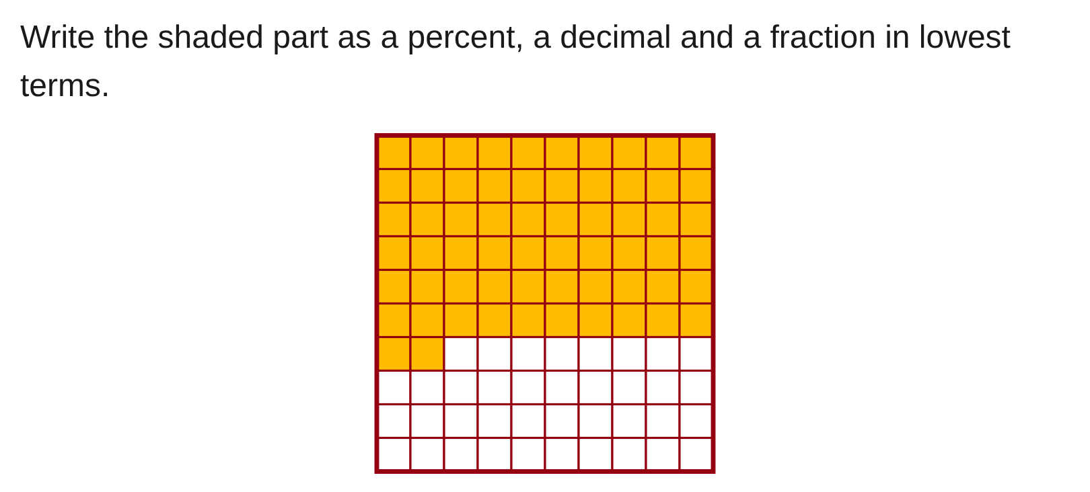
W04-L05 • PRACTISE • 1:25 PM–1:45 PM • 20 MIN TOTAL
Practise from the Exercise Book | 6C Q1
Write the operation, working and units before checking.
Textbook sections 6.1–6.3 pp.138–142; calculator percent p.55
Textbook
Exercise Book
Numeracy Hub
Shape Canvas
Day 12 • 2026-11-18 • 19
Notes:
Timing: PRACTISE | 1:25 PM–1:45 PM | 20 MIN TOTAL. Shared phase allocation across these slides.
In 6C Q1, count the shaded portion of the grid and describe the same share as a percent, decimal and simplest fraction. Check the size of the whole grid before choosing a denominator. Record all three forms before we compare.
Instructor-only, after the attempt: 62%, 0.62 and 31/50. Sixty-two shaded hundredths give 62/100; divide numerator and denominator by two. The three forms describe exactly the same shaded portion.

Slide 20
W04-L05 • CHECK • 1:45 PM–1:55 PM • 10 MIN TOTAL
Check independently
Exercise Book 6A Q8–9 with a labelled part/whole calculation.
Solve without displayed answers; include working, units and the requested rounding.
Resources: Exercise Book 6A Q1–10 (p.55); 6C Q1–2 (p.59)
Textbook sections 6.1–6.3 pp.138–142; calculator percent p.55
Textbook
Exercise Book
Numeracy Hub
Shape Canvas
Day 12 • 2026-11-18 • 20
Notes:
Timing: CHECK | 1:45 PM–1:55 PM | 10 MIN TOTAL. Shared phase allocation across these slides.
Complete 6A Q8–9 independently. One question gives a rate and a whole and asks for the part. The other gives a part and a whole and asks for the rate. Label what is known before calculating so I can see why you multiplied or divided. What changes between the two? The unknown quantity, not the meaning of percent. Keep your estimate and final unit or percent symbol visible with the working.

Slide 21
W04-L05 • CHECK • 1:45 PM–1:55 PM • 10 MIN TOTAL
Independent check | 6A Q8
Answer independently. Keep worked solutions closed.
Textbook sections 6.1–6.3 pp.138–142; calculator percent p.55
Textbook
Exercise Book
Numeracy Hub
Shape Canvas
Day 12 • 2026-11-18 • 21
Notes:
Timing: CHECK | 1:45 PM–1:55 PM | 10 MIN TOTAL. Shared phase allocation across these slides.
For 6A Q8, find 6.5% of 4,200. Label the whole and convert the rate before multiplying. Use a ten-percent benchmark to check that your answer is a sensible size. Do not reveal the result until the attempt is complete.
Instructor-only, after the attempt: 0.065 × 4,200 = 273. Ten percent is 420, so a 6.5% part should be below 420. The question provides no measurement unit; do not invent one.

Slide 22
W04-L05 • CHECK • 1:45 PM–1:55 PM • 10 MIN TOTAL
Independent check | 6A Q9
Answer independently. Keep worked solutions closed.
Textbook sections 6.1–6.3 pp.138–142; calculator percent p.55
Textbook
Exercise Book
Numeracy Hub
Shape Canvas
Day 12 • 2026-11-18 • 22
Notes:
Timing: CHECK | 1:45 PM–1:55 PM | 10 MIN TOTAL. Shared phase allocation across these slides.
For 6A Q9, twenty-seven is what percent of three hundred sixty? Decide which number is the part and which is the whole. Write the division that expresses that relationship, then convert the resulting decimal to percent.
Instructor-only, after the attempt: 27 ÷ 360 = 0.075; multiplied by 100, this is 7.5%. A useful check is that ten percent of 360 is 36, so twenty-seven must be less than ten percent.

Slide 23
W04-L05 • WRAP UP • 1:55 PM–2:00 PM • 5 MIN TOTAL
Wrap up and choose the next step
Ask: What did you learn? Where will you use it? What will you check next time?
Name the math and one other essential skill used; write the next practice step.
Resources: Exercise Book 6A Q1–10 (p.55); 6C Q1–2 (p.59)
Textbook sections 6.1–6.3 pp.138–142; calculator percent p.55
Textbook
Exercise Book
Numeracy Hub
Shape Canvas
Play quiz
Quiz PDF
Day 12 • 2026-11-18 • 23
Notes:
Timing: WRAP UP | 1:55 PM–2:00 PM | 5 MIN TOTAL. Shared phase allocation across these slides.
Say one complete percent statement from your work: name the rate, the whole and the resulting part. Why is “six percent” incomplete as a material quantity? We still need to know six percent of what. Today we converted between forms and chose the operation from the missing quantity. After the break, we will keep that same whole in view while adding an allowance or taking off a discount. Mark one corrected example that shows your clearest reasoning.

Slide 24
DAY 12 • SCHEDULED BREAK
Break
2:00 PM–2:15 PM
Return ready for: Waste allowance and purchase quantities
This break is excluded from teaching minutes.
Textbook
Exercise Book
Numeracy Hub
Shape Canvas
Day 12 • 2026-11-18 • 24
Notes:
Timing: scheduled break, 2:00–2:15 PM.
Our break is 2:00–2:15. When we return, keep the idea of the original whole in mind. We will use it to distinguish a waste allowance from the complete order and a discount from the price after discount.

Slide 25
W04-L06 • START • 2:15 PM–2:20 PM • 5 MIN TOTAL
Waste allowance and purchase quantities
Today’s goal: Apply an allowance or discount once, then round an order to whole purchase units.
Share a prior use of this skill; identify the quantity and unit.
Textbook sections 6.4 pp.142–143; review sections 5.7 pp.124–132
Exercise Book 6A Q11–13 (p.56); 6B Q1–3,5 (p.57)
Keep your notebook, textbook, exercise book and chosen calculator ready.
Textbook sections 6.4 pp.142–143; review sections 5.7 pp.124–132
Textbook
Exercise Book
Numeracy Hub
Shape Canvas
Day 12 • 2026-11-18 • 25
Notes:
Timing: START | 2:15 PM–2:20 PM | 5 MIN TOTAL. Shared phase allocation across these slides.
Now we turn a percent calculation into a purchase decision. Sometimes we need the original quantity plus an allowance; sometimes we pay the original price minus a discount. Then a supplier may require whole sheets or whole lengths. Open 6A Q11–13 and 6B Q1–3 and Q5. What are the two separate decisions? First calculate the adjusted quantity, then decide the whole purchase amount. We will keep those steps visible so the allowance is applied once and the order is large enough.

Slide 26
W04-L06 • RECALL • 2:20 PM–2:25 PM • 5 MIN TOTAL
Recall and reconnect
Discuss whether a 15% allowance means ordering 15% or 115% of the original quantity.
Attempt the short retrieval task independently; explain the method before seeing answers.
Resources: Exercise Book 6A Q11–13 (p.56); 6B Q1–3,5 (p.57)
Textbook sections 6.4 pp.142–143; review sections 5.7 pp.124–132
Textbook
Exercise Book
Numeracy Hub
Shape Canvas
Day 12 • 2026-11-18 • 26
Notes:
Timing: RECALL | 2:20 PM–2:25 PM | 5 MIN TOTAL. Shared phase allocation across these slides.
Does a fifteen percent allowance mean ordering fifteen percent of the original quantity? Think about what would be missing if that were the entire order. We still need the original one hundred percent. Adding fifteen percent gives one hundred fifteen percent, or a multiplier of 1.15. What does 0.15 represent by itself? Only the extra allowance. Say which of those two quantities you are calculating before entering keys.

Slide 27
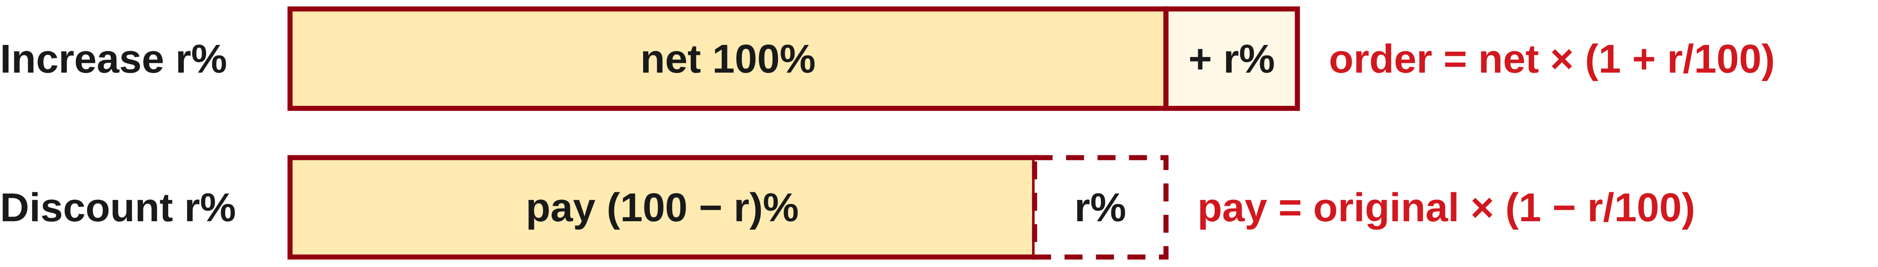
W04-L06 • TEACH • 2:25 PM–2:40 PM • 15 MIN TOTAL
Apply an allowance to the original amount
1
First identify the net quantity before any allowance.
2
An increase of r% gives net quantity × (1 + r/100).
3
A discount of r% gives original amount × (1 − r/100).
4
Use the percentage stated in the exercise; it is problem data.
Textbook sections 6.4 pp.142–143; review sections 5.7 pp.124–132
Textbook
Exercise Book
Numeracy Hub
Shape Canvas
Day 12 • 2026-11-18 • 27
Notes:
Timing: TEACH | 2:25 PM–2:40 PM | 15 MIN TOTAL. Shared phase allocation across these slides.
Begin with the net quantity: the amount needed before an allowance. An increase of r percent combines the original one hundred percent with the added r percent, giving a multiplier of one plus r divided by one hundred. A discount removes a share, so use one minus r divided by one hundred. For a fifteen percent increase the multiplier is 1.15; for a twelve percent discount it is 0.88. Which result should be larger than the original? The increase. Use the exercise’s stated rate; the rate is part of this problem’s data, not a universal job rule.

Slide 28
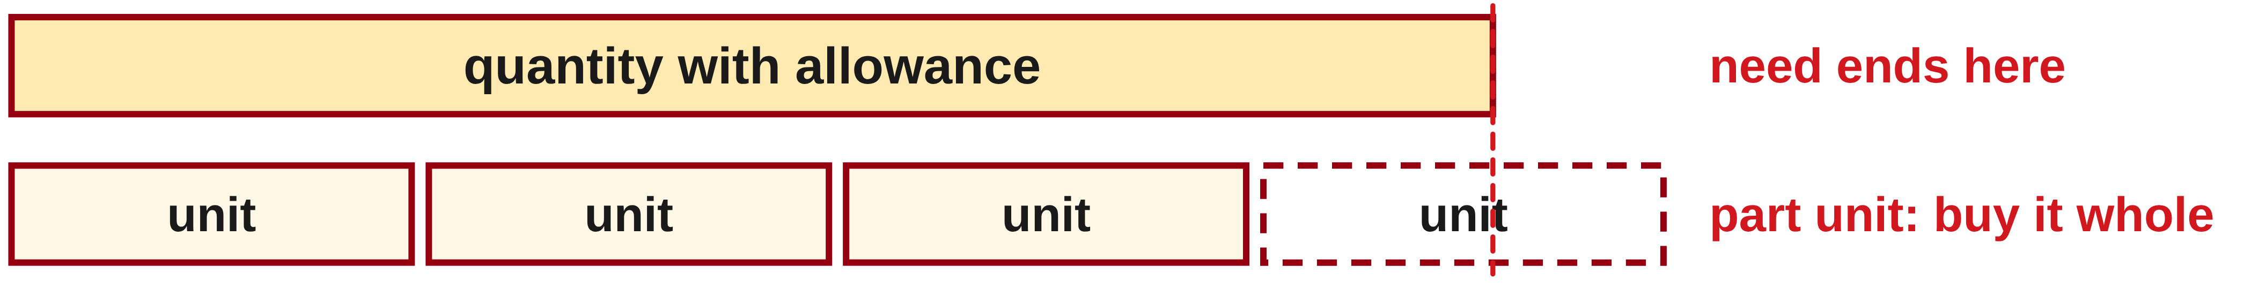
W04-L06 • TEACH • 2:25 PM–2:40 PM • 15 MIN TOTAL
Turn a calculation into an order
1
Keep the unrounded quantity after applying the allowance.
2
Divide by the quantity supplied in one purchase unit if needed.
3
Round up once at the final step to buy enough whole units.
4
Show net quantity, allowance and final order separately.
Textbook sections 6.4 pp.142–143; review sections 5.7 pp.124–132
Textbook
Exercise Book
Numeracy Hub
Shape Canvas
Day 12 • 2026-11-18 • 28
Notes:
Timing: TEACH | 2:25 PM–2:40 PM | 15 MIN TOTAL. Shared phase allocation across these slides.
A calculated material requirement and a purchase order answer different questions. Keep the adjusted quantity unrounded, then divide by the amount supplied in one unit if needed. If the result says part of an additional unit is required, purchase enough whole units by rounding up. Why not use ordinary nearest-whole rounding? Rounding down can leave the order short. Record the net requirement, the allowance and the final order separately. That lets another person see both the mathematical requirement and the purchasing decision instead of mistaking a rounded order for an exact measured need.

Slide 29
W04-L06 • TEACH • 2:25 PM–2:40 PM • 15 MIN TOTAL
Allowance first; whole-unit order last
6B Q2: 18 sheets × 1.15 = 20.7 sheets
Whole sheets to purchase = 21
Check another way: allowance = 18 × 0.15 = 2.7 sheets;
18 + 2.7 = 20.7. Do not add another 15% to this result.
Together: 6A Q11–13 and 6B Q3.
Identify the original base before calculating a discount. Compare percent-key and decimal-multiplier methods.
All allowances here are problem data—not standard job allowances.
W4 L6 • Shape Canvas labels: net material versus order quantity
Textbook
Exercise Book
Numeracy Hub
Shape Canvas
Day 12 • 2026-11-18 • 29
Notes:
Timing: TEACH | 2:25 PM–2:40 PM | 15 MIN TOTAL. Shared phase allocation across these slides.
In 6B Q2, the net requirement is eighteen sheets. The fifteen percent allowance is 18 times 0.15, or 2.7 sheets. Add that once: 18 plus 2.7 equals 20.7 sheets. Equivalently, 18 times 1.15 gives 20.7 directly. Because sheets are purchased whole, order twenty-one. What would happen if we added another fifteen percent to 20.7? We would apply the allowance twice and use a larger base the second time. Keep the unrounded 20.7 in your working so the reason for ordering twenty-one is clear.

Slide 30
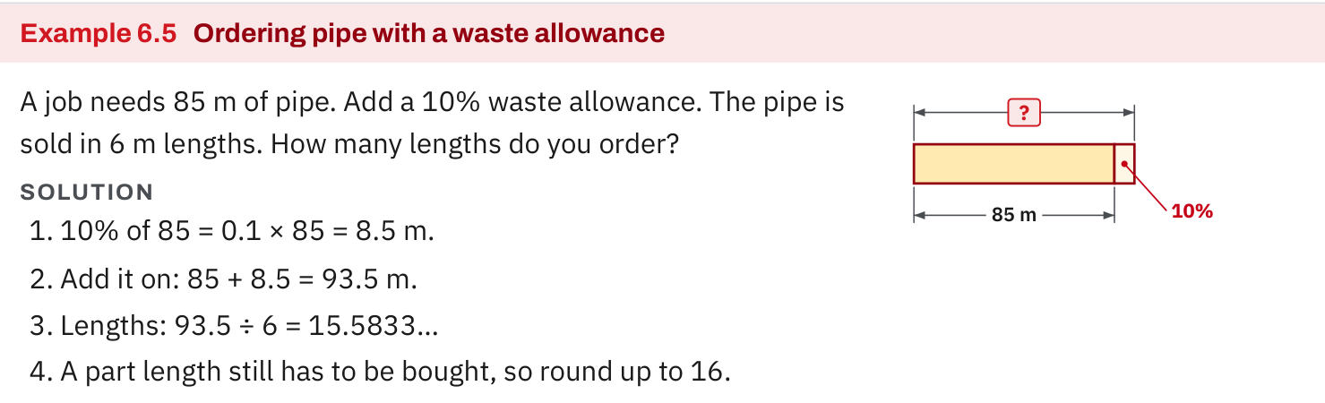
W04-L06 • TEACH • 2:25 PM–2:40 PM • 15 MIN TOTAL
Textbook | page 142
Textbook p.142 • Example 6.5 — Allowance and whole purchase lengths
Textbook sections 6.4 pp.142–143; review sections 5.7 pp.124–132
Textbook
Exercise Book
Numeracy Hub
Shape Canvas
Day 12 • 2026-11-18 • 30
Notes:
Timing: TEACH | 2:25 PM–2:40 PM | 15 MIN TOTAL. Shared phase allocation across these slides.
Textbook Example 6.5 starts with eighty-five metres of pipe and a stated ten percent allowance. Ten percent of eighty-five is 8.5 metres, so the adjusted requirement is 93.5 metres. The pipe comes in six-metre lengths. Divide 93.5 by six to get about 15.5833 lengths, then round up to sixteen. Why is the allowance added before dividing into purchase lengths? We first need the full material requirement, then find enough supplied lengths to cover it. Keep metres and number of lengths distinct throughout the working; they describe different quantities.

Slide 31
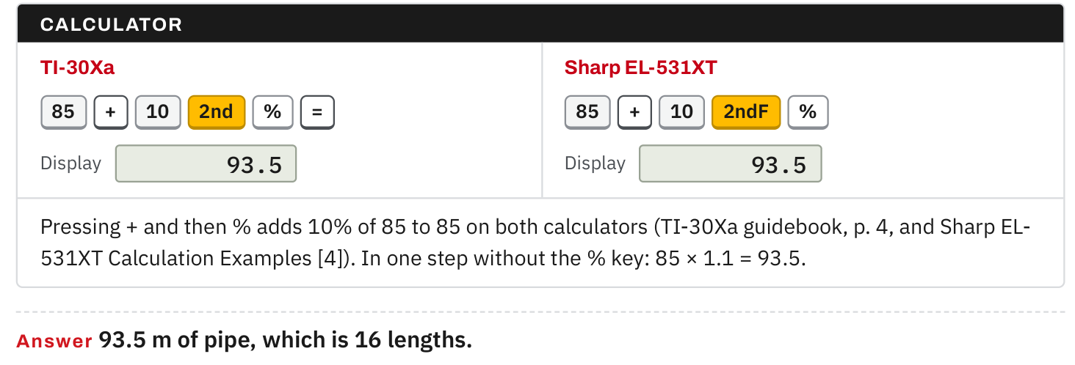
W04-L06 • TEACH • 2:25 PM–2:40 PM • 15 MIN TOTAL
Textbook | page 142
Textbook p.142 • Example 6.5 — Calculator check and final order
Textbook sections 6.4 pp.142–143; review sections 5.7 pp.124–132
Textbook
Exercise Book
Numeracy Hub
Shape Canvas
Day 12 • 2026-11-18 • 31
Notes:
Timing: TEACH | 2:25 PM–2:40 PM | 15 MIN TOTAL. Shared phase allocation across these slides.
The calculator check on page 142 reaches the same adjusted amount: eighty-five increased by ten percent is 93.5 metres. The decimal-multiplier method is 85 times 1.10. Now check the purchase decision: sixteen six-metre lengths supply ninety-six metres, enough to cover 93.5. Fifteen lengths supply only ninety metres, which is short. Which check confirms that rounding up was needed? Comparing the available total with the adjusted requirement. A calculator can give 15.5833, but we must interpret that result as a count of whole lengths to buy.

Slide 32
W04-L06 • TEACH • 2:25 PM–2:40 PM • 15 MIN TOTAL
Spot the mistake. Explain the correction.
Does a 15% allowance mean ordering 15% of the original quantity?
Discuss the method before checking the answer.
No. The original 100% plus 15% gives 115% of the net quantity. Apply the allowance once.
Textbook sections 6.4 pp.142–143; review sections 5.7 pp.124–132
Textbook
Exercise Book
Numeracy Hub
Shape Canvas
Day 12 • 2026-11-18 • 32
Notes:
Timing: TEACH | 2:25 PM–2:40 PM | 15 MIN TOTAL. Shared phase allocation across these slides.
The error is confusing an allowance with the total. Fifteen percent alone gives only the extra share, not the original material plus that share. For eighteen sheets, the allowance is 2.7 sheets; the total before whole-sheet rounding is 20.7. Ask yourself: does my answer include the original eighteen? If not, I have stopped after finding the extra. The correction is one hundred percent plus fifteen percent, or 115% of the original amount. Which decimal multiplier includes both? 1.15. Apply it once, then make the purchase rounding decision.

Slide 33
W04-L06 • TOGETHER • 2:40 PM–2:55 PM • 15 MIN TOTAL
Work together
Work Exercise Book 6A Q11–13 and 6B Q3; learners identify the original base before calculating.
Work in pairs; alternate calculator operator and checker. Show units and an estimated answer.
Resources: Exercise Book 6A Q11–13 (p.56); 6B Q1–3,5 (p.57)
Textbook sections 6.4 pp.142–143; review sections 5.7 pp.124–132
Textbook
Exercise Book
Numeracy Hub
Shape Canvas
Day 12 • 2026-11-18 • 33
Notes:
Timing: TOGETHER | 2:40 PM–2:55 PM | 15 MIN TOTAL. Shared phase allocation across these slides.
Work together on 6A Q11–13 and 6B Q3. Before each calculation, say the original base and whether the question increases or decreases it. One person explains the multiplier; the other checks whether the result moves in the expected direction. For a discount, should the new price be above the list price? No. Keep that direction check visible. Start with the increase on the next slide, then use the same reasoning for the other assigned items.

Slide 34
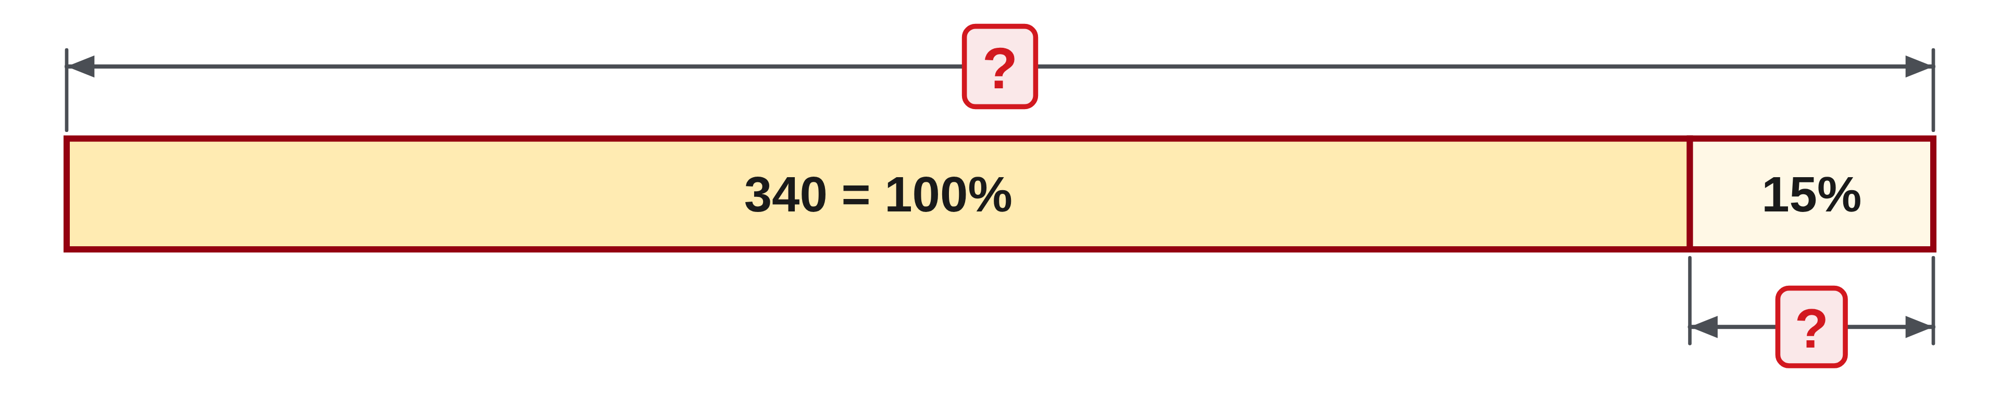
W04-L06 • TOGETHER • 2:40 PM–2:55 PM • 15 MIN TOTAL
Guided practice | 6A Q11
Work with a partner. Take turns explaining the next step.
Textbook sections 6.4 pp.142–143; review sections 5.7 pp.124–132
Textbook
Exercise Book
Numeracy Hub
Shape Canvas
Day 12 • 2026-11-18 • 34
Notes:
Timing: TOGETHER | 2:40 PM–2:55 PM | 15 MIN TOTAL. Shared phase allocation across these slides.
For 6A Q11, increase 340 by fifteen percent. Identify the original amount, calculate the increase and combine them, or use one multiplier that includes both. Explain why your result must exceed 340 before checking it.
Instructor-only, after the attempt: 15% of 340 is 51; 340 + 51 = 391. The one-step method is 340 × 1.15 = 391. The number 51 is the increase only, not the requested increased amount.

Slide 35
W04-L06 • TOGETHER • 2:40 PM–2:55 PM • 15 MIN TOTAL
Compare your method | 6A Q11
CHECK TOGETHER
391
Textbook sections 6.4 pp.142–143; review sections 5.7 pp.124–132
Textbook
Exercise Book
Numeracy Hub
Shape Canvas
Day 12 • 2026-11-18 • 35
Notes:
Timing: TOGETHER | 2:40 PM–2:55 PM | 15 MIN TOTAL. Shared phase allocation across these slides.
The increased amount is 391. Compare the two valid routes: 340 times 0.15 gives 51, then add 340; or multiply 340 by 1.15. Why do both agree? The second multiplier combines one whole original amount and fifteen hundredths of that same amount. If someone writes 340 plus fifteen, what did they misunderstand? They treated fifteen percent as a fixed number of units instead of a proportion of 340.

Slide 36
W04-L06 • PRACTISE • 2:55 PM–3:15 PM • 20 MIN TOTAL
Your scheduled practice
Solve Exercise Book 6B Q1,5 and rework Q2 with a written order explanation. Label all practice allowances as problem data, not a standard job allowance.
Solve on paper first; use the tool to check; correct one error with a written reason.
Resources: Exercise Book 6A Q11–13 (p.56); 6B Q1–3,5 (p.57)
Textbook sections 6.4 pp.142–143; review sections 5.7 pp.124–132
Textbook
Exercise Book
Numeracy Hub
Shape Canvas
Day 12 • 2026-11-18 • 36
Notes:
Timing: PRACTISE | 2:55 PM–3:15 PM | 20 MIN TOTAL. Shared phase allocation across these slides.
Complete 6B Q1 and Q5, then rework Q2 with a written order explanation. In Q1, track metres separately from the number of supplied lengths. In Q5, identify the rejected part and the total tested. In Q2, explain why the adjusted sheet quantity becomes a whole-sheet order. What rate should you use for each task? The one stated in that exercise. Label the allowance as problem data so the calculation remains tied to its given assumptions.

Slide 37
W04-L06 • PRACTISE • 2:55 PM–3:15 PM • 20 MIN TOTAL
Open Shape Canvas
Navigation example. Use the values and units in the assigned task.
Textbook sections 6.4 pp.142–143; review sections 5.7 pp.124–132
Textbook
Exercise Book
Numeracy Hub
Shape Canvas
Day 12 • 2026-11-18 • 37
Notes:
Timing: PRACTISE | 2:55 PM–3:15 PM | 20 MIN TOTAL. Shared phase allocation across these slides.
Use Shape Canvas to label the net amount and the exercise’s allowance. The purpose of the labels is to show what was needed originally and what was added. Which quantity should remain the base for the allowance calculation? The original net quantity. Do not repeatedly increase the updated amount. Keep a separate line for the final whole-unit order, because an order label represents what is purchased, not an exact dimension of the drawn rectangle.

Slide 38
W04-L06 • PRACTISE • 2:55 PM–3:15 PM • 20 MIN TOTAL
Practise in Numeracy Hub and Shape Canvas
1
Label a Shape Canvas rectangle with the net amount and its allowance from the exercise.
2
Compare the percent-key and decimal-multiplier methods in Numeracy Hub Calculator.
3
Record the unrounded amount, then the whole-unit order with your rounding reason.
Textbook sections 6.4 pp.142–143; review sections 5.7 pp.124–132
Textbook
Exercise Book
Numeracy Hub
Shape Canvas
Day 12 • 2026-11-18 • 38
Notes:
Timing: PRACTISE | 2:55 PM–3:15 PM | 20 MIN TOTAL. Shared phase allocation across these slides.
Record the original amount, its stated allowance and the unrounded adjusted total. Compare the percent-key method with decimal multiplication in Numeracy Hub using the appropriate calculator model. Then write the whole-unit order and explain why it supplies enough. What should agree before rounding? Both methods should give the same adjusted quantity. If they differ, inspect the key sequence and whether the multiplier included the original one hundred percent. Use Shape Canvas labels to keep net material and order quantity separate.

Slide 39
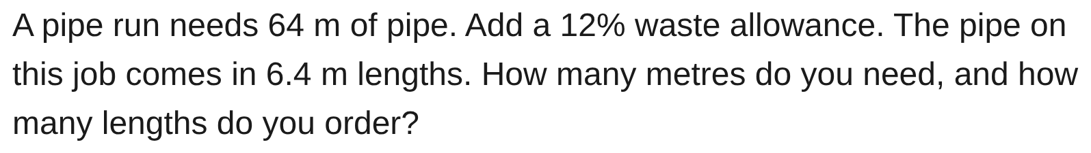
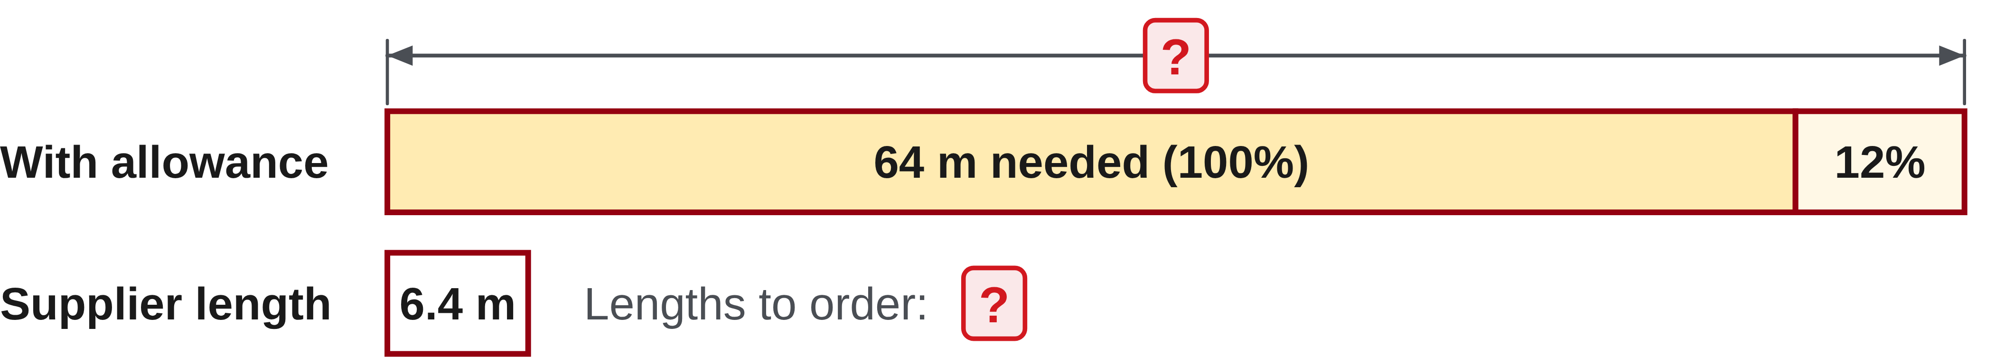
W04-L06 • PRACTISE • 2:55 PM–3:15 PM • 20 MIN TOTAL
Practise from the Exercise Book | 6B Q1
Write the operation, working and units before checking.
Textbook sections 6.4 pp.142–143; review sections 5.7 pp.124–132
Textbook
Exercise Book
Numeracy Hub
Shape Canvas
Day 12 • 2026-11-18 • 39
Notes:
Timing: PRACTISE | 2:55 PM–3:15 PM | 20 MIN TOTAL. Shared phase allocation across these slides.
For 6B Q1, a pipe run needs sixty-four metres, with a twelve percent allowance, and stock lengths are 6.4 metres. Find the adjusted metres before deciding the number of lengths. Show why the final order is sufficient.
Instructor-only, after the attempt: 64 × 1.12 = 71.68 m. Then 71.68 ÷ 6.4 = 11.2 lengths, so order 12. Eleven lengths supply 70.4 m and are short; twelve supply 76.8 m.

Slide 40
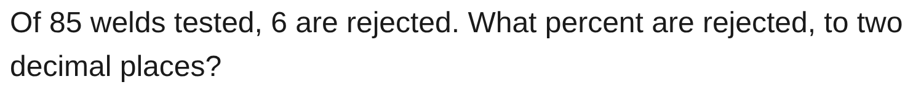
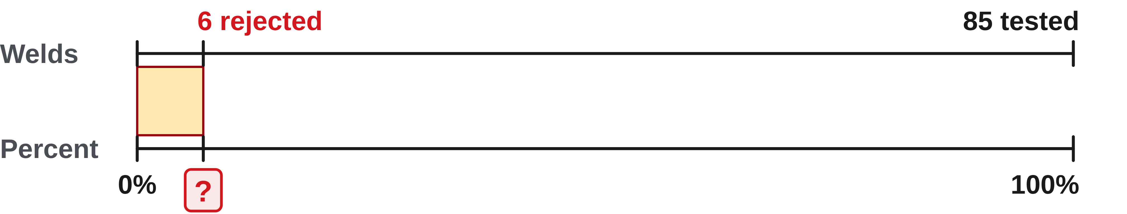
W04-L06 • PRACTISE • 2:55 PM–3:15 PM • 20 MIN TOTAL
Practise from the Exercise Book | 6B Q5
Write the operation, working and units before checking.
Textbook sections 6.4 pp.142–143; review sections 5.7 pp.124–132
Textbook
Exercise Book
Numeracy Hub
Shape Canvas
Day 12 • 2026-11-18 • 40
Notes:
Timing: PRACTISE | 2:55 PM–3:15 PM | 20 MIN TOTAL. Shared phase allocation across these slides.
For 6B Q5, six of eighty-five tested welds are rejected. We need the rejected percent, rounded to two decimal places. Identify the rejected part and the complete tested whole, then express their ratio as a percent.
Instructor-only, after the attempt: 6 ÷ 85 × 100 = 7.058823…%, which rounds to 7.06%. The denominator is all eighty-five tested welds, not only the seventy-nine accepted welds. The comparison must match the question.

Slide 41
W04-L06 • CHECK • 3:15 PM–3:25 PM • 10 MIN TOTAL
Check independently
Exercise Book 6B Q2 and Q3, showing the unrounded order and discount calculation.
Solve without displayed answers; include working, units and the requested rounding.
Resources: Exercise Book 6A Q11–13 (p.56); 6B Q1–3,5 (p.57)
Textbook sections 6.4 pp.142–143; review sections 5.7 pp.124–132
Textbook
Exercise Book
Numeracy Hub
Shape Canvas
Day 12 • 2026-11-18 • 41
Notes:
Timing: CHECK | 3:15 PM–3:25 PM | 10 MIN TOTAL. Shared phase allocation across these slides.
Complete 6B Q2 and Q3 independently. In Q2, show both the unrounded allowance total and the whole-sheet order. In Q3, show the discount calculation, the price for one bearing and the cost for six. What makes the rounding different? Sheets are purchased in whole units, while the prices are rounded to cents. Keep the original quantities visible so I can see that each percentage was applied to the correct base.

Slide 42
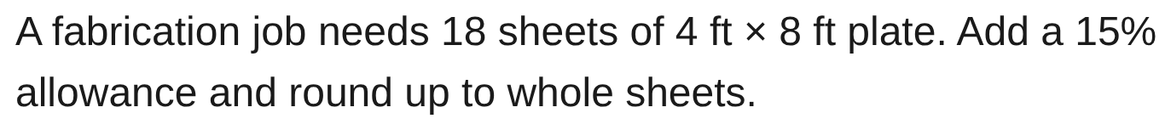
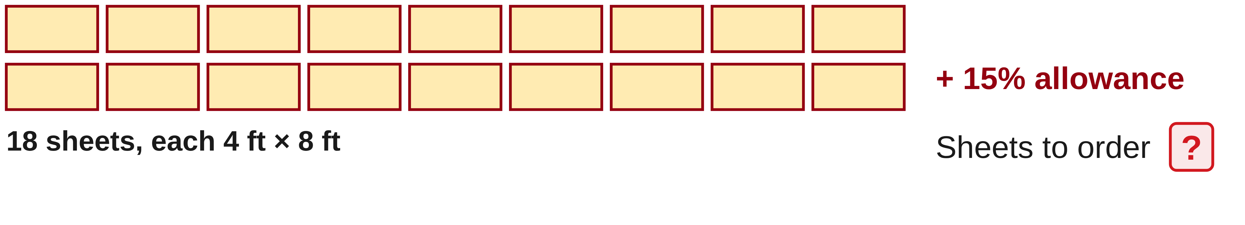
W04-L06 • CHECK • 3:15 PM–3:25 PM • 10 MIN TOTAL
Independent check | 6B Q2
Answer independently. Keep worked solutions closed.
Textbook sections 6.4 pp.142–143; review sections 5.7 pp.124–132
Textbook
Exercise Book
Numeracy Hub
Shape Canvas
Day 12 • 2026-11-18 • 42
Notes:
Timing: CHECK | 3:15 PM–3:25 PM | 10 MIN TOTAL. Shared phase allocation across these slides.
For 6B Q2, eighteen sheets are required before a fifteen percent allowance. Write the adjusted total, then the whole-sheet order. Explain the purchase rounding rather than reporting only an integer.
Instructor-only, after the attempt: 18 × 1.15 = 20.7 sheets, so purchase 21 sheets. Eighteen times 0.15 gives only the 2.7-sheet allowance. Twenty sheets would not cover the full adjusted requirement, so ordinary rounding that reduces the order is unsuitable.

Slide 43
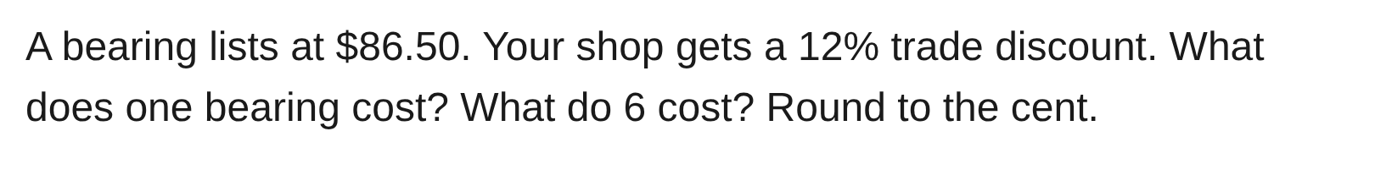
W04-L06 • CHECK • 3:15 PM–3:25 PM • 10 MIN TOTAL
Independent check | 6B Q3
Answer independently. Keep worked solutions closed.
Textbook sections 6.4 pp.142–143; review sections 5.7 pp.124–132
Textbook
Exercise Book
Numeracy Hub
Shape Canvas
Day 12 • 2026-11-18 • 43
Notes:
Timing: CHECK | 3:15 PM–3:25 PM | 10 MIN TOTAL. Shared phase allocation across these slides.
For 6B Q3, one bearing lists at $86.50 and receives a twelve percent discount. Find the discounted price and then the cost of six, rounded to cents. Keep the list price as the base of the discount.
Instructor-only, after the attempt: Pay 88% of list: $86.50 × 0.88 = $76.12 each. Six cost $456.72. The discount itself is $10.38. A discounted price above $86.50 would fail the direction check.

Slide 44
W04-L06 • WRAP UP • 3:25 PM–3:30 PM • 5 MIN TOTAL
Wrap up and choose the next step
Ask: What did you learn? Where will you use it? What will you check next time?
Name the math and one other essential skill used; write the next practice step.
Resources: Exercise Book 6A Q11–13 (p.56); 6B Q1–3,5 (p.57)
Textbook sections 6.4 pp.142–143; review sections 5.7 pp.124–132
Textbook
Exercise Book
Numeracy Hub
Shape Canvas
Play quiz
Quiz PDF
Day 12 • 2026-11-18 • 44
Notes:
Timing: WRAP UP | 3:25 PM–3:30 PM | 5 MIN TOTAL. Shared phase allocation across these slides.
Finish with one sentence explaining an order: “The net amount was this, the stated allowance gave this adjusted amount, so I ordered this many whole units.” Then explain a discount using the original price as the base. What prevents double-counting an allowance? Apply it once to the original quantity and keep each stage labelled. Write one correction from your work that you can reuse when reading a supplier quantity, a sheet count or a price adjustment.

