Slide 1

CARPENTRY FOUNDATION / INTAKE 142
Day 14 | Tuesday
14
November 24, 2026
Measurement systems and readable dimensions
12:45 PM–2:00 PM • Math • 75 min
Exact conversion factors and mixed-unit practice
2:15 PM–3:30 PM • Math • 75 min
Week 5 • 2 scheduled blocks • 150 teaching minutes
Estimate. Show the method. Label units. Check the result.
Textbook
Exercise Book
Numeracy Hub
Shape Canvas
Day 14 • 2026-11-24 • 01
Notes:
Timing: opening orientation within the scheduled start period.
Today we read and convert measurements without changing the actual length. From 12:45 to 2:00, we work within metric and imperial systems. After the 2:00–2:15 break, we connect inches and millimetres using exact conversion factors and finish at 3:30. Keep a rule or tape, your calculator and the exercise book ready. Our recurring question is “Should the number grow or shrink?” Smaller units need more of them to describe the same object, and that gives us a useful check.

Slide 2
DAY 14 / WEEK 5 / CLASS TIMETABLE
Today’s exact schedule
12:45 PM–2:00 PM • 75 min
2:15 PM–3:30 PM • 75 min
Measurement systems and readable dimensions
Exact conversion factors and mixed-unit practice
12:45 PM–12:50 PM
Start
5
2:15 PM–2:20 PM
Start
5
12:50 PM–12:55 PM
Recall
5
2:20 PM–2:25 PM
Recall
5
12:55 PM–1:10 PM
Teach
15
2:25 PM–2:40 PM
Teach
15
1:10 PM–1:25 PM
Together
15
2:40 PM–2:55 PM
Together
15
1:25 PM–1:45 PM
Practise
20
2:55 PM–3:15 PM
Practise
20
1:45 PM–1:55 PM
Check
10
3:15 PM–3:25 PM
Check
10
1:55 PM–2:00 PM
Wrap up
5
3:25 PM–3:30 PM
Wrap up
5
Math • Math Week 5, Lesson 1
Math • Math Week 5, Lesson 2
Break: 2:00 PM–2:15 PM • 15 minutes • excluded from teaching time
Textbook
Exercise Book
Numeracy Hub
Shape Canvas
Day 14 • 2026-11-24 • 02
Notes:
Timing: opening orientation within the scheduled start period.
The first block takes us through metric conversions and feet-and-inch readings; the second bridges the two systems. Each has five minutes to start, five to recall, fifteen to learn, fifteen together, twenty to practise, ten to check and five to finish. We break at 2:00 and restart at 2:15. As you work, distinguish changing the unit from changing the length. A correctly converted dimension describes the same physical distance in a different set of units.

Slide 3
W05-L01 • START • 12:45 PM–12:50 PM • 5 MIN TOTAL
Measurement systems and readable dimensions
Today’s goal: Read metric and imperial lengths and convert within one system before using mixed-unit drawings.
Describe a prior use of the skill; identify the given and unknown quantities.
Textbook sections 7.1–7.2 pp.164–166; sections 4.2 pp.89–90
Exercise Book 7A Q1–10 (p.67); 5A Q3 (p.45)
Keep your notebook, textbook, exercise book and chosen calculator ready.
Textbook sections 7.1–7.2 pp.164–166; sections 4.2 pp.89–90
Textbook
Exercise Book
Numeracy Hub
Shape Canvas
Day 14 • 2026-11-24 • 03
Notes:
Timing: START | 12:45 PM–12:50 PM | 5 MIN TOTAL. Shared phase allocation across these slides.
Open exercise book 7A Q1–10 and have 5A Q3 available for reading a metric rule. Today we will read the unit before choosing an operation. A number written without millimetres, inches or another unit cannot fully describe a cut length. What information do you need from a tape before reading a fractional inch? The size of its graduations. We will connect those visible divisions to the numbers we write, then compare measurements with a partner.

Slide 4
W05-L01 • RECALL • 12:50 PM–12:55 PM • 5 MIN TOTAL
Recall and reconnect
Use Exercise Book 7A Q1,7; ask which quantities are lengths and which are capacities.
Attempt the retrieval task independently; explain the method before checking.
Resources: Exercise Book 7A Q1–10 (p.67); 5A Q3 (p.45)
Textbook sections 7.1–7.2 pp.164–166; sections 4.2 pp.89–90
Textbook
Exercise Book
Numeracy Hub
Shape Canvas
Day 14 • 2026-11-24 • 04
Notes:
Timing: RECALL | 12:50 PM–12:55 PM | 5 MIN TOTAL. Shared phase allocation across these slides.
Use 7A Q1 and Q7 to recall within-system conversions. Before calculating, identify what kind of quantity each question describes. Is it a length or a capacity? A metre and a litre measure different things, even though both systems use decimal prefixes. Which conversion relationship belongs in the calculation? The one for that quantity and those units. For our length example, one metre contains one thousand millimetres, so a metre-to-millimetre count should increase.

Slide 5
W05-L01 • RECALL • 12:50 PM–12:55 PM • 5 MIN TOTAL
Recall from the Exercise Book | 7A Q1
Write the operation, working and units before checking.
Textbook sections 7.1–7.2 pp.164–166; sections 4.2 pp.89–90
Textbook
Exercise Book
Numeracy Hub
Shape Canvas
Day 14 • 2026-11-24 • 05
Notes:
Timing: RECALL | 12:50 PM–12:55 PM | 5 MIN TOTAL. Shared phase allocation across these slides.
For 7A Q1, convert 4.75 metres to millimetres. Predict the size of the answer: it should be between four thousand and five thousand millimetres. Write the factor that connects the units before calculating.
Instructor-only, after the attempt: 4.75 × 1000 = 4750 mm. Four metres accounts for 4000 mm, and three quarters of a metre adds 750 mm. The length is unchanged even though the numerical count is much larger.

Slide 6
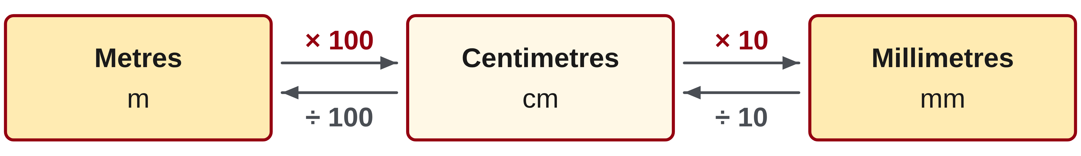
W05-L01 • TEACH • 12:55 PM–1:10 PM • 15 MIN TOTAL
Convert within the metric system
1
1 m = 100 cm = 1,000 mm; 1 cm = 10 mm.
2
Moving to a smaller unit makes the numerical count larger.
3
Moving to a larger unit makes the numerical count smaller.
4
Write the starting and ending units beside the conversion.
Textbook sections 7.1–7.2 pp.164–166; sections 4.2 pp.89–90
Textbook
Exercise Book
Numeracy Hub
Shape Canvas
Day 14 • 2026-11-24 • 06
Notes:
Timing: TEACH | 12:55 PM–1:10 PM | 15 MIN TOTAL. Shared phase allocation across these slides.
One metre contains one hundred centimetres or one thousand millimetres, and each centimetre contains ten millimetres. Think of the same length being counted with different-sized units. When the units become smaller, we need more of them, so the number grows. When the units become larger, fewer are needed, so the number shrinks. Why is 2.35 metres equal to 235 centimetres? Each metre contributes one hundred centimetres, so multiplying by one hundred changes the count appropriately. Write the starting and target units alongside the factor so the arithmetic explains which conversion you intended.

Slide 7
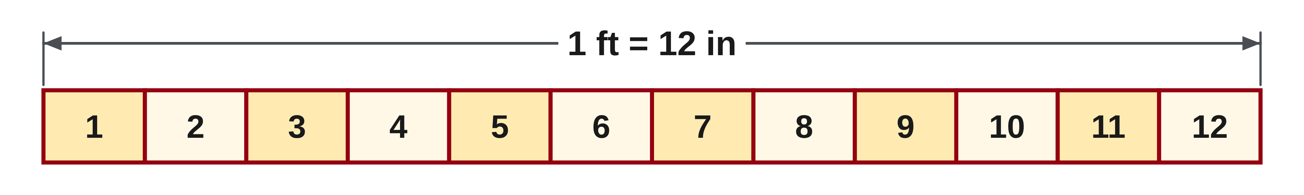
W05-L01 • TEACH • 12:55 PM–1:10 PM • 15 MIN TOTAL
Read feet, inches and drawing labels
1
1 ft = 12 in; convert the feet before adding the extra inches.
2
To reverse the conversion, group complete sets of 12 inches.
3
Read the tape’s graduation before naming a fractional inch.
4
Use written drawing dimensions; do not measure the displayed picture.
Textbook sections 7.1–7.2 pp.164–166; sections 4.2 pp.89–90
Textbook
Exercise Book
Numeracy Hub
Shape Canvas
Day 14 • 2026-11-24 • 07
Notes:
Timing: TEACH | 12:55 PM–1:10 PM | 15 MIN TOTAL. Shared phase allocation across these slides.
A foot contains twelve inches. To write feet and inches entirely in inches, convert the feet first, then add the remaining inches. To go back, group complete sets of twelve and keep the remainder as inches. On a tape, identify the graduation before naming the fractional remainder. What would go wrong if you added five feet and seven inches as five plus seven? Those numbers count different-sized units. The result twelve would have no consistent meaning. Convert to one unit first, and use written drawing dimensions rather than the apparent size of a projected picture.

Slide 8
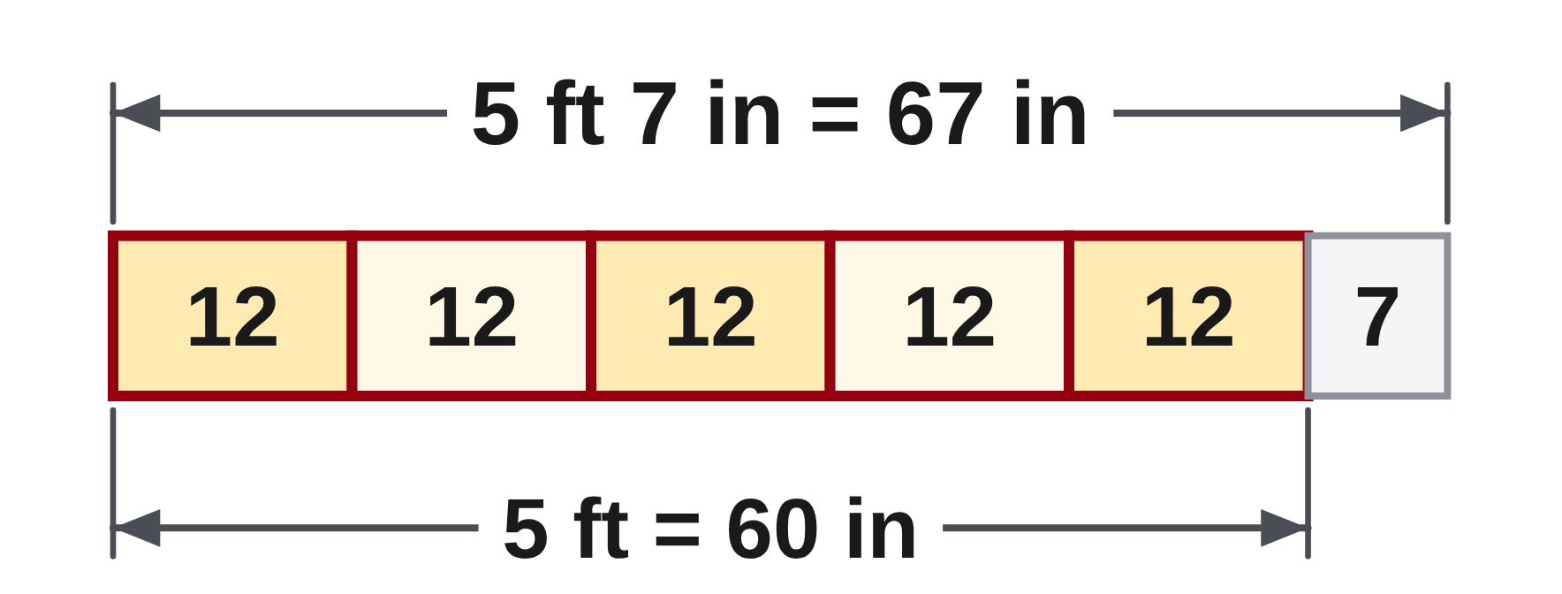
W05-L01 • TEACH • 12:55 PM–1:10 PM • 15 MIN TOTAL
Change the unit—not the length
1 m = 100 cm = 1,000 mm
2.35 m = 235 cm = 2,350 mm
1 ft = 12 in
5 ft 7 in = 5 × 12 + 7 = 67 in
Together: 7A Q2–3 and Q8–10. Read units aloud.
Check 67 in by dividing into groups of 12: 5 whole feet and 7 in.
Numeracy Hub: Measuring Tools and Unit Conversions.
W5 L1 • Shape Canvas: compare labelled dimensions in mm and in
Textbook
Exercise Book
Numeracy Hub
Shape Canvas
Day 14 • 2026-11-24 • 08
Notes:
Timing: TEACH | 12:55 PM–1:10 PM | 15 MIN TOTAL. Shared phase allocation across these slides.
Our metric example keeps one length unchanged: 2.35 metres equals 235 centimetres and 2350 millimetres. The unit gets smaller as the count gets larger. Now convert five feet seven inches. Five feet contain five times twelve, or sixty inches; add the seven remaining inches to get sixty-seven inches. Check backwards: sixty-seven contains five complete groups of twelve, with seven left over. What does the remainder mean? Seven inches, not seven tenths of a foot. Mixed feet-and-inch notation uses groups of twelve, so we must not read it like a decimal number.

Slide 9
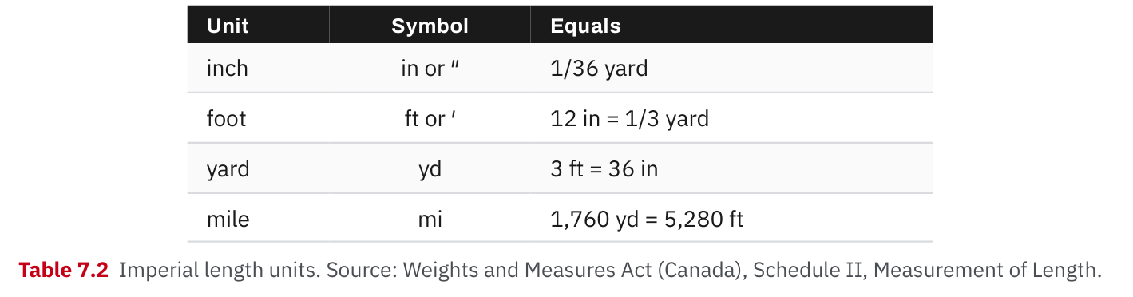
W05-L01 • TEACH • 12:55 PM–1:10 PM • 15 MIN TOTAL
Textbook | page 166
Textbook p.166 • Table 7.2 — Imperial length units
Textbook sections 7.1–7.2 pp.164–166; sections 4.2 pp.89–90
Textbook
Exercise Book
Numeracy Hub
Shape Canvas
Day 14 • 2026-11-24 • 09
Notes:
Timing: TEACH | 12:55 PM–1:10 PM | 15 MIN TOTAL. Shared phase allocation across these slides.
The table on textbook page 166 collects imperial length relationships. One foot is twelve inches, one yard is three feet and therefore thirty-six inches. These are equal lengths written in different units. How can we confirm a yard equals thirty-six inches? Three feet times twelve inches per foot gives thirty-six inches. Pay attention to the symbols: a single prime mark denotes feet and a double prime denotes inches. Read them aloud when copying a dimension so a small symbol does not become a large cutting error. Use the table to select the relationship you actually need.

Slide 10
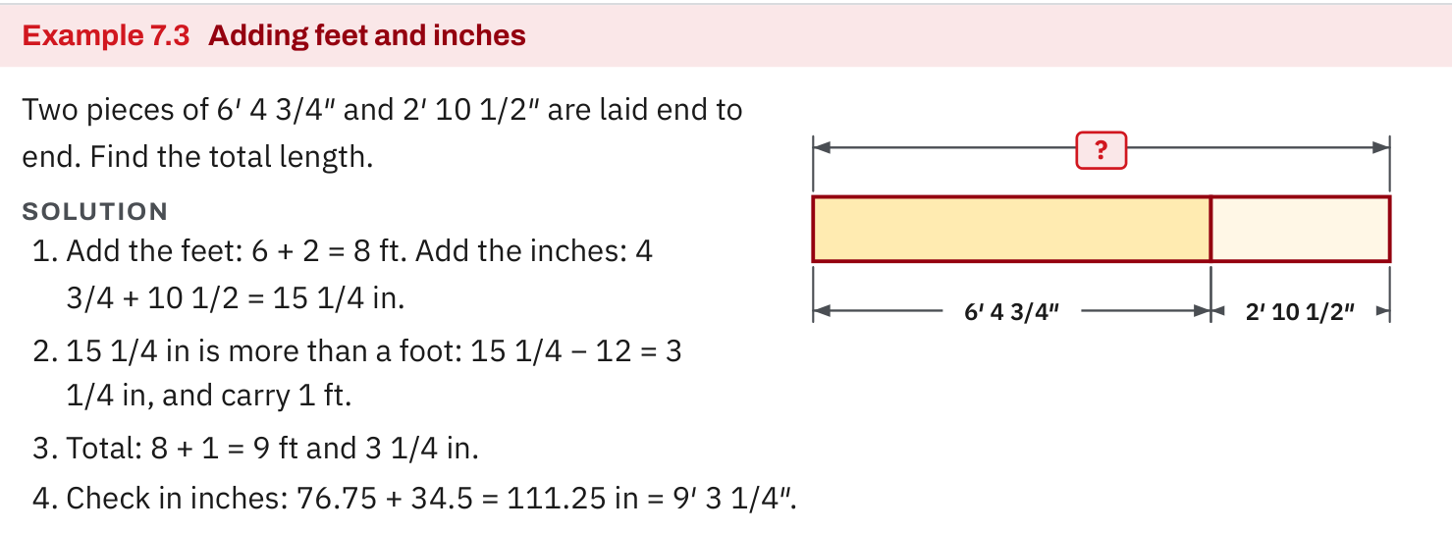
W05-L01 • TEACH • 12:55 PM–1:10 PM • 15 MIN TOTAL
Textbook | page 166
Textbook p.166 • Example 7.3 — Adding feet and inches
Textbook sections 7.1–7.2 pp.164–166; sections 4.2 pp.89–90
Textbook
Exercise Book
Numeracy Hub
Shape Canvas
Day 14 • 2026-11-24 • 10
Notes:
Timing: TEACH | 12:55 PM–1:10 PM | 15 MIN TOTAL. Shared phase allocation across these slides.
Textbook Example 7.3 adds 6′ 4 3/4″ and 2′ 10 1/2″. Add the feet to get eight feet. The inch portions total 15 1/4 inches, which contains one complete foot plus 3 1/4 inches. Carry that foot: the result is 9′ 3 1/4″. Check in one unit: 76.75 inches plus 34.5 inches equals 111.25 inches. Why can we not leave fifteen inches as the usual final inch portion? We can regroup twelve of them into a foot, giving conventional feet-and-inch notation with a remainder below twelve inches.

Slide 11
W05-L01 • TEACH • 12:55 PM–1:10 PM • 15 MIN TOTAL
Spot the mistake. Explain the correction.
A length is written in feet and inches. Can the two numbers simply be added?
Discuss the method before checking the answer.
Convert the feet to inches first, then add the remaining inches in the same unit.
Textbook sections 7.1–7.2 pp.164–166; sections 4.2 pp.89–90
Textbook
Exercise Book
Numeracy Hub
Shape Canvas
Day 14 • 2026-11-24 • 11
Notes:
Timing: TEACH | 12:55 PM–1:10 PM | 15 MIN TOTAL. Shared phase allocation across these slides.
A learner sees five feet seven inches and adds five plus seven to get twelve. What has been combined incorrectly? Feet and inches are different units. First convert five feet to sixty inches, then add seven inches to get sixty-seven. This resembles adding dollars and cents: we need a common unit before combining the counts. Which written step makes the conversion clear? Five times twelve inches per foot. Keep the extra inches outside that multiplication; otherwise you would multiply a quantity already expressed in inches by twelve again.

Slide 12
W05-L01 • TOGETHER • 1:10 PM–1:25 PM • 15 MIN TOTAL
Work together
Work Exercise Book 7A Q2–3,8–10. Work with a partner to read and say the units aloud.
Work in pairs, alternating solver and checker. Write a diagram, formula, units and estimate.
Resources: Exercise Book 7A Q1–10 (p.67); 5A Q3 (p.45)
Textbook sections 7.1–7.2 pp.164–166; sections 4.2 pp.89–90
Textbook
Exercise Book
Numeracy Hub
Shape Canvas
Day 14 • 2026-11-24 • 12
Notes:
Timing: TOGETHER | 1:10 PM–1:25 PM | 15 MIN TOTAL. Shared phase allocation across these slides.
Work together on 7A Q2–3 and Q8–10. The solver reads the starting and requested units aloud; the checker predicts whether the number should increase or decrease. For mixed feet and inches, write the foot-to-inch conversion separately from the leftover inches. What should a reverse check recover? The original dimension. Begin with Q2, then use the same unit reasoning to explain each later answer rather than memorizing a direction for the decimal point.

Slide 13
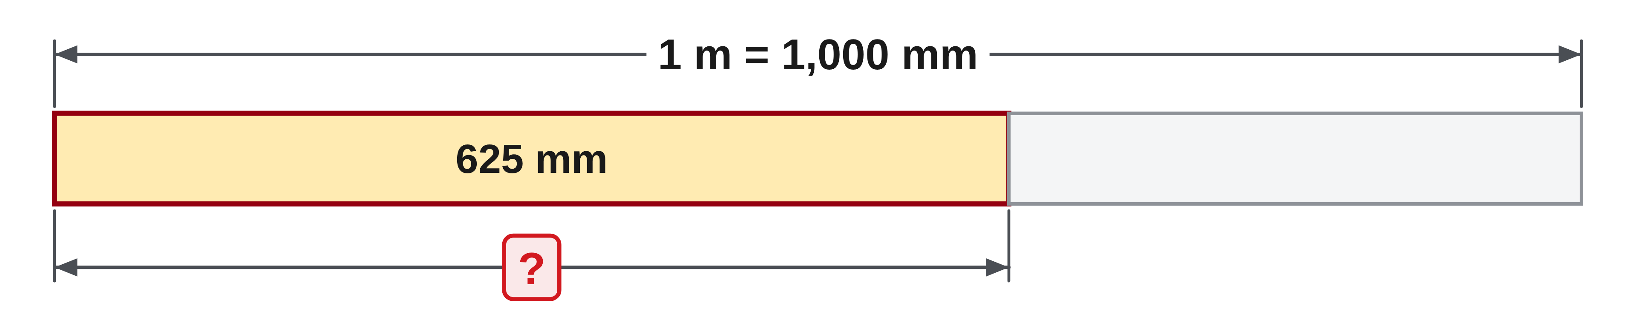
W05-L01 • TOGETHER • 1:10 PM–1:25 PM • 15 MIN TOTAL
Guided practice | 7A Q2
Work with a partner. Take turns explaining the next step.
Textbook sections 7.1–7.2 pp.164–166; sections 4.2 pp.89–90
Textbook
Exercise Book
Numeracy Hub
Shape Canvas
Day 14 • 2026-11-24 • 13
Notes:
Timing: TOGETHER | 1:10 PM–1:25 PM | 15 MIN TOTAL. Shared phase allocation across these slides.
For 7A Q2, convert 625 millimetres to metres. One metre contains one thousand millimetres, so ask what fraction of that metre is represented by 625. Predict a result below one metre, then write the calculation.
Instructor-only, after the attempt: 625 ÷ 1000 = 0.625 m. Check by multiplying 0.625 m by 1000 mm per metre to return to 625 mm. An answer of 625000 m would reverse the conversion direction.

Slide 14
W05-L01 • TOGETHER • 1:10 PM–1:25 PM • 15 MIN TOTAL
Compare your method | 7A Q2
CHECK TOGETHER
0.625 m
Textbook sections 7.1–7.2 pp.164–166; sections 4.2 pp.89–90
Textbook
Exercise Book
Numeracy Hub
Shape Canvas
Day 14 • 2026-11-24 • 14
Notes:
Timing: TOGETHER | 1:10 PM–1:25 PM | 15 MIN TOTAL. Shared phase allocation across these slides.
The answer is 0.625 metres. We grouped millimetres into units of one thousand, so the numerical value decreased while the physical length stayed unchanged. Is 0.625 metre more or less than half a metre? More, since half a metre is 500 millimetres and this length is 625 millimetres. That benchmark helps confirm the position of the decimal point. Explain the reverse check to your partner: 0.625 times one thousand returns 625 millimetres.

Slide 15
W05-L01 • PRACTISE • 1:25 PM–1:45 PM • 20 MIN TOTAL
Your scheduled practice
Complete remaining 7A Q1–10 and 5A Q3. Measure two classroom objects with rule/tape; record units and compare readings with a partner.
Solve on paper first; check with tools; correct one error and explain the change.
Resources: Exercise Book 7A Q1–10 (p.67); 5A Q3 (p.45)
Textbook sections 7.1–7.2 pp.164–166; sections 4.2 pp.89–90
Textbook
Exercise Book
Numeracy Hub
Shape Canvas
Day 14 • 2026-11-24 • 15
Notes:
Timing: PRACTISE | 1:25 PM–1:45 PM | 20 MIN TOTAL. Shared phase allocation across these slides.
Complete the remaining 7A Q1–10 and 5A Q3. Then measure two classroom objects using the rule or tape, record the units and compare readings with a partner. Start from the same reference point and agree on the graduation before comparing. What could explain two slightly different readings? Different starting points, a missed division or different rounding. Check those details before changing a recorded value. Keep the measurement and any conversion on separate lines so your partner can follow both.

Slide 16
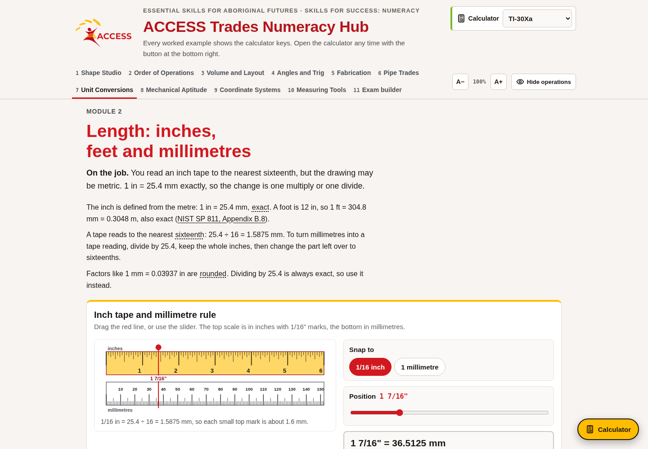
W05-L01 • PRACTISE • 1:25 PM–1:45 PM • 20 MIN TOTAL
Open Numeracy Hub
Navigation example. Use the values and units in the assigned task.
Textbook sections 7.1–7.2 pp.164–166; sections 4.2 pp.89–90
Textbook
Exercise Book
Numeracy Hub
Shape Canvas
Day 14 • 2026-11-24 • 16
Notes:
Timing: PRACTISE | 1:25 PM–1:45 PM | 20 MIN TOTAL. Shared phase allocation across these slides.
Open Measuring Tools in Numeracy Hub. Identify the zero and the labelled divisions before reading an unlabelled mark. Then use Unit Conversions to check the assigned within-system conversion. What does a tool check add to your paper work? It can confirm the arithmetic, but it does not replace deciding whether the quantity is a length and whether the correct units were selected. Read the output unit before comparing it with your written answer.

Slide 17
W05-L01 • PRACTISE • 1:25 PM–1:45 PM • 20 MIN TOTAL
Practise in Numeracy Hub and Shape Canvas
1
Use Numeracy Hub Measuring Tools to read a rule and a tape before checking.
2
Use Unit Conversions to check the assigned within-system conversion.
3
Read a Shape Canvas rectangle in mm and in from its labels, not its screen size.
Textbook sections 7.1–7.2 pp.164–166; sections 4.2 pp.89–90
Textbook
Exercise Book
Numeracy Hub
Shape Canvas
Day 14 • 2026-11-24 • 17
Notes:
Timing: PRACTISE | 1:25 PM–1:45 PM | 20 MIN TOTAL. Shared phase allocation across these slides.
Read the rule and tape in Numeracy Hub before revealing their values. Check a within-system conversion, then compare the labelled dimensions of a rectangle in Shape Canvas. What should you trust when interpreting the rectangle? The numerical labels and units, not its apparent screen size. Keep millimetres and inches clearly distinguished when they appear. We will calculate between those systems in the next block; for now, focus on recognizing what each written dimension represents.

Slide 18
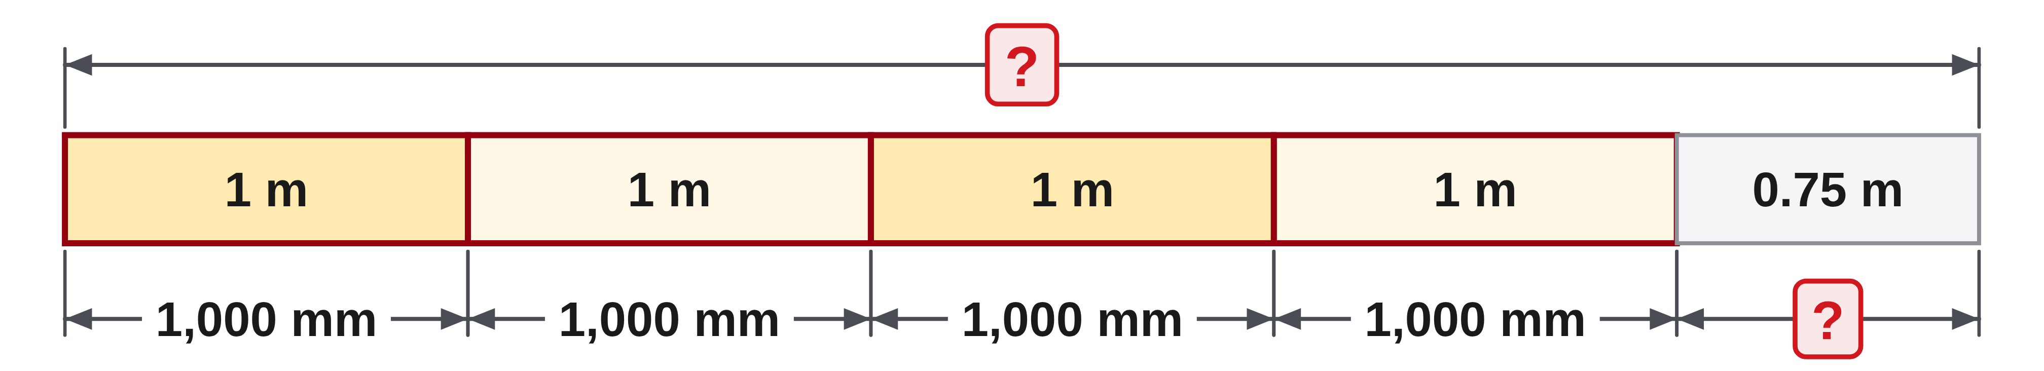
W05-L01 • PRACTISE • 1:25 PM–1:45 PM • 20 MIN TOTAL
Practise from the Exercise Book | 7A Q1
Write the operation, working and units before checking.
Textbook sections 7.1–7.2 pp.164–166; sections 4.2 pp.89–90
Textbook
Exercise Book
Numeracy Hub
Shape Canvas
Day 14 • 2026-11-24 • 18
Notes:
Timing: PRACTISE | 1:25 PM–1:45 PM | 20 MIN TOTAL. Shared phase allocation across these slides.
Return to 7A Q1: convert 4.75 metres to millimetres and show the conversion factor. Use the whole metres and fractional metre to explain your answer, then check it in reverse.
Instructor-only, after the attempt: 4750 mm. Four metres gives 4000 mm and 0.75 m gives 750 mm. Dividing 4750 by 1000 returns 4.75 m. The conversion changes the description, not the size of the measured object.

Slide 19
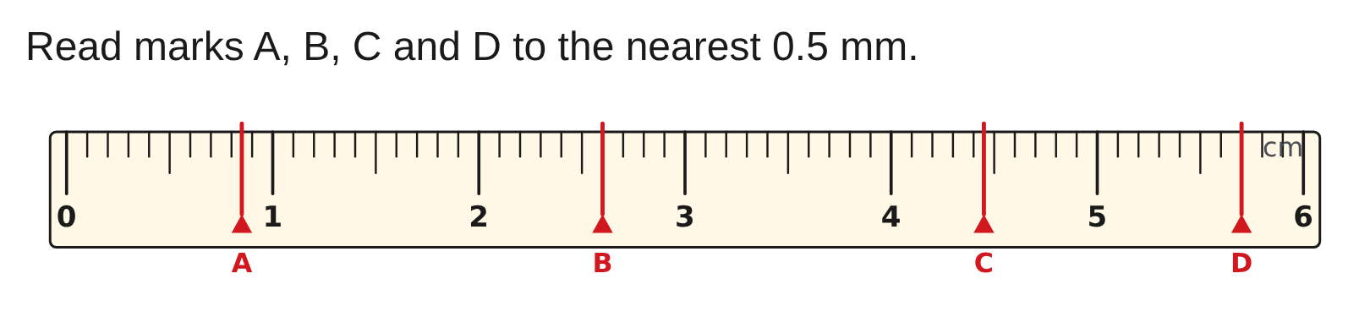
W05-L01 • PRACTISE • 1:25 PM–1:45 PM • 20 MIN TOTAL
Practise from the Exercise Book | 5A Q3
Write the operation, working and units before checking.
Textbook sections 7.1–7.2 pp.164–166; sections 4.2 pp.89–90
Textbook
Exercise Book
Numeracy Hub
Shape Canvas
Day 14 • 2026-11-24 • 19
Notes:
Timing: PRACTISE | 1:25 PM–1:45 PM | 20 MIN TOTAL. Shared phase allocation across these slides.
For 5A Q3, read marks A through D to the nearest 0.5 millimetre. Locate each mark between the whole-millimetre labels, then decide whether it falls on a whole or half-millimetre graduation. Record the unit for every reading.
Instructor-only, after the attempt: A = 8.5 mm, B = 26 mm, C = 44.5 mm, D = 57 mm. A whole-millimetre value is still a valid reading to the nearest half millimetre.

Slide 20
W05-L01 • CHECK • 1:45 PM–1:55 PM • 10 MIN TOTAL
Check independently
Exercise Book 7A Q8–9; show conversion of mixed feet/inches and a reverse check.
Solve without displayed answers; include working, units and final rounding.
Resources: Exercise Book 7A Q1–10 (p.67); 5A Q3 (p.45)
Textbook sections 7.1–7.2 pp.164–166; sections 4.2 pp.89–90
Textbook
Exercise Book
Numeracy Hub
Shape Canvas
Day 14 • 2026-11-24 • 20
Notes:
Timing: CHECK | 1:45 PM–1:55 PM | 10 MIN TOTAL. Shared phase allocation across these slides.
Complete 7A Q8–9 independently. One task turns feet and fractional inches into inches; the other groups inches back into feet and inches. Include a reverse check with each. Why is a remainder useful in the second calculation? It identifies the inches left after all complete twelve-inch feet are counted. Keep the symbols readable so I can tell where feet end and inches begin, and do not treat a decimal fraction of a foot as an inch count.

Slide 21
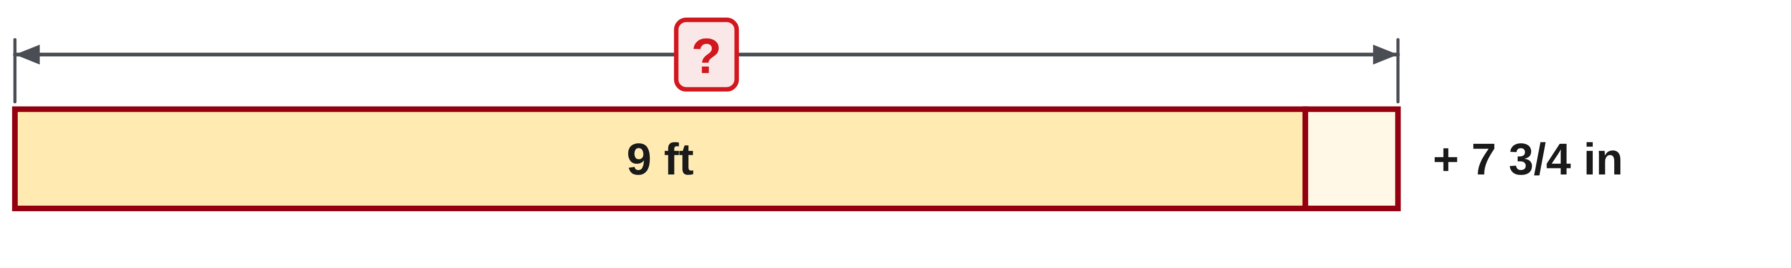
W05-L01 • CHECK • 1:45 PM–1:55 PM • 10 MIN TOTAL
Independent check | 7A Q8
Answer independently. Keep worked solutions closed.
Textbook sections 7.1–7.2 pp.164–166; sections 4.2 pp.89–90
Textbook
Exercise Book
Numeracy Hub
Shape Canvas
Day 14 • 2026-11-24 • 21
Notes:
Timing: CHECK | 1:45 PM–1:55 PM | 10 MIN TOTAL. Shared phase allocation across these slides.
For 7A Q8, express 9′ 7 3/4″ entirely in inches. Convert the nine feet, then add the complete inch portion including its fraction. Show a reverse check after calculating.
Instructor-only, after the attempt: 9 × 12 = 108 in; 108 + 7.75 = 115.75 in, or 115 3/4 in. Taking away nine twelve-inch groups leaves 7 3/4 inches. The three-quarter inch is preserved during the conversion.

Slide 22
W05-L01 • CHECK • 1:45 PM–1:55 PM • 10 MIN TOTAL
Independent check | 7A Q9
Answer independently. Keep worked solutions closed.
Textbook sections 7.1–7.2 pp.164–166; sections 4.2 pp.89–90
Textbook
Exercise Book
Numeracy Hub
Shape Canvas
Day 14 • 2026-11-24 • 22
Notes:
Timing: CHECK | 1:45 PM–1:55 PM | 10 MIN TOTAL. Shared phase allocation across these slides.
For 7A Q9, write ninety-four inches in feet and inches. Find the largest complete number of twelve-inch groups, then calculate the remaining inches. Avoid treating the decimal part of 94 ÷ 12 as inches directly.
Instructor-only, after the attempt: Seven feet use 84 inches, leaving 10 inches, so the answer is 7′ 10″. Check: 7 × 12 + 10 = 94 in. Eight feet would already be 96 inches, too long.

Slide 23
W05-L01 • WRAP UP • 1:55 PM–2:00 PM • 5 MIN TOTAL
Wrap up and choose the next step
Ask: What changed in your understanding? Where will you use it? What should you check next time?
Name the math and one other essential skill used; record a next practice step.
Resources: Exercise Book 7A Q1–10 (p.67); 5A Q3 (p.45)
Textbook sections 7.1–7.2 pp.164–166; sections 4.2 pp.89–90
Textbook
Exercise Book
Numeracy Hub
Shape Canvas
Play quiz
Quiz PDF
Day 14 • 2026-11-24 • 23
Notes:
Timing: WRAP UP | 1:55 PM–2:00 PM | 5 MIN TOTAL. Shared phase allocation across these slides.
What stayed unchanged when we moved between metres and millimetres or feet and inches? The physical length. What changed? The unit and the number of those units. Name one check you used: predicting the number’s direction, grouping twelve-inch feet or comparing a rule reading with its graduation. Record that check beside an example. After the break, we connect imperial and metric dimensions using a fixed exact relationship rather than guessing from how the numbers look.

Slide 24
DAY 14 • SCHEDULED BREAK
Break
2:00 PM–2:15 PM
Return ready for: Exact conversion factors and mixed-unit practice
This break is excluded from teaching minutes.
Textbook
Exercise Book
Numeracy Hub
Shape Canvas
Day 14 • 2026-11-24 • 24
Notes:
Timing: scheduled break, 2:00–2:15 PM.
Our break is from 2:00 to 2:15. When we return, we will use the exact inch-to-millimetre relationship and decide how to round a converted length for a tape. Keep your measurement and unit notes ready.

Slide 25
W05-L02 • START • 2:15 PM–2:20 PM • 5 MIN TOTAL
Exact conversion factors and mixed-unit practice
Today’s goal: Convert inch and metric dimensions using the book factor, rounding only to the requested final precision.
Describe a prior use of the skill; identify the given and unknown quantities.
Textbook sections 7.3 pp.167–169; conversion factors pp.362–363
Exercise Book 7A Q11–16 (p.68); 7B Q1–2 (p.69); 7C Q1–3 (p.71)
Keep your notebook, textbook, exercise book and chosen calculator ready.
Textbook sections 7.3 pp.167–169; conversion factors pp.362–363
Textbook
Exercise Book
Numeracy Hub
Shape Canvas
Day 14 • 2026-11-24 • 25
Notes:
Timing: START | 2:15 PM–2:20 PM | 5 MIN TOTAL. Shared phase allocation across these slides.
Now we bridge the two measurement systems. A drawing may specify millimetres while the tape in your hand reads feet and inches. We will use the textbook’s exact factor, keep the calculation precise and round only to the final graduation requested. Open 7A Q11–16, 7B Q1–2 and 7C Q1–3. What should be written before the numerical result? The starting unit, target unit and conversion factor. Those three pieces make the operation clear.

Slide 26
W05-L02 • RECALL • 2:20 PM–2:25 PM • 5 MIN TOTAL
Recall and reconnect
Discuss whether converting inches to millimetres should enlarge or shrink the number. Retrieve 1 in = 25.4 mm.
Attempt the retrieval task independently; explain the method before checking.
Resources: Exercise Book 7A Q11–16 (p.68); 7B Q1–2 (p.69); 7C Q1–3 (p.71)
Textbook sections 7.3 pp.167–169; conversion factors pp.362–363
Textbook
Exercise Book
Numeracy Hub
Shape Canvas
Day 14 • 2026-11-24 • 26
Notes:
Timing: RECALL | 2:20 PM–2:25 PM | 5 MIN TOTAL. Shared phase allocation across these slides.
Recall the exact relationship: one inch equals 25.4 millimetres. If we change an inch measurement to millimetres, should the numerical value grow or shrink? Grow, because many small millimetres fit into one inch. In the reverse direction, the count shrinks. Explain why this is a unit change rather than stretching the object. The same length is being counted with different-sized units. Keep that picture in mind whenever the factor’s direction feels uncertain.

Slide 27

W05-L02 • TEACH • 2:25 PM–2:40 PM • 15 MIN TOTAL
Use a conversion factor with direction
1
1 in = 25.4 mm is an exact length conversion.
2
Inches to millimetres: multiply by 25.4.
3
Millimetres to inches: divide by 25.4.
4
Write the factor so the original unit cancels and the target unit remains.
Textbook sections 7.3 pp.167–169; conversion factors pp.362–363
Textbook
Exercise Book
Numeracy Hub
Shape Canvas
Day 14 • 2026-11-24 • 27
Notes:
Timing: TEACH | 2:25 PM–2:40 PM | 15 MIN TOTAL. Shared phase allocation across these slides.
The inch is defined as exactly 25.4 millimetres. To convert inches to millimetres, multiply by 25.4 millimetres per inch. The inch unit cancels and millimetres remain. To convert millimetres to inches, divide by 25.4, or multiply by one inch per 25.4 millimetres. Which direction should make the numerical answer larger? Inches to millimetres. Writing the unit with the factor makes the reasoning visible and protects against reversing it. This is an exact conversion relationship; any later rounding comes from the requested measurement precision, not uncertainty in the factor itself.

Slide 28
W05-L02 • TEACH • 2:25 PM–2:40 PM • 15 MIN TOTAL
Separate exact values from rounded readings
1
Keep the exact factor and full calculation precision.
2
Predict whether the numerical result should increase or decrease.
3
Round only the final result to the requested unit or tape graduation.
4
Convert back before rounding to check the conversion direction.
Textbook sections 7.3 pp.167–169; conversion factors pp.362–363
Textbook
Exercise Book
Numeracy Hub
Shape Canvas
Day 14 • 2026-11-24 • 28
Notes:
Timing: TEACH | 2:25 PM–2:40 PM | 15 MIN TOTAL. Shared phase allocation across these slides.
Keep two ideas separate: the exact conversion and the rounded measurement you can mark. Use the full 25.4 factor and retain calculation precision until the question’s final request. For a tape marked in sixteenths, convert to inches first, then select the nearest sixteenth. Why not round the inch decimal to two places before selecting the tape mark? An early change can shift a value across a rounding boundary. Convert the unrounded result back as a check when practical. Then round once to the stated graduation and identify that final result as a rounded measurement.

Slide 29
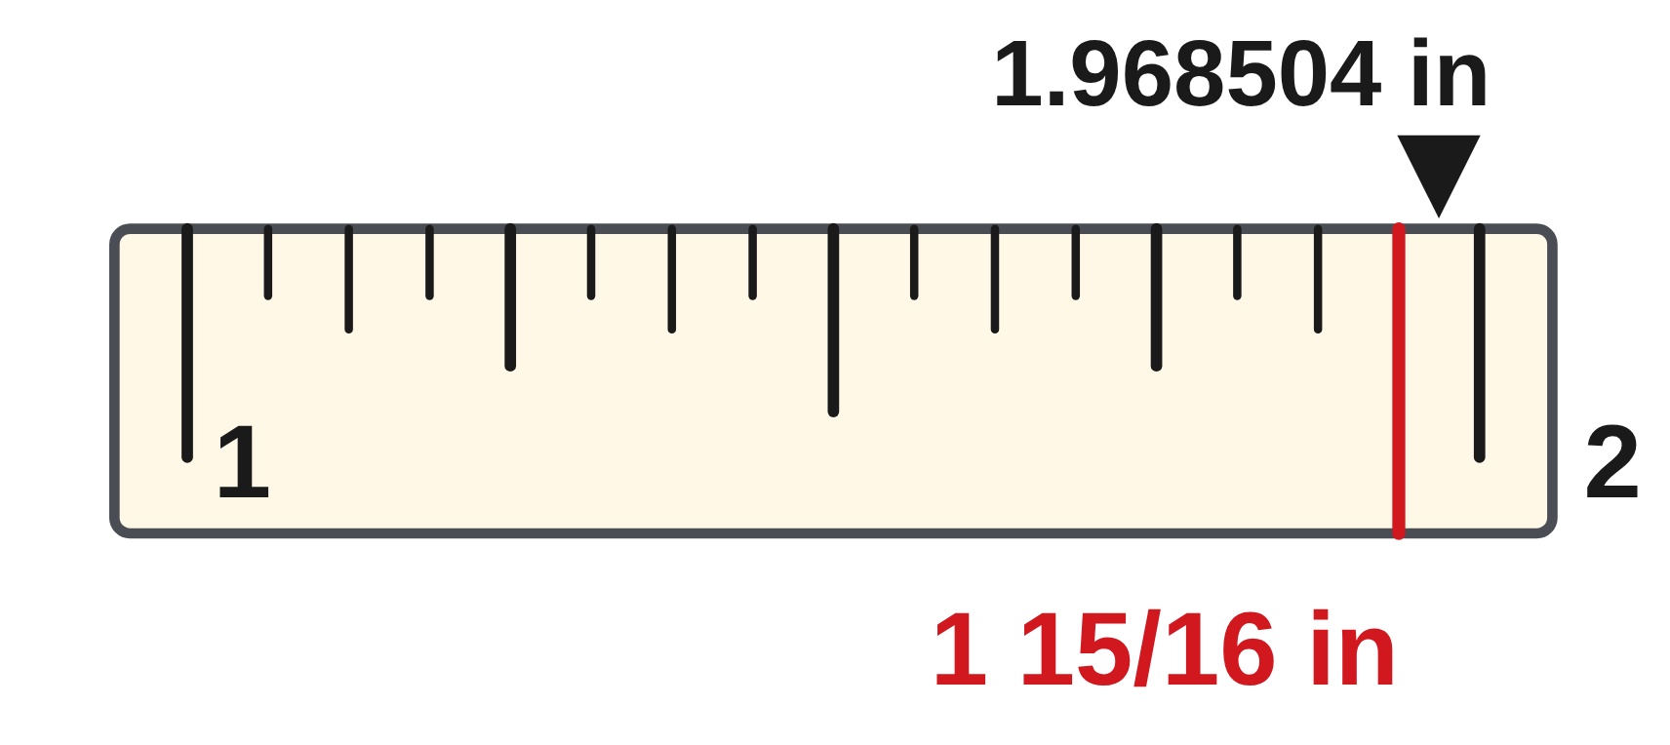
W05-L02 • TEACH • 2:25 PM–2:40 PM • 15 MIN TOTAL
Arrange the factor to cancel the unit
3/4 in × 25.4 mm/in = 19.05 mm
50 mm ÷ 25.4 mm/in ≈ 1.968504 in
Nearest 1/16 in: 0.968504 × 16 ≈ 15.496 → 15 sixteenths.
Rounded measurement = 1 15/16 in.
The exact factor is not the same as the rounded result.
Together: 7A Q11–14. Convert one answer back before rounding.
Numeracy Hub Unit Conversions; Shape Canvas for 7C Q1.
W5 L2 • Classroom examples • Check requested precision carefully
Textbook
Exercise Book
Numeracy Hub
Shape Canvas
Day 14 • 2026-11-24 • 29
Notes:
Timing: TEACH | 2:25 PM–2:40 PM | 15 MIN TOTAL. Shared phase allocation across these slides.
Three quarters of an inch is 0.75 inch. Multiplying by 25.4 gives exactly 19.05 millimetres. In the other direction, fifty millimetres divided by 25.4 gives about 1.968504 inches. To mark the nearest sixteenth, keep one whole inch and multiply the fractional part by sixteen: about 15.496. That is below 15.5, so round to fifteen, giving 1 15/16 inches. Why is it important not to round 1.968504 to 1.97 first? The rounded intermediate value could move the sixteenth count above the halfway point and change the chosen mark.

Slide 30
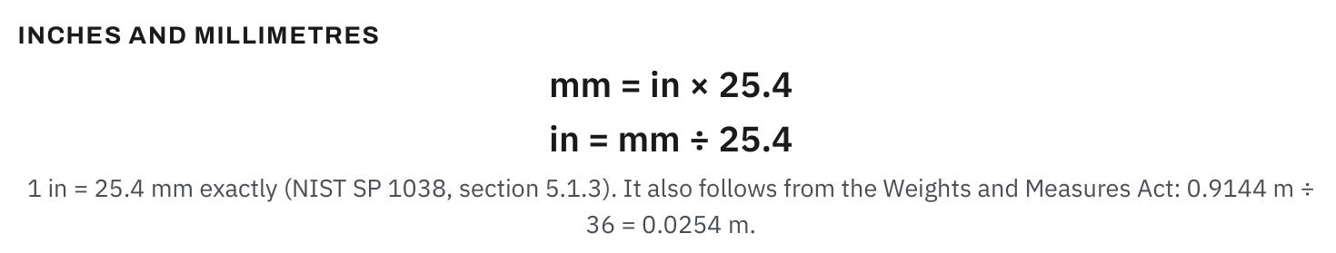
W05-L02 • TEACH • 2:25 PM–2:40 PM • 15 MIN TOTAL
Textbook | pages 167–168
Textbook pp.167–168 • Exact inch–millimetre conversion factors
Textbook sections 7.3 pp.167–169; conversion factors pp.362–363
Textbook
Exercise Book
Numeracy Hub
Shape Canvas
Day 14 • 2026-11-24 • 30
Notes:
Timing: TEACH | 2:25 PM–2:40 PM | 15 MIN TOTAL. Shared phase allocation across these slides.
The conversion table on textbook pages 167–168 gives exact factors. For inches to millimetres, the factor is 25.4; inches to centimetres uses 2.54. A foot is exactly 0.3048 metre. Which factor belongs in an inch-to-millimetre calculation? 25.4, with millimetres per inch written beside it. Do not select a factor merely because the number looks familiar; read the “from” and “to” units. To go in the reverse direction, divide by the stated factor. The table’s long decimals are precise definitions, so keep all their digits when the assigned conversion calls for them.

Slide 31
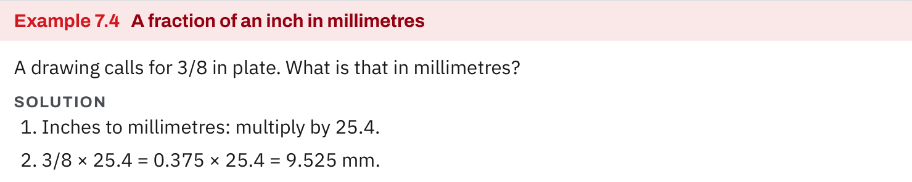
W05-L02 • TEACH • 2:25 PM–2:40 PM • 15 MIN TOTAL
Textbook | page 168
Textbook p.168 • Example 7.4 — Fractional inches to millimetres
Textbook sections 7.3 pp.167–169; conversion factors pp.362–363
Textbook
Exercise Book
Numeracy Hub
Shape Canvas
Day 14 • 2026-11-24 • 31
Notes:
Timing: TEACH | 2:25 PM–2:40 PM | 15 MIN TOTAL. Shared phase allocation across these slides.
Textbook Example 7.4 converts three eighths of an inch to millimetres. First, three divided by eight gives 0.375 inch. Multiply by 25.4 millimetres per inch: 0.375 times 25.4 equals 9.525 millimetres. You may enter the fraction directly on a suitable calculator, but the division form describes the same calculation. Is this less than half an inch expressed in millimetres? Yes; half an inch is 12.7 millimetres, and 9.525 is smaller. Check the direction and size, then keep the exact result unless the question asks for a particular rounding.

Slide 32
W05-L02 • TEACH • 2:25 PM–2:40 PM • 15 MIN TOTAL
Spot the mistake. Explain the correction.
A learner divides an inch measurement by 25.4 to get millimetres. Does the size make sense?
Discuss the method before checking the answer.
No. One inch contains 25.4 millimetres, so the numerical count must increase; multiply.
Textbook sections 7.3 pp.167–169; conversion factors pp.362–363
Textbook
Exercise Book
Numeracy Hub
Shape Canvas
Day 14 • 2026-11-24 • 32
Notes:
Timing: TEACH | 2:25 PM–2:40 PM | 15 MIN TOTAL. Shared phase allocation across these slides.
A learner divides an inch measurement by 25.4 to convert it to millimetres. Does that agree with the fact that one inch contains 25.4 millimetres? No. Dividing would make the count smaller, but smaller millimetre units require a larger count. The correct factor is 25.4 millimetres for every inch, so we multiply. Ask the learner to test their method on one inch: it should give 25.4 millimetres immediately. A known benchmark is often the quickest way to diagnose a reversed conversion before checking a longer calculation.

Slide 33
W05-L02 • TOGETHER • 2:40 PM–2:55 PM • 15 MIN TOTAL
Work together
Solve Exercise Book 7A Q11–14 together; check one by converting back before rounding.
Work in pairs, alternating solver and checker. Write a diagram, formula, units and estimate.
Resources: Exercise Book 7A Q11–16 (p.68); 7B Q1–2 (p.69); 7C Q1–3 (p.71)
Textbook sections 7.3 pp.167–169; conversion factors pp.362–363
Textbook
Exercise Book
Numeracy Hub
Shape Canvas
Day 14 • 2026-11-24 • 33
Notes:
Timing: TOGETHER | 2:40 PM–2:55 PM | 15 MIN TOTAL. Shared phase allocation across these slides.
Work together on 7A Q11–14. First state the target unit and predict the answer’s size. Write the fraction as division where necessary, apply the correct factor and retain full precision. Check one answer by converting back before any requested rounding. What should the reverse conversion produce? The original dimension, apart from the calculator’s display limits. If it does not, check whether the same factor was used in the wrong direction or an intermediate result was rounded.

Slide 34
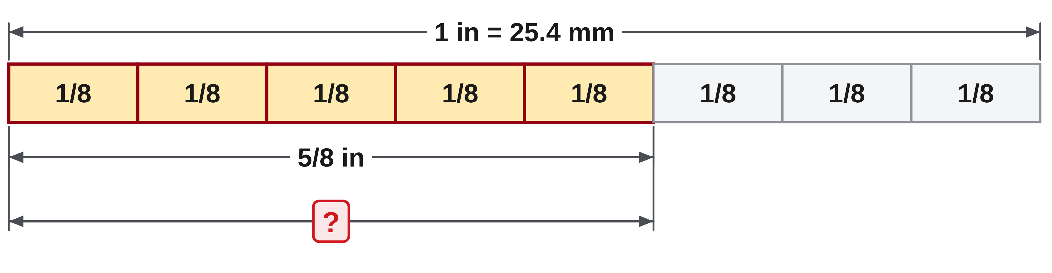
W05-L02 • TOGETHER • 2:40 PM–2:55 PM • 15 MIN TOTAL
Guided practice | 7A Q11
Work with a partner. Take turns explaining the next step.
Textbook sections 7.3 pp.167–169; conversion factors pp.362–363
Textbook
Exercise Book
Numeracy Hub
Shape Canvas
Day 14 • 2026-11-24 • 34
Notes:
Timing: TOGETHER | 2:40 PM–2:55 PM | 15 MIN TOTAL. Shared phase allocation across these slides.
For 7A Q11, convert five eighths of an inch to millimetres. First find the decimal equivalent, then apply the exact inch-to-millimetre factor. Predict a value between half an inch and one inch in millimetres.
Instructor-only, after the attempt: 5 ÷ 8 = 0.625; 0.625 × 25.4 = 15.875 mm. It lies between 12.7 mm and 25.4 mm, as expected. Dividing 15.875 by 25.4 returns 0.625 inch.

Slide 35
W05-L02 • TOGETHER • 2:40 PM–2:55 PM • 15 MIN TOTAL
Compare your method | 7A Q11
CHECK TOGETHER
15.875 mm
Textbook sections 7.3 pp.167–169; conversion factors pp.362–363
Textbook
Exercise Book
Numeracy Hub
Shape Canvas
Day 14 • 2026-11-24 • 35
Notes:
Timing: TOGETHER | 2:40 PM–2:55 PM | 15 MIN TOTAL. Shared phase allocation across these slides.
The result is 15.875 millimetres. We used the exact fraction value, 0.625, and the exact conversion factor, 25.4. Why should we not automatically shorten that to 15.88? This question asks for the conversion without an additional rounding instruction. Preserve the value unless a requested precision tells you otherwise. Verify by reversing the operation: 15.875 divided by 25.4 equals 0.625, which is five eighths. The unit changes, while the represented length remains the same.

Slide 36
W05-L02 • PRACTISE • 2:55 PM–3:15 PM • 20 MIN TOTAL
Your scheduled practice
Complete Exercise Book 7B Q1–2 and 7C Q1–3. Show the factor and units on paper; use the Numeracy Hub and Shape Canvas only after predicting the result.
Solve on paper first; check with tools; correct one error and explain the change.
Resources: Exercise Book 7A Q11–16 (p.68); 7B Q1–2 (p.69); 7C Q1–3 (p.71)
Textbook sections 7.3 pp.167–169; conversion factors pp.362–363
Textbook
Exercise Book
Numeracy Hub
Shape Canvas
Day 14 • 2026-11-24 • 36
Notes:
Timing: PRACTISE | 2:55 PM–3:15 PM | 20 MIN TOTAL. Shared phase allocation across these slides.
Complete 7B Q1–2 and 7C Q1–3. These tasks connect written dimensions with actual measurement choices. On paper, show the factor and units before using Numeracy Hub or Shape Canvas. Predict whether your numeric answer increases or decreases. What should you preserve when tape rounding is required? The unrounded inch result in your working, followed by the requested rounded mark. That record lets a partner distinguish a conversion error from a rounding decision.

Slide 37
W05-L02 • PRACTISE • 2:55 PM–3:15 PM • 20 MIN TOTAL
Open Numeracy Hub
Navigation example. Use the values and units in the assigned task.
Textbook sections 7.3 pp.167–169; conversion factors pp.362–363
Textbook
Exercise Book
Numeracy Hub
Shape Canvas
Day 14 • 2026-11-24 • 37
Notes:
Timing: PRACTISE | 2:55 PM–3:15 PM | 20 MIN TOTAL. Shared phase allocation across these slides.
Open Unit Conversions in Numeracy Hub. Select the starting and target length units deliberately, then enter the assigned value after making your own prediction. Read the output label before comparing the number with your notebook. What if the tool gives centimetres while your written answer is in millimetres? The values will differ by a factor of ten even if both are correct. Align the units first so the comparison tests your calculation rather than comparing different descriptions of the same length.

Slide 38
W05-L02 • PRACTISE • 2:55 PM–3:15 PM • 20 MIN TOTAL
Practise in Numeracy Hub and Shape Canvas
1
Predict and calculate each assigned conversion on paper with the factor and units.
2
Check a length conversion in Numeracy Hub Unit Conversions.
3
Build the 7C Q1 rectangle in Shape Canvas; switch displayed units and compare labels.
Textbook sections 7.3 pp.167–169; conversion factors pp.362–363
Textbook
Exercise Book
Numeracy Hub
Shape Canvas
Day 14 • 2026-11-24 • 38
Notes:
Timing: PRACTISE | 2:55 PM–3:15 PM | 20 MIN TOTAL. Shared phase allocation across these slides.
Calculate each assigned conversion on paper, then check one in Numeracy Hub. Build the 7C Q1 rectangle in Shape Canvas using the stated sizes and compare the labels in the requested units. What should remain physically consistent when you describe the same sheet in millimetres? Its proportions and represented dimensions. If a displayed unit choice merely changes the label or entry interpretation, enter the equivalent calculated values explicitly. Judge agreement from the numerical dimensions, not the apparent screen size.

Slide 39
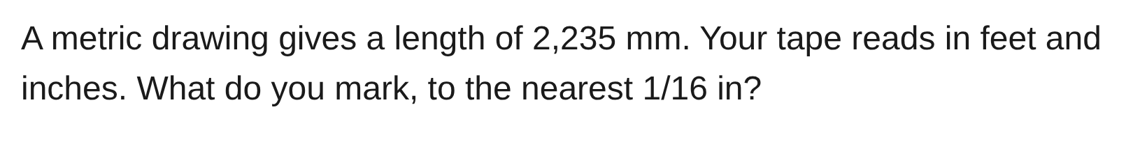
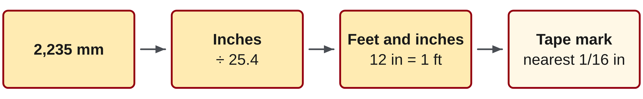
W05-L02 • PRACTISE • 2:55 PM–3:15 PM • 20 MIN TOTAL
Practise from the Exercise Book | 7B Q1
Write the operation, working and units before checking.
Textbook sections 7.3 pp.167–169; conversion factors pp.362–363
Textbook
Exercise Book
Numeracy Hub
Shape Canvas
Day 14 • 2026-11-24 • 39
Notes:
Timing: PRACTISE | 2:55 PM–3:15 PM | 20 MIN TOTAL. Shared phase allocation across these slides.
For 7B Q1, convert 2235 millimetres to feet and inches, rounded to the nearest sixteenth inch. Keep the unrounded inch value, then round to a tape graduation and regroup whole feet.
Instructor-only, after the attempt: 2235 ÷ 25.4 ≈ 87.992126 in. The fractional 0.992126 × 16 ≈ 15.874, which rounds to sixteen sixteenths, carrying to 88 in. Since 84 in is seven feet, the mark is 7′ 4″.

Slide 40
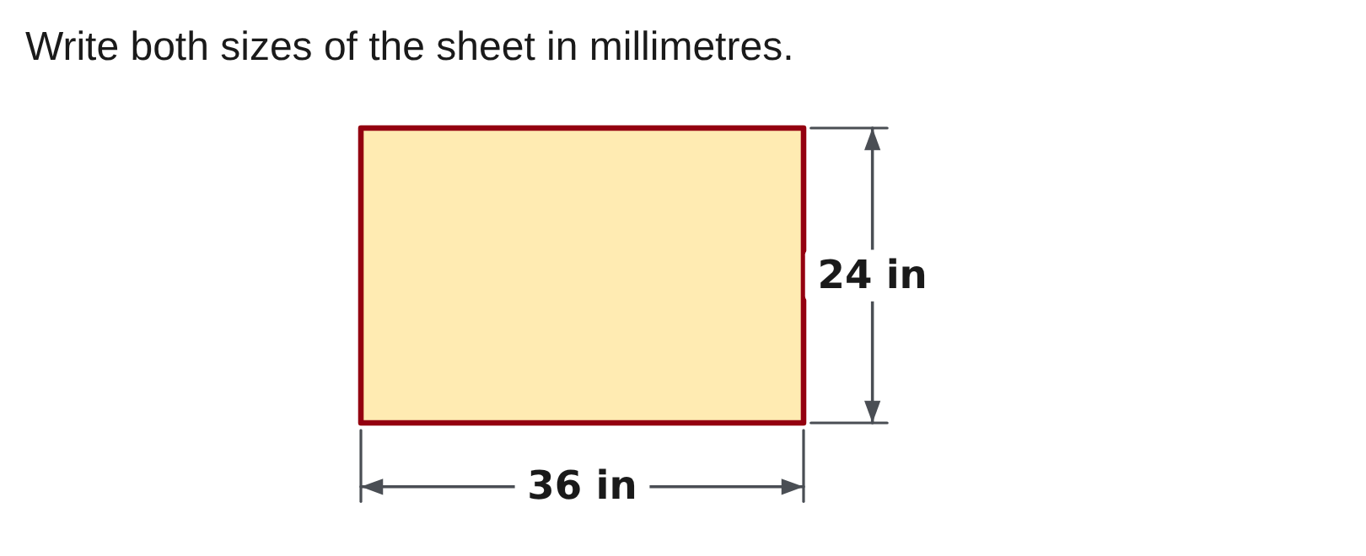
W05-L02 • PRACTISE • 2:55 PM–3:15 PM • 20 MIN TOTAL
Practise from the Exercise Book | 7C Q1
Write the operation, working and units before checking.
Textbook sections 7.3 pp.167–169; conversion factors pp.362–363
Textbook
Exercise Book
Numeracy Hub
Shape Canvas
Day 14 • 2026-11-24 • 40
Notes:
Timing: PRACTISE | 2:55 PM–3:15 PM | 20 MIN TOTAL. Shared phase allocation across these slides.
For 7C Q1, convert both labelled sheet sizes to millimetres. Read each dimension from the diagram, use the exact inch-to-millimetre relationship and keep the two converted sizes paired with their original sides. Why must both sides be converted? A rectangle is not fully described by one dimension.
Instructor-only, after the attempt: 914.4 mm by 609.6 mm. These correspond to 36 in × 25.4 and 24 in × 25.4. The common factor preserves the sheet’s proportions.

Slide 41
W05-L02 • CHECK • 3:15 PM–3:25 PM • 10 MIN TOTAL
Check independently
Exercise Book 7A Q11 and Exercise Book 7B Q1; show the exact result before final tape rounding.
Solve without displayed answers; include working, units and final rounding.
Resources: Exercise Book 7A Q11–16 (p.68); 7B Q1–2 (p.69); 7C Q1–3 (p.71)
Textbook sections 7.3 pp.167–169; conversion factors pp.362–363
Textbook
Exercise Book
Numeracy Hub
Shape Canvas
Day 14 • 2026-11-24 • 41
Notes:
Timing: CHECK | 3:15 PM–3:25 PM | 10 MIN TOTAL. Shared phase allocation across these slides.
Complete 7A Q11 and 7B Q1 independently. Show the exact conversion setup and preserve the unrounded result before tape rounding. In Q11, the fraction conversion terminates exactly. In Q1, write the division expression as the exact value and a sufficiently precise decimal before selecting the tape mark. What happens if the fractional-inch count rounds to sixteen sixteenths? Carry one whole inch. Show that step so the final feet-and-inch notation is easy to verify.

Slide 42
W05-L02 • CHECK • 3:15 PM–3:25 PM • 10 MIN TOTAL
Independent check | 7A Q11
Answer independently. Keep worked solutions closed.
Textbook sections 7.3 pp.167–169; conversion factors pp.362–363
Textbook
Exercise Book
Numeracy Hub
Shape Canvas
Day 14 • 2026-11-24 • 42
Notes:
Timing: CHECK | 3:15 PM–3:25 PM | 10 MIN TOTAL. Shared phase allocation across these slides.
For 7A Q11, convert five eighths of an inch to millimetres. Show the fraction-to-decimal step or an equivalent direct fraction calculation, then verify with the reverse conversion. Work independently before checking.
Instructor-only, after the attempt: 5/8 × 25.4 = 15.875 mm. Since 5/8 = 0.625, the result should lie between half an inch, 12.7 mm, and one inch, 25.4 mm. No extra rounding is requested here.

Slide 43
W05-L02 • CHECK • 3:15 PM–3:25 PM • 10 MIN TOTAL
Independent check | 7B Q1
Answer independently. Keep worked solutions closed.
Textbook sections 7.3 pp.167–169; conversion factors pp.362–363
Textbook
Exercise Book
Numeracy Hub
Shape Canvas
Day 14 • 2026-11-24 • 43
Notes:
Timing: CHECK | 3:15 PM–3:25 PM | 10 MIN TOTAL. Shared phase allocation across these slides.
For 7B Q1, write the conversion for 2235 millimetres, then choose the nearest sixteenth and express it in feet and inches. Preserve the value before rounding so the carry is visible.
Instructor-only, after the attempt: The exact inch value is 2235/25.4, approximately 87.992126. Rounding the fractional part gives 16/16, so the measurement becomes 88 in. That is 7′ 4″. The final mark is rounded; it is not an exact equality to 2235 mm.

Slide 44
W05-L02 • WRAP UP • 3:25 PM–3:30 PM • 5 MIN TOTAL
Wrap up and choose the next step
Ask: What changed in your understanding? Where will you use it? What should you check next time?
Name the math and one other essential skill used; record a next practice step.
Resources: Exercise Book 7A Q11–16 (p.68); 7B Q1–2 (p.69); 7C Q1–3 (p.71)
Textbook sections 7.3 pp.167–169; conversion factors pp.362–363
Textbook
Exercise Book
Numeracy Hub
Shape Canvas
Play quiz
Quiz PDF
Day 14 • 2026-11-24 • 44
Notes:
Timing: WRAP UP | 3:25 PM–3:30 PM | 5 MIN TOTAL. Shared phase allocation across these slides.
Name the difference between an exact factor and a rounded answer. The factor 25.4 millimetres per inch is fixed exactly; our tape mark may be rounded to a stated graduation. Which step should happen last? The requested rounding. Choose a completed example and explain how you checked direction, units and precision. Write a reminder beside it that would help you transfer a dimension from a metric drawing to an imperial tape without losing the whole inches or rounding too early.

