Slide 1

CARPENTRY FOUNDATION / INTAKE 142
Day 16 | Thursday
16
November 26, 2026
Hidden dimensions: square roots and formula checks
2:15 PM–3:30 PM • Math • 75 min
Week 5 • 1 scheduled block • 75 teaching minutes
Estimate. Show the method. Label units. Check the result.
Textbook
Exercise Book
Numeracy Hub
Shape Canvas
Day 16 • 2026-11-26 • 01
Notes:
Opening — within the first Start allocation.
Today we are going to work backwards from an area to a missing dimension. That is useful when a drawing tells us how much surface a part must cover but leaves one size for us to find. Our math block is 2:15 to 3:30. Keep one question in mind: what operation created this area, and what operation will undo it? By the end, you will be able to prove your dimension by rebuilding the original area.

Slide 2
DAY 16 / WEEK 5 / CLASS TIMETABLE
Today’s exact schedule
2:15 PM–3:30 PM • 75 min
Hidden dimensions: square roots and formula checks
2:15 PM–2:20 PM
Start
5
2:20 PM–2:25 PM
Recall
5
2:25 PM–2:40 PM
Teach
15
2:40 PM–2:55 PM
Together
15
2:55 PM–3:15 PM
Practise
20
3:15 PM–3:25 PM
Check
10
3:25 PM–3:30 PM
Wrap up
5
Math • Math Week 5, Lesson 5
One math block today. Other scheduled program sessions remain separate.
Textbook
Exercise Book
Numeracy Hub
Shape Canvas
Day 16 • 2026-11-26 • 02
Notes:
Opening — within the first Start allocation.
We have one 75-minute math block today. We will reconnect with squares and roots, work through the method together, and then use the exercise book and Shape Canvas to test it. Practice runs from 2:55 to 3:15; the independent check is 3:15 to 3:25. Our final five minutes are for explaining what the check tells us. The times belong to whole activities, so we will move between slides within each activity.

Slide 3
W05-L05 • START • 2:15 PM–2:20 PM • 5 MIN TOTAL
Hidden dimensions: square roots and formula checks
Today’s goal: Find a missing dimension from a known area and check the answer in the original formula.
Describe a prior use of the skill; identify the given and unknown quantities.
Textbook sections 8.6 pp.201–203; sections 8.7 pp.203–204; calculator pp.51–53
Exercise Book 8A Q23–24 (p.78); 8B Q6,13 (pp.79–80); 8C Q1–4 (p.81)
Keep your notebook, textbook, exercise book and chosen calculator ready.
Textbook sections 8.6 pp.201–203; sections 8.7 pp.203–204; calculator pp.51–53
Textbook
Exercise Book
Numeracy Hub
Shape Canvas
Day 16 • 2026-11-26 • 03
Notes:
START • 2:15 PM–2:20 PM • 5 MIN TOTAL — shared across this phase’s slides.
Imagine a rectangular panel drawing with the area filled in and the width left blank. The question mark is a length, even though the information we start with is an area. Point to the known quantity and then the quantity you need. What units would the unknown width have if the drawing uses centimetres? Centimetres, not square centimetres. Today we will use the textbook, pages 200 to 204, to choose the inverse operation and then substitute the dimension back into the area formula.

Slide 4
W05-L05 • RECALL • 2:20 PM–2:25 PM • 5 MIN TOTAL
Recall and reconnect
Explain how to undo a square, and why dividing by two is not the same as taking a square root.
Attempt the retrieval task independently; explain the method before checking.
Resources: Exercise Book 8A Q23–24 (p.78); 8B Q6,13 (pp.79–80); 8C Q1–4 (p.81)
Textbook sections 8.6 pp.201–203; sections 8.7 pp.203–204; calculator pp.51–53
Textbook
Exercise Book
Numeracy Hub
Shape Canvas
Day 16 • 2026-11-26 • 04
Notes:
RECALL • 2:20 PM–2:25 PM • 5 MIN TOTAL — shared across this phase’s slides.
What does squaring a number mean? It means multiplying it by itself. So 6 squared is 6 times 6, which is 36. To undo that, we ask which positive number multiplied by itself gives 36. The answer is 6. Dividing 36 by 2 gives 18, but 18 times 18 is 324, so that cannot be the side of this square. Explain to your partner why the small 2 in a square means something different from multiplying by two.

Slide 5
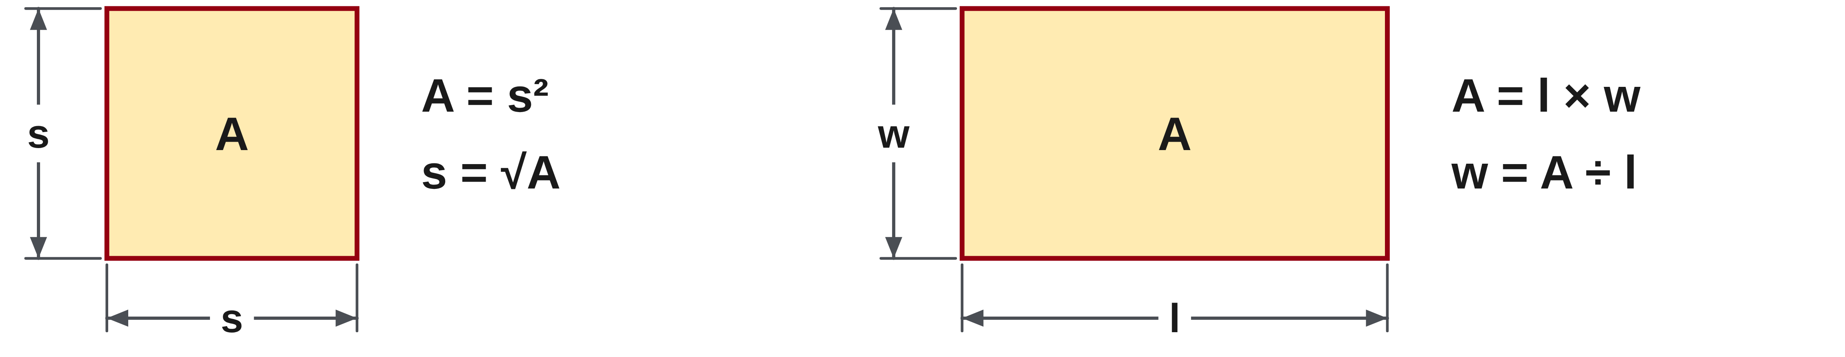
W05-L05 • TEACH • 2:25 PM–2:40 PM • 15 MIN TOTAL
Choose the operation that undoes the formula
1
For a square, A = s², so the side length is s = √A.
2
For a rectangle, A = l × w; divide by the known side to find the other.
3
A square root undoes squaring; it is not the same as dividing by two.
4
A physical side length is reported as a positive length.
Textbook sections 8.6 pp.201–203; sections 8.7 pp.203–204; calculator pp.51–53
Textbook
Exercise Book
Numeracy Hub
Shape Canvas
Day 16 • 2026-11-26 • 05
Notes:
TEACH • 2:25 PM–2:40 PM • 15 MIN TOTAL — shared across this phase’s slides.
The shape decides the inverse operation. A square has two equal dimensions, so A equals s squared. To find s, take the square root of the area. A rectangle may have different length and width. If we know its length, dividing the area by that length leaves the width. Which method would you choose if only a square’s area were given? A square root, because neither separate side is known. In our dimension problems we report the positive root: a physical side length is positive. We will always test that choice in the original formula.

Slide 6
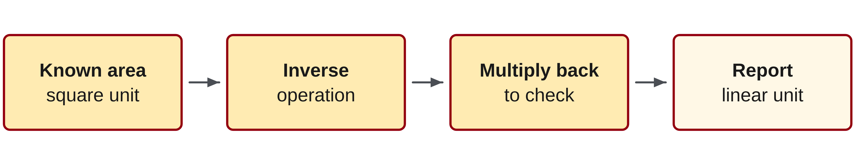
W05-L05 • TEACH • 2:25 PM–2:40 PM • 15 MIN TOTAL
Validate a hidden dimension
1
Write the known area and its square unit.
2
Find the missing dimension using the appropriate inverse operation.
3
Multiply the found dimensions to reproduce the original area.
4
Report the dimension in a linear unit, not a square unit.
Textbook sections 8.6 pp.201–203; sections 8.7 pp.203–204; calculator pp.51–53
Textbook
Exercise Book
Numeracy Hub
Shape Canvas
Day 16 • 2026-11-26 • 06
Notes:
TEACH • 2:25 PM–2:40 PM • 15 MIN TOTAL — shared across this phase’s slides.
A calculator result becomes useful when we can explain and check it. First write the known area with its squared unit. Next identify whether we are undoing a multiplication by a known side or undoing a square. After calculating the missing length, put it back into the original area formula. If the reconstructed area does not match, we have something to investigate. Why does a dimension use millimetres rather than square millimetres? Because it measures one direction. The check multiplies two lengths and returns us to the square unit that the area started with.

Slide 7
W05-L05 • TEACH • 2:25 PM–2:40 PM • 15 MIN TOTAL
Divide for a rectangle; root for a square
RECTANGLE • A = l × w
A = 4,800 cm²; l = 80 cm
w = 4,800 ÷ 80 = 60 cm
Check: 80 × 60 = 4,800 cm².
SQUARE • A = s²
A = 3,136 mm²
s = √3,136 = 56 mm
Check: 56² = 3,136 mm².
Together • Work 8A Q23 and 8C Q1–2. Name the shape first.
Write the rearranged formula before calculator entry.
Demonstrate square-root entry for the learner’s chosen calculator model.
Shape Canvas • Hide a square or rectangle dimension. Predict it on paper,
then reveal it. Check the found dimensions by multiplication.
Textbook pp.200–204 • Exercise Book 8C Q1–2 p.81 • Units change from square units to length units
Textbook
Exercise Book
Numeracy Hub
Shape Canvas
Day 16 • 2026-11-26 • 07
Notes:
TEACH • 2:25 PM–2:40 PM • 15 MIN TOTAL — shared across this phase’s slides.
Read the rectangle first: 4,800 square centimetres and a length of 80 centimetres. Area equals length times width, so width equals 4,800 divided by 80: 60 centimetres. Multiplying 80 by 60 returns 4,800 square centimetres. Now the square has area 3,136 square millimetres. There is no separate known side to divide by. Take the square root: 56 millimetres. Check 56 times 56: 3,136. Which problem uses a root, and why? The square, because the same unknown side is used twice. Write the rearranged formula before using the calculator.

Slide 8
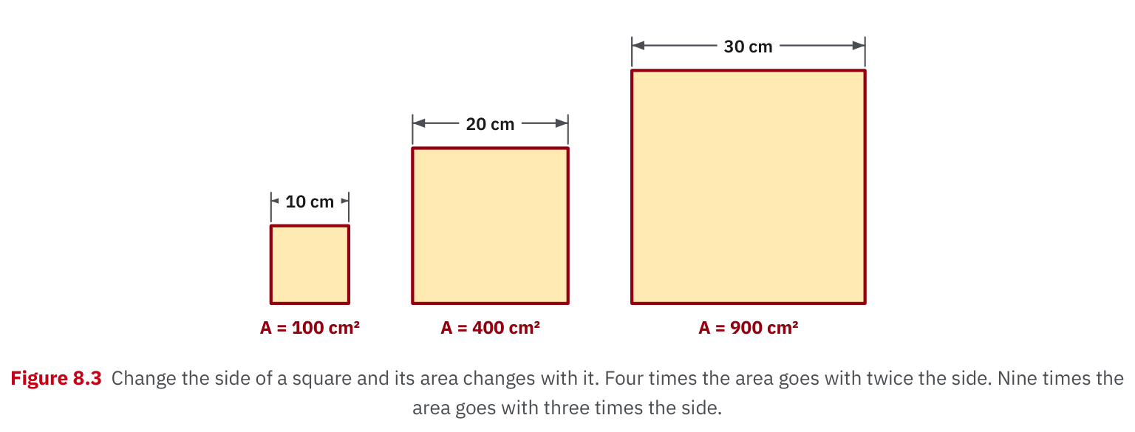
W05-L05 • TEACH • 2:25 PM–2:40 PM • 15 MIN TOTAL
Textbook | page 201
Textbook p.201 • Figure 8.3 — Square side length and area
Textbook sections 8.6 pp.201–203; sections 8.7 pp.203–204; calculator pp.51–53
Textbook
Exercise Book
Numeracy Hub
Shape Canvas
Day 16 • 2026-11-26 • 08
Notes:
TEACH • 2:25 PM–2:40 PM • 15 MIN TOTAL — shared across this phase’s slides.
In Figure 8.3 on page 201, follow the square sides: 10 centimetres, 20 centimetres and 30 centimetres. Their areas are 100, 400 and 900 square centimetres. Doubling the side multiplies the area by four, because both directions double. Tripling the side multiplies the area by nine. If the area becomes four times as large, does the side become four times as large? No, it becomes twice as large. This picture explains why we use a square root when we know the area: we are recovering the single side from two equal factors.

Slide 9
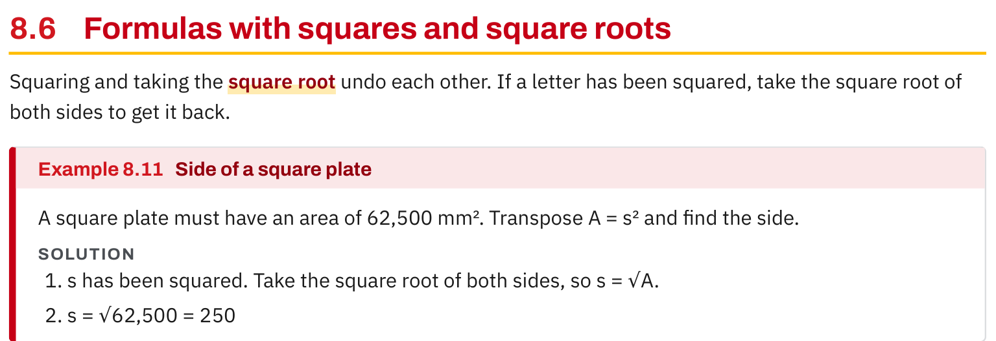
W05-L05 • TEACH • 2:25 PM–2:40 PM • 15 MIN TOTAL
Textbook | page 201
Textbook p.201 • Example 8.11 — Find a square side using a square root
Textbook sections 8.6 pp.201–203; sections 8.7 pp.203–204; calculator pp.51–53
Textbook
Exercise Book
Numeracy Hub
Shape Canvas
Day 16 • 2026-11-26 • 09
Notes:
TEACH • 2:25 PM–2:40 PM • 15 MIN TOTAL — shared across this phase’s slides.
Example 8.11 starts with a square plate of 62,500 square millimetres. We write s equals the square root of 62,500, giving 250 millimetres. Check it aloud: 250 times 250 equals 62,500. Notice the calculator sequence in the continuation on pages 201–202. On the TI-30Xa, enter 62500 and then the square-root key. On the Sharp EL-531XT, press the square-root key, enter 62500, then equals. The mathematical operation is identical even though the key order differs. What must the display show for either method? 250, which we label millimetres.

Slide 10
W05-L05 • TEACH • 2:25 PM–2:40 PM • 15 MIN TOTAL
Spot the mistake. Explain the correction.
Someone divides a square’s area by two to find its side. Which inverse is needed?
Discuss the method before checking the answer.
Take the square root, because the side was multiplied by itself. Then square the result to check.
Textbook sections 8.6 pp.201–203; sections 8.7 pp.203–204; calculator pp.51–53
Textbook
Exercise Book
Numeracy Hub
Shape Canvas
Day 16 • 2026-11-26 • 10
Notes:
TEACH • 2:25 PM–2:40 PM • 15 MIN TOTAL — shared across this phase’s slides.
Someone says, “A square uses two sides, so I divide the area by two.” What has that person mixed up? Two equal factors are being multiplied; the area has not simply been doubled. Use the 3,136 square millimetre example to test the claim. Dividing by two gives 1,568, and a side that large cannot reproduce the area when squared. The correct inverse is the square root, giving 56 millimetres. The best correction includes a reason and a check: 56 times 56 is 3,136. Tell your partner why dividing by two undoes doubling, but does not undo squaring.

Slide 11
W05-L05 • TOGETHER • 2:40 PM–2:55 PM • 15 MIN TOTAL
Work together
Work Exercise Book 8A Q23 and Exercise Book 8C Q1–2. Learners check by multiplying the found dimensions.
Work in pairs, alternating solver and checker. Write a diagram, formula, units and estimate.
Resources: Exercise Book 8A Q23–24 (p.78); 8B Q6,13 (pp.79–80); 8C Q1–4 (p.81)
Textbook sections 8.6 pp.201–203; sections 8.7 pp.203–204; calculator pp.51–53
Textbook
Exercise Book
Numeracy Hub
Shape Canvas
Day 16 • 2026-11-26 • 11
Notes:
TOGETHER • 2:40 PM–2:55 PM • 15 MIN TOTAL — shared across this phase’s slides.
Open exercise 8A question 23 and exercise 8C questions 1 and 2. Before calculating, name each shape and identify what is given. One partner explains the inverse operation; the other checks the result in the original equation. In 8A question 23 we are changing the formula itself. In 8C, we apply that formula reasoning to actual dimensions. When you check, say the unit aloud. Does your substitution produce the stated area, with a square unit? That is stronger evidence than simply getting the same calculator display as your partner.

Slide 12
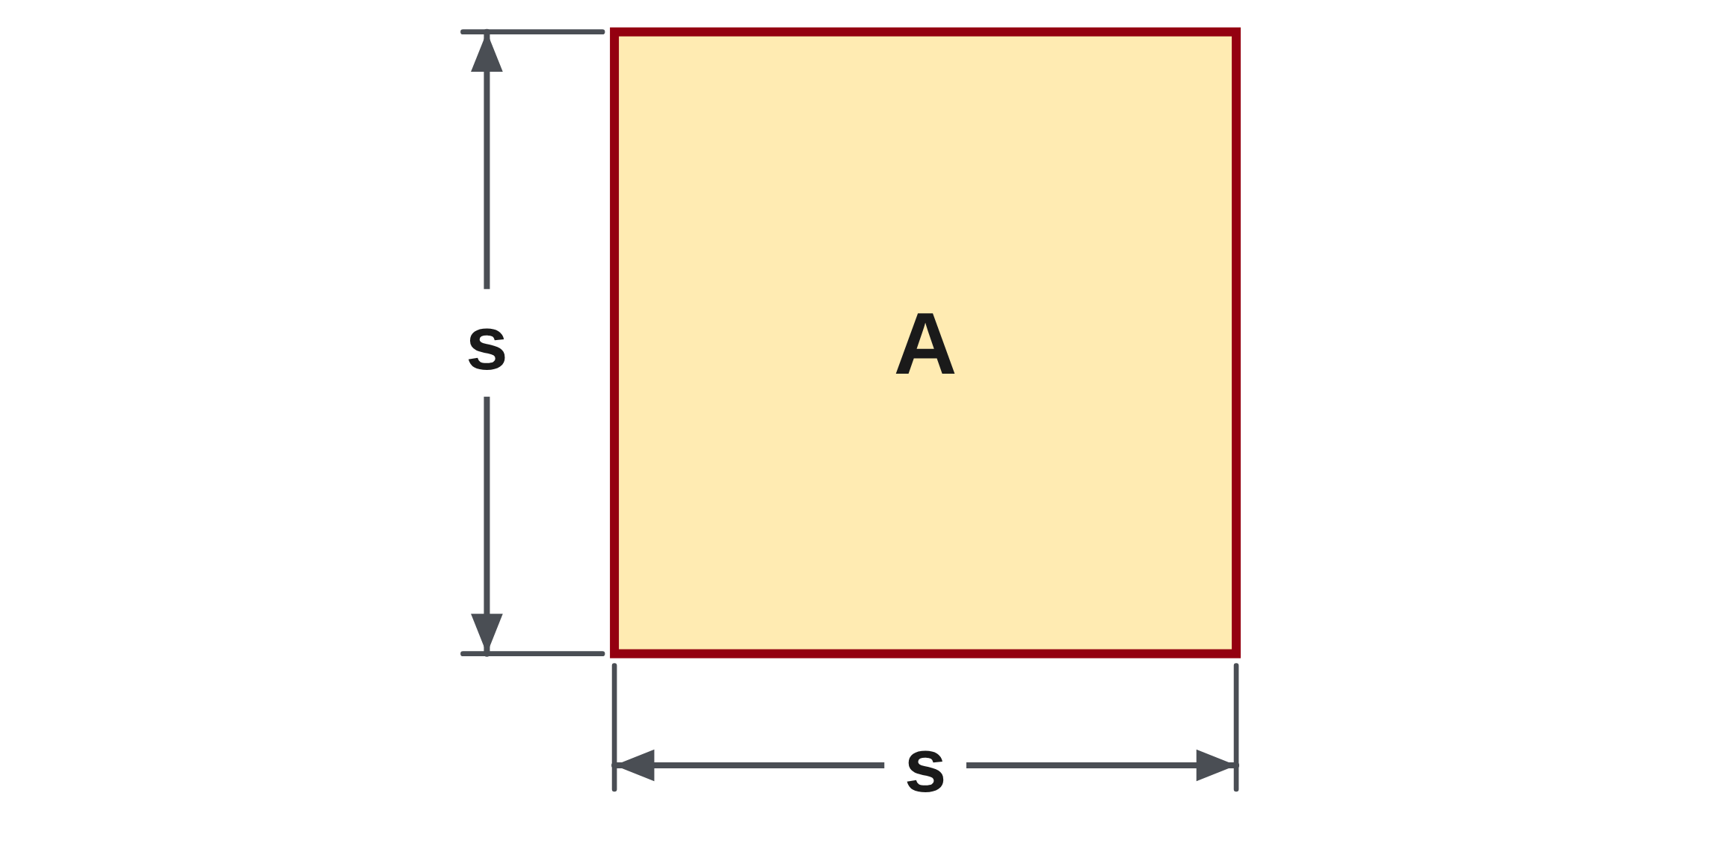
W05-L05 • TOGETHER • 2:40 PM–2:55 PM • 15 MIN TOTAL
Guided practice | 8A Q23
Work with a partner. Take turns explaining the next step.
Textbook sections 8.6 pp.201–203; sections 8.7 pp.203–204; calculator pp.51–53
Textbook
Exercise Book
Numeracy Hub
Shape Canvas
Day 16 • 2026-11-26 • 12
Notes:
TOGETHER • 2:40 PM–2:55 PM • 15 MIN TOTAL — shared across this phase’s slides.
For 8A question 23, make s the subject of A equals s squared. “The subject” means the letter standing by itself. What operation has been done to s, and how can we undo it on both sides? Write your rearranged formula before comparing it with your partner.
Instructor only, after the attempt: s = √A. Taking the square root undoes the square. For a physical side length, use the positive root.

Slide 13
W05-L05 • TOGETHER • 2:40 PM–2:55 PM • 15 MIN TOTAL
Compare your method | 8A Q23
CHECK TOGETHER
s = √A
Textbook sections 8.6 pp.201–203; sections 8.7 pp.203–204; calculator pp.51–53
Textbook
Exercise Book
Numeracy Hub
Shape Canvas
Day 16 • 2026-11-26 • 13
Notes:
TOGETHER • 2:40 PM–2:55 PM • 15 MIN TOTAL — shared across this phase’s slides.
Our rearranged formula is s equals the square root of A. Notice that we have not divided A by two and have not square-rooted only part of the equation. Both sides undergo the same inverse operation. How could you check this symbolically? Square the result: the square of the square root of A returns A for our nonnegative area. Now use the same reasoning in 8C questions 1 and 2, taking care to identify the rectangle and the square before choosing the operation.

Slide 14
W05-L05 • PRACTISE • 2:55 PM–3:15 PM • 20 MIN TOTAL
Your scheduled practice
Complete Exercise Book 8B Q6,13; attempt Exercise Book 8C Q3–4 with formula support if ready. Make a hidden-dimension Shape Canvas prompt for a partner.
Solve on paper first; check with tools; correct one error and explain the change.
Resources: Exercise Book 8A Q23–24 (p.78); 8B Q6,13 (pp.79–80); 8C Q1–4 (p.81)
Textbook sections 8.6 pp.201–203; sections 8.7 pp.203–204; calculator pp.51–53
Textbook
Exercise Book
Numeracy Hub
Shape Canvas
Day 16 • 2026-11-26 • 14
Notes:
PRACTISE • 2:55 PM–3:15 PM • 20 MIN TOTAL — shared across this phase’s slides.
Complete 8B questions 6 and 13 first. One asks for the side of a square, and the other gives the width of a rectangular sheet. Those different shapes require different inverse operations. If you are ready, continue to 8C questions 3 and 4 with the formula support. Then make a hidden-dimension prompt in Shape Canvas for a partner. Ask the solver to explain the operation before entering numbers. Keep the original area visible so your partner can multiply the found dimensions and check the result.

Slide 15

W05-L05 • PRACTISE • 2:55 PM–3:15 PM • 20 MIN TOTAL
Open Shape Canvas
Navigation example. Use the values and units in the assigned task.
Textbook sections 8.6 pp.201–203; sections 8.7 pp.203–204; calculator pp.51–53
Textbook
Exercise Book
Numeracy Hub
Shape Canvas
Day 16 • 2026-11-26 • 15
Notes:
PRACTISE • 2:55 PM–3:15 PM • 20 MIN TOTAL — shared across this phase’s slides.
Open Shape Canvas and choose a square or rectangle. Keep the area visible and hide one dimension. Do not use the apparent size on the screen as a measurement; use the labels. For a square, your partner should ask, “What length multiplied by itself gives this area?” For a rectangle with one side known, the question becomes, “What times that side gives the area?” Which information must stay visible in the rectangle prompt? Its area and the other side. Without both, the missing width is not uniquely determined.

Slide 16
W05-L05 • PRACTISE • 2:55 PM–3:15 PM • 20 MIN TOTAL
Practise in Numeracy Hub and Shape Canvas
1
Create a square or rectangle in Shape Canvas and hide one dimension for a partner.
2
Calculate the hidden dimension on paper; use the selected calculator’s square-root key order.
3
Use Practice / Check all only after the attempt, then verify in the original area formula.
Textbook sections 8.6 pp.201–203; sections 8.7 pp.203–204; calculator pp.51–53
Textbook
Exercise Book
Numeracy Hub
Shape Canvas
Day 16 • 2026-11-26 • 16
Notes:
PRACTISE • 2:55 PM–3:15 PM • 20 MIN TOTAL — shared across this phase’s slides.
Work out the hidden dimension on paper before revealing the Shape Canvas answer. If it is a square, use the square-root sequence for your selected calculator in Numeracy Hub. If it is a rectangle, divide by the known side. Then use Practice or Check all to compare. What should you do if the number matches but the units say square millimetres? Correct the unit: a side is measured in millimetres. Finish by substituting your dimension into the area formula so the checking step tests the mathematics, not just the display.

Slide 17
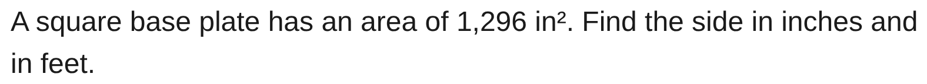
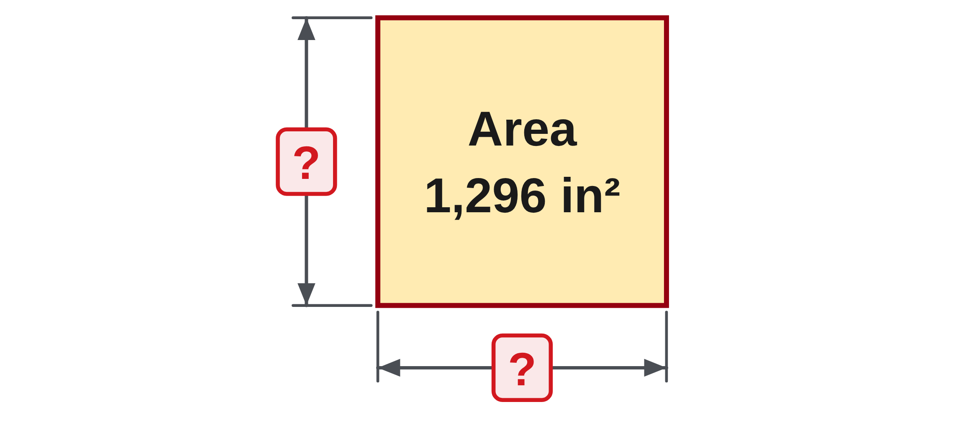
W05-L05 • PRACTISE • 2:55 PM–3:15 PM • 20 MIN TOTAL
Practise from the Exercise Book | 8B Q6
Write the operation, working and units before checking.
Textbook sections 8.6 pp.201–203; sections 8.7 pp.203–204; calculator pp.51–53
Textbook
Exercise Book
Numeracy Hub
Shape Canvas
Day 16 • 2026-11-26 • 17
Notes:
PRACTISE • 2:55 PM–3:15 PM • 20 MIN TOTAL — shared across this phase’s slides.
A square base plate has an area of 1,296 square inches. Find the side first in inches, then convert that length to feet. What operation will recover one equal side from the area? Try it, and verify by multiplication before converting.
Instructor only, after the attempt: s = √1,296 = 36 in. Since 12 in = 1 ft, 36 ÷ 12 = 3 ft. Check: 36 × 36 = 1,296 in². The length conversion uses 12, not 144.

Slide 18
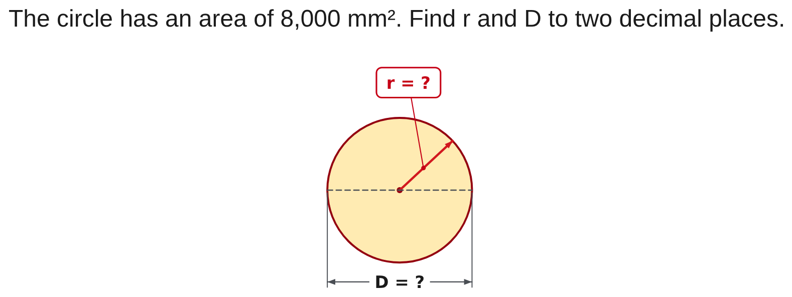
W05-L05 • PRACTISE • 2:55 PM–3:15 PM • 20 MIN TOTAL
Practise from the Exercise Book | 8C Q3
Write the operation, working and units before checking.
Textbook sections 8.6 pp.201–203; sections 8.7 pp.203–204; calculator pp.51–53
Textbook
Exercise Book
Numeracy Hub
Shape Canvas
Day 16 • 2026-11-26 • 18
Notes:
PRACTISE • 2:55 PM–3:15 PM • 20 MIN TOTAL — shared across this phase’s slides.
This circle has an area of 8,000 square millimetres. Use A equals pi r squared. To recover r, undo the multiplication by pi first, then undo the square. Write the entire quotient inside the root. Keep the full calculator value when doubling the radius for the diameter.
Instructor only, after the attempt: r = √(8,000 ÷ π) = 50.46265… mm, so r = 50.46 mm. D = 2r = 100.92530… mm, so D = 100.93 mm. Doubling the rounded radius would lose precision.

Slide 19
W05-L05 • CHECK • 3:15 PM–3:25 PM • 10 MIN TOTAL
Check independently
Exercise Book 8C Q1–2 independently; substitute each answer back.
Solve without displayed answers; include working, units and final rounding.
Resources: Exercise Book 8A Q23–24 (p.78); 8B Q6,13 (pp.79–80); 8C Q1–4 (p.81)
Textbook sections 8.6 pp.201–203; sections 8.7 pp.203–204; calculator pp.51–53
Textbook
Exercise Book
Numeracy Hub
Shape Canvas
Day 16 • 2026-11-26 • 19
Notes:
CHECK • 3:15 PM–3:25 PM • 10 MIN TOTAL — shared across this phase’s slides.
Now complete 8C questions 1 and 2 independently. The goal is to choose the operation without a partner prompting you. For each drawing, identify the given area, write the formula, find the missing dimension, and substitute your answer back. Keep the worked solutions closed until both attempts are complete. What will a successful check look like? Your dimensions multiply to the stated area and your final dimension has a linear unit. I will look at both the answer and the reasoning that connects it to the drawing.

Slide 20

W05-L05 • CHECK • 3:15 PM–3:25 PM • 10 MIN TOTAL
Independent check | 8C Q1
Answer independently. Keep worked solutions closed.
Textbook sections 8.6 pp.201–203; sections 8.7 pp.203–204; calculator pp.51–53
Textbook
Exercise Book
Numeracy Hub
Shape Canvas
Day 16 • 2026-11-26 • 20
Notes:
CHECK • 3:15 PM–3:25 PM • 10 MIN TOTAL — shared across this phase’s slides.
For 8C question 1, use the rectangle’s area of 4,800 square centimetres and the labelled length of 80 centimetres. Find the unknown width on your own. Include a multiplication check so someone else can follow your reasoning.
Instructor only, after the independent attempt: w = A ÷ l = 4,800 ÷ 80 = 60 cm. Check: 80 cm × 60 cm = 4,800 cm². A square root would assume equal sides, which the rectangle does not require.

Slide 21
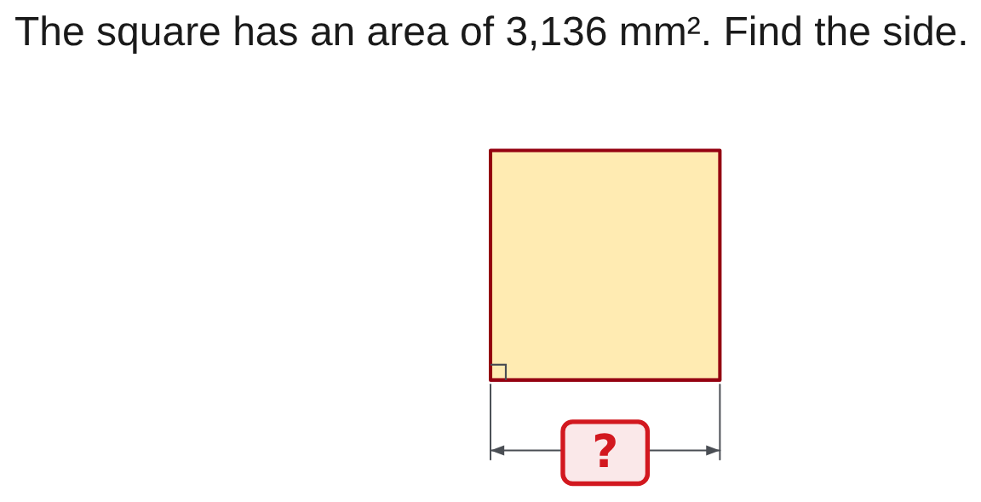
W05-L05 • CHECK • 3:15 PM–3:25 PM • 10 MIN TOTAL
Independent check | 8C Q2
Answer independently. Keep worked solutions closed.
Textbook sections 8.6 pp.201–203; sections 8.7 pp.203–204; calculator pp.51–53
Textbook
Exercise Book
Numeracy Hub
Shape Canvas
Day 16 • 2026-11-26 • 21
Notes:
CHECK • 3:15 PM–3:25 PM • 10 MIN TOTAL — shared across this phase’s slides.
For 8C question 2, find the side of the square whose area is 3,136 square millimetres. Write the inverse operation explicitly and include the final unit. Use a multiplication check after finding the side.
Instructor only, after the independent attempt: s = √3,136 = 56 mm. Check: 56 × 56 = 3,136 mm². Ask, “What tells you that the root is appropriate here?” The equal sides of the square mean the unknown length was multiplied by itself.

Slide 22
W05-L05 • WRAP UP • 3:25 PM–3:30 PM • 5 MIN TOTAL
Wrap up and choose the next step
Ask: What changed in your understanding? Where will you use it? What should you check next time?
Name the math and one other essential skill used; record a next practice step.
Resources: Exercise Book 8A Q23–24 (p.78); 8B Q6,13 (pp.79–80); 8C Q1–4 (p.81)
Textbook sections 8.6 pp.201–203; sections 8.7 pp.203–204; calculator pp.51–53
Textbook
Exercise Book
Numeracy Hub
Shape Canvas
Play quiz
Quiz PDF
Day 16 • 2026-11-26 • 22
Notes:
WRAP UP • 3:25 PM–3:30 PM • 5 MIN TOTAL — shared across this phase’s slides.
Look at your two checked answers. One used division by a known side; the other used a square root. Complete this sentence in your own words: “I choose the inverse operation by looking at …” I am listening for the shape and the original formula. Where might you use this when reading a drawing? Finding a missing panel dimension is one example. Record one thing you will check next time: the formula, the key sequence, or the units. Our next math work uses perimeter, so keep the difference between an area and a boundary length clear.

