Slide 1

CARPENTRY FOUNDATION / INTAKE 142
Day 17 | Friday
17
November 27, 2026
Perimeter, frame lengths and material totals
9:00 AM–10:15 AM • Math • 75 min
Circumference, arcs and perimeter consolidation
10:30 AM–12:00 PM • Math • 90 min
Week 5 • 2 scheduled blocks • 165 teaching minutes
Estimate. Show the method. Label units. Check the result.
Textbook
Exercise Book
Numeracy Hub
Shape Canvas
Day 17 • 2026-11-27 • 01
Notes:
Opening — within the first Start allocation.
Today we will calculate material around straight and curved boundaries. Our first block, 9:00 to 10:15, is about perimeter and frame lengths. After the break, 10:30 to noon, we move to circles and arcs. The practical question is the same: which path does the material follow? We will trace that path before calculating. By the end, you should be able to explain why an internal height line does not belong in a perimeter and why a semicircular boundary may include a straight edge.

Slide 2
DAY 17 / WEEK 5 / CLASS TIMETABLE
Today’s exact schedule
9:00 AM–10:15 AM • 75 min
10:30 AM–12:00 PM • 90 min
Perimeter, frame lengths and material totals
Circumference, arcs and perimeter consolidation
9:00 AM–9:05 AM
Start
5
10:30 AM–10:35 AM
Start
5
9:05 AM–9:10 AM
Recall
5
10:35 AM–10:40 AM
Recall
5
9:10 AM–9:25 AM
Teach
15
10:40 AM–10:55 AM
Teach
15
9:25 AM–9:40 AM
Together
15
10:55 AM–11:10 AM
Together
15
9:40 AM–10:00 AM
Practise
20
11:10 AM–11:45 AM
Practise
35
10:00 AM–10:10 AM
Check
10
11:45 AM–11:55 AM
Check
10
10:10 AM–10:15 AM
Wrap up
5
11:55 AM–12:00 PM
Wrap up
5
Math • Math Week 5, Lesson 6
Math • Math Week 5, Lesson 7
Break: 10:15 AM–10:30 AM • 15 minutes • excluded from teaching time
Textbook
Exercise Book
Numeracy Hub
Shape Canvas
Day 17 • 2026-11-27 • 02
Notes:
Opening — within the first Start allocation.
We have 165 teaching minutes today, with a break from 10:15 to 10:30. In the first block, practice is 9:40 to 10:00 and the independent check follows at 10:00. The second block has a longer practice period, 11:10 to 11:45, so we can compare curved-boundary methods and fix radius or diameter errors. The final check is 11:45 to 11:55. Keep your drawing beside your calculation: the arithmetic must match the actual boundary.

Slide 3
W05-L06 • START • 9:00 AM–9:05 AM • 5 MIN TOTAL
Perimeter, frame lengths and material totals
Today’s goal: Calculate a straight-sided perimeter and identify missing dimensions without counting internal lines.
Describe a prior use of the skill; identify the given and unknown quantities.
Textbook sections 9.1 pp.220–221; sections 9.6 pp.228–229
Exercise Book 9A Q1–8 (p.85); 9B Q1 (p.87); 9C Q1–2 (p.89)
Keep your notebook, textbook, exercise book and chosen calculator ready.
Textbook sections 9.1 pp.220–221; sections 9.6 pp.228–229
Textbook
Exercise Book
Numeracy Hub
Shape Canvas
Day 17 • 2026-11-27 • 03
Notes:
START • 9:00 AM–9:05 AM • 5 MIN TOTAL — shared across this phase’s slides.
Suppose you need material for the outside of a frame. The amount follows the edges, not the surface inside. Today we will find straight-sided perimeters, including drawings with a missing dimension. What would we measure for the frame: a length or an area? A length. Our answer might be millimetres or feet and inches, depending on the drawing. Open the exercise book to chapter 9 and keep a pencil ready to mark each boundary segment before adding it.

Slide 4
W05-L06 • RECALL • 9:05 AM–9:10 AM • 5 MIN TOTAL
Recall and reconnect
Try to trace the outside of a sketch; contrast perimeter with area.
Attempt the retrieval task independently; explain the method before checking.
Resources: Exercise Book 9A Q1–8 (p.85); 9B Q1 (p.87); 9C Q1–2 (p.89)
Textbook sections 9.1 pp.220–221; sections 9.6 pp.228–229
Textbook
Exercise Book
Numeracy Hub
Shape Canvas
Day 17 • 2026-11-27 • 04
Notes:
RECALL • 9:05 AM–9:10 AM • 5 MIN TOTAL — shared across this phase’s slides.
Use your finger or pencil to trace the outside of the sketch. Start at a corner and finish at that same corner. That complete trip is the perimeter. Now point inside the shape: covering this region would be an area problem. How would the units differ? Perimeter uses a length unit; area uses a square unit. If your traced path crosses the middle of the shape, stop and check whether you have followed an internal measuring line rather than the boundary.

Slide 5
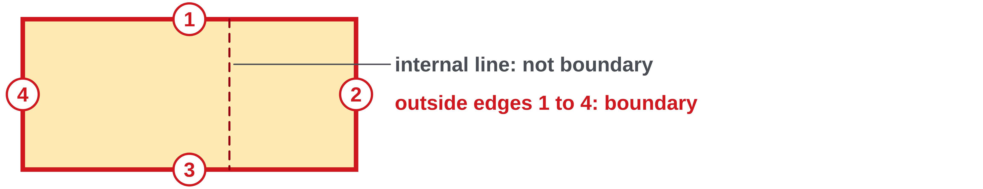
W05-L06 • TEACH • 9:10 AM–9:25 AM • 15 MIN TOTAL
Trace the outside boundary
1
Perimeter is the total length around the outside of a shape.
2
Mark each boundary segment once before adding lengths.
3
An internal line or dashed height is not part of the boundary.
4
Use one length unit throughout and report a linear unit.
Textbook sections 9.1 pp.220–221; sections 9.6 pp.228–229
Textbook
Exercise Book
Numeracy Hub
Shape Canvas
Day 17 • 2026-11-27 • 05
Notes:
TEACH • 9:10 AM–9:25 AM • 15 MIN TOTAL — shared across this phase’s slides.
Perimeter is the total length of the outside boundary. We can make the method visible by marking each edge as we count it. On a rectangle, travel along the length, the width, the second length and the second width. A dashed height inside a triangle helps with area, but it is not an extra outside edge. Why must we convert mixed units before adding? Otherwise the numbers represent different-sized units and cannot be added directly. The final unit remains a length because we added lengths; we did not multiply one direction by another.

Slide 6
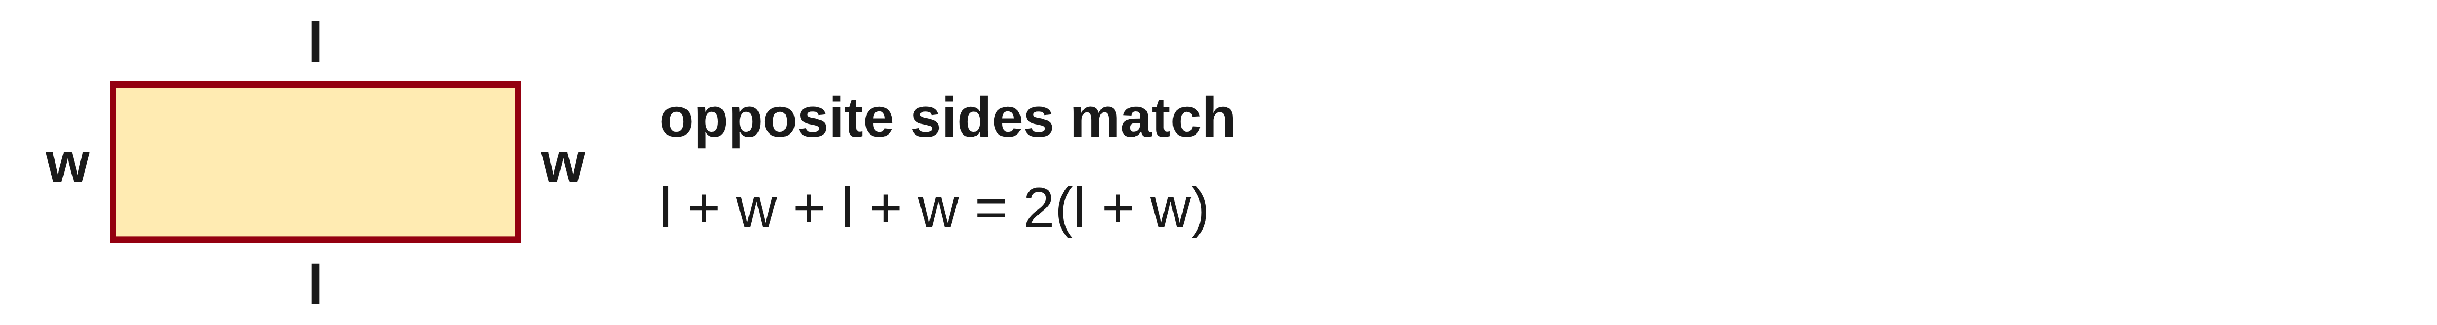
W05-L06 • TEACH • 9:10 AM–9:25 AM • 15 MIN TOTAL
Find missing sides before adding
1
For a rectangle, opposite sides match.
2
Use P = 2(l + w) or add all four sides as a check.
3
Convert mixed feet and inches to one unit before calculating.
4
For other shapes, use only side relationships supported by the drawing.
Textbook sections 9.1 pp.220–221; sections 9.6 pp.228–229
Textbook
Exercise Book
Numeracy Hub
Shape Canvas
Day 17 • 2026-11-27 • 06
Notes:
TEACH • 9:10 AM–9:25 AM • 15 MIN TOTAL — shared across this phase’s slides.
A rectangle has two equal lengths and two equal widths, so adding all four edges gives l plus w plus l plus w. Grouping the repeated pair gives P equals 2 times the quantity l plus w. Those brackets matter: both the length and the width are doubled. What if the question gives feet and inches? Convert each dimension to one unit before combining them. For other shapes, use only relationships shown or justified by the drawing. A line that looks equal to another on the screen is not enough evidence to assign it the same length.

Slide 7
W05-L06 • TEACH • 9:10 AM–9:25 AM • 15 MIN TOTAL
Trace the boundary before calculating
2 ft 6 in = 30 in
P = 2(30 + 21)
= 102 in
= 8 ft 6 in
1 ft 9 in
= 21 in
Check by adding:
30 + 21 + 30 + 21 = 102 in.
Together • 9A Q1,6–8 and 9C Q2.
Mark each boundary segment used. Compare addition with a formula.
Shape Canvas: rectangle and triangle; distinguish edges from height lines.
Textbook pp.220–221 • Exercise Book 9B Q1 p.87 • Diagram is schematic; read labels, not screen size
Textbook
Exercise Book
Numeracy Hub
Shape Canvas
Day 17 • 2026-11-27 • 07
Notes:
TEACH • 9:10 AM–9:25 AM • 15 MIN TOTAL — shared across this phase’s slides.
The frame is 2 feet 6 inches by 1 foot 9 inches. Convert first: 2 times 12 plus 6 is 30 inches; 1 times 12 plus 9 is 21 inches. Now the perimeter is 2 times 30 plus 21 inside brackets: 2 times 51 equals 102 inches. Check by walking all four edges: 30, 21, 30, 21. To express 102 inches in feet and inches, eight feet uses 96 inches, leaving six. The answer is 8 feet 6 inches. What mistake would result from doubling only 30? We would count just one of the widths.

Slide 8
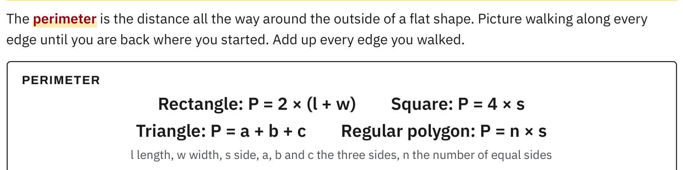
W05-L06 • TEACH • 9:10 AM–9:25 AM • 15 MIN TOTAL
Textbook | pages 220–221
Textbook pp.220–221 • Perimeter — Outside boundary and formulas
Textbook sections 9.1 pp.220–221; sections 9.6 pp.228–229
Textbook
Exercise Book
Numeracy Hub
Shape Canvas
Day 17 • 2026-11-27 • 08
Notes:
TEACH • 9:10 AM–9:25 AM • 15 MIN TOTAL — shared across this phase’s slides.
On pages 220–221, the textbook turns the boundary walk into several formulas. A rectangle has two pairs of matching edges, so P equals 2 times l plus w in brackets. A square has four equal edges, giving 4s. A triangle needs the sum of its three sides. Which formula would you use for a triangle with unequal sides? Add all three labelled sides. A formula is a short way to record a boundary sum. If you cannot connect each term to an edge in the drawing, return to tracing the outside first.

Slide 9
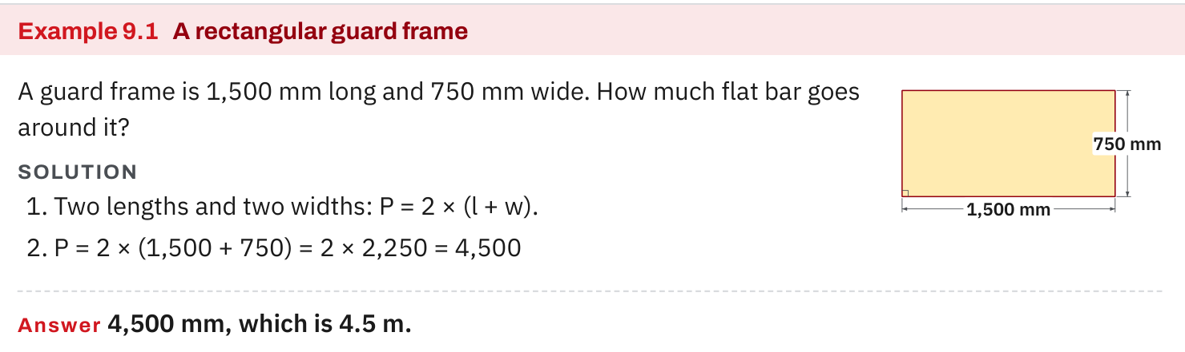
W05-L06 • TEACH • 9:10 AM–9:25 AM • 15 MIN TOTAL
Textbook | page 220
Textbook p.220 • Example 9.1 — A rectangular guard frame
Textbook sections 9.1 pp.220–221; sections 9.6 pp.228–229
Textbook
Exercise Book
Numeracy Hub
Shape Canvas
Day 17 • 2026-11-27 • 09
Notes:
TEACH • 9:10 AM–9:25 AM • 15 MIN TOTAL — shared across this phase’s slides.
The rectangular guard frame in Example 9.1 is 1,500 millimetres long and 750 millimetres wide. One length plus one width is 2,250 millimetres. There are two of those pairs, so the total is 4,500 millimetres, or 4.5 metres. What would 1,500 times 750 calculate? Area, which is a different requirement. We need flat bar around the frame, so adding boundary lengths is appropriate. Check by naming all four edges: 1,500, 750, 1,500 and 750. Both methods should produce the same material length.

Slide 10
W05-L06 • TEACH • 9:10 AM–9:25 AM • 15 MIN TOTAL
Spot the mistake. Explain the correction.
A triangle shows a dashed height. Should it be added to the three sides for perimeter?
Discuss the method before checking the answer.
No. The height is an internal measuring line; trace and total the three outside edges.
Textbook sections 9.1 pp.220–221; sections 9.6 pp.228–229
Textbook
Exercise Book
Numeracy Hub
Shape Canvas
Day 17 • 2026-11-27 • 10
Notes:
TEACH • 9:10 AM–9:25 AM • 15 MIN TOTAL — shared across this phase’s slides.
Look at the dashed height in the triangle. Should it be included with the three sides? Trace the perimeter with your finger before answering. The path stays on the outside and never travels down the internal height line. That height is useful information for an area calculation, but it is not another edge of the frame. Ask your partner to explain the correction using the picture, not only the words “do not add it.” A strong explanation identifies the three outside sides and shows exactly where the dashed line lies.

Slide 11
W05-L06 • TOGETHER • 9:25 AM–9:40 AM • 15 MIN TOTAL
Work together
Work Exercise Book 9A Q1,6–8 and Exercise Book 9C Q2. Mark every boundary segment used.
Work in pairs, alternating solver and checker. Write a diagram, formula, units and estimate.
Resources: Exercise Book 9A Q1–8 (p.85); 9B Q1 (p.87); 9C Q1–2 (p.89)
Textbook sections 9.1 pp.220–221; sections 9.6 pp.228–229
Textbook
Exercise Book
Numeracy Hub
Shape Canvas
Day 17 • 2026-11-27 • 11
Notes:
TOGETHER • 9:25 AM–9:40 AM • 15 MIN TOTAL — shared across this phase’s slides.
Work through 9A questions 1 and 6 to 8, then 9C question 2. On every drawing, mark the boundary segments you use. One partner explains the route around the shape while the other follows the calculation. If a length is missing, establish it before finding the total. How will you test a rectangle perimeter formula? Add all four sides separately. If the answers disagree, check for an uncounted edge, a repeated edge, a missing pair of brackets, or a unit that was not converted.

Slide 12
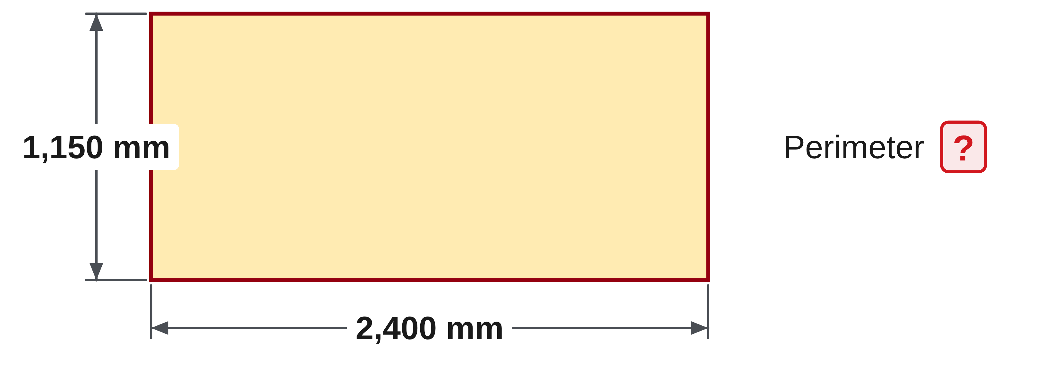
W05-L06 • TOGETHER • 9:25 AM–9:40 AM • 15 MIN TOTAL
Guided practice | 9A Q1
Work with a partner. Take turns explaining the next step.
Textbook sections 9.1 pp.220–221; sections 9.6 pp.228–229
Textbook
Exercise Book
Numeracy Hub
Shape Canvas
Day 17 • 2026-11-27 • 12
Notes:
TOGETHER • 9:25 AM–9:40 AM • 15 MIN TOTAL — shared across this phase’s slides.
For 9A question 1, the rectangle measures 2,400 millimetres by 1,150 millimetres. Trace the four edges, then write either their sum or the rectangle perimeter formula. Predict whether the total is nearer 3,500 or 7,000 millimetres before calculating.
Instructor only, after the attempt: P = 2(2,400 + 1,150) = 2 × 3,550 = 7,100 mm. The estimate should be near 7,000 because there are two lengths and two widths.

Slide 13
W05-L06 • TOGETHER • 9:25 AM–9:40 AM • 15 MIN TOTAL
Compare your method | 9A Q1
CHECK TOGETHER
7,100 mm
Textbook sections 9.1 pp.220–221; sections 9.6 pp.228–229
Textbook
Exercise Book
Numeracy Hub
Shape Canvas
Day 17 • 2026-11-27 • 13
Notes:
TOGETHER • 9:25 AM–9:40 AM • 15 MIN TOTAL — shared across this phase’s slides.
The perimeter is 7,100 millimetres. Our bracketed pair is 2,400 plus 1,150, which equals 3,550; doubling gives 7,100. Now check by adding 2,400 plus 1,150 plus 2,400 plus 1,150. Why would 3,550 be incomplete? It includes only half of the boundary. Why is the answer not square millimetres? We are adding lengths around the outside. Compare your method with your partner’s, and make sure each term has a matching edge on the drawing.

Slide 14
W05-L06 • PRACTISE • 9:40 AM–10:00 AM • 20 MIN TOTAL
Your scheduled practice
Complete Exercise Book 9A Q2–5, 9B Q1 and 9C Q1. Create a dimensioned frame on Shape Canvas; calculate by both addition and formula.
Solve on paper first; check with tools; correct one error and explain the change.
Resources: Exercise Book 9A Q1–8 (p.85); 9B Q1 (p.87); 9C Q1–2 (p.89)
Textbook sections 9.1 pp.220–221; sections 9.6 pp.228–229
Textbook
Exercise Book
Numeracy Hub
Shape Canvas
Day 17 • 2026-11-27 • 14
Notes:
PRACTISE • 9:40 AM–10:00 AM • 20 MIN TOTAL — shared across this phase’s slides.
Complete 9A questions 2 to 5, 9B question 1 and 9C question 1. These move from known sides to mixed units and a missing dimension. On Shape Canvas, create a dimensioned frame and calculate its perimeter both by adding the edges and by using the formula. If the two methods disagree, check the equation before checking the calculator. Keep the exercise book question labels on your page so you can return to the exact example that needs another look.

Slide 15
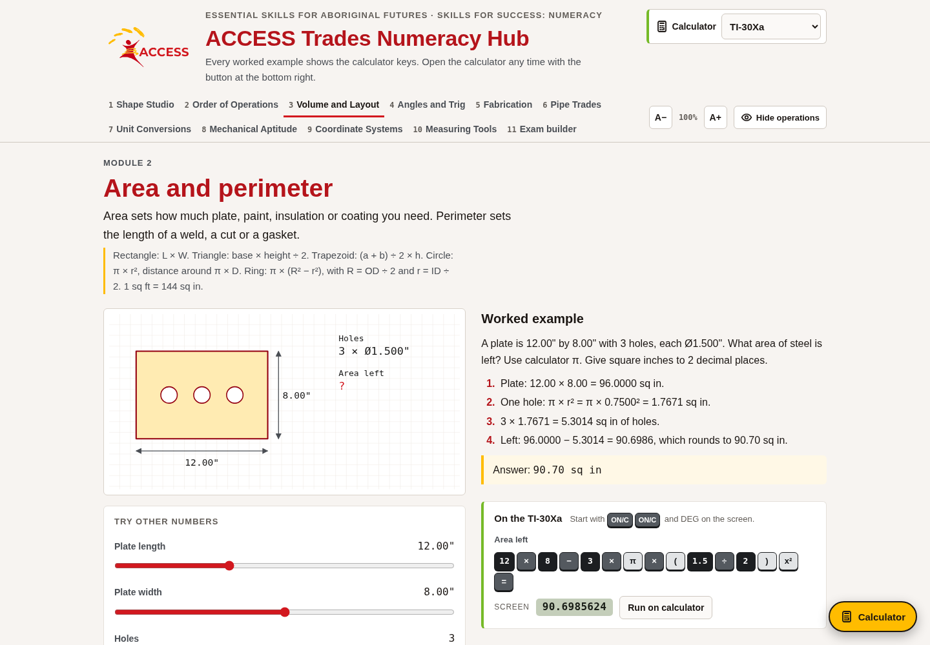
W05-L06 • PRACTISE • 9:40 AM–10:00 AM • 20 MIN TOTAL
Open Numeracy Hub
Navigation example. Use the values and units in the assigned task.
Textbook sections 9.1 pp.220–221; sections 9.6 pp.228–229
Textbook
Exercise Book
Numeracy Hub
Shape Canvas
Day 17 • 2026-11-27 • 15
Notes:
PRACTISE • 9:40 AM–10:00 AM • 20 MIN TOTAL — shared across this phase’s slides.
Open Numeracy Hub and go to Volume and Layout, then Area and perimeter. Read the problem carefully: the same drawing can support an area question or a perimeter question. For our frame task, choose the distance around the boundary. What unit should you expect in the answer? A linear unit such as millimetres. Make your paper attempt before checking the result. Use the feedback to locate the step that needs attention, especially whether both pairs of rectangle sides have been included.

Slide 16
W05-L06 • PRACTISE • 9:40 AM–10:00 AM • 20 MIN TOTAL
Practise in Numeracy Hub and Shape Canvas
1
Use Shape Canvas to inspect a rectangle and triangle; trace only their outside edges.
2
Create the assigned frame and calculate its perimeter by addition and formula.
3
Check the method in Numeracy Hub Volume and Layout → Area and perimeter.
Textbook sections 9.1 pp.220–221; sections 9.6 pp.228–229
Textbook
Exercise Book
Numeracy Hub
Shape Canvas
Day 17 • 2026-11-27 • 16
Notes:
PRACTISE • 9:40 AM–10:00 AM • 20 MIN TOTAL — shared across this phase’s slides.
Use Shape Canvas to inspect a rectangle and a triangle. Trace their outside edges and point out any height or construction lines that should not be counted. Then create the assigned frame and write two matching calculations: the sum of the edges and the appropriate perimeter formula. Use Numeracy Hub’s Area and perimeter work to check your reasoning. What should the two calculations show? The same total length. If one answer has a squared unit, you have changed the question from boundary length to area.

Slide 17
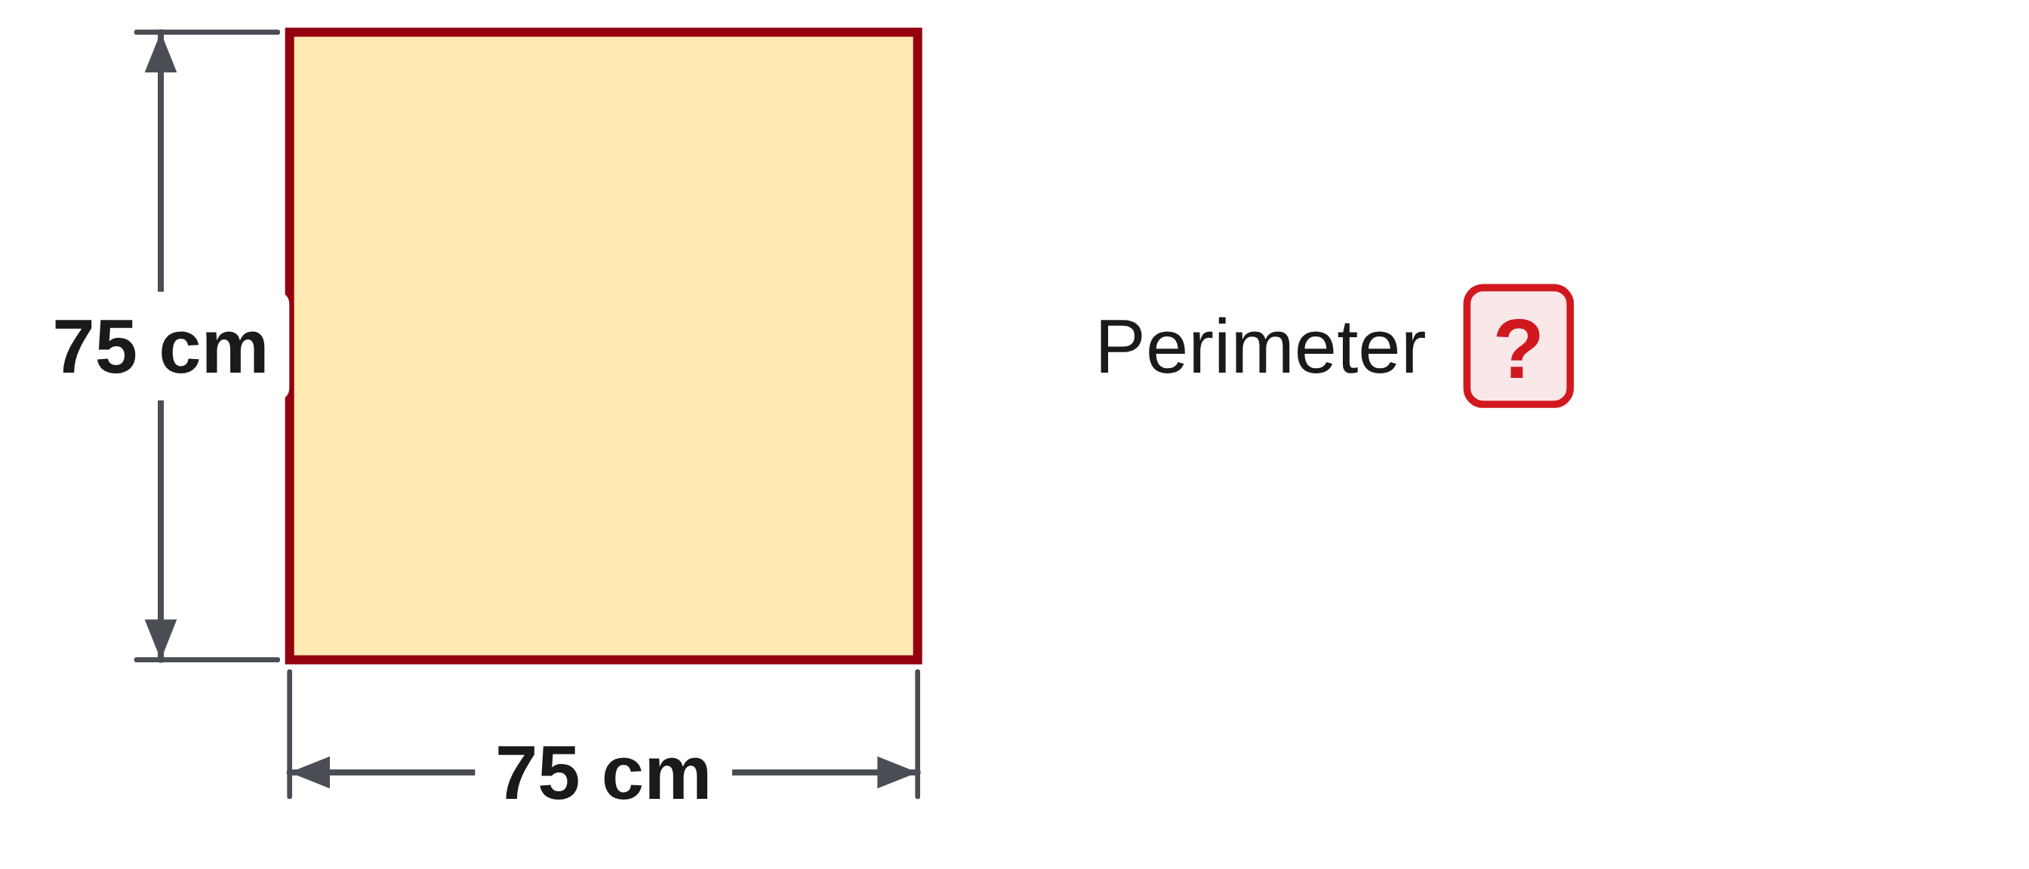
W05-L06 • PRACTISE • 9:40 AM–10:00 AM • 20 MIN TOTAL
Practise from the Exercise Book | 9A Q2
Write the operation, working and units before checking.
Textbook sections 9.1 pp.220–221; sections 9.6 pp.228–229
Textbook
Exercise Book
Numeracy Hub
Shape Canvas
Day 17 • 2026-11-27 • 17
Notes:
PRACTISE • 9:40 AM–10:00 AM • 20 MIN TOTAL — shared across this phase’s slides.
Question 9A 2 gives a square with 75 centimetre sides. Find the length all the way around it. Explain what the multiplier in your formula represents, and give a length unit.
Instructor only, after the attempt: P = 4 × 75 = 300 cm. The four represents the four equal outside edges. Adding 75 four times is an equally valid check. Squaring 75 would calculate area, which is not asked for here.

Slide 18
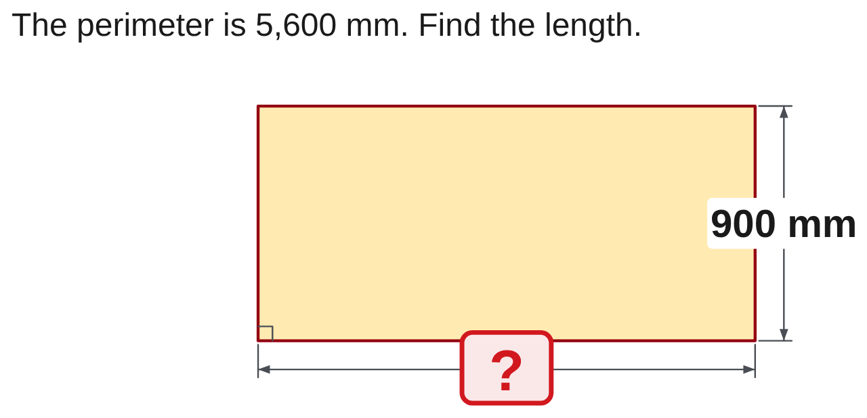
W05-L06 • PRACTISE • 9:40 AM–10:00 AM • 20 MIN TOTAL
Practise from the Exercise Book | 9C Q1
Write the operation, working and units before checking.
Textbook sections 9.1 pp.220–221; sections 9.6 pp.228–229
Textbook
Exercise Book
Numeracy Hub
Shape Canvas
Day 17 • 2026-11-27 • 18
Notes:
PRACTISE • 9:40 AM–10:00 AM • 20 MIN TOTAL — shared across this phase’s slides.
In 9C question 1, the perimeter is 5,600 millimetres and the labelled width is 900 millimetres. Find the missing length. Remember that the total perimeter contains two lengths and two widths. Try an equation before entering the calculator.
Instructor only, after the attempt: l = P ÷ 2 − w = 5,600 ÷ 2 − 900 = 1,900 mm. Check: 2(1,900 + 900) = 5,600 mm. Subtracting only one width from the entire perimeter would leave three edges, not one length.

Slide 19
W05-L06 • CHECK • 10:00 AM–10:10 AM • 10 MIN TOTAL
Check independently
Exercise Book 9A Q8 and 9B Q1; explain the units and show the boundary calculation.
Solve without displayed answers; include working, units and final rounding.
Resources: Exercise Book 9A Q1–8 (p.85); 9B Q1 (p.87); 9C Q1–2 (p.89)
Textbook sections 9.1 pp.220–221; sections 9.6 pp.228–229
Textbook
Exercise Book
Numeracy Hub
Shape Canvas
Day 17 • 2026-11-27 • 19
Notes:
CHECK • 10:00 AM–10:10 AM • 10 MIN TOTAL — shared across this phase’s slides.
Complete 9A question 8 and 9B question 1 independently. In the first, show how you recover a missing width from the total perimeter. In the second, show your feet-and-inches conversion before adding the boundary. Keep the worked solutions closed while you attempt both. What evidence should another reader see? A complete boundary calculation with consistent units, followed by the requested final unit. A correct number without that reasoning does not tell us whether the method will work on the next drawing.

Slide 20
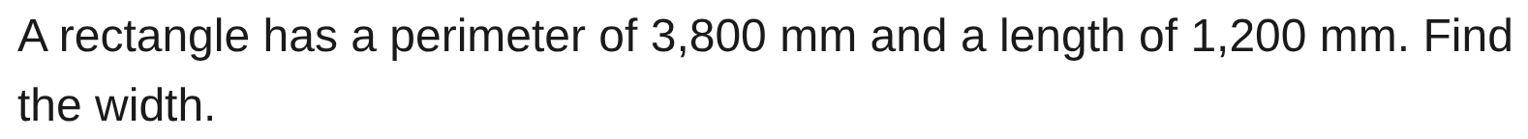
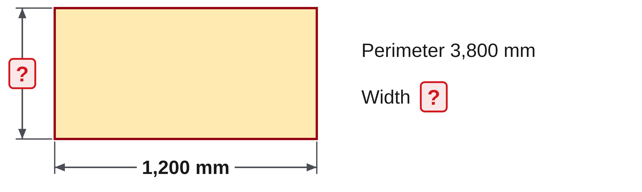
W05-L06 • CHECK • 10:00 AM–10:10 AM • 10 MIN TOTAL
Independent check | 9A Q8
Answer independently. Keep worked solutions closed.
Textbook sections 9.1 pp.220–221; sections 9.6 pp.228–229
Textbook
Exercise Book
Numeracy Hub
Shape Canvas
Day 17 • 2026-11-27 • 20
Notes:
CHECK • 10:00 AM–10:10 AM • 10 MIN TOTAL — shared across this phase’s slides.
A rectangle has perimeter 3,800 millimetres and length 1,200 millimetres. Find its width independently. Include a check using the full perimeter equation.
Instructor only, after the independent attempt: w = 3,800 ÷ 2 − 1,200 = 1,900 − 1,200 = 700 mm. Check: 2(1,200 + 700) = 3,800 mm. Ask what halving the perimeter gives: one length plus one width, not the width by itself.

Slide 21
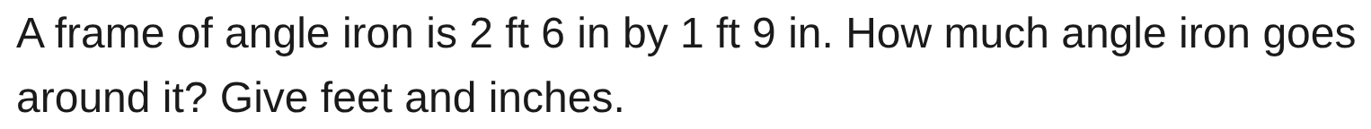
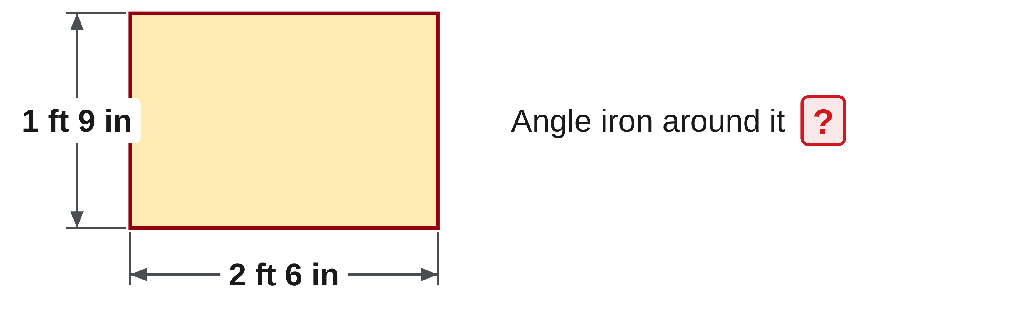
W05-L06 • CHECK • 10:00 AM–10:10 AM • 10 MIN TOTAL
Independent check | 9B Q1
Answer independently. Keep worked solutions closed.
Textbook sections 9.1 pp.220–221; sections 9.6 pp.228–229
Textbook
Exercise Book
Numeracy Hub
Shape Canvas
Day 17 • 2026-11-27 • 21
Notes:
CHECK • 10:00 AM–10:10 AM • 10 MIN TOTAL — shared across this phase’s slides.
Find the angle-iron length around a frame measuring 2 feet 6 inches by 1 foot 9 inches. Work in one unit first, then report the answer in feet and inches. Show all four edges in your calculation or drawing.
Instructor only, after the independent attempt: the dimensions are 30 in and 21 in. P = 2(30 + 21) = 102 in. Since 102 = 8 × 12 + 6, the answer is 8 ft 6 in.

Slide 22
W05-L06 • WRAP UP • 10:10 AM–10:15 AM • 5 MIN TOTAL
Wrap up and choose the next step
Ask: What changed in your understanding? Where will you use it? What should you check next time?
Name the math and one other essential skill used; record a next practice step.
Resources: Exercise Book 9A Q1–8 (p.85); 9B Q1 (p.87); 9C Q1–2 (p.89)
Textbook sections 9.1 pp.220–221; sections 9.6 pp.228–229
Textbook
Exercise Book
Numeracy Hub
Shape Canvas
Play quiz
Quiz PDF
Day 17 • 2026-11-27 • 22
Notes:
WRAP UP • 10:10 AM–10:15 AM • 5 MIN TOTAL — shared across this phase’s slides.
Choose one of your boundary calculations and explain why every number belongs in it. Did you use an internal line by mistake, miss a repeated edge, or have to correct a unit? Record that correction with a short reason. What is the essential difference between perimeter and area? Perimeter measures the outside length; area measures coverage. After the break we will keep tracing the outside, but some of those boundaries will be curved. The meaning of perimeter will stay the same even though the formula changes.

Slide 23
DAY 17 • SCHEDULED BREAK
Break
10:15 AM–10:30 AM
Return ready for: Circumference, arcs and perimeter consolidation
This break is excluded from teaching minutes.
Textbook
Exercise Book
Numeracy Hub
Shape Canvas
Day 17 • 2026-11-27 • 23
Notes:
Scheduled break — no teaching time.
We are taking our scheduled break from 10:15 to 10:30. Leave your perimeter work where you can find it when we return. Our next block is circumference and arcs, so we will use the same habit of tracing the required path before calculating. We will resume at 10:30.

Slide 24
W05-L07 • START • 10:30 AM–10:35 AM • 5 MIN TOTAL
Circumference, arcs and perimeter consolidation
Today’s goal: Find circumference or an arc length and combine curved and straight boundary segments.
Describe a prior use of the skill; identify the given and unknown quantities.
Textbook sections 9.2–9.6 pp.222–229
Exercise Book 9A Q9–17 (p.86), selected; 9B Q2,8 (p.87); 9C Q3–5 (pp.89–90)
Keep your notebook, textbook, exercise book and chosen calculator ready.
Textbook sections 9.2–9.6 pp.222–229
Textbook
Exercise Book
Numeracy Hub
Shape Canvas
Day 17 • 2026-11-27 • 24
Notes:
START • 10:30 AM–10:35 AM • 5 MIN TOTAL — shared across this phase’s slides.
Now we move from straight edges to circular ones. Imagine a band wrapped once around a tank or a rail following only part of a circle. Both need a length, but they do not necessarily need the same fraction of the boundary. Today we will identify the radius, diameter and arc fraction before calculating. What is the first drawing question to ask? Which path does the material actually follow? That question tells us whether we need a whole circumference, an arc, or curved and straight pieces together.

Slide 25
W05-L07 • RECALL • 10:35 AM–10:40 AM • 5 MIN TOTAL
Recall and reconnect
Try to label r and D on a circle and explain their relationship.
Attempt the retrieval task independently; explain the method before checking.
Resources: Exercise Book 9A Q9–17 (p.86), selected; 9B Q2,8 (p.87); 9C Q3–5 (pp.89–90)
Textbook sections 9.2–9.6 pp.222–229
Textbook
Exercise Book
Numeracy Hub
Shape Canvas
Day 17 • 2026-11-27 • 25
Notes:
RECALL • 10:35 AM–10:40 AM • 5 MIN TOTAL — shared across this phase’s slides.
Sketch a circle and mark its centre. Draw a radius from the centre to the edge. Now draw a diameter across the circle through the centre. How many radii fit along that diameter? Two, so D equals 2r. If the radius doubles, what happens to the diameter? It doubles too. Keep those labels visible because a common circumference error is putting a radius into a formula that expects a diameter. We will choose the formula only after identifying which measurement the drawing supplies.

Slide 26
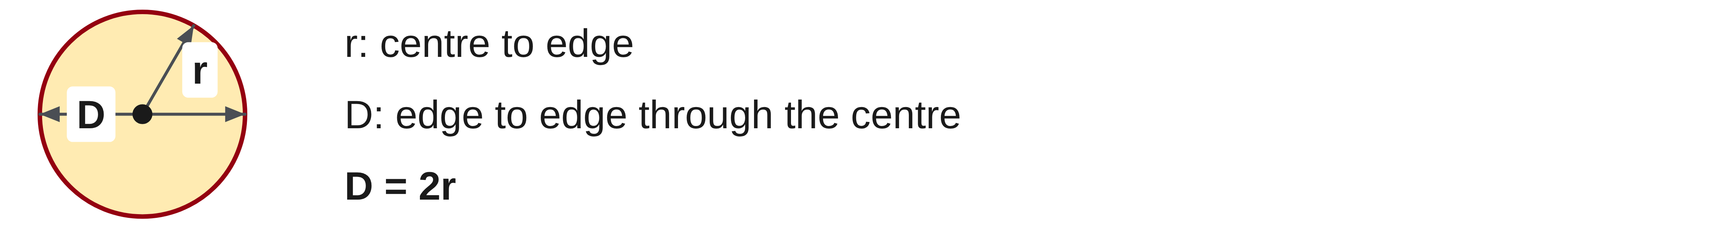
W05-L07 • TEACH • 10:40 AM–10:55 AM • 15 MIN TOTAL
Distinguish radius from diameter
1
Radius runs from the centre to the circle; diameter runs across through the centre.
2
D = 2r, so C = πD and C = 2πr describe the same circumference.
3
Use the π key and retain precision until the final answer.
4
Circumference is a length, so it uses a linear unit.
Textbook sections 9.2–9.6 pp.222–229
Textbook
Exercise Book
Numeracy Hub
Shape Canvas
Day 17 • 2026-11-27 • 26
Notes:
TEACH • 10:40 AM–10:55 AM • 15 MIN TOTAL — shared across this phase’s slides.
Radius and diameter are related, but they are not interchangeable. The diameter is twice the radius. Circumference equals pi times diameter, or equivalently two times pi times radius. Both expressions describe the same trip around the circle. If the drawing supplies a radius, either double it to get the diameter or use 2πr directly. Why use the pi key rather than typing 3.14? The key retains more precision, and small errors grow with the size of the circle. Keep that precision until the final rounding, then report a linear unit.

Slide 27
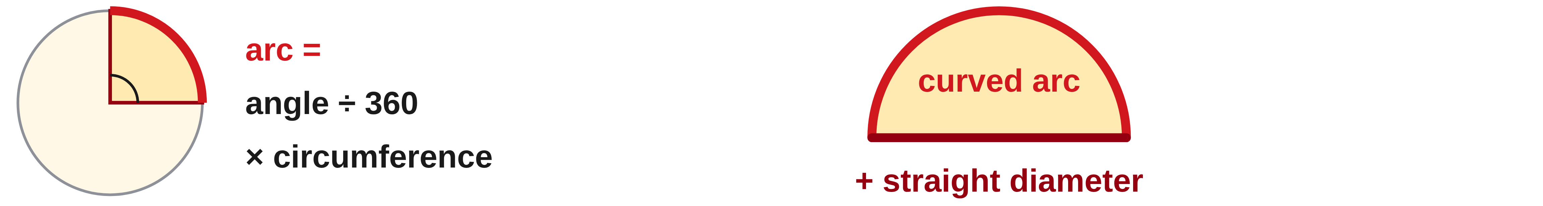
W05-L07 • TEACH • 10:40 AM–10:55 AM • 15 MIN TOTAL
Combine curved and straight boundaries
1
A full circumference represents 360°.
2
Arc length = angle/360 × full circumference.
3
Add the straight boundary segments shown in the problem.
4
Draw the complete boundary first so no required edge is omitted or counted twice.
Textbook sections 9.2–9.6 pp.222–229
Textbook
Exercise Book
Numeracy Hub
Shape Canvas
Day 17 • 2026-11-27 • 27
Notes:
TEACH • 10:40 AM–10:55 AM • 15 MIN TOTAL — shared across this phase’s slides.
A full circle is 360 degrees. An arc takes a fraction of that full circumference, so divide the arc angle by 360 before multiplying by πD. A 90-degree arc uses one quarter; a 180-degree arc uses one half. But an arc length may not be the entire perimeter of the shape. If a semicircle is closed by its diameter, that straight edge also belongs to the boundary. Which formula term accounts for it? An added D. Trace the complete requested path before deciding whether any straight pieces must be included.

Slide 28
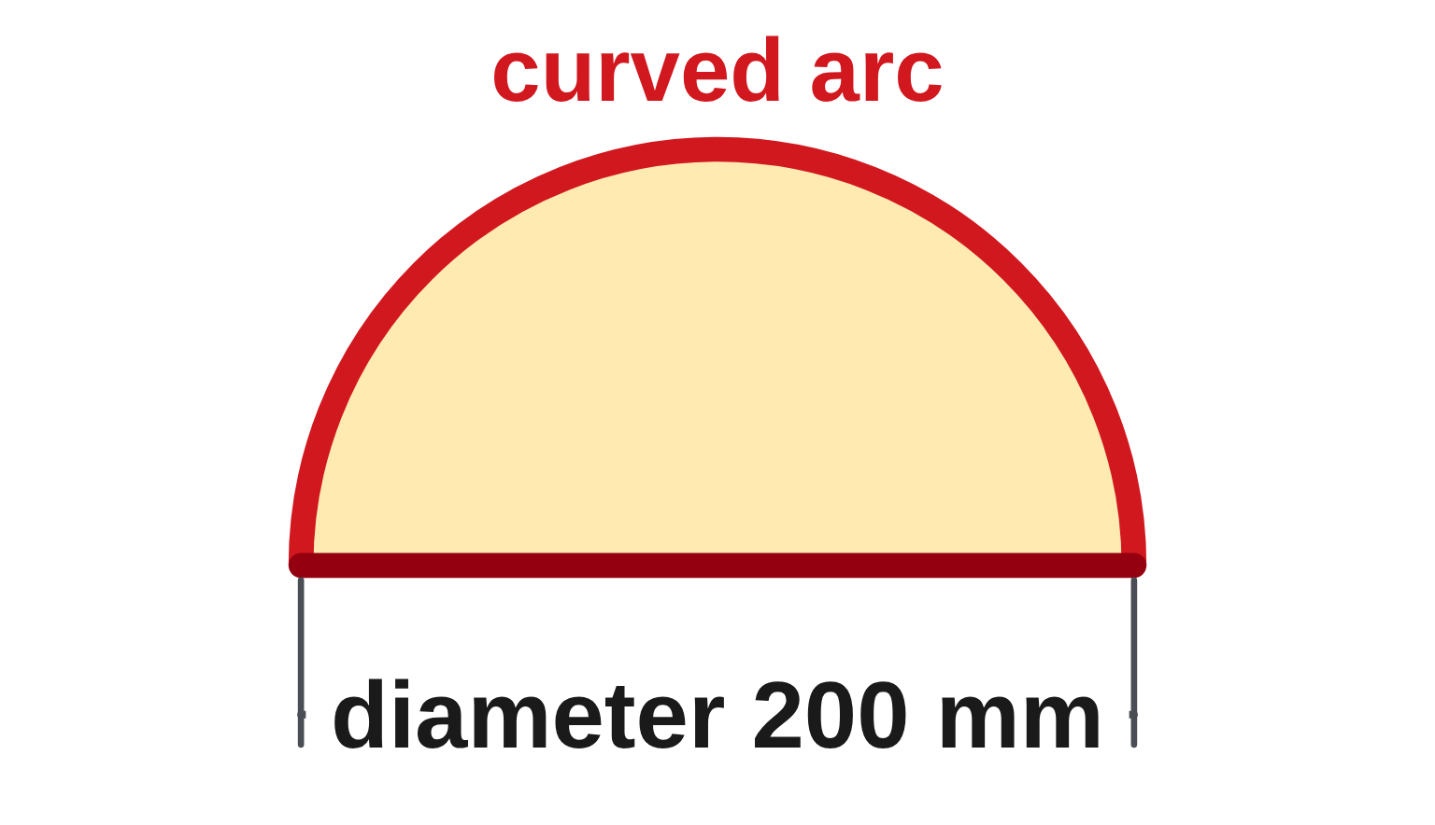
W05-L07 • TEACH • 10:40 AM–10:55 AM • 15 MIN TOTAL
An arc is not always the whole perimeter
Classroom example • A circle has diameter 200 mm.
C = π × 200 ≈ 628.32 mm.
90° arc = ¼ × 200π ≈ 157.08 mm
Semicircular arc = ½ × 200π ≈ 314.16 mm
Semicircle perimeter = 100π + 200 ≈ 514.16 mm
Why the difference? The semicircle’s complete boundary includes
the diameter. The curved arc alone does not.
Together • Work 9A Q11–13,15. Sketch before calculating.
Shape Canvas: change a circle’s radius and predict its circumference.
Classroom example, not a reproduction of an unseen book question • Numeracy Hub: Area and perimeter, Easy
Textbook
Exercise Book
Numeracy Hub
Shape Canvas
Day 17 • 2026-11-27 • 28
Notes:
TEACH • 10:40 AM–10:55 AM • 15 MIN TOTAL — shared across this phase’s slides.
This circle has diameter 200 millimetres. Its circumference is 200π, about 628.32 millimetres. A 90-degree arc is one quarter of that: about 157.08 millimetres. The semicircular arc is half, about 314.16 millimetres. Now look at a complete semicircle shape: the boundary returns along the straight diameter. Adding 200 gives about 514.16 millimetres. Why are the last two answers different? One describes only the curve, while the other includes the straight closing edge. The word “perimeter” requires us to identify the entire outside path.

Slide 29
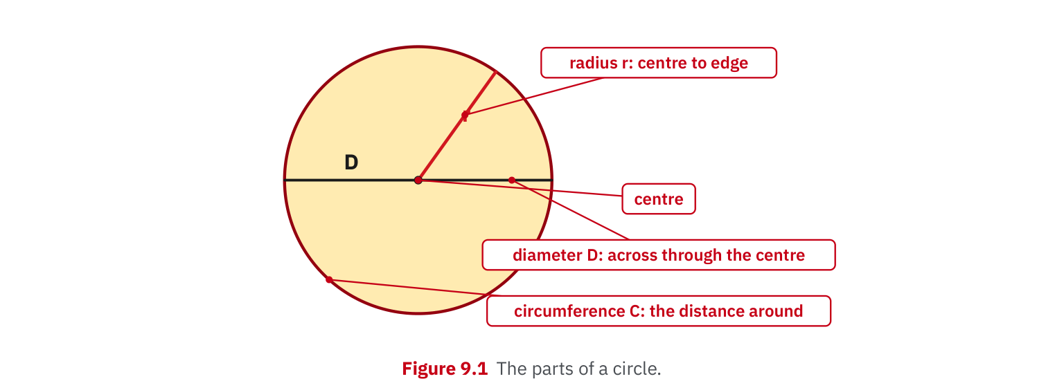
W05-L07 • TEACH • 10:40 AM–10:55 AM • 15 MIN TOTAL
Textbook | page 222
Textbook p.222 • Figure 9.1 — Radius, diameter and circumference
Textbook sections 9.2–9.6 pp.222–229
Textbook
Exercise Book
Numeracy Hub
Shape Canvas
Day 17 • 2026-11-27 • 29
Notes:
TEACH • 10:40 AM–10:55 AM • 15 MIN TOTAL — shared across this phase’s slides.
Figure 9.1 on page 222 separates the three measurements visually. The radius goes from centre to edge; the diameter crosses through the centre; the circumference goes around. Imagine wrapping a string around the circle and laying it beside the diameter. It is a little more than three diameters long: that ratio is pi. Which is longer, circumference or diameter? Circumference, about 3.14 times as long. That estimate is useful before calculation. If your circumference is smaller than the diameter, stop and check the formula or the values you entered.

Slide 30
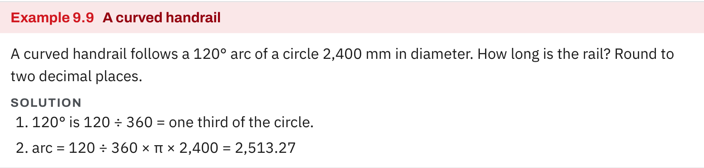
W05-L07 • TEACH • 10:40 AM–10:55 AM • 15 MIN TOTAL
Textbook | page 227
Textbook p.227 • Example 9.9 — A curved handrail as a fraction of a circumference
Textbook sections 9.2–9.6 pp.222–229
Textbook
Exercise Book
Numeracy Hub
Shape Canvas
Day 17 • 2026-11-27 • 30
Notes:
TEACH • 10:40 AM–10:55 AM • 15 MIN TOTAL — shared across this phase’s slides.
Example 9.9 on page 227 is a curved handrail following a 120-degree arc of a circle 2,400 millimetres in diameter. First find the fraction: 120 divided by 360 is one third. The rail length is one third times π times 2,400, giving 2,513.27 millimetres to two decimals. Why do we not add the diameter here? The requested rail follows the curved arc only; it does not close the shape with a straight bar. The physical path in the question determines which lengths belong in the calculation.

Slide 31
W05-L07 • TEACH • 10:40 AM–10:55 AM • 15 MIN TOTAL
Spot the mistake. Explain the correction.
A semicircle’s perimeter is entered as half its circumference. What boundary is missing?
Discuss the method before checking the answer.
The straight diameter must also be included when the full semicircular boundary is required.
Textbook sections 9.2–9.6 pp.222–229
Textbook
Exercise Book
Numeracy Hub
Shape Canvas
Day 17 • 2026-11-27 • 31
Notes:
TEACH • 10:40 AM–10:55 AM • 15 MIN TOTAL — shared across this phase’s slides.
Someone has calculated a semicircle’s perimeter as half the circumference. Before correcting the arithmetic, trace the full outside of the semicircle. After following the curve, how do you return to where you started? Along the diameter. That straight length is the missing part. Half a circumference is correct for the curved arc alone. For the complete semicircular boundary, add the diameter as well. Tell your partner which words or drawing features would make you choose an arc-only answer and which would require the full boundary.

Slide 32
W05-L07 • TOGETHER • 10:55 AM–11:10 AM • 15 MIN TOTAL
Work together
Work Exercise Book 9A Q11–13,15 together; sketch each circle or arc before calculating.
Work in pairs, alternating solver and checker. Write a diagram, formula, units and estimate.
Resources: Exercise Book 9A Q9–17 (p.86), selected; 9B Q2,8 (p.87); 9C Q3–5 (pp.89–90)
Textbook sections 9.2–9.6 pp.222–229
Textbook
Exercise Book
Numeracy Hub
Shape Canvas
Day 17 • 2026-11-27 • 32
Notes:
TOGETHER • 10:55 AM–11:10 AM • 15 MIN TOTAL — shared across this phase’s slides.
Work through 9A questions 11 to 13 and 15 together. Sketch each circle or arc before calculating. Label whether the given dimension is r or D, and write the fraction of a full turn if the question asks for an arc. One partner explains the formula; the other checks the labels and units. What should you do before rounding? Keep the pi value and intermediate result in the calculator. We want to round the final requested length, not introduce an early approximation into every later step.

Slide 33
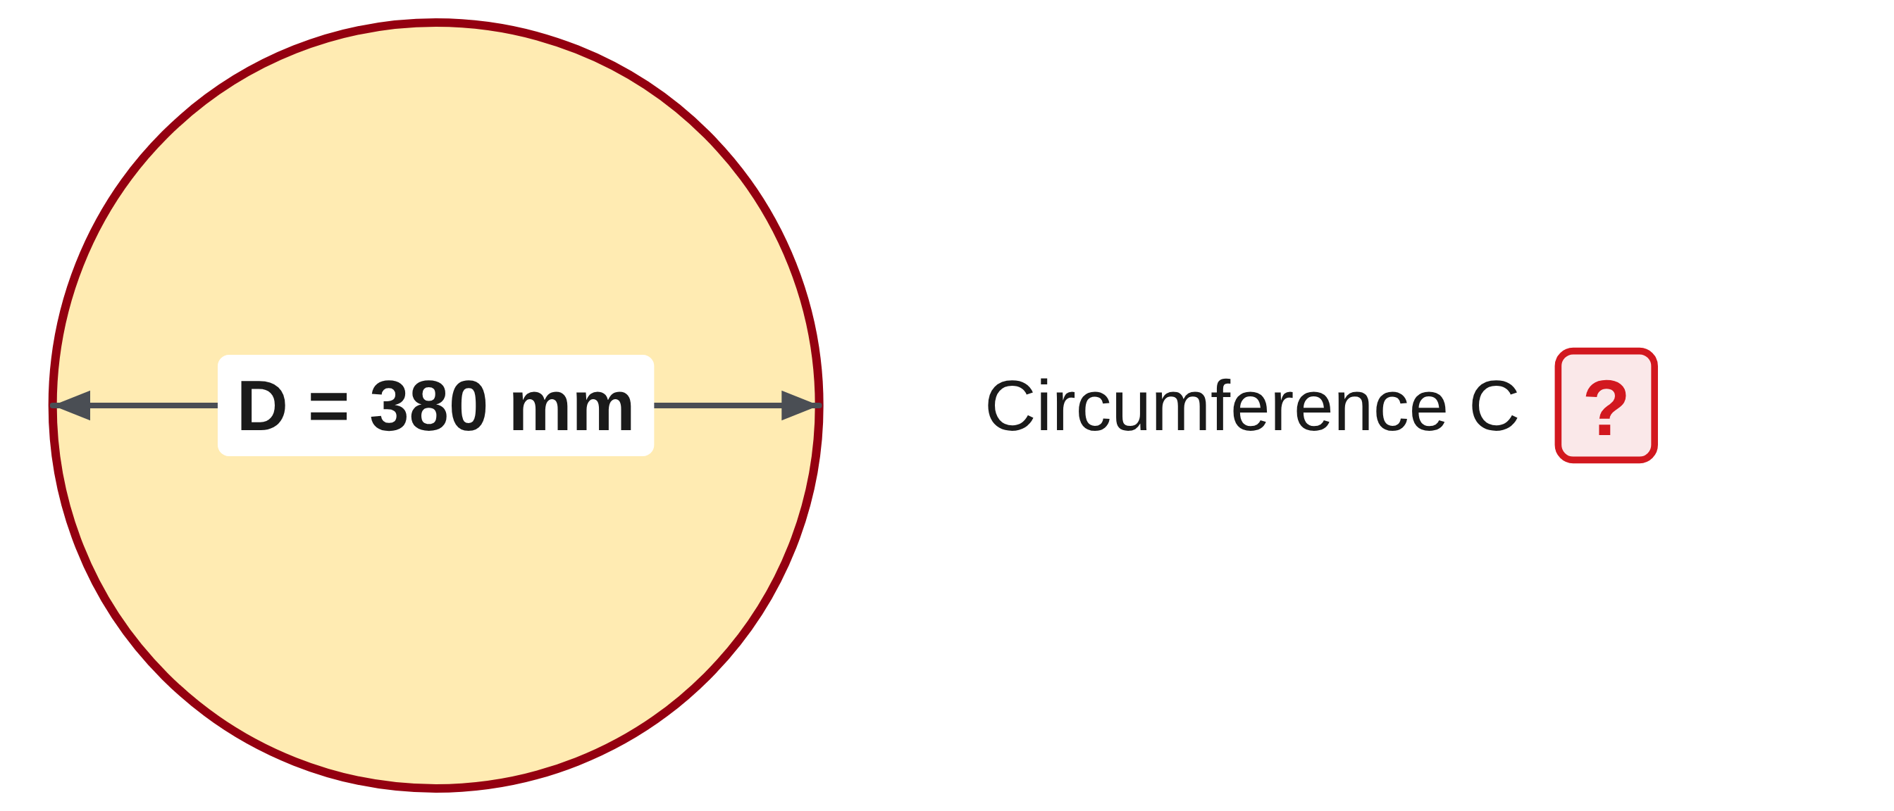
W05-L07 • TOGETHER • 10:55 AM–11:10 AM • 15 MIN TOTAL
Guided practice | 9A Q11
Work with a partner. Take turns explaining the next step.
Textbook sections 9.2–9.6 pp.222–229
Textbook
Exercise Book
Numeracy Hub
Shape Canvas
Day 17 • 2026-11-27 • 33
Notes:
TOGETHER • 10:55 AM–11:10 AM • 15 MIN TOTAL — shared across this phase’s slides.
In 9A question 11, the diameter is 380 millimetres. Find the circumference to two decimal places. Since the diameter is already given, decide whether it needs doubling. Estimate the circumference as a little more than three times 380 before calculating.
Instructor only, after the attempt: C = π × 380 = 1,193.8052… mm, rounded to 1,193.81 mm. Do not double 380: that would treat the given diameter as a radius.

Slide 34
W05-L07 • TOGETHER • 10:55 AM–11:10 AM • 15 MIN TOTAL
Compare your method | 9A Q11
CHECK TOGETHER
1,193.81 mm
Textbook sections 9.2–9.6 pp.222–229
Textbook
Exercise Book
Numeracy Hub
Shape Canvas
Day 17 • 2026-11-27 • 34
Notes:
TOGETHER • 10:55 AM–11:10 AM • 15 MIN TOTAL — shared across this phase’s slides.
The circumference is 1,193.81 millimetres. Our formula was π times 380 because 380 was already the diameter. The estimate, a little more than 1,140 millimetres, supports the result. If someone got roughly 2,387.61 millimetres, what would you investigate? They may have doubled an already-given diameter. Explain the two-decimal rounding: the third decimal is 5, so the hundredths place rounds up. Keep “millimetres” beside the answer; circumference measures a distance around the circle.

Slide 35
W05-L07 • PRACTISE • 11:10 AM–11:45 AM • 35 MIN TOTAL
Your scheduled practice
Solve Exercise Book 9B Q2,8 and 9C Q3–5. Use extra time to compare two methods and correct radius/diameter errors. Tool answers stay hidden until a paper attempt.
Solve on paper first; check with tools; correct one error and explain the change.
Resources: Exercise Book 9A Q9–17 (p.86), selected; 9B Q2,8 (p.87); 9C Q3–5 (pp.89–90)
Textbook sections 9.2–9.6 pp.222–229
Textbook
Exercise Book
Numeracy Hub
Shape Canvas
Day 17 • 2026-11-27 • 35
Notes:
PRACTISE • 11:10 AM–11:45 AM • 35 MIN TOTAL — shared across this phase’s slides.
Work on 9B questions 2 and 8, then 9C questions 3 to 5. We have 35 minutes for this practice, including comparing methods and correcting radius-or-diameter errors. Some problems add material such as an overlap; others ask for a stretch-out. Read what is required before adding allowances. Use Shape Canvas and Numeracy Hub after a paper attempt. When you find an error, write its cause: wrong circle measurement, wrong arc fraction, missing straight segment, or premature rounding. That explanation helps prevent the same error on another job.

Slide 36
W05-L07 • PRACTISE • 11:10 AM–11:45 AM • 35 MIN TOTAL
Open Numeracy Hub
Navigation example. Use the values and units in the assigned task.
Textbook sections 9.2–9.6 pp.222–229
Textbook
Exercise Book
Numeracy Hub
Shape Canvas
Day 17 • 2026-11-27 • 36
Notes:
PRACTISE • 11:10 AM–11:45 AM • 35 MIN TOTAL — shared across this phase’s slides.
Open Numeracy Hub’s Area and perimeter work at the Easy level. Before checking a circle example, label the provided measurement as radius or diameter on your paper. Say which formula you will use and why. If the problem is an arc, identify its fraction of 360 degrees. What should the answer unit tell us? That we found a length, not a circular area. Use the answer to check the method you wrote, then correct the earliest step that caused any disagreement.

Slide 37
W05-L07 • PRACTISE • 11:10 AM–11:45 AM • 35 MIN TOTAL
Practise in Numeracy Hub and Shape Canvas
1
In Shape Canvas, change a circle’s radius and predict how its circumference changes.
2
Sketch and calculate the assigned circle or arc on paper with r and D labelled.
3
Check an Easy Area and perimeter example in Numeracy Hub after the paper attempt.
Textbook sections 9.2–9.6 pp.222–229
Textbook
Exercise Book
Numeracy Hub
Shape Canvas
Day 17 • 2026-11-27 • 37
Notes:
PRACTISE • 11:10 AM–11:45 AM • 35 MIN TOTAL — shared across this phase’s slides.
In Shape Canvas, change a circle’s radius and predict the circumference before revealing it. Because C equals 2πr, doubling r doubles C. It does not make C four times as large; that four-times relationship belongs to area. Sketch the assigned circle or arc on paper with r and D labelled. Then compare an Easy Area and perimeter example in Numeracy Hub. What stays constant when the circle grows? The ratio C divided by D stays pi. Use that relationship to explain the change rather than relying only on the screen.

Slide 38
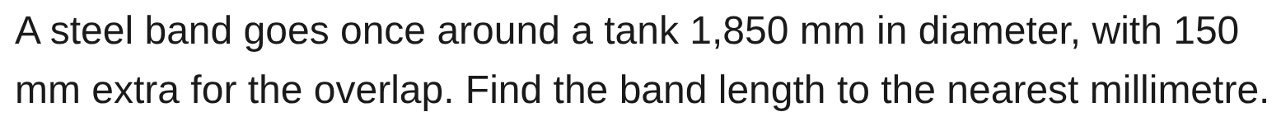
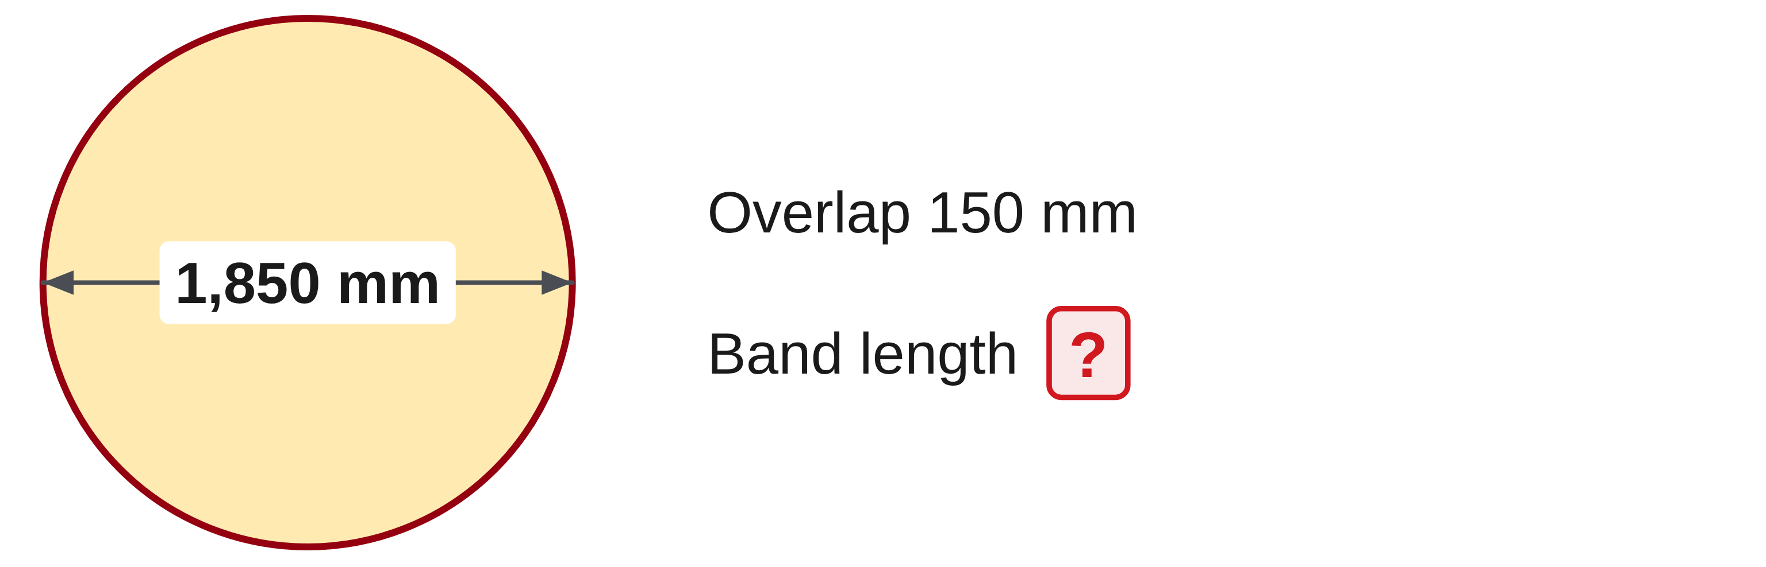
W05-L07 • PRACTISE • 11:10 AM–11:45 AM • 35 MIN TOTAL
Practise from the Exercise Book | 9B Q2
Write the operation, working and units before checking.
Textbook sections 9.2–9.6 pp.222–229
Textbook
Exercise Book
Numeracy Hub
Shape Canvas
Day 17 • 2026-11-27 • 38
Notes:
PRACTISE • 11:10 AM–11:45 AM • 35 MIN TOTAL — shared across this phase’s slides.
A band goes once around a tank of diameter 1,850 millimetres, with another 150 millimetres for overlap. First identify the full circular length, then decide where the overlap belongs. Give the final length to the nearest millimetre.
Instructor only, after the attempt: length = π × 1,850 + 150 = 5,961.9464… mm, so 5,962 mm. The overlap is added after finding the circumference; it is not added to the diameter before multiplying by pi.

Slide 39
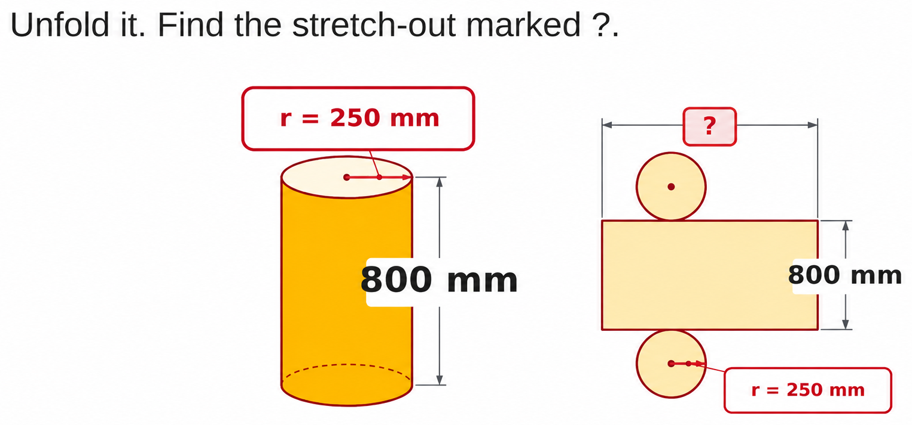
W05-L07 • PRACTISE • 11:10 AM–11:45 AM • 35 MIN TOTAL
Practise from the Exercise Book | 9C Q3
Write the operation, working and units before checking.
Textbook sections 9.2–9.6 pp.222–229
Textbook
Exercise Book
Numeracy Hub
Shape Canvas
Day 17 • 2026-11-27 • 39
Notes:
PRACTISE • 11:10 AM–11:45 AM • 35 MIN TOTAL — shared across this phase’s slides.
In 9C question 3, follow the curved side as it unfolds into a rectangle. The circle’s radius is 250 millimetres, so identify the diameter before finding the unknown stretch-out. Does the 800 millimetre height change the distance around the circle?
Instructor only, after the attempt: D = 500 mm and stretch-out = π × 500 = 1,570.80 mm. The 800 mm dimension is the rectangle’s other dimension. It is needed for surface area, but not for this circumference length.

Slide 40
W05-L07 • CHECK • 11:45 AM–11:55 AM • 10 MIN TOTAL
Check independently
Exercise Book 9A Q11 and Q15; label diameter and identify the arc fraction.
Solve without displayed answers; include working, units and final rounding.
Resources: Exercise Book 9A Q9–17 (p.86), selected; 9B Q2,8 (p.87); 9C Q3–5 (pp.89–90)
Textbook sections 9.2–9.6 pp.222–229
Textbook
Exercise Book
Numeracy Hub
Shape Canvas
Day 17 • 2026-11-27 • 40
Notes:
CHECK • 11:45 AM–11:55 AM • 10 MIN TOTAL — shared across this phase’s slides.
Complete 9A questions 11 and 15 independently. One asks for a full circumference; the other asks for an arc. On each sketch, label the diameter. For the arc, write the fraction of the circle before using the calculator. Keep the worked answers closed until both attempts are finished. What makes the calculations different? The arc uses only a fraction of πD. Include your formula, working, units and final rounding so I can see whether your method matches the requested path.

Slide 41
W05-L07 • CHECK • 11:45 AM–11:55 AM • 10 MIN TOTAL
Independent check | 9A Q11
Answer independently. Keep worked solutions closed.
Textbook sections 9.2–9.6 pp.222–229
Textbook
Exercise Book
Numeracy Hub
Shape Canvas
Day 17 • 2026-11-27 • 41
Notes:
CHECK • 11:45 AM–11:55 AM • 10 MIN TOTAL — shared across this phase’s slides.
Find the circumference of the circle with diameter 380 millimetres, to two decimal places. Work independently and include an estimate or a short reasonableness check. Be clear about whether the given measurement is a radius or a diameter.
Instructor only, after the independent attempt: C = πD = π × 380 = 1,193.81 mm. The diameter does not need doubling. A result a little more than 3 × 380 supports the answer.

Slide 42
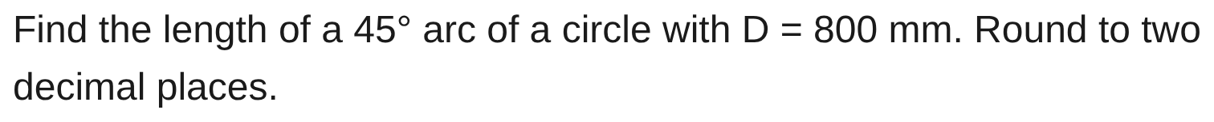
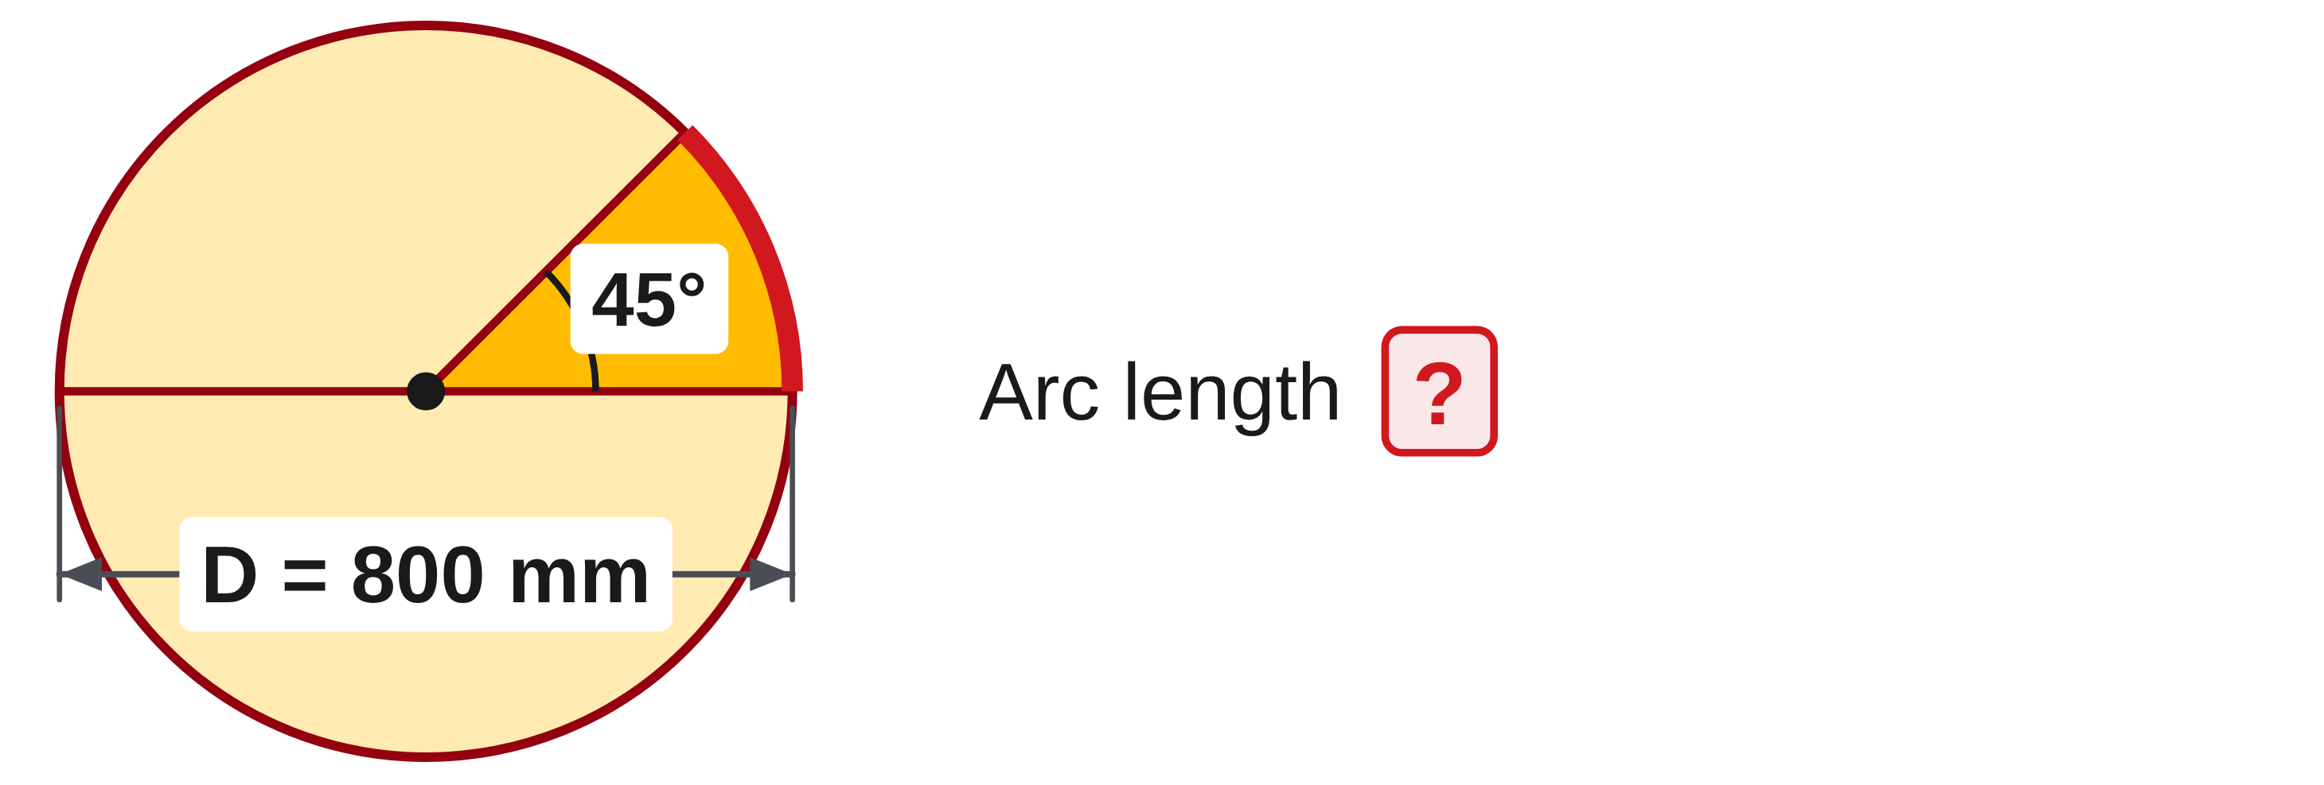
W05-L07 • CHECK • 11:45 AM–11:55 AM • 10 MIN TOTAL
Independent check | 9A Q15
Answer independently. Keep worked solutions closed.
Textbook sections 9.2–9.6 pp.222–229
Textbook
Exercise Book
Numeracy Hub
Shape Canvas
Day 17 • 2026-11-27 • 42
Notes:
CHECK • 11:45 AM–11:55 AM • 10 MIN TOTAL — shared across this phase’s slides.
Find the 45-degree arc length for a circle with diameter 800 millimetres. First determine what fraction of a full turn 45 degrees represents. Then calculate and round the length to two decimal places.
Instructor only, after the independent attempt: 45 ÷ 360 = 1/8. Arc = (1/8) × π × 800 = 100π = 314.1592… mm, so 314.16 mm. The question asks for the arc only, so no straight closing segments are added.

Slide 43
W05-L07 • WRAP UP • 11:55 AM–12:00 PM • 5 MIN TOTAL
Wrap up and choose the next step
Ask: What changed in your understanding? Where will you use it? What should you check next time?
Name the math and one other essential skill used; record a next practice step.
Resources: Exercise Book 9A Q9–17 (p.86), selected; 9B Q2,8 (p.87); 9C Q3–5 (pp.89–90)
Textbook sections 9.2–9.6 pp.222–229
Textbook
Exercise Book
Numeracy Hub
Shape Canvas
Play quiz
Quiz PDF
Day 17 • 2026-11-27 • 43
Notes:
WRAP UP • 11:55 AM–12:00 PM • 5 MIN TOTAL — shared across this phase’s slides.
Choose one problem from this block and explain the path you calculated. Did it go all the way around, follow an arc, or include an extra straight length? What check helped most: labelling the diameter, estimating with three times the diameter, or drawing the full boundary? Record one correction in your own words. We have now handled both straight and curved lengths. Next we move to area and material coverage, where the units become square units and the formulas describe the space inside the boundary.

