Slide 1

CARPENTRY FOUNDATION / INTAKE 142
Day 18 | Monday
18
November 30, 2026
Area and material coverage
12:45 PM–2:00 PM • Math • 75 min
Composite areas, openings and surface coverage
2:15 PM–3:30 PM • Math • 75 min
Week 6 • 2 scheduled blocks • 150 teaching minutes
Estimate. Show the method. Label units. Check the result.
Textbook
Exercise Book
Numeracy Hub
Shape Canvas
Day 18 • 2026-11-30 • 01
Notes:
Opening — within the first Start allocation.
Today we move from the distance around a shape to the surface it covers. We start with rectangle and triangle areas from 12:45 to 2:00, then use composite shapes and openings from 2:15 to 3:30. These calculations help us estimate sheet quantities and coating coverage. Keep two questions in view: which surface is actually being covered, and which square unit matches the dimensions? A sketch and the units will guide the calculation before the calculator does.

Slide 2
DAY 18 / WEEK 6 / CLASS TIMETABLE
Today’s exact schedule
12:45 PM–2:00 PM • 75 min
2:15 PM–3:30 PM • 75 min
Area and material coverage
Composite areas, openings and surface coverage
12:45 PM–12:50 PM
Start
5
2:15 PM–2:20 PM
Start
5
12:50 PM–12:55 PM
Recall
5
2:20 PM–2:25 PM
Recall
5
12:55 PM–1:10 PM
Teach
15
2:25 PM–2:40 PM
Teach
15
1:10 PM–1:25 PM
Together
15
2:40 PM–2:55 PM
Together
15
1:25 PM–1:45 PM
Practise
20
2:55 PM–3:15 PM
Practise
20
1:45 PM–1:55 PM
Check
10
3:15 PM–3:25 PM
Check
10
1:55 PM–2:00 PM
Wrap up
5
3:25 PM–3:30 PM
Wrap up
5
Math • Math Week 6, Lesson 1
Math • Math Week 6, Lesson 2
Break: 2:00 PM–2:15 PM • 15 minutes • excluded from teaching time
Textbook
Exercise Book
Numeracy Hub
Shape Canvas
Day 18 • 2026-11-30 • 02
Notes:
Opening — within the first Start allocation.
Our first block runs from 12:45 to 2:00, followed by the scheduled break until 2:15. The first independent check, 1:45 to 1:55, asks you to show floor area, sheet area and sheet quantity. In the second block we will add areas of separate pieces and subtract openings. That check runs from 3:15 to 3:25. Each practice period is 20 minutes. Use that time to explain the geometry as well as getting the number, because the surface being counted is what determines the formula.

Slide 3
W06-L01 • START • 12:45 PM–12:50 PM • 5 MIN TOTAL
Area and material coverage
Today’s goal: Calculate rectangle and triangle areas and distinguish linear units from square units.
Describe a prior use of the skill; identify the given and unknown quantities.
Textbook sections 10.1–10.3 pp.242–245; sections 7.4 pp.170–172
Exercise Book 10A Q1–8 (p.93); 10B Q1,4 (p.95)
Keep your notebook, textbook, exercise book and chosen calculator ready.
Textbook sections 10.1–10.3 pp.242–245; sections 7.4 pp.170–172
Textbook
Exercise Book
Numeracy Hub
Shape Canvas
Day 18 • 2026-11-30 • 03
Notes:
START • 12:45 PM–12:50 PM • 5 MIN TOTAL — shared across this phase’s slides.
When we buy material to cover a floor, the outside boundary alone is not enough. We need the area inside it. Today our focus is rectangles and triangles, with the correct square units. What two dimensions make a rectangle’s area? Length and width. For a triangle, we need a base and its perpendicular height. Have the exercise book open to chapter 10. On every drawing, identify the surface to be covered and mark the dimensions that actually describe that surface.

Slide 4
W06-L01 • RECALL • 12:50 PM–12:55 PM • 5 MIN TOTAL
Recall and reconnect
Explain why 1 m² is not 1,000 mm²; retrieve a rectangle perimeter and name its different unit.
Attempt the retrieval task independently; explain the method before checking.
Resources: Exercise Book 10A Q1–8 (p.93); 10B Q1,4 (p.95)
Textbook sections 10.1–10.3 pp.242–245; sections 7.4 pp.170–172
Textbook
Exercise Book
Numeracy Hub
Shape Canvas
Day 18 • 2026-11-30 • 04
Notes:
RECALL • 12:50 PM–12:55 PM • 5 MIN TOTAL — shared across this phase’s slides.
Think about a square one metre on each side. Each side is 1,000 millimetres, so the area in millimetres is 1,000 times 1,000: one million square millimetres. Why is it not 1,000 square millimetres? Both directions changed units. Now contrast the perimeter: it adds four one-metre lengths and gives 4 metres. The same shape has a perimeter in metres and an area in square metres. Tell your partner what each number measures so the unit is part of the meaning, not a label added at the end.

Slide 5
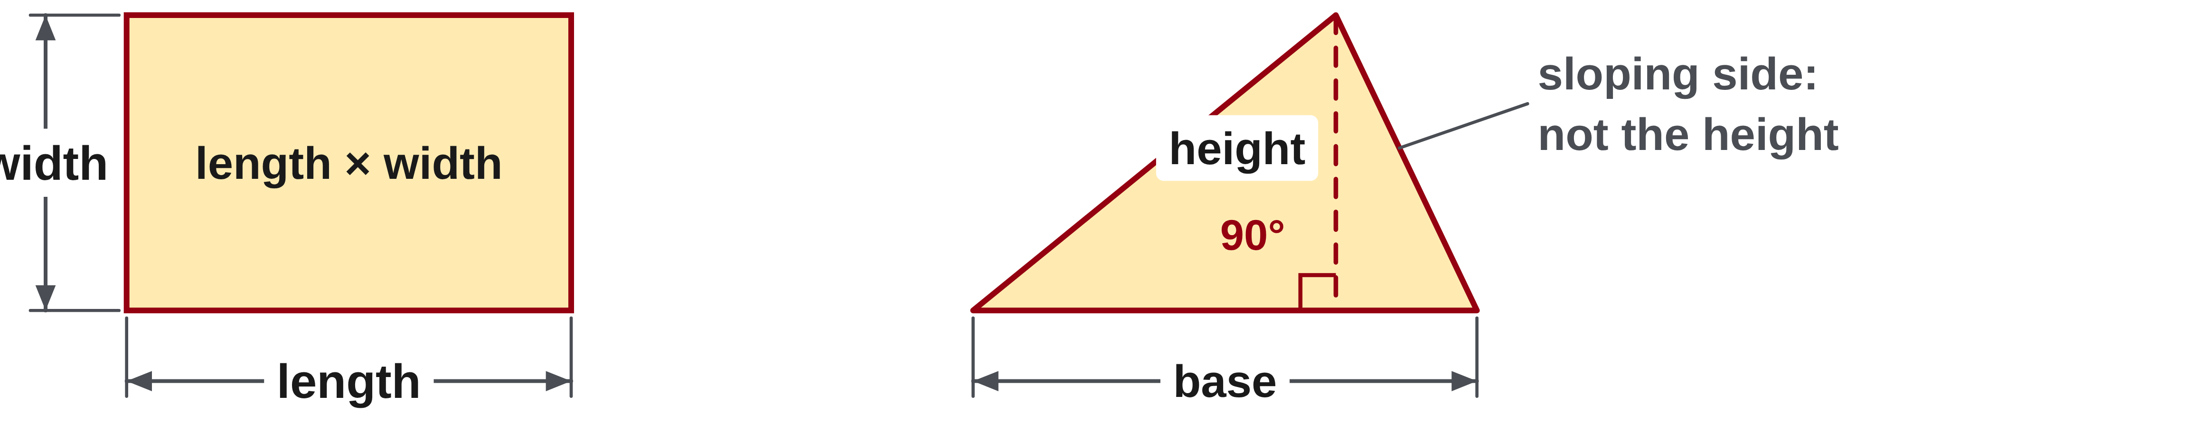
W06-L01 • TEACH • 12:55 PM–1:10 PM • 15 MIN TOTAL
Measure coverage in squares
1
Rectangle area = length × width.
2
Triangle area = ½ × base × perpendicular height.
3
The height meets the base at 90°; it is not usually the sloping side.
4
Area answers use square units such as mm² or m².
Textbook sections 10.1–10.3 pp.242–245; sections 7.4 pp.170–172
Textbook
Exercise Book
Numeracy Hub
Shape Canvas
Day 18 • 2026-11-30 • 05
Notes:
TEACH • 12:55 PM–1:10 PM • 15 MIN TOTAL — shared across this phase’s slides.
Picture covering a rectangle with equal unit squares arranged in rows. The length tells us how many squares fit along each row; the width tells us how many rows there are. That is why rectangle area is length times width. A triangle with the same base and perpendicular height covers half as much as the matching rectangle, so its formula includes one half. Which line must meet the base at 90 degrees? The height. A sloping side is generally not that height. Multiplying two lengths gives a square unit, and halving the result keeps that square unit.

Slide 6
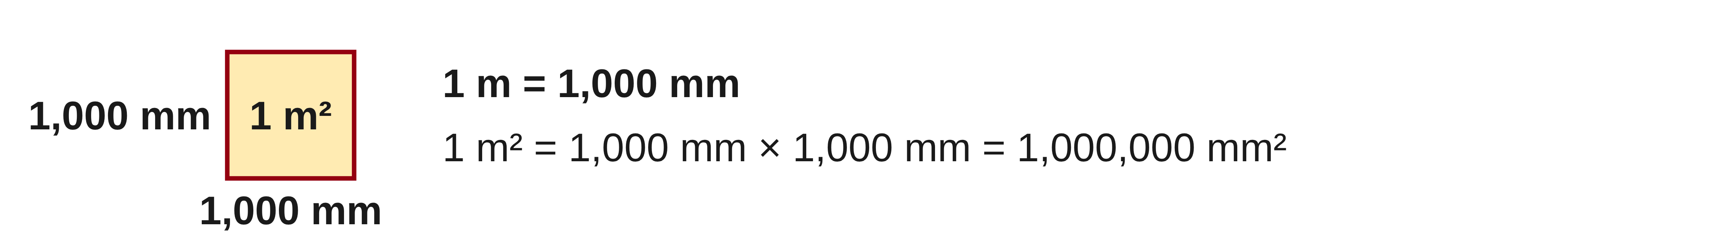
W06-L01 • TEACH • 12:55 PM–1:10 PM • 15 MIN TOTAL
Convert areas and count sheets
1
A square conversion applies the length factor twice.
2
Because 1 m = 1,000 mm, 1 m² = 1,000,000 mm².
3
Sheet count = surface area ÷ one-sheet area in matching units.
4
Keep the exercise’s no-waste assumption explicit; round purchases as required.
Textbook sections 10.1–10.3 pp.242–245; sections 7.4 pp.170–172
Textbook
Exercise Book
Numeracy Hub
Shape Canvas
Day 18 • 2026-11-30 • 06
Notes:
TEACH • 12:55 PM–1:10 PM • 15 MIN TOTAL — shared across this phase’s slides.
When a length unit changes, its conversion factor acts once. For area, that factor acts in two directions. One metre squared is 1,000 millimetres times 1,000 millimetres, or one million square millimetres. Once the surface area and sheet area use the same square unit, divide to find the number of sheets. Why must those units match? Otherwise we would be comparing different-sized area units. The exercise’s no-waste assumption matters: an area quotient describes coverage, while a real cutting layout may have additional constraints. Keep that assumption attached to the answer.

Slide 7
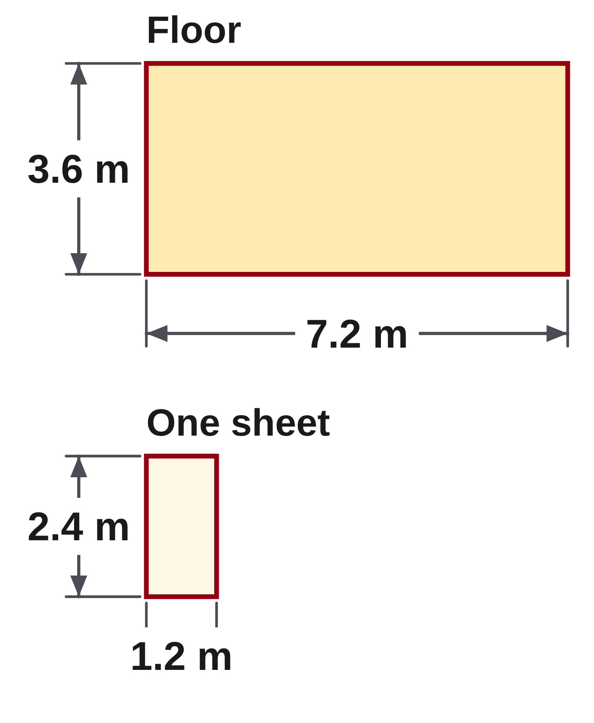
W06-L01 • TEACH • 12:55 PM–1:10 PM • 15 MIN TOTAL
Turn floor area into a sheet quantity
Floor: 7.2 m × 3.6 m = 25.92 m²
One sheet: 1.2 m × 2.4 m = 2.88 m²
No-waste quantity: 25.92 ÷ 2.88 = 9 sheets
What the result means • This is a no-waste classroom calculation.
An area quotient is not automatically a workable cutting plan.
Keep the sheet dimensions and layout assumptions visible.
Together • Work 10A Q2–4,7–8. Label perpendicular heights.
Shape Canvas: compare a rectangle and a right triangle with the same
base and height. Predict why the triangle has half the area.
Exercise Book 10B Q1 p.95 • Numeracy Hub → Volume and Layout → Area and perimeter
Textbook
Exercise Book
Numeracy Hub
Shape Canvas
Day 18 • 2026-11-30 • 07
Notes:
TEACH • 12:55 PM–1:10 PM • 15 MIN TOTAL — shared across this phase’s slides.
The floor is 7.2 metres by 3.6 metres, so its area is 25.92 square metres. One sheet is 1.2 metres by 2.4 metres, giving 2.88 square metres. Divide the floor area by the sheet area: 25.92 divided by 2.88 equals 9 sheets. Check by multiplication: 9 times 2.88 returns 25.92. What makes this a no-waste result? We are treating all the sheet area as usable coverage, as the exercise specifies. The division alone does not prove a practical cutting layout, so we keep the dimensions and assumption visible.

Slide 8
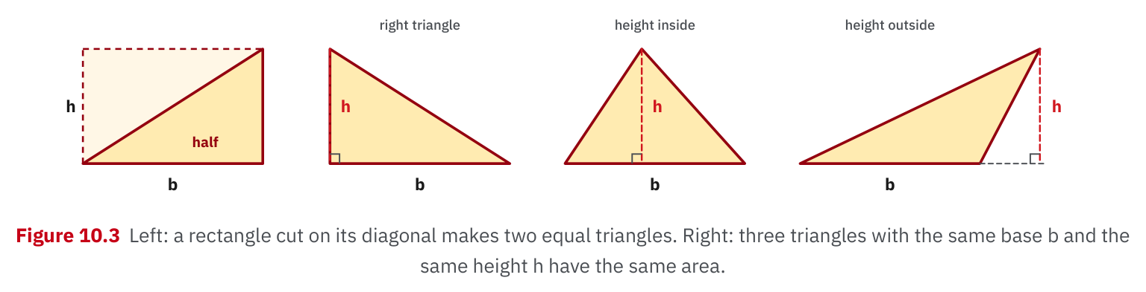
W06-L01 • TEACH • 12:55 PM–1:10 PM • 15 MIN TOTAL
Textbook | page 244
Textbook p.244 • Figure 10.3 — Equal base and perpendicular height
Textbook sections 10.1–10.3 pp.242–245; sections 7.4 pp.170–172
Textbook
Exercise Book
Numeracy Hub
Shape Canvas
Day 18 • 2026-11-30 • 08
Notes:
TEACH • 12:55 PM–1:10 PM • 15 MIN TOTAL — shared across this phase’s slides.
Figure 10.3 on page 244 shows a rectangle cut along its diagonal. The two resulting triangles together cover the original rectangle, so each covers half its area. Now follow the other triangles: the height can lie inside or outside the triangle, but it always meets the base at a right angle. Why can differently leaning triangles have the same area? They share the same base and perpendicular height. Do not substitute the sloping side just because it is a visible edge. The perpendicular distance is what controls how much area lies above the base.

Slide 9
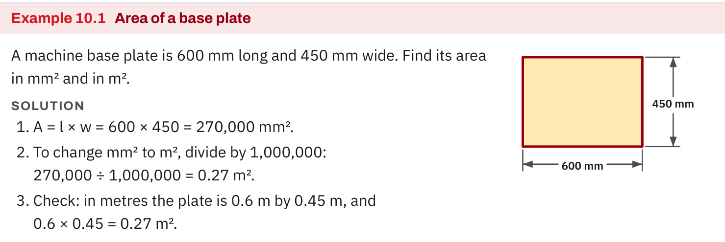
W06-L01 • TEACH • 12:55 PM–1:10 PM • 15 MIN TOTAL
Textbook | page 243
Textbook p.243 • Example 10.1 — Rectangle area and squared unit conversion
Textbook sections 10.1–10.3 pp.242–245; sections 7.4 pp.170–172
Textbook
Exercise Book
Numeracy Hub
Shape Canvas
Day 18 • 2026-11-30 • 09
Notes:
TEACH • 12:55 PM–1:10 PM • 15 MIN TOTAL — shared across this phase’s slides.
Example 10.1 on page 243 uses a base plate 600 millimetres by 450 millimetres. Multiply to get 270,000 square millimetres. Converting to square metres means dividing by one million, giving 0.27 square metres. Check another way: convert the sides first to 0.6 metre and 0.45 metre, then multiply them. The answer is again 0.27 square metres. Which method is more comfortable for you? Both are valid, and comparing them is a strong check. Dividing the area by only 1,000 would produce 270 square metres, far too large for this plate.

Slide 10
W06-L01 • TEACH • 12:55 PM–1:10 PM • 15 MIN TOTAL
Spot the mistake. Explain the correction.
Can an area in m² be converted to mm² by multiplying by 1,000?
Discuss the method before checking the answer.
No. Both dimensions change by 1,000, so the area factor is 1,000 squared.
Textbook sections 10.1–10.3 pp.242–245; sections 7.4 pp.170–172
Textbook
Exercise Book
Numeracy Hub
Shape Canvas
Day 18 • 2026-11-30 • 10
Notes:
TEACH • 12:55 PM–1:10 PM • 15 MIN TOTAL — shared across this phase’s slides.
The proposed shortcut is to multiply square metres by 1,000 to get square millimetres. Test it with a one-metre square. Each side contains 1,000 millimetres, so the square contains 1,000 rows of 1,000 little square millimetres. That is one million, not one thousand. The correction is to square the length conversion factor. Ask your partner to explain where the second factor of 1,000 comes from. We want an explanation about the two dimensions, not only a rule about moving a decimal point.

Slide 11
W06-L01 • TOGETHER • 1:10 PM–1:25 PM • 15 MIN TOTAL
Work together
Work Exercise Book 10A Q2–4,7–8; learners label perpendicular height, not the sloping side.
Work in pairs, alternating solver and checker. Write a diagram, formula, units and estimate.
Resources: Exercise Book 10A Q1–8 (p.93); 10B Q1,4 (p.95)
Textbook sections 10.1–10.3 pp.242–245; sections 7.4 pp.170–172
Textbook
Exercise Book
Numeracy Hub
Shape Canvas
Day 18 • 2026-11-30 • 11
Notes:
TOGETHER • 1:10 PM–1:25 PM • 15 MIN TOTAL — shared across this phase’s slides.
Work through 10A questions 2 to 4 and 7 to 8. For conversions, write the square-unit factor before using it. For triangle drawings, mark the base and perpendicular height, including the right-angle relationship. One partner explains the choice of dimensions, and the other checks that those dimensions belong in the formula. What would reveal that a sloping side was used by mistake? The chosen height would not meet the base at 90 degrees. Keep each result labelled with the square unit requested by the question.

Slide 12
W06-L01 • TOGETHER • 1:10 PM–1:25 PM • 15 MIN TOTAL
Guided practice | 10A Q2
Work with a partner. Take turns explaining the next step.
Textbook sections 10.1–10.3 pp.242–245; sections 7.4 pp.170–172
Textbook
Exercise Book
Numeracy Hub
Shape Canvas
Day 18 • 2026-11-30 • 12
Notes:
TOGETHER • 1:10 PM–1:25 PM • 15 MIN TOTAL — shared across this phase’s slides.
Convert 1,500,000 square millimetres to square metres in 10A question 2. Start by writing how many square millimetres make one square metre. Decide whether the number should become larger or smaller when the unit becomes larger.
Instructor only, after the attempt: 1,500,000 ÷ 1,000,000 = 1.5 m². The number decreases because each square metre represents a million square millimetres. Multiplying 1.5 by one million checks the conversion.

Slide 13
W06-L01 • TOGETHER • 1:10 PM–1:25 PM • 15 MIN TOTAL
Compare your method | 10A Q2
CHECK TOGETHER
1.5 m²
Textbook sections 10.1–10.3 pp.242–245; sections 7.4 pp.170–172
Textbook
Exercise Book
Numeracy Hub
Shape Canvas
Day 18 • 2026-11-30 • 13
Notes:
TOGETHER • 1:10 PM–1:25 PM • 15 MIN TOTAL — shared across this phase’s slides.
The result is 1.5 square metres. We divided by one million, because there are one million square millimetres in every square metre. Why is an answer of 1,500 square metres unreasonable here? It uses the length conversion factor only once. The original quantity is only one and a half million square millimetres, so it should be one and a half one-million-sized units. This way of reading the conversion helps you check the magnitude instead of trusting a decimal movement by itself.

Slide 14
W06-L01 • PRACTISE • 1:25 PM–1:45 PM • 20 MIN TOTAL
Your scheduled practice
Complete Exercise Book 10A Q5–6 and 10B Q1,4. On Shape Canvas, compare the two shapes’ areas. Keep the sheet count’s no-waste assumption explicit.
Solve on paper first; check with tools; correct one error and explain the change.
Resources: Exercise Book 10A Q1–8 (p.93); 10B Q1,4 (p.95)
Textbook sections 10.1–10.3 pp.242–245; sections 7.4 pp.170–172
Textbook
Exercise Book
Numeracy Hub
Shape Canvas
Day 18 • 2026-11-30 • 14
Notes:
PRACTISE • 1:25 PM–1:45 PM • 20 MIN TOTAL — shared across this phase’s slides.
Complete 10A questions 5 and 6, followed by 10B questions 1 and 4. Write the area formula and units before calculating. In Shape Canvas, compare a rectangle and right triangle with matching base and height. Explain why one covers half as much. For the sheet-count problem, keep the no-waste condition beside your calculation. What does the area division tell us? The number of sheet areas needed to match the floor area under that condition. It does not by itself supply a cutting plan.

Slide 15
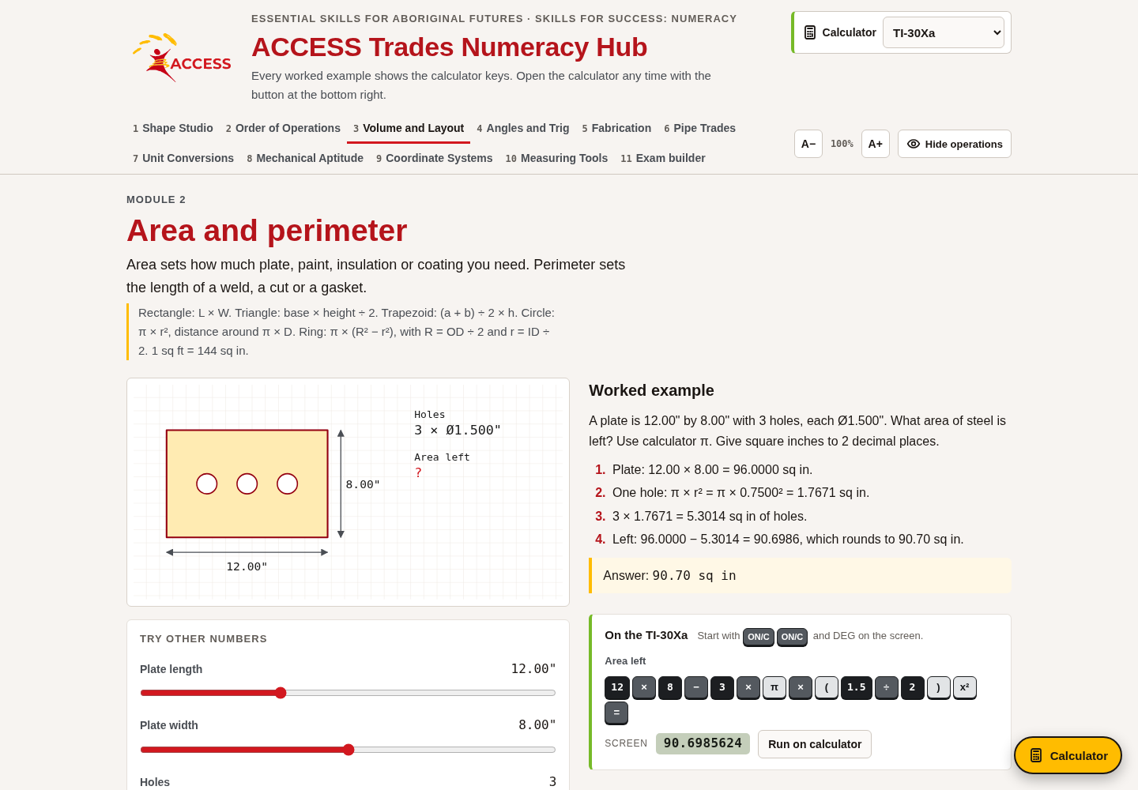
W06-L01 • PRACTISE • 1:25 PM–1:45 PM • 20 MIN TOTAL
Open Numeracy Hub
Navigation example. Use the values and units in the assigned task.
Textbook sections 10.1–10.3 pp.242–245; sections 7.4 pp.170–172
Textbook
Exercise Book
Numeracy Hub
Shape Canvas
Day 18 • 2026-11-30 • 15
Notes:
PRACTISE • 1:25 PM–1:45 PM • 20 MIN TOTAL — shared across this phase’s slides.
Open Numeracy Hub and choose Volume and Layout, then Area and perimeter. Read whether the question asks for the boundary or for coverage before selecting your method. Our work now concerns area, so identify two relevant dimensions and expect a square unit. For a triangle, find the perpendicular height rather than automatically using every labelled side. Try the calculation on paper first. What should you compare when checking the result? The formula, the dimensions and the unit, as well as the numerical answer.

Slide 16
W06-L01 • PRACTISE • 1:25 PM–1:45 PM • 20 MIN TOTAL
Practise in Numeracy Hub and Shape Canvas
1
Create a rectangle and right triangle with equal base and height in Shape Canvas.
2
Calculate both areas on paper; explain why the triangle covers half as much.
3
Check the area method in Numeracy Hub Volume and Layout → Area and perimeter.
Textbook sections 10.1–10.3 pp.242–245; sections 7.4 pp.170–172
Textbook
Exercise Book
Numeracy Hub
Shape Canvas
Day 18 • 2026-11-30 • 16
Notes:
PRACTISE • 1:25 PM–1:45 PM • 20 MIN TOTAL — shared across this phase’s slides.
Create a rectangle and a right triangle in Shape Canvas with equal base and height. Calculate both areas on paper before checking the display. What relationship do you predict? The triangle has half the area of the rectangle. Explain it by imagining two matching right triangles making the rectangle. If your answers do not have that relationship, check whether the dimensions really match and whether you included one half. Use the Area and perimeter section of Numeracy Hub to compare the method after your paper attempt.

Slide 17
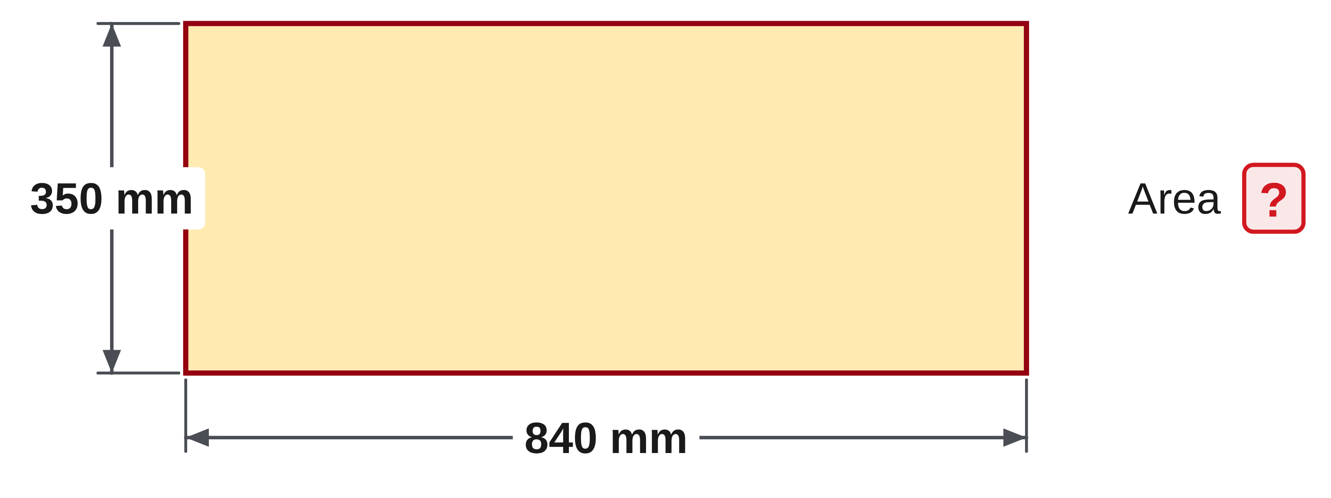
W06-L01 • PRACTISE • 1:25 PM–1:45 PM • 20 MIN TOTAL
Practise from the Exercise Book | 10A Q5
Write the operation, working and units before checking.
Textbook sections 10.1–10.3 pp.242–245; sections 7.4 pp.170–172
Textbook
Exercise Book
Numeracy Hub
Shape Canvas
Day 18 • 2026-11-30 • 17
Notes:
PRACTISE • 1:25 PM–1:45 PM • 20 MIN TOTAL — shared across this phase’s slides.
For 10A question 5, find the area of the rectangle measuring 840 millimetres by 350 millimetres. Identify what each factor measures and write the resulting unit. Estimate the size before calculating.
Instructor only, after the attempt: A = 840 × 350 = 294,000 mm². One check is 84 × 35 = 2,940, then restore the two factors of ten. The answer is square millimetres because both dimensions are lengths in millimetres.

Slide 18
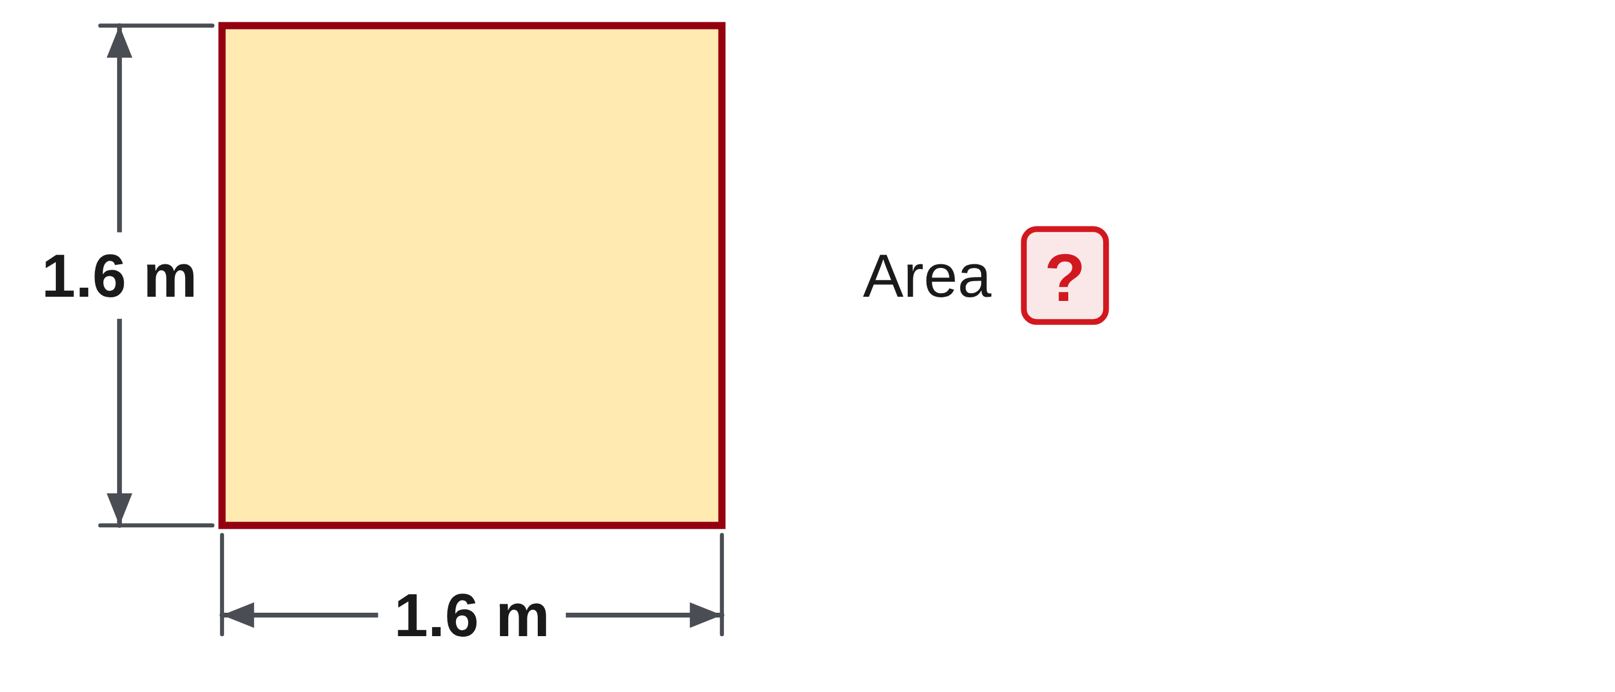
W06-L01 • PRACTISE • 1:25 PM–1:45 PM • 20 MIN TOTAL
Practise from the Exercise Book | 10A Q6
Write the operation, working and units before checking.
Textbook sections 10.1–10.3 pp.242–245; sections 7.4 pp.170–172
Textbook
Exercise Book
Numeracy Hub
Shape Canvas
Day 18 • 2026-11-30 • 18
Notes:
PRACTISE • 1:25 PM–1:45 PM • 20 MIN TOTAL — shared across this phase’s slides.
Question 10A 6 gives a square with sides of 1.6 metres. Find its area and explain why the side appears twice in the multiplication. Do not replace multiplication by adding the four edges.
Instructor only, after the attempt: A = 1.6 × 1.6 = 2.56 m². A square is a rectangle with equal length and width. Adding 1.6 four times would give the perimeter, 6.4 m, which answers a different question.

Slide 19
W06-L01 • CHECK • 1:45 PM–1:55 PM • 10 MIN TOTAL
Check independently
Exercise Book 10B Q1; show floor area, one-sheet area and sheet quantity.
Solve without displayed answers; include working, units and final rounding.
Resources: Exercise Book 10A Q1–8 (p.93); 10B Q1,4 (p.95)
Textbook sections 10.1–10.3 pp.242–245; sections 7.4 pp.170–172
Textbook
Exercise Book
Numeracy Hub
Shape Canvas
Day 18 • 2026-11-30 • 19
Notes:
CHECK • 1:45 PM–1:55 PM • 10 MIN TOTAL — shared across this phase’s slides.
Complete 10B question 1 independently. Show three separate quantities: the floor area, the area of one sheet, and the number of sheets. Keep the no-waste condition in your explanation and use matching square units before dividing. Leave the worked answers closed during the attempt. What check can you perform after finding the count? Multiply the sheet count by the area of one sheet and compare it with the floor area. Your working should make each stage understandable without guessing what a number represents.

Slide 20
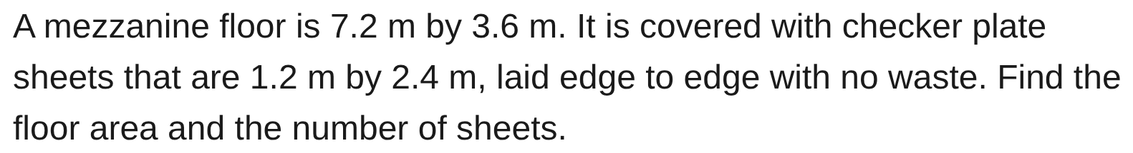
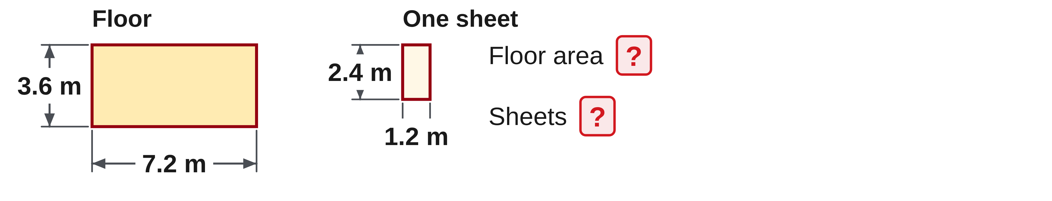
W06-L01 • CHECK • 1:45 PM–1:55 PM • 10 MIN TOTAL
Independent check | 10B Q1
Answer independently. Keep worked solutions closed.
Textbook sections 10.1–10.3 pp.242–245; sections 7.4 pp.170–172
Textbook
Exercise Book
Numeracy Hub
Shape Canvas
Day 18 • 2026-11-30 • 20
Notes:
CHECK • 1:45 PM–1:55 PM • 10 MIN TOTAL — shared across this phase’s slides.
The mezzanine floor is 7.2 metres by 3.6 metres. Its checker plate sheets are 1.2 metres by 2.4 metres and are laid edge to edge with no waste. Find the floor area and sheet quantity independently, showing both areas before division.
Instructor only, after the attempt: floor = 7.2 × 3.6 = 25.92 m²; sheet = 1.2 × 2.4 = 2.88 m²; 25.92 ÷ 2.88 = 9 sheets. Check: 9 × 2.88 = 25.92 m².

Slide 21
W06-L01 • WRAP UP • 1:55 PM–2:00 PM • 5 MIN TOTAL
Wrap up and choose the next step
Ask: What changed in your understanding? Where will you use it? What should you check next time?
Name the math and one other essential skill used; record a next practice step.
Resources: Exercise Book 10A Q1–8 (p.93); 10B Q1,4 (p.95)
Textbook sections 10.1–10.3 pp.242–245; sections 7.4 pp.170–172
Textbook
Exercise Book
Numeracy Hub
Shape Canvas
Play quiz
Quiz PDF
Day 18 • 2026-11-30 • 21
Notes:
WRAP UP • 1:55 PM–2:00 PM • 5 MIN TOTAL — shared across this phase’s slides.
Look back at one area and one unit conversion from this block. Explain why the answer uses square units and why a metre-to-millimetre area conversion needs two factors of 1,000. What drawing feature tells us which height belongs in a triangle formula? The right angle to the base. Record one useful check from today. After the break, we will use these familiar areas as building blocks: sometimes we add separate pieces, and sometimes we subtract an opening from a larger surface.

Slide 22
DAY 18 • SCHEDULED BREAK
Break
2:00 PM–2:15 PM
Return ready for: Composite areas, openings and surface coverage
This break is excluded from teaching minutes.
Textbook
Exercise Book
Numeracy Hub
Shape Canvas
Day 18 • 2026-11-30 • 22
Notes:
Scheduled break — no teaching time.
Our scheduled break is 2:00 to 2:15. Keep the rectangle and triangle work available for the next block, because composite areas use the same formulas on separate pieces. When we return, the key question will be which pieces remain and which openings have been removed. We will restart at 2:15.

Slide 23
W06-L02 • START • 2:15 PM–2:20 PM • 5 MIN TOTAL
Composite areas, openings and surface coverage
Today’s goal: Break a composite shape into known parts and subtract openings before estimating coverage.
Describe a prior use of the skill; identify the given and unknown quantities.
Textbook sections 10.4–10.7 pp.246–254
Exercise Book 10A Q10–12 (p.94); 10B Q2 (p.95), Q11–12 (p.96); 10C Q4 (p.97)
Keep your notebook, textbook, exercise book and chosen calculator ready.
Textbook sections 10.4–10.7 pp.246–254
Textbook
Exercise Book
Numeracy Hub
Shape Canvas
Day 18 • 2026-11-30 • 23
Notes:
START • 2:15 PM–2:20 PM • 5 MIN TOTAL — shared across this phase’s slides.
A real panel may have a cut-out, or its outline may combine several simple shapes. We do not need a completely new formula for every outline. We can break the surface into known parts and add their areas, or calculate the outer area and subtract what is missing. What must the final answer describe? The material actually left or the surface actually being covered. Today we will mark those pieces on the drawing before calculating, then connect the result to coating quantities.

Slide 24
W06-L02 • RECALL • 2:20 PM–2:25 PM • 5 MIN TOTAL
Recall and reconnect
Show a panel with a hole; ask which area is added and which is subtracted.
Attempt the retrieval task independently; explain the method before checking.
Resources: Exercise Book 10A Q10–12 (p.94); 10B Q2 (p.95), Q11–12 (p.96); 10C Q4 (p.97)
Textbook sections 10.4–10.7 pp.246–254
Textbook
Exercise Book
Numeracy Hub
Shape Canvas
Day 18 • 2026-11-30 • 24
Notes:
RECALL • 2:20 PM–2:25 PM • 5 MIN TOTAL — shared across this phase’s slides.
Picture a panel with a hole cut through it. Point to the outer panel area and then the opening. If we need the material area that remains, should the opening be added or subtracted? Subtracted, because that part is no longer material. Now imagine joining another solid piece to the panel: that area would be added, provided it does not overlap an area already counted. Say the calculation in words first: outer area minus opening area. That sentence will help you choose the signs before entering numbers.

Slide 25
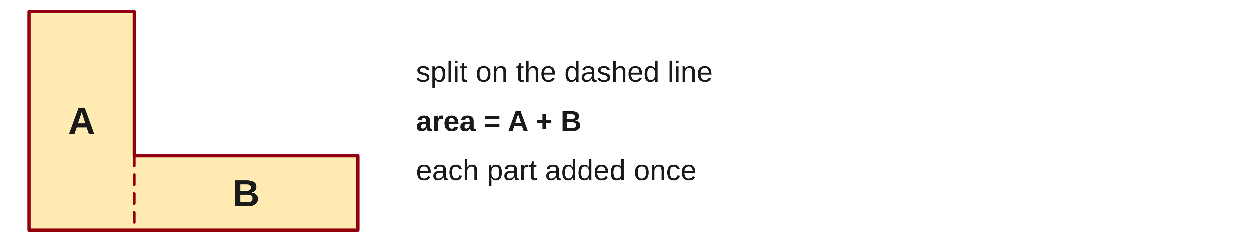
W06-L02 • TEACH • 2:25 PM–2:40 PM • 15 MIN TOTAL
Build a composite area from known pieces
1
Split the outline into non-overlapping shapes with known area formulas.
2
Label the required lengths and perpendicular heights.
3
Add the separate areas once each.
4
For a trapezoid, multiply the average parallel-side length by its height.
Textbook sections 10.4–10.7 pp.246–254
Textbook
Exercise Book
Numeracy Hub
Shape Canvas
Day 18 • 2026-11-30 • 25
Notes:
TEACH • 2:25 PM–2:40 PM • 15 MIN TOTAL — shared across this phase’s slides.
A composite area can be split into familiar shapes, but each part must be counted only once. Draw dividing lines so the pieces do not overlap. Label the lengths and perpendicular heights needed for each formula, calculate the separate areas, then add them. For a trapezoid, the two parallel sides set an average width: add those sides, divide by two, then multiply by perpendicular height. Why use the average of the parallel sides? The shape changes steadily from one width to the other. The average gives the equivalent width for the same coverage.

Slide 26
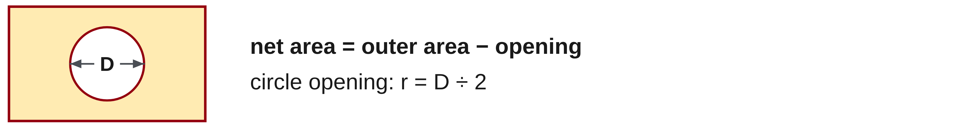
W06-L02 • TEACH • 2:25 PM–2:40 PM • 15 MIN TOTAL
Subtract openings before estimating coverage
1
Net area = outer area − opening area.
2
For a circular opening, use A = πr² with half the diameter as r.
3
Keep all areas in the same square unit.
4
Use net area and the stated coverage to calculate whole tins to buy.
Textbook sections 10.4–10.7 pp.246–254
Textbook
Exercise Book
Numeracy Hub
Shape Canvas
Day 18 • 2026-11-30 • 26
Notes:
TEACH • 2:25 PM–2:40 PM • 15 MIN TOTAL — shared across this phase’s slides.
Net area means the area remaining after openings are removed. Write outer area minus opening area, using the same square unit for both. For a circular opening, the formula is πr². If the drawing labels a diameter, halve it first to find r. Why is that step especially important here? Radius is squared, so using the diameter would make the circle area four times too large. After finding net area, a coverage rate can turn that area into litres. Whole tins are rounded up when a partial tin is still needed to cover the stated surface.

Slide 27
W06-L02 • TEACH • 2:25 PM–2:40 PM • 15 MIN TOTAL
Subtract the opening, not the outside
Outer: 1,200 × 800 mm
Outer area = 960,000 mm²
Opening area = 60,000 mm²
Net = 900,000 mm² = 0.9 m²
Check: 900,000 + 60,000
= 960,000 mm².
Keep all dimensions in one unit.
Opening: 300 × 200 mm
Together • 10A Q10–12 and 10C Q4. Annotate non-overlapping parts.
Use a Shape Canvas sketch only after choosing the add/subtract steps.
Exercise Book 10B Q11 p.96 • Schematic, not to scale • Surface-net preview is optional after core work
Textbook
Exercise Book
Numeracy Hub
Shape Canvas
Day 18 • 2026-11-30 • 27
Notes:
TEACH • 2:25 PM–2:40 PM • 15 MIN TOTAL — shared across this phase’s slides.
The outside measures 1,200 by 800 millimetres, so the outer area is 960,000 square millimetres. The opening is 300 by 200, giving 60,000 square millimetres. Subtract the opening: 960,000 minus 60,000 is 900,000 square millimetres. Divide by one million to express this as 0.9 square metre. How can we check the subtraction geometrically? Add the remaining material and the opening back together: 900,000 plus 60,000 returns the complete outer area. The result should also be smaller than the outer area and larger than zero.

Slide 28
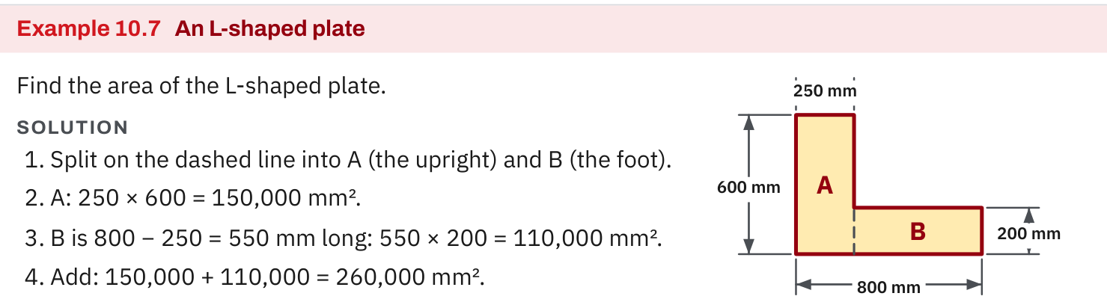
W06-L02 • TEACH • 2:25 PM–2:40 PM • 15 MIN TOTAL
Textbook | page 251
Textbook p.251 • Example 10.7 — Split an L-shaped plate into non-overlapping rectangles
Textbook sections 10.4–10.7 pp.246–254
Textbook
Exercise Book
Numeracy Hub
Shape Canvas
Day 18 • 2026-11-30 • 28
Notes:
TEACH • 2:25 PM–2:40 PM • 15 MIN TOTAL — shared across this phase’s slides.
The L-shaped plate in Example 10.7 is split into an upright and a foot. The upright is 250 by 600 millimetres, giving 150,000 square millimetres. The foot must exclude the width already counted in the upright: its length is 800 minus 250, or 550 millimetres. Its area is 550 times 200, or 110,000 square millimetres. Adding gives 260,000 square millimetres. Why not use the full 800 for the foot as well? That would count the overlapping corner twice. The split lines make the no-overlap rule visible.

Slide 29
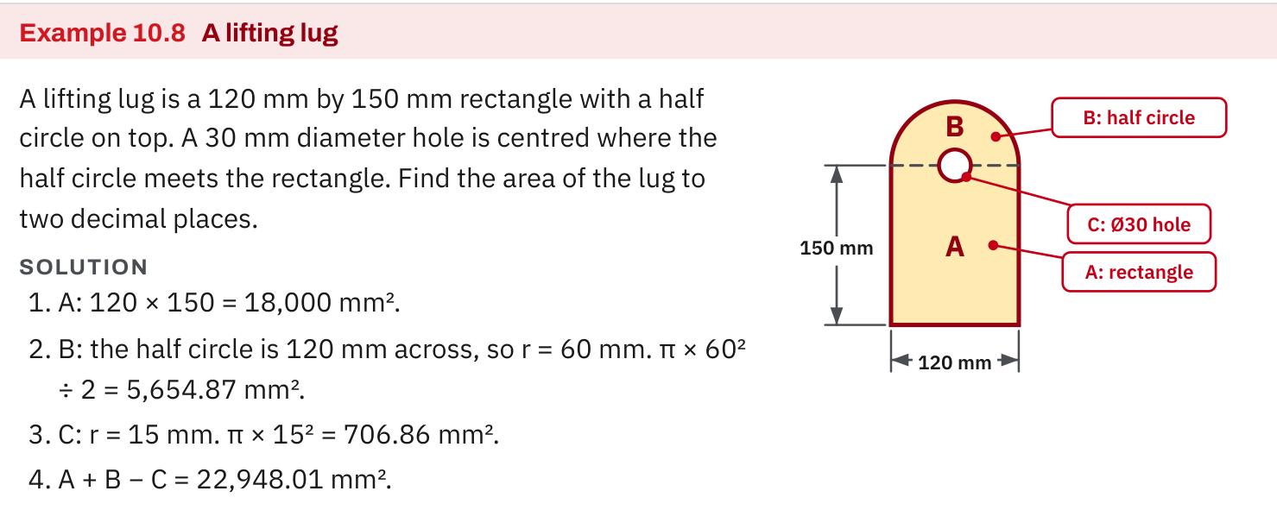
W06-L02 • TEACH • 2:25 PM–2:40 PM • 15 MIN TOTAL
Textbook | page 252
Textbook p.252 • Example 10.8 — Add the shapes and subtract the opening
Textbook sections 10.4–10.7 pp.246–254
Textbook
Exercise Book
Numeracy Hub
Shape Canvas
Day 18 • 2026-11-30 • 29
Notes:
TEACH • 2:25 PM–2:40 PM • 15 MIN TOTAL — shared across this phase’s slides.
Example 10.8 combines a rectangle, a semicircle and a hole. The rectangle is 120 by 150 millimetres, or 18,000 square millimetres. The top semicircle has diameter 120, so its radius is 60; its area is π times 60 squared divided by two. The hole has diameter 30, so its radius is 15; its area is π times 15 squared. Add the rectangle and semicircle, then subtract the hole, retaining precision until the end: 22,948.01 square millimetres. Which part gets subtracted? Only the opening, because no material remains there.

Slide 30
W06-L02 • TEACH • 2:25 PM–2:40 PM • 15 MIN TOTAL
Spot the mistake. Explain the correction.
A panel has a circular opening labelled by diameter. Can that diameter go directly into πr²?
Discuss the method before checking the answer.
No. Divide the diameter by two to obtain the radius, then square the radius.
Textbook sections 10.4–10.7 pp.246–254
Textbook
Exercise Book
Numeracy Hub
Shape Canvas
Day 18 • 2026-11-30 • 30
Notes:
TEACH • 2:25 PM–2:40 PM • 15 MIN TOTAL — shared across this phase’s slides.
The circular opening is labelled with a diameter, but the area formula asks for a radius. What must happen before squaring? Divide the diameter by two. If we accidentally use the diameter as r, we double the input to the square, and the calculated opening area becomes four times too large. That would remove far too much from the outer area. Explain the correction using the centre of a circle: a radius reaches halfway across, while a diameter reaches all the way across. Then write r equals D divided by two before using πr².

Slide 31
W06-L02 • TOGETHER • 2:40 PM–2:55 PM • 15 MIN TOTAL
Work together
Work Exercise Book 10A Q10–12 and Exercise Book 10C Q4. Partners annotate non-overlapping pieces.
Work in pairs, alternating solver and checker. Write a diagram, formula, units and estimate.
Resources: Exercise Book 10A Q10–12 (p.94); 10B Q2 (p.95), Q11–12 (p.96); 10C Q4 (p.97)
Textbook sections 10.4–10.7 pp.246–254
Textbook
Exercise Book
Numeracy Hub
Shape Canvas
Day 18 • 2026-11-30 • 31
Notes:
TOGETHER • 2:40 PM–2:55 PM • 15 MIN TOTAL — shared across this phase’s slides.
Work through 10A questions 10 to 12 and 10C question 4 with a partner. On each drawing, label the separate pieces and decide whether each area is added or subtracted. For the trapezoid, identify the parallel sides and the perpendicular height. For a composite shape, make sure the pieces do not overlap. What should your partner be able to trace? Every term in your area calculation back to a specific region of the drawing. That connection matters more than simply agreeing on a calculator result.

Slide 32
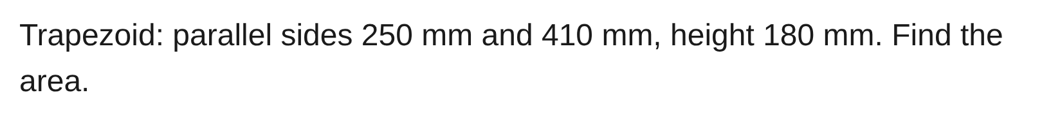
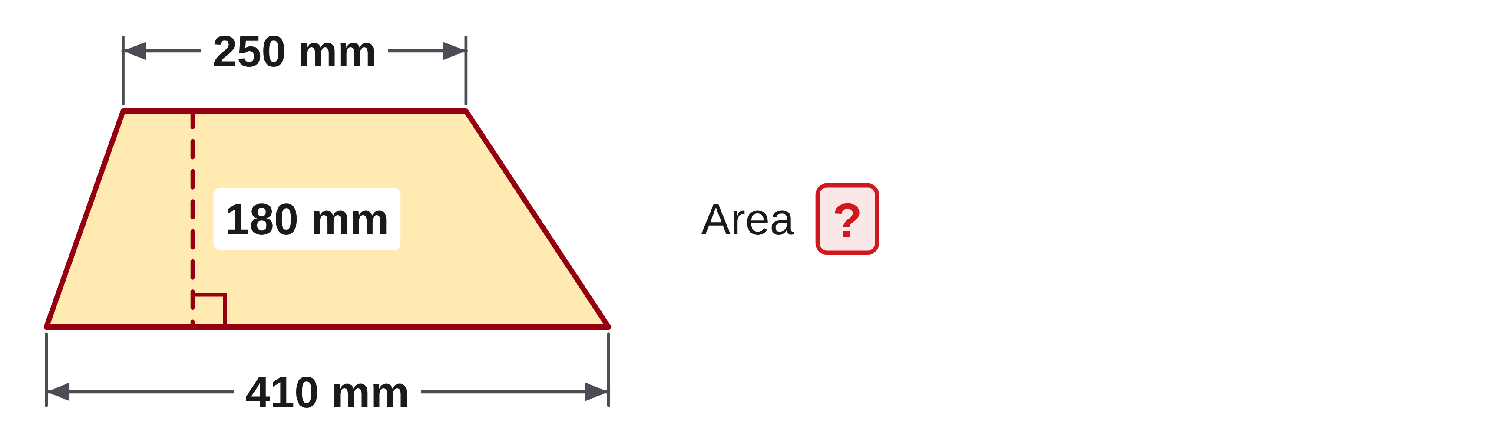
W06-L02 • TOGETHER • 2:40 PM–2:55 PM • 15 MIN TOTAL
Guided practice | 10A Q10
Work with a partner. Take turns explaining the next step.
Textbook sections 10.4–10.7 pp.246–254
Textbook
Exercise Book
Numeracy Hub
Shape Canvas
Day 18 • 2026-11-30 • 32
Notes:
TOGETHER • 2:40 PM–2:55 PM • 15 MIN TOTAL — shared across this phase’s slides.
The trapezoid in 10A question 10 has parallel sides 250 and 410 millimetres, with a height of 180 millimetres. Find the average of the parallel sides, then use the height. Predict whether the answer should lie between the areas of 250-by-180 and 410-by-180 rectangles.
Instructor only, after the attempt: A = (250 + 410) ÷ 2 × 180 = 330 × 180 = 59,400 mm². It lies between 45,000 and 73,800 mm².

Slide 33
W06-L02 • TOGETHER • 2:40 PM–2:55 PM • 15 MIN TOTAL
Compare your method | 10A Q10
CHECK TOGETHER
59,400 mm²
Textbook sections 10.4–10.7 pp.246–254
Textbook
Exercise Book
Numeracy Hub
Shape Canvas
Day 18 • 2026-11-30 • 33
Notes:
TOGETHER • 2:40 PM–2:55 PM • 15 MIN TOTAL — shared across this phase’s slides.
The trapezoid’s area is 59,400 square millimetres. Adding its parallel sides gives 660 millimetres; halving gives the average width, 330 millimetres. Multiplying by the perpendicular height of 180 gives the area. Why is that result reasonable? It lies between the areas of rectangles using the smaller and larger parallel sides. If someone forgot to divide by two, the result would be twice the correct area. Read your formula aloud so both the averaging step and the perpendicular height are clear.

Slide 34
W06-L02 • PRACTISE • 2:55 PM–3:15 PM • 20 MIN TOTAL
Your scheduled practice
Complete Exercise Book 10B Q2,11–12. Build a Shape Canvas sketch and label areas; use the net preview only if core subtraction and coverage are secure.
Solve on paper first; check with tools; correct one error and explain the change.
Resources: Exercise Book 10A Q10–12 (p.94); 10B Q2 (p.95), Q11–12 (p.96); 10C Q4 (p.97)
Textbook sections 10.4–10.7 pp.246–254
Textbook
Exercise Book
Numeracy Hub
Shape Canvas
Day 18 • 2026-11-30 • 34
Notes:
PRACTISE • 2:55 PM–3:15 PM • 20 MIN TOTAL — shared across this phase’s slides.
Complete 10B questions 2, 11 and 12. In the coating problem, count the number of plates and the number of faces before applying coverage. In the opening problem, subtract the removed area from the outside. Build a labelled Shape Canvas sketch to support your calculations. Only after those core calculations are secure should you explore the optional solid-and-net preview. What will you check first if a result is too large? Whether an opening was added, an overlapping part counted twice, or an extra face included.

Slide 35

W06-L02 • PRACTISE • 2:55 PM–3:15 PM • 20 MIN TOTAL
Open Shape Canvas
Navigation example. Use the values and units in the assigned task.
Textbook sections 10.4–10.7 pp.246–254
Textbook
Exercise Book
Numeracy Hub
Shape Canvas
Day 18 • 2026-11-30 • 35
Notes:
PRACTISE • 2:55 PM–3:15 PM • 20 MIN TOTAL — shared across this phase’s slides.
Open Shape Canvas and represent the outer rectangle and its opening as two labelled shapes. Keep the dimensions and the role of each shape clear. The opening is not another piece to add: it records material removed. Calculate their areas separately on paper, then subtract. What must be true of the opening’s area? It must be smaller than the outer panel for the drawing we are using. The screen helps us inspect the geometry, but the labels, formulas and signs should explain the numerical result.

Slide 36
W06-L02 • PRACTISE • 2:55 PM–3:15 PM • 20 MIN TOTAL
Practise in Numeracy Hub and Shape Canvas
1
Use two labelled shapes in Shape Canvas to represent the outer rectangle and opening.
2
Compute the separate areas and net area on paper before comparing the labels.
3
Only after core coverage work is secure, inspect the optional Shape Studio solid/net preview.
Textbook sections 10.4–10.7 pp.246–254
Textbook
Exercise Book
Numeracy Hub
Shape Canvas
Day 18 • 2026-11-30 • 36
Notes:
PRACTISE • 2:55 PM–3:15 PM • 20 MIN TOTAL — shared across this phase’s slides.
Use two labelled shapes to show the outer surface and the opening. Write each area with the same square unit, then write the net calculation as a subtraction. Compare the labels only after you have a paper result. What happens if you add the two areas? You count the opening as extra material instead of removing it. If the core area and coverage work is complete, the optional solid-and-net preview can help you see how flat faces correspond to a solid, but keep that extension separate from the required opening calculation.

Slide 37
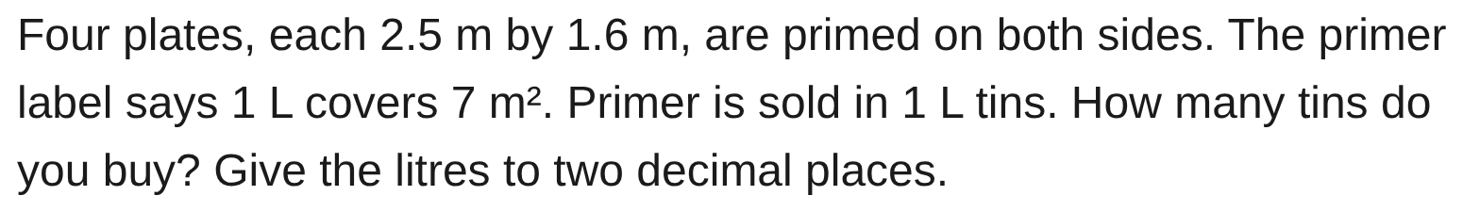
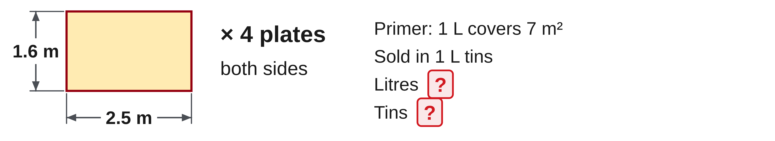
W06-L02 • PRACTISE • 2:55 PM–3:15 PM • 20 MIN TOTAL
Practise from the Exercise Book | 10B Q2
Write the operation, working and units before checking.
Textbook sections 10.4–10.7 pp.246–254
Textbook
Exercise Book
Numeracy Hub
Shape Canvas
Day 18 • 2026-11-30 • 37
Notes:
PRACTISE • 2:55 PM–3:15 PM • 20 MIN TOTAL — shared across this phase’s slides.
Four plates measure 2.5 by 1.6 metres, and both sides are primed. One litre covers 7 square metres, and tins hold one litre. Count all the faces before converting area to litres. Find litres to two decimals, then decide the whole tins to buy.
Instructor only, after the attempt: one face = 4 m²; four plates, both sides = 4 × 4 × 2 = 32 m². 32 ÷ 7 = 4.5714… L = 4.57 L, so buy 5 tins.

Slide 38
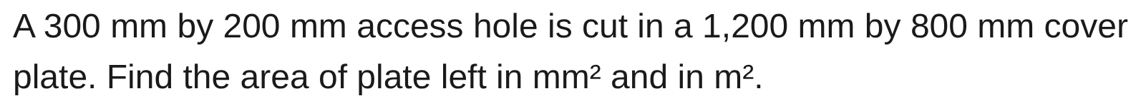
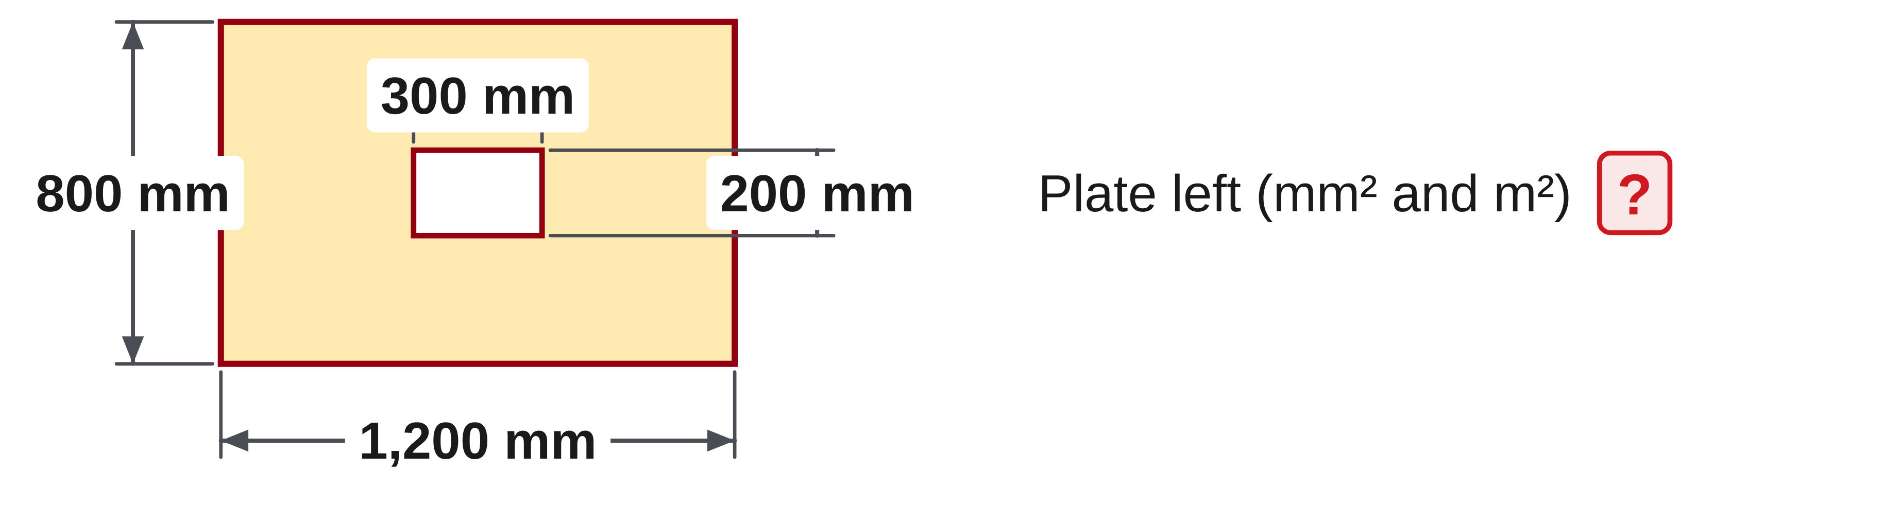
W06-L02 • PRACTISE • 2:55 PM–3:15 PM • 20 MIN TOTAL
Practise from the Exercise Book | 10B Q11
Write the operation, working and units before checking.
Textbook sections 10.4–10.7 pp.246–254
Textbook
Exercise Book
Numeracy Hub
Shape Canvas
Day 18 • 2026-11-30 • 38
Notes:
PRACTISE • 2:55 PM–3:15 PM • 20 MIN TOTAL — shared across this phase’s slides.
Question 10B 11 removes a 300-by-200-millimetre opening from a 1,200-by-800-millimetre plate. Sketch the outer panel and opening, then find the material left in both square millimetres and square metres.
Instructor only, after the attempt: outer = 960,000 mm²; opening = 60,000 mm²; remaining = 900,000 mm² = 0.9 m². Check by adding the remaining area and opening area to recover 960,000 mm². The result must be smaller than the original plate.

Slide 39
W06-L02 • CHECK • 3:15 PM–3:25 PM • 10 MIN TOTAL
Check independently
Exercise Book 10B Q11 and Q2; report net area and whole tins to buy.
Solve without displayed answers; include working, units and final rounding.
Resources: Exercise Book 10A Q10–12 (p.94); 10B Q2 (p.95), Q11–12 (p.96); 10C Q4 (p.97)
Textbook sections 10.4–10.7 pp.246–254
Textbook
Exercise Book
Numeracy Hub
Shape Canvas
Day 18 • 2026-11-30 • 39
Notes:
CHECK • 3:15 PM–3:25 PM • 10 MIN TOTAL — shared across this phase’s slides.
Complete 10B questions 11 and 2 independently. For question 11, show the outer area, opening area and net area, including the unit conversion. For question 2, show how many faces are coated before calculating litres and whole tins. Keep worked solutions closed during both attempts. What makes these two tasks different? One removes a region; the other counts multiple surfaces. Your diagram or labelled working should make that distinction clear before you enter the final arithmetic.

Slide 40
W06-L02 • CHECK • 3:15 PM–3:25 PM • 10 MIN TOTAL
Independent check | 10B Q11
Answer independently. Keep worked solutions closed.
Textbook sections 10.4–10.7 pp.246–254
Textbook
Exercise Book
Numeracy Hub
Shape Canvas
Day 18 • 2026-11-30 • 40
Notes:
CHECK • 3:15 PM–3:25 PM • 10 MIN TOTAL — shared across this phase’s slides.
Find the area left after the 300-by-200-millimetre opening is cut from the 1,200-by-800-millimetre cover plate. Report square millimetres and square metres independently, with a check of the subtraction.
Instructor only, after the independent attempt: 1,200 × 800 − 300 × 200 = 960,000 − 60,000 = 900,000 mm². Divide by 1,000,000 to obtain 0.9 m². Adding the 60,000 mm² opening returns the original 960,000 mm².

Slide 41
W06-L02 • CHECK • 3:15 PM–3:25 PM • 10 MIN TOTAL
Independent check | 10B Q2
Answer independently. Keep worked solutions closed.
Textbook sections 10.4–10.7 pp.246–254
Textbook
Exercise Book
Numeracy Hub
Shape Canvas
Day 18 • 2026-11-30 • 41
Notes:
CHECK • 3:15 PM–3:25 PM • 10 MIN TOTAL — shared across this phase’s slides.
Find the primer needed for four plates, each 2.5 by 1.6 metres, coated on both sides. Coverage is 7 square metres per litre, with one-litre tins. Work independently and distinguish the calculated litres from the tins purchased.
Instructor only, after the independent attempt: 2.5 × 1.6 = 4 m² per face; 4 × 4 × 2 = 32 m² total. 32 ÷ 7 = 4.57 L to two decimals. Buy 5 tins because 4 tins cannot supply the required volume.

Slide 42
W06-L02 • WRAP UP • 3:25 PM–3:30 PM • 5 MIN TOTAL
Wrap up and choose the next step
Ask: What changed in your understanding? Where will you use it? What should you check next time?
Name the math and one other essential skill used; record a next practice step.
Resources: Exercise Book 10A Q10–12 (p.94); 10B Q2 (p.95), Q11–12 (p.96); 10C Q4 (p.97)
Textbook sections 10.4–10.7 pp.246–254
Textbook
Exercise Book
Numeracy Hub
Shape Canvas
Play quiz
Quiz PDF
Day 18 • 2026-11-30 • 42
Notes:
WRAP UP • 3:25 PM–3:30 PM • 5 MIN TOTAL — shared across this phase’s slides.
Choose a calculation where you had to decide between adding and subtracting. Explain what each part represented physically: material joined, an opening removed, or a surface coated. What check caught or prevented an error? The net area should be smaller than the outer area, and purchased tins must supply enough coating. Record one specific check you will carry forward. Our next work introduces volume, so we will extend the same idea of identifying the measured object from a flat surface into three dimensions.

