Slide 1
Design and Analysis of Algorithms
L22: Heapsort
Transform and Conquer Approach
Dr. Ram P Rustagi
Sem IV (2020-Even)
Dept of CSE, KSIT
rprustagi@ksit.edu.in
DAA/Greedy Algorithms
RPR/

Slide 2
Resources
Text book 1: 6.4 - Levitin
R1: Introduction to Algorithms
Cormen et al.
DAA/Greedy Algorithms
RPR/

Slide 3
Transform and Conquer
Secret to life: Replace one worry with another.
American cartoonist Charles M Shulz (1922-2000)
src: https://www.pinterest.com/pin/107453141079040075/
DAA/Greedy Algorithms
RPR/

Slide 4
Transform and Conquer
Transform and conquer approach
A two stage process
Transformation stage: change the problem instance to another form, more amenable to solution
Conquering stage: Solve the problem
Transformation can be done in 3 ways
Instance simplification: to a simpler or more convenient instance of the problem: presorted lists
Different representation: Heaps, Horner’s rule
Problem reduction: transform to a different problem for which solution is available.
DAA/Greedy Algorithms
RPR/

Slide 5
Priority Queue
Priority Queue:
A data structure with an orderable (called priority) characteristic on set of elements maintained by it
Allows 3 operations in an efficient way
FindMin (or even FindMax):
Find an item with highest priority (e.g. max, min)
DeleteMin:
Delete an item with highest priority
Insert:
Add a new item to the data structure
Heaps makes these 3 operations interesting and useful
Heapsort: a cornerstone of theoretical sorting problem
DAA/Greedy Algorithms
RPR/

Slide 6
Heap
Definition:
Heap is defined as binary tree with keys assigned to nodes (one key per node) with following conditions
Binary tree is a a complete tree except possibly at the last level
Few rightmost leaves may be missing
The key of a parent is greater than or equal to keys of its children and hence descendants
Also, known as parental dominance.
DAA/Greedy Algorithms
RPR/

Slide 7
Examples
Q: Identify if given binary tree is a heap?
9
9
9
5
7
5
7
5
7
6
2
1
4
2
1
2
1
DAA/Greedy Algorithms
RPR/

Slide 8
Max Heap Properties
There exists only 1 complete binary tree with n nodes.
The root of the heap is always the largest element
(For minheap, it will be smallest element0
Any heap node alongwith all its descendants is also a heap
Heap implementation
Can be an array H[] with top-down and left to right
Store heap elements in positions thru 1 to n.
Element H[0] can either be unused or a sentinel
Its value can be greater than every element of heap
Parental nodes are in first ⌊n/2⌋ positions of the array
Leaf nodes will be last ⌈n/2⌉ positions of the array
DAA/Greedy Algorithms
RPR/

Slide 9
Example: Heap Implementation
9
Left child of node at j is at 2j
Right child (if exists) of node at j is at 2j+1
Parent of node at j is at ⌊j/2⌋
Parental nodes are in first ⌊n/2⌋ positions of the array
Leaf nodes are in last ⌈n/2⌉ positions of the array
5
7
4
2
1
0
1
2
3
4
5
6
 | 9 | 5 | 7 | 4 | 2 | 1
DAA/Greedy Algorithms
RPR/

Slide 10
Heap Construction
S0: Initiaize heap structure with keys in order of occurrence
S1: Start with the last (right most) parental node i.e start with node at position ⌊n/2⌋
Fix the heap rooted at it.
If it fails the heap condition, then exchange with larger of two children
Repeat the process till heap condition satisfies
S2: Repeat the previous step (s1) for preceding parental nodes i.e from nodes ⌊n/2⌋-1 to 1
DAA/Greedy Algorithms
RPR/

Slide 11
Heap Construction
Consider the data: 2,9,1,6,5,7
Construct the heap in order.
Let us heapify
Last parental node (at ⌊6/2⌋=3 is 1
Smaller than child node 7 at pos 6
Exchange it
Heap property satisfies
2
9
1
6
5
7
2
- | 2 | 9 | 1 | 6 | 5 | 7
9
1
7
- | 2 | 9 | 7 | 6 | 5 | 1
7
6
5
1
DAA/Greedy Algorithms
RPR/

Slide 12
Heap Construction
Consider preceding parental node 9 (at pos 3-1=2)
It is in order. No exchange required
Next parental node 2 (at pos 1). Needs heapification.
Exchange it with 9, and repeat the process
2
2
9
9
9
7
2
7
7
6
5
1
6
5
1
6
5
1
keys: 2,9,7,6,5,1
DAA/Greedy Algorithms
RPR/

Slide 13
Heap Construction
Since exchanged node 2 is not in heap order
This needs to be exchanged with 6.
9
9
2
6
7
7
6
5
1
2
5
1
Now heap is in order.
DAA/Greedy Algorithms
RPR/

Slide 14
Heap Algorithm
Algo HeapBottomUp(H[1:n])
// i/p: an array H[1:n] of items to be ordered
// o/p: Heap H[1:n] of ordered items
for i ← ⌊n/2⌋ to 1 do
k←i; v←H[k]; heap←False
while not heap and 2*k≤n do
j ←2*k
if j<n // there are two children
if H[j] < H[j+1]
j ←j+1
if v≥H[j]
heap←True
else
H[k] ← H[j]; k←j
H[k]←v
2
9
1
6
5
7
DAA/Greedy Algorithms
RPR/

Slide 15
Complexity Analysis
Consider the tree height
Height of a node:
Length of the path from it to leaf
n-element heap has height ⌊lg2 n⌋
Number of nodes at height
h is ⌈n/2^{h+1}⌉
e.g. n=15, h=3,
nodes at h=0 is 8,
at h=1 is 4, at h=2 is 2,at h=3 is 1
Generalized analysis
Moving ⌊n/2⌋ nodes
i.e. considering parent nodes
Each node may move h=⌊lg2 n⌋ times.
Thus complexity for heapifying array is Θ(nlg2 n)
A
h=3
B
C
h=2
h=1
D
E
F
G
H
I
J
K
L
M
N
O
h=0
DAA/Greedy Algorithms
RPR/

Slide 16
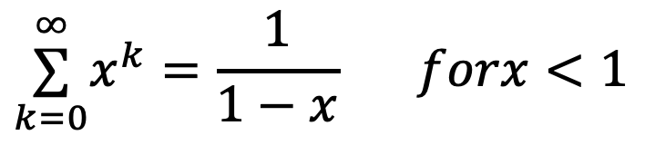
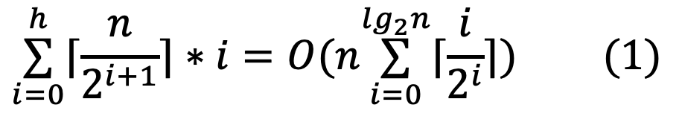
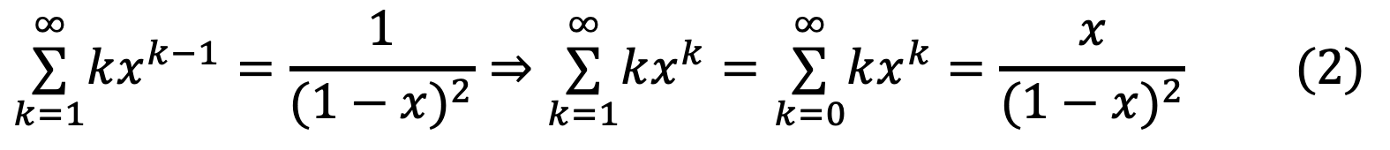
Complexity Analysis: Improved
Node at height 1 moves(down) at most 1 times
Node at height 2 moves(down) at most 2 times
… Node at height h moves(down) at most h times.
Total number of moves are
∑𝑖=0h⌈𝑛2𝑖+1⌉∗𝑖=𝑂(𝑛∑𝑖=0𝑙𝑔2𝑛⌈𝑖2𝑖⌉)𝑋𝑋𝑋(1)
∑𝑘=0∞𝑥𝑘=11−𝑥𝑋𝑋𝑓𝑜𝑟𝑥<1
Some basic mathematics
Differentiating both sides
∑𝑘=1∞𝑘𝑥𝑘−1=1(1−𝑥)2⇒∑𝑘=1∞𝑘𝑥𝑘=∑𝑘=0∞𝑘𝑥𝑘=𝑥(1−𝑥)2𝑋𝑋𝑋(2)
DAA/Greedy Algorithms
RPR/

Slide 17
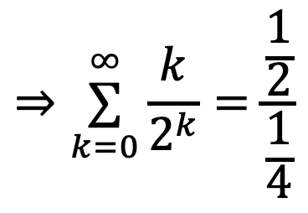
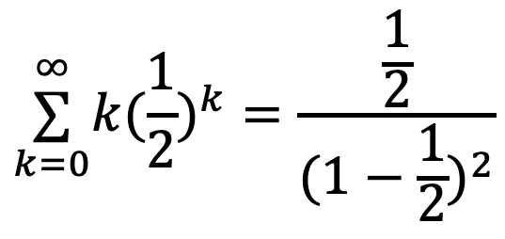
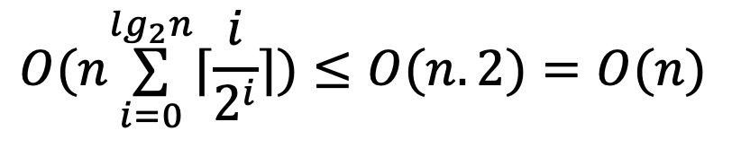
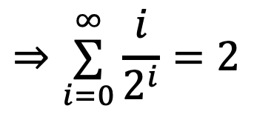
Complexity Analysis: Improved
Taking x=1/2 in eqn (2) gives
$$\overset{∞}{\underset{k=0}{∑}}k(\frac{1}{2})^{k}=\frac{\frac{1}{2}}{(1−\frac{1}{2})^{2}}$$
$$⇒\overset{∞}{\underset{k=0}{∑}}\frac{k}{2^{k}}=\frac{\frac{1}{2}}{\frac{1}{4}}$$
$$⇒\overset{∞}{\underset{i=0}{∑}}\frac{i}{2^{i}}=2$$
$$O(n\overset{lg_{2}n}{\underset{i=0}{∑}}⌈\frac{i}{2^{i}}⌉)≤O(n.2)=O(n)$$
Thus eqn (1) becomes
That is heap from the array can be built in O(n) time
DAA/Greedy Algorithms
RPR/

Slide 18
Exercises:
Consider the array
3,5,6,7,20,8,2,9,12,15,30,17
Draw the Complete Binary Tree
Heapify the tree.
Workout the upates in array when heapifying.
In the above heap, insert the following items, one at a time.
16, 21, 45
Perform 3 DeleteMax operations
Show the heap structure after each delete
DAA/Greedy Algorithms
RPR/

Slide 19
Summary
Priority queue
3 Operations
FindMin
DeleteMin
Add
Heap
Heapification (building an heap)
Time complexity analysis
DAA/Greedy Algorithms
RPR/

