Slide 1
Design and Analysis of Algorithms
L09: Divide and Conquer
Dr. Ram P Rustagi
Sem IV (2020-Even)
Dept of CSE, KSIT/KSSEM
rprustagi@ksit.edu.in
DAA/Divide and Conquer
RPR/

Slide 2
Resources
Text book 2: Horowitz
Text book 1: Levitin
https://visualgo.net/en
DAA/Divide and Conquer
RPR/

Slide 3
Divide and Conquer Algo
Divide (break) the problem (size n) into similar sub problems
Size of sub problems should be some factor of original e.g. n/c
When small enough, solve by brute force
Conquer (Solve) the sub-problem
Use recursion to solve small problem
Combine (Merge) the solution of sub-parts
The cost is
Cost of breaking
Cost of solving subproblem
Cost of combining
DAA/Divide and Conquer
RPR/

Slide 4
Divide and Conquer Approach
Problem of
Size n
Subprob 1
of size n/k
Subprob 2
of size n/k
…
Subprob k
of size n/k
Solution to
Subprob 1
Solution to
Subprob 2
…
Solution to
Subprob k
Solution to Original Problem of Size n
DAA/Divide and Conquer
RPR/

Slide 5
Divide and Conquer Examples
Sorting and Searching
Binary Tree traversals
Binary search
Multiplication of large numbers (Karatsuba Algo)
Matrix multiplicatin - Strassen’s algorithm
Closest pair problem
Convex Hull problem
DAA/Divide and Conquer
RPR/

Slide 6
Simple Example
Given 16 balls with one defective (say lighter)
Identify the defective ball.
01
02
03
04
05
06
07
08
09
10
11
12
13
14
15
16
Solution 1:
Compare 1 with 2
Compare 1 with 3
:
Compare 1 with 16
Time taken:
15 comparisons (worst case)
01
02
01
03
01
11
01
16
DAA/Divide and Conquer
RPR/

Slide 7
Simple Example
Given 16 balls with one defective (say lighter)
Identify the defective ball.
01
02
03
04
05
06
07
08
09
10
11
12
13
14
15
16
Solution 2:
Compare 1 with 2
Compare 3 with 4
:
Compare 15 with 16
Time taken:
8 comparisons (worst case)
01
02
03
04
2k-1
2k
15
16
DAA/Divide and Conquer
RPR/

Slide 8
Simple Example
Given 16 balls with one defective (say lighter)
Identify the defective ball.
01
02
03
04
05
06
07
08
09
10
11
12
13
14
15
16
Soltion3: Divide and Conquer
Divide into 2 sets, each of 8 balls
Compare 1-8 with 9-16, and divide the lighter set into two parts each of 4.
:
Continue the process till lighter ball is found
Time taken: 4 comparisons (log216)
01
…
08
09
…
16
13
…
09
…
16
12
DAA/Divide and Conquer
RPR/

Slide 9
Simple Example
Given 16 balls with one defective (say lighter)
Identify the defective ball.
01
02
03
04
05
06
07
08
09
10
11
12
13
14
15
16
Soltion3: Time complexity
T(n) = T(n/2) + 1 #1 comparison reduces it by half
= T(n/4) + 1 + 1 = T(n/2²)+2
= T(n/2³) + 3
:
= T(n/2^{i}) + i
= log₂n
DAA/Divide and Conquer
RPR/

Slide 10
Divide & Conquer: Control Abstraction
Algo D_And_C(P) {
if Small(P)
return S(P)
else {
Divide P into smaller sets P1, …,Pk
Apply D_And_C to each subproblem
return Combine(D_And_C(P1),
…,
D_And_C(Pk))
}
}
DAA/Divide and Conquer
RPR/

Slide 11
Divide and Conquer: Recurrence Relation
$$T(n)=\{{g(n) \atop T(n_{1})+T(n_{2})+...+T(n_{k})+f(n)}{nsmall \atop otherwise}$$
T(n): time complexity for a problem of input size n
g(n): time complexity for solving directly for small inputs
f(n): Time complexity for dividing the problem into k subproblems and combining again from the solutions of k sub problems.
k would vary depending upon the problem
Generally, n1=n2=…=nk
Assuming a instances, each of size n/b
$$T(n)=\{{T(1) \atop aT(n/b)+f(n)}{n=1 \atop n>1}$$
DAA/Divide and Conquer
RPR/

Slide 12
DAA/Divide and Conquer
RPR/

Slide 13
Solving Recurrence Relation
$$T(n)=aT(n/b)+f(n)$$
Let n=b^{k}, then
$$T(b^{k})=aT(b^{k-1})+f(b^{k})$$
$$=a[aT(b^{k-2})+f(b^{k-1})]+f(b^{k})$$
$$=a^{2}T(b^{k-2})+af(b^{k-1})+f(b^{k})$$
$$=a^{3}T(b^{k-3})+a^{2}f(b^{k-2})+af(b^{k-1})+a^{0}f(b^{k})$$
:
$$=a^{k}T(b^{k-k})+a^{k-1}f(b^{k-(k-1)}+a^{2}f(b^{k-2})+af(b^{k-1})+a^{0}f(b^{k})$$
$$=a^{k}T(1)+a^{k-1}f(b^{1})+a^{k-2}f(b^{2})+...+a^{0}f(b^{k})$$
$$=a^{k}[T(1)+f(b^{1})/a^{1}+f(b^{2})/a^{2}+...+f(b^{k})/a^{k}]$$
DAA/Divide and Conquer
RPR/

Slide 14
Solving Recurrence Relation
$$T(n)=aT(n/b)+f(n)$$
$$T(b^{k})=aT(b^{k-1})+f(b^{k})$$
$$=a^{k}[T(1)+f(b^{1})/a^{1}+f(b^{2})/a^{2}+...+f(b^{k})/a^{k}]$$
$$=a^{k}[T(1)+\overset{k}{\underset{j=1}{∑}}\frac{f(b^{j})}{a^{j}}]$$
Thus, T(n) depends upon a, b, and f()
As n=b^{k}, then k=logbn, thus
a^{k}=a^{log}b^{n} =n^{log}bª, the recursion equation becomes
T(n)=nlogba[T(1)+∑j=1logbnf(bj)aj]XXXXXXXXX(1)
DAA/Divide and Conquer
RPR/

Slide 15
Recurrence Relation: Examples
Example 01: a=2, b=2,T(1)=1,f(n)=n
T(n)=2T(n/2)+n
= 2[2T(n/2²)+n/2]=2²T(n/2²)+n+n
= 2³T(n/2³)+n+n+n
= 2^{k}T(1)+n+…+n (log2n times)
= 2^{k}+n.log2n
= n + n.(log2n)
= n + nlog2n = Θ(nlog2n)
Using the eqn (1)
logba=log22=1, b/a=1→f(b^{j})/a^{j}=b^{j}/a^{j}=1
$$T(n)=n^{log_{b}a}[T(1)+\overset{log_{b}n}{\underset{j=1}{∑}}\frac{f(b^{j})}{a^{j}}]$$
= n[1+(1+1+…(log2n times)+1)]=nlog2n
=Θ(nlog2n)
DAA/Divide and Conquer
RPR/

Slide 16
Recurrence Relation: Examples
Example 02: a=9, b=3,T(1)=4,f(n)=4n⁶
Given
logba=log39=2,
f(b^{j})/a^{j}=4b^{6j}/a^{j}=4*3^{6j}/3^{2j}=4*3^{4j}
$$T(n)=n^{log_{b}a}[T(1)+\overset{log_{b}n}{\underset{j=1}{∑}}\frac{f(b^{j})}{a^{j}}]$$
= n²[4+(4*3⁴+4*3^{4*2}+…+4*3^{4*log}3^{n})]
= n²*4(3^{4*(log}3^{n+1)}-1)/(3⁴-1)
= c*n²*3^{4*(log}3^{n)}+d=c*n²*n⁴+d
=Θ(n⁶)
DAA/Divide and Conquer
RPR/

Slide 17
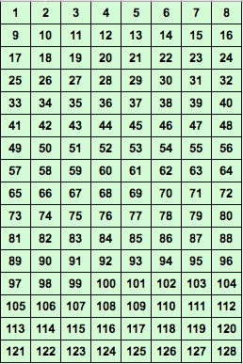
Fun Exercise of Game of 128 numbers
A practical fun example of Data structures and Algorithm
Game:
. Go thru a set of cards
. Say Y/N if present or not
. You will get your number
graphically displayed to you
Q?:
Which algorithm we are
discussing?
Aim: Can we find more such
examples
DAA/Divide and Conquer
RPR/

Slide 18
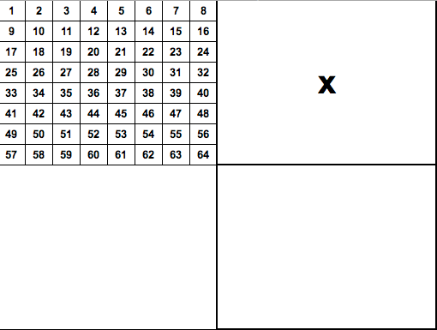
Game of 128 numbers - b
DAA/Divide and Conquer
RPR/

Slide 19
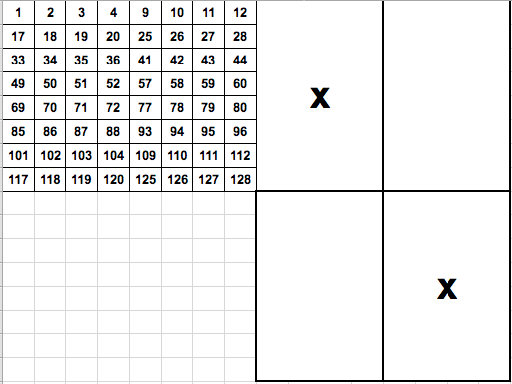
Game of 128 numbers - c
DAA/Divide and Conquer
RPR/

Slide 20
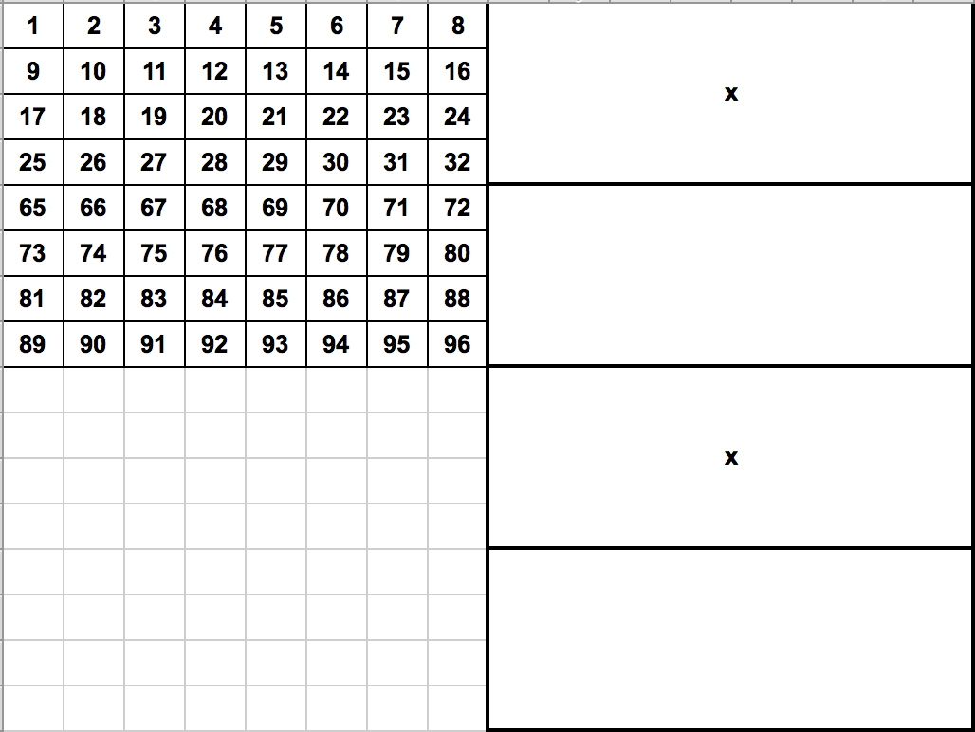
Game of 128 numbers - d
DAA/Divide and Conquer
RPR/

Slide 21
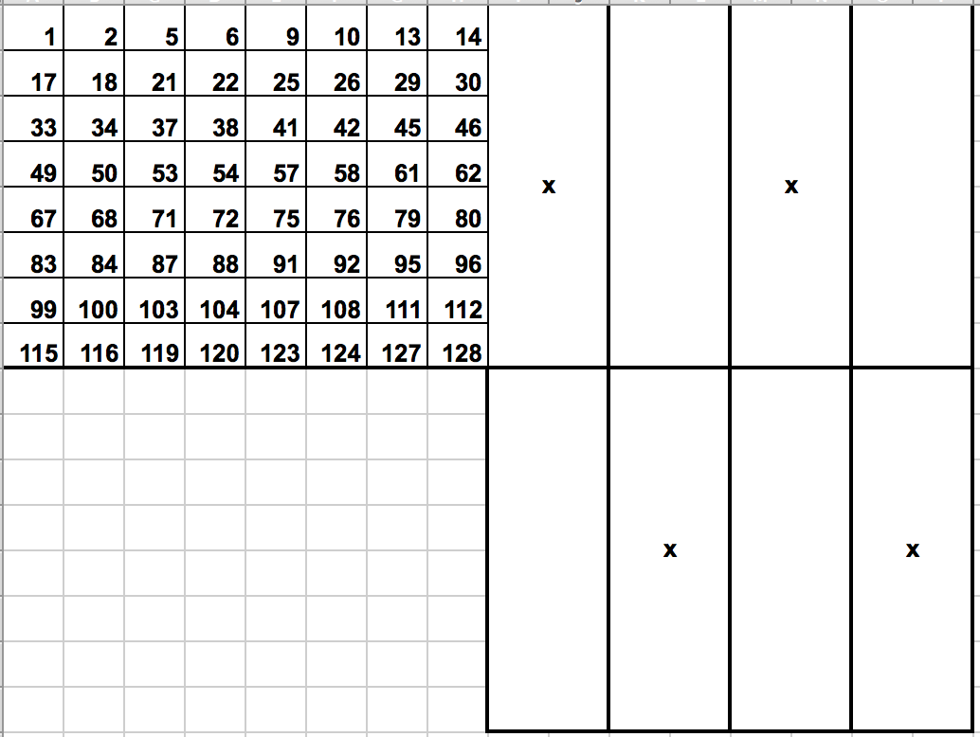
Game of 128 numbers - d
DAA/Divide and Conquer
RPR/

Slide 22
Exercise G
Exercise G
Work out the remaining 3 cards
DAA/Divide and Conquer
RPR/

Slide 23
Summary: Divide and Conquer
Break the problem into smaller subsets
By a factor c i.e. n—> n/c
Conquer (Solve) the sub-problem
Combine (Merge) the solution of sub-parts
Example cases
Sorting and Searching
Binary Tree traversals
Binary search
Multiplication of large numbers (Karatsuba Algo)
Matrix multiplicatin - Strassen’s algorithm
Closest pair problem
Convex Hull problem
DAA/Divide and Conquer
RPR/

Slide 24
Summary
Divide and Conquer approach
Cost efficiency:
Define recurrence relation
Solve the recurrance equation
Example of binary search (visual)
DAA/Divide and Conquer
RPR/

