Slide 1
Design and Analysis of Algorithms
L28: Optimal Binary Search
Dynamic Programming
Dr. Ram P Rustagi
Sem IV (2020-Even)
Dept of CSE, KSIT
rprustagi@ksit.edu.in
DAA/Dynamic Programming
RPR/

Slide 2
Resources
Text book 1: Levitin
Sec 8.3
R1: Introduction to Algorithms
Cormen et al.
DAA/Dynamic Programming
RPR/

Slide 3
Binary Search
Binary search tree
Key value of left child is smaller than parent
Key value of right child is greater than the parent
Balanced binary search tree- Height : O(log n)
Red Black tree - faster insertion and deletion
Root is always black
Both children of Red node are black
Any path from any node to leaf descendant contains same number of black nodes.
For any node, height of one subtree is at most twice the height of other subtree
AVL (Adelson-Velskii and Landis)Tree: faster search
Difference of height of two subtree is at most 1
For a random binary search tree, height is O(log n)
Worst case height can be O(n)
DAA/Dynamic Programming
RPR/

Slide 4
Optimal Binary Search Tree
Use case 1:
You need to translate a english document containing (n words) to Kannada.
You have a dictionary providing kannada translation for each english word.
Translation process:
Consider each word of english document, search in the english-kannada dictionary and use the same
Using a generic balanced binary search tree, average translation would take O(n.log2n) time.
If we know the frequency of occurrence of each word in english document, can we do better?
How to optimally organize binary search tree?
DAA/Dynamic Programming
RPR/

Slide 5
Optimal Binary Search Tree
Use case 2:
As an e-tailor, you are selling phones.
Total n types of brands/models etc.
Different customer will choose different brand/models
You organize the product details (price etc) in a binary search tree.
In general, each search O(n.log2n)takes time.
If we know the purchase frequency of each brand/model, can we improve upon the search time
How to optimally organize binary search tree?
Objective: organize binary search tree in such a way to reduce average look up time.
DAA/Dynamic Programming
RPR/

Slide 6
Binary Search Tree
Given n nodes, how many possible binary trees
Catalan number C(n): ^{2n}Cn/(n+1)
C(2)=⁴C2/3=6/3=2
C(3)=⁶C3/4=20/4=5
C(4)=⁸C4/5=70/5=14
3c
2a
2b
3a
3b
2
1
1
1
2
1
3
2
1
2
3
3
3d
3
3e
3
2
1
2
2
1
DAA/Dynamic Programming
RPR/

Slide 7
Binary Search Tree : 4 nodes…
1
1
4a
1
4b
1
4c
1
4d
4e
4
2
2
3
4
3
3
4
2
4
2
4
3
3
2
2
4f
2
4g
3
4h
3
4i
1
3
1
4
1
4
2
4
4
3
2
1
C(4)=⁸C4/5=70/5=14
DAA/Dynamic Programming
RPR/

Slide 8
Binary Search Tree : 4 nodes
4
4j
4
4k
4l
4
3
3
2
2
1
1
3
1
2
4
4m
4
4n
1
1
2
3
3
2
C(4)=⁸C4/5=70/5=14
DAA/Dynamic Programming
RPR/

Slide 9
Optimal Binary Search Tree
Problem:
Given n keys a1≤a2≤…≤an, with
Probabilities of occurrences p1,p2,…,pn
Find a Binary Search Tree (BST) with
Minimum average number of comparisons in successful search
Brute force methods
Total number of BST: C(n)= ^{2n}Cn/(n+1)
= Ω(4^{n}/n^{1.5})
Requires exponential number of searches
An impractical approach
DAA/Dynamic Programming
RPR/

Slide 10
Example: BSTs
Consider 4 keys A,B,C,D with their probabilities as
pA=0.1,pB=0.2,pC=0.4 and pD=0.3
Compute the average number of comparisons for BSTs given below
Average number of comparisons
=0.1*3+0.2*2+0.4*1+0.3*2
=1.7
C
B
D
A
C
Average number of comparisons
=0.1*2+0.2*3+0.4*1+0.3*2
=1.8
A
D
B
DAA/Dynamic Programming
RPR/

Slide 11
Finding Optimal BST
For 4 nodes, possible BSTs : 14
Finding the optimal BST requires evalutaion of 14 trees
When probability values changes, need recomputation to find a new BST
With inreasing n, it becomes challenging
Requires exponential computing.
Use of dynamic programming helps solve this issue in polynomial time.
DAA/Dynamic Programming
RPR/

Slide 12
Optimal BST: DP Approach
Given n keys: a1≤a2≤…≤an, with
Respective prob. of occurrences p1,p2,…,pn
Let Ti^{j} is a tree consisting of keys ai≤ai+1≤…≤aj,
i,j are some integer indices 1≤i≤j≤n.
Let C(i,j) denote the smallest number of average comparisons in a successful search for BST Ti^{j}.
Thus, desired answer for our n keys would be C(1,n)
Dynamic Programming approach:
Find smaller instances corresponding to C(i,j)
With the aim to solve C(1,n)
DAA/Dynamic Programming
RPR/

Slide 13
Optimal BST: DP Approach
Solving C(i,j) for Ti^{j}, ai≤ai+1≤…≤aj, 1≤i≤j≤n
Derive a recurrence for C(i,j).
Need to find the root ak(i≤k≤j) for Ti^{j},
Consider all possible ways of choosing root ak
ak could be any node between ai and aj
To find an optimal BST with root ak,
Use principle of optimality
Left subtree will have keys ai≤…≤ak-1 arranged optimally
Right subtree will have keys ak+1≤…≤aj arranged optimally.
DAA/Dynamic Programming
RPR/

Slide 14
DP for Optimal BST
Trees Ti^{k-1}, and Tk+1^{j}, are 1 level below the root node ak.
Comparison with ak require 1 operation, comparions of keys in two subtrees need to count this operation of comparison at root ak
ak
Optimal BST for ai…ak-1
Optimal BST for ak+1…aj
DAA/Dynamic Programming
RPR/

Slide 15
DP for Optimal BST
Recurrence for BST using DP
$$C(i,j)={min \atop i≤k≤j}\{p_{k}.1+\overset{k-1}{\underset{s=i}{∑}}p_{s}.(levelofa_{s}∈T_{i}^{k-1}+1)$$
$$+\overset{j}{\underset{s=k+1}{∑}}p_{s}.(levelofa_{s}∈T_{k+1}^{j}+1)\}$$
$$={min \atop i≤k≤j}\{p_{k}+\overset{k-1}{\underset{s=i}{∑}}p_{s}.levelofa_{s}∈T_{i}^{k-1}+\overset{k-1}{\underset{s=i}{∑}}p_{s}$$
$$+\overset{j}{\underset{s=k+1}{∑}}p_{s}.levelofa_{s}∈T_{k+1}^{j}+\overset{j}{\underset{s=k+1}{∑}}p_{s}\}$$
$$={min \atop i≤k≤j}\{\overset{k-1}{\underset{s=1}{∑}}p_{s}+p_{k}+\overset{j}{\underset{s=k+1}{∑}}p_{s}+\overset{k-1}{\underset{s=i}{∑}}p_{s}.levelofa_{s}∈T_{i}^{k-1}+\overset{j}{\underset{s=k+1}{∑}}p_{s}.levelofa_{s}∈T_{k+1}^{j}\}$$
$$={min \atop i≤k≤j}\{\overset{j}{\underset{s=i}{∑}}p_{s}+\overset{k-1}{\underset{s=i}{∑}}p_{s}.levelofa_{s}∈T_{i}^{k-1}+\overset{j}{\underset{s=k+1}{∑}}p_{s}.levelofa_{s}∈T_{k+1}^{j}\}$$
=∑s=ijps+mini≤k≤j{C(i,k-1)+C(k+1,j)}XXXXXX(1)
DAA/Dynamic Programming
RPR/

Slide 16
DP for Optimal BST
C(i,j)=∑s=ijps+mini≤k≤j{C(i,k-1)+C(k+1,j)}XXXXXX(1)
Recurrence for BST using DP:
C(i,i-1)=0 (number of comparisons in empty tree)
C(i,i)=pi*1=pi since tree has only one key ai
Example: computation for C(2,4) using eqn (1)
C(2,4)=Σ2≤s≤4 ps + min{C(2,1)+C(3,4),
C(2,2)+C(4,4),
C(2,3)+C(5,4)}
=Σ2≤s≤4 ps + min{0+C(3,4), p2+p4, C(2,3)+0}
DAA/Dynamic Programming
RPR/

Slide 17
DP for Optimal BST
=Σ2≤s≤4 ps + min{C(2,1)+C(3,4),
C(2,2)+C(4,4),
C(2,3)+C(5,4)}
=Σ2≤s≤4 ps+min{0+C(3,4), p2+p4,C(2,3)+0}
C(2,4)
0
1
2
3
4
5
1
2
0
p2
C(2,3)
C(2,4)
3
0
p3
C(3,4)
4
0
p4
5
0
DAA/Dynamic Programming
RPR/

Slide 18
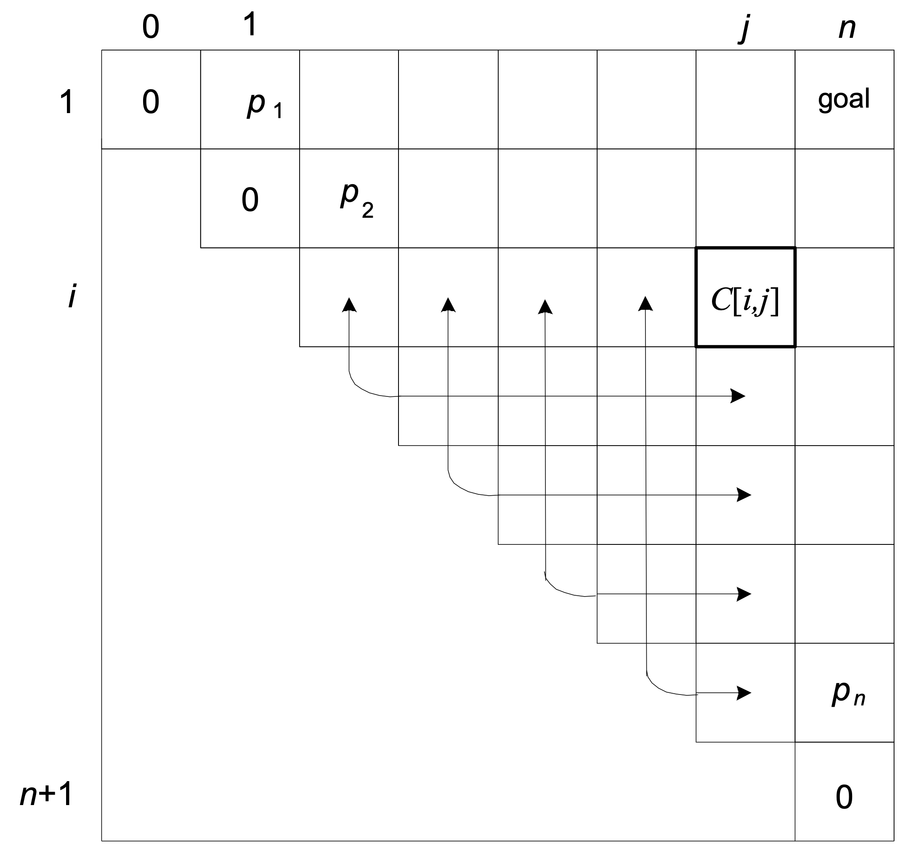
DP for Optimal BST
C(i,j)=∑s=ijps+mini≤k≤j{C(i,k-1)+C(k+1,j)}XXXXXX(1)
Contribution for C(i,j) is from
C(i,i-1)+C(i+1,j)
C(i,i)+C(i+2,j)
C(i,i+1)+C(i+3,j)
:
:
C(i,j-1)+C(j+1,j)
DAA/Dynamic Programming
RPR/

Slide 19
Exercise: Optimal BST
Consider 4 keys : A(1),B(2),C(3),D(4) with their prob. as
pA=0.1, pB=0.2, pC=0.4, pD=0.3,
$$C(1,4)=\overset{4}{\underset{s=1}{∑}}p_{s}+{min \atop 1≤k≤4}\{C(1,k-1)+C(k+1,4)\}$$
Note: 0=C(1,0)=C(2,1)+C(3,2)=C(4,3)=C(5,4)
Table: Computation of C(i,j)
Table: Optimal k for C(i,j)
0
1
2
3
4
 | 0 | 1 | 2 | 3 | 4
1
2
3
4
5
1
0
0.1
1
2
0
0.2
2
3
0
0.4
3
4
0
0.3
4
5
0
DAA/Dynamic Programming
RPR/

Slide 20
Exercise: Optimal BST
C(1,2)=Σ1≤s≤2ps+min{C(1,0)+C(2,2),C(1,1)+C(3,2)}
=0.3+min{0+0.2,0.1+0)=0.4,optimal k=2
C(2,3)=Σ2≤s≤3ps+min{C(2,1)+C(3,3),C(2,2)+C(4,3)}
=0.6+min{0+0.4,0.2+0)=0.8,optimal k=3
C(3,4)=Σ3≤s≤4ps+min{C(3,2)+C(4,4),C(3,3)+C(5,4)}
=0.7+min{0+0.3,0.4+0)=1.0,optimal k=3
Table: Computation of C(i,j)
Table: Optimal k for C(i,j)
0
1
2
3
4
 | 0 | 1 | 2 | 3 | 4
1 |  | 1
2 |  |  | 2
3 |  |  |  | 3
4 |  |  |  |  | 4
5
1
0
0.1
0.4
2
2
0
0.2
0.8
3
3
0
0.4
1.0
3
4
0
0.3
5
0
DAA/Dynamic Programming
RPR/

Slide 21
Exercise: Optimal BST
C(1,3)=Σ1≤s≤3ps+min{C(1,0)+C(2,3),
C(1,1)+C(3,3), C(1,2)+C(4,3)
=0.7+min{0+0.8,0.1+0.4,0.4+0)=1.1, opt k=3
C(2,4)=Σ2≤s≤4ps+min{C(2,1)+C(3,4),
C(2,2)+C(4,4), C(2,3)+C(5,4)}
=0.9+min{0+1.0,0.2+0.3,0.8+0)=1.4,opt k=3
Table: Computation of C(i,j)
Table: Optimal k for C(i,j)
0
1
2
3
4
 | 0 | 1 | 2 | 3 | 4
1 |  | 1 | 2
2 |  |  | 2 | 3
3 |  |  |  | 3 | 3
4 |  |  |  |  | 4
5
1
0
0.1
0.4
1.1
3
2
0
0.2
0.8
1.4
3
3
0
0.4
1.0
4
0
0.3
5
0
DAA/Dynamic Programming
RPR/

Slide 22
Exercise: Optimal BST
C(1,4)=Σ1≤s≤4ps+min{C(1,0)+C(2,4),
C(1,1)+C(3,4),
C(1,2)+C(4,4),
C(1,3)+C(5,4)}
=1.0+min{0+1.4,0.1+1.0,0.4+0.3,1.1+0)
=1.7, optimal k=3
Table: Computation of C(i,j)
Table: Optimal k for C(i,j)
0
1
2
3
4
 | 0 | 1 | 2 | 3 | 4
1 |  | 1 | 2 | 3
2 |  |  | 2 | 3 | 3
3 |  |  |  | 3 | 3
4 |  |  |  |  | 4
5
1
0
0.1
0.4
1.1
1.7
2
0
0.2
3
0.8
1.4
3
0
0.4
1.0
4
0
0.3
5
0
DAA/Dynamic Programming
RPR/

Slide 23
Ex: Optimal BST Construction
Table: Computation of C(i,j)
Table: Optimal k for C(i,j)
 | 0 | 1 | 2 | 3 | 4
1 |  |  |  | 3
2 |  |  | 2 | 3 | 3
3 |  |  |  | 3 | 3
4
0
1
2
3
4
1
0
0.1
0.4
1.1
1.7
1
2
3
2
0
0.2
0.8
1.4
3
0
0.4
1.0
4
4
0
0.3
0
R(1,4)=3=C
5
Root Tree
C
R(1,2)=2=B
R(4,4)=4=D
B
D
R(1,1)=1=A
A
DAA/Dynamic Programming
RPR/

Slide 24
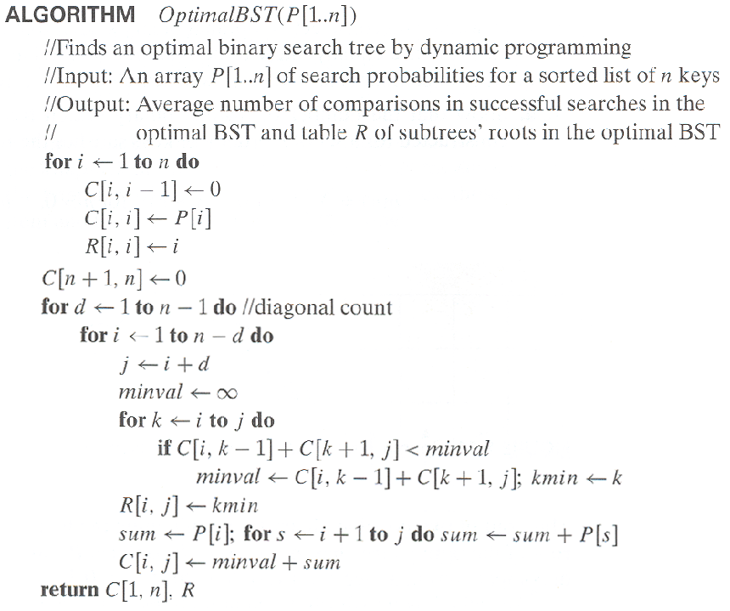
Algorithm
DAA/Dynamic Programming
RPR/

Slide 25
Time Efficiency: Optimal BST
From general analysis of algo,
3 nested loops, each running n times
Thus time efficiency: O(n³)
Space Efficiency: O(n²)
Time Efficiency: Accounting time smartly.
Entries in root(2nd) table are always non-decreasing
Along each row and column
Value of root table entry R[i,j] is limited to the range R[i,j-1],…,R[i+1,j]
This reduces the time complexity to O(n²)
DAA/Dynamic Programming
RPR/

Slide 26
Summary
Binary search tree
Optimal binary search tree
Dynamic programming for BST
Algo: DP for BST
Evaluation of C(i,j) and Tree construction
DAA/Dynamic Programming
RPR/

