Slide 1

COMPUTER NETWORKS PROJECT
Educational (College)
Management System
A Computer Network Based Client–Server Management System
1 / 10
Notes:
1

Slide 2
Introduction & Background
Current Challenges
Proposed Idea
  College information is handled by multiple departments and user groups
  Data may be distributed across different systems or terminals
  Manual information exchange can cause delays and duplication
  Students, faculty, parents and administration need different information
  Different users require different levels of access
  Real-time sharing requires reliable network communication
A centralized Educational Management System in which multiple authorized users communicate with a central server through a computer network.
The server manages:
  User requests
  Authentication
  Data access
  Information sharing
  Communication between clients and the database
2 / 10
Notes:
2

Slide 3






Problem Statement & Project Objectives
Project Objectives
Problem Statement
Develop a centralized college management system
A college contains multiple stakeholders who need access to academic and administrative information. Without a properly networked, centralized system:
Connect multiple user terminals through a network
Demonstrate client–server communication
  Information can become fragmented
  Communication between departments can be inefficient
  Multiple copies of data may exist
  Access control becomes difficult
  Real-time information sharing becomes challenging
Provide controlled access based on user roles
Enable centralized storage and retrieval of information
Demonstrate practical application of Computer Networks concepts
3 / 10
Notes:
3

Slide 4
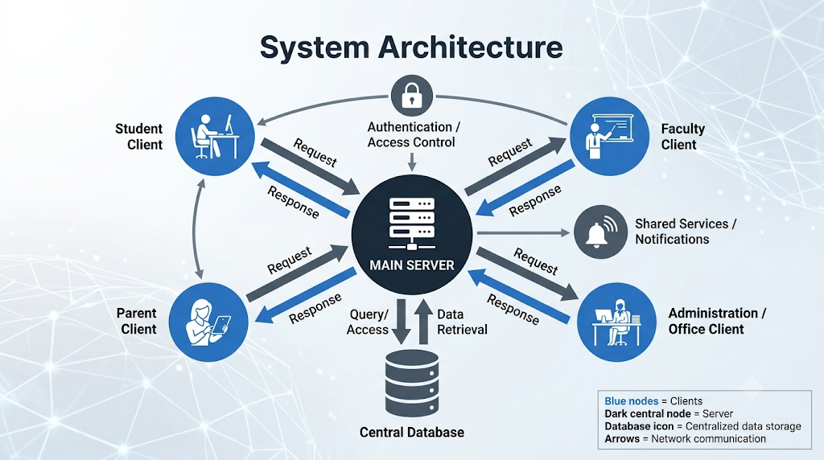







System Architecture
Student
Client
Faculty
Client
Authentication /
Access Control
Shared Services /
Notifications
MAIN SERVER
Central
Database
Parent
Client
Admin / Office
Client
Blue nodes = Clients
Dark node = Server
Database icon = Centralized storage
Arrows = Network communication
4 / 10
Notes:
4

Slide 5



Computer Network Concepts Applied
Client–Server Architecture
TCP/IP Communication
Request–Response Model
Centralized Data Access
Multiple clients communicate with a centralized server.
Reliable communication between clients and server via TCP/IP suite.
Clients send requests; server returns appropriate responses.
Server provides controlled access to centralized college data.
Multiple Clients
Authentication & Access Control
Network Security
Concurrent Communication
Several users/terminals can communicate with the server.
Users receive access according to their assigned roles.
Authentication and controlled communication protect information.
Architecture designed to support requests from multiple users.
5 / 10
Notes:
5

Slide 6
College Entities & Network Terminals
Student Terminal
Faculty Terminal
  Academic information
  Attendance
  Marks / results
  Timetable
  Notices
  Attendance management
  Marks entry
  Student information
  Academic updates
  Notices
Parent Access
Administration / Office
  Student academic info
  Attendance
  Notices
  Communication
  Student records
  Academic administration
  General management
  Reports
6 / 10
Notes:
6

Slide 7

Core Functionalities
Academic Management
Communication
Administrative Management
User Management
  Student records
  Attendance
  Marks / results
  Timetable
  Course / subject info
  Notices
  Announcements
  Notifications
  Faculty–student communication
  Student registration
  Faculty information
  Department information
  Reports
  Login / authentication
  Role-based access
  User-specific dashboards
User Login
Authentication
Role
Identification
Request
Processing
Database
Access
Response to
Client
7 / 10
Notes:
7

Slide 8


Network Security, Testing & Reliability
Security
Network Testing
Reliability
  User authentication
  Role-based authorization
  Controlled database access
  Secure handling of credentials
  Protection of academic information
  Client–server connectivity testing
  Request / response testing
  Multiple-client testing
  Input validation
  Error handling
  Database consistency testing
  Handling of failed requests
  Server-side validation
  Controlled access to resources
  Recovery from communication errors
9 / 10
Notes:
9

Slide 9








Goals, Future Scope & Conclusion
Project Goal: Demonstrate how Computer Networks can be applied to build a centralized, multi-user Educational Management System.
Future Scope
Mobile application clients
Web-based access
Secure encrypted communication
Cloud deployment
Remote access
Advanced notification systems
Integration with additional college services
Improved scalability for more users
10 / 10
Notes:
10

Slide 10
THANK YOU

