Slide 1

X
M
By, GOVARDAN - December 10 2023

Slide 2

What is XML
XML stands for eXtensible Markup Language.
XML is designed to send, store, share, receive and display data.
XML is platform and programming independent.
Unlike HTML where most of the tags are predefined, XML doesn’t have predefined tags.

Slide 3

Machine Communication
<Friends>
<Friend>
<Name> Alex </Name>
</Friend>
<Friend>
<Name> Mark </Name>
</Friend>
<Friend>
<Name> Rachael </Name>
</Friend>
</Friends >

Slide 4

Why XML called as Markup Language ?
XML is called Markup language because we use tags and marks in it
XML tags are not predefined nor limited. They are extensible.
World Wide Web Consortium specifies data transportation rules

Slide 5

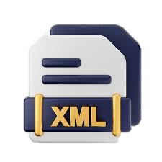
Features of XML
1
XML is Extensible and Human Readable.
2
XML preserves White-Spaces.
3
XML is Simple to use and you can create your own tags with it.
4
XML adds an Extra layer that seperates data from HTML.

Slide 6

Grammer of XML
To Specify Structure
DCT (Document Type Definition)
To Specify Content
Schema

Slide 7
Document Type Definition (DCT )
What is a DTD?
DTD stands for Document Type Definition.
A DTD defines the structure and the legal elements and attributes of an XML document.
Types of DCT
Internal DCT
External DCT

Slide 8
Internal DCT
<?xml version="1.0" encoding="UTF-8"?>
<!DOCTYPE employees [
<!ELEMENT employees (employee+)>
<!ELEMENT employee (name, salary)>
<!ELEMENT name (#PCDATA)>
<!ELEMENT salary (#PCDATA)>
<!ELEMENT employee aid ID #REQUIRED>
]>
<employees>
<employee aid="A1">
<name>Navin</name>
<salary>3000</salary>
</employee >
< employee aid='A2'>
<name>Manoj</name>
<salary>5000</salary>
</employee >
</employees>

Slide 9
External DCT
emp.xml
empType.dct
<?xml version="1.0" encoding="UTF-8"?>
<!DOCTYPE employees SYSTEM 'empType.dtd'>
<employees>
<employee aid="A1">
<name>Durai Murugan</name>
<age>19</age>
</employee>
<employee aid='A2'>
<name>Boobathi</name>
<age>19</age>
</employee>
</employees>
<!ELEMENT employees (employee+)>
<!ELEMENT employee (name, age)>
<!ELEMENT name (#PCDATA)>
<!ELEMENT age (#PCDATA)>
<!ATTLIST employee aid ID #REQUIRED>

Slide 10
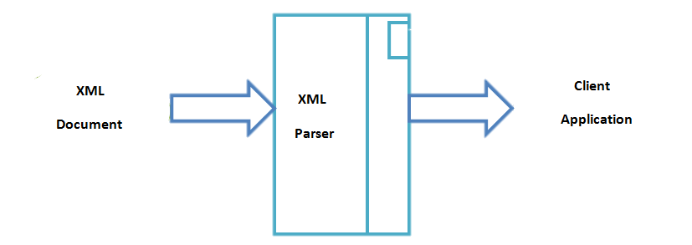
XML Parsers
An XML parser is a software library or package that provides interfaces for client applications to work with an XML document.
The XML Parser is designed to read the XML and create a way for programs to use XML.
XML parser validates the document and check that the document is well formatted.
API

Slide 11
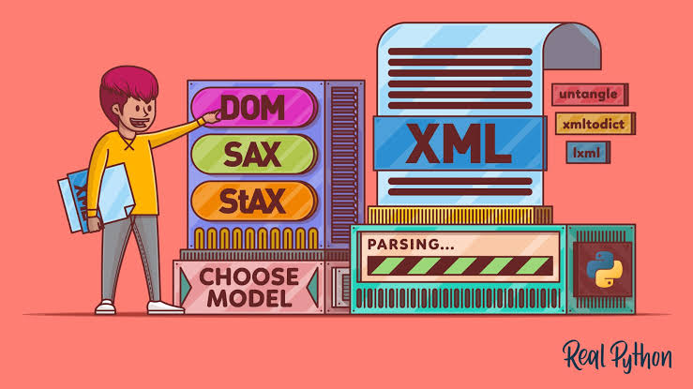
Types of XML Parser
There are two of XML Parsers
DOM (Document Object Model)
SAX (Simple API for XML)

Slide 12
Document Object Model (DOM)
A DOM document is an object which contains all the information of an XML document. The DOM Parser implements a DOM API. This API is very simple to use.
A DOM Parser create an internal structure in memory which is a DOM document object and the client applications get information of the original XML document by invoking methods on this document object.
DOM Parser has a tree based structure.
1
2
3

Slide 13
According to the XML DOM, everything in an XML document is a node:
The entire document is a document node
Every XML element is an element node
The text in the XML elements are text nodes
Every attribute is an attribute node
Comments are comment nodes
1
2
3
4
5

Slide 14
Simple API for XML
SAX (Simple API for XML) is an event-based parser for XML documents.
Unlike a DOM parser, a SAX parser creates no parse tree.
Clients does not know what methods to call, they just overrides the methods of the API and place his own code inside method.
1
2

Slide 15
eXtensible Style Sheet(XSL)
XSL stands for eXtensible Stylesheet Language.
XSL is a styling language for XML.
XSLT stands for XSL Transformation. It is used to transform XML documents into other formats (like transforming XML into HTML).

Slide 16


