Slide 1
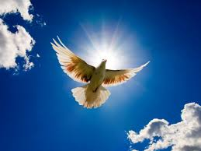
The spirit of life: Delivering from the law of sin and death

Slide 2

The spirit of walking : for the fulfillment of the righteous recruitment of the lord

Slide 3
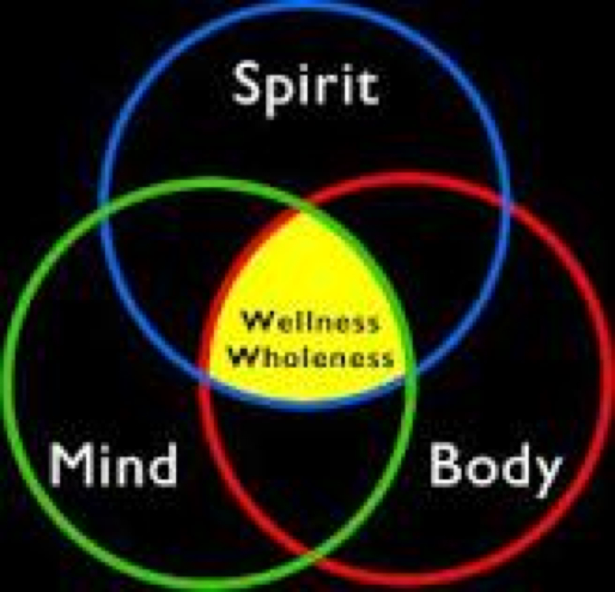
The Spirit of mind and attitude: for life and peace

Slide 4

The Spirit of dwelling : for being captivated by the lord to be in possession of the lord

Slide 5

The Spirit of righteousness: to make the fleah dead to sin

Slide 6

The Spirit of resurrection : to give life to the mortal bodies

Slide 7

The Spirit of leading : To become the sons of god

Slide 8

The Spirit of adoption : To intercede and to my ABBA, Father

Slide 9

The Spirit of inheritance : To be the heirs of god and to become the joint heirs with Christ

Slide 10

The Spirit of suffering : To become the Partekars of chart

Slide 11

The spirit of glorification: for example tolerance

Slide 12

The spirit of liberty: for the revelary of the sons of the god

Slide 13

The Spirit of birth parry's : to be delivered from the bondage of corruption Rom 8:26,22

Slide 14

The spirit of first fruits: to groom within clarifies Rom 8,23

Slide 15

The spirit of transformation : for the redemption of the body

