Slide 1
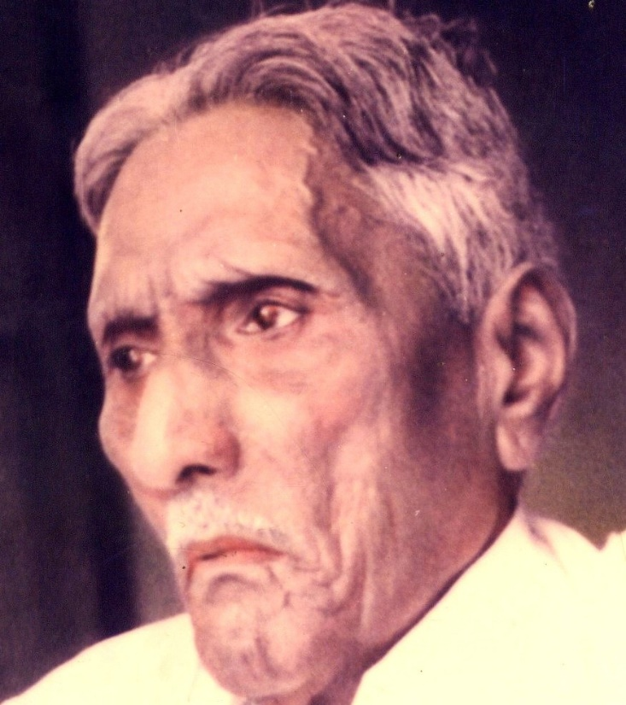

The Bible Mission The Revelation of God to St. M. Devadas

Slide 2

1.The spirit of life: Delivering from the law of sin and death (Rom 8:2)

Slide 3

2.The spirit of walking : For the fulfillment of the righteous recruitment of the Lord (Rom 8:4(KJV))

Slide 4
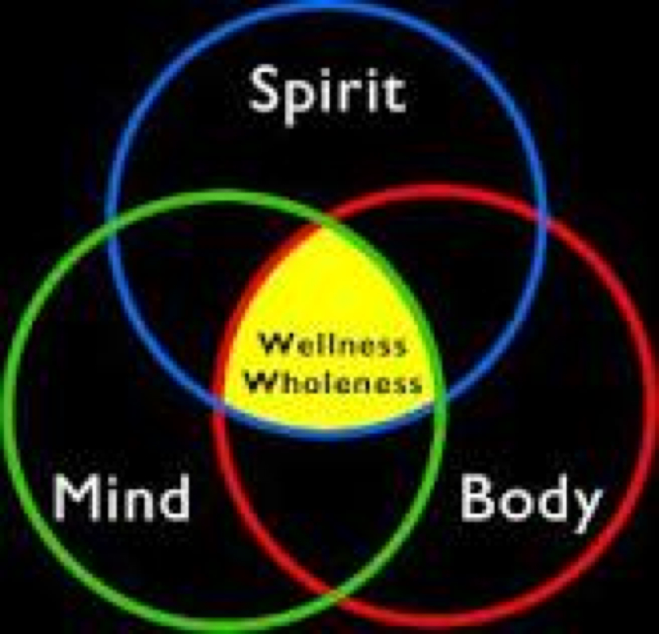
3.The Spirit of mind and attitude: For life and peace (Rom 8:6)

Slide 5

4.The Spirit of dwelling : For being captivated by the Lord to be in possession of the Lord (Rom 8:9)

Slide 6

5.The Spirit of righteousness: To make the flesh dead to sin (Rom 8:10)

Slide 7

6.The Spirit of resurrection : To give life to the mortal bodies (Rom 8:11)

Slide 8

7.The Spirit of leading : To become the sons of God (Rom 8:14)

Slide 9

8.The Spirit of adoption : To intercede and to my ABBA, Father (Rom 8:15)

Slide 10

9.The Spirit of inheritance : To be the heirs of God and to become the joint heirs with Christ (Rom 8:17)

Slide 11

10.The Spirit of suffering : To become the Partakers of chart (Rom 8:17)

Slide 12

11.The spirit of liberty: For the revealing of the sons of the God (II Cor 3:17, Rom 8:21)

Slide 13

12.The Spirit of birth pang's : To be delivered from the bondage of corruption Rom 8:26,22

Slide 14

13.The spirit of first fruits: To groom within satisfies (Rom 8:23)

Slide 15

14.The spirit of glorification: For example just Tolerance (I Peter 4:14 , Rom 8:17)

Slide 16

The spirit of transformation : For the redemption of the body

Slide 17
Summary 1.The Spirit of Life -30 folds 2.The Spirit of Adoption - 60 folds 3.The Spirit of transformation - 100 folds

