Slide 1
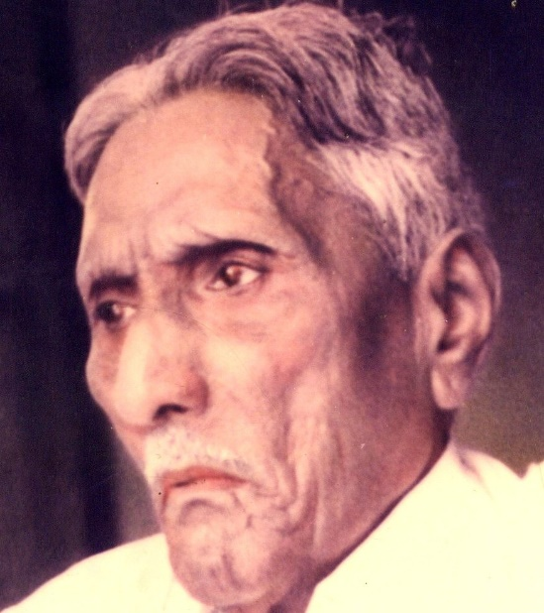

The Bible Mission The Revelation of God to St. M. Devadas

Slide 2
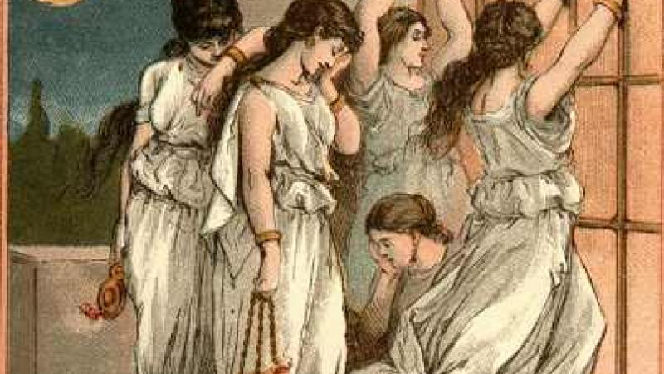
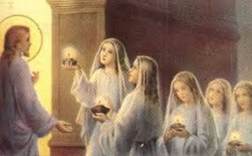
The Parable of Ten Virgins
The Parable that was told by Lord Jesus about the Kingdom of Heaven
Five Foolish Virgins
Five Wise Virgins

Slide 3
Can there be foolish Virgins in Kingdom of Heaven?
YES

Slide 4
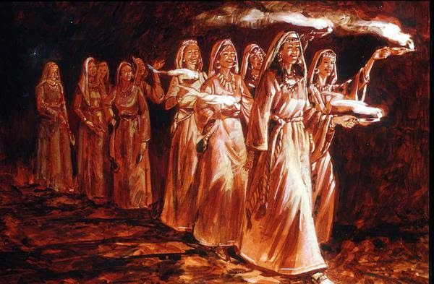
Wise virgins representing the Bride church.
Foolish virgins representing the Universal church.

Slide 5
SIMILARITIES
They are all Virgins
Virgin is the one who was made pure and perfect in the blood of Christ.
Virgin is the one who was betrothed to one husband i.e. Christ ( II COR 11:23).
Virgin is the one that was set out to meet the Bridegroom

Slide 6
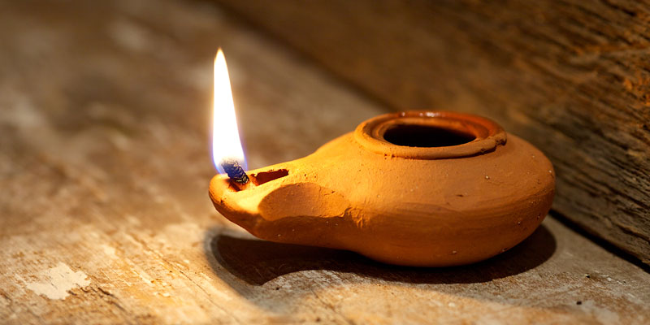
2) They all carry lamps
a) Lamp is the light of the Spirit, the light of Salvation
b) The spirit of man is the lamp of the lord (PROV.20:27)

Slide 7

c) Lamp is the legacy of God (I kings 11:36) .
chosen state, hierarchy promise.
d) Lamp is the ultimate grace of God (II Kings 8:19)

Slide 8
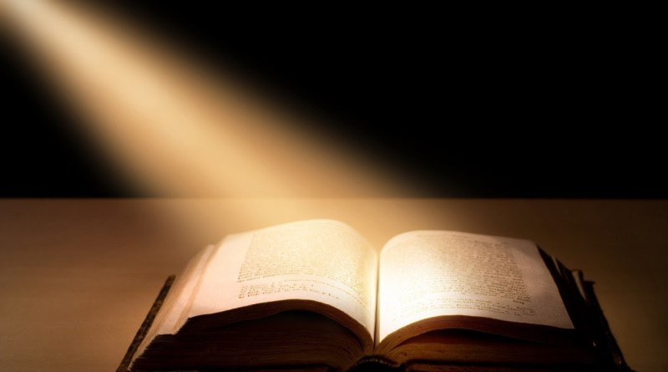
e) Lamp is the glory of God ( Job 29:3 ).
f) Lamp is the word of God ( PS 119.105 ) ;
( Prov 5:3 )

Slide 9
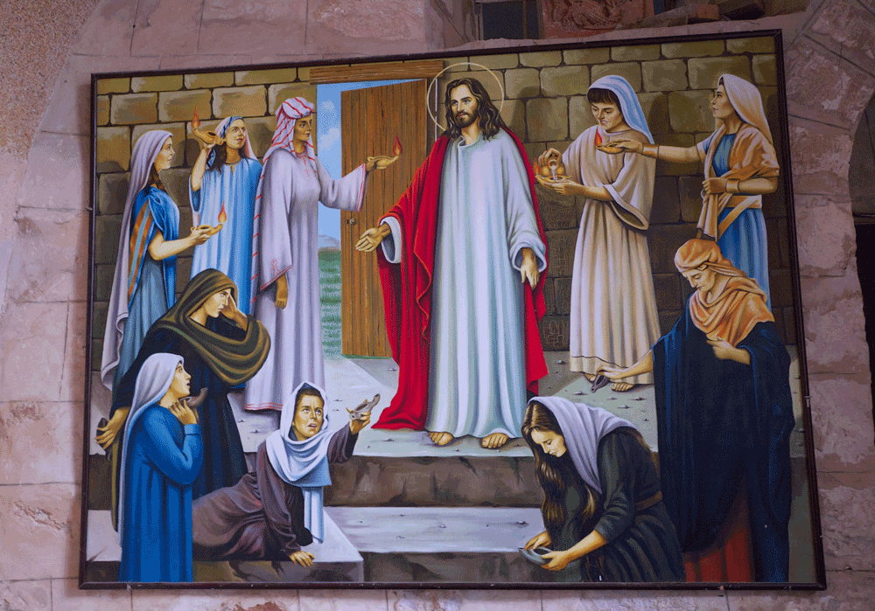
3) They all went out to meet the Bridegroom
They overcome the world
They have no bondages

Slide 10
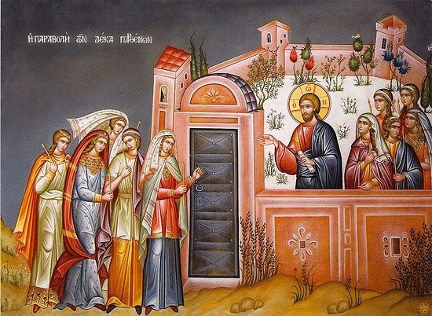
They are on their rapture Journey
They see Christ as a Bridegroom

Slide 11
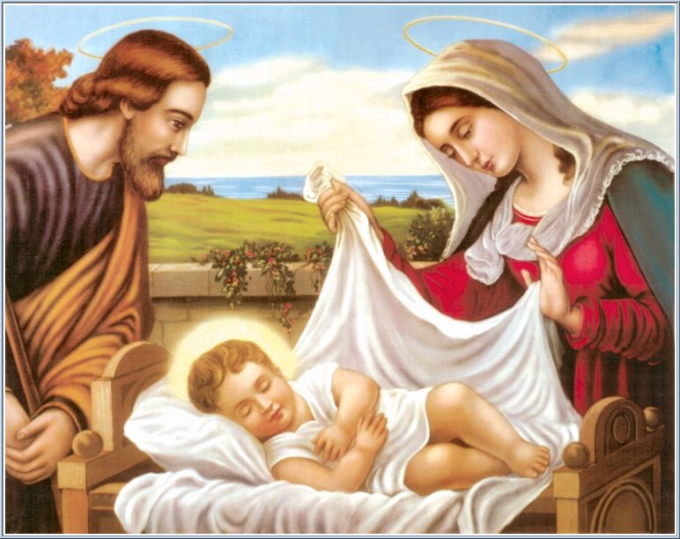
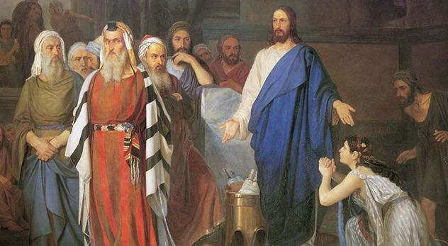
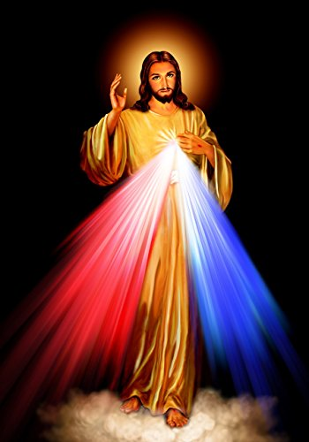
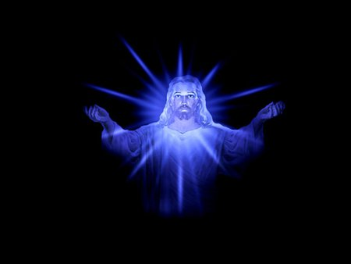
Baby Jesus-Son
Adult Jesus-Son of Man
Divine Jesus-Son of God
Glorious Jesus - Bridegroom

Slide 12
How are you looking at Jesus?
Master
Friend
Saviour
Bridegroom

Slide 13
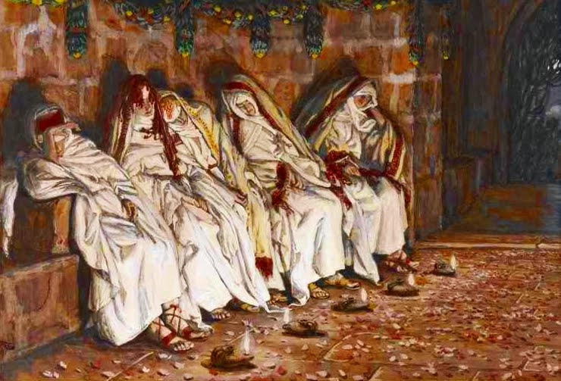
4) They all slumbered and slept
The woes of mid night
The unconditional delay of the bridegroom
The spiritual weaknesses (Mar. 26:40-43)

Slide 14
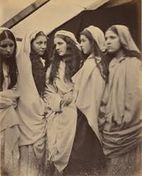
Unspiritual practice and elements (II Cor.11:30)
For this reason many are weak and sick among you , and many sleep

Slide 15
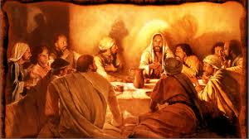
5.They were all together until mid night
They dressed together
They decorated together
They departed together
They dined together
They dozed off together
They waited together
They woke up together

Slide 16
Differences
They differ in many aspects, Finally
At Mental level
At Physical level
At Spiritual level
These three levels of differences will help as to deriver the bride from the universal church

Slide 17
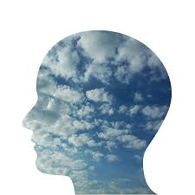
Mental Level
They are mentally distinguished by the lord as 'wise virgins' who are symbolic of the bride church and 'foolish virgins' who are symbol of the universal church

Slide 18

Mental Level
The foolish virgins tried to depend on their partners rather than the grace of their bridegroom as they took resource to the latter's jar of oil.
The wise virgins tried to satisfy their bridegroom rather than impressing their fellow virgins

Slide 19
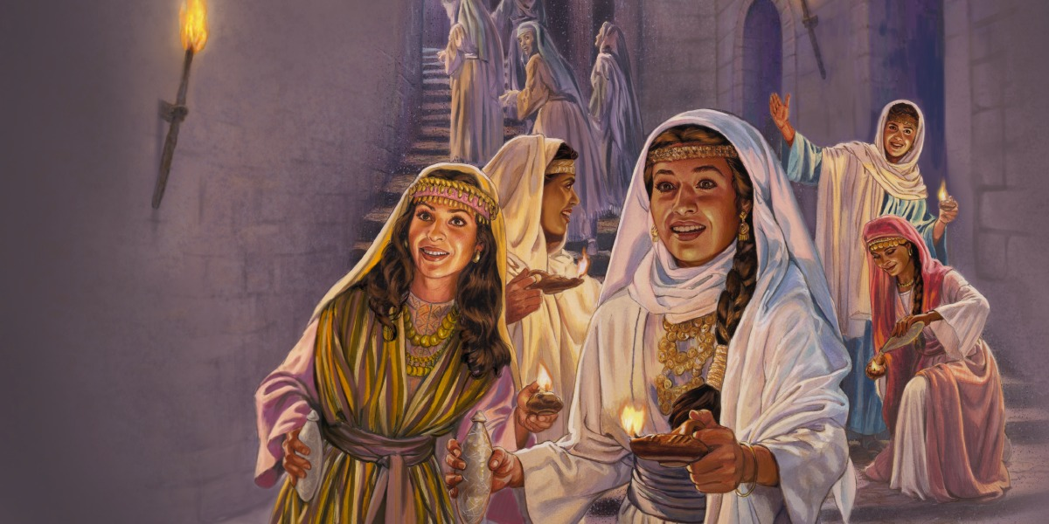
The wise virgins proved their wisdom by showing the right path to the foolish virgins instead of falling prey to their pleasing please(which are the ...) of the devil.
The foolish virgins were really as they not only ignored the importance of the oil jars but also inconsistence of their presence in the hands of wise virgins

Slide 20
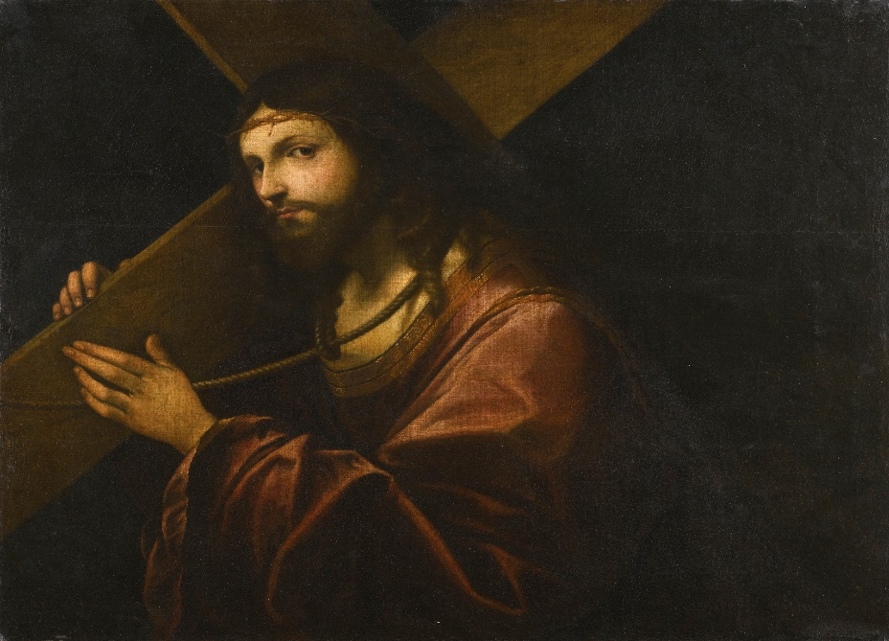
Physical Level
At Physical level, the wise virgins carried jars with them, and foolish virgins felt it as a burden
The wise group had extra oil with them and the foolish group satisfied with the oil that is in their lamps

Slide 21
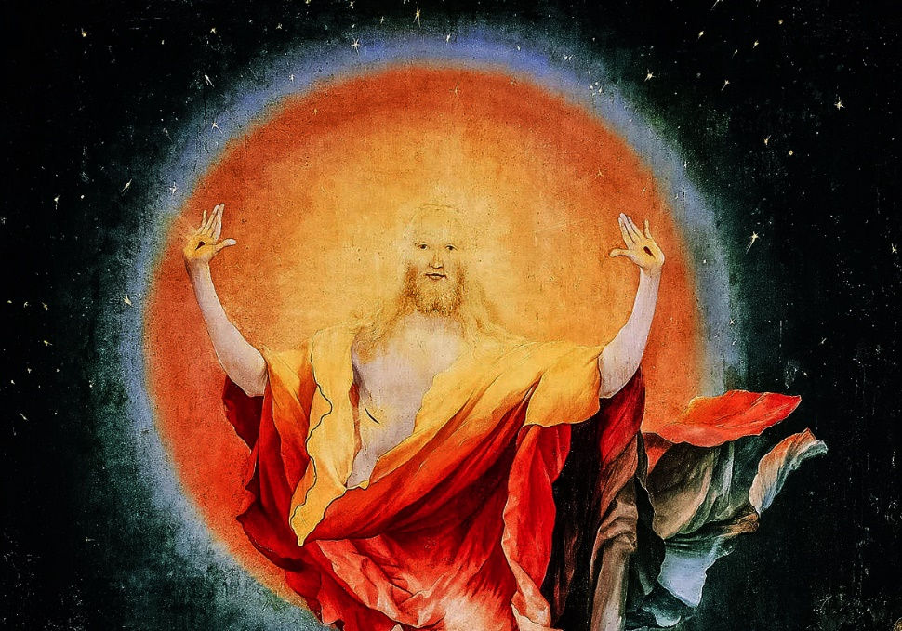
Spiritual level
At spiritual level, as the wise virgins heard the mid night cry of the holy spirit, and they arose and trimmed their lamps.
Although the foolish virgins woke up, they couldn't keep their lamps, burning because they have no oil with them

Slide 22

Implications:
a)The oil jars or the oil vessels, the wise virgins carrying with themselves, oil represents the anointing of the Holy spirit
b)Their hidden love towards the bridegroom

Slide 23
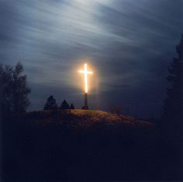
c)Their secret preparation to meet the derived untold delay of the coming bridegroom
d)Their alacrity to open their jars immediately fill their lamps, so they keep burning again, with full brilliance

Slide 24
e)The foolish virgins were satisfied with what they have in their lamps as they were burning when they set out from their places, They are happy with their Salvation. They couldn't think beyond salvation i.e.. The Rapture Perfection
f)After the midnight warning, they decided to go out, rather than to gain to meet the groom

Slide 25
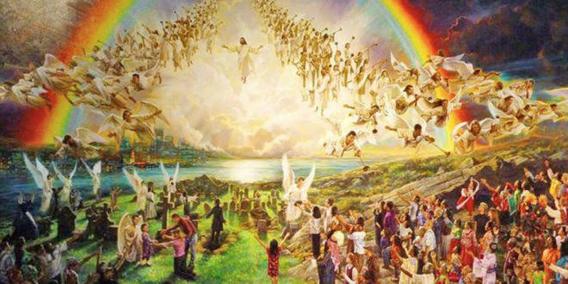
Thus the bride is going to be raptured and the nominal believers or the believing who cannot prepare them as the Bride ,are going to be left behind

