Slide 1
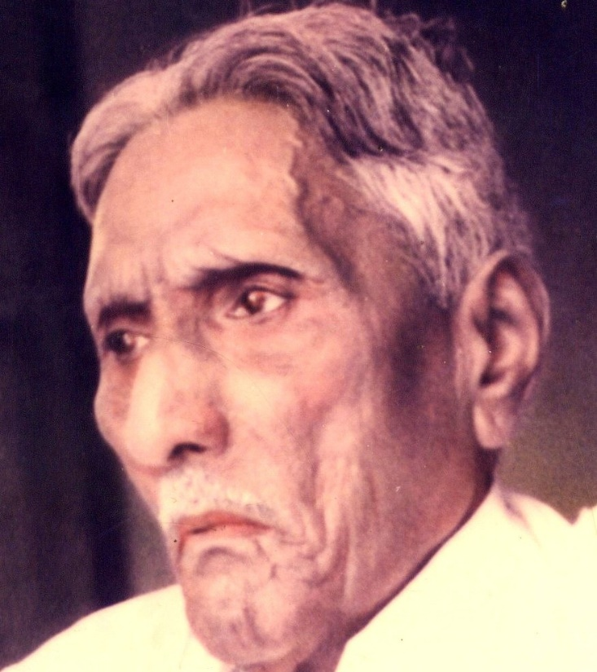

The Bible Mission The Revelation of God to St. M. Devadas

Slide 2
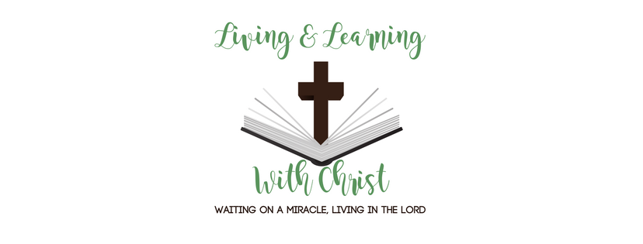
Elementary Teaching and Maturity Teachings
Introduction :
Meaning of the two concepts
Elementary teaching is the basic teachings about Christ and the primary lessons in Christian walk.
Elementary Teaching :
Teaching that concerns the Christian foundation (I col 3:10)
Repentance i.e. confession of sins
Belief in God i.e. faith in the Lord;
Doctrinal debates on Baptism
Laying of hands.
Resurrection of the dead.
Eternal Judgement.

Slide 3

As every construction has a solid secure and suitable foundation, the beginnings of our Christian life has a foundation
The below are the four pillars of Christian faith and foundation
Word of God
the teachings of the Apostles
The Holy Communion
Perennial Prayer

Slide 4
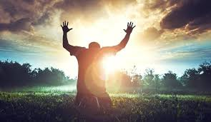
Confession of Sins
confession of sins is essential for complete forgiveness.
confession being backed up by faith
constant confession without real repentance is meaning less and making mockery of god
confession at the level of thought and mind at the level of deed.

Slide 5
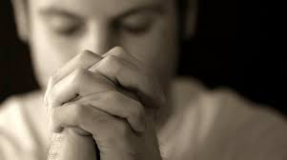
Belief In God
Belief in God i.e. Basic faith
James warns us of the rudimentary faith you believe that there is one God
Good! Even the demons believe that (James 2:19)

Slide 6
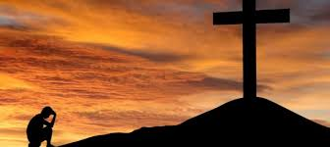
Faith that comes through the listening of God's word (Rom - 10:17)
Faith that cannot openly admit Jesus (John 12:42)
Faith that can not stand the tempests of life Luke 8.25

Slide 7
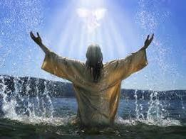
Battles of Baptism
"For Christ did not send me to baptize but to preach the gospel" (I Cor 1:17)
Re Baptisms,
Different methods of baptisms

Slide 8
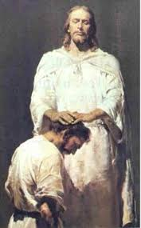
Laying of hands
Fresh initiations,
Ordaining again and again,
When something is initiated by someone we must see that it goes on. we shouldn't stop it freshly initiate once again.
Seasonal and functional laying on of hands.

Slide 9
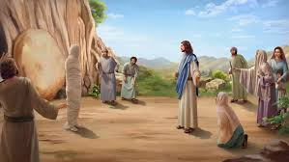
Resurrection of the dead:
For some of the things Christ has granted us, we shouldn't keep on stressing on them and pay extra attention...
We know the death of this saints is dear in the sight of the Lord PS 116:15;

Slide 10
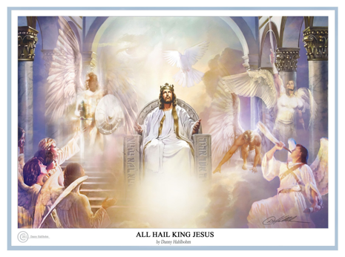
Eternal judgement
Many preach about eternal condemnation rather than eternal salvation.
Eternal judgement is at the end of all things but not during the rapture
On the day of final judgement also some people will be saved.

Slide 11

Maturity Teaching.
Maturity teaching is the solid food that was mentioned and prescribed by St Paul in (Heb 5:12- 14) against simple nulk. The same we see in (I cor 3:1-2) also.
a)It is concerned with the super structure not the foundation (I cor 3:10-14)
b)It is accruing the righteous of Christ (Heb 5 :13), but not ceremonial repentance.
c)It is exhibiting the faith that welcome the world (I Iohn 5:4),the faith that symbolizes and stands out the bride from aiming the maidens, as the wife of the Lands (R 19:7)

Slide 12
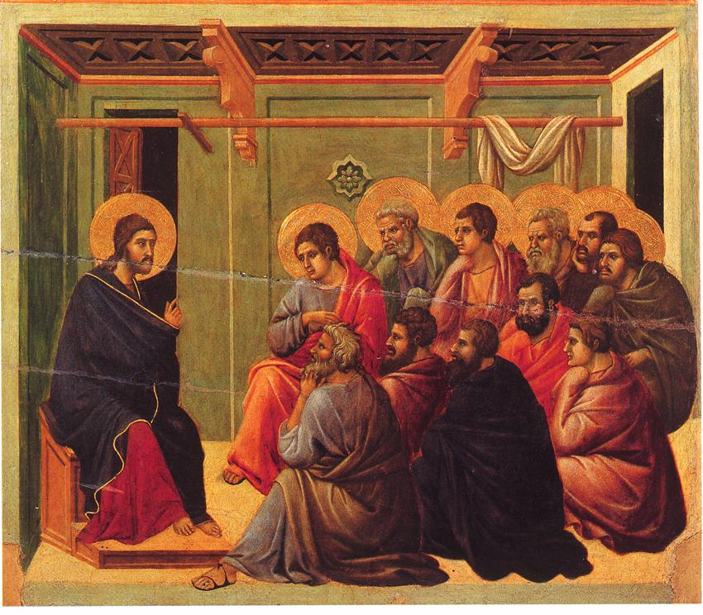
d) Maturity teaching is the Baptism of the Holy Spirit but not re Baptism.
e) Maturity teaching is sending out believers evangelists prophets, apostles to preach the gospel to the world while preparing the church for the rapture of Christ,
f)Maturity teaching is not simply laying hands but it is impairing of the gifts of the Holy Spirit laying on the hands (II Thimothy 1:6)

Slide 13
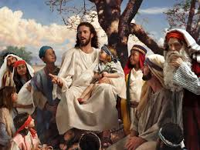
g) Maturity teaching is all about the bodily ascension of the church.
It has nothing to do with the resurrection of the body.
Maturity Teaching aims at the rapture of the Living saints but not at the ascension of the believes who slept in the lord with rapture faith.

Slide 14
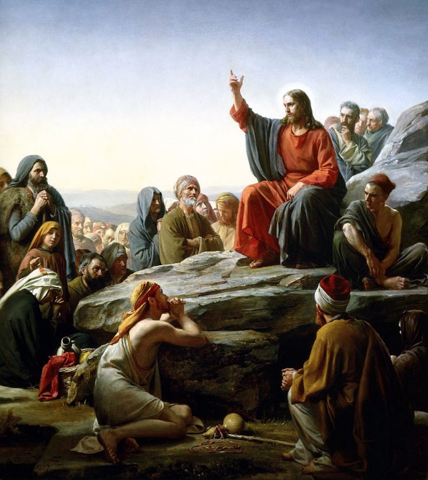
H )Maturity teaching is that "And so we will be with the Lord forever“ ( I Thes 4:17)
It does not focus on the eternal judgement.
Rather Maturity Teaching makes believers to pray and plead God to save people from the eternal judgement or the great white throne judgement.
Maturity Teaching focusses on preaching much about Salvation and perfection and preaching less about condemnation and hell fire

Slide 15
Maturity Teaching in contrast with the elementary teaching:
Elementary teaching
Maturity teaching
word of god
teachings of apostles
the holy communion
perennial prayer
constant confession of sins
basic faith for salvation
water baptism & many baptisms
laying on the hands(functional)
locking for resurrection
electrical judgement( scares of lake of fire)
living word (i.e. Jesus)
revelation from the lord
the glorious communion served by the lord himself
face to face fellowship with the lord
praising god for complete forgiveness
rapture faith for ascension
one baptism. the baptism of the holy spirit
imparting the gifts of the holy spirit (spirit filled)
waiting for the rapture cloud (shekchina)
eternal salvation.( fullfillment of the three fold solvation 30, 60, 100)

