Slide 1
UNIVERSAL COLOR-CODE VEHICLE REAR SPEED INDICATOR SYSTEM
PRESENTED BY :- GOLAGANI GOVINDU

Slide 2
INTRODUCTION:-
This project proposes a smart rear warning system for vehicles using an Arduino-based setup. It detects sudden speed drops and alerts rear drivers with a color-coded LED system: green for normal braking, yellow for moderate deceleration, and red for emergency braking. By comparing previous and current speeds, the system calculates the drop and triggers the appropriate LED. This helps following vehicles react faster and avoid rear-end collisions, especially in traffic or high-speed conditions. The system enhances road safety and supports better driver communication.

Slide 3
PROJECT OBJECTIVES & SCOPE
Objectives:
• To design a rear-mounted color-coded digital speed indicator.
• To display real-time speed variations using red and green color cues
• To improve road safety and assist traffic monitoring.
Scope:
• Applicable to all types of road vehicles.
• Functional in various lighting and weather conditions.
• Supports integration with existing vehicle speed sensors.

Slide 4
COMPONENT & PURPOSE
Speed Sensor(IR) – Detects vehicle speed
Microcontroller (Arduino) – Processes speed data and controls output
LED Indicators (Red/Yellow/Green) – Show speed increase or decrease
through color
Digital Display Unit – Displays speed visibly at the rear
Power Supply – Powers all components in the system

Slide 5
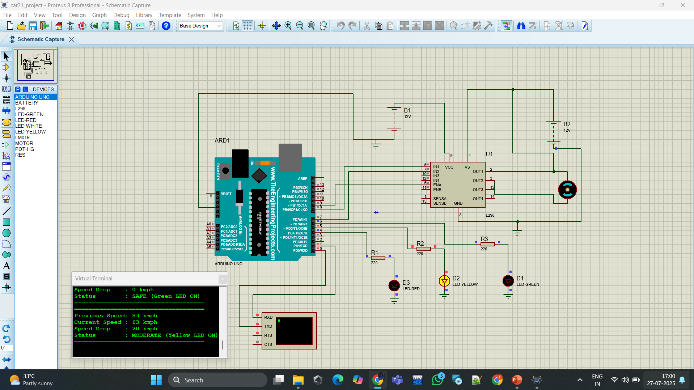
DIAGRAMS:-

Slide 6
CONCLUSION:
This project delivers a compact and efficient solution for real-time speed drop indication using Arduino and LED indicators. By continuously analyzing speed changes and displaying clear color-coded signals, it improves situational awareness for rear drivers and promotes safer driving practices. The system is low-cost, easily deployable, and holds strong potential for integration into modern automotive safety systems.

