Slide 1
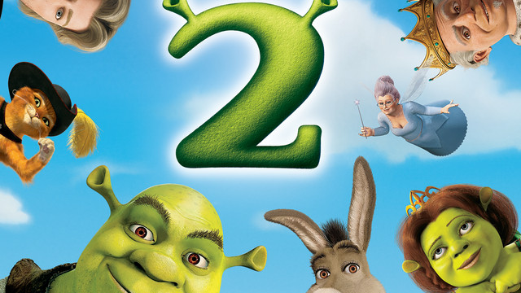

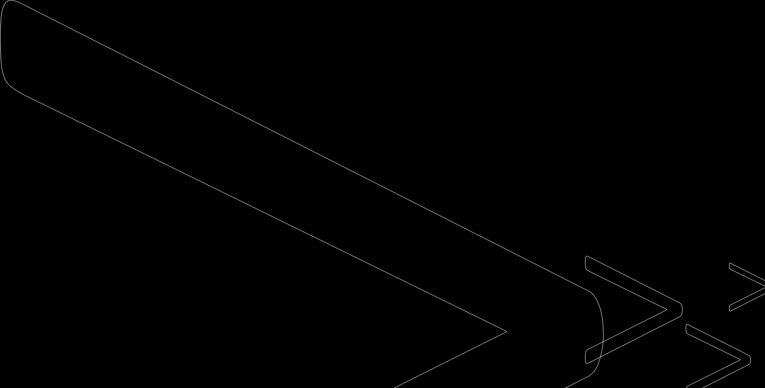
Predicting and Comparing MPAA Ratings for "Shrek 2"
Glory Onyeugbo and Amelia Green
IST 718: Big Data Analytics
March 17, 2024
Professor Lando

Slide 2
AGENDA
z
Introduction / Objective
Data Sources
Observations
Models
Recommendations

Slide 3

Introduction
Problem Statement: Predicting the MPAA rating for Shrek 2.
Business Questions:
What features significantly influence the MPAA rating for "Shrek 2" and potentially all movies?
How accurate can we predict the MPAA rating for "Shrek 2"?
Hypothesis: The parental guide fields including sex, violence, profanity, drugs, and intensity will have a significant impact on a movie's rating.

Slide 4

Data Sources
z
IMDB Parental Guide
- Rows: 53,000+
- Columns: 22
Movie Lens
- Rows: 45,000+
- Columns: 24
Movies data frame: Combined the two datasets in imdb_ID.
- Rows: 26,000+
- Columns: 27

Slide 5
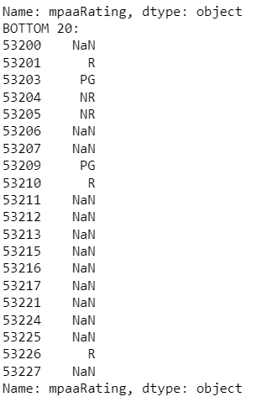
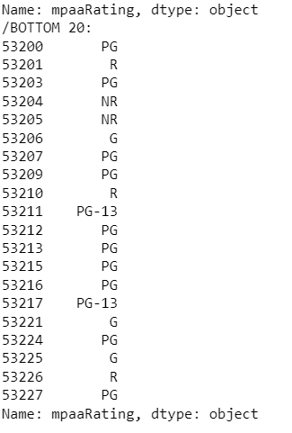
Observations Pt. 1
z
Main Challenge: Missing Data specifically MPAA rating.
Remedy: Utilized the parental guidance fields such as sex, violence, profanity, drugs, and intensity to infer and fill in the missing MPAA ratings.
Highlighted the importance of these parental guidance fields as crucial predictors for building our models.

Slide 6
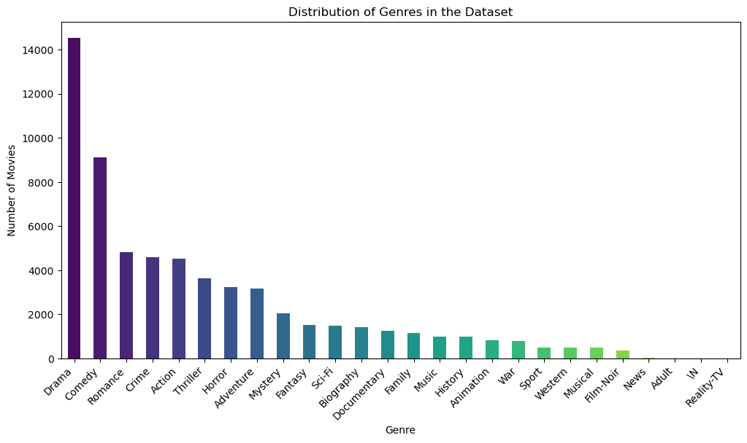
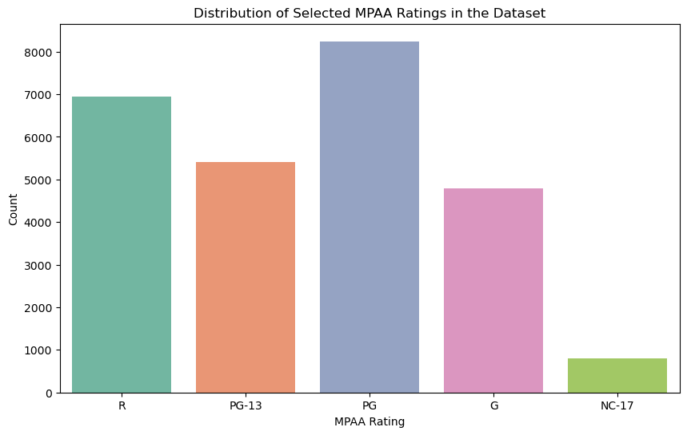
Observations Pt. 2
z
PG has the highest rating among the movies in the data, followed by R.
Genres is highly skewed with drama leading.

Slide 7
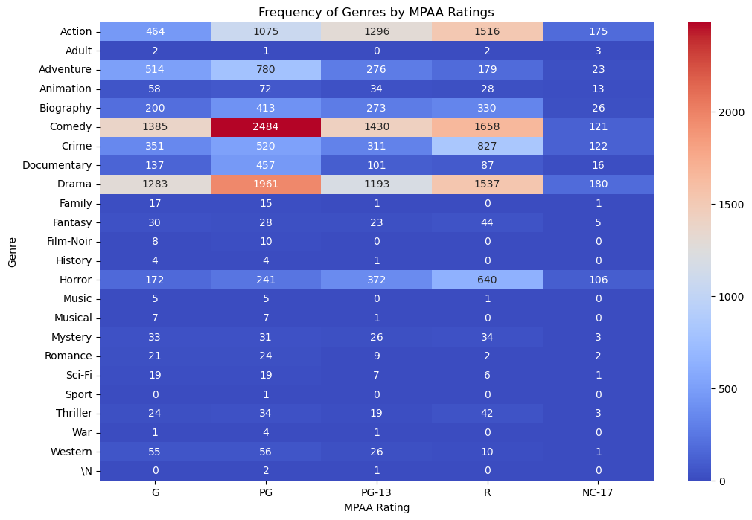
Observations Pt. 3
Genre may be a semi-predictor of what the rating will be. For example, most comedies are rated PG, followed by R. Same with dramas.
May consider it for our models.

Slide 8
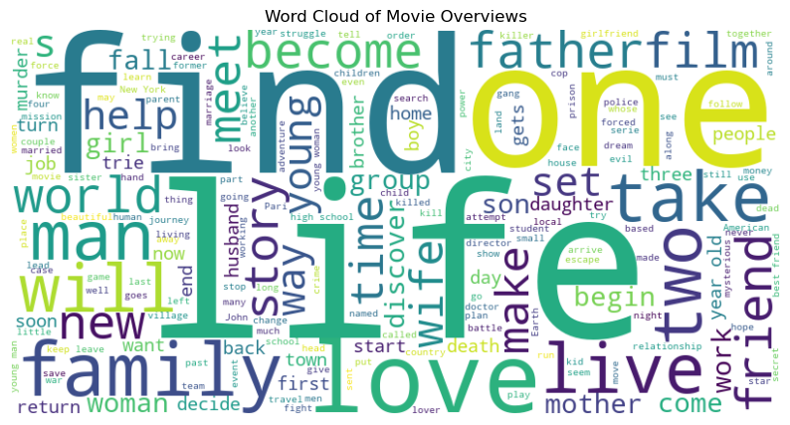
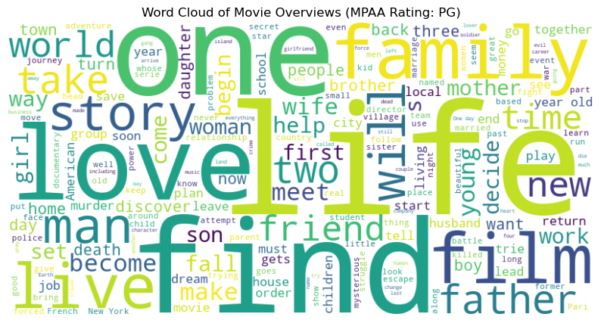
Word Clouds
Overall
Most used words include love, life, find, one, family.
Shrek 2 Overview:
“Shrek, Fiona and Donkey set off to Far, Far Away to meet Fiona's mother and father. But not everyone is happy. Shrek and the King find it hard to get along, and there's tension in the marriage. The fairy godmother discovers that Shrek has married Fiona instead of her Son Prince Charming and sets about destroying their marriage.”
Love and family is implied but not explicitly stated.
At this point, we found that parental guidance variables and possible genre were probably significant predictors.

Slide 9

Model: Decision Tree 1
z
Main features included sex, violence, profanity, drugs, and intense.
Accuracy: 76%
Evaluation: Correctly predicted Shek 2 MPAA rating as PG.

Slide 10
Model: Random Forest 1
Main features included sex, violence, profanity, drugs, and intense.
Accuracy: 73.65%
Evaluation: Correctly predicted Shek 2 MPAA rating as PG.

Slide 11


Model: Random Forest 2
Same features as previous model but included genre
Accuracy fell to 70.88%
Still correctly predicted Shek 2 MPAA rating as PG.

Slide 12
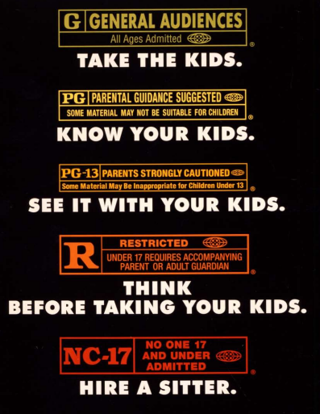
Recommendations
z
If given more time, we would explore more outside variables beyond parental guidance and genres.
Improve the model without looking at it historically but more as a snapshot in time. For example, focus on movies released in 2004.
How has the rating system changed overtime? Are we more (or less) flexible in our rating system compared to when movies were initially rated?

Slide 13
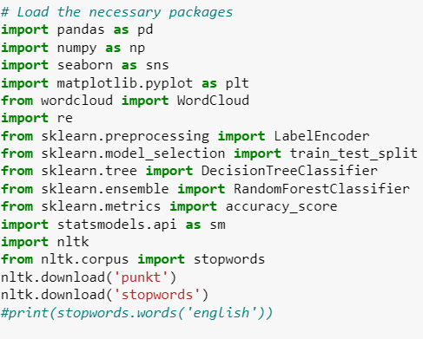
References
Data Sources
Packages
- IMDB: https://www.kaggle.com/datasets/barryhaworth/imdb-parental-guide
- Movie Lens: https://grouplens.org/datasets/movielens/

Slide 14
THANK YOU
Glory Onyeugbo and Amelia Green

