Slide 1
Detecting sinkhole subsidence in Dead Sea InSAR
Temporal U-Net architectures, two generalization splits, and object-level evaluation
Guy Pinkas · 17 August 2026
Notes:
Six slides: the two temporal architectures, the two splits, full-interferogram object-level results on both splits, the positives-only protocol against the paper, and a summary of which model is best.

Slide 2
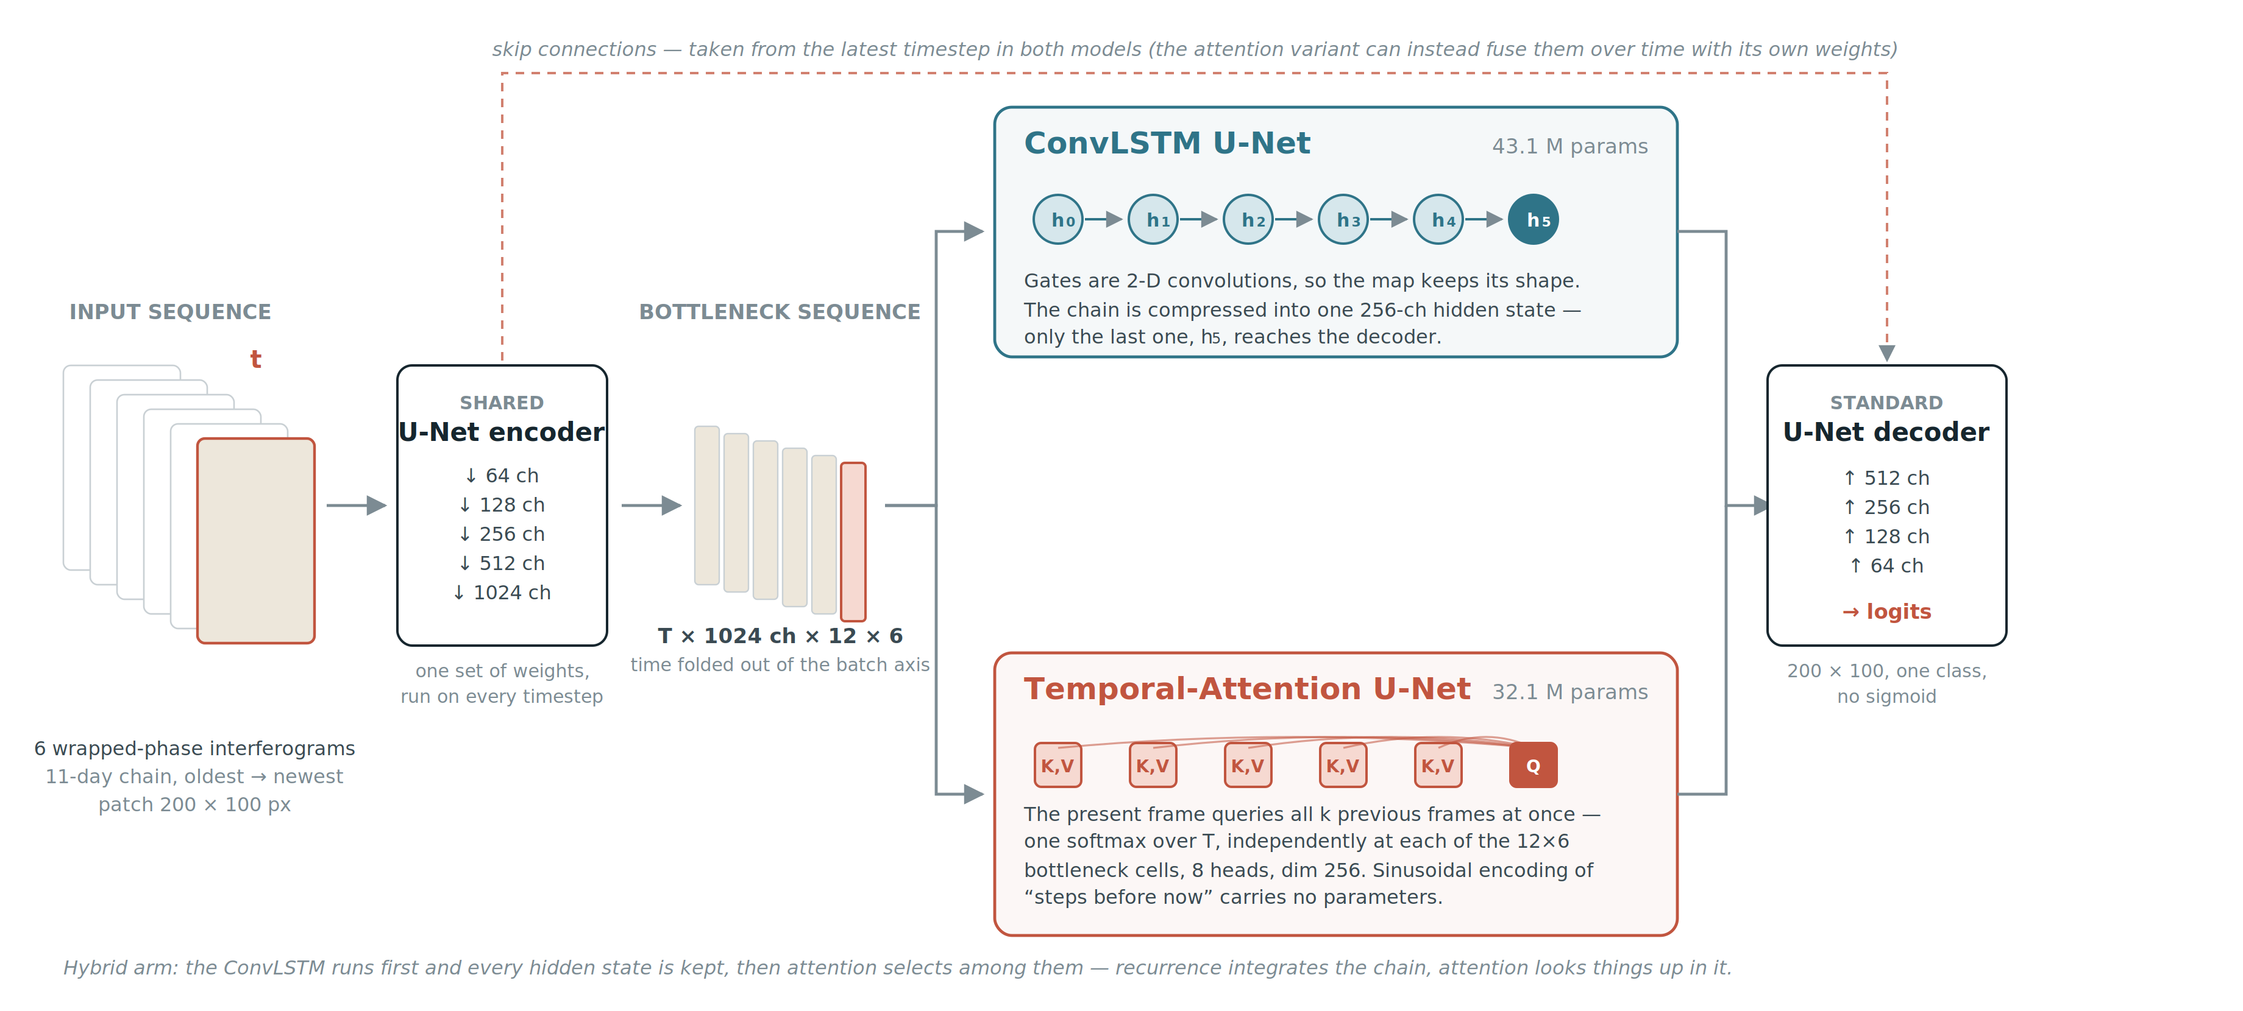
The two temporal architectures
Both share the U-Net encoder and decoder. They differ only in how the six-frame chain is collapsed at the bottleneck.
Also compared: a single-frame U-Net (one interferogram, no history) and a channel-stack U-Net (the chain fed as input channels).
Notes:
The encoder runs on every timestep with shared weights. ConvLSTM: convolutional gates, the chain compressed to one 256-channel hidden state, only the last reaches the decoder. Attention: the present frame queries its history at each bottleneck cell, 8 heads, dim 256. Hybrid: the ConvLSTM runs first and every hidden state is kept, then attention selects among them.

Slide 3
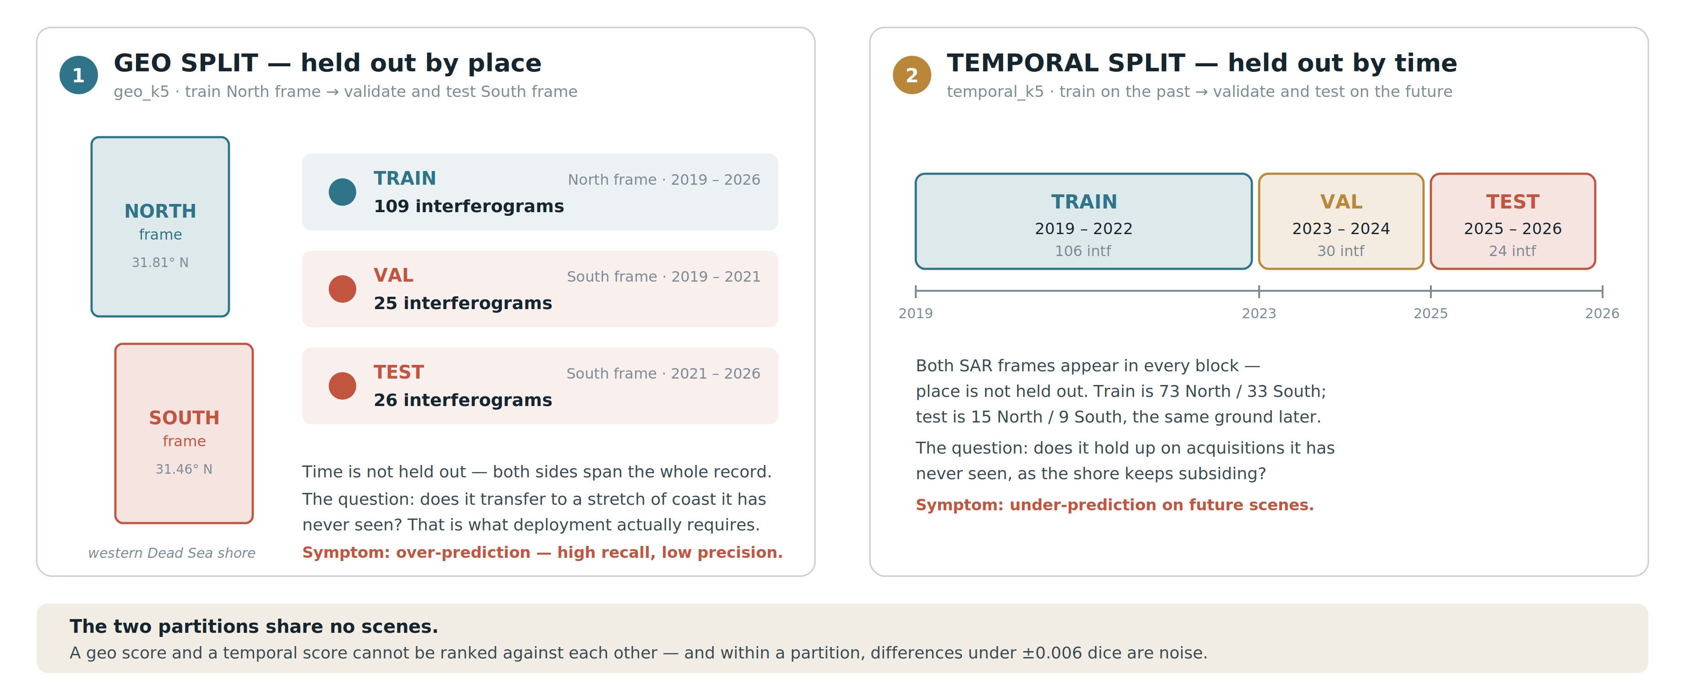
The two train/test splits
Geo holds out a place; temporal holds out a time. They share no scenes, so their scores cannot be ranked against each other.
Models trained on the k5 partitions are scored on the k10 test lists, so every model below is evaluated on exactly the same scenes.
Notes:
Geo: train the whole North SAR frame (109 interferograms, 2019-2026), validate and test on the South frame. Temporal: train 2019-2022, validate 2023-2024, test 2025-2026, both frames throughout.

Slide 4
Object-level results on full interferograms
Mean object recall and precision over the test scenes, each model at its own best confidence threshold. ITh 0.7, buffer 5 px.
GEO SPLIT — 18 test interferograms
TEMPORAL SPLIT — 20 test interferograms
Model | Recall | Prec. | OL F1 | conf
ConvLSTM · ring 3:1 | 0.77 | 0.68 | 0.724 | 0.9
ConvLSTM · ring 1:1 | 0.78 | 0.65 | 0.712 | 0.7
Hybrid · ring 1:1 | 0.82 | 0.62 | 0.708 | 0.7
Attention · ring 1:1 | 0.80 | 0.59 | 0.683 | 0.7
ConvLSTM · no negs | 0.66 | 0.68 | 0.667 | 0.9
Single U-Net · ring 1:1 | 0.67 | 0.66 | 0.662 | 0.9
Single U-Net · no negs | 0.66 | 0.60 | 0.629 | 0.9
Model | Recall | Prec. | OL F1 | conf
ConvLSTM · ring 10 | 0.67 | 0.73 | 0.698 | 0.25
Attention · ring 3 | 0.66 | 0.62 | 0.642 | 0.25
Hybrid · ring 3 | 0.67 | 0.61 | 0.639 | 0.25
ConvLSTM · ring 3 | 0.66 | 0.59 | 0.626 | 0.25
ConvLSTM · no negs | 0.61 | 0.62 | 0.612 | 0.5
Attention · no negs | 0.59 | 0.61 | 0.598 | 0.5
Single U-Net · no negs | 0.68 | 0.51 | 0.581 | 0.5
Channel stack · no negs | 0.54 | 0.58 | 0.562 | 0.5
Ring negatives — empty patches sampled from an annulus around each sinkhole — are the largest single gain: geo 0.667 → 0.724, temporal 0.612 → 0.698.
The three temporal architectures land within 0.04 F1 of each other on geo and 0.07 on temporal. Both single-frame and channel-stack baselines sit below all of them.
Source: outputs/predictions/<model>/best/scenes_*/olm_results_*.json
Notes:
Every row is the mean over scenes of the per-scene object recall and precision, with F1 computed from those means. Quoting a geo model without its confidence threshold is meaningless — the ordering changes with it.

Slide 5
Positives-only evaluation, and the published baseline
The paper scores only on patches that contain subsidence. Matching that protocol makes our numbers comparable with its Table 1.
PATCH LEVEL, POSITIVES ONLY — 4,445 patches, 18 geo test interferograms
Model | Dice | Pixel recall | Pixel prec. | Object recall | Object prec.
Dekel et al. 2026 · spatial, lat 31.4° | 0.56 | 0.67 | 0.71 | 0.78 | 0.83
Dekel et al. 2026 · spatial, lat 31.4°, augmented | 0.60 | 0.77 | 0.65 | 0.86 | 0.86
Attention · ring 1:1 | 0.635 | 0.74 | 0.75 | 0.86 | 0.90
Hybrid · ring 1:1 | 0.631 | 0.74 | 0.75 | 0.85 | 0.90
ConvLSTM · geo_k10 | 0.632 | 0.74 | 0.72 | 0.85 | 0.90
ConvLSTM · ring 3:1 | 0.625 | 0.70 | 0.78 | 0.81 | 0.88
SAME MODELS — POSITIVES-ONLY vs FULL INTERFEROGRAM, OBJECT F1
Model | Positives only | Full interferogram | Gap
Attention · ring 1:1 | 0.911 | 0.683 | −0.23
Hybrid · ring 1:1 | 0.904 | 0.708 | −0.20
ConvLSTM · ring 3:1 | 0.904 | 0.724 | −0.18
ConvLSTM · geo_k10 | 0.911 | 0.456 | −0.46
ConvLSTM · ring 10 (temporal) | 0.815 | 0.698 | −0.12
Against the paper: object recall matches its best row (0.86) and object precision is higher (0.90 vs 0.86) — while holding out an entire SAR frame rather than a latitude line inside the same scenes. On the protocol: the same model scores 0.2–0.4 higher on object F1 when only the tiles holding ground truth are predicted. A positives-only number and a full-interferogram number are not the same quantity, and the protocol has to be named whenever either is quoted.
Our confidence threshold is not the paper's RTh: we reconstruct at stride 2 and average the sigmoid probabilities, while the paper reconstructs at stride 4 and RTh counts how many of sixteen patches call an object positive.
Sources: outputs/predictions_positives/<model>/ · remotesensing-18-00211-v2.pdf, Table 1
Notes:
Patch level is the only genuinely protocol-matched comparison here: test-patches scores each patch independently with no reconstruction, exactly as the paper's Table 1 does on non-zero mask patches. Object-level recall carries about plus or minus 0.01 between repeat passes of the same job.

Slide 6
Summary
1.
Best on object F1, full interferogram
Geo: ConvLSTM with ring negatives 3:1 — 0.724 (recall 0.77, precision 0.68). Temporal: ConvLSTM with far-field ring-10 negatives — 0.698 (recall 0.67, precision 0.73).
2.
Ring negatives are the main gain
Geo 0.667 → 0.724, temporal 0.612 → 0.698. Training only on patches that contain subsidence made the models flag far too much ground.
3.
Architecture matters less than negatives
ConvLSTM, attention and hybrid are within 0.04 F1 on geo. Attention uses 26 % fewer parameters (32.1 M vs 43.1 M). Single-frame and channel-stack baselines are below all three.
4.
Against the published baseline
Under the paper's positives-only protocol we match its object recall at 0.86 and improve object precision to 0.90 from 0.86, on a harder hold-out.
Notes:
Numbers throughout are mean per-scene object recall and precision at ITh 0.7 and buffer 5 px, with F1 computed from those means.

