Slide 1
Document Question Answering (DocQA) Framework
A novel multi-agent framework for Document Question Answering (DocQA) that effectively integrates specialized agents.
The framework consists of several stages: Multi-Modal Integration, Specialized Agent Processing, and Answer Synthesis.

Slide 2
Multi-Modal Integration
A general agent AG receives both textual context Tq and visual context Iq and generates a preliminary answer aG.
A critical agent AC refines the retrieved information by analyzing the question q, retrieved contexts Tq and Iq, and the preliminary answer aG.

Slide 3
Specialized Agent Processing
The critical agent AC extracts critical textual information Tc and visual information Ic.
Specialized agents (text and image agents) analyze the retrieved context within their respective modalities, guided by the critical information.

Slide 4
Answer Synthesis
A summarizing agent integrates all agent responses to produce the final answer.

Slide 5
Evaluation Analyses
A fine-grained performance analysis to pinpoint the source of improvements.
A compatibility analysis to demonstrate robustness and generalizability with different image-based RAG backbones.

Slide 6
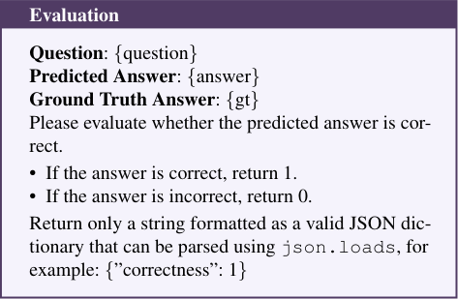
Evaluation Framework for Predicted Answers
The image shows a screenshot of an evaluation framework used to assess the correctness of predicted answers.
The framework is presented in a structured format with a purple header titled 'Evaluation' and a white body containing the evaluation criteria.

Slide 7
Key Points
A multi-agent framework for DocQA that integrates specialized agents for text and image modalities.
A general agent generates a preliminary answer, which is refined by a critical agent.
Specialized agents analyze the retrieved context within their respective modalities.
The framework's performance is evaluated through various analyses.

