Slide 1
Mobile Game Programming: Heap Data Structure
jintaeks@gmail.com
Division of Digital Contents, DongSeo University.
November 2016

Slide 2
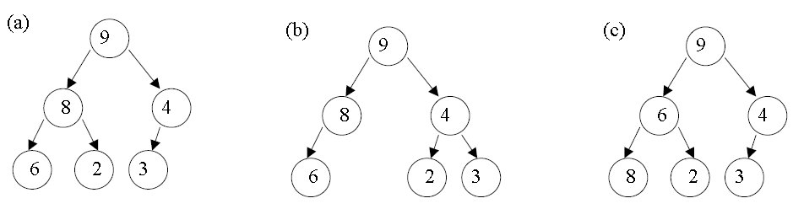
What is a Heap Data Structure?
A Heap data structure is a binary tree with the following properties:
It is a complete binary tree; that is, each level of the tree is completely filled, except possibly the bottom level. At this level, it is filled from left to right.
It satisfies the heap-order property: The data item stored in each node is greater than or equal to the data items stored in its children.
Examples:
In the above examples only (a) is a heap. (b) is not a heap as it is not complete and (c) is complete but does not satisfy the second property defined for heaps.

Slide 3
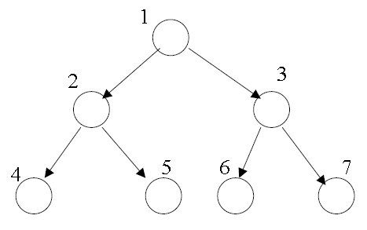
Heap as an Array
We could implement heaps using a linked list like structure, like we did with binary trees but in this instance it is actually easier to implement heaps using arrays.
We simply number the nodes in the heap from top to bottom, numbering the nodes on each level from left to right and store the i-th node in the i-th location of the array.

Slide 4
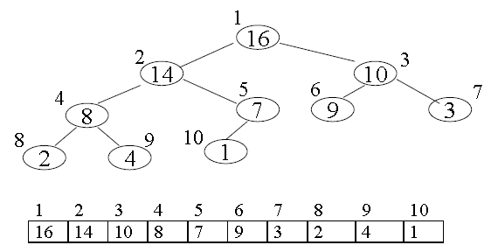
Heap as an Array (2)
An array A that represents a heap is an array with two attributes
length, the number of elements in the array
heap-size, the number of heap elements stored in the array
Viewed as a binary tree and as an array :
The root of the tree is stored at A[0], its left-child at A[1], its right child at A[2] etc.

Slide 5
Accessing the Heap Values
Given the index i of a node, the indices of its parent Parent(i), left-child LeftChild(i) and right child RightChild(i) can be computed simply :
Parent(i) { return i/2; }
LeftChild(i) { return 2*i; }
RightChild(i) { return 2*i+1; }
Heaps must also satisfy the heap property for every node i, other than the root.
A[Parent(i)] ≥ A[i]
Therefore, the largest element in a heap is stored at the root, and the subtrees rooted at a node contain smaller values than does the node itself.

Slide 6
Heap Operations
The height of a node in a tree is the number of edges on the longest simple downward path from the node to a leaf. (i.e. maximum depth from that node)
The height of an n-element heap based on a binary tree is lg( n ).
The basic operations on heaps run in time at most proportional to the height of the tree and thus take O(lg n) time.

Slide 7
Maintaining the Heap Property
One of the more basic heap operations is converting a complete binary tree to a heap.
Such an operation is called “Heapify”.
Its inputs are an array A and an index i into the array.
When Heapify is called, it is assumed that the binary trees rooted at LeftChild(i) and RightChild(i) are heaps, but that A[i] may be smaller than its children, thus violating the 2nd heap property.
The function of Heapify is to let the value at A[i] “float down” in the heap so that the subtree rooted at index i becomes a heap.

Slide 8
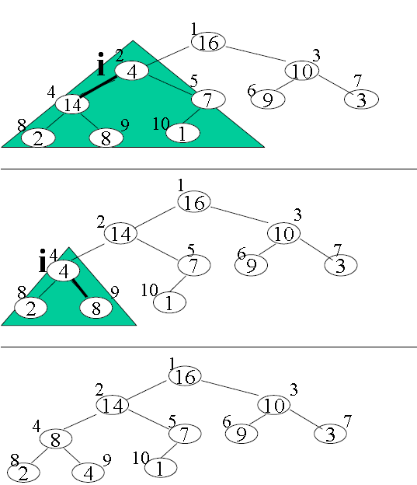
Example of Heapify
• Subtree to be heapified is marked by the shaded triangle.
• Node i if smaller than its children is swapped with the greater of its two children – in this case the left child with value 14 is swapped for value 4 in node I.
• If the next subtree down (again marked with the
shaded triangle region) is not a heap, we “percolate” down to the next subtree level and find the larger of the two children again to swap with current root node.
• We keep “percolating” down until either the
subtree conforms to the heap properties or a leaf
has been reached.

Slide 9
The Heapify Algorithm
Begin
Heapify(A[], i) // Heapify takes in our heap and index of current root node of subtree to be heapified
{
left = LeftChild(i); // index of left child
right = RightChild(i); // index of right child
if left ≤ A.heap-size AND A[left] > A[i] { // if still within bounds AND left child
largest = left; // greather than parent – remember largest as left child
}
else {
largest = i; // else parent still has largest value for now
}
if right ≤ A.heap-size AND A[right] > A[largest] { // if still within bounds AND right child
largest = right // greather than parent – remember largest as right child
}
if largest NOT EQUAL i { // if parent does not hold largest value
swap A[i] and A[largest] // swap parent with child that does have largest value
Heapify(A, largest) // Percolate down and Heapify next subtree
}
}
End

Slide 10
The Heapify Algorithm
At each step, the index of the largest of the elements A[i], A[Left(i)], and A[Right(i)] is stored in the variable largest.
If A[i] is largest, then the subtree rooted at node i is a heap and the procedure ends.
Otherwise, one of the two children has the largest element, and A[i] is swapped with A[largest], which causes node i and its children to satisfy the heap property.
The node largest, however, now has the original value A[i], and thus the subtree rooted at largest may violate the heap property.
Therefore, Heapify must be called recursively on that subtree.

Slide 11
Building a Heap
For the general case of converting a complete binary tree to a heap, we begin at the last node that is not a leaf, apply the “percolate down” routine to convert the subtree rooted at this current root node to a heap.
We then move onto the preceding node and “percolate down” that subtree.
We continue on in this manner, working up the tree until we reach the root of the given tree.
We use the Heapify procedure here in a bottom up manner. This means also means that to convert an array A[1..n], where n = A.length, into a heap we can apply the same procedure as described above.
Now, since the subarray A[(⌊n/2 ⌋ + 1)..n] are all leaves of the tree, each is a 1-element heap.
The procedure “Build-Heap” goes through the remaining nodes and runs Heapify on each.
The order of processing guarantees that the subtrees rooted at children of node i are heaps before Heapify is run at that node.

Slide 12
Begin:
Build-Heap (A[]) { // takes in an array to be heapified
A.heap-size = A.length; // heap size is number of elements in the array
for i =⌊A.length/2⌋ downto 1 // starting at first subtree up to root full tree
{
Heapify(A, i); // Heapify the current subtree
}
}
End
Each call to Heapify costs O(lg n) time, and there are O(n) such calls.
Thus, the running time is at most O(n lg n)
A more complex analysis, however, gives us a tighter upper bound of O(n).
Hence, we can build a heap from an unordered array in linear time.
Lets have a look at a visual example of this operation (have a look at the next slide).
The current subtrees that are being worked on are marked inside a shaded triangle.
Any swapping that goes on is marked with a thicker edge.

Slide 13
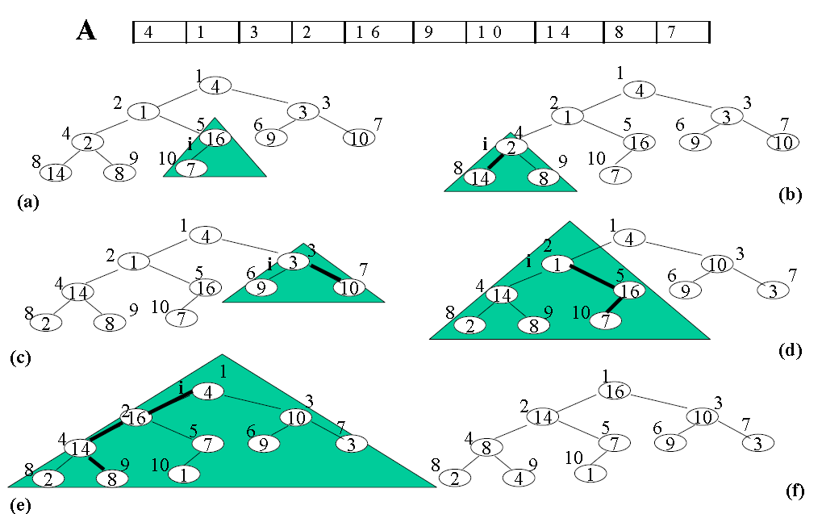
Example of Build Heap

Slide 14
Other Heap Operations
Other important heap operations include :
Heap Insert (inserting an element into a heap)
Heap Extract Max/Min (extracting an Max/Min element from a heap)
Heap Delete (remove an element from a heap)
HeapSort - O(N lg N) sorting algorithm
very basic idea :
swap and remove root value with final position element value
decrement size of heap and Heapify from position one (i.e. new root) again to restore new heap
Keep doing this while there is more nodes. This eventually gives us a sorted list.

Slide 15
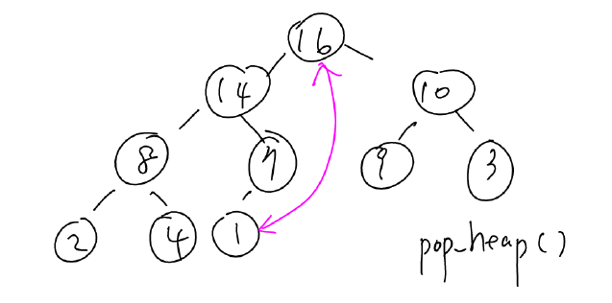
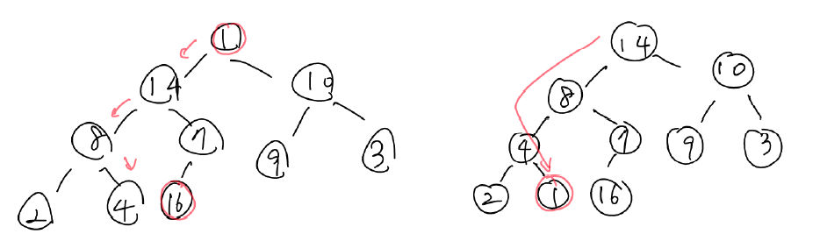
Heap Delete

Slide 16
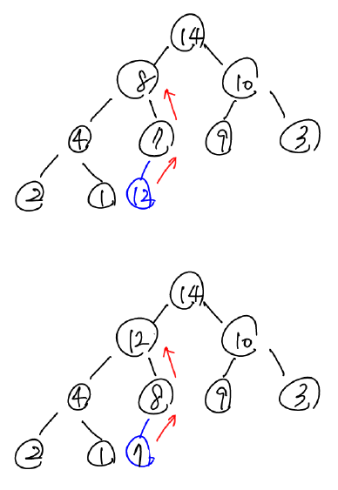
Heap Insert

Slide 17
Ex) std::heap functions
int main()
{
std::vector<int> v{ 4,1,3,2,16,9,10,14,8,7 };
std::make_heap(v.begin(), v.end());
std::cout << "v: ";
for (auto i : v) std::cout << i << ' ';
std::cout << '\n';

Slide 18
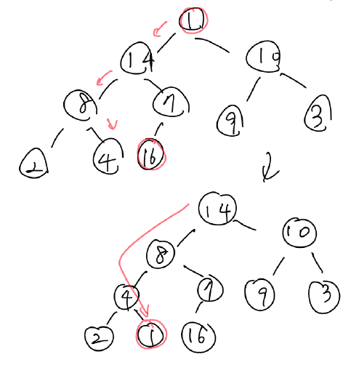
int main()
{
…
std::pop_heap(v.begin(), v.end());
// moves the largest to the end
std::cout << "after pop_heap: ";
for (auto i : v) std::cout << i << ' ';
std::cout << '\n';
int largest = v.back();
v.pop_back();
// actually removes the largest element
std::cout << "largest element: " << largest << '\n';
std::cout << "heap without largest: ";
for (auto i : v) std::cout << i << ' ';
std::cout << '\n';

Slide 19
std::cout << "after push heap: ";
v.push_back(12);
//Sorts the new element into the heap
std::push_heap(v.begin(), v.end());
for (auto i : v) std::cout << i << ' ';
std::cout << '\n';
/* output:
v: 16 14 10 8 7 9 3 2 4 1
after pop_heap: 14 8 10 4 7 9 3 2 1 16
largest element: 16
heap without largest: 14 8 10 4 7 9 3 2 1
after push heap: 14 12 10 4 8 9 3 2 1 7
*/
}

Slide 20
References
AStar_heaps-120622083335-phpapp01.pdf

