Slide 1

Mobile Game Programming: A-Star Path Finding
jintaeks@dongseo.ac.kr
Division of Digital Contents, DSU
November 2017

Slide 2
Add the starting node to the open list.
Repeat the following steps:
Look for the node which has the lowest f on the open list. Refer to this node as the current node.
Switch(move) it to the closed list.
For each reachable node from the current node
If it is on the closed list, ignore it.
If it isn’t on the open list, add it to the open list. Make the current node the parent of this node. Record the f, g, and h value of this node.
If it is on the open list already, check to see if this is a better path. If so, change its parent to the current node, and recalculate the f and g value.
Stop when
Add the target node to the closed list.
Fail to find the target node, and the open list is empty.
Tracing backwards from the target node to the starting node. That is your path.

Slide 3
the standard terminology
g(n) represents the exact cost from starting point to any point n
h(n) represents the estimated cost from point n to the destination
f(n)=g(n)+h(n).

Slide 4
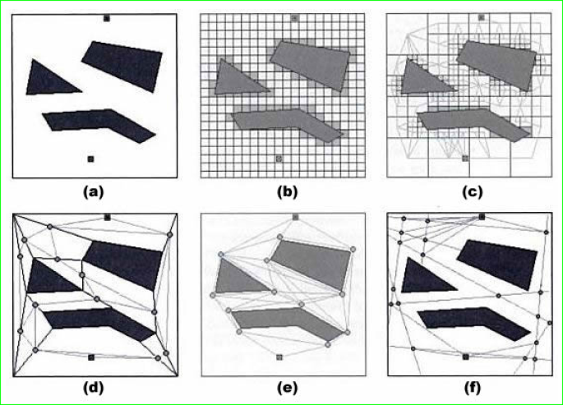

Slide 5
rectangular grid (Fig. 2a)
quadtree (Fig. 2c)
convex polygons (Fig. 2d)
points of visibility (Fig. 2e)
generalized cylinders (Fig. 2f).

Slide 6



