Slide 1
Irreducible Complexity
jintaeks@gmail.com
November 2017

Slide 2
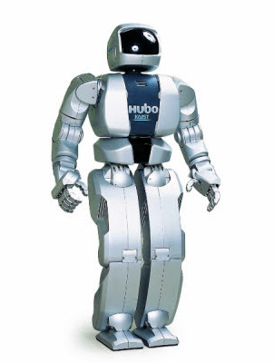
Robot

Slide 3
Trimal
000
001
002
010
011
012
020
021
022 → 0×3² + 2×3¹ + 2×3⁰ = 8_{10(decimal)}
100

Slide 4
Binary
0000
0001
0010
0011
0100
0101
0110
0111 → 0×2³ + 1×2² + 1×2¹ + 1×2⁰ = 7_{10(decimal)}
1000

Slide 5
Tetramel
000
001
002
003
010
011
012
013
020
021
AAA
AAT
AAC
AAG
ATA
ATT
ATC
ATG
ACA
ACT
Binary 00 → A
Binary 01 → T
Binary 10 → C
Binary 11 → G
Notes:
amino acids
DNA sequencing
a base, A, T, C and G(adenine, thymine/θáimiːn/, Cytosine, guanine/gwάːniːn/)
3 bases builds triplet code, an amino acids.
the series of an amino acid builds a protein.
There are 20 different amino acids in a living objects.

Slide 6
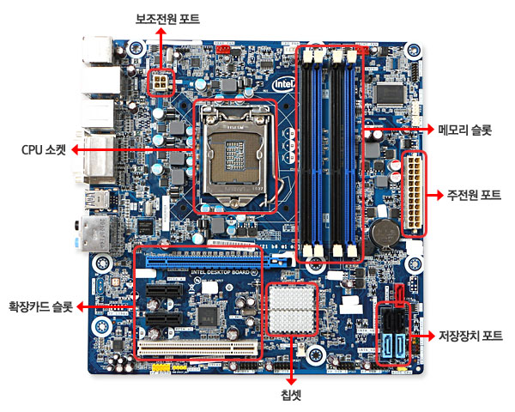
Computer
Hardware
Software : Meaningful chunk of binary number
Q. Where is binary numbers?

Slide 7
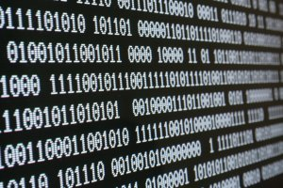
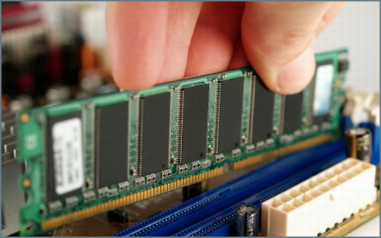
Binary numbers in Memory, Ex) Pc Online Game
Some binary number determines a color of skin
Data
Some binary number determines a motion of a character
Code

Slide 8
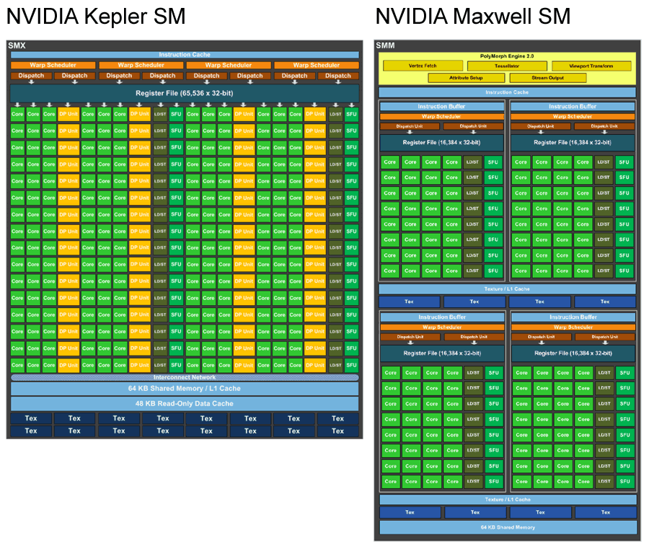
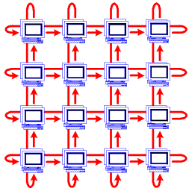
Recent Computer Architecture
Parallel
Multicore

Slide 9
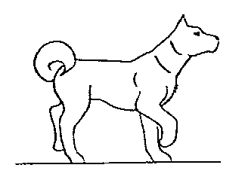
Animal

Slide 10
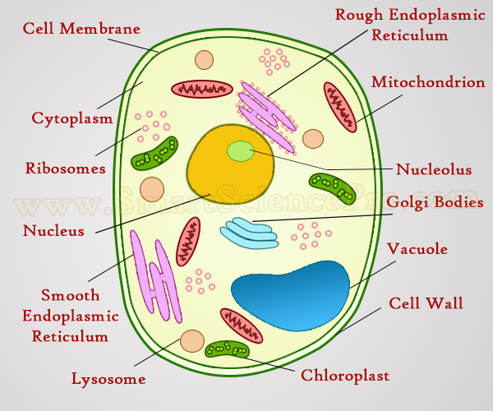
Structure of a Cell
Notes:
nucleus
ribosome/ráibəsòum/
the cell membrane

Slide 11
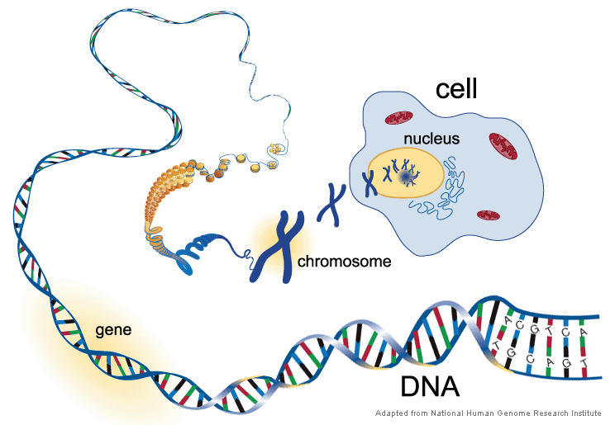
Cell ← Nucleus ← Chromosome ← Dna : Gene

Slide 12
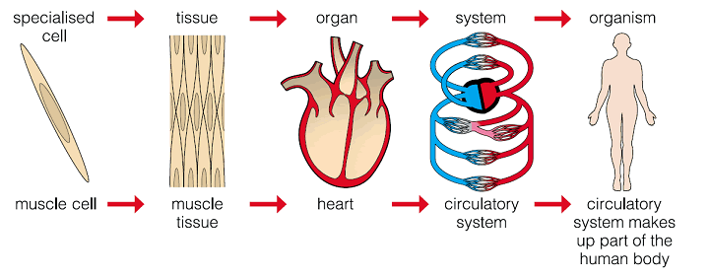
Cell → Tissue → Organ → Object

Slide 13
Similarity of Computer and Cell

Slide 14
Computer
Cell

Slide 15
Binary Number
DNA
Binary 00 → A
Binary 01 → T
Binary 10 → C
Binary 11 → G

Slide 16
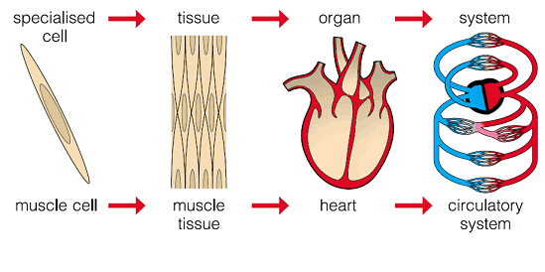
Multicore Architecture
Tissue
Parallel
Multicore

Slide 17
Robot
Living Object

Slide 18
Demo: Gene Manipulation

Slide 19
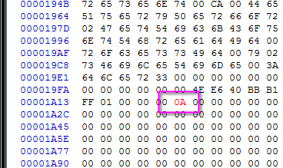
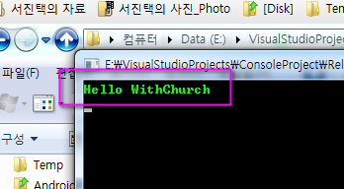
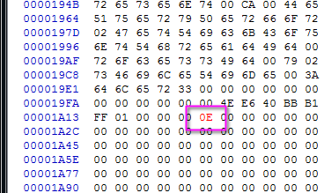
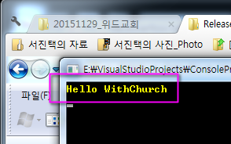

Slide 20
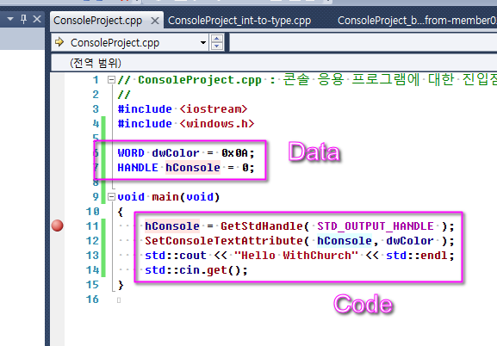

Slide 21
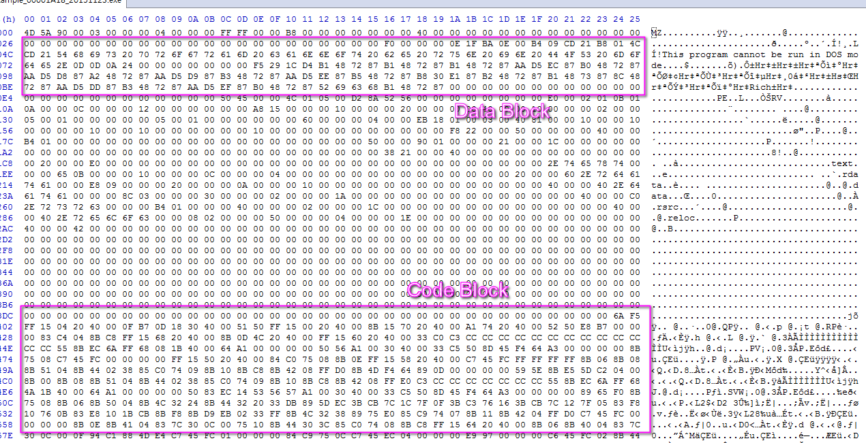

Slide 22
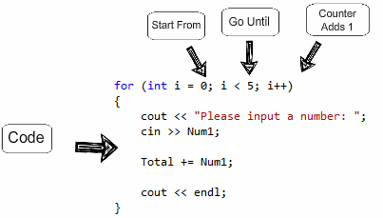
Ex) Dna Generating Dna
for-statement of C++

Slide 23
Conclusion
I can’t believe a living creature is created by chance.

Slide 24
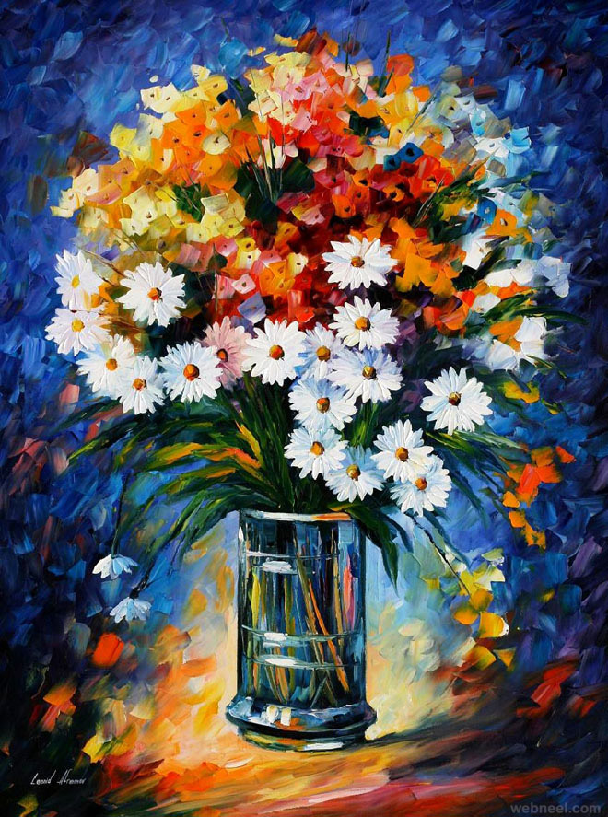
Painting ← Painter

Slide 25
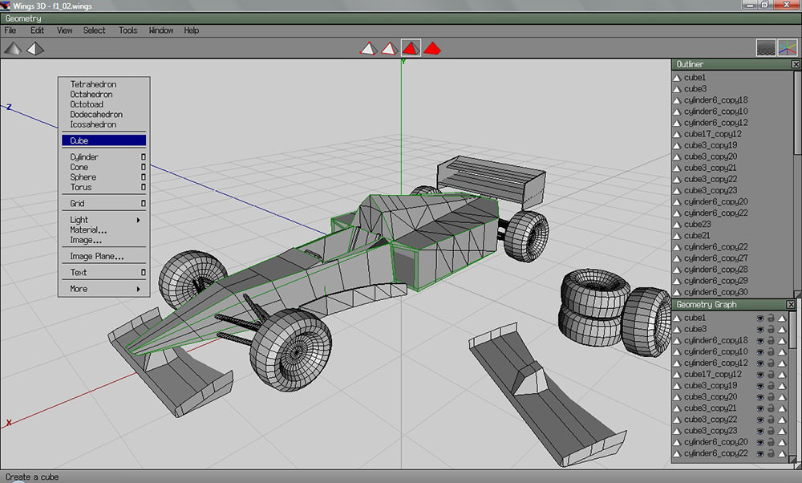
Modelling ← Modeller

Slide 26
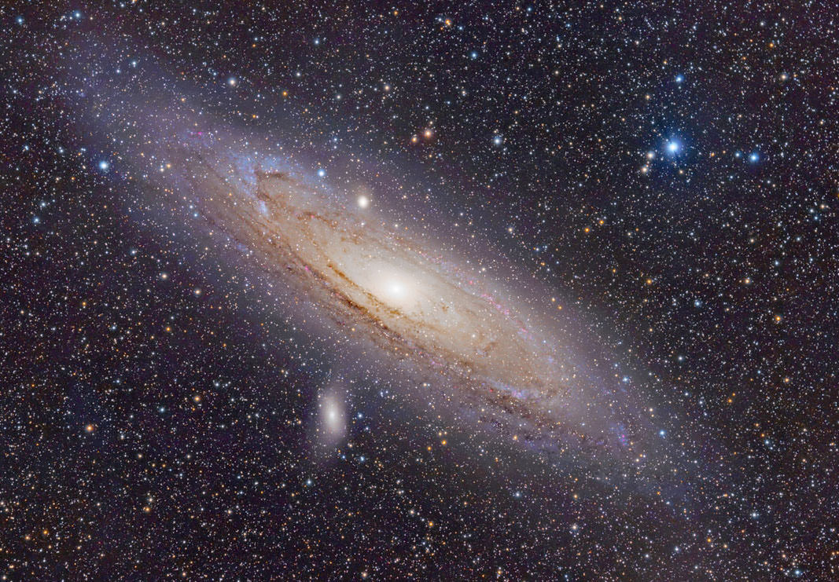
Cosmos ← The Creator

