Slide 1
Views on the Universe Character Education & Course Plan
Jintaek Seo, jintaeks@gmail.com
Division of Digital Contents, DongSeo Univ.
October 5, 2016

Slide 2
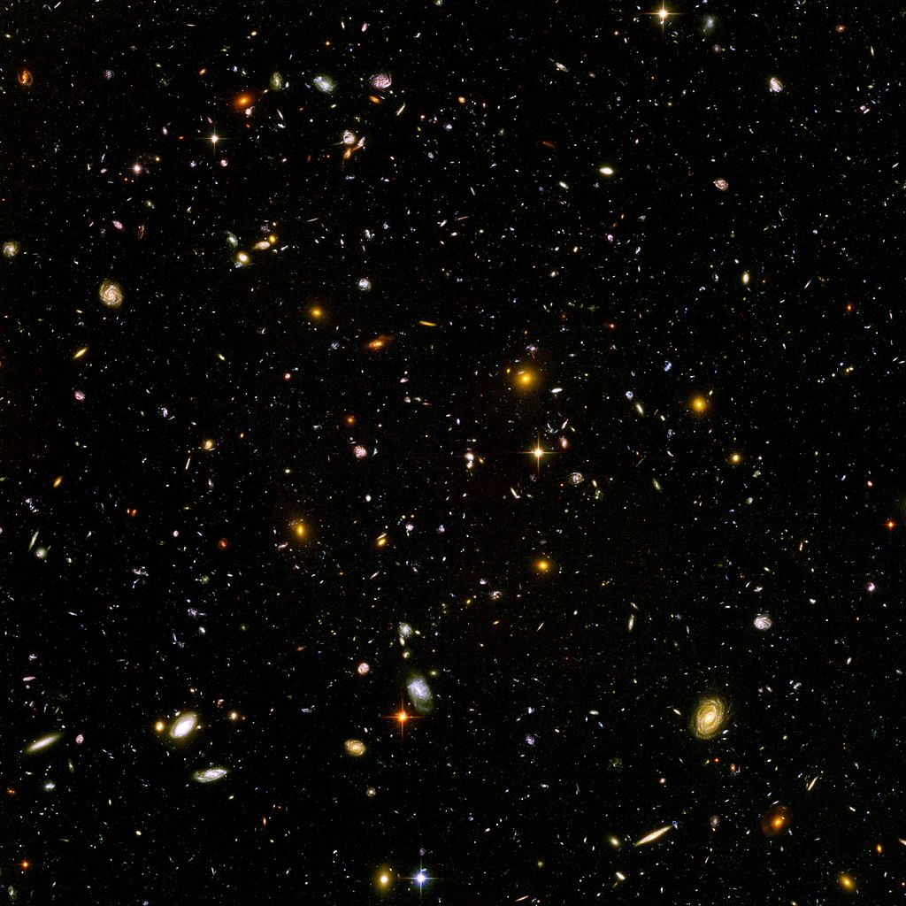
Hubble ultra deep field
This photo shows the farthest part of the universe so far.

Slide 3
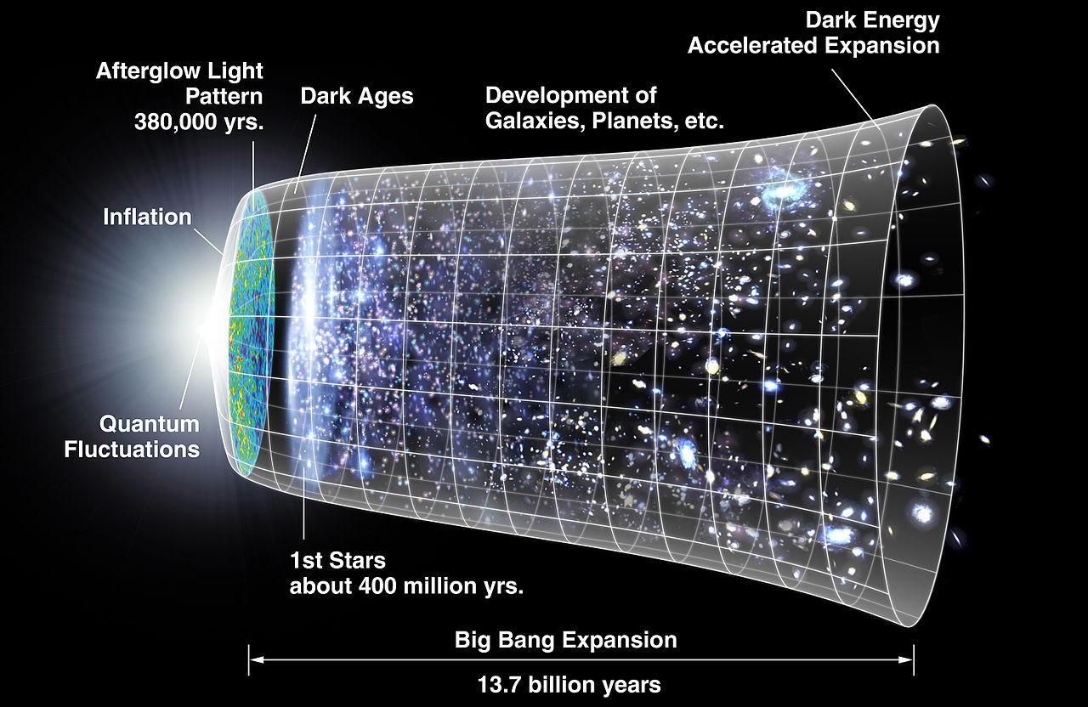
A graphical representation of the expansion of the universe with the inflationary epoch represented as the dramatic expansion of the metric seen on the left.

Slide 4
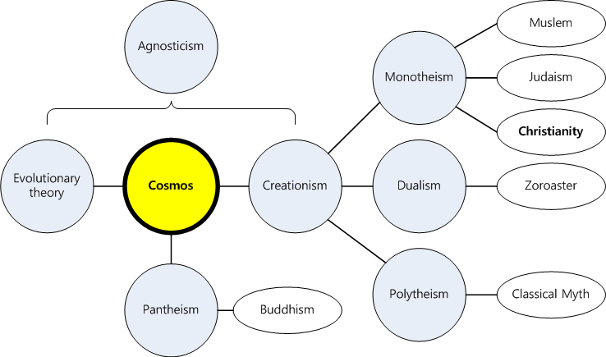
Views on the Universe.
Notes:
It was made by itself.
rotation, metempsychosis
You can classify it into three types.
sacrilege

Slide 5
The Greatest Question.
Which one is true?

Slide 6
The Second Greatest Question.
Which one do you believe?

Slide 7




