Slide 1

“Department of Information Technology”
Micro Project on:
Library Management System
Presented by:
1. Snehal Pradhan (197047)
2. Malvi Satpute (197053)
Guided By:-Prof. Dhaiwal Sir

Slide 2
INTRODUCTION TO PROJECT
This Project related to Library management.
It’s a well organized Software Solution for a Library.
It has a Database which is constantly managed and updated.
It helps to provide information on any book present in library to the user who uses it.
It keeps a track of books issued,returned and added to the library
Allows users to virtually Browse the books without doing so manually.

Slide 3
CONTENT WE USED IN THIS PROJECT
GUI :-
Use (tkinter import*) for GUI.
MessageBox widget module is used to display a message.
Tkinter Label is a widget that is used to implement display boxes where you can place text or images.
DATABASE :-
(import sqllite3) for database connection.
Use of insert ,select and update query to insert and update the information of Student in library Management System.
Create query to create the table.

Slide 4
PROCESS
PROCESS OF LIBRARY MANAGEMENT SYSTEM

Slide 5
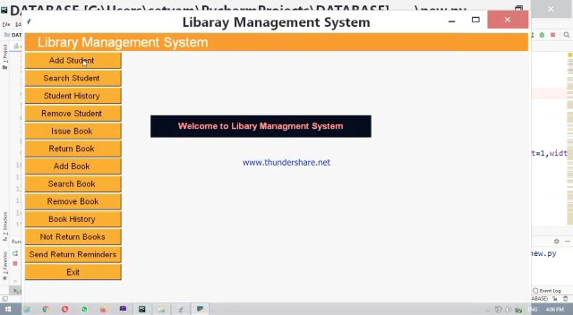
WELCOME TO LIBRARY MANAGEMENT SYSTEM

Slide 6
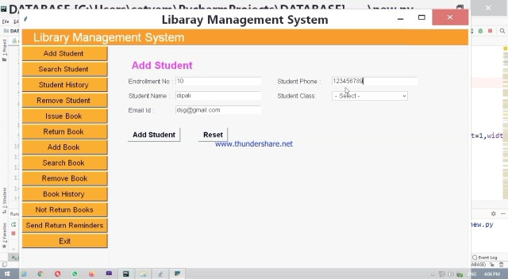
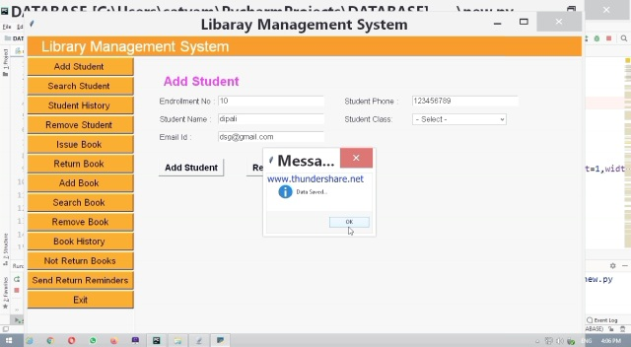
ADD STUDENT()
INPUT
OUTPUT

Slide 7
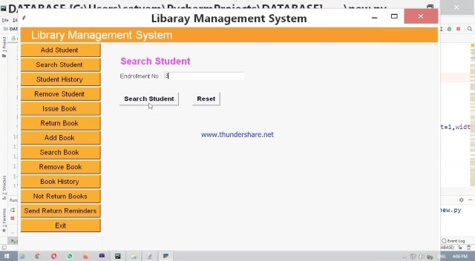
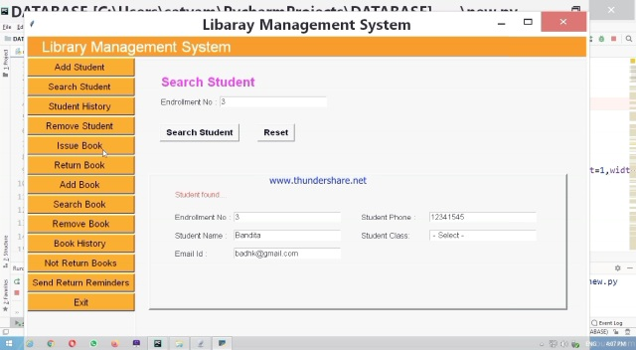
SEARCH STUDENT ()
INPUT
OUTPUT

Slide 8
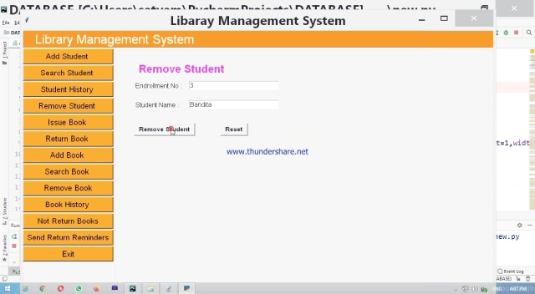
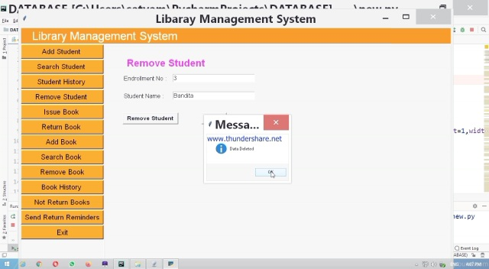
REMOVE STUDENT()
INPUT
OUTPUT

Slide 9
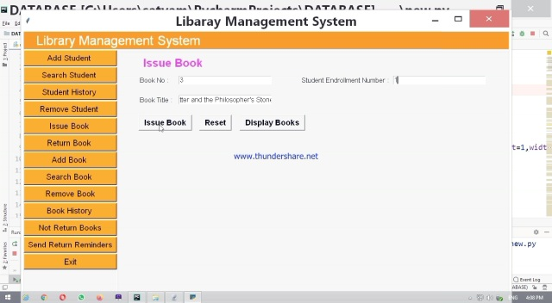
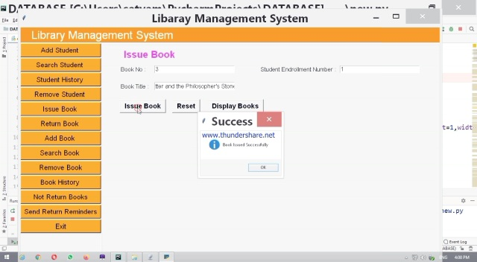
ISSUE BOOK()
INPUT
OUTPUT

Slide 10
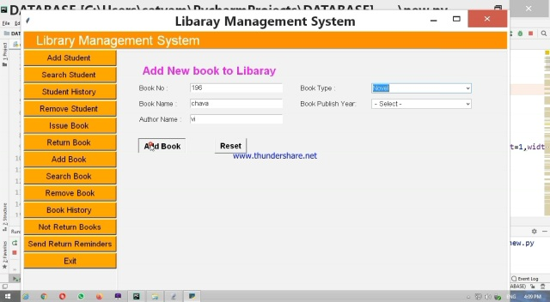
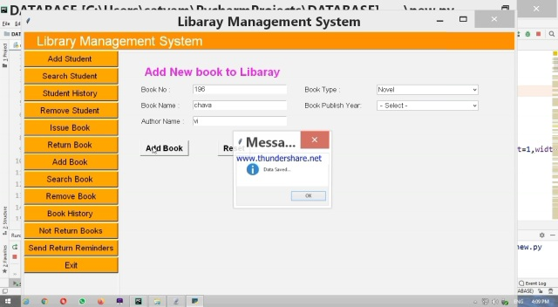
ADD NEW BOOK TO LIBRARY()
INPUT
OUTPUT

Slide 11


SEARCH BOOK()
INPUT
OUTPUT

Slide 12

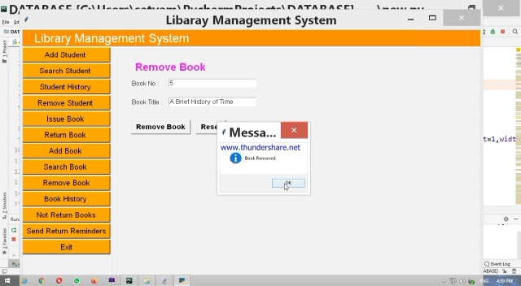
REMOVE BOOK ()
INPUT
OUTPUT

Slide 13
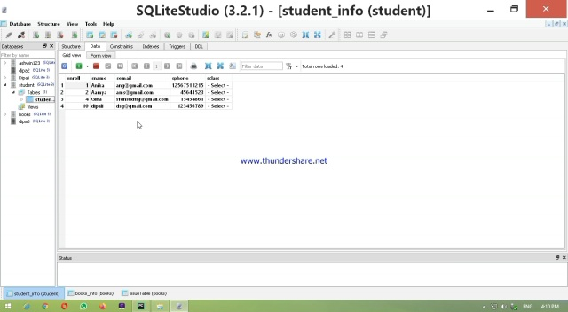
STUDENT INFORMATION IN DATABASE

Slide 14


