Slide 1

The CHIPS Are Coming!!
What RFID Might Mean For You
(Frank J. Fortner / Sr. VP, Application Development)

Slide 2
Objective
Acquire a basic understanding of current RFID technology and apply that understanding to a real-world set of future possibilities, probabilities and incontrovertible facts as they relate to the healthcare industry.
Notes:
[ READ SLIDE ]
There is an overwhelming amount of resource material available on the internet concerning RFID, which in and of itself is a sign of the times. This presentation is simply one more voice in the technological wilderness, crying out to let people know of the soon coming technology.

Slide 3
What is RFID?
Radio Frequency IDentification
In short, it is the use of radio waves to uniquely identify objects at a distance.
Radio waves are electromagnetic energy that move through space.
In its most basic form, RFID consists of a “tag” and a “reader”
Notes:
It is the “energy” produced by the radio wave that is the key.
In the case of the most widely deployed tag types, passive tags, the energy from the radio waves is used for communication, and to power the tag enough for it to respond and answer back.

Slide 4
What is RFID? (Continued)…
Also called DSRC (Dedicated Short Range Communication)
Similar (in principle) to traditional bar code identification, but much greater capabilities.
RFID is to the bar code what internet- enabled cell phones are to walkie-talkies
Is NOT a new technology. Invented in 40s!
Notes:
It is a wireless, short-range communication protocol.

Slide 5
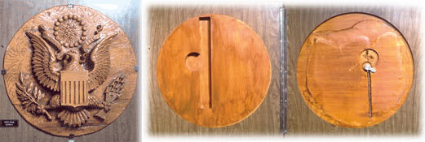
History of RFID
The Great Seal Bug
Given to US ambassador to USSR in 1946
Used passive RF technology to bug office
Not discovered until bug sweep in 1952!!
Currently on display at NSA’s National Cryptologic Museum
Notes:
Leon Theremin (Russian) was doing RFID-type experiments in the 30’s!!
During WWII, the UK used RFID to distinguish returning English airplanes from German ones.
In 1948, Harry Stockman wrote a paper titled, “Communication by Means of Reflected Power” where he made predictions about the future use of RFID.
It took another 30 years to become a reality.

Slide 6
History of RFID (continued)…
Decades of research have gone into RFID
EAS = Electronic Article Surveillance is an early form of RFID
Companies like Sensormatic were founded in the 1960s. (Makers of EAS systems)
Wide scale deployment of electronic toll collection (via transponders) in 1990’s

Slide 7
History of RFID (continued)…
Explosion of RFID in the retail Industry
Major companies like Wal-Mart, Gillette, Proctor and Gamble, Kraft, Target, IBM …
RFID allows unique tagging of retail items via an Electronic Product Code (EPC)
EPC is a 96-bit code which allows for 80,000 trillion trillion unique numbers!
Notes:
In retail, the idea is to uniquely identify every unique “thing” and collect reams of data, from manufacturing to consumption and beyond.
This creates what some call the “Internet of Things”
Wal-Mart’s current RFID database is said to already contain twice as much data as the internet!

Slide 8
How Does RFID Work?
Two types of RFID: Passive and Active
With passive RFID, radio waves transmitted by the reader, activate an RFID tag, which is energized enough to either write incoming information to the tag’s computer chip or transmit information back to the reader.
Notes:
No batteries involved, but shorter read range.

Slide 9
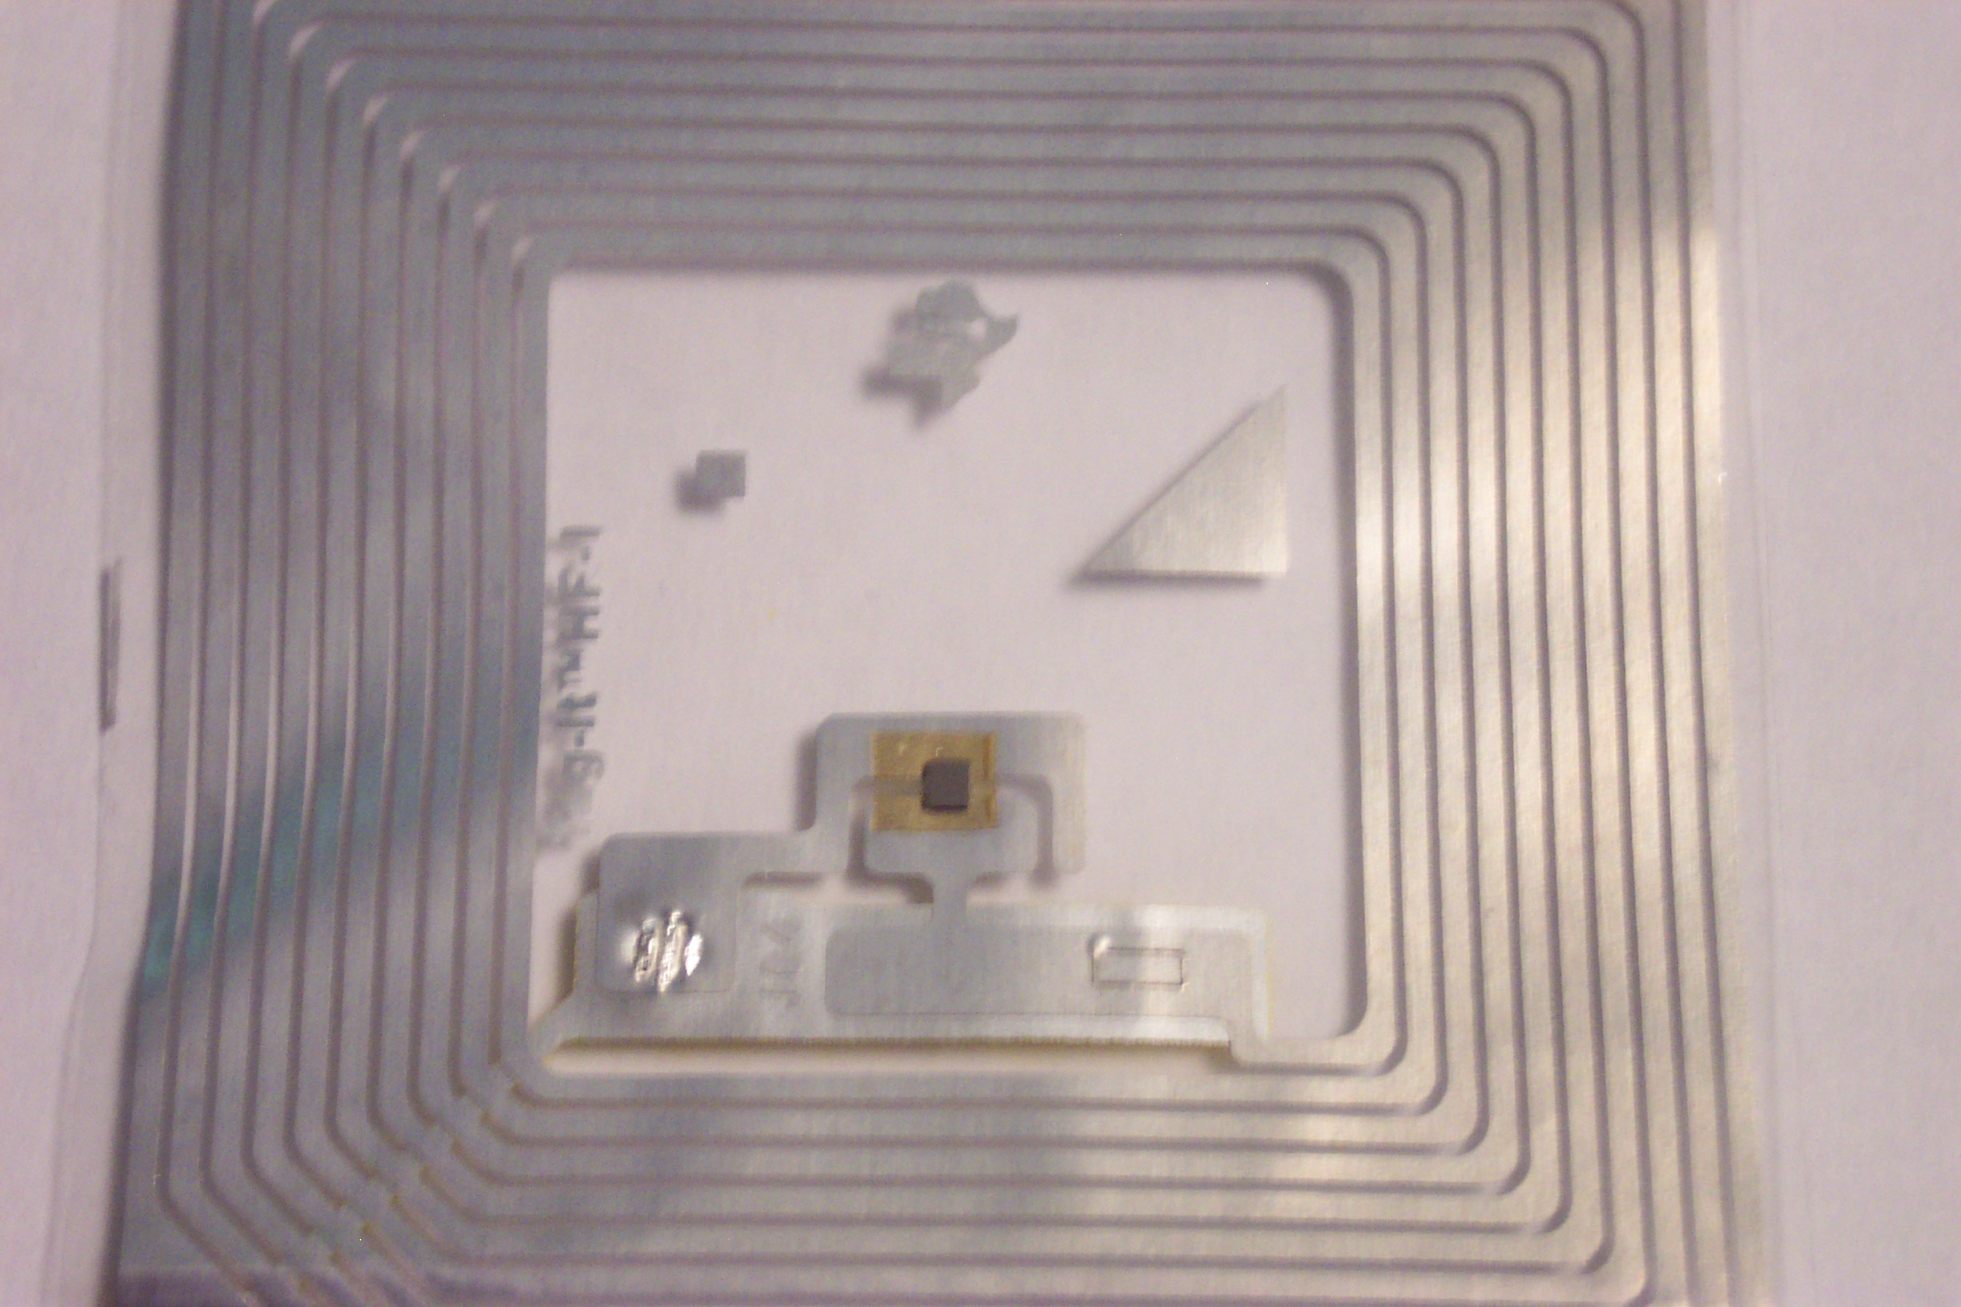
How Does RFID Work? (cont)…
Passive Tag
Computer chip
Antenna

Slide 10
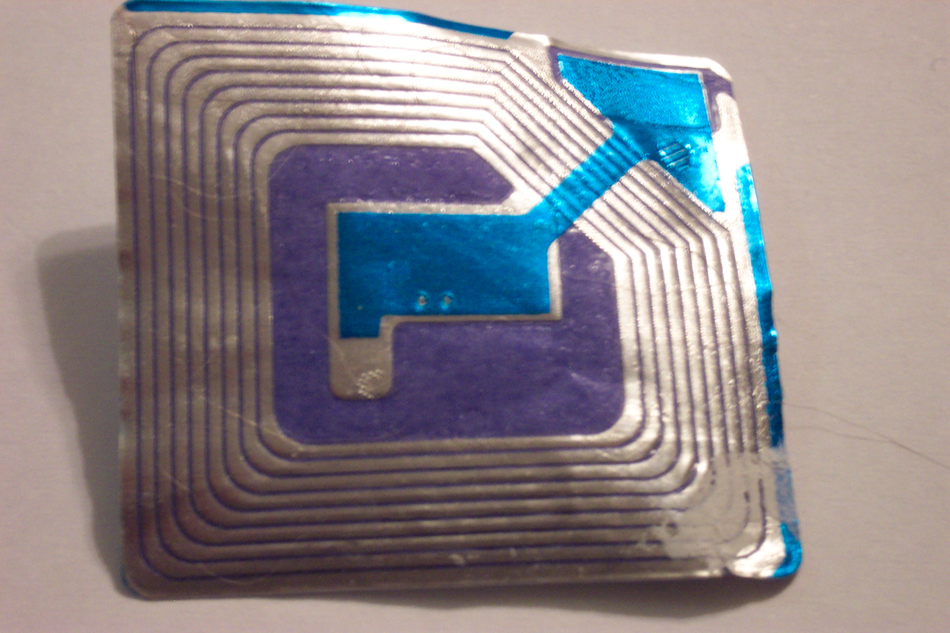
Lest You Be Fooled
RF EAS (anti-theft) Tag
Antenna
(Lacks a computer chip required to store data)
Notes:
EAS = Electronic Article Surveillance

Slide 11
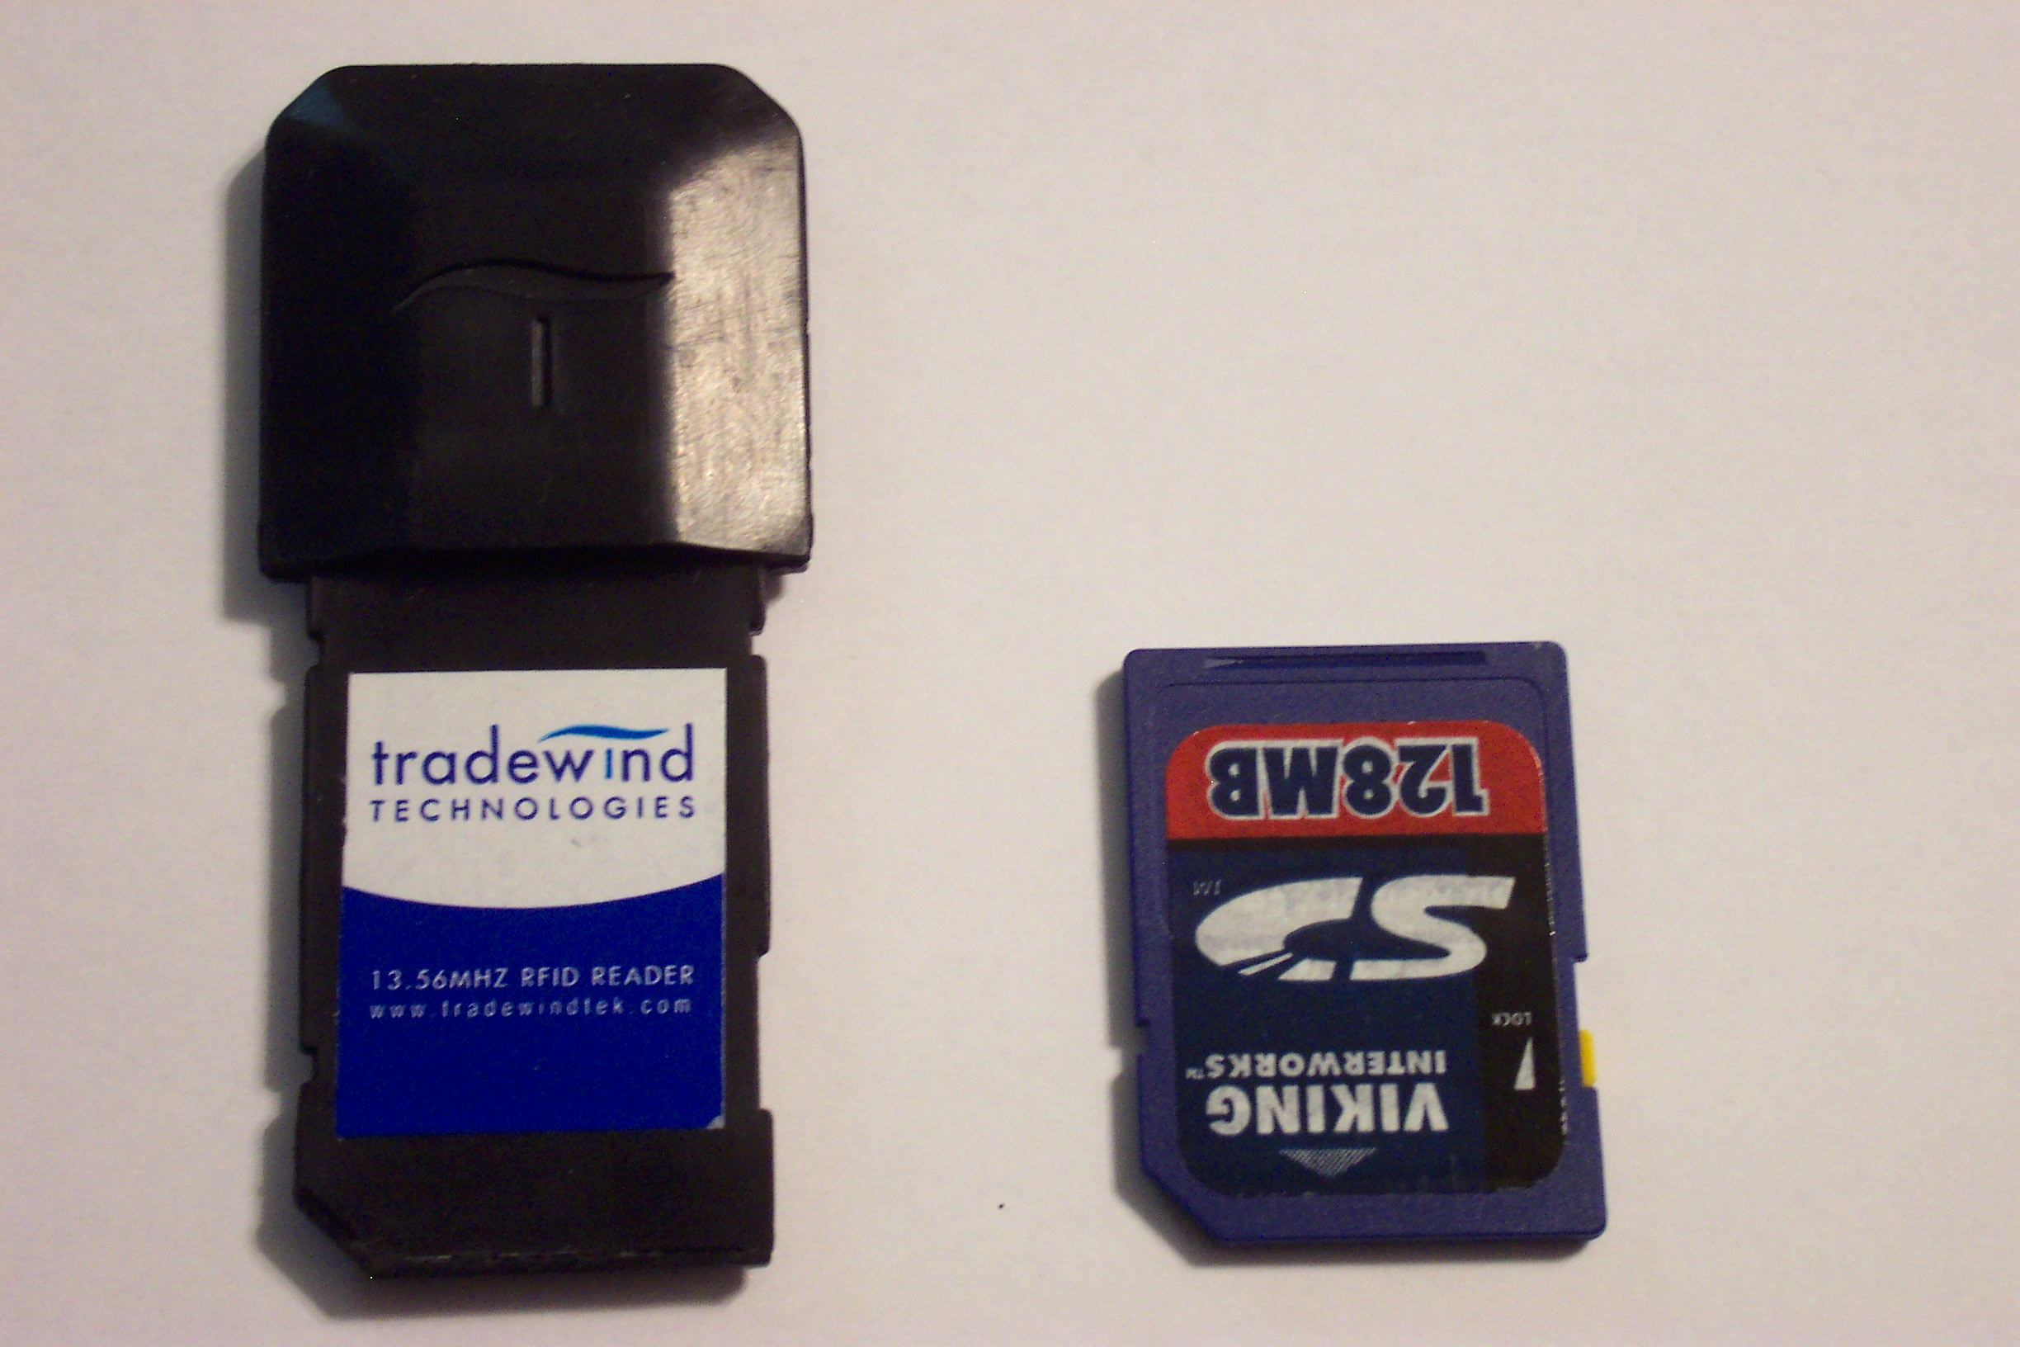
How Does RFID Work? (cont)…
Sample (plug-in) Reader
Notes:
This example fits in a Secure Digital (SD) slot in a pocket PC or tablet device equipped with an SD slot.

Slide 12
How Does RFID Work? (cont)…
With active RFID, tags contain their own power supply and can transmit on their own, rather than waiting to be energized.
Active tags are capable of transmitting at greater distances than passive tags and they can store larger amounts of data.
They also cost considerably more than passive tags

Slide 13
How Does RFID Work? (cont)…
For a reader to be able to read a tag, both the reader and the tag must operate on the same frequency.
Low: 30 to 400 kHz (animals, humans - VeriChip)
High: 13.56MHz “smart tags” (manufacturing, retail)
UHF: 300MHz to 1GHz - usually 915MHz (supply chain)
Microwave: +1GHz (2.45Ghz, 5.8GHz)
Notes:
Just like the way you would tune your radio to a station.
VeriChip operates at 135kHz
135KHz operates through more obstructions, but has a low read rate, distance is limited by FCC regulations on emitted power, and the standards do not include unique identifiers for tags. Therefore, any vendor using 135KHz which advertises unique identifiers, has a proprietary standard.
13.56MHz still has reasonable penetration through obstructions, a higher read rate, and unique tag identifiers. Distance is approximately half that of 135KHz, which is actually better for differentiation between items, patients, etc, and helps restrict issues with patient privacy.
900MHz has very good distance, due to higher emitted power allowed by the FCC, however, the penetration through objects is severely limited.
Microwave has very long distance (100m), and in some cases with very expensive active tags, can operate on an existing 802.11b network. However, it has very poor penetration through objects and people. Tags in this range are also subject to interference from 2.4GHz wireless, microwave ovens, etc.

Slide 14
How Does RFID Work? (cont)…
The reader and the tag must also use the same protocol. Various protocols have been created to bring standards to specific areas.
Examples:
ISO 15693 – Vicinity card / smart labels
ISO 14443 – Contactless payments
ISO 11784 – Livestock and Agriculture
ISO 18000 – Air interface protocol
Notes:
Again, go back to the radio station analogy. You can have your radio tuned into a Russian radio station, but unless you understand Russian, it’s useless.

Slide 15
How Does RFID Work? (cont)…
The standards themselves can often support tags with similar characteristics, in some cases cooperating; on others, competing.

Slide 16
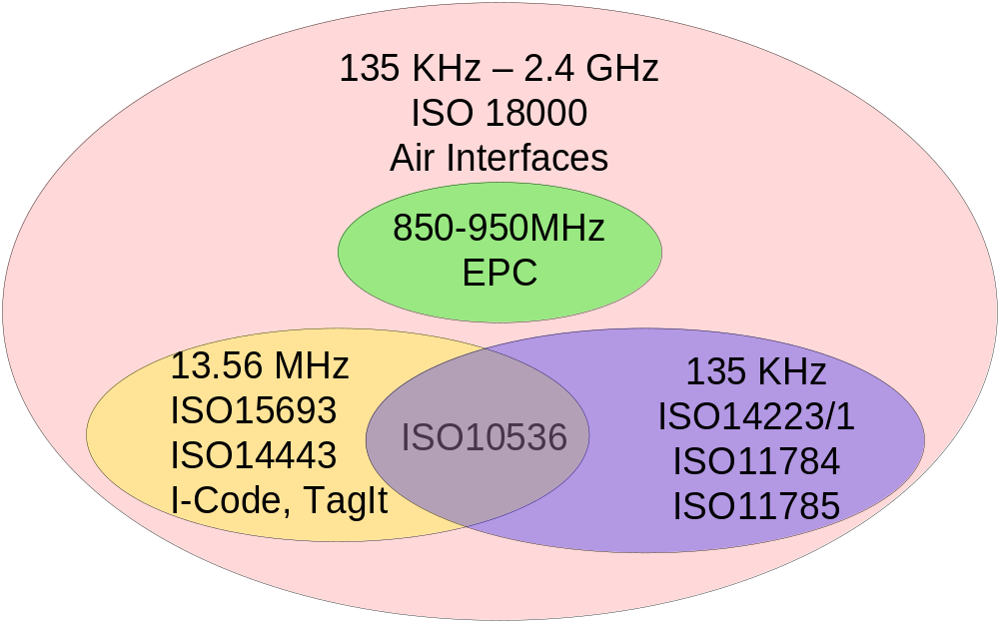
How Does RFID Work? (cont)…
Notes:
This illustrates the relationship between many of the standards in use for RFID tags today.
In each frequency range there are various standards which apply, though those standards may be related by nothing other than frequency.
135KHz
ISO 11784 & 11785: (up to 3m) Designed for use with Livestock and Agriculture, these do not have guaranteed unique ID numbers.
ISO 14223/1: (up to 3m) Builds on ISO 11784 & ISO 11785 to establish an authority for numbers, but still does not guarantee unique ID numbers, and a number of manufacturer’s already have large product lines for ISO 11784/11785 tags which are compatible and can be used to forge ISO 14223/1 tags if desired.
13.56Mhz
ISO 15693: Vicinity (up to 1.5m) ID Cards, Smart Cards, Product tagging, and Patient and Medication Identification
ISO 14443: Proximity (up to 8cm) ID Cards, Passports and Smart Cards
I-Code and TagIt – These are tags produced in this range, and both have their own protocols, in addition to supporting ISO15693 and ISO14443
Consider ISO 10536 – This standard for ID-1 Contactless ID cards encompasses both 13.56Mhz and 135Khz ranges. This doesn’t mean tags must support both, merely that a tag which is ISO 10536 compliant might be operating in either, so you would want to ask, or look at the other standards that tag supports to determine which frequency range it operates in.
900Mhz
EPC: (up to 10m) This actually encompasses a number of different tags, classes, and competing standards for Gen1 and Gen2 tags.
While pushed for heavily by supply chain industries and retails, there are no clear winners here yet, and frequency ranges around the world are incompatible due to differing radio frequency laws.
ISO 18000
This standard covers air interfaces and protocols. It is an attempt to standardize and extend features across the many different existing protocols and standards in place.
This has not been fully ratified, however, the portions relating to 13.56Mhz have been completed and ratified.

Slide 17
How Does RFID Work? (cont)…
Typically, tags cover only a very narrow frequency range.
For example, tags manufactured for 13.56MHz will typically operate only in that range.
Most 13.56Mhz tags are manufactured to handle the ISO 15693 standard protocol.
Most tags manufactured for patient wristbands, for example, are ISO15693. Philips I-Code and Texas Instruments Tag-It seem to be the most popular.
Notes:
Dual Frequency readers for 13.56MHz/900MHz are now becoming available

Slide 18
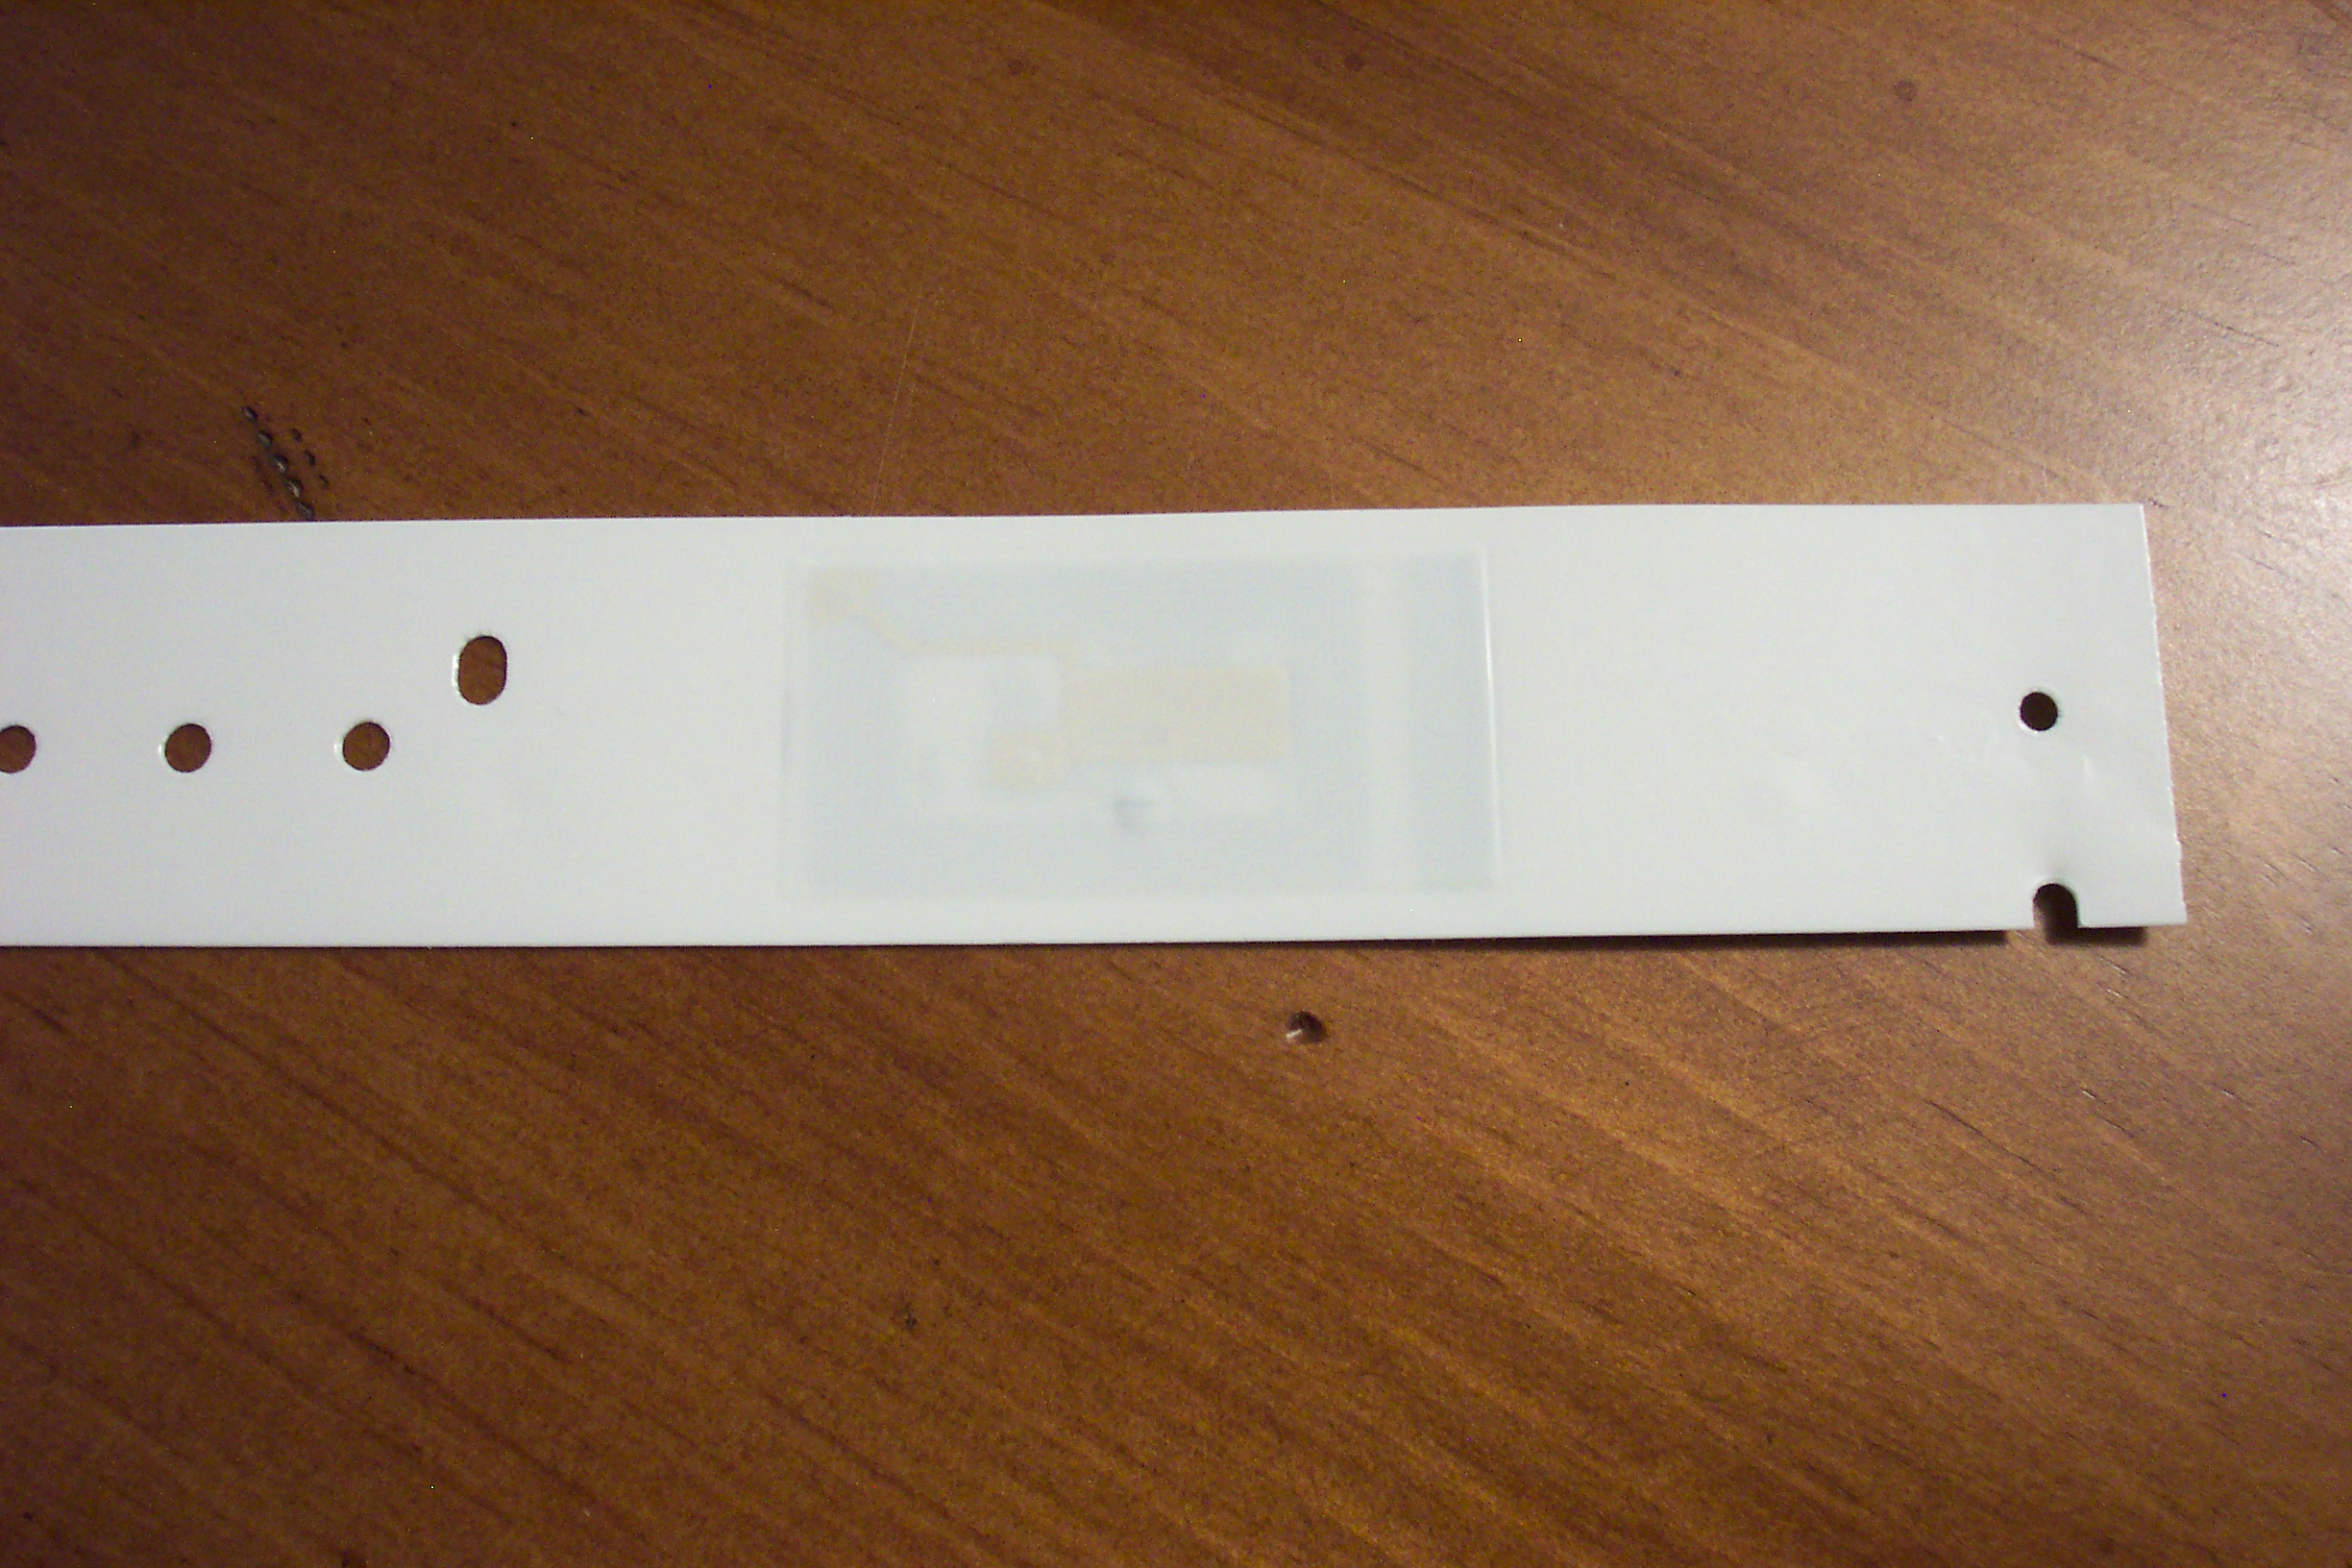
Patient Wristbands
RFID Tag

Slide 19
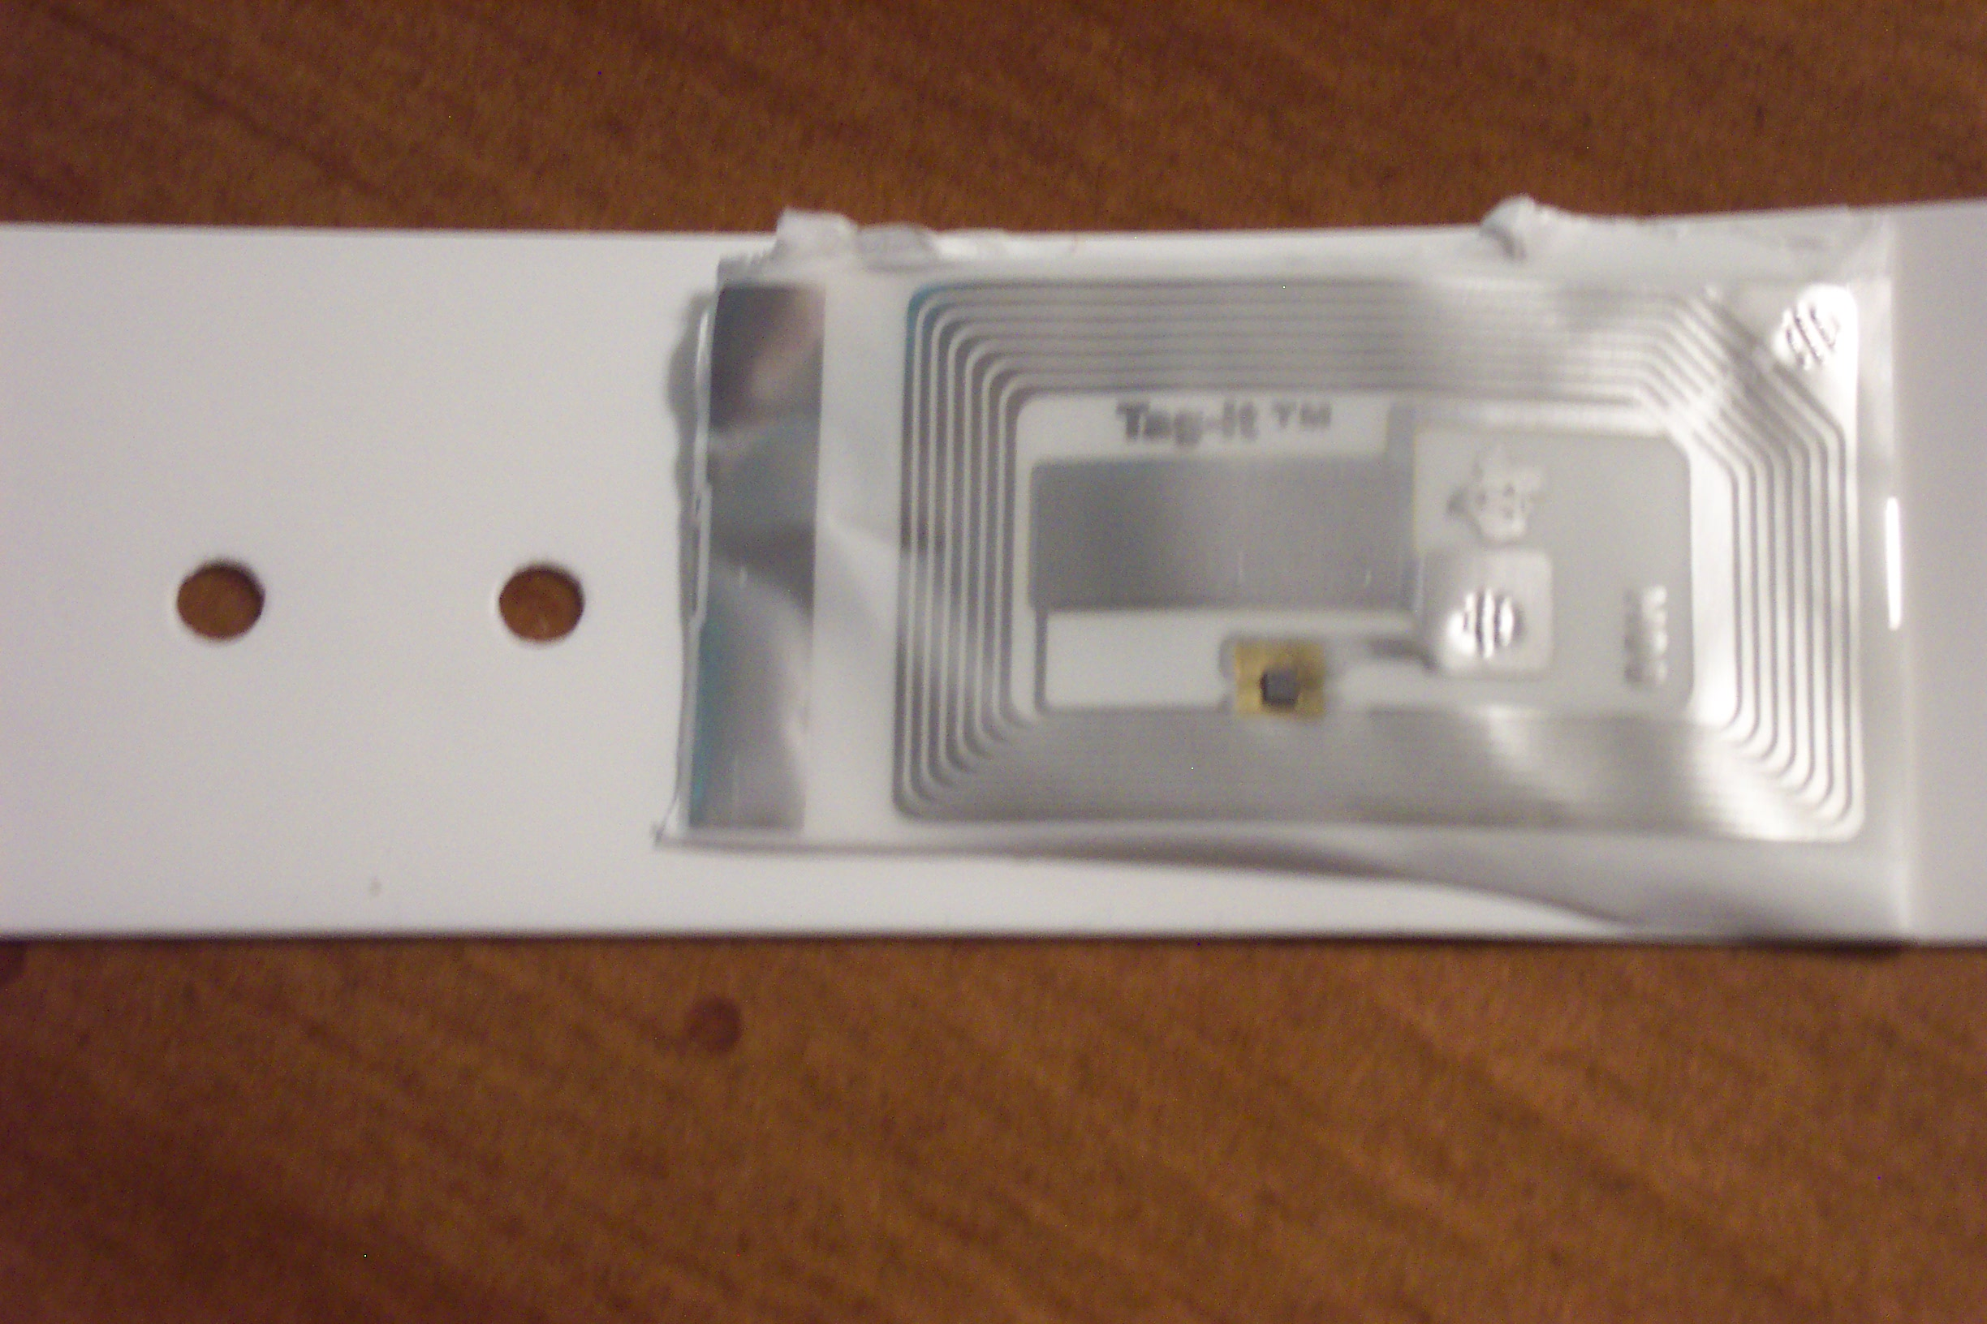
Patient Wristbands (cont)…
RFID Tag

Slide 20
How Does RFID Work? (cont)…
Following recent studies into both UHF and HF tags, the FDA seems to be leaning toward the HF 15693 (13.56 MHz) standards. Why?
13.56MHz tags perform adequately in or near masses of water and through thin metals.
13.56MHz tags are transmittable only a few feet even with the most powerful readers. This raises fewer privacy issues.
UHF (900 MHz) radio waves produce a heating effect similar to a microwave oven. (FDA still researching…)
Notes:
The human body is a mass of water and HF (13.56MHz) outperforms UHF (900 Mhz) in this kind of environment.
UHF Heating effect: while the effect is minimal in most environments, there have been concerns expressed that the use of these UHF tags may lead to unforeseen consequences for some medications. The use of these tags in a “smart shelf” environment would subject pharmaceuticals to a constant, low-grade heating effect.

Slide 21
Passing Fad?
Is RFID just another passing fad?
According to a report by AberdeenGroup in Jan 06, 73% of companies surveyed are currently building internal RFID knowledge.
Despite ROI concerns, a majority of senior managers are focused on the long-term
The number of companies conducting RFID pilots will increase by 50% in 2006

Slide 22
Passing Fad? (cont’d)
Checking in on Retail…
Companies like Wal-Mart have spent billions on RFID product tracking technology.
As of Jan 2005, 137 companies had already complied with the Wal-Mart Mandate requiring RFID tags on all palette and case levels.
Mandate initially focused on top 100 suppliers, but will expand to 300 by the end of 2006 and 600 by the end of 2007, according to WM CIO.

Slide 23
Passing Fad? (cont’d)
Checking in on US Government…
US DoD had their own mandate for suppliers to use RFID by Jan 1, 2005.
In a May 2005 report, the Government Accountability Office (GAO) said that 13 of 23 agencies are already using or plan to use RFID
Applications include: employee access, passports, supplies, pharmaceuticals, etc.
FDA envisions tags on all drugs by 2007
Notes:
FDA’s vision is to see RFID Tags on all drugs (at the PALLET, CASE and UNIT level) by 2007

Slide 24
Passing Fad? (cont’d)
Checking in on the World…
The RFID market in China was approx. $200M (USD) in 2005 and will continue to grow.
China is expected to use more than 5 trillion RFID tags annually, largely for Wal-Mart items.
Global revenues from RFID systems to push $6 billion (USD) by 2008, growing 36% annually.
European spending on RFID to push $2 billion by 2009, growing 30% annually
Notes:
China’s RFID market grew 8.6% in the fourth quarter of 2005 alone.

Slide 25
Passing Fad? (cont’d)
Miscellaneous…
900 million RFID-enabled credit cards are expected to be issued by the end of 2008.
Both former HHS Secretary Tommy Thompson and former DHS Secretary Tom Ridge have joined the boards of RFID technology companies.
Thompson is currently on the board of VeriChip, a maker of human-implantable RFID tags and has pledged to be implanted with the chip.

Slide 26
RFID vs. Barcoding
How does RFID compare to 1D/2D Barcoding?
RFID
Line of sight not required to read
Read or Read/Write
Greater security and product authentication
Smart Labels monitor shelf life, temperature
Barcodes
Requires line of sight to read
Read Only
Easy to Read and Counterfeit
No additional functionality possible
Notes:
Key Advantages
While barcodes always require line of sight access for reading. RFID by comparison can be read through clothing and sheets, the human body, etc.
Barcodes are read-only, whereas RFID tags can be read-write, have built-in security, a burned in unique Id number, and are very difficult to counterfeit.
The unique tag number can be used in conjunction with manufacturer ID’s to ensure a high degree of product identification. Barcodes by contrast are easily duplicated or forged. For this reason, the FDA and Pharmaceutical industry are pushing toward tagging per unit (as opposed to per pallet or per dose) to help reduce counterfeiting and allow care providers to validate shipments.
There are already smart labels available which monitor and record temperature or other environmental factors during shipment and storage. These labels record date and time, temperature, shelf life, etc. The first of these are already in use on produce, with tags beginning to appear on blood units, transplants, etc.

Slide 27
RFID - The End of Barcodes?
Will RFID spell the end of Barcodes?
RFID is currently not cost effective for unit medication dosages, where barcodes are making significant advances in patient safety
Not all suppliers will be shipping with RFID yet
Lower costs ensure that barcodes will still be used where there is not a significant driving influence
Notes:
Virgin Atlantic airways pilot found that small parts housed in small containers on shelves (very near to each other) was NOT a good candidate for RFID. They chose to stick with traditional bar codes.
Ultimately, for the foreseeable future, RFID is not the great barcode killer – at least not with today’s RFID technology.

Slide 28
RFID - The End of Barcodes?
(Cont’d)
Not Here Yet
FDA requires drug manufacturers to place linear barcode tags on the outside of containers and individual blister wrapped cells (Title 21 CFR Parts 201, 606, and 610)
It’s On The Way!
FDA recently began requiring manufacturers to submit labels in electronic Structured Product Label format, with intentions for eventual electronic tags (Title 21 CFR Parts 201, 314, and 601)
Notes:
When?
Well, according to the recent (Nov 2005) ruling requiring drug information in SPL format, all drugs approved after Jun 2006 require SPL format labels. Those approved after Jun 2004 must have labels submitted in SPL format in 2007, and all others by 2010.
2010 sounds like a long time, but, really, it’s just 3 years out.
http://dailymed.nlm.nih.gov Contains all the information about any approved drugs with SPL’s currently on file

Slide 29
Healthcare Application of RFID
What are some practical uses for healthcare?
Medical Device and Asset Tracking
Patient Tracking / Location Assistance
Positive Patient ID / “Smart” Banding
Product Tracking
Pharmaceutical Tracking (counterfeiting)
Notes:
MEDICAL DEVICE & ASSET TRACKING
FDA requires that medical device companies can identify each unit by serial number. Returns can occur more than 50% of the time. RFID on medical devices would speed up re-deployment because companies would know when an unused product could be returned.
IV pumps and wheelchairs are two examples of items that items that personnel often go looking for. RFID could help quickly locate these.
Tags on surgical instruments and readers on sterilization chambers and storage cabinets could validate proper cleaning and help locate instruments.
Smart tags placed on devices coupled with readers installed on doorways can help personnel quickly locate needed equipment.
PATIENT TRACKING
The tagging of patients (people) can be a sensitive subject and a lot of this is fueled by the kinds of solutions being offered by companies such as VeriChip, with their human-injectable solution.
For the context of this presentation, we’re simply talking about the patient “wearing” an RFID tag, perhaps embedded in the wristband.
If patients did have a tag, RFID readers placed around the hospital could determine the whereabouts of a wandering patient - somewhere within a reasonable distance to a known point.
Placing tags on the ankle or wrist of infants has already paid off in terms of thwarted abductions. Once such case occurred at Presbyterian Hospital in Charlotte, NC – but the infant was wearing the tag/transmitter and staff were alerted immediately, and were able to recover the infant.
POSITIVE PATIENT ID / SMART BANDING
Here, we’re talking about a better barcode.
RFID would make it easier to read patient’s wristband, no line of sight required. Can read wristband right through blankets, clothing, etc.
Additional information (such as patient’s current location/room/bed) could be “written” to the tag. No need to re-band the patient if transferred.
Contrary to popular belief, there are enough options out there to make this an affordable venture. A pilot on a unit or two could theoretically be accomplished with a relatively small investment. It all depends on what options are chosen.
PRODUCT TRACKING
Hospitals currently track radioactive isotopes (used for example in Oncology treatments) from storage to transport, then from administration to disposal. RFID can help automate this process. RFID tags with read/write capabilities can actually detect seal integrity on the containers and packages. Obviously, bar codes cannot do this.
PHARMACEUTICAL TRACKING
World Health Organization estimates that between 5 to 8 percent of global pharmaceuticals are counterfeit.
Counterfeit drugs cost the pharmaceutical industry 28-30 BILLION dollars / year
RFID could help by placing tags at the pallet, case and (eventually) unit level. Drugs could be tracked from the original manufacturer to the point of dispensing.
The FDA agrees that RFID provides the best protection against drug counterfeiting (feels this can be in place in 2007)

Slide 30

Status of RFID in Healthcare
Papa Smurf, is it time for RFID?
YES!! IT IS!!!
Healthcare is on the eve of RFID adoption
ROI as an obstacle is losing its footing
Healthcare RFID spending to go from $90M to $2.1B in next 10 years (2006 IDTechEx)

Slide 31
Status of RFID (cont’d)
4 Reasons Why ROI Argument is Weakening:
Price of RFID systems are coming down
Early adopter data is showing an ROI is possible in as little as two years (or less)
Item level tagging of drugs
(Likely) future FDA mandates
Notes:
FALLING PRICES
Prices on RFID tags and readers have come down dramatically in the past few years and will continue to do so. Last October, Alien Technology and Avery Dennison lowered their prices on tags, getting down around 8 cents, close to the 5 cent mark – which is where a lot of folks feel it needs to be.
ROI in TWO Years or LESS:
Remember, the “wait and see” period that healthcare has been in for the past few years was largely due to the fact that there simply was NO ROI data. Now, it’s starting to trickle in from the early adopters and in some cases, it’s a lot better than expected. According to a March 2006 article in Healthcare Informatics, Pinnacle Health in Harrisburg, PA realized an ROI of the initial investment in less than a year.
TAGGING OF DRUGS
What does the tagging of drugs have to do with ROI? If you sit by a pool the summer (AND YOU’VE GOT KIDS) – you’re going to get wet, whether you are ready or not. You can either take a pro-active approach and ease into the pool on your terms, or have it splashed on you throughout the day until you are just as thoroughly soaked.
The way in which the tagging of drugs weakens the ROI argument is very similar. While hospitals are waiting around to see ROI results and decide on their terms when they will enter the world of RFID, the drugs will already be in their facilities with tags on them. Software systems will naturally want to leverage those tags. Hospitals will effectively get pulled in, ready or not. (BTW… 10 drug companies are likely to pilot RFID trials over the next year.) Pfizer became the first when it began shipping Viagra in January with RFID tags.
(LIKELY) FUTURE FDA MANDATES
BIG PUSH for FDA mandate on drugs tagged with RFID at the unit level is anti-counterfeiting. Drug counterfeiting is said to cost US-based pharmaceutical companies between $28 - $30Billion annually. World Health Organization estimates that as much as 10% of the drug market is counterfeit.
Again, once drugs come into the hospital with RFID tags, the readers and software applications will essentially come with them.
An FDA task force expected to make further recommendations was meeting in May. Stay tuned…

Slide 32
Status of RFID (cont’d)
Remaining Barriers to Widespread Adoption:
Lack of (mature) standards
Initial cost for some healthcare facilities
Lack of understanding by decision makers
Lack of devices with embedded RFID readers
Notes:
LACK OF STANDARDS
A July 2005 survey in iHealthBeat said only 29% of process manufacturers felt that RFID standards had reached an appropriate maturity level.
INITIAL COST
While the ROI may not be a big of a barrier as it once was, many smaller facilities still don’t have the capital budgets necessary to implement many of the current RFID solutions on the market.

Slide 33
Timeline
When will healthcare see more RFID solutions?
FDA expects widespread adoption of RFID in pharmaceutical industry in 2007
BearingPoint survey predicted 2007 to be a pivotal year. 74% of hospitals surveyed planned to invest in RFID technology in 2007.
39% expect to invest $250,000 or more in 2007
Expect a flurry of activity in the next 18 months
Notes:
70% of C-level respondents consider RFID technology to be strategically “important” or “very important”

Slide 34
What Does All This Mean?
What will RFID ultimately mean for my hospital?
Positive Patient Identification without waking the patient to scan a wristband
Equipment, pharmaceuticals, and supplies will be arriving at your hospital with tags already in place in many instances.
Smart Labels with temperature and time recording capabilities will track and positively identify Blood Units, Transplants, Medications and more.
Shelf Readers may be deployed to automate inventory, re-ordering, and locating items.
Notes:
Dual Frequency shelf readers are now available to handle 13.56MHz and 900Mhz tags. These will be particularly useful in Pharmacies, where some products will be coming in with 13.56MHz tags on drugs, and 900MHz or 13.56MHz on some items (non-drug items, OTC, etc)

Slide 35
What Does All This Mean? (Cont’d)
What will RFID ultimately mean for my hospital?
Improved Patient Safety
Simplified Inventory
Simplified Re-ordering
Typical RFID Implementation Payback
12-18 Months
Notes:
Improved Patient Safety
Medication Counterfeit detection
Shelf Life monitoring
Temperature monitoring of blood, transplants, and other perishable items
Medication verification and tracking – This med, with it’s unique id, went to this department, and was given to this patient.
Locating misplaced equipment – What’s the danger associated with equipment that can’t be found in a timely manner. Studies place the nursing time spent on searching for misplaced equipment at 30+ minutes/day/nurse!
Simplified Inventory
Shelf Readers can be used to perform daily inventories and help locate items which may have been misplaced or stocked elsewhere due to space constraints
Does not eliminate the need for specific, hands-on inventory, but does allow quick accurate counts. Barcodes can be scanned multiple, for instance, but RFID tags, with unique identifiers in addition to product codes, provide for very accurate counts quickly.
Simplified re-ordering
Shelf Readers can be used in conjunction with inventory applications to trigger reordering when the item is removed from the shelf, or can be used to create reports. i.e. Current manual systems do not take into account human error (forgetting to mark the item as being used) or consumables which aren’t tracked as medications (sterile gauze); However, with RFID, even without automated reordering, reports can be triggered when the shelf count drops below requirements.
Typical RFID Implementation Payback 12-18 Months
HIMSS Weekly 11/04
Equipment tracking – Beth Israel Deaconess expects to save $300,000 - $400,000/year by eliminating losses due to stolen or misplaced equipment.

