Slide 1
Knowledgebase of Interatomic Models Application Programming Interface (KIM API)
Ryan S. Elliott, Ellad B. Tadmor, and Valeriu Smirichinski
Dept. of Aerospace Engineering and Mechanics, University of Minnesota
December 2012
This document describes how KIM Tests and Models written in different languages work together. A unified interface, tuned for the specific needs of atomistic simulations, is presented. This interface is based on the concept of “descriptor files”. A descriptor file specifies all variables and methods required for communication between a particular Model and a Test. A “KIM API object” is created, based on the descriptor files, that holds all arguments (variable/data and method pointers) needed for Test/Model interaction. A complete set of KIM API service routines are available for accessing the various pointers in the KIM API object.
openkim-api package
1
Notes:
1

Slide 2
Contents
KIM overview
Barriers faced by molecular modelers
Knowledgebase of Interatomic Models (KIM) is proposed to overcome the barriers
KIM framework
KIM repository: Models
KIM repository: Tests
KIM repository: KIM data
KIM API concept and implementation:
The KIM API facilitates communication between Models and Tests
The most challenging technical requirement is the need for multi-language support
The KIM API is based on exchanging pointers to data and methods
How can a Test know what type of input/output data is required by a Model? We have solved this problem by introducing the KIM API descriptor file
The structure of a descriptor file
Handling of Neighbor lists and Boundary Conditions – NBC methods
Test/Model coupling: The Model’s initialization routine stores a pointer to the “compute” routine in the KIM API object
Initialization of a KIM API object, setting and getting data-pointers can be done through the KIM service routines
2
University of Minnesota
Notes:
2

Slide 3
Contents (2)
Appendix
Every argument that needs to be communicated between Tests and Models must be in the descriptor file
The KIM API directory structure
3
University of Minnesota
Notes:
3

Slide 4
KIM overview
4
University of Minnesota
Notes:
4

Slide 5

KIM TEAM
PIs
Ellad Tadmor (U. Minnesota)
Ryan Elliott (U. Minnesota)
James Sethna (Cornell)
Developers
Alex Alemi (Cornell)
Matt Bierbaum (Cornell)
Woo Song Choi (Cornell)
Daniel Karls (U. Minnesota)
John Crow (Silicon Life Sciences)
Trevor Wenblom (Silicon Life Sciences)
Advisory Board
Graeme Ackland (U. Edinburgh)
Michael Baskes (LANL)
Chandler Becker (NIST)
Noam Bernstein (NRL)
Ioana Cozmuta (NASA)
Karsten Jacobsen (Tech. U. Den.)
Ronald Miller (Carleton)
John Moriarty (LLNL)
Sadasivan Shankar (Intel)
Adri van Duin (Penn State)
Gabriel Wainer (Carleton)
5
University of Minnesota
Notes:
5

Slide 6
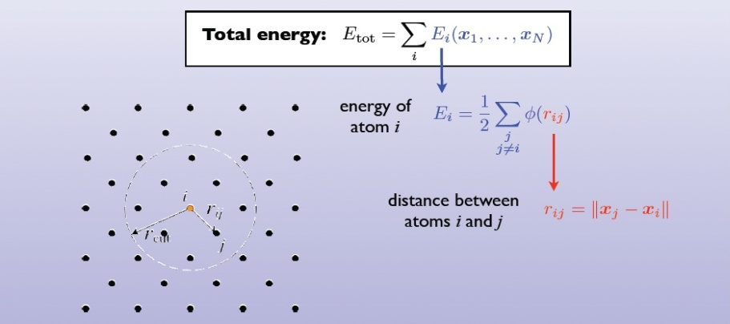
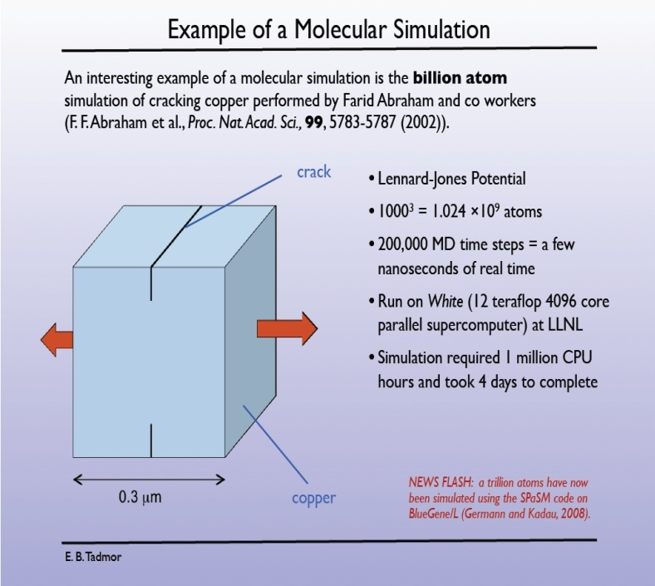
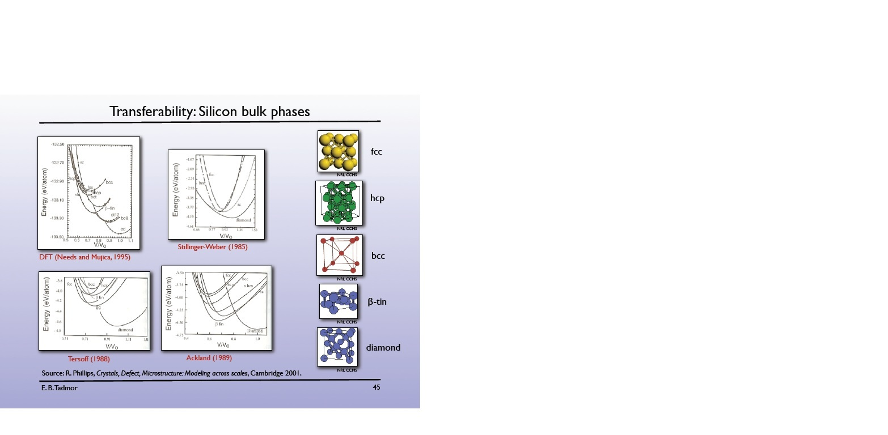
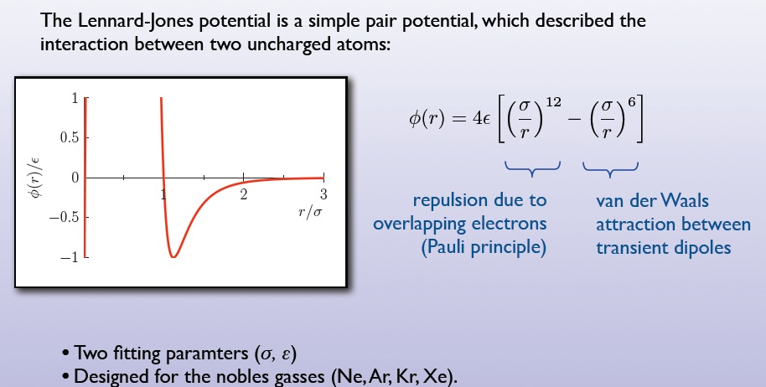
Molecular/atomistic simulations: tests and models
Tests
Models
Test :a specific computer program which, when coupled with a suitable Model, calculates and returns a specific Prediction about a particular Configuration (or sequence of Configurations for dynamical properties).
Model : Computer implementation representing a specific interaction between atoms, e.g. an interatomic potential or force field
Source: openkim.org
6
University of Minnesota
Notes:
6

Slide 7
Types of molecular modelers
Very broadly speaking there are two types of molecular modelers:
Developers
Users
- Create new models
- Study materials physics and applications
- Create new knowledge
Developers
Users
- Use models to study materials problems of
scientific/technological importance
- Build sophisticated simulations to extract
meaningful data
- Create new knowledge
7
University of Minnesota
Notes:
7

Slide 8
Barriers faced by molecular modelers
The difficulties faced by developers and users of interatomic
models include:
No easy access to an extensive list of reliable reference data from experiments and first principles calculations for fitting.
No easy access to implementations of existing models with known provenance and cross-language capability.
No standardized tests for evaluating properties of molecular systems.
No framework for evaluating the precision and transferability of models and therefore no rigorous guidelines for choosing an appropriate model for a given application.
8
University of Minnesota
Notes:
8

Slide 9
Knowledgebase of Interatomic Models (KIM) is proposed to overcome the barriers
The Knowledgebase of Interatomic Models (KIM) project is based on a four-year NSF cyber-enabled discovery and innovation (CDI) grant. The KIM project is designed to overcome the barriers mentioned on the previous page. KIM has the following main objectives:
Development of an online open resource for standardized testing and long-term warehousing of interatomic models (potentials and force fields) and data.
Development of an application programming interface (API) standard for atomistic simulations, which will allow any interatomic model to work seamlessly with any atomistic simulation code.
Fostering the development of a quantitative theory of transferability of interatomic models to provide guidance for selecting application-appropriate models based on rigorous criteria, and error bounds on results.
Striving for the permanence of the KIM project, including development of a sustainability plan, and establishment of a long-term home for its content.
More information on KIM is available at the project website: http://openKIM.org
9
University of Minnesota
Notes:
9

Slide 10
KIM framework
A web interface that will facilitate:
user upload and download of Tests, Models and Reference Data
searching and querying the repository
comparing and visualizing Predictions and Reference Data
recording user feedback (ranking and discussion forums)
Web portal
Repository
Processing pipeline
KIM
A user-extendible database of
interatomic Models
standardized Tests (simulation codes)
Predictions (results from Model-Test couplings)
Reference Data (obtained from experiments and first principles calculations)
External repositories
Processing Pipeline:
An automatic system for generating Predictions due to new Test or Model upload or changes:
detect viable Test-Model couplings
assign computational resources based on priority and dependencies
store results in Repository
requires an application programming interface (API) to be defined
10
University of Minnesota
Notes:
10

Slide 11
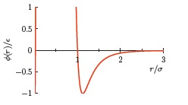



KIM repository: Models
Models Tests Predictions Reference Data KIM API
Models
Model: Computer implementation representing a specific interaction between atoms, e.g. an interatomic potential or force field.
Model Format
- Stand-alone Model (black box)
Model Driver (e.g. Lennard-Jones )
+ Parameter Set (e.g. =10.4 meV, =0.34 nm)
Every model will have a unique KIM ID for referencing in papers.
Lennard-Jones (pair)
• Ar parameterization
• ...
⠇
Morse (pair)
• Cu parameterization
• ...
⠇
Born-Mayer (ionic pair)
⠇
Stillinger-Weber (3-bdy)
• Si parameterization
• ...
⠇
MGPT (4-body)
• Mo parameterization
• Ta parameterization
• ...
⠇
CHARMM/AMBER
⠇
EAM/Finnis-Sinclair/glue
⠇
MEAM
⠇
Tersoff
⠇
EDIP
Brenner
⠇
Bond-order potentials
⠇
ReaxFF
⠇
GAP
⠇
11
University of Minnesota
Notes:
11

Slide 12
KIM repository: Tests
Models Tests Predictions Reference Data KIM API
Tests
Test: a specific computer program which when coupled with a suitable Model, possible including additional input, calculates and returns a specific Prediction about a particular Configuration (or sequence of Configurations for dynamical properties).
• Prediction of a Test will be a logical, scalar, tensor, graph, configuration or field, computed from a Test-Model coupling
• Popular codes (ddcMD, DL_POLY, GROMACS, GULP, iMD, LAMMPS, NAMD, SPaSM, etc.) can be included in a library of tools for writing Tests.
• Automatic test generation by linking to external repositories of first principles results.
Scalars
- lattice constants
- cohesive energy
- vacancy formation energy
- surface energy
- grain boundary energy
- vacancy migration barrier
- dislocation mobility
- peierls stress
- melting temperature
-...
Tensors
- stress
- elastic constants
...
Configurations
- dislocation core structure
- surface structure
- grain boundary structure
- nanocluster structure
...
Graph
- phonon spectrum
- cohesive energy vs volume
- energy along transition path
- radial distribution functions
...
Fields
- simulated TEM hi-res image
- gamma surface
…
12
University of Minnesota
Notes:
12

Slide 13
KIM repository: KIM Data
Models Tests Predictions Reference Data KIM API
Predictions Reference Data
Data in KIM can either be
‣ a Prediction computed from a Test-Model coupling, or
‣ Reference Data computed by first principles or measured experimentally.
• Standardization of Data
- Identified in terms of a set of “descriptors” drawn from a standardized “dictionary”
(similar to that used in the Protein Data Bank project)
- Descriptors will be automatically generated when possible (for example, the “Space Group”
descriptor will be automatically generated for a given crystal structure).
• Data classes
- Logical (true/false result for a test, e.g. a given crystal phase is stable)
- Scalar or Tensor (lattice constant, cohesive energy, elastic constants...)
- Graphs (transition pathway energy, phonon spectrum, ...)
- Configurations (relaxed defect core, surface structure, ...)
- Fields (simulated hires TEM image, ...)
• Quality assurance
- Acceptance of only “publication quality” data enforced by KIM Editor
- “Data Provenance”
13
University of Minnesota
Notes:
13

Slide 14
KIM API concept and implementation
14
University of Minnesota
Notes:
14

Slide 15
The KIM API facilitates communication between Models and Tests
1
Tests can be written in different languages
Models can be written in different languages
Test #1: using model find min. energy configuration…
Model #1: Lennard-Jones potential with cutoff….
Test #n: using potential
for the given configuration finds stresses
Requires: forces between each pair of neighboring atoms…
Model #4: EAM potential with tabulated embedding function
Calculates: forces between each pair neighboring atoms …
Input for Model
Test calls the Model---therefore they should be linked together as one executable.
Results
Users and developers will be able to download Tests and Models (from openkim.org) , then compile, link and run the resulting programs to produce new results.
15
University of Minnesota
Notes:
15

Slide 16
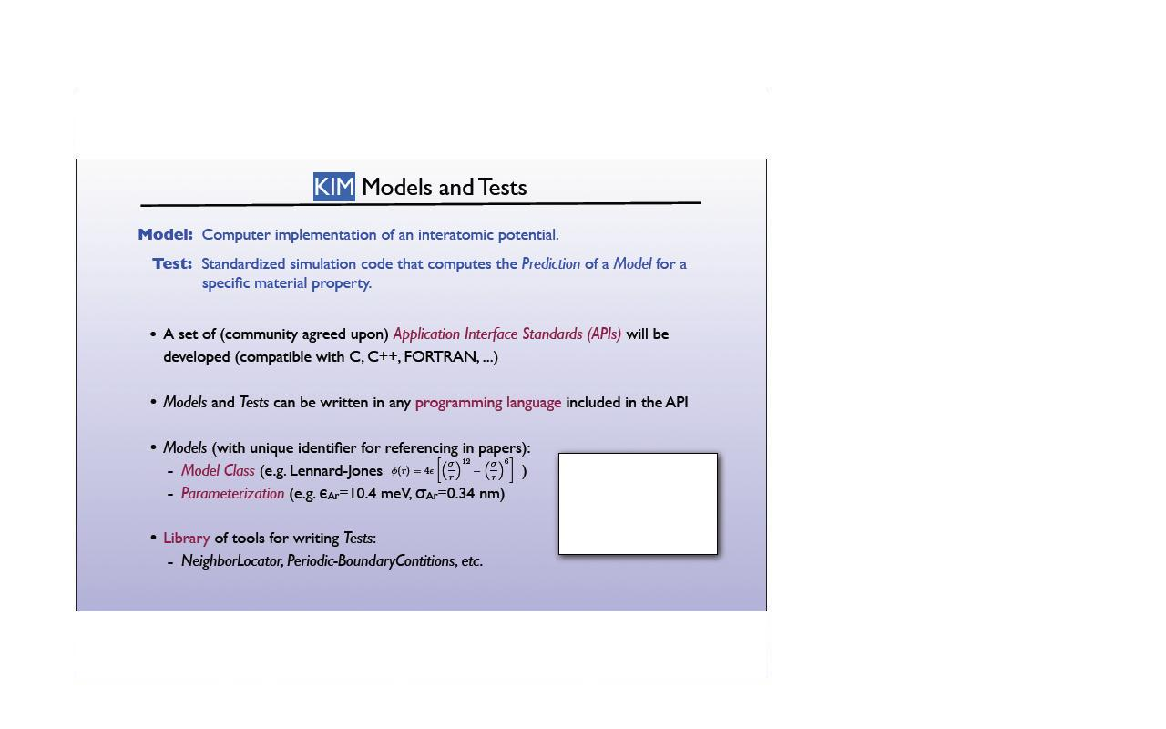
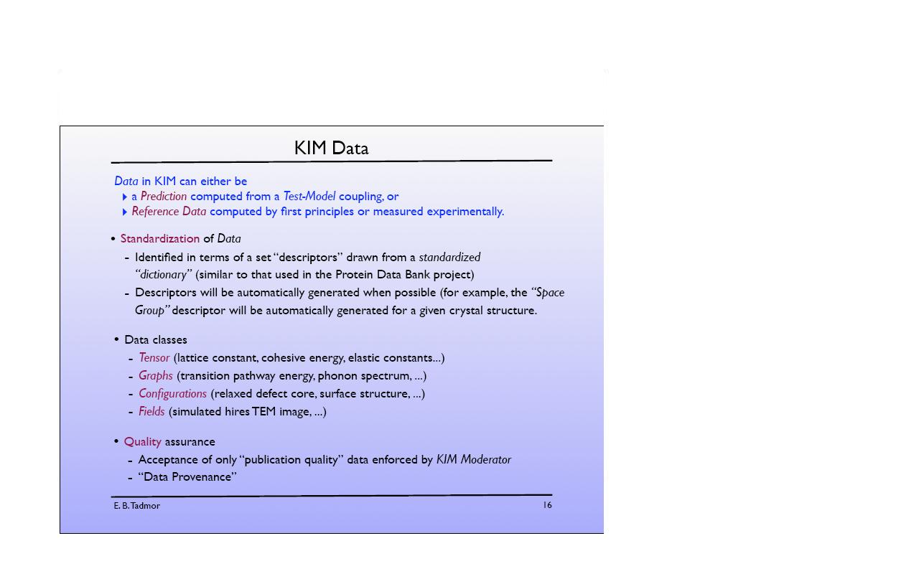
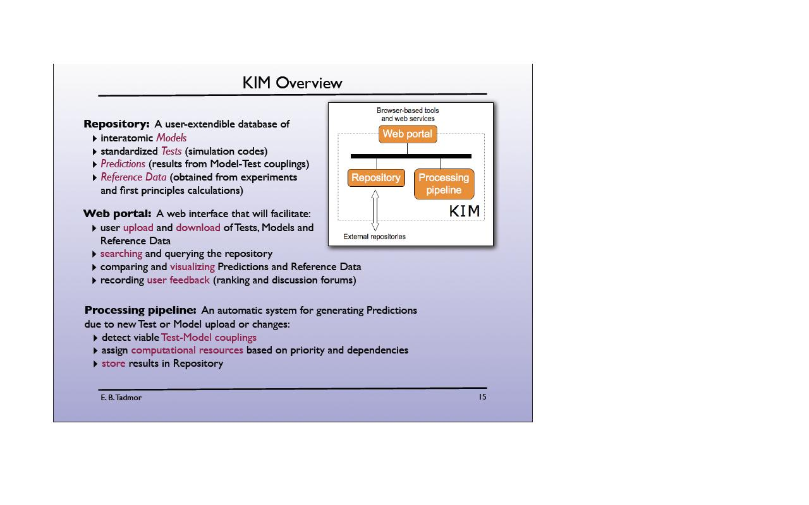
The most challenging technical requirement is the need for multi-language support
2
openKIM.org framework
Requirements:
Multilanguage support (C, C++, F77, FORTRAN 90, Python …)
A variety of data structures need to be accommodated: scalars, multidimensional arrays, variable size arrays, etc..
Speed & performance are very important
Standardized API, version tracking, etc…
Processing pipeline: sequence of actions
detect a viable Model/Test coupling
build (compile and link) Tests against Model
run probe-tests
assign computational resources
run full-scale Test against Model
analyze results …
store results in the repository
?
? ? ? ? ? ? ?
Processing pipeline: an automatic system for generating predictions when Tests or Models are uploaded or changed.
Need a simple interface : ideally just one argument per call
Source: KIM kickoff presentation
16
University of Minnesota
Notes:
16

Slide 17
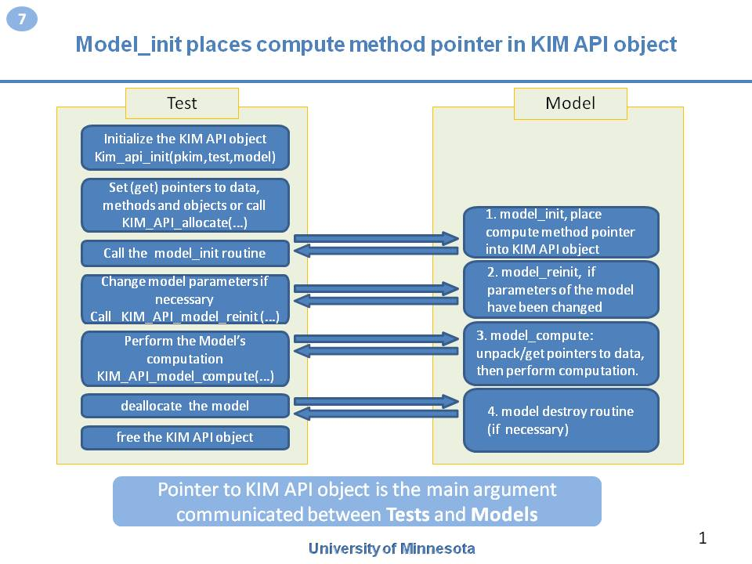
The KIM API is based on exchanging pointers to data and methods
3
Concept
Schematic of implementation
Data
standard
Data and method pointers are packed in one object. The Interface consists of exchanging one pointer to the KIM API object between a Test and a Model
All languages naturally support pointers:
FORTRAN (cray or 2003 standard)
C/C++
Java
Python
Many languages link
Method flexibility and speed
KIM
API
Single executable
Pointer
Test
(client)
Pointer to standard data
Model
(server)
Pointer
Data standard should accommodate every possible data set required for the model
? ? ? ? ? ? ?
17
University of Minnesota
Notes:
17

Slide 18
Using C-style pointers in Fortran
3.1
In order to implement the KIM API concept in a cross-language environment, all
languages have to work with C-style pointers.
FORTRAN 77 and Fortran 90/95 do not support C-style pointers directly, however
essentially all compilers support the `cray pointers' extension which provides this capability.
A cray pointer is an integer that can store a memory address. An example below shows the
general syntax and usage of a cray pointer in Fortran compared with C.
FORTRAN code
C code
…
double precision :: y=10.0d0
double precision :: x
pointer (px,x)
…
px = loc(y)
print*,”x=“,x
…
Keyword pointer, followed by two arguments
…
double y=10.0;
double *x;
x = &y;
printf(“*x=%f \n”, *x);
…
px - is a pointer (analog double *x in C)
x - is a pointee
As soon as px holds an address, access to that address is done by pointee x
18
University of Minnesota
Notes:
18

Slide 19
How can a Test know what type of input/output data is required by a Model? We have solved this problem by introducing the KIM API descriptor file
4
ex_model_Ne_P_MLJ_NEIGH_PURE_H.kim
####################################################################################################
MODEL_NAME := ex_model_Ne_P_LJ_NEIGH_PURE_H
Unit_Handling := fixed
...
####################################################################################################
SUPPORTED_ATOM/PARTICLES_TYPES:
# Symbol/name Type code
Ne spec 1
...
MODEL_INPUT:
# Name Type Unit Shape Requirements
numberOfParticles integer none []
...
numberParticleTypes integer none []
particleTypes integer none [numberOfParticles]
...
KIM API descriptor file defines all arguments that the model needs for computation including input and output arguments. Also on the test side, the .kim file defines what the Test can provide as input for the Model and what it expects from the Model as a result.
Tests and Models expose the required input/output arguments that will be communicated using the KIM API
Note: full .kim file shown here can be found in EXAMPLEs/MODELs/ex_model_Ne_P_MLJ_NEIGH_PURE_H/
19
University of Minnesota
Notes:
19

Slide 20
Structure of descriptor file
5
Model/Test name and system of units lines
Brief description of Section lines
MODEL_NAME := ex_model_Ar_P_Morse
Unit_Handling := flexible
These lines identify logically distinct sections within the KIM descriptor file.
All lines following a Section line, up to the next Section line or end of the file, will be assigned to the indicated section.
These sections may occur in any order within a KIM descriptor file, however the order given here is recommended. A section line may only occur once within a KIM descriptor file.
Section lines
SUPPORTED_ATOM/PARTICLES_TYPES:
CONVENTIONS:
MODEL_INPUT:
MODEL_OUTPUT:
MODEL_PARAMETERS:
Brief description of Data lines
These lines are used to specify the information that a Model (Test) will provide to and require from a Test (Model), as well as the conventions that the Model(Test) uses.
* Species Data lines – allow for the definition of atomic species by providing a symbol and an integer code. These lines are located in section SUPPORTED_ATOM/PARTICLES_TYPES.
* Flag Data lines - this line type defines a convention that can be used to ensure that Models and Tests are able to work together, and should only be used within the CONVENTIONS section of the KIM descriptor file.
* Argument Data lines – the main KIM descriptor file line format, used within the MODEL_INPUT, MODEL_OUTPUT, and MODEL_PARAMETERS sections.
Data lines
* Species Data lines
* Flag Data lines
* Argument Data lines
20
University of Minnesota
Notes:
20

Slide 21
Each argument line in the descriptor file describes an argument and its properties
5.1
All characters after a ‘#’ are ignored
(a comment field)
EXAMPLEs/MODELs/ex_model_Ar_P_MLJ_F90.kim
MODEL_NAME := ex_model_Ar_P_MLJ_F90
Unit_Handling := fixed
….
compute method none []
MODEL_OUTPUT:
# Name Type Unit Shape Requirements
energy real*8 energy [] optional
forces real*8 force [numberOfParticles,3] optional
Method means a subroutine or function pointer
The name of an argument is its “key word”. By using key words, the KIM service routines can pack/unpack data pointers from the KIM API object. Key words are standardized as part of the KIM API.
Physical dimensions
The “requirements” field is only used in Model descriptor files. An empty field indicates that the argument is required. A value of “optional” indicates that the associated data will be computed only if the argument is in the Test’s descriptor file and if the Test explicitly requests it.
The shape of an argument describes its array properties. It specifies the number (rank) and size (range or extent) of indices. For example, [] means a scalar (zero-dimensional array), [numberOfParticles] means a one-dimensional array and [numberOfParticles,3] means a two-dimensional array of size numberOfParticles x 3.
Type of data in computer representation
Note: a detailed description of all Type values and Units can be found in the file DOCs/standard.kim
21
University of Minnesota
Notes:
21

Slide 22
Specifying particle types – species data lines
5.2
Species data lines define the atom/particle types supported by the Test/Model and should only be used within the SUPPORTED_ATOM/PARTICLES_TYPES
section of the KIM descriptor file. Each line consists of three white-space separated (case sensitive) strings The three strings are as follows:
code: This is the integer that the Model uses internally
to identify the atom/particle type. The value specified
by a Test is ignored.
Type: This must be `spec'.
Name: This string gives a unique name to the atom/particle type. This name is checked against the standard list in `standard.kim'.
EXAMPLEs/MODELs/ex_model_Ar_P_MLJ_F90.kim
...
###############################################
SUPPORTED_ATOM/PARTICLES_TYPES:
# Symbol/name Type code
Ar spec 1
###############################################...
The KIM_API_get_partcl_types() service routine allows one to obtain a list of all particle types used by the model during runtime. Also the KIM_API_get_partcl_type_code() service routine allows one to get the particle type integer code (see DOCs/KIM_API_Description.txt).
22
University of Minnesota
Notes:
22

Slide 23
In order to define “conventions” of test/model behavior, flag data lines are reserved
5.3
EXAMPLEs/MODELs/ex_model_Ar_P_MLJ_F90.kim
##############################################
CONVENTIONS:
# Name Type
OneBasedLists flag
Neigh_IterAccess flag
Neigh_LocaAccess flag
NEIGH_RVEC_H flag
NEIGH_PURE_H flag
NEIGH_RVEC_F flag
...
A flag data line defines a convention, that can be used to ensure that Models and Tests are able to work together, and should only be used within the CONVENTIONS section of the KIM descriptor file. The line consists of two white-space separated (case sensitive) strings. The two strings, in order, are as follows:
Name: This string gives a unique name to the convention. This name is checked against the standard list in `standard.kim‘
Type: This must be `flag'
KIM_API_allocate() has no effect on “flag“ type arguments, because they are not “data pointer holders“.
For a detailed description of all flag lines see the file DOCs/standard.kim. Also see the files in DOCs/.
23
University of Minnesota
Notes:
23

Slide 24
Parameter arguments are used to publish/access internal parameters of a Model
5.4
EXAMPLEs/MODELs/ex_model_Ar_P_MLJ_CLUSTER_F90/ex_model_Ar_P_MLJ_CLUSTER_F90.kim
MODEL_PARAMETERS:
# Name Type Unit Shape Requirements
PARAM_FREE_sigma real*8 length []
PARAM_FREE_epsilon real*8 energy []
PARAM_FREE_cutoff real*8 length []
...
The format for parameter arguments in a KIM descriptor file is the same as that for argument data types.
Two types of model parameters are allowed
1) PARAM_FIXED_XXXXXX - these should not be changed by the Test
2) PARAM_FREE_XXXXXX - these may be changed by the Test (which must then call the
Model's reinit() function to inform the model that its parameters have changed)
KIM_API_get_params() service routine will return a list of all parameters in the object during runtime (as an array of text strings).
KIM_API_get_free_params() service routine will return a list of FREE parameters and
KIM_API_get_fixed_params() will return a list of FIXED parameters (see KIM_API_Description.txt)
Names of parameter arguments are not checked against standard.kim
24
University of Minnesota
Notes:
24

Slide 25
Specifying units that model can handle: Units Handling and base units
5.5
EXAMPLEs/MODELs/ex_model_Ar_P_MLJ_F90/ex_model_Ar_P_MLJ_F90.kim
For Models, a variable `Unit_Handling' specifies
whether the Model can adjust its input and output to
match a Test (`flexible') or can only work with one set of
units (`fixed'). This information is ignored for Tests.
Base unit lines:
Five lines that describe a set of five base units from
which all other units are derived in a consistent way:
Unit_length := `A' | `Bohr' | `cm' | `m' | `nm'
Unit_energy := `amu*A^2/(ps)^2' | `erg' | `eV' |
`Hartree' | `J' |`kcal/mol' | kJ/mol‘
Unit_charge := `C' | `e' | `statC‘
Unit_temperature := `K'
Unit_time := `fs' | `ps' | `ns' | `s'
The list of recognized units above may be extended in the future.
...
#########################################
MODEL_NAME := ex_model_Ar_P_MLJ_F90
Unit_Handling := fixed
Unit_length := A
Unit_energy := eV
Unit_charge := e
Unit_temperature := K
Unit_time := ps
#########################################
...
There are several service routines related to units and units handling in KIM API:
KIM_API_get_unit_handling(), KIM_API_convert_to_act_unit(), KIM_API_get_unit_length(),
KIM_API_get_unit_energy(), etc...(see DOCs/KIM_API_Description.txt).
25
University of Minnesota
Notes:
25

Slide 26
Handling of Neighbor lists and Boundary Conditions – NBC methods
6
No
Neighbor list ?
Yes
MI-ORTHO
PBC ?
No
Yes
No
Relative Pos. Vectors Rij ?
Yes
CLUSTER
MI-OPBC
NEIGH-PURE
NEIGH-RVEC
Plain vanilla method:
Model needs only coordinates
MI_OPBC_H
MI_OPBC_F
Minimum image orthogonal periodic boundary conditions:
model needs neighbor lists and box side lengths
NEIGH_PURE_H
NEIGH_PURE_F
Model needs neighbor lists
NEIGH_RVEC_H
NEIGH_RVEC_F
Model needs neighbor list and relative position vectors R_{ij}=x_{j}-x_{i}
Note: NBC stands for Neighbor lists and Boundary Conditions
26
University of Minnesota
Notes:
26

Slide 27
Descriptions of the NBC methods
6.1
CLUSTER:
In the CLUSTER method, the Model receives the number of particles and coordinates without additional information (such as neighbor lists or other boundary condition specifiers) and computes requested quantities under the assumption that the particles form an isolated cluster. For example, if energy and forces are requested, it will compute the total energy of all the particles based on the supplied particle coordinates and the derivative of the total energy with respect to the positions of the particles.
NEIGH_PURE_[H|F]:
In the NEIGH_PURE methods (NEIGH_PURE_H and NEIGH_PURE_F), the Model receives the number of particles, coordinates and a full or half neighbor list. The neighbor list defines the environment of each particle, from which the particles's energy is defined. In the case of a half list, the value of the argument `numberContributingParticles' indicates that the first `numberContributingParticles' contribute their energy to the total and the remaining particles do not contribute to the energy (they are "ghost” particles). When `numberContributingParticles' is equal to `numberParticles’ the half list is called "symmetric", otherwise it is called "unsymmetric.” In the case of a full list, any particle that has one or more neighbors contributes its energy to the total and those particles with zero neighbors do not contribute to the total energy. The model computes the requested quantities using the supplied information. For example, if energy and forces are requested, it will compute the total energy of all the particles based on their neighbor lists and the derivative of the total energy with respect to the positions of the particles. This method can be used with codes that use ghost particles to apply boundary conditions. The ghost particles are treated as regular particles by the Model, and it is up to the calling code to discard some information such as the forces on the ghost particles and to compute the appropriate total energy from per-particle energies of the physical particles, or to use a modified neighbor list to obtain the desired values.
NEIGH_PURE_H:
This is the Pure Half neighbor list method. The model needs `coordinates', a half neighbor list (with data stored in the `neighObject' argument), the `numberContributingParticles', and the `get_neigh' method supplied by the Test.
NEIGH_PURE_F:
This is the Pure Full neighbor list method. The model needs `coordinates', a full neighbor list (with data stored in the `neighObject' argument), and the `get_neigh' method supplied by the Test.
27
University of Minnesota
Notes:
27

Slide 28
Descriptions of the NBC methods (2)
6.2
NEIGH_RVEC_[H|F]:
In the NEIGH_RVEC methods (NEIGH_RVEC_H and NEIGH_RVEC_F), the Model receives the number of particles, coordinates, a half or full neighbor list, and the relative position vectors r_ij (r_ij = x_j-x_i). The neighbor list and r_ij vectors define the environment of each particle, from which the particles's energy is defined. In the case of a half list, a neighbor pair i and j (where i < j) with relative position vector (RVEC) r_ij defines two pieces of information: (1) j is a neighbor of i with RVEC r_ij and (2) i is a neighbor of j with RVEC r_ji = -r_ij. Additionally, the value of the argument `numberContributingParticles' indicates that the first `numberContributingParticles' contribute their energy to the total and the remaining particles do not contribute to the energy (they are "ghost" particles). When `numberContributingParticles' is equal to `numberParticles' the half list is called "symmetric", otherwise it is called "unsymmetric." In the case of a full list, any particle that has one or more neighbors contributes its energy to the total and those particles with zero neighbors do not contribute to the total energy. The model computes the requested quantities using the supplied information. For example, if energy and forces are requested, it will compute the total energy of all the particles based on their neighbor lists and the derivative of the total energy with respect to the positions of the particles. These methods enable the application of general periodic boundary conditions, including multiple images. A possible future extension to these methods is to allow the Test to provide a ForceTransformation() function for each neighbor, which would enable the application of complex boundary conditions such as torsion and objective boundary conditions.
NEIGH_RVEC_H:
This is the Relative Vector Boundary Condition Full neighbor list method. The Model needs `coordinates', a full neighbor list (with data stored in the `neighObject' argument), and the `get_neigh' method supplied by the Test. The `neighObject' argument must also contain the relative position vectors (RVEC) (which are returned by the `get_neigh' function).
NEIGH_RVEC_F:
This is the Relative Vector Boundary Condition Full neighbor list method. The Model needs `coordinates', a full neighbor list (with data stored in the `neighObject' argument), and the `get_neigh' method supplied by the Test. The `neighObject' argument must also contain the relative position vectors (RVEC) (which are returned by the `get_neigh' function).
28
University of Minnesota
Notes:
28

Slide 29
Descriptions of the NBC methods (3)
6.3
MI_OPBC_[H|F]:
In the MI_OPBC methods (MI_OPBC_H and MI_OPBC_F), the Model receives the number of particles and coordinates, the side lengths for the periodic orthogonal box and a neighbor list. It assumes all particles lie inside the periodic box. Side lengths of the box must be at least twice the cutoff range. This method computes the requested quantities under the assumption that the particles are subjected to the minimum image, orthogonal, periodic boundary conditions.
MI_OPBC_H:
This is the Minimum Image Orthogonal Periodic Boundary Condition Half neighbor list method. The Model needs `coordinates', a half neighbor list (with data stored in the `neighObject' argument), `numberContributingParticles', the`get_neigh' method supplied by theTest, and the `boxSideLengths’ argument (which specifies the three side-lengths of the orthogonal simulation box).
MI_OPBC_H:
This is the Minimum Image Orthogonal Periodic Boundary Condition Full neighbor list method. The Model needs `coordinates', a full neighbor list (with data stored in the `neighObject' argument), the `get_neigh' method supplied by the Test, and the `boxSideLengths’ argument (which specifies the three side-lengths of the orthogonal simulation box).
29
University of Minnesota
Notes:
29

Slide 30
Example of using NBC methods in KIM file
6.4
EXAMPLEs/MODELs/ex_model_Ne_P_LJ/ ex_model_Ne_P_LJ.kim
…
CONVENTIONS:
# Name Type
OneBasedLists flag
Neigh_IterAccess flag
Neigh_LocaAccess flag
NEIGH_RVEC_H flag
NEIGH_PURE_H flag
NEIGH_RVEC_F flag
NEIGH_PURE_F flag
MI_OPBC_H flag
MI_OPBC_F flag
CLUSTER flag
...
The example in ex_model_Ne_P_LJ.kim
is designed to work with six different NBC methods.
If the Test can also work with multiple NBC methods and there are several matches, the first matched method listed in the Model’s KIM file will have precedence.
The KIM_API_init () routine will check that all needed data lines for the chosen method are in the KIM descriptor file.
NBC Methods
30
University of Minnesota
Notes:
30

Slide 31
Neighbor list access methods: all related lines in the KIM descriptor files
6.5
DOCs/standard.kim (only related to Neighbor list access are shown here)
…
CONVENTIONS:
# Name Type
…
ZeroBasedLists flag # presence of this line indicates that indexes
# for particles are from 0 to numberOfParticles-1 (C-style)
OneBasedLists flag # presence of this line indicates that indexes for
# atoms are from 1 to numberOfParticles (Fortran-style)
Neigh_IterAccess flag # works with iterator mode
Neigh_LocaAccess flag # works with locator mode
Neigh_BothAccess flag # needs both locator and iterator modes
NEIGH_PURE_H flag
NEIGH_PURE_F flag
NEIGH_RVEC_H flag
NEIGH_RVEC_F flag
MI_OPBC_H flag
MI_OPBC_F flag
MODEL_INPUT:
# Name Type Unit Shape requirements
get_neigh method none []
neighObject pointer none []
boxSideLengths real*8 length [3]
neighObject stores completely encapsulated neighbor list object
Access to the object is done through method get_neigh. The neighbor list object and the method to access it are supplied by the Test.
31
University of Minnesota
Notes:
31

Slide 32
Interface to get_neigh method
6.6
get_neigh function for access to the neighbor list object
here :
mode - operate in iterator or locator mode
mode = 0 : iterator mode
mode = 1 : locator mode
request - Requested operation
If mode = 0
request = 0 : reset iterator
request = 1 : increment iterator
If mode = 1
request = # : number of the
particle whose
neighbor list
is requested
integer function get_neigh(pkim,mode,request,particle,numnei,pnei1particle,prij)
implicit none
integer(kind=kim_intptr), intent(in) :: pkim
integer, intent(in) :: mode
integer, intent(in) :: request
integer, intent(out) :: particle
integer, intent(out) :: numnei
integer, intent(out) :: pnei1particle
integer, :: nei1particle(1);
pointer(pnei1particle,nei1particle)
double precision, intent(out) :: prij
double precision, :: rij(3,*); pointer(prij,rij)
end function get_neigh
FORTRAN style
int get_neigh(void ** pkim, int * mode, int * request, int * particle,
int * numnei, int ** pnei1particle, double ** prij) ;
C style
particle - the number of the particle whose neighbor list is returned
numnei - number of neighbors returned
nei1particle - integer array of neighbors of an particle which will point
to the list of neighbors on exit.
rij - array of relative position vectors of the neighbors of a
particle (including boundary conditions if applied) if they
have been computed (NBC scenario NEIGH_RVEC_[H|F]
only). Has NULL value otherwise (all other NBC
scenarios).
The return value depends on the results of execution.
(see DOCs/KIM_API_Description.txt for details)
Test must supply the get_neigh method and store a pointer to it in the KIM API object
32
University of Minnesota
Notes:
32

Slide 33
Model_init places compute method pointer in KIM API object
7
Test
Model
Initialize the KIM API object
KIM_API_init(pkim,test,model)
Set (get) pointers to data, methods and objects or call KIM_API_allocate(…)
1. model_init, place compute method pointer into KIM API object
Call the model_init routine
2. model_reinit, if parameters of the model have been changed
Change model parameters if necessary
Call KIM_API_model_reinit (…)
Use the Model’s compute method
KIM_API_model_compute(…)
3. model_compute: unpack/get pointers to data, then perform computation.
deallocate the Model
4. model_destroy routine
(if necessary)
free the KIM API object
Pointer to KIM API object is the main argument communicated between Tests and Models
33
University of Minnesota
Notes:
33

Slide 34
Initialization of KIM API object, setting and getting data-pointers can be done through the KIM service routines
8
KIM_API/KIM_API_C.h
#include <stdint.h>
#ifdef __cplusplus
extern "C" {
#endif
//global methods
int KIM_API_init(void * kimmdl, char * testname, char *mdlname);
void KIM_API_allocate(void *kimmdl, intptr_t natoms, int ntypes);
void KIM_API_free(void *kimmdl, int * kimerror);
void KIM_API_print(void *kimmdl, int *kimerror);
int KIM_API_model_compute(void * kimmdl);
…
//element access methods
int KIM_API_set_data(void *kimmdl,char *nm, intptr_t size, void *dt);
void * KIM_API_get_data(void *kimmdl,char *nm, int * kimerror);
…
//multiple data set/get methods
//
void KIM_API_setm_data(void *kimmdl, int *error, int numargs, ... );
void KIM_API_getm_data(void *kimmdl, int *error, int numargs, ... );
Initialization is done by analyzing test and model descriptor files
One can use optional KIM service routine to allocate standard arguments and data
Call model_compute routine by address stored in KIM API object
Directly place data pointer into the KIM API object
“Multiple” version of set/get data
Description of all KIM API service routines are located in the file:
DOCs/KIM_API_Description.txt
34
University of Minnesota
Notes:
34

Slide 35
Examples of using KIM_API_init and KIM_API_allocate service routines
8.1
.../ex_test_Ar_free_cluster_CLUSTER_F90/ex_test_Ar_free_cluster_CLUSTER_F90.F90
...
! Initialize the KIM object
ier = kim_api_init_f(pkim, testname, modelname)
if (ier.lt.KIM_STATUS_OK) then
idum = kim_api_report_error_f(__LINE__, THIS_FILE_NAME,
"kim_api_init_f", ier)
stop
endif
! Allocate memory via the KIM system
call kim_api_allocate_f(pkim, N, ATypes, ier)
if (ier.lt.KIM_STATUS_OK) then
idum = kim_api_report_error_f(__LINE__, THIS_FILE_NAME,
"kim_api_allocate_f", ier)
stop
endif
...
KIM API init will check the consistency of KIM descriptor file (Test and Model) against standard.kim, after that will check if Test and Model match: NBC methods, particle species (if any) , conventions and argument data lines
If the match is successful, then the KIM API object is created. This object conforms to the Model descriptor KIM file and can store all described data as pointers
KIM_API_allocate will allocate memory for all arguments with, fully specified shape, stored in the KIM API object
It is not mandatory to use
KIM_ API_allocate. A Test can use its own memory and set address of the data in the KIM API object.
.../ex_test_Ar_multiple_models/ex_test_Ar_multiple_models.c
...
status = KIM_API_init(&pkim_periodic_model_0, testname, modelname0);
if (KIM_STATUS_OK > status)
KIM_API_report_error(__LINE__, __FILE__,"KIM_API_init() for MODEL_ZERO for period
...
35
University of Minnesota
Notes:
35

Slide 36
Examples of using KIM API getm/setm data ("multiple” version of get/set data)
8.2
.../ex_test_Ar_free_cluster_CLUSTER_F90/ex_test_Ar_free_cluster_CLUSTER_F90.F90
...
! Unpack data from KIM object
call kim_api_getm_data_f(pkim, ier, &
"numberOfParticles", pnAtoms, 1, &
"numberParticleTypes", pnparticleTypes, 1, &
"particleTypes", pparticleTypesdum, 1, &
"coordinates", pcoor, 1, &
"cutoff", pcutoff, 1, &
"energy", penergy, 1, &
"virial", pvirialglob, 1, &
"forces", pforces, 1)
if (ier.lt.KIM_STATUS_OK) then
idum = kim_api_report_error_f(__LINE__, THIS_FILE_NAME,&
"kim_api_getm_data_f", ier)
goto 42
endif
...
KIM_API_getm_data (or kim_api_getm_data_f) will return pointers stored in KIM_API object. “Multiple” version of get data routines allows to get several variable pointers from the KIM API object s at once.
KIM_API_setm_data (or kim_api_setm_data_f) allows to place (pack) several data pointers into KIM API objects
See DOCs/KIM_API_Description.txt for the details
.../ex_test_Ar_multiple_models/ex_test_Ar_multiple_models.c
...
/* Register memory */
KIM_API_setm_data(pkim_periodic_model_0, &status, 8*4,
"numberOfParticles", 1, &numberOfParticles_periodic, 1,
"numberParticleTypes", 1, &numberParticleTypes, 1,
...
"energy", 1, &energy_periodic_model_0, 1);
if (KIM_STATUS_OK > status) KIM_API_report_error(__LINE__, __FILE__,"KIM_API_setm_data",status);...
36
University of Minnesota
Notes:
36

Slide 37
KIM_API_model_init will call model initialize routine that, in turn, will place model compute into KIM object
8.3
KIM_API_model_init will call the model_init routine . KIM_API_model_init utilizes the KIM standard naming convention in order to make the call. In C the name of the model init routine must have all lower case letters in the following format modelname_init_, for example:
model_ar_p_mlj_cluster_init_
model name
.../ex_test_Ar_multiple_models/ex_test_Ar_multiple_models.c
...
/* call model init routines */
status = KIM_API_model_init(pkim_periodic_model_0);
if (KIM_STATUS_OK > status) KIM_API_report_error(__LINE__,__FILE__,"KIM_API_model_i
...
/* call compute functions */
status = KIM_API_model_compute(pkim_periodic_model_0);
if (KIM_STATUS_OK > status) KIM_API_report_error(__LINE__, __FILE__,"compute", status);
...
KIM_API_model_compute calls the address of the model compute subroutine stored in KIM API object.
By the time KIM_API_model_compute is called the address is placed in KIM API object by model_init_ routine
.../ex_model_Ar_P_MLJ_C/ex_model_Ar_P_MLJ_C.c
/* store pointer to compute function in KIM object */
ier = KIM_API_set_data(pkim, "compute", 1, (void*) &compute);
if (KIM_STATUS_OK > ier){
KIM_API_report_error(__LINE__, __FILE__, "KIM_API_set_data", ier);
exit(1);
}
...
Place address of actual compute routine into the KIM API object
37
University of Minnesota
Notes:
37

Slide 38
An example of using get_neigh method through KIM API service routines
8.4
.../ex_model_Ar_P_MLJ_NEIGH_PURE_H_F/ex_model_Ar_P_MLJ_NEIGH_PURE_H_F.F90
...
do i = 1,numberOfParticles
! Get neighbors for atom i
!
atom = i ! request neighbors for atom i
ier= kim_api_get_neigh_f(pkim,1,atom,atom_ret,numnei,pnei1atom,&
pRij_dummy)
if (ier.lt.KIM_STATUS_OK) then
idum = kim_api_report_error_f(__LINE__, THIS_FILE_NAME,&
"kim_api_get_neigh", ier)
return
endif
! Loop over the neighbors of atom i
!
do jj = 1, numnei
j = nei1atom(jj)
Rij(:) = coor(:,j) - coor(:,i) ! distance vector between i j
Rsqij = dot_product(Rij,Rij) ! compute square distance
if ( Rsqij < model_cutsq ) then ! particles are interacting?
r = sqrt(Rsqij) ! compute distance
call pair(model_epsilon,model_sigma,model_A,model_B,&
model_C, r,phi,dphi,d2phi) ! compute pair potential
...
Locator mode -- get neighbors of a particle using half or full neighbor lists as requested.
KIM_API_get_neigh will call the method using the address stored in the KIM API object. These methods are supplied by the Test.
KIM_API_get_neigh will check if the arguments are set correctly. It will also convert the result from OneBaseLists to ZeroBaseLists (or vice versa) if necessary .
Details on the interface and a description of error codes are in
DOCs/KIM_API_Description.txt
38
University of Minnesota
Notes:
38

Slide 39
Computing quantities from the first derivative
8.5
MODELs/ ex_model_Ne_P_fastLJ/ex_model_Ne_P_fastLJ.c
This routine can be called by a Model to provide the Test with a contribution, dEdr, to the first derivative of the Model's energy with respect to the (scalar) distance r_ij between particle `i' and particle `j'. The Test can use this information to compute, via the chain-rule, many properties. Examples include forces, the virial, and other thermodynamic tensions. The KIM API performs automatic index conversion (based on ZeroBasedList and OneBasedList flag settings) before calling the Test‘s supplied process_dEdr function. If the Test does not provide its own process_dEdr routine, then the KIM API standard process_dEdr routine is used. If the standard process_dEdr routine is used, the KIM API ensures that any appropriate memory initializations are performed. This routine and currently supports the computation of `virial' and `particleVirial'.
...
while (KIM_STATUS_OK == *ier)
{
i = currentAtom + model_index_shift;;
zi=i*DIM;
/* loop over the neighbors of currentAtom */
for (jj = 0; jj < numOfAtomNeigh; ++ jj)
{
...
/* process dEdr */
if (comp_process_dEdr)
{
R = sqrt(Rsqij);
double DE = fac*R;
ier = KIM_API_process_dEdr(km, &DE, &R, &pdx, &i, &j);
}
...
...
int * I,j -- pointers to particle index I and j.
int * I,j -- pointers to particle index I and j.
void **km -- pointer to KIM_API_model object
double *dE -- pointer to the contribution to the first derivative of the energy with respect to the pair-distance r_ij
double *r -- pointer to r_ij -- the distance between particles i and j
double **pdx -- pointer to the relative position vector of particle j relative to particle i (i.e., r_ij = x_j - x_i).
On details of interface using process_dEdr see documentation in KIM_API_Description.txt and standard.kim
39
University of Minnesota
Notes:
39

Slide 40
Appendix
40
University of Minnesota
Notes:
40

Slide 41
Every argument that needs to be communicated between Tests and Models must be in the descriptor file
A1
Each Test has its own descriptor file that describes the data it can supply to the Model and what data it expects the Model to compute. There are no optional arguments in a Test’s descriptor file (because the Test knows, a priori, what it will need to compute).
Each Model has its own descriptor file that describes the data it needs to perform its computations and what results it can compute. Some of the arguments/methods can be identified as optional. Optional arguments/methods are ones that the Test does not have to provide or are results that the Model will only compute if the Test explicitly requests it.
KIM service routines (such as KIM_API_init) use both Test and Model descriptor files to:
Check if the Model and Test match, also check if their descriptor files conform to the KIM API standard
If they do -- create a KIM API object to store all arguments described in the Model’s descriptor file
Mark each optional argument that is not used by the Test “do not compute” (i.e., compute = false)
The flag here is an integer: KIM_COMPUTE_TRUE – compute, KIM_COMPUTE_FALSE – do not compute
Other service routines are used to:
Set (get) argument or method pointers into (from) the KIM API object
(e.g., KIM_API_set_data, KIM_API_get_data, etc.)
Check if the “compute flag” is set to “compute” for an argument in the KIM API object
(KIM_API_get_compute).
Execute the Model’s compute method (KIM_API_model_compute)
etc…
41
University of Minnesota
Notes:
41

Slide 42
KIM API directory structure
A2
openkim-api-XX.XX.XX
DOCs
KIM_API
MODEL_DRIVERs
MODELs
TESTs
Sample_01_lj_cutoff
Sample_01_lj_cutoff
Sample_01_lj_cutoff
Sample_01_lj_cutoff
Sample_01_lj_cutoff
Sample_01_lj_cutoff
Sample_01_lj_cutoff
Sample_01_lj_cutoff
Sample_01_lj_cutoff
Sample_01_lj_cutoff
Sample_01_lj_cutoff
Sample_01_lj_cutoff
ex_model_driver_P_Morse
ex_model_Ar_P_MLJ_C
ex_test_Al_free_cluster
KIM_API.h
KIM_API.cpp
KIM_API_C.h
KIM_API_C.cpp
KIM_API_F.F90
KIM_API_status.h
…
Makefile
ex_model_driver_P_Morse.kim
ex_model_driver_P_Morse.c
Plus any other files
needed
…
Makefile
ex_model_Ar_P_MLJ_C.kim
ex_model_Ar_P_MLJ_C.c
Plus any other files
needed
…
Makefile
ex_test_Al_free_cluster.kim
ex_test_Al_free_cluster.F90
Plus any other files
needed
…
Each Test and Model has its own descriptor file
42
University of Minnesota
Notes:
42

Slide 43
The end
43
University of Minnesota
Notes:
43

Slide 44
KIM API object is an array of Base data elements. Each Base data element can hold a pointer to any relevant data
A4
Number of fields is fixed to 9
Base data:
Can hold any type of array: real, integer, pointer…
Stores enough information for a complete description of the data
pointer to contiguous array of data of size “size”
size of data in terms of underlying elements
auxiliary array: very useful for 2d arrays (variable and fixed dimensions)
name contains description information like “coordinates”, “velocities”, “forces”, etc…
type tells the type for elements of array: “real”, “real*8“integer”, “integer*8”, pointer
rank and shape:
rank is the number of indices for the array: for 2D it is 2, for 3D it is 3 etc…
shape is an integer array of size rank and holds the size (range) of each index.
Flag contains additional information (all fields are integers)
peratom
Every field in the Base data structure is a pointer or “pointer size” integer.
freeable
pointerchanged
Base data type can be used to store all needed data for Tests and Models
ID
44
University of Minnesota
Notes:
44

