Slide 1
KIM API (Knowledgebase of Interatomic Models Application Programming Interface)
Valeriu Smirichinski, Ryan S. Elliott and Ellad B. Tadmor
Dept. of Aerospace Engineering and Mechanics, University of Minnesota
August 2011
This document describes how KIM Tests and Models written in different languages work together. A unified interface, tuned for the specific needs of atomistic simulations, is presented. This interface is based on the concept of “descriptor files”. A descriptor file specifies all variables and methods required for communication between a particular Model and a Test. A “KIM API object” is created, based on the descriptor files, that holds all arguments (variable/data and method pointers) needed for Test/Model interaction. A complete set of KIM API service routines are available for accessing the various pointers in the KIM API object.
alpha version openkim-api-00.01.00
1
Notes:
1

Slide 2
Contents
KIM overview
Barriers faced by molecular modelers
Knowledgebase of Interatomic Models (KIM) is proposed to overcome the barriers
KIM framework
KIM repository: Models
KIM repository: Tests
KIM repository: KIM data
KIM API concept and implementation:
The KIM API facilitates communication between Models and Tests
The most challenging technical requirement is the need for multi-language support
The KIM API is based on exchanging pointers to data and methods
How can a Test know what type of input/output data is required by a Model? We have solved this problem by introducing the KIM API descriptor file
The structure of a descriptor file
Handling of Neighbor lists and Boundary Conditions – NBC methods
Test/Model coupling: The Model’s initialization routine stores a pointer to the “compute” routine in the KIM_API object
Initialization of a KIM API object, setting and getting data-pointers can be done through the KIM service routines
KIM installation: compilation, linking and running Tests
2
University of Minnesota
Notes:
2

Slide 3
Contents (2)
Appendix
Every variable that needs to be communicated between Tests and Models must be in the descriptor file
The KIM API directory structure
Model and Test examples available in the current version of the KIM API
The KIM API object is an array of base data elements. Each base data element can hold a pointer to any relevant data (scalar, array, method, etc.)
3
University of Minnesota
Notes:
3

Slide 4
KIM overview
4
University of Minnesota
Notes:
4

Slide 5

KIM TEAM
PIs
Ellad Tadmor (U. Minnesota)
Ryan Elliott (U. Minnesota)
James Sethna (Cornell)
Developers
Valeriu Smirichinski (U. Minnesota)
Daniel Karls (U. Minnesota)
Mihir Khadilkar (Cornell)
Alex Alemi (Cornell)
John Crow (Silicon Life Sciences)
Trevor Wenblom (Silicon Life Sciences)
Advisory Board
Graeme Ackland (U. Edinburgh)
Michael Baskes (LANL)
Chandler Becker (NIST)
Noam Bernstein (NRL)
Ioana Cozmuta (NASA)
Karsten Jacobsen (Tech. U. Den.)
Ronald Miller (Carleton)
John Moriarty (LLNL)
Sadasivan Shankar (Intel)
Adri van Duin (Penn State)
Gabriel Wainer (Carleton)
5
University of Minnesota
Notes:
5

Slide 6
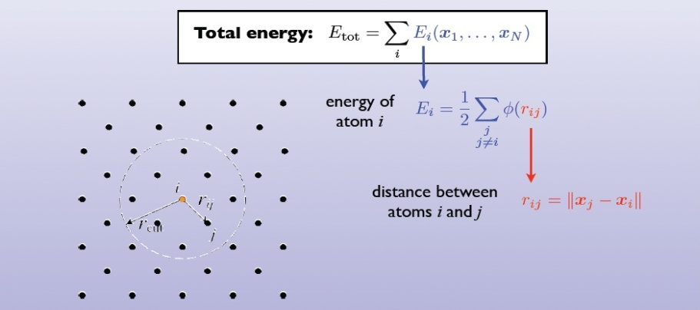
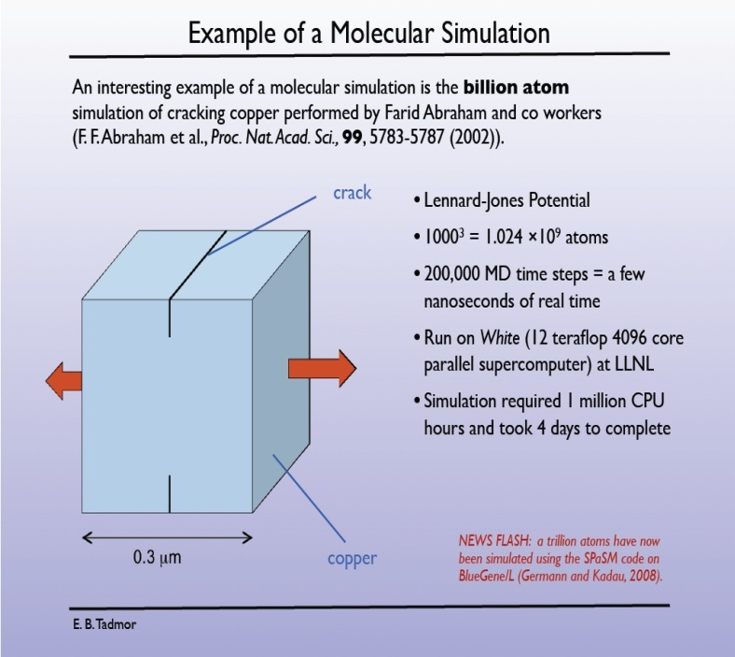
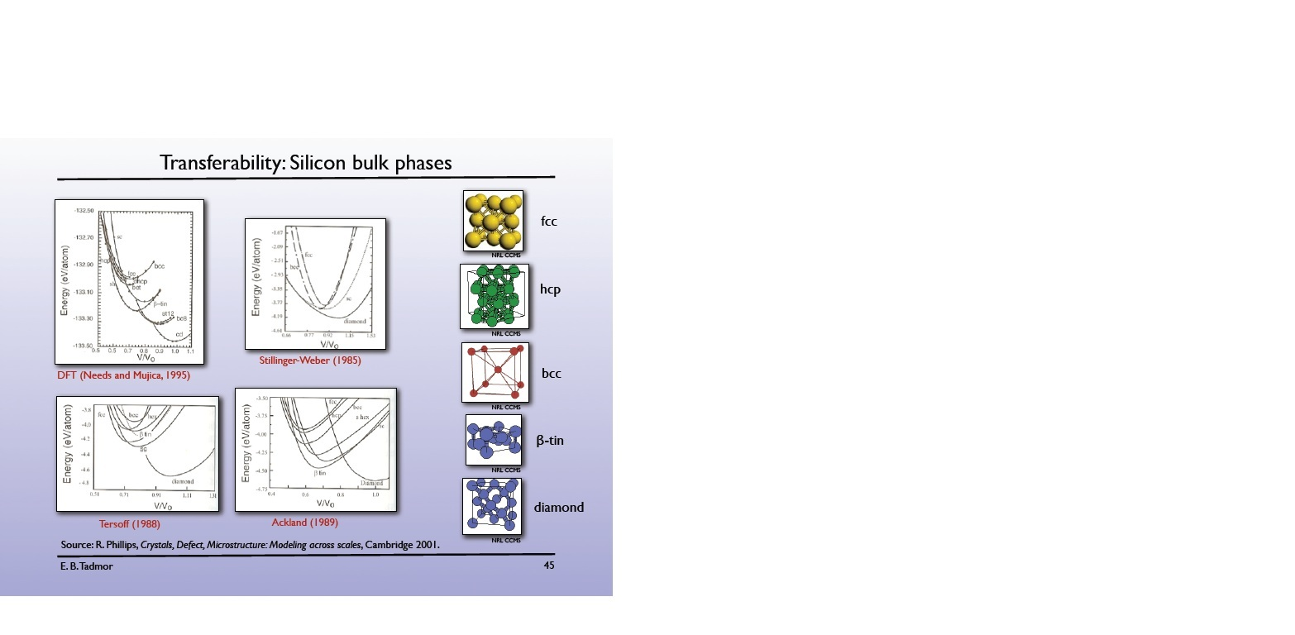
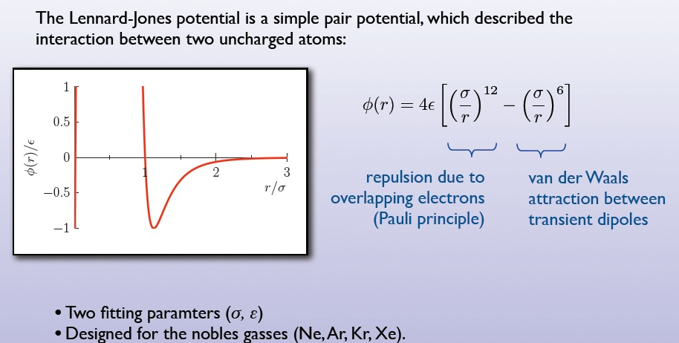
Molecular/atomistic simulations: tests and models
Tests
Models
Test :a specific computer program which, when coupled with a suitable Model, calculates and returns a specific Prediction about a particular Configuration (or sequence of Configurations for dynamical properties).
Model : Computer implementation representing a specific interaction between atoms, e.g. an interatomic potential or force field
Source: openkim.org
6
University of Minnesota
Notes:
6

Slide 7
Types of molecular modelers
Very broadly speaking there are two types of molecular modelers:
Developers
Users
- Create new models
- Study materials physics and applications
- Create new knowledge
Developers
Users
- Use models to study materials problems of
scientific/technological importance
- Build sophisticated simulations to extract
meaningful data
- Create new knowledge
7
University of Minnesota
Notes:
7

Slide 8
Barriers faced by molecular modelers
The difficulties faced by developers and users of interatomic
models include:
No easy access to an extensive list of reliable reference data from experiments and first principles calculations for fitting.
No easy access to implementations of existing models with known provenance and cross-language capability.
No standardized tests for evaluating properties of molecular systems.
No framework for evaluating the precision and transferability of models and therefore no rigorous guidelines for choosing an appropriate model for a given application.
8
University of Minnesota
Notes:
8

Slide 9
Knowledgebase of Interatomic Models (KIM) is proposed to overcome the barriers
The Knowledgebase of Interatomic Models (KIM) project is based on a four-year NSF cyber-enabled discovery and innovation (CDI) grant and has the following main objectives:
Development of an online open resource for standardized testing and long-term warehousing of interatomic models (potentials and force fields) and data.
Development of an application programming interface (API) standard for atomistic simulations, which will allow any interatomic model to work seamlessly with any atomistic simulation code.
Fostering the development of a quantitative theory of transferability of interatomic models to provide guidance for selecting application-appropriate models based on rigorous criteria, and error bounds on results.
Striving for the permanence of the KIM project, including development of a sustainability plan, and establishment of a long-term home for its content.
More information on KIM is available at the project website: http://openKIM.org
9
University of Minnesota
Notes:
9

Slide 10
KIM framework
A web interface that will facilitate:
user upload and download of Tests, Models and Reference Data
searching and querying the repository
comparing and visualizing Predictions and Reference Data
recording user feedback (ranking and discussion forums)
Web portal
Repository
Processing pipeline
KIM
A user-extendible database of
interatomic Models
standardized Tests (simulation codes)
Predictions (results from Model-Test couplings)
Reference Data (obtained from experiments and first principles calculations)
External repositories
Processing Pipeline:
An automatic system for generating Predictions due to new Test or Model upload or changes:
detect viable Test-Model couplings
assign computational resources based on priority and dependencies
store results in Repository
requires an application programming interface (API) to be defined
10
University of Minnesota
Notes:
10

Slide 11
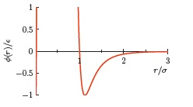



KIM repository: Models
Models Tests Predictions Reference Data KIM API
Models
Model: Computer implementation representing a specific interaction between atoms, e.g. an interatomic potential or force field.
Model Format
- Stand-alone Model (black box)
Model Driver (e.g. Lennard-Jones )
+ Parameter Set (e.g. =10.4 meV, =0.34 nm)
Every model will have a unique KIM ID for referencing in papers.
Lennard-Jones (pair)
• Ar parameterization
• ...
⠇
Morse (pair)
• Cu parameterization
• ...
⠇
Born-Mayer (ionic pair)
⠇
Stillinger-Weber (3-bdy)
• Si parameterization
• ...
⠇
MGPT (4-body)
• Mo parameterization
• Ta parameterization
• ...
⠇
CHARMM/AMBER
⠇
EAM/Finnis-Sinclair/glue
⠇
MEAM
⠇
Tersoff
⠇
EDIP
Brenner
⠇
Bond-order potentials
⠇
ReaxFF
⠇
GAP
⠇
11
University of Minnesota
Notes:
11

Slide 12
KIM repository: Tests
Models Tests Predictions Reference Data KIM API
Tests
Test: a specific computer program which when coupled with a suitable Model, possible including additional input, calculates and returns a specific Prediction about a particular Configuration (or sequence of Configurations for dynamical properties).
• Prediction of a Test will be a logical, scalar, tensor, graph, configuration or field, computed from a Test-Model coupling
• Popular codes (ddcMD, DL_POLY, GROMACS, GULP, iMD, LAMMPS, NAMD, SPaSM, etc.) can be included in a library of tools for writing Tests.
• Automatic test generation by linking to external repositories of first principles results.
Scalars
- lattice constants
- cohesive energy
- vacancy formation energy
- surface energy
- grain boundary energy
- vacancy migration barrier
- dislocation mobility
- peierls stress
- melting temperature
-...
Tensors
- stress
- elastic constants
...
Configurations
- dislocation core structure
- surface structure
- grain boundary structure
- nanocluster structure
...
Graph
- phonon spectrum
- cohesive energy vs volume
- energy along transition path
- radial distribution functions
...
Fields
- simulated TEM hi-res image
- gamma surface
…
12
University of Minnesota
Notes:
12

Slide 13
KIM repository: KIM Data
Models Tests Predictions Reference Data KIM API
Predictions Reference Data
Data in KIM can either be
‣ a Prediction computed from a Test-Model coupling, or
‣ Reference Data computed by first principles or measured experimentally.
• Standardization of Data
- Identified in terms of a set of “descriptors” drawn from a standardized “dictionary”
(similar to that used in the Protein Data Bank project)
- Descriptors will be automatically generated when possible (for example, the “Space Group”
descriptor will be automatically generated for a given crystal structure).
• Data classes
- Logical (true/false result for a test, e.g. a given crystal phase is stable)
- Scalar or Tensor (lattice constant, cohesive energy, elastic constants...)
- Graphs (transition pathway energy, phonon spectrum, ...)
- Configurations (relaxed defect core, surface structure, ...)
- Fields (simulated hires TEM image, ...)
• Quality assurance
- Acceptance of only “publication quality” data enforced by KIM Editor
- “Data Provenance”
13
University of Minnesota
Notes:
13

Slide 14
KIM API concept and implementation
14
University of Minnesota
Notes:
14

Slide 15
The KIM API facilitates communication between Models and Tests
1
Tests can be written in different languages
Models can be written in different languages
Test #1: using model find min. energy configuration…
Model #1: Lennard-Jones potential with cutoff….
Test #n: using potential
for the given configuration finds stresses
Requires: forces between each pair of neighboring atoms…
Model #4: EAM potential with tabulated embedding function
Calculates: forces between each pair neighboring atoms …
Input for Model
Test calls the Model---therefore they should be linked together as one executable.
Results
Users and developers will be able to download Tests and Models (from openkim.org) , then compile, link and run the resulting programs to produce new results.
15
University of Minnesota
Notes:
15

Slide 16
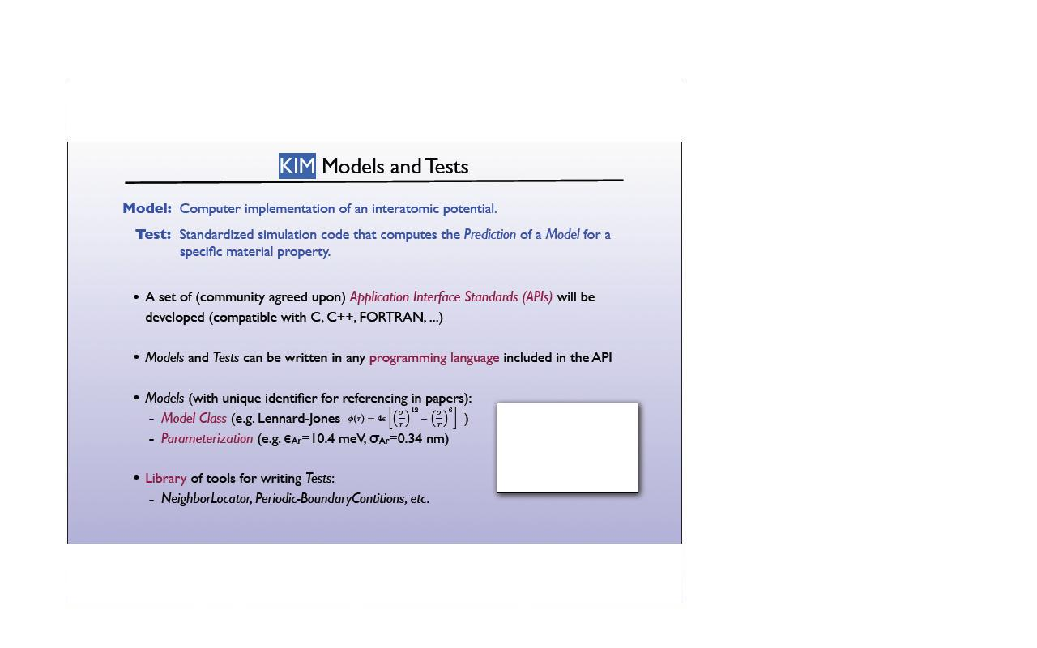
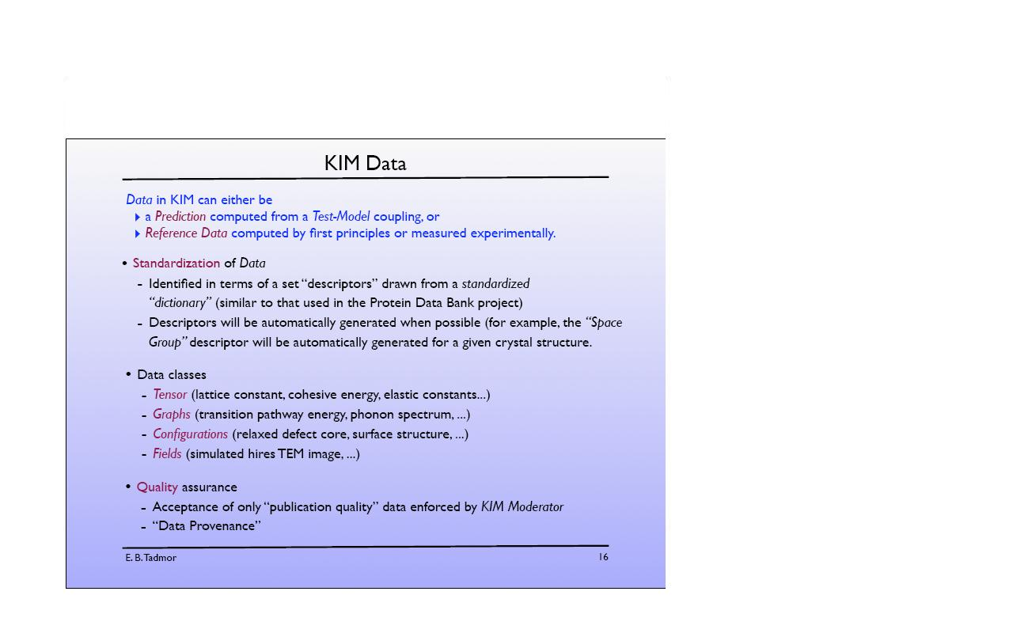
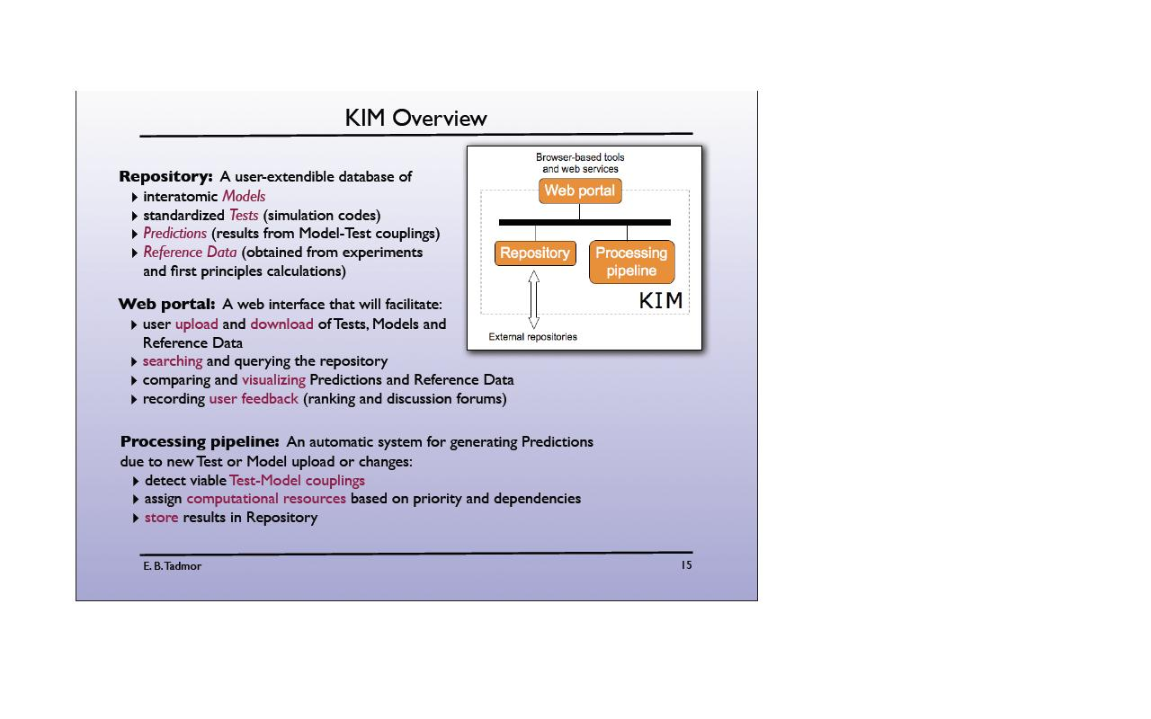
The most challenging technical requirement is the need for multi-language support
2
openKIM.org framework
Requirements:
Multilanguage support (C, C++, F77, FORTRAN 90, Python …)
A variety of data structures need to be accommodated: scalars, multidimensional arrays, variable size arrays, etc..
Speed & performance are very important
Standardized API, version tracking, etc…
Processing pipeline: sequence of actions
detect a viable Model/Test coupling
build (compile and link) Tests against Model
run probe-tests
assign computational resources
run full-scale Test against Model
analyze results …
store results in the repository
?
? ? ? ? ? ? ?
Processing pipeline: an automatic system for generating predictions when Tests or Models are uploaded or changed.
Need a simple interface : ideally just one argument per call
Source: KIM kickoff presentation
16
University of Minnesota
Notes:
16

Slide 17
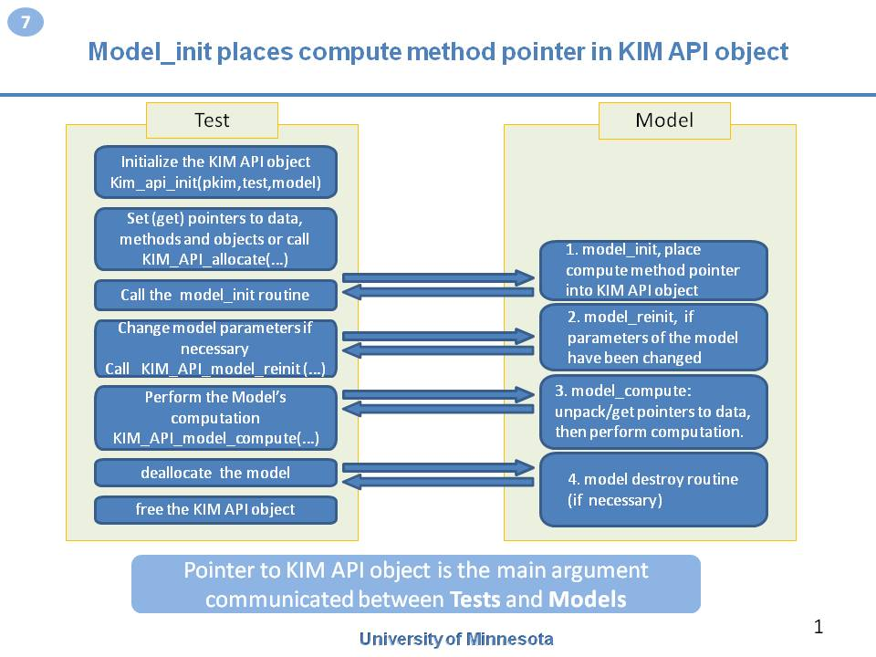
The KIM API is based on exchanging pointers to data and methods
3
Concept
Schematic of implementation
Data
standard
Data and method pointers are packed in one object. The Interface consists of exchanging one pointer to the KIM API object between a Test and a Model
All languages naturally support pointers:
FORTRAN (cray or 2003 standard)
C/C++
Java
Python
Many languages link
Method flexibility and speed
KIM
API
Single executable
Pointer
Test
(client)
Pointer to standard data
Model
(server)
Pointer
Data standard should accommodate every possible data set required for the model
? ? ? ? ? ? ?
17
University of Minnesota
Notes:
17

Slide 18
How can a Test know what type of input/output data is required by a Model? We have solved this problem by introducing the KIM API descriptor file
4
model_Ne_P_MLJ_NEIGH_PURE_H.kim
####################################################################################################
MODEL_NAME := model_Ne_P_MLJ_NEIGH_PURE_H
SystemOfUnitsFix := fixed
####################################################################################################
SUPPORTED_ATOM/PARTICLES_TYPES:
# Symbol/name Type code
Ne spec 1
...
MODEL_INPUT:
# Name Type Unit SystemU/Scale Shape Requirements
numberOfAtoms integer*8 none none []
numberAtomTypes integer none none []
atomTypes integer none none [numberOfAtoms]
...
KIM API descriptor file defines all variables that the model needs for computation including input and output variables. Also on the test side, the .kim file defines what the Test can provide as input for the Model and what it expects from the Model as a result.
Tests and Models expose the required input/output variables that will be communicated using the KIM API
Note: full .kim file shown here can be found in MODELs/model_Ne_P_MLJ_NEIGH_PURE_H/
18
University of Minnesota
Notes:
18

Slide 19
Structure of descriptor file
5
Model/Test name and system of units lines
Brief description of Section lines
MODEL_NAME:=model_Ar_P_Morse
SystemOfUnitsFix := fixed
These lines identify logically distinct sections within the KIM descriptor file.
All lines following a Section line, up to the next Section line or end of the file, will be assigned to the indicated section.
These sections may occur in any order within a KIM descriptor file, however the order given here is recommended. A section line may only occur once within a KIM descriptor file.
Section lines
SUPPORTED_ATOM/PARTICLES_TYPES:
CONVENTIONS:
MODEL_INPUT:
MODEL_OUTPUT:
MODEL_PARAMETERS:
Brief description of Data lines
These lines are used to specify the information that a Model (Test) will provide to and require from a Test (Model), as well as the conventions that the Model(Test) uses.
* Species Data lines – allow for the definition of atomic species by providing a symbol and an integer code. These lines are located in section SUPPORTED_ATOM/PARTICLES_TYPES.
* Dummy Data lines - this line type defines a convention that can be used to ensure that Models and Tests are able to work together, and should only be used within the CONVENTIONS section of the KIM descriptor file.
* Argument Data lines – the main KIM descriptor file line format, used within the MODEL_INPUT, MODEL_OUTPUT, and MODEL_PARAMETERS sections.
Data lines
* Species Data lines
* Dummy Data lines
* Argument Data lines
19
University of Minnesota
Notes:
19

Slide 20
Each argument line in the descriptor file describes a variable and its properties
5.1
All characters after a ‘#’ are ignored
(a comment field)
MODELs/model_Ar_P_MLJ_F90.kim
MODEL_NAME := model_Ar_P_MLJ_F90
SystemOfUnitsFix := fixed
….
compute method none none []
MODEL_OUTPUT:
# Name Type Unit SystemU/Scale Shape requirements
energy real*8 energy standard []
energyPerAtom real*8 energy standard [numberOfAtoms] optional
….
Method means a subroutine or function pointer
The name of a variable is its “key word”. By using key words, the KIM service routines can pack/unpack data pointers from the KIM API object. Key words are standardized as part of the KIM API.
Physical dimensions
System of units: standard, SI, none
The “requirements” field is only used in Model descriptor files. An empty field indicates that the variable is required. A value of “optional” indicates that the associated data will be computed only if the variable is in the Test’s descriptor file and if the Test explicitly requests it.
The shape of a variable describes its array properties. It specifies the number and size (range) of indices. For example, [] means a scalar (zero-dimensional array), [numberOfAtoms] means a one-dimensional array and [numberOfAtoms,3] means a two-dimensional array of size numberOfAtoms x 3.
Type of data in computer representation
Note: detailed description of all Types value , Unit, SystemU/Scale can be found in the file KIM_API/standard.kim
20
University of Minnesota
Notes:
20

Slide 21
Specifying atom types – species data lines
5.2
Species data lines define the atom/particle types supported by the Test/Model and should only be used within the SUPPORTED_ATOM/PARTICLES_TYPES
section of the KIM descriptor file. Each line consists of three white-space separated (case sensitive) strings The three strings are as follows:
code: This is the integer that the Model uses internally
to identify the atom/particle type. The value specified
by a Test is ignored.
Type: This must be `spec'.
Name: This string gives a unique name to the atom/particle type. This name is checked against the standard list in `standard.kim'.
MODELs/model_Ar_P_MLJ_F90.kim
...
###############################################
SUPPORTED_ATOM/PARTICLES_TYPES:
# Symbol/name Type code
Ar spec 1
###############################################...
The KIM_API_get_listAtomTypes() service routine allows one to obtain a list of all atom species used by the model during runtime. Also the KIM_API_get_atypeCode() service routine allows one to get the atom species integer code (see KIMserviceDescription.txt).
21
University of Minnesota
Notes:
21

Slide 22
In order to define “conventions” of test/model behavior, dummy data lines are reserved
5.3
DOCs/TEMPLATEs/model_El_P_Template.f.kim
##############################################
CONVENTIONS:
# Name Type
OneBasedLists dummy
Neigh_IterAccess dummy
Neigh_LocaAccess dummy
NEIGH-RVEC-F dummy
NEIGH-PURE-H dummy
...
A dummy data line defines a convention (or parameter), that can be used to ensure that Models and Tests are able to work together, and should only be used within the CONVENTIONS section of the KIM descriptor file. The line consists of two white-space separated (case sensitive) strings. The two strings, in order, are as follows:
Name: This string gives a unique name to the convention. This name is checked against the standard list in `standard.kim‘
Type: This must be `dummy'
KIM_API_allocate() has no effect on “dummy “ type variables, because they are not “data pointer holders“.
For a detailed description of all dummy lines see the file KIM_API/standard.kim. Also see templates file in DOCs/TEMPLATEs/.
22
University of Minnesota
Notes:
22

Slide 23
Parameter variables are used to publish/access internal parameters of a Model
5.4
model_Ar_P_MLJ_CLUSTER/model_Ar_P_MLJ_CLUSTER.kim
MODEL_PARAMETERS:
# Name Type Unit SystemU/Scale Shape requirements
PARAM_FREE_sigma real*8 length standard []
PARAM_FREE_epsilon real*8 energy standard []
PARAM_FIXED_cutsq real*8 area standard []
...
The format for parameter variables in a KIM descriptor file is the same as that for argument data types.
Two types of model parameters are allowed
1) PARAM_FIXED_XXXXXX - these should not be changed by the Test
2) PARAM_FREE_XXXXXX - these may be changed by the Test (which should then call the
Model's reinit() function to inform the model that its parameters have changed)
KIM_API_get_listParams() service routine will return a list of all parameters in the object during runtime (as an array of text strings).
KIM_API_get_listFreeParams() service routine will return a list of FREE parameters and
KIM_API_get_listFixedParams() will return a list of FIXED parameters (see KIMserviceDescription.txt)
Names of parameter variables are not checked against standard.kim
23
University of Minnesota
Notes:
23

Slide 24
Handling of Neighbor lists and Boundary Conditions – NBC methods
6
No
Neighbor list ?
Yes
MI-ORTHO
PBC ?
No
Yes
No
Relative Pos. Vectors Rij ?
Yes
CLUSTER
MI-OPBC
NEIGH-PURE
NEIGH-RVEC
Plain vanilla method:
Model needs only coordinates
MI-OPBC-H
MI-OPBC-F
Minimum image periodic boundary conditions:
model needs neighbor lists and box side lengths
NEIGH-PURE-H
NEIGH-PURE-F
Model needs neighbor lists
NEIGH-RVEC-F
Model needs neighbor list and relative position vectors Rij
Note: NBC stands for Neighbor lists and Boundary Conditions
24
University of Minnesota
Notes:
24

Slide 25
Descriptions of the NBC methods
6.1
CLUSTER:
Receives the number of atoms and coordinates without additional information (such as neighbor lists or other boundary condition specifiers) and computes requested quantities under the assumption that the atoms form an isolated cluster. For example, if energy and forces are requested, it will compute the total energy of all the atoms based on the supplied atom coordinates and the derivative of the total energy with respect to the positions of the atoms.
MI-OPBC-[F|H]:
Receives the number of atoms and coordinates, the side lengths for the periodic orthogonal box and a neighbor list as detailed below. Assumes all atoms lie inside the periodic box. Side lengths of box must be at least twice the cutoff range. Computes the requested quantities under the assumption that the atoms are subjected to minimum image, orthogonal, periodic boundary conditions.
Neighbor list requirements for MI-OPBC-[F|H]:
The minimum image convention is applied during construction of the neighbor list consistent with the orthogonal box size.
The neighbor list can be supplied in either full or half mode.
Full neighbor list: All neighbors of an atom are stored
Half neighbor list: For an atom i only the neighbors j>i are stored.
Calculated quantities for both –H and –F modes should be equivalent to those obtained were the model to compute its own neighbor list using the provided orthogonal periodic box side lengths.
25
University of Minnesota
Notes:
25

Slide 26



Descriptions of the NBC methods (2)
6.2
NEIGH-PURE-[F|H]:
Receives the number of atoms, coordinates and a full or half neighbor list. The neighbor list defines the environment of each atom, from which the atom’s energy is defined. The model computes the requested quantities using the supplied information. For example, if energy and forces are requested, it will compute the total energy of all the atoms based on their neighbor lists and the derivative of the total energy with respect to the positions of the atoms. This method can be used with codes that use ghost atoms to apply boundary conditions. The ghost atoms are treated as regular atoms by the model, and it is up to the calling code to discard some information such as the forces on the ghost atoms and to compute the appropriate total energy from per-atom energies of the physical atoms, or to use a modified neighbor list to obtain the desired values.
NEIGH-RVEC-F:
Receives the number of atoms and coordinates, a full neighbor list and the relative position vectors ( ). The neighbor list and vectors define the environment of each atom, from which the atom’s energy is defined. The model computes the requested quantities using the supplied information. For example, if energy and forces are requested, it will compute the total energy of all the atoms based on their neighbor lists and relative position vectors and the derivative of the total energy with respect to the positions of the atoms. This method enables the application of general periodic boundary conditions, including multiple images. (This approach can fail with half neighbor lists and therefore the –H variant of the method does not exist.) A possible future extension to this method is to allow the Test to provide a ForceTransformation() function for each neighbor, which would enable the application of complex boundary conditions such as torsion and objective boundary conditions.
26
University of Minnesota
Notes:
26

Slide 27
Example of using NBC methods in KIM file
6.3
DOCs/TEMPLATEs/model_El_P_Template.f.kim
…
CONVENTIONS:
# Name Type
OneBasedLists dummy
NEIGH-RVEC-F
NEIGH-PURE-H dummy
NEIGH-PURE-F dummy
...
CLUSTER dummy
...
The template example in model_El_P_Template.f.kim
is designed to work with five different NBC methods.
If the Test can also work with multiple NBC methods and there are several matches, the first matched method listed in the Model’s KIM file will have precedence.
The KIM_API_init () routine will check that all needed lines for the chosen method are in KIM descriptor file.
NBC Methods
27
University of Minnesota
Notes:
27

Slide 28
Neighbor list access methods: all related lines in KIM descriptor files
6.4
standard.kim (only related to Neighbor list access are shown here)
…
CONVENTIONS:
# Name Type
…
ZeroBasedLists dummy # presence of this line indicates that indexes
# for atoms are from 0 to numberOfAtoms-1 (C-style)
OneBasedLists dummy # presence of this line indicates that indexes for
# atoms are from 1 to numberOfAtoms (Fortran-style)
Neigh_IterAccess dummy # works with iterator mode
Neigh_LocaAccess dummy # works with locator mode
Neigh_BothAccess dummy # needs both locator and iterator modes
MI-OPBC-H dummy
MI-OPBC-F dummy
NEIGH-RVEC-F dummy
NEIGH-PURE-H dummy
NEIGH-PURE-F dummy
MODEL_INPUT:
# Name Type Unit SystemU/Scale Shape requirements
get_full_neigh method none none []
get_half_neigh method none none []
neighObject pointer none none []
boxlength real*8 length unspecified [3]
neighObject stores completely encapsulated neighbor list object
Access to the object is done through methods get_full_neigh or get_half_neigh . The neighbor list object and the method to access it are supplied by the test.
28
University of Minnesota
Notes:
28

Slide 29
Interface to methods: get_half_neigh & get_full_neigh
6.5
get_half_neigh and get _full_neigh functions both have the same interface
here :
mode - operate in iterator or locator
mode
mode = 0 : iterator mode
mode = 1 : locator mode
request - Requested operation
If mode = 0
request = 0 : reset iterator
request = 1 : increment iterator
If mode = 1
request = # : number of the atom
whose neighbor list
is requested
integer function get_half_neigh(pkim,mode,request,atom,numnei,pnei1atom,pRij)
implicit none
integer(kind=kim_intptr), intent(in) :: pkim
integer, intent(in) :: mode
integer, intent(in) :: request
integer, intent(out) :: atom
integer, intent(out) :: numnei
integer, intent(out) :: pnei1atom
integer, :: nei1atom(1); pointer(pnei1atom,nei1atom)
double precision, intent(out) :: pRij
double precision, :: Rij(3,*); pointer(pRij,Rij)
end function get_half_neigh
FORTRAN style
int get_half_neigh(void ** pkim, int * mode, int * request, int * atom,
int * numnei, int ** pnei1atom, double ** pRij) ;
C style
atom - the number of the atom whose neighbor list is returned
numnei - number of neighbors returned
nei1atom - integer array of neighbors of an atom which will point to
the list of neighbors on exit.
Rij - array of relative position vectors of the neighbors of an
atom (including boundary conditions if applied) if they
have been computed (NBC scenario NEIGH-RVEC-F
only). Has NULL value otherwise (all other NBC
scenarios).
The return value depends on the results of execution:
2 -- iterator has been successfully initialized
1 -- successful operation
0 -- iterator has been incremented past end of list
-1 -- or any negative value means unsuccessful
operation (see KIM_API/KIMserviceDescription.txt )
Test must supply the get_half/full_neigh method and set it to KIM API object
29
University of Minnesota
Notes:
29

Slide 30
Model_init places compute method pointer in KIM API object
7
Test
Model
Initialize the KIM API object
Kim_api_init(pkim,test,model)
Set (get) pointers to data, methods and objects or call KIM_API_allocate(…)
1. model_init, place compute method pointer into KIM API object
Call the model_init routine
2. model_reinit, if parameters of the model have been changed
Change model parameters if necessary
Call KIM_API_model_reinit (…)
Perform the Model’s computation
KIM_API_model_compute(…)
3. model_compute: unpack/get pointers to data, then perform computation.
deallocate the model
4. model_destroy routine
(if necessary)
free the KIM API object
Pointer to KIM API object is the main argument communicated between Tests and Models
30
University of Minnesota
Notes:
30

Slide 31
Initialization of KIM API object, setting and getting data-pointers can be done through the KIM service routines
8
KIMserviceC.h
#include <stdint.h>
#ifdef __cplusplus
extern "C" {
#endif
//global methods
int KIM_API_init(void * kimmdl, char * testname, char *mdlname);
void KIM_API_allocate(void *kimmdl, intptr_t natoms, int ntypes);
void KIM_API_free(void *kimmdl, int * kimerror);
void KIM_API_print(void *kimmdl, int *kimerror);
void KIM_API_model_compute(void * kimmdl,int *kimerror);
…
//element access methods
int KIM_API_set_data(void *kimmdl,char *nm, intptr_t size, void *dt);
void * KIM_API_get_data(void *kimmdl,char *nm, int * kimerror);
…
Initialization is done by analyzing test and model descriptor files
One can use optional KIM service routine to allocate standard variables and data
Call model_compute routine by address stored in KIM API object
Directly place data pointer into the KIM API object
Description of all KIM API service routines are located in the file:
KIM_API/KIMserviceDescription.txt
31
University of Minnesota
Notes:
31

Slide 32
Examples of using KIM_API_init and KIM_API_allocate service routines
8.1
test_Ar_free_cluster_CLUSTER/test_Ar_free_cluster_CLUSTER.F90
...
! Initialize the KIM object
ier = kim_api_init_f(pkim, testname, modelname)
if (ier.le.0) then
call report_error(__LINE__, "kim_api_init_f", ier)
stop
endif
! Allocate memory via the KIM system
call kim_api_allocate_f(pkim, N, ATypes, ier)
if (ier.le.0) then
call report_error(__LINE__, "kim_api_allocate_f", ier)
stop
endif
...
KIM API init will check the consistency of KIM descriptor file (Test and Model) against standard.kim, after that will check if test and model match: NBC methods, atom species (if any) , conventions and argument data lines
If match, then KIM API model object will be created. The object follows exactly model descriptor KIM file and can store all described data as pointers
KIM_API_allocate will allocate memory for all arrays and variables stored in KIM API object
It is not mandatory to use
KIM_ API_allocate. A Test can use its own memory and set address of the data in KIM API object.
test_Ar_multiple_models/test_Ar_multiple_models.c
...
if (1 != (status = KIM_API_init(&pkim_periodic_model_0, testname, argv[1])))
report_error(__LINE__,"KIM_API_init() for MODEL_ZERO for periodic",status);
...
32
University of Minnesota
Notes:
32

Slide 33
Examples of using KIM API get/set data
8.2
test_Ar_free_cluster_CLUSTER/test_Ar_free_cluster_CLUSTER.F90
KIM_API_get_data (or kim_api_get_data_f) will return address of data stored in the KIM API object.
kimerror will be equal 1 upon successful completion, otherwise it will be 0 or negative
(see KIM_API/ KIMserviceDescription.txt)
...
integer(kind=8) numberOfAtoms;
pointer(pnAtoms,numberOfAtoms)
...
! Unpack data from KIM object
!
pnAtoms = kim_api_get_data_f(pkim, "numberOfAtoms", ier);
if (ier.le.0) then
call report_error(__LINE__, "kim_api_get_data_f", ier)
stop
endif
...
KIM_API_set_data (or kim_api_set_data_f) will place the address of data into KIM API object and will return integer error code : 1– success, 0 or negative – unsuccessful completion
test_Ar_multiple_models/test_Ar_multiple_models.c
...
/* Register memory */
/* model inputs */
status = KIM_API_set_data(pkim_periodic_model_0, "numberOfAtoms", 1, &numberOfAtoms_periodic);
if (1 != status) report_error(__LINE__,"set data",status);
status = KIM_API_set_data(pkim_periodic_model_1, "numberOfAtoms", 1, &numberOfAtoms_periodic);
if (1 != status) report_error(__LINE__,"set data",status);
...
33
University of Minnesota
Notes:
33

Slide 34
KIM_API_model_init will call model initialize routine that in turn will place model compute into KIM object
8.3
KIM_API_model_init will call the model_init routine . KIM_API_model_init utilizes the KIM standard naming convention in order to make the call. In C the name of the model init routine must have all lower case letters in the following format modelname_init_, for example:
model_ar_p_mlj_cluster_init_
model name
test_Ar_multiple_models/test_Ar_multiple_models.c
...
/* call model init routines */
if (1 != (status = KIM_API_model_init(pkim_periodic_model_0))) report_error(__LINE__,"KIM_API_model_init", status);
...
/* call compute functions */
KIM_API_model_compute(pkim_periodic_model_0, &status);
if (1 != status) report_error(__LINE__,"compute", status);
...
KIM_API_model_compute calls the address of the model compute subroutine stored in KIM API object.
By the time KIM_API_model_compute is called the address is placed in KIM API object by model_init_ routine
DOCs/TEMPLATEs/model_El_P_Template.F90
...
subroutine model_<FILL element name>_P_<FILL model name>_init(pkim)
...
! store pointer to compute function in KIM object
if (kim_api_set_data_f(pkim,"compute",sz,loc(Compute_Energy_Forces)).ne.1)&
stop '* ERROR: compute keyword not found in KIM object.'
...
Place address of actual compute routine into the KIM API object
34
University of Minnesota
Notes:
34

Slide 35
An example of using get_half_neigh methods through KIM API service routines
8.4
MODELs/model_Ne_P_LJ_NEIGH_PURE_H/model_Ne_P_LJ_NEIGH_PURE_H_compute.F
SUBROUTINE calculate(pkim,x,f,ea,natom,en,cutof,
& f_flag,e_flag, kimget_h_neigh,kimerr)
...
C reset neighbor iterator to beginning
request=0
retcode =kimget_h_neigh(pkim,mode,request,atom,
& numnei,pnei1atom,pRij)
IF(retcode .NE. 2) THEN
WRITE(*,'("model_Ne_pure_LJ_NEIGH_PURE_*.F error: ",I5)')
& retcode
kimerr = retcode
return
ENDIF
retcode=1
101 CONTINUE
IF (retcode .NE. 1) GOTO 103
!increment iterator
mode=0; request=1;
retcode = kimget_h_neigh(pkim,mode,request,
& atom,numnei,pnei1atom,pRij)
IF(retcode.LT.0) THEN
WRITE(*,'("neigh iterator error:retcode",I5)'),retcode
kimerr=retcode
return
ENDIF
IF(retcode.EQ.0) THEN
kimerr=1
GOTO 103
ENDIF
i=atom
...
GOTO 101
103 CONTINUE
...
Iterator mode -- reset iterator
Iterator mode -- increment iterator
KIM_API_get_half_neigh will call the method by address stored in KIM API object (“get_half_neigh”) and supplied by test.
It will check if mode and request are set correctly, also will convert the result from oneBaseLists to zeroBaseLists (or vice versa) if necessary .
Details on interface and description of error codes are in
KIM_API/KIMserviceDescription.txt
35
University of Minnesota
Notes:
35

Slide 36
Summary
KIM project aims to overcome the barriers faced by molecular modelers by creating an online resource for standardized testing, long-term warehousing and easy retrieval of interatomic models and data.
Tests and Models written by different researcher/developer teams, in different programming languages and programming styles, must be able to couple and work together.
To address the challenge, KIM API has been created. KIM API is based on descriptor files where the models and tests provide all variables and methods needed for their interactions. Using the descriptor files KIM API routines create an intermediate object that holds all pointers to the data variables, needed for test-model communications. Access to the data in that object is done also through service routines.
36
University of Minnesota
Notes:
36

Slide 37
Appendix
37
University of Minnesota
Notes:
37

Slide 38
Every variable that needs to be communicated between tests and models must be in the descriptor file
A1
Each Test has its own descriptor file that describes the data it can supply to the Model and what data it expects the Model to compute. There are no optional variables in a Test’s descriptor file (“the test knows, a priori, what to compute”).
Each Model has its own descriptor file that describes the data it needs to perform its computations and what results it can compute. Some of the variables/methods can be identified as optional. Optional variables/methods are ones that the Test does not have to provide or are results that the Model will only compute if the Test explicitly requests it.
KIM service routines (such as kim_api_init_) use both Test and Model descriptor files to:
Check if the Model and Test match, also check if their descriptor files conform to the KIM API standard
If they do -- create a KIM API object to store all variables described in the Model’s descriptor file
Mark each optional variable that is not used by the Test “uncompute” (i.e., do not compute)
Other service routines are used to:
Set (get) variable or method pointers into (from) the KIM API object
(e.g., kim_api_set_data, kim_api_get_data, etc.)
Check if the “compute flag” is set to “compute” for a variable in the KIM_API obejct
(kim_api_isit_compute)
Execute the Model’s compute method (kim_api_model_compute)
etc…
38
University of Minnesota
Notes:
38

Slide 39
Model and Test examples available in the current version of KIM API ( generated from EXAMPLES-LEGO)
A3
TESTs
MODELs
test_Al_FCCcohesive_MI_OPBC
test_Al_free_cluster
test_Ar_FCCcohesiveCutoff_NEIGH_RVEC
test_Ar_FCCcohesive_MI_OPBC
test_Ar_FCCcohesive_NEIGH_PURE
test_Ar_FCCcohesive_NEIGH_RVEC
test_Ar_free_cluster
test_Ar_free_cluster_CLUSTER_C
test_Ar_free_cluster_CLUSTER_F90
test_Ar_multiple_models
test_ArNe_B2cohesive_NEIGH_RVEC
test_Ne_free_cluster
model_Al_PF_ErcolessiAdams
model_ArNe_P_MLJ_NEIGH_RVEC_F
model_Ar_P_MLJ_C
model_Ar_P_MLJ_CLUSTER_C
model_Ar_P_MLJ_CLUSTER_F90
model_Ar_P_MLJ_F90
model_Ar_P_MLJ_MI_OPBC_H_F
model_Ar_P_MLJ_NEIGH_PURE_H_F
model_Ar_P_MLJ_NEIGH_RVEC_F
model_Ar_P_MMorse
model_Ne_P_LJ_NEIGH_PURE_H
model_Ne_P_MLJ_NEIGH_RVEC_F
Indicates a Test can work (match) with a Model in the current KIM API version
39
University of Minnesota
Notes:
39

Slide 40
KIM API directory structure
A2
openkim-api
KIM_API
MODELs
TESTs
Sample_01_lj_cutoff
Sample_01_lj_cutoff
Sample_01_lj_cutoff
Sample_01_lj_cutoff
Sample_01_lj_cutoff
Sample_01_lj_cutoff
Sample_01_lj_cutoff
Sample_01_lj_cutoff
model_Ar_P_MMorse
test_Al_free_cluster
KIMservice.h
KIMservise.cpp
KIMserviceC.h
KIMserviceC.c
KIMservice.F90
…
Makefile
model_Ar_P_MMorse.kim
model_Ar_P_MMorse.c
Plus any other file
needed
…
Makefile
test_Al_free_cluster.kim
test_Al_free_cluster.F90
Plus any other file
needed
…
Each Test and Model has its own descriptor file
40
University of Minnesota
Notes:
40

Slide 41
KIM installation: compilation, linking and running tests
Instructions for installing, compiling and linking KIM:
In the desired directory, execute the command: ‘tar xzvf openkim-api-XX.XX.XX.tgz’
Set up environment variable (bash):
> export KIM_DIR=/your_location/openkim-api/
your_location is the correct path where the openkim-api directory is located.
(Make sure to include the trailing slash)
By default, all make files use the GNU compilers for 64 bit linux.
In order to use the Intel compiler, define the environment variable KIM_INTEL
bash:
> export KIM_INTEL="yes".
For using a 32 bit machine, define the environment variable KIM_SYSTEM32
bash:
> export KIM_SYSTEM32="yes"
4. Change directory to EXAMPLES_LEGO type make: it will populate TESTs and MODELs directories with actual code.
4. change to the KIM_DIR directory and execute the commands:
‘make clean’
‘make’
This will compile the KIM API and examples in TESTs and MODELs.
To run a Test, change to the appropriate directory and run the executable. For example:
> cd TESTs/<test_name>
> echo “<model_name>" | ./<test_name>
Note: refer to openkim-api/INSTALL for details on environment variables and other features
41
University of Minnesota
Notes:
41

Slide 42
KIM API object is an array of Base data elements. Each Base data element can hold a pointer to any relevant data
A4
Number of fields is fixed to 9
Base data:
Can hold any type of array: real, integer, pointer…
Stores enough information for a complete description of the data
pointer to contiguous array of data of size “size”
size of data in terms of underlying elements
auxiliary array: very useful for 2d arrays (variable and fixed dimensions)
name contains description information like “coordinates”, “velocities”, “forces”, etc…
type tells the type for elements of array: “real”, “real*8“integer”, “integer*8”, pointer
rank and shape:
rank is the number of indices for the array: for 2D it is 2, for 3D it is 3 etc…
shape is an integer array of size rank and holds the size (range) of each index.
Flag contains additional information (all fields are integers)
peratom
Every field in the Base data structure is a pointer or “pointer size” integer.
freeable
pointerchanged
Base data type can be used to store all needed data for Tests and Models
ID
42
University of Minnesota
Notes:
42

Slide 43
Unused
43
University of Minnesota
Notes:
43

Slide 44
Knowledgebase of Interatomic Models (KIM) and an Application Programming Interface as a Standard for Molecular Simulation
Valeriu Smirichinski, Ryan S. Elliott and Ellad B. Tadmor
Dept. of Aerospace Engineering and Mechanics, University of Minnesota
July 2011
Funded by NSF Cyber-Enabled Discovery and Innovation (CDI) program
alpha version openkim-api-00.01.00
44
Notes:
44

Slide 45
Boundary conditions, parallel execution, neighbor list and neighbor list iterator (discussion)
2
One domain in multi-domain execution
Periodic boundary
O
X
O
X
O
X
Image
Real atoms
Image
Ghosts left
Local atoms
Ghosts right
At least two possibilities to organize neighbor list and neighbor list iterator
1
Treat ghost and image atoms uniformly by the model. In it’s internal loop the model need to know the following: this id is the last id of local/real atom the rest is ghost/image. Iterator returns only pair of (i,j) -- neighbors pair id’s
neighborsiterate(pneiobj,pnei1atom,numnei,restart)
Neighbor list object does not care about boundaries or ghosts. Structurally separated code takes configuration gives back neighbors
2
Treat ghosts and image separately. No image atoms coordinates are kept as configuration space, neighbor list is have information about (I,j) pairs and distances r(I,j) , therefore iterator returns (i,j) pairs and r(i,j)
neighborsiterate(pneiobj,pnei1atom,numnei,restart, x, rij)
Neighbor list need to know info about boundary condition, current position of real atom. Will have performance gain in some cases.
45
University of Minnesota
Notes:
45

Slide 46
How to supply information about the model to the test, during building the code or run-time?
2
Can be automated by smart make script where the model is supplied through defined constant on compilation stage
Best suits for statically linked executables
Requires rebuilding each time you change the model
Suitable for static and dynamic linking
Straight forward implantation in processing pipeline
All developers need to write test that accept string of model name as argument and pass it to KIM API
What is the preferable way?
Hard wired in test program
Argument to the test’s executables
Model name defined in test .kim file
Interactive input
Suitable for static and dynamic linking
In order to be automated (pipeline) some script – program is needed that knows how to replace model name in the test .kim file
probably best for users and developers
Conceptually not different from above
Developers of tests additionally will have to make sure that input is correct
Static versus dynamic linking requires more discussion:
Static linking may be problematic in case many models and several external engines
Dynamic linking may not be compatible with some external engines ( more info needed here …
46
University of Minnesota
Notes:
46

Slide 47
Three Lennard-Jones models (in the C, C++ and F90 languages) are available in this release. Each uses a neighbor-list iterator (written in F90) for its internal calculation loop.
2
MODELs/Sample_01_lj_cutoff_c/LJ_sample1.c
void (*nei_iterator)(void *,int **,int *,int *); //prototype for iterator
(*nei_iterator)(&neighObject,&n1atom,&numnei,&restart);
MODELs/Sample_01_lj_cutoff_cpp/ LJ_sample1.cpp
typedef void (*NEI_Iterator)(void *,int **,int *, int *);
NEI_Iterator nei_iterator;
(*nei_iterator)(&neighObject,&n1atom,&numnei,&restart);
MODELs/Sample_01_lj_cutoff/ LJ_mod.f90
interface
subroutine neighborsiterate(pneiobj,pnei1atom,numnei,restart)
integer*8 ::pneiobj,pnei1atom
integer :: numnei,restart! if restart = 0 set iterator to start
! if restart != 0 proceed next
end subroutine neighborsiterate
end interface
pointer (piterator,neighborsiterate)
call neighborsiterate (pnei_obj,pnei1atom,numnei,restart)
Neighbor -list object – supplied by the Test
The neighbor-list iterator and the neighbor-list object are supplied by the Test. If the neighbor-list iterator is called with restart=0, then it resets its internal state to the beginning of the list.
When restart is not zero, it returns the id of the next atom and all of its neighbor atom ids.
In the examples it is assumed that the neighbor-list has a short form (i.e., only atoms with id i<j are included in the neighbor list. This avoids “multiple counting”).
-1 when reached the
end of neighbor list
Array of integer : integer nei1atom; pointer(pnei1atom,nei1atom)
nei1atom(1) -- size of all elements in the array
nei1atom(2) -- atom id and
nei1atom(3:size) -- it’s neighbors
47
University of Minnesota
Notes:
47

Slide 48
Content
KIM API concept and implementation:
The KIM repository contains Models and Tests
The most challenging technical requirement is the need for multi-language support
The KIM API is based on exchanging pointers to data and methods
How can a Test know what type of input/output data is required by a Model? We have solved this problem by introducing the KIM API descriptor file
Structure of descriptor file and type of the variable in the descriptor file
Each argument line in the descriptor file defines a variable (scalar, array, method, etc.) and its properties
Specifying atom – species data lines
In order to define “convention” of test models behavior, dummy data lines are reserved
Parameter variable serves the purpose to publish and have access to models internal parameters
NBC methods define the convention to deal with various neighbor lists and boundary conditions
Descriptions of the NBC methods
Descriptions of the NBC methods (2)
Example of NBC using methods in KIM file
Neighbor list access methods: all related lines in KIM descriptor files
Interface for get_half_neigh and get_full_neigh methods
Test/Model coupling: The Model’s initialization routine stores a pointer to the “compute” routine in the KIM_API object
Initialization of KIM API object, setting and getting data-pointers can be done through the KIM service routines
Examples of using KIM_API_init and KIM_API_allocate service routines
Examples of using KIM API get/set data
KIM_API_model init will call model initialize routine that in turn will place model compute into KIM object
An example of using get_half_neigh methods through KIM API service routines
KIM installation, compilation, linking and running tests
48
University of Minnesota
Notes:
48

Slide 49
Knowledgebase of Interatomic Models (KIM) is proposed to overcome the barriers
KIM aims to be:
An online resource for standardized testing, longterm warehousing and easy retrieval of interatomic models and data.
KIM will address the barriers in two stages:
Stage I
Stage II
• develop an online database of freely available Models, Tests and Reference Data
• develop coding, dictionary, and testing/benchmarking standards
• develop KIM API for test-model coupling
• develop a framework for evaluating precision and transferability of Models
• develop automatic guidelines for selecting suitable Models for given applications
49
University of Minnesota
Notes:
49

