Slide 1
Genetic Algorithm(John Holland)

Slide 2
Agenda
Introduction
Basic components
Workflow
Pros and cons
Application
Solving a simple problem
Conclusion

Slide 3
Introduction to Genetic Algorithms
Definition: Genetic Algorithms (GAs) are optimization techniques inspired by the process of natural selection and evolution.
Inspiration from Natural Evolution: Mimics concepts like survival of the fittest, reproduction, and mutation.
Key Concepts:
Genes: The smallest units of information (e.g., binary digits).
Chromosomes: A collection of genes representing a potential solution.
Population: A set of chromosomes evolving over generations.

Slide 4
Basic Components of Genetic Algorithms
Representation (Encoding): How solutions are encoded (e.g., binary, real-valued).
Initialization: Creating an initial population of random solutions.
Fitness Function: Evaluates how "good" a solution is (e.g., maximizing or minimizing a value).
Selection: Choosing the best individuals to pass their genes to the next generation.
Crossover (Recombination): Combining genes of two parents to create offspring.
Mutation: Randomly altering genes to introduce diversity.

Slide 5
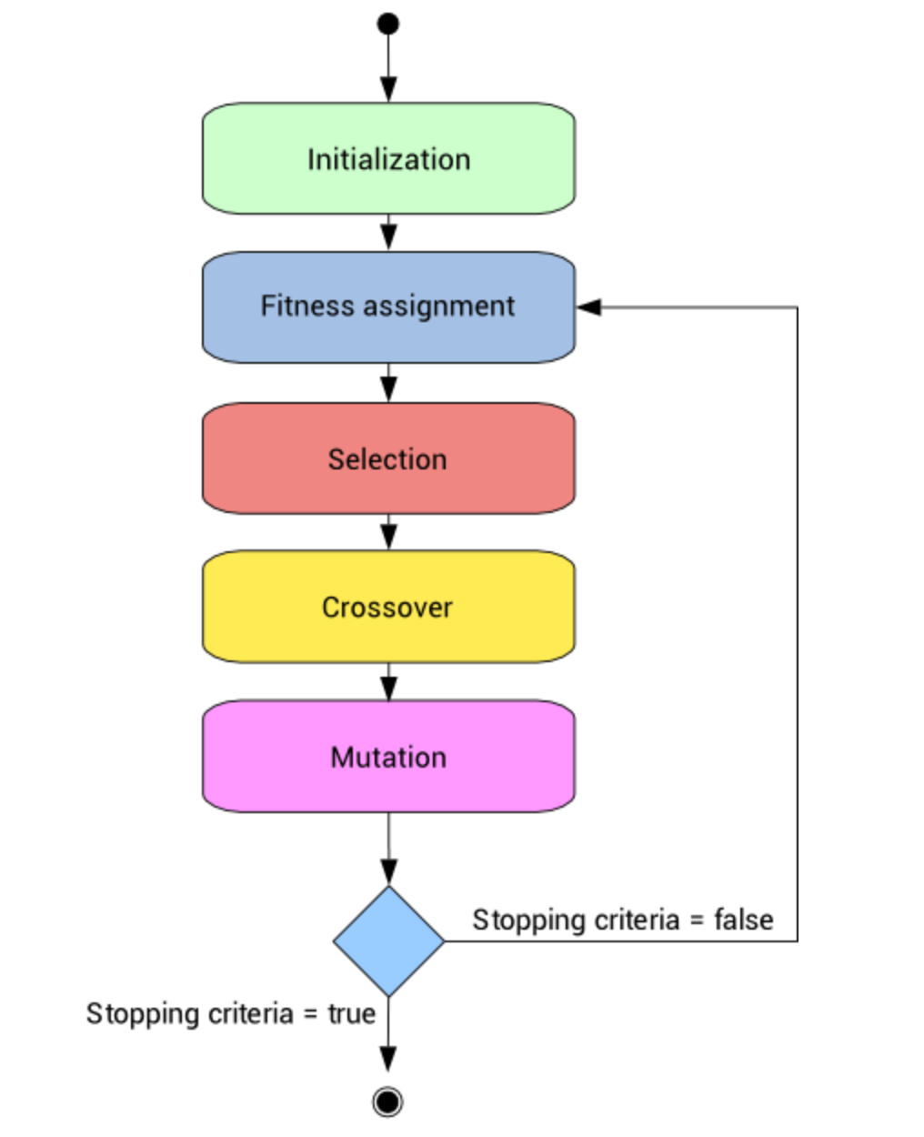
Genetic Algorithm Workflow
Step-by-Step Process:
Initialize a population.
Evaluate fitness of each individual.
Select the best individuals.
Perform crossover and mutation to create a new population.
Repeat until a stopping condition is met (e.g., max generations).
Iterative Evolution: The population evolves over generations, improving fitness over time.

Slide 6
Advantages and Disadvantages
Pros:
Can solve complex, non-linear problems.
Does not require derivative information.
Highly parallelizable.
Cons:
Computationally expensive for large populations.
No guarantee of finding the global optimum.
Requires careful tuning of parameters (e.g., mutation rate).

Slide 7
Applications of Genetic Algorithms
Optimization Problems: Solving problems with multiple constraints (e.g., scheduling, routing).
Machine Learning: Feature selection, hyperparameter tuning.
Robotics: Path planning, control systems.
Game Development: AI for NPCs, procedural content generation.

Slide 8
Solving a Simple Problem
Results and Analysis: The algorithm converges to the optimal solution (e.g., [1, 1, 1, 1, 1, 1, 1, 1] with a fitness of 255).
Problem Statement: Maximize the decimal value of a binary string.
Python Implementation:
Population of binary strings evolves over generations.
Fitness function calculates the decimal value.
Selection, crossover, and mutation are applied iteratively.
Result and Analysis : The algorithms converges to the optimal solution (e.g., [1,1,1,1,1,1,1,1] with fitness of 255.)

Slide 9
Summary:
Genetic Algorithms are powerful optimization tools inspired by natural evolution.
They involve representation, fitness evaluation, selection, crossover, and mutation.
Future Directions:
Hybrid approaches combining GAs with other techniques.
Applications in emerging fields like quantum computing and bioinformatics.

