Slide 1

Learning Management System (eCampus)

Slide 2
Agenda
Introduction
Problem Statement
Objective
Methodology
Gantt Chart
Expected Outcome

Slide 3

Introduction

Slide 4

Educational institutions face challenges due to disconnected systems and manual processes.
This leads to delays, errors, and inefficiencies in academic workflows.
Students struggle to access timely information and track their academic progress.
Teachers and staff find it difficult to manage courses and communicate effectively.
The absence of a unified platform increases workload and reduces transparency.
These issues are more critical with the rise of remote and flexible learning.
The project introduces a centralized Learning Management System (LMS).

Slide 5
Problem Statement
Educational institutions use disconnected systems or manual processes.
This leads to delays, inefficiencies, and frequent errors.
Students struggle to access timely information and track progress.
Faculty and staff face difficulty managing schedules, assignments, and communication.
Lack of a unified platform increases workload and reduces transparency.
The need for digital, flexible learning is growing but remains unmet.

Slide 6

Objective
To develop a unified digital platform for managing academic and administrative tasks.
To enhance student learning through accessible course materials and real-time updates.
To improve institutional efficiency and reduce operational costs with streamlined processes.

Slide 7
Methodology

Slide 8
Methodology

Slide 9
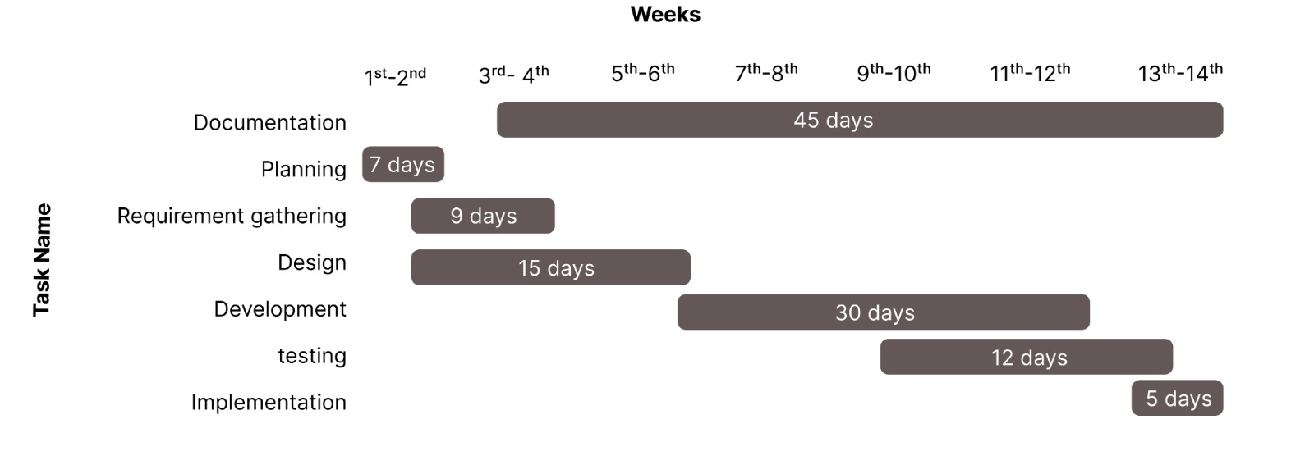
Gantt Chart

Slide 10

To provide a unified and user-friendly platform that streamlines attendance, scheduling, assignments, and communication, improving overall academic efficiency.
To enhance collaboration and academic integrity through plagiarism detection, while supporting personalized learning and minimizing manual workload and costs.

Slide 11

- Biplov Karki
- Prerana Koirala

