Slide 1
Introduction to HPC
HPC Summer School 2016
Claudio Gheller
cgheller@cscs.ch

Slide 2
School scope, objectives, program
The purpose of the school is to give you an introduction to the the main approaches to exploit modern High Performance Computing systems
Understand the big picture, the ideas, the concepts
Understand the programming models
Experiment specific solutions

Slide 3
A quick introduction to HPC

Slide 4
Why HPC…
HPC helps with
Huge data
Data management in memory
Data management on disk
Complex problems
Time consuming algorithms for describing the behavior of a system
Machine learning
Data mining and analysis
Visualization
HPC Requires
Special purpose solutions, in terms of
Processors
Networks
Storage
Software
Applications

Slide 5

HPC systems: the building blocks
Single powerful processing unit
C P U
Multi-core, multi-threaded processor with shared memory
Node
Combination of multi-core processors with NUMA shared memory and shared components

Slide 6
They need talk to each other…
Network
Node

Slide 7
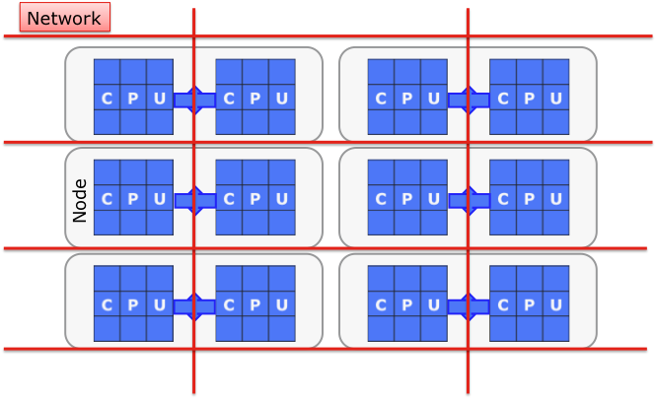
…they need also to talk to you…
Storage
User

Slide 8
Issues and limitations: a matter of money…
…because money matters: HPC systems are expensive!
Power consumption
Cooling and infrastructural costs
Costs of technology:
Speed-up the processor
Increase network bandwidth
Reduce latencies
Improve connectivity
Make I/O faster
…

Slide 9
Example: HPC systems power consumption
Coming HPC systems are anticipated to draw enormous amounts of electrical power…
Example: N.1 Top 500
Year (Nov.) | System | Performance(Tflop/s) | Electrical power (KW)
2002 | Hearth Simulator | 41 | 3200
2005 | Blue Gene/L | 367 | 1433
2008 | Roadrunner | 1105 | 2483
2009 | Jaguar | 2331 | 6950
2011 | K computer | 11280 | 12659
2012 | Titan | 27112 | 8209
2014 | Tianhe-2 | 54902 | 17808
→2020 | ???????? | 1000000 | >100000 (100 MW!!!)
THIS IS NOT SUSTAINABLE!!!

Slide 10
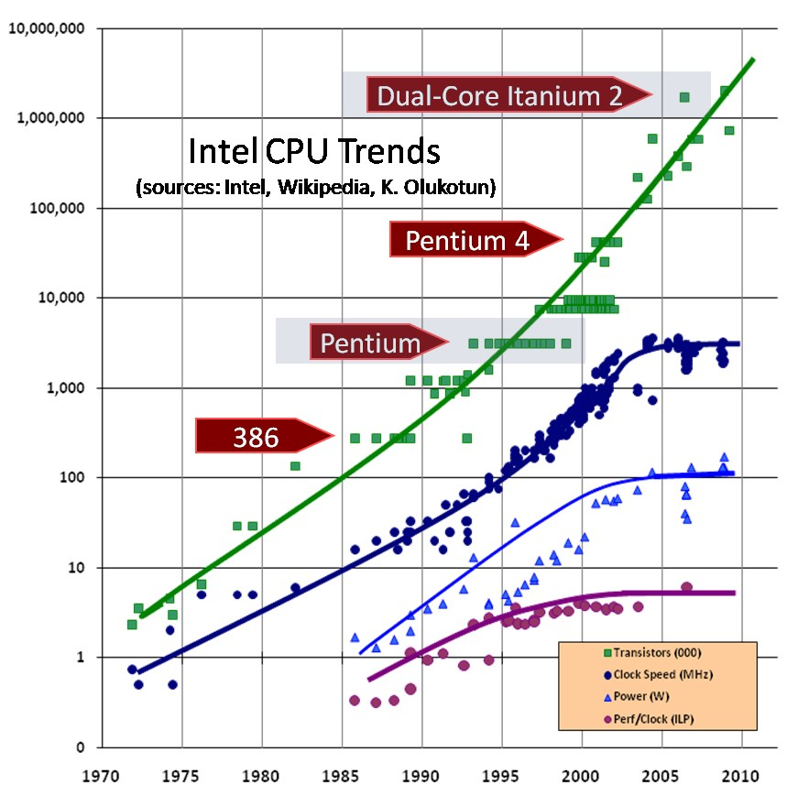
The end of the “Free Performance Lunch” era
Moore’s Law does not help anymore in increasing the performance
Clock speed cannot increase more:
heat (too much of it and too hard to dissipate)
current leakage
power consumption (too high – also memory must be considered!!!)
Notes:
However, below 90 nm, the static power dissipation (power lost due to
current leakage through the silicon substrate) has overtaken
dynamic power dissipation. This leads to a stall in clock fre-
quency improvements in order to stay within practical ther-
mal power dissipation limits.

Slide 11
Improving efficiency: the advent of accelerators
Network
Node

Slide 12
Why accelerators help
A few main reasons:
lower frequencies of GPU clocks
more of the transistors in a gpu are actually working on the computation. CPUs are more general purpose. They require energy to support such “flexibility”
Single Instruction Multiple Data (SIMD) approach, which leads to a simpler architecture and instruction set

Slide 13
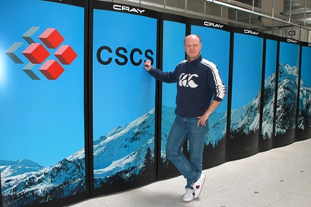
Piz Daint
“Piz Daint” CRAY XC30 system @ CSCS
(N.6 in Top500)
Nodes:
5272 CPUs 8-core Intel SandyBridge equipped with:
32 GB DDR3 memory
One NVIDIA Tesla K20X GPU with 6 GB of GDDR5 memory
Overall system
42176 cores and 5272 GPUs
170+32 TB
Interconnect: Aries routing and communications ASIC, and dragonfly network topology
Peak performance: 7.787 Petaflops
User Lab:
http://www.cscs.ch/user_lab/becoming_a_user/index.html

Slide 14
Efficiency comparison
Data from last Top500 (November 2014) UPDATE!!!!
System | RPEAK (TFlop/sec) | Power (MW) | Efficiency (MF/sec/W)
Piz Daint (GPU - 6) | 7788 | 2.325 | 3349
Thiane-2 (MIC - 1) | 54902 | 17.808 | 3083
Titan (GPU - 2) | 27112 | 8.209 | 3302
Sequoia (BGQ - 3) | 20132 | 7.890 | 2551
K computer (Sparc - 4) | 11280 | 12.66 | 891
Pleiades (SGI ICE X - 11) | 3988 | 3.141 | 1270

Slide 15
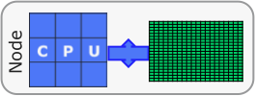


Programming Models
Distributed Memory domain
Message passing: MPI
Other approaches:
coarrays, UPC…
Message/Task driven:
Charm++, HPX…
Shared memory,
Multi-threads domain:
OpenMP, pthreads,
C++11…
Accelerator domain:
CUDA, OpenCL, OpenACC, OpenMP, OpenGL…

Slide 16
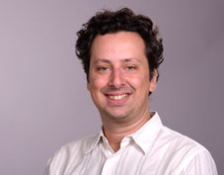
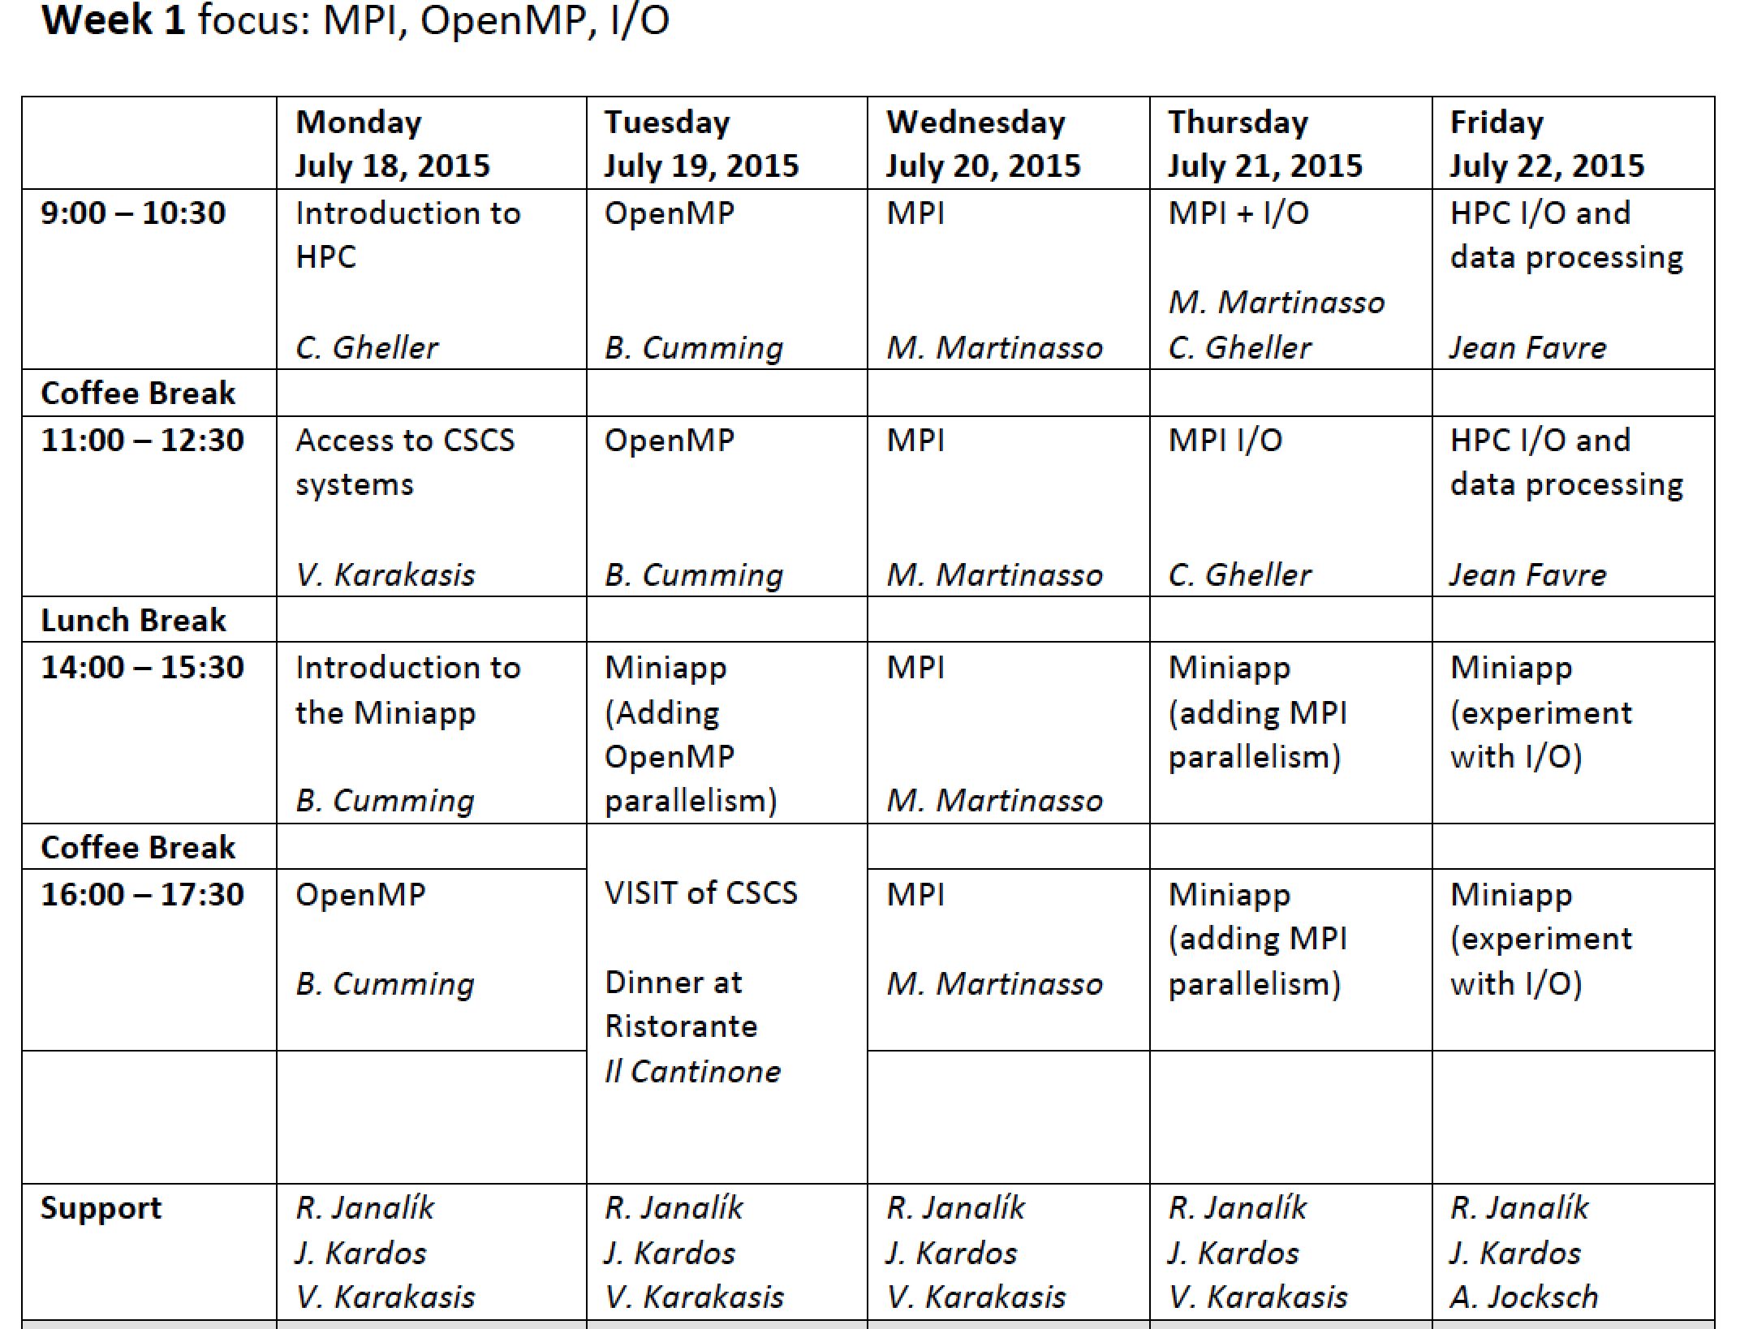
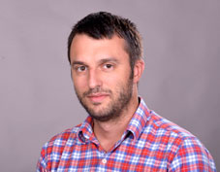
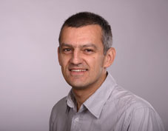
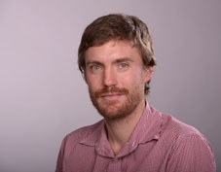
Week 1: MPI & OpenMP

Slide 17
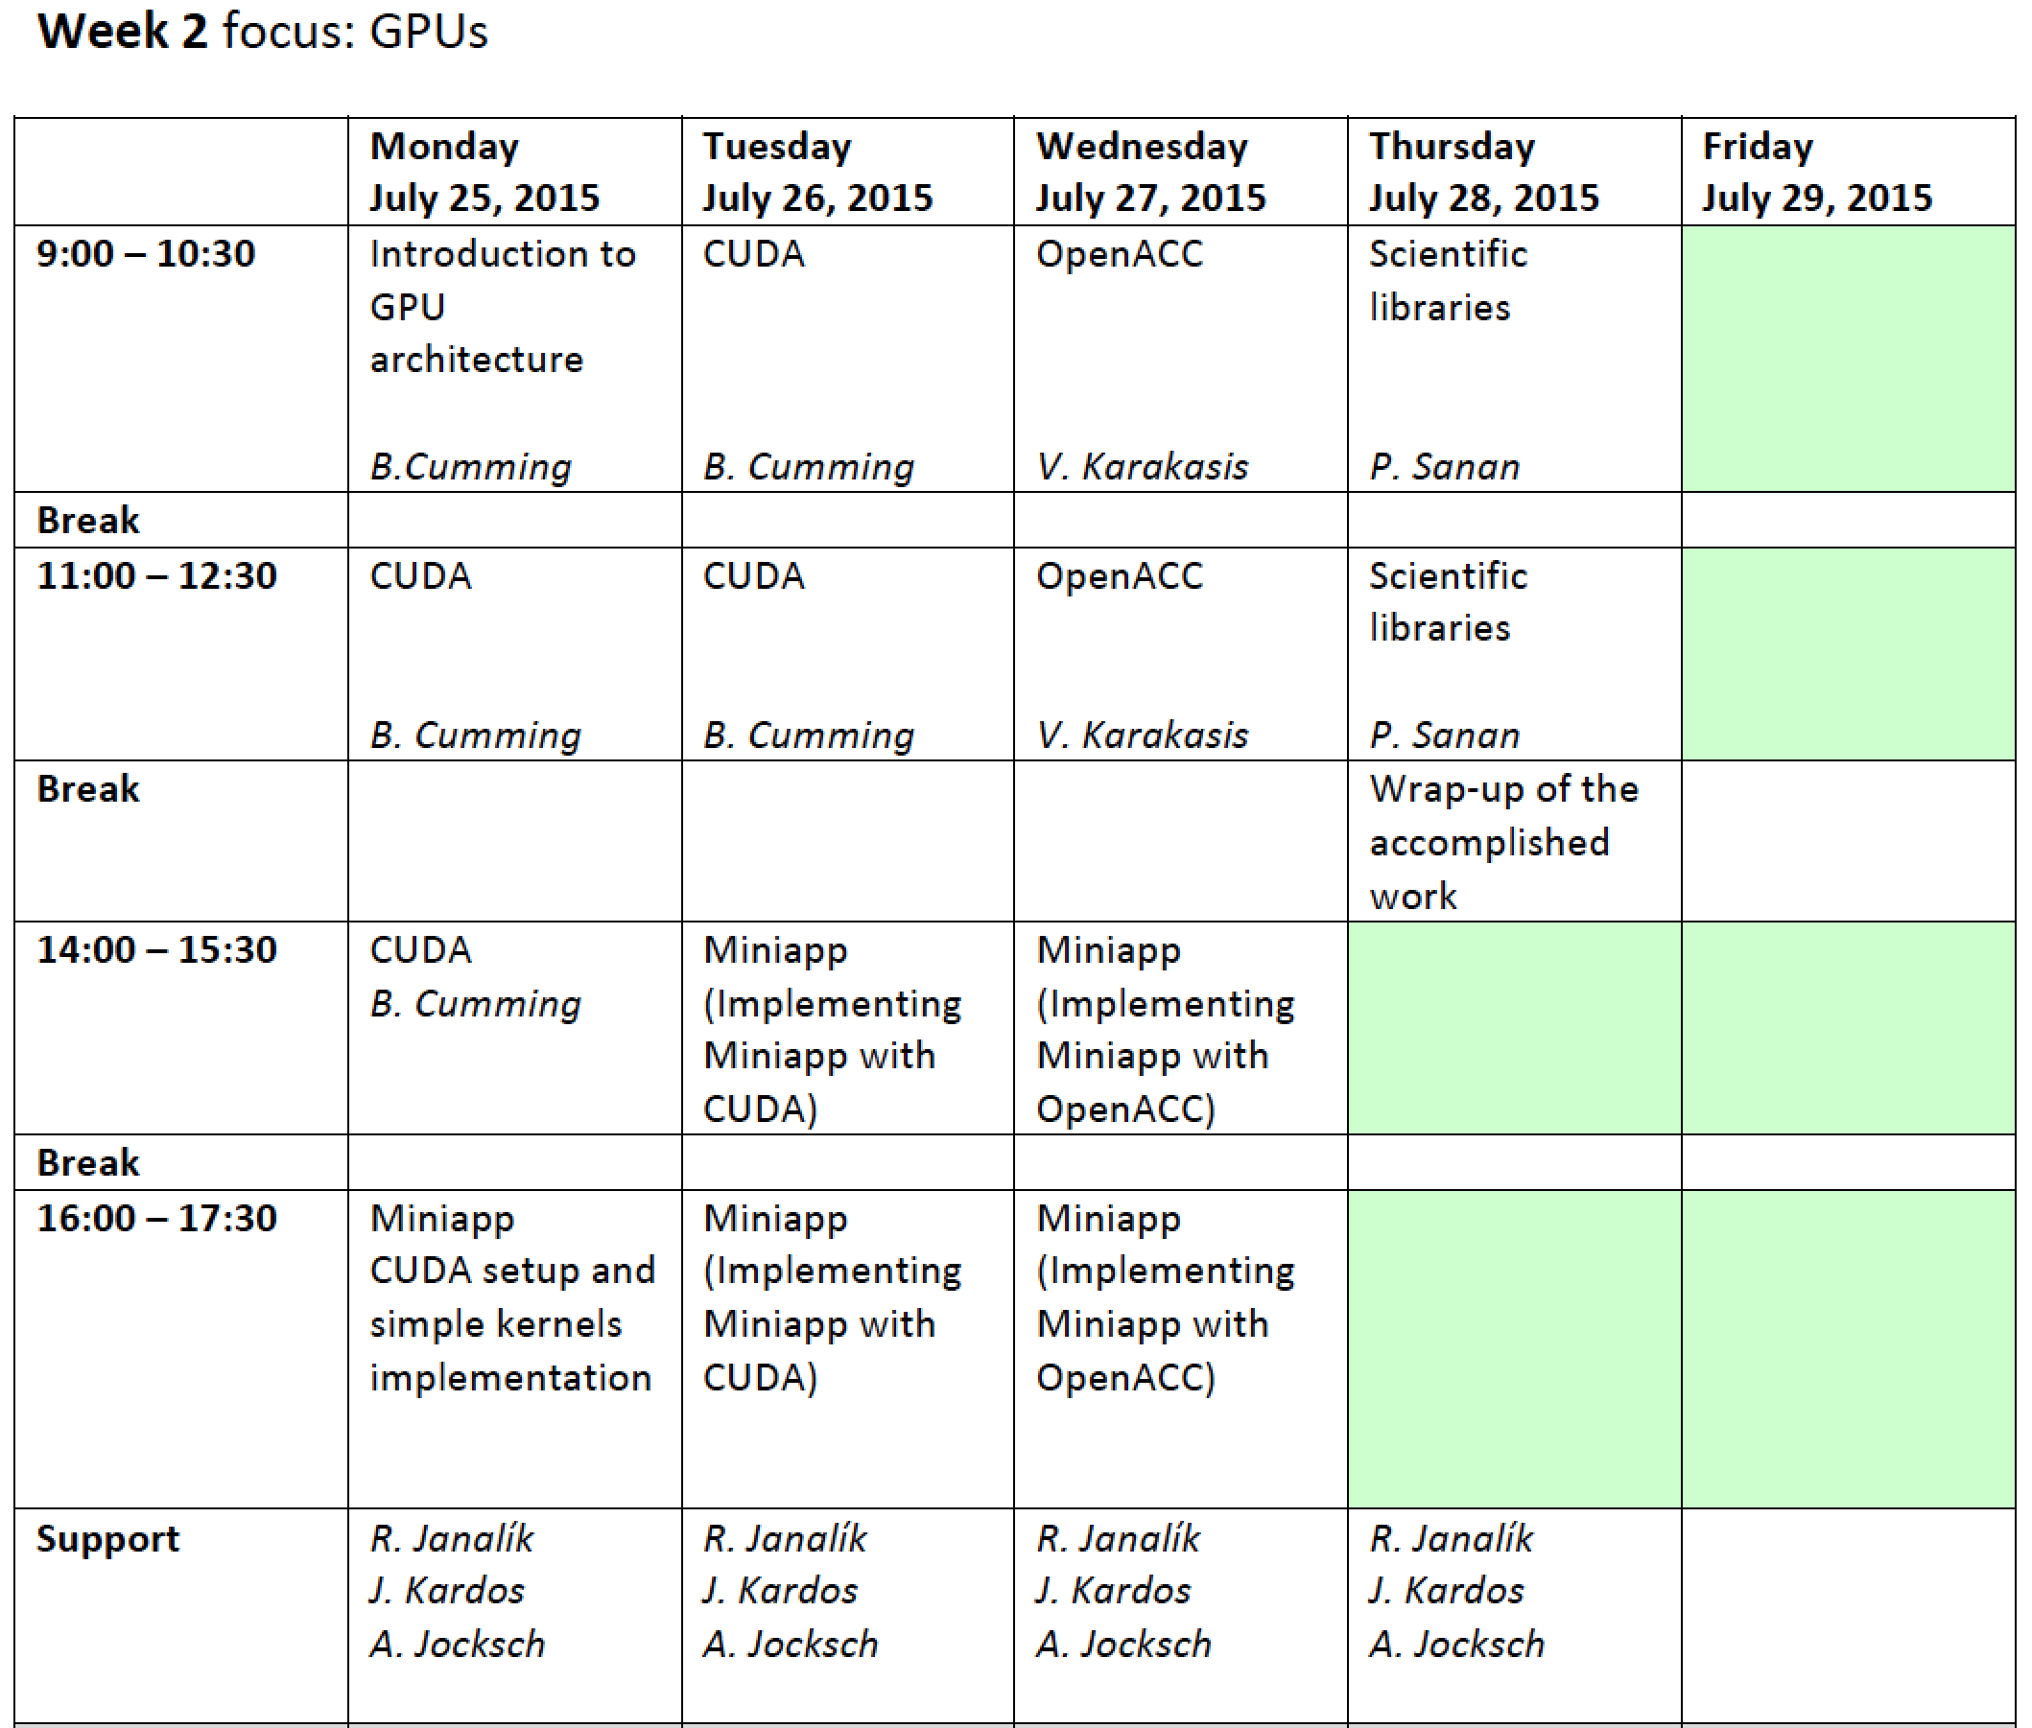

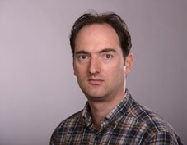
Week 2: GPU programming

Slide 18
BOF
JULY 20 (wed.) A.Ziegler, P.Lenarczyk:
Quantum transport in nanoelectronic devices
JULY 21 (thurs.) M.Beseda, J.Kruzik:
Energy consumption optimization of the Total-FETI solver
JULY 26 (tue.) M.Zacharias
Raptr – Parallel implementation of an iterative reconstruction algorithm
Free slots still available! Other seminars are welcome!!!

Slide 19
The Team
Claudio Gheller – School coordinator (everyday), MPI I/O (Thursday first week)
Ben Cumming – OpenMP, CUDA (mon., tue., first week; mon., tue., second week)
Karakasis Vasileios – Tools and practicals (first week), OpenACC (wed. second week)
Maxime Martinasso – MPI (wed., thur., first week)
Jean Favre – Visualization (fri., first week)
Radim Janalík – Practicals (everyday)
Juraj Kardos – Practicals (everyday)
Andreas Jocksch – Practicals (second week)
Patrick Sanan – Scientific Libraries (thur., second week)
Tatjana Ruefli – Event manager (on call)

