Slide 1
Presentation Breakup
Hypothesis
Openness/picking states
Baseline for mental health
Mental Health and Covid cases
Mental Health and Unemployment
Putting it all together
(where to put state openness level vs mental health)

Slide 2
Mental Health during COVID-19

Slide 3
Hypothesis
The following factors have a correlation to mental health during COVID-19
State openness
The number of COVID-19 cases/death
Unemployment

Slide 4
Openness Level and Picking States

Slide 5
States quartiles

Slide 6
Picking the states

Slide 7
Openness vs Mental Health

Slide 8
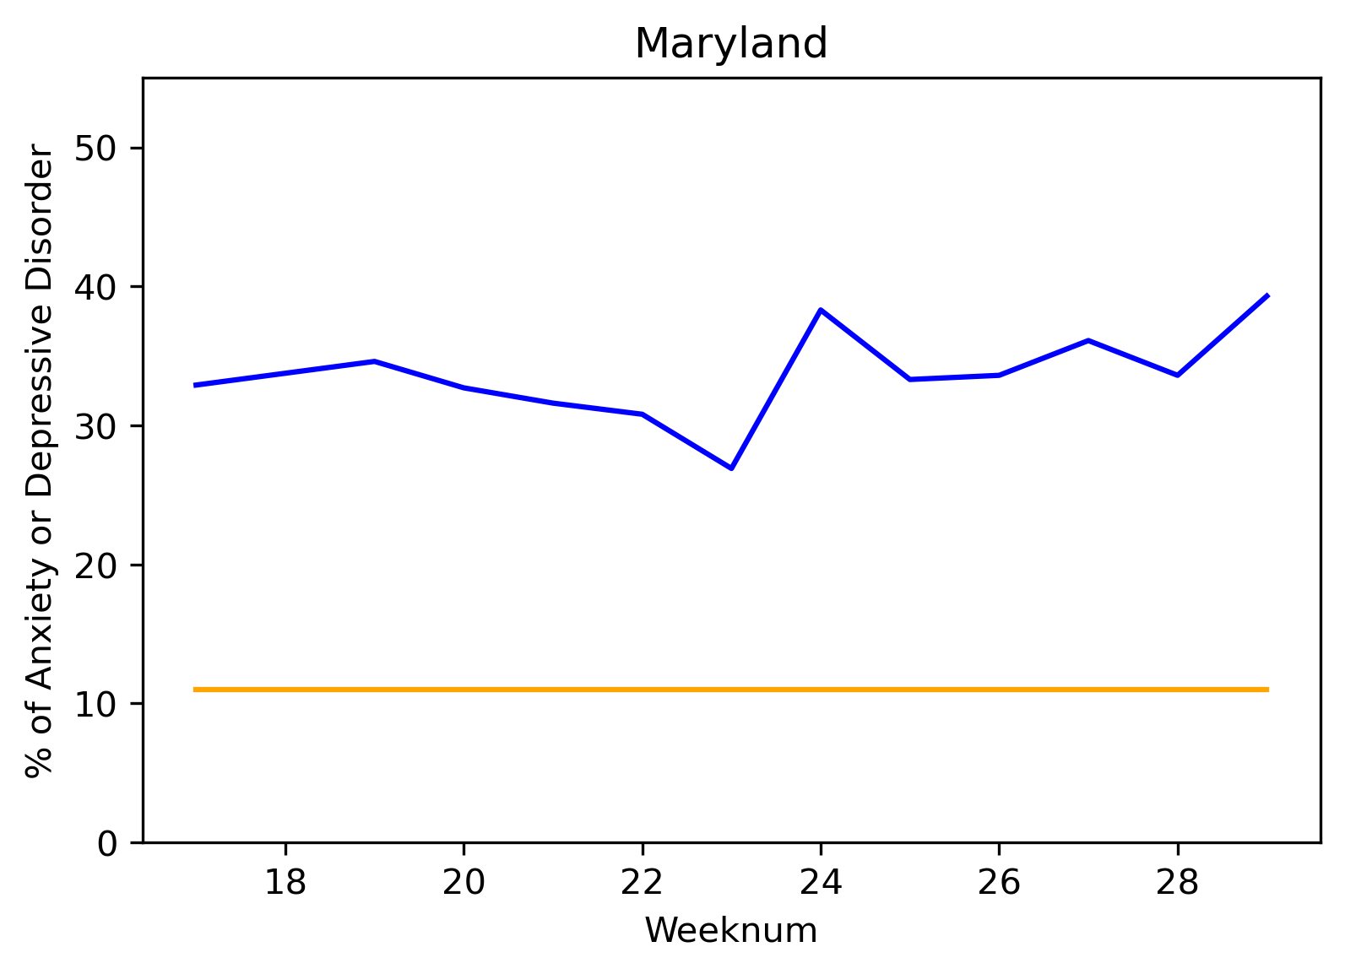
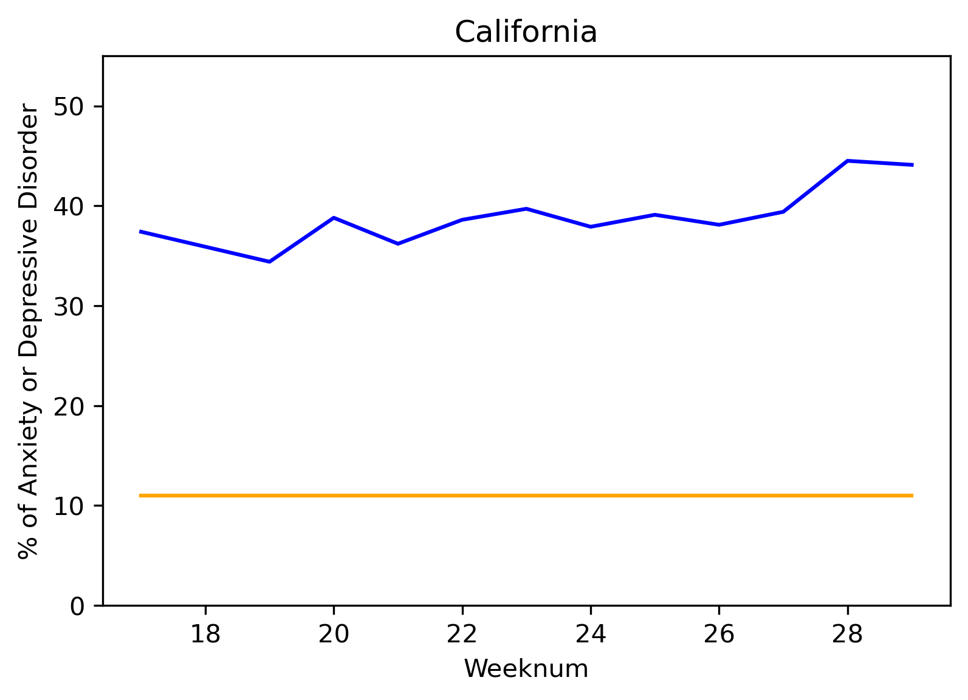
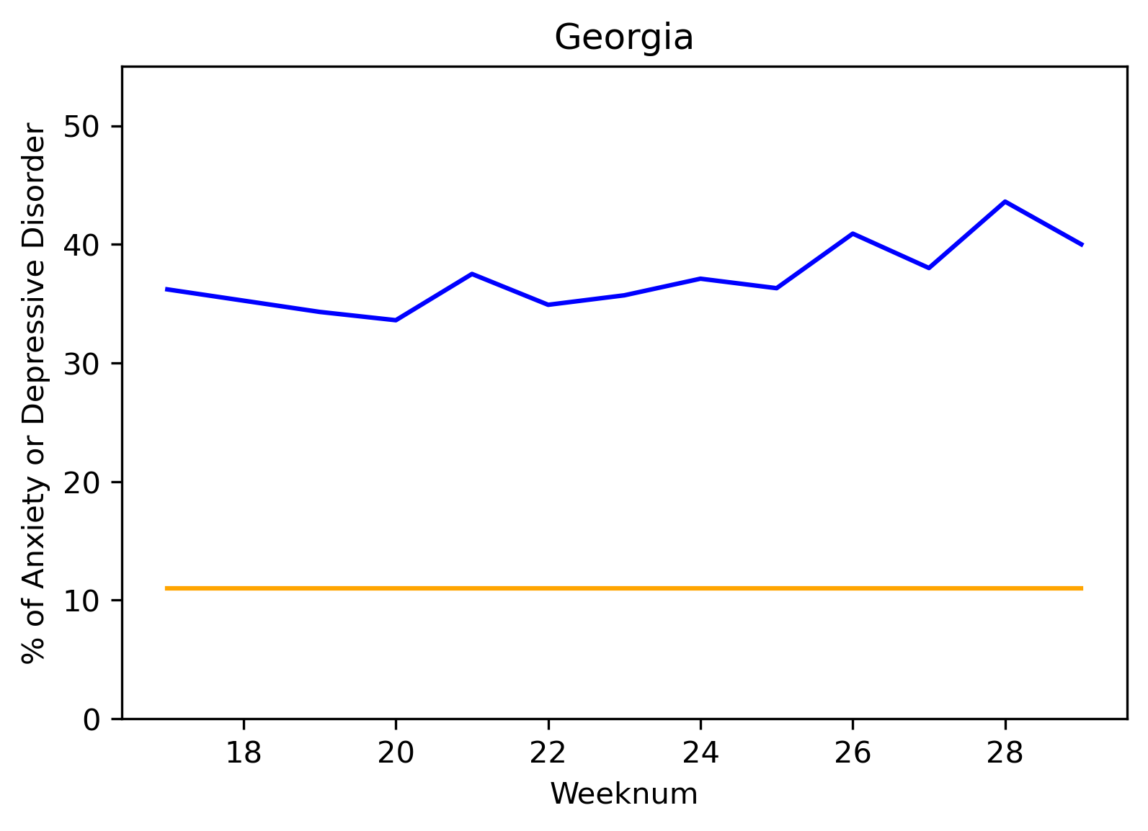
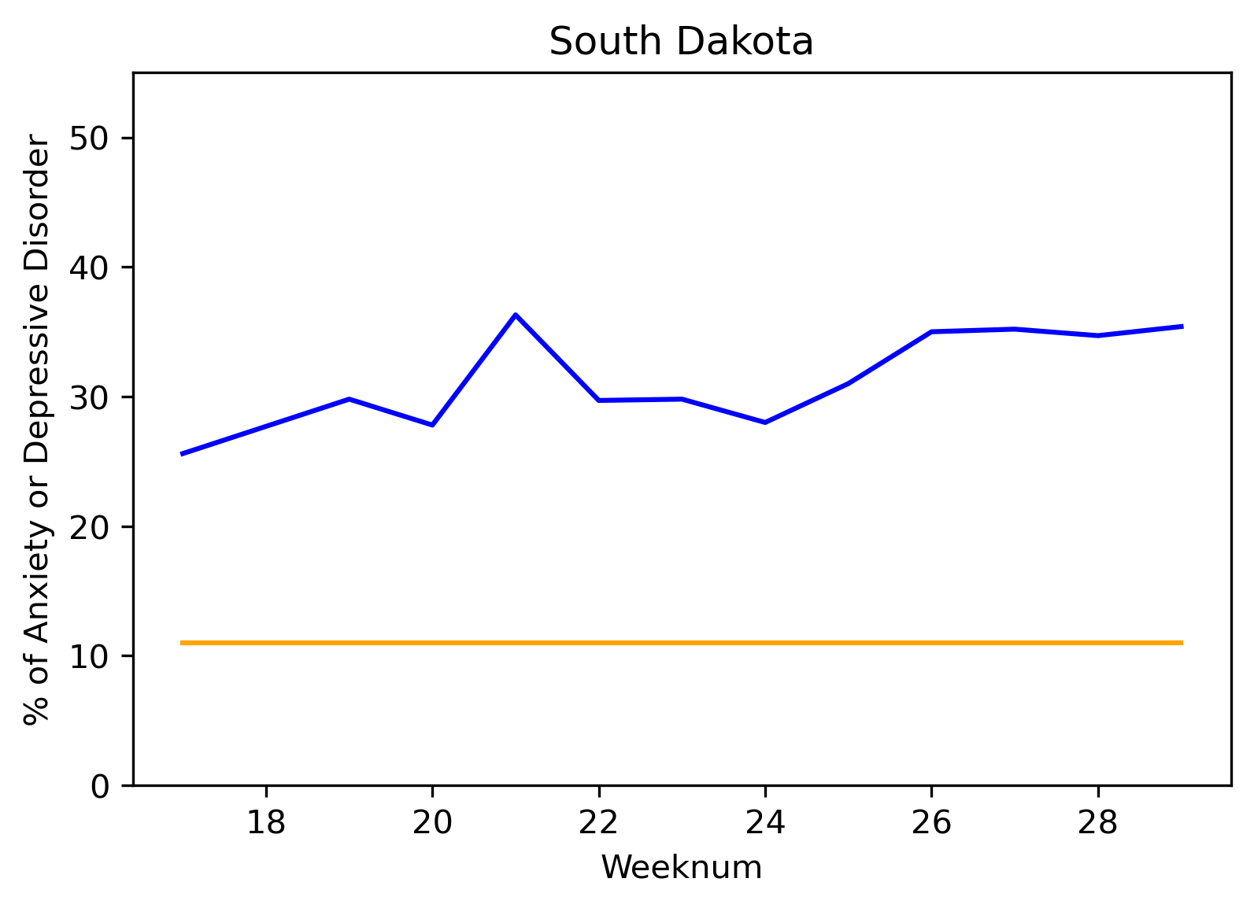
Percentage baselines of states from July 2019 and current percentage anxiety or depression disorder levels. Anxiety or depression disorder levels taken from week 18 (beginning April 27, 2020).

Slide 9
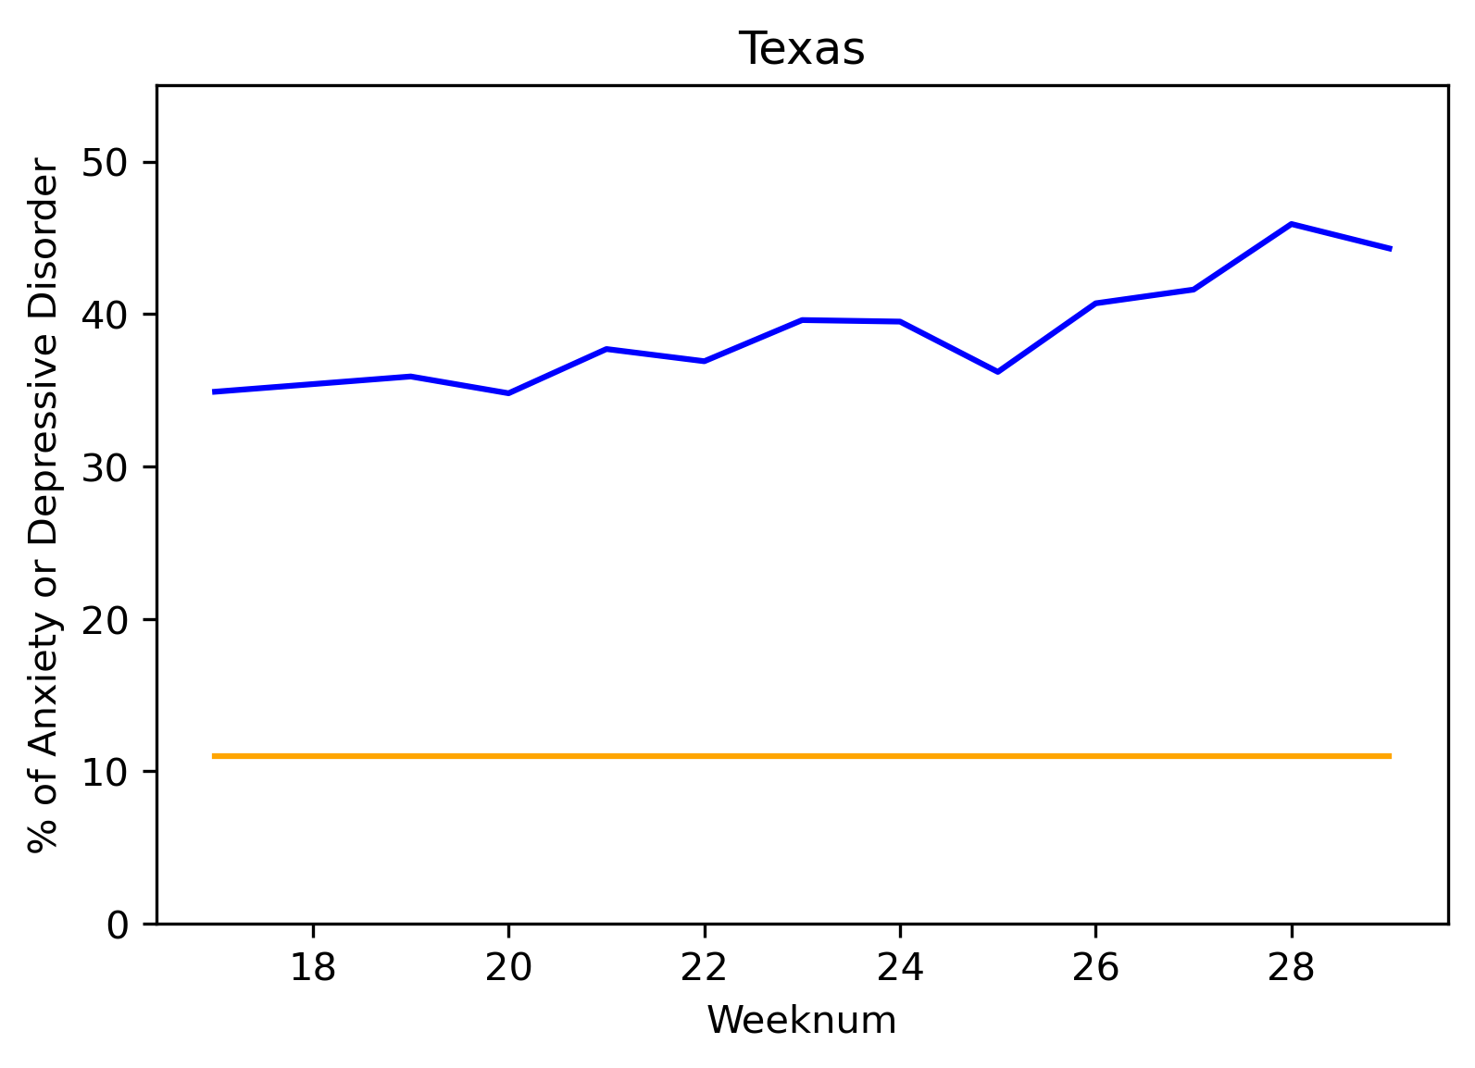
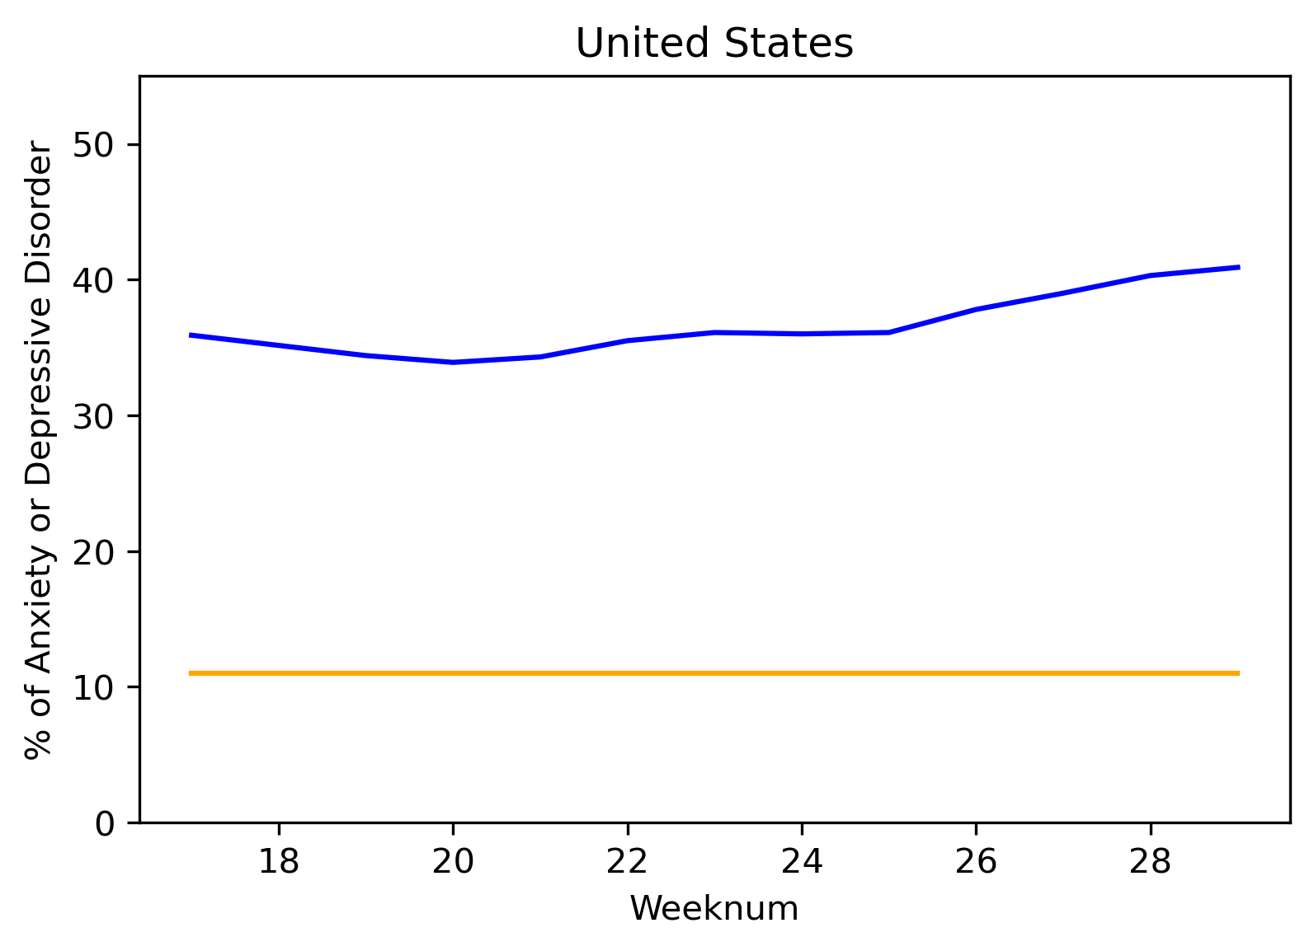
Percentage baselines of states from July 2019 and current percentage anxiety or depression disorder levels. Anxiety or depression disorder levels taken from week 18 (beginning April 27, 2020).

Slide 10
Baseline compared to covid time

Slide 11
Mental Health and Covid Cases

Slide 12
Mental Health and Covid Cases

Slide 13
Mental Health and Covid Cases

Slide 14
Mental Health and Unemployment

Slide 15
Mental Health and Unemployment

Slide 16
Mental Health and Unemployment

Slide 17
Putting it all together

Slide 18
Putting it all together

Slide 19
Putting it all together

Slide 20
Sources

