Slide 1
Mental Health during COVID-19
UTSA Data Analytics Bootcamp Project 1
Adela Garza, Kristina Ruhl, Giam Sigaud, and Leo Zambrano

Slide 2
Hypothesis
The following factors have a correlation to mental health during COVID-19
State openness
The number of weekly new COVID-19 cases
Unemployment

Slide 3
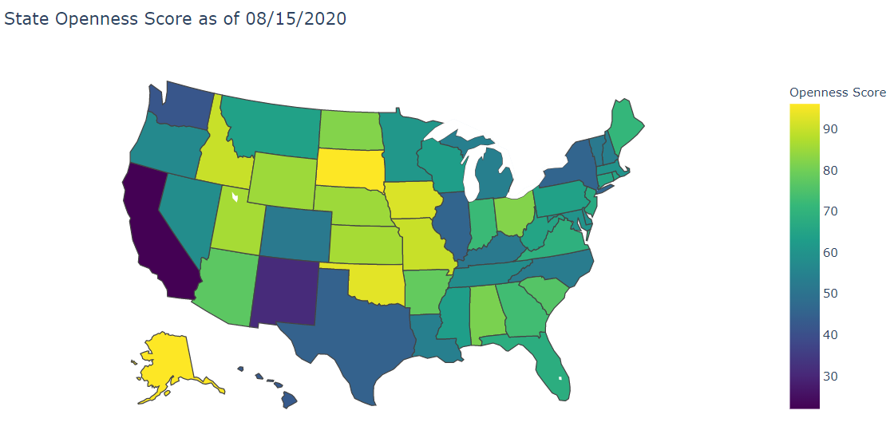
Current State Openness Level
Based on the following factors:
Reopening Plan
State of Emergency Declaration
Travel Restrictions
Mass Gathering Restrictions
School Closures
Mask Mandates

Slide 4
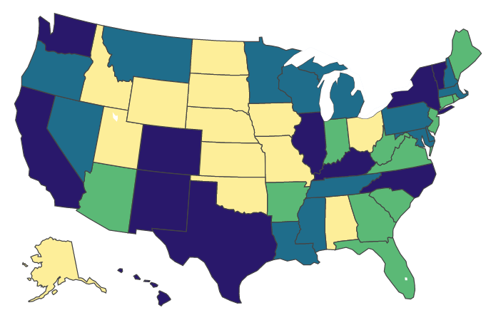
State Quartiles
Divided states into 4 bins by quartiles based on openness level
Lowest Openness Score – 22
Highest Openness Score – 96
Lower quartile – 54
Mean – 64
Upper quartile – 80
States by Quartile
Quartiles
Q1
Q2
Q3
Q4

Slide 5
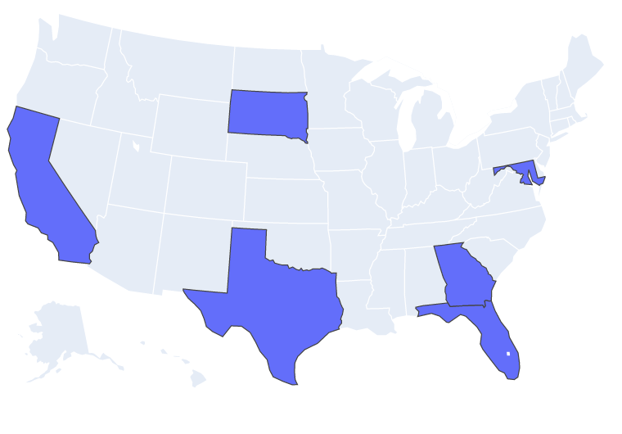
Picking our Sample States
To select our sample of states, we used the following criteria:
The state with the lowest opening score (California)
The state with the highest opening score (South Dakota)
A state near the mean of the 2nd quartile (Maryland)
A state near the mean of the 3rd quartile (Florida)
For the states near the mean, we also wanted to make sure we got a good distribution across the U.S.
Texas because we live here
Georgia because its been a focus in the news

Slide 6
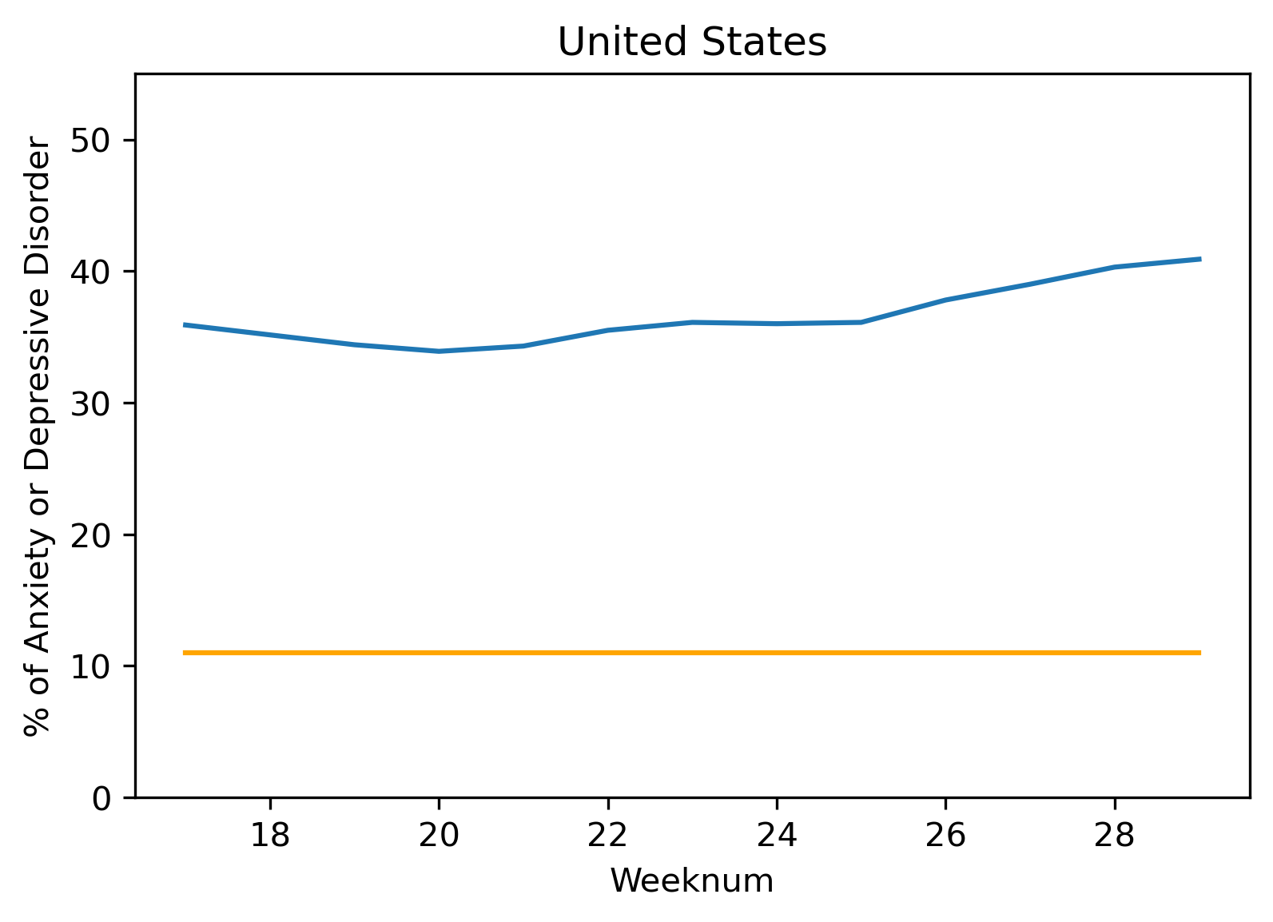
Anxiety and Depressive Disorders Percentage During COVID19 vs same period 2019.
During COVID19, Anxiety and Depressive Disorder levels increased around 25 percentage points.
As the weeks progressed the trend in Anxiety and Depressive Disorder levels continue to rise.

Slide 7
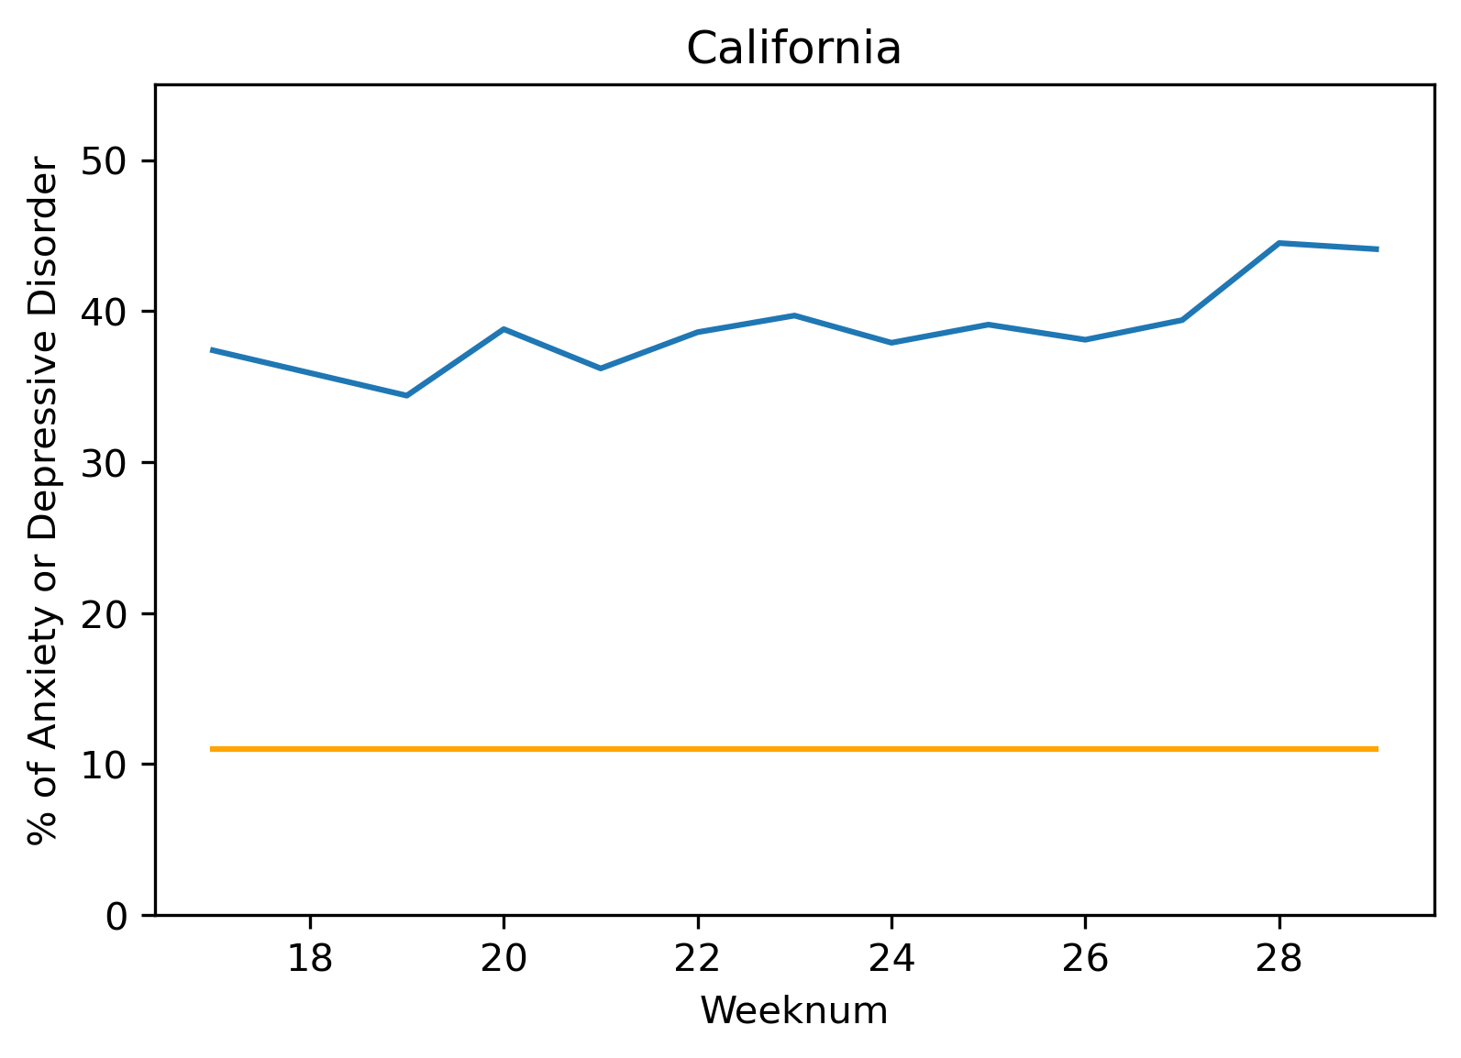
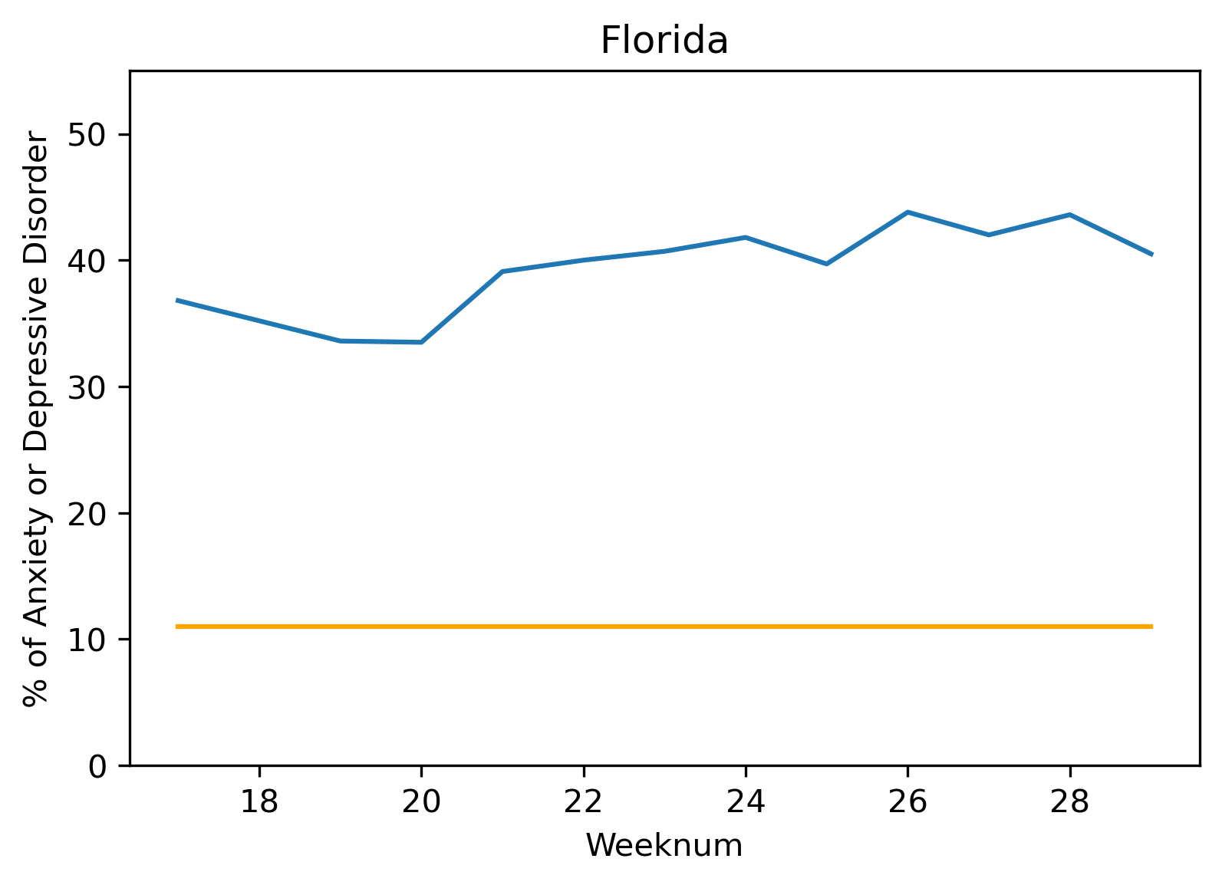
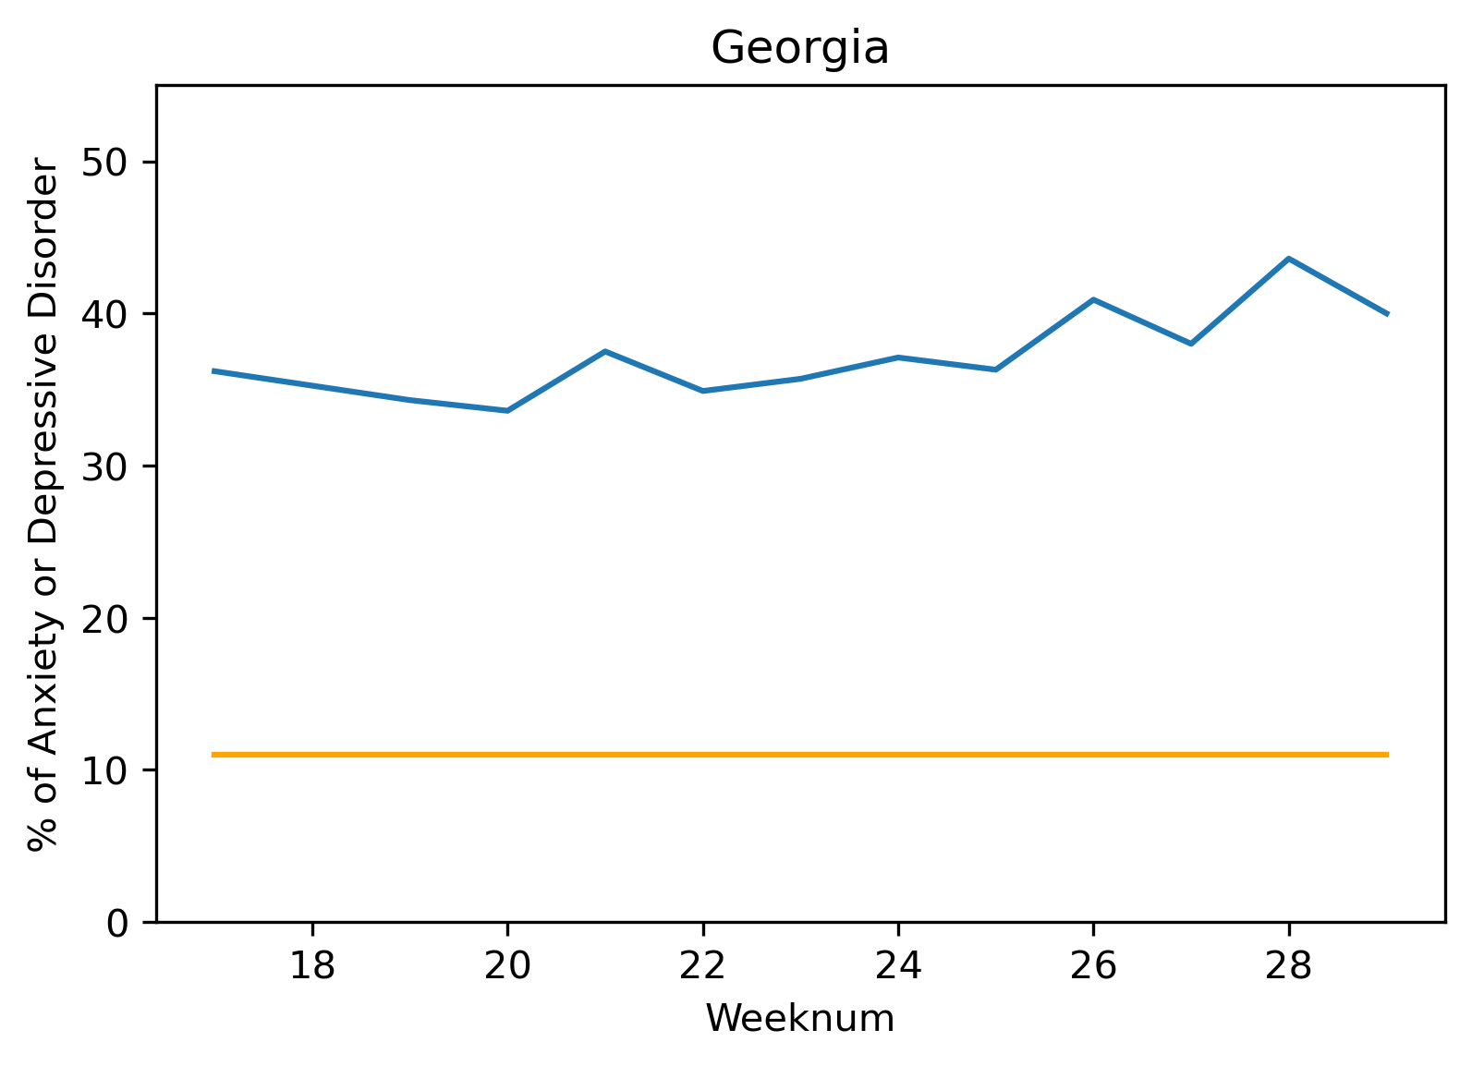
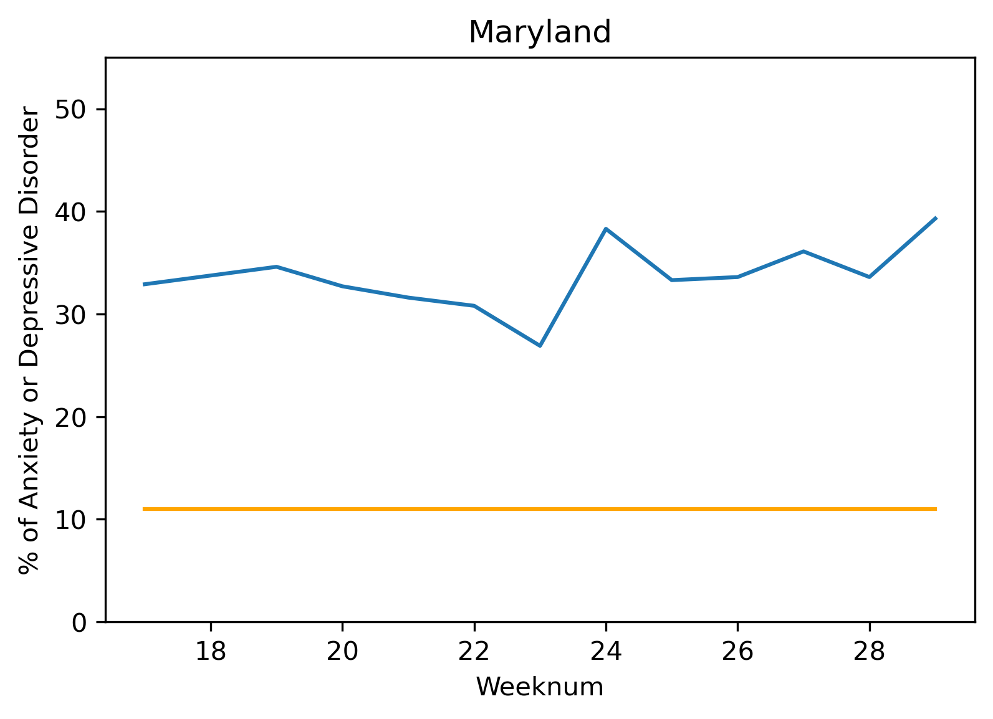
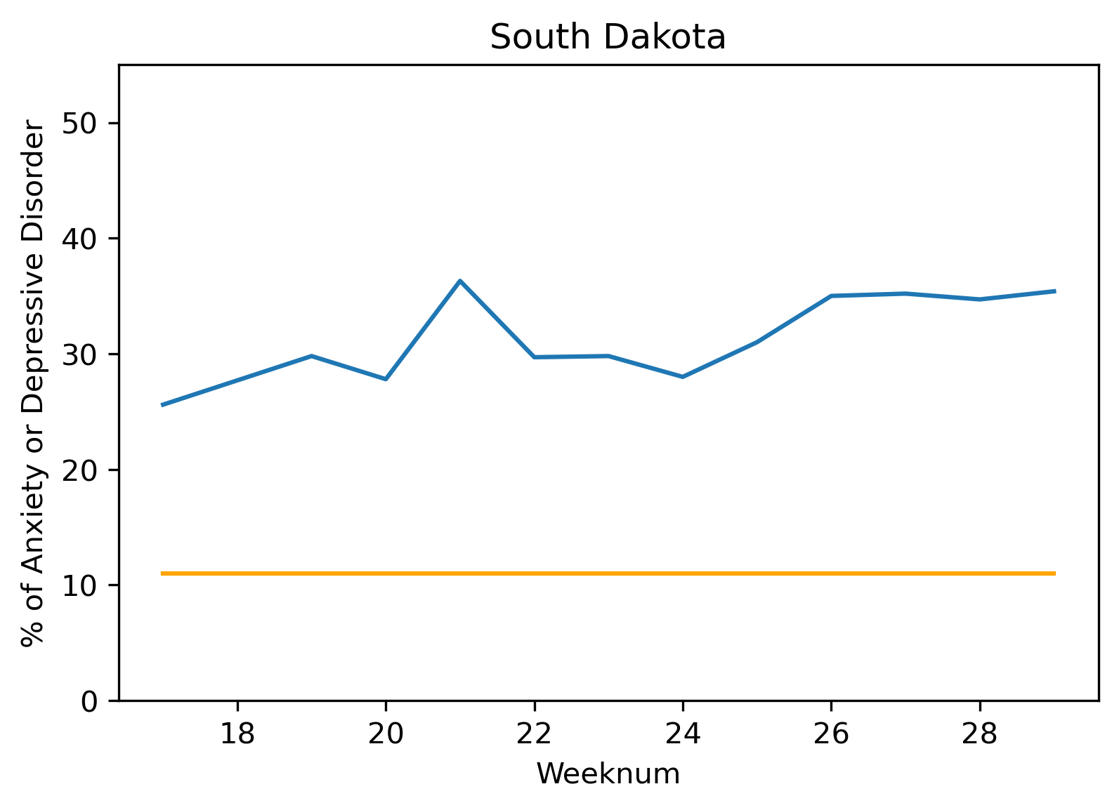
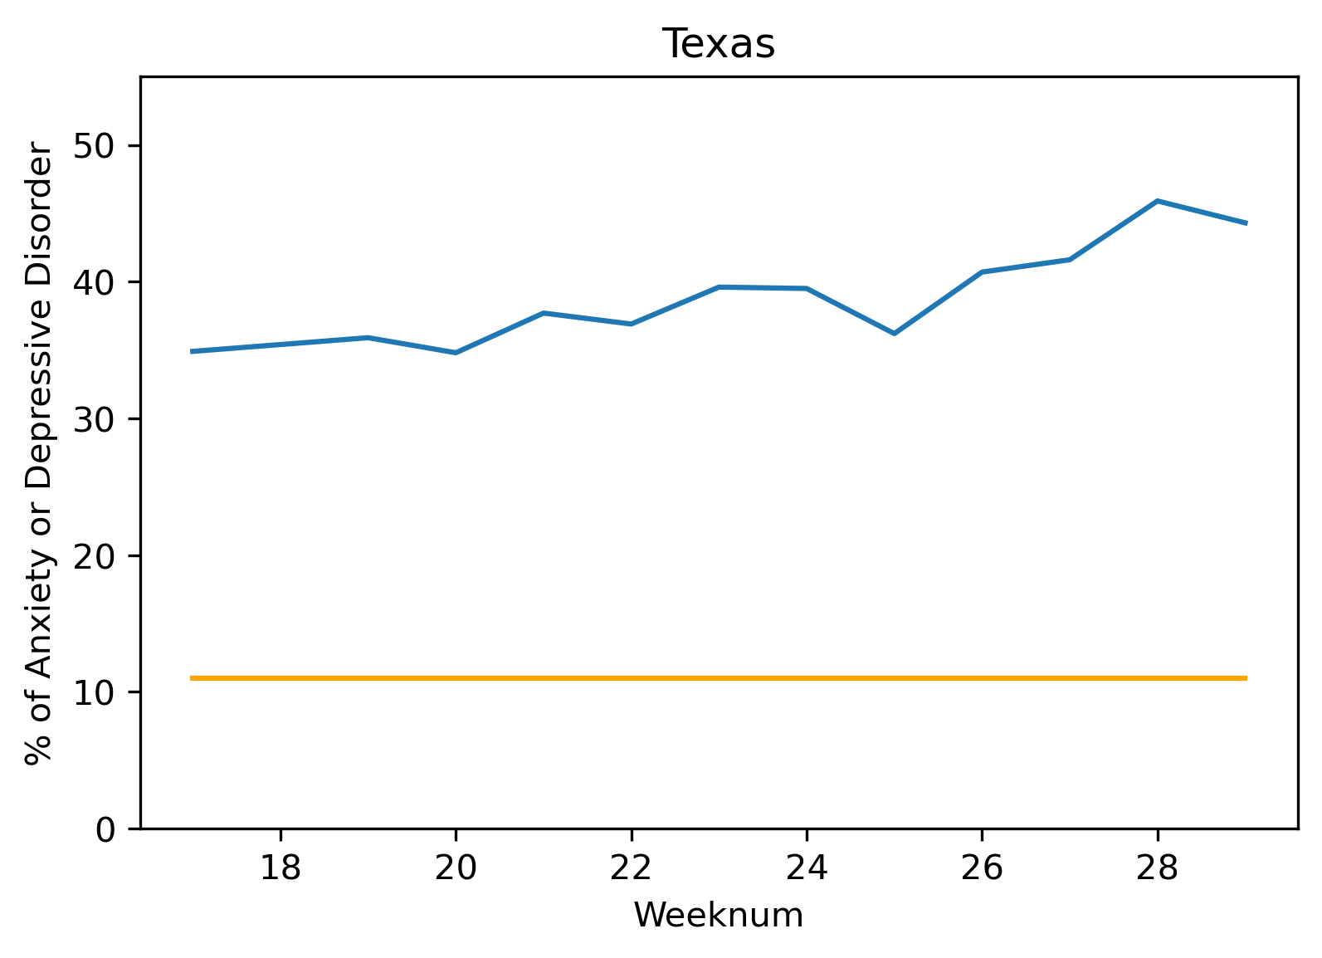
Mental Health during COVID19 by State
Anxiety and Depressive Disorders overall increased weekly during the COVID19 period for each of the states sampled below.
Legend
% anxiety/depression during Covid
Base % of anxiety/depression

Slide 8
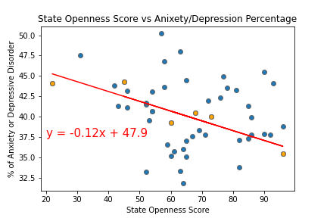
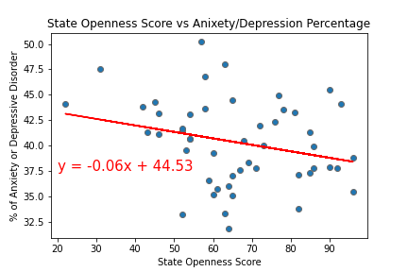
Openness Score vs Mental Health
When looking at State Openness Score versus Mental Health for our sample states you can see there is a statistical correlation, but when expanded to all states the correlation is no longer present.
Regression line based on sample states
Regression line based on all states
Texas
California
Florida
Georgia
Maryland
South Dakota
R Squared Val is 0.839
R Squared Val is 0.068

Slide 9
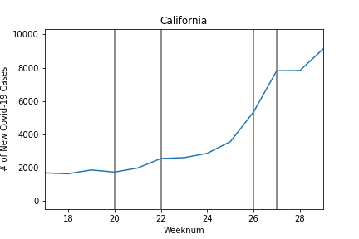
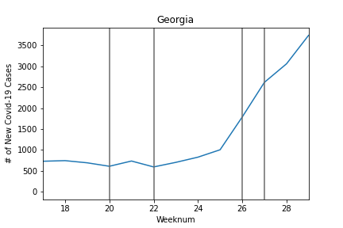
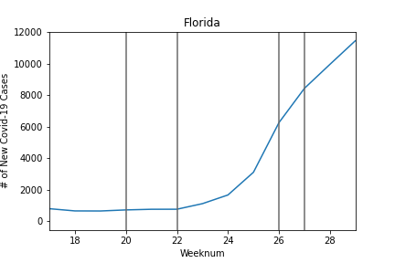
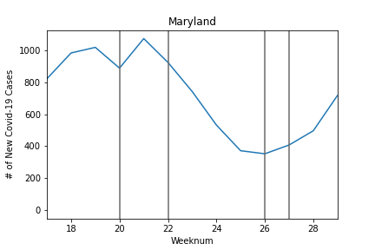
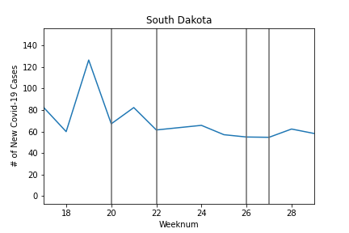
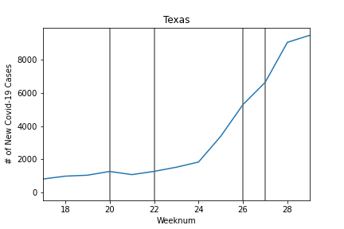
New Covid-19 Cases by State
5 - 10
5 - 25
7- 4
6 - 21

Slide 10
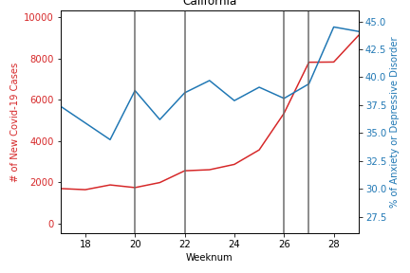
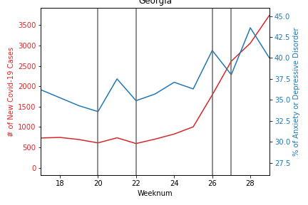
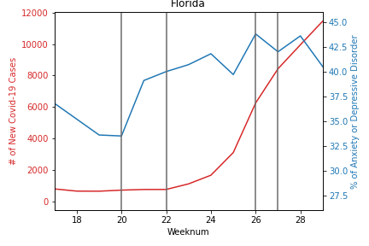
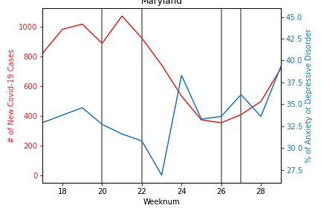
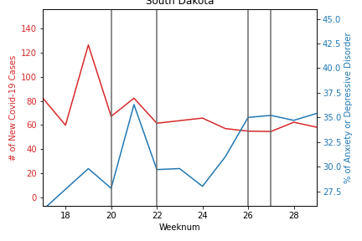
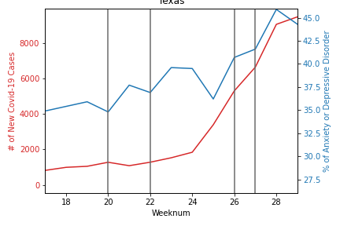
New Covid-19 Cases by State
California
Florida
Georgia
5 - 10
5 - 25
7- 4
6 - 21
Maryland
South Dakota
Texas

Slide 11
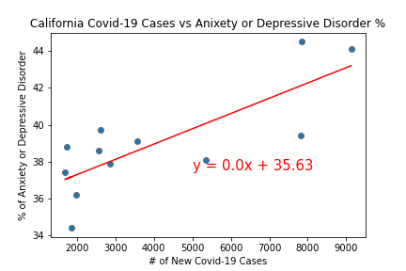
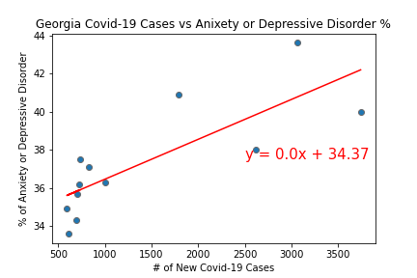
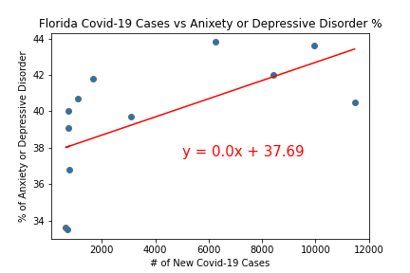
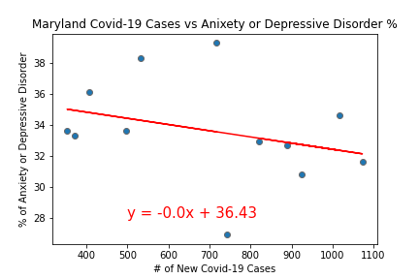
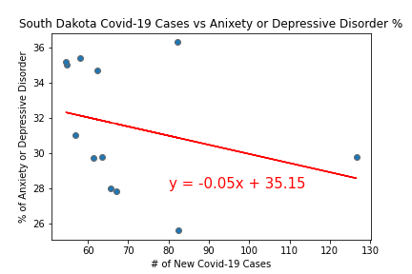
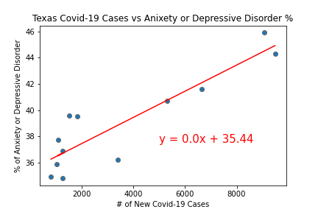
New Covid-19 Cases vs
R Squared Val is 0.621
R Squared Val is 0.629
R Squared Val is 0.358
R Squared Val is 0.097
R Squared Val is 0.083
R Squared Val is 0.801

Slide 12
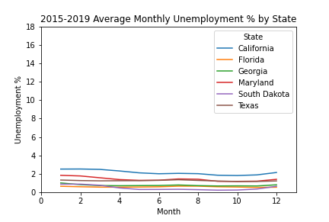
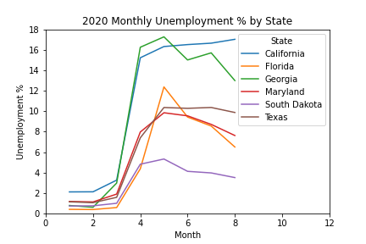
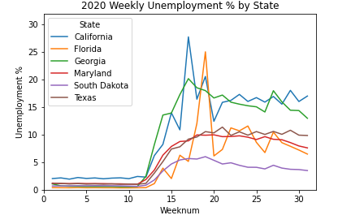
Highly “open” South Dakota had the lowest unemployment rates, while highly “closed” California had high levels of unemployment. But the reverse was also true with highly “closed” Texas with mid levels of unemployment vs “open” Georgia with high unemployment. This suggests unemployment and openness were not highly correlated.
Unemployment Baseline vs COVID-19
While unemployment averaged between 1% & 3% over the prior 5 years, beginning March, unemployment spiked with COVID-19.

Slide 13
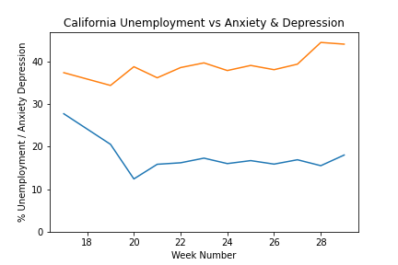
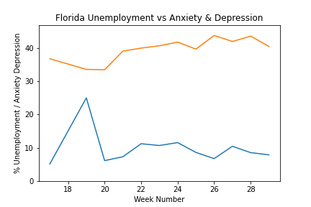
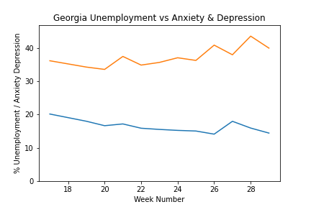
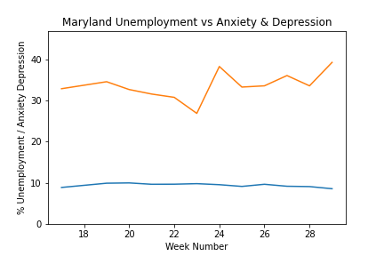
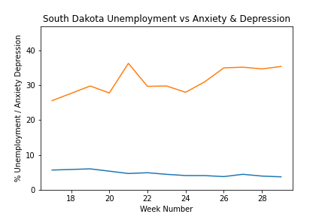
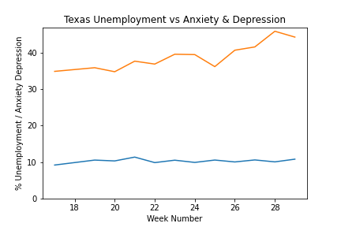
Mental Health and Unemployment
As COVID-19 continued to extend over the weeks, anxiety and depressive disorder levels increased, despite unemployment decreasing. This suggests, unemployment and anxiety and depressive disorder levels were not significantly correlated.
Legend
Unemployment %
Anxiety & Depression

Slide 14
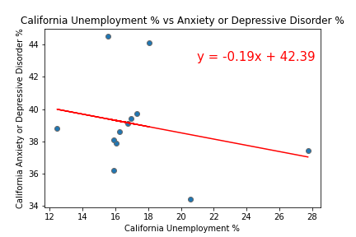
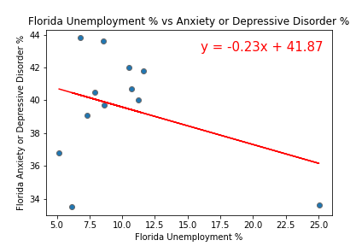
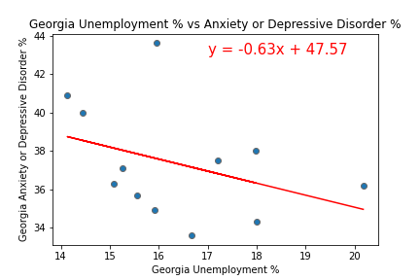
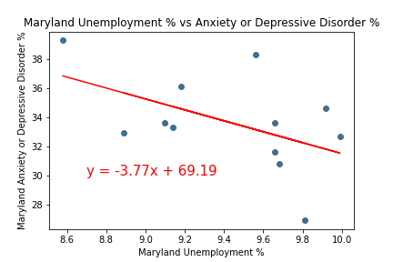
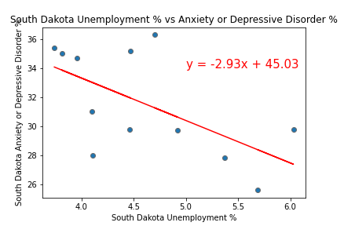
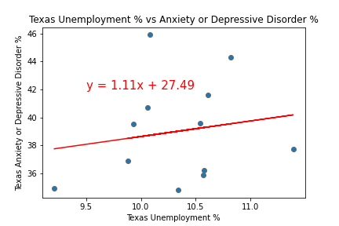
Mental Health and Unemployment
South Dakota delivered a low correlation R squared value suggesting a slight correlation, but otherwise the remaining states registered low correlations, confirming low correlations between Unemployment and anxiety and depressive disorder levels.
R Squared Val is 0.06348861620335115
R Squared Val is 0.12038601420623161
R Squared Val is 0.1388517442028963
R Squared Val is 0.2550161097387838
R Squared Val is 0.3700032239524132
R Squared Val is 0.02893057673053143

Slide 15
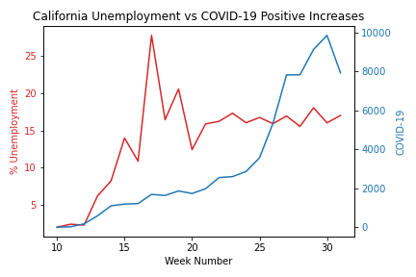
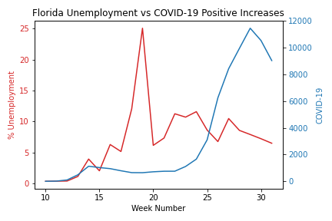
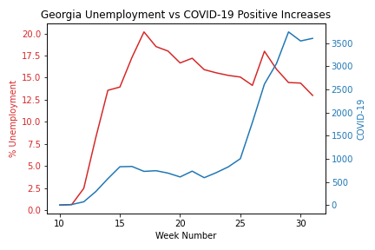
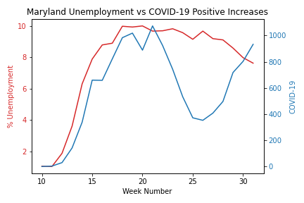
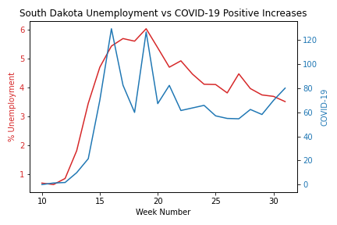

Unemployment vs COVID-19
Overall, COVID-19 weekly positive increases and unemployment tended to increase as the week’s progressed, but Maryland and South Dakota seemed to correlate closely.

Slide 16






Unemployment Vs COVID-19
Indeed Maryland and South Dakota were highly correlated, while the other states were not. Maryland and South Dakota had clustered data and the lowest weekly positive increases in COVID-19. This suggests we may need more data.
R Squared Val is 0.2061400286961551
R Squared is 0.013558957894785322
R Squared is 0.10417330917941174
R Squared is 0.62987345459035
R Squared Val is 0.7404008022828966
R Squared Val is 0.2539567916715078

Slide 17
Based on the analyses, we conclude the following:
Our original Hypothesis was:
The following factors have a correlation to mental health during COVID-19
State openness
The number of weekly new COVID-19 cases
Unemployment
Regarding Openness compared to Anxiety and Depressive Disorder levels, there was a correlation for our 6 sample states but not for the population of all U.S. States.
Regarding new COVID-19 cases and Anxiety and Depressive Disorder levels,
Regarding unemployment and anxiety and depressive disorder levels, there was not a significant correlation level.
Regarding unemployment and anxiety and COVID-19 weekly positive increases, unemployment tended to increase as the week’s progressed.
COVID-19 is a new virus, so we have few data points. As the disease continues, data points will increase making the finding more reliable.

Slide 18
Based on the analyses, we conclude the following:
Our original Hypothesis was:
The following factors have a correlation to mental health during COVID-19
State openness
The number of weekly new COVID-19 cases
Unemployment
Regarding Openness compared to Anxiety and Depressive Disorder levels, there was a correlation for our 6 sample states but not for the population of all U.S. States. Regarding COVID-19 and Anxiety and Depressive Disorder levels, Adela
Regarding unemployment and openness we concluded that there was not a high correlation.
Regarding unemployment and anxiety and depressive disorder levels, there was not a significant correlation level.
Regarding unemployment and anxiety and COVID-19 weekly positive increases, unemployment tended to increase as the week’s progressed.
COVID-19 is a new virus, so we have few data points. As the disease continues, data points will increase making the finding more reliable.

Slide 19
Sources
ANXIETY & DEPRESSIVE DISORDER 1. Center for Disease Control and Prevention (CDC): Indicators of Anxiety or Depression Based on Reported Frequency of Symptoms During Last 7 Days
2. https://data.cdc.gov/NCHS/Indicators-of-Anxiety-or-Depression-Based-on-Repor/8pt5-q6wp
STATE OPENNESS SCORE 1. MultiState COVID-19 State and Local Policy Dashboard 2. https://www.multistate.us/research/covid/public
COVID-19 1. The COVID Tracking Project. The Atlantic Monthly Group 2. https://covidtracking.com/data/api
UNEMPLOYMENT 1. United States Department of Labor, Unemployment Insurance Weekly Claims Data 2. https://oui.doleta.gov/unemploy/claims.asp

Slide 20

Mental Health and Unemployment
Slide 13.1
There was a low correlation between increasing levels of weekly Unemployment from the sample states compared to increased Anxiety and Depression levels
R Val is 0.08916941867418232

Slide 21






State Unemployment Since COVID-19
Slide 13.2
Delete red calculation
California and Georgia have experienced the highest COVID-19 Percentage increases based on their populations.

Slide 22

Unemployment Vs COVID-19
Slide 13.2
TK
R Val is 0.11049865197151916

Slide 23
States divided into Quartiles
Jurisdiction | Openness Score
California | 22
New Mexico | 31
Washington | 42
Hawaii | 43
Texas | 45
Illinois | 46
New York | 46
Colorado | 52
Kentucky | 52
Vermont | 52
North Carolina | 53
Louisiana | 54
Michigan | 54
New Hampshire | 54
Jurisdiction | Openness Score
Oregon | 57
Nevada | 58
Tennessee | 58
Delaware | 59
Maryland | 60
Massachusetts | 60
Minnesota | 61
Mississippi | 63
Wisconsin | 63
Montana | 64
Pennsylvania | 64
Jurisdiction | Openness Score
Connecticut | 65
Rhode Island | 65
West Virginia | 65
New Jersey | 67
Florida | 68
Virginia | 69
Maine | 71
Indiana | 72
Georgia | 73
South Carolina | 76
Arizona | 77
Arkansas | 78
Jurisdiction | Openness Score
Alabama | 81
North Dakota | 82
Ohio | 82
Nebraska | 85
Wyoming | 85
Kansas | 86
Utah | 86
Idaho | 90
Missouri | 90
Iowa | 92
Oklahoma | 93
Alaska | 96
South Dakota | 96

