Slide 1
Presentation Breakup
Hypothesis
Openness/picking states
Baseline for mental health
Mental Health and Covid cases
Mental Health and Unemployment
Putting it all together
(where to put state openness level vs mental health)

Slide 2
Mental Health during COVID-19
UTSA Data Analytics Bootcamp Project 1
Adela Garza, Kristina Ruhl, Giam Sigaud, and Leo Zambrano

Slide 3
Hypothesis
The following factors have a correlation to mental health during COVID-19
State openness
The number of weekly new COVID-19 cases
Unemployment

Slide 4
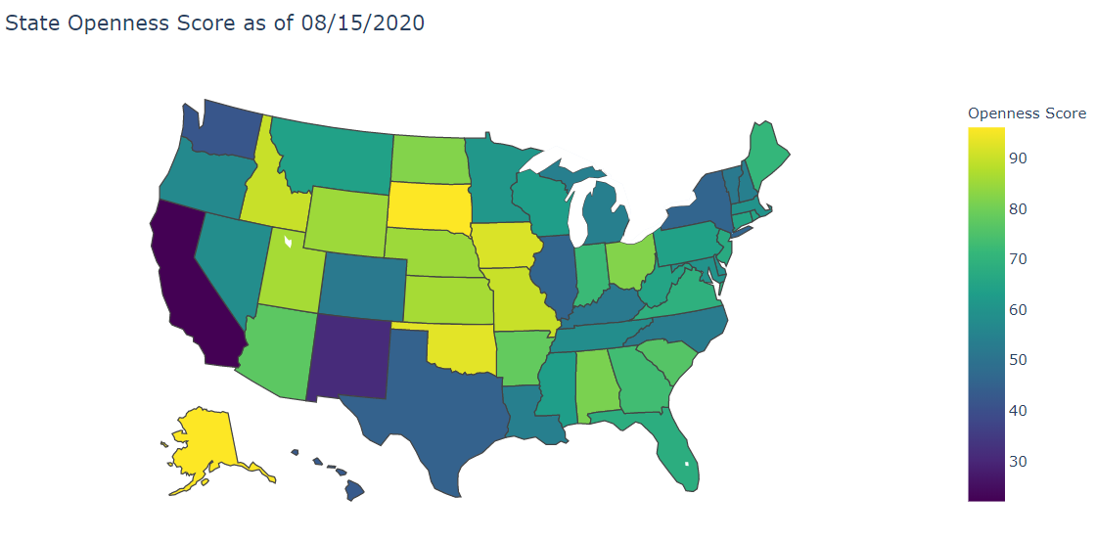
Current State Openness Level*
Based on the following factors:
Reopening Plan
State of Emergency Declaration
Travel Restrictions
Mass Gathering Restrictions
School Closures
Mask Mandates
*openness score came from

Slide 5
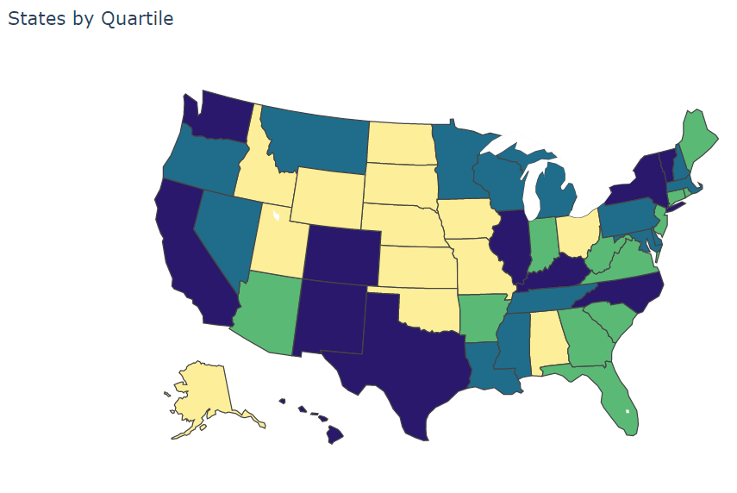
State Quartiles
Q2
mean
Q3

Slide 6
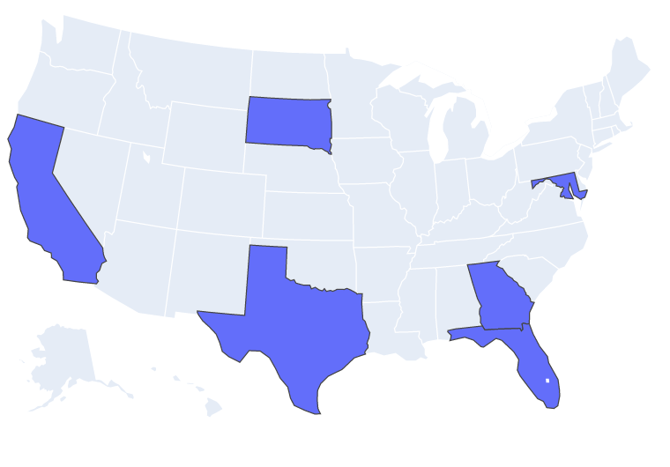
Picking our Sample States
To select our sample of states, we used the following criteria:
The state with the lowest opening score (California)
The state with the highest opening score (South Dakota)
A state near the mean of the 2nd quartile (Maryland)
A state near the mean of the 3rd quartile (Florida)
For the states near the mean, we also wanted to make sure we got a good distribution of across the U.S.
Texas because we live here
Georgia because its been a focus in the news

Slide 7
How we calculated baseline

Slide 8
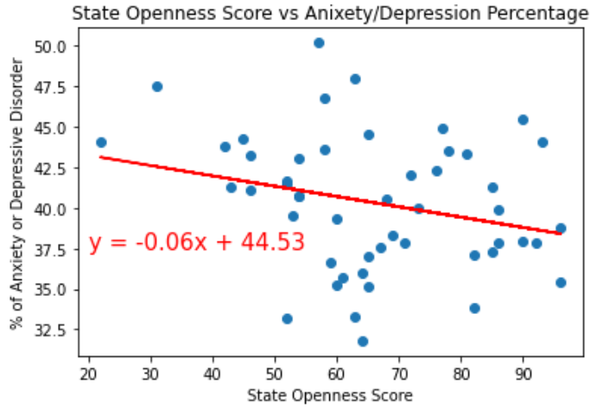
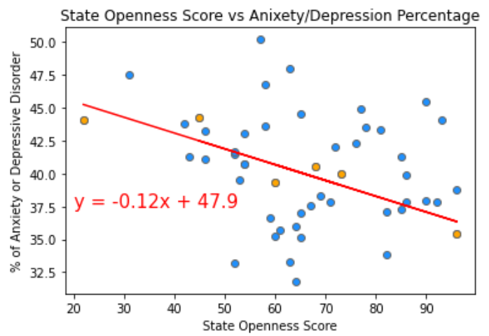
Openness vs Mental Health

Slide 9
Baseline compared to covid time

Slide 10
Mental Health and Covid Cases

Slide 11
Mental Health and Covid Cases

Slide 12
Mental Health and Covid Cases

Slide 13
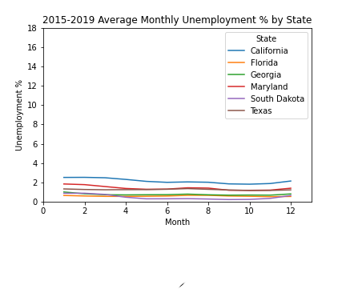
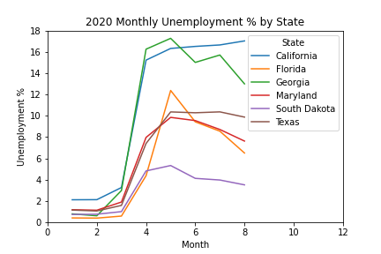
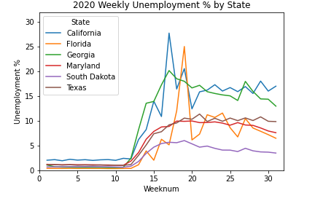
Spikes In California And Florida Have Driven Higher COVID-19 Unemployment Levels, But Georgia Has Remained Consistently High
Slide 13.2
Verify initial UI claims

Slide 14
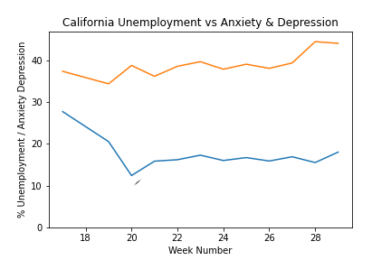
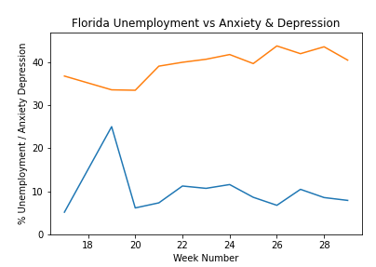
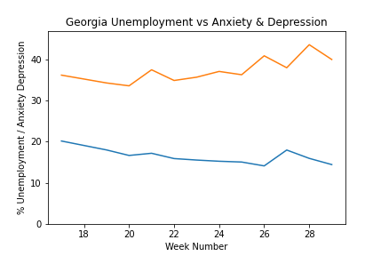
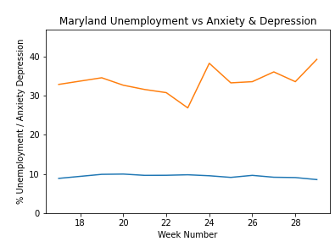
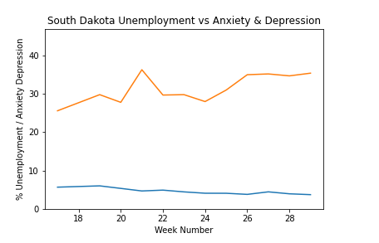
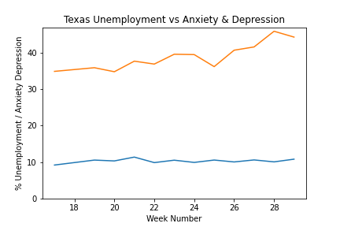
Mental Health and Unemployment
Slide 13.2
Texas Anxiety and Depression was going in the wrong direction delivering the highest levels of any state in the most recent weeks.
Legend
Unemployment %
Anxiety & Depression

Slide 15
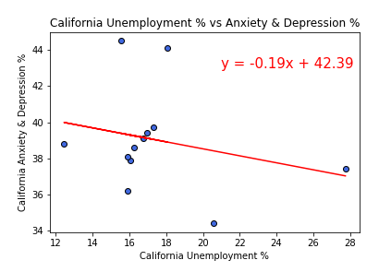
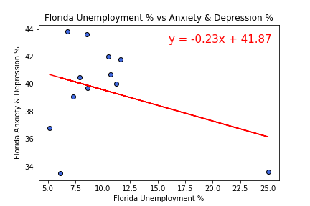
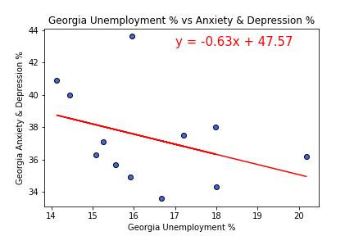
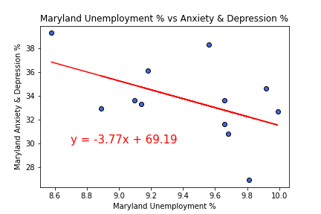
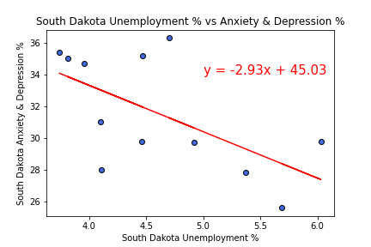
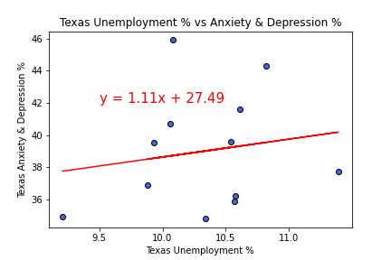
Mental Health and Unemployment
Slide 13.2
On a State level, correlations between weekly unemployment and anxiety and depression levels were low to not significant. South Dakota had the most significant levels with the lowest A&D levels.
R Val is 0.06348861620335115
R Val is 0.12038601420623161
R Val is 0.1388517442028963
Change to R Square
And
Change to Anxiety OR Depressive Disorder
R Val is 0.2550161097387838
R Val is 0.3700032239524132
R Val is 0.02893057673053143

Slide 16
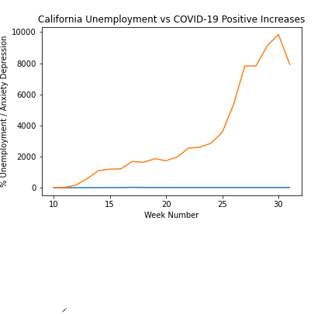
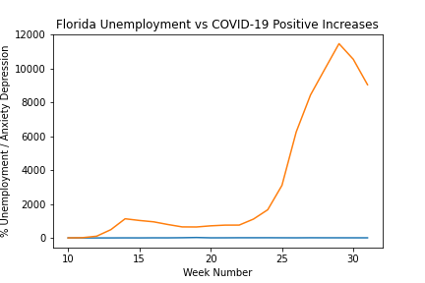
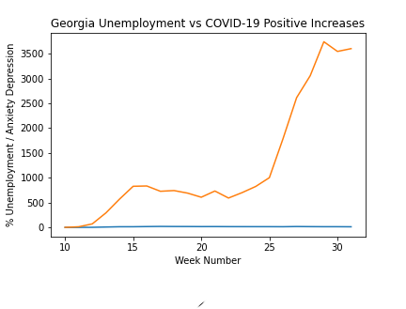
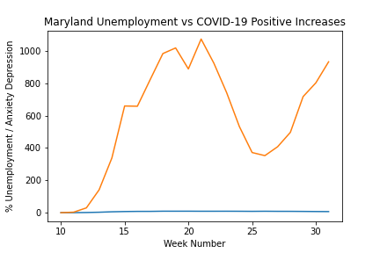
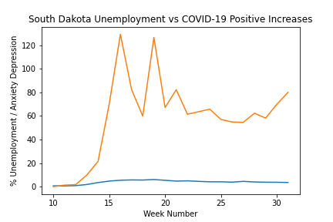
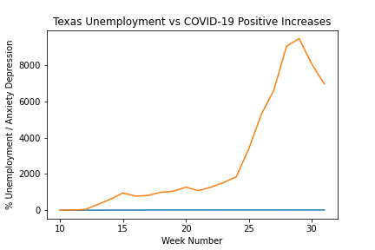
Unemployment Vs COVID-19
Slide 13.2
Texas Covid-19 Positive Cases were steady until around week 25, when there was a sudden spike in new cases
Add Double Scale
Legend
Unemployment %
COVID-19 Positive
Case Increases

Slide 17
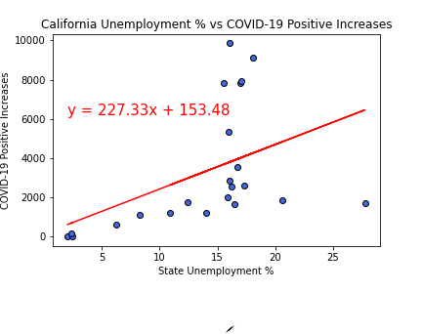
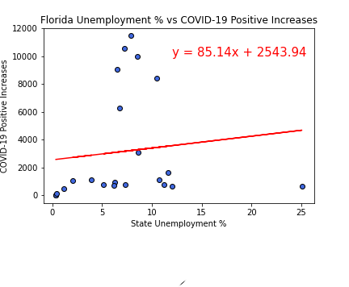
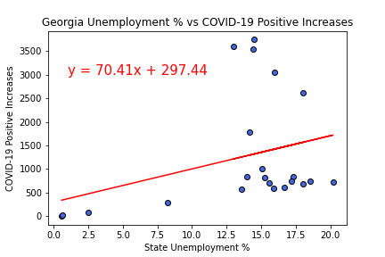
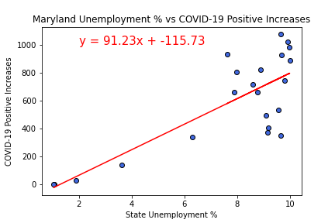
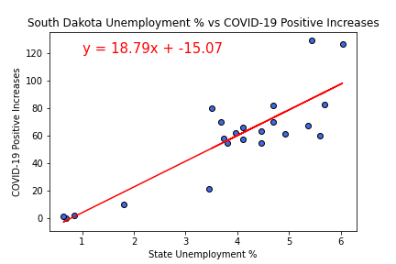
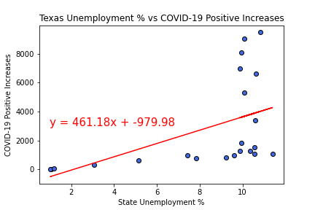
Unemployment Vs COVID-19
Slide 13.2
State Correlations of Unemployment levels compared to COVID-19 Positive Increase levels were low.
R Val is 0.2061400286961551
R Val is 0.013558957894785322
R Val is 0.10417330917941174
Change to R Square
And
Change to Anxiety OR Depressive Disorder
R Val is 0.62987345459035
R Val is 0.7404008022828966
R Val is 0.2539567916715078

Slide 18
Putting it all together

Slide 19
Putting it all together

Slide 20
Putting it all together

Slide 21
Sources
Unemployment based on: United States Department of Labor, Unemployment Insurance Weekly Claims Data at https://oui.doleta.gov/unemploy/claims.asp
https://www.multistate.us/research/covid/public

Slide 22
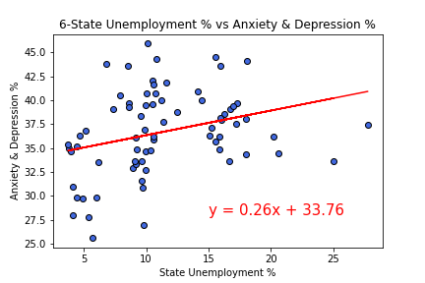
Mental Health and Unemployment
Slide 13.1
There was a low correlation between increasing levels of weekly Unemployment from the sample states compared to increased Anxiety and Depression levels
R Val is 0.08916941867418232

Slide 23
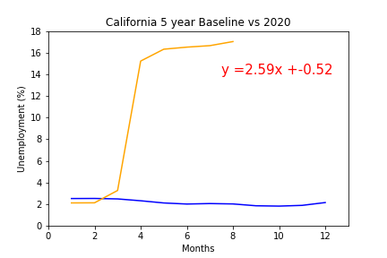
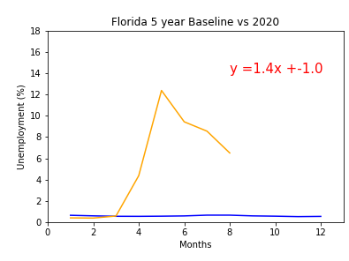
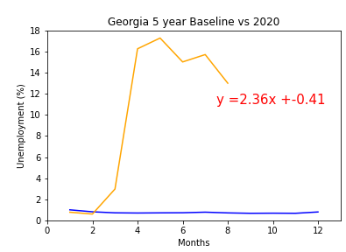
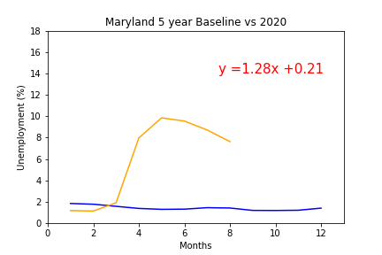
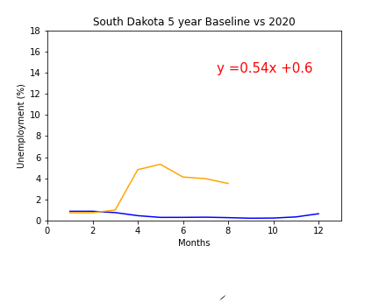
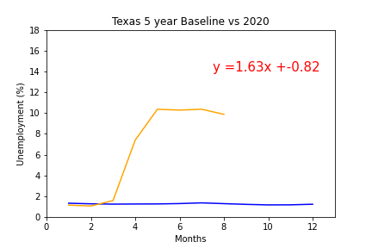
State Unemployment Since COVID-19
Slide 13.2
Delete red calculation
California and Georgia have experienced the highest COVID-19 Percentage increases based on their populations.

Slide 24
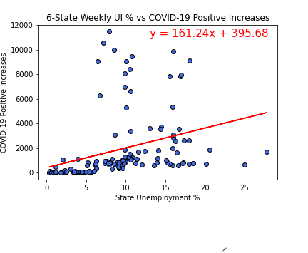
Unemployment Vs COVID-19
Slide 13.2
TK
R Val is 0.11049865197151916

