Slide 1
Presentation Breakup
Hypothesis
Openness/picking states
Baseline for mental health
Mental Health and Covid cases
Mental Health and Unemployment
Putting it all together
(where to put state openness level vs mental health)

Slide 2
Mental Health during COVID-19
UTSA Data Analytics Bootcamp Project 1
Adela Garza, Kristina Ruhl, Giam Sigaud, and Leo Zambrano

Slide 3
Hypothesis
The following factors have a correlation to mental health during COVID-19
State openness
The number of weekly new COVID-19 cases
Unemployment

Slide 4
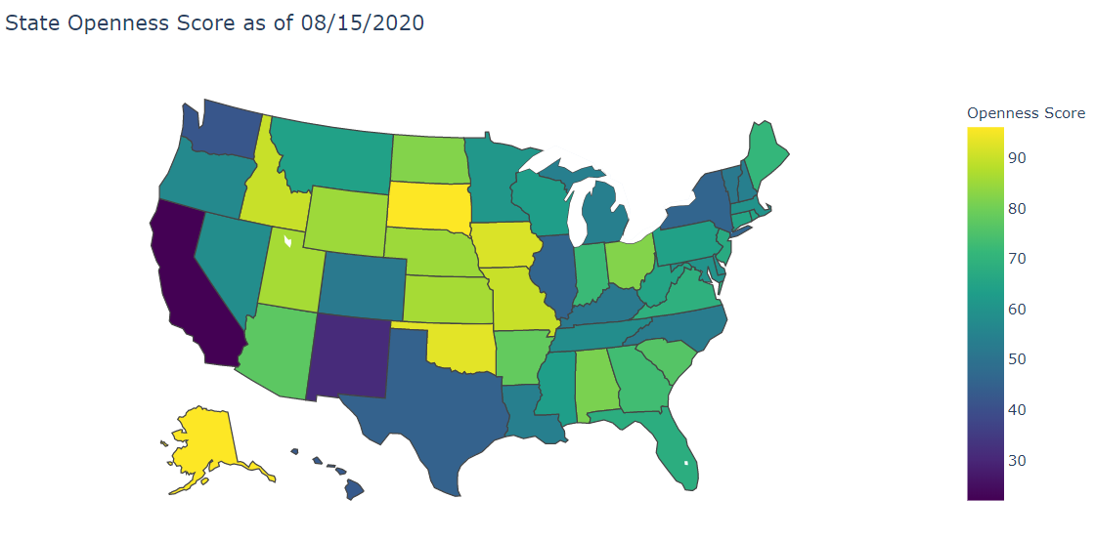
Current State Openness Level
Based on the following factors:
Reopening Plan
State of Emergency Declaration
Travel Restrictions
Mass Gathering Restrictions
School Closures
Mask Mandates

Slide 5
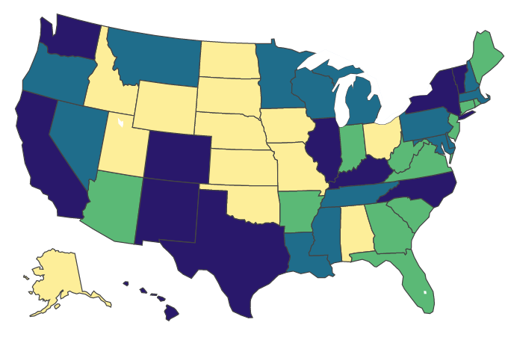
State Quartiles
Divided states into 4 bins by quartiles based on openness level
Lowest Openness Score – 22
Highest Openness Score – 96
Lower quartile – 54
Mean – 64
Upper quartile – 80
States by Quartile
Quartiles
Q1
Q2
Q3
Q4

Slide 6
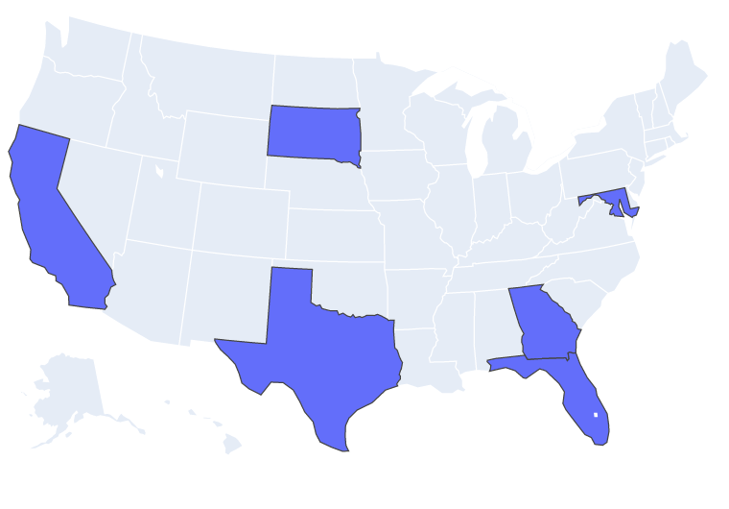
Picking our Sample States
To select our sample of states, we used the following criteria:
The state with the lowest opening score (California)
The state with the highest opening score (South Dakota)
A state near the mean of the 2nd quartile (Maryland)
A state near the mean of the 3rd quartile (Florida)
For the states near the mean, we also wanted to make sure we got a good distribution across the U.S.
Texas because we live here
Georgia because its been a focus in the news

Slide 7
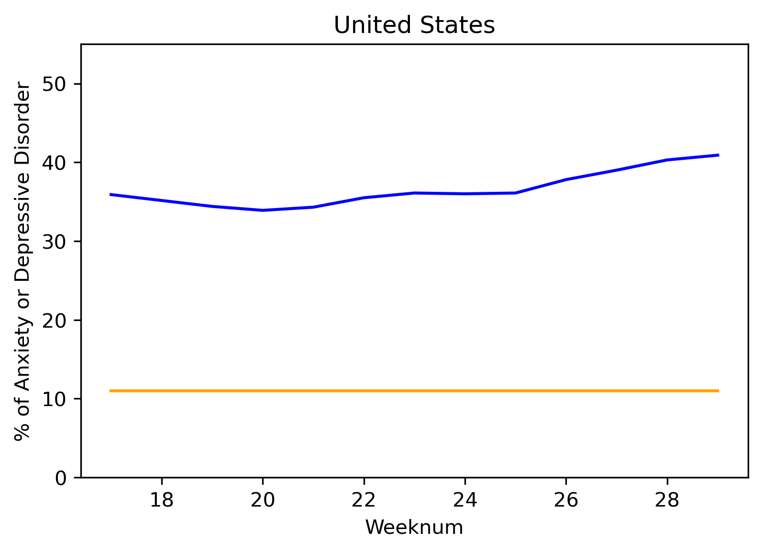
How we calculated baseline
Percentage baseline is the average from Q1 and Q2 in 2019 from ???
Leo : finish out text, need source of baseline in sources slide at end of presentation
Change blue to “tab:blue”

Slide 8
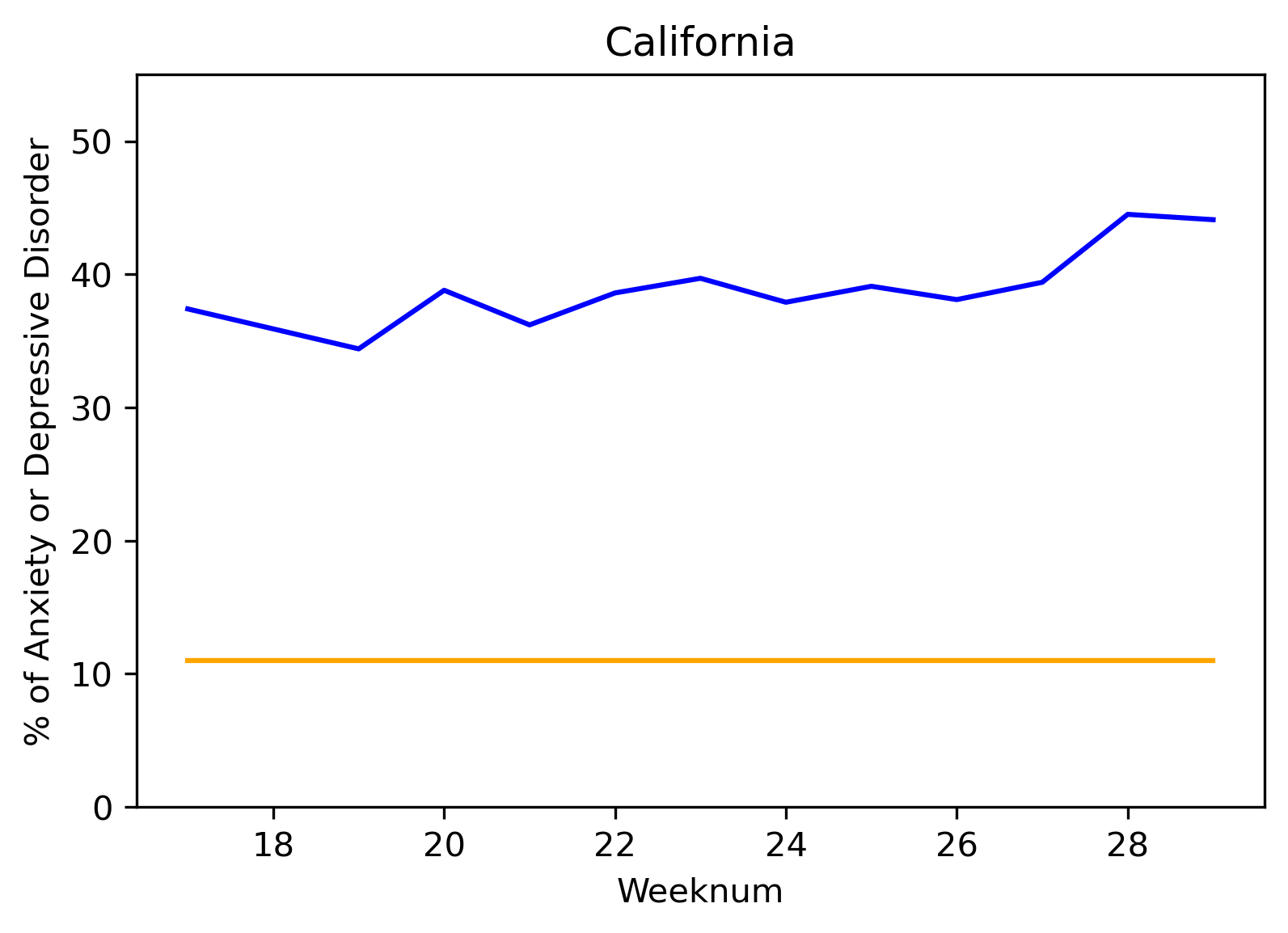
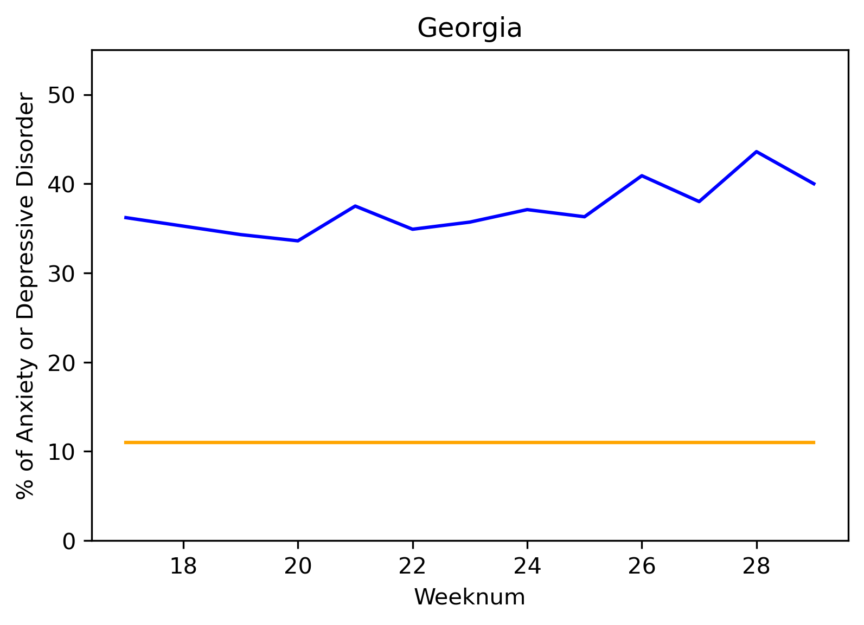
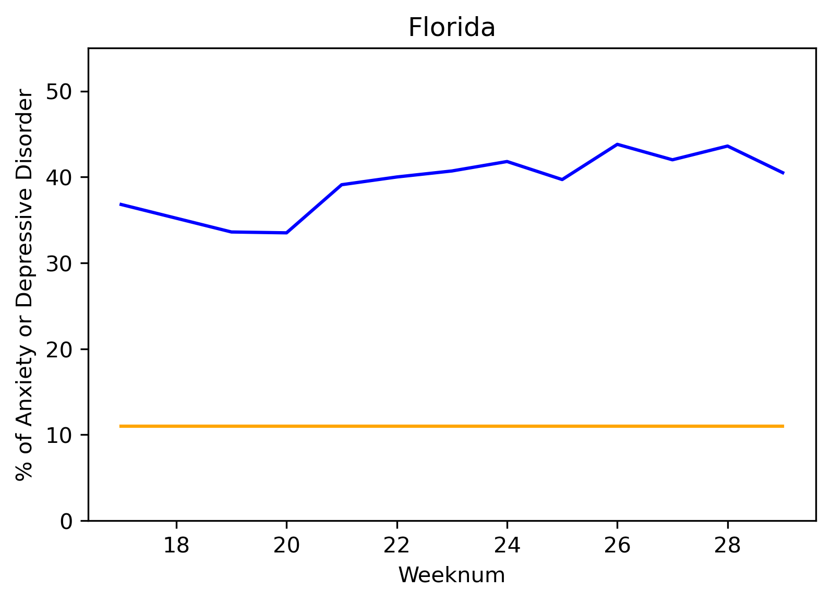
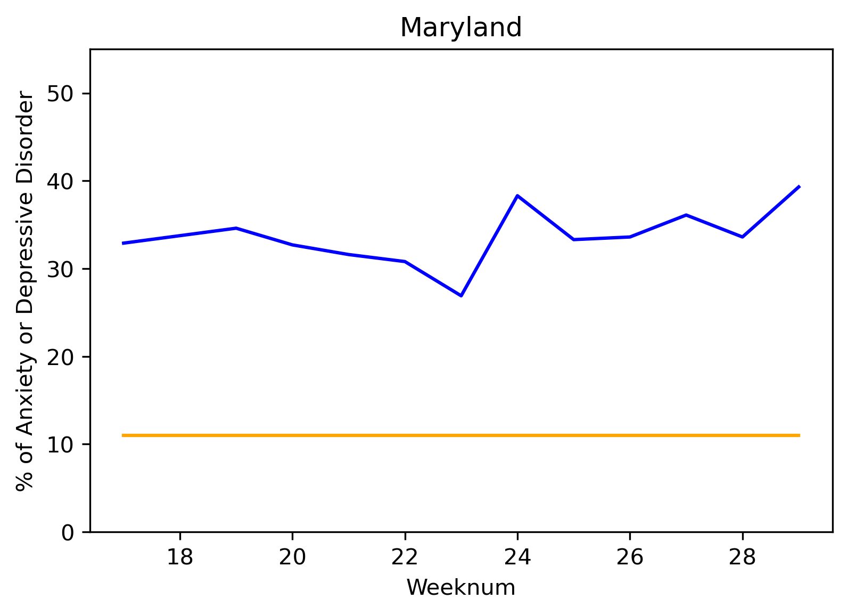
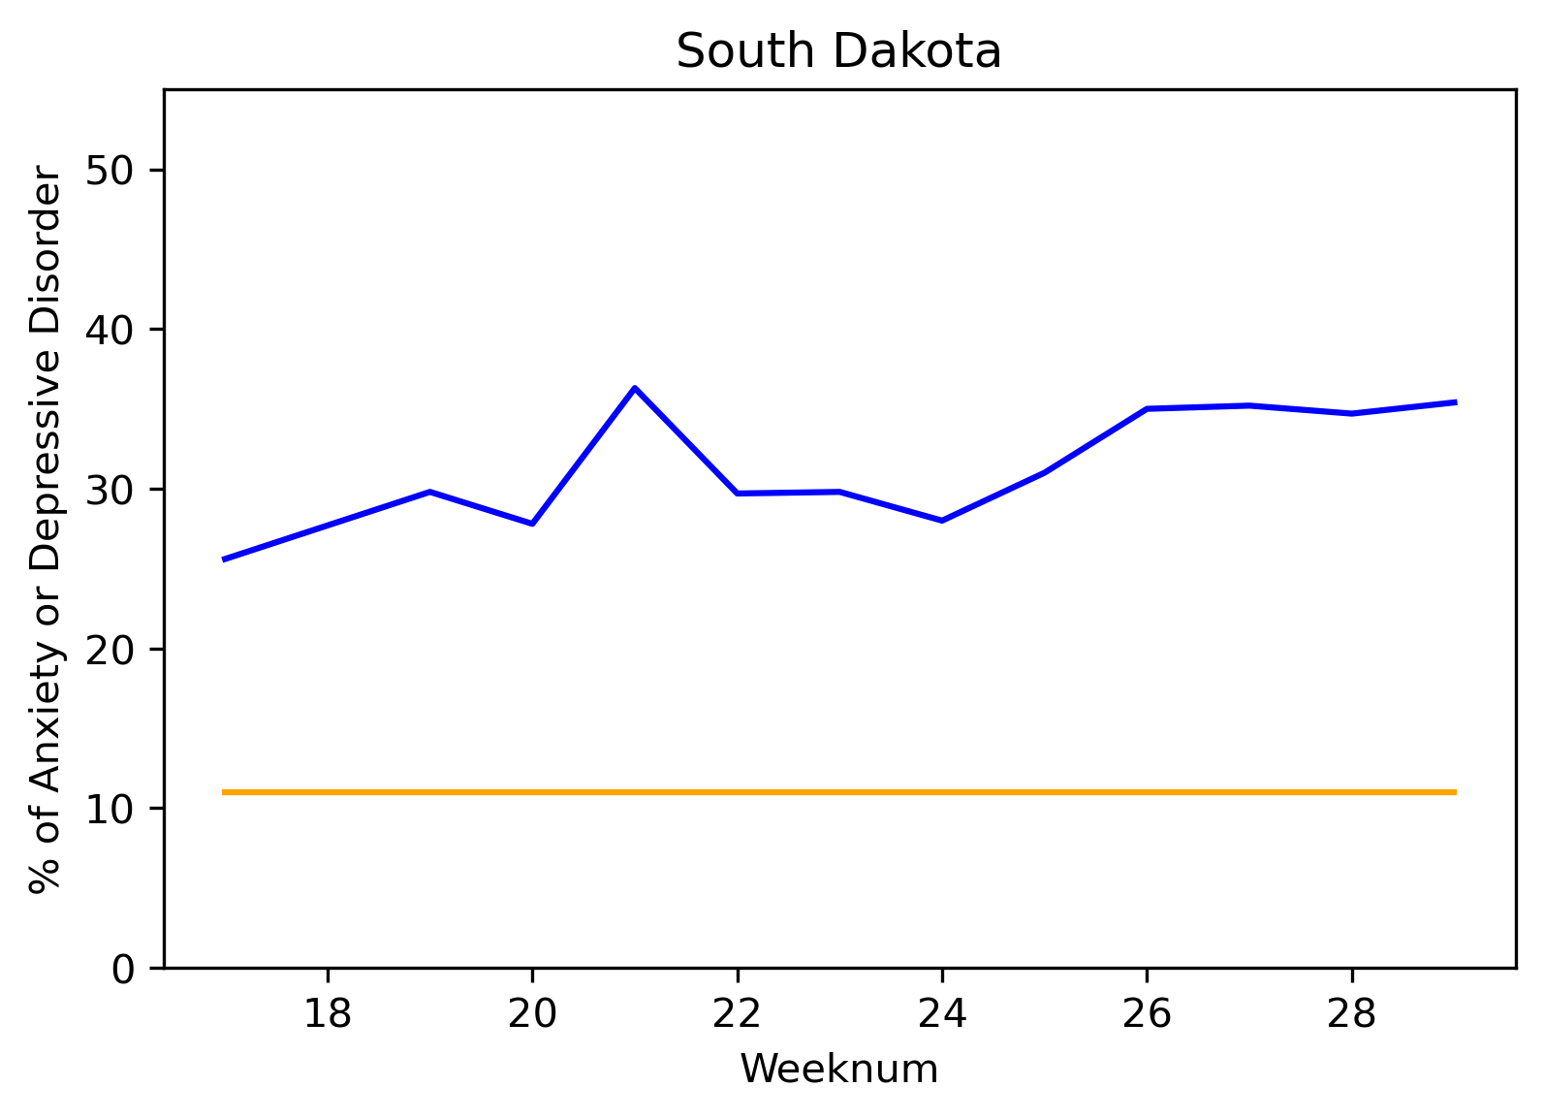
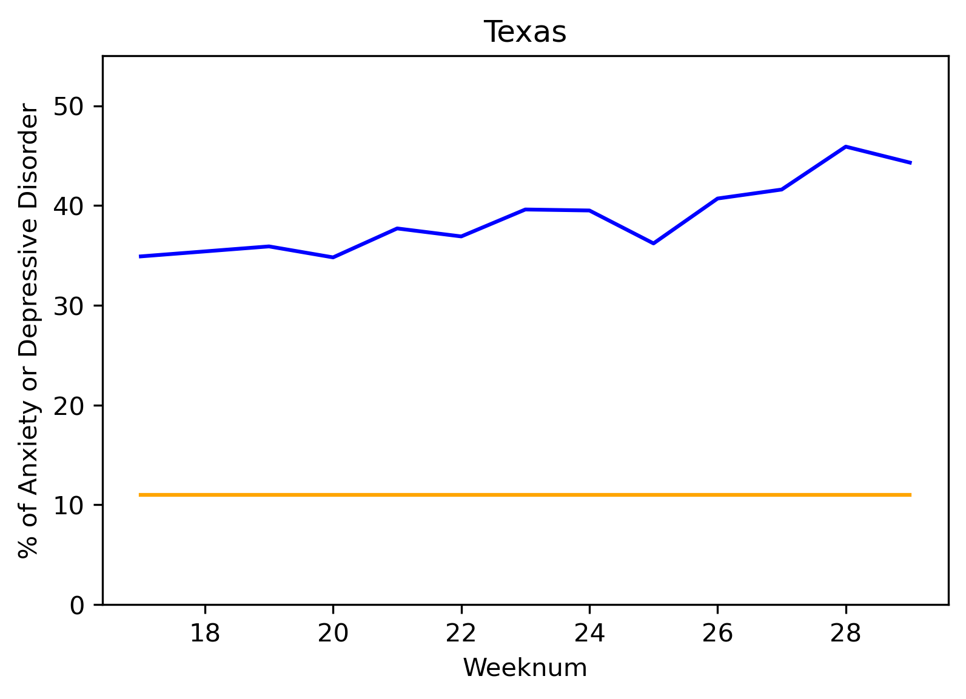
Mental Health during Covid -19 by State
Anxiety or depression disorder levels data starts on week 18 (beginning April 27, 2020).
Change blue to “tab:blue”
Legend
Unemployment %
Anxiety & Depression

Slide 9
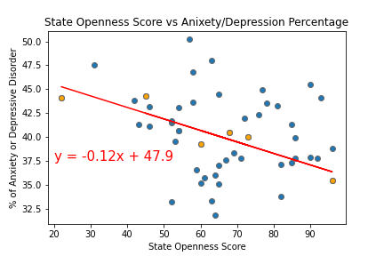
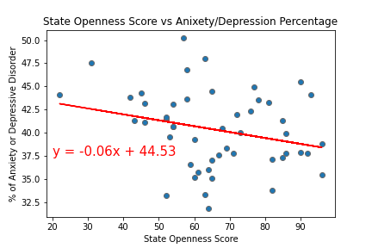
Openness Score vs Mental Health
When looking at State Openness Score versus Mental Health for our sample states you can see there is a statistical correlation, but when expanded to all states the correlation is no longer present.
Regression line based on sample states
Regression line based on all states
Texas
California
Florida
Georgia
Maryland
South Dakota
R Squared Val is 0.839
R Squared Val is 0.068

Slide 10
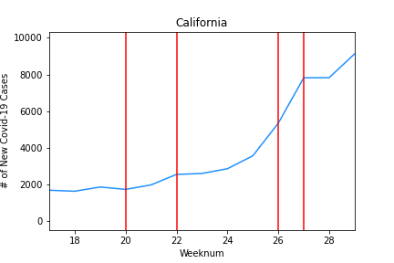
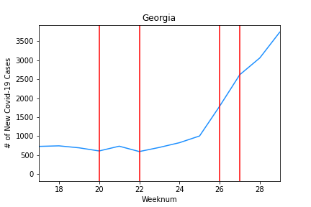
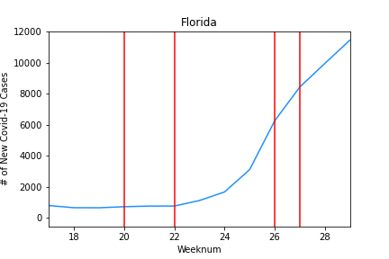
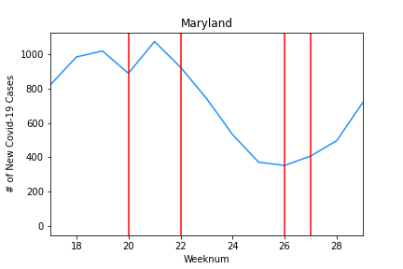
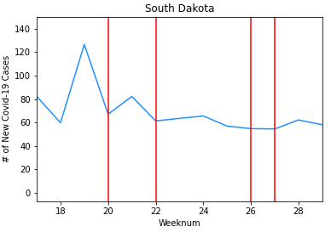
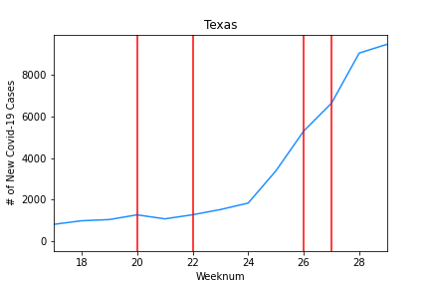
New Covid-19 Cases by State
-Change blue to “tab:blue”, and lines to dimgray
- Need legend
-Just drop in, I will resize and arrange

Slide 11
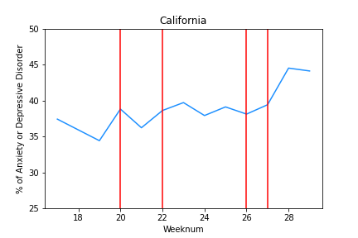
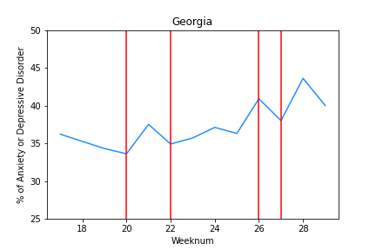
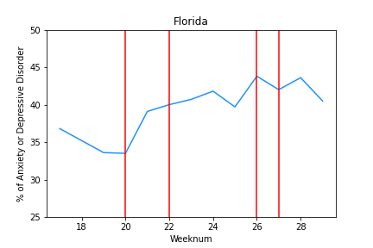
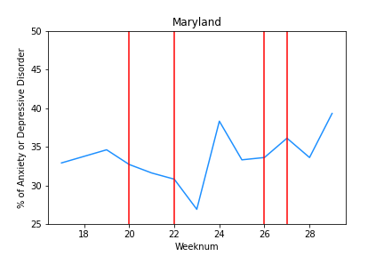
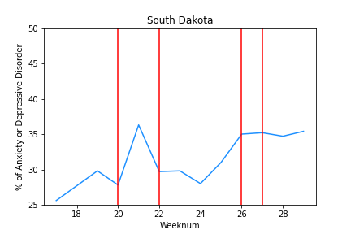
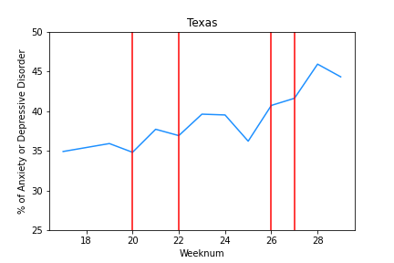
Anxiety Depression by State
I don’t think we need this slide as Leo covers it, but its up to you
Change blue to “tab:blue”, and lines to dimgray, fix scale
Just drop in, I will resize and arrange

Slide 12
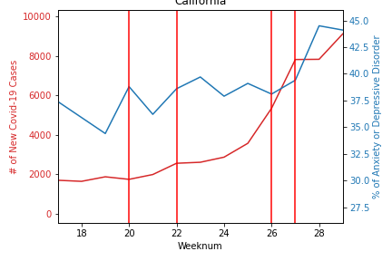
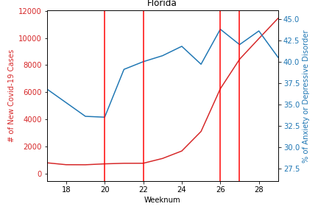
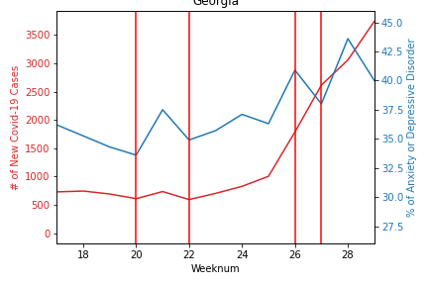
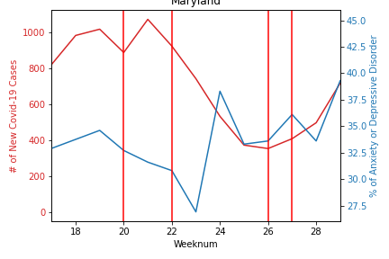
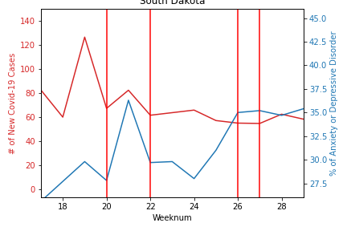
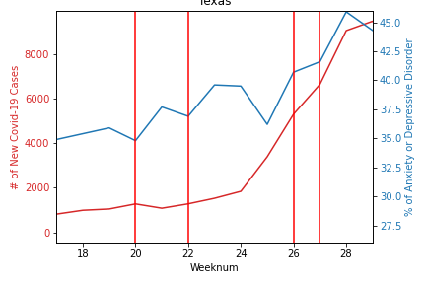
Comparing Mental Health and Covid-19
-Change blue to “tab:blue”, and lines to dimgray
- Still need legend
-Just drop in, I will resize and arrange
Change blue to “tab:blue”
Legend:

Slide 13
Scatter Plots?
-Change blue to “tab:blue”, and lines to dimgray
- Still need legend
-Just drop in, I will resize and arrange
Change blue to “tab:blue”
Legend:

Slide 14
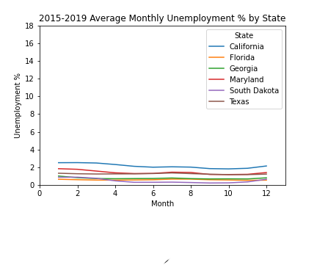
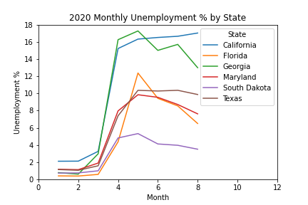
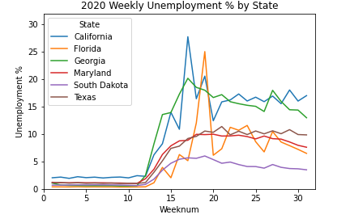
Spikes In California And Florida Have Driven Higher COVID-19 Unemployment Levels, But Georgia Has Remained Consistently High

Slide 15
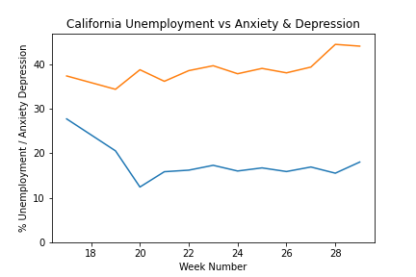
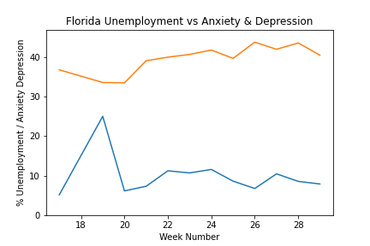
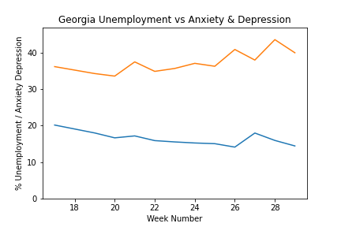
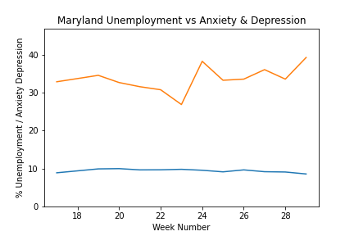
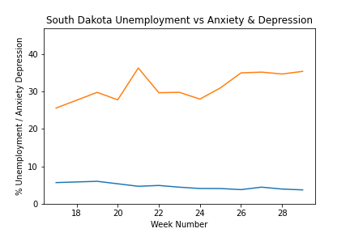
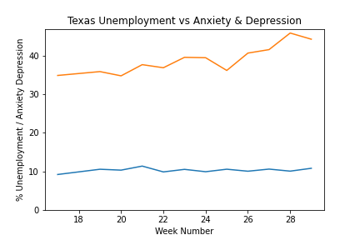
Mental Health and Unemployment
Texas Anxiety and Depression was going in the wrong direction delivering the highest levels of any state in the most recent weeks.
Legend
Unemployment %
Anxiety & Depression

Slide 16
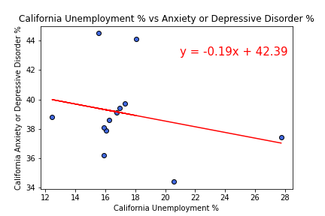
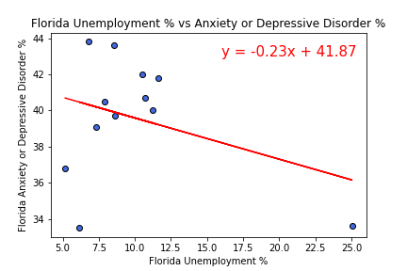
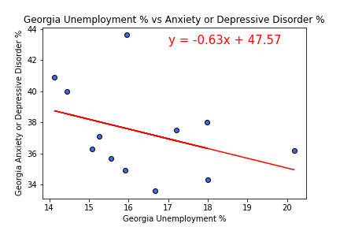
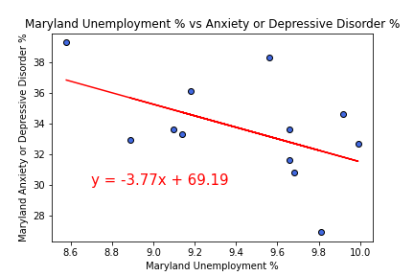
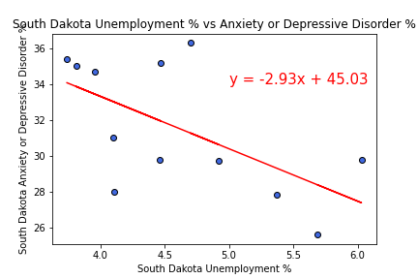
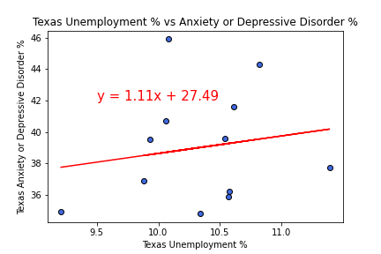
Mental Health and Unemployment
On a State level, correlations between weekly unemployment and anxiety and depression levels were low to not significant. South Dakota had the most significant levels with the lowest A&D levels.
Change blue to “tab:blue”, and outlines to dimgray
R Squared Val is 0.06348861620335115
R Squared Val is 0.12038601420623161
R Squared Val is 0.1388517442028963
R Squared Val is 0.2550161097387838
R Squared Val is 0.3700032239524132
R Squared Val is 0.02893057673053143

Slide 17
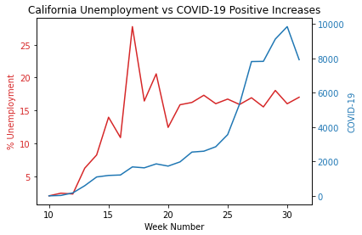
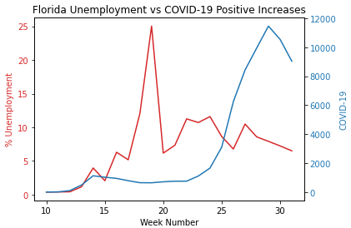
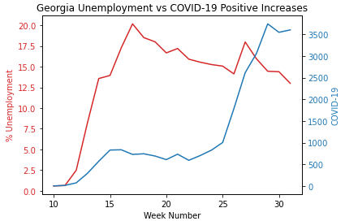
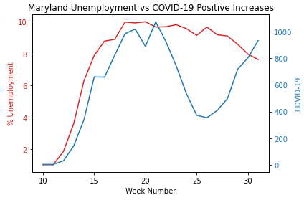
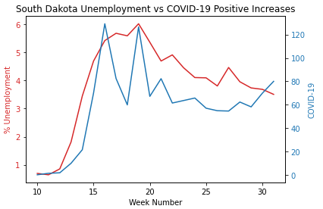

Unemployment vs COVID-19
Texas Covid-19 Positive Cases were steady until around week 25, when there was a sudden spike in new cases
Change blue to “tab:blue”

Slide 18






Unemployment Vs COVID-19
State Correlations of Unemployment levels compared to COVID-19 Positive Increase levels were low.
Change blue to “tab:blue”, and lines to dimgray
R Squared Val is 0.2061400286961551
R Squared is 0.013558957894785322
R Squared is 0.10417330917941174
R Squared is 0.62987345459035
R Squared Val is 0.7404008022828966
R Squared Val is 0.2539567916715078

Slide 19
Putting it all together
State Openness and Anxiety/Depression – no correlation
SUMMARY!!!!

Slide 20
Putting it all together

Slide 21
Sources
Unemployment based on: United States Department of Labor, Unemployment Insurance Weekly Claims Data at https://oui.doleta.gov/unemploy/claims.asp
https://www.multistate.us/research/covid/public
https://covidtracking.com/data/api

Slide 22

Mental Health and Unemployment
Slide 13.1
There was a low correlation between increasing levels of weekly Unemployment from the sample states compared to increased Anxiety and Depression levels
R Val is 0.08916941867418232

Slide 23






State Unemployment Since COVID-19
Slide 13.2
Delete red calculation
California and Georgia have experienced the highest COVID-19 Percentage increases based on their populations.

Slide 24

Unemployment Vs COVID-19
Slide 13.2
TK
R Val is 0.11049865197151916

Slide 25
States divided into Quartile
Jurisdiction | Openness Score
California | 22
New Mexico | 31
Washington | 42
Hawaii | 43
Texas | 45
Illinois | 46
New York | 46
Colorado | 52
Kentucky | 52
Vermont | 52
North Carolina | 53
Louisiana | 54
Michigan | 54
New Hampshire | 54
Jurisdiction | Openness Score
Oregon | 57
Nevada | 58
Tennessee | 58
Delaware | 59
Maryland | 60
Massachusetts | 60
Minnesota | 61
Mississippi | 63
Wisconsin | 63
Montana | 64
Pennsylvania | 64
Jurisdiction | Openness Score
Connecticut | 65
Rhode Island | 65
West Virginia | 65
New Jersey | 67
Florida | 68
Virginia | 69
Maine | 71
Indiana | 72
Georgia | 73
South Carolina | 76
Arizona | 77
Arkansas | 78
Jurisdiction | Openness Score
Alabama | 81
North Dakota | 82
Ohio | 82
Nebraska | 85
Wyoming | 85
Kansas | 86
Utah | 86
Idaho | 90
Missouri | 90
Iowa | 92
Oklahoma | 93
Alaska | 96
South Dakota | 96

