Slide 1
Presentation Breakup
Hypothesis
Openness/picking states
Baseline for mental health
Mental Health and Covid cases
Mental Health and Unemployment
Putting it all together
(where to put state openness level vs mental health)

Slide 2
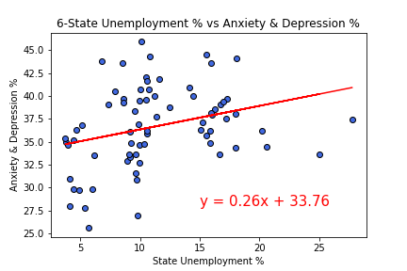
Mental Health and Unemployment
Slide 13.1
There was a low correlation between increasing levels of weekly Unemployment from the sample states compared to increased Anxiety and Depression levels
R Val is 0.08916941867418232

Slide 3
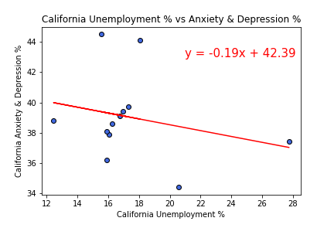
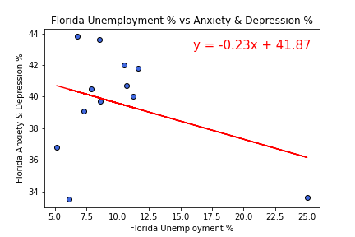
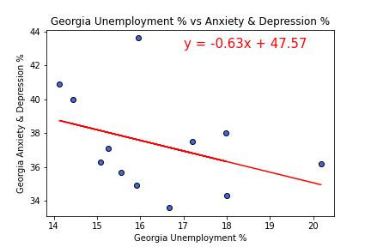
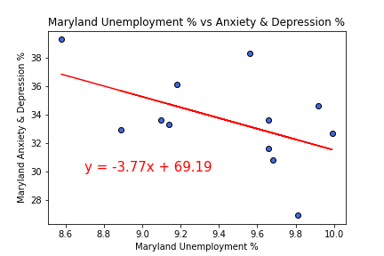
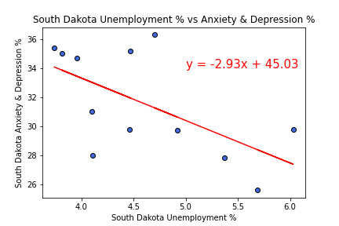
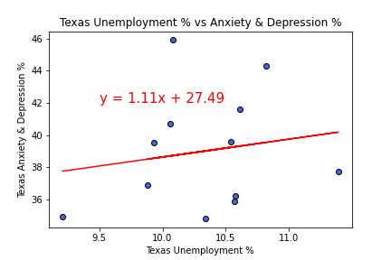
Mental Health and Unemployment
Slide 13.2
On a State level, correlations between weekly unemployment and anxiety and depression levels were low to not significant. South Dakota had the most significant levels with the lowest A&D levels.
R Val is 0.06348861620335115
R Val is 0.12038601420623161
R Val is 0.1388517442028963
R Val is 0.2550161097387838
R Val is 0.3700032239524132
R Val is 0.02893057673053143

Slide 4
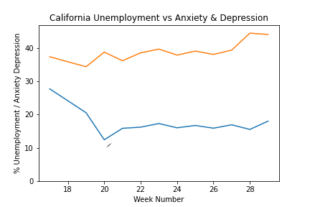
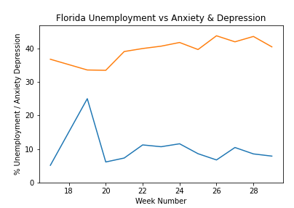
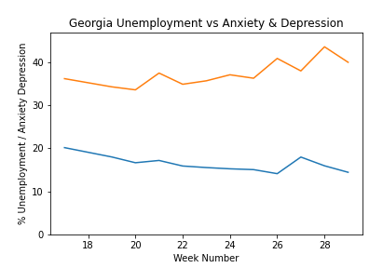
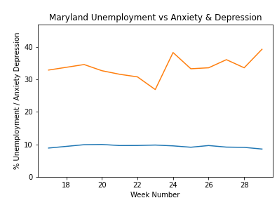
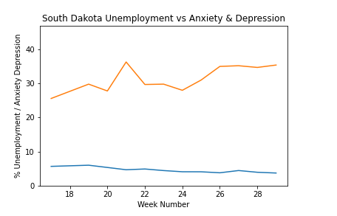
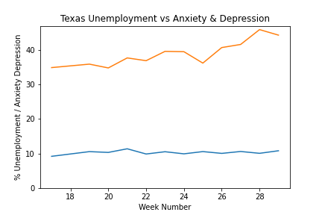
Mental Health and Unemployment
Slide 13.2
Texas Anxiety and Depression was going in the wrong direction delivering the highest levels of any state in the most recent weeks.
Legend
Unemployment %
Anxiety & Depression

Slide 5
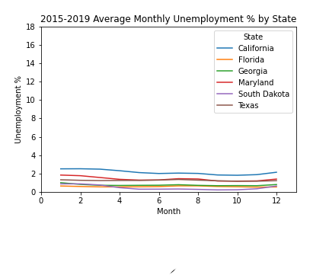
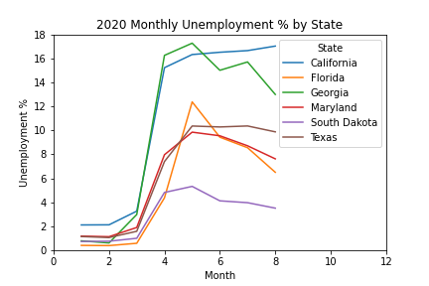
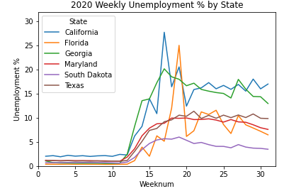
Spikes In California And Florida Have Driven Higher COVID-19 Unemployment Levels, But Georgia Has Remained Consistently High
Slide 13.2

Slide 6
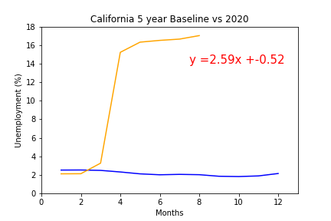
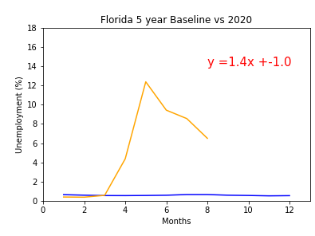
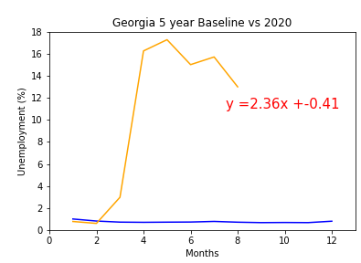
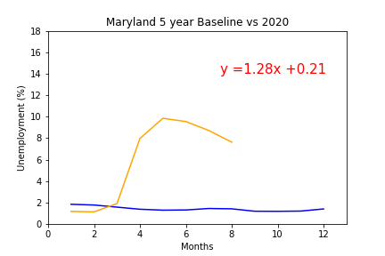
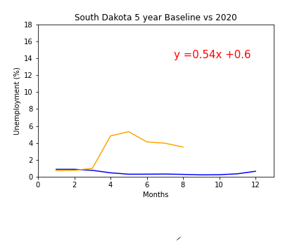
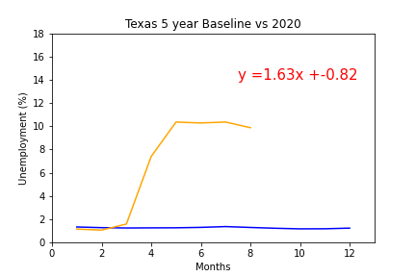
State Unemployment Since COVID-19
Slide 13.2
California and Georgia have experienced the highest COVID-19 Percentage increases based on their populations.

Slide 7
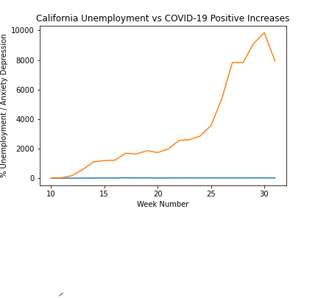
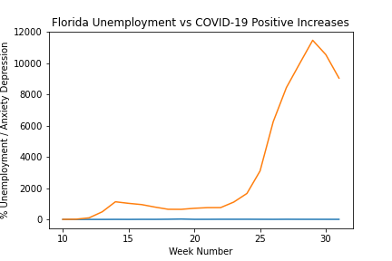
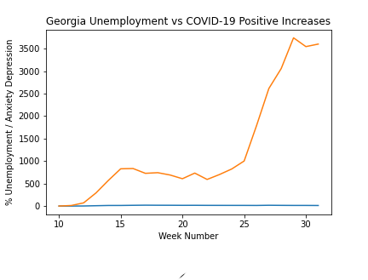
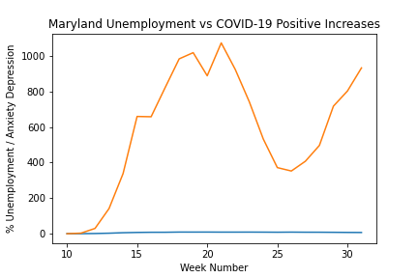
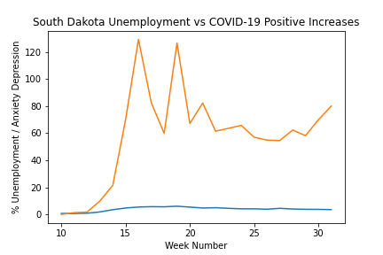
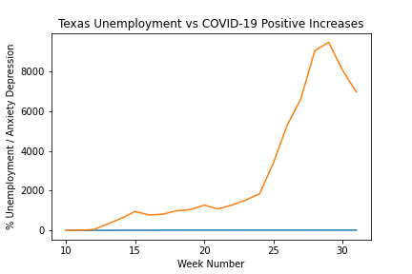
Unemployment Vs COVID-19
Slide 13.2
Texas Covid-19 Positive Cases were steady until around week 25, when there was a sudden spike in new cases
Legend
Unemployment %
COVID-19 Positive
Case Increases
Y AXIS NOT SAME

Slide 8
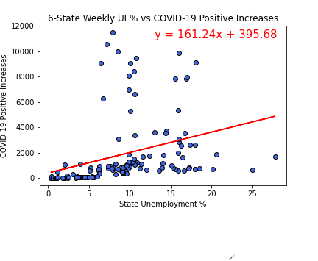
Unemployment Vs COVID-19
Slide 13.2
TK
R Val is 0.11049865197151916

Slide 9
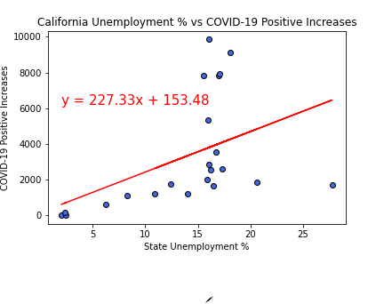
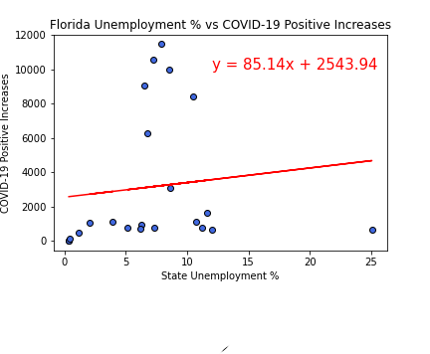
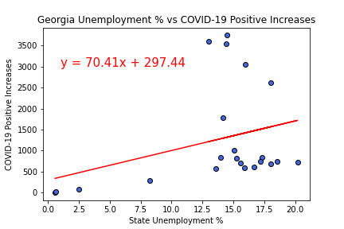
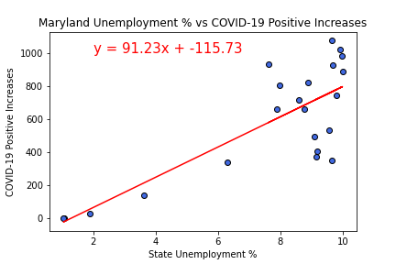
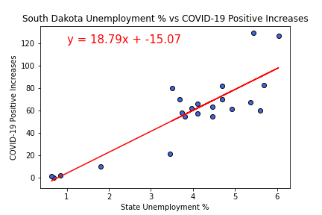
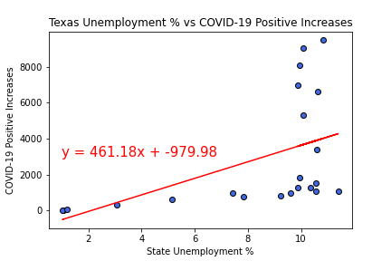
Unemployment Vs COVID-19
Slide 13.2
State Correlations of Unemployment levels compared to COVID-19 Positive Increase levels were low.
R Val is 0.2061400286961551
R Val is 0.013558957894785322
R Val is 0.10417330917941174
R Val is 0.62987345459035
R Val is 0.7404008022828966
R Val is 0.2539567916715078

Slide 10
Sources
Unemployment based on: United States Department of Labor, Unemployment Insurance Weekly Claims Data at https://oui.doleta.gov/unemploy/claims.asp

