Slide 1
Hypothesis: Educated Guess
Hypothesis Statement: If / Then
Hypothesis Testing:
1. Null: Assumes the results happened by chance
2. Alternative: Assumes the results did not happen by chance
P-Value rejects the Null at <0.05

Slide 2
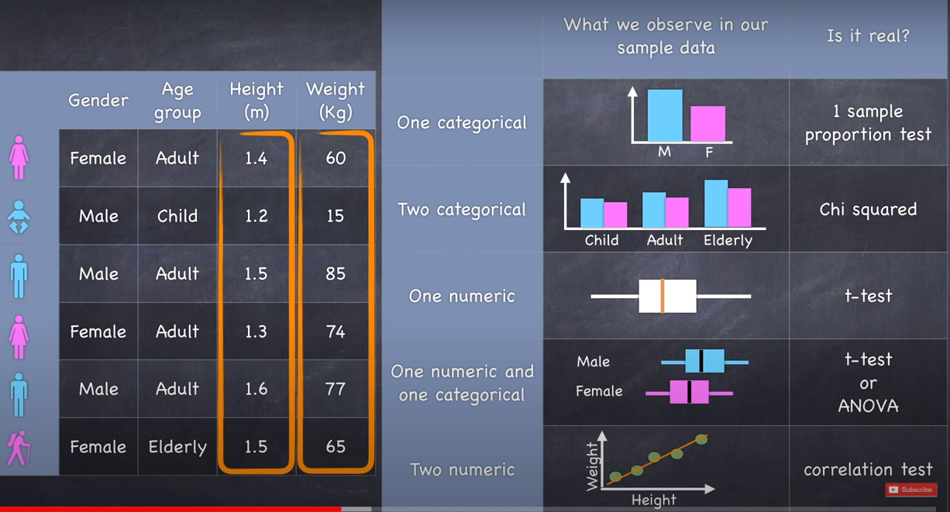
ALL OF THIS IS SAMPLE OF POPULATION SO NEED TO TEST FOR RESULTS BEING CAUSED BY CHANCE
Categorical
Numeric
Notes:
https://www.youtube.com/watch?v=I10q6fjPxJ0

Slide 3
Hypothesis: Educated Guess
Null: result = Chance
Alternate: result ≠ Chance
P-Value rejects the Null at <0.05
Hypothesis: Educated Guess
Null: result = Chance
Alternate: result ≠ Chance
P-Value rejects the Null at <0.05
NULL: There is NO Difference between count of men and women
ALTERNATIVE: There is a difference between count of men and women
TEST: Calculate P-Value

