Slide 1

Azure Resource Graph

Slide 2
Get-Presenter -Force
David das Neves
34 years old
IT Architect at Munich RE
Worked at Microsoft & Google
Co-Orga PowerShell UG MUC
Speaker here and there
Twitter: @david_das_neves
LinkedIn: in/daviddasneves/

Slide 3
What is Azure Resource Graph?
Azure Resource Graph is a service in Azure that is designed to extend Azure Resource Management by providing efficient and performant resource exploration with the ability to query at scale across a given set of subscriptions so that you can effectively govern your environment.

Slide 4

Are you already using it?
Azure Resource Graph powers:
Azure portal's search bar
The new browse 'All resources' experience
Azure Policy's Change history visual diff.

Slide 5
What is Azure Resource Graph?
Ability to query resources
Ability to iteratively explore resources e.g. Governance
Ability to assess the impact of applying policies
Ability to detail changes made to resource properties (preview).
Notes:
Ability to query resources with complex filtering, grouping, and sorting by resource properties.
Ability to iteratively explore resources based on governance requirements.
Ability to assess the impact of applying policies in a vast cloud environment.
Ability to detail changes made to resource properties (preview).
https://docs.microsoft.com/en-us/azure/azure-monitor/app/change-analysis

Slide 6
Benefit over Azure Resource Manager?
Azure Resource Manager currently supports queries over basic resource fields
Resource Manager also provides facilities for calling individual resource providers
With ARG you can access these properties without needing to make individual calls to each resource provider.
Notes:
- , specifically - Resource name, ID, Type, Resource Group, Subscription, and Location.
- for detailed properties one resource at a time.

Slide 7
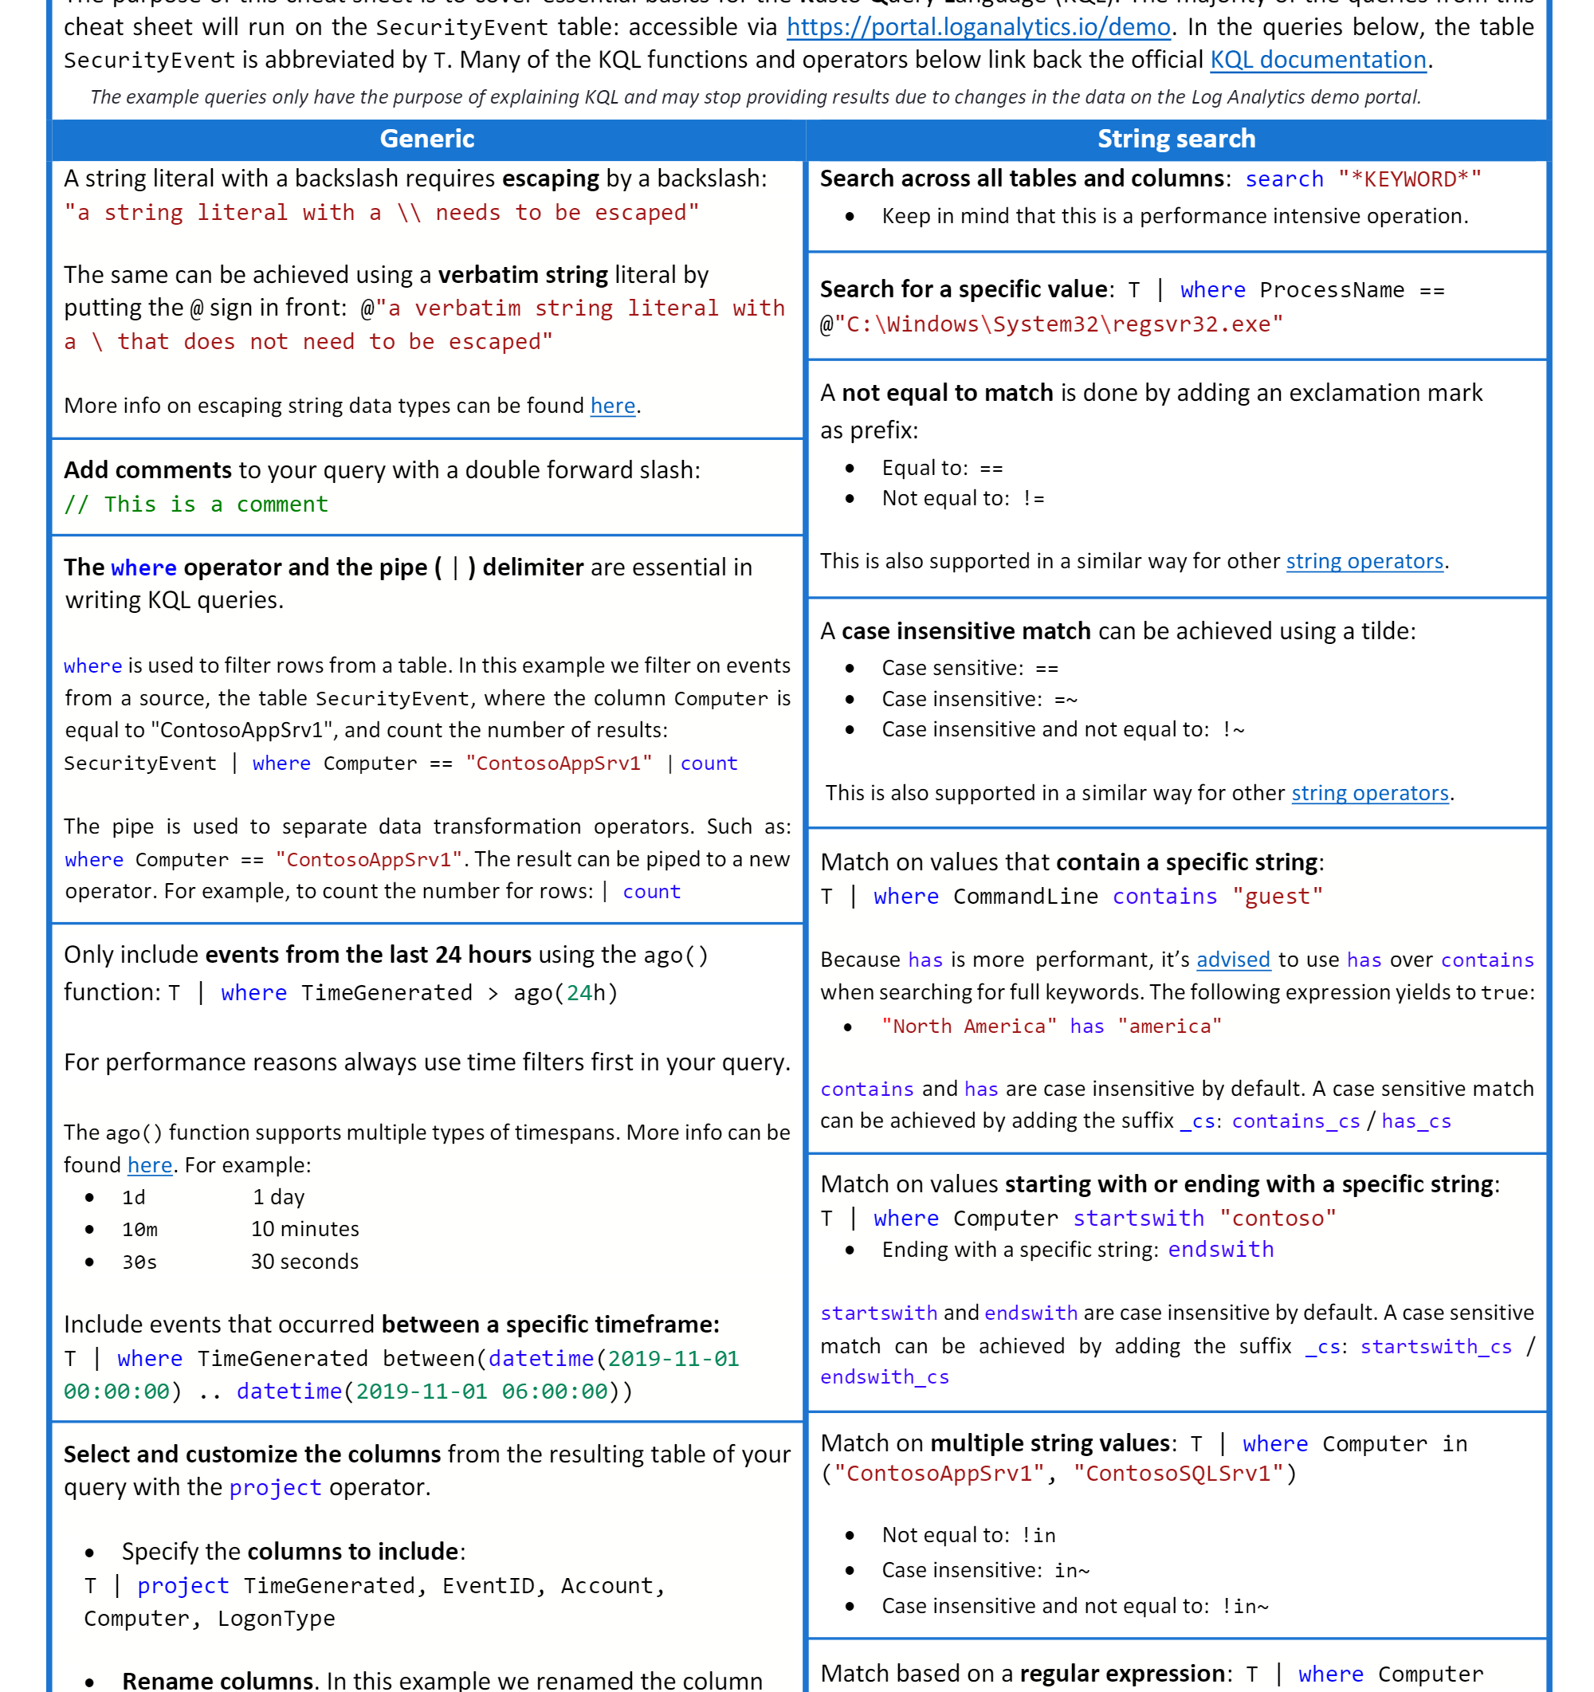
First things first
Kusto Query Language

Slide 8
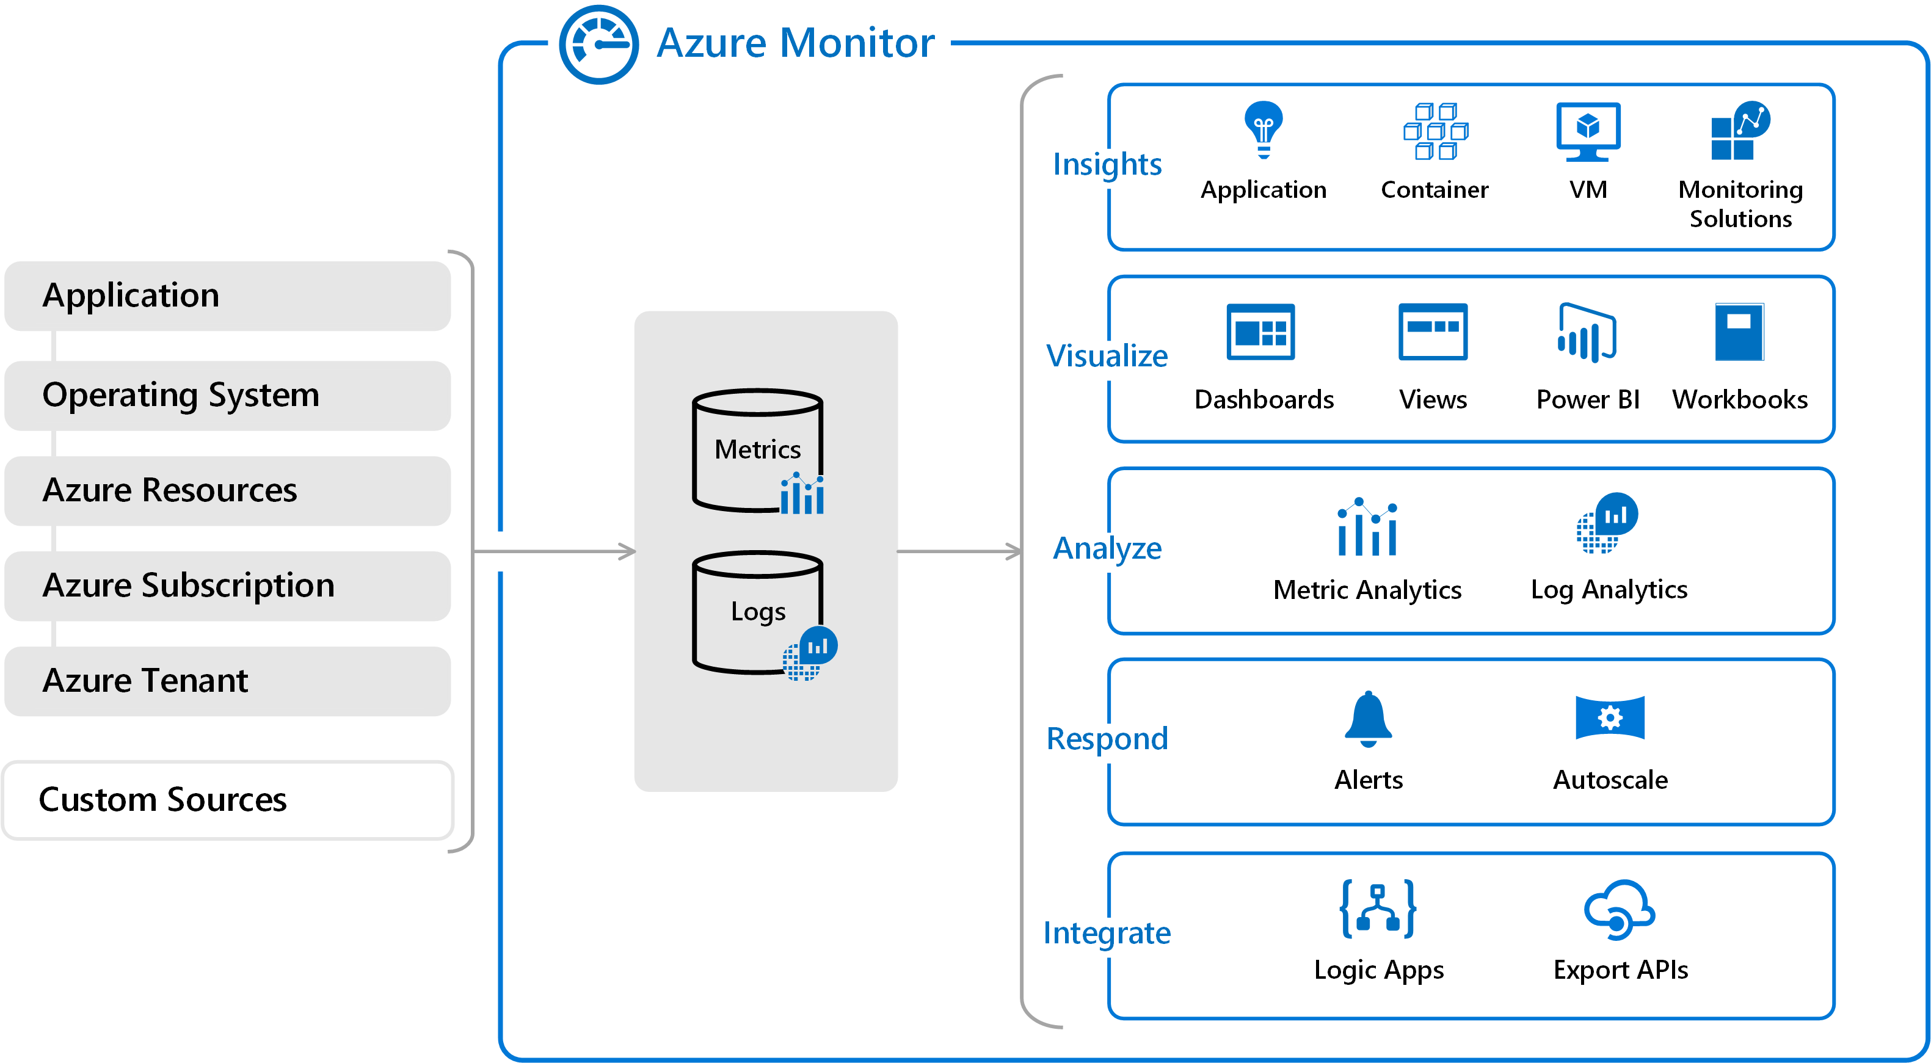

Slide 9
Kusto basics
Table based queries: Resources | where type =~ 'Microsoft.Compute/virtualMachines'
Search queries: search in (SecurityEvent) "Cryptographic" | take 10
Control commands: .create table Logs (Level:string, Text:string)
Notes:
- , specifically - Resource name, ID, Type, Resource Group, Subscription, and Location.
- for detailed properties one resource at a time.

Slide 10

Examples
Notes:
Go to web page
https://docs.microsoft.com/en-us/azure/governance/resource-graph/samples/starter?tabs=azure-cli
https://docs.microsoft.com/en-us/azure/governance/resource-graph/samples/advanced?tabs=azure-cli

Slide 11
Good to know
Paging
Throttling
Joining on dynamic IDs

Slide 12

Paging
here
When First is configured to be greater than 1000 records, the query must project the id field in order for pagination to work. If it's missing from the query, the response won't get paged and the results are limited to 1000 records.

Slide 13
Throttling
Here
Azure Resource Graph allocates a quota number for each user based on a time window. For example, a user can send at most 15 queries within every 5-second window without being throttled. The quota value is determined by many factors and is subject to change.

Slide 14
Joining on dynamic IDs
Resources
| where type == "microsoft.compute/disks"
| project StorageType = sku.name, diskID = tolower(tostring(id))
| join (
Resources
| where type =~ 'Microsoft.Compute/virtualmachines'
| extend disk = properties.storageProfile.osDisk.managedDisk
| project name, properties.hardwareProfile.vmSize, disk.storageAccountType, diskID = tolower(tostring(disk.id))
)
on diskID

Slide 15

Automation
Notes:
Open VSCode

Slide 16

The End
Questions?

Slide 17
Resources
KQL Tutorial: https://docs.microsoft.com/en-us/azure/azure-monitor/log-query/get-started-queries
ARG Landing Page: https://docs.microsoft.com/en-us/azure/governance/resource-graph/
Cheat Sheet https://github.com/marcusbakker/KQL
Azure Examples
https://docs.microsoft.com/en-us/azure/governance/resource-graph/samples/starter?tabs=azure-cli
https://docs.microsoft.com/en-us/azure/governance/resource-graph/samples/advanced?tabs=azure-cli
More Examples: https://github.com/MicrosoftDocs/azure-docs/tree/master/articles/azure-monitor/log-query
Important tips
Paging
https://docs.microsoft.com/en-us/azure/governance/resource-graph/concepts/work-with-data
Join on dynamic Ids - casting to same type
Session: https://myignite.techcommunity.microsoft.com/sessions/80810?source=sessions
KQL GitHub: https://github.com/microsoft/Kusto-Query-Language

Slide 18
Just one more thing.
Having fun with Tagging

