Slide 1
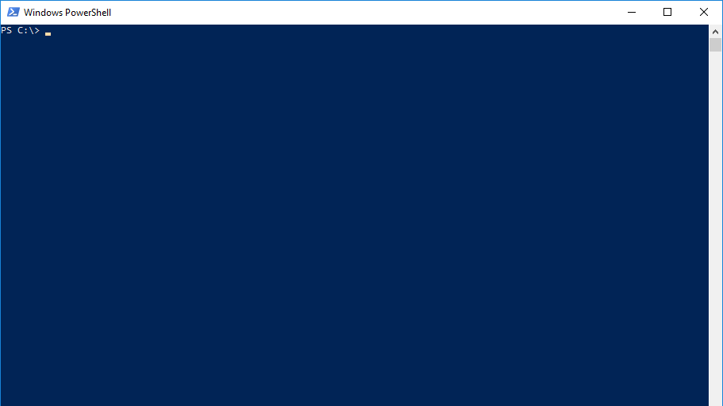
Powershell Jobs
By Christoph Ruf

Slide 2
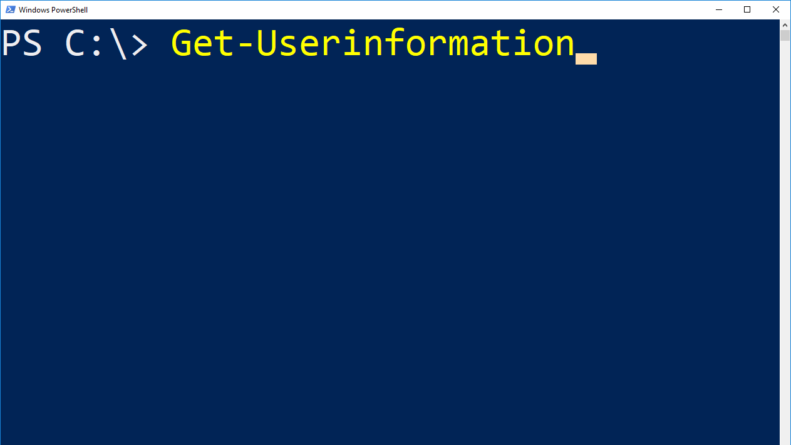
Name: Christoph Ruf
Job: SCCM Specialist, System- and Taskautomation, Client Management, Client Security
Employer: Hirschvogel Holding GmbH

Slide 3
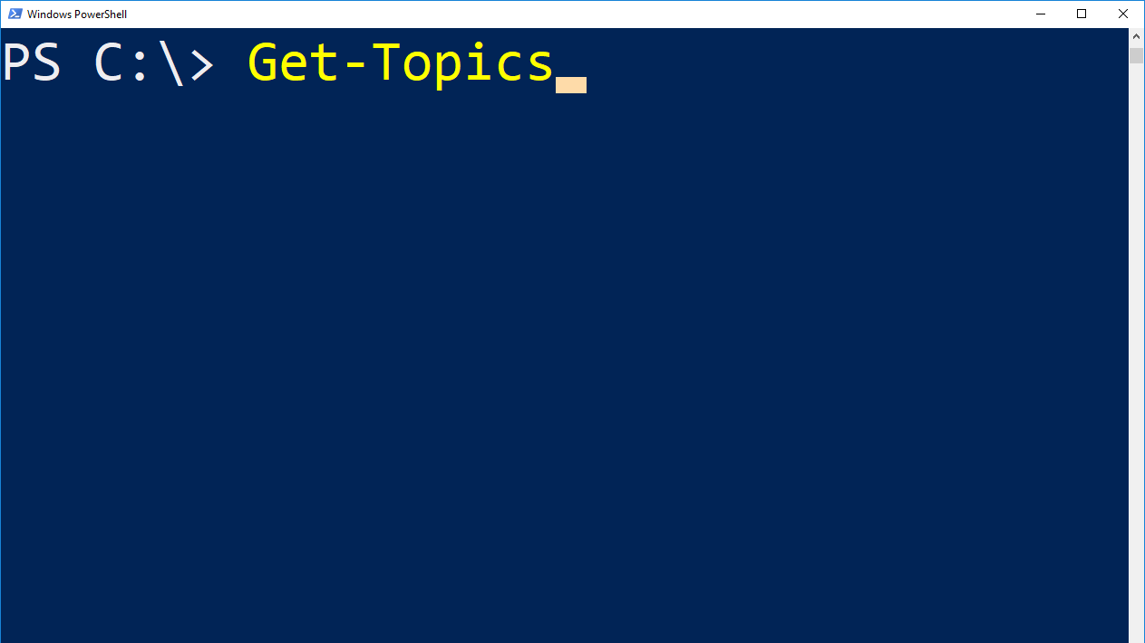
Jobs in Powershell
How to use
Future

Slide 4
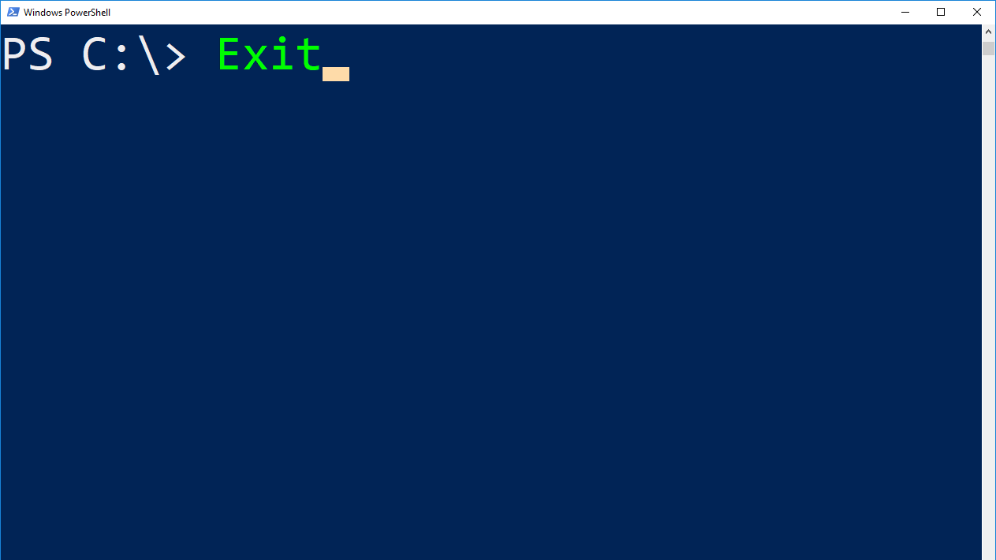
$Questions = Get-Questions -all
If (($Questions).count –gt 0) {
$Questions.ReceiveAll()
$Questions.Answer()
}
Else { Write-Host „Thank you for listening“; Exit; }

